Slide 1
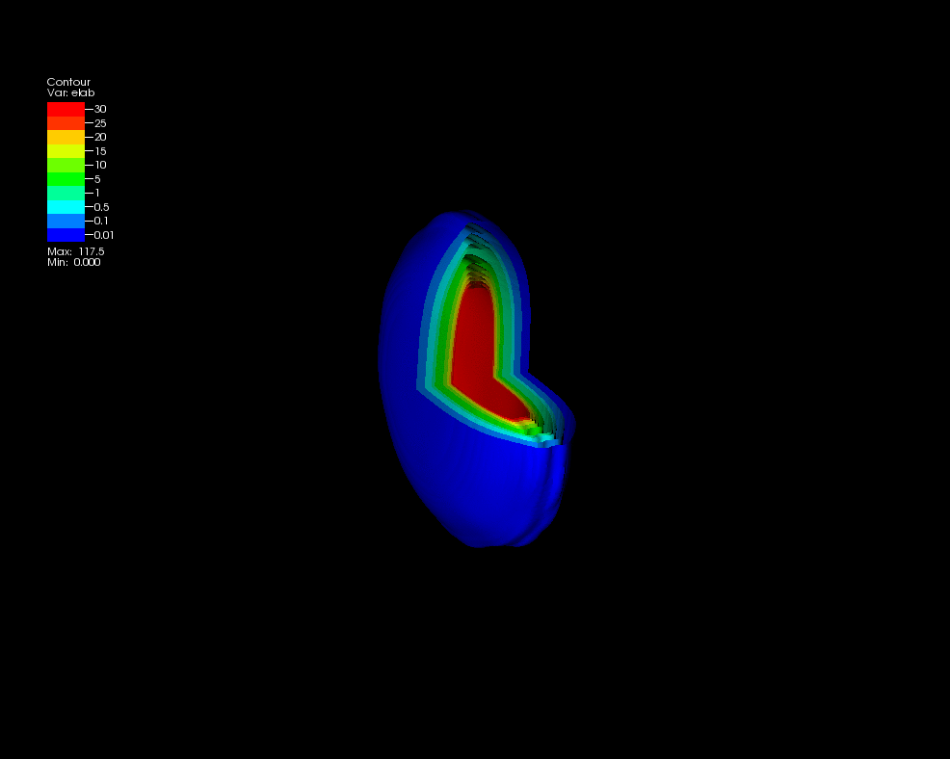
Measuring the energy density of the QGP
Christine Nattrass
University of Tennessee at Knoxville
Calculations done on the Titan supercomputer by the CJet collaboration https://sites.google.com/site/cjetsite/

Slide 2
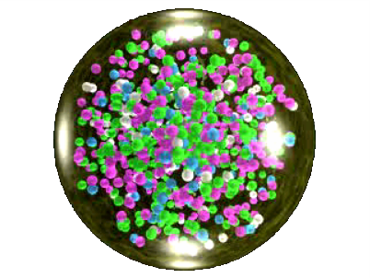
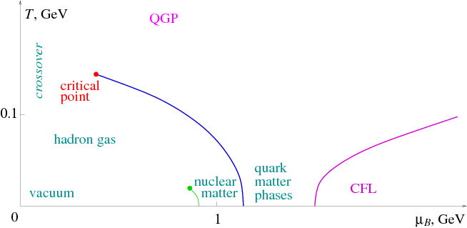
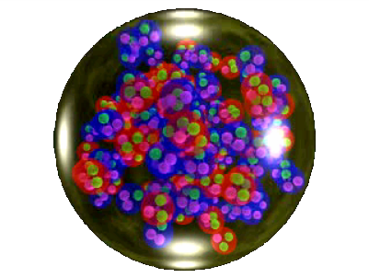
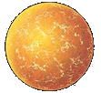

Phase diagram of nuclear matter
Quark Gluon Plasma
Core of neutron stars?
Quark Gluon Plasma – a liquid of quarks and gluons created at temperatures above ~170 MeV (2·10¹²K) – over a million times hotter than the core of the sun
Notes:
But wait – how can we have a liquid of quarks and gluons? Doesn't asymptotic freedom tell us that we can't have free quarks and gluons? How, then, can we have a liquid of quarks and gluons?

Slide 3
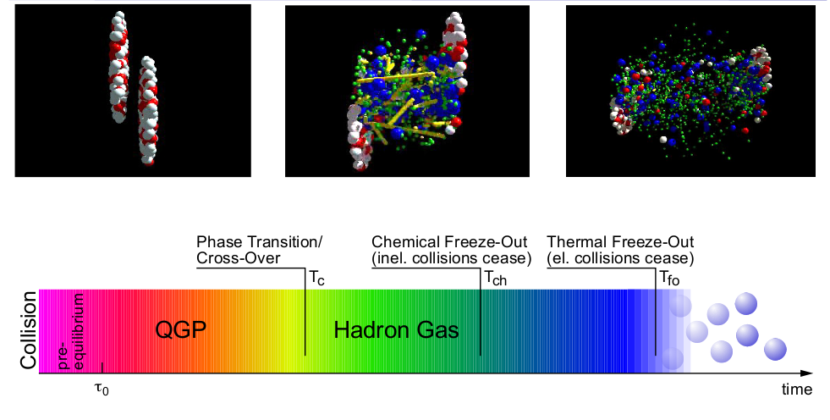
The phase transition in the laboratory

Slide 4
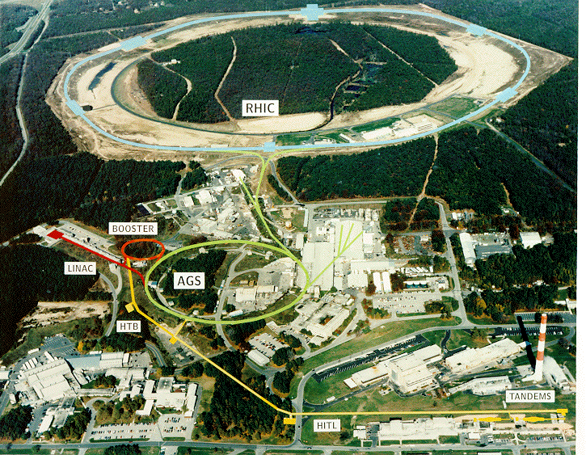
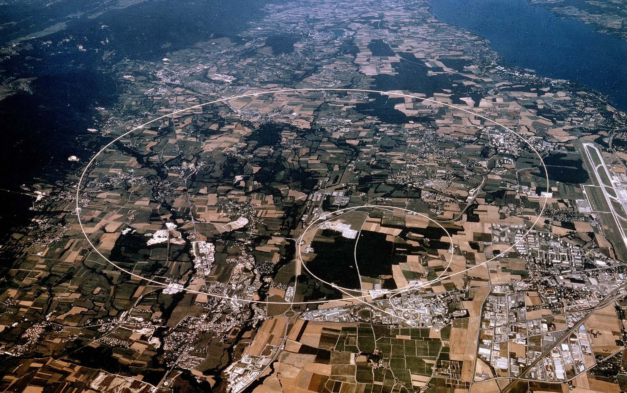
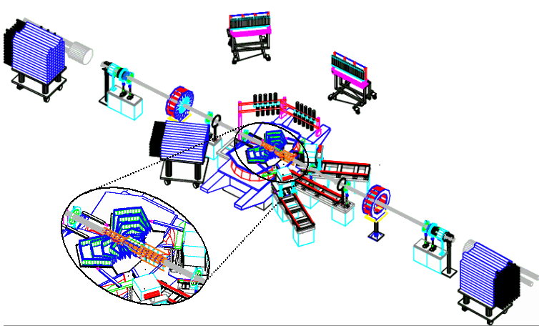
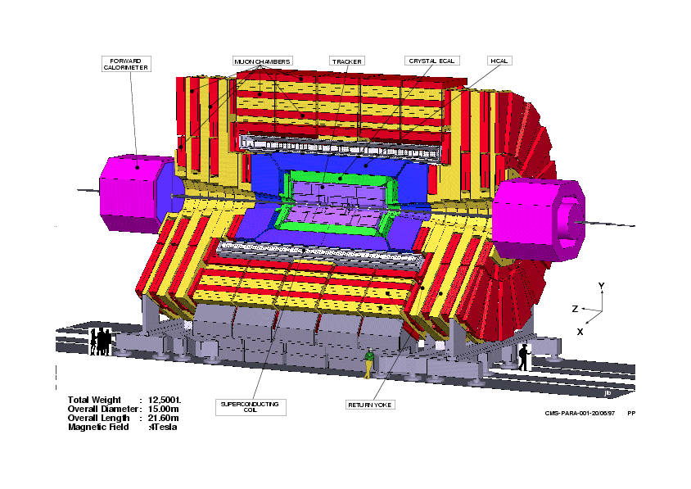
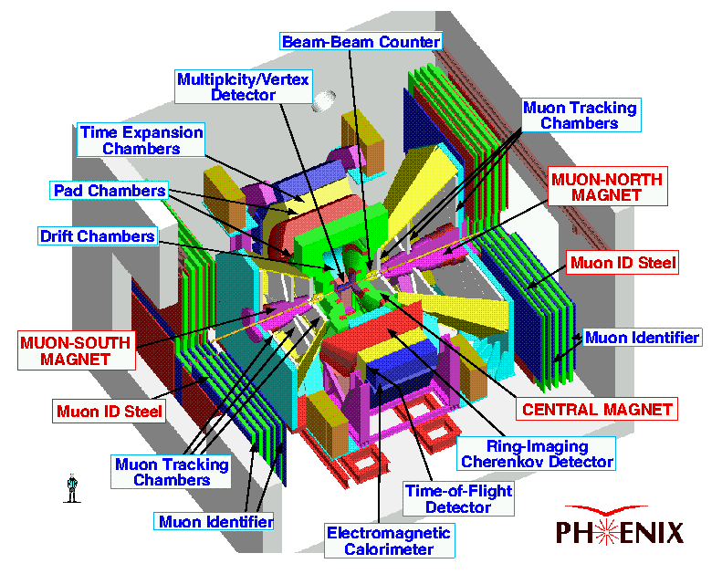
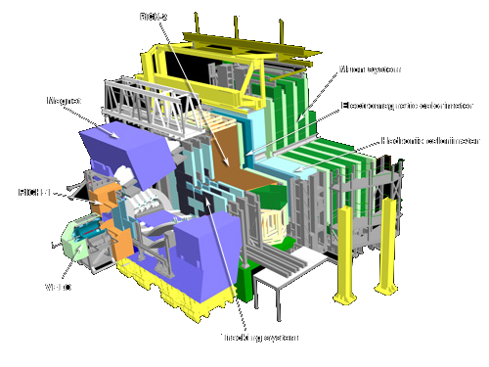
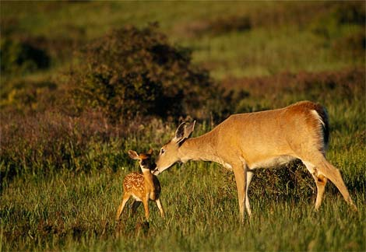

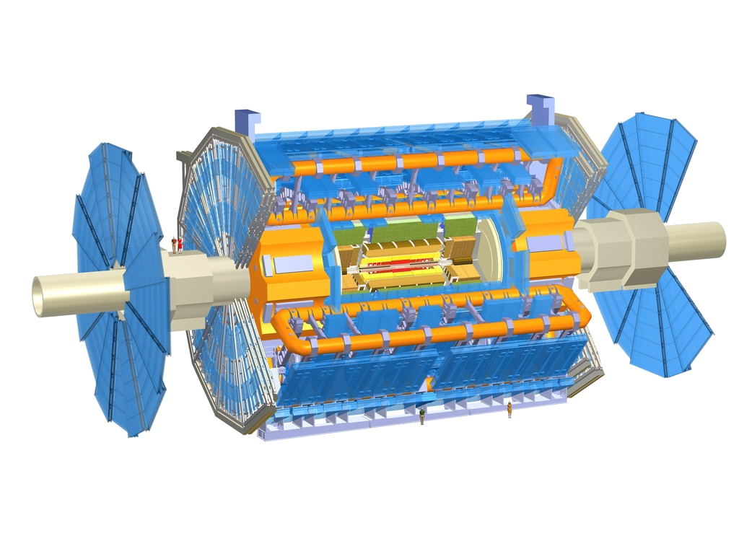
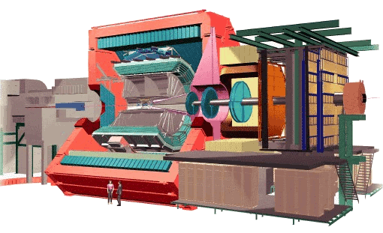
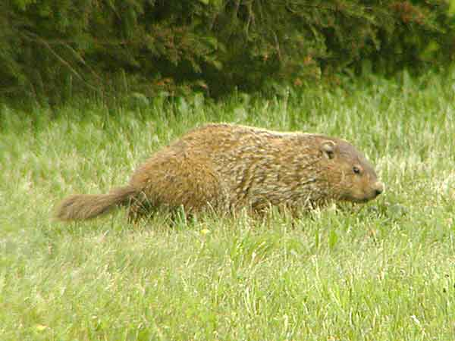
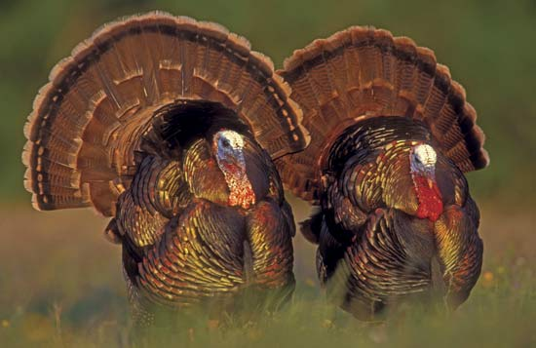
Relativistic Heavy Ion Collider
Large Hadron Collider
PHOBOS
BRAHMS
CMS
PHENIX
STAR
RHIC
LHCb
ALICE
ATLAS
LHCf
Upton, NY
1.2km diameter
p+p, d+Au, Cu+Cu, Au+Au, U+U
√s_{NN} = 9 - 200 GeV
Geneva, Switzerland
8.6km diameter
p+p, p+Pb, Pb+Pb
√s_{NN} = 2.76 GeV, 5.5 TeV
LHC
Quark Gluon Plasma
RHIC
Core of neutron stars?
Notes:
Mention that RHIC planning began 1983

Slide 5
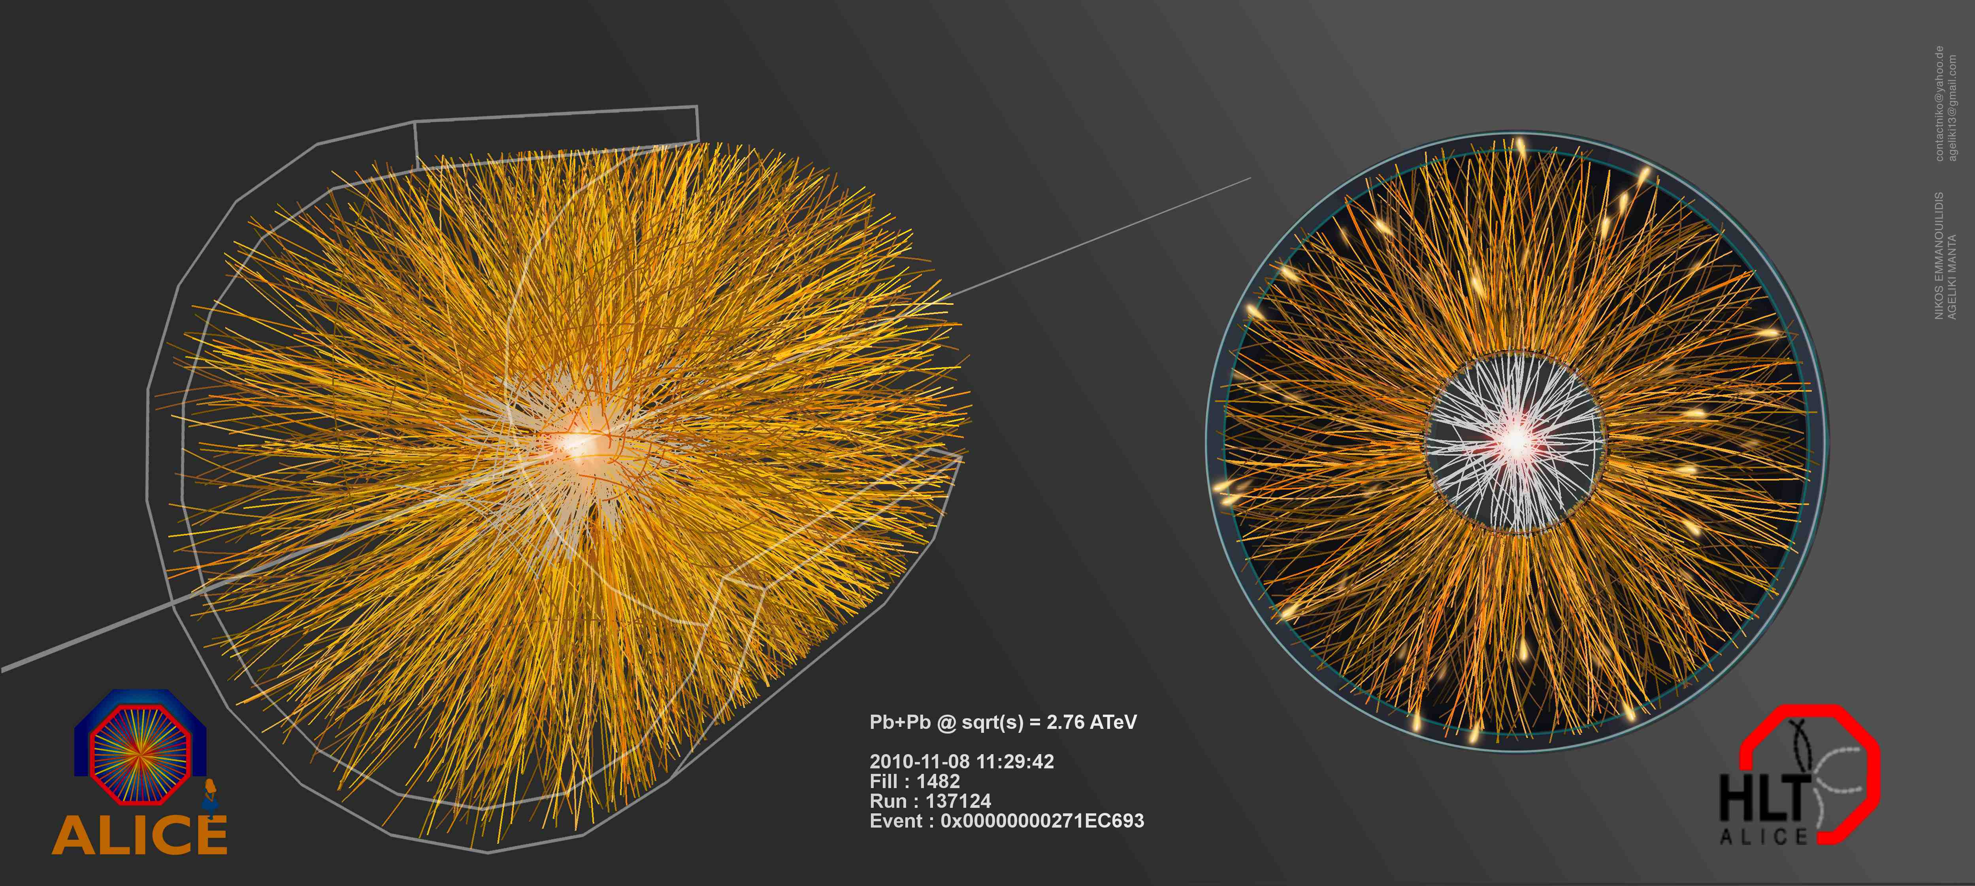
Pb+Pb collisions
5

Slide 6
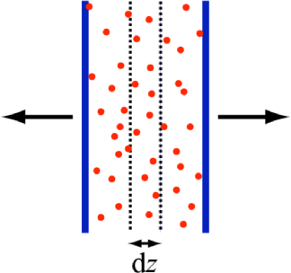
How can we estimate the energy density?
Transverse energy (E_{T})
  sum of particle energies in transverse direction
Volume V = A_{T} τc
τ = formation time
Energy density ε
QGP formation for ε > 0.5 GeV/fm³
A_{T}
= τc

Slide 7
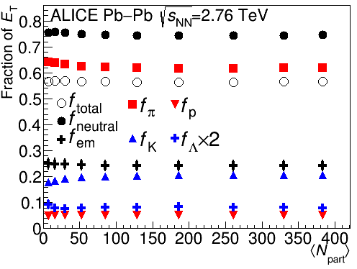
Where is the energy?
The distribution of energy is surprisingly centrality independent.

Slide 8
Where is the energy?
p
_{L}
π⁰
K⁰
‾p
K⁺
_{S}
π⁺
K⁰
K⁻
π⁻
n
Λ
‾n
‾Λ
Scale: diameter in inches = √fraction * 5

Slide 9
Methods for measuring E_{T}
CMS: Tracking + electromagnetic calorimeter + hadronic calorimeter
PHENIX: Electromagnetic calorimeter
STAR: Tracking + Electromagnetic calorimeter
ALICE: Tracking*
*Other methods tried – focusing on this one here

Slide 10
How does it hit your detector?
γ
γ
π⁺
π⁰
π⁺
π⁻
_{L}
~69%
K⁰
_{S}
π⁻
K⁰
~31%
π⁰
π⁰
γ
γ
π⁰
π⁰
γ
γ
Λ
~64%
p
π⁻
‾Λ
~64%
‾p
π⁺
n
n
γ
~36%
π⁰
γ
n
n
γ
K⁺
K⁻
~36%
π⁰
γ
‾n
n
‾p
p
Scale: diameter in inches = √fraction * 5

Slide 11
How does it hit your detector?
Tracking detectors
γ
γ
π⁺
π⁻
π⁰
π⁺
π⁻
_{S}
K⁰
n
γ
_{L}
p
π⁻
‾Λ
K⁰
γ
γ
_{S}
γ
Λ
K⁰
π⁰
π⁰
K⁺
n
γ
γ
γ
K⁻
Λ
π⁺
γ
‾p
‾Λ
n
‾n
7% Secondaries
p
‾p
35% No signal
58% Primaries
Scale: diameter in inches = √fraction * 5

Slide 12
ALICE
3%
2%
3%
40%
But known well!
What we measure directly
45%
Corrections

Slide 13
ALICE: f_{total}
= 0.567 ± 0.009
π⁺
π⁻
‾p
K⁺
K⁻
p
‾p
K⁺
K⁻
Λ
π⁺
π⁻
π⁰
p
_{S}
_{L}
‾Λ
K⁰
K⁰
‾n
n
Scale: diameter in inches = √fraction * 5

Slide 14
Measuring energy with tracking detectors
f_{total} is robust
Other corrections are either small or known well

Slide 15
What can we learn from measuring E_{T}?
Reach energy densities around 10 GeV/fm³, several times the energy density necessary to form QGP
E_{T} higher than expected at LHC
E_{T} seems to scale with N_{quark}
At LHC increasing energy → increasing energy/particle, not more particles

Slide 16
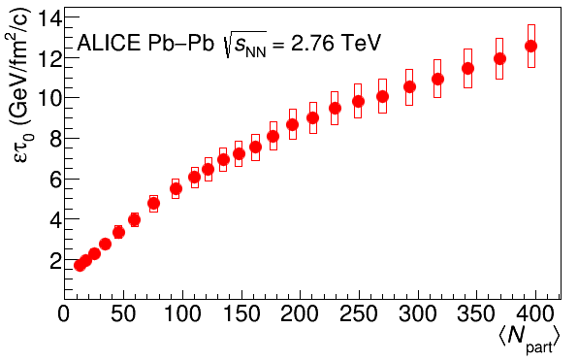
Energy density
RHIC
Standard estimate τ₀ ≈ 1 fm/c
QGP formation

Slide 17
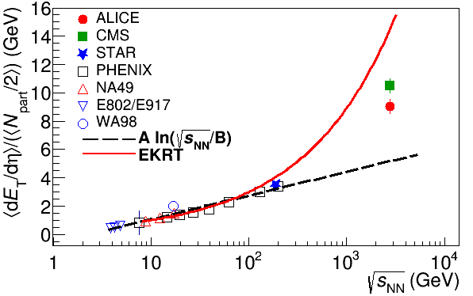
Energy dependence
Higher than extrapolations of RHIC data

Slide 18
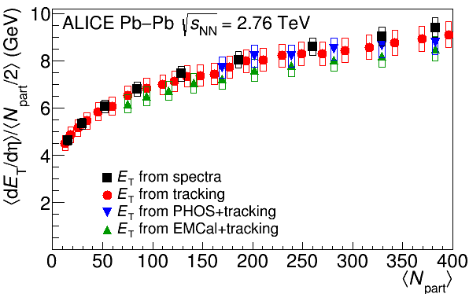
Comparison of different methods
ALICE

Slide 19
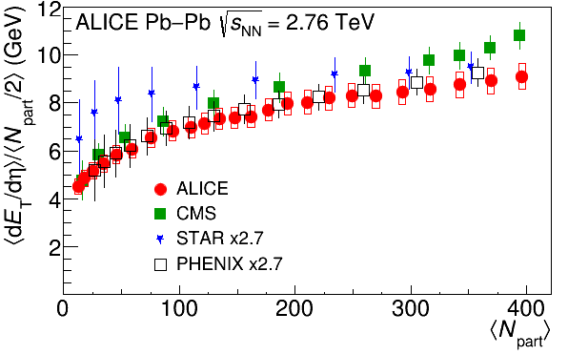
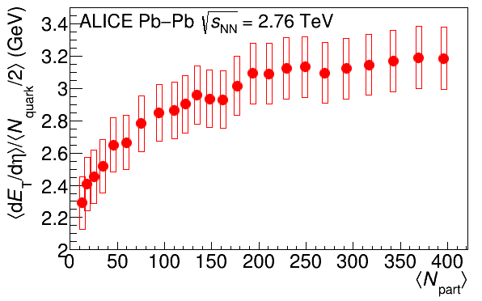
Scaling
Same centrality dependence as at RHIC
E_{T} appears to scale better with N_{quark} than N_{part}

Slide 20
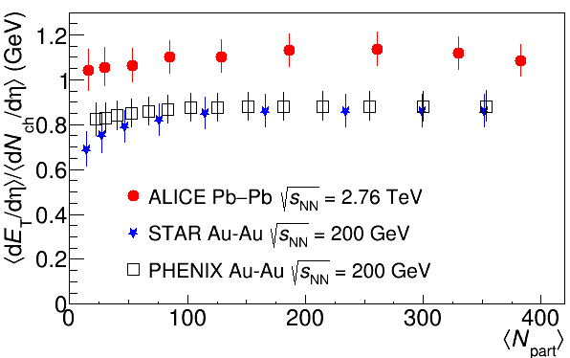
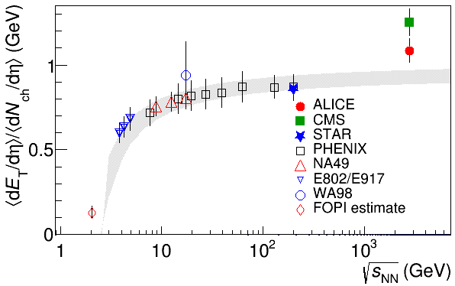
Average energy/particle
Same centrality dependence as at RHIC
At RHIC: more energy → more particles
At LHC: more energy → higher energy/particle

Slide 21
Conclusions:
What can we learn from measuring E_{T}?
Reach energy densities around 10 GeV/fm³, several times the energy density necessary to form QGP
E_{T} higher than expected at LHC
E_{T} seems to scale with N_{quark}
At LHC increasing energy → increasing energy/particle, not more particles

Slide 22
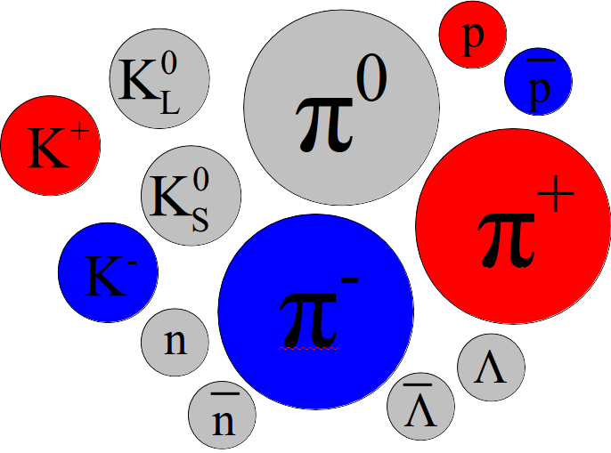
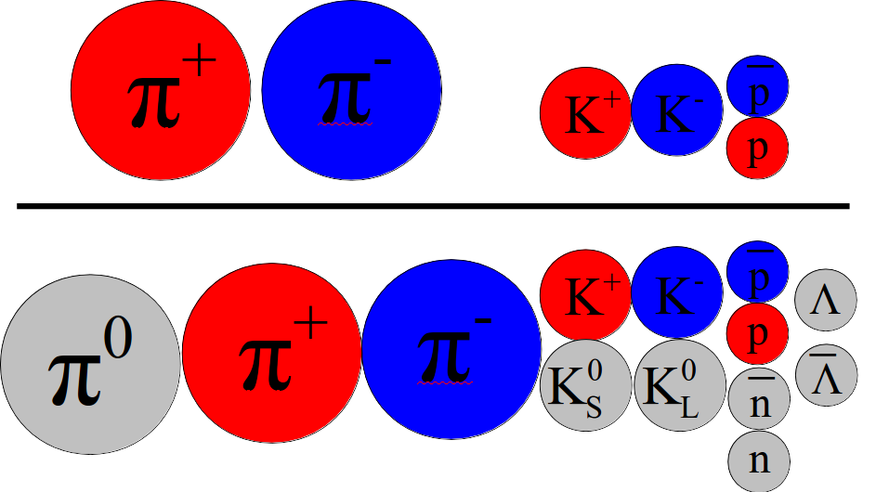
Conclusions
Energy distribution in an event:
  NOT 1/3 neutral!
  ...but hits your detector as ~1/3 neutral
Measurements of E_{T}: tracking only measurements highly accurate!
E_{T} higher than expected at LHC

Slide 23
The End

Slide 24
Comparison of colliders
 | RHIC | LHC
√s_{NN} (GeV) | 9-200 | 2760, 5500 | center of mass energy
dN_{ch}/dη | ~1200 | ~1600 | number of particles
T/T_{c} | 1.9 | 3.0-4.2 | temperature
ε (GeV/fm³) | 5 | ~15 | energy density
τ_{QGP} (fm/c) | 2-4 | >10 | lifetime of QGP
RHIC and LHC:
Cover 2 –3 decades of energy (√s_{NN}= 9 GeV –5.5 TeV)
To discover the properties of hot nuclear matter at T ~ 150 –600 MeV

Slide 25
Hybrid method
E_{t}^{had}
E_{t}^{em}
A. Well-measured by TPC
B. Not well measured but included in def.
E. Well-measured by EMCal
π∓,k∓,p`p
n,K⁰_{L},`n
π⁰,e∓, γ, η
F. Not
included in def. but occurs as a background
Not included in def. but occurs as a background
Not included in def. but occurs as a background
D. Included in def, but will exclude with DCA and correct for missing energy
C. Not included in def. but occurs as a background
π∓,k∓,p`p
π∓,k∓,p`p
π∓,k∓,p`p
n,K⁰_{L},`n
n,K0L,`n
n,K0L,`n
e∓
K⁰_{S}, Λ`Λ
Stuff the tracking detectors measure well
Stuff the EMCal measures well

Slide 26
Calculation from spectra
Use spectra data and use Blast wave fits to extrapolate to higher and lower p_{T}
Three assumptions
E_{T}^{n}=E_{T}^{p}
E_{T}^{`n}=E_{T}^{`p}
K⁰_{L}=K⁰_{S}
Then, neglecting pseudorapidity dependence and assuming that the correction is the same for 900 GeV, 2.76 TeV, and 7 TeV:
Everything else is negligible

Slide 27
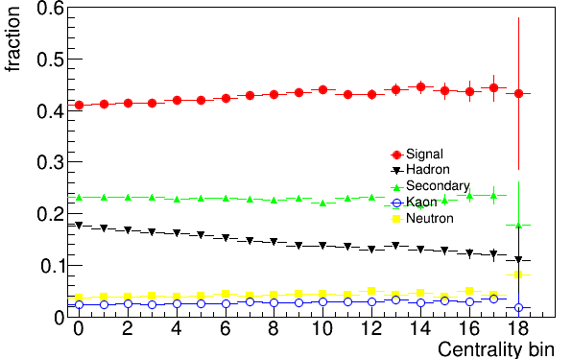
What does the EMCal measure?
Note that this gets the fraction from kaons wrong. The fraction from kaons is actually about 10% of what we measure. Signal is actually ~30%.

Slide 28
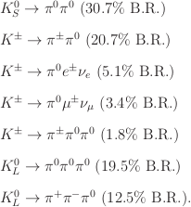
Kaon deposits
There are several kaon decays into pi0's and pi0's decay mostly into photons
These will (mostly) not be matched to tracks
Simulations are unreliable because of how far off simulations are for strange particles

Slide 29
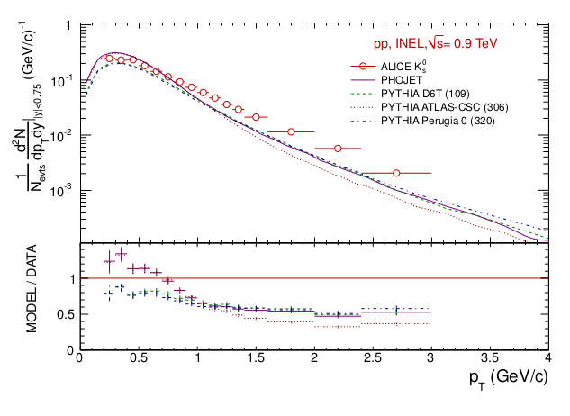
Kaons – measured vs simulation

Slide 30
E_{T}^{em}
Sum over clusters
Geometric acceptance, not including dead channels
Contributions to final E_{T}^{em} systematic error
Correction for minimum energy threshold ~6%
Correction for nonlinearity of detector response ~0.5%
Data driven
All energy deposited by K⁰_{S}, K⁰_{L}, K±, including decays like K⁰_{S}→π⁰π⁰→γγγγ <3%
Correction for other charged hadron deposits in calorimeter ~10-20%
Correction for (anti)neutron deposits in calorimeter ~1.5-5%
Input from data
Correction for deposits by particles from secondary interactions <4 <5%
efficiency x acceptance within geometric acceptance of detector ~1%

Slide 31
E_{T}^{had}
Correction for the geometric acceptance – 1, with acceptance due to sector boundaries, etc. rolled into the track efficiency
Correction for the low p_{T} cut off in the acceptance
Correction for neutral hadrons included in the definition but not measured well:
K⁰_{S}, Λ,`Λ, K⁰_{L}, n,`n
Not trying to measure K⁰_{S}, Λ,`Λ in TPC – apply DCA cut to eliminate, correct for missing energy
Correction for background not included in definition (e∓) or not measured easily event-by-event (K⁰_{S}, Λ,`Λ)
Correction for π, K, p not identified
Correction for tracking efficiency
Definition of energy to mimic the behavior of a calorimeter

