Slide 1

Understanding the Quark Gluon Plasma through measurements of jets

Slide 2

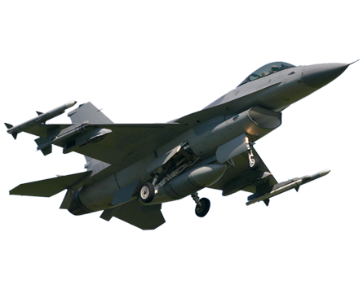
Overview
What is the QGP?
Jet quenching in a nutshell
  Partons lose energy in the medium
  This lost energy makes jets broader and softer
Towards quantitative understanding
  Measurement details matter
  Cold nuclear matter effects?
  Measuring the lost energy
Please interrupt me with questions!

Slide 3
What is the QGP?

Slide 4





Phase diagram of nuclear matter
Quark Gluon Plasma
Core of neutron stars?
Quark Gluon Plasma – a liquid of quarks and gluons created at temperatures above ~170 MeV (2·10¹²K) – over a million times hotter than the core of the sun
Notes:
But wait – how can we have a liquid of quarks and gluons? Doesn't asymptotic freedom tell us that we can't have free quarks and gluons? How, then, can we have a liquid of quarks and gluons?

Slide 5

The phase transition in the laboratory

Slide 6












Relativistic Heavy Ion Collider
Large Hadron Collider
PHOBOS
BRAHMS
CMS
PHENIX
STAR
RHIC
LHCb
ALICE
ATLAS
LHCf
Upton, NY
1.2km diameter
p+p, d+Au, Cu+Cu, Au+Au, U+U
√s_{NN} = 9 - 200 GeV
Geneva, Switzerland
8.6km diameter
p+p, p+Pb, Pb+Pb
√s_{NN} = 2.76 GeV, 5.5 TeV
LHC
Quark Gluon Plasma
RHIC
Core of neutron stars?
Notes:
Mention that RHIC planning began 1983

Slide 7
Comparison of colliders
 | RHIC | LHC
√s_{NN} (GeV) | 9-200 | 2760, 5500 | center of mass energy
dN_{ch}/dη | ~1200 | ~1600 | number of particles
T/T_{c} | 1.9 | 3.0-4.2 | temperature
ε (GeV/fm³) | 5 | 12, 16 | energy density
τ_{QGP} (fm/c) | 2-4 | >10 | lifetime of QGP
RHIC and LHC:
Cover 2 –3 decades of energy (√s_{NN}= 9 GeV –5 TeV)
To discover the properties of hot nuclear matter at T ~ 150 –600 MeV

Slide 8
Interesting observables
Different hadronization mechanisms
→ Identify particle types
Collective motion of particles
→ Low momentum acceptance
Even common processes are not well understood
→ Do not need 4π acceptance or high rates

Slide 9

ALICE
ATLAS
CMS
STAR
PHENIX
Notes:
Mention that RHIC planning began 1983

Slide 10




Size: 16 x 26 meters
Weight: 10,000 tons
Detectors: 18
Trigger detectors: When do we have a collision?
Tracking detectors: Where did the particle go?
Identification detectors: What kind of particle is it?
Calorimeters: How much energy does the particle have?
<number>
Notes:
By comparison ATLAS is 25 meters in diameter and 44 meters long – not quite twice as large

Slide 11

p+p collisions
3D image of each collision

Slide 12

Pb+Pb collisions
5

Slide 13
Jet quenching in a nutshell

Slide 14

Jets – the cartoon
nucleus
nucleus
Want a probe which traveled through the medium
QGP is short lived → need a probe created in the collision
We expect the medium to be dense → absorb/modify probe

Slide 15
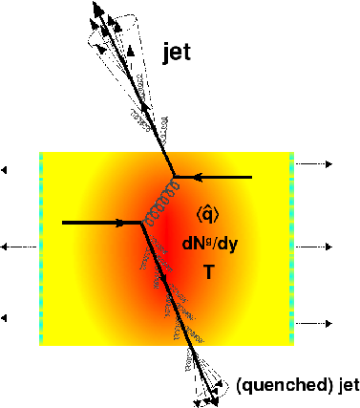
Quenched jets:
what we're trying to study
Softer constituents
Broader radius
Figure from Nucl.Phys. A827 (2009) 356C-364C arXiv:0902.2488 [nucl-ex]

Slide 16

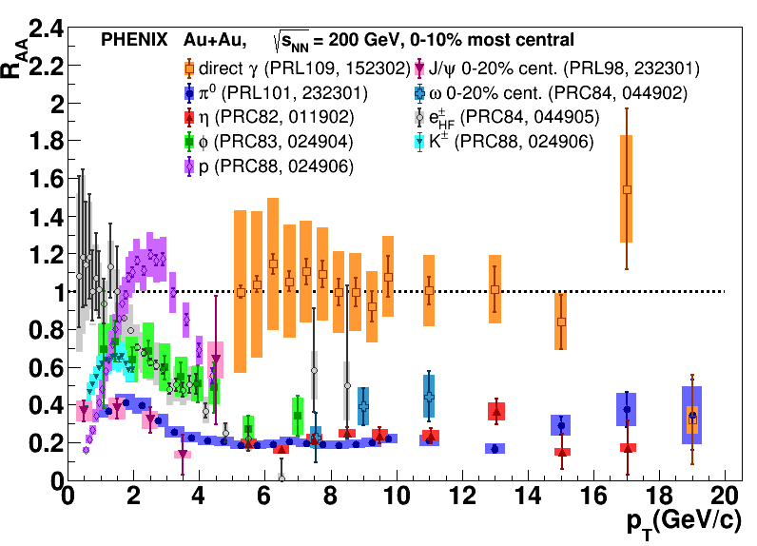
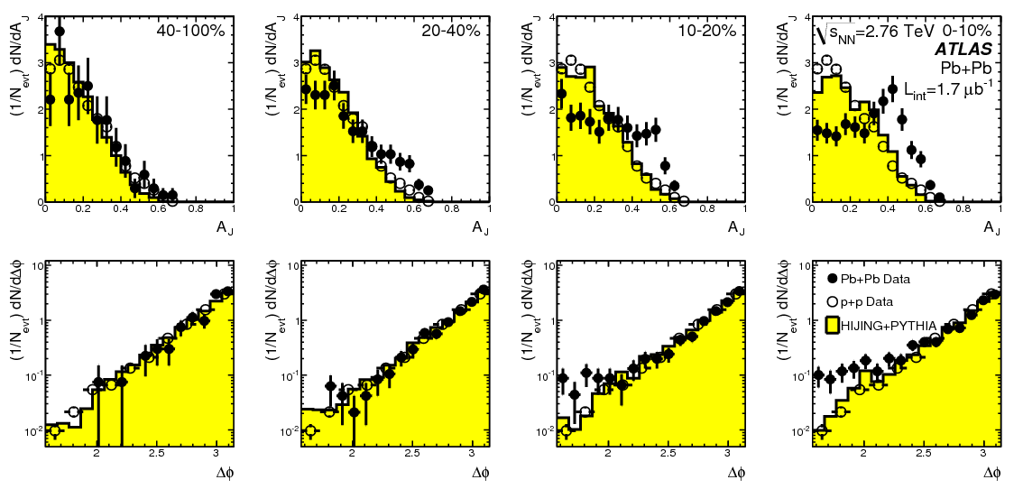
Ways to study jets
Single particle
Di-hadron (multi-hadron) correlations
Fully reconstructed jets
PRL 105 (2010) 252303
Phys.Rev.Lett.93:252301,2004

Slide 17


Nuclear modification factor
Measure spectra of probe (jets) and compare to those in p+p collisions or peripheral A+A collisions
If high-p_{T} probes (jets) are suppressed, this is evidence of jet quenching
Enhancement
Suppression

Slide 18

Nuclear modification factor R_{AA}
RHIC
LHC
Electromagnetic probes – consistent with no modification – medium is transparent to them
Strong probes – significant suppression – medium is opaque to them

Slide 19
Nuclear modification factor R_{AA}
Single particles
Jets
Electromagnetic probes – consistent with no modification – medium is transparent to them
Strong probes – significant suppression – medium is opaque to them

Slide 20
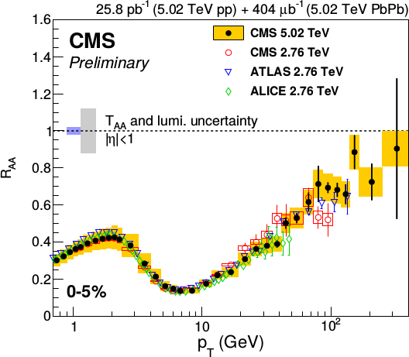
Nuclear modification factor R_{AA}
Single particles at the LHC
Reaches 1 at very high p_{T}
Must happen due to causality
Feature of all QCD-inspired models

Slide 21
Di-jet asymmetry
PRL 105 (2010) 252303

Slide 22
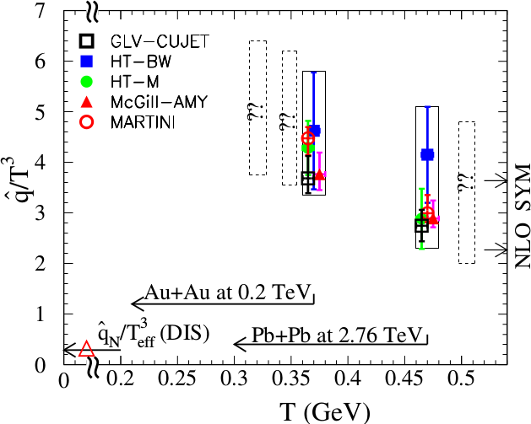
Quantifying
Phys. Rev. C 90, 014909 (2014)
Jet Collaboration: For a 10 GeV quark traveling 4 fm
≈1.2±0.3 GeV²/fm at τ₀=0.6 fm/c in Au+Au at √s_{NN}=200 GeV →loses 2.2 Gev
≈1.9±0.7 GeV²/fm in Pb+Pb collisions at √s_{NN}=2.76 TeV →loses 2.8 Gev
Q = Momentum transfer from parton to medium
L = path length

Slide 23
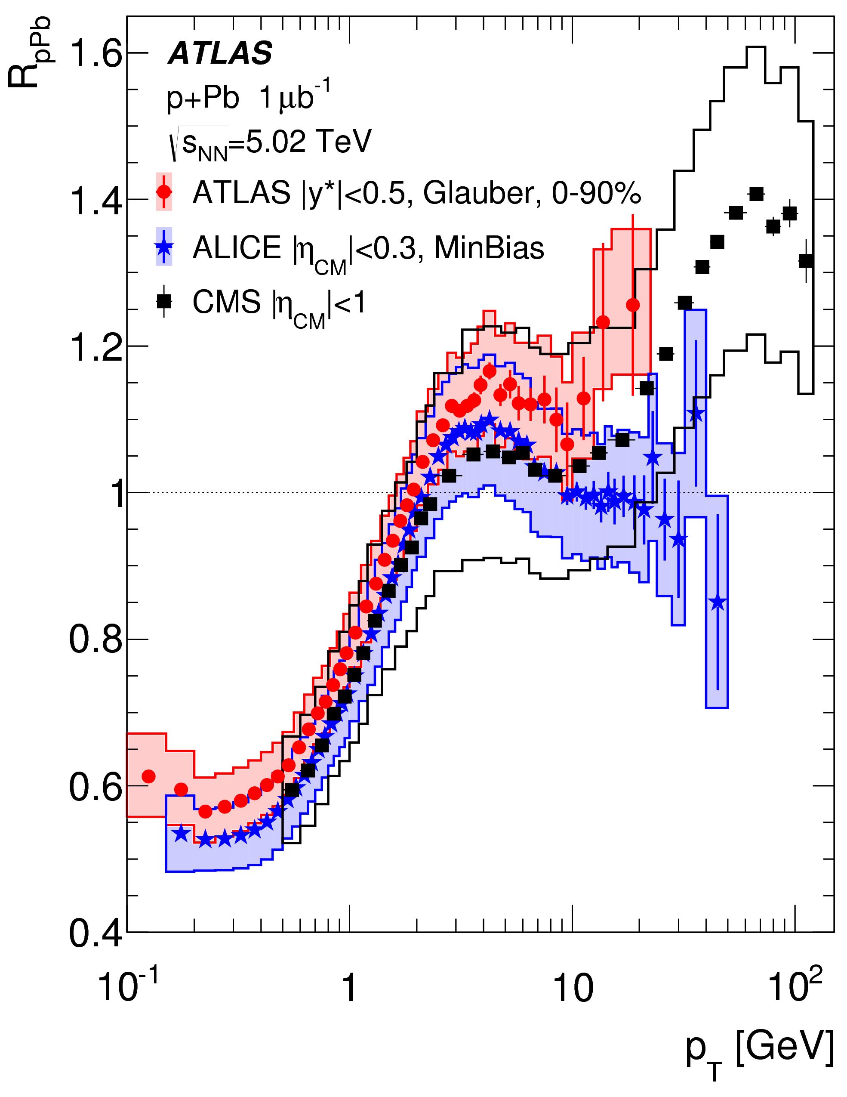
p+Pb as a control
ATLAS
CERN-EP-2016-077 arXiv:1605.06436

Slide 24
Towards quantitative understanding

Slide 25
What is a jet?
A jet is what a jet finder finds.

Slide 26

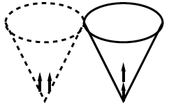
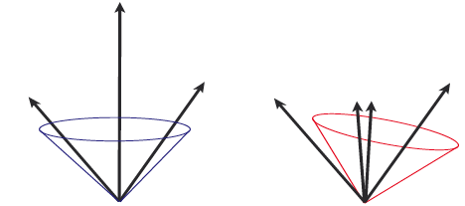
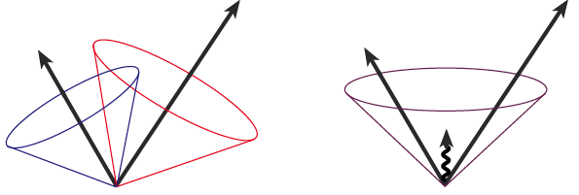
Jets in principle
Jet measures partons
Hadronic degrees of freedom are integrated out
Algorithms are infrared and colinear safe
OK
BAD: 2 jets are merged in one

Slide 27
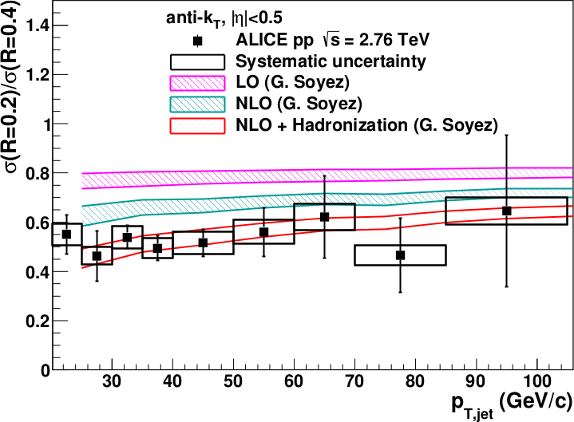
<footer>
Full jet ratios in pp
√s = 2.76 TeV, R = 0.2, 0.4 Inclusive
arXiv:1301.3475
PLB: 10.1016/j.physletb.2013.04.026
Hadronization is important even in pp collisions!
Notes:
----- Meeting Notes (6/24/13 16:47) -----
PRB -> PLB
mention ratio
<number>

Slide 28

Jet finding algorithms
Tracks
Jet finding algorithm
Jet candidates
Clusters
Particles
Any list of objects works as input
Use the same algorithm on theory & experiment
Output only as good as input
M. Cacciari, G. P. Salam, G.Soyez, JHEP 0804:063,2008

Slide 29

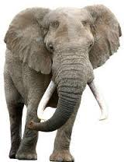

Bias & Background

Slide 30



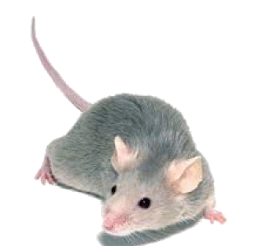
p+p di-jet event in STAR
Central Au+Au collision in STAR
Background
Signal
Harder
Correlated with rxn plane
Low p_{T} modifications
Flavor modifications?
Softer
Correlated with rxn plane
Large fluctuations/hot spots
Combinatorial background
Degraded energy resolution

Slide 31
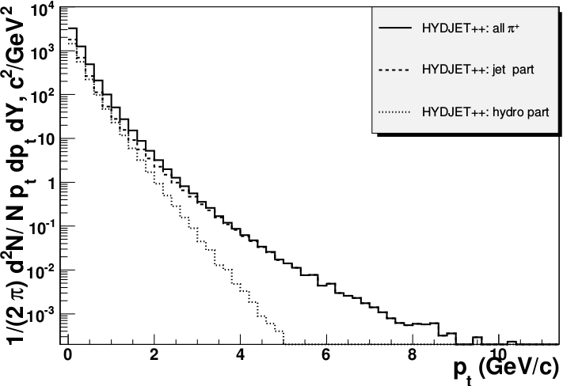
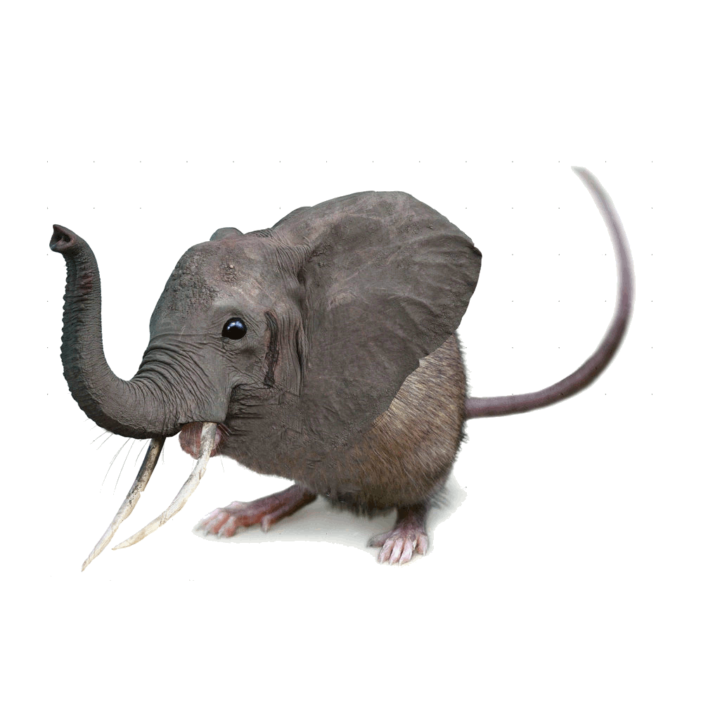
Focus on high p_{T}
Pros:
  Reduces combinatorial background
Cons:
  Cuts signal where we expect modifications
  Could bias towards partons which have not interacted
  Biases sample towards quarks
PoS High-pTphysics09:023,2009

Slide 32
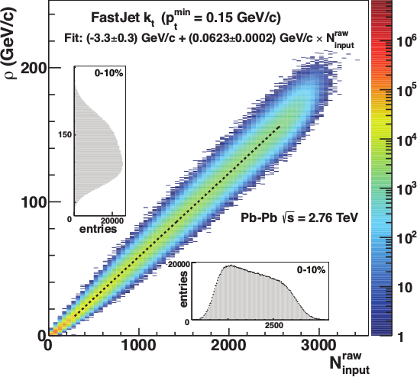
Focus on smaller angles
Pros
  Background is smaller
  Background fluctuations smaller
Cons:
  Modifications expected at higher R
  Biases sample towards quarks
JHEP 03 (2012) 053

Slide 33

<footer>
ALICE/STAR
Combinatorial “jets”
Estimate combinatorial jet contributions and its fluctuations from data
Require leading track p_{T} > 5 GeV/c
  Suppresses combinatorial “jets”
  Biases fragmentation
No threshold on constituents
Limited to small R
Measured spectra:
Full jets
Where
comes from FastJet anti-k_{T} algorithm
Notes:
<number>

Slide 34

ATLAS
Constituent biases don't matter that much up here
Iterative procedure
  Calorimeter jets: Reconstruct jets with R=0.2. v₂ modulated <Bkgd> estimated by energy in calorimeters excluding jets with at least one tower with
  E_{tower} > <E_{tower}>
  Track jets: Use tracks with p_{T}>4 GeV/c
  Calorimeter jets from above with E>25 GeV and track jets with p_{T}>10 GeV/c used to estimate background again.
Calorimeter tracks matching one track with p_{T}>7 GeV/c or containing a high energy cluster E >7 GeV are used for analysis down to E_{jet} = 20 GeV
But they do matter down here!
Definitely imposes a bias, especially at 20 GeV!
We should treat that bias as a tool, not a handicap
Phys. Lett. B 719 (2013) 220-241

Slide 35
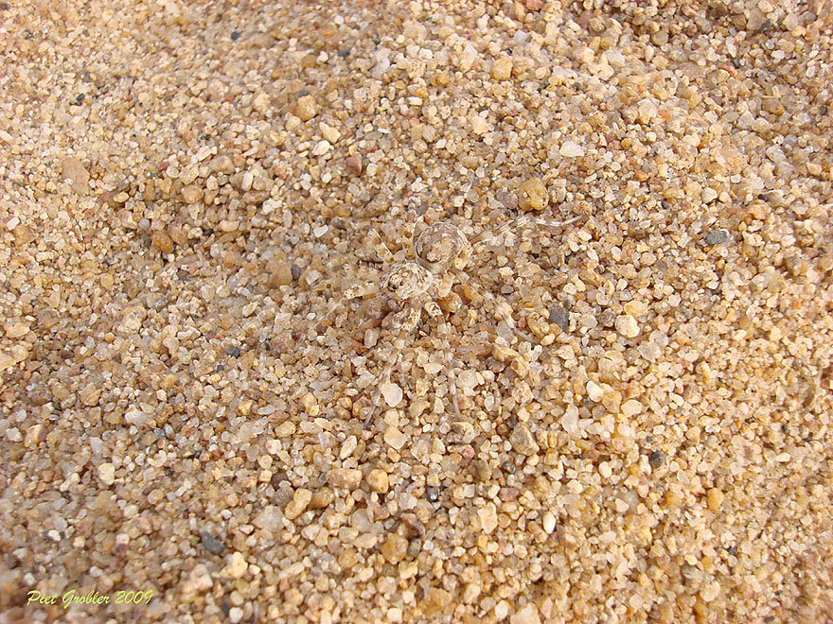
http://www.boredpanda.com/animal-camouflage/

Slide 36
Bias
Modified jets probably look more like the medium
Quark jets are narrower, have fewer tracks, fragment harder [Z Phys C 68, 179-201 (1995), Z Phys C 70, 179-196 (1996), ]
Gluon jets reconstructed with k_{T} algorithm have more particles than jets reconstructed with anti-k_{T} algorithm [Phys. Rev. D 45, 1448 (1992)]
Gluon jets fragment into more baryons [EPJC 8, 241-254, 1998]
http://www.boredpanda.com/animal-camouflage/

Slide 37
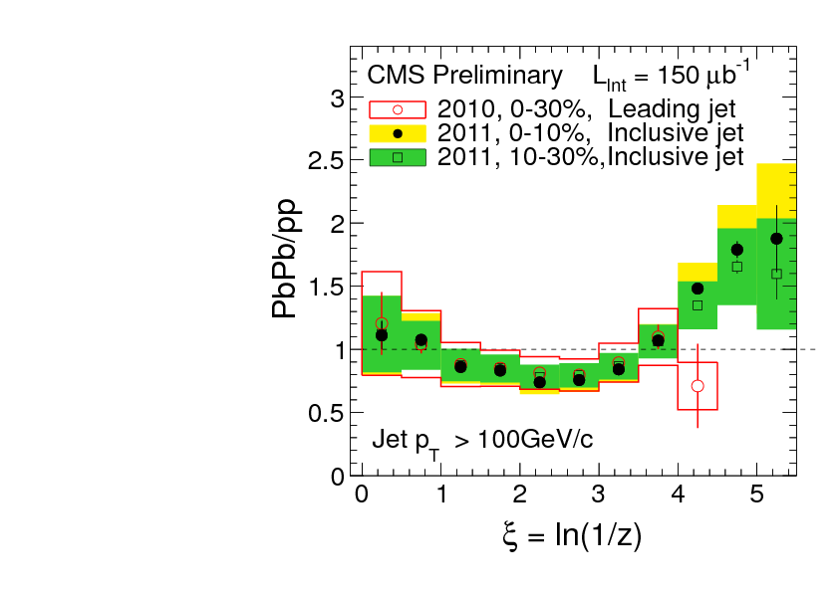
What you see depends on where you look
Phys. Rev. C 90, 024908 (2014)
JHEP10(2012)087
z = p_{T}/E_{jet}
Low p_{T}
High p_{T}
Low p_{T}
Low p_{T}
Low p_{T}
Low p_{T}
High p_{T}
Low p_{T}
High p_{T}
High p_{T}
High p_{T}

Slide 38
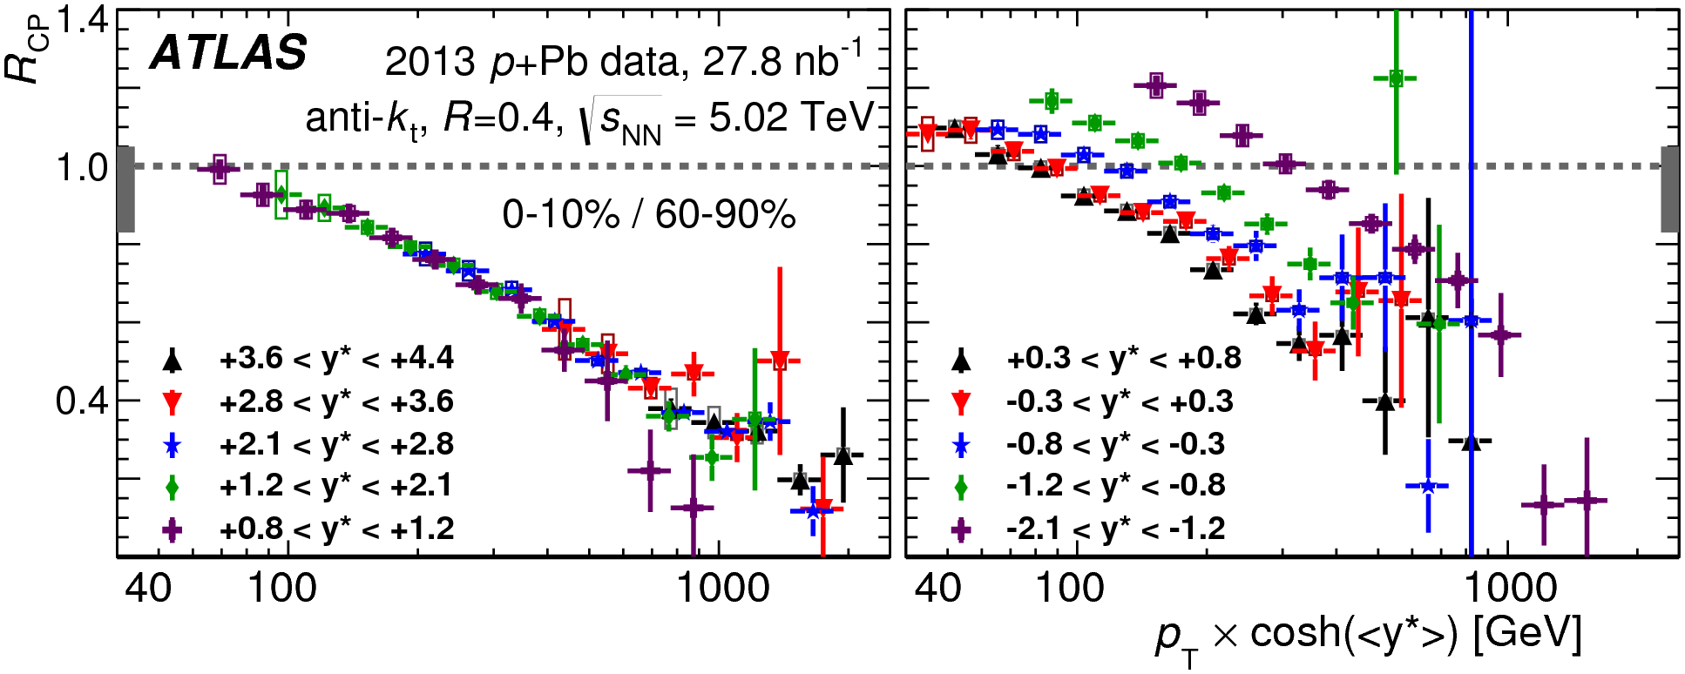
Cold Nuclear Matter effects
PLB 748 (2015) 392-413
No indication of modified jet structure in cold nuclear matter (d+Au and p+Pb collisions)
[Phys.Rev.C73:054903,2006, Phys.Rev.Lett.96:222301,2006]
Minimum bias R_{pPb}, R_{dAu} for charged particles, jets consistent with 1 [Phys.Rev.Lett.98:172302,2007,Phys.Rev.C81:064904,2010,Phys. Rev. Lett. 110 (2013) 082302, arXiv:1605.06436]
Indications of modification at forward rapidities from dihadron correlations
[Phys. Rev. Lett. 107, 172301 (2011)]
Centrality dependence observed
[PLB 748 (2015) 392-413, Phys. Rev. Lett. 116, 122301 (2016)]

Slide 39
Path length dependence

Slide 40
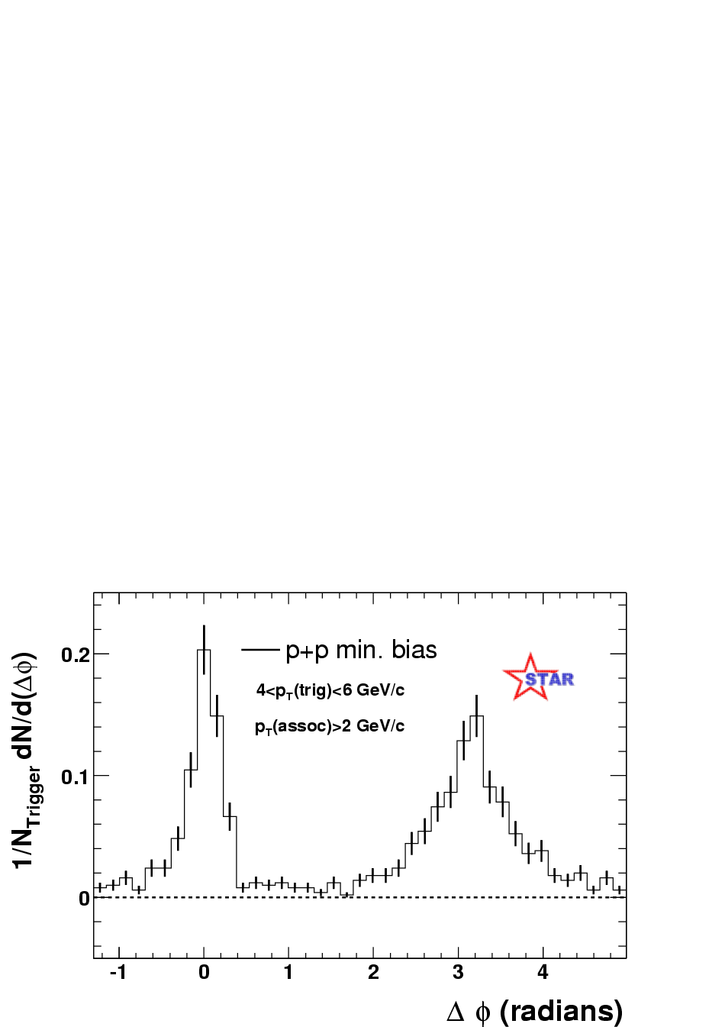
Jets – azimuthal correlations
p+p → dijet
Trigger
trigger
Phys Rev Lett 90, 082302
Associated
Select high momentum particles → biased towards jets

Slide 41
Azimuthal correlations
Phys.Rev.Lett.93:252301,2004

Slide 42
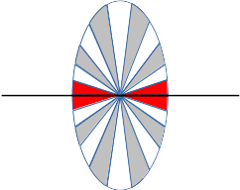
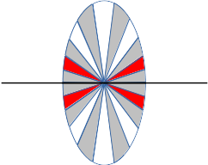
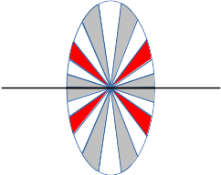
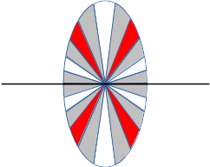
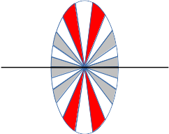
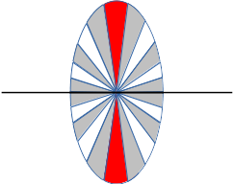
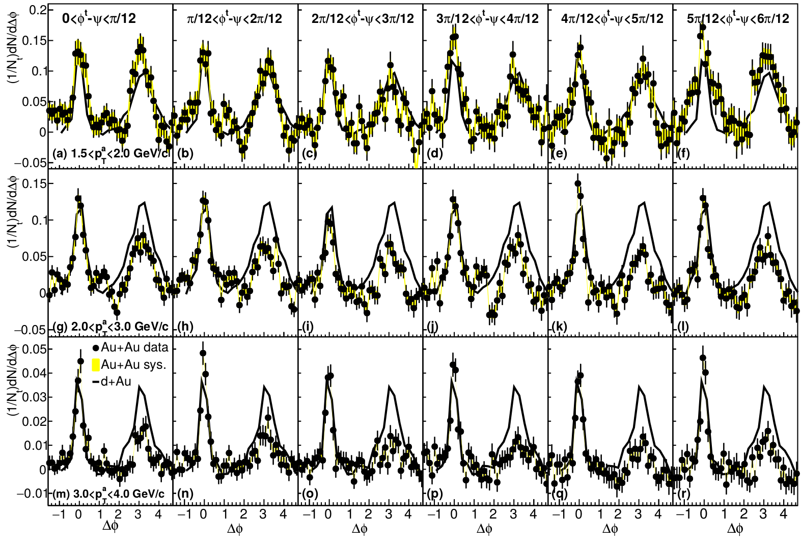
Dihadron correlations
4.0<p_{T}^{trig}<6.0 GeV/c
Phys.Rev.Lett.93:252301,2004
Phys. Rev. C 94, 011901(R) 2016
Sharma, Mazer, Stuart, Nattrass: (Phys. Rev. C 93, 044915 2016)

Slide 43
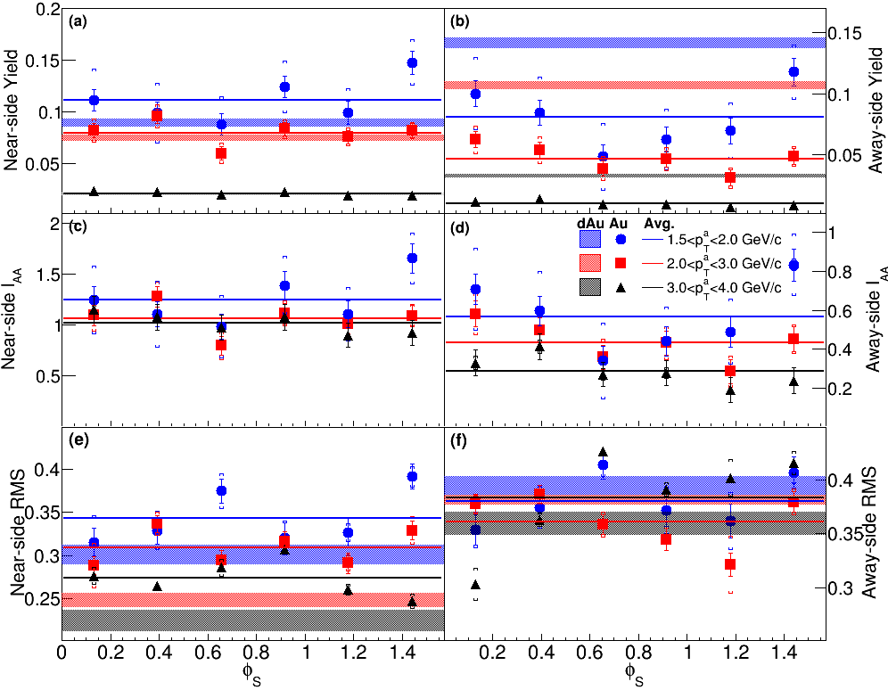
Dihadron correlations
Phys. Rev. C 94, 011901(R) 2016

Slide 44
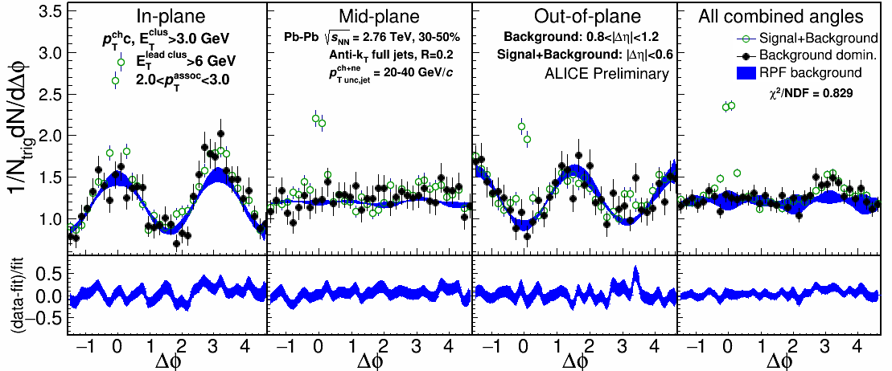

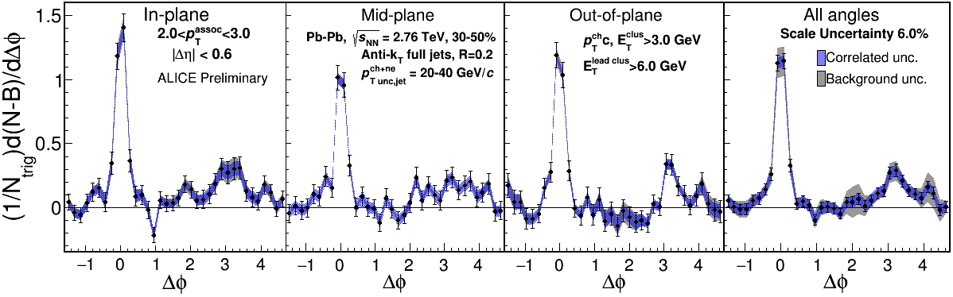
2.0-3.0 GeV/c
1) signal+bkgrd
2) bkgrd dominated
3) bkgrd RPF fit
Correlation function
Joel Mazer
Hot Quarks 2016
Away side clearly there and suppressed

Slide 45
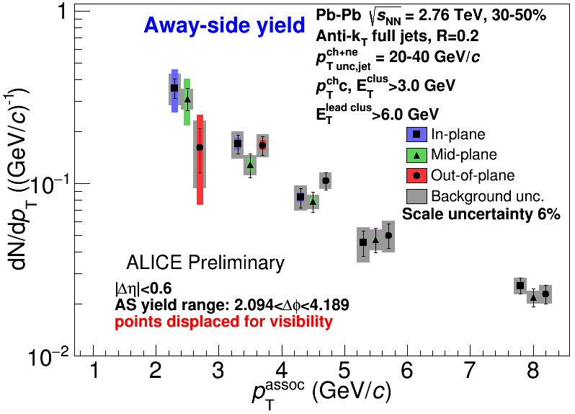
Away-side jet yields vs EP
Jets 20-40 GeV/c, 30-50% centrality
Within uncertainties of
current statistics, no
event plane ordering
Different effects in
different p_{T} associated
bins
Competing effects
1) Quenching
2) Bremsstrahlung
3) etc
Joel Mazer
Hot Quarks 2016

Slide 46
Little/no path length dependence?
Path length dependence naively predicted by every model
  No path length dependence seen in rxn plane dependent A_{j} either
Insufficient sensitivity?
Statistical variation in energy loss is more important than path length dependence
  J. G. Milhano and K. C. Zapp, “Origins of the di-jet asymmetry in heavy ion collisions,” arXiv:1512.08107
  F. Senzel, O. Fochler, J. Uphoff, Z. Xu, and C. Greiner, “Influence of multiple in-medium scattering processes on the momentum imbalance of reconstructed di-jets,” J. Phys. G42 no. 11, (2015) 115104, arXiv:1309.1657 [hep-ph].

Slide 47
Conclusions
What to remember
  A jet is not a parton
  All jet measurements are biased
  Background subtraction/suppression methods are important
  Beware Cold Nuclear Matter effects!
Challenges for the field
  Cross check between experiments using the same method
  Experimentalists: explain method/measurement to theorists!
  Theorists: don't ignore the method!
Many thanks to Rosi Reed, Sevil Salur, and Megan Connors for many productive discussions

Slide 48
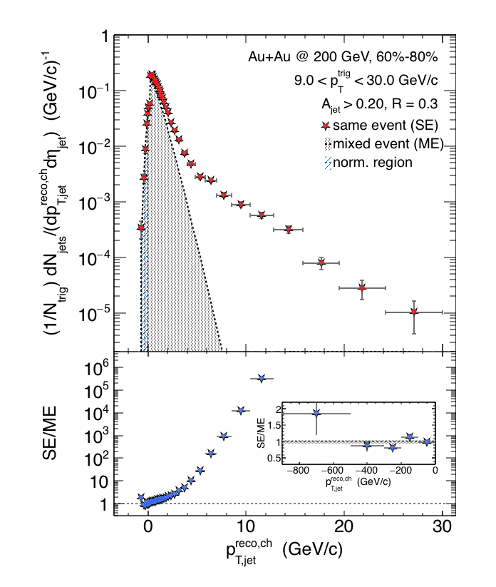

Charged Raw Recoil Jet Spectrum: Reference
Event mixing
Peripheral
Reference spectrum:
peripheral collisions
Much less combinatorial
background compared to
most central data
Excellent signal/background
ratio down to 3 GeV/c
Preliminary
Requires normalization at low p_{T}
All physical correlations treated like jets
Alex Schmah, Hard Probes 2015
06/29/2015
Alexander Schmah - Hard Probes 2015
<number>

Slide 49
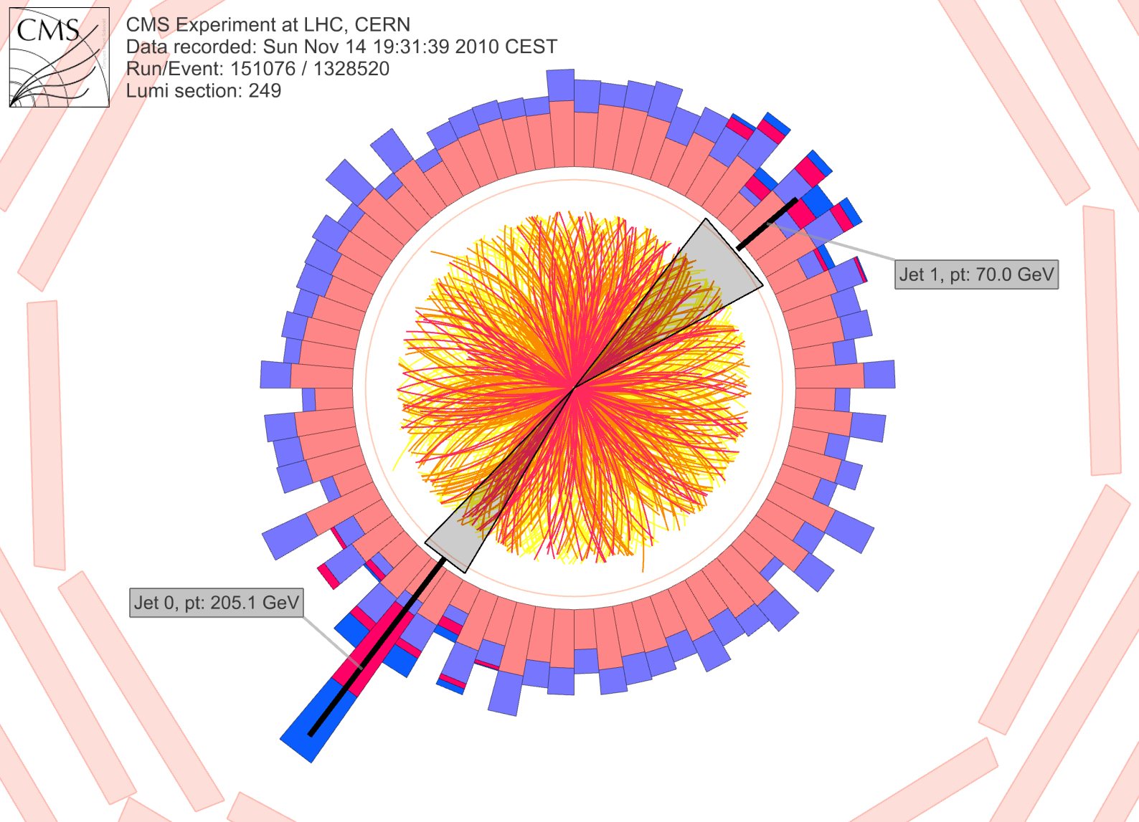
CMS: Iterative Pile-Up Event Background Subtraction
Background is estimated
for each calorimeter ring of constant η
subtracted before jet finding
re-iterated after excluding the jets found in the first iteration
Fake Jets: After the background subtraction, some local fluctuations remain!
Fluctuations will deteriorate the jet resolution in central events.
Sevil Salur
<number>

Slide 50
QGP Energy Density

Slide 51

How can we estimate the energy density?
Transverse energy (E_{T})
  sum of particle energies in transverse direction
Volume V = A_{T} τc
τ = formation time
Energy density ε
QGP formation for ε > 0.5 GeV/fm³
A_{T}
= τc

Slide 52

Energy density
RHIC
Standard estimate τ₀ ≈ 1 fm/c
QGP formation

Slide 53
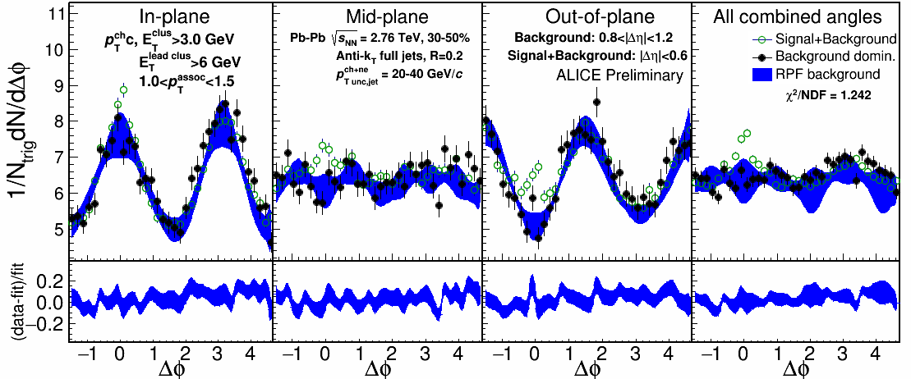
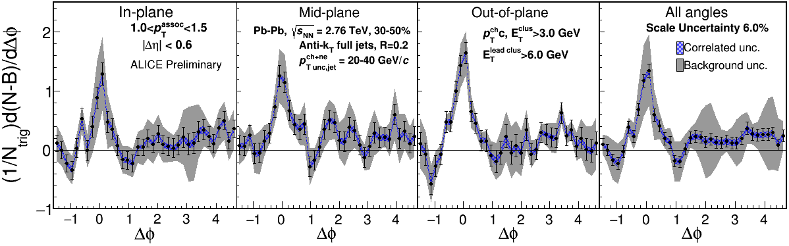
1.0-1.5 GeV/c
1) signal+bkgrd
2) bkgrd dominated
3) bkgrd RPF fit
Correlation function
Uncertainties dominated by statistics
Background uncertainty is non-trivially correlated point-to-point

Slide 54
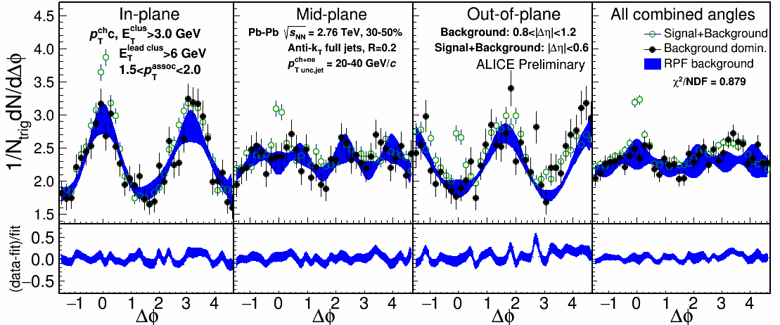
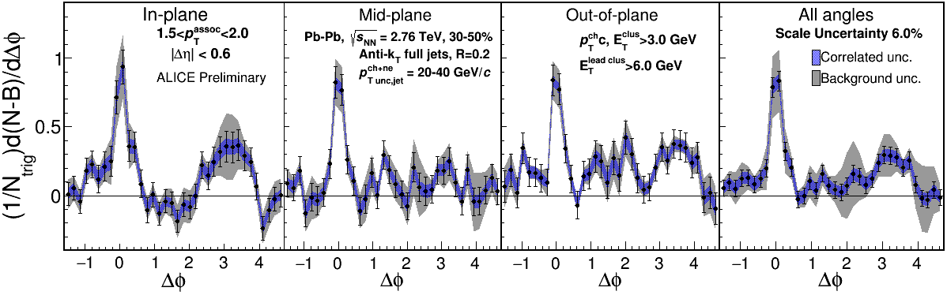
1.5-2.0 GeV/c
1) signal+bkgrd
2) bkgrd dominated
3) bkgrd RPF fit
Correlation function
v₃ and v₄ components important
Background uncertainty is non-trivially correlated point-to-point

Slide 55
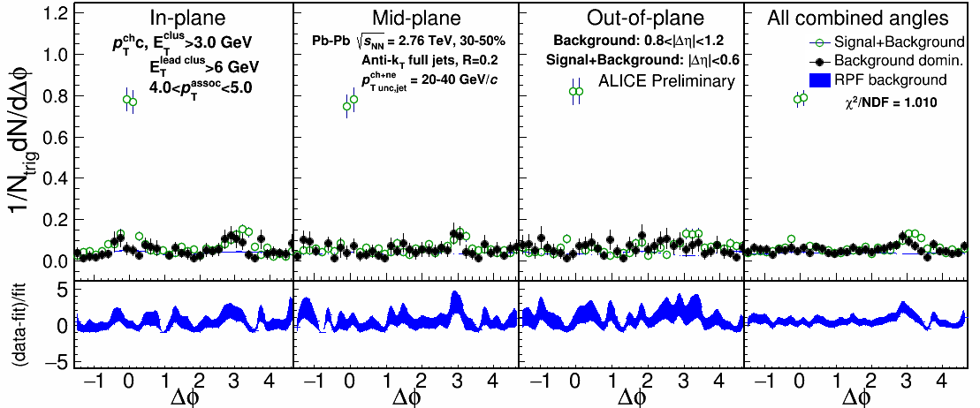
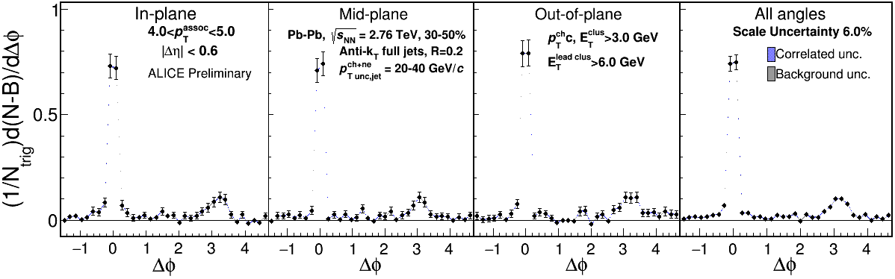
4.0-5.0 GeV/c
1) signal+bkgrd
2) bkgrd dominated
3) bkgrd RPF fit
Correlation function
Background level negligible

Slide 56
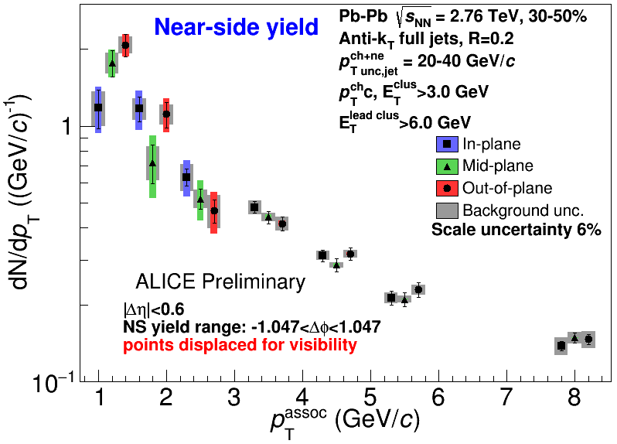
Near-side jet yields vs EP
Jets 20-40 GeV/c, 30-50% centrality
Within uncertainties of
current statistics, no
event plane ordering
Different effects in
different p_{T} associated
bins
Competing effects
1) Quenching
2) Bremsstrahlung
3) etc

Slide 57

Di-jet asymmetry
Kolja Kauder, RHIC/AGS User's Meeting 2016
arXiv:1609.03878
Au+Au di-jets more imbalanced than p+p for pTcut>2 GeV/c
Au+Au AJ ~ p+p AJ for matched di-jets (R=0.4)

Slide 58
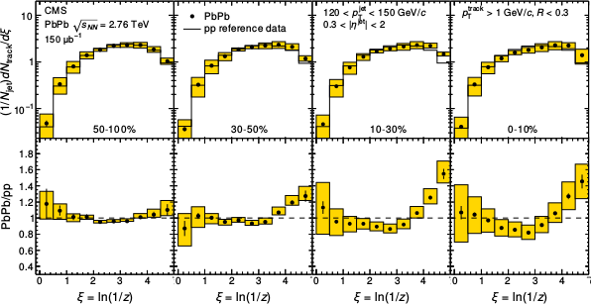
Fragmentation functions
z = p_{T}/E_{jet}
CMS
PRC 90 (2014) 024908
High p_{T}
Low p_{T}

Slide 59
Dihadron correlations
4.0<p_{T}^{trig}<6.0 GeV/c
Phys.Rev.Lett.93:252301,2004
Phys. Rev. C 94, 011901(R) 2016

Slide 60
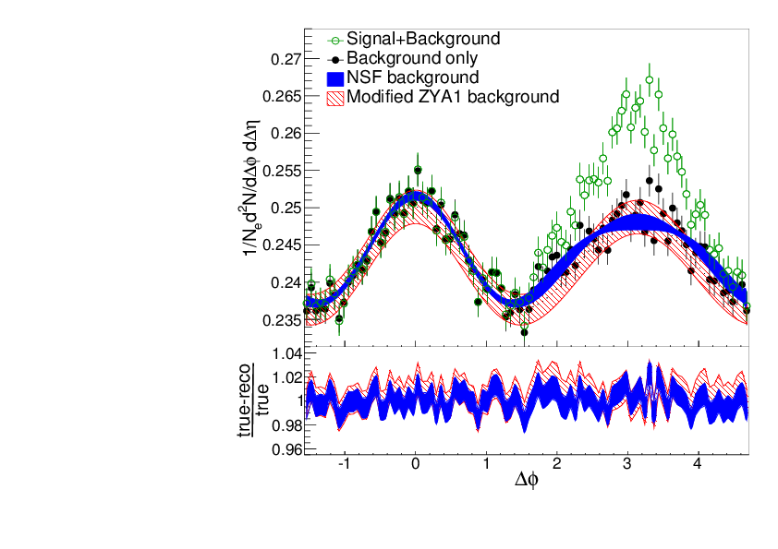
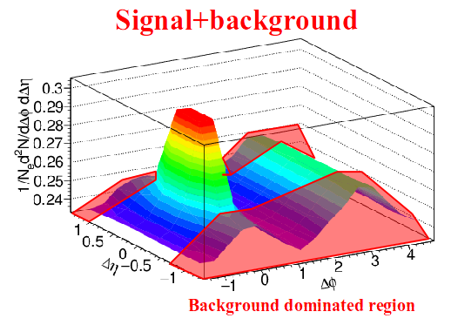
Reaction plane fit (RPF) method
TOY MODEL
Signal is negligible at large Δη and small ΔΦ region.
NSF method
h-h
√s_{NN} = 2.76 TeV
30-40% PbPb
8<p_{T}^{trigger}<10 GeV/c
1<p_{T}^{assoc}<2 GeV/c
Fit
extrapolation
Project signal+background over 0.8 < |Δη| < 1.2
Fit background in |Δφ| < π/2
Fitting till 4th order v_{n} term, total 6 fit parameters: B, v₂^{assoc}, v₂^{trig}, v₃^{assoc}×v₃^{trig}, v₄^{assoc}, and v₄^{trig}
Sharma, Mazer, Stuart, Nattrass: (Phys. Rev. C 93, 044915 2016)
Nattrass, Sharma, Mazer, Stuart, and Bejnood: (Phys. Rev. C 94, 011901(R) 2016)

Slide 61
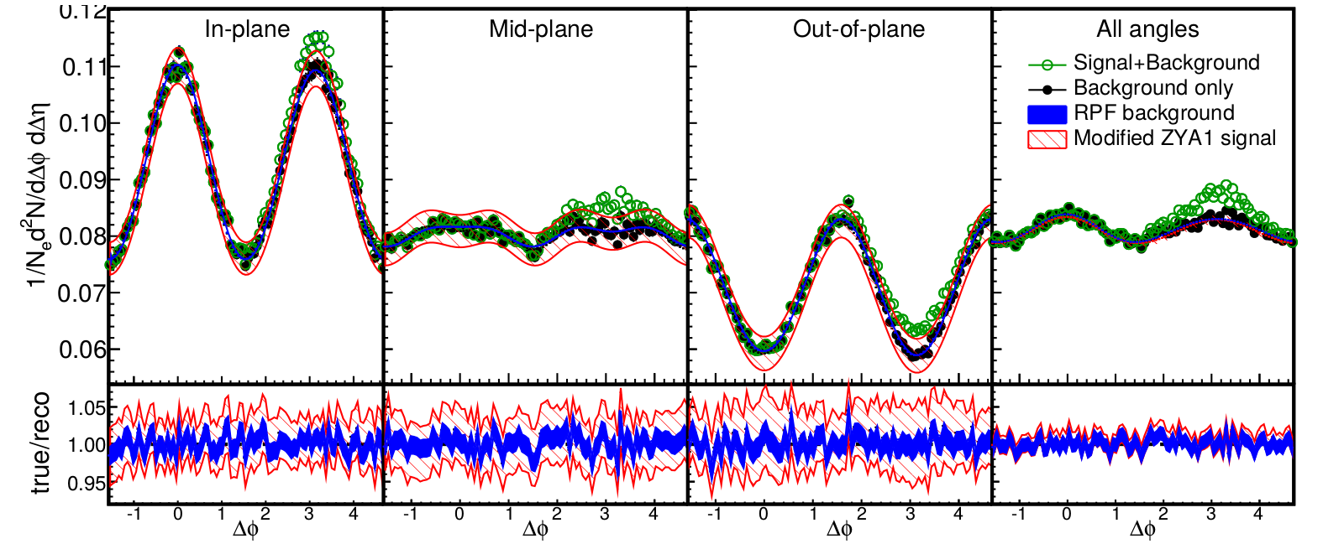
Reaction plane fit (RPF) method
30-40% central (simulation)
TOY MODEL
Each orientation has different functional form, but require same parameters
More robust method, now have a higher constrained background
with more information going into fit
h-h
√s_{NN} = 2.76 TeV
30-40% PbPb
8<p_{T}^{trigger}<10 GeV/c
1<p_{T}^{assoc}<2 GeV/c
Fit
Project signal+background over 0.8<|Δη|<1.2
v_{n} and B extracted
Fewer assumptions and bias than ZYAM while having much smaller errors

