Slide 1
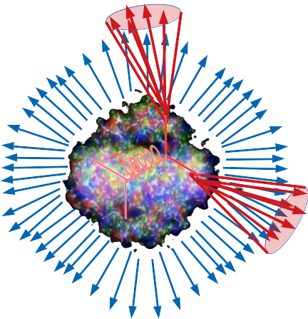


Background fluctuations in jet studies in heavy ion collisions
Antonio Da Silva
Charles Hughes
Antonio Da Silva, Charles Hughes, Christine Nattrass
University of Tennessee, Knoxville

Slide 2
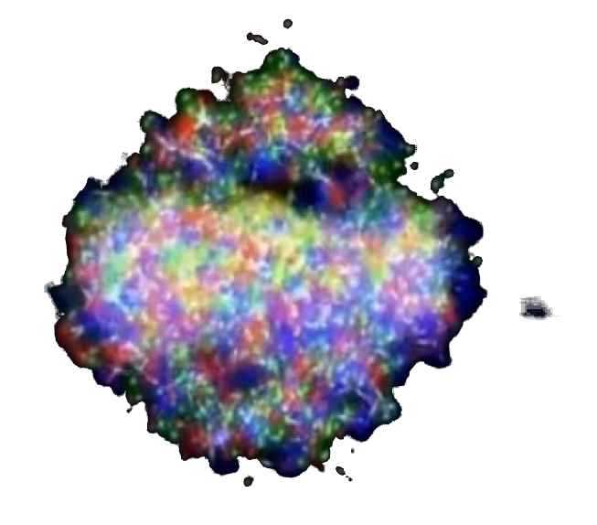
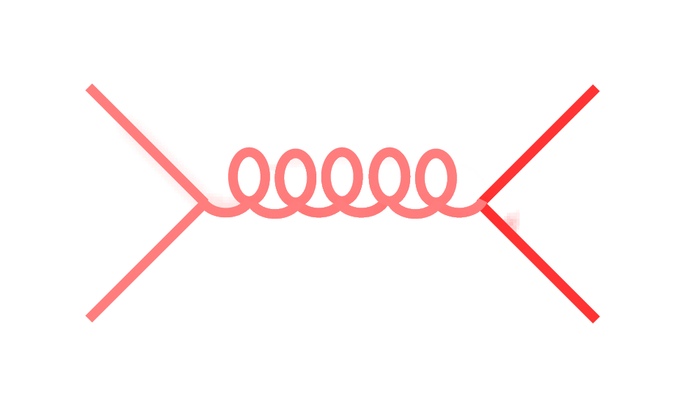
Motivation
Want to study jets in heavy ion collisions
But there’s a large background.
ALICE Random cones
We need to understand it.
JHEP 03 (2012) 053
compared to
TennGen background generator
PYTHIA Angantyr
Signal
Background

Slide 3
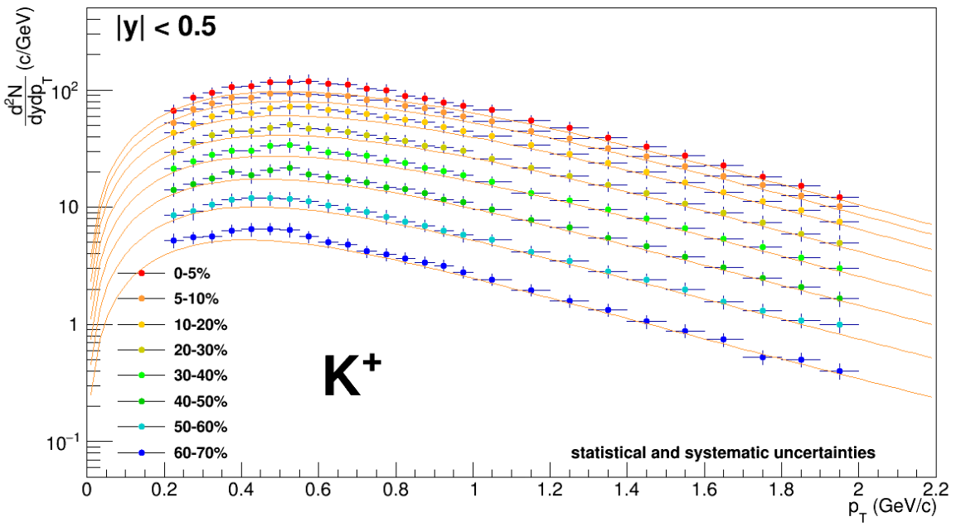
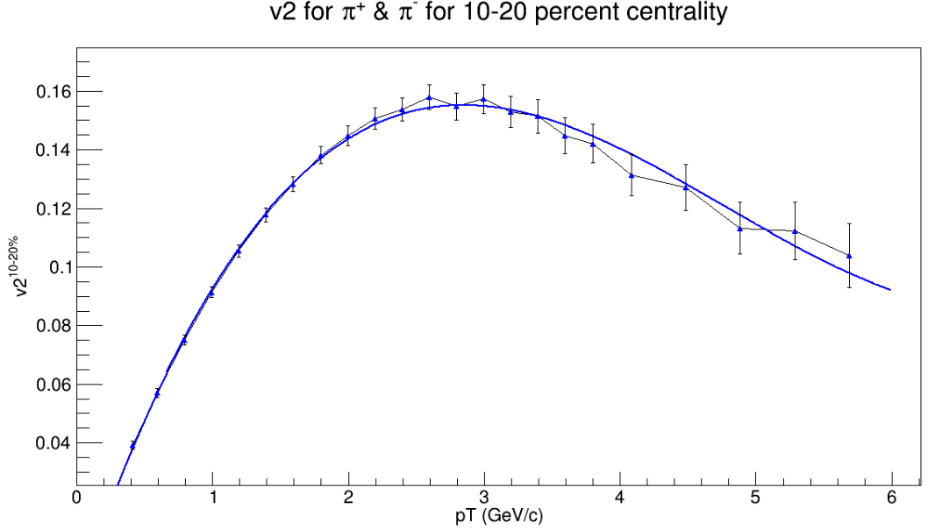
TennGen background generator
Event properties
Track properties
ε₁
ε₃
Momentum spectra
Blast Wave Fit
dN/dy
Random p_{T}
ε₂, ε₄, ε₆
ALICE PLB720 (2013) 52-62
ε₅
p_{T}
Even event planes fixed at Ψ=0
Odd planes at random φ
Multiplies from ALICE PRC88 (2013) 044910
Polynomial Fit
v_{n}
v_{n}
ALICE JHEP 1609 (2016) 164
Azimuthal asymmetries
Random φ
No jets! No resonances
Emulates hydro correlations
p_{T}

Slide 4
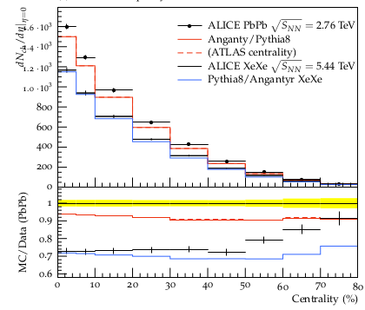
PYTHIA Angantyr
JHEP (2018) 2018: 134
Based on PYTHIA 8
Sjöstrand, Mrenna & Skands,
JHEP05 (2006) 026
Comput. Phys. Comm. 178 (2008) 852.
Based on Fritiof & wounded nucleons
N-N collisions w/fluctuating radii → fluctuating σ
Lots of jets! And resonances!
No hydrodynamics, no jet quenching

Slide 5
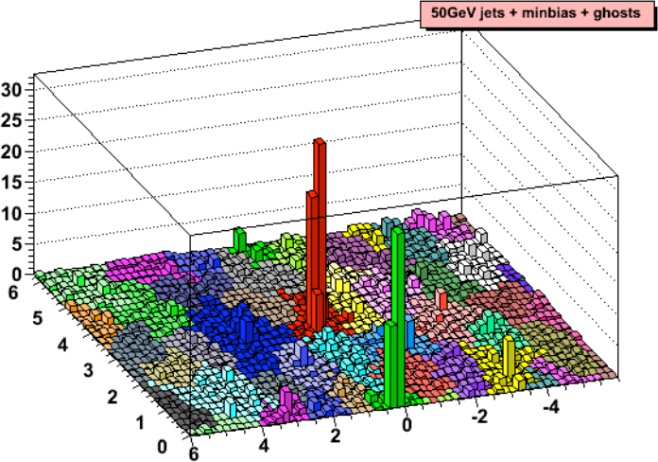
Area-based background subtraction
Cacciari & Salam, PLB659:119–126,2008
Particles, clusters
k_{T} algorithm
Cacciari DIS 2006
$k_{T}=p_{T},ΔR_{ij}=\sqrt{{\left(η_{i}−η_{j}\right)}^{2}+{\left(ϕ_{i}−ϕ_{j}\right)}^{2}}$
For all i,j calculate:
Combine smallest d_{ij}.
If d_{iB} smallest, d_{iB}→ jet
Repeat until no particles left
$d_{ij}=min\left(p_{T,i}^{2},p_{T,j}^{2}\right)ΔR_{ij}^{2}$
Energy (arb. units)
$d_{iB}=p_{T,i}$
Cacciari & Salam
Phys.Lett.B641:57-61,2006
Jet candidates
$ϕ$
Median ρ=p_{T}/A
$η$
$p_{T}^{jet}=p_{T}^{reco}−ρ_{median}A^{jet}$

Slide 6
Random cones
X
Excluded
$ϕ$
R=0.4
Real jets
Excluded
$η$

Slide 7
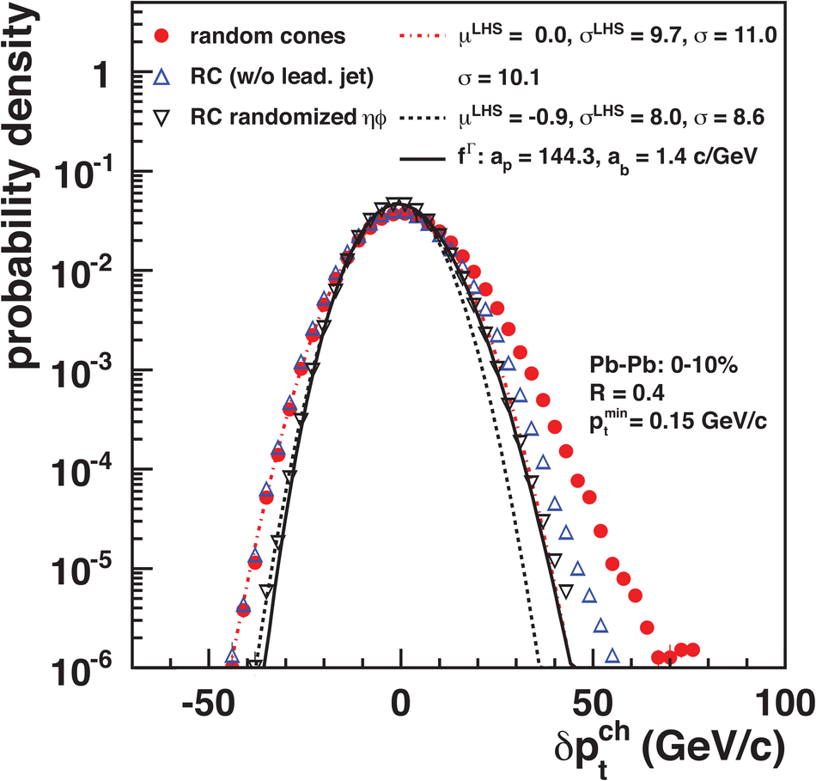
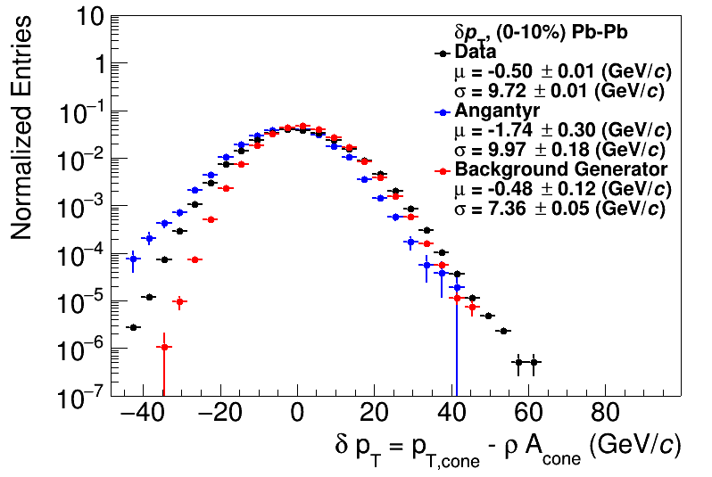
Random cones
JHEP 03 (2012) 053
ALICE
This work

Slide 8
Shape of width of the distribution
Single particle spectra
$f_{Γ}\left(p_{T},p,b\right)=\frac{b}{Γ\left(p\right)}{\left(bp_{T}\right)}^{p−1}e^{−bx}$
Σp_{T} of N particles→N-fold convolution:
$\frac{{dpT}^{total}}{dy}∝f_{N}\left(p_{T},Np,b\right)$
$f_{N}\left(p_{T},p,b\right)=f_{Γ}\left(p_{T},Np,b\right)$
$\frac{dN}{dy}∝f_{Γ}\left(p_{T},2,b\right)=b^{2}p_{T}e^{−kp_{T}}$
$N=\frac{N_{total}}{A_{total}}πR^{2}$
$μ_{total}=\frac{Np}{b}=Nμ_{p_{T}},σ_{total}=\frac{\sqrt{Np}}{b}=\sqrt{N}σ_{p_{T}}$
$μ_{p_{T}}=\frac{p}{b},σ_{p_{T}}=\frac{\sqrt{p}}{b}$
Tannenbaum, PLB(498),1–2,Pg.29-34(2001)
Add Poissonian fluctuations in N:
$σ_{total}=\sqrt{Nσ_{p_{T}}^{2}+Nμ_{p_{T}}^{2}}$
Add non-Poissonian fluctuations in N due to flow
$σ_{total}=\sqrt{Nσ_{p_{T}}^{2}+\left(N+2\sum{v_{n}^{2}}\right)μ_{p_{T}}^{2}}$

Slide 9
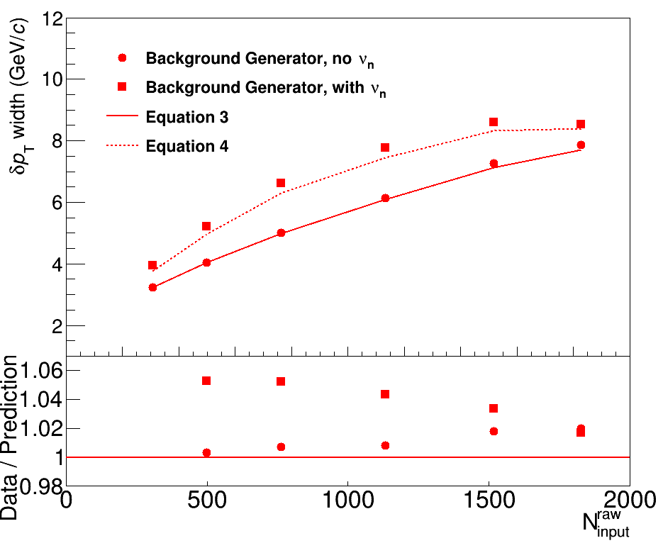
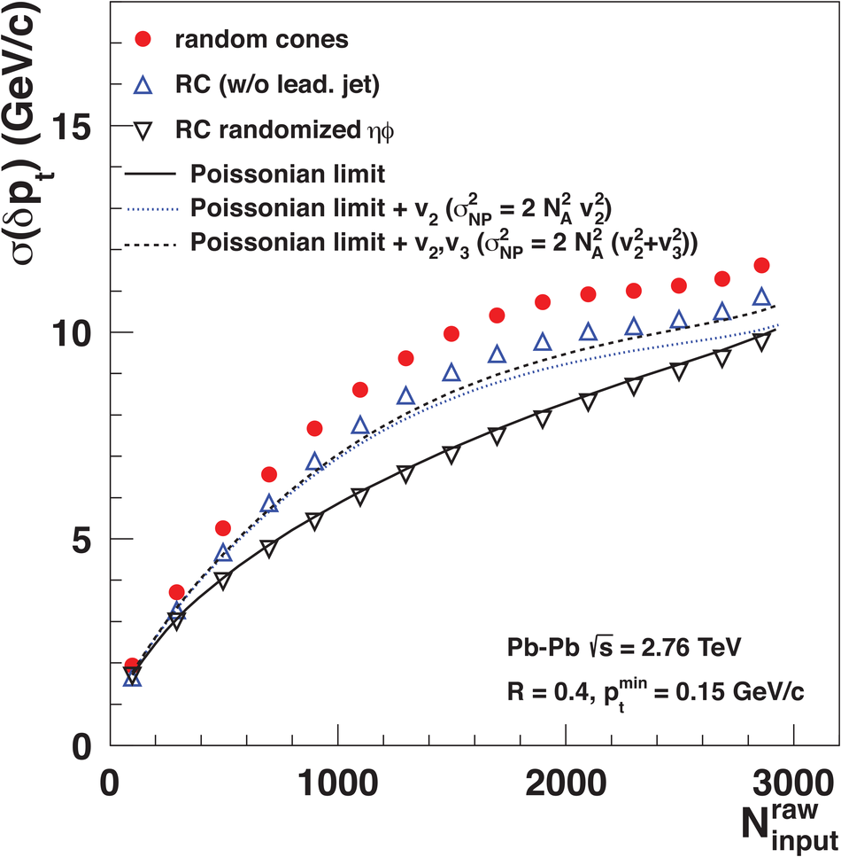
Width vs multiplicity
TennGen
ALICE
Deviations

Slide 10
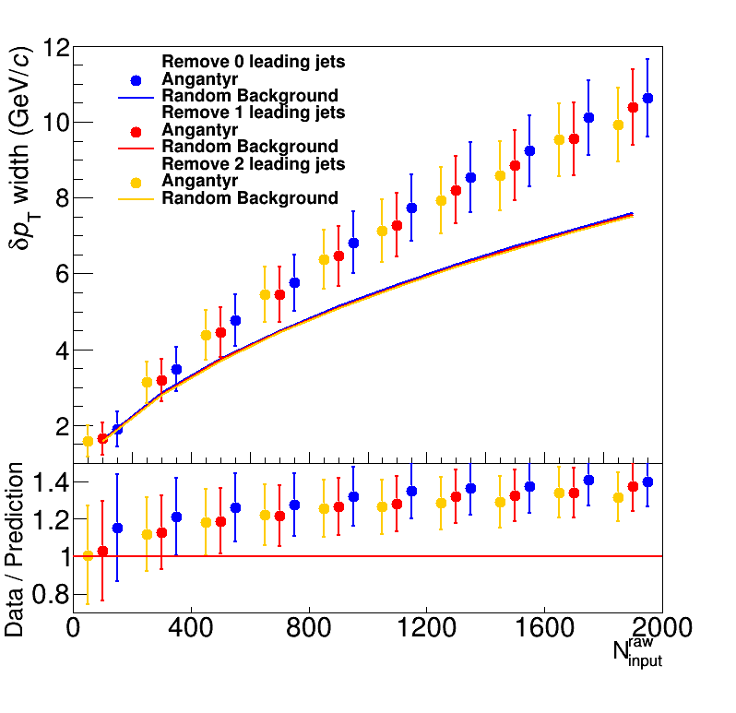
Width vs multiplicity
Angantyr
ALICE
Discrepancy not from an excess of jets!

Slide 11
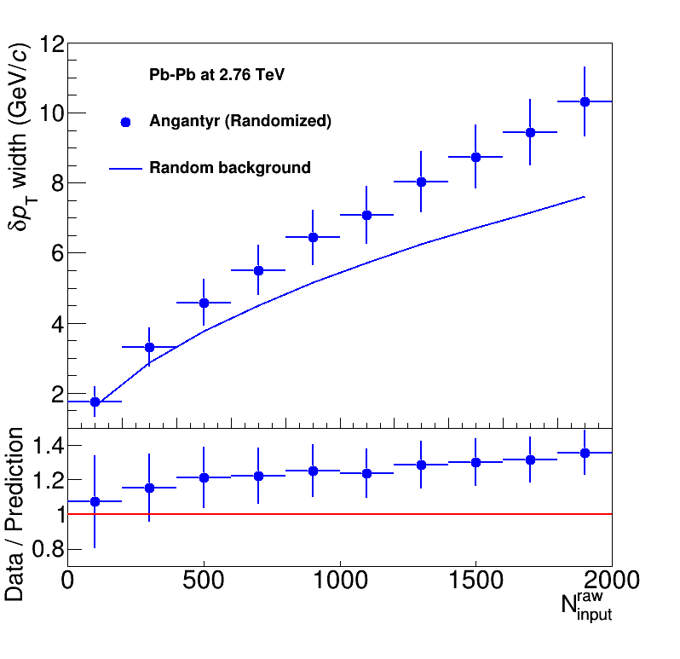
Width vs multiplicity
Angantyr
ALICE
Doesn’t go away with random track orientation!

Slide 12
Shape of width of the distribution
Single particle spectra
$f_{Γ}\left(p_{T},p,b\right)=\frac{b}{Γ\left(p\right)}{\left(bp_{T}\right)}^{p−1}e^{−bx}$
Σp_{T} of N particles→N-fold convolution:
$\frac{{dpT}^{total}}{dy}∝f_{N}\left(p_{T},Np,b\right)$
$f_{N}\left(p_{T},p,b\right)=f_{Γ}\left(p_{T},Np,b\right)$
$\frac{dN}{dy}∝f_{Γ}\left(p_{T},2,b\right)=b^{2}p_{T}e^{−kp_{T}}$
$N=\frac{N_{total}}{A_{total}}πR^{2}$
$μ_{total}=\frac{Np}{b}=Nμ_{p_{T}},σ_{total}=\frac{\sqrt{Np}}{b}=\sqrt{N}σ_{p_{T}}$
$μ_{p_{T}}=\frac{p}{b},σ_{p_{T}}=\frac{\sqrt{p}}{b}$
Tannenbaum, PLB(498),1–2,Pg.29-34(2001)
Add Poissonian fluctuations in N:
$σ_{total}=\sqrt{Nσ_{p_{T}}^{2}+Nμ_{p_{T}}^{2}}$
Assumes shape
Add non-Poissonian fluctuations in N due to flow
Assumes uncorrelated number fluctuations
$σ_{total}=\sqrt{Nσ_{p_{T}}^{2}+\left(N+2\sum{v_{n}^{2}}\right)μ_{p_{T}}^{2}}$

Slide 13
Conclusions
Comparisons with TennGen and Angantyr broadly support ALICE conclusions: random background
  Both studies indicate sensitivity to shape of spectrum
  TennGen studies indicate trivial flow correlations also import
Important for model studies to treat background the same way as data!
  Rivet 3.0 heavy ion capable!!

Slide 14
Width vs multiplicity
Consistent with random fluctuations
Slight deviations
  Other sources of correlations...?
ALICE

Slide 15
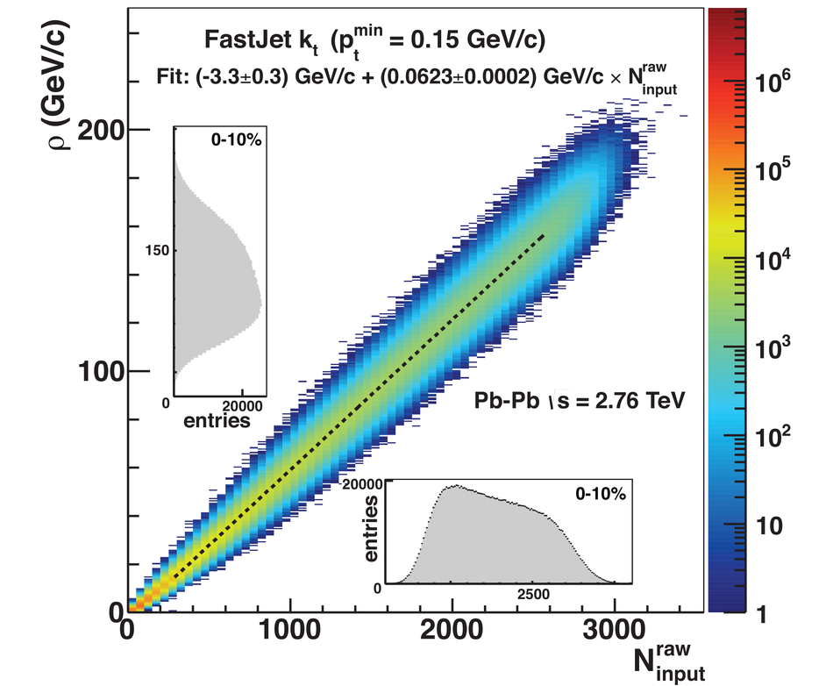
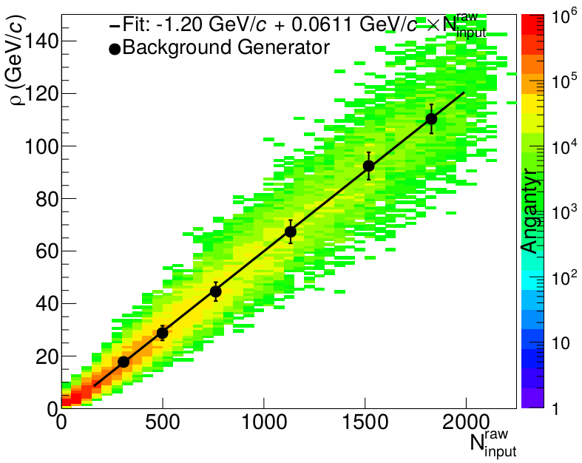
Background density ρ
`
ALICE
This work

Slide 16
Random cones in ALICE
Estimate ρ
  k_{T} jet finder→jet candidates
  ρ = Median(p_{T}/A)
Draw Random cone
JHEP 03 (2012) 053
$δp_{T}=p_{T}^{reco}−ρA$

Slide 17
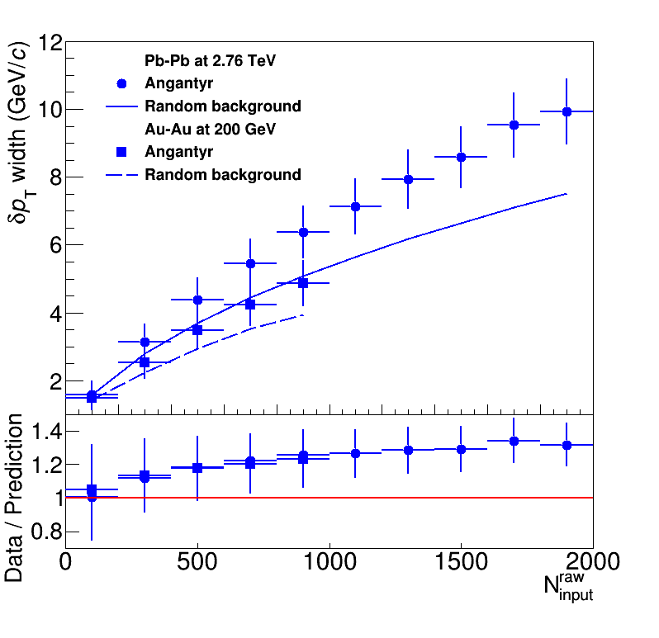
Width vs multiplicity
Angantyr
ALICE
Little difference with collision energy!

Slide 18
Signal vs Background: the standard paradigm
Background
Combinatorial jet
Signal

