Slide 1
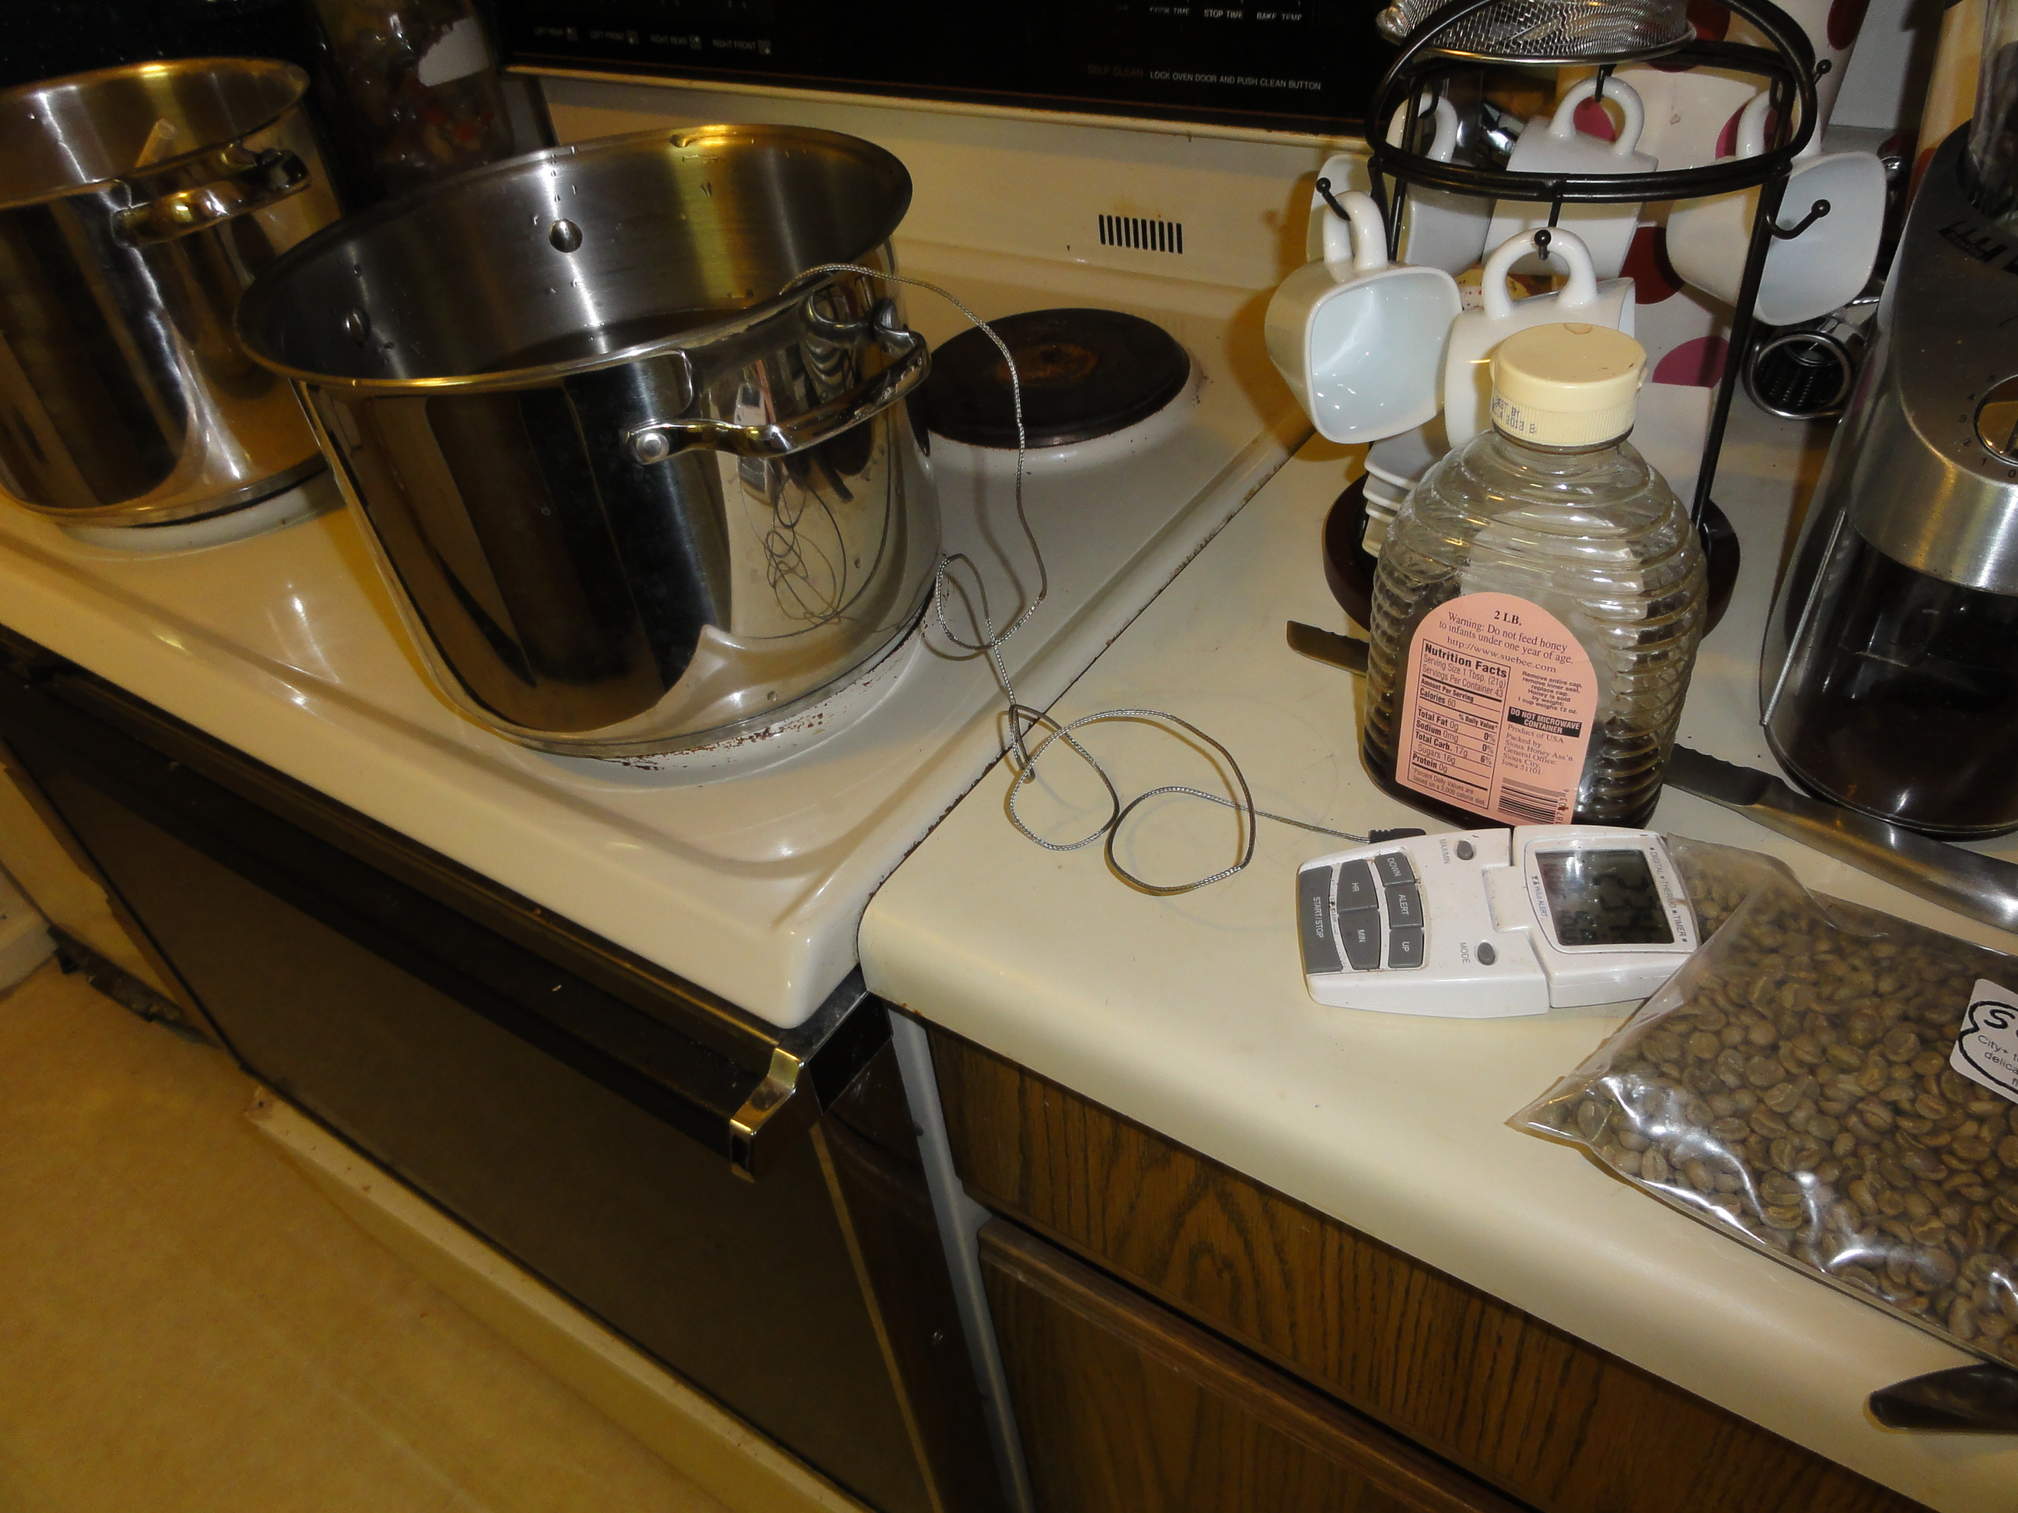
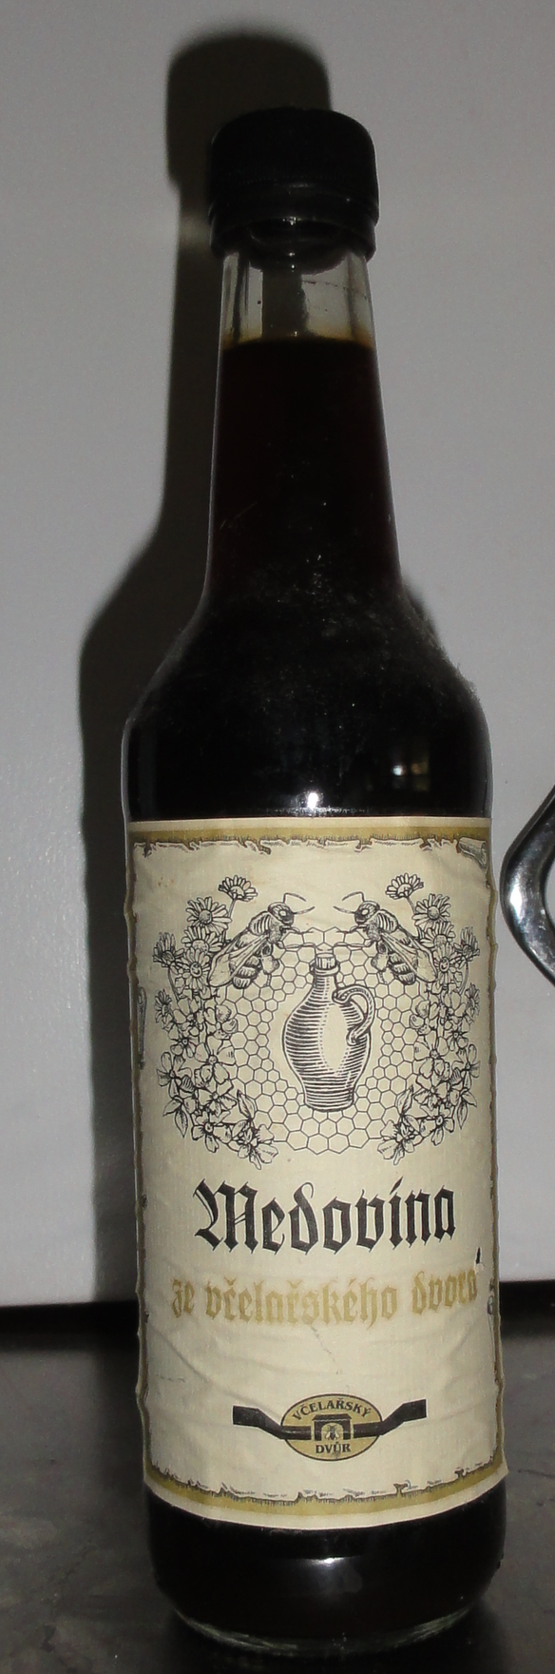
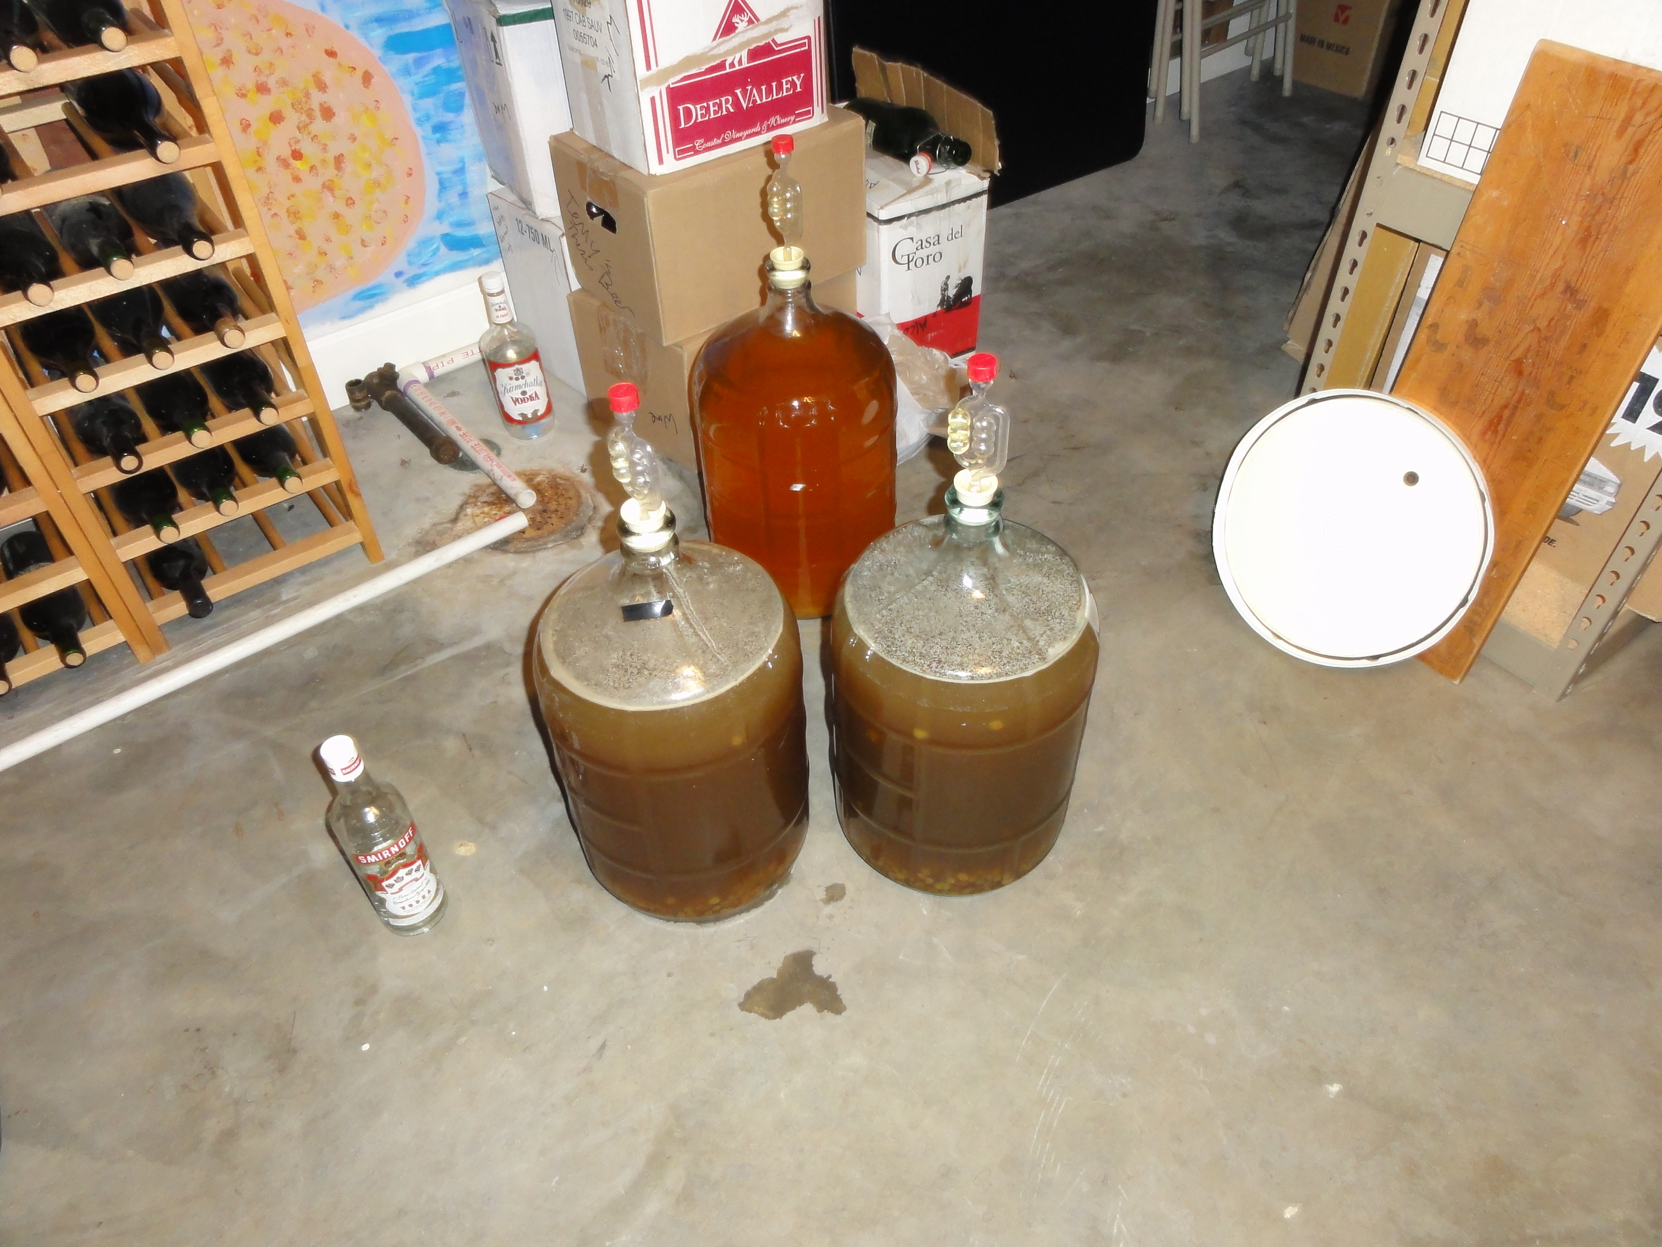
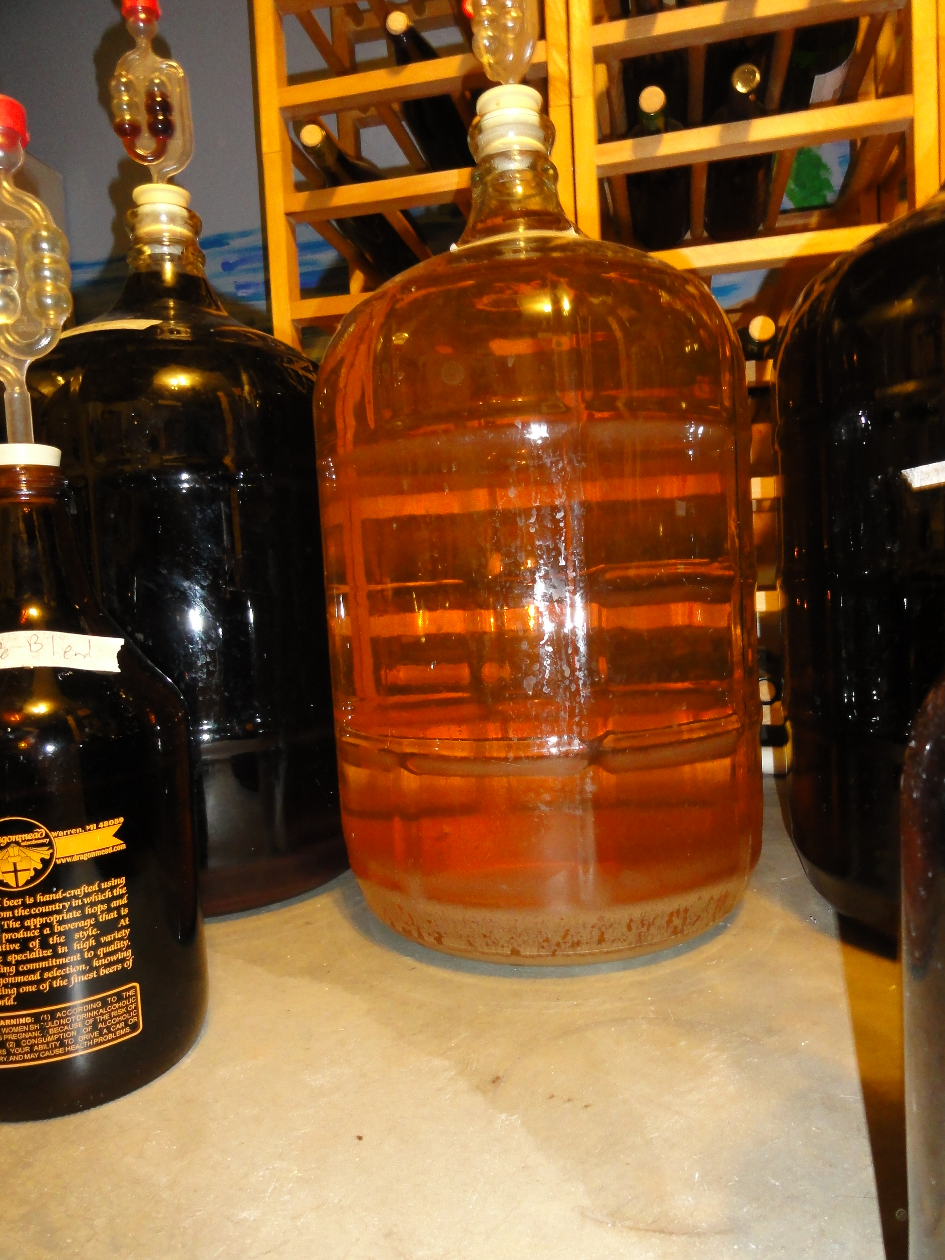
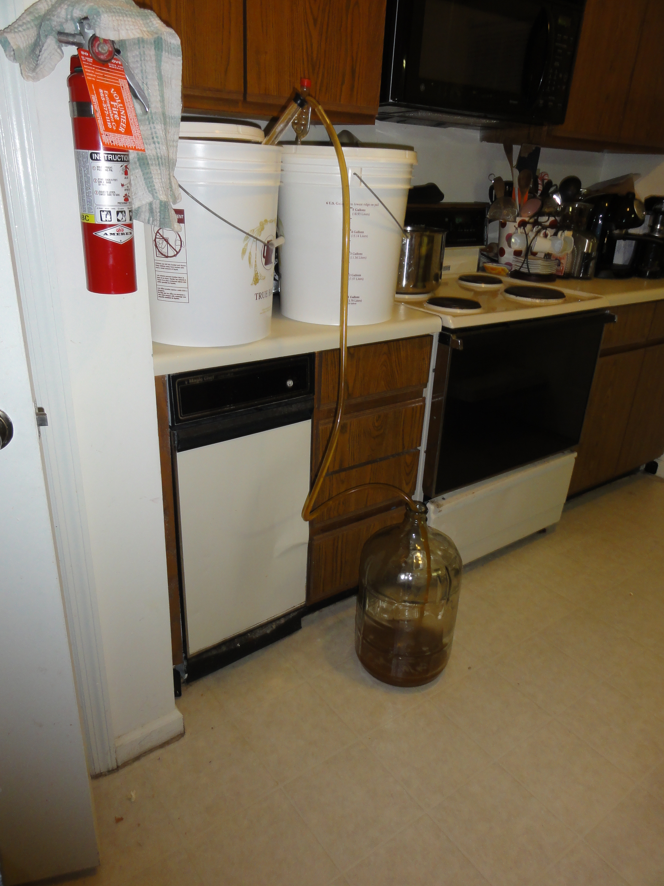
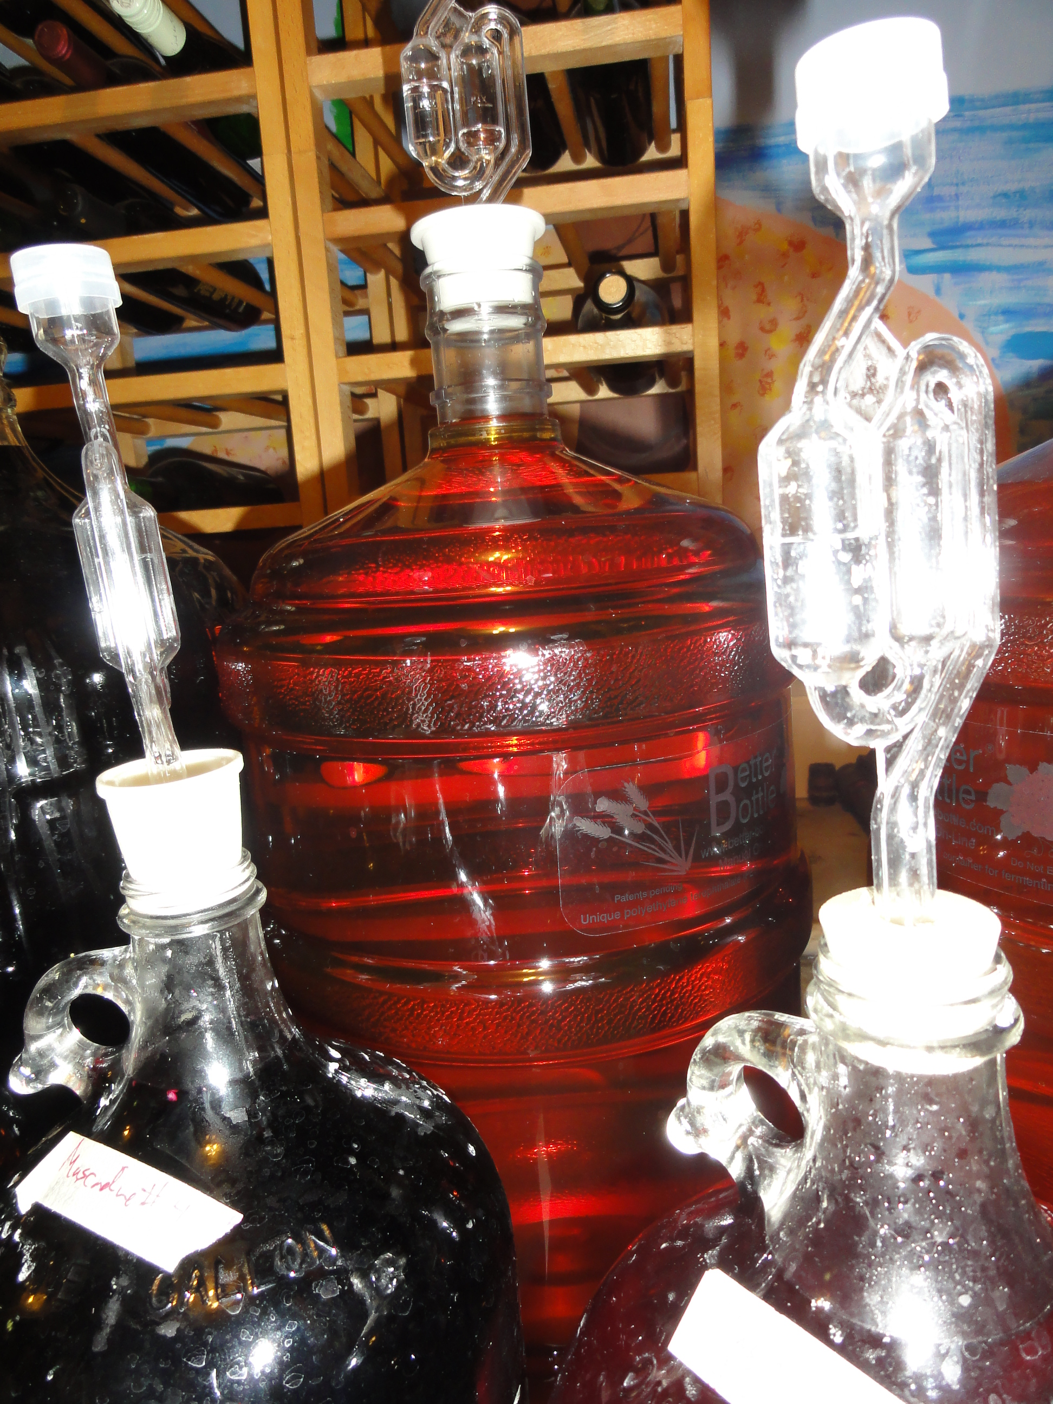
Making Mead
(honey wine)
Christine Nattrass
This work is licensed under the Creative Commons Attribution-NonCommercial-ShareAlike 3.0 Unported License. To view a copy of this license, visit http://creativecommons.org/licenses/by-nc-sa/3.0/deed.en_US.

Slide 2
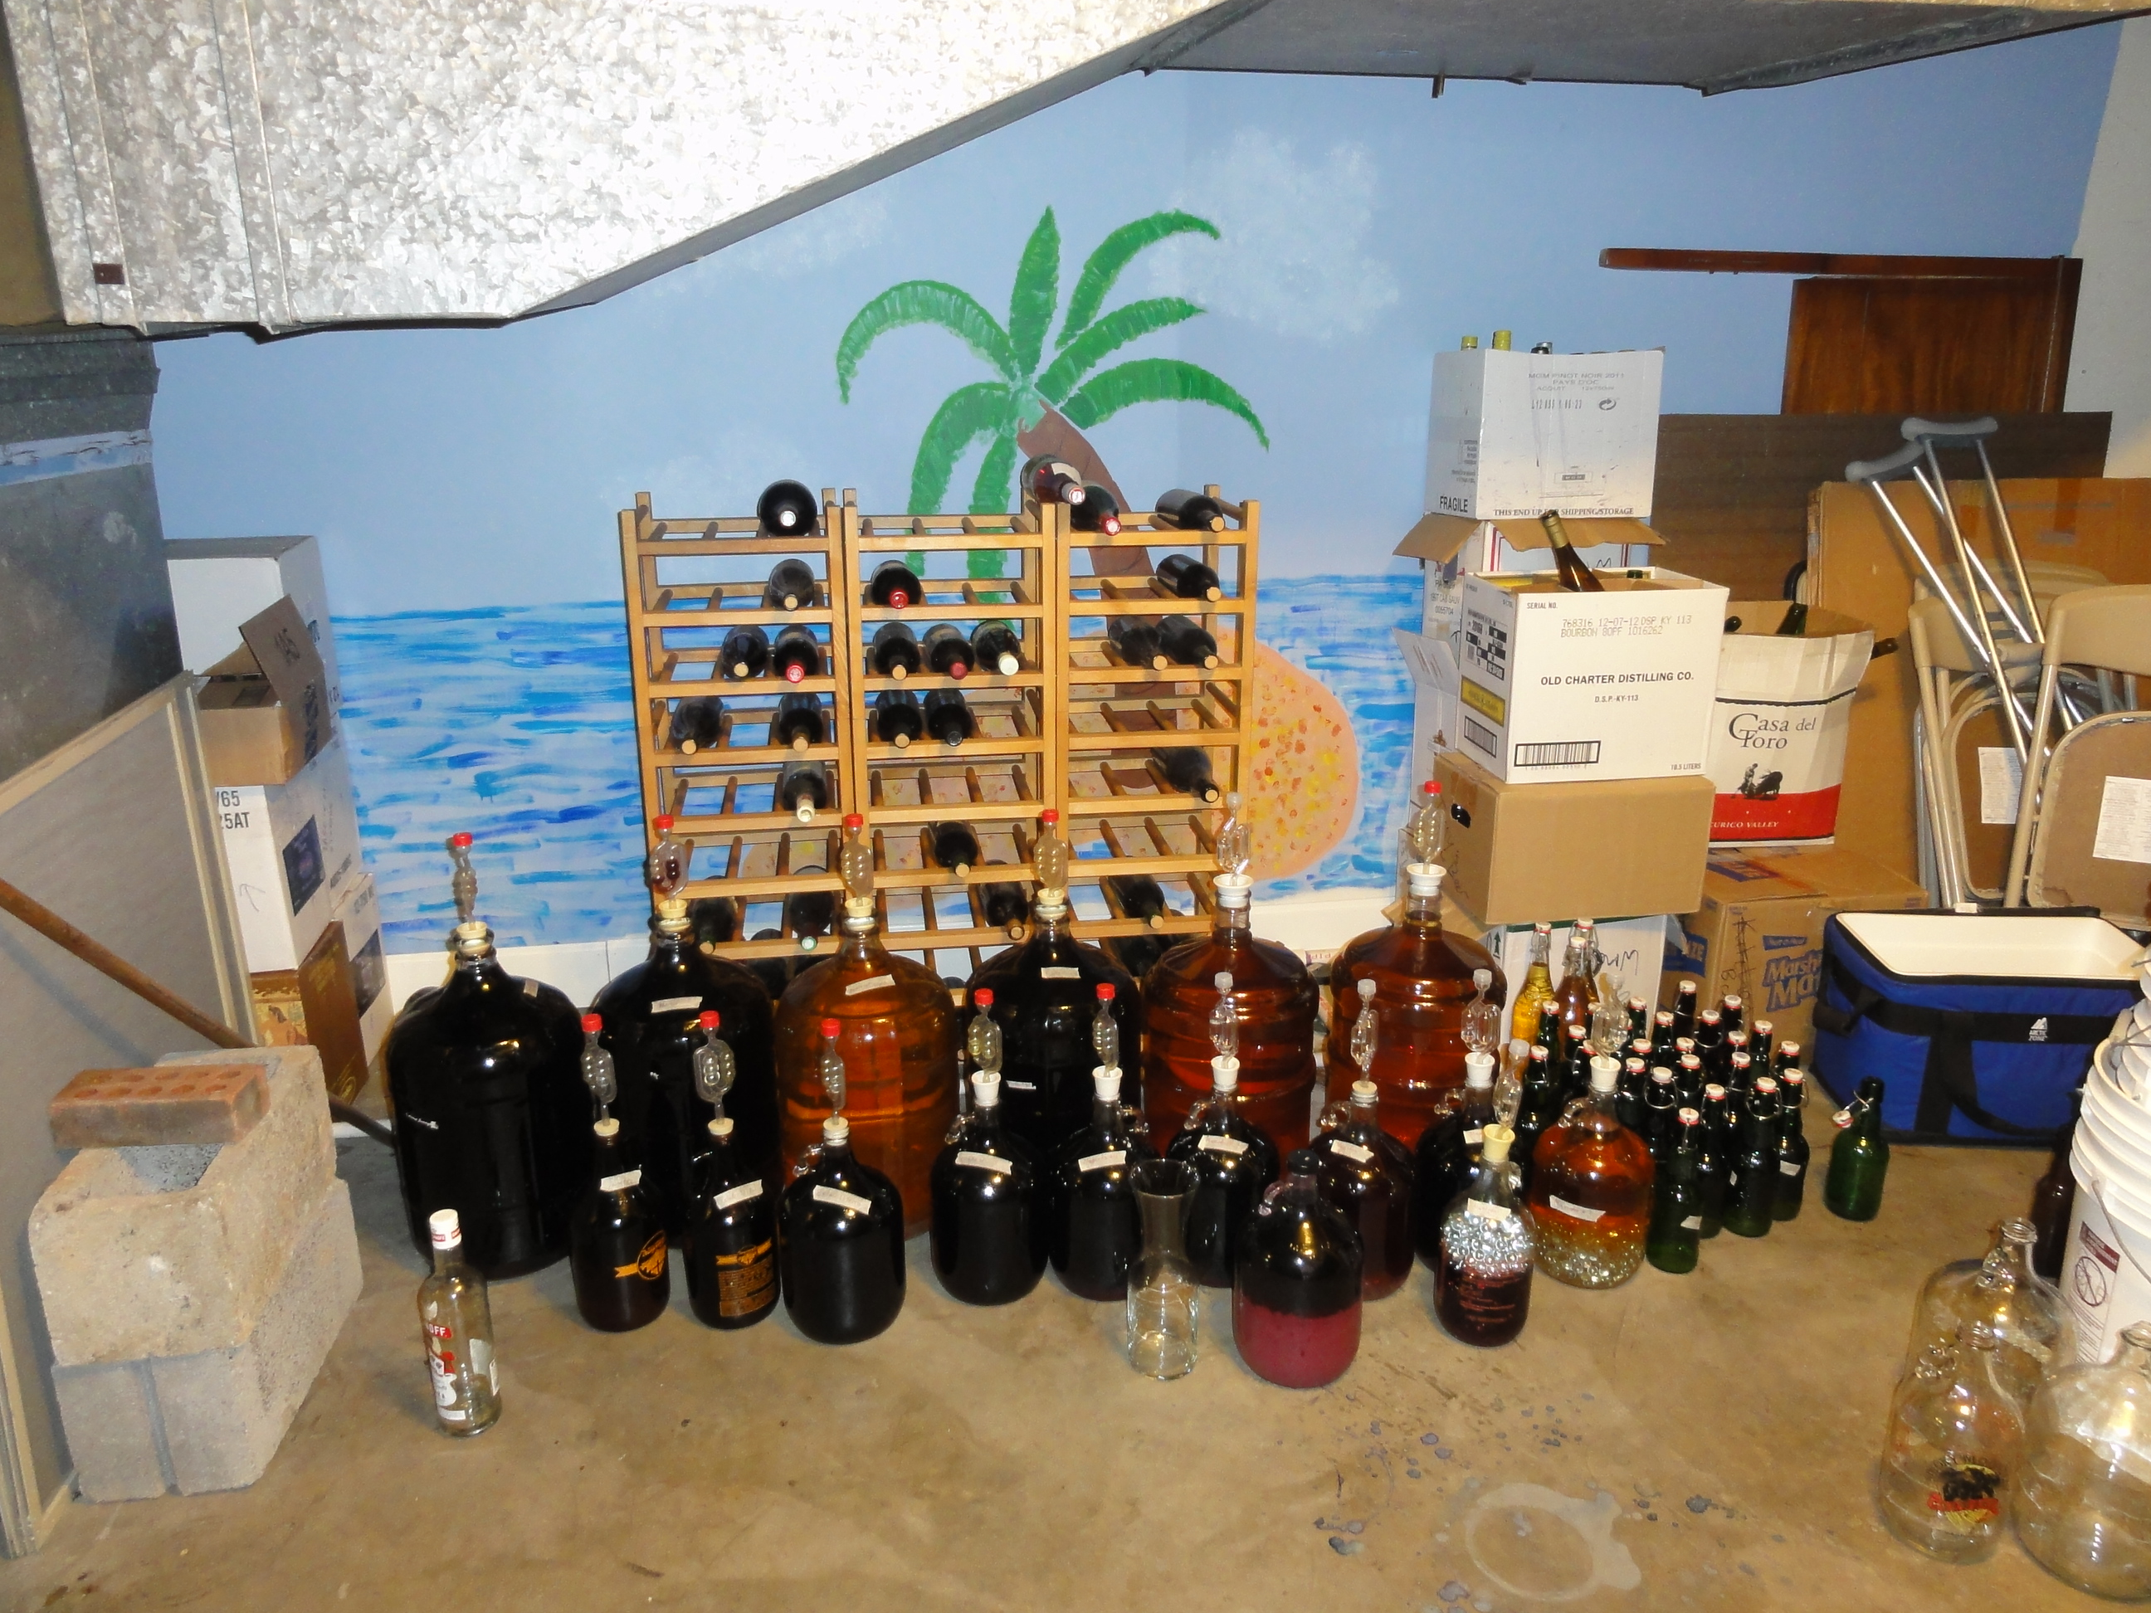
Who am I?
Professional physicist, but... bachelors degree in biochemistry.
Have brewed: beer, wine (starting from grapes!), mead, fruit wine, and cider
Am currently brewing: mead, cabernet sauvignon, petite sirah, merlot, sauvignon blanc, 4 different muscadine wines
Cider
Vitis vinifera wine
Muscadine wine
Mead

Slide 3
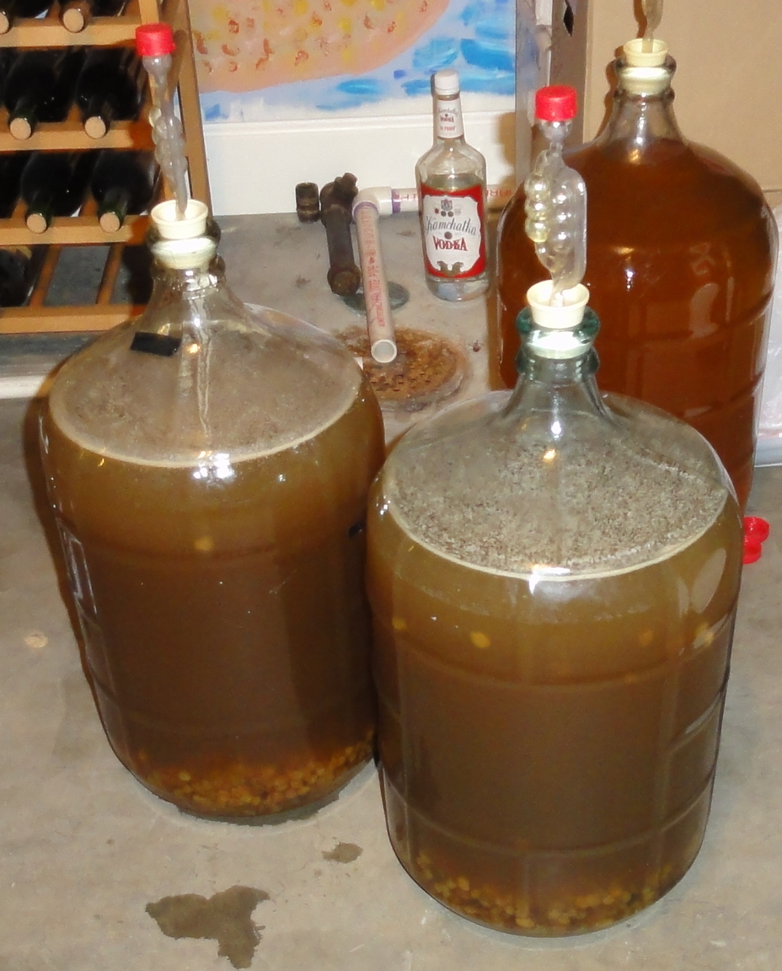
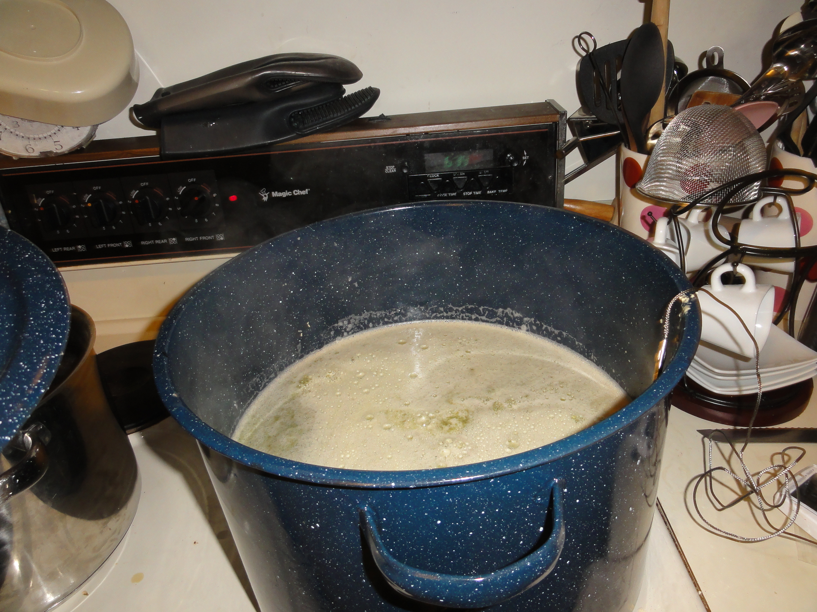
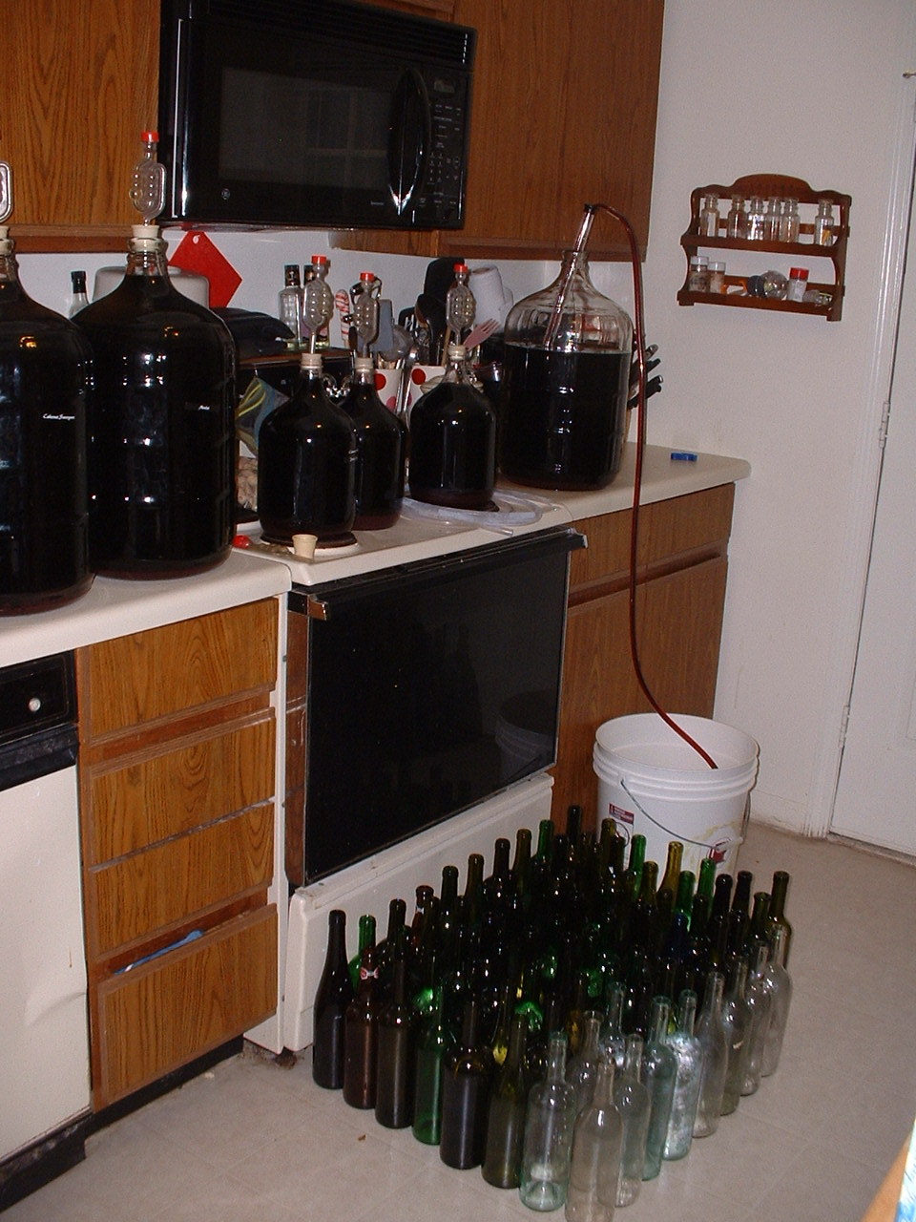
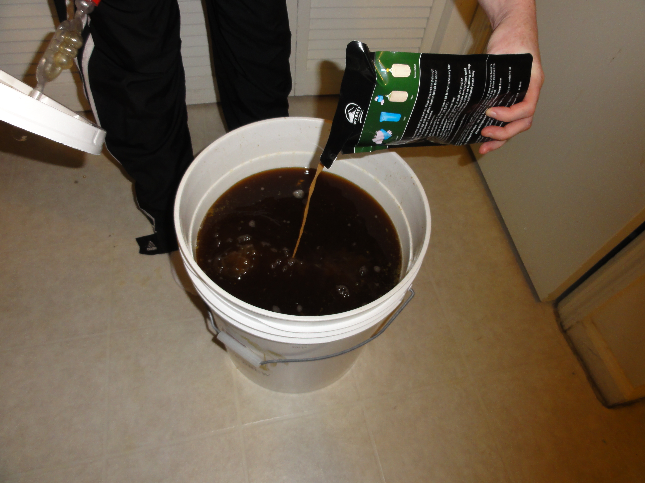
The process
Dissolve honey in water
  Sterilize
  Add nutrients
  Let cool/rest
Add yeast
Primary fermentation
Secondary fermentation
Bottling

Slide 4
Supply stores
Fermentation Station
http://www.fermentstation.com/
8817 Kingston Pike
(865) 694-7993
Allen Biermakens
4111 Martin Mill Pike
(865) 577-2430
www.maltose.com

Slide 5
The recipe

Slide 6
My recipe
4 pounds of honey/gallon
2 boxes Sun Maid white raisins/5 gallons
Heat to ~160ºF for 45 minutes.
Let cool.
Inoculate with Lalvin EC-1118 yeast and use carboy for primary fermentation
Rack in ~1 month and 2-3 times over the next year
Bottle ~1 year after starting

Slide 7
How much honey?
4 lbs/gallon is a lot. This makes a very strong mead. Initially the honey won't even all dissolve in the water. There will be some residual sugar.
2 lbs/gallon is weak enough that the alcohol content might not get high enough for it to store well. A wine needs to get to ~12.5% to keep contaminants from growing well and this is a little too low for many honeys.
  Should work better for making vinegar – it will ferment faster. BUT keep your vinegar far away from your wine making supplies.
3 lbs/gallon should be sufficient.
Exact flavor and final alcohol content depends on the honey and the yeast!
You can try to adjust the specific gravity to what it should be according to wine books/ the web but beware – honey is not pure sugar and the calculations can be off.

Slide 8
Adding nutrients
Grapes and apples are the only fruits with all of the essential nutrients to grow yeast. To make mead, you need to add something that will give the yeast nutrients or else your mead will ferment v e r y s l o w l y.
Two choices:
  Grapes/raisins
    Any type of grape will do, but this will affect the color and flavor of the mead.
    If you use fresh/frozen grapes with seeds, you need to limit the contact with the must to no more than 2 weeks.
    Beware any product which may have been (chemically) pasturized! It will prevent your must from fermenting!
  Yeast nutrient
    Available at a brewing supply store

Slide 9
Sterilizing the must
When you start with any natural product, there is a chance it contains yeast or bacteria which could contaminate the must.
For that reason when you start any fermentation you sterilize the must.
Three main methods:
  Boil/heat – some people think this destroys at least some of the flavors in the honey.
  Sulfites – sold as Campden tablets, typically 1/gallon but read the package! Sulfite concentration will decrease with time.
  Sorbate – if you do this you have to shake your must vigorously for 15 minutes before introducing yeast.

Slide 10
Melomels
Honey + fruit wine
If you do this, consider adding pectic enzyme. Must must be cool. This will break down the cell walls of the fruit and allow more juice out. This is most important with berries.
You can sterilize fruit by just pouring boiling water over it. This could be your hot honey/water solution.
You still need yeast nutrients.
If you sterilize your must with sulfites, wait 12 hours before adding pectic enzyme.
Wait 12 hours after adding pectic enzyme before adding yeast.

Slide 11
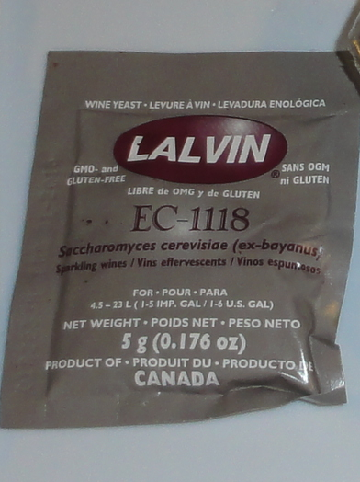
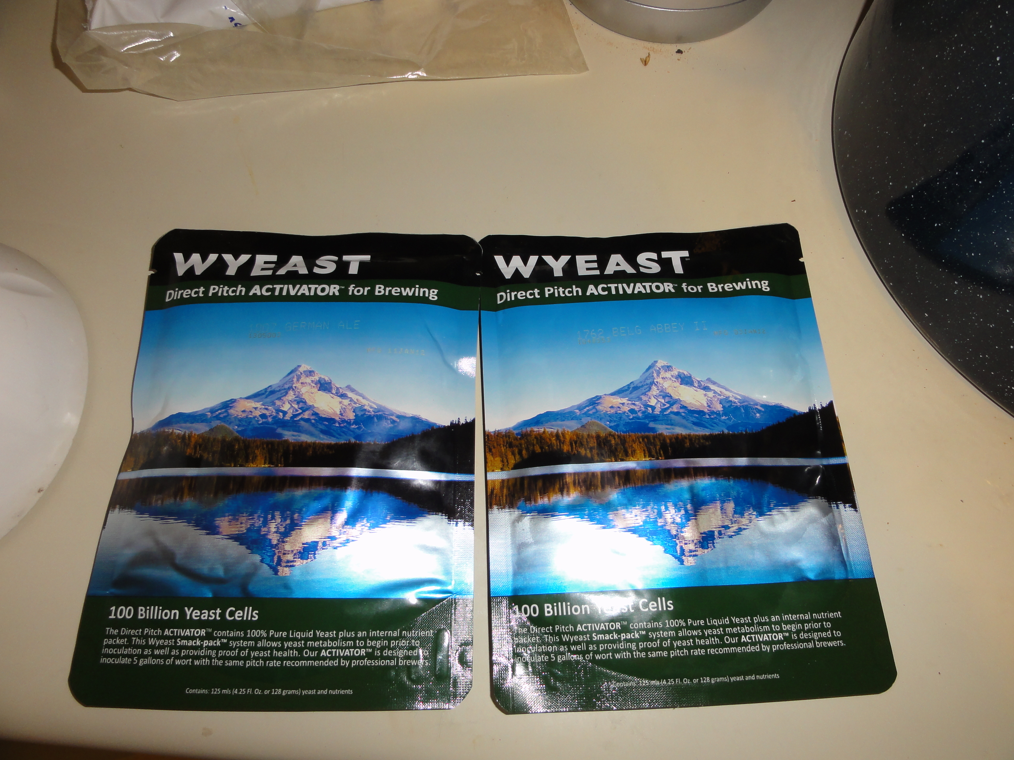
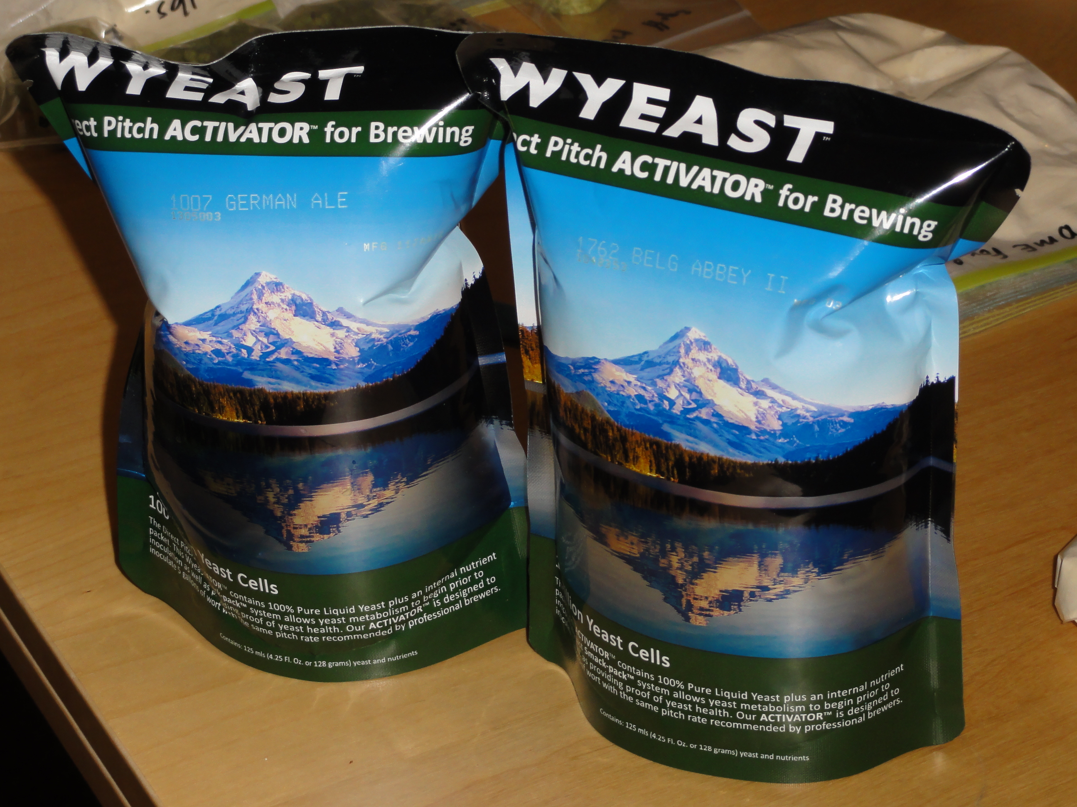
Which yeast?
After trying a few different yeasts, my favorite is Lalvin EC-1118.
  Champagne yeast with alcohol tolerance of ~18%
  Will dry out the must
    This means no popped corks!
  Ferments well in just about anything, including the difficult environment of mead.
Any wine yeast should work
Dry vs liquid
  I've tried both. The strain is what matters. Dry is cheaper, easier to store and less likely to fail so I've mostly moved over to dry.

Slide 12
How to stop the fermentation
Wait until the yeast runs out of sugar
  Beware of yeasts other than Lalvin EC-1118, especially with high honey concentrations. They could just ferment very slowly and then later you have popped corks.
Add alcohol
  Fortified wines like brandy
Add pressure
  Champagne
  Not really practical for home brewers
Add chemicals
  Sorbate – prevents yeast's ability to reproduce. Add after fermentation finished and wine racked and before bottling.
  Usually added with sulfates to keep bacteria from growing too.
  I never do this but just let the fermentation stop naturally and bottle it like that.

Slide 13
How long should it take?
4 lbs/gallon of honey takes about 1 year to ferment with Lalvin EC-1118
Less honey → faster fermentation
Ways to tell it's done:
  Specific gravity stops changing
  No more bubbles coming out of fermentation lock
  Fermentation lock not pressurized
Err on waiting longer since it will not hurt and you will have fewer popped caps.

Slide 14
Bottling
To add or not to add sorbate and/or sulfites? That is the question.
  I never have added them at bottling. I have never had a problem.
Use clean bottles. Sterilize them the way you would sterilize your other equipment. You can buy them or collect them. If you collect them, rinse them out immediately after use.

Slide 15
Your recipe
2-4 pounds of honey/gallon
Grapes or raisins or yeast nutrient
Fruit if desired
Heat/boil or add sulfites and/or sorbate.
Wait until cool (heating) or 12 hours (sulfites)
Inoculate with yeast
Rack in ~1-4 weeks month and 2-3 times before bottling
Bottle no sooner than 6 months after starting
Wait at least 1 year to drink

Slide 16
Sterile technique

Slide 17
Sterile technique
Treat everything as if it is contaminated – any surface not explicitly sterilized (including hands) and the air.
Contact with air can lead to contaminants.
  This is how your mead can accidentally turn to vinegar. If you want to do this on purpose I recommend using a starter culture (mother of vinegar).
  Minimize your equipment and your wine's contact with air.

Slide 18
Methods for sterilizing
Heat – boiling or autoclaving
  Not practical for most equipment for home brewers
Iodine
  For kegs – chlorine-based cleaners can pit the metal
Sulfites
  Only kill bacteria
B-Brite
Bleach
  Add ~1 tsp/gallon, preferably with hot water. Let sit 20 minutes in bleach solution. Let dry for 20 minutes before using.
  CDC method for restaurants. One method we used around the lab for cleaning the counters.
  Scares people at hobby stores. Claims that it can lead to off tastes.
  I've done this all the time and have no problems, BUT have always timed the 20 minute intervals.

Slide 19
BUT...
Fear of contamination keeps a lot of people from brewing.
People have been making beer & wine since before the Germ Theory.
My guideline: If it smells funny, looks funny, or tastes funny, don't drink it. No matter how much it cost to make it.
This guideline has worked well for me so far.

Slide 20
Equipment

Slide 21
Equipment
Mandatory
Food grade fermenting containers with holes for fermentation lock – at least two with at least one with little head space ($25-35)
Fermentation lock (~$1.50), bung (~$2-3)
Siphon (for >= 5 gallon batches) ($5)
Corker or bottle capper ($20) + corks/caps
Bottle brush ($5-8)
Optional
hydrometer – for measuring alcohol content ($8-18)
Auto-start siphon ($13-18)
Bottling tip for siphon ($5)

Slide 22
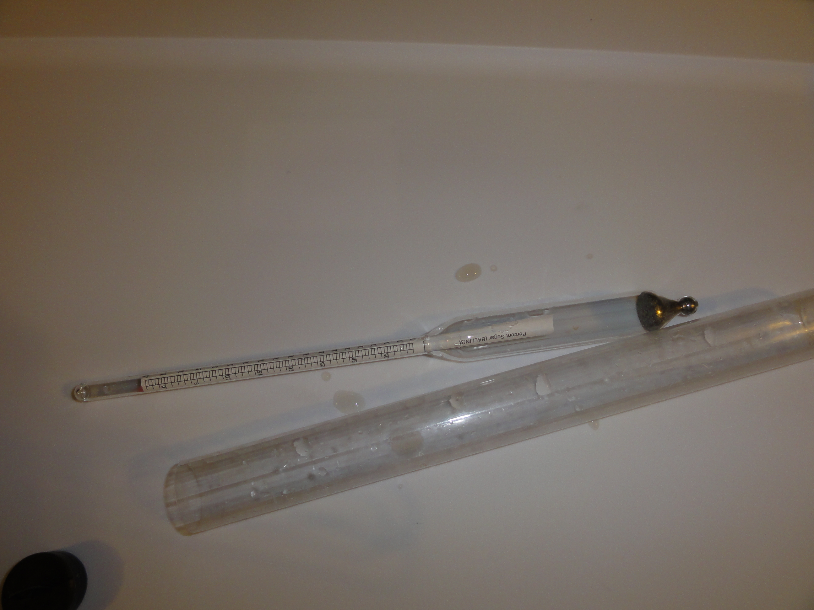
Hydrometer

Slide 23
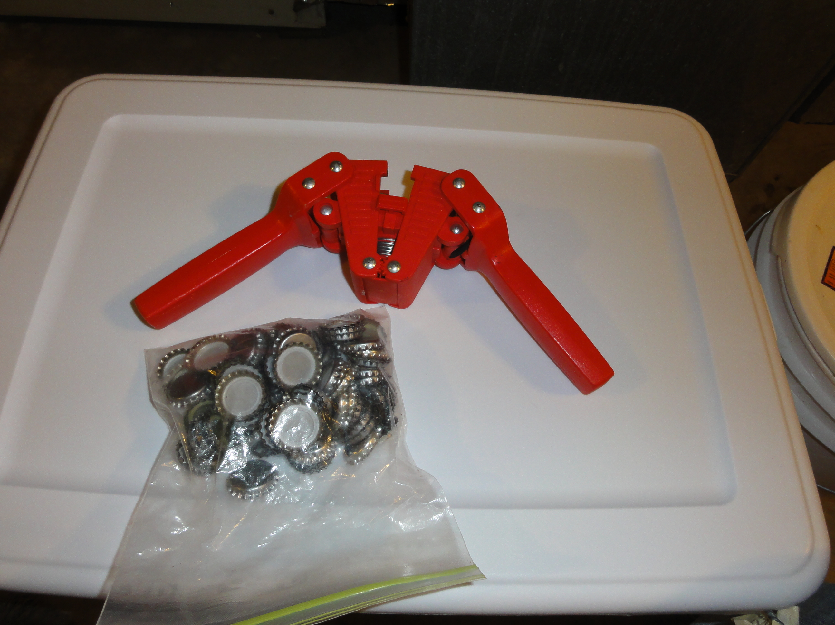
Bottle capper

Slide 24
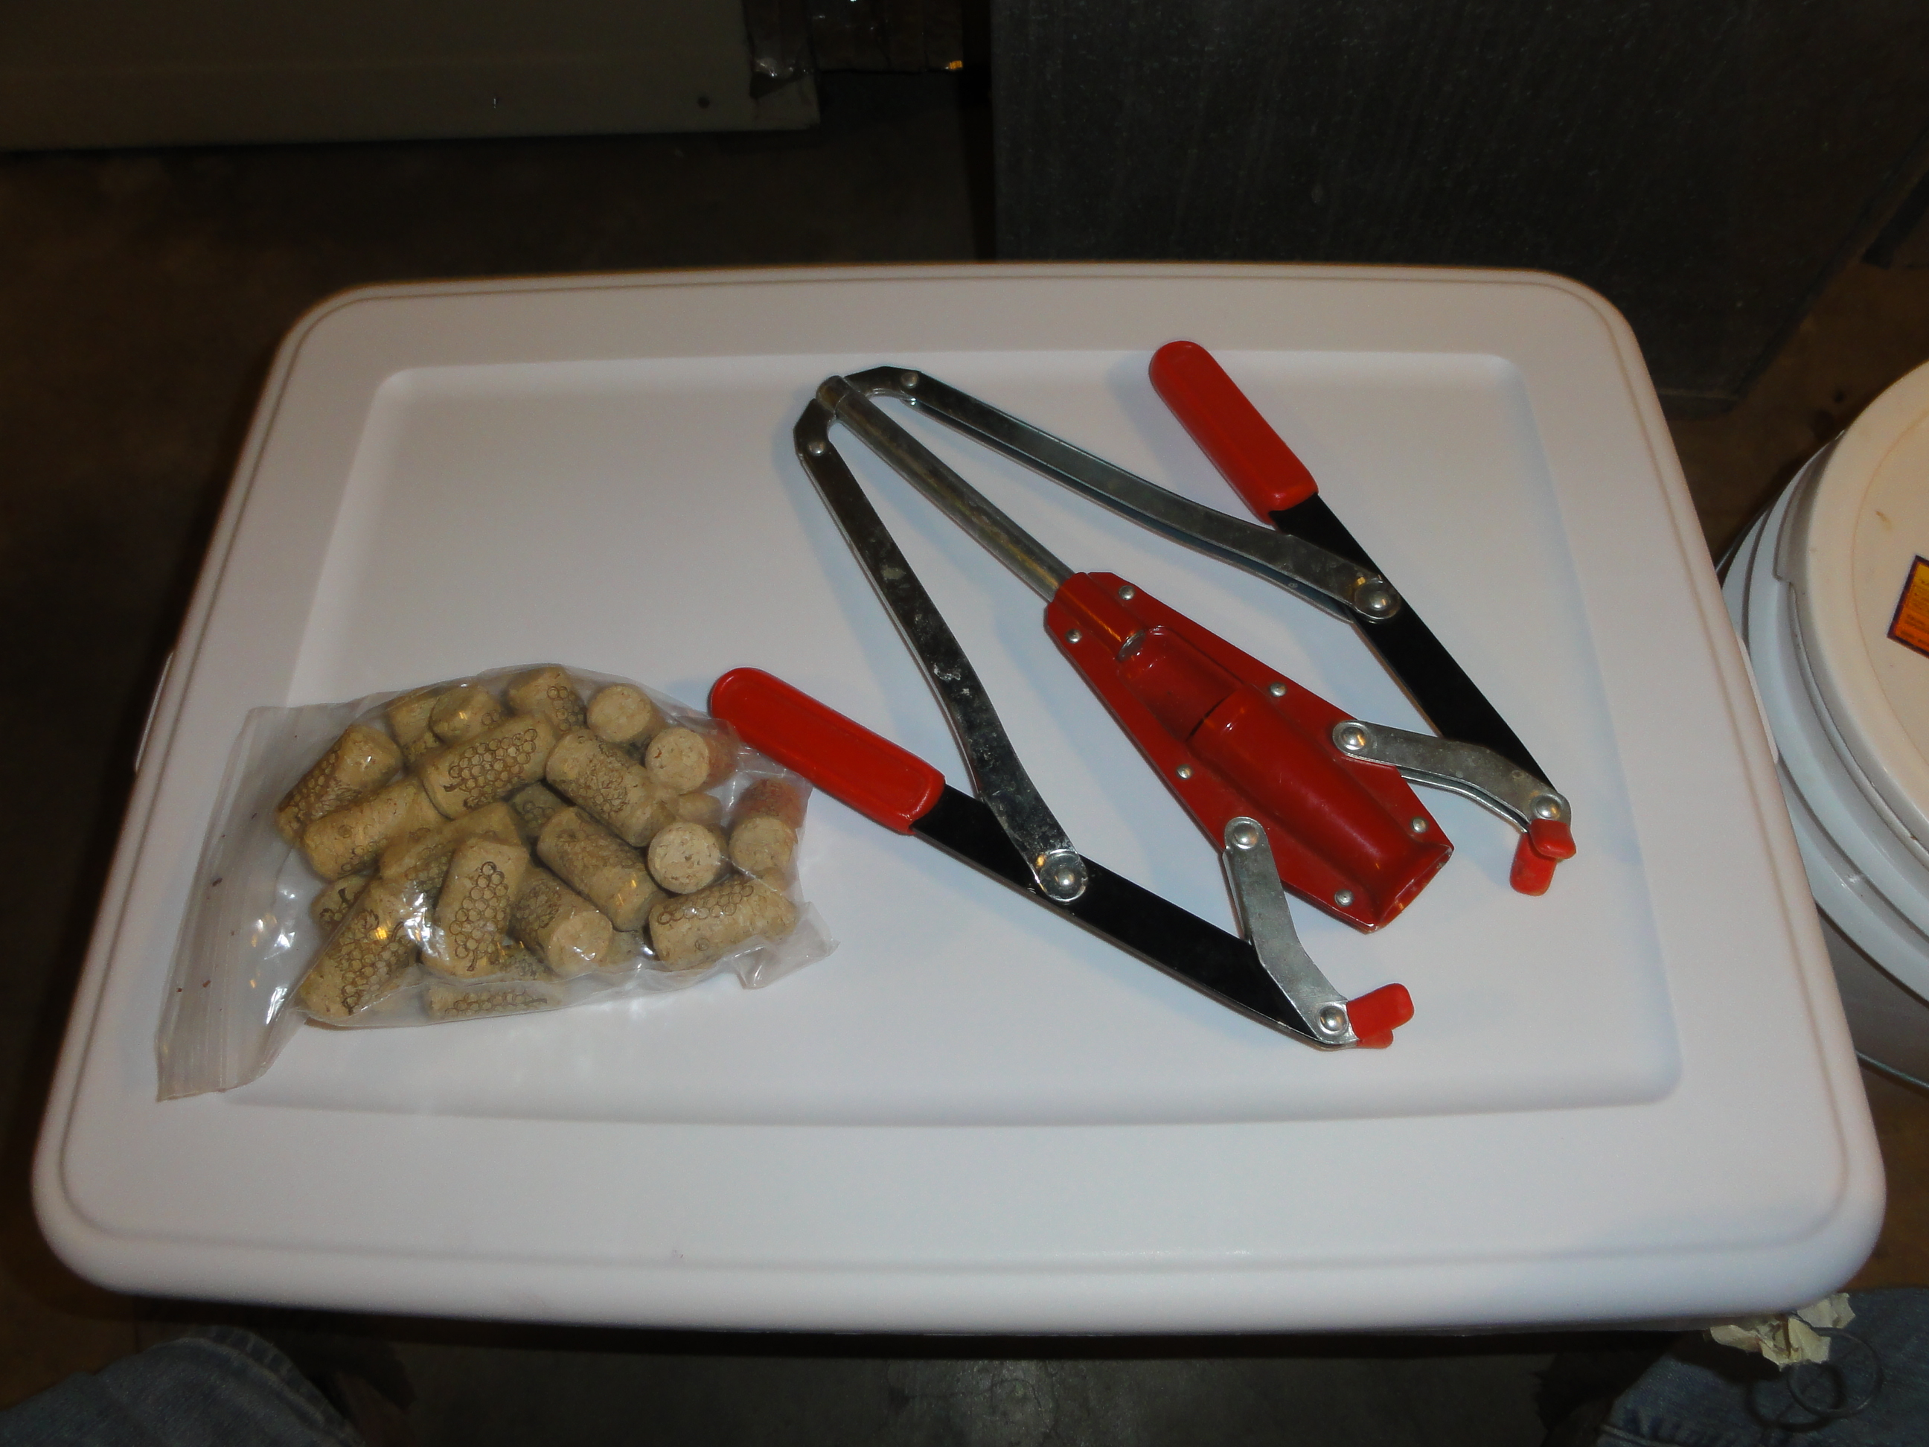
Wine corker

Slide 25
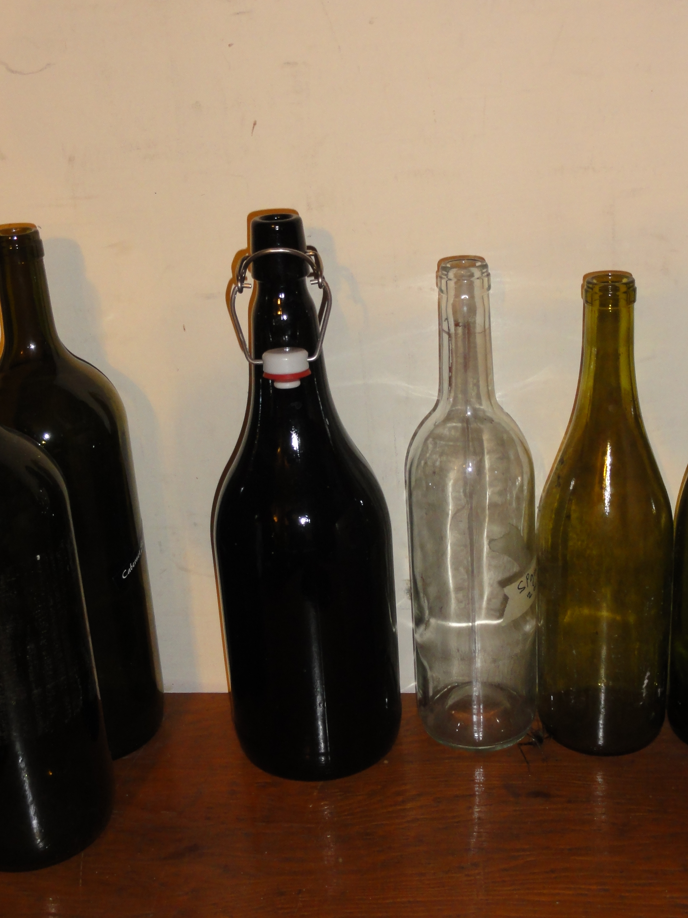
Bottles

Slide 26
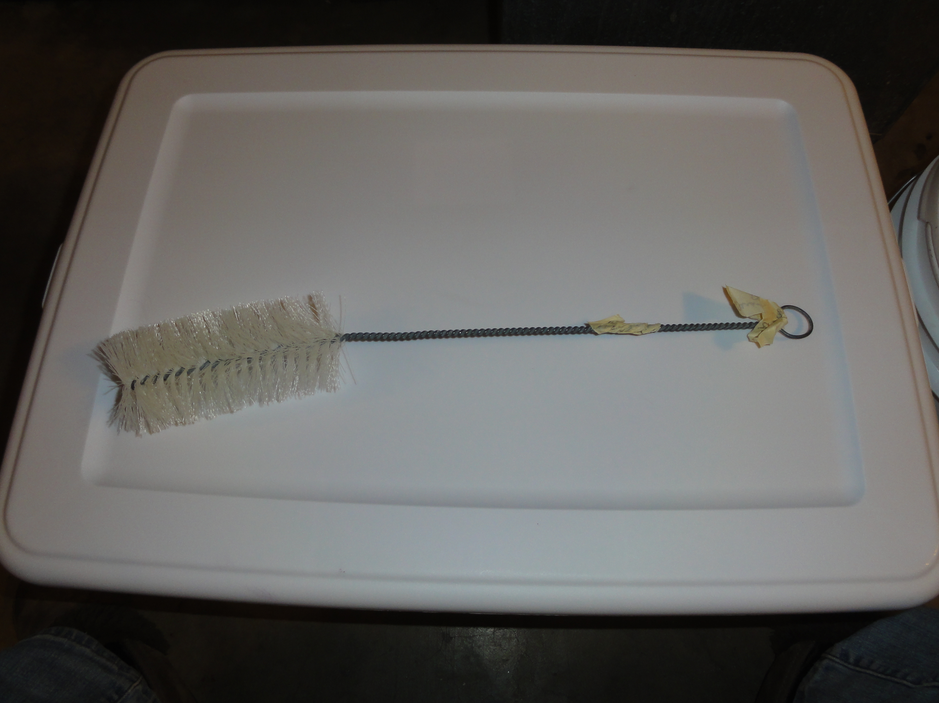
Bottle brush

Slide 27
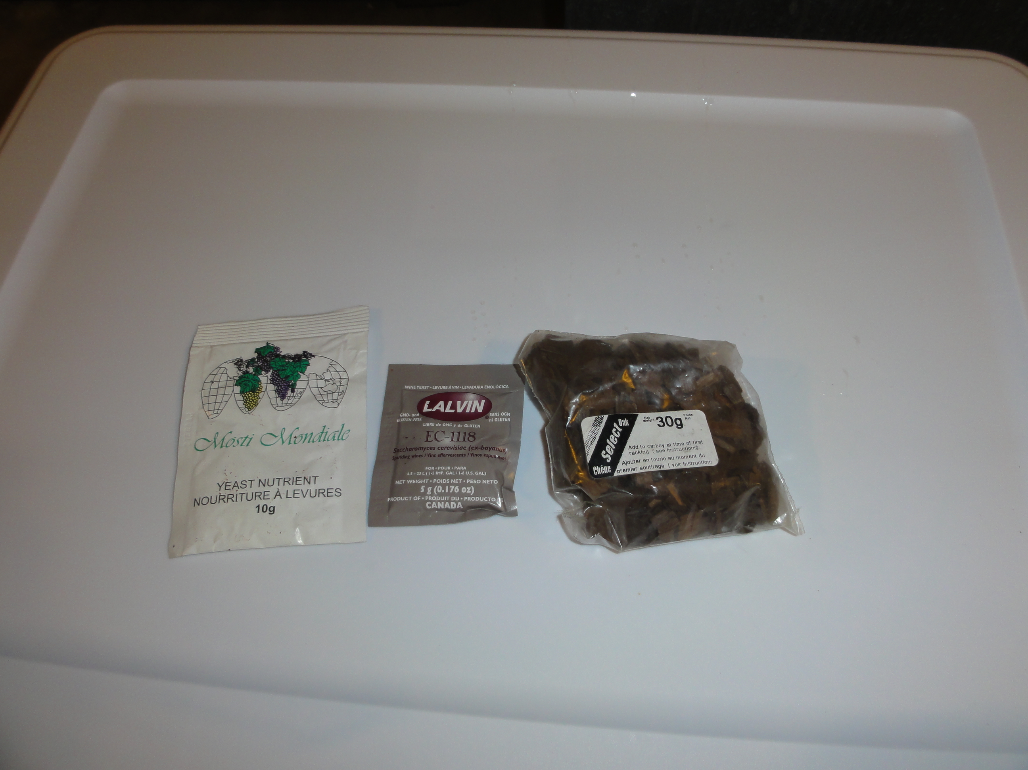
Yeast nutrient, yeast, oak

Slide 28
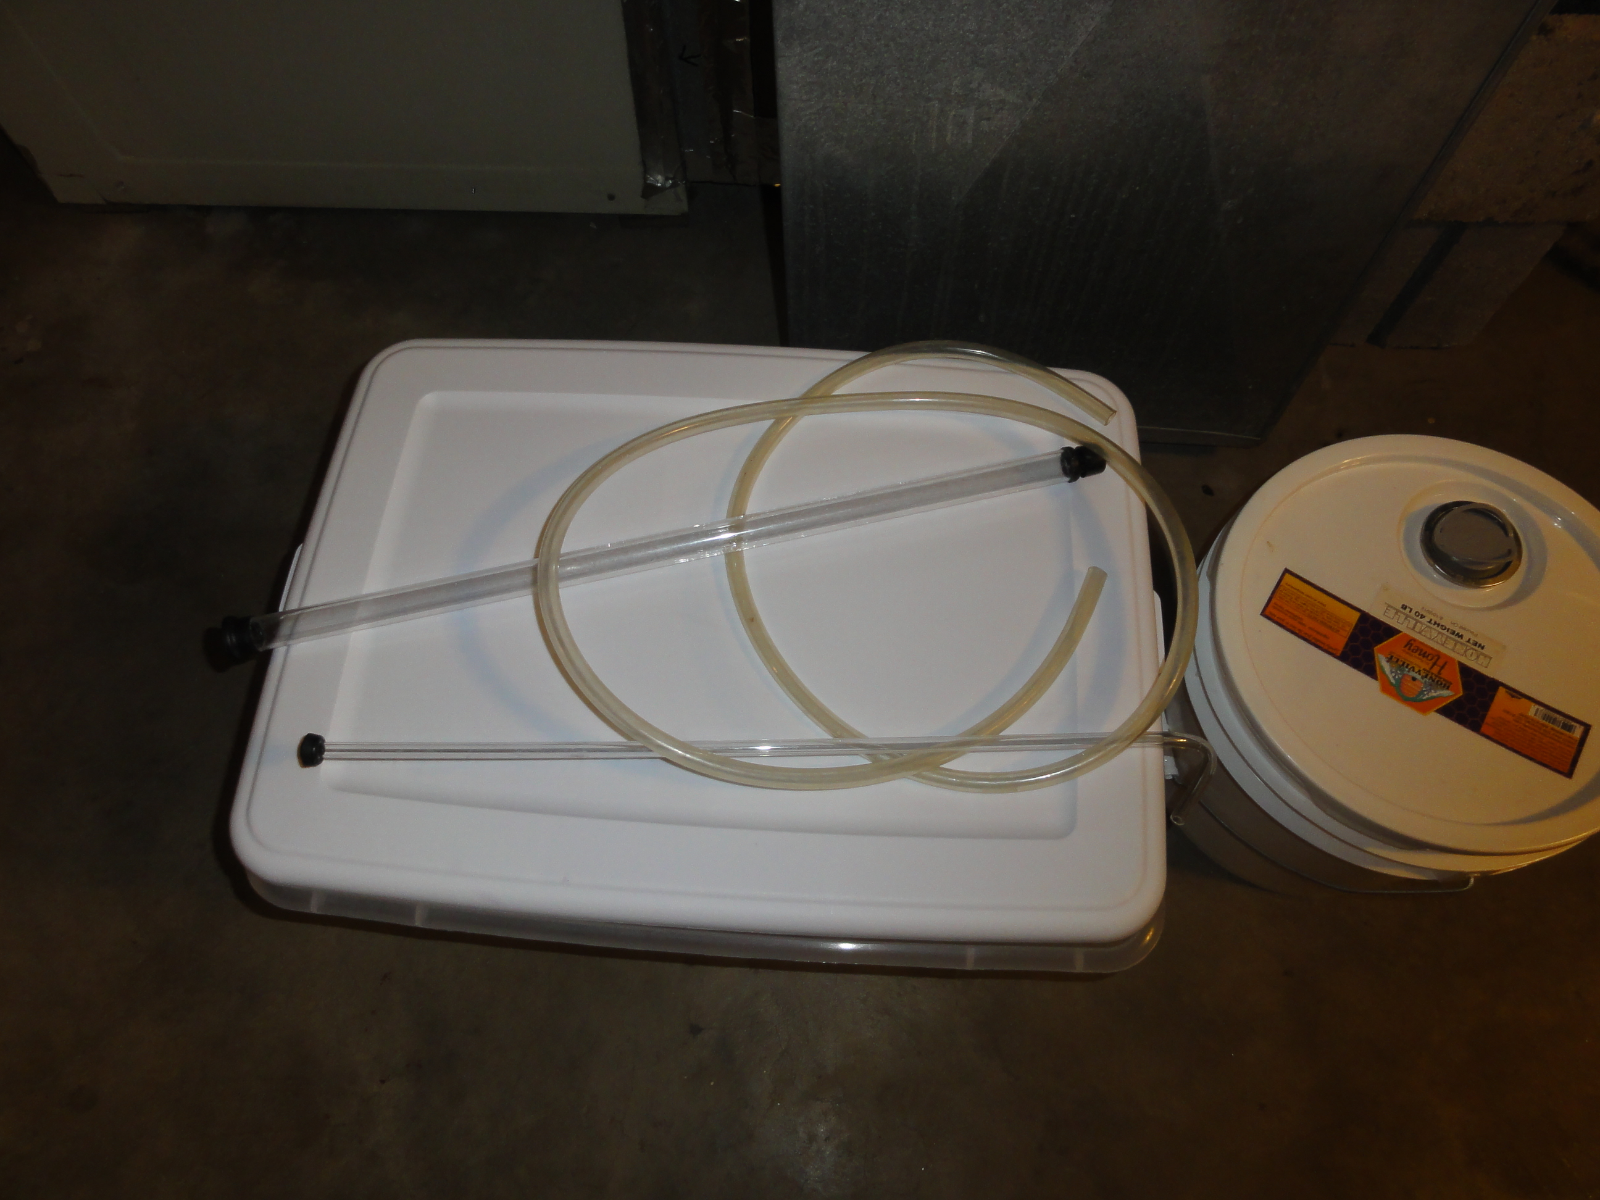
Self-starting siphon

Slide 29
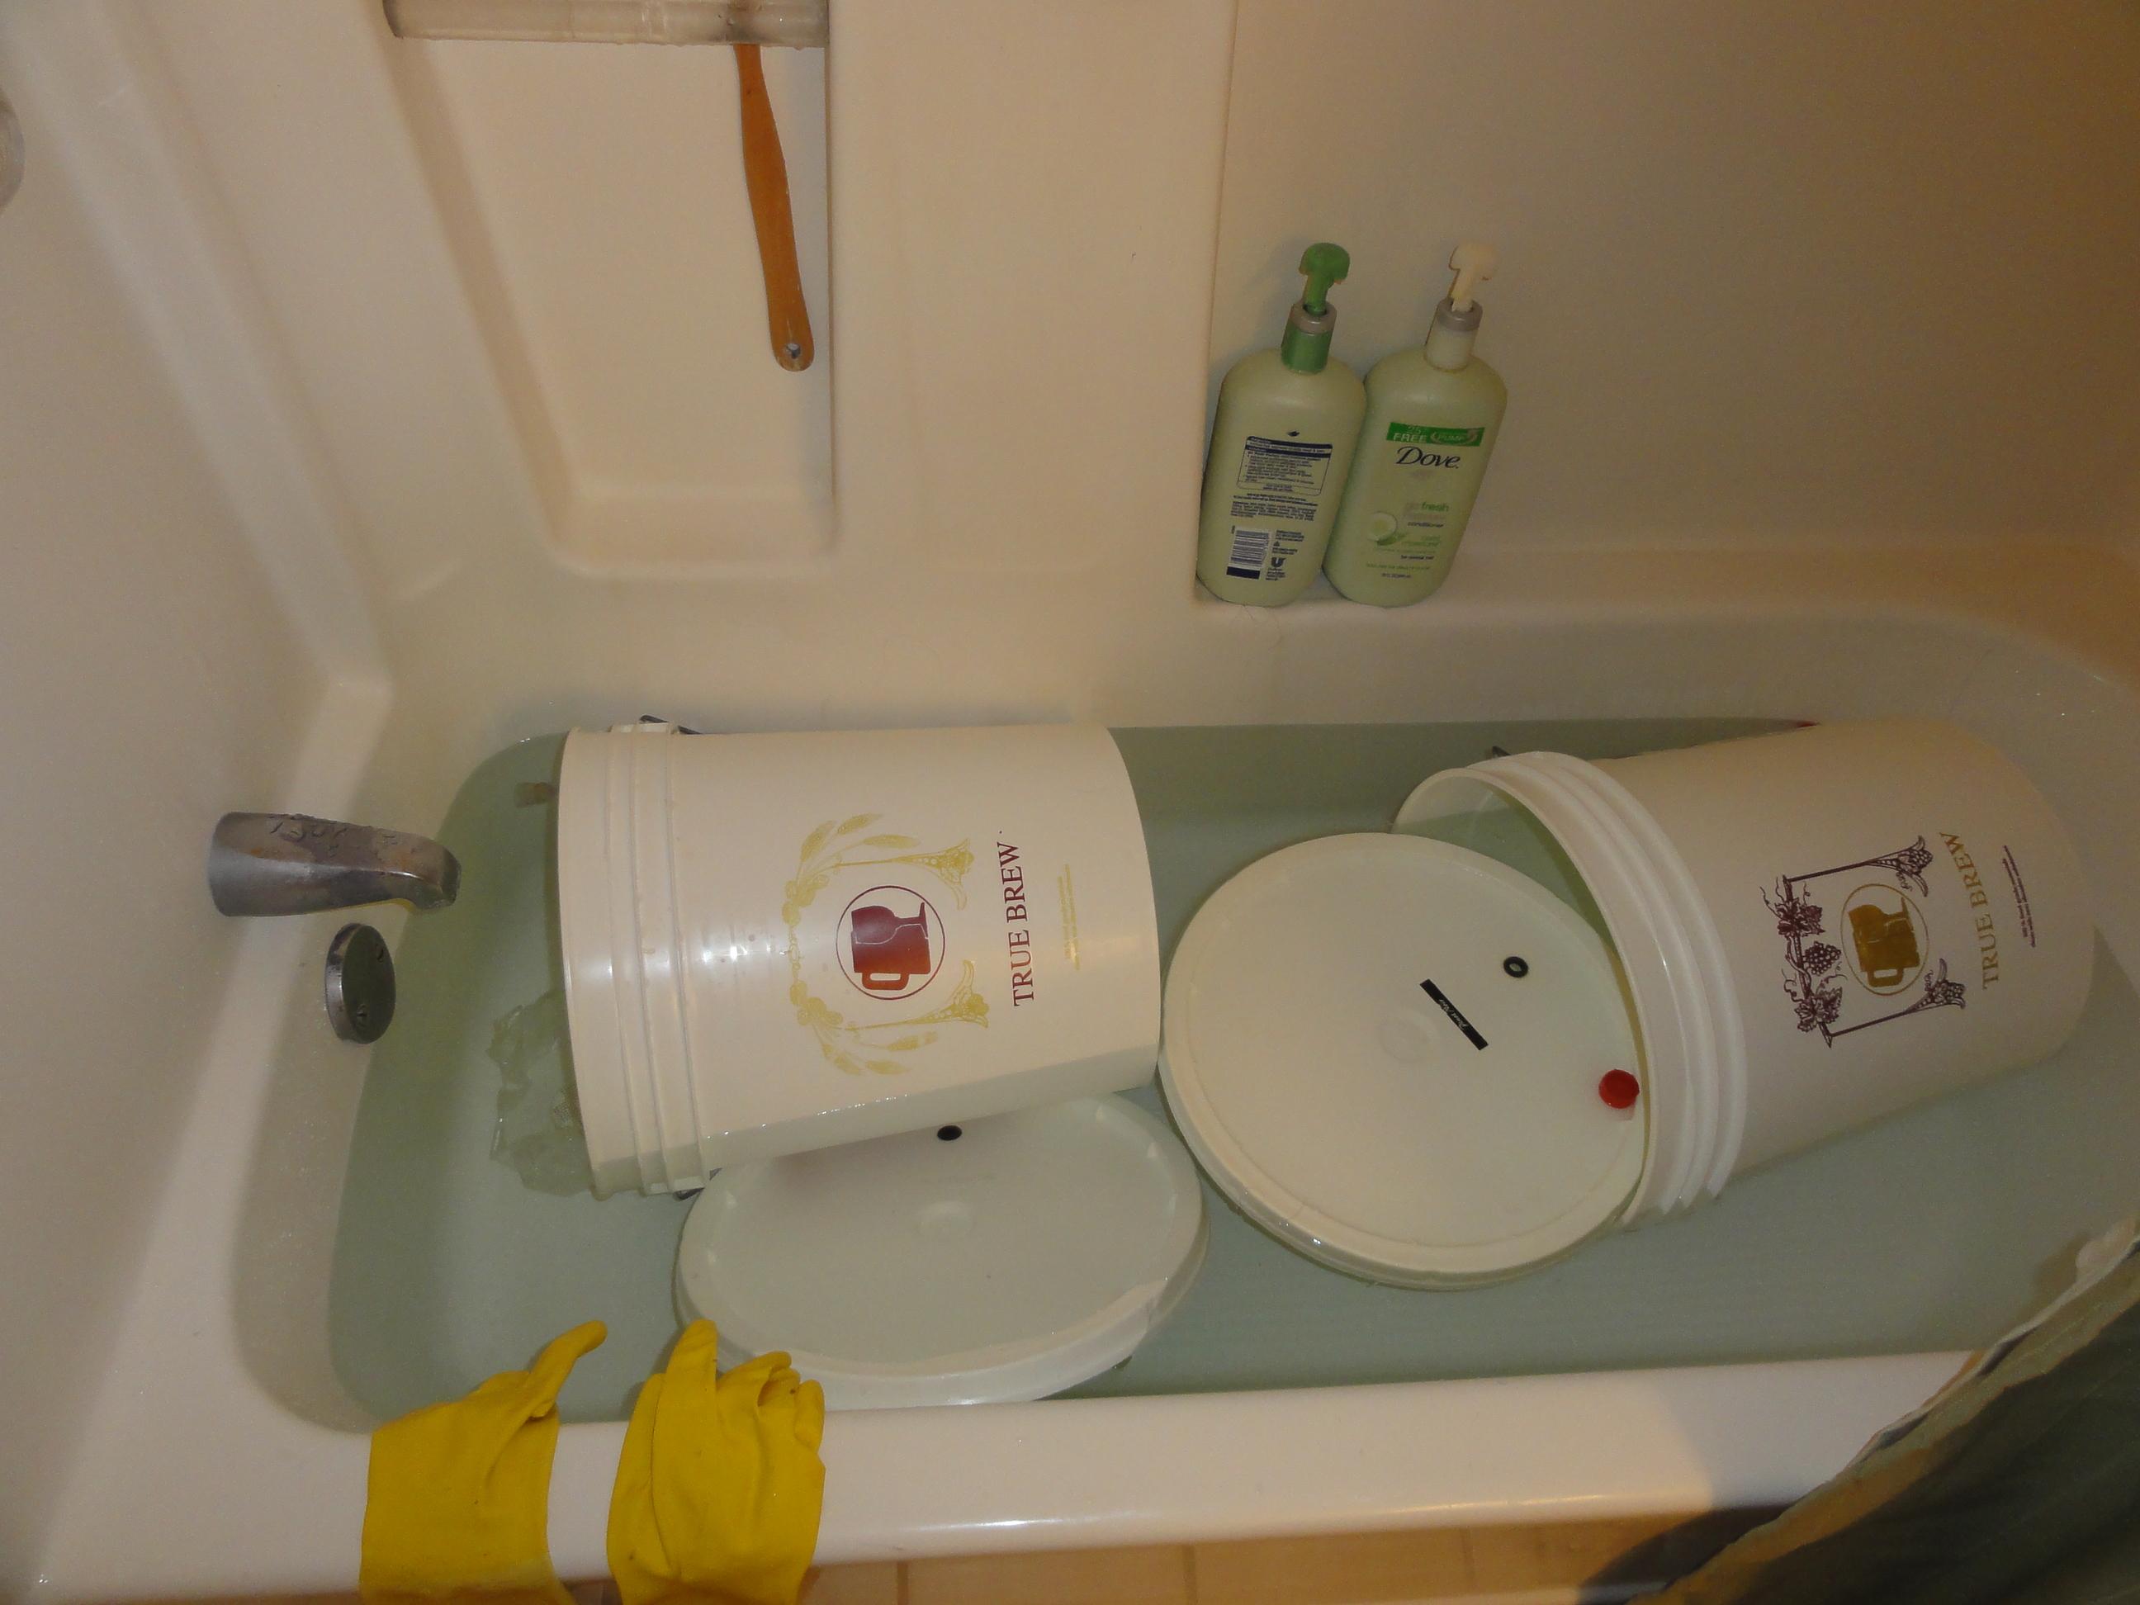
Cleaning equipment

Slide 30
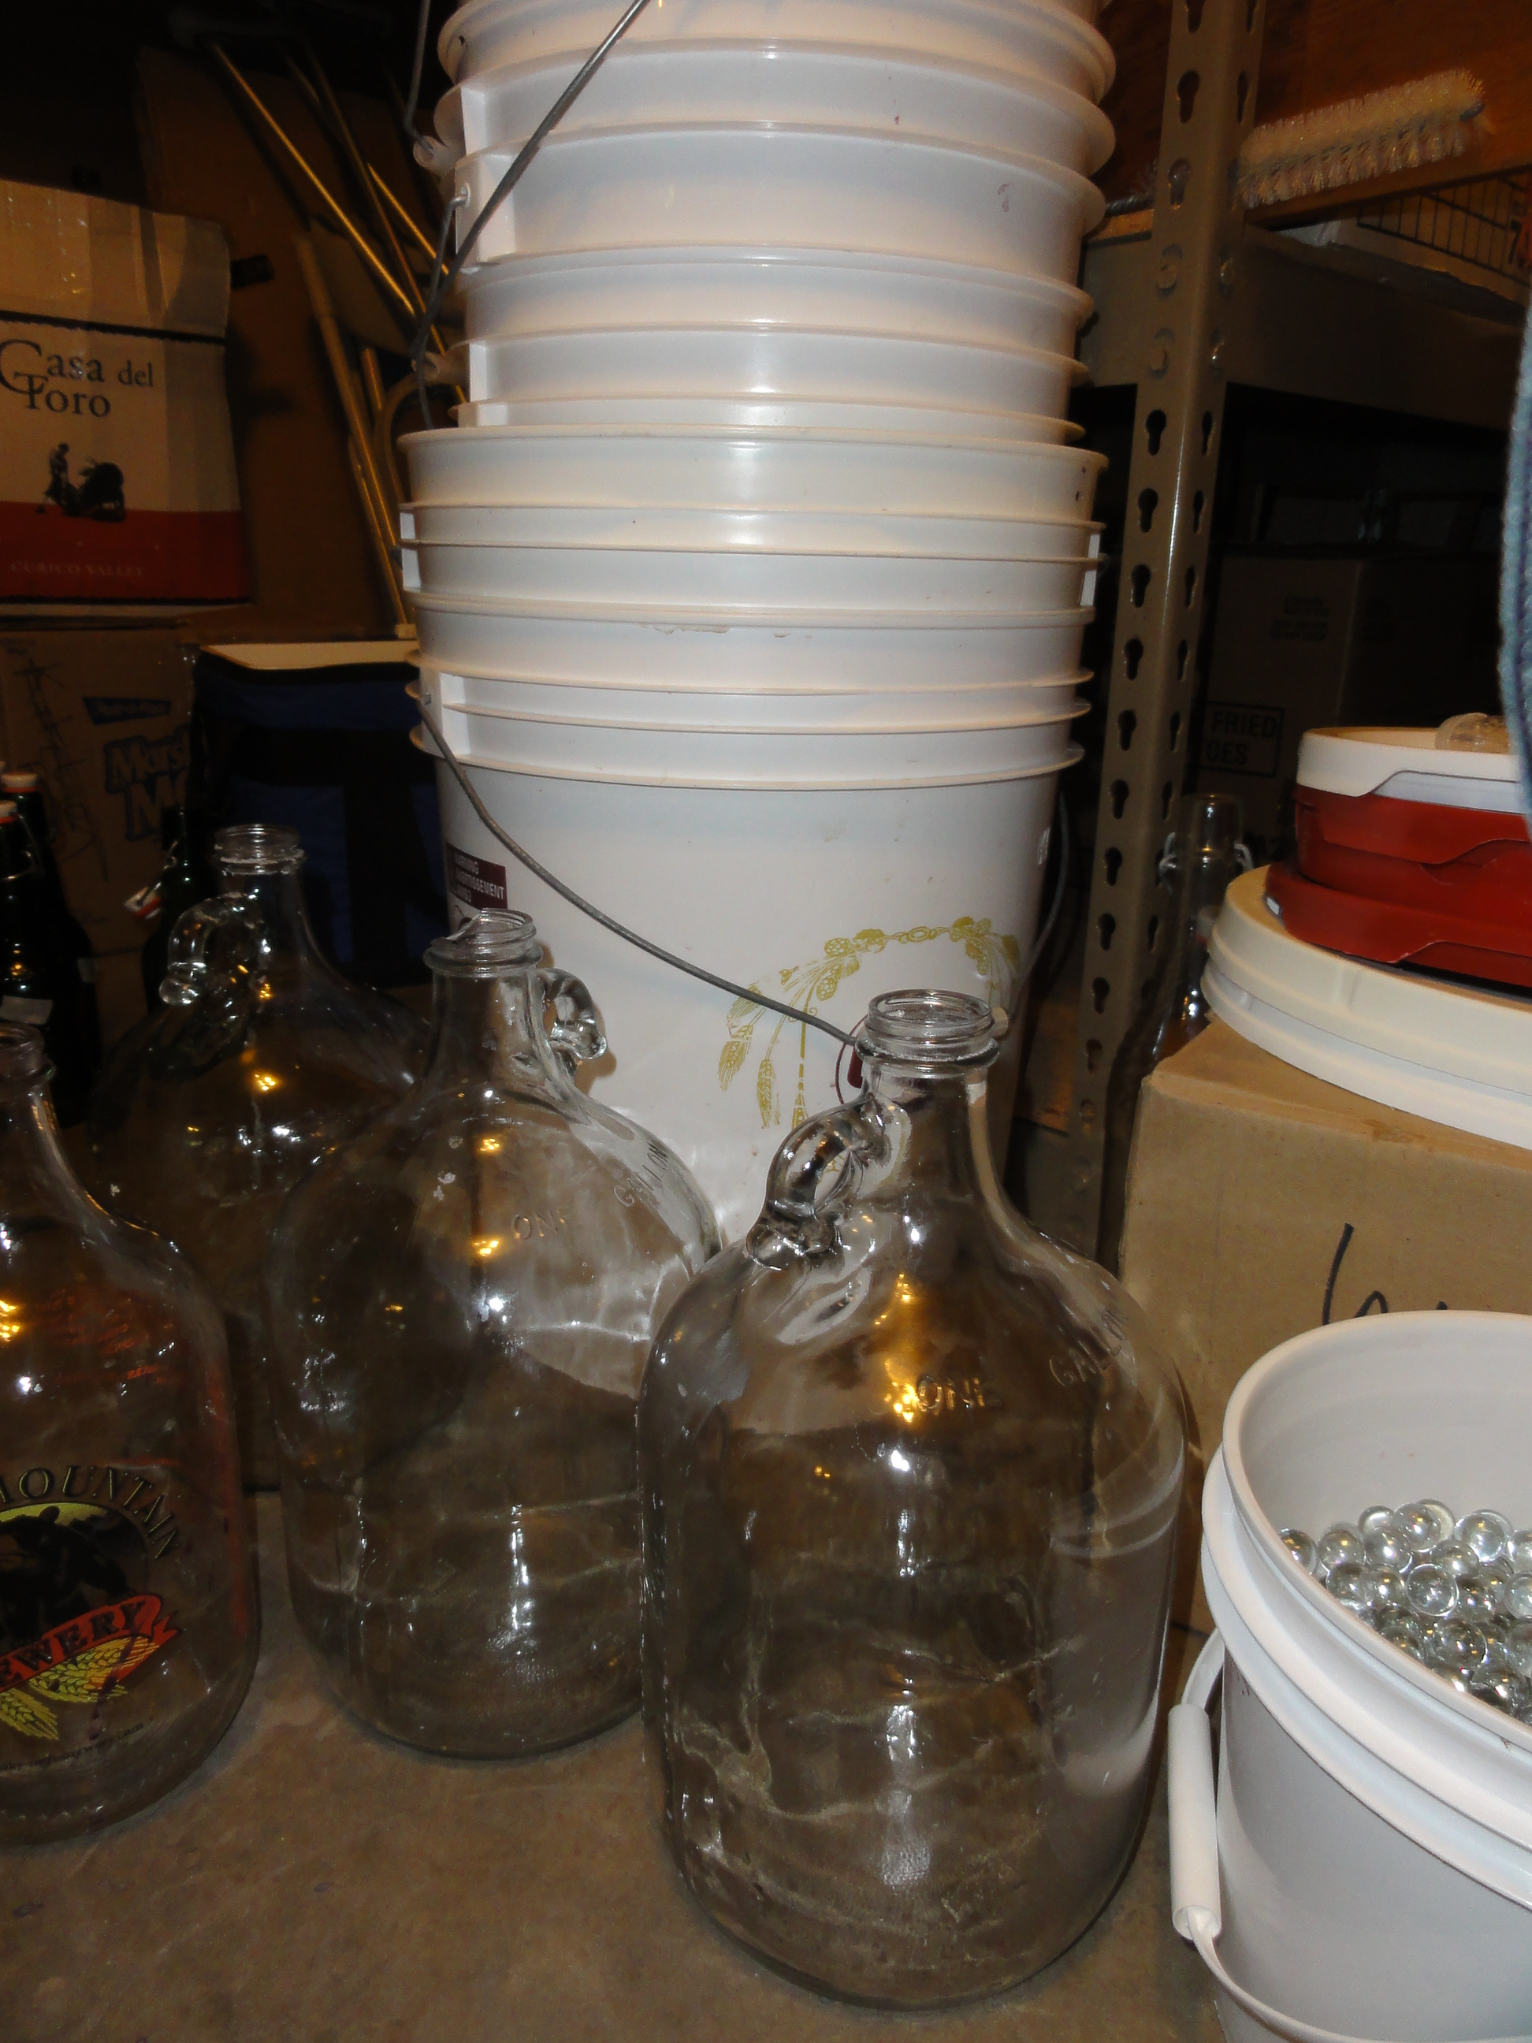
Fermenting buckets
Glass carboys

Slide 31
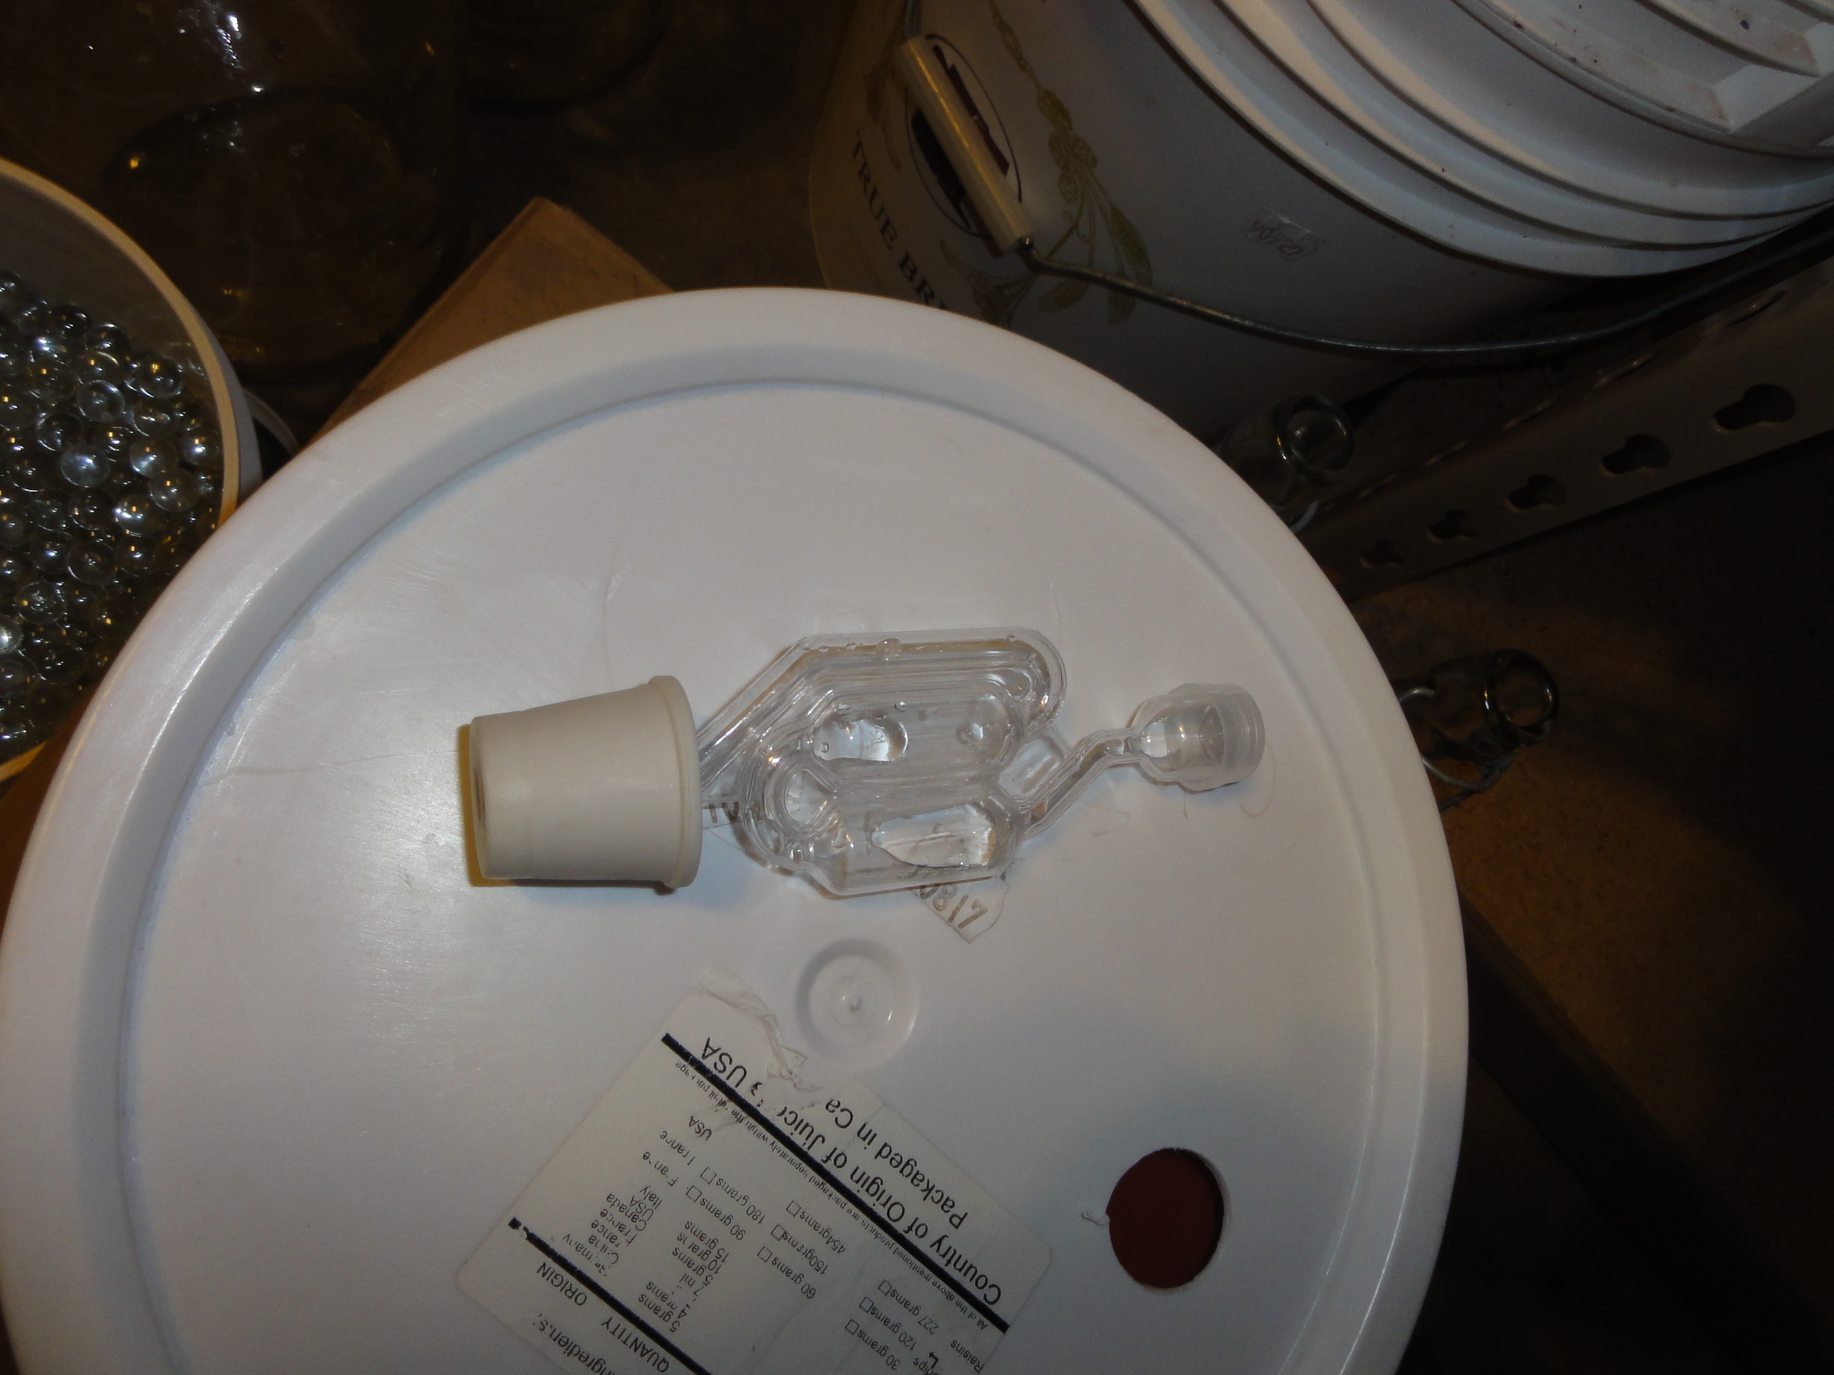
Fermentation lock

Slide 32
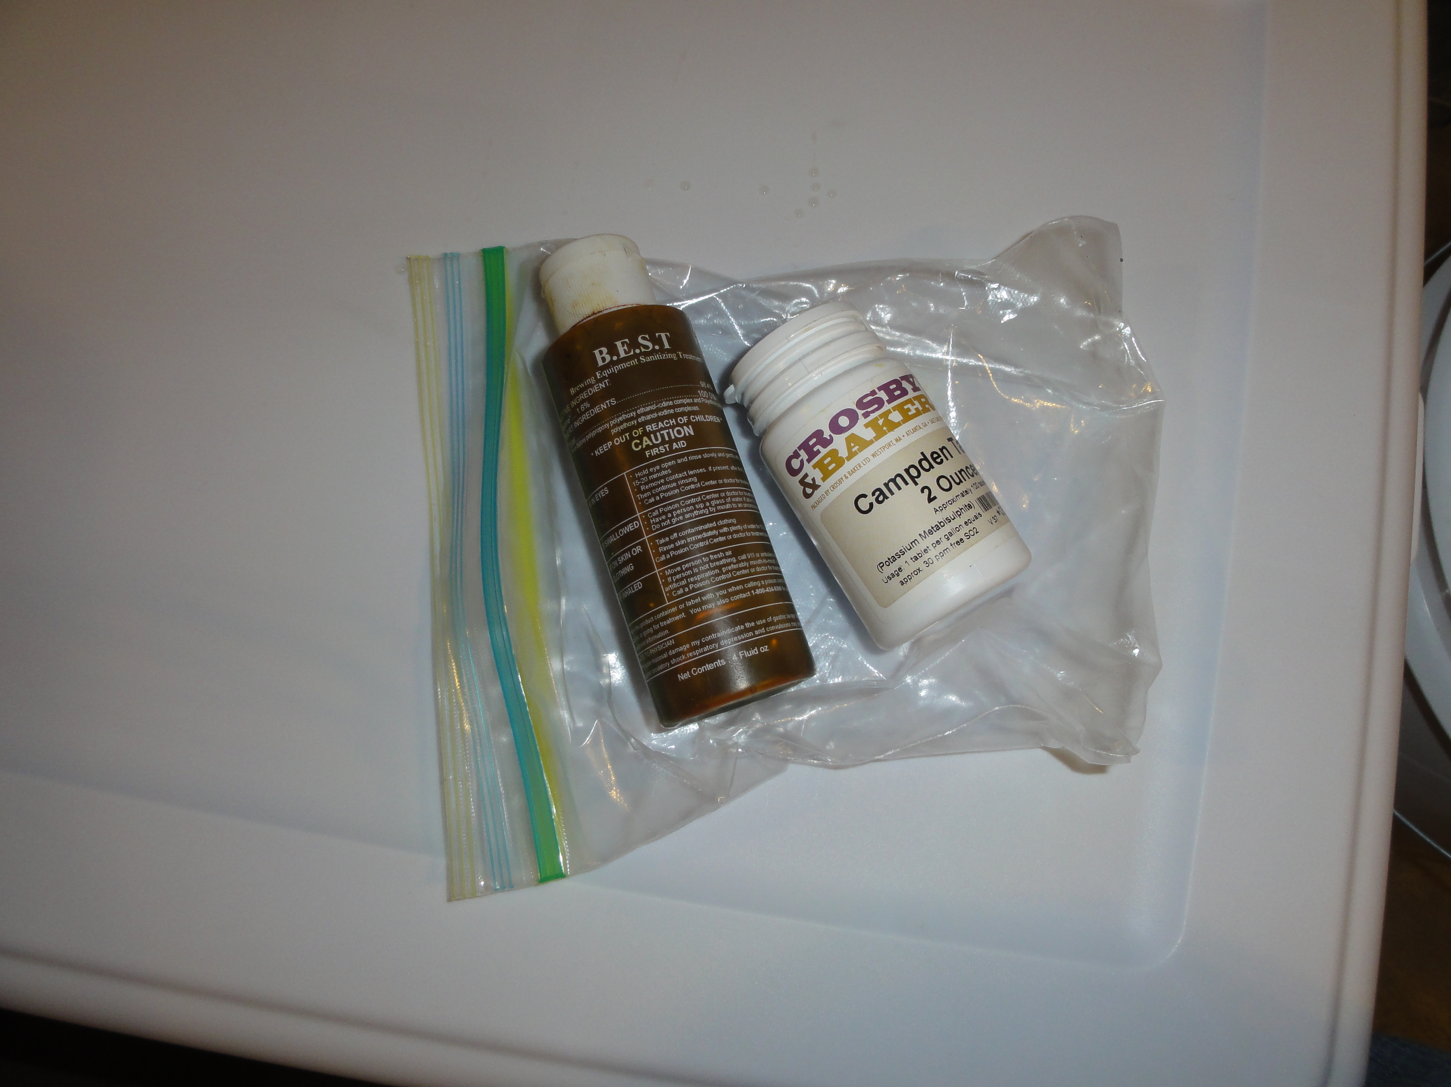
Campden tablets
Iodine cleaning solution

Slide 33
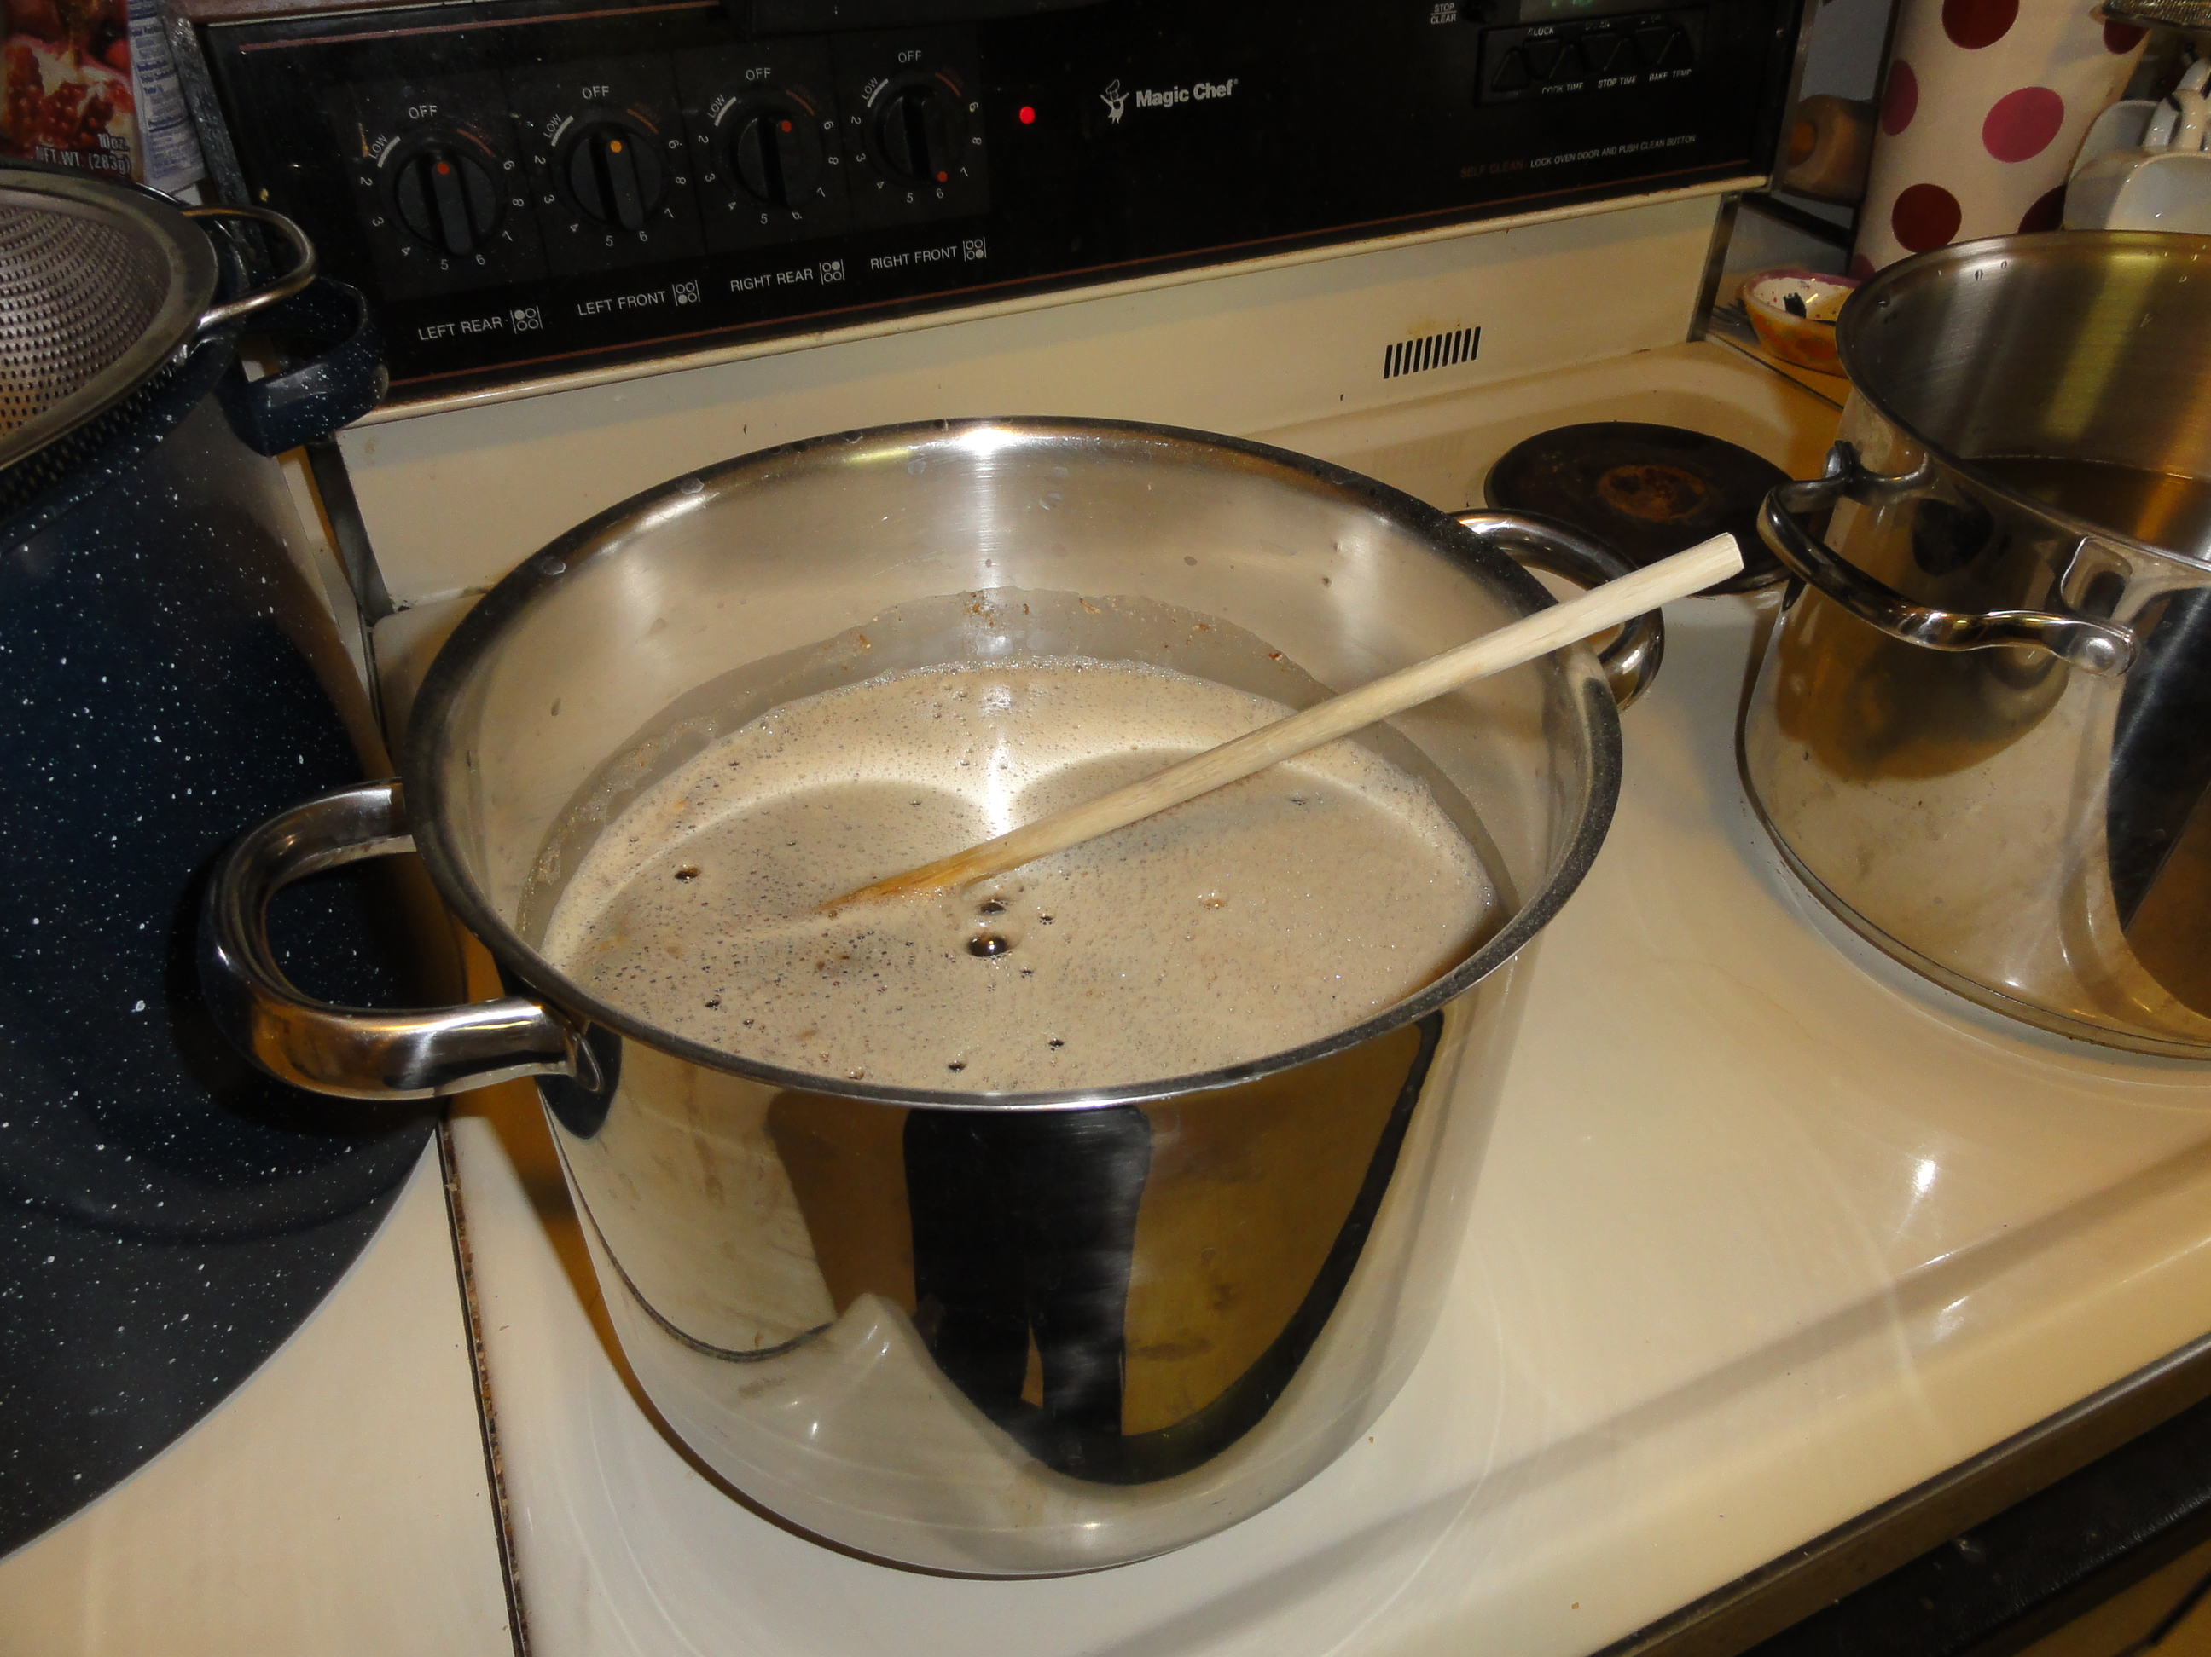
Preparing the must

Slide 34
Preparing the must

Slide 35
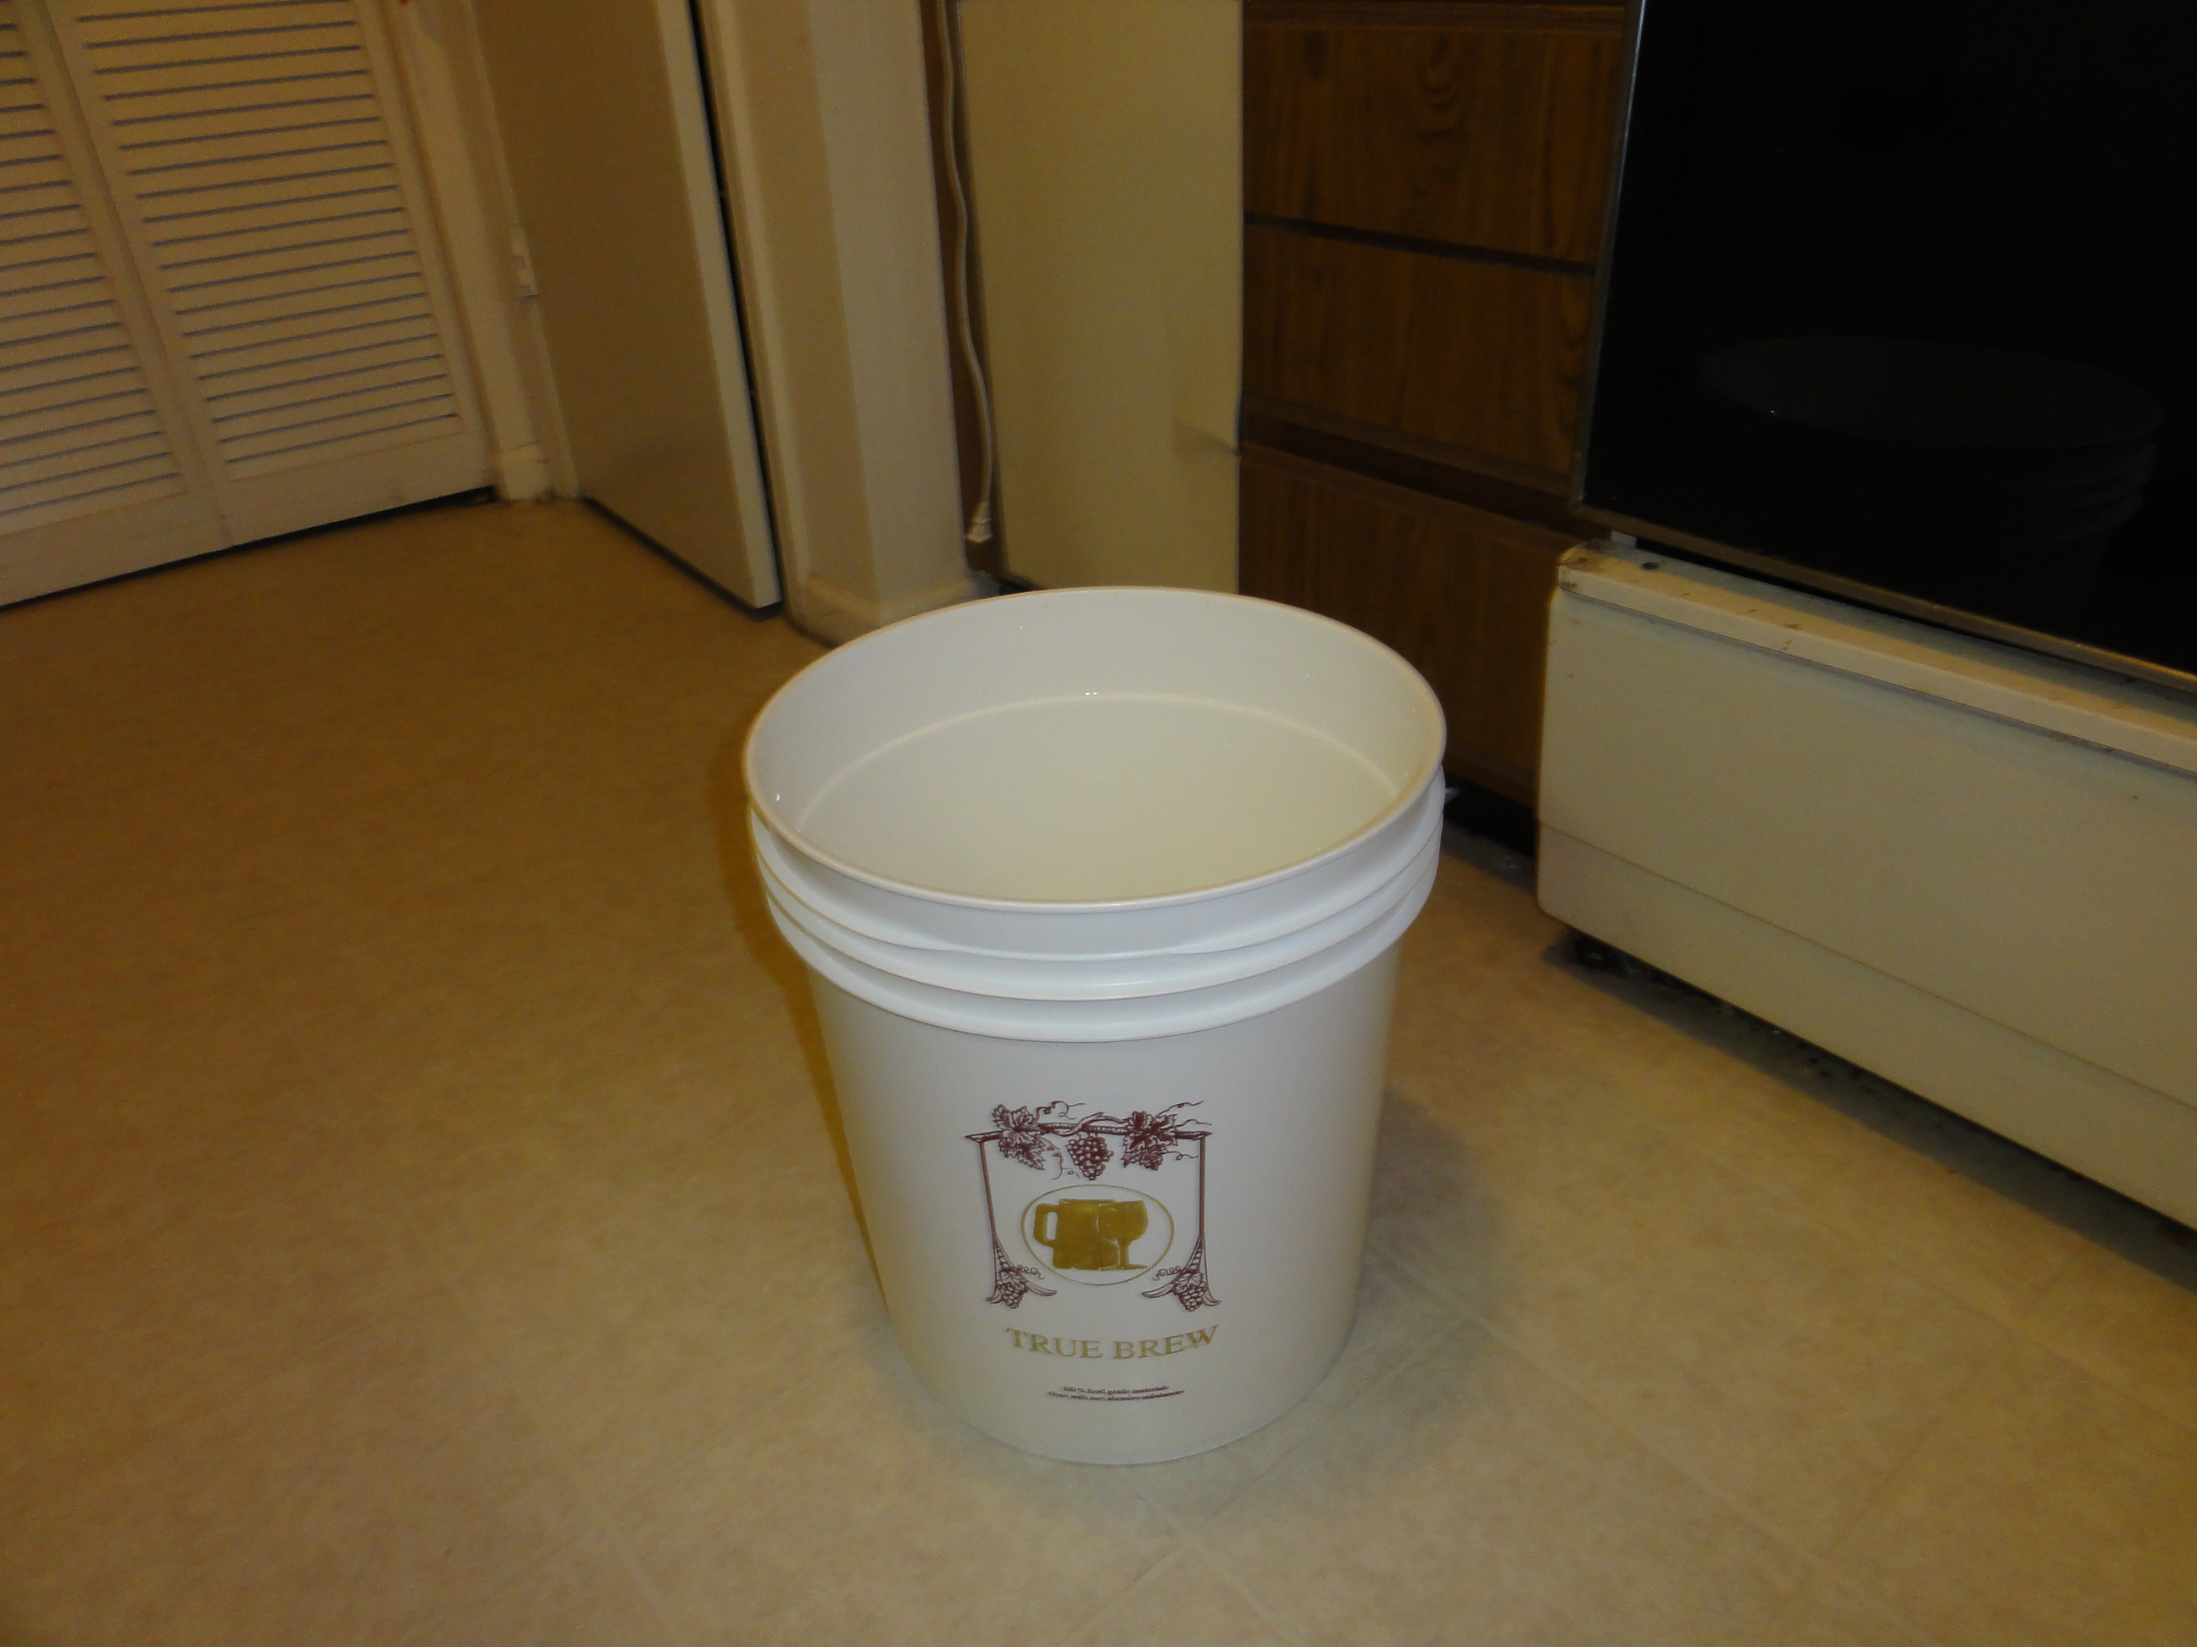

Slide 36
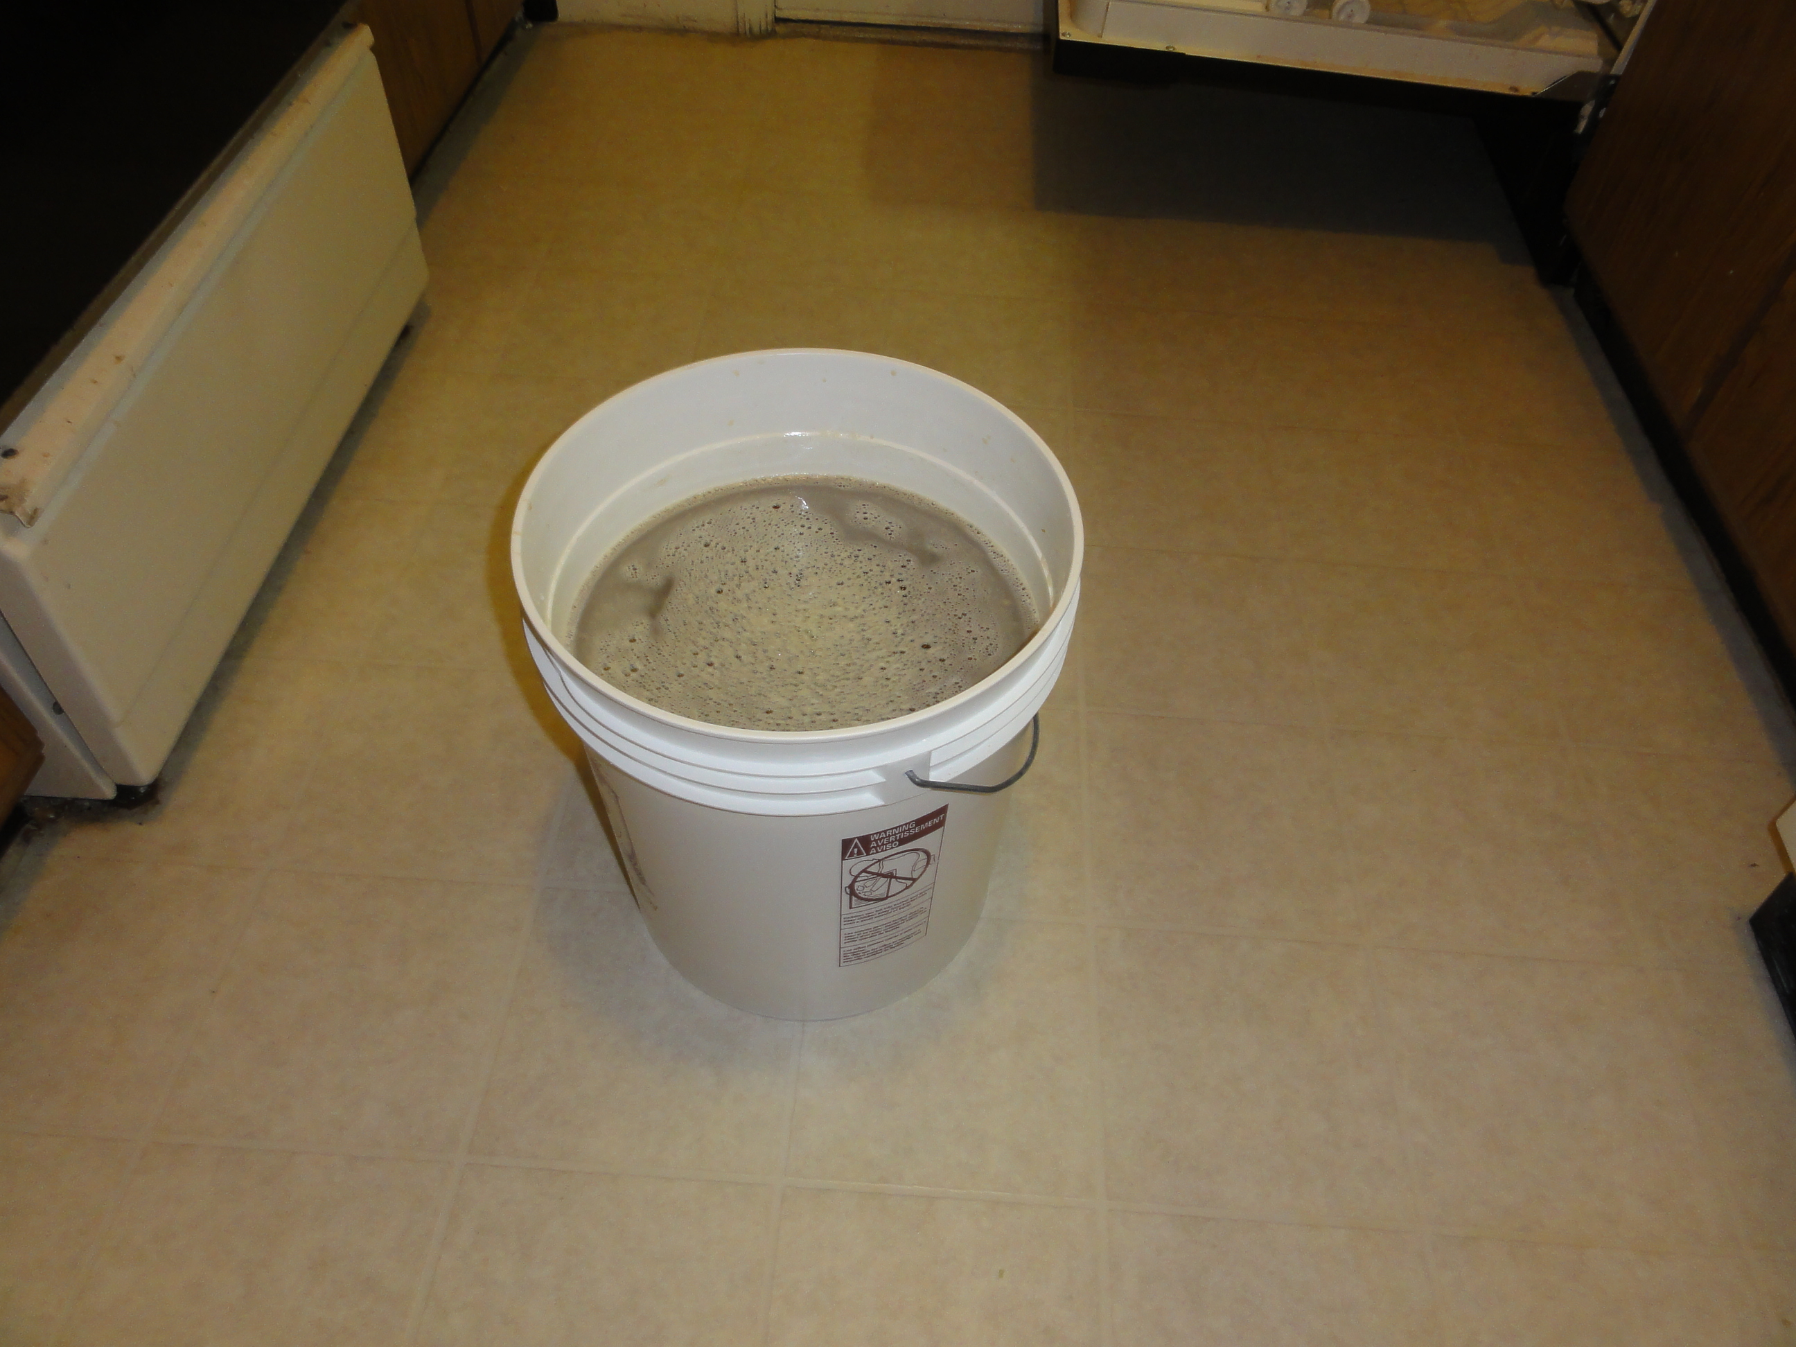

Slide 37
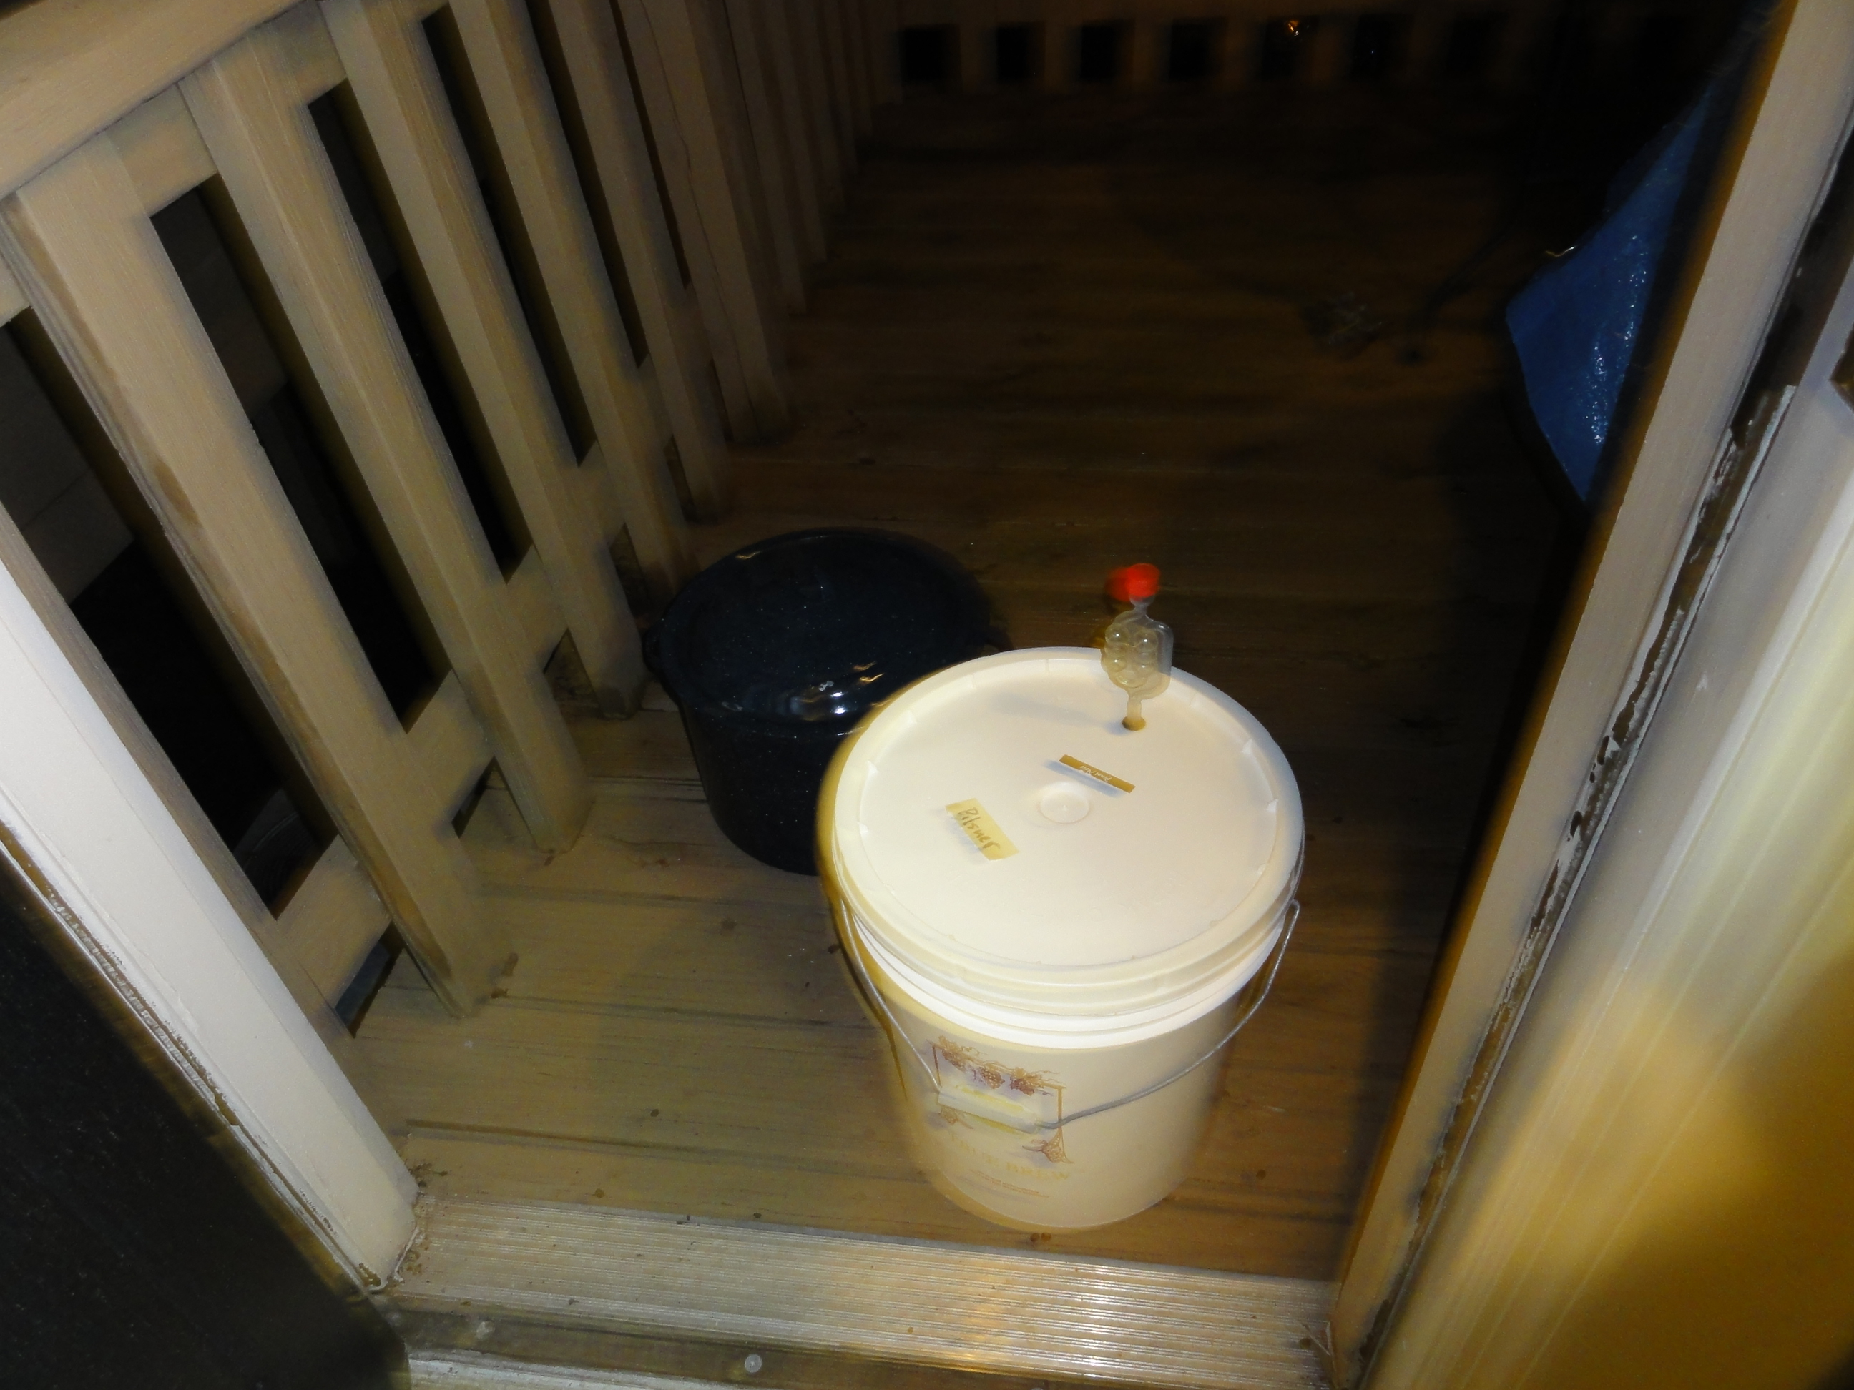

Slide 38
Liquid yeast - before

Slide 39
Liquid yeast - after

Slide 40
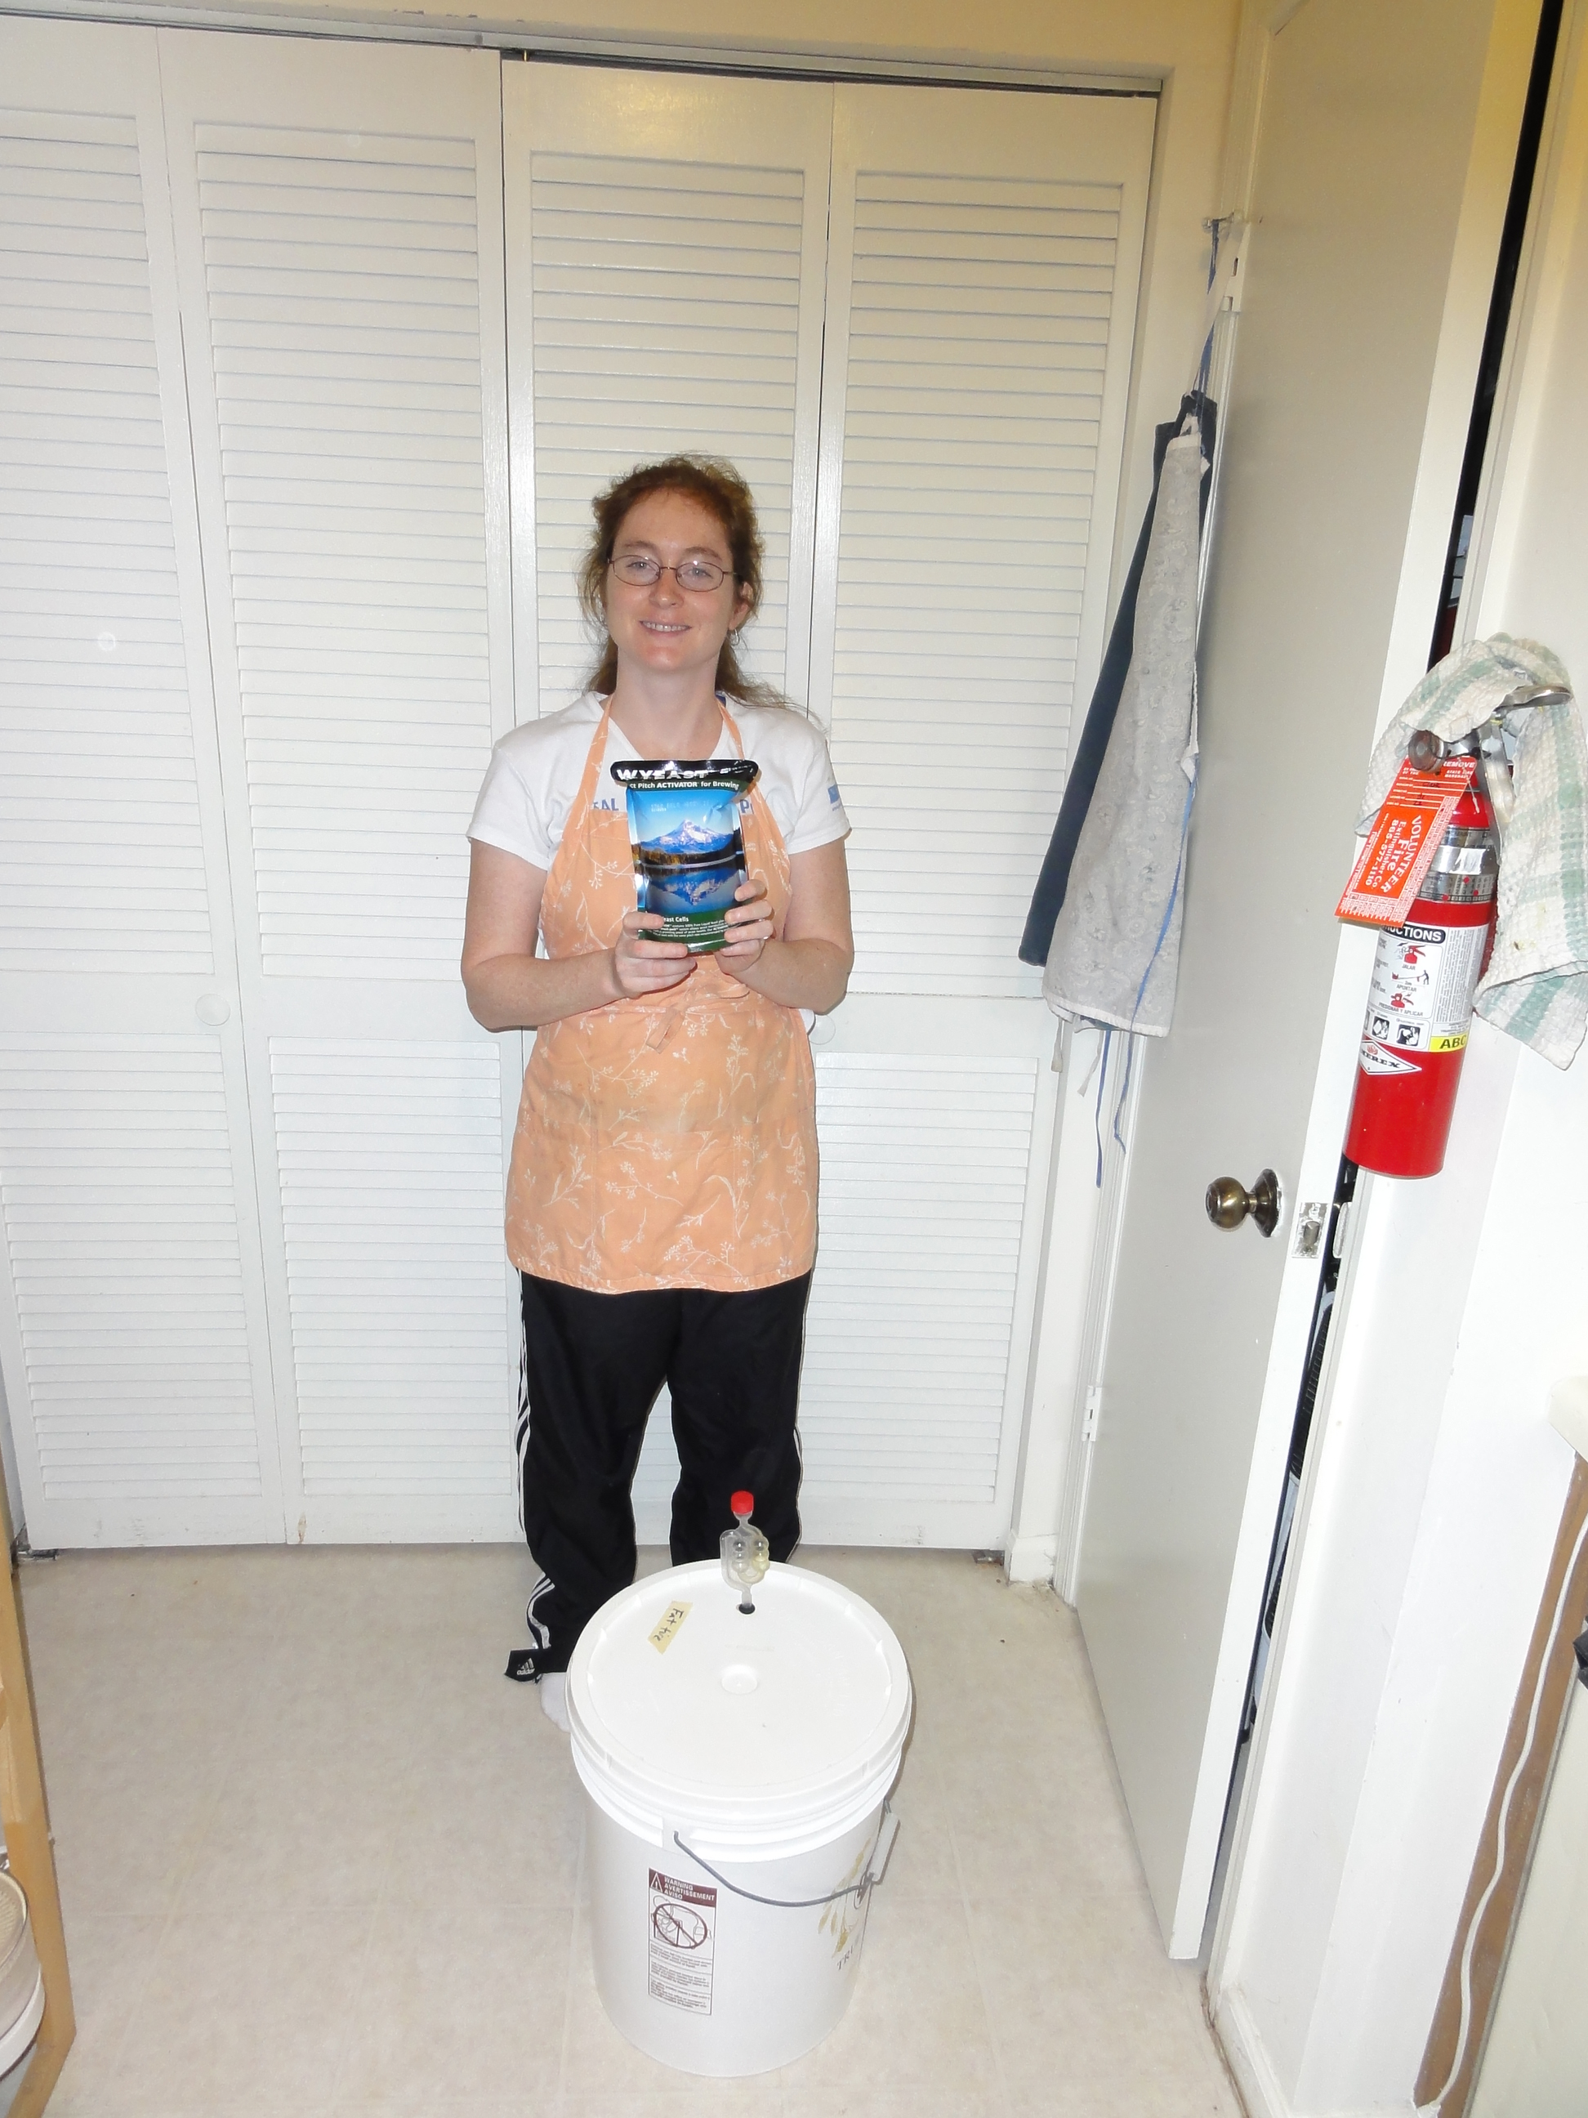

Slide 41
Pitching the yeast

Slide 42
Racking

Slide 43
Primary fermentation

Slide 44
End of primary
fermentation

Slide 45
Secondary fermentation

