Slide 1
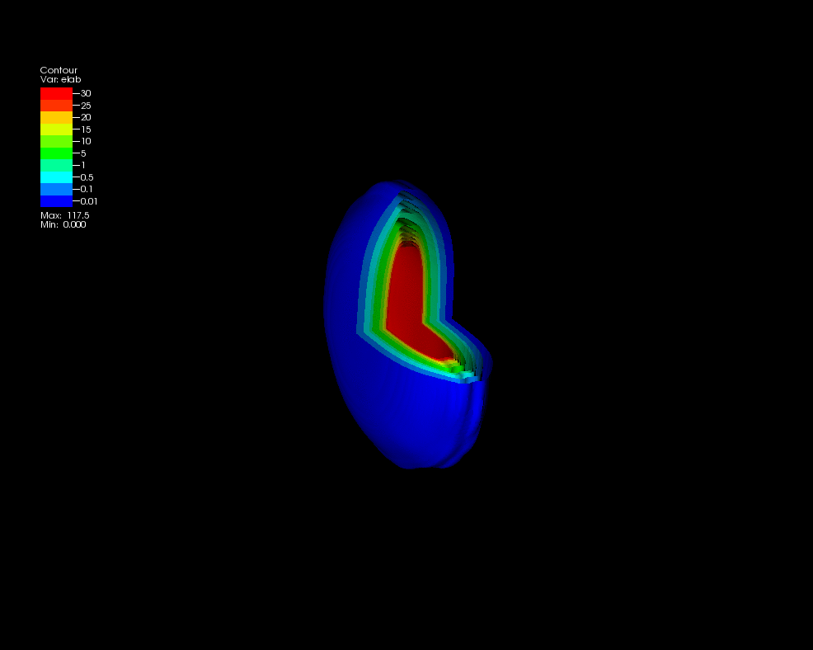
Melting Nuclei
Christine Nattrass
University of Tennessee at Knoxville
Calculations done on the Titan supercomputer by the CJet collaboration https://sites.google.com/site/cjetsite/

Slide 2




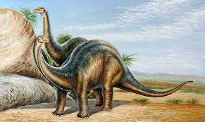
Structure of matter
Hadrons
Baryons
Standard model
Mesons
125000
Higgs

Slide 3

How to make a Quark Gluon Plasma

Slide 4



The phase transition in the laboratory
Initial State
QGP
Freeze-out
  K, O’Hara, S. Hemmer, M. Gehm, S. Granade, J. Thomas Science 298 2179 (2002)
Hydrodynamical flow
Jet quenching
https://physics.aps.org/articles/v7/97

Slide 5















Relativistic Heavy Ion Collider
Large Hadron Collider
PHOBOS
BRAHMS
CMS
PHENIX
STAR
RHIC
LHCb
ALICE
ATLAS
LHCf
LHC
Upton, NY
1.2km diameter
p+p, d+Au, Cu+Cu, Au+Au, U+U
√s_{NN} = 9 - 200 GeV
Geneva, Switzerland
8.6km diameter
p+p, p+Pb, Pb+Pb
√s_{NN} = 2.76 GeV, 5.5 TeV
RHIC
Notes:
Mention that RHIC planning began 1983

Slide 6

ALICE
ATLAS
CMS
STAR
PHENIX
Notes:
Mention that RHIC planning began 1983

Slide 7




Size: 16 x 26 meters
Weight: 10,000 tons
Detectors: 18
Trigger detectors: When do we have a collision?
Tracking detectors: Where did the particle go?
Identification detectors: What kind of particle is it?
Calorimeters: How much energy does the particle have?
<number>
Notes:
By comparison ATLAS is 25 meters in diameter and 44 meters long – not quite twice as large

Slide 8

p+p collisions
3D image of each collision

Slide 9

Pb+Pb collisions
5

Slide 10
QGP Chemistry

Slide 11


Chemistry - equilibrium
T~170 MeV
arXiv:1701.07065
Nuclear Physics A Volume 757, 102-183
Ratios of particles expected from a model
Even strange quarks are at equilibrium!

Slide 12



QCD Phase Diagram
Quark Gluon Plasma
Hadron Gas
arXiv:1701.07065
Notes:
But wait – how can we have a liquid of quarks and gluons? Doesn't asymptotic freedom tell us that we can't have free quarks and gluons? How, then, can we have a liquid of quarks and gluons?

Slide 13


trajectory of system
arXiv:1701.07065

Slide 14
QGP Thermometers

Slide 15


Measuring temperature

Slide 16


Thermal photons
Phys.Rev.Lett.104:132301,2010
Thermal photons
QCD processes
ALICE collaboration:
Pb+Pb collisions at √s_{NN}=2.76 TeV
Inverse slope: T = 304 +/-51
PHENIX collaboration: Au+Au collisions at √s_{NN}=200 GeV
Inverse slope: T = 221 +/- 19 (stat) +/- 19 (syst) MeV

Slide 17





Building a quarkonium-thermometer
CMS-PAS HIN-11-011
N_{part}
Clear hierarchy in R_{AA} of different quarkonium states
c
c
b
b

Slide 18

Building a quarkonium-thermometer
Note: 6.5<p_{T}<30 GeV for J/ψ and ψ(2s)
CMS-PAS HIN-11-011
N_{part}
Clear hierarchy in R_{AA} of different quarkonium states
Expected in terms of binding energy
CMS-PAS HIN-12-014, HIN-12-007

Slide 19
~600
trajectory of system
arXiv:1701.07065

Slide 20
QGP Energy Density

Slide 21

How can we estimate the energy density?
Transverse energy (E_{T})
  sum of particle energies in transverse direction
Volume V = A_{T} τc
τ = formation time
Energy density ε
QGP formation for ε > 0.5 GeV/fm³
A_{T}
= τc

Slide 22

Energy density
RHIC
Standard estimate τ₀ ≈ 1 fm/c
QGP formation

Slide 23
QGP Spectroscopy

Slide 24
Probing the Quark Gluon Plasma
Medium
Probe
Detector
Want a probe which traveled through the collision
QGP is very short-lived (~1-10 fm/c) →
cannot use an external probe

Slide 25


Probes of the Quark Gluon Plasma
nucleus
nucleus
Want a probe which traveled through the medium
QGP is short lived → need a probe created in the collision

Slide 26
Probes of the Quark Gluon Plasma
nucleus
nucleus
Want a probe which traveled through the medium
QGP is short lived → need a probe created in the collision
We expect the medium to be dense → absorb/modify probe

Slide 27





Jets
p+p → dijet
D
c, x_{c}
p
a, x_{a}
b, x_{b}
p
σ_{ab}
Beam pipe
d, x_{d}
D
Jets – hard parton scattering leads to back-to-back quarks or gluons, which then fragment as a columnated spray of particles

Slide 28


Nuclear modification factor
Measure spectra of probe (jets) and compare to those in p+p collisions or peripheral A+A collisions
If high-p_{T} probes (jets) are suppressed, this is evidence of jet quenching
Enhancement
Suppression

Slide 29

Nuclear modification factor
LHCb-PAPER-2017-015
Control
Control
Probe
Charged hadrons (colored probes) suppressed in Pb—Pb
Charged hadrons not suppressed in p—Pb at midrapidity
Electroweak probes not suppressed in Pb—Pb

Slide 30


Nuclear modification factor R_{AA}
RHIC
LHC
Connors, Nattrass, Reed, SalurarXiv:1705.01974 [nucl-ex]
Electromagnetic probes – consistent with no modification – medium is transparent to them
Strong probes – significant suppression – medium is opaque to them - even heavy quarks!

Slide 31


Di-hadron correlations
p+p → dijet
Trigger
nucleus
Associated
Phys.Rev.Lett.93:252301,2004
nucleus

Slide 32

Di-hadron correlations
p+p → dijet
Trigger
nucleus
Associated
nucleus
Updated to include latest information about background

Slide 33
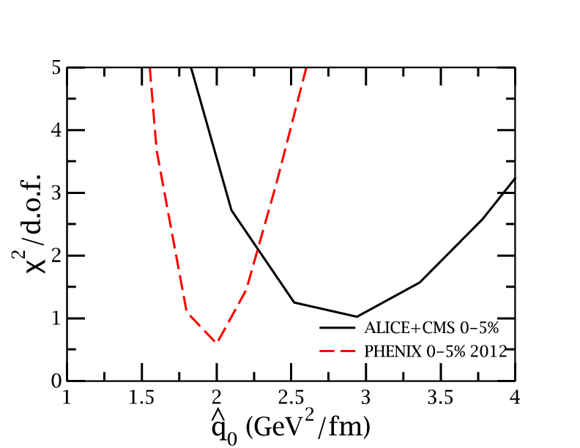
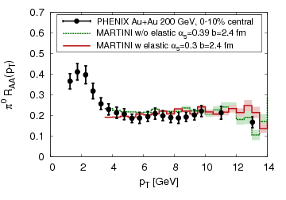

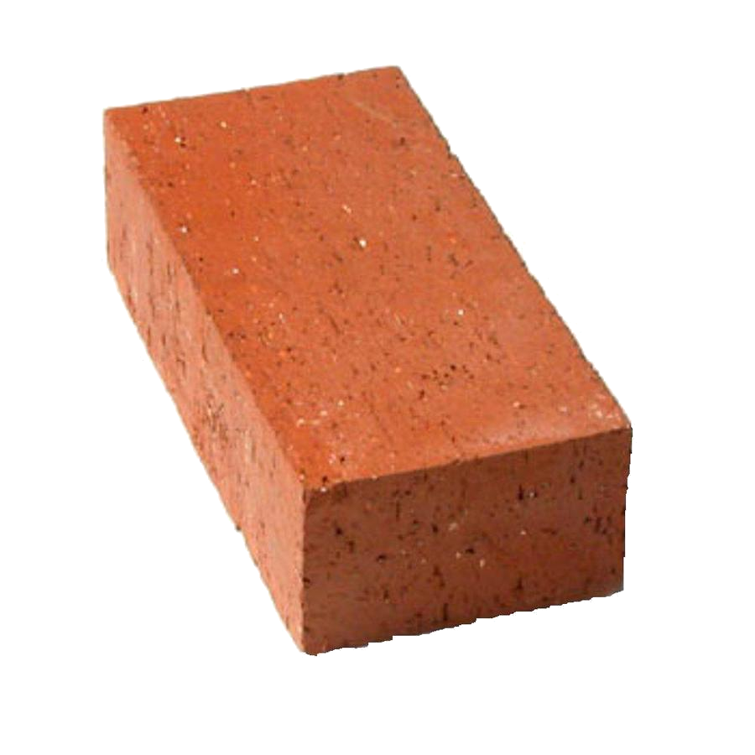
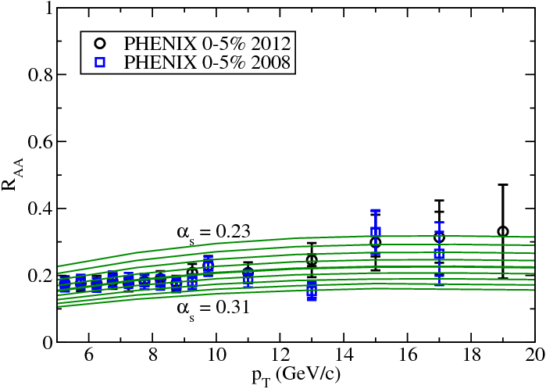

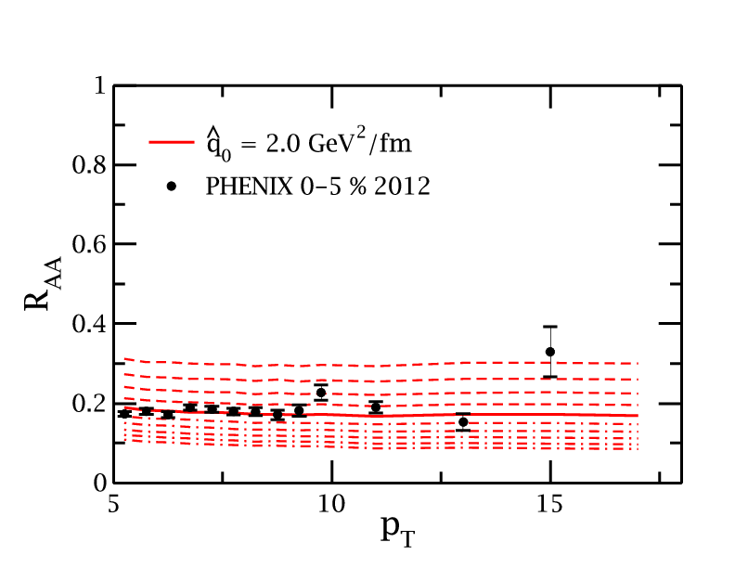
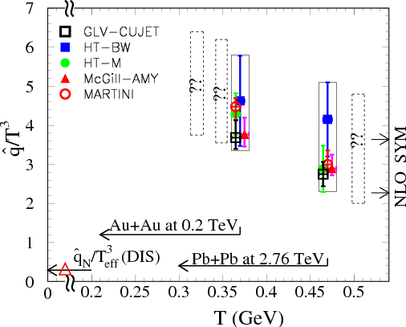
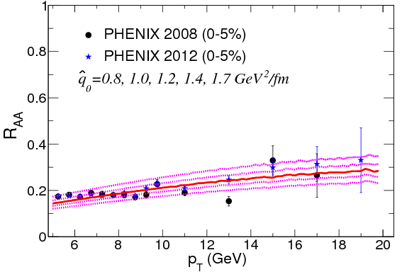
JET collaboration
Phys. Rev. C 90, 014909 (2014)
Martini
McGill
QGP brick + jet
HTM
HTBW
Data
200 GeV Au+Au
2.76 TeV Pb+Pb

Slide 34

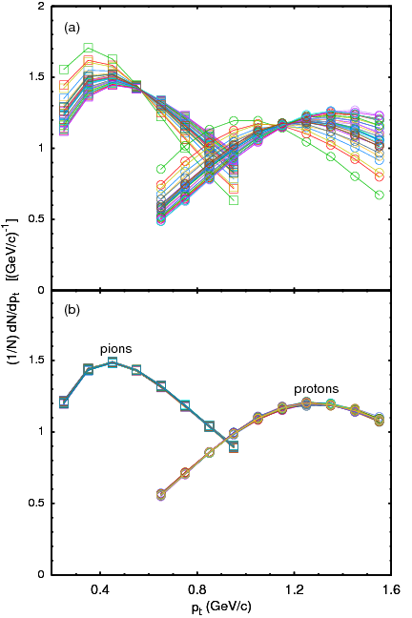
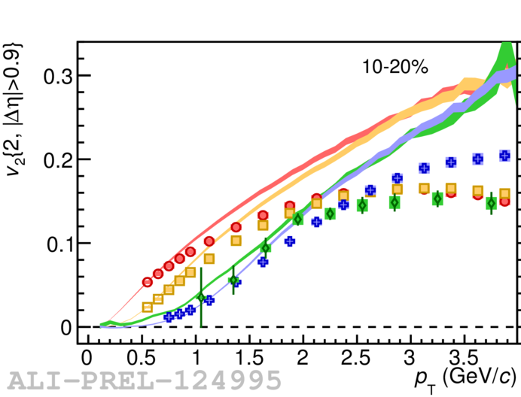
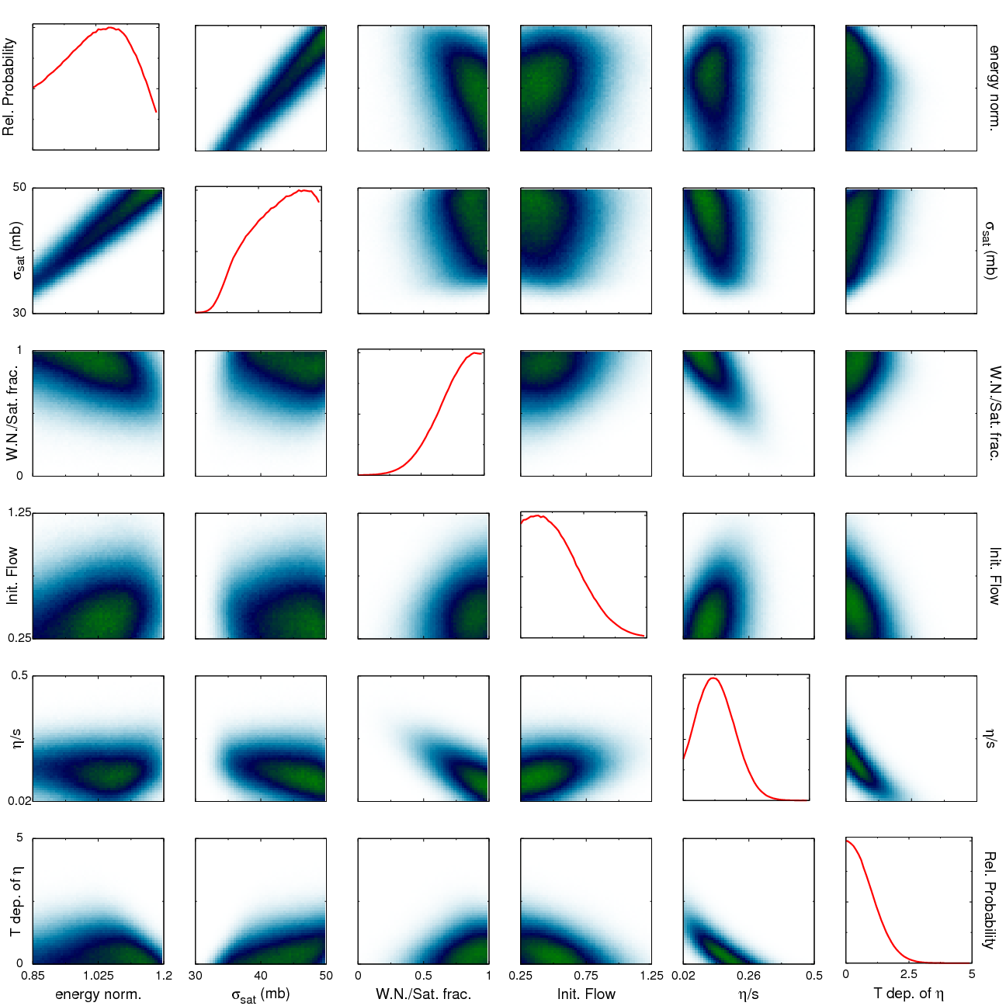

Bayesian Statistical Analysis
Models and Data Analysis Initiative
http://madai.us
Prior
Data
Posterior
Optimization
Monte Carlo
models
Model emulation
Run full model ~1000 times
MCMC parameter search uses emulator (interpolator) in lieu of full model
Constraint of QGP properties
Novak et al, Phys.Rev. C89 (2014) no.3, 034917

Slide 35

JETSCAPE
Event generator
Jet Energy-loss Tomography with a Statistically and Computationally Advanced Program Envelope
http://jetscape.wayne.edu/
Realistic medium
Realistic
theoretical
calculations
Experimental
techniques
Realistic Monte Carlo Model
Realistic jets

Slide 36


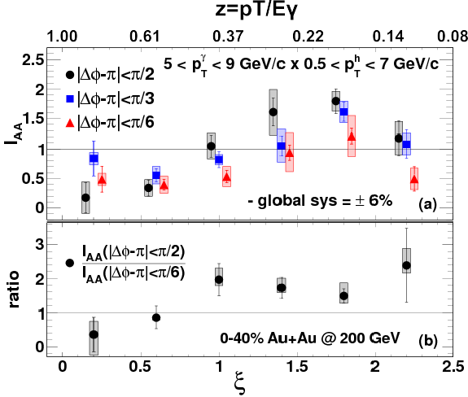





Event Generator + Bayesian Statistical analysis
Realistic theoretical calculations
Data
Bayesian Statistical Analysis
Constraint of QGP properties

Slide 37


Take home messages
If we get nuclear matter dense enough, we make a new phase of matter, which we produce in high energy heavy ion collisions.
This medium is extremely hot and dense...
...and opaque to colored probes and translucent to electromagnetic probes.

Slide 38


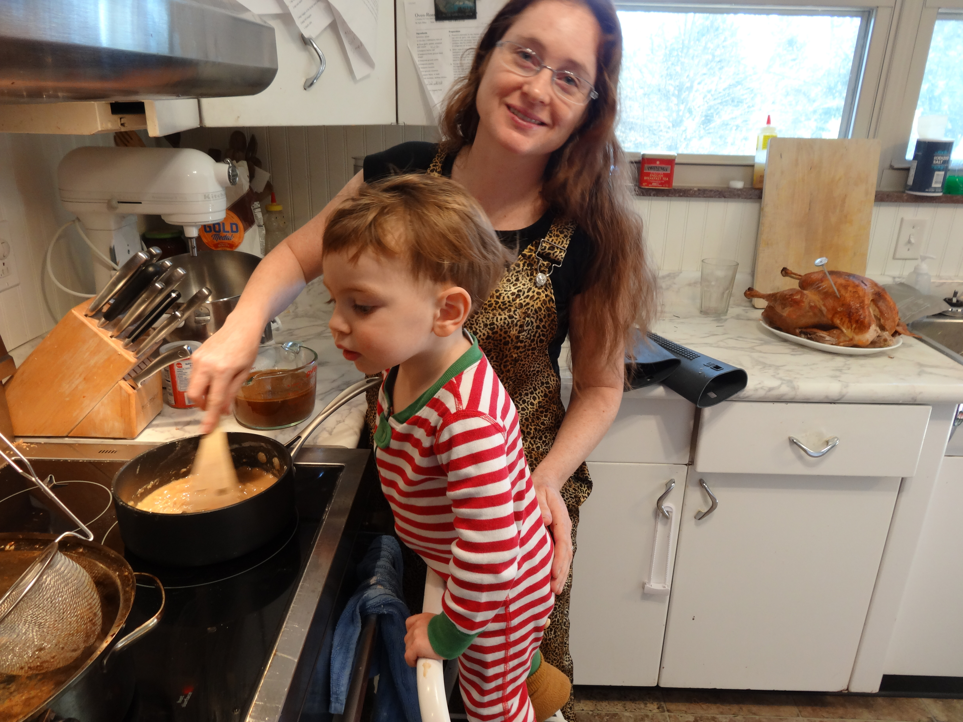
About me
BS, Colorado State University, 2003
PhD, Yale University, 2009
Postdoc, University of Tennessee, Knoxville, 2009-2012
Assistant prof, University of Tennessee, Knoxville 2012 –
Active on issues related to women in physics and working on being a more effective ally for people of color
Parent
Brew beer & wine, keep bees, avid cook, cyclist

Slide 39
Careers in high energy physics
You should consider high energy physics if...
  You like programming and working with computers
  You're a people person – and don't mind working with 1000 people
  You like to travel around the world – and work
  You enjoy giving talks
Common career options for people with a Ph.D. in high energy physics
  Academia – research and teaching universities
  Research at a National Laboratory
  National security
  Finance
  Computer programming

Slide 40




What I spend my time doing
Programming (c++) - analyzing data
Writing and giving talks – 3 research talks, 1 seminar, 2 posters, 1 software tutorial, and lots of talks (>30) at internal meetings in 2010
Hardware work: assembling & testing the detector
Outreach: blogging for ALICE, giving tours of PHENIX to the public...
Writing papers and conference proceedings
Reviewing the work of my collaborators
Reading papers
Taking shifts – including being on call 24/7
Teaching, advising students (undergrad & grad)
Committee work

Slide 41
Resources
US LHC blog and Facebook page
Experiments
  Relativistic Heavy Ion Collider: STAR PHENIX
  Large Hadron Collider: ALICE ATLAS CMS LHCb TOTEM
Event displays and pretty pictures from ALICE
Really cool ATLAS event animation
Links to articles in the press on PHENIX
Scientific American article

Slide 42
US Universities with graduate programs in experimental heavy ion physics
Relativistic Heavy Ion Collider
STAR
  University of California at Davis
  University of California Los Angelos
  University of Houston
  University of Illinois at Chicago
  Creighton University (masters only)
  Kent State University
  Michigan State University
  Ohio State University
  Purdue University
  Texas A&M University
  University of Texas Austin
  University of Washington
  Wayne State University
  Yale University
PHENIX
  University of California Riverside
  University of Colorado Boulder
  Columbia University
  Florida State University
  Georgia State University
  Iowa State University
  Ohio University
  State University of New York (Chemistry & Physics departments)
  University of Tennessee at Knoxville
  Vanderbilt University

Slide 43
US Universities with graduate programs in experimental heavy ion physics
Large Hadron Collider
ALICE
  University of Texas Austin
  Chicago State University
  Ohio State University
  Wayne State University
  University of Texas Houston
  University of Tennessee Knoxville
  Yale University
  Creighton University (masters only)
  Purdue University
CMS
  University of California Davis
  University of Illinois Chicago
  University of Kansas
  University of Maryland
  University of Iowa
  Rutgers University
  Massachusetts Institute of Technology
  Vanderbilt University
ATLAS
  Columbia University

Slide 44
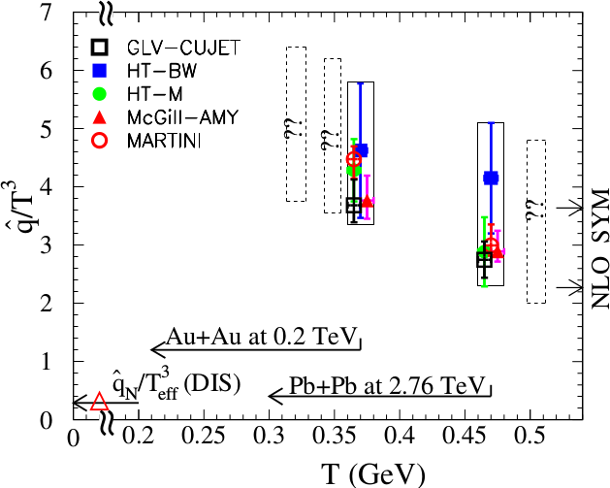
Quantifying
Phys. Rev. C 90, 014909 (2014)
Jet Collaboration: For a 10 GeV quark traveling 4 fm
≈1.2±0.3 GeV²/fm at τ₀=0.6 fm/c in Au+Au at √s_{NN}=200 GeV →loses 2.2 Gev
≈1.9±0.7 GeV²/fm in Pb+Pb collisions at √s_{NN}=2.76 TeV →loses 2.8 Gev
Q = Momentum transfer from parton to medium
L = path length

