Slide 1
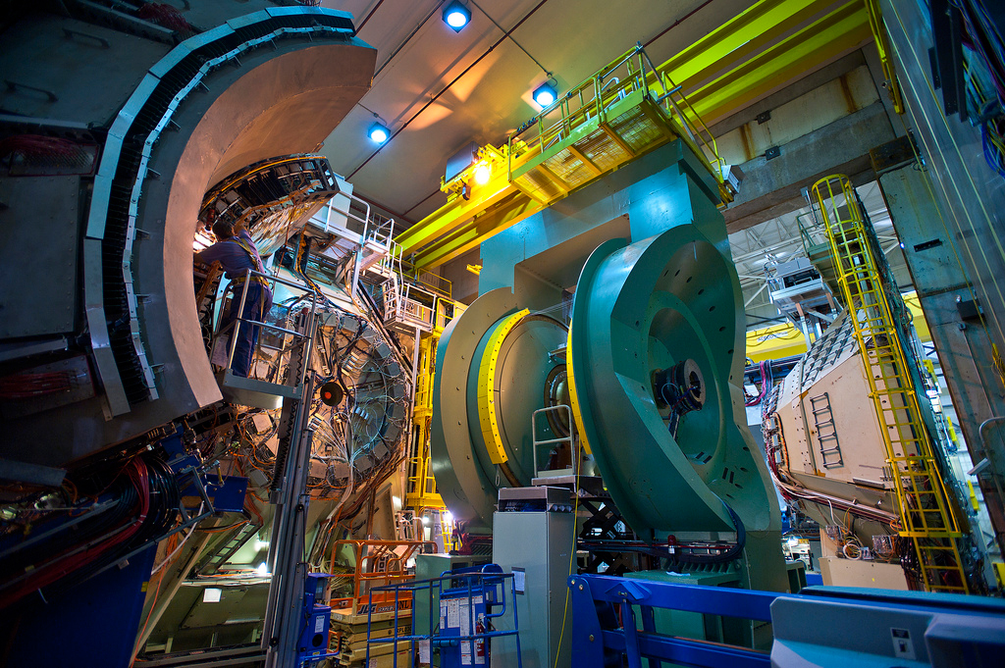
Results from PHENIX
Christine Nattrass
University of Tennessee, Knoxville
https://www.colorado.edu/physics/2013/12/09/quark-gluon-droplets-discovered-bnls-phenix-experiment

Slide 2
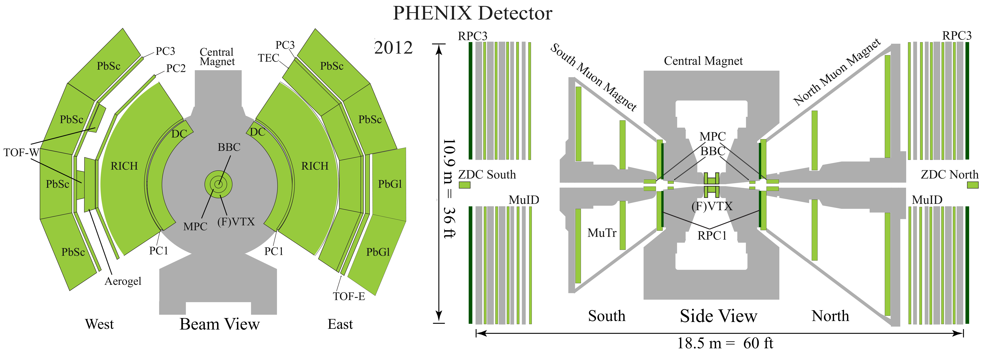
4-spectrometer arms
• Central detector |η| < 0.35
• Forward/backward detector
1.2<|η| <2.2
Ended operations in 2016 but still
produce new results from the large
data acquired during its final years

Slide 3
Au+Au

Slide 4
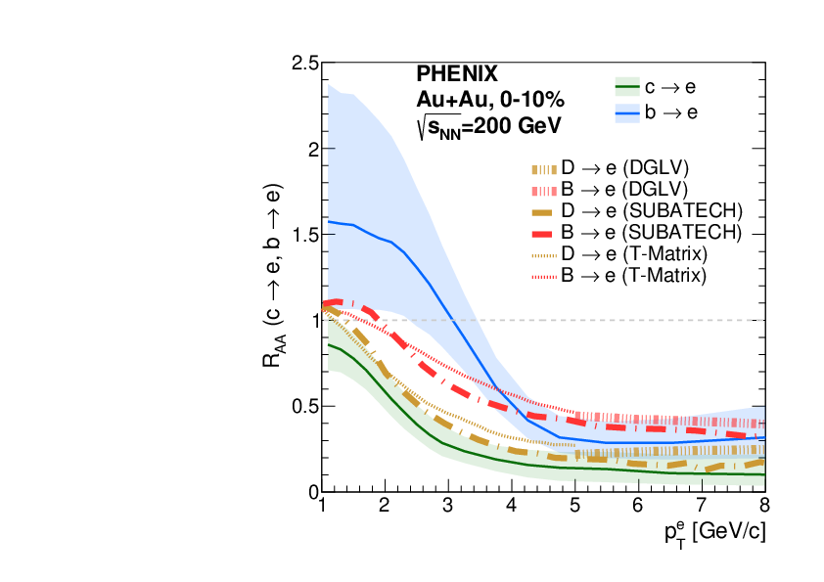
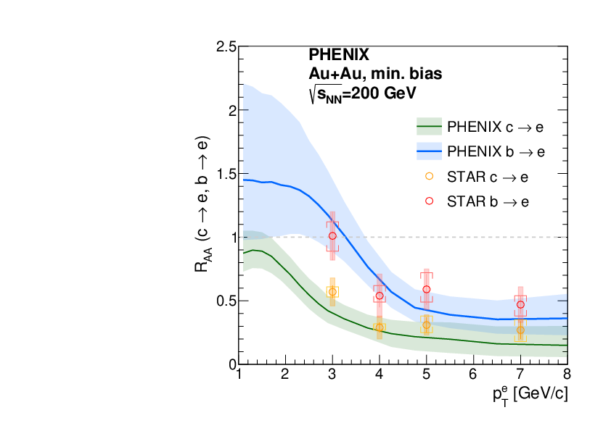
b/c quark RAA
Au+Au
arXiv:2203.17058 (submitted to Phys. Rev. C)
Beauty is less suppressed than charm

Slide 5
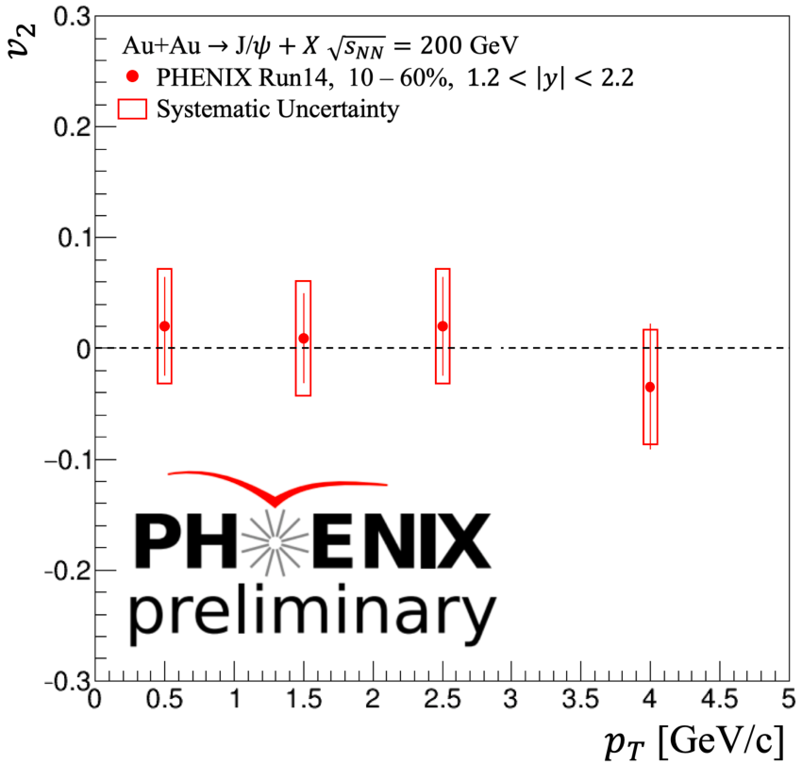
J/ψ v2 in Au+Au
Au+Au
Consistent with zero at forward rapidity, different from the LHC results
May indicate absence of charmonium regeneration in the forward rapidity region at RHIC energies

Slide 6
p+p

Slide 7
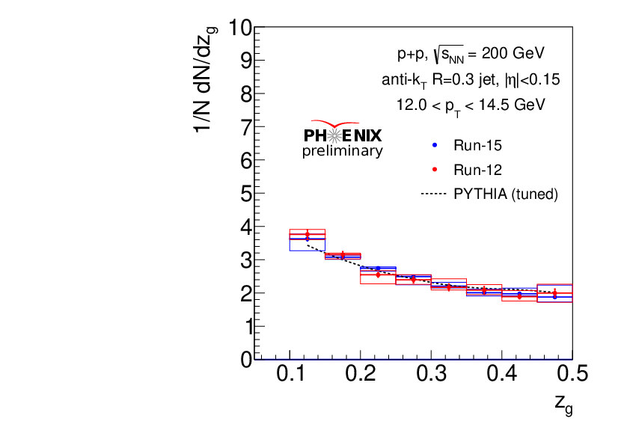
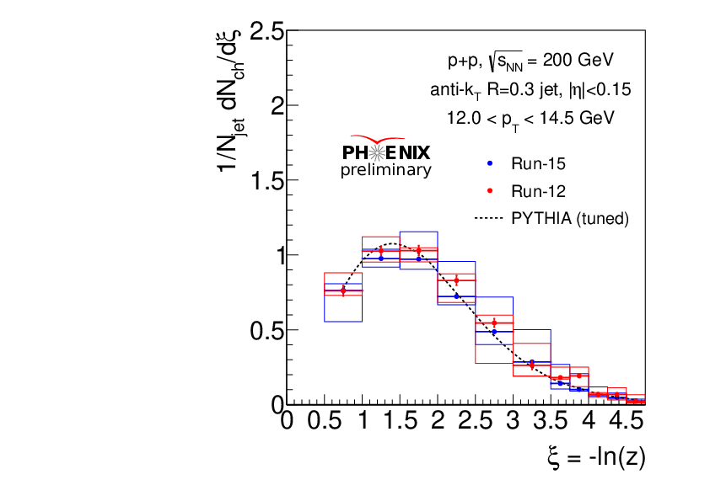
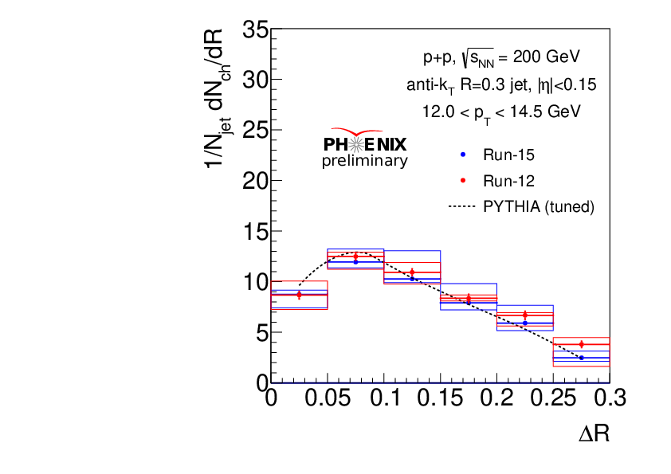
Jet substructure
p+p
$Z_{g}=\frac{min\left(p_{T}^{1},p_{T}^{2}\right)}{p_{T}^{1}+p_{T}^{2}}$
$z=\frac{p_{T}^{h}}{p_{T}^{jet}}$
$ΔR=\frac{dN^{h}}{dΔR}$
$ΔR$
Jet splitting function
Radial profile
Fragmentation function
New analysis of jet substructure
  R = 0.3
  12.0 GeV/c < pT < 14.5 GeV/c
Analysis ongoing with p+Au, results coming soon!

Slide 8
Jet substructure
p+p
$Z_{g}=\frac{min\left(p_{T}^{1},p_{T}^{2}\right)}{p_{T}^{1}+p_{T}^{2}}$
$z=\frac{p_{T}^{h}}{p_{T}^{jet}}$
$ΔR=\frac{dN^{h}}{dΔR}$
$ΔR$
Jet splitting function
Jet splitting function
Radial profile
Radial profile
Fragmentation function
New analysis of jet substructure
  R = 0.3
  20.5 GeV/c < pT < 24.5 GeV/c
Analysis ongoing with p+Au, results coming soon!

Slide 9
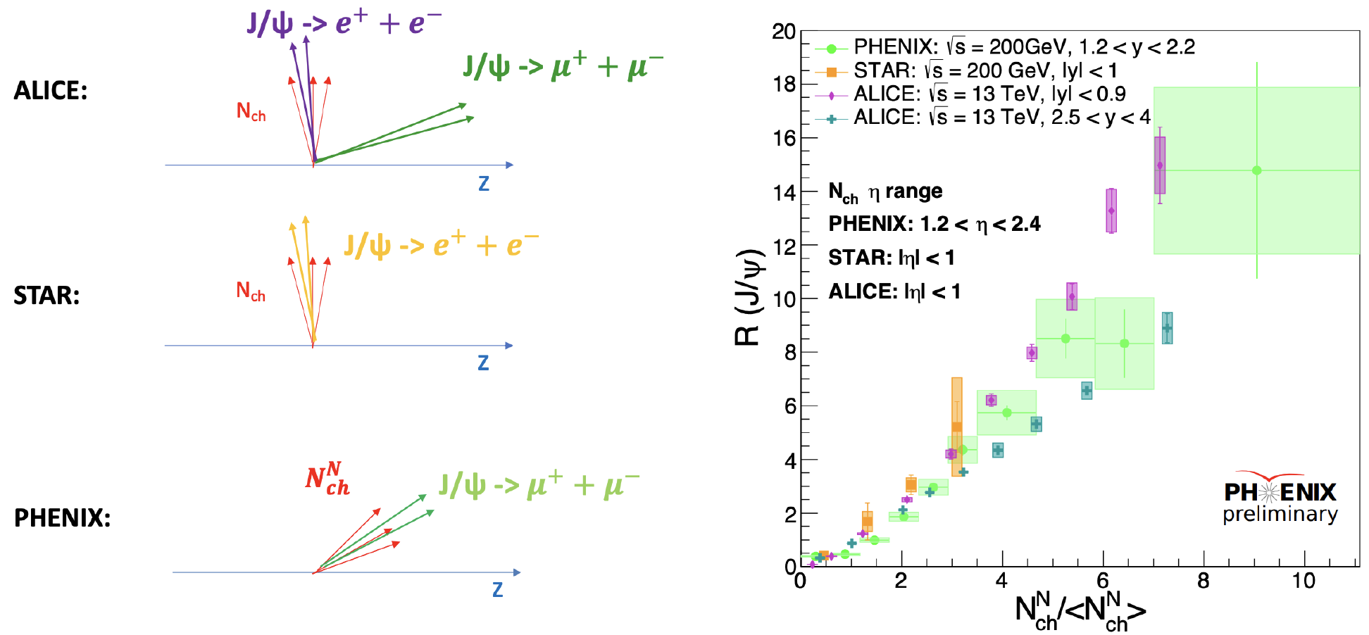
J/ψ yield in p+p
p+p
${N_{J/Ψ}}/{\left\langle N_{J/Ψ}\right\rangle }$
=
J/ψ yield exhibits large dependence on local track multiplicity
Usually attributed to multi-parton interactions

Slide 10
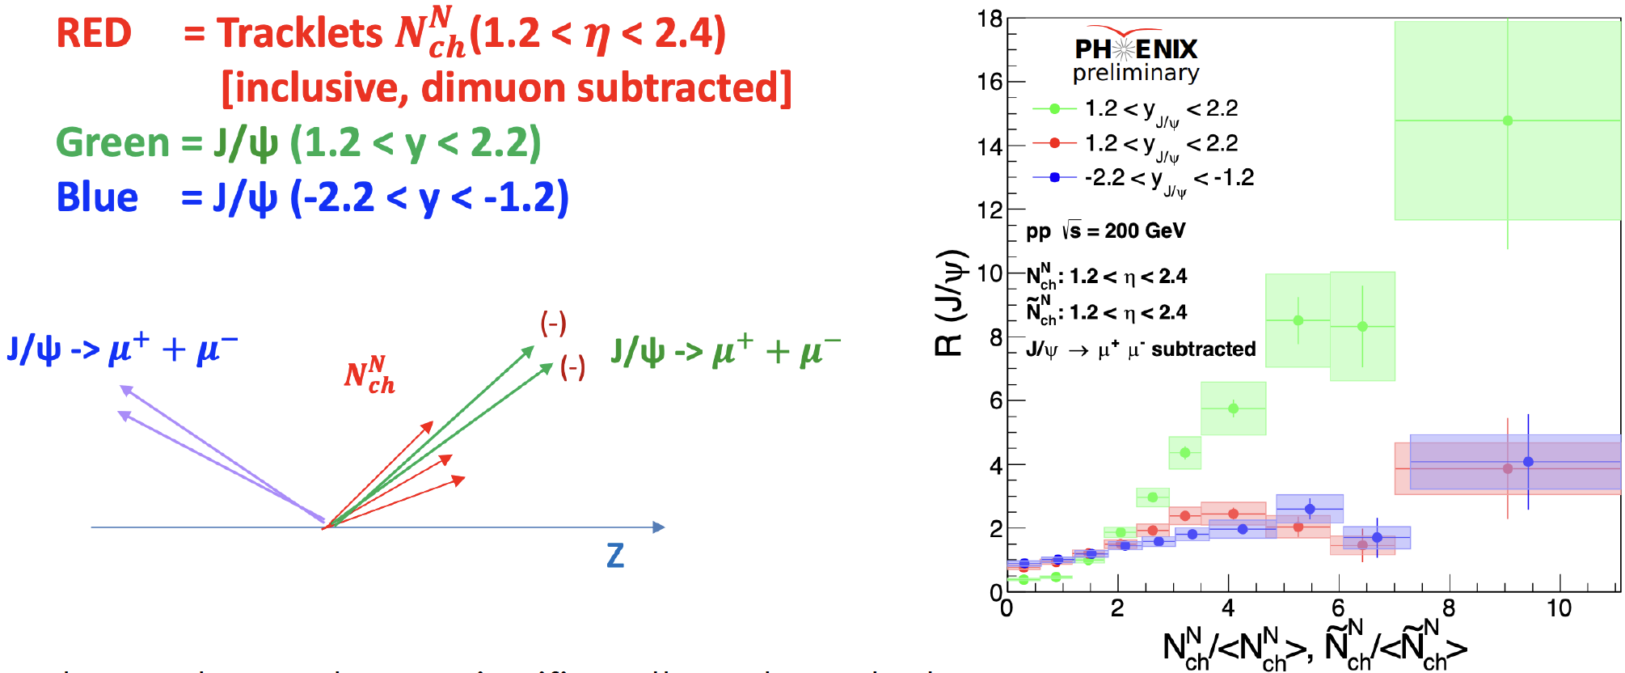
J/ψ yield in p+p
p+p
${N_{J/Ψ}}/{\left\langle N_{J/Ψ}\right\rangle }$
=
J/ψ yield vs multiplicity significantly reduced when
Looking at J/ψ and multiplicity in separate rapidity
windows
    Looking at J/ψ and multiplicity in the same rapidity window but removing the μ+ μ− from the multiplicity
Important implications for MPI picture

Slide 11
Au+p,X

Slide 12
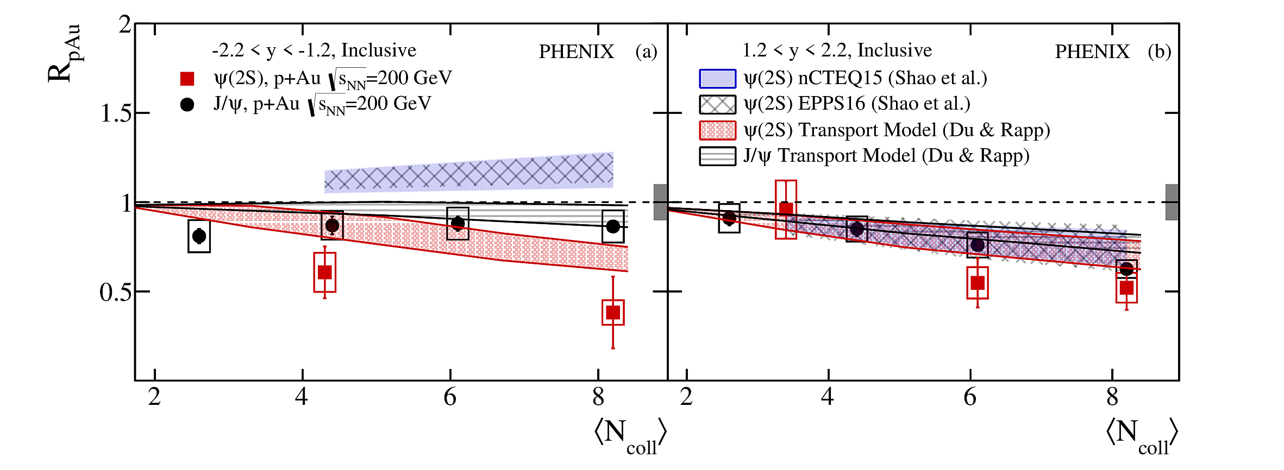
J/ψ and ψ(2S) nuclear modification factor
Au+X
arXiv:2202.03863
J/ψ modification consistent with initial state effects alone at forward and backward rapidity
ψ(2S) modification indicates presence of final state effects at backward rapidity
  Presence of co-movers? QGP?

Slide 13
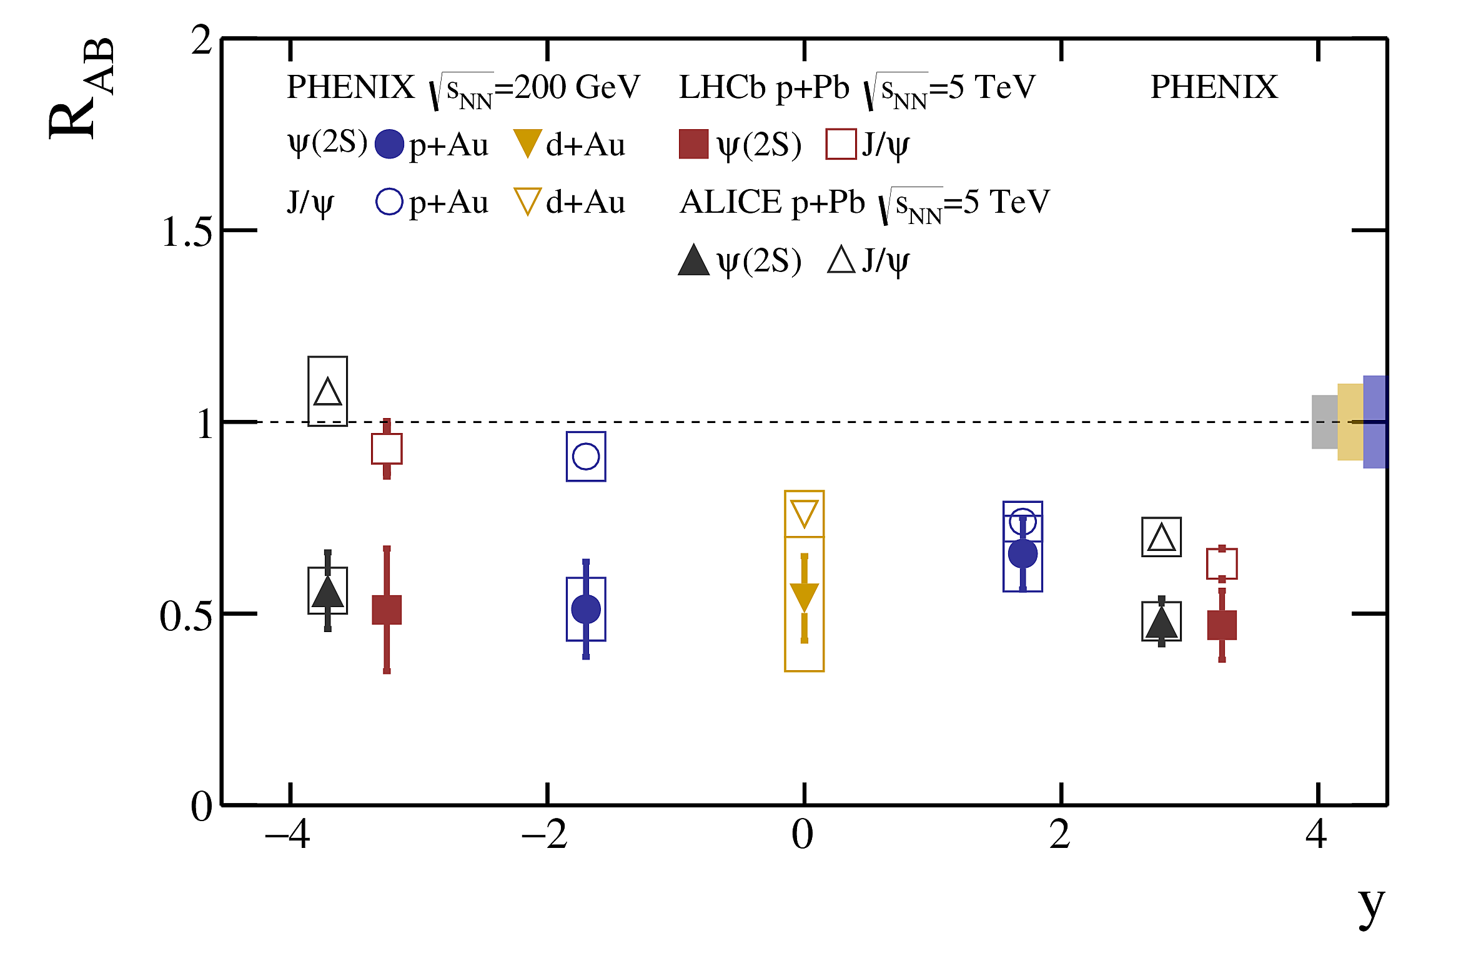
J/ψ and ψ(2S) nuclear modification factor
Au+X
arXiv:2202.03863
Similar patterns for J/ψ and ψ(2S) found at RHIC and LHC

Slide 14
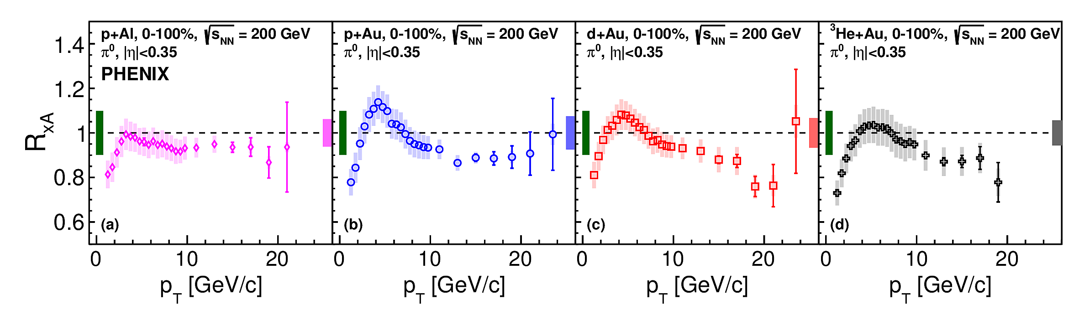
Nuclear modification of π⁰ in small systems
Au+X
Phys. Rev. C 105, 064902 (2022)
Minimum bias collisions shown
Cronin enhancement at intermediate pT
  Lighter target shows smaller enhancement (p+Al < p+Au)
  Heavier projectile shows smaller enhancement (3 He+Au < d+Au < p+Au)

Slide 15
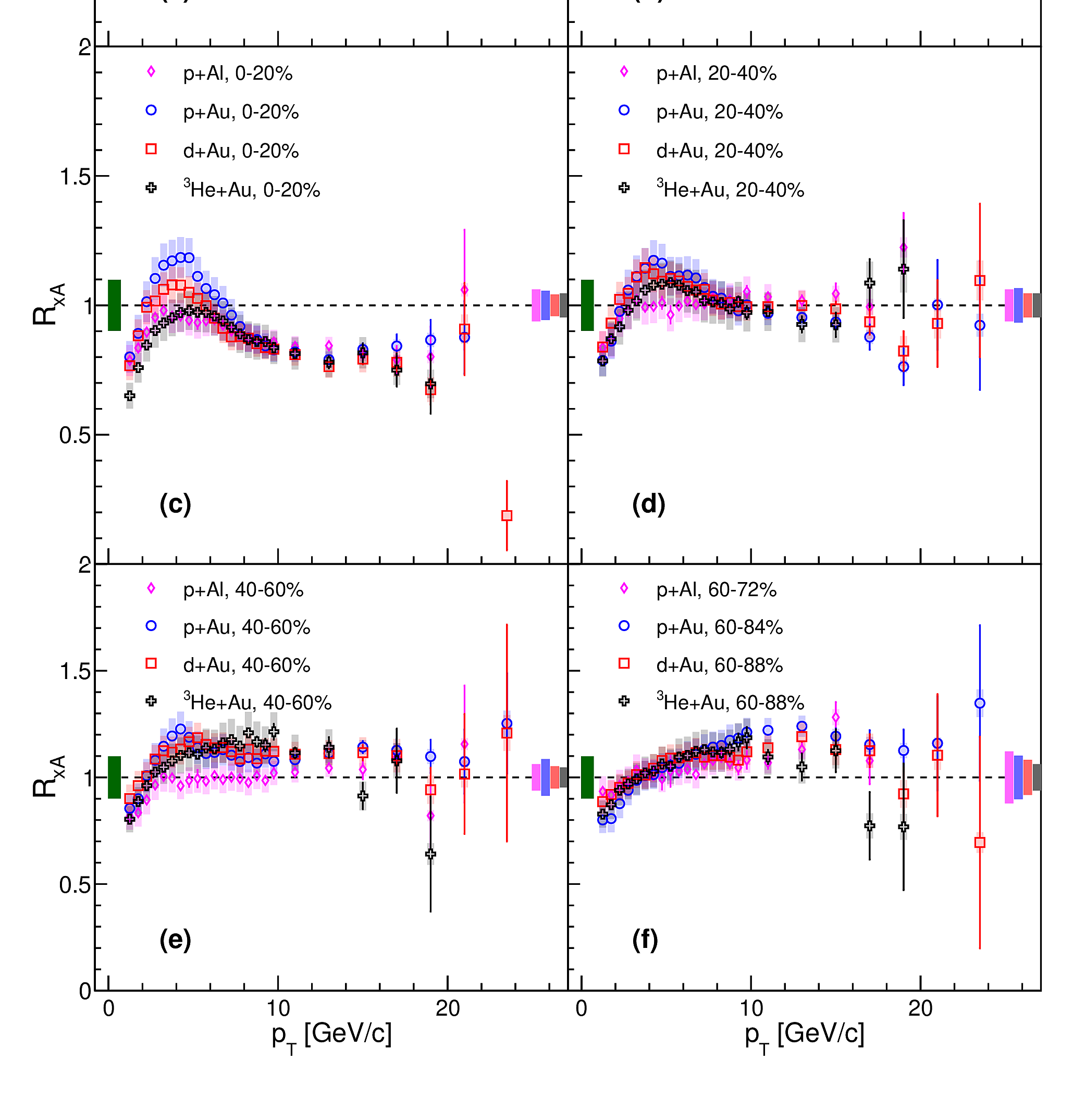
Nuclear modification of π⁰ in small systems
Au+X
Considerable centrality dependence—suppression in central, enhancement in peripheral
Peripheral enhancement not new, but still difficult to understand...
Phys. Rev. C 105, 064902 (2022)

Slide 16
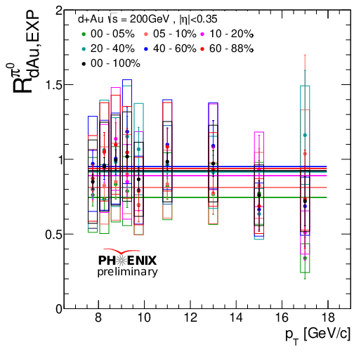
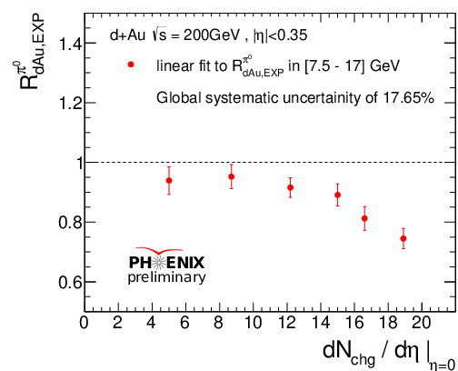
Direct photons and π⁰ in small systems
Au+X
Can use non-modification of photons to correct for bias in Ncoll determination
Resolves a decade-long mystery of apparent enhancement in peripheral collisions
Small but non-negligible suppression in central collisions
  EMC effect? QGP?

Slide 17
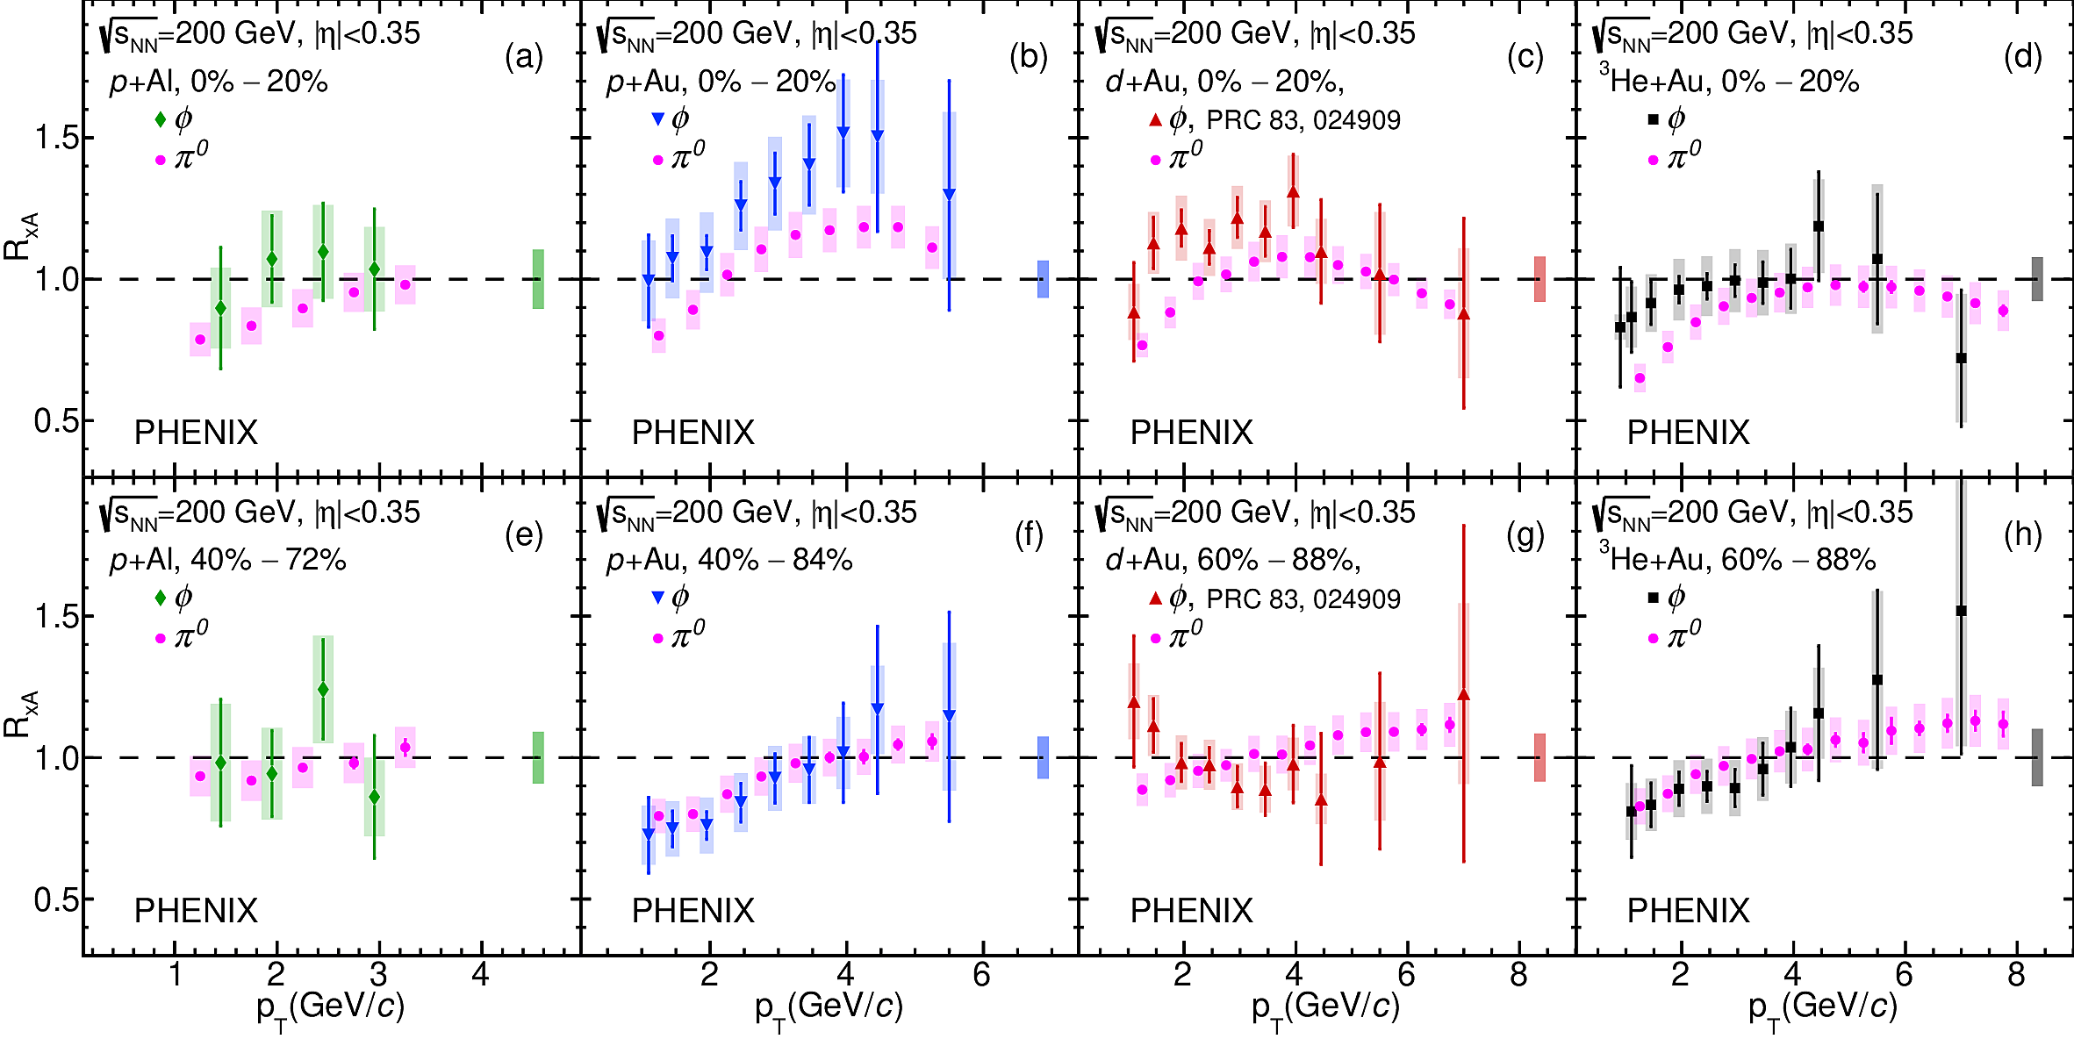
φ meson in small systems
Au+X
arXiv:2203.06087
φ similar to π⁰ with a few hints of a slight enhancement relative to π⁰

Slide 18
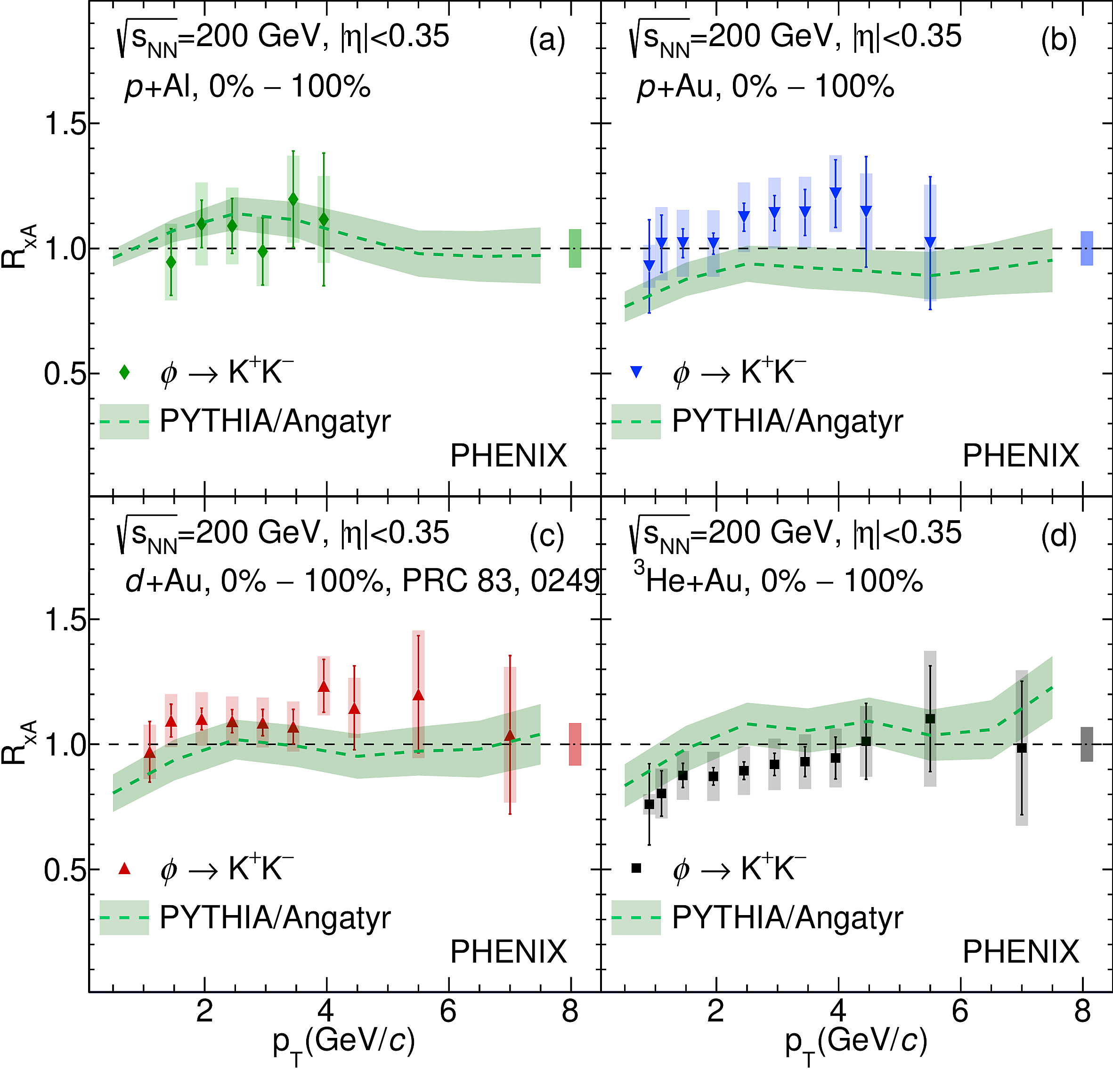
φ meson in small systems
Au+X
φ nuclear modification reasonably well-described by PYTHIA Angantyr, but overall system size ordering is missed
arXiv:2203.06087

Slide 19
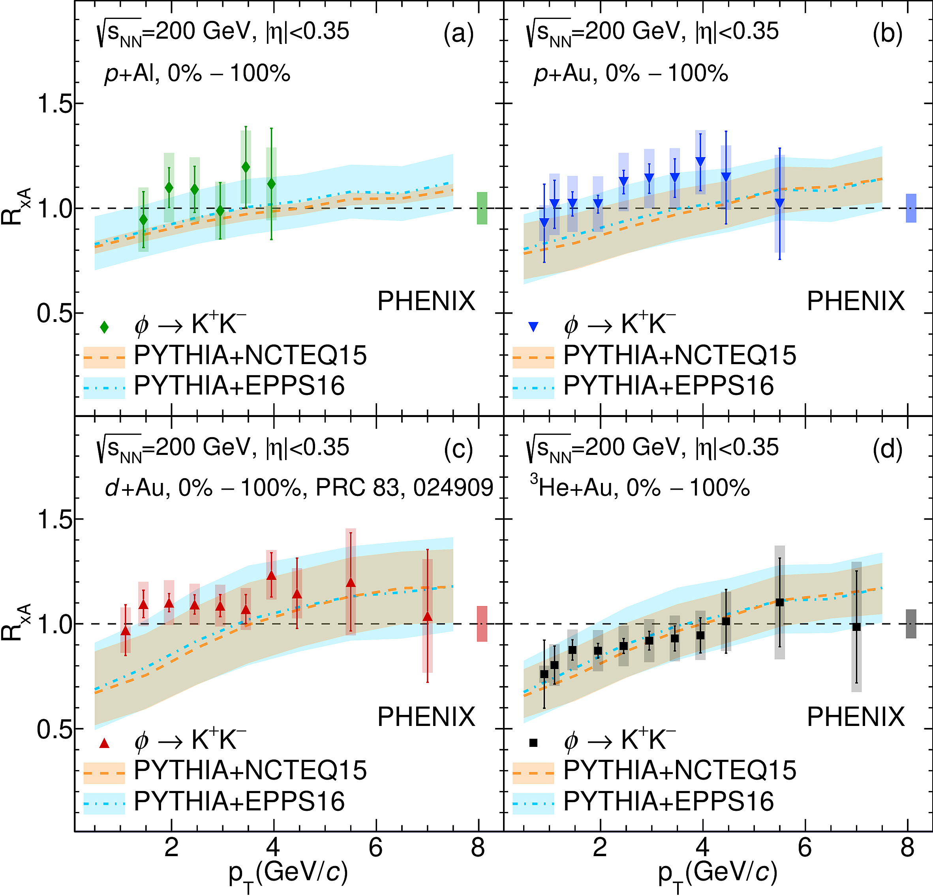
φ meson in small systems
Au+X
Also reasonably well-described by PYTHIA with nPDFs, but overall system size ordering is missed
arXiv:2203.06087

Slide 20
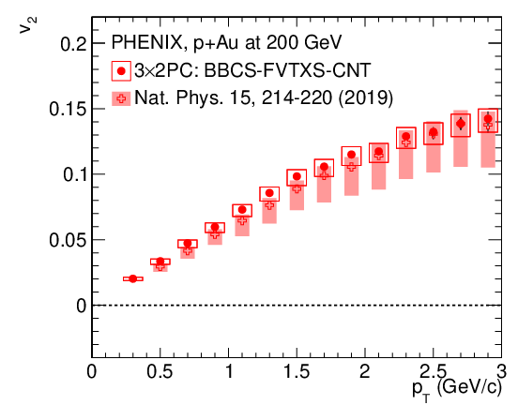
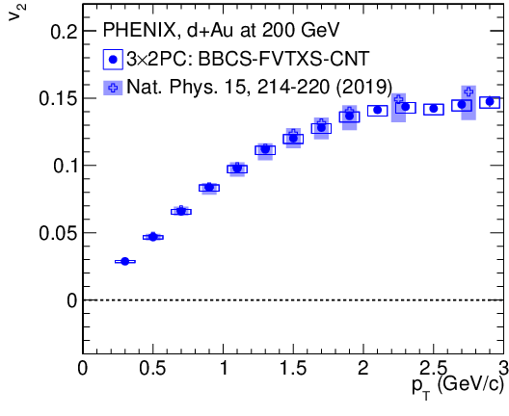
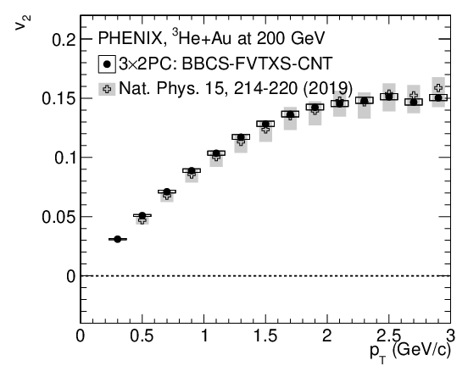
vn in small systems
Au+X
All new analysis using two-particle correlations with event mixing instead of event plane
method used in Nature Physics publication
  Very different sensitivity to key experimental effects (beam position, detector alignment)
Uses same detector combination as used in Nature Physics publication

Slide 21
Data and Analysis Preservation (DAP)
Knowledge management: analysis preservation is more than just software preservation
Minimum goal: reproducibility of (newly) published result (in principle “forever”)
  new, standardized analysis notes (template-based), mandatory since 2020
  all analysis codes, macros, auxiliary files stored in HPSS since 2020
  published data uploaded in HEPData (since 2020)
  older publications uploaded retroactively – undergraduate assistants hired at UTK!
  currently 62 uploads from about 200 PHENIX publications, growing
Maximum goal: making re-analysis (with different conditions) possible “forever”, in principle even for “outsiders”
  Docker/REAna (“Reproducible Analysis”)
  high pT direct photons in d+Au already implemented
  Plan to do the same with at least one of each signature PHENIX analysis
  (muons, dielectrons, spin asymmetry, hadron flow, etc.)
Availability: everything in github (private access) and Zenodo (public access)
First from RHIC to publish data and simplified analysis tools on CERN OpenData for the general public
All info available from the new “DAP website” https://www.phenix.bnl.gov/ in Analysis tab

Slide 22
Conclusions
A still vibrant PHENIX collaboration despite competing efforts
PHENIX physics program still unique in several studies of QCD and QGP
Students who came after PHENIX ended of operation are a vital part of PHENIX collaboration and responsible for many more discoveries
Many more interesting and important measurements from PHENIX coming soon!

