Slide 1

What have we learned from jets in heavy ion collisions
Christine Nattrass
University of Tennessee, Knoxville
Largely based on Connors, Nattrass, Reed, & Salur arxiv:1705.01974

Slide 2



The phase transition in the laboratory
Initial State
QGP
Freeze-out
  K, O’Hara, S. Hemmer, M. Gehm, S. Granade, J. Thomas Science 298 2179 (2002)
Hydrodynamical flow
Jet quenching
https://physics.aps.org/articles/v7/97

Slide 3















Relativistic Heavy Ion Collider
Large Hadron Collider
PHOBOS
BRAHMS
CMS
PHENIX
STAR
RHIC
LHCb
ALICE
ATLAS
LHCf
LHC
Upton, NY
1.2km diameter
p+p, d+Au, Cu+Cu, Au+Au, U+U
√s_{NN} = 9 - 200 GeV
Geneva, Switzerland
8.6km diameter
p+p, p+Pb, Pb+Pb
√s_{NN} = 2.76 GeV, 5.5 TeV
RHIC
Notes:
Mention that RHIC planning began 1983

Slide 4
Probing the Quark Gluon Plasma
Medium
Probe
Detector
Want a probe which traveled through the collision
QGP is very short-lived (~1-10 fm/c) →
cannot use an external probe

Slide 5


Probes of the Quark Gluon Plasma
nucleus
nucleus
Want a probe which traveled through the medium
QGP is short lived → need a probe created in the collision

Slide 6
Probes of the Quark Gluon Plasma
nucleus
nucleus
Want a probe which traveled through the medium
QGP is short lived → need a probe created in the collision
We expect the medium to be dense → absorb/modify probe

Slide 7





Jets
p+p → dijet
D
c, x_{c}
p
a, x_{a}
b, x_{b}
p
σ_{ab}
Beam pipe
d, x_{d}
D
Jets – hard parton scattering leads to back-to-back quarks or gluons, which then fragment as a columnated spray of particles

Slide 8

Energy loss

Slide 9


Nuclear modification factor
Measure spectra of probe (jets) and compare to those in p+p collisions or peripheral A+A collisions
If high-p_{T} probes (jets) are suppressed, this is evidence of jet quenching
Enhancement
Suppression

Slide 10

Nuclear modification factor
LHCb-PAPER-2017-015
Control
Control
Probe
Charged hadrons (colored probes) suppressed in Pb—Pb
Charged hadrons not suppressed in p—Pb at midrapidity
Electroweak probes not suppressed in Pb—Pb

Slide 11


Nuclear modification factor R_{AA}
RHIC
LHC
Connors, Nattrass, Reed, SalurarXiv:1705.01974 [nucl-ex]
Electromagnetic probes – consistent with no modification – medium is transparent to them
Strong probes – significant suppression – medium is opaque to them - even heavy quarks!

Slide 12


Jet R_{AA}
arXiv:1705.01974
arXiv:1705.01974
Jet R_{AA} also demonstrates suppression
Similar suppression of heavy quark jets?

Slide 13


Di-hadron correlations
p+p → dijet
Trigger
nucleus
Associated
Phys.Rev.Lett.93:252301,2004
nucleus

Slide 14

Di-hadron correlations
p+p → dijet
Trigger
nucleus
Associated
nucleus
Updated to include latest information about background

Slide 15
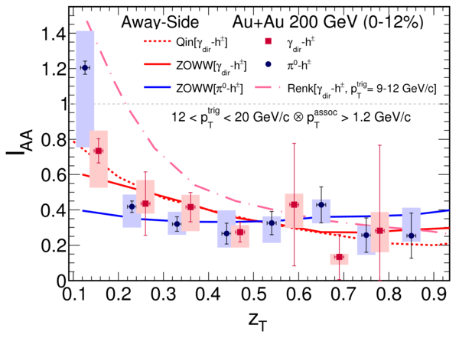
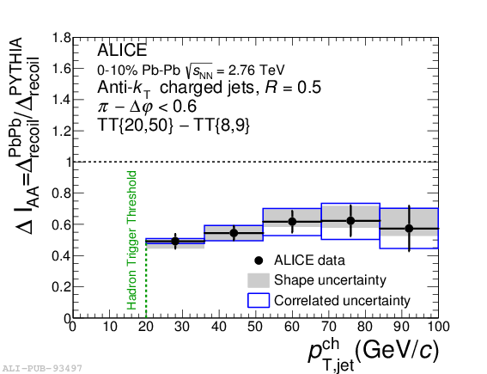

suppression
suppression
Jet v₂
[Phys.Lett. B 753 (2016) 511-525,
Phys. Rev. Lett.111 152301 (2013)]
Di-hadron correlations
[Too many to list]
γ-hadron correlations
[Phys.Rev.C80:024908,2009,
Phys.Rev.D82:072001,2010,
Phys.Rev.C82:034909,2010
Physics Letters B 760 (2016)]
γ-jet
correlations
[Phys. Lett. B 718 (2013) 773]
High-p_{T}
hadron v₂
[too many to list]
suppression
Dijet asymmetry
[Phys.Rev.C84:024906,2011,
Phys. Lett. B 712 (2012) 176,
Phys.Rev.Lett.105:252303,2010,
Phys. Rev. Lett. 119, 062301 (2017)]
Hadron-jet correlations
[JHEP 09 (2015) 170,
Phys. Rev. C 96, 024905 (2017)]

Slide 16
Fragmentation

Slide 17
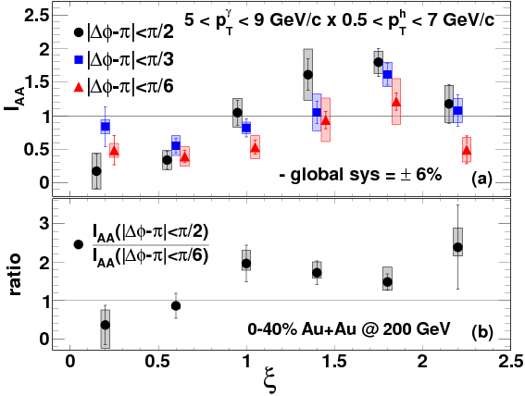
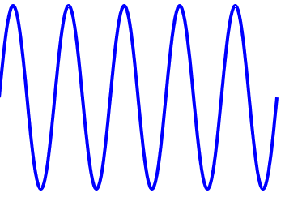
Fragmentations from γ-hadron correlations
z=p_{T}/E_{γ}
1.00
0.61
0.37
0.22
0.14
0.08
Enhancement at low z
Slight suppression at high z

Slide 18

Modified fragmentation
z=p_{T}/E_{γ}
Enhancement at low z
No modification/enhancement at high z?

Slide 19






Jet-hadron correlations vs reaction plane
Full jets
1) signal+bkgd
2) bkgd dominated
3) bkgd RPF fit
Trigger
Associated
No modification of constituents relative to reaction plane
→ Jet-by-jet fluctuations more important than path length [PLB 735 157(2014)]
  Also needed to explain high p_{T} v₂ [PRL 116 252301 (2016)]

Slide 20

Jet-hadron correlations
Jets are broader, constituents are softer
Also seen in:
  Di-hadron correlations [Lots of papers]
  Jet shapes [arXiv:1708.09429, arXiv:1512.07882, arXiv:1704.03046]
  Dijet asymmetry with soft constituents [PRL119 (2017) 62301]

Slide 21

Modified fragmentation
Jet-hadron correlations
Fragmentation functions with jets
Fragmentation functions with jets
arXiv:1609.03878
Di-jet asymmetry
Leading jet
z=p_{T}/E_{γ}
Di-hadron correlations
[Lots of papers]
Jet shapes
[arXiv:1708.09429,
arXiv:1512.07882,
arXiv:1704.03046]
Sys. Uncertainties:
Tracking:6%
Tower energy scale: 2%
Kolja Kauder, RHIC/AGS
User's Meeting 2016
Subleading jet

Slide 22


Jet structure

Slide 23


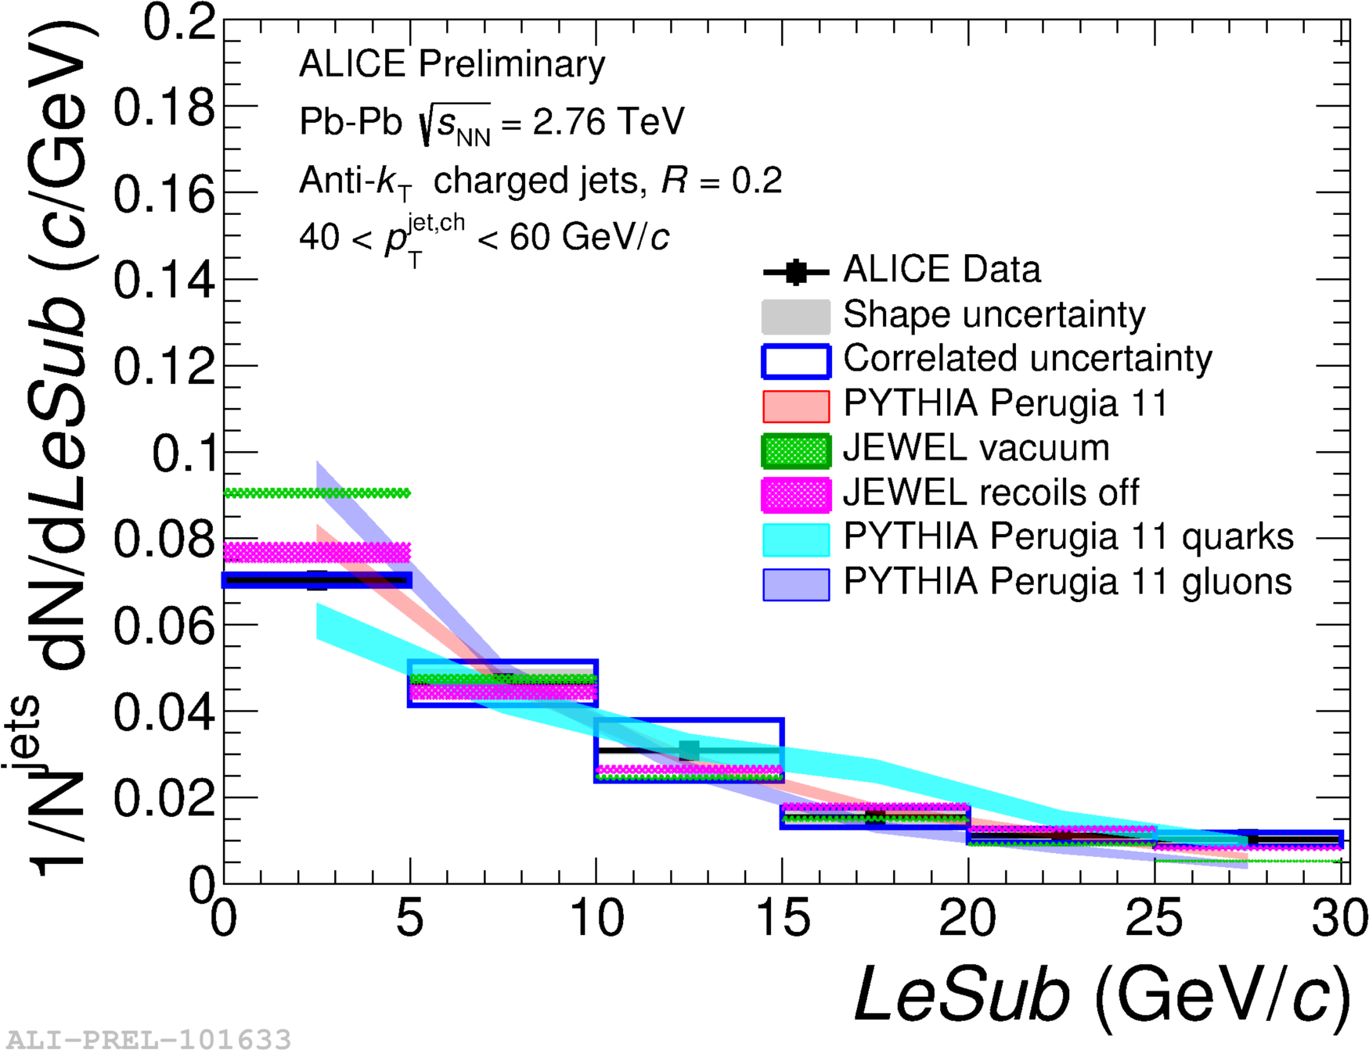
Girth g
Dispersion p_{T}D
LeSub
Jets are slightly more collimated than in pp
Agrees with PYTHIA

Slide 24
Theory

Slide 25
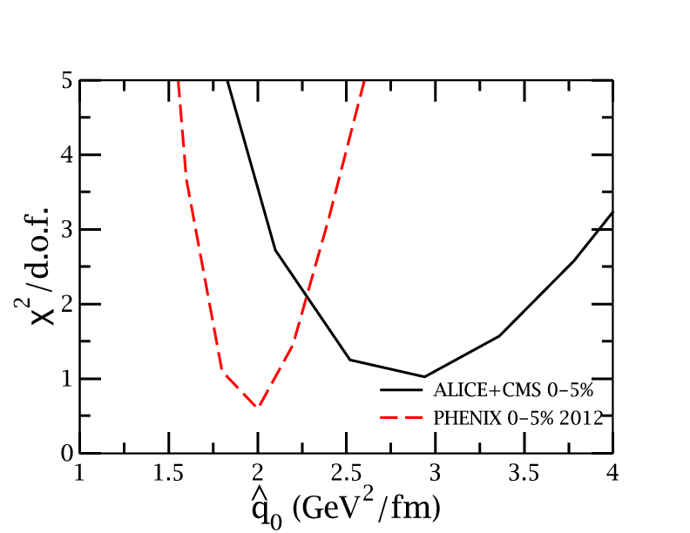
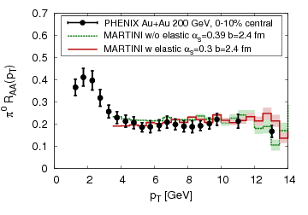
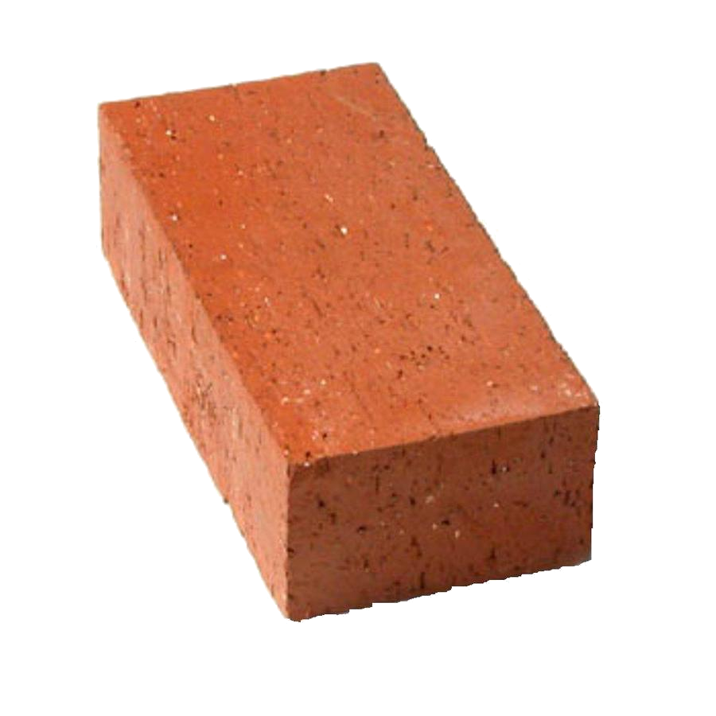
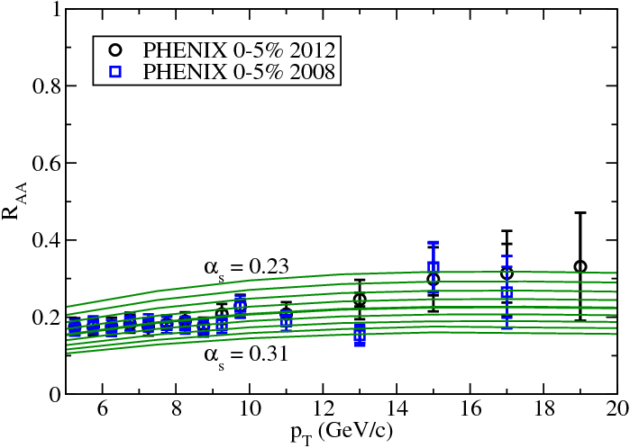
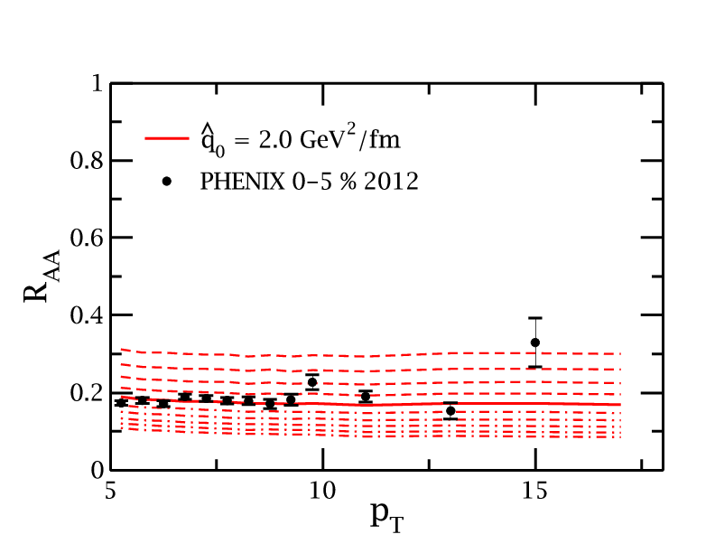
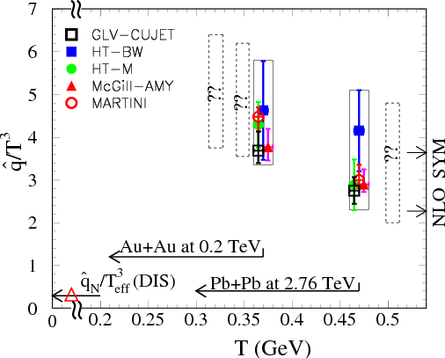
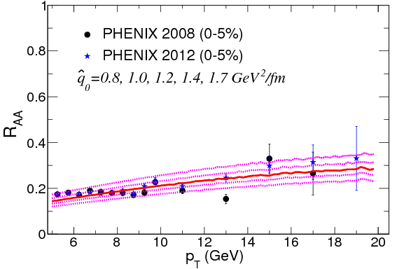
JET collaboration
Phys. Rev. C 90, 014909 (2014)
McGill
QGP brick + jet
HTM
HTBW
Data
200 GeV Au+Au
2.76 TeV Pb+Pb

Slide 26

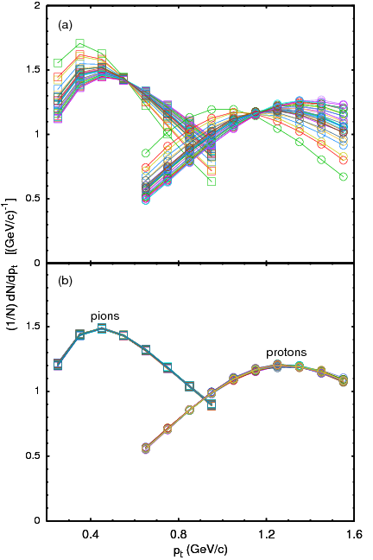
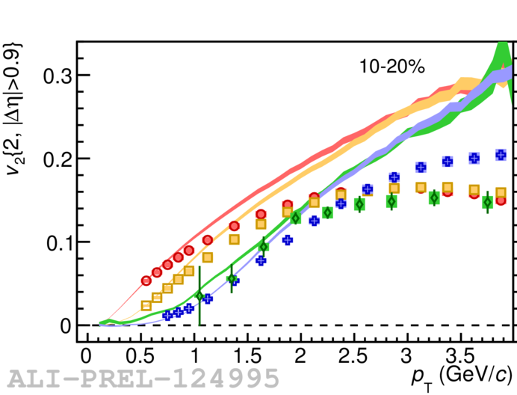
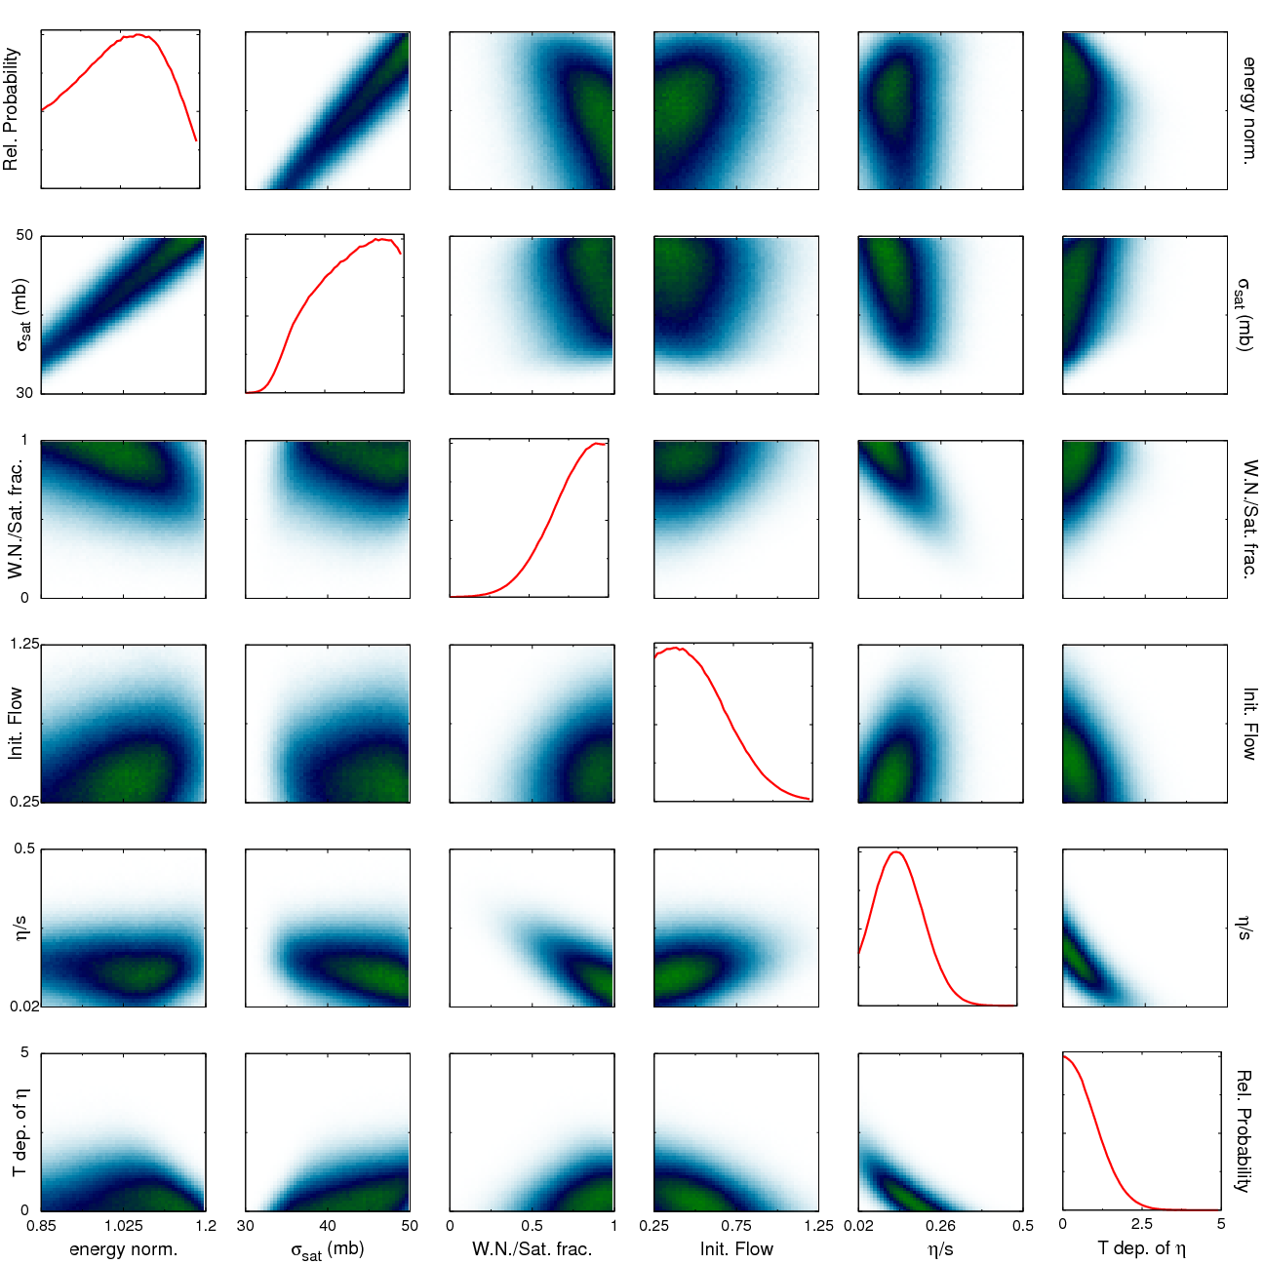

Bayesian Statistical Analysis
Models and Data Analysis Initiative
http://madai.us
Prior
Data
Posterior
Optimization
Monte Carlo
models
Model emulation
Run the model ~1000 times
Determine Principal
Emulate (Interpolate) for other parameter values
Constraint of QGP properties
Novak et al, Phys.Rev. C89 (2014) no.3, 034917

Slide 27

JETSCAPE
Event generator
Jet Energy-loss Tomography with a Statistically and Computationally Advanced Program Envelope
http://jetscape.wayne.edu/
Realistic medium
Realistic
theoretical
calculations
Experimental
techniques
Realistic Monte Carlo Model
Realistic jets

Slide 28
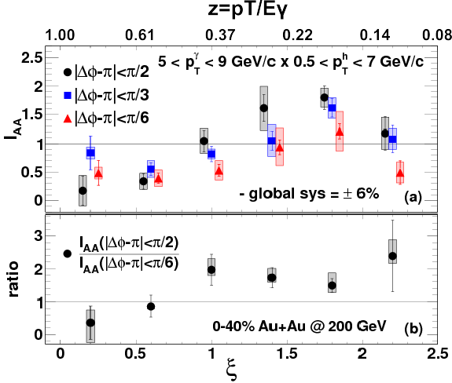
Event Generator + Bayesian Statistical analysis
Realistic theoretical calculations
Data
?
Constraint of QGP properties

Slide 29
What have we accomplished?
Qualitative confirmation of partonic energy loss models
Quantitative constraints of
Lots of measurements
What do we still have to do?
Understand bias
Make quantitative comparisons to theory
Make more differential measurements
We need an accord on how to treat background
Connors, Nattrass, Reed, SalurarXiv:1705.01974 [nucl-ex]

