Slide 1
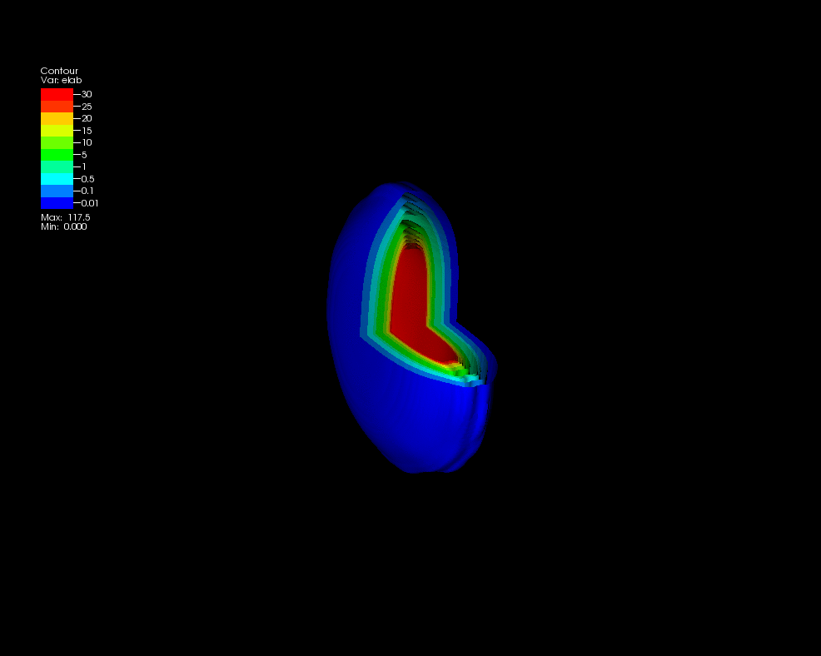
The little bang: understanding the Quark Gluon Plasma
Christine Nattrass
University of Tennessee at Knoxville
Calculations done on the Titan supercomputer by the CJet collaboration https://sites.google.com/site/cjetsite/

Slide 2

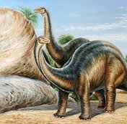
The Standard Model
Weak force
Electromagnetic force
Strong force
125000
Higgs
http://e4.physik.uni-dortmund.de/bin/view/ATLAS/SmBilder?PhotoarchivePlugin_page=1&PhotoarchivePlugin_view=detailed

Slide 3
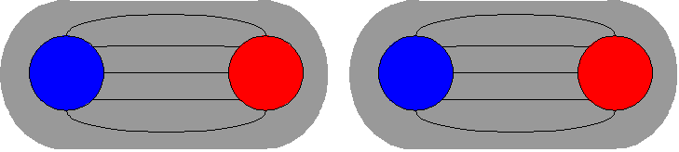
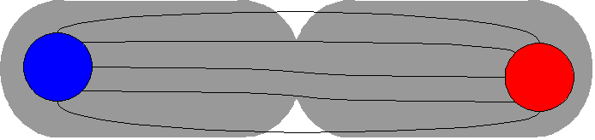
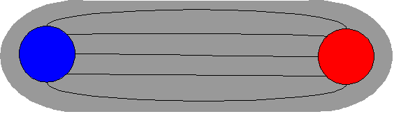
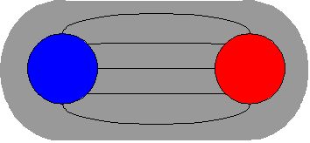
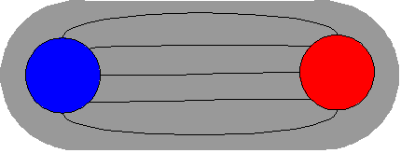
What keeps the nucleus together?
Electric force: gets weaker as two objects get pulled apart
Strong force: gets stronger as two objects get pulled apart – like a rubber band
As we pull apart the quark and antiquark in a meson, at some point it takes less energy to make a quark-antiquark pair than to pull them further apart
No free quarks - confinement
Electromagnetic force
strength
Strong
force
distance

Slide 4


Hadrons
Baryons
Mesons
3 quarks/antiquarks
Color charge: red-green-blue
Quark-antiquark
Color charge: blue - anti-blue

Slide 5





Phase diagram of nuclear matter
Quark Gluon Plasma
Core of neutron stars?
Quark Gluon Plasma – a liquid of quarks and gluons created at temperatures above ~170 MeV (2·10¹²K) – over a million times hotter than the core of the sun
Notes:
But wait – how can we have a liquid of quarks and gluons? Doesn't asymptotic freedom tell us that we can't have free quarks and gluons? How, then, can we have a liquid of quarks and gluons?

Slide 6

How to make a Quark Gluon Plasma

Slide 7

The phase transition in the laboratory

Slide 8












Relativistic Heavy Ion Collider
Large Hadron Collider
PHOBOS
BRAHMS
CMS
PHENIX
STAR
RHIC
LHCb
ALICE
ATLAS
LHCf
Upton, NY
1.2km diameter
p+p, d+Au, Cu+Cu, Au+Au, U+U
√s_{NN} = 9 - 200 GeV
Geneva, Switzerland
8.6km diameter
p+p, p+Pb, Pb+Pb
√s_{NN} = 2.76 GeV, 5.5 TeV
LHC
Quark Gluon Plasma
RHIC
Core of neutron stars?
Notes:
Mention that RHIC planning began 1983

Slide 9
Comparison of colliders
 | RHIC | LHC
√s_{NN} (GeV) | 9-200 | 2760, 5500 | center of mass energy
dN_{ch}/dη | ~1200 | ~1600 | number of particles
T/T_{c} | 1.9 | 3.0-4.2 | temperature
ε (GeV/fm³) | 5 | 12, 16 | energy density
τ_{QGP} (fm/c) | 2-4 | >10 | lifetime of QGP
RHIC and LHC:
Cover 2 –3 decades of energy (√s_{NN}= 9 GeV –5 TeV)
To discover the properties of hot nuclear matter at T ~ 150 –600 MeV

Slide 10

ALICE
ATLAS
CMS
STAR
PHENIX
Notes:
Mention that RHIC planning began 1983

Slide 11
Interesting observables
Different hadronization mechanisms
→ Identify particle types
Collective motion of particles
→ Low momentum acceptance
Even common processes are not well understood
→ Do not need 4π acceptance or high rates

Slide 12




Size: 16 x 26 meters
Weight: 10,000 tons
Detectors: 18
Trigger detectors: When do we have a collision?
Tracking detectors: Where did the particle go?
Identification detectors: What kind of particle is it?
Calorimeters: How much energy does the particle have?
<number>
Notes:
By comparison ATLAS is 25 meters in diameter and 44 meters long – not quite twice as large

Slide 13

p+p collisions
3D image of each collision

Slide 14

Pb+Pb collisions
5

Slide 15
QGP Energy Density

Slide 16

How can we estimate the energy density?
Transverse energy (E_{T})
  sum of particle energies in transverse direction
Volume V = A_{T} τc
τ = formation time
Energy density ε
QGP formation for ε > 0.5 GeV/fm³
A_{T}
= τc

Slide 17

Energy density
RHIC
Standard estimate τ₀ ≈ 1 fm/c
QGP formation

Slide 18
QGP Spectroscopy

Slide 19
Probing the Quark Gluon Plasma
Medium
Probe
Detector
Want a probe which traveled through the collision
QGP is very short-lived (~1-10 fm/c) →
cannot use an external probe

Slide 20

Probes of the Quark Gluon Plasma
nucleus
nucleus
Want a probe which traveled through the medium
QGP is short lived → need a probe created in the collision

Slide 21
Probes of the Quark Gluon Plasma
nucleus
nucleus
Want a probe which traveled through the medium
QGP is short lived → need a probe created in the collision
We expect the medium to be dense → absorb/modify probe

Slide 22





Jets
p+p → dijet
D
c, x_{c}
p
a, x_{a}
b, x_{b}
p
σ_{ab}
Beam pipe
d, x_{d}
D
Jets – hard parton scattering leads to back-to-back quarks or gluons, which then fragment as a columnated spray of particles

Slide 23

Jet reconstruction
p+p di-jet event in STAR
Central Au+Au collision in STAR
Identify all of the particles in the jet → parton energy, momentum
Difficult in heavy ion collisions – but possible!

Slide 24

Jets
Phys.Rev.Lett. 105 (2010) 252303
nucleus
nucleus
ATLAS

Slide 25

Quenched jets
nucleus
nucleus
One of the jets is absorbed by the medium
The quark or gluon has equilibrated with the medium
Phys. Rev. Lett. 105, 252303 (2010)
ATLAS

Slide 26


Nuclear modification factor
Measure spectra of probe (jets) and compare to those in p+p collisions or peripheral A+A collisions
If high-p_{T} probes (jets) are suppressed, this is evidence of jet quenching
Enhancement
Suppression

Slide 27
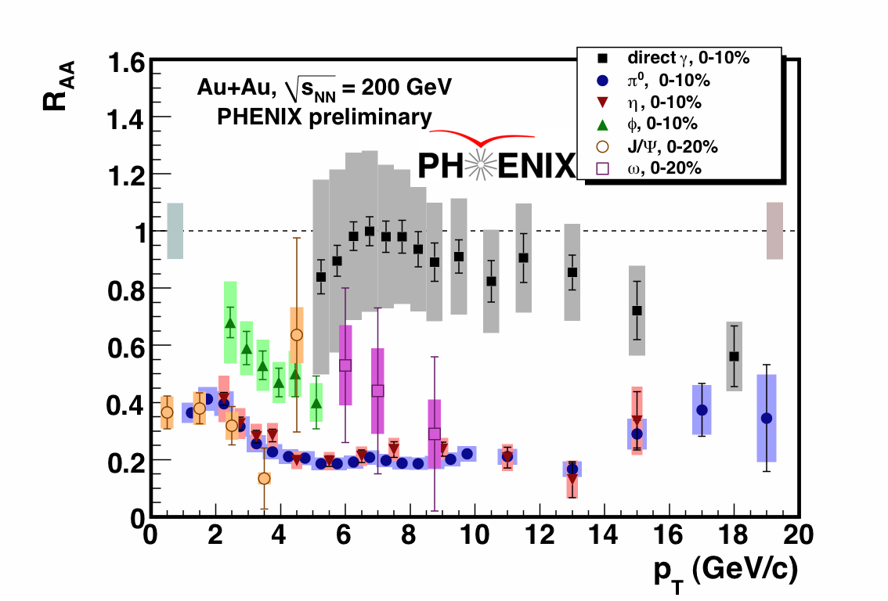

Nuclear modification factor R_{AA}
RHIC
LHC
Electromagnetic probes – consistent with no modification – medium is transparent to them
Strong probes – significant suppression – medium is opaque to them

Slide 28
Nuclear modification factor R_{AA} at LHC
Fully unfolded inclusive jet R_{AA}
pp 2.76 TeV reference
CMS-PAS HIN-12-001
Like for charged particles, high-p_{T} jet R_{AA} flat at ≈ 0.5

Slide 29
QGP Chemistry

Slide 30

Chemistry - equilibrium
T~170 MeV
Nuclear Physics A Volume 757, 102-183
Ratios of particles expected from a model
Even strange quarks are at equilibrium!

Slide 31
QGP Thermometers

Slide 32


Measuring temperature

Slide 33


Thermal photons
Phys.Rev.Lett.104:132301,2010
Thermal photons
QCD processes
ALICE collaboration:
Pb+Pb collisions at √s_{NN}=2.76 TeV
Inverse slope: T = 304 +/-51
PHENIX collaboration: Au+Au collisions at √s_{NN}=200 GeV
Inverse slope: T = 221 +/- 19 (stat) +/- 19 (syst) MeV

Slide 34





Building a quarkonium-thermometer
CMS-PAS HIN-11-011
N_{part}
Clear hierarchy in R_{AA} of different quarkonium states
c
c
b
b

Slide 35

Building a quarkonium-thermometer
Note: 6.5<p_{T}<30 GeV for J/ψ and ψ(2s)
CMS-PAS HIN-11-011
N_{part}
Clear hierarchy in R_{AA} of different quarkonium states
Expected in terms of binding energy
CMS-PAS HIN-12-014, HIN-12-007

Slide 36
QGP Fluid Dynamics

Slide 37


If we have a fluid...
Au+Au √s_{NN} = 200 GeV
b=7 fm
Particles pushed out
Equipotential lines
arXiv:nucl-th/0305084
Initial overlap asymmetric → pressure gradients
Momentum anisotropy → Fourier decomposition:
Notes:
So at this point you're probably wondering how on earth we measure the viscosity of this thing that exists for only a few fermi/c – for less than 10^-24 seconds
When the nuclei collide, they create a droplet of QGP. This droplet of QGP is not symmetric – this shows the incoming nuclei - and there are huge pressure gradients in it. This shows a calculation of the equipotential lines in the QGP.
These pressure gradients push particles out – meaning that particles in this direction are going faster than particles in this direction
What we do is measure the Fourier coefficients of the distribution of particles

Slide 38
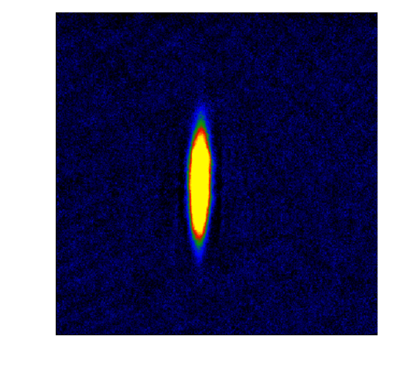

What does this mean?
Same phenomena observed in gases of strongly interacting atoms
  K, O’Hara, S. Hemmer, M. Gehm, S. Granade, J. Thomas Science 298 2179 (2002)
High viscosity
Low viscosity

Slide 39










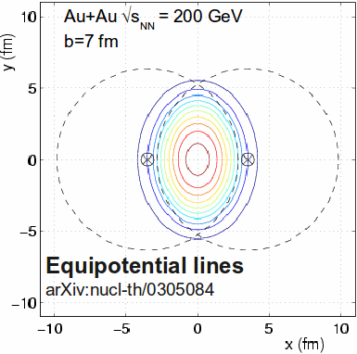
What does it mean?
Same phenomena observed in gases of strongly interacting atoms
Time
K, O’Hara, S. Hemmer, M. Gehm, S. Granade, J. Thomas Science 298 2179 (2002)
Initial state anisotropies converted to final state anisotropies
Fourier decomposition:
Offset
measured

Slide 40
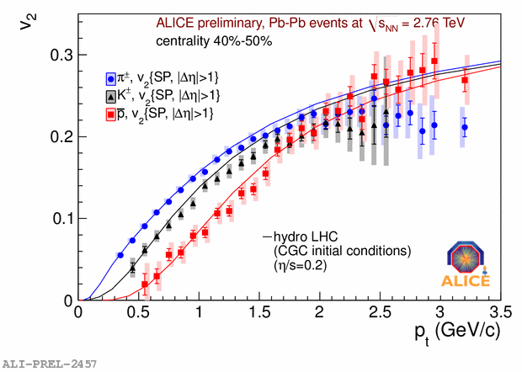
Does this describe the data?
Lower viscosity
arXiv: 1108.5323v1
Yes!
Notes:
Now I don't want to get into the details of this plot but

Slide 41
What does this mean?
Same phenomena observed in gases of strongly interacting atoms
  K, O’Hara, S. Hemmer, M. Gehm, S. Granade, J. Thomas Science 298 2179 (2002)
High viscosity
Low viscosity
The Quark Gluon Plasma has a very low viscosity

Slide 42
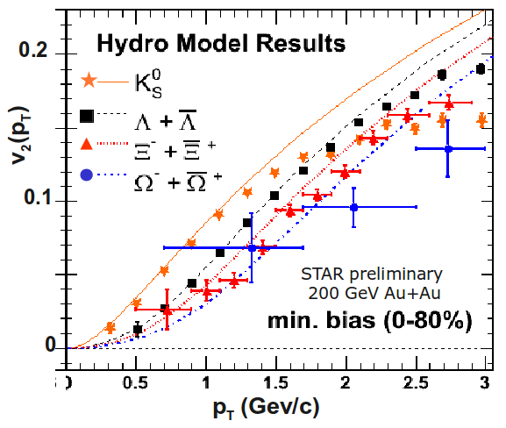
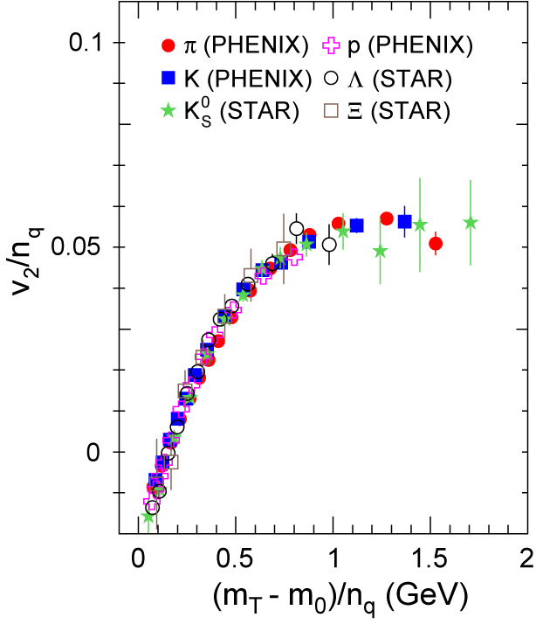
More data
Phys. Rev. Lett. 98, 162301 (2007)
Mass ordering:
v₂(K) > v₂(Λ) > v₂(Ξ)
v₂(p_{T}^{hadron}) µ n_{quark}v₂(p_{T}^{quark})
We have a liquid of quarks and gluons!

Slide 43
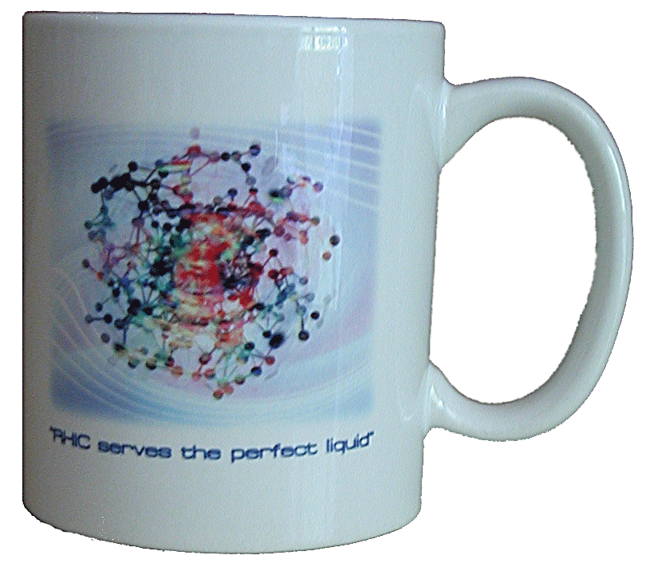
What do we learn about the QGP?
Hydrodynamics works →
  (local) thermalization
  image of the initial state
Really low viscosity
  Near AdS/CFT bound
  η/S ~ 1/4π
The QGP is the perfect liquid!
(not the gas of “free” quarks and gluons we expected)

Slide 44


Take home messages
If we get nuclear matter dense enough, we make a new phase of matter, which we produce in high energy heavy ion collisions.
This medium is transparent to colored probes and translucent to electromagnetic probes...
...and an extremely hot and dense...
...perfect liquid.

Slide 45
Careers in high energy physics
You should consider high energy physics if...
  You like programming and working with computers
  You're a people person – and don't mind working with 1000 people
  You like to travel around the world – and work
  You enjoy giving talks
Common career options for people with a Ph.D. in high energy physics
  Academia – research and teaching universities
  Research at a National Laboratory
  National security
  Finance
  Computer programming

Slide 46




What I spend my time doing
Programming (c++) - analyzing data
Writing and giving talks – 3 research talks, 1 seminar, 2 posters, 1 software tutorial, and lots of talks (>30) at internal meetings in 2010
Hardware work: assembling & testing the detector
Outreach: blogging for ALICE, giving tours of PHENIX to the public...
Writing papers and conference proceedings
Reviewing the work of my collaborators
Reading papers
Taking shifts – including being on call 24/7
Teaching, advising students (undergrad & grad)
Committee work

Slide 47
Resources
US LHC blog and Facebook page
Experiments
  Relativistic Heavy Ion Collider: STAR PHENIX
  Large Hadron Collider: ALICE ATLAS CMS LHCb TOTEM
Event displays and pretty pictures from ALICE
Really cool ATLAS event animation
Links to articles in the press on PHENIX
Scientific American article

Slide 48
US Universities with graduate programs in experimental heavy ion physics
Relativistic Heavy Ion Collider
STAR
  University of California at Davis
  University of California Los Angelos
  University of Houston
  University of Illinois at Chicago
  Creighton University (masters only)
  Kent State University
  Michigan State University
  Ohio State University
  Purdue University
  Texas A&M University
  University of Texas Austin
  University of Washington
  Wayne State University
  Yale University
PHENIX
  University of California Riverside
  University of Colorado Boulder
  Columbia University
  Florida State University
  Georgia State University
  Iowa State University
  Ohio University
  State University of New York (Chemistry & Physics departments)
  University of Tennessee at Knoxville
  Vanderbilt University

Slide 49
US Universities with graduate programs in experimental heavy ion physics
Large Hadron Collider
ALICE
  University of Texas Austin
  Chicago State University
  Ohio State University
  Wayne State University
  University of Texas Houston
  University of Tennessee Knoxville
  Yale University
  Creighton University (masters only)
  Purdue University
CMS
  University of California Davis
  University of Illinois Chicago
  University of Kansas
  University of Maryland
  University of Iowa
  Rutgers University
  Massachusetts Institute of Technology
  Vanderbilt University
ATLAS
  Columbia University

Slide 50
Interesting observables
Different hadronization mechanisms
→ Identify particle types
Collective motion of particles
→ Low momentum acceptance
Even common processes are not well understood
→ Do not need 4π acceptance or high rates

Slide 51
Probing the Quark Gluon Plasma

Slide 52
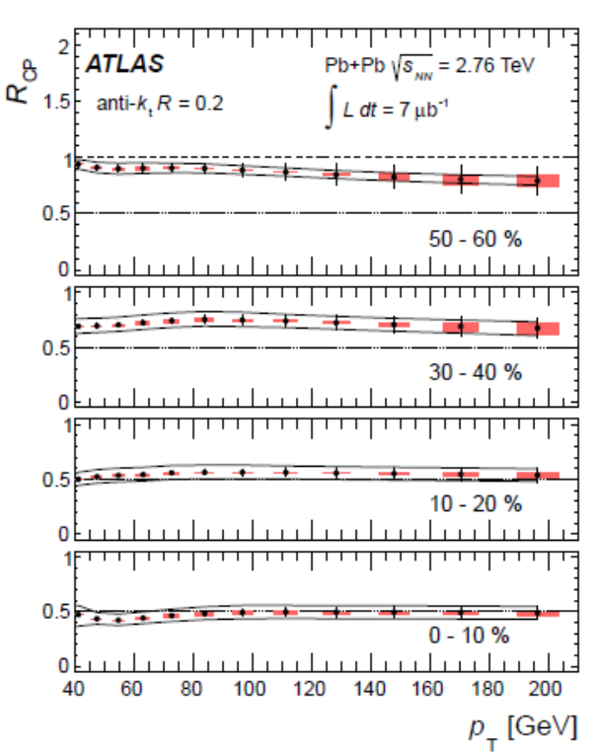
Jet nuclear modification factor*
arXiv:1208.1967 [hep-ex] Submitted to Phys. Lett.B
ATLAS collaboration
Anti-kT algorithm
R=0.2
*Rcp is the ratio of central to peripheral A+A collisions instead of A+A collisions to p+p

Slide 53
Measuring temperature

Slide 54
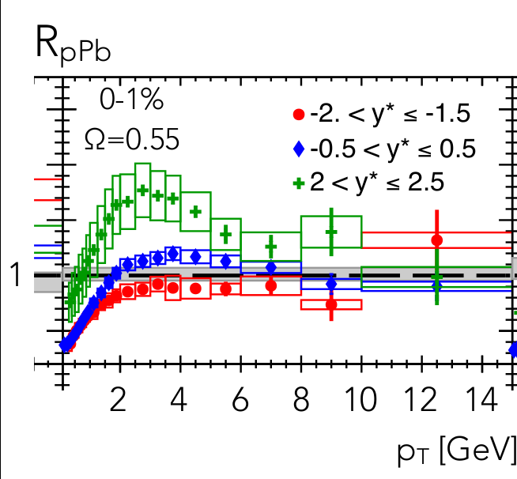
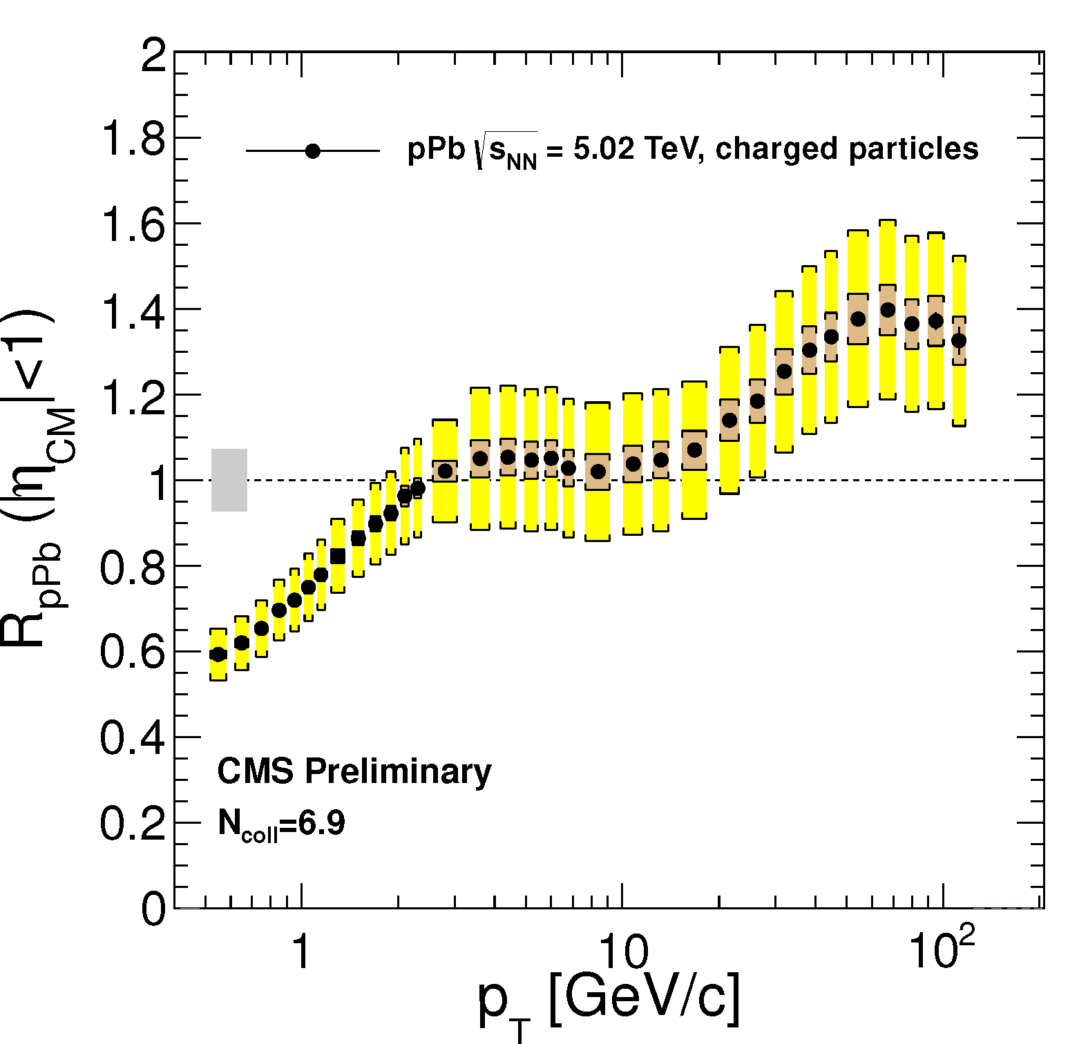
p+Pb as a control
ATLAS-CONF-2013-096
CMS
ATLAS

Slide 55
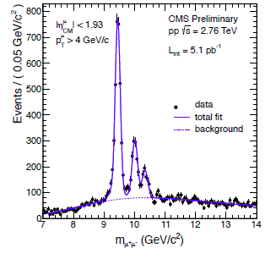
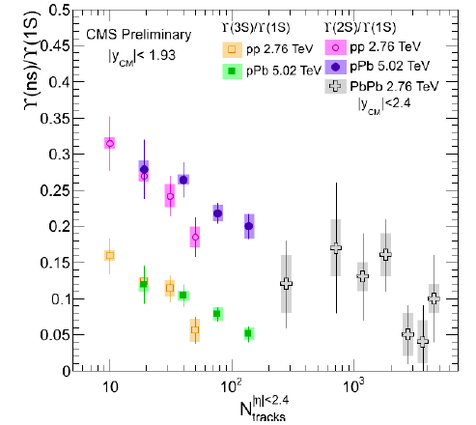
Suppression of quarkonia in p+Pb
pp
pPb
PbPb
p
pPb

Slide 56

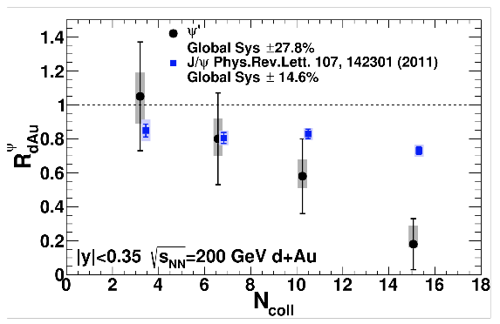
Suppression of quarkonia in d+Au
PHENIX

Slide 57
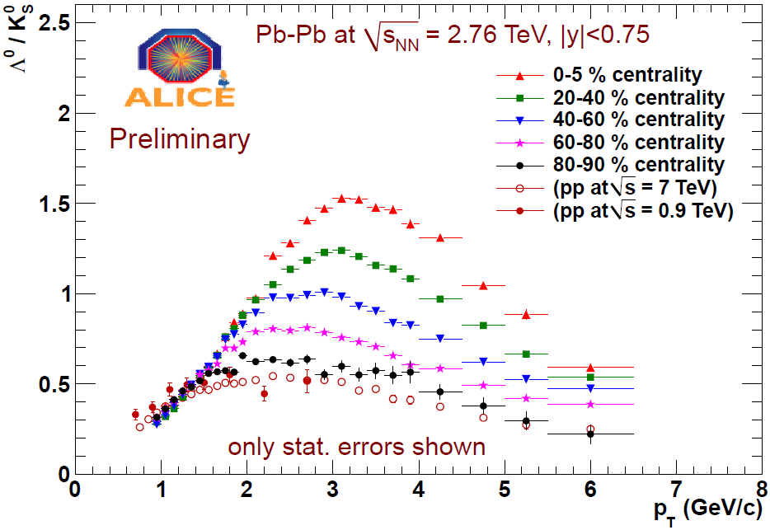
Baryon anomaly: Λ/K⁰_{S}
Pb+Pb

Slide 58
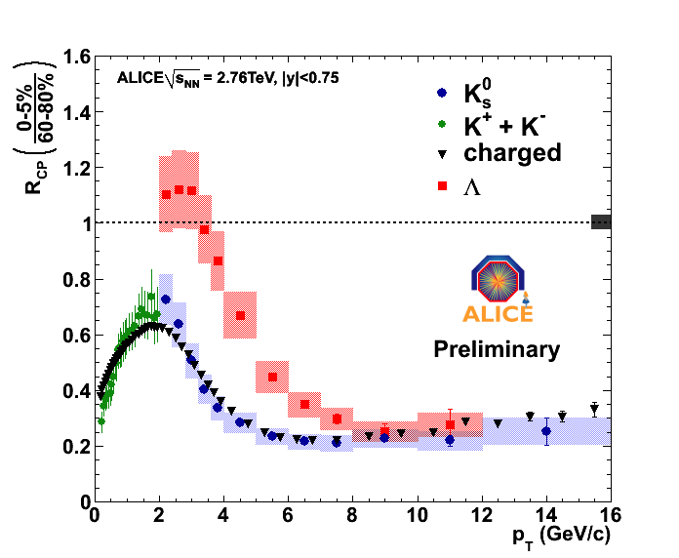
Nuclear modification factor (R_{AA})
Λ
K⁰_{S}
K±
Pb+Pb

Slide 59
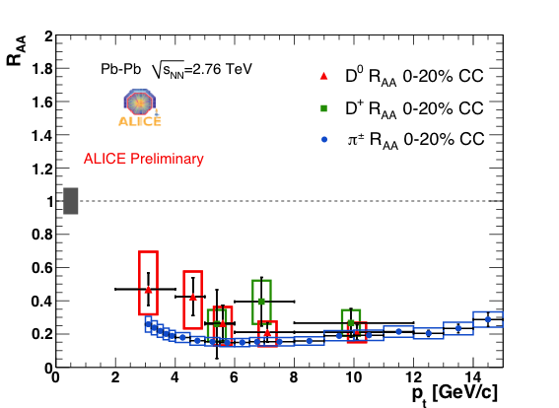
Charm nuclear modification factor
Pb+Pb

