Slide 1
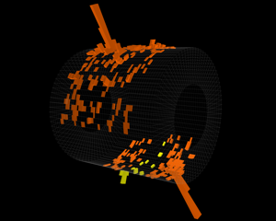

Measurements of jets in ALICE
Christine Nattrass
University of Tennessee, Knoxville
for the ALICE collaboration

Slide 2
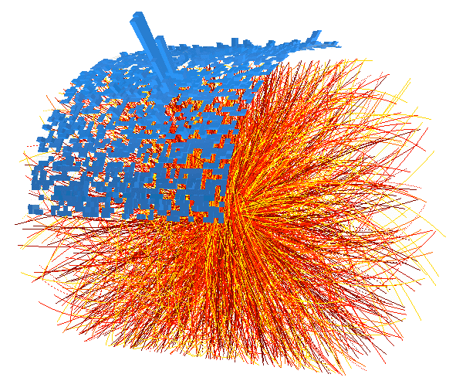
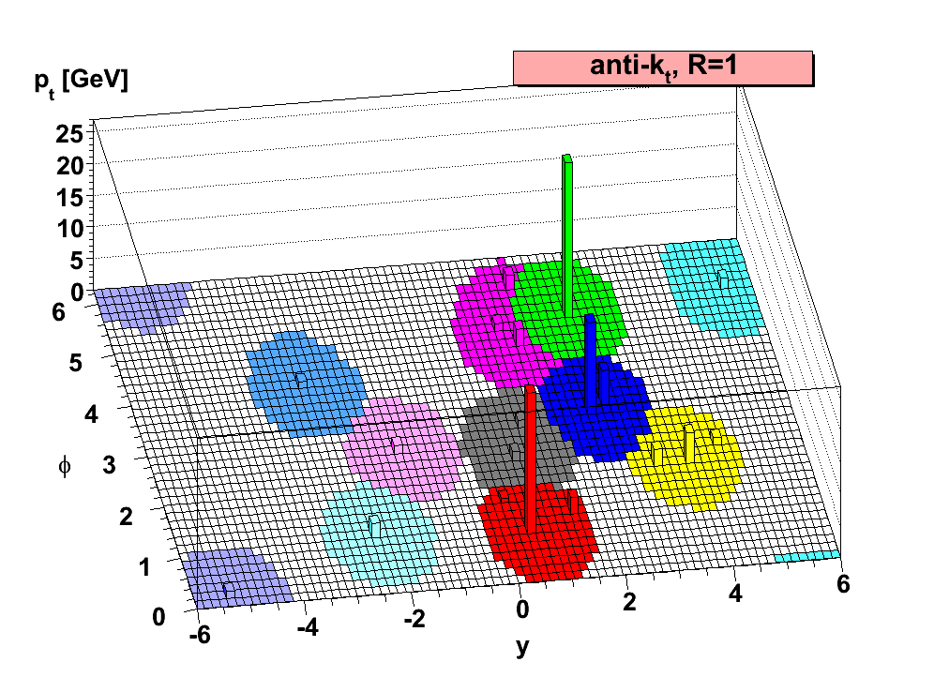
Observables
Jet spectra, R_{AA}
Production rates
Jet-hadron correlations
Average jet properties
Cacciari, Matteo et al. JHEP 0804 (2008) 063 arXiv:0802.1189 [hep-ph] LPTHE-07-03
New jet (shape) observables
Jet substructure
Spectra & R_{AA}
Jet-hadron correlations
Jet structure
See also Alexandre Shabetai July 6 QCD & Hadronic Physics
Tracks
Jet finding algorithm
Jet candidates
Clusters
Particles

Slide 3
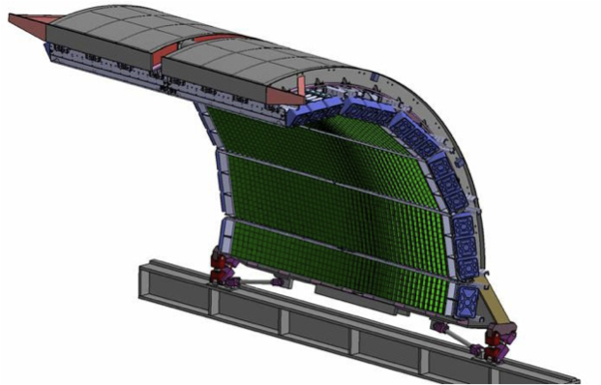
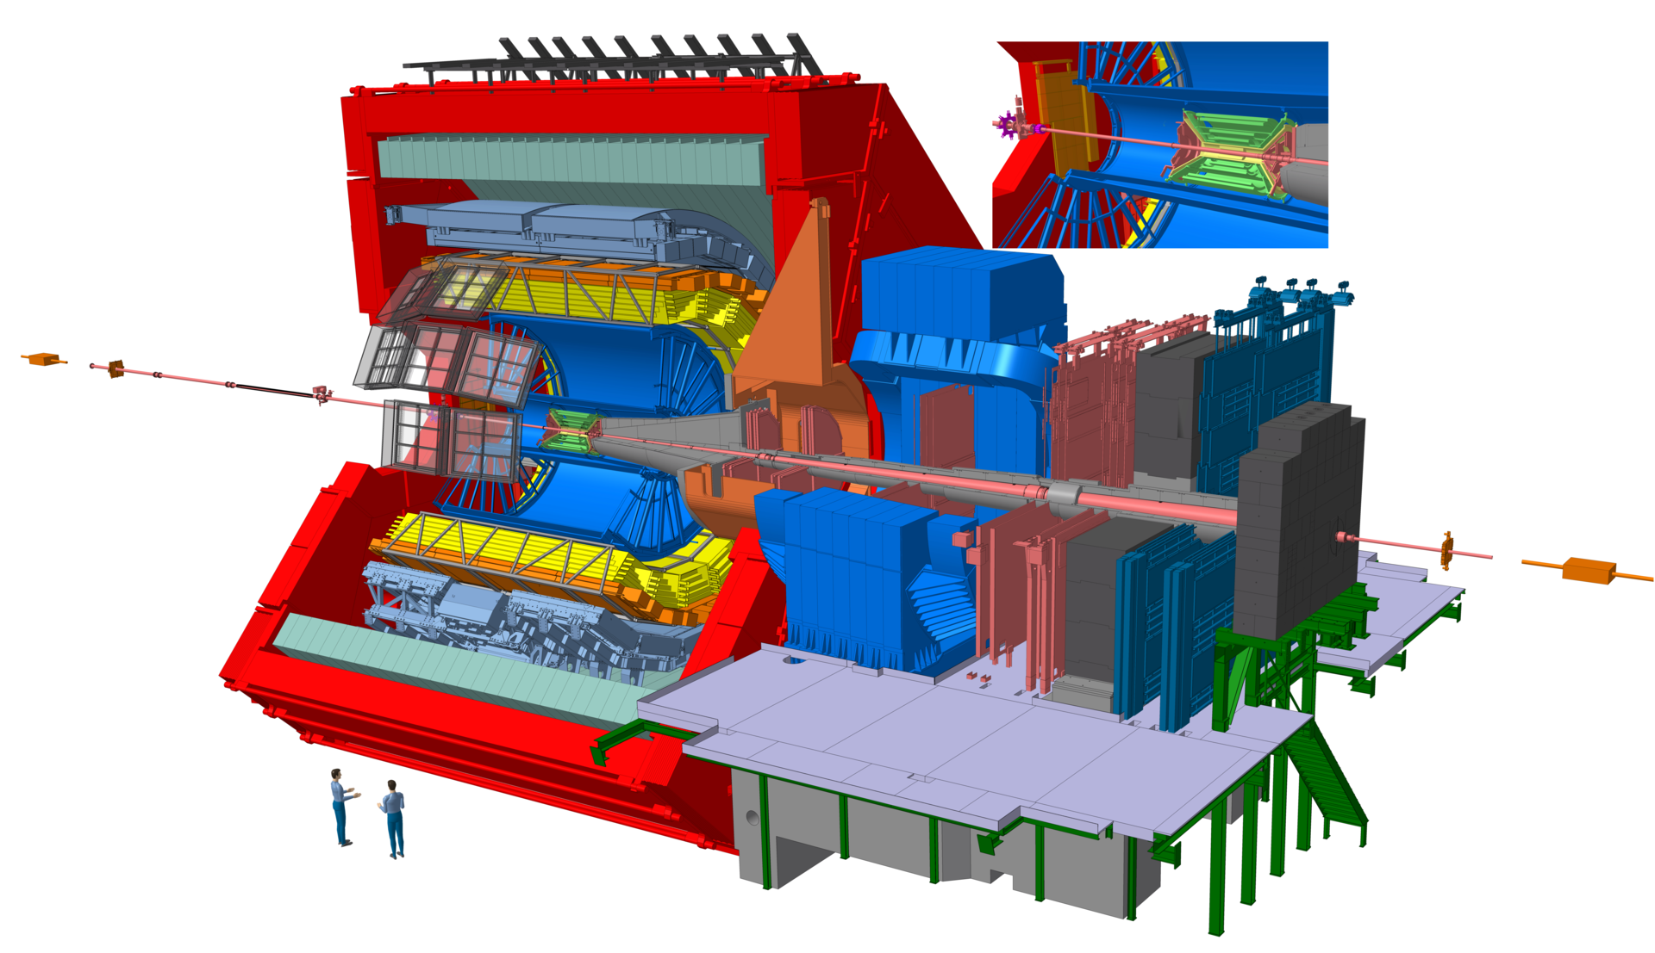

<footer>
<number>
Jets in ALICE
EMCal –γ,π⁰,η,ω
trigger
EMCal
TOF
Tracking - h±
EMCal Pb-scintillator sampling calorimeter:
  |η| < 0.7, 1.4 < φ < π
  tower Δη~0.014,Δφ ~0.014
ITS
PID
TPC
DCal
Remove contamination from
Charged particles
Neutral constituents
Full jet
Charged
constituents
Tracking:|η|< 0.9, 0<φ<2π
TPC, ITS
Charged jet
Notes:
----- Meeting Notes (6/24/13 14:33) -----
Fix Arrows
<number>

Slide 4
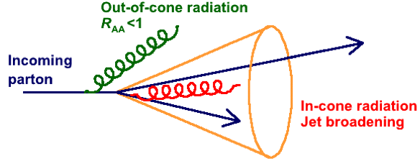
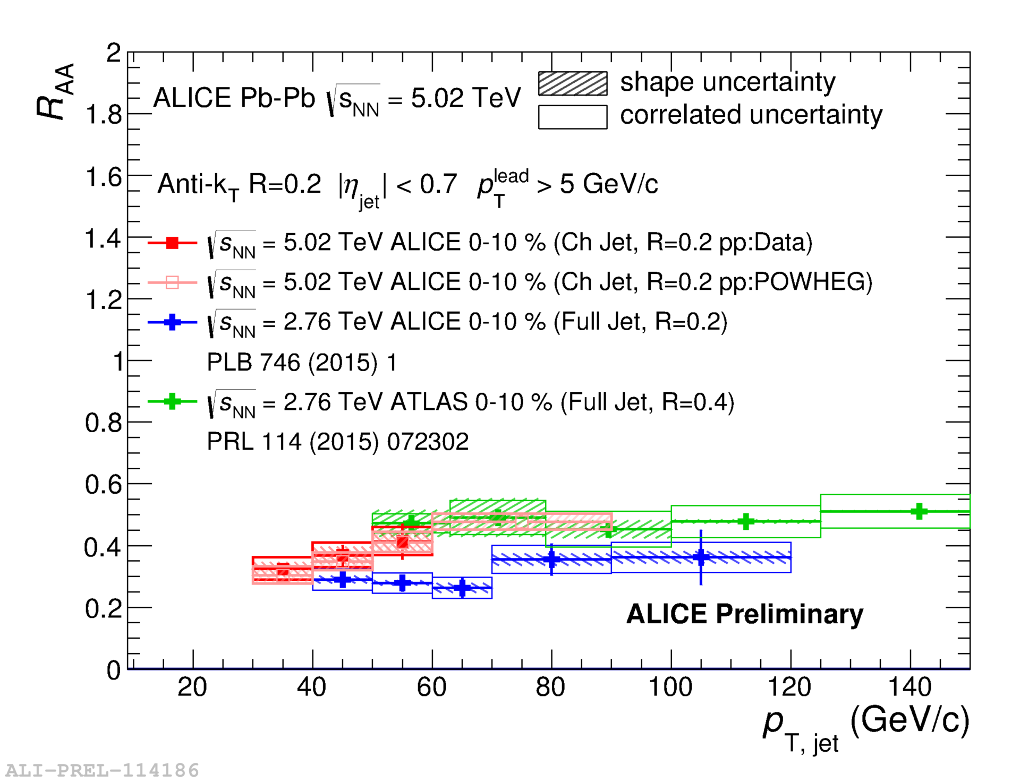
Jet R_{AA}
Out-of-cone radiation: energy loss in jet cone
  Jet yield suppression, di-jet energy imbalance, jet-jet/hadron-jet acoplanarity…
In-cone radiation: medium modified fragmentation
  Jet shape broadening, modification of transverse energy profile…
Consistent with RAA of charged particles and charged-jet RAA at 2.76 TeV

Slide 5
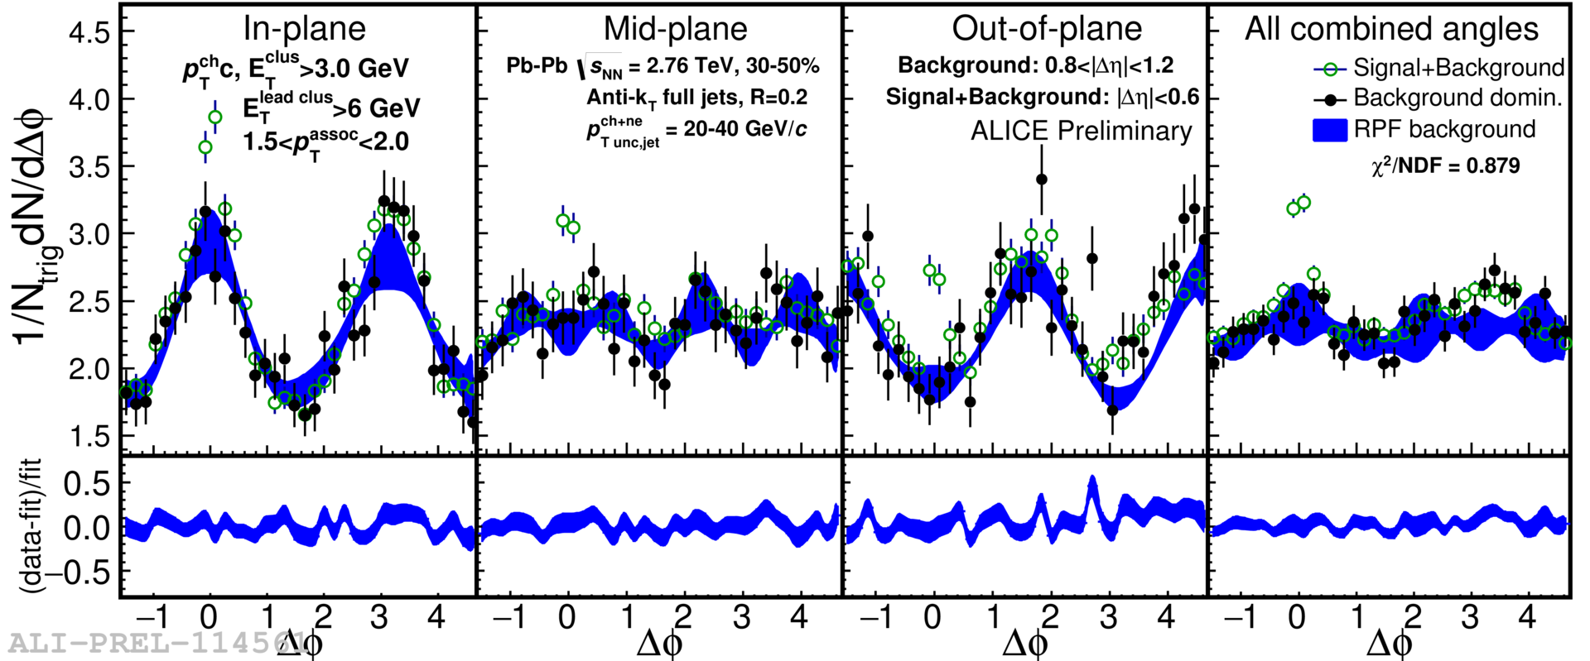


Jet-hadron correlations vs reaction plane
1.5<p_{T}^{assoc}<2.0 GeV/c
Full jets
1) signal+bkgd
2) bkgd dominated
3) bkgd RPF fit
Trigger
Associated
Background uncertainty non-trivially correlated point-to-point
Method described in Sharma, Mazer, Stuart, Nattrass Phys. Rev. C 93 (2016), 044915

Slide 6
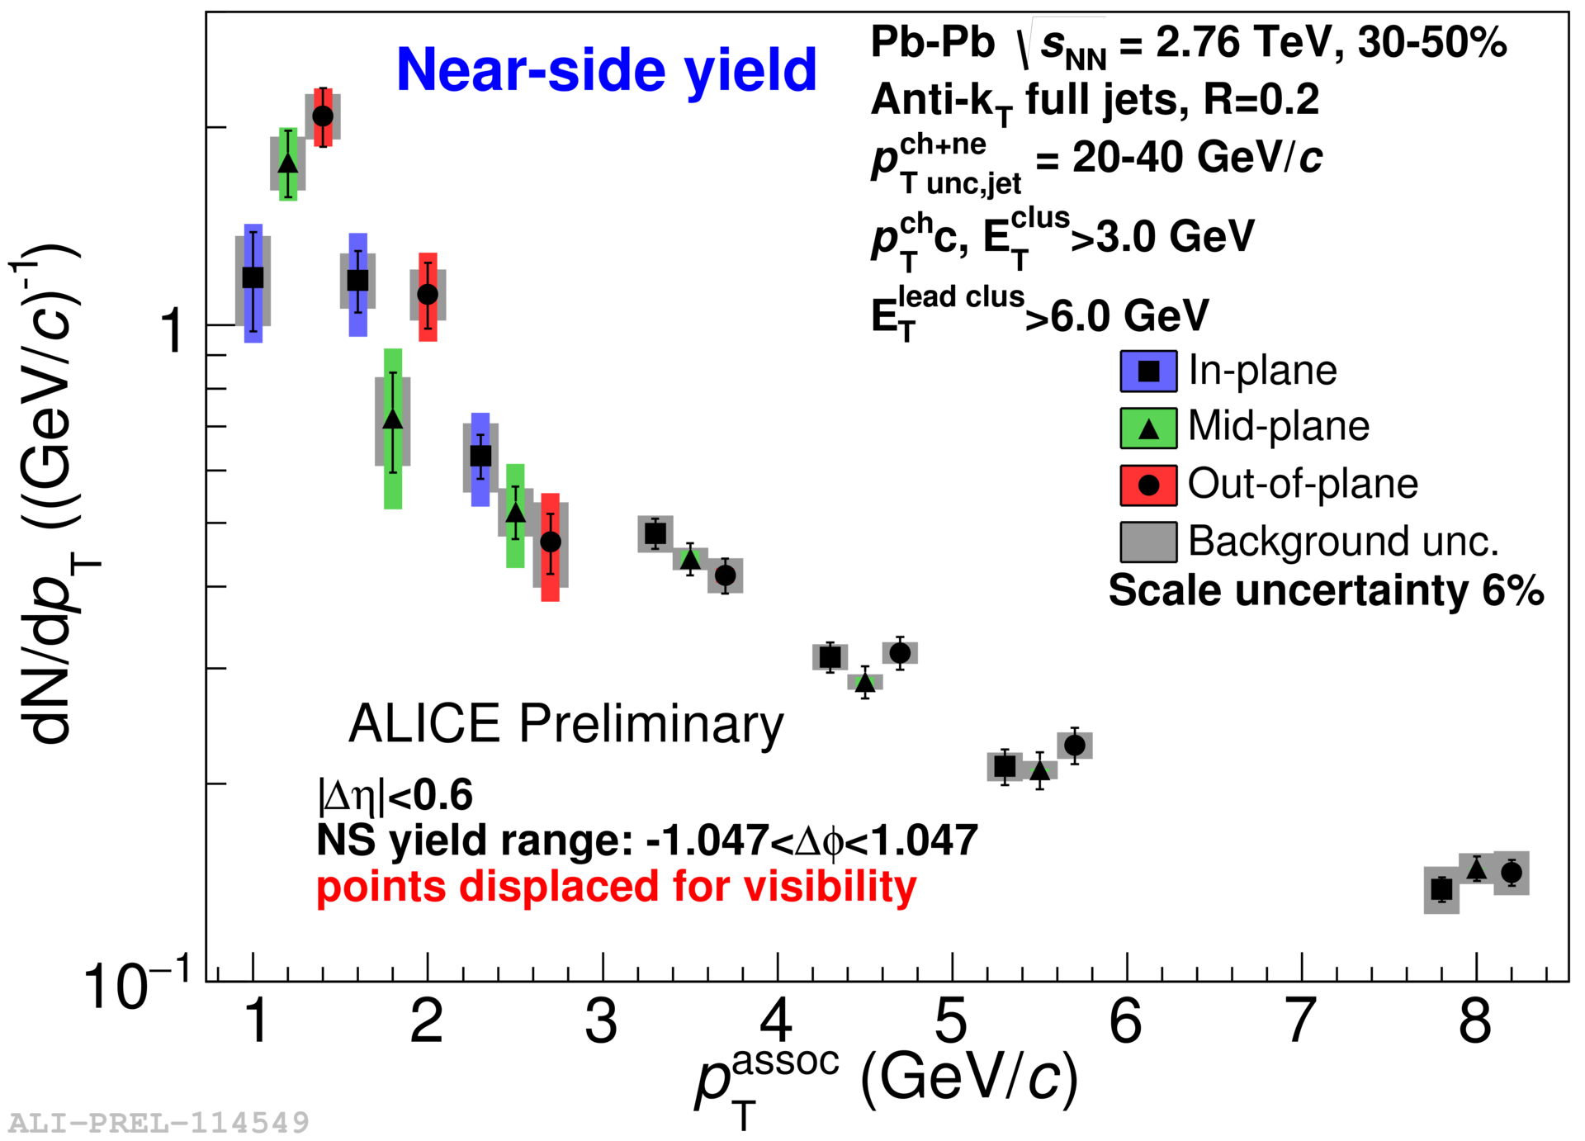
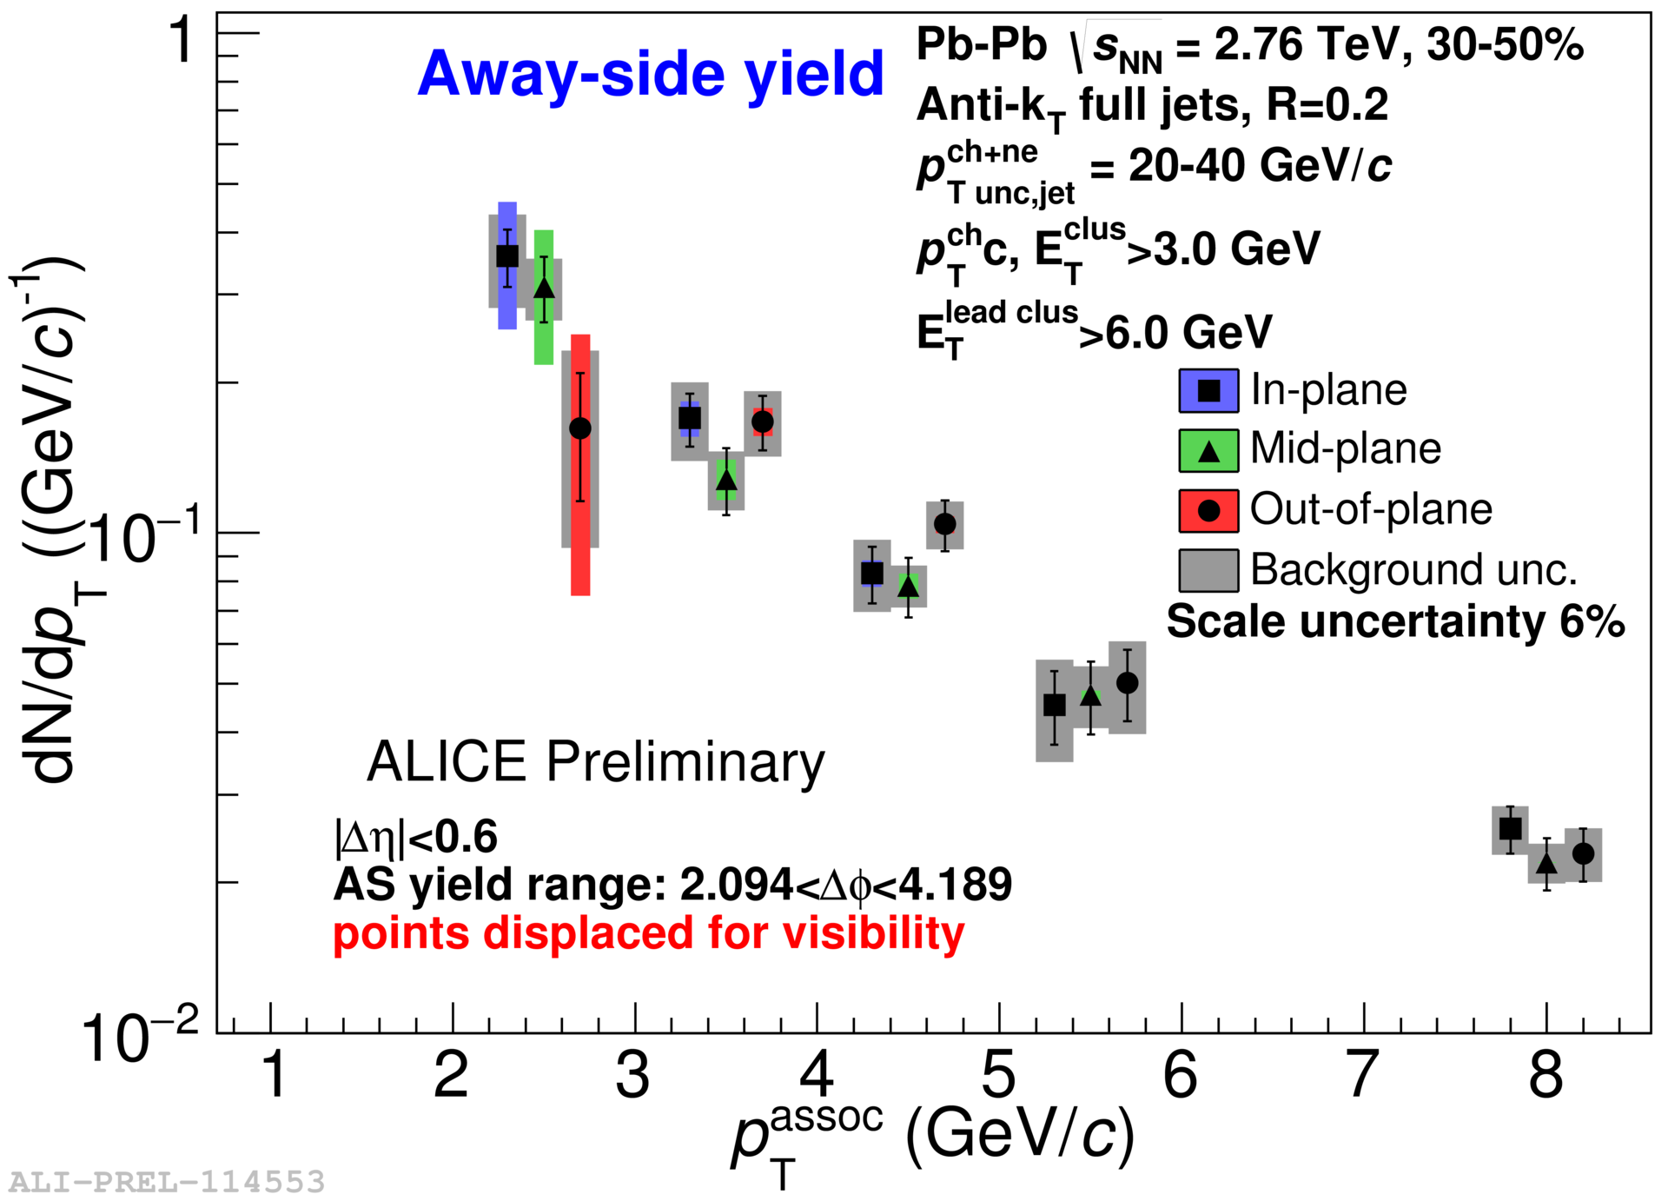
Near- and away-side yields
Full jet-hadron correlations vs reaction plane
Jets 20-40 GeV/c, 30-50% centrality
Possible competing effects:
  Quenching (decrease yield in → out)
  Bremsstrahlung (increase yield in → out)
  Jet-by-jet fluctuations in energy loss (Milhano & Zapp, Eur.Phys.J. C76 (2016) no.5, 288)

Slide 7


Near- and away-side yield ratios
Full jet-hadron correlations vs reaction plane
Jets 20-40 GeV/c, 30-50% centrality
Within uncertainties of current statistics, no event plane ordering
Indication that path-length is a secondary effect to fluctuations of jet energy loss in the medium
Consistent with reanalysis of STAR dihadron correlation data
Nattrass, Sharma, Mazer, Stuart, and Bejnood (Phys. Rev. C 94, 011901(R) 2016)

Slide 8



Jet mass
arXiv:1702.00804
Quenching models (JEWEL, Q-PYTHIA) show a larger mass than pp-like PYTHIA jets
Pb-Pb measurement can discriminate among these predictions

Slide 9
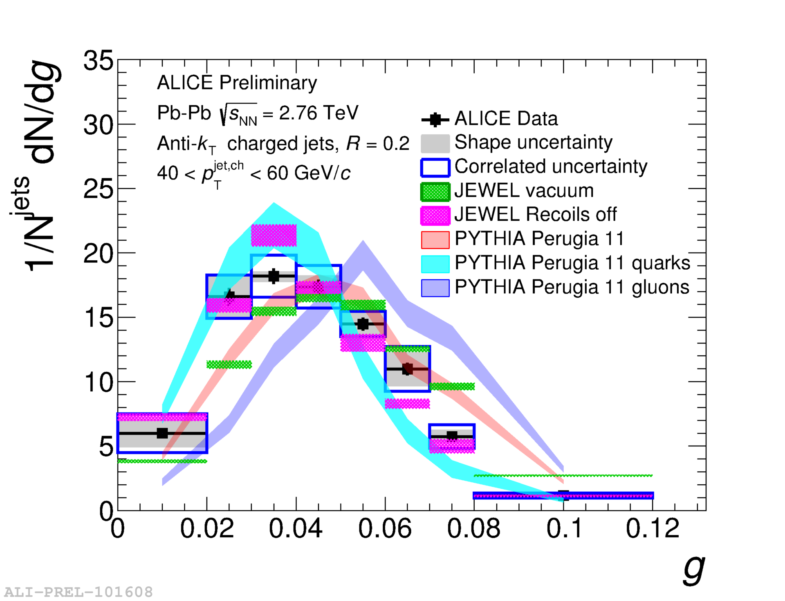
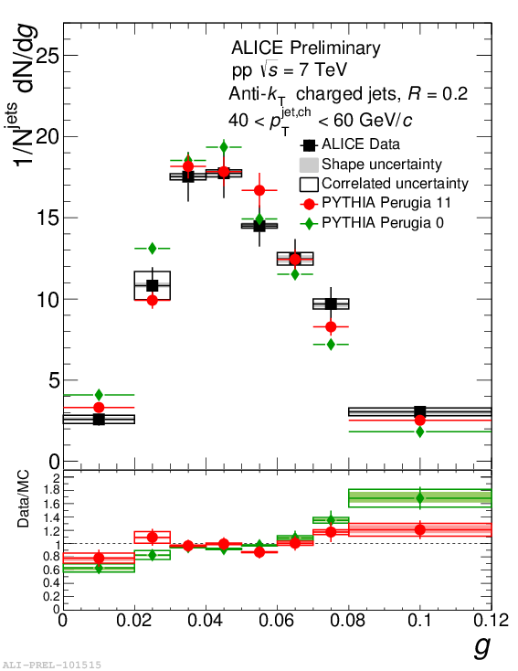
Girth g
Radial moment g is p_{T}-weighted width of jet
In pp collisions: g consistent with PYTHIA even for low R
In Pb—Pb collisions: may be slightly more collimated

Slide 10
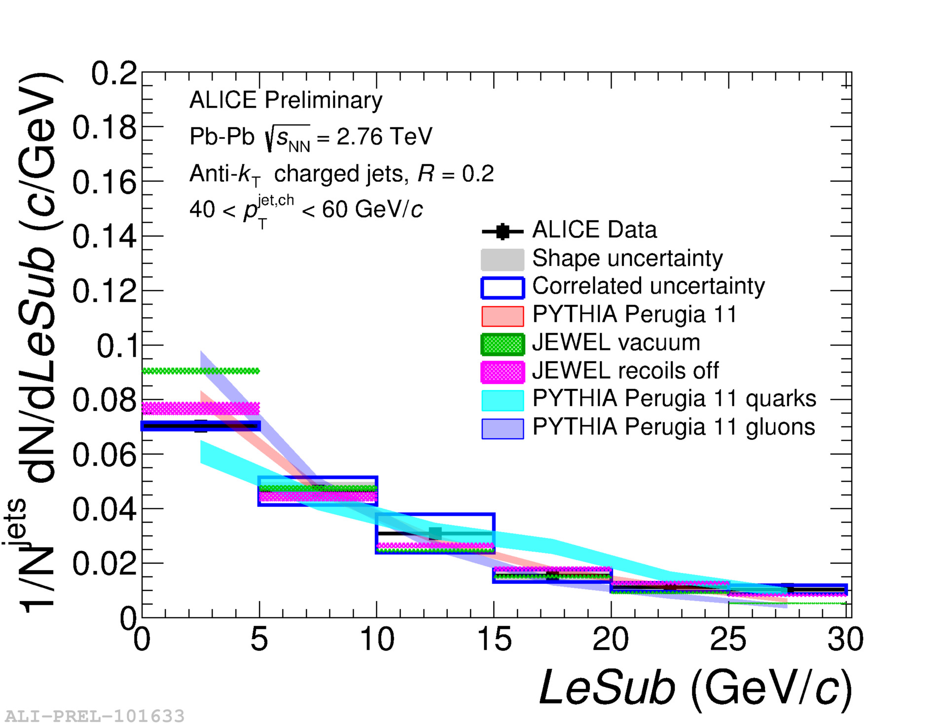
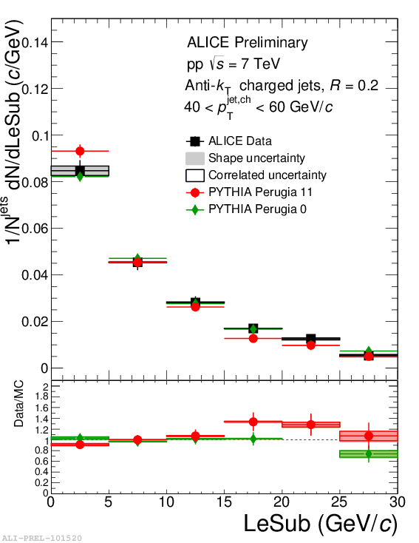
LeSub
LeSub=p_{T}^{leading}-p_{T}^{subleading}
Not IR-safe but robust to background
In pp collisions: agrees with PYTHIA
In Pb—Pb collisions: agrees with PYTHIA

Slide 11
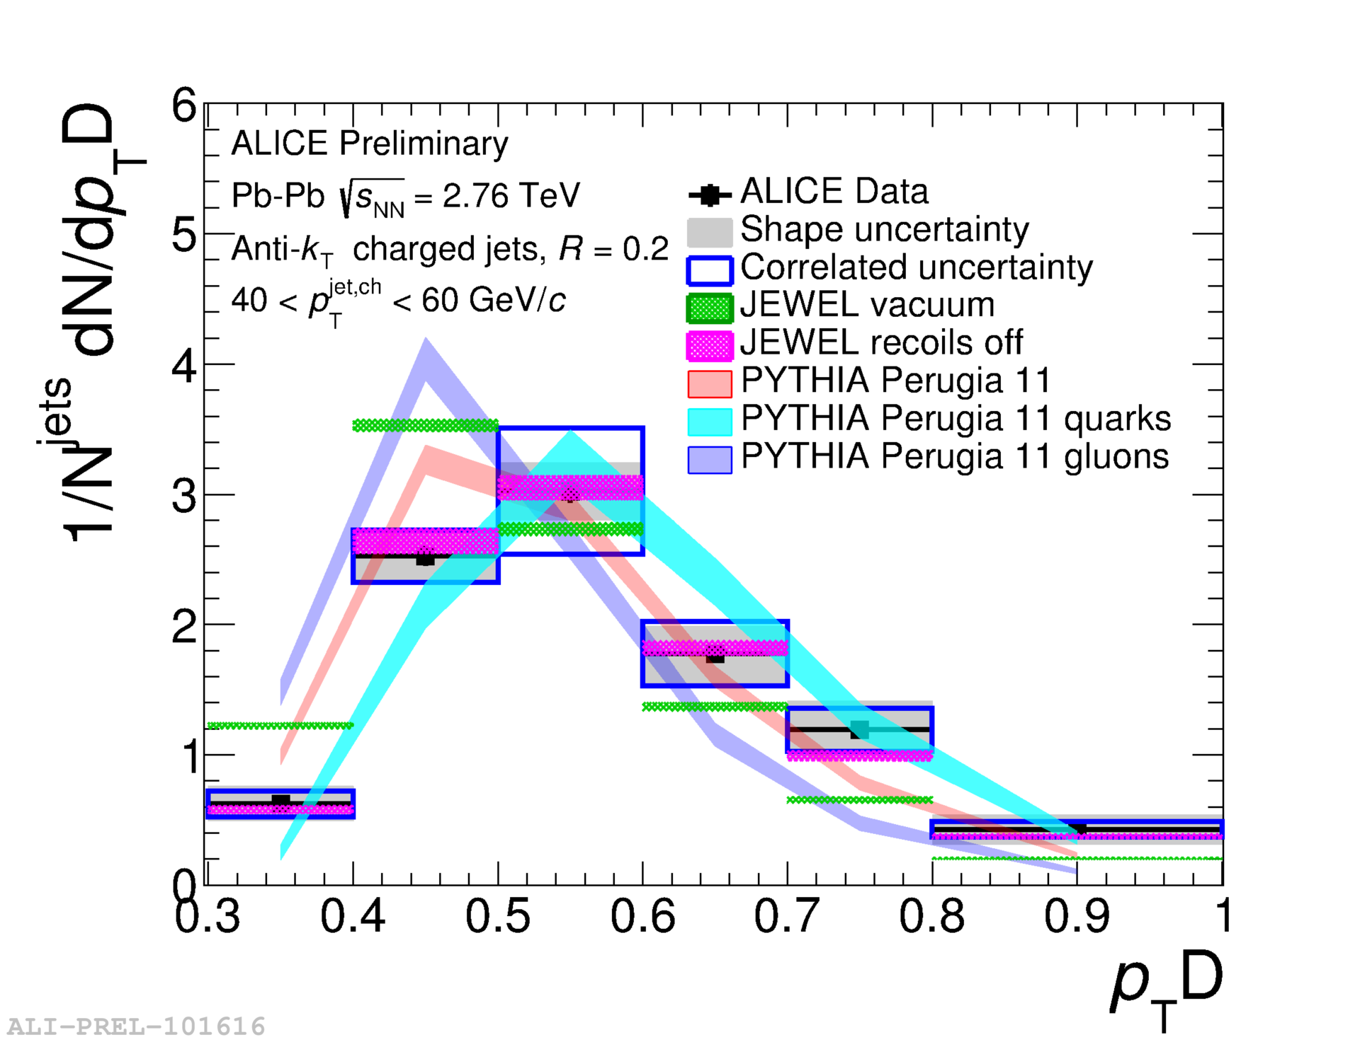
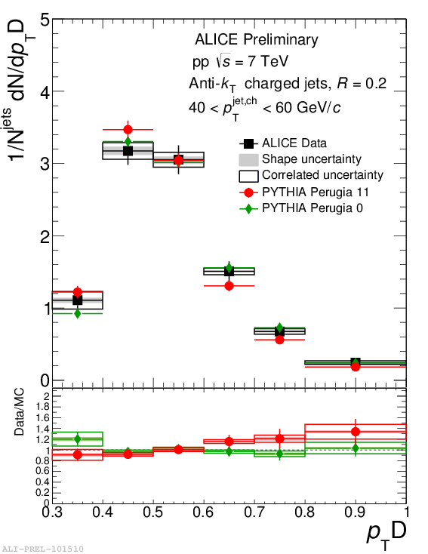
Dispersion p_{T}D
Measures dispersion – fewer constituents→ lower p_{T}D
In pp collisions: agrees with PYTHIA
In Pb—Pb collisions: slightly more collimated

Slide 12
Conclusions
Jet spectra, R_{AA}
Jet suppression
Jet-hadron correlations
No rxn plane dependence → jet-by-jet fluctuations in energy loss significant?
New jet shape observables
Consistent with expectations from vacuum
Slight hints of more collimation in Pb—Pb

Slide 13
backup

Slide 14
Jet mass
arXiv:1702.00804
Quenching models (JEWEL, Q-PYTHIA) show a larger mass than pp-like PYTHIA jets
  JEWEL: 2→2 pQCD matrix elements with parton shower taking into account radiation. For charged jets the background subtraction is implemented by shifting the distribution considering the background estimated for full jets and the difference between full and charged jets in pp
  Q-PYTHIA: PYTHIA with medium effects in the final state branching through an additive term in the splitting functions computed in the multiple-soft scattering approximation
JEWEL with “recoil off” (removing recoil centres before hadronization) shows a depletion of the jet mass wrt pp due to less low-p_{T} fragments wrt recoil on
Pb-Pb measurement can discriminate among these predictions

Slide 15
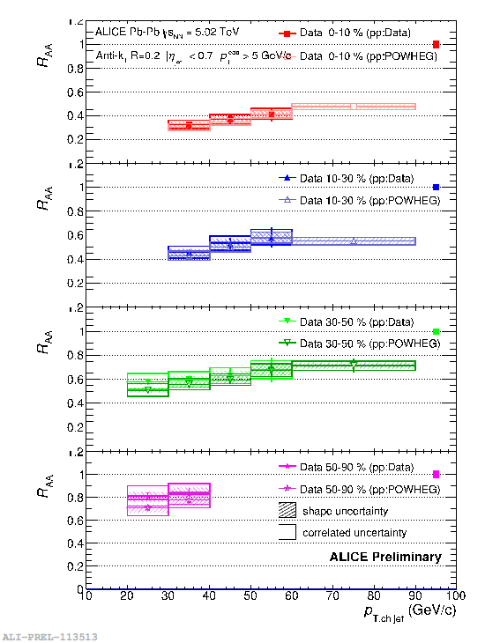

Jet R_{AA}
Out-of-cone radiation: energy loss in jet cone
  Jet yield suppression, di-jet energy imbalance, jet-jet/hadron-jet acoplanarity…
In-cone radiation: medium modified fragmentation
  Jet shape broadening, modification of transverse energy profile…
Consistent with RAA of charged particles and charged-jet RAA at 2.76 TeV

Slide 16
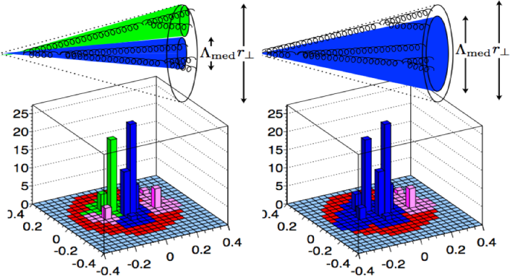
Nsubjettiness: search for color (de)coherence
Resolved subtructure
Unresolved subtructure
N: number of subjets
M: number of tracks
ΔR_{i,j}: η-φ distance between track i and subjet j
R₀: jet resolution parameter
Casalderrey-Solana, Mehtar­‐Tani, Salgado, Tywoniuk Phys.Lett.B 725 (2013) 357–360
τ_{N}→0: Jet has N or fewer cores
τ_{N}→1: Jet has at least N+1cores
τ_{N}/τ_{N-1}→0: Jet has N cores
τ₂/τ₁→0: Jet has 2 cores
Find jets with anti-k_{T} algorithm
Run k_{T} algorithm over jet constituents
Reverse the last merging τ₂

Slide 17
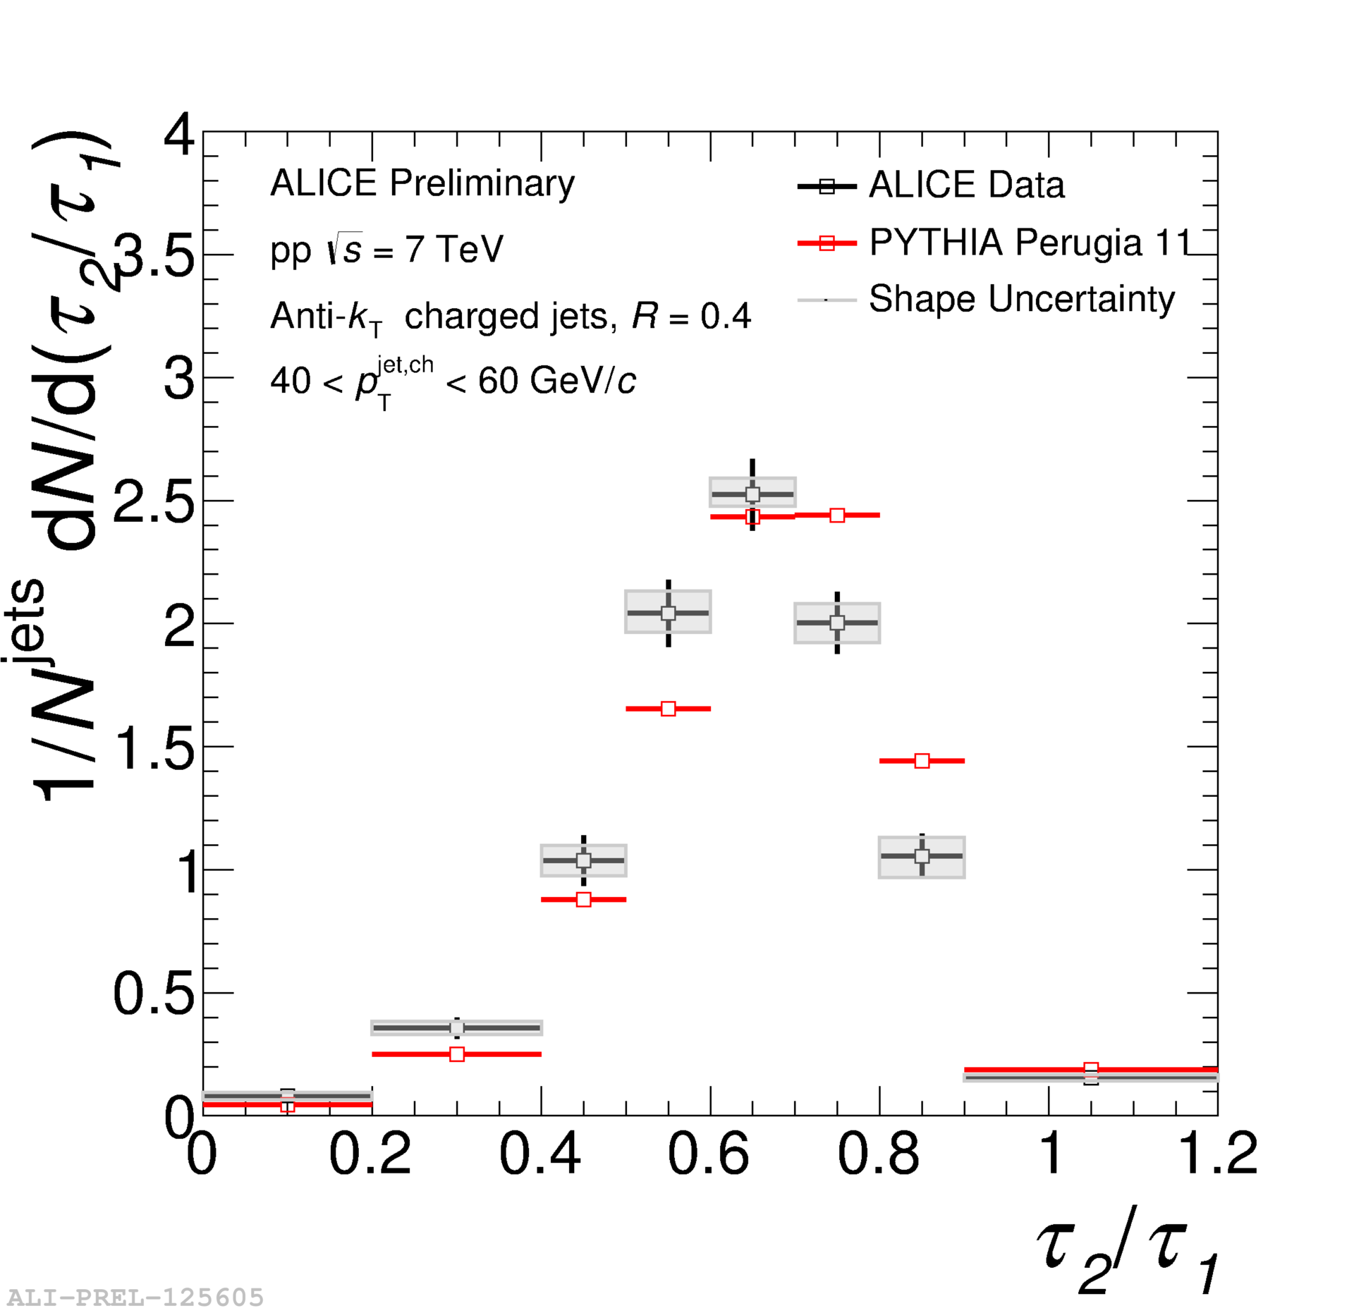
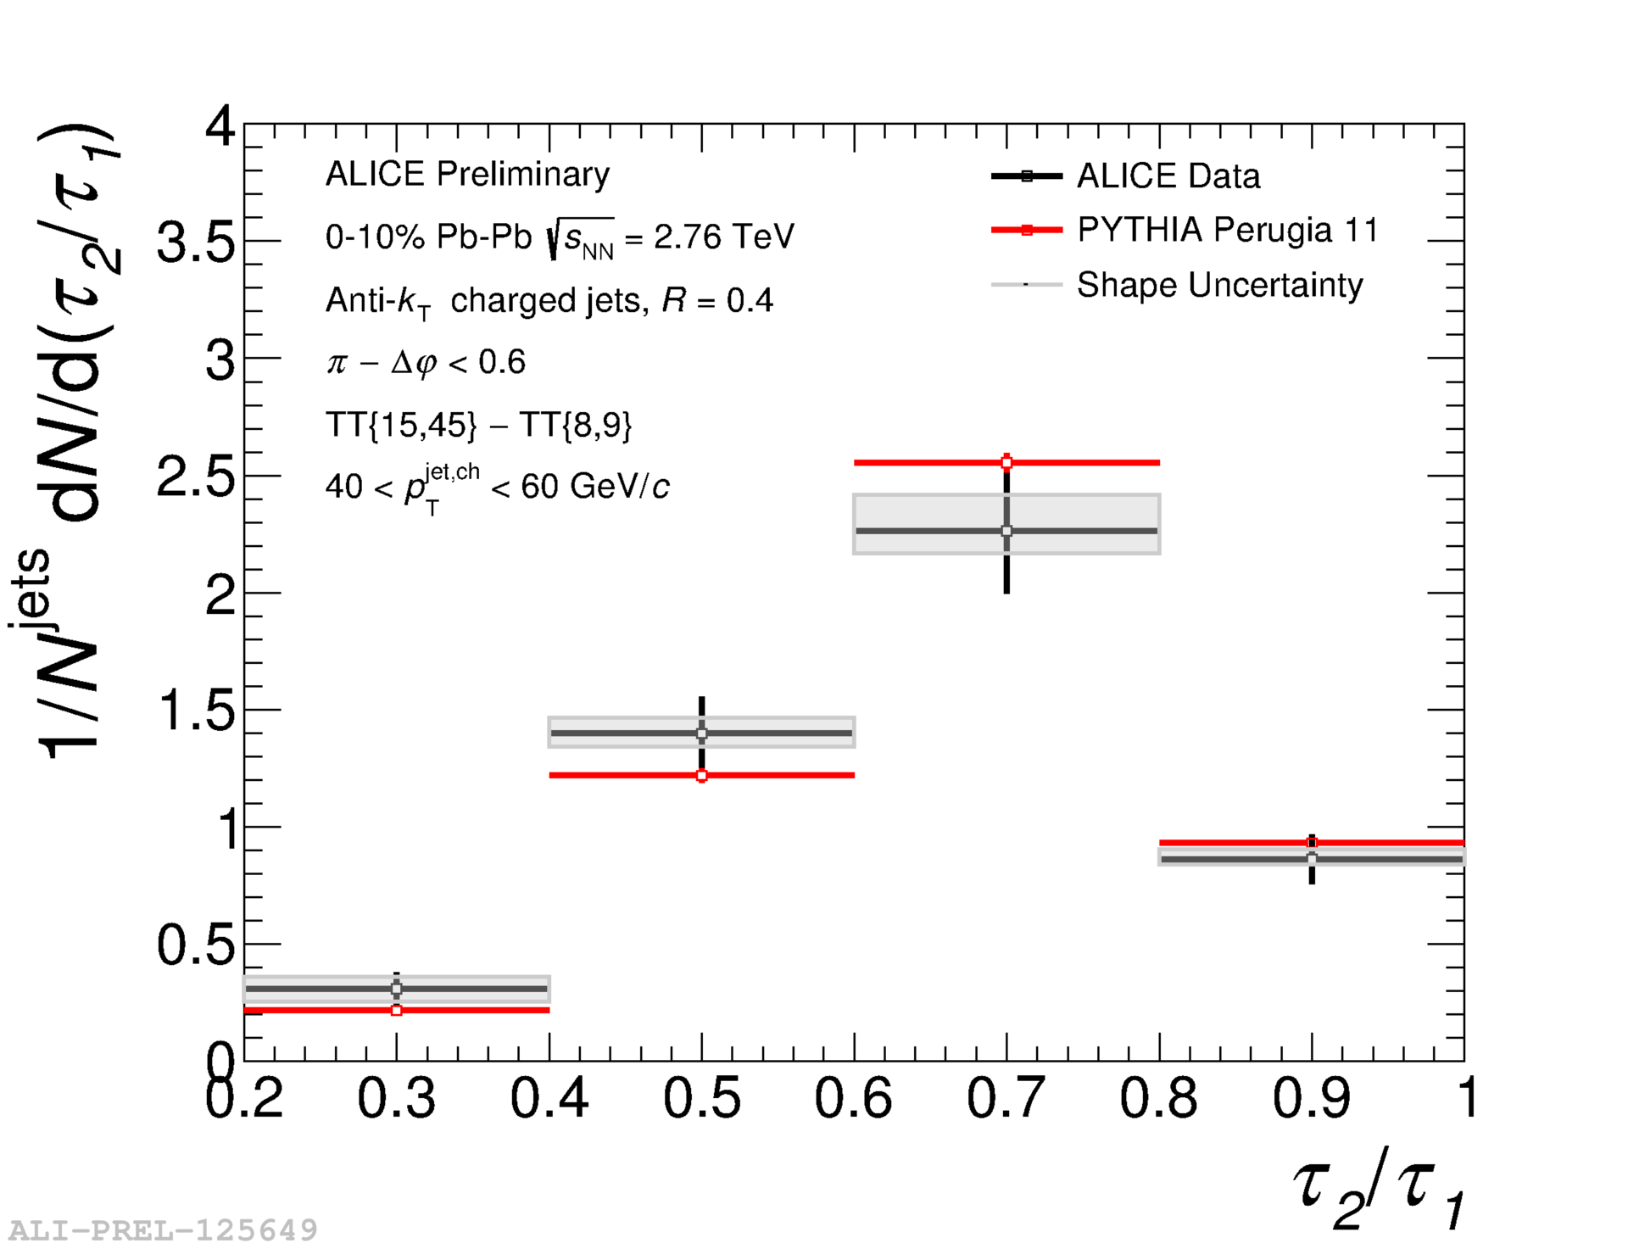
Nsubjettiness
Data mean = 0.638±0.005 (stat)
PYTHIA mean = 0.667±0.001 (stat)
Data mean = 0.652±0.011 (stat)
PYTHIA mean = 0.670±0.002 (stat)
τ₂/τ₁ measures alignment of radiation to two subjets
No significant shift in τ₂/τ₁ to higher values→no significant change in alignment of radiation to the cores

Slide 18
Jet reconstruction
Input to the jet finder
  Assumed to be massless
  Charged tracks (ITS+TPC) with p_{T} > 150 MeV/c
  Cluster energies E_{cluster} > 300 MeV
  EMCal cluster energies corrected for charged particle contamination with
  f = 100%
ALICE measures
  Full Jets (tracks + clusters) – corrected to include n, K⁰_{L}...
  Charged jets (tracks only) – corrected to charged particle energy only
Notes:
----- Meeting Notes (6/24/13 16:47) -----
anti-kT used for our signal for consistency
Use as subbullets
Keep things together
<number>

Slide 19
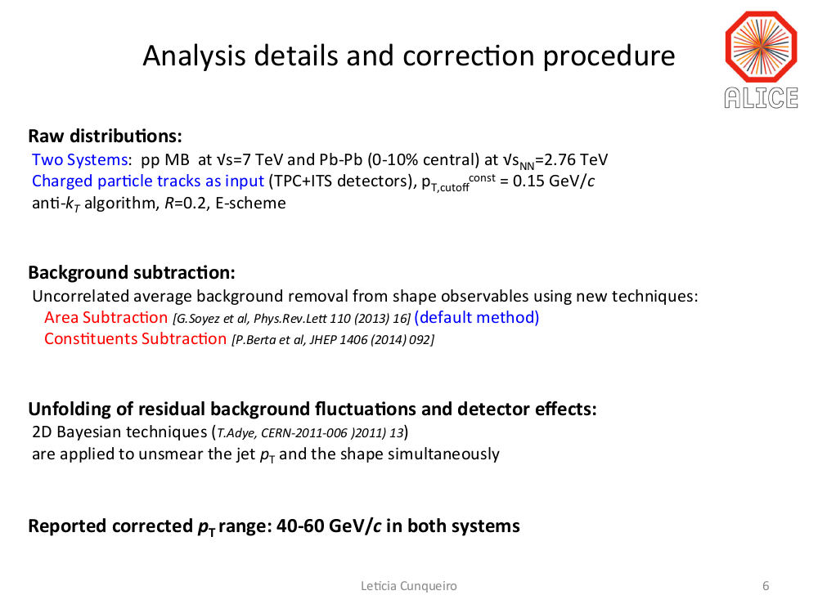

Slide 20
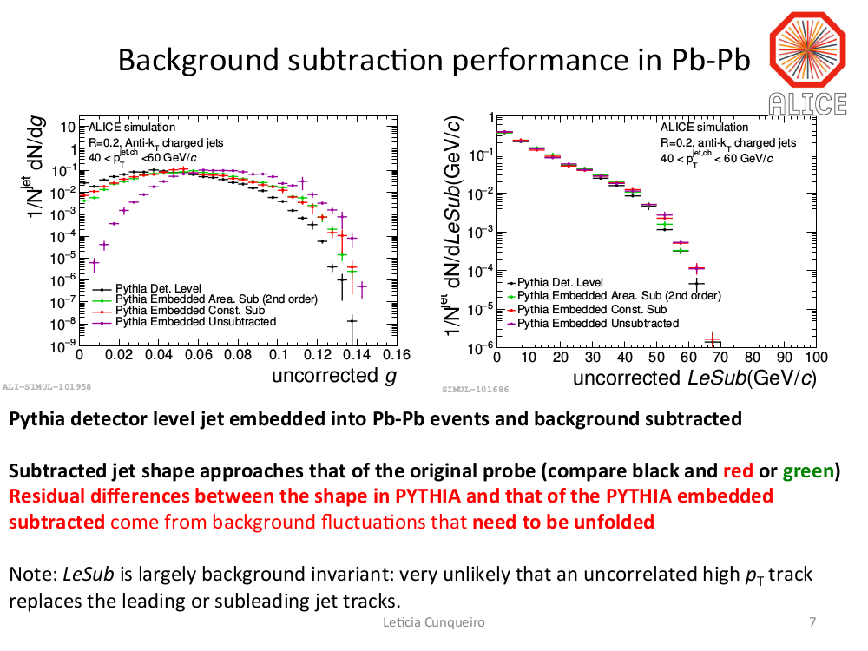

Slide 21
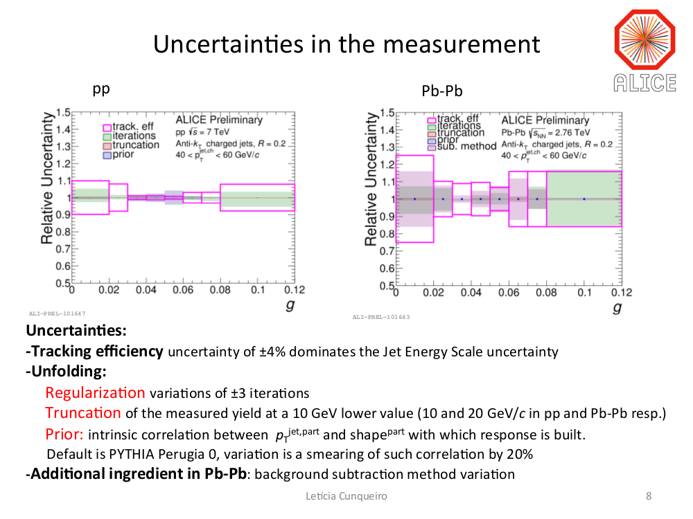

Slide 22
