Slide 1
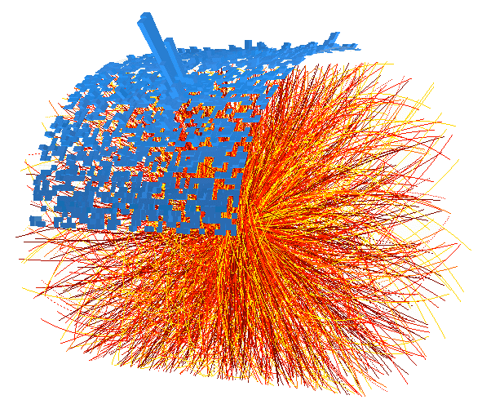
Measurements of jets in ALICE
Christine Nattrass
University of Tennessee, Knoxville
for the ALICE collaboration

Slide 2
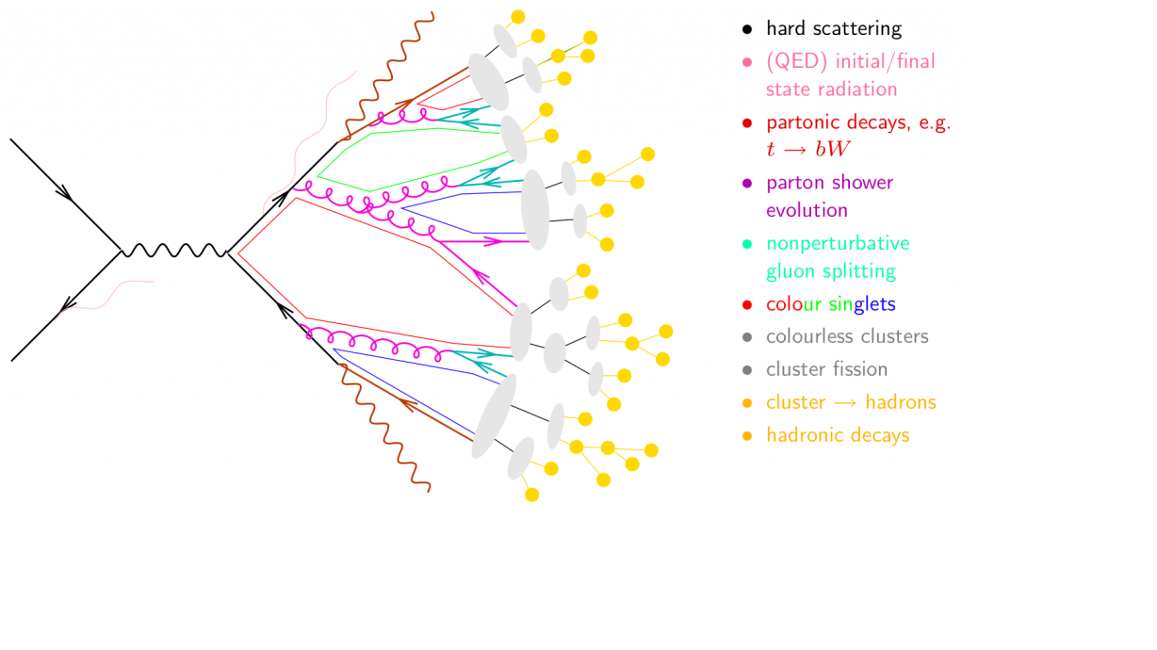
Jet formation in a vacuum
Hard scattering
Parton shower
Hadronization
Image from http://www.gk-eichtheorien.physik.uni-mainz.de/Dateien/Zeppenfeld-3.pdf

Slide 3
Jet formation in a vacuum
Jet 1
Hard scattering
Jet 2
Parton shower
Hadronization
Image from http://www.gk-eichtheorien.physik.uni-mainz.de/Dateien/Zeppenfeld-3.pdf

Slide 4

Jet finding
in pp collisions
No unambiguous definition of a jet
Jet finder: groups final state particles into jet candidates
  Anti-k_{T} algorithm
  JHEP 0804 (2008) 063 [arXiv:0802.1189]
Depends on hadronization
Ideally
  Infrared safe
  Colinear safe

Slide 5
Jet finding
in AA collisions
No unambiguous definition of a jet
Jet finder: groups final state particles into jet candidates
  Anti-k_{T} algorithm
  JHEP 0804 (2008) 063 [arXiv:0802.1189]
Combinatorial jet candidates
Sensitive to methods to suppress combinatorial jets

Slide 6




The ALICE experiment
ITS
EMCal
Tracking - h±
TPC
EMCal –γ,π⁰,η,ω
trigger
DCal
PID
TOF

Slide 7
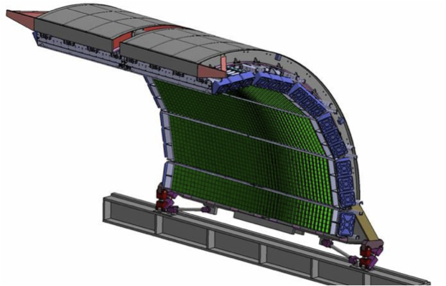
<footer>
<number>
Jets in ALICE
EMCal Pb-scintillator sampling calorimeter:
  |η| < 0.7, 1.4 < φ < π
  tower Δη~0.014,Δφ ~0.014
Remove contamination from
Charged particles
Neutral
constituents
Tracking:|η|< 0.9, 0<φ<2π
TPC, ITS
Charged
constituents
Jet
Notes:
----- Meeting Notes (6/24/13 14:33) -----
Fix Arrows
<number>

Slide 8
Jet reconstruction
Input to the jet finder
  Assumed to be massless
  Charged tracks (ITS+TPC) with p_{T} > 150 MeV/c
  Cluster energies E_{cluster} > 300 MeV
  EMCal cluster energies corrected for charged particle contamination with
  f = 100%
ALICE measures
  Full Jets (tracks + clusters) – corrected to include n, K⁰_{L}...
  Charged jets (tracks only) – corrected to charged particle energy only
Notes:
----- Meeting Notes (6/24/13 16:47) -----
anti-kT used for our signal for consistency
Use as subbullets
Keep things together
<number>

Slide 9
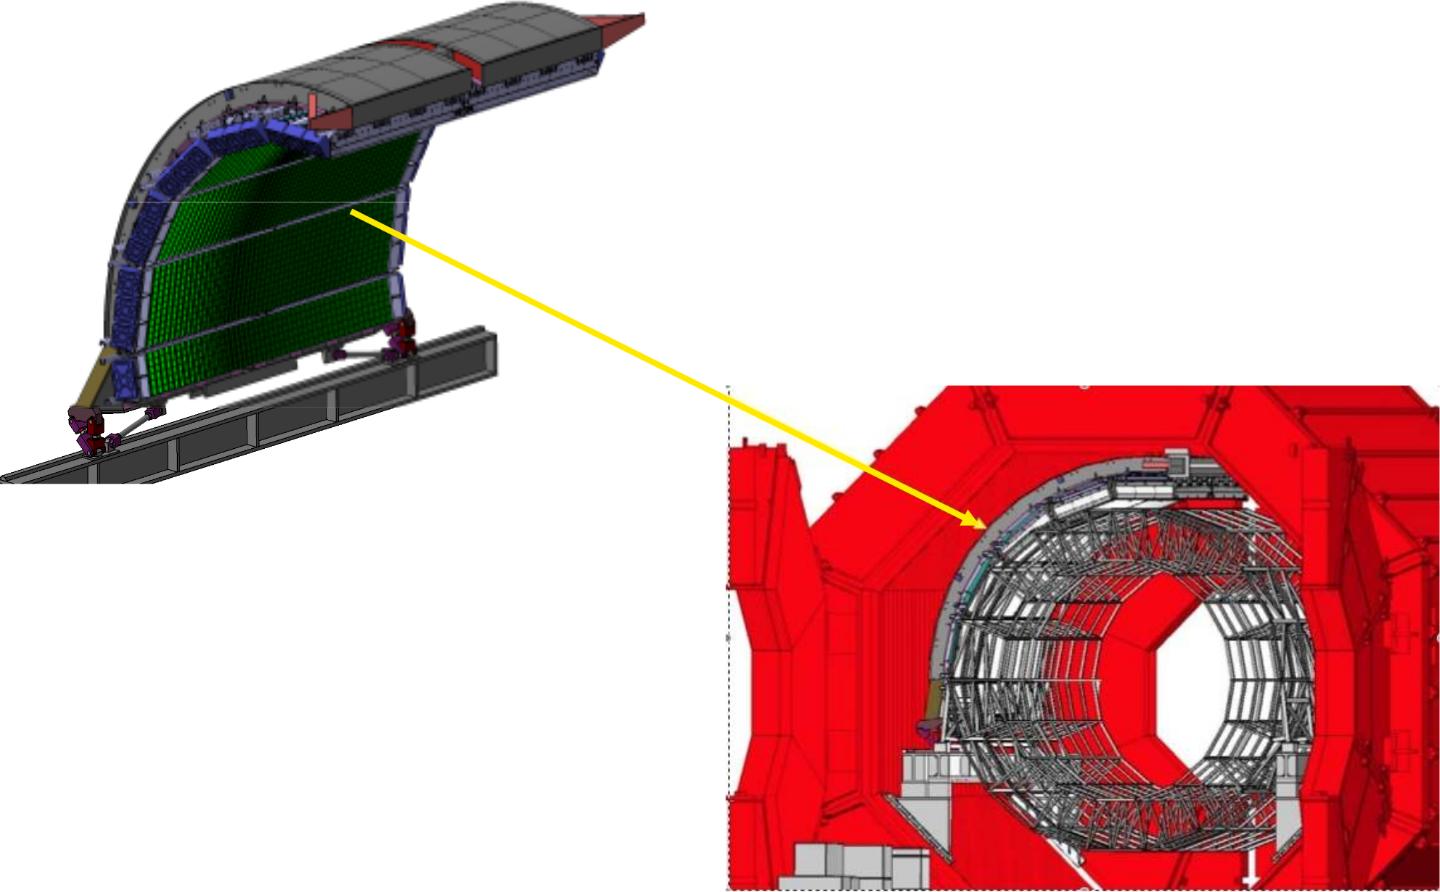
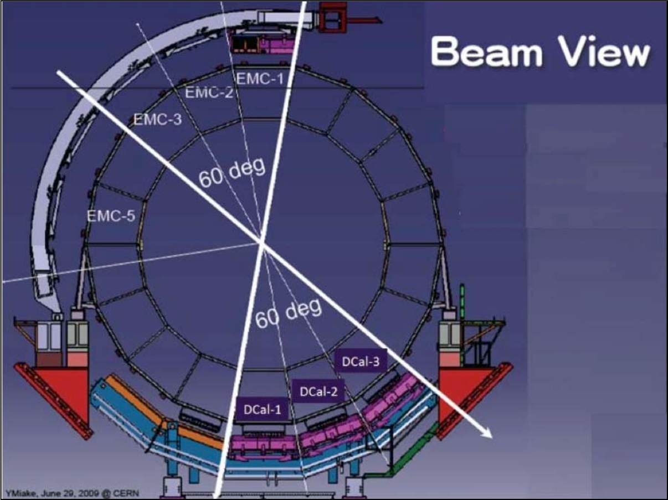
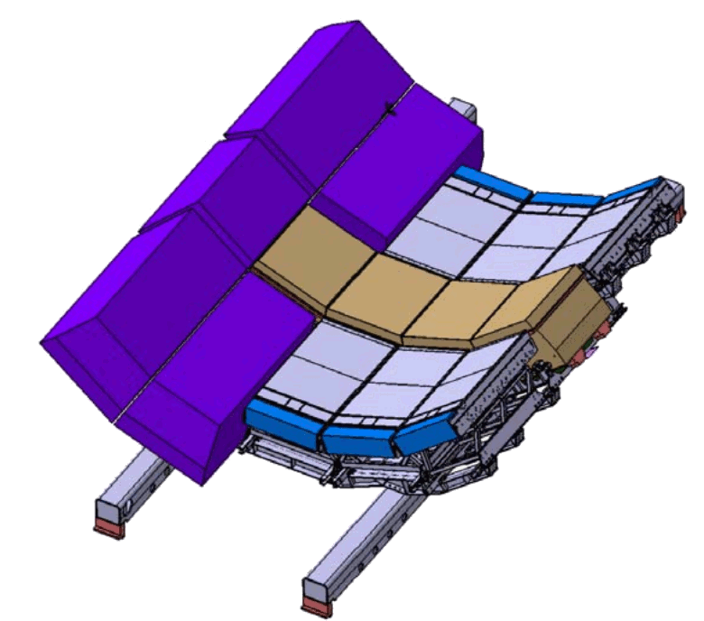
EMCal
& DCal
Δη=1.4,Δφ=107º
Installed in Fall 2014
Δη=1.4,Δφ=60º
Lead-scintillator sampling calorimeter
13 k towers
Each tower Δη X Δφ= 0.014 x 0.014
σ(E)/E=0.12/√E + 0.02

Slide 10
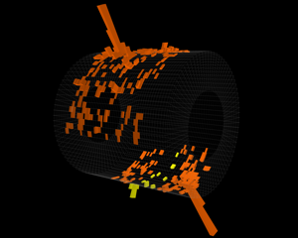
EMCal
& DCal
Pb-Pb √s_{NN} = 5.02 TeV
Δη=1.4,Δφ=107º
Installed in Fall 2014
Δη=1.4,Δφ=60º
Lead-scintillator sampling calorimeter
13 k towers
Each tower Δη x Δφ= 0.014 x 0.014
σ(E)/E=0.12/√E + 0.02

Slide 11
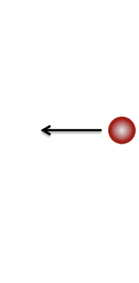
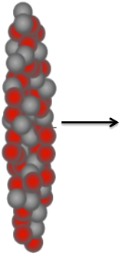
Measurements of jets
In pp collisions
  Test QCD
In pPb collisions
  Cold nuclear matter effects
In Pb-Pb collisions
  Hot QCD effects

Slide 12
Measurements of jets
In pp collisions
  Test QCD
  Consistent with QCD
In pPb collisions
  Cold nuclear matter effects
  No significant effects for jets
In Pb-Pb collisions
  Hot QCD effects
  Significant medium effects

Slide 13
pp collisions

Slide 14
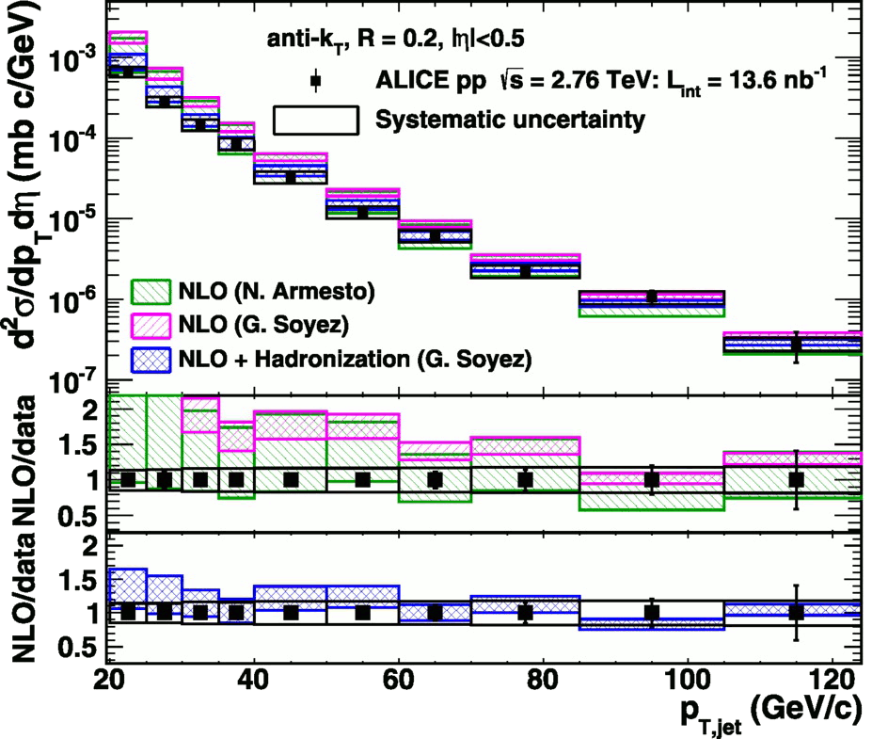
<footer>
Full jet cross-section in pp
√s = 2.76 TeV, R = 0.2 Inclusive
arXiv:1301.3475
PLB: 10.1016/j.physletb.2013.04.026
f_{hadcor} = 100%,
p_{T} > 150 MeV/c
E_{T} > 300 MeV
Green and magenta bands: NLO on Parton level
Blue band: NLO + hadronization
Hadronization calculations necessary to describe data
Notes:
----- Meeting Notes (6/24/13 16:47) -----
PRB -> PLB
Mention lack of bias
Make Large figure
<number>

Slide 15
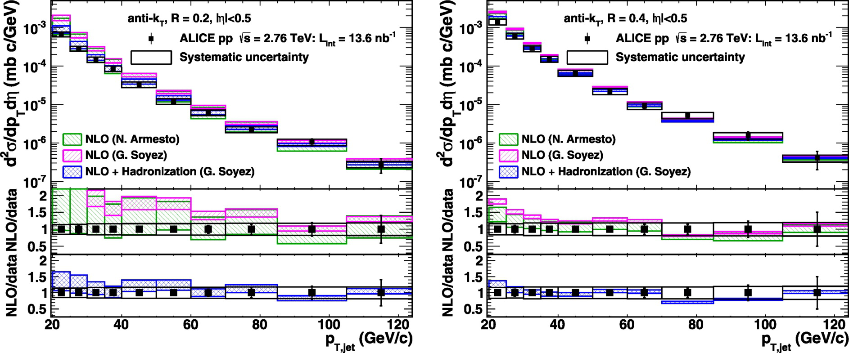
<footer>
Full jet cross-section in pp
√s = 2.76 TeV, R = 0.2, 0.4 Inclusive
arXiv:1301.3475
PLB: 10.1016/j.physletb.2013.04.026
Data and NLO+ hadronization calculations agree well
for both R = 0.2 and 0.4
Notes:
----- Meeting Notes (6/24/13 16:47) -----
PRB -> PLB
mention ratio
<number>

Slide 16
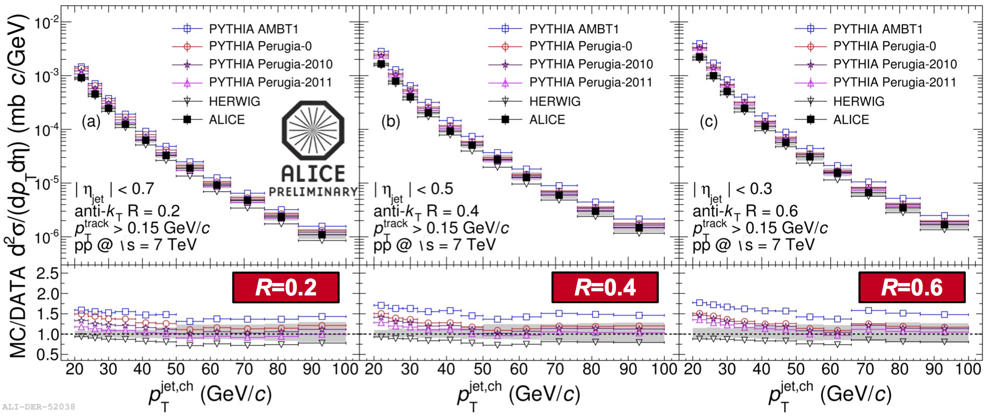
Charged jet cross-section pp
Charged √s = 7 TeV Inclusive
Data agree well with: PYTHIA Perugia 2011 & HERWIG
Rosi Reed - WWND 2015
<number>
Notes:
----- Meeting Notes (6/24/13 16:47) -----
PRB -> PLB
mention ratio
<number>

Slide 17
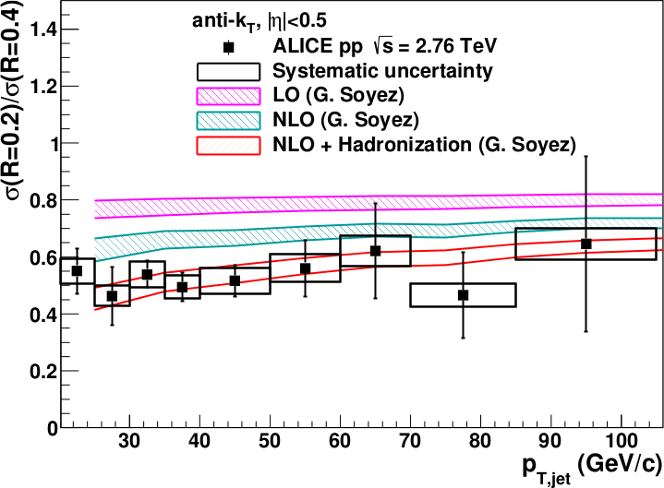
<footer>
Full jet ratios in pp
√s = 2.76 TeV, R = 0.2, 0.4 Inclusive
arXiv:1301.3475
PLB: 10.1016/j.physletb.2013.04.026
Data and NLO+ hadronization calculations agree well
Notes:
----- Meeting Notes (6/24/13 16:47) -----
PRB -> PLB
mention ratio
<number>

Slide 18
Measurements of jets
In pp collisions
  Test QCD
  Consistent with QCD
In pPb collisions
  Cold nuclear matter effects
In Pb-Pb collisions
  Hot QCD effects

Slide 19
pPb collisions

Slide 20
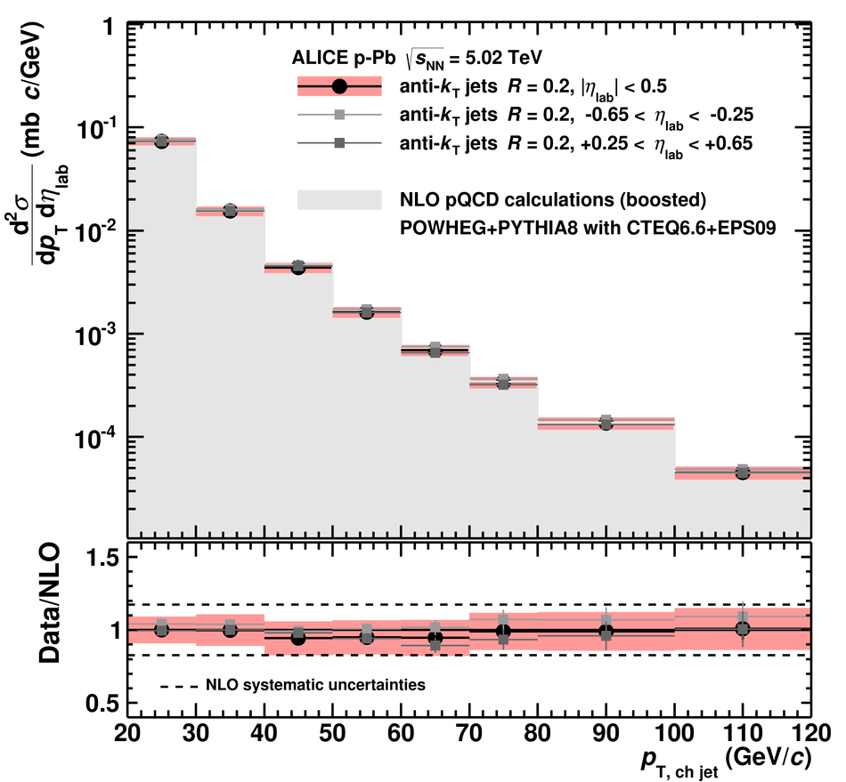
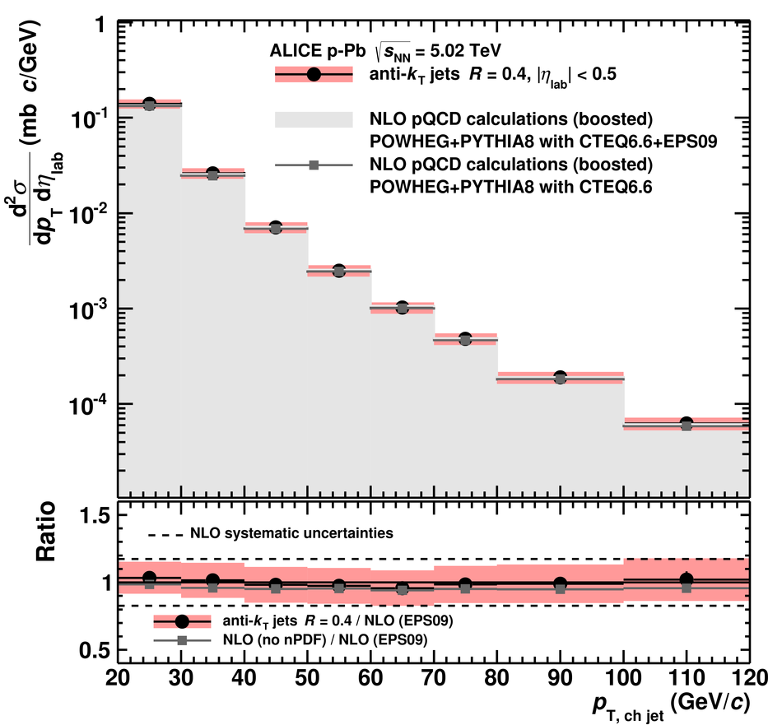
Charged jet cross-section in pPb
√s_{NN} = 5.02 TeV, R = 0.2, 0.4 Inclusive

Slide 21
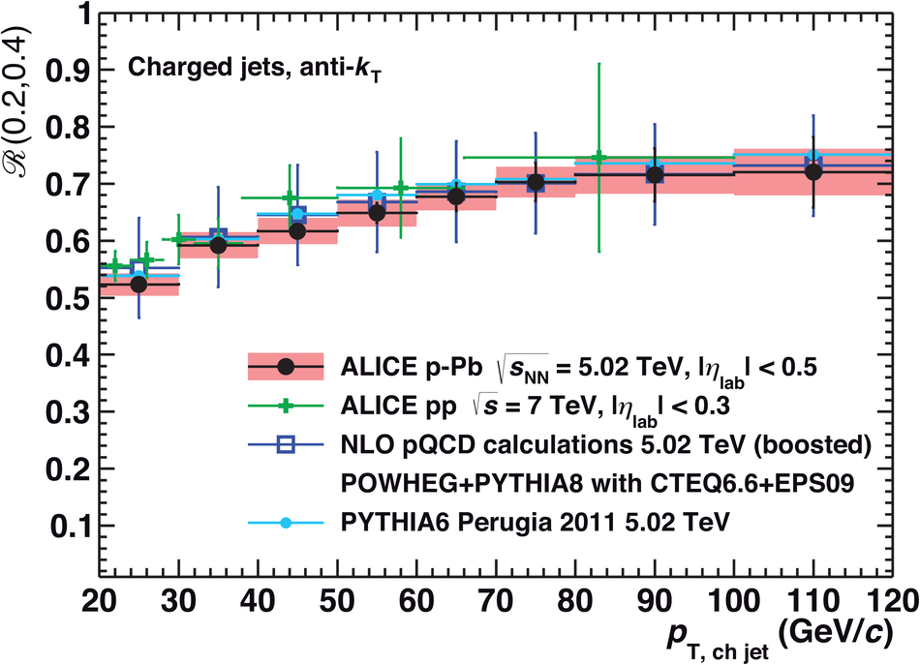
Charged jet ratios in pPb
√s_{NN} = 5.02 TeV, R = 0.2, 0.4 Inclusive
Comparing to pp simulations, no differences observed within error bars.
Collimation increases with jet pT as in pp.
No significant energy dependence or change with collision species is observed.

Slide 22
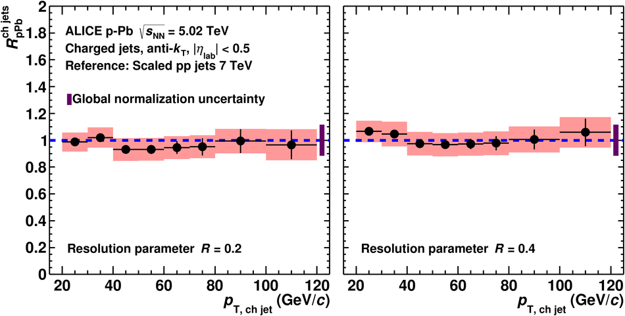
Charged jet R_{pPb}
√s_{NN} = 5.02 TeV, R = 0.2, 0.4 Inclusive
R_{pPb} consistent with unity
No cold nuclear matter effects observed for jets

Slide 23
Measurements of jets
In pp collisions
  Test QCD
  Consistent with QCD
In pPb collisions
  Cold nuclear matter effects
  No significant effects for jets
In Pb-Pb collisions
  Hot QCD effects

Slide 24
Pb-Pb collisions

Slide 25
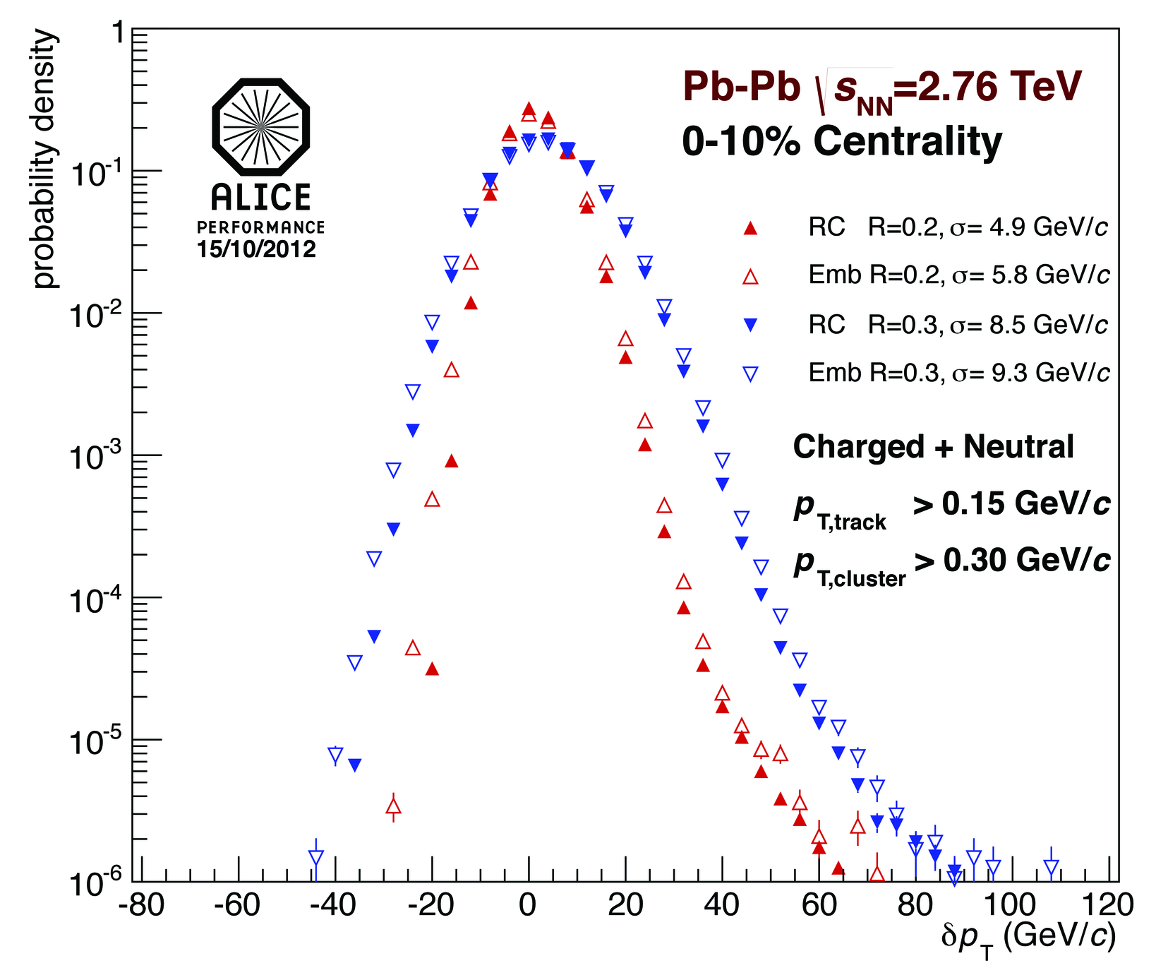
Background fluctuations
Full Jets in Pb-Pb √s_{NN} = 2.76 TeV
Fluctuations in the background determined via δp_{T}
  Random cones (RC)
  Depends on
    Constituent cut R
    Centrality
    Event plane
    Detector
δp_{T} is used to construct unfolding response matrix
δp_{T} is not corrected for detector effects – Experiment specific
Notes:
Random cones – completely random?
Which jet finder
<number>

Slide 26

<footer>
Leading track jet bias
√s_{NN} = 2.76 TeV Pb-Pb, R=0.2
Combinatorial “jets”
Combinatorial jets a challenge in HI collisions
  Require leading track p_{T} > 5 GeV/c
  Suppresses combinatorial “jets”
  Biases fragmentation
Measured spectra:
Full jets
Where
comes from FastJet anti-k_{T} algorithm
Notes:
<number>

Slide 27
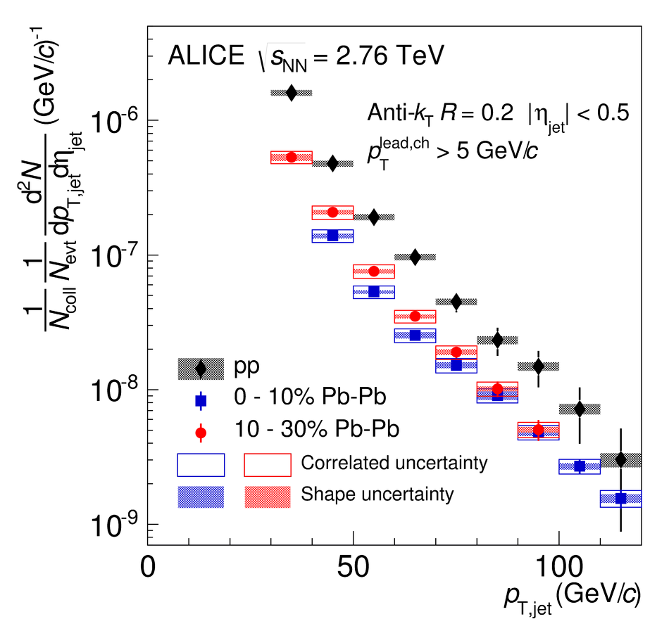
Full jet cross-section in Pb-Pb
√s_{NN} = 2.76 TeV, R = 0.2 Inclusive

Slide 28

Full jet R_{AA}
√s_{NN} = 2.76 TeV, R = 0.2 Inclusive
Full jet RAA in central Pb-Pb collisions,
Different jet reconstruction techniques (ATLAS: Calo Jets, CMS: Particle-Flow Jets, ALICE: Ch+En Jets) used by the different experiments
R=0.2: ATLAS scaled from R=0.4 to R=0.2

Slide 29
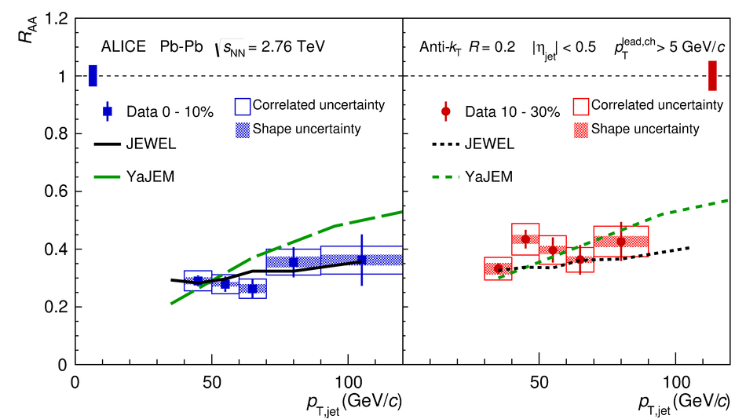
Full jet R_{AA}
√s_{NN} = 2.76 TeV, R = 0.2 Inclusive
Both models use a fit to hadron R_{AA} to adjust their parameters
Both models agree well with data

Slide 30
Measurements of jets
In pp collisions
  Test QCD
  Consistent with QCD
In pPb collisions
  Cold nuclear matter effects
  No significant effects for jets
In Pb-Pb collisions
  Hot QCD effects
  Significant medium effects

Slide 31
Conclusions
In pp collisions
  Data agree with NLO pQCD + hadronization
In pPb collisions
  Data agree with NLO pQCD
  Consistent with no CNM effect
In Pb-Pb collisions
  Strong jet suppression

Slide 33
Backup

Slide 34
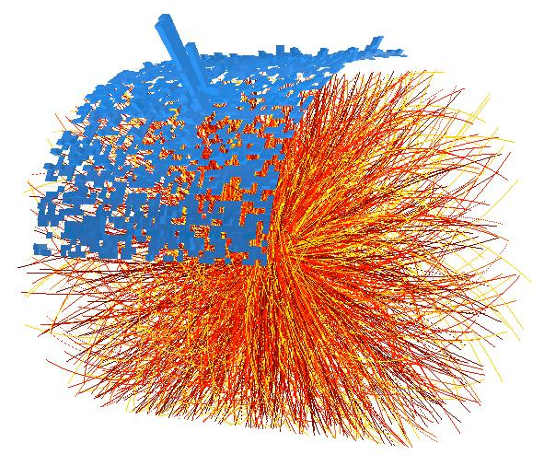
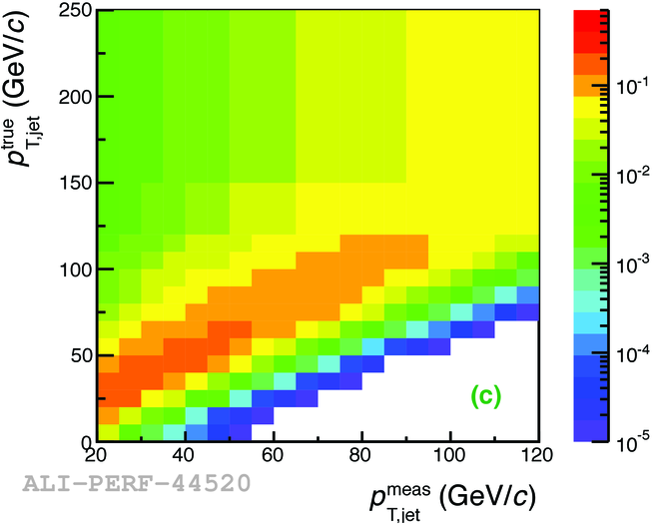
Method
1. Find jet candidates
2. Subtract background
Background
3. Correct for resolution

Slide 35
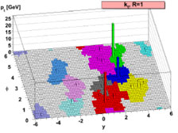

Jet Reconstruction
Jets reconstructed using FastJet package
  R = 0.2 - 0.4
  Anti-k_{T} – Used for signal determination
  k_{T} – Used for background determination
Correct for detector effects using unfolding
  Momentum resolution
  Energy resolution
  Track Matching
M. Cacciari, G. P. Salam, G.Soyez, JHEP 0804:063,2008
Notes:
----- Meeting Notes (6/24/13 16:47) -----
anti-kT used for our signal for consistency
Use as subbullets
Keep things together
<number>

Slide 36
<footer>
<number>
Full Jet Selection Requirements
EMCal fiducial acceptance cut
  R away from EMCal boundaries
  R=0.2:
    |η_{jet}| < 0.5
    1.60 < φ_{jet} < 2.94
Jets with leading track p_{T} > 100 GeV/c are rejected due to limitations of tracking beyond 100 GeV/c
Jet at edge of acceptance
Notes:
----- Meeting Notes (6/24/13 16:47) -----
eta_jet and phi_jet
put edges of calorimeter - R
<number>

Slide 37
<footer>
Jets in Heavy Ion Collisions
Experimental Challenges
Need to remove underlying event (UE) contribution
  A = Jet area, ρ = median UE momentum density
  p_{T, Jet} = Jet p_{T} from jet finder
  We can only remove the average background
  contribution
B_{σ} from UE fluctuations
Combinatorial (fake) jets can be reconstructed from UE
Detector effect corrections depend on fragmentation
Both background and detector effects are corrected in unfolding
  Corrects spectra for the B_{σ} term
  Quantified in Response Matrix (RM)
Background
Notes:
----- Meeting Notes (6/24/13 16:47) -----
mention that the last term is corrected via unfolding - put in last bullet
<number>

Slide 38
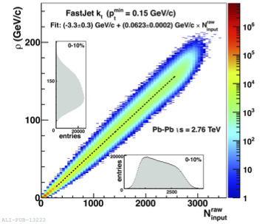
<footer>
HI Background Determination
Charged Jets √s_{NN} = 2.76 TeV
ρ_{ch} : median of
  2 leading jets removed
  May be sensitive to jet fragments outside k_{T} jet cone
  Determined event-by-event
ρ_{ch} is not corrected for detector effects or missing energy
Subtracted from signal jets on a jet-by-jet basis
JHEP 1203:053, 2012
(arxiv:1201.2423)
Notes:
----- Meeting Notes (6/24/13 16:47) -----
More time on the plot
move "sensitive" bullet to 2 leading jets bullet
make point about median (bold)
<number>

Slide 39
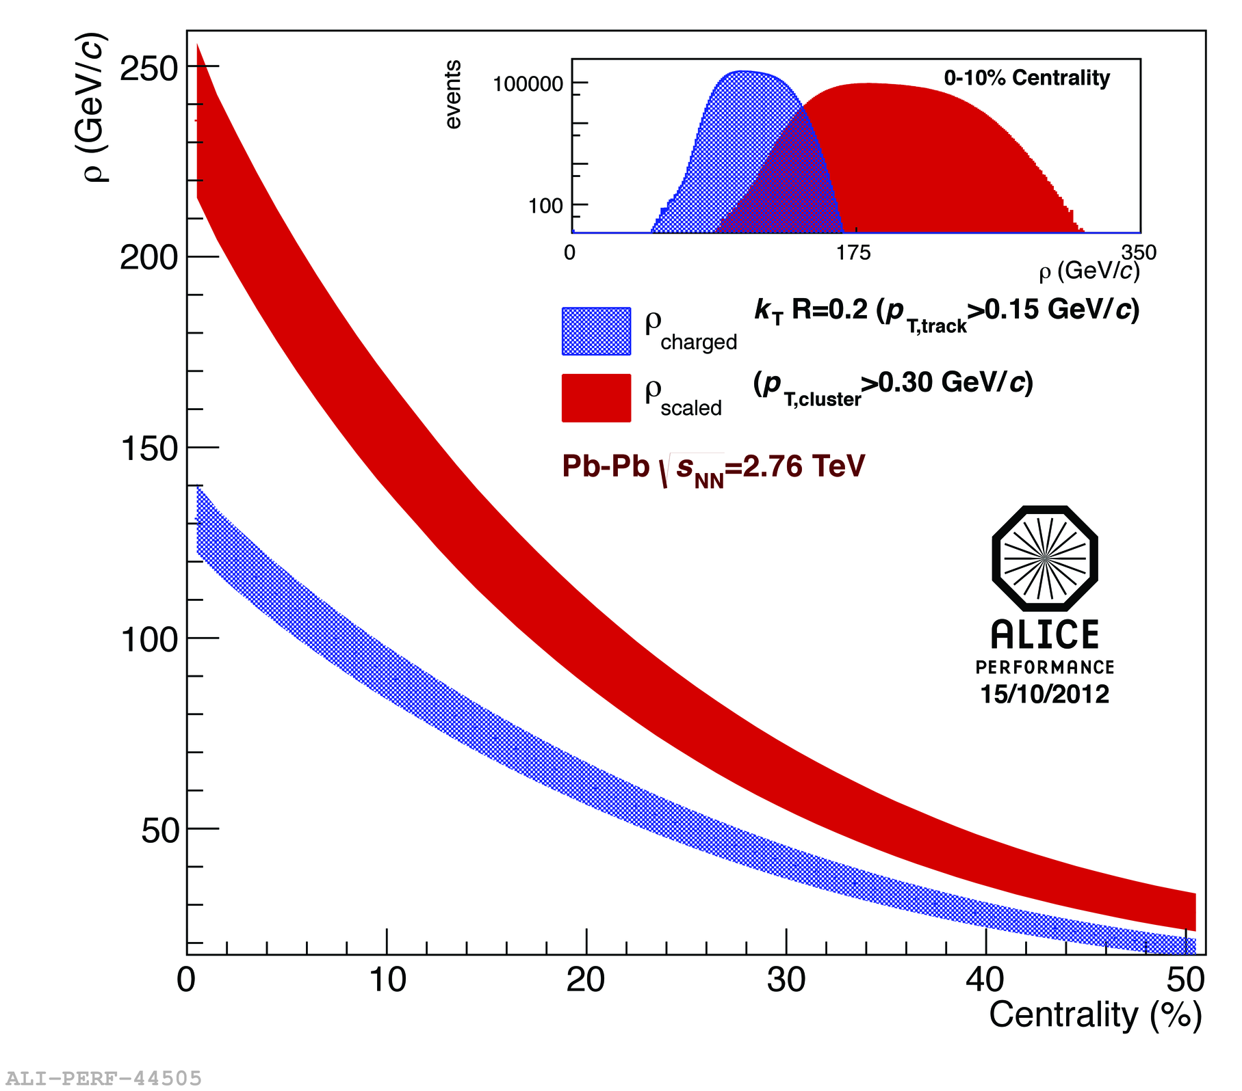
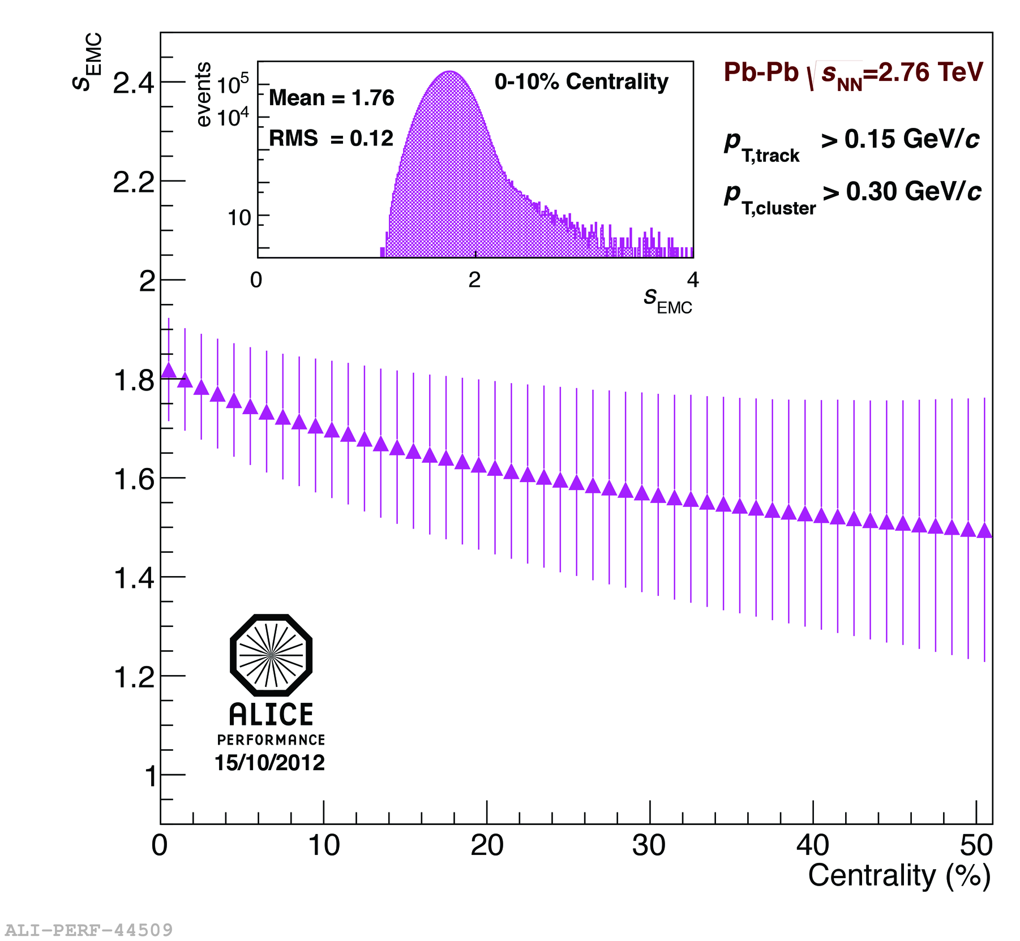
HI Background Determination
Full Jets √s_{NN} = 2.76 TeV
Centrality dependent scale factor accounts for neutral energy
ρ_{scaled} = ρ_{ch} × ρ_{EMC}
Notes:
----- Meeting Notes (6/24/13 16:47) -----
make pretty
use performance plots
mention RMS scale factor
Remove 1st bullet and move up second
make colors for equations
As of today "full jets are jets"
<number>

Slide 40
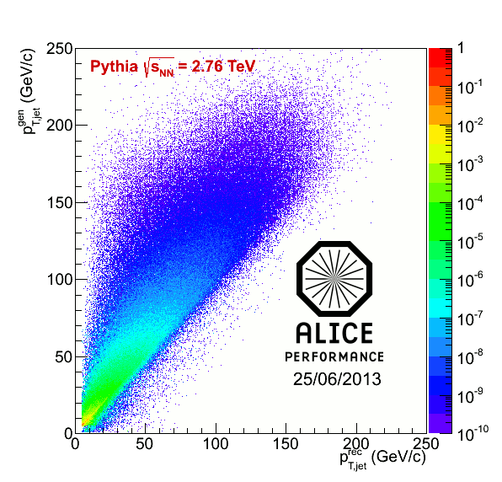
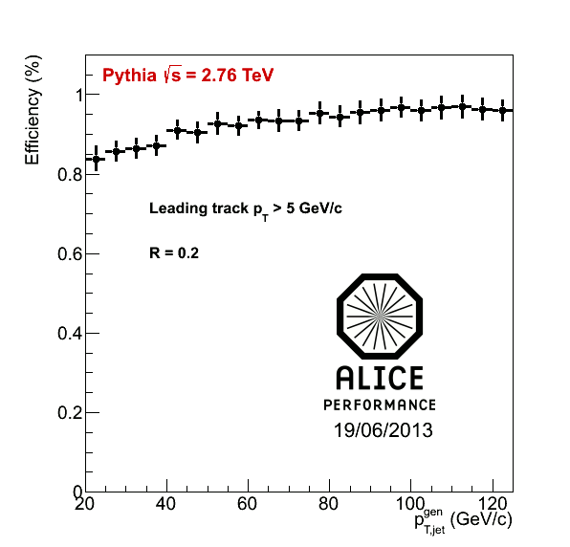
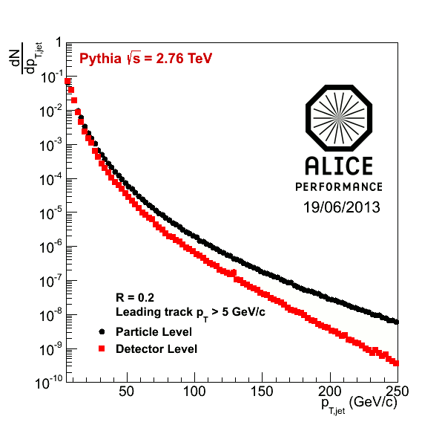
Response matrix RM_{det}
RM_{det} quantifies detector response to jets
  “Particle” level jets – defined by jet finder on MC particles
  Pythia with Pb-Pb tracking efficiency
  “Detector” level jets – defined by jet finder after event reconstruction through GEANT
  Particle level jets are geometrically matched to detector level jets
  Matrix has a dependence on spectral shape and fragmentation
Jet-finding efficiency is probability of a matched particle level jet
Notes:
----- Meeting Notes (6/24/13 16:47) -----
Say "matched jets" instead of 2 jets -> so people don't get confused with dijets
<number>

Slide 41
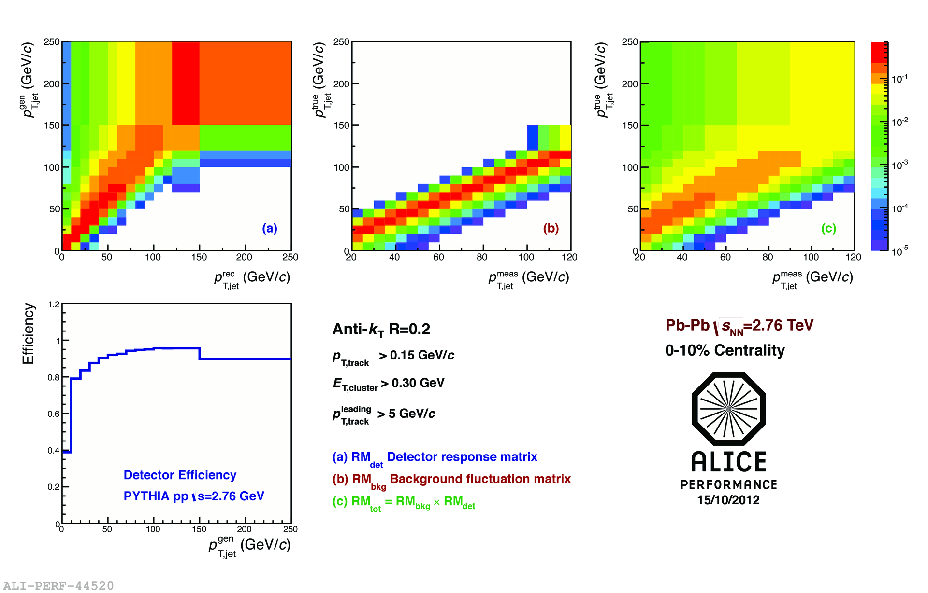
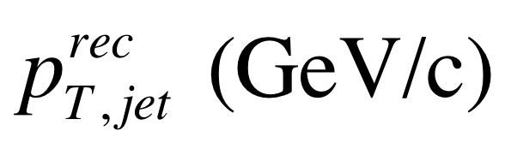
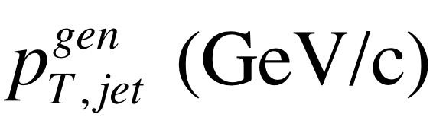
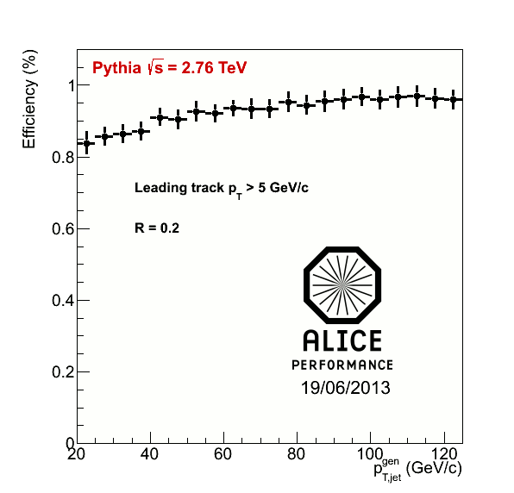
<footer>
Response Matrix Construction
RMdet X RMbkg = RM
RM_{bkg} and RM_{det} are approximately factorizable
Notes:
----- Meeting Notes (6/24/13 16:47) -----
Put Large Labels on
b) change pT true -> pT rec so consistence
c) change gT true ->pT gen
<number>

Slide 42
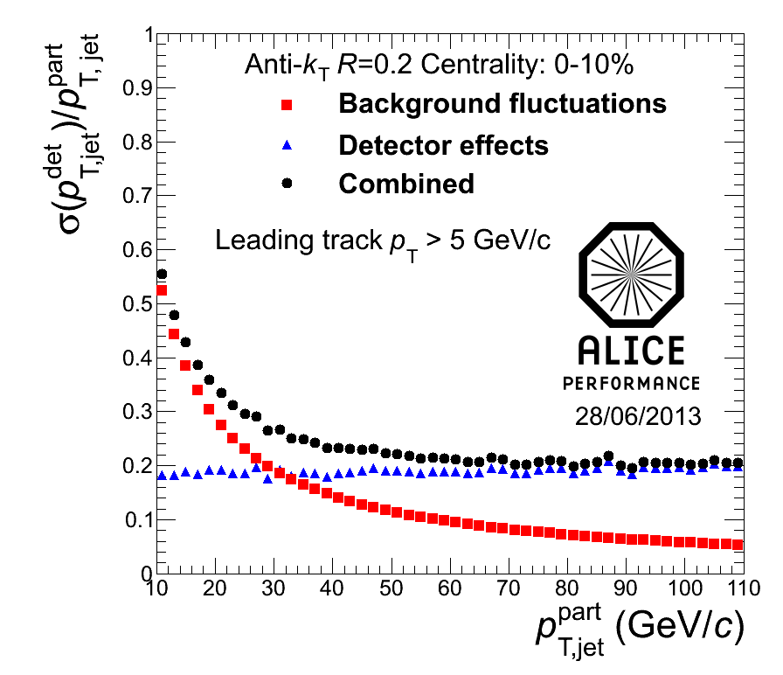
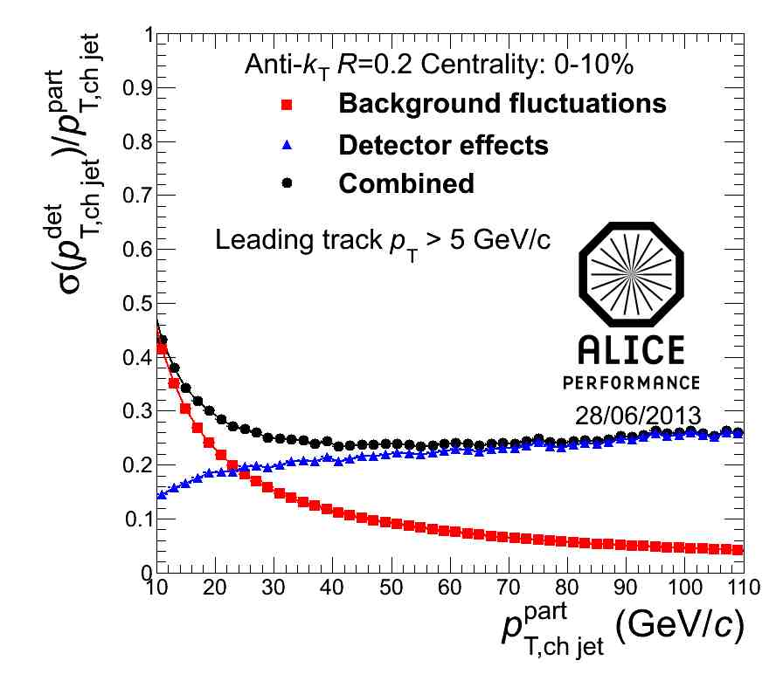
<footer>
Jet Resolution
Full
Charged
Jet resolution
  Dominated by background fluctuations at low momentum
  Dominated by detector effects at high momentum
Notes:
----- Meeting Notes (6/24/13 16:47) -----
Ask Marta for R = 0.2 plots for this
make sure performance
increase label size
<number>

