Slide 1

Understanding the Quark Gluon Plasma
Christine Nattrass
University of Tennessee, Knoxville

Slide 2




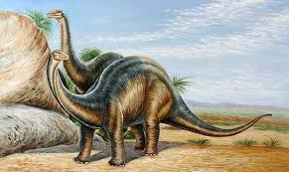
Structure of matter
Hadrons
Baryons
Standard model
Mesons
125000
Higgs

Slide 3



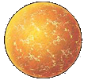

Phase diagram of nuclear matter
Quark Gluon Plasma
Core of neutron stars?
Quark Gluon Plasma – a liquid of quarks and gluons created at temperatures above ~170 MeV (2·10¹²K) – over a million times hotter than the core of the sun
Notes:
But wait – how can we have a liquid of quarks and gluons? Doesn't asymptotic freedom tell us that we can't have free quarks and gluons? How, then, can we have a liquid of quarks and gluons?

Slide 4

How to make a Quark Gluon Plasma

Slide 5

The phase transition in the laboratory

Slide 6












Relativistic Heavy Ion Collider
Large Hadron Collider
PHOBOS
BRAHMS
CMS
PHENIX
STAR
RHIC
LHCb
ALICE
ATLAS
LHCf
Upton, NY
1.2km diameter
p+p, d+Au, Cu+Cu, Au+Au, U+U
√s_{NN} = 9 - 200 GeV
Geneva, Switzerland
8.6km diameter
p+p, p+Pb, Pb+Pb
√s_{NN} = 2.76 GeV, 5.5 TeV
LHC
Quark Gluon Plasma
RHIC
Core of neutron stars?
Notes:
Mention that RHIC planning began 1983

Slide 7

ALICE
ATLAS
CMS
STAR
PHENIX
Notes:
Mention that RHIC planning began 1983

Slide 8




Size: 16 x 26 meters
Weight: 10,000 tons
Detectors: 18
Trigger detectors: When do we have a collision?
Tracking detectors: Where did the particle go?
Identification detectors: What kind of particle is it?
Calorimeters: How much energy does the particle have?
<number>
Notes:
By comparison ATLAS is 25 meters in diameter and 44 meters long – not quite twice as large

Slide 9

p+p collisions
3D image of each collision

Slide 10

Pb+Pb collisions
5

Slide 11
QGP Chemistry

Slide 12


Chemistry - equilibrium
T~170 MeV
arXiv:1701.07065
Nuclear Physics A Volume 757, 102-183
Ratios of particles expected from a model
Even strange quarks are at equilibrium!

Slide 13

Phase diagram of nuclear matter
Quark Gluon Plasma
Critical point?
arXiv:1701.07065
Core of neutron stars?
Quark Gluon Plasma – a liquid of quarks and gluons created at temperatures above ~170 MeV (2·10¹²K) – over a million times hotter than the core of the sun
Notes:
But wait – how can we have a liquid of quarks and gluons? Doesn't asymptotic freedom tell us that we can't have free quarks and gluons? How, then, can we have a liquid of quarks and gluons?

Slide 14


trajectory of system
arXiv:1701.07065

Slide 15
QGP Thermometers

Slide 16


Measuring temperature

Slide 17


Thermal photons
Phys.Rev.Lett.104:132301,2010
Thermal photons
QCD processes
ALICE collaboration:
Pb+Pb collisions at √s_{NN}=2.76 TeV
Inverse slope: T = 304 +/-51
PHENIX collaboration: Au+Au collisions at √s_{NN}=200 GeV
Inverse slope: T = 221 +/- 19 (stat) +/- 19 (syst) MeV

Slide 18





Building a quarkonium-thermometer
CMS-PAS HIN-11-011
N_{part}
Clear hierarchy in R_{AA} of different quarkonium states
c
c
b
b

Slide 19

Building a quarkonium-thermometer
Note: 6.5<p_{T}<30 GeV for J/ψ and ψ(2s)
CMS-PAS HIN-11-011
N_{part}
Clear hierarchy in R_{AA} of different quarkonium states
Expected in terms of binding energy
CMS-PAS HIN-12-014, HIN-12-007

Slide 20
~600
trajectory of system
arXiv:1701.07065

Slide 21
QGP Energy Density

Slide 22

How can we estimate the energy density?
Transverse energy (E_{T})
  sum of particle energies in transverse direction
Volume V = A_{T} τc
τ = formation time
Energy density ε
QGP formation for ε > 0.5 GeV/fm³
A_{T}
= τc

Slide 23

Energy density
RHIC
Standard estimate τ₀ ≈ 1 fm/c
QGP formation

Slide 24
QGP Spectroscopy

Slide 25
Probing the Quark Gluon Plasma
Medium
Probe
Detector
Want a probe which traveled through the collision
QGP is very short-lived (~1-10 fm/c) →
cannot use an external probe

Slide 26

Probes of the Quark Gluon Plasma
nucleus
nucleus
Want a probe which traveled through the medium
QGP is short lived → need a probe created in the collision

Slide 27
Probes of the Quark Gluon Plasma
nucleus
nucleus
Want a probe which traveled through the medium
QGP is short lived → need a probe created in the collision
We expect the medium to be dense → absorb/modify probe

Slide 28





Jets
p+p → dijet
D
c, x_{c}
p
a, x_{a}
b, x_{b}
p
σ_{ab}
Beam pipe
d, x_{d}
D
Jets – hard parton scattering leads to back-to-back quarks or gluons, which then fragment as a columnated spray of particles

Slide 29


Nuclear modification factor
Measure spectra of probe (jets) and compare to those in p+p collisions or peripheral A+A collisions
If high-p_{T} probes (jets) are suppressed, this is evidence of jet quenching
Enhancement
Suppression

Slide 30


Nuclear modification factor R_{AA}
RHIC
LHC
Electromagnetic probes – consistent with no modification – medium is transparent to them
Strong probes – significant suppression – medium is opaque to them

Slide 31
Nuclear modification factor R_{AA} at LHC
Fully unfolded inclusive jet R_{AA}
pp 2.76 TeV reference
CMS-PAS HIN-12-001
Like for charged particles, high-p_{T} jet R_{AA} flat at ≈ 0.5

Slide 32
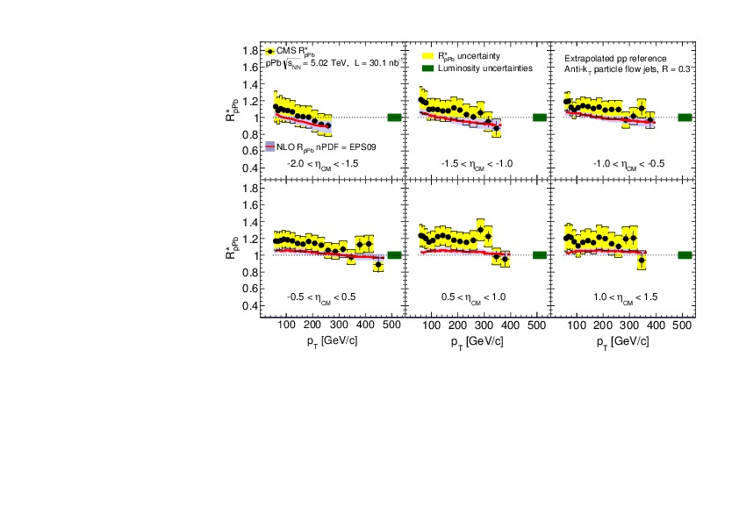
p+Pb as a control
CMS
CMS-HIN-15-015 arXiv:1611.01664

Slide 33
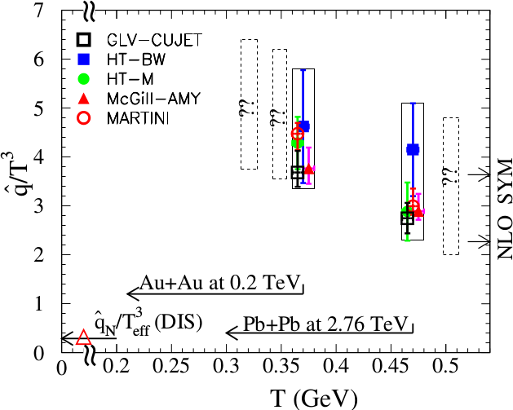
Quantifying
Phys. Rev. C 90, 014909 (2014)
Jet Collaboration: For a 10 GeV quark traveling 4 fm
≈1.2±0.3 GeV²/fm at τ₀=0.6 fm/c in Au+Au at √s_{NN}=200 GeV →loses 2.2 Gev
≈1.9±0.7 GeV²/fm in Pb+Pb collisions at √s_{NN}=2.76 TeV →loses 2.8 Gev
Q = Momentum transfer from parton to medium
L = path length

Slide 34
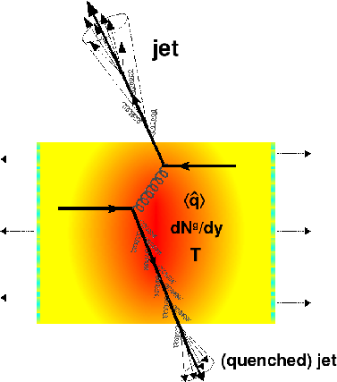
Gluon bremsstrahlung
Softer constituents
Broader radius
Figure from Nucl.Phys. A827 (2009) 356C-364C arXiv:0902.2488 [nucl-ex]

Slide 35


Azimuthal correlations
p+p → dijet
Trigger
nucleus
Associated
Phys.Rev.Lett.93:252301,2004
nucleus

Slide 36
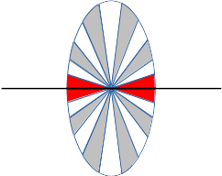
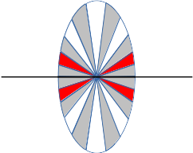
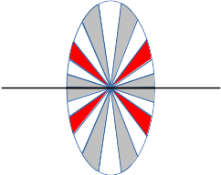
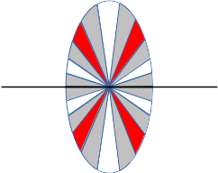
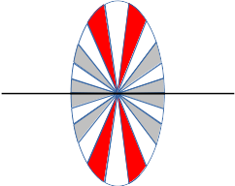
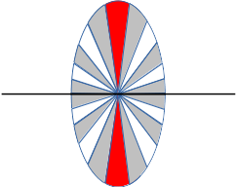
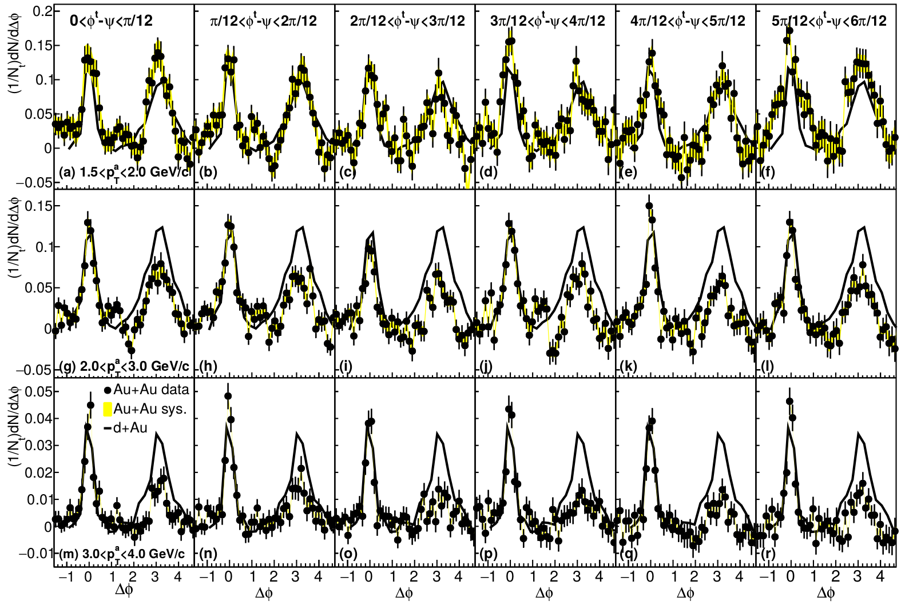
Dihadron correlations
4.0<p_{T}^{trig}<6.0 GeV/c
Phys.Rev.Lett.93:252301,2004
Phys. Rev. C 94, 011901(R) 2016
Sharma, Mazer, Stuart, Nattrass: (Phys. Rev. C 93, 044915 2016)

Slide 37
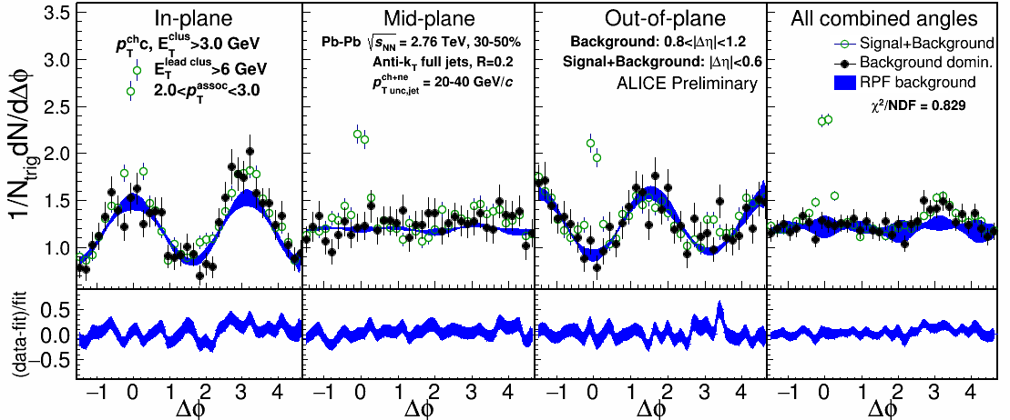

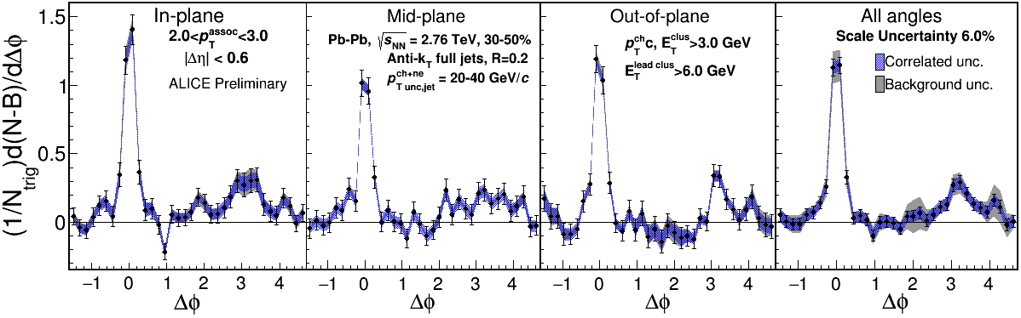
2.0-3.0 GeV/c
1) signal+bkgrd
2) bkgrd dominated
3) bkgrd RPF fit
Correlation function
Joel Mazer
Hot Quarks 2016
Away side clearly there and suppressed

Slide 38
Little/no path length dependence?
Path length dependence naively predicted by every model
  No path length dependence seen in rxn plane dependent A_{j} either
Insufficient sensitivity?
Statistical variation in energy loss is more important than path length dependence
  J. G. Milhano and K. C. Zapp, “Origins of the di-jet asymmetry in heavy ion collisions,” arXiv:1512.08107
  F. Senzel, O. Fochler, J. Uphoff, Z. Xu, and C. Greiner, “Influence of multiple in-medium scattering processes on the momentum imbalance of reconstructed di-jets,” J. Phys. G42 no. 11, (2015) 115104, arXiv:1309.1657 [hep-ph].

Slide 39


Take home messages
If we get nuclear matter dense enough, we make a new phase of matter, which we produce in high energy heavy ion collisions.
This medium is extremely hot and dense...
...and opaque to colored probes and translucent to electromagnetic probes.

Slide 40
Comparison of colliders
 | RHIC | LHC
√s_{NN} (GeV) | 9-200 | 2760, 5500 | center of mass energy
dN_{ch}/dη | ~1200 | ~1600 | number of particles
T/T_{c} | 1.9 | 3.0-4.2 | temperature
ε (GeV/fm³) | 5 | 12, 16 | energy density
τ_{QGP} (fm/c) | 2-4 | >10 | lifetime of QGP
RHIC and LHC:
Cover 2 –3 decades of energy (√s_{NN}= 9 GeV –5 TeV)
To discover the properties of hot nuclear matter at T ~ 150 –600 MeV

Slide 41
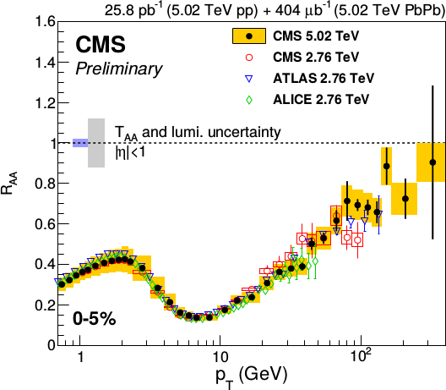
Nuclear modification factor R_{AA}
Single particles at the LHC
Reaches 1 at very high p_{T}
Must happen due to causality
Feature of all QCD-inspired models

Slide 42
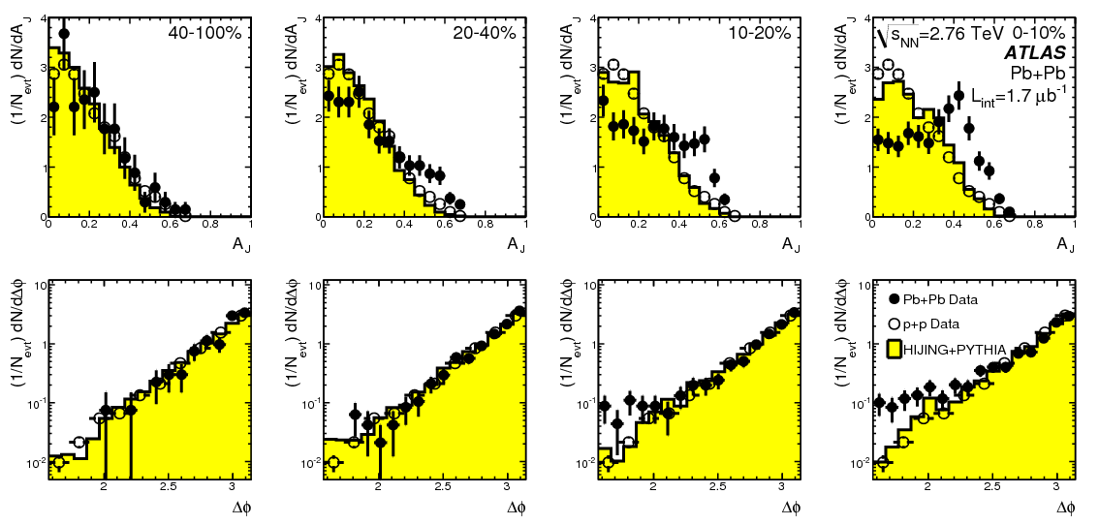
Di-jet asymmetry
PRL 105 (2010) 252303

Slide 43

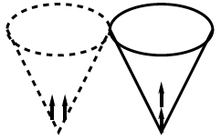
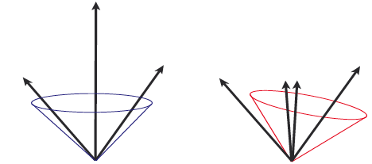
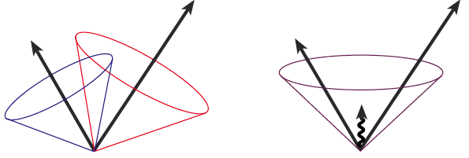
Jets in principle
Jet measures partons
Hadronic degrees of freedom are integrated out
Algorithms are infrared and colinear safe
OK
BAD: 2 jets are merged in one

Slide 44
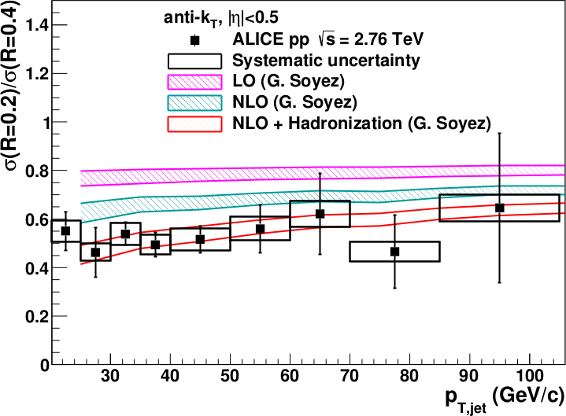
<footer>
Full jet ratios in pp
√s = 2.76 TeV, R = 0.2, 0.4 Inclusive
arXiv:1301.3475
PLB: 10.1016/j.physletb.2013.04.026
Hadronization is important even in pp collisions!
Notes:
----- Meeting Notes (6/24/13 16:47) -----
PRB -> PLB
mention ratio
<number>

Slide 45

Jet finding algorithms
Tracks
Jet finding algorithm
Jet candidates
Clusters
Particles
Any list of objects works as input
Use the same algorithm on theory & experiment
Output only as good as input
M. Cacciari, G. P. Salam, G.Soyez, JHEP 0804:063,2008

Slide 46
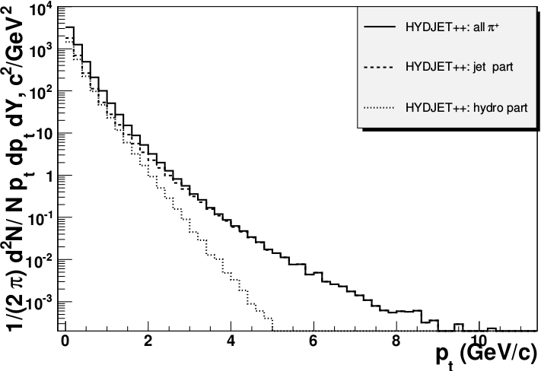
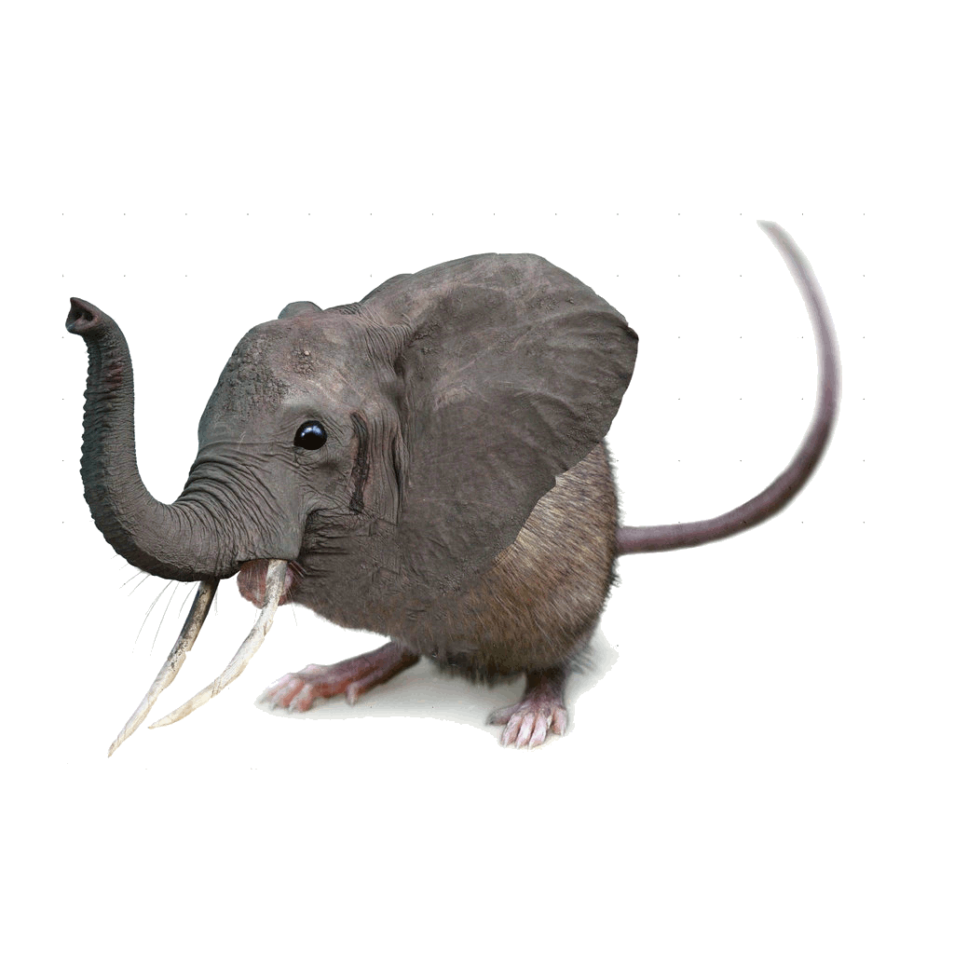
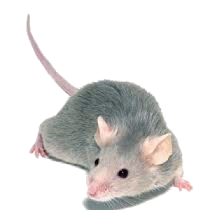

Focus on high p_{T}
Pros:
  Reduces combinatorial background
Cons:
  Cuts signal where we expect modifications
  Could bias towards partons which have not interacted
  Biases sample towards quarks
PoS High-pTphysics09:023,2009

Slide 47
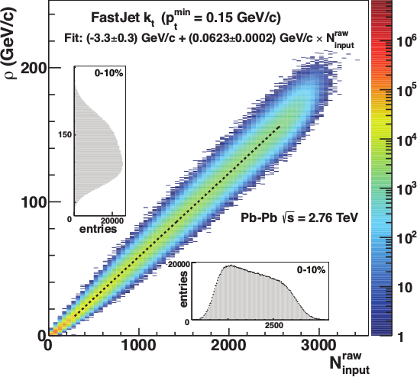
Focus on smaller angles
Pros
  Background is smaller
  Background fluctuations smaller
Cons:
  Modifications expected at higher R
  Biases sample towards quarks
JHEP 03 (2012) 053

Slide 48

<footer>
ALICE/STAR
Combinatorial “jets”
Estimate combinatorial jet contributions and its fluctuations from data
Require leading track p_{T} > 5 GeV/c
  Suppresses combinatorial “jets”
  Biases fragmentation
No threshold on constituents
Limited to small R
Measured spectra:
Full jets
Where
comes from FastJet anti-k_{T} algorithm
Notes:
<number>

Slide 49

ATLAS
Constituent biases don't matter that much up here
Iterative procedure
  Calorimeter jets: Reconstruct jets with R=0.2. v₂ modulated <Bkgd> estimated by energy in calorimeters excluding jets with at least one tower with
  E_{tower} > <E_{tower}>
  Track jets: Use tracks with p_{T}>4 GeV/c
  Calorimeter jets from above with E>25 GeV and track jets with p_{T}>10 GeV/c used to estimate background again.
Calorimeter tracks matching one track with p_{T}>7 GeV/c or containing a high energy cluster E >7 GeV are used for analysis down to E_{jet} = 20 GeV
But they do matter down here!
Definitely imposes a bias, especially at 20 GeV!
We should treat that bias as a tool, not a handicap
Phys. Lett. B 719 (2013) 220-241

Slide 50
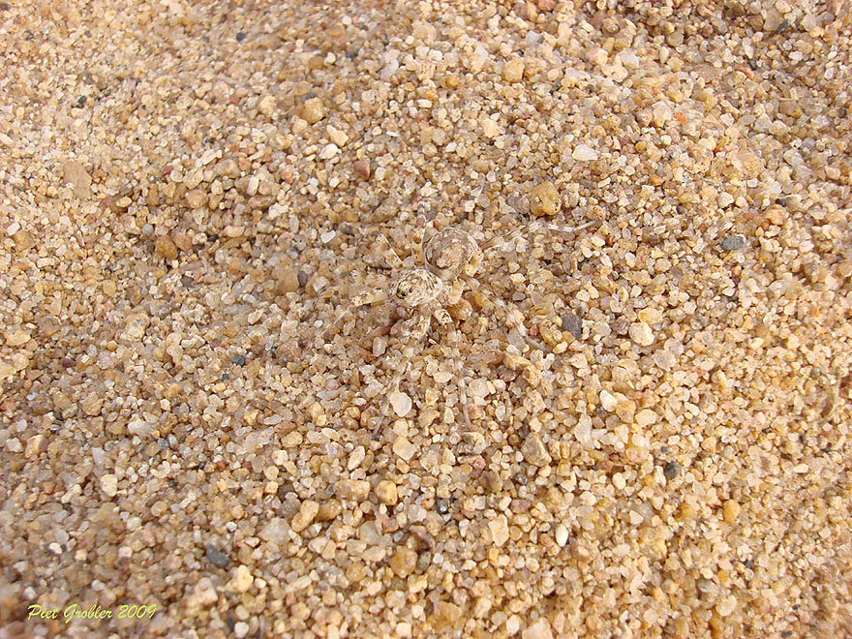
http://www.boredpanda.com/animal-camouflage/

Slide 51
Bias
Modified jets probably look more like the medium
Quark jets are narrower, have fewer tracks, fragment harder [Z Phys C 68, 179-201 (1995), Z Phys C 70, 179-196 (1996), ]
Gluon jets reconstructed with k_{T} algorithm have more particles than jets reconstructed with anti-k_{T} algorithm [Phys. Rev. D 45, 1448 (1992)]
Gluon jets fragment into more baryons [EPJC 8, 241-254, 1998]
http://www.boredpanda.com/animal-camouflage/

Slide 52
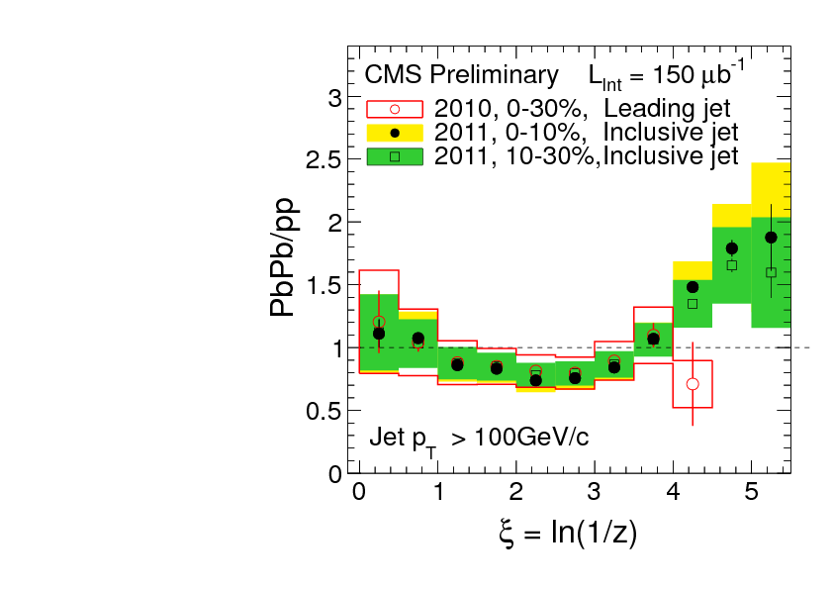
What you see depends on where you look
Phys. Rev. C 90, 024908 (2014)
JHEP10(2012)087
z = p_{T}/E_{jet}
Low p_{T}
High p_{T}
Low p_{T}
Low p_{T}
Low p_{T}
Low p_{T}
High p_{T}
Low p_{T}
High p_{T}
High p_{T}
High p_{T}

Slide 53
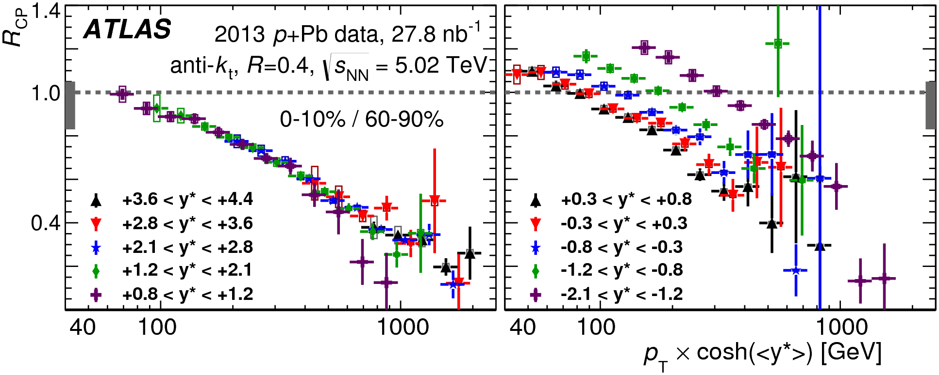
Cold Nuclear Matter effects
PLB 748 (2015) 392-413
No indication of modified jet structure in cold nuclear matter (d+Au and p+Pb collisions)
[Phys.Rev.C73:054903,2006, Phys.Rev.Lett.96:222301,2006]
Minimum bias R_{pPb}, R_{dAu} for charged particles, jets consistent with 1 [Phys.Rev.Lett.98:172302,2007,Phys.Rev.C81:064904,2010,Phys. Rev. Lett. 110 (2013) 082302, arXiv:1605.06436]
Indications of modification at forward rapidities from dihadron correlations
[Phys. Rev. Lett. 107, 172301 (2011)]
Centrality dependence observed
[PLB 748 (2015) 392-413, Phys. Rev. Lett. 116, 122301 (2016)]

Slide 54
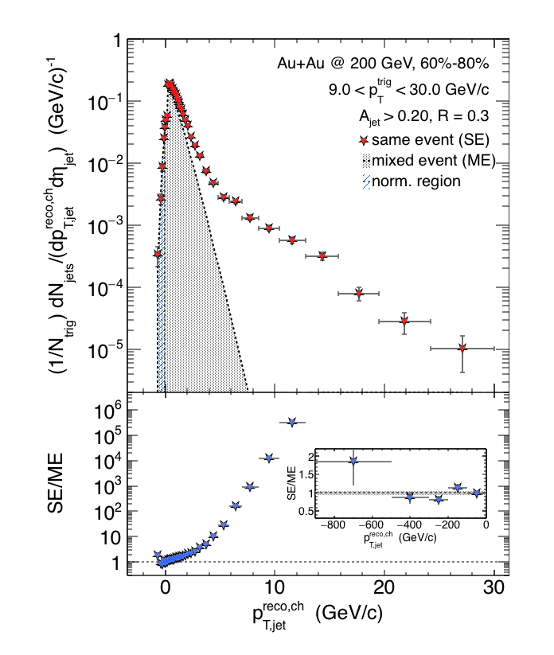

Charged Raw Recoil Jet Spectrum: Reference
Event mixing
Peripheral
Reference spectrum:
peripheral collisions
Much less combinatorial
background compared to
most central data
Excellent signal/background
ratio down to 3 GeV/c
Preliminary
Requires normalization at low p_{T}
All physical correlations treated like jets
Alex Schmah, Hard Probes 2015
06/29/2015
Alexander Schmah - Hard Probes 2015
<number>

Slide 55
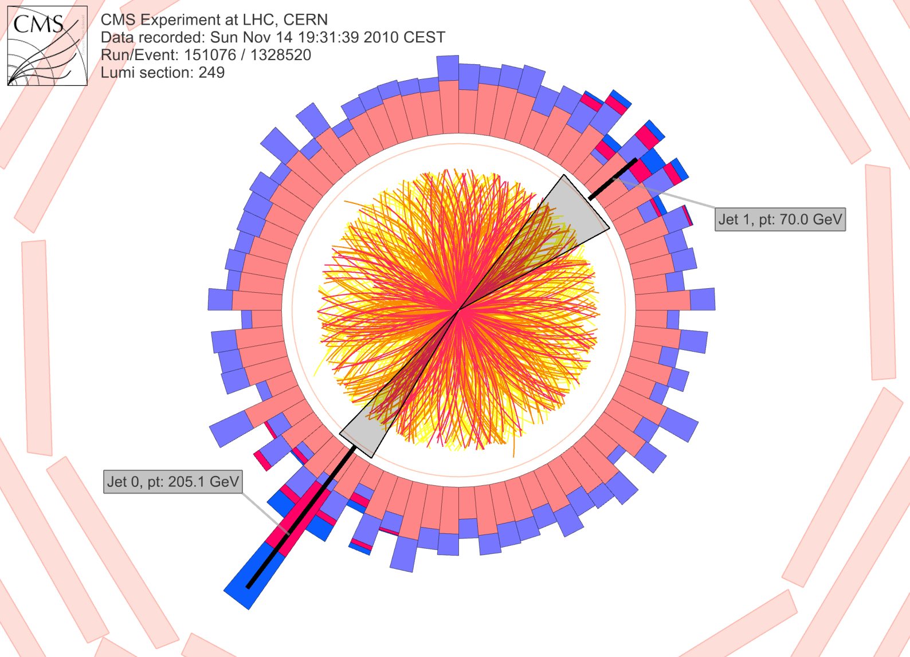
CMS: Iterative Pile-Up Event Background Subtraction
Background is estimated
for each calorimeter ring of constant η
subtracted before jet finding
re-iterated after excluding the jets found in the first iteration
Fake Jets: After the background subtraction, some local fluctuations remain!
Fluctuations will deteriorate the jet resolution in central events.
Sevil Salur
<number>

Slide 56
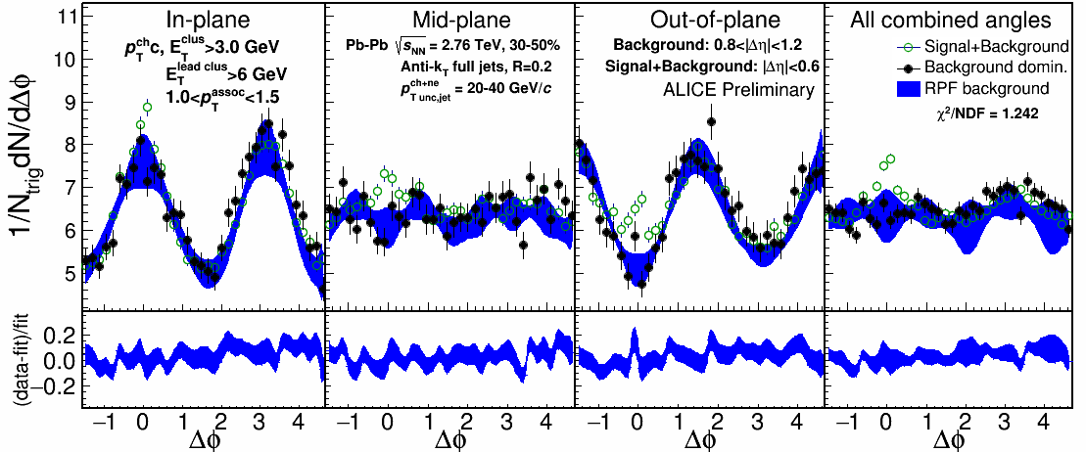
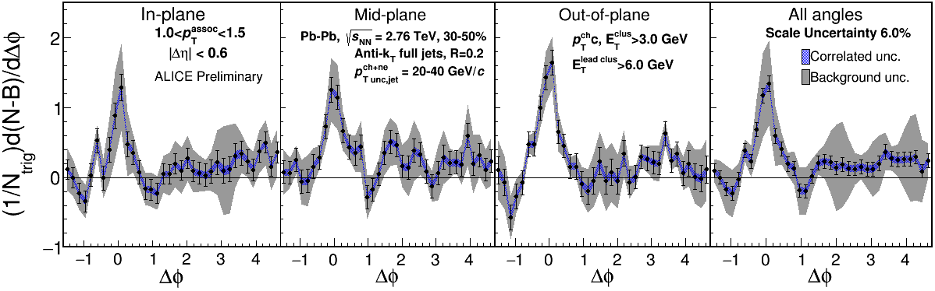
1.0-1.5 GeV/c
1) signal+bkgrd
2) bkgrd dominated
3) bkgrd RPF fit
Correlation function
Uncertainties dominated by statistics
Background uncertainty is non-trivially correlated point-to-point

Slide 57
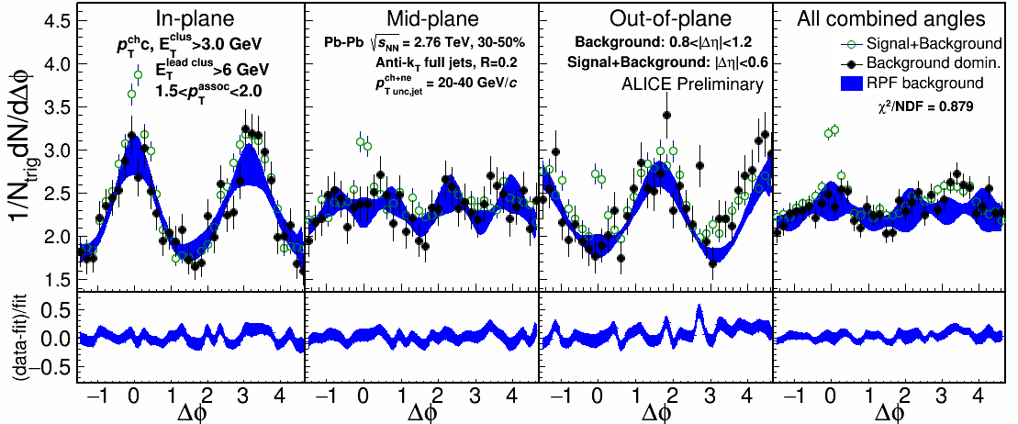
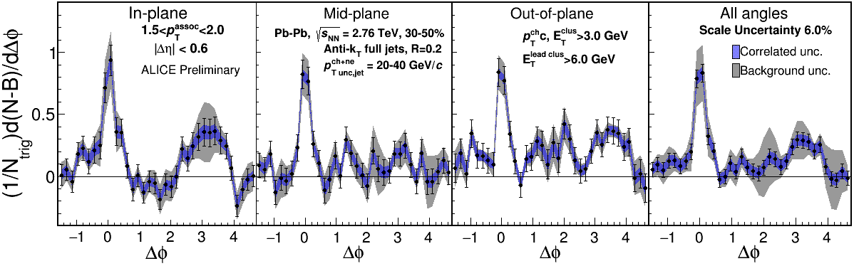
1.5-2.0 GeV/c
1) signal+bkgrd
2) bkgrd dominated
3) bkgrd RPF fit
Correlation function
v₃ and v₄ components important
Background uncertainty is non-trivially correlated point-to-point

Slide 58
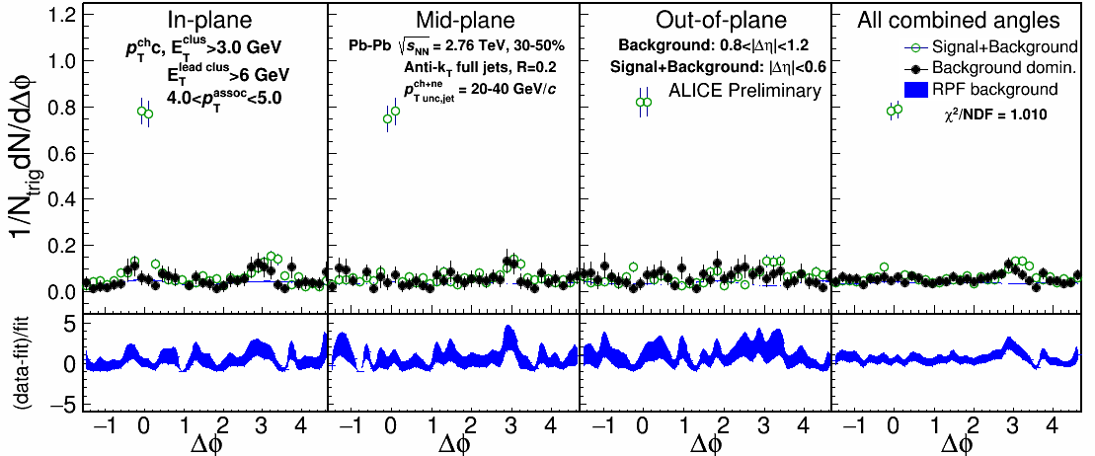
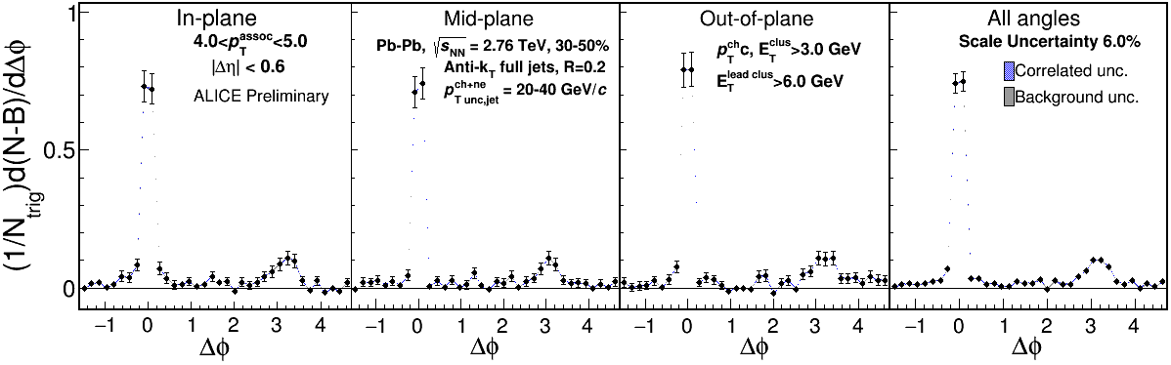
4.0-5.0 GeV/c
1) signal+bkgrd
2) bkgrd dominated
3) bkgrd RPF fit
Correlation function
Background level negligible

Slide 59
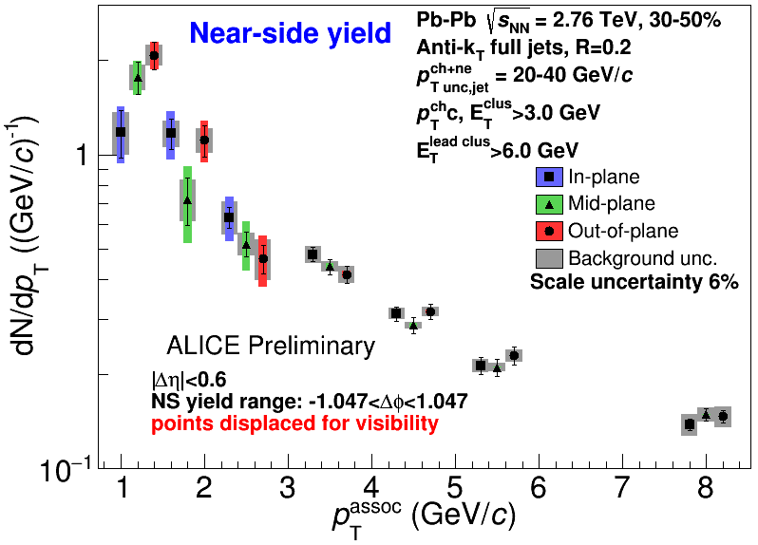
Near-side jet yields vs EP
Jets 20-40 GeV/c, 30-50% centrality
Within uncertainties of
current statistics, no
event plane ordering
Different effects in
different p_{T} associated
bins
Competing effects
1) Quenching
2) Bremsstrahlung
3) etc

Slide 60

Di-jet asymmetry
Kolja Kauder, RHIC/AGS User's Meeting 2016
arXiv:1609.03878
Au+Au di-jets more imbalanced than p+p for pTcut>2 GeV/c
Au+Au AJ ~ p+p AJ for matched di-jets (R=0.4)

Slide 61
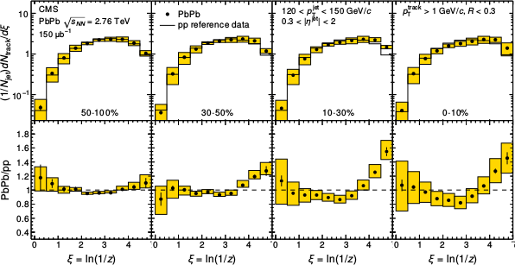
Fragmentation functions
z = p_{T}/E_{jet}
CMS
PRC 90 (2014) 024908
High p_{T}
Low p_{T}

Slide 62
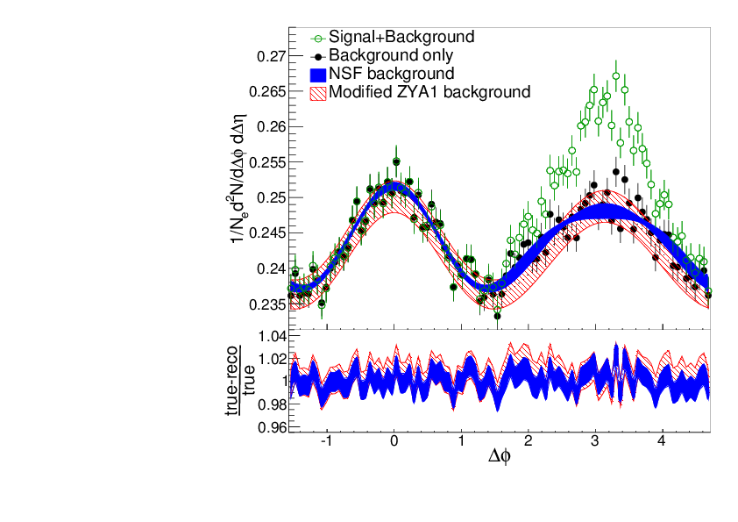
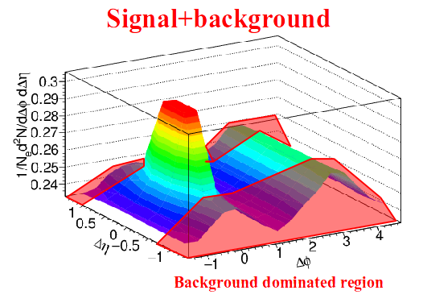
Reaction plane fit (RPF) method
TOY MODEL
Signal is negligible at large Δη and small ΔΦ region.
NSF method
h-h
√s_{NN} = 2.76 TeV
30-40% PbPb
8<p_{T}^{trigger}<10 GeV/c
1<p_{T}^{assoc}<2 GeV/c
Fit
extrapolation
Project signal+background over 0.8 < |Δη| < 1.2
Fit background in |Δφ| < π/2
Fitting till 4th order v_{n} term, total 6 fit parameters: B, v₂^{assoc}, v₂^{trig}, v₃^{assoc}×v₃^{trig}, v₄^{assoc}, and v₄^{trig}
Sharma, Mazer, Stuart, Nattrass: (Phys. Rev. C 93, 044915 2016)
Nattrass, Sharma, Mazer, Stuart, and Bejnood: (Phys. Rev. C 94, 011901(R) 2016)

Slide 63
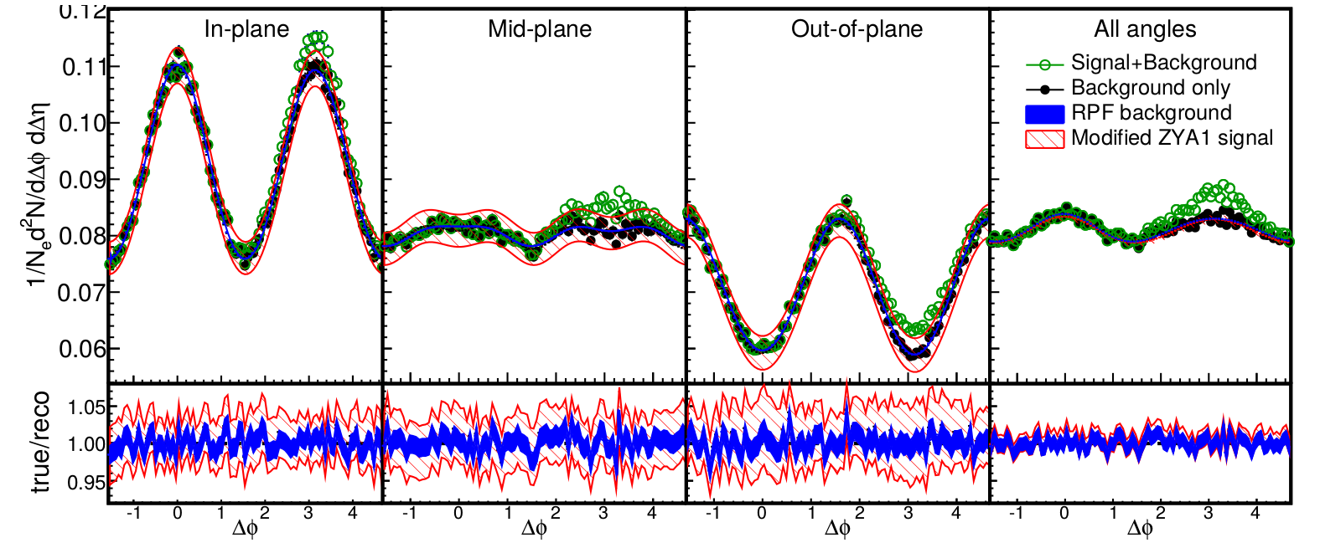
Reaction plane fit (RPF) method
30-40% central (simulation)
TOY MODEL
Each orientation has different functional form, but require same parameters
More robust method, now have a higher constrained background
with more information going into fit
h-h
√s_{NN} = 2.76 TeV
30-40% PbPb
8<p_{T}^{trigger}<10 GeV/c
1<p_{T}^{assoc}<2 GeV/c
Fit
Project signal+background over 0.8<|Δη|<1.2
v_{n} and B extracted
Fewer assumptions and bias than ZYAM while having much smaller errors

