Slide 1

Measurements of jets in heavy ion collisions
Christine Nattrass
University of Tennessee, Knoxville
Largely based on Connors, Nattrass, Reed, & Salur arxiv:1705.01974

Slide 2
What have we learned?
How do we move forward?

Slide 3
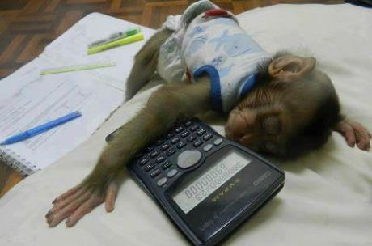
Partonic energy loss
https://onkeymonkey.files.wordpress.com/2013/03/5387946_460s_v1.jpeg

Slide 4


Nuclear modification factor R_{AA}
RHIC
LHC
arXiv:1705.01974 [nucl-ex]
Electromagnetic probes – consistent with no modification – medium is transparent to them
Strong probes – significant suppression – medium is opaque to them - even heavy quarks!

Slide 5


Jet R_{AA}
arXiv:1705.01974
arXiv:1705.01974
Tension between ATLAS & ALICE/CMS
Jet R_{AA} also demonstrates suppression
Similar suppression of heavy quark jets?

Slide 6
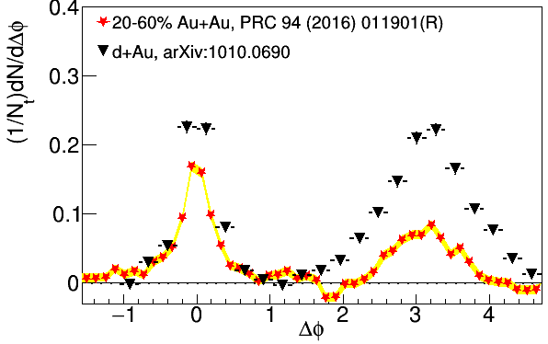
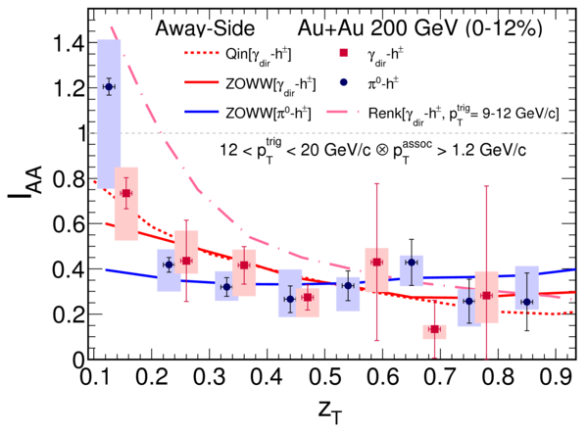
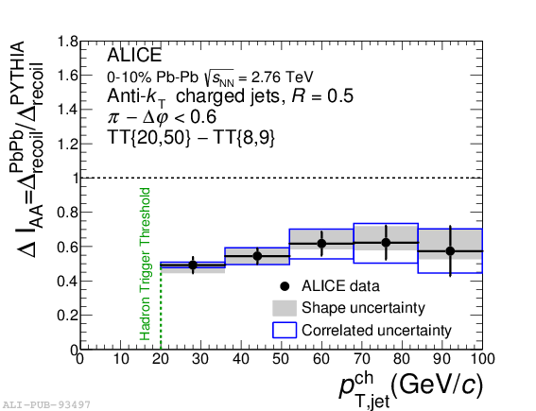

suppression
Jet v₂
[Phys.Lett. B 753 (2016) 511-525,
Phys. Rev. Lett.111 152301 (2013)]
suppression
Di-hadron correlations
[Too many to list]
γ-hadron correlations
[Phys.Rev.C80:024908,2009,
Phys.Rev.D82:072001,2010,
Phys.Rev.C82:034909,2010
Physics Letters B 760 (2016)]
Au+Au √s_{NN}=200 GeV
Pb+Pb √s_{NN}=2.76 TeV
Pb+Pb √s_{NN}=2.76 TeV
[Phys. Rev. C 90, 014909 (2014)]
γ-jet
correlations
[Phys. Lett. B 718 (2013) 773]
suppression
High-p_{T}
hadron v₂
[too many to list]
Dijet asymmetry
[Phys.Rev.C84:024906,2011,
Phys. Lett. B 712 (2012) 176,
Phys.Rev.Lett.105:252303,2010,
Phys. Rev. Lett. 119, 062301 (2017)]
Hadron-jet correlations
[JHEP 09 (2015) 170,
Phys. Rev. C 96, 024905 (2017)]

Slide 7
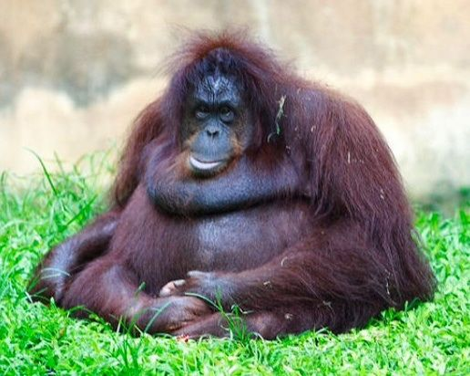
Broadening and Softening
https://i.pinimg.com/736x/28/9b/9e/289b9e8e63c56fe8496c0aaafee58183--funny-fat-animals-scout-cookies.jpg

Slide 8
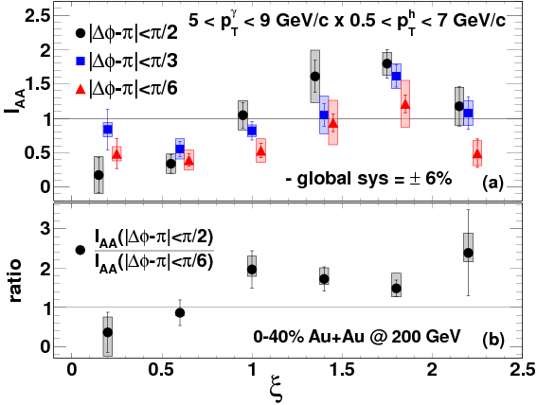

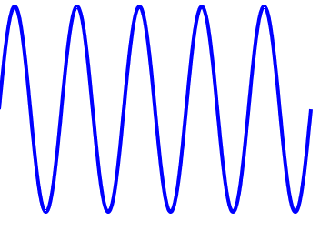
Fragmentations from γ-hadron correlations
z=p_{T}/E_{γ}
1.00
0.61
0.37
0.22
0.14
0.08
Enhancement at low z
Slight suppression at high z

Slide 9



Modified fragmentation
Jet-hadron correlations
Fragmentation functions with jets
Fragmentation functions with jets
arXiv:1609.03878
Di-jet asymmetry
Leading jet
z=p_{T}/E_{γ}
Di-hadron correlations
[Lots of papers]
Jet shapes
[arXiv:1708.09429,
arXiv:1512.07882,
arXiv:1704.03046]
Sys. Uncertainties:
Tracking:6%
Tower energy scale: 2%
Kolja Kauder, RHIC/AGS
User's Meeting 2016
Subleading jet

Slide 10






Jet-hadron correlations vs reaction plane
Full jets
1) signal+bkgd
2) bkgd dominated
3) bkgd RPF fit
Trigger
Associated
No modification of constituents relative to reaction plane
→ Jet-by-jet fluctuations more important than path length [PLB 735 157(2014)]
  Also needed to explain high p_{T} v₂ [PRL 116 252301 (2016)]

Slide 11
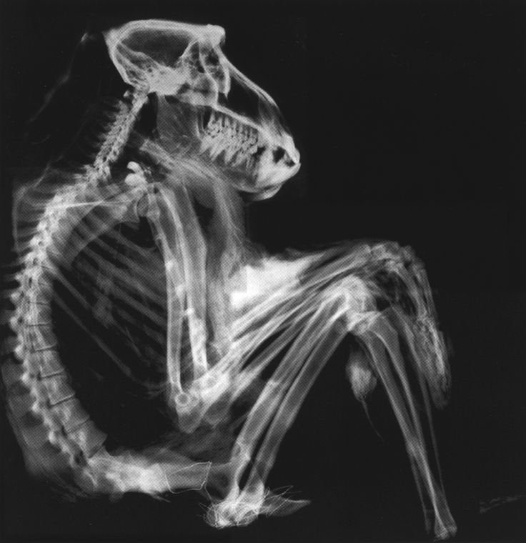
Jet structure
https://i.pinimg.com/736x/a7/42/bc/a742bc8c2dcb0ad8bb47576a7f106c9a--images-of-animals-x-rays.jpg

Slide 12



Jet mass
arXiv:1702.00804
Quenching models (JEWEL, Q-PYTHIA) show a larger mass than pp-like PYTHIA jets
Pb-Pb measurement can discriminate among these predictions

Slide 13


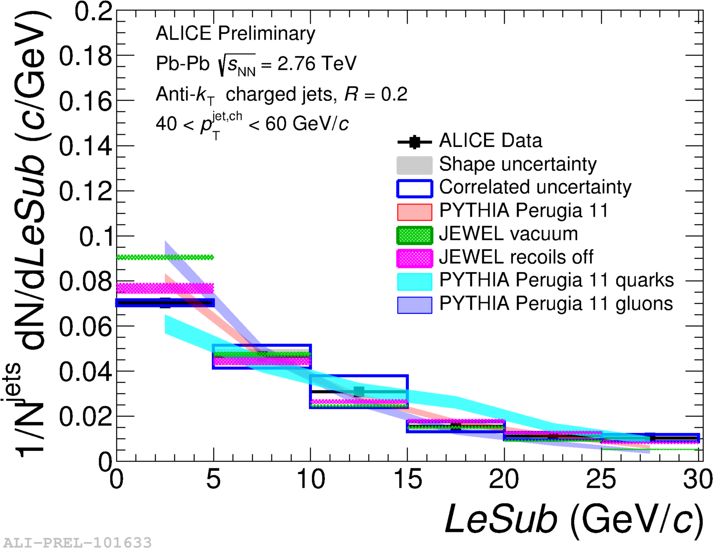
Girth g
Dispersion p_{T}D
LeSub
Jets are slightly more collimated than in pp
Agrees with PYTHIA

Slide 14
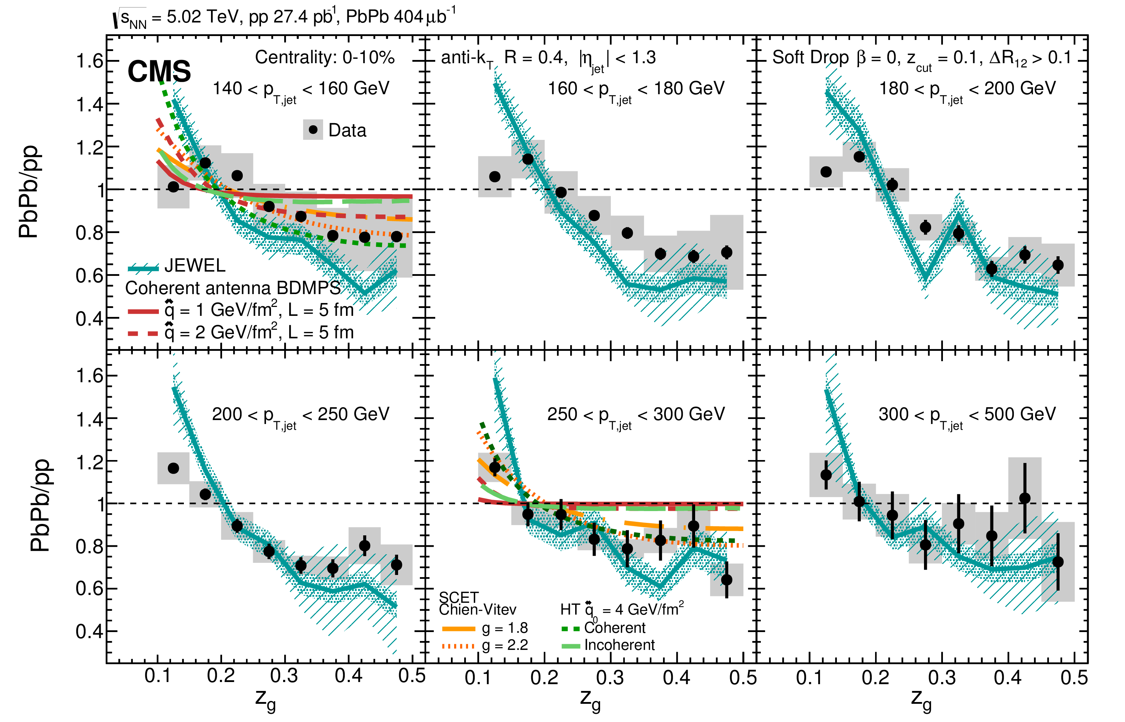
Splitting function

Slide 15
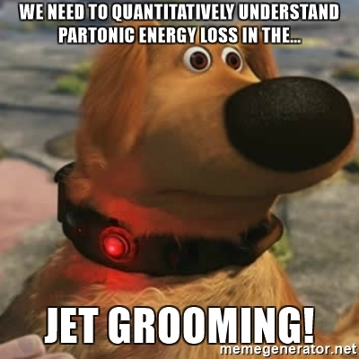
It is 2017. What have we learned?
Qualitative confirmation of our model for partonic energy loss
Reasonable constraints on
  Using mostly hadron spectra
We have not gotten many quantitative constraints out of other observables.
We don't truly know if they are actually sensitive to the physics we want to measure.
Theoretical calculations sensitive to things we might not have under control.

Slide 16
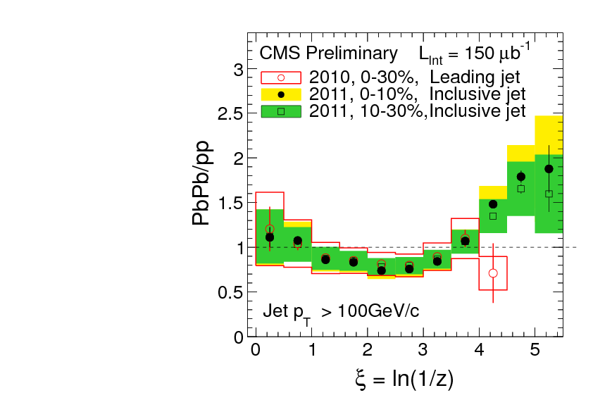
What you see depends on where you look
Phys. Rev. C 90, 024908 (2014)
JHEP10(2012)087
z = p_{T}/E_{jet}
Low p_{T}
High p_{T}
Low p_{T}
Low p_{T}
Low p_{T}
Low p_{T}
High p_{T}
Low p_{T}
High p_{T}
High p_{T}
High p_{T}

Slide 17
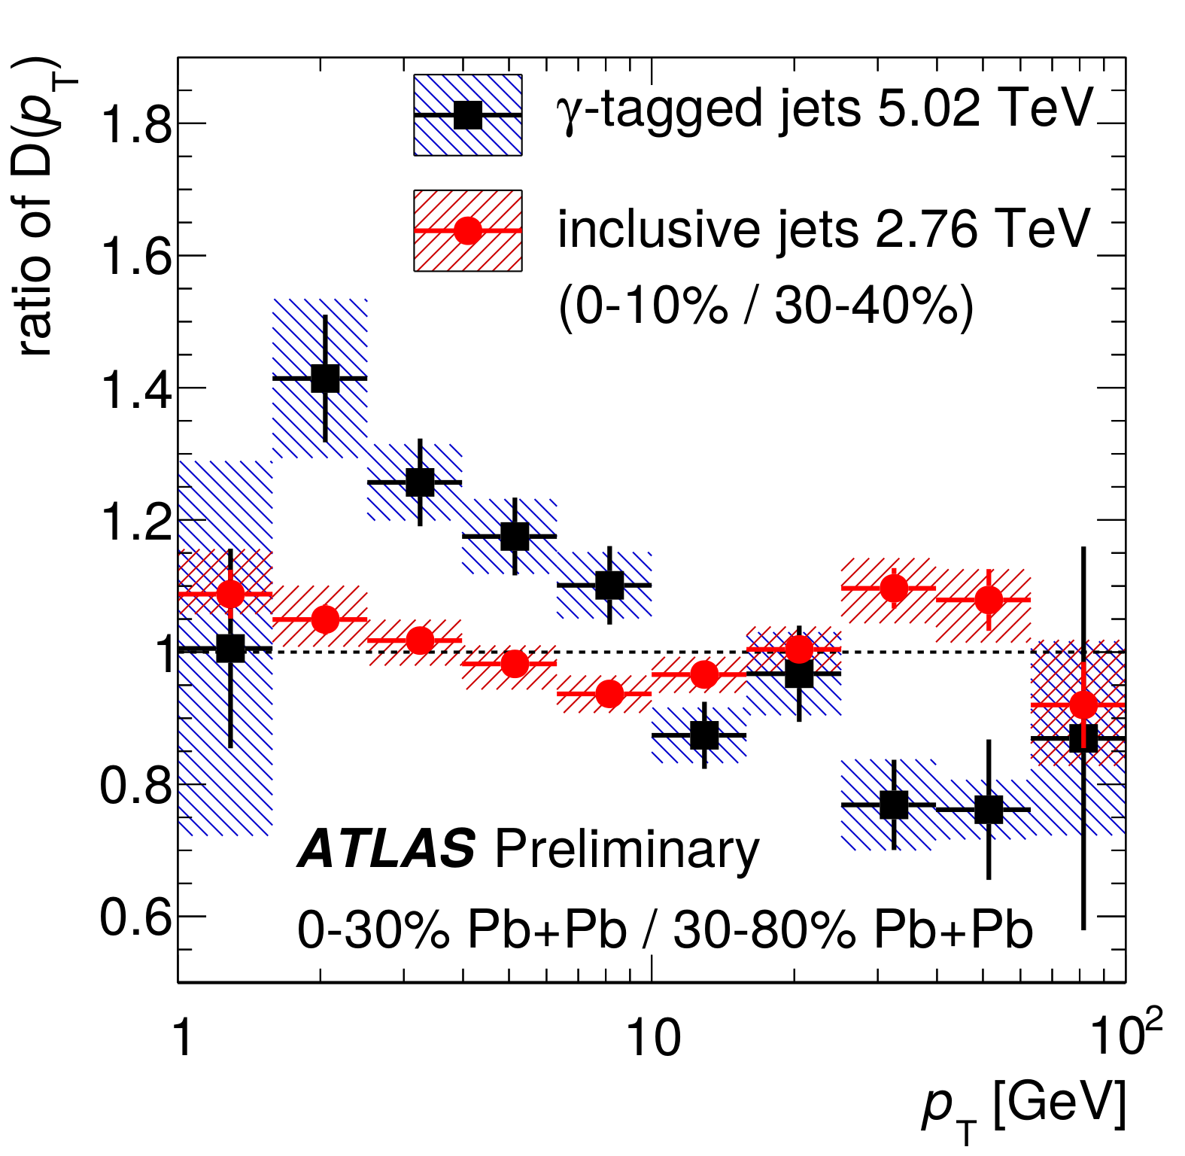
What you see depends on where you look

Slide 18
ATLAS
Background subtraction method:
Iterative procedure
  Calorimeter jets: Reconstruct jets with R=0.2. v₂ modulated <Bkgd> estimated by energy in calorimeters excluding jets with at least one tower with
  E_{tower} > <E_{tower}>
  Track jets: Use tracks with p_{T}>4 GeV/c
  Calorimeter jets from above with E>25 GeV and track jets with p_{T}>10 GeV/c used to estimate background again.
Calorimeter tracks matching one track with p_{T}>7 GeV/c or containing a high energy cluster E >7 GeV are used for analysis down to E_{jet} = 20 GeV
arXiv:1705.01974
Constituent biases don't matter that much up here
Phys. Lett. B 719 (2013) 220-241
But they do matter down here!

Slide 19
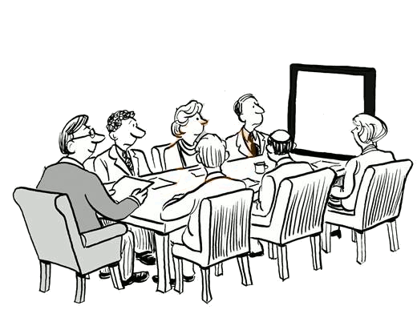
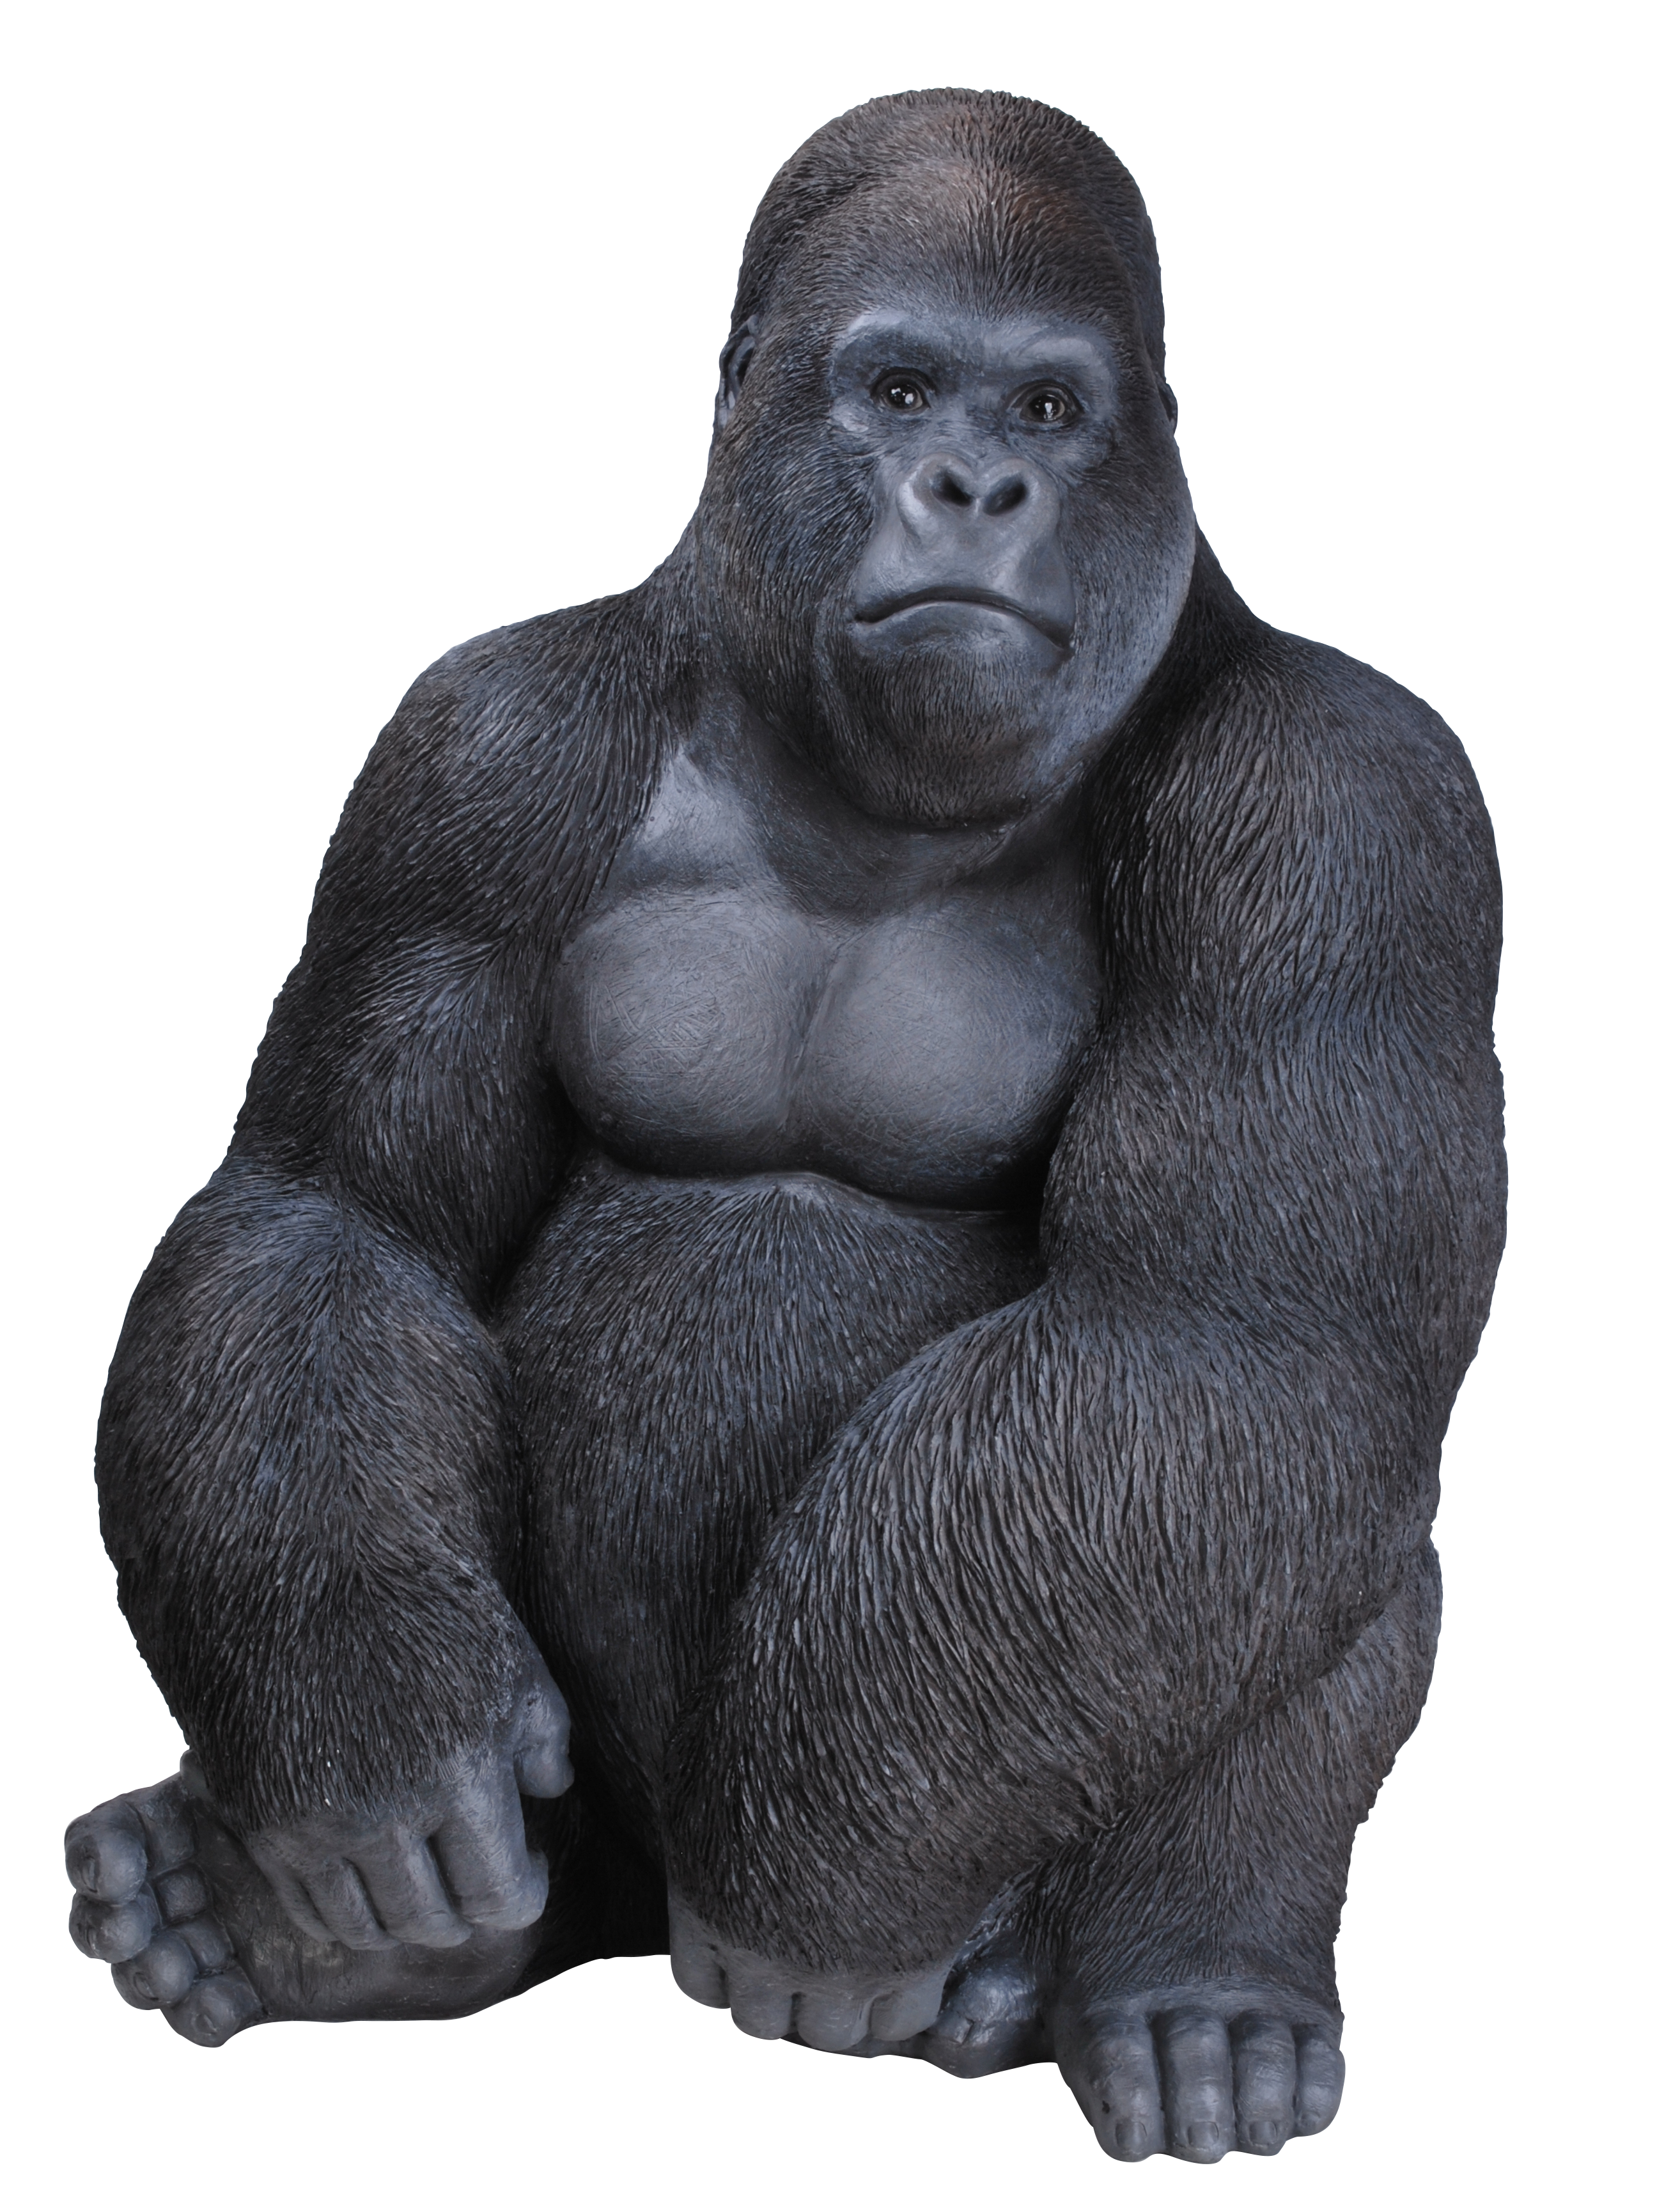

Slide 20
What is a jet?

Slide 21

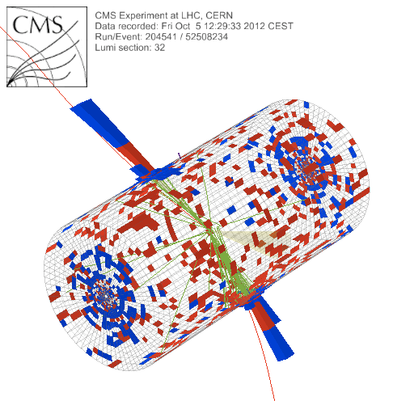
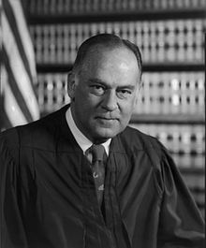
What is a jet?
p+p → dijet
Beam pipe
“I know it when I see it”
US Supreme Court Justice Potter Stewart, Jacobellis v. Ohio

Slide 22

Jet finding
in pp collisions
Jet finder: groups final state particles into jet candidates
  Anti-k_{T} algorithm
  JHEP 0804 (2008) 063 [arXiv:0802.1189]
Depends on hadronization
Ideally
  Infrared safe
  Colinear safe
Snowmass Accord: Theoretical calculations and experimental measurements should use the same jet finding algorithm. Otherwise they will not be comparable.

Slide 23
A jet is what a jet finder finds.

Slide 24
Jet finding
in AA collisions
Jet finder: groups final state particles into jet candidates
  Anti-k_{T} algorithm
  JHEP 0804 (2008) 063 [arXiv:0802.1189]
Combinatorial jet candidates
Energy smearing from background
Large, fluctuating, correlated background
Sensitive to methods to suppress combinatorial jets and correct energy
Focus on narrow/high energy jets
We need an accord on how to treat background

Slide 25
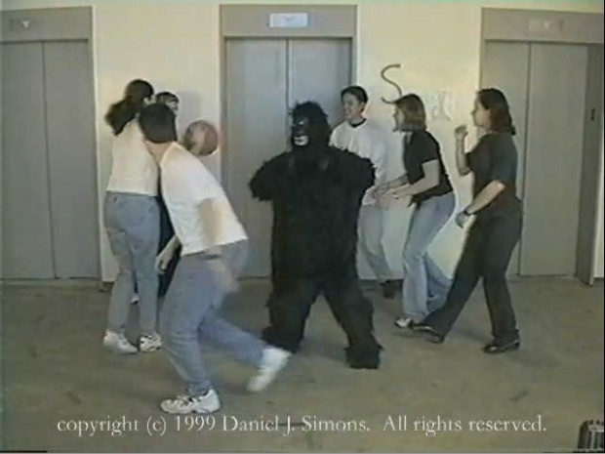
The invisible gorilla
http://www.theinvisiblegorilla.com/

Slide 26
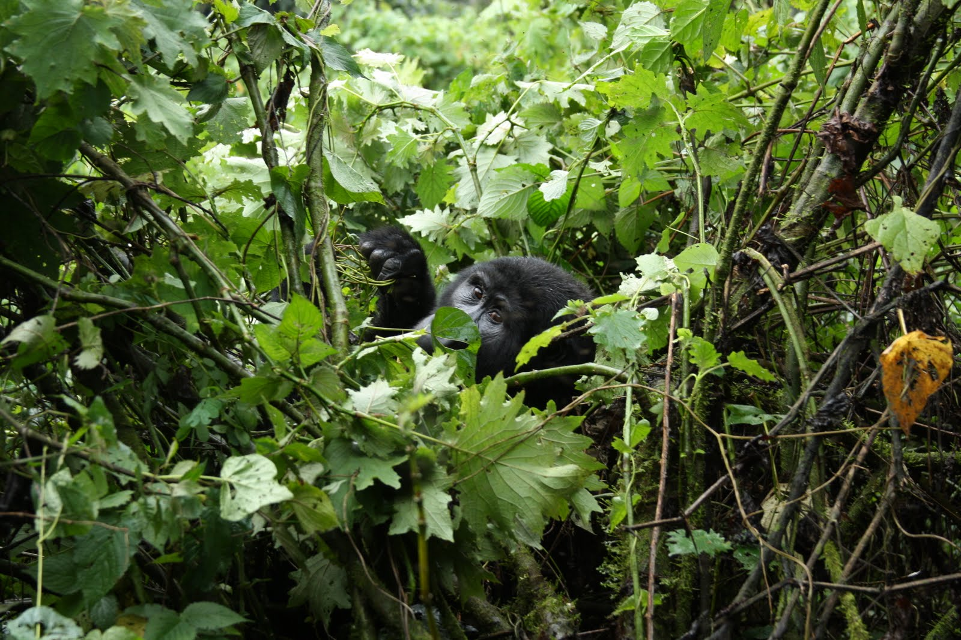

Slide 27
Bias & background
Experimental background subtraction methods: complex, make assumptions, apply biases
Survivor bias: Modified jets probably look more like the medium
Quark/Gluon bias:
  Quark jets are narrower, have fewer tracks, fragment harder [Z Phys C 68, 179-201 (1995), Z Phys C 70, 179-196 (1996), ]
  Gluon jets reconstructed with k_{T} algorithm have more particles than jets reconstructed with anti-k_{T} algorithm [Phys. Rev. D 45, 1448 (1992)]
  Gluon jets fragment into more baryons [EPJC 8, 241-254, 1998]
Fragmentation bias: Experimental measurements explicitly select jets with hard fragments

Slide 28
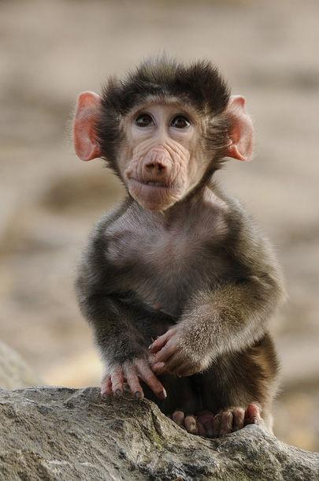
What should we measure?
Jupiter and the Monkey
Jupiter promised a royal reward to the one whose offspring should be deemed the handsomest.
The monkey came with the rest, and presented a flat-nosed, hairless, ill-featured young monkey.
A general laugh saluted her on the presentation of her son.
She resolutely said; "He is at least in the eyes of me, his mother, the dearest, handsomest, and most beautiful of all."
http://aesopsfables.org/F9_Jupiter-and-the-Monkey.html
Abbreviated

Slide 29
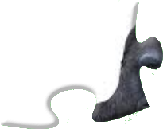
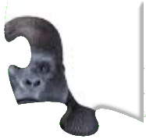
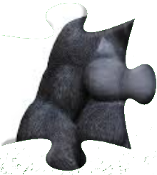
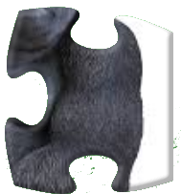
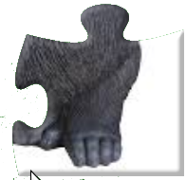
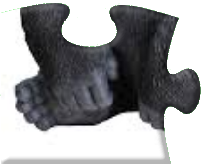
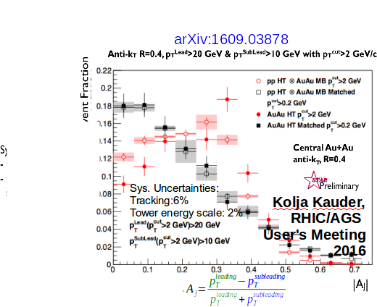
What should we measure?

Slide 30

Learning about the QGP from jets
The JETSCAPE collaboration is an NSF funded multi-institutional effort to design the next generation of event generators to simulate the physics of ultra-relativistic heavy-ion collisions. It involves teams of theoretical and experimental physicists, computer scientists, and statisticians from nine institutions.

Slide 31
Lessons from measurements of jets
Understand bias – it's a tool, not a dirty word
Make quantitative comparisons to theory
  Report correlation between uncertainties
    Report spectra without T_{AA}!
    Report point-to-point correlations
Make more differential measurements
We need an accord on how to treat background
  Experimental cuts matter and are unavoidable
  Clear definition and implementation of background, biases (via Rivet?)
  Summer 2018?

Slide 32

Connors, Nattrass, Reed, & Salur arxiv:1705.01974
Thank you!

Slide 33
Modified fragmentation
z=p_{T}/E_{γ}
Enhancement at low z
No modification/enhancement at high z?

Slide 34
Di-jet asymmetry
Leading jet
Sys. Uncertainties:
Tracking:6%
Tower energy scale: 2%
Kolja Kauder, RHIC/AGS
User's Meeting 2016
arXiv:1609.03878
Subleading jet
Au+Au di-jets more imbalanced than p+p for pTcut>2 GeV/c
Au+Au AJ ~ p+p AJ for matched di-jets (R=0.4)

Slide 35
Jet-hadron correlations
Jets are broader, constituents are softer
Also seen in:
  Di-hadron correlations [Lots of papers]
  Jet shapes [arXiv:1708.09429, arXiv:1512.07882, arXiv:1704.03046]
  Dijet asymmetry with soft constituents [PRL119 (2017) 62301]

Slide 36
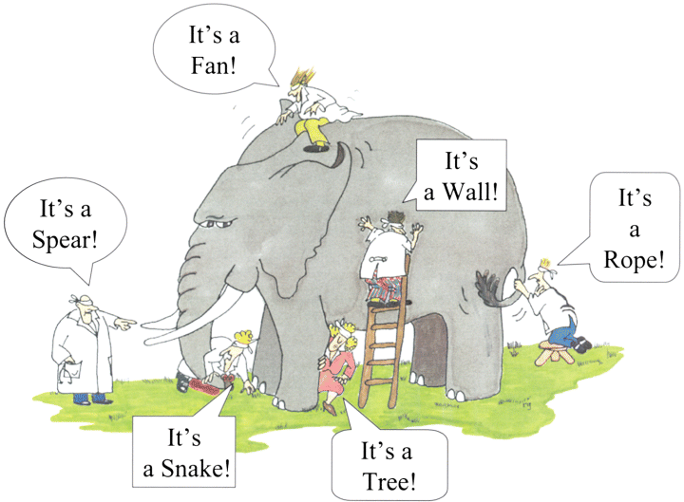
Blind men and the elephant

Slide 37
V1 estimates

Slide 38
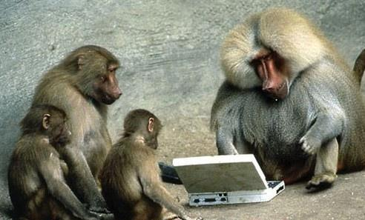
What have we learned?
http://www.pak101.com/funnypictures/Funny/2011/9/20/Funny_Animals_Pictures_mhsqs.jpg

Slide 39
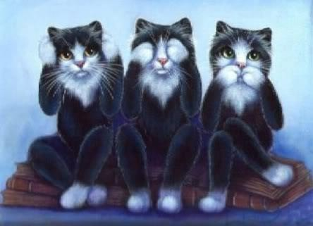
https://i.pinimg.com/736x/b1/06/40/b10640a9668443428d0228a7dc4e5a92--see-no-evil-evil-cats.jpg

Slide 40
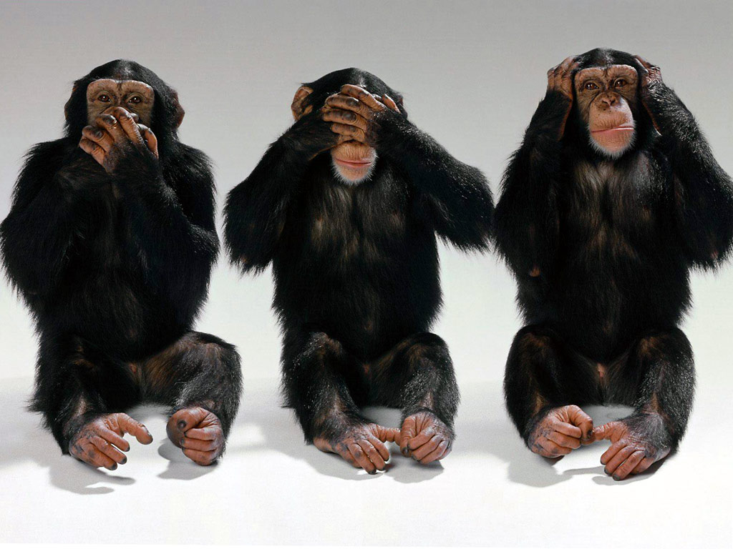
Hear no evil, see no evil, speak no evil
Wikipedia:
There are various meanings ascribed to the monkeys and the proverb including associations with being of good mind, speech and action.
In the Western world the phrase is often used to refer to those who deal with impropriety by turning a blind eye.

Slide 41

Partonic energy loss
http://i.huffpost.com/gen/1111048/images/o-TIRED-KITTEN-facebook.jpg

Slide 42

Broadening and Softening

Slide 43
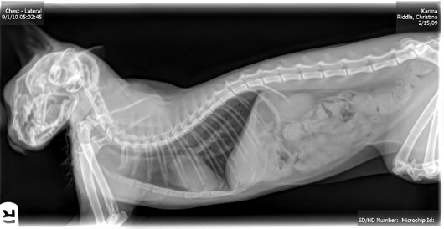
Jet structure
http://www.kestrel.ws/erasmus/pics/cat-xray_body.jpg

Slide 44

What have we learned?

