Slide 1

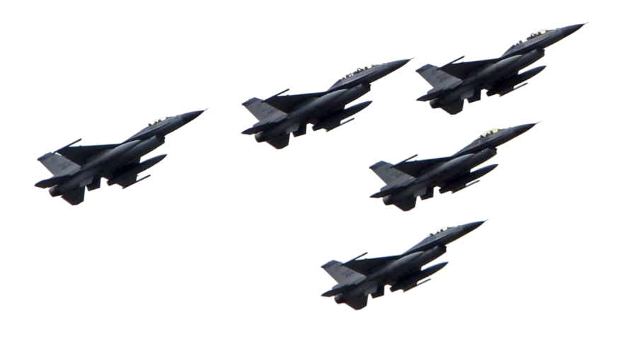
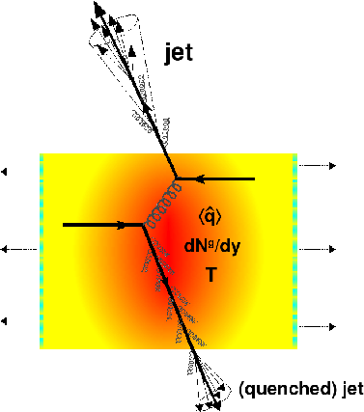
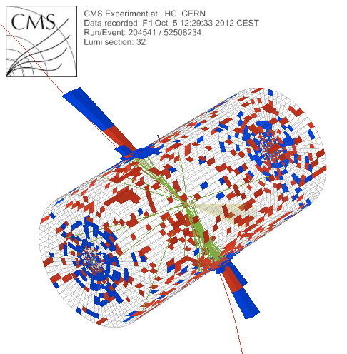


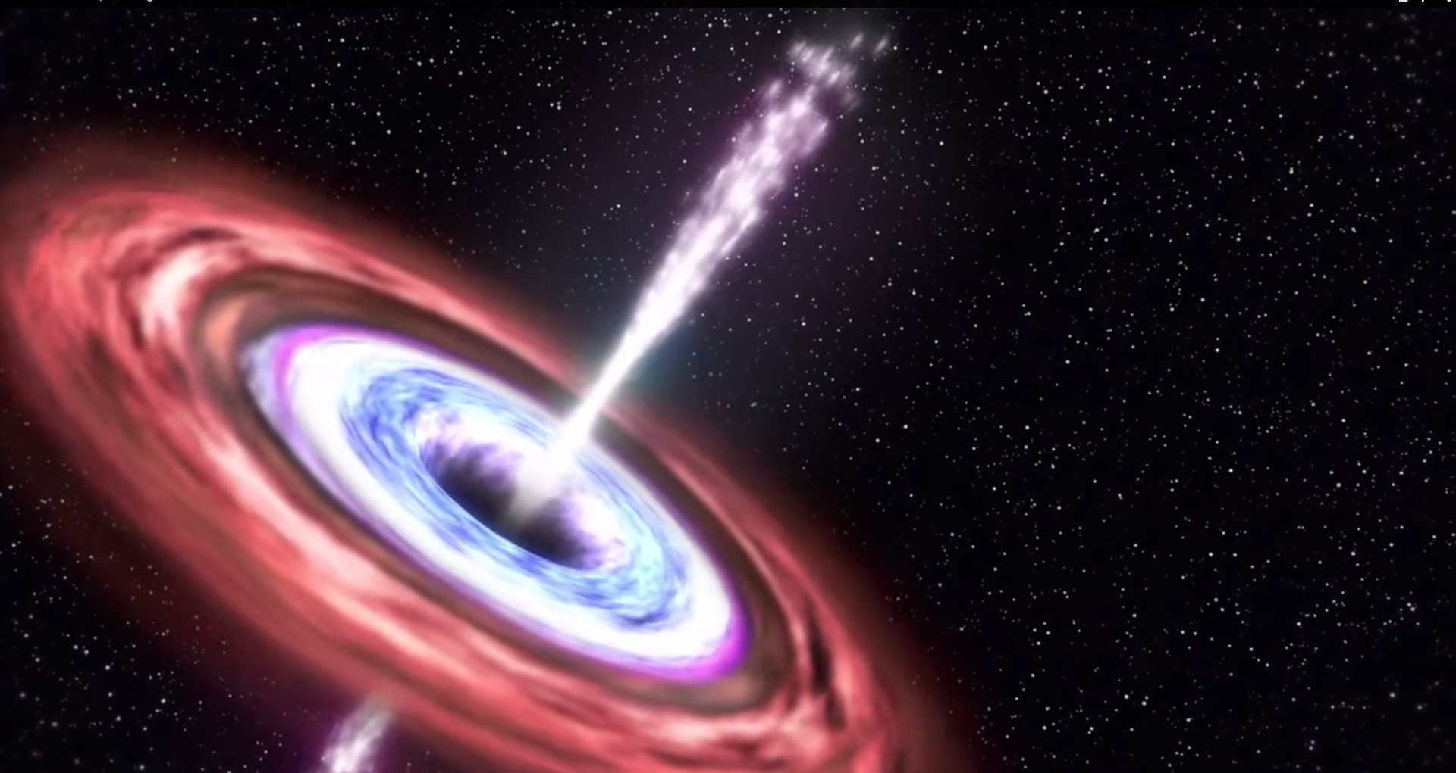
Jets

Slide 2

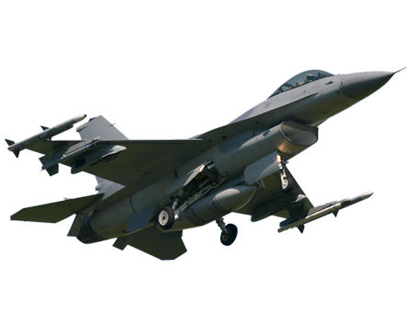
Overview
Jet quenching in a nutshell
  Partons lose energy in the medium
  This lost energy makes jets broader and softer
Towards quantitative understanding
  Measurement details matter
  Cold nuclear matter effects?

Slide 3
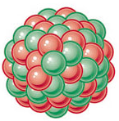
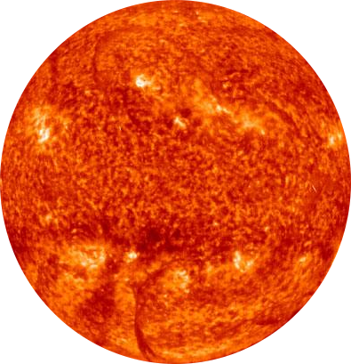
Jets – the cartoon
nucleus
nucleus
Want a probe which traveled through the medium
QGP is short lived → need a probe created in the collision
We expect the medium to be dense → absorb/modify probe

Slide 4
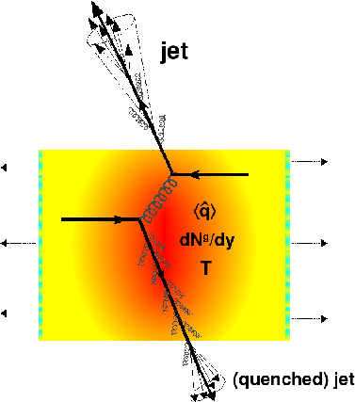
Quenched jets:
what we're trying to study
Softer constituents
Broader radius
Figure from Nucl.Phys. A827 (2009) 356C-364C arXiv:0902.2488 [nucl-ex]

Slide 5
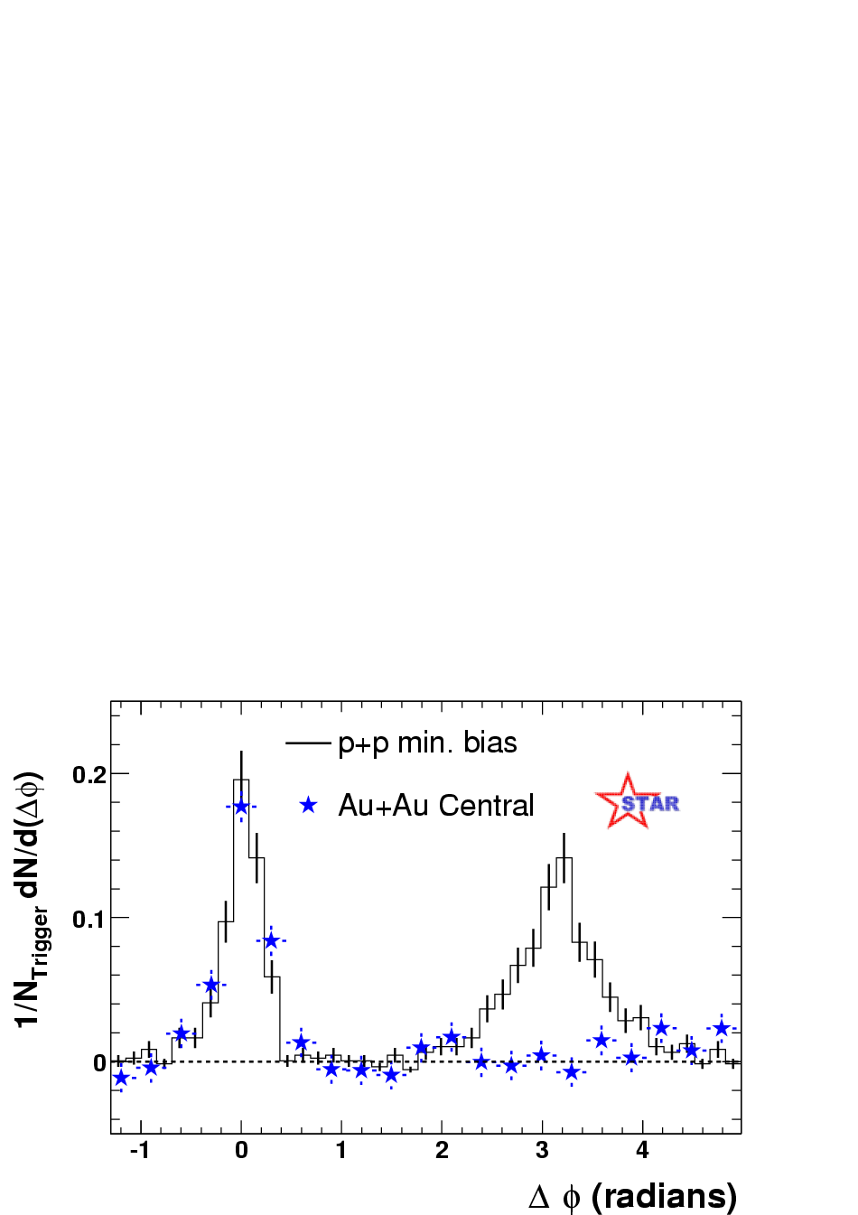
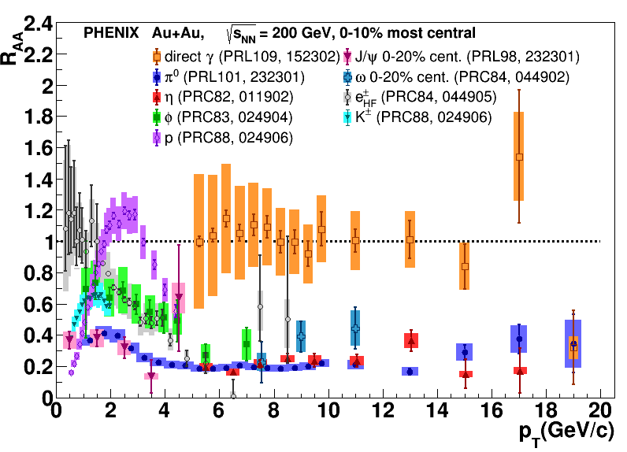
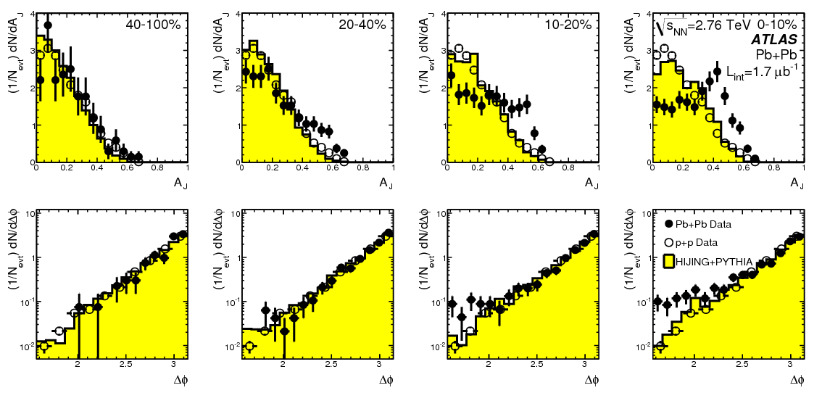
Ways to study jets
Single particle
Di-hadron (multi-hadron) correlations
Fully reconstructed jets
PRL 105 (2010) 252303
Phys.Rev.Lett.93:252301,2004

Slide 6
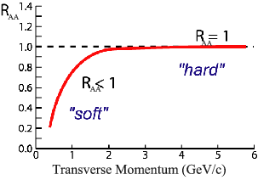
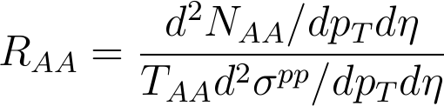
Nuclear modification factor
Measure spectra of probe (jets) and compare to those in p+p collisions or peripheral A+A collisions
If high-p_{T} probes (jets) are suppressed, this is evidence of jet quenching
Enhancement
Suppression

Slide 7
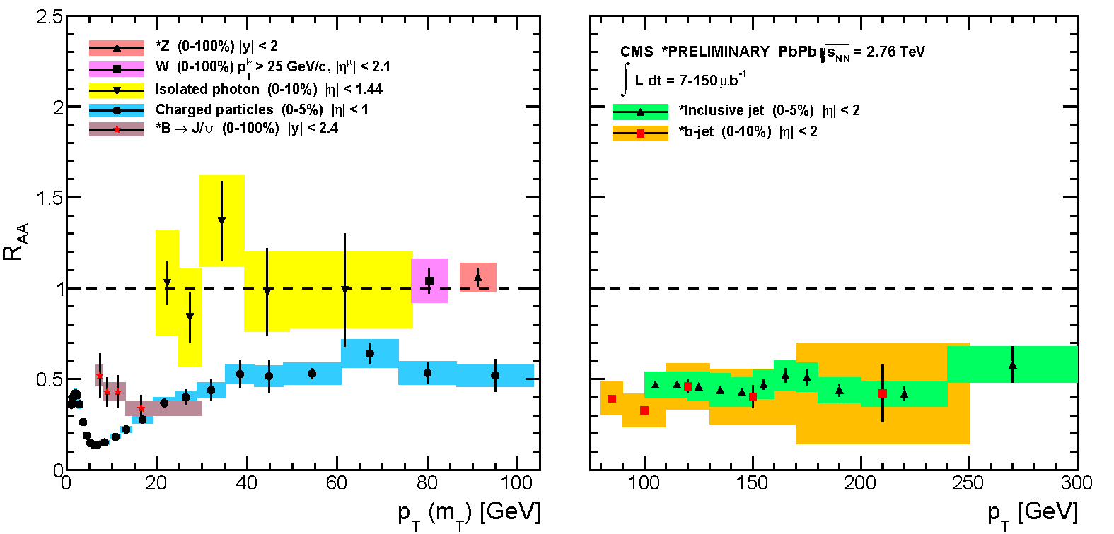
Nuclear modification factor R_{AA}
RHIC
LHC
Electromagnetic probes – consistent with no modification – medium is transparent to them
Strong probes – significant suppression – medium is opaque to them

Slide 8
Nuclear modification factor R_{AA}
Single particles
Jets
Electromagnetic probes – consistent with no modification – medium is transparent to them
Strong probes – significant suppression – medium is opaque to them

Slide 9
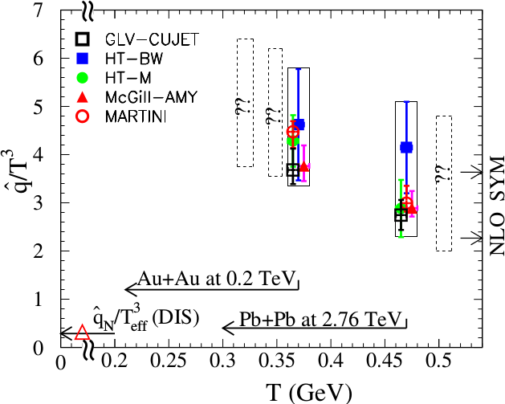
Quantifying
Phys. Rev. C 90, 014909 (2014)
Jet Collaboration: For a 10 GeV quark traveling 4 fm
≈1.2±0.3 GeV²/fm at τ₀=0.6 fm/c in Au+Au at √s_{NN}=200 GeV →loses 2.2 Gev
≈1.9±0.7 GeV²/fm in Pb+Pb collisions at √s_{NN}=2.76 TeV →loses 2.8 Gev
Q = Momentum transfer from parton to medium
L = path length

Slide 10
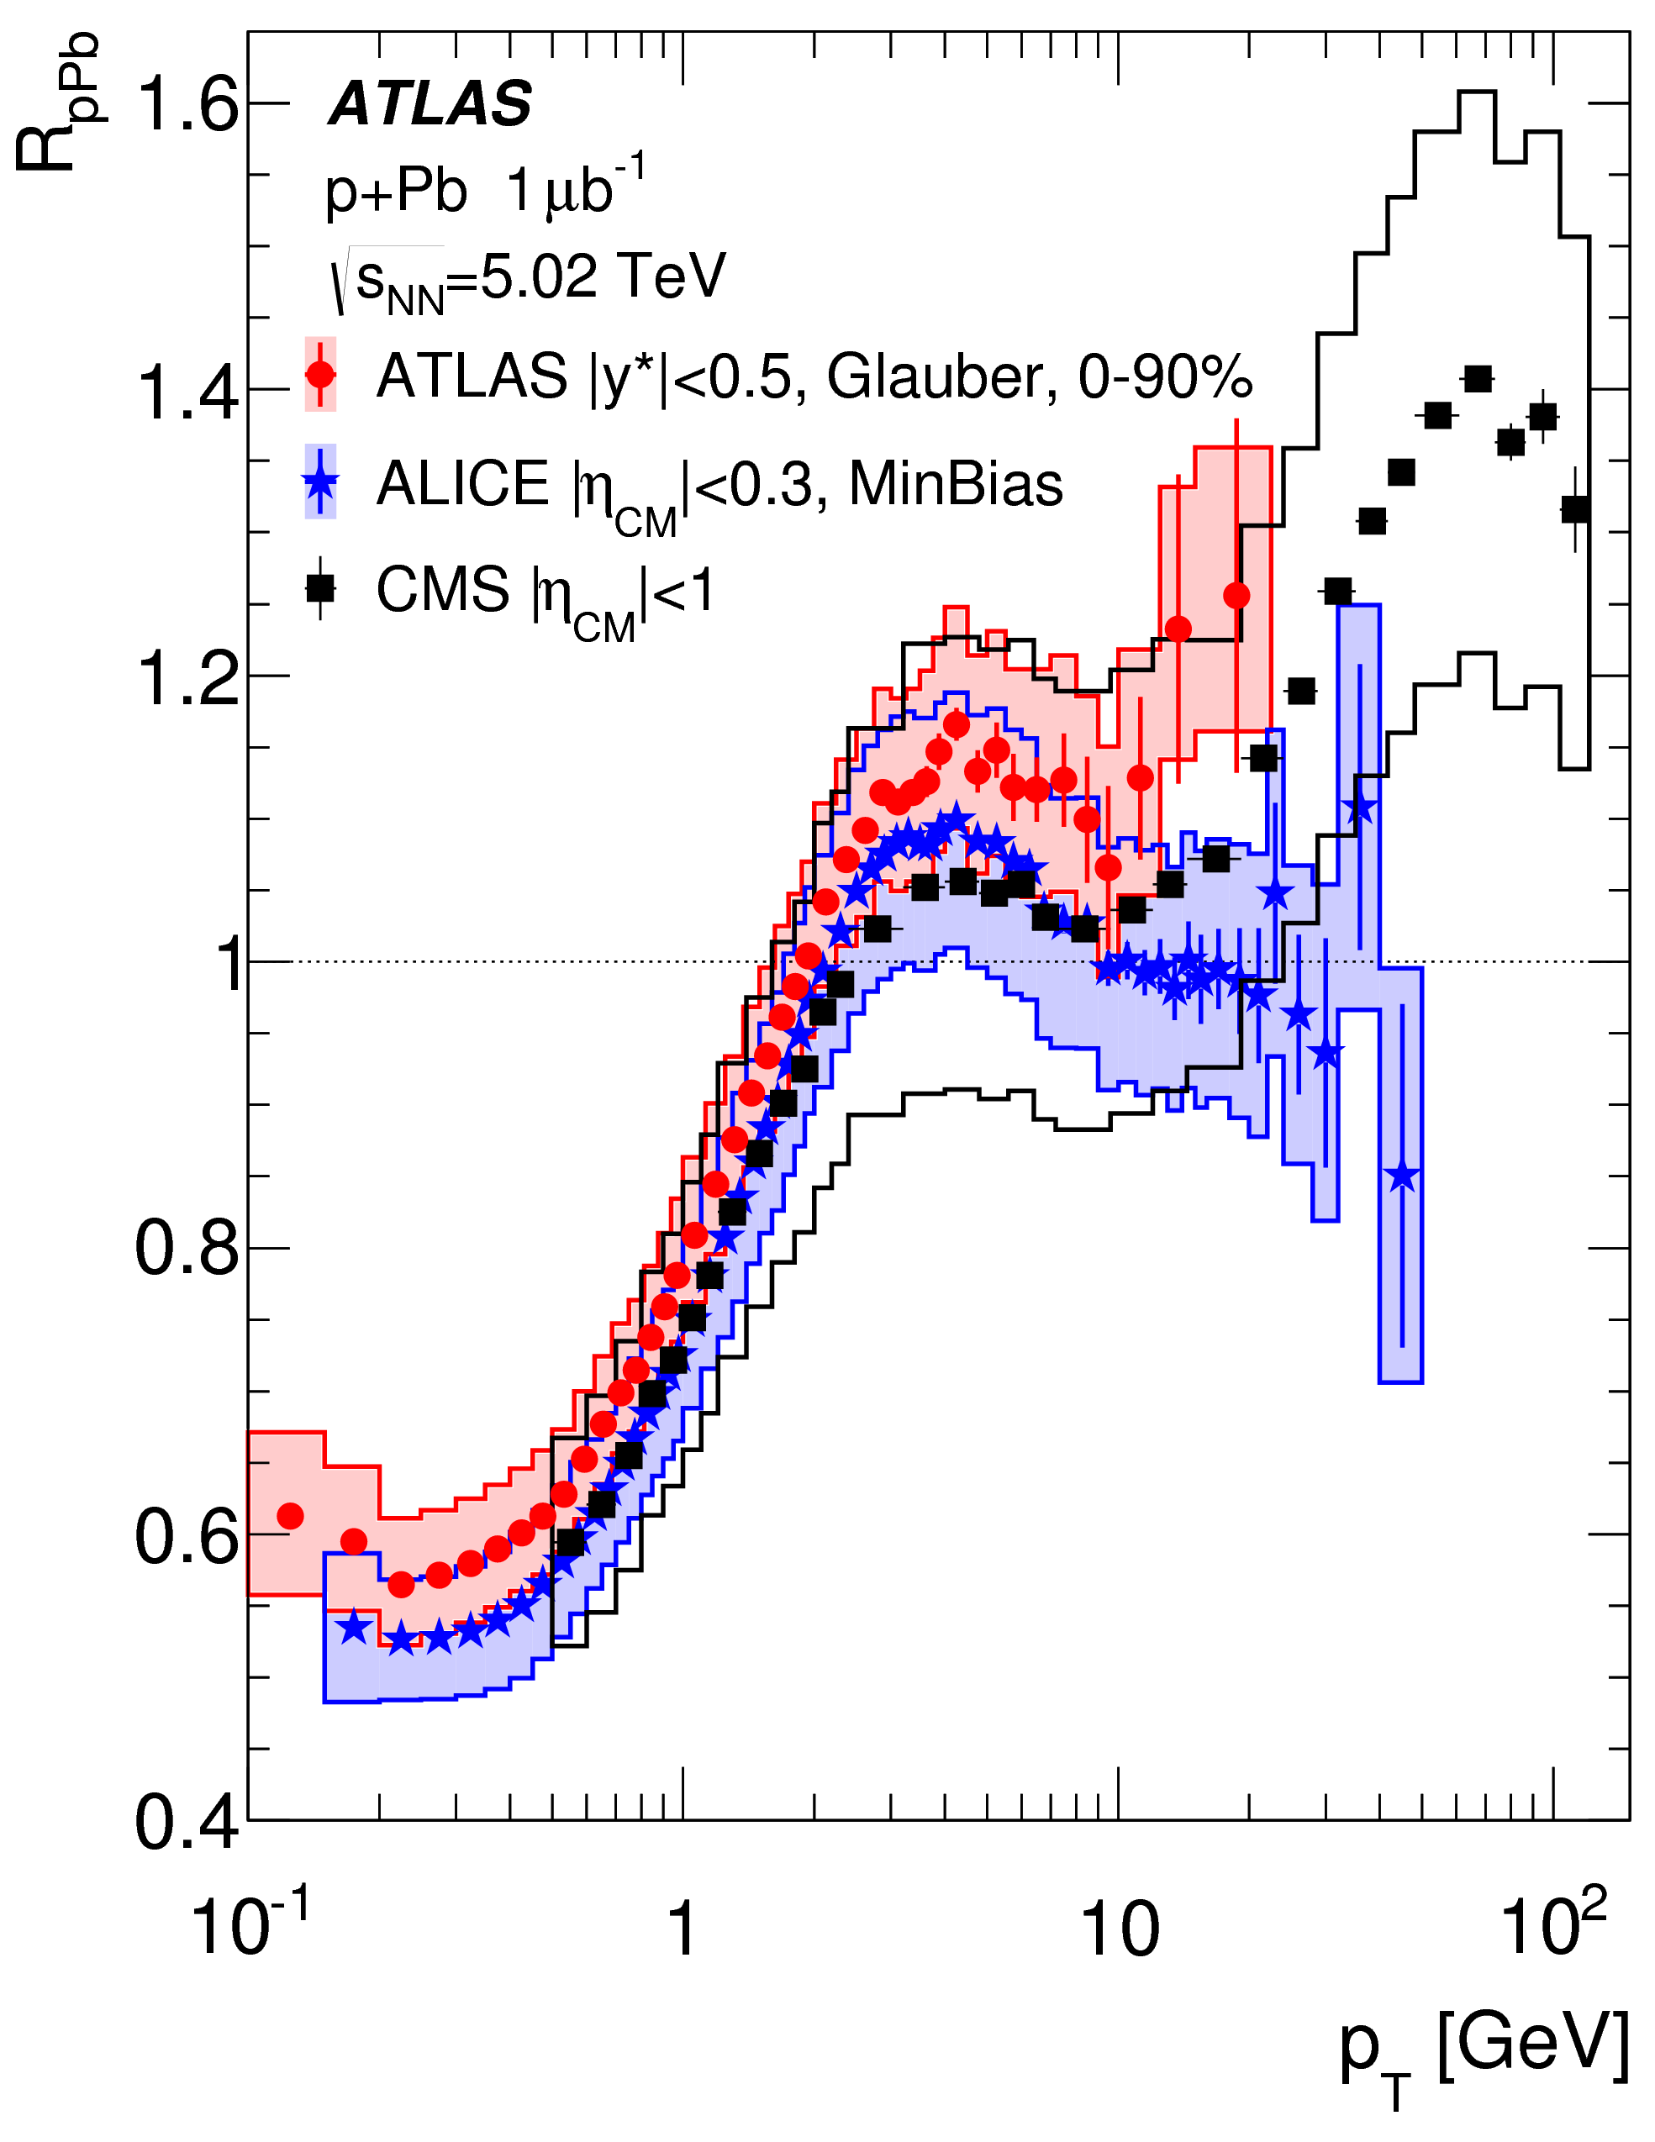
p+Pb as a control
ATLAS
CERN-EP-2016-077 arXiv:1605.06436

Slide 11
Di-jet asymmetry
PRL 105 (2010) 252303

Slide 12
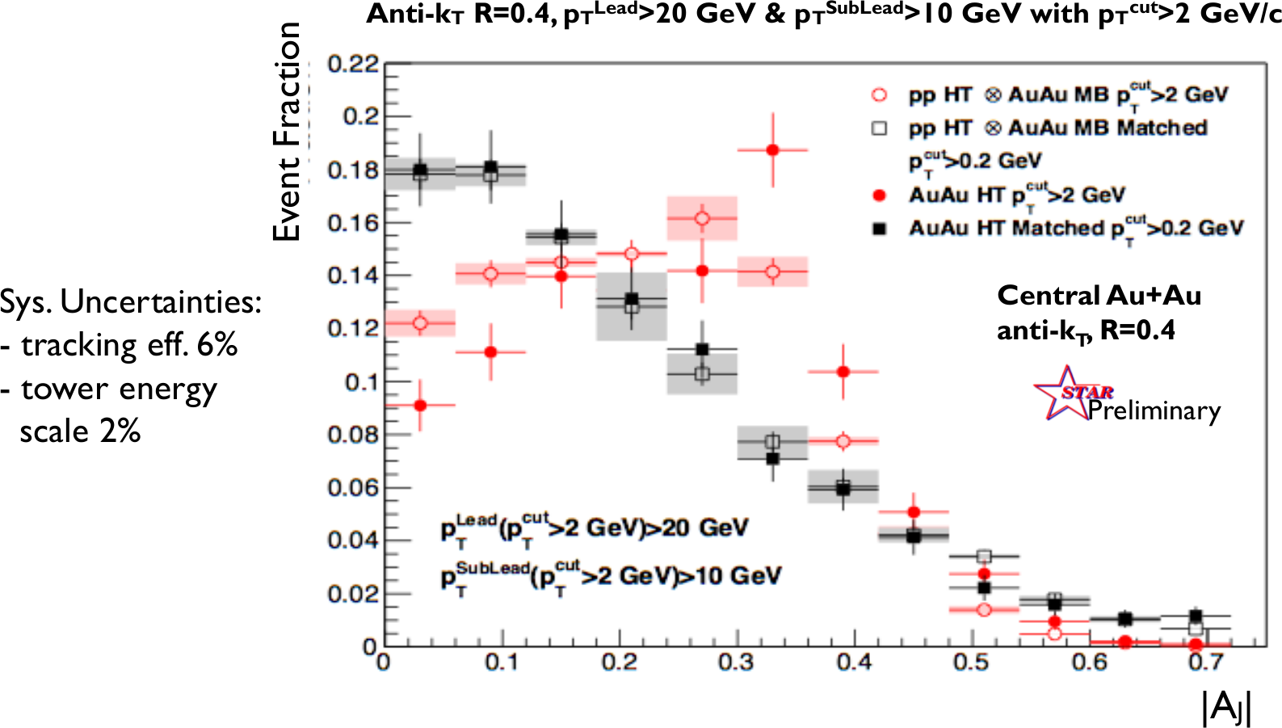
Di-jet asymmetry
Kolja Kauder, RHIC/AGS User's Meeting 2016
arXiv:1609.03878
Au+Au di-jets more imbalanced than p+p for pTcut>2 GeV/c
Au+Au AJ ~ p+p AJ for matched di-jets (R=0.4)

Slide 13
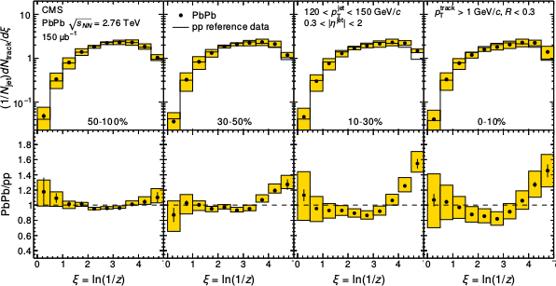
Fragmentation functions
z = p_{T}/E_{jet}
CMS
PRC 90 (2014) 024908
High p_{T}
Low p_{T}

Slide 14
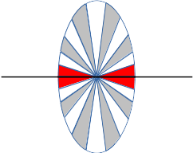
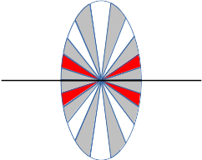
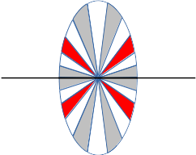
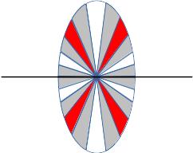
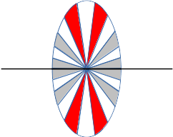
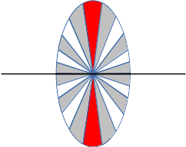
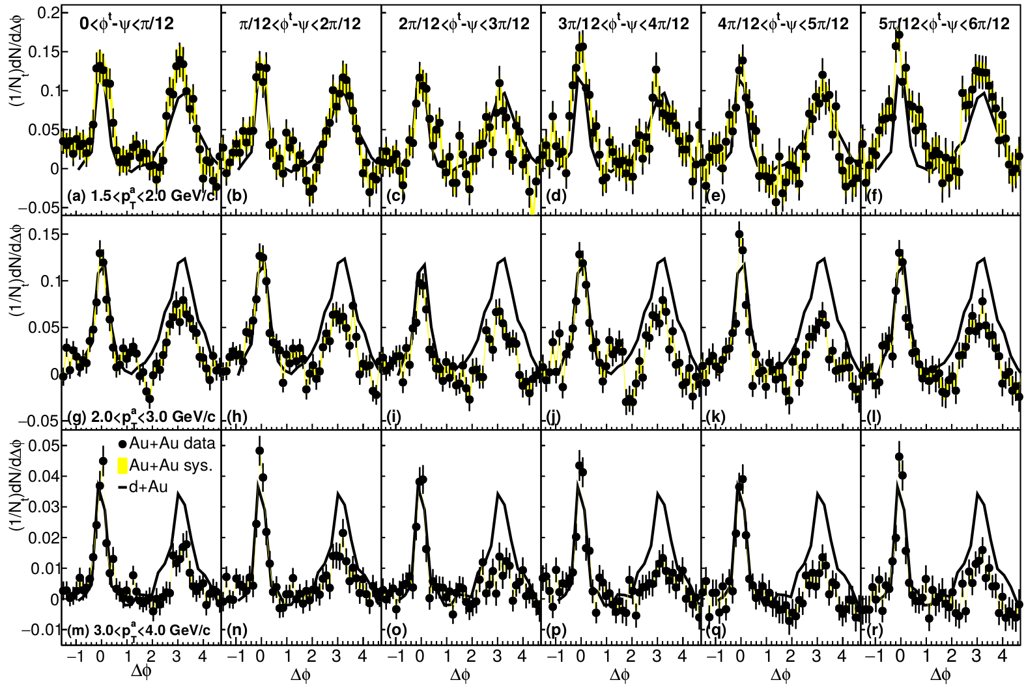
Dihadron correlations
4.0<p_{T}^{trig}<6.0 GeV/c
Phys.Rev.Lett.93:252301,2004
Phys. Rev. C 94, 011901(R) 2016

Slide 15
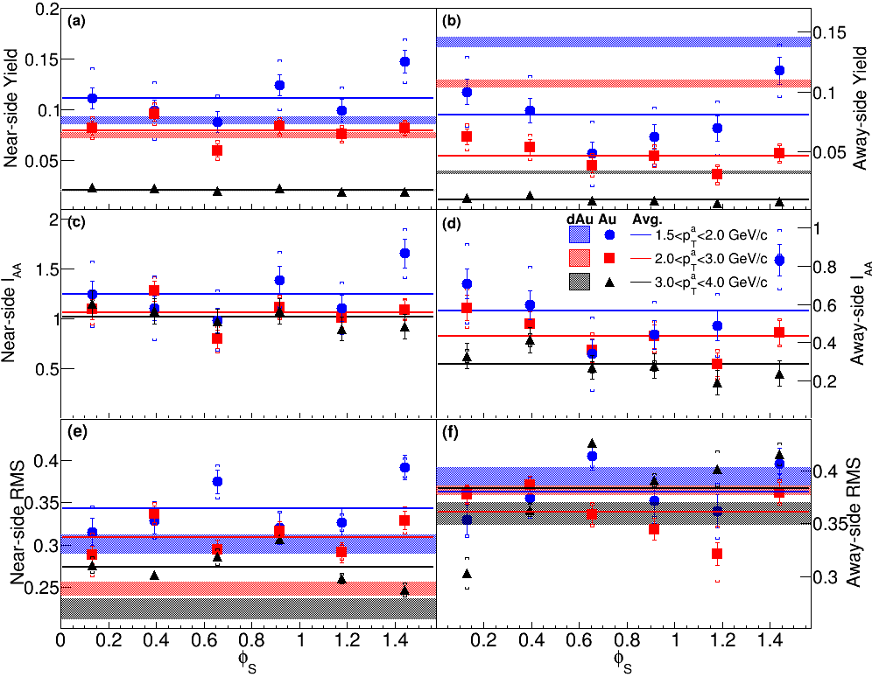
Dihadron correlations
Phys. Rev. C 94, 011901(R) 2016

Slide 16
What is a jet?
A jet is what a jet finder finds.

Slide 17
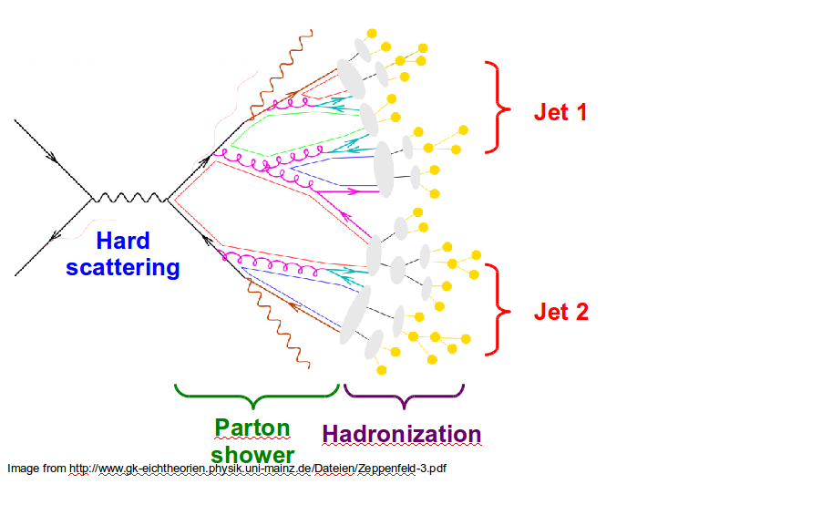
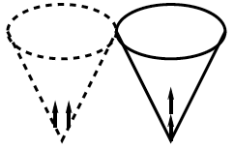
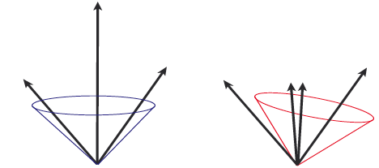
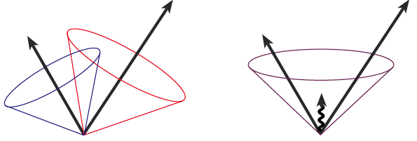
Jets in principle
Jet measures partons
Hadronic degrees of freedom are integrated out
Algorithms are infrared and colinear safe
OK
BAD: 2 jets are merged in one

Slide 18
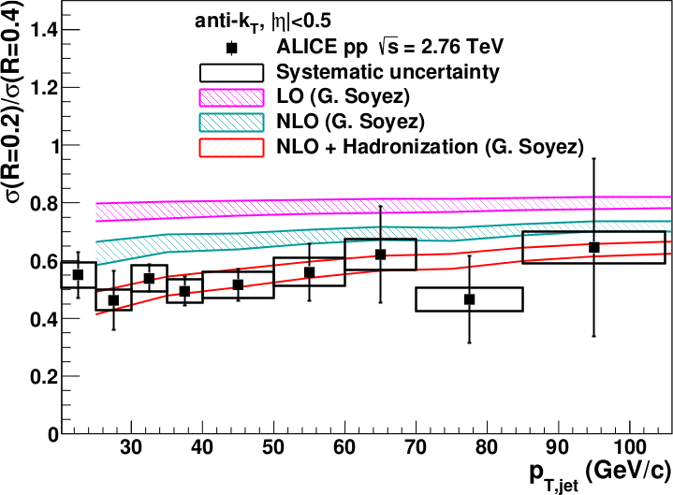
<footer>
Full jet ratios in pp
√s = 2.76 TeV, R = 0.2, 0.4 Inclusive
arXiv:1301.3475
PLB: 10.1016/j.physletb.2013.04.026
Hadronization is important even in pp collisions!
Notes:
----- Meeting Notes (6/24/13 16:47) -----
PRB -> PLB
mention ratio
<number>

Slide 19
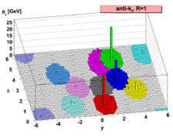
Jet finding algorithms
Tracks
Jet finding algorithm
Jet candidates
Clusters
Particles
Any list of objects works as input
Use the same algorithm on theory & experiment
Output only as good as input
M. Cacciari, G. P. Salam, G.Soyez, JHEP 0804:063,2008

Slide 20

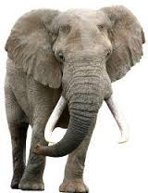
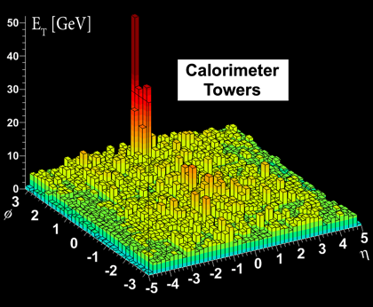
Bias & Background

Slide 21
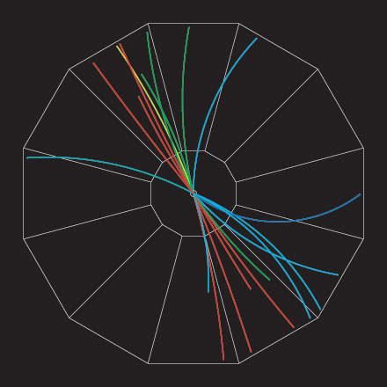
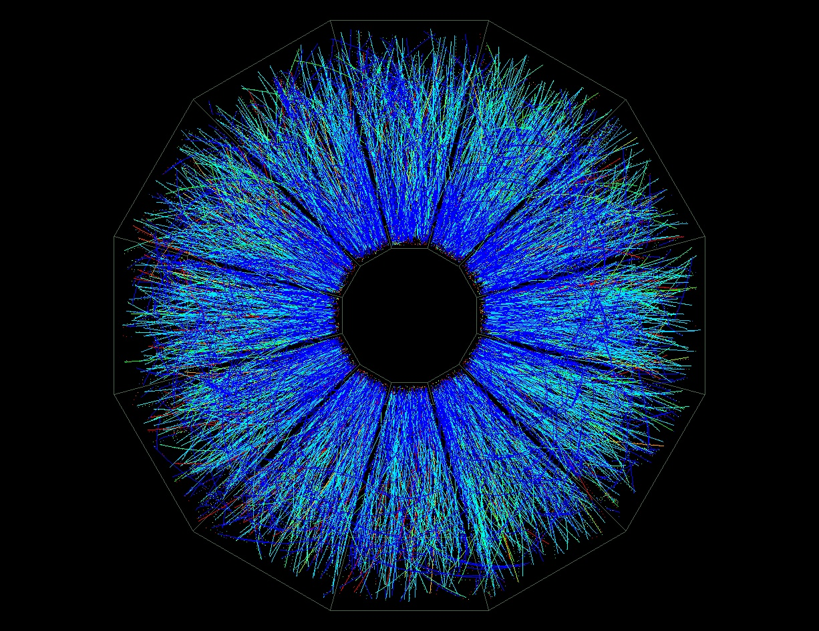

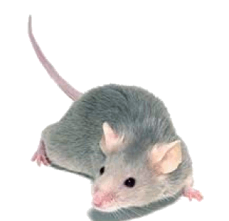
p+p di-jet event in STAR
Central Au+Au collision in STAR
Background
Signal
Harder
Correlated with rxn plane
Low p_{T} modifications
Flavor modifications?
Softer
Correlated with rxn plane
Large fluctuations/hot spots
Combinatorial background
Degraded energy resolution

Slide 22
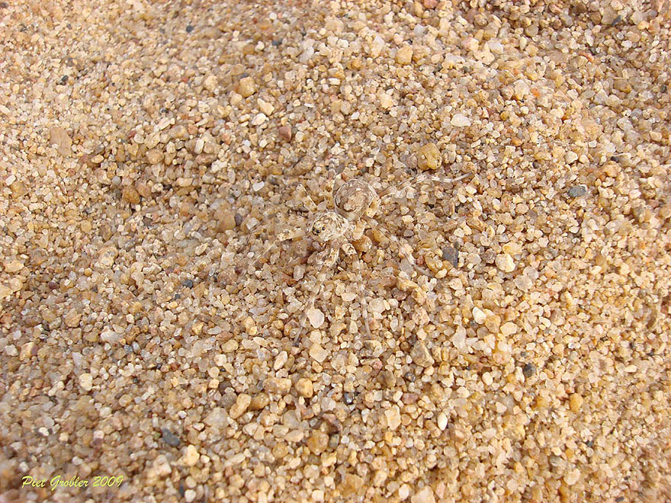
http://www.boredpanda.com/animal-camouflage/

Slide 23
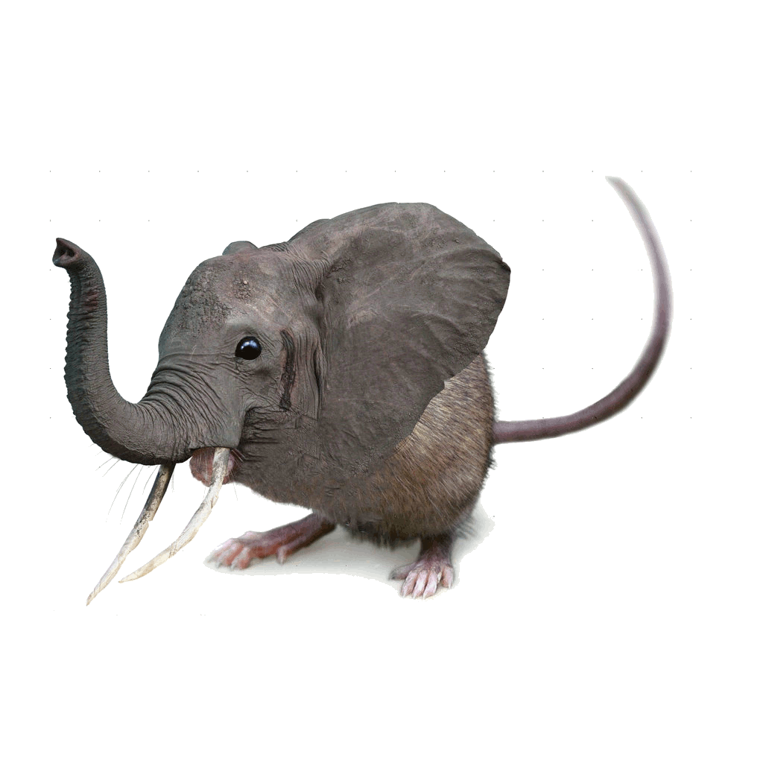
Bias
Modified jets probably look more like the medium
Quark jets are narrower, have fewer tracks, fragment harder [Z Phys C 68, 179-201 (1995), Z Phys C 70, 179-196 (1996), ]
Gluon jets reconstructed with k_{T} algorithm have more particles than jets reconstructed with anti-k_{T} algorithm [Phys. Rev. D 45, 1448 (1992)]
Gluon jets fragment into more baryons [EPJC 8, 241-254, 1998]
http://www.boredpanda.com/animal-camouflage/

Slide 24
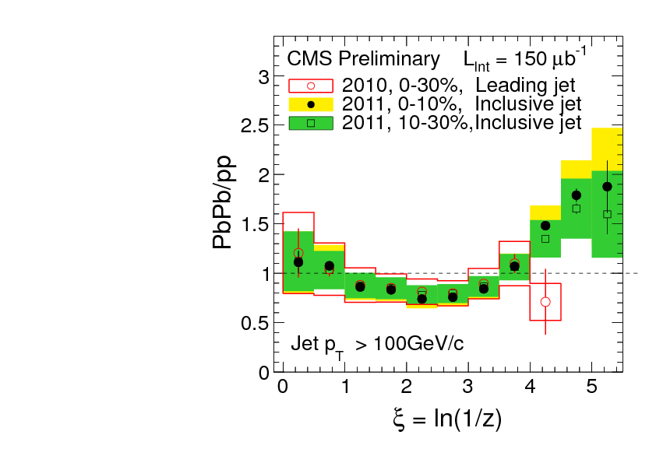
What you see depends on where you look
Phys. Rev. C 90, 024908 (2014)
JHEP10(2012)087
z = p_{T}/E_{jet}
Low p_{T}
High p_{T}
Low p_{T}
Low p_{T}
Low p_{T}
Low p_{T}
High p_{T}
Low p_{T}
High p_{T}
High p_{T}
High p_{T}

Slide 25
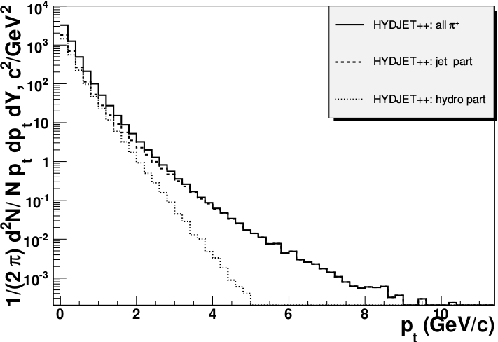
Focus on high p_{T}
Pros:
  Reduces combinatorial background
Cons:
  Cuts signal where we expect modifications
  Could bias towards partons which have not interacted
  Biases sample towards quarks
PoS High-pTphysics09:023,2009

Slide 26
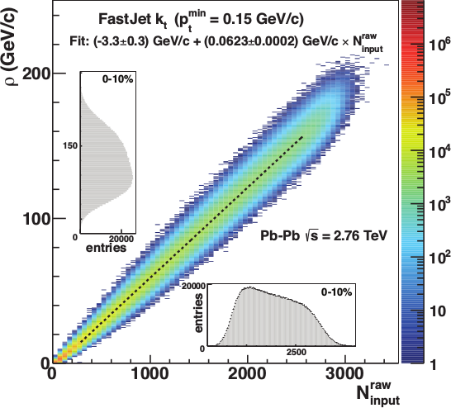
Focus on smaller angles
Pros
  Background is smaller
  Background fluctuations smaller
Cons:
  Modifications expected at higher R
  Biases sample towards quarks
JHEP 03 (2012) 053

Slide 27
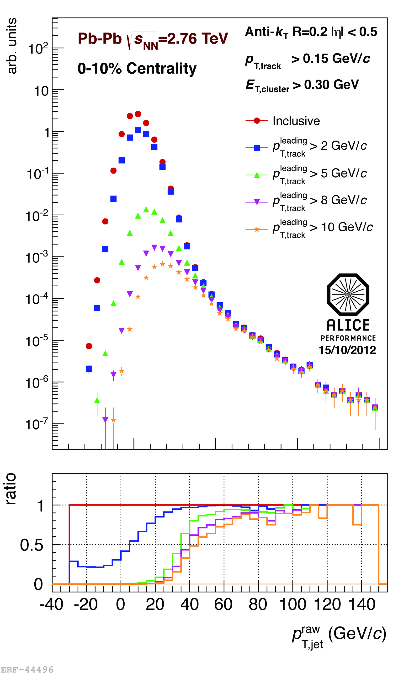
<footer>
ALICE/STAR
Combinatorial “jets”
Estimate combinatorial jet contributions and its fluctuations from data
Require leading track p_{T} > 5 GeV/c
  Suppresses combinatorial “jets”
  Biases fragmentation
No threshold on constituents
Limited to small R
Measured spectra:
Full jets
Where
comes from FastJet anti-k_{T} algorithm
Notes:
<number>

Slide 28
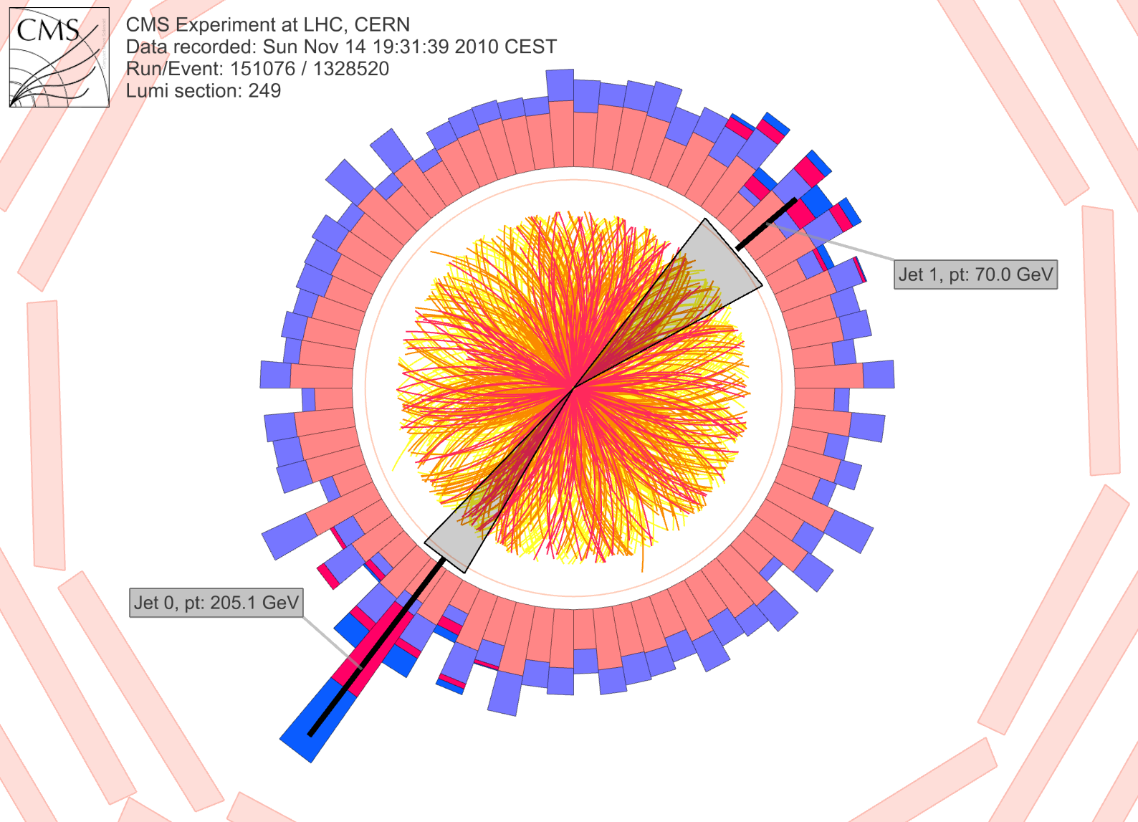
CMS: Iterative Pile-Up Event Background Subtraction
Background is estimated
for each calorimeter ring of constant η
subtracted before jet finding
re-iterated after excluding the jets found in the first iteration
Fake Jets: After the background subtraction, some local fluctuations remain!
Fluctuations will deteriorate the jet resolution in central events.
Sevil Salur
<number>

Slide 29
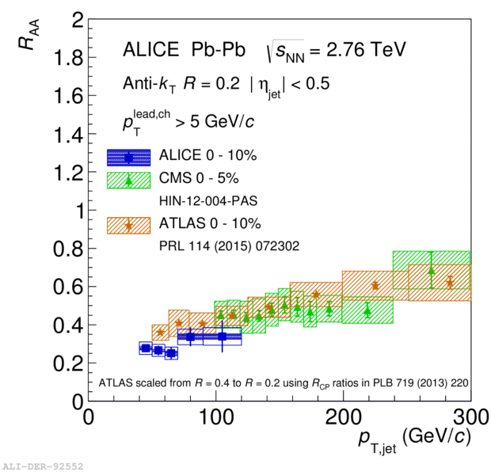
ATLAS
Constituent biases don't matter that much up here
Iterative procedure
  Calorimeter jets: Reconstruct jets with R=0.2. v₂ modulated <Bkgd> estimated by energy in calorimeters excluding jets with at least one tower with
  E_{tower} > <E_{tower}>
  Track jets: Use tracks with p_{T}>4 GeV/c
  Calorimeter jets from above with E>25 GeV and track jets with p_{T}>10 GeV/c used to estimate background again.
Calorimeter tracks matching one track with p_{T}>7 GeV/c or containing a high energy cluster E >7 GeV are used for analysis down to E_{jet} = 20 GeV
But they do matter down here!
Definitely imposes a bias, especially at 20 GeV!
We should treat that bias as a tool, not a handicap
Phys. Lett. B 719 (2013) 220-241

Slide 30
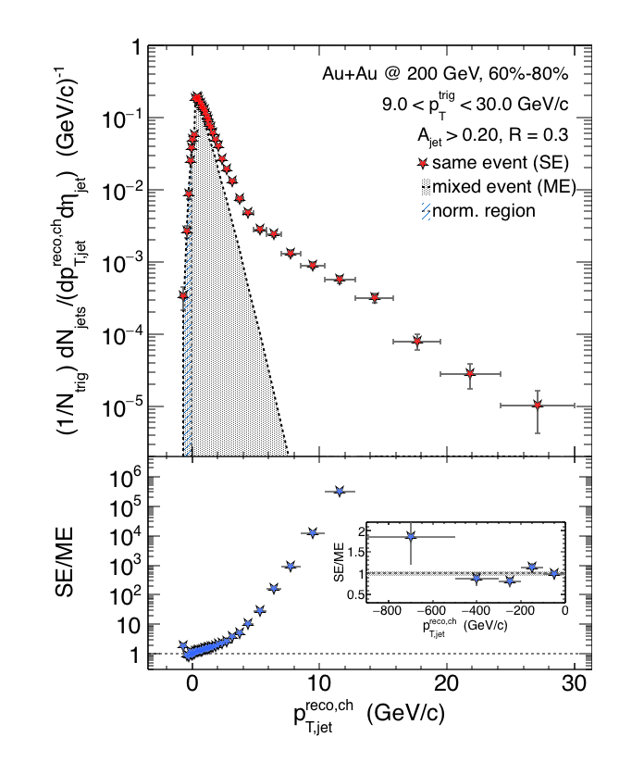

Charged Raw Recoil Jet Spectrum: Reference
Event mixing
Peripheral
Reference spectrum:
peripheral collisions
Much less combinatorial
background compared to
most central data
Excellent signal/background
ratio down to 3 GeV/c
Preliminary
Requires normalization at low p_{T}
All physical correlations treated like jets
Alex Schmah, Hard Probes 2015
06/29/2015
Alexander Schmah - Hard Probes 2015
<number>

Slide 31
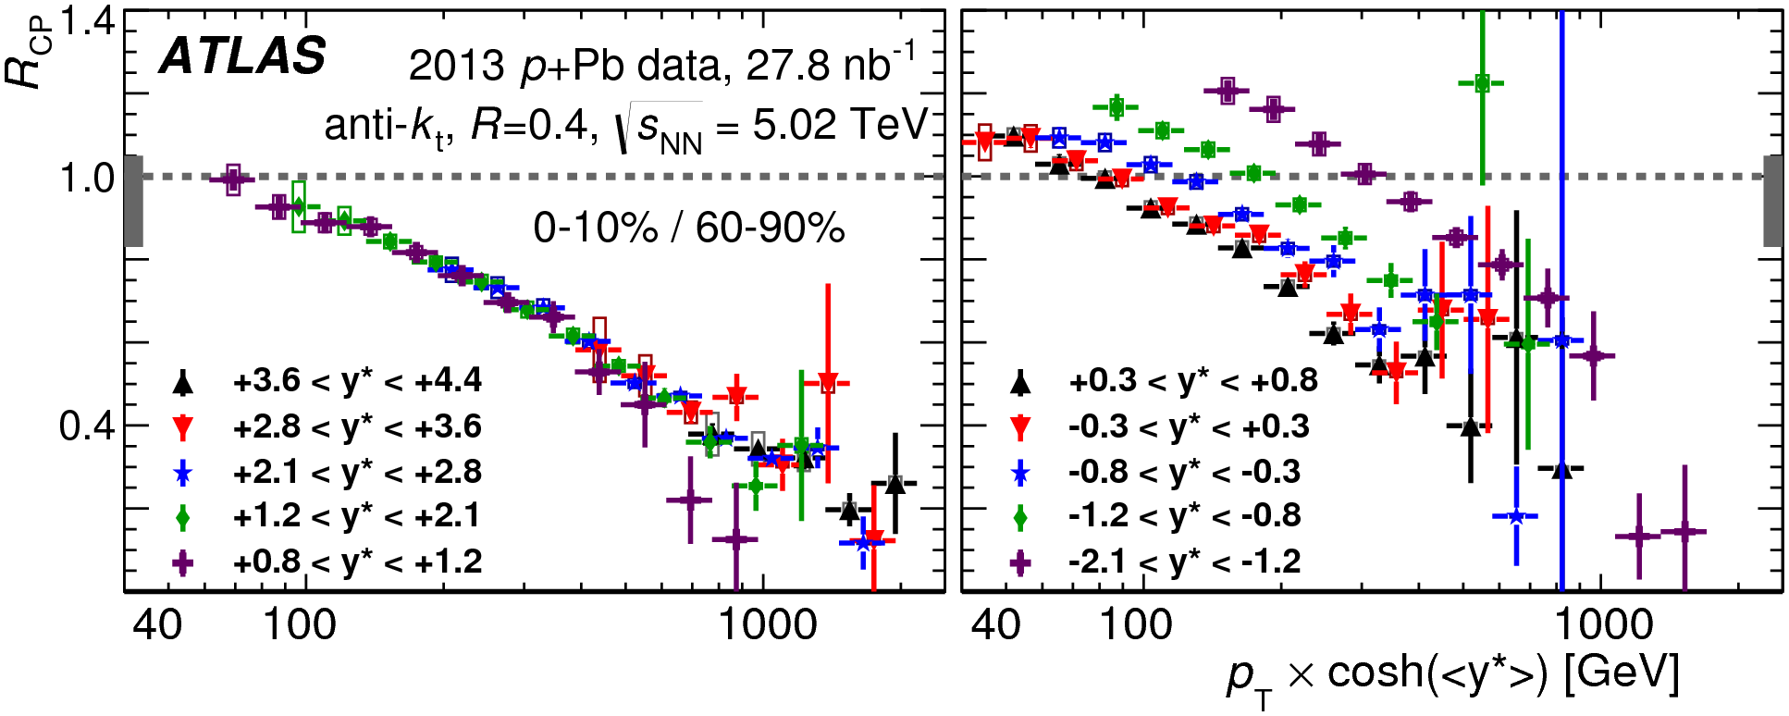
Cold Nuclear Matter effects
PLB 748 (2015) 392-413
No indication of modified jet structure in cold nuclear matter (d+Au and p+Pb collisions)
[Phys.Rev.C73:054903,2006, Phys.Rev.Lett.96:222301,2006]
Minimum bias R_{pPb}, R_{dAu} for charged particles, jets consistent with 1 [Phys.Rev.Lett.98:172302,2007,Phys.Rev.C81:064904,2010,Phys. Rev. Lett. 110 (2013) 082302, arXiv:1605.06436]
Indications of modification at forward rapidities from dihadron correlations
[Phys. Rev. Lett. 107, 172301 (2011)]
Centrality dependence observed
[PLB 748 (2015) 392-413, Phys. Rev. Lett. 116, 122301 (2016)]

Slide 32
Conclusions
What to remember
  A jet is not a parton
  All jet measurements are biased
  Background subtraction/suppression methods are important
  Beware Cold Nuclear Matter effects!
Challenges to the field
  Cross check between experiments using the same method
  Experimentalists: explain method/measurement to theorists!
  Theorists: don't ignore the method!
Many thanks to Rosi Reed, Sevil Salur, and Megan Connors for many productive discussions

