Slide 1
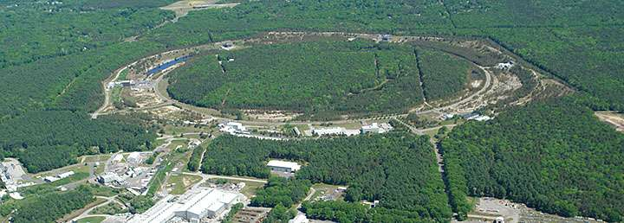
Relativistic Heavy Ion Collider/ Alternating Gradient Synchrotron Users’ Executive Committee

Slide 2

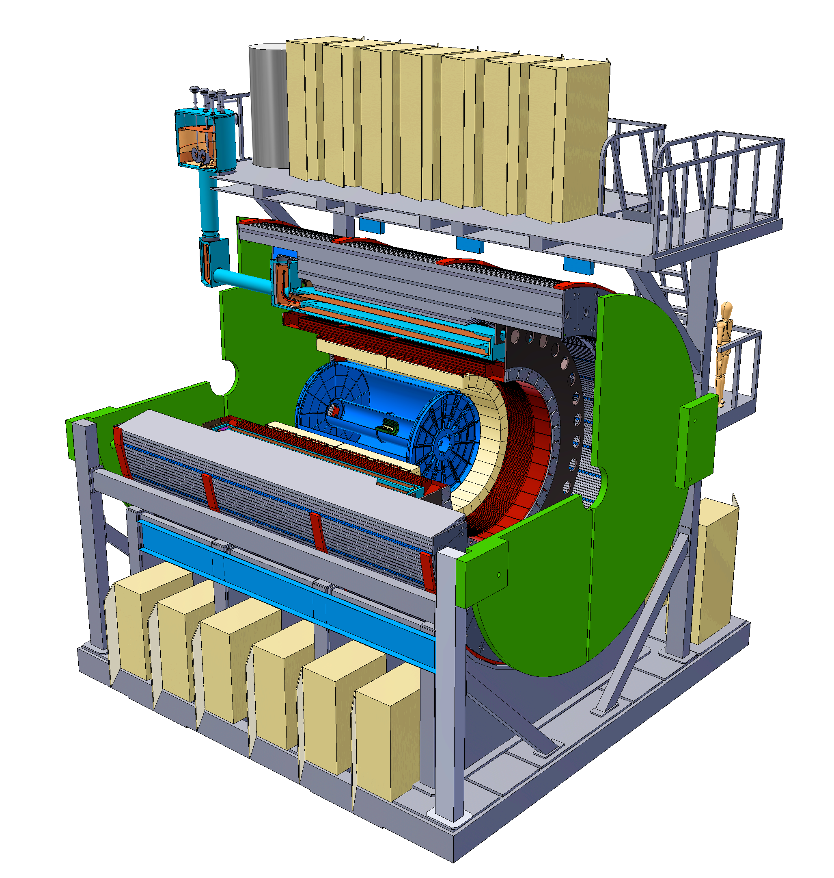

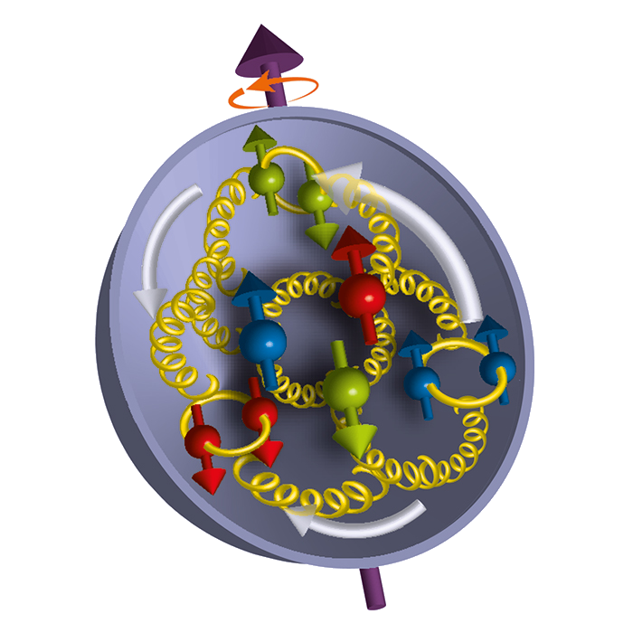
Opportunities
STAR
PHENIX
sPHENIX
Theory
AGS

Slide 3
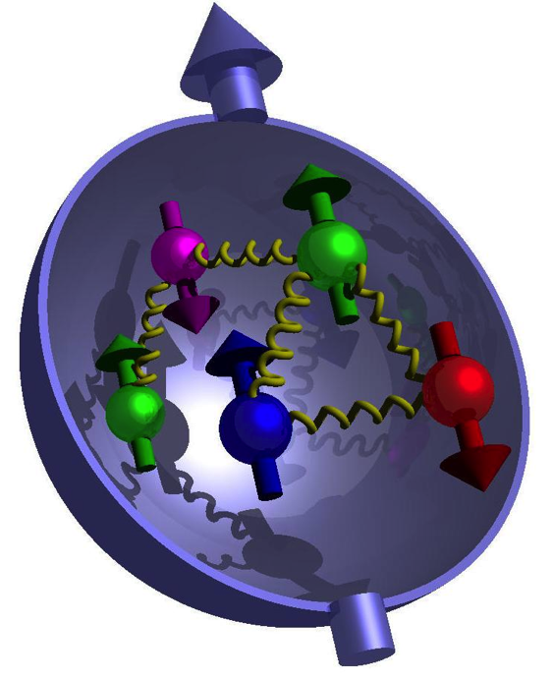
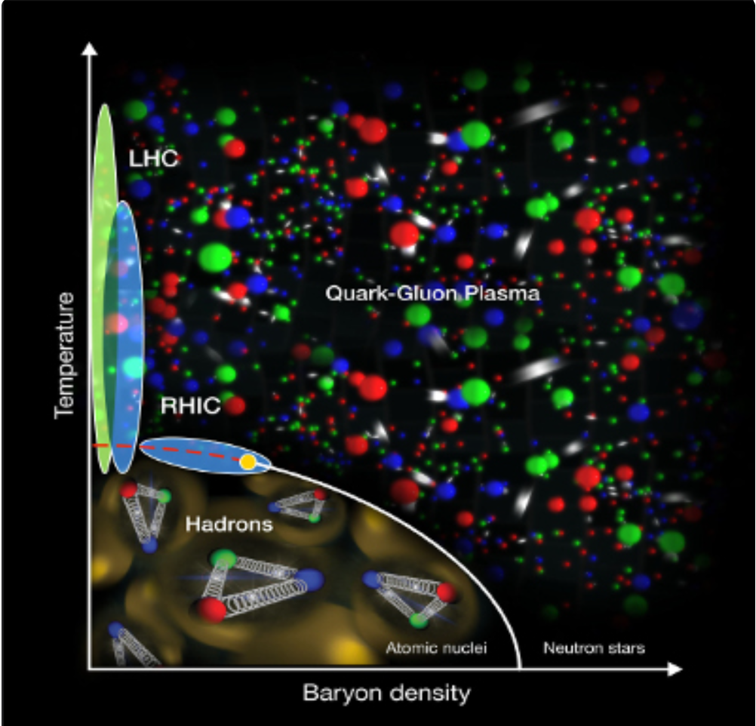
Subjects
Proton structure with polarized proton beams
Quark Gluon Plasma created in high energy nuclear collisions
Dark matter searches
Accelerator physics
Impact of radiation on cells

Slide 4
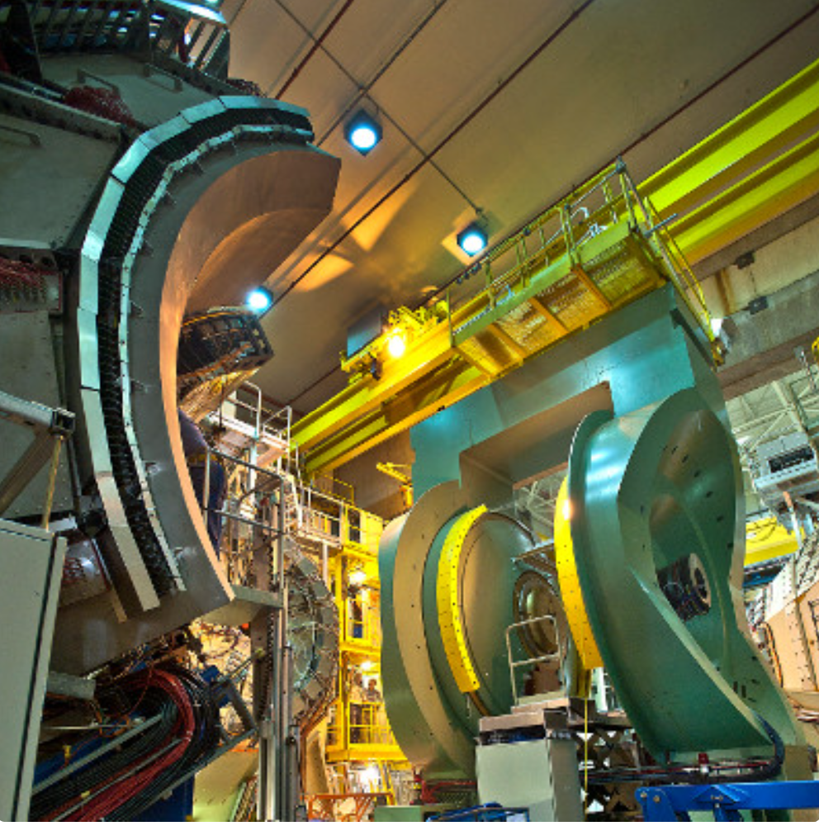
PHENIX
Data Taking complete 2016
Published >200 papers

Slide 5
PHENIX data sets
year | Beam, E(GeV) | Recorded data (pp equiv) | upgrade | Physics
2016 | AuAu 200 dAu 200 dAu 62,39,20 | 2.3/nb (90/pb) 15B events 1G & 73/nb (29/pb) 0.6G 0.1G, 8M | VTX,FVTX MPC-EX | Heavy Flavor Gluon nPDF Small QGP
2015 | pp 200 pAu 200 pAl 200 | 23/pb 80/nb (16/pb) 275/nb (7.4/pb) | VTX, FVTX | Heavy Flavor Transverse spin CNM, small QGP
2014 | AuAu 200, 15 ³HeAu 200 | 2.3/nb (90/pb) 15 B events 25/nb (15/pb) | VTX, FVTX | Heavy Flavor Small QGP
2013 | pp 510 | 240/pb | W-trigger | Anti-quark spin Gluon spin
2012 | pp 510 pp 200 CuAu 200 UU 193 | 50/pb 4/pb 5/nb (60/pb) 0.17/nb (10/pb) | W-trigger VTX, FVTX | Anti-quark spin Transverse spin Heavy flavor Geometry
2011 | pp 510 AuAu 200 AuAu 19, 27 | 28/pb 0.8/nb (32/pb) | W-trigger VTX | Anti-quark spin Heavy flavor BES-I
2010 | AuAu 200 AuAu 62,39,7 | 1.1/nb (44/pb) | HBD | Low mass ee BES-I
Many physics topics with variety of high statistics datasets
5
Notes:
<number>

Slide 6

Remaining PHENIX Key Physics Analyses
RUN14 and RUN16 Au+Au collisions at 200 GeV data set of about 30 billion events remains to be fully analyzed
Unique high impact analysis topics to be addressed with PHENIX data from RUN14+16 in next 2-3 years
Measure initial temperature of QGP at RHIC
  Thermal e⁺e⁻ pairs in mass range 1 to 3 GeV/c²
Separate charm and bottom energy loss and flow
  midrapidity measurement with electrons
  forward/backward rapidity measurements with muons
For more information contact:
Spokesperson: Y. Akiba akiba@bnl.gov
Deputy Spokespersons: Axel Drees axel.drees@stonybrook.edu
Sasha Bailevsky shura@bnl.gov
6

Slide 7
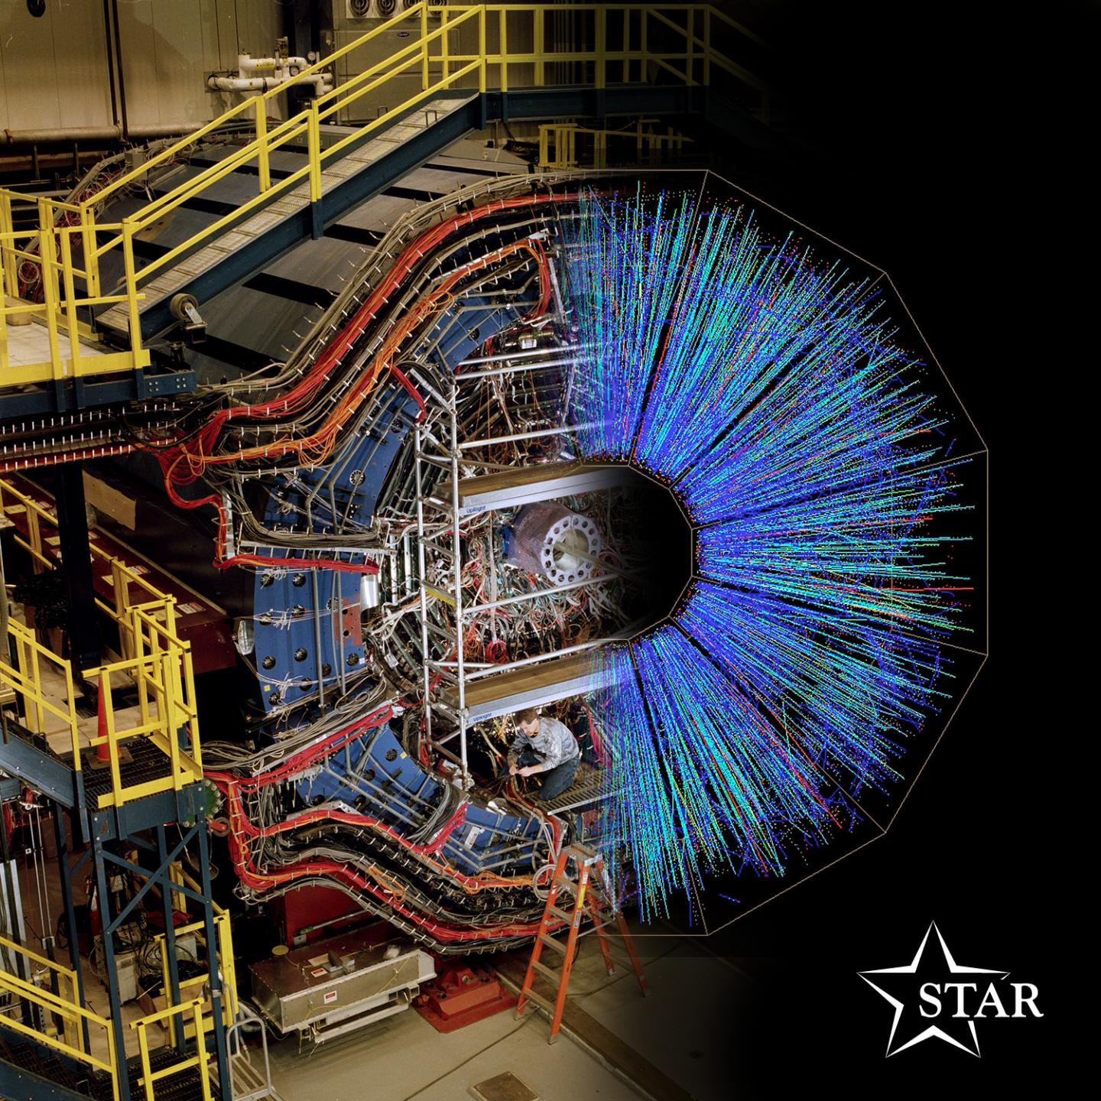
STAR
STAR is composed of 72 institutions from 15 countries, with a total of 695 collaborators. A variety of personnel participate in the collaboration, including students, university faculty and staff, national laboratory staff, and engineers.

Slide 8
STAR’s Future Run Plan
p+p 510 GeV: probe down to x~2×10-3 (gluons) and up to x~0.5 (valence quarks) regions
Data Taking
24 weeks Au+Au
11 weeks pp
11 weeks p+Au
24 weeks Au+Au
Transversely polarized pp and p+Au with
equal nucleon-nucleon luminosities essential to optimize several critical measurements
p+p: enable detailed evolution studies, critical for precise factorization and universality tests, essential baseline for p+Au
p+Au: probe gluon saturation, quark-gluon structure of heavy nuclei, propagation and hadronization of colored partons
Au+Au: probe the inner workings of the QGP
Lijuan Ruan, BNL
6

Slide 9
Physics program
quantitative comparisons of the validity and the limits of factorization and universality in lepton-proton and proton-proton collisions for initial and final state TMDs. Test of Sivers non-universality
  Requirement:
    large data sets √s = 200 and 500 GeV p↑p
→ low to high x, highest and lowest x with fSTAR
    A_{UT} for W+/- Z0, A_{UT} for hadrons in jet
First look Gluon GPD → E_{g}
  Requirement:
    data sets √s = 500 GeV p↑p and √s = 200 GeV p↑A
    A_{UT} for J/ψ in UPC
Physics driving the large A_{N} at forward rapidities and high x_{F}
  Requirement:
    large data sets √s = 200 and 500 GeV p↑p
→ low to highest x_{F} → fSTAR
    charge hadron A_{N} at forward rapidities
Nuclear dependence of PDFs, FF, and TMDs
  Requirement:
    large equal data set of √s = 200 p↑p and p↑Au
→ low to high x, highest and lowest x with fSTAR
    R_{pA} direct photons and DY, hadrons in jet A_{UT}
non-linear effects in QCD
  Requirement:
    large equal data set of √s = 200 p↑p and p↑Au
→ lowest-x through fSTAR
    dihadron correlations for h+/-, γ-jet, di-jets
To address important questions about the inner workings of the QGP
What is the precise temperature dependence of shear and bulk viscosity? v_{n} as a function of η
What is the nature of the 3-dimensional initial state at RHIC energies? r_{n} over a wide rapidity
How is global vorticity transferred to the spin angular momentum of particles on such short time scales? How can the global polarization of hyperons be reconciled with the spin alignment of vector mesons? Λ, Ξ, Ω P_{H} and 𝛒₀₀ of K*, ɸ, J/ѱ
What is the precise nature of the transition near µ_{B}=0? Net-proton C₆/C₂
What is the electrical conductivity, and what are the chiral properties of the medium? Dielectron
What can be learned about confinement and thermalization in a QGP from charmonium measurement? J/ѱ v₂ and v₁, ѱ(2S)
What are the underlying mechanisms of jet quenching at RHIC energies? What do jet probes tell us about the microscopic structure of the QGP as a function of resolution scale? 𝛾_{dir}+jet I_{AA}, 𝛾_{dir}+jet acoplanarity, jet substructure
Lijuan Ruan, BNL
6
Notes:
<number>

Slide 10
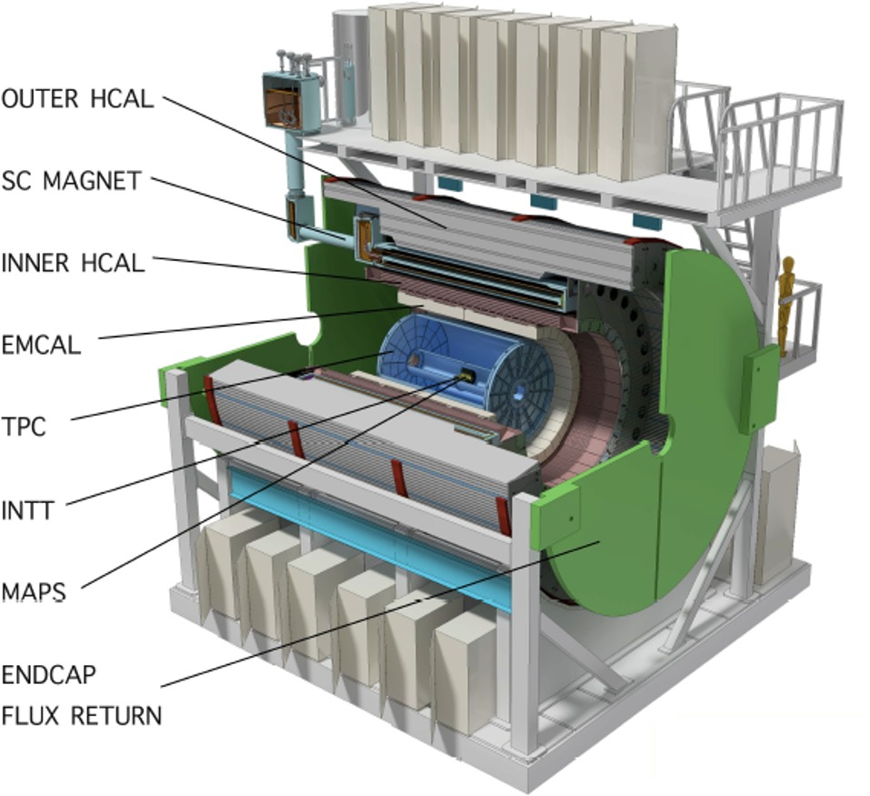
sPHENIX
Calorimetry
Outer Hadronic Calorimeter (oHCAL) Inner Hadronic Calorimeter (iHCAL) Electromagnetic Calorimeter (EMCAL)
Magnet
1.4T superconducting solenoid used by the BaBar experiment
Tracking
Time Projection Chamber (TPC) Intermediate Silicon Tracker (INTT) MAPS-based Vertex Tracker (MVTX)
Performance
High data rate : read out rate of 15 kHz for all subdetectors
Acceptance : hermetic coverage over full azimuth & pseudorapidity |η| ≤ 1.1 for the tracking & calorimeter systems

Slide 11
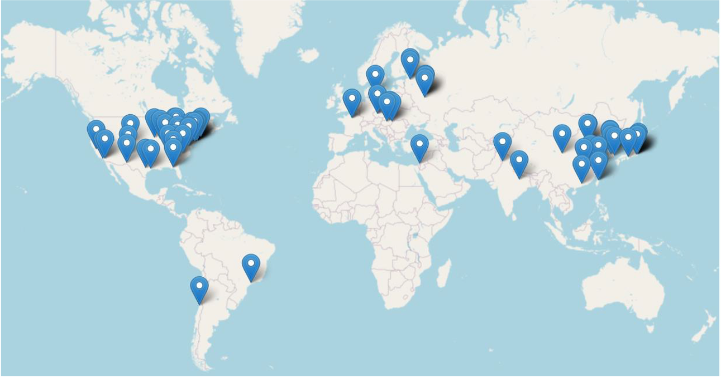
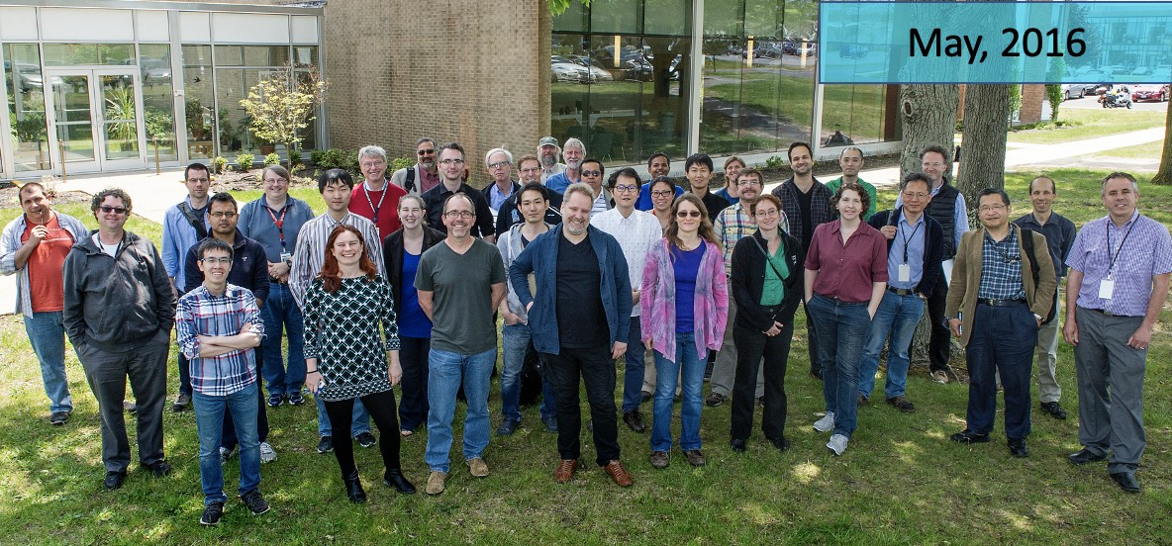
sPHENIX Collaboration
Officially formed in 2016
More than 320 members from 84 institutions in 14 countries as of 2021 Over 100 bi-weekly general meetings since inception

Slide 12
sPHENIX 3-Year Run Plan
Year | Species | √s_{NN} | Cryoweeks | Physics weeks | Rec. Luminosity | Samp. Luminosity
2023 | Au+Au | 200 | 24 (28) | 9 (13) | 3.7 (5.7) nb⁻¹ | 4.5 (6.9) nb⁻¹
2024 | p↑p↑ | 200 | 24 (28) | 12 (16) | 0.3 (0.4) pb⁻¹ | 45 (62) pb⁻¹
2024 | p↑+Au | 200 | - | 5 | 0.003 pb⁻¹ | 0.11 pb⁻¹
2025 | Au+Au | 200 | 24 (28) | 20.5 (24.5) | 13 (15) nb⁻¹ | 21 (25) nb⁻¹

Slide 13
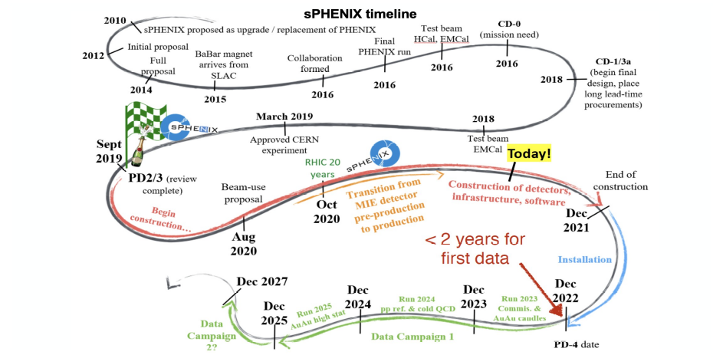
Ejiro Umaka
RHIC/AGS UEC Meeting

Slide 14
How to join an experiment? Example from STAR
Initiate a discussion with the Spokespeople
Generally speaking we will ask:
    what are your science interests?
    how many people, and at what level (faculty,Postdocs, grad/undergrad students etc) are currently and do you expect eventually to be in your group?
    How long do you plan to work on STAR and what other commitments do you have?
    Do you expect to have funding to enable you to travel to cover your shift dues etc?
After initial discussion we ask you to submit a formal application – an “application form” is provided
Application is discussed in management team
If positive we send your application, endorsed by the management to the STAR Council
STAR Council has final decision. After reading the application and inviting you to present your case to the Council a vote will be taken
If positive you will be admitted as an associate institution for a period of one year. During that one year each new institution will be associated with a mentoring STAR institution that will assist the new institution to become integrated and
productive in STAR. The new institution will be represented on the STAR Council by the mentor institution Council representative. At the conclusion of this one year the new institution may apply for full membership that will include a seat on the Council. Such an application must receive an affirmative vote from at least 75% of all eligible Council voters.

Slide 15
BNL Nuclear Theory group
Excellence in scientific research aimed towards supporting and guiding the experimental programs at RHIC and the future EIC
Training a new generation of scientists (most of the former group postdocs are now faculty members across the globe working in RHIC and EIC physics or work in high performance computing)
Lay out for future directions in Nuclear Physics: gluon saturation in eA collisions, Chiral Magnetic Effect, synergy of QIS and physics of RHIC and EIC
Scientific Staff: Y. Hatta (RBRC theory leader), D. Kharzeev (joint with Stony Brook U.), Y. Mehtar-Tani (RBRC Fellow), S. Mukherjee, ( BEST Director, SciDAC, Co-PI), P. Petreczky (Group Leader), R. Pisarski (C²QA, sub-thrust leader ) , B. Schenke , R. Venugopalan, (C²QA, sub-thrust leader )
BEST= Beam Energy Scan Topical Collaboration
C²QA = Co-design Center for Quantum Advantage
RBRC = Riken-BNL Research Center
15

Slide 16
Support for RHIC and EIC science
QCD phase diagram and physics of BES program, sPHENIX: quarkonia, jets, out of equilibrium dynamics and early states in HIC
Nucleon spin, hadron structure, color glas condensate (was proposed by BNL Theorists)
Leadership in lattice QCD (SciDAC, USQCD, also INCITE and ALCC computing awards), Quantum Information science (leadership in C²QA)
15

Slide 17


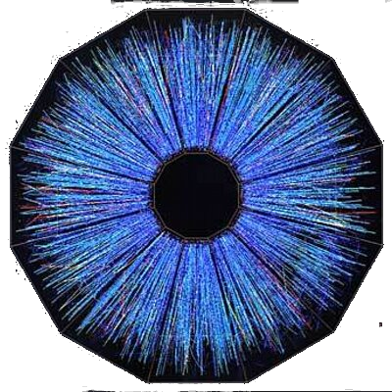
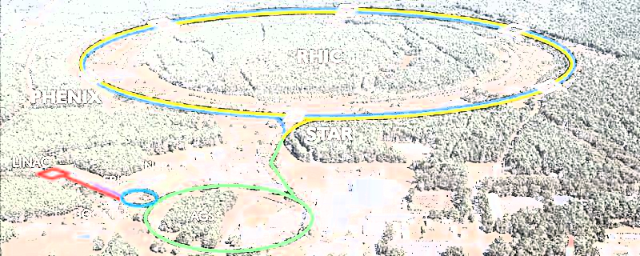
Relativistic Heavy Ion Collider
(s)

Slide 18
Contacts and links
RHIC/AGS Users’ Executive Committee
http://www.rhicuec.org/
Chair Elect: Zhenyu Ye (University of Illinois Chicago)
Chair: Christine Nattrass (University of Tennessee, Knoxville)
Past Chair: Ron Belmont (University of North Carolina at Greensboro)
STAR Collaboration
https://www.star.bnl.gov/
Co-spokespeople: Helen Caines (Yale University) and Lijuan Ruan (Brookhaven National Laboratory)
PHENIX Collaboration
https://www.phenix.bnl.gov/
Spokesperson: Yasuyuki Akiba (RIKEN Nishina Center for Accelerator-Based Science)
sPHENIX Collaboration
https://www.sphenix.bnl.gov/
Co-spokespeople: Dave Morrison (Brookhaven National Laboratory) and Gunther Roland(MIT)
BNL Nuclear Theory Group
https://www.bnl.gov/physics/ntg/
Group leader: Peter Petreczky (Brookhaven National Laboratory)
Collider and Accelerator Group
https://www.star.bnl.gov/
Group leader: Bill Christie (Brookhaven National Laboratory)

Slide 19
PHENIX: data analysis and publication
Members can access to PHENIX data and all internal information of PHENIX
Analysis are presented in Physics Working Group (PWG) and discussed in PWG. PHENIX has two PWGs (Heavy Ion PWG and Spin PWG)
Analysis results can be presented in conferences outside of PHENIX after they are approved as “PHENIX Preliminary”.
  Only 1 preliminary approval for the same measurement
One analysis gets mature, a Paper Preparation Group (PPG) of the topics is formed. PPG finalize the analsyis and draft manuscripts of the paper.
  1st internal release (2weeks) : all collaboration can give commetns
  Revision of the manuscript by PPG with Internal Review Committee
  2nd internal release (1 week)
  submit to journal (PRL, PRC, PRD)
19

Slide 20
PHENIX organization
PHENIX is one of two large experiments at RHIC when RHIC started in 2000. It is an international collaboration of 14 countries/areas.
PHENIX completed data taking in 2016. The successor experiment, sPHENIX experiment will start in 2023 to complete scientific mission of RHIC.
PHENIX collaboration collaborates based on bylaws.
Spokesperson (term: 3 years) Y. Akiba akiba@bnl.gov
Deputy Spokespersons: Axel Drees axel.drees@stonybrook.edu
Sasha Bailevsky shura@bnl.gov
Executive Council (EC) advise the spokesperson
14 members (4 exofficio, 6 elected, 2 juniors, 2 appointed)
Institutional Board (IB)
one member from each collaboration institutes
One institute: at least one Member of Good Standing (MGS)
A MGS is expected to devote >30% of research time for PHENIX
Admission of new collaboration is discussed in an IB meeting and voted by IB
  4 new collaboration institutes after 2016
PHENIX Speakers Bureau (PSB) distributes PHENIX talks among international conferences to PHENIX members.
20

Slide 21
Datasets of PHENIX
year | Beam, E(GeV) | Recorded data (pp equiv) | upgrade | Physics
2016 | AuAu 200 dAu 200 dAu 62,39,20 | 2.3/nb (90/pb) 15B events 1G & 73/nb (29/pb) 0.6G 0.1G, 8M | VTX,FVTX MPC-EX | Heavy Flavor Gluon nPDF Small QGP
2015 | pp 200 pAu 200 pAl 200 | 23/pb 80/nb (16/pb) 275/nb (7.4/pb) | VTX, FVTX | Heavy Flavor Transverse spin CNM, small QGP
2014 | AuAu 200, 15 ³HeAu 200 | 2.3/nb (90/pb) 15 B events 25/nb (15/pb) | VTX, FVTX | Heavy Flavor Small QGP
2013 | pp 510 | 240/pb | W-trigger | Anti-quark spin Gluon spin
2012 | pp 510 pp 200 CuAu 200 UU 193 | 50/pb 4/pb 5/nb (60/pb) 0.17/nb (10/pb) | W-trigger VTX, FVTX | Anti-quark spin Transverse spin Heavy flavor Geometry
2011 | pp 510 AuAu 200 AuAu 19, 27 | 28/pb 0.8/nb (32/pb) | W-trigger VTX | Anti-quark spin Heavy flavor BES-I
2010 | AuAu 200 AuAu 62,39,7 | 1.1/nb (44/pb) | HBD | Low mass ee BES-I
Many physics topics with variety of high statistics datasets
21
Notes:
<number>

Slide 22

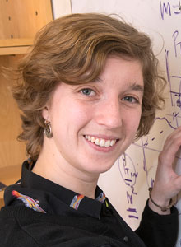

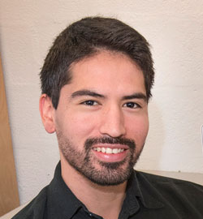


Diversity in Nuclear Theory
Training and education is key for a diverse workforce
Postdocs:
Latino grad students:
Abha Rajan,
Now at ODU
Alba Otonso Soto,
now in Saclay
Sohini Bhattacharya,
Started 10/4/2021
F. Salazar Wong,
postdoc UCLA
C. Shugert,
Applied Physics
Lab, John
Hopkins U.
Advisors:
Petreczky, Schenke, Venugopalan
Schenke and Venugopalan participate in various lab educational programs:
Sixtus Kuudar (Florida A&M,URM), Viraj Jayam (HSRP, now undergrad
at Stanford), Casey Cartwright (DOE's SCGSR program, U Alabama),
Wenjie Gong (SULI, Harvard, Goldwater Fellowship),
collaboration with Prof. C. Miller Glass
(St. Joseph’s College, MSI)
22

Slide 23
