Slide 1

A tale of two jets
Christine Nattrass, University of Tennessee, Knoxville
https://lp-cms-production.imgix.net/image_browser/Effiel%20Tower%20-%20Paris%20Highlights.jpg?auto=format&fit=crop&sharp=10&vib=20&ixlib=react-8.6.4&w=850

Slide 2



Acknowledgements
Antonio Da Silva
Patrick Steffanic
Charles Hughes

Slide 3
What a theorist needs to know about background
You have background too!
The distinction between signal and background is somewhat arbitrary
Experimental background subtraction techniques may lead to non-trivial bias
The gold standard is treating the model exactly like the data

Slide 4
Background is not just an experimental problem
arXiv:2005.02320

Slide 5

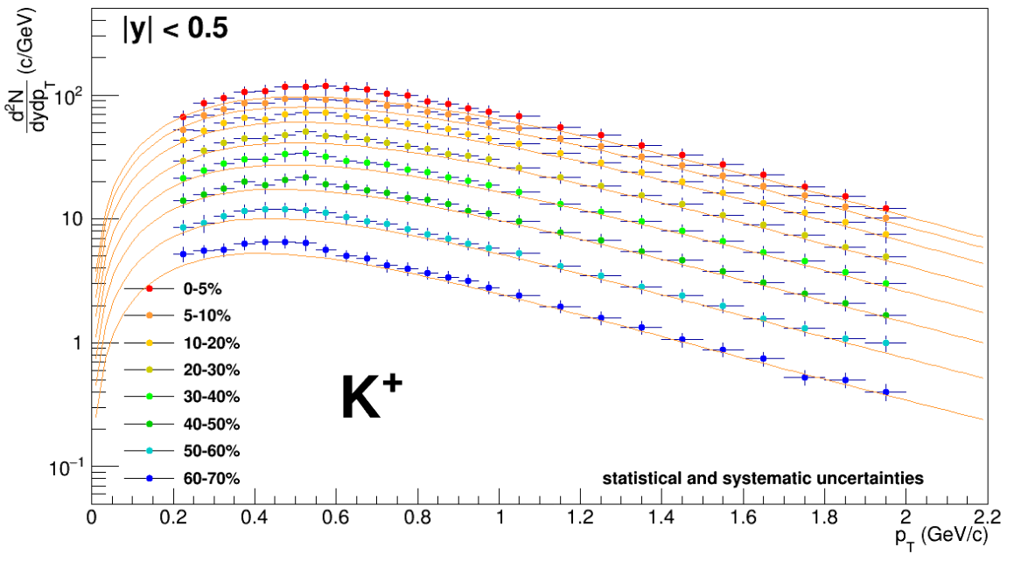
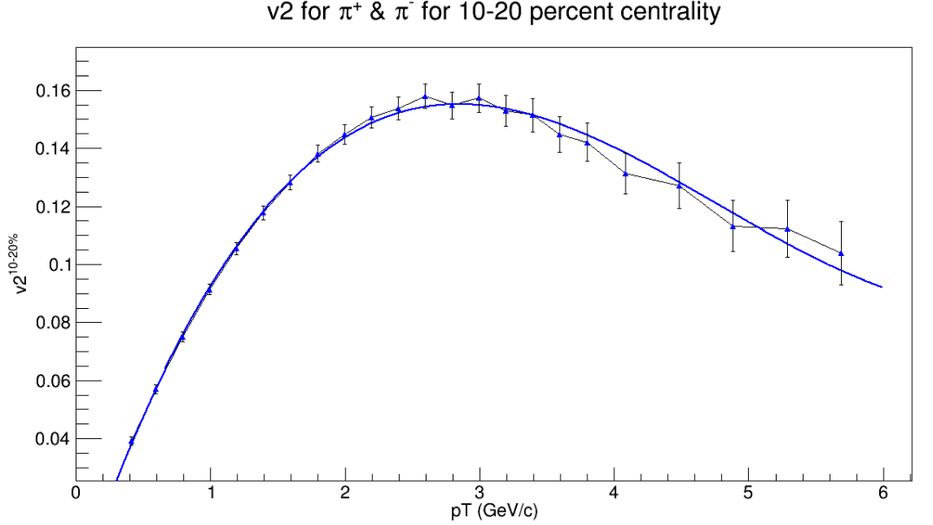

TennGen background generator
Event properties
Track properties
ε₁
ε₃
Momentum spectra
Blast Wave Fit
dN/dy
Random p_{T}
ε₂, ε₄, ε₆
ALICE PLB720 (2013) 52-62
ε₅
p_{T}
Even event planes fixed at Ψ=0
Odd planes at random φ
Multiplies from ALICE PRC88 (2013) 044910
Polynomial Fit
v_{n}
v_{n}
ALICE JHEP 1609 (2016) 164
Azimuthal asymmetries
Random φ
No jets! No resonances
Emulates hydro correlations
p_{T}

Slide 6
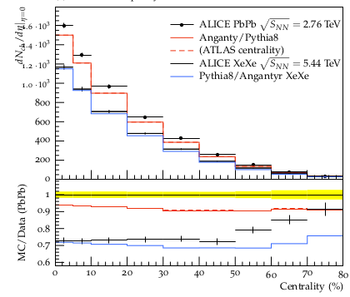
PYTHIA Angantyr
JHEP (2018) 2018: 134
Based on PYTHIA 8
Sjöstrand, Mrenna & Skands,
JHEP05 (2006) 026
Comput. Phys. Comm. 178 (2008) 852.
Based on Fritiof & wounded nucleons
N-N collisions w/fluctuating radii → fluctuating σ
Lots of jets! And resonances!
No hydrodynamics, no jet quenching

Slide 7
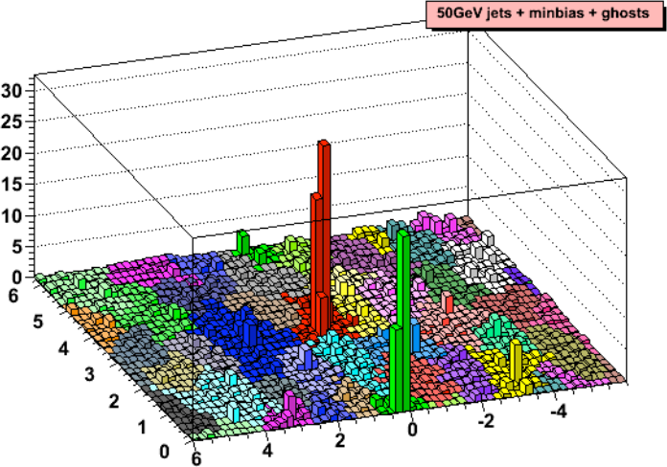
Area-based background subtraction
Cacciari & Salam, PLB659:119–126,2008
Particles, clusters
k_{T} algorithm
Cacciari DIS 2006
$k_{T}=p_{T},ΔR_{ij}=\sqrt{{\left(η_{i}−η_{j}\right)}^{2}+{\left(ϕ_{i}−ϕ_{j}\right)}^{2}}$
For all i,j calculate:
Combine smallest d_{ij}.
If d_{iB} smallest, d_{iB}→ jet
Repeat until no particles left
$d_{ij}=min\left(p_{T,i}^{2},p_{T,j}^{2}\right)ΔR_{ij}^{2}$
Energy (arb. units)
$d_{iB}=p_{T,i}$
Cacciari & Salam
Phys.Lett.B641:57-61,2006
Jet candidates
$ϕ$
Median ρ=p_{T}/A
$η$
$p_{T}^{jet}=p_{T}^{reco}−ρ_{median}A^{jet}$

Slide 8
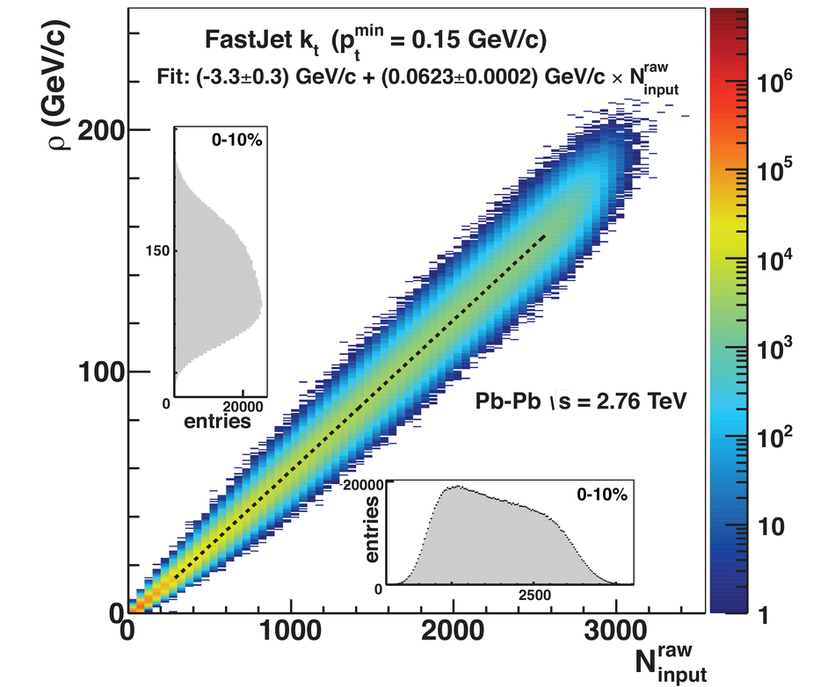
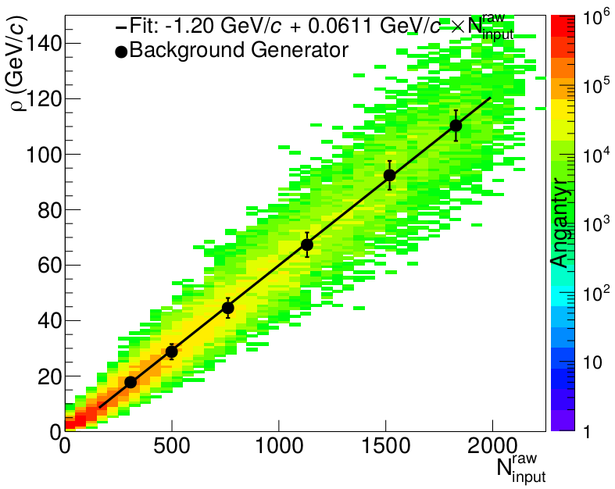
Background density ρ
`
ALICE
arXiv:2005.02320

Slide 9
Random cones
X
Excluded
$ϕ$
R=0.4
Real jets
Excluded
$η$

Slide 10
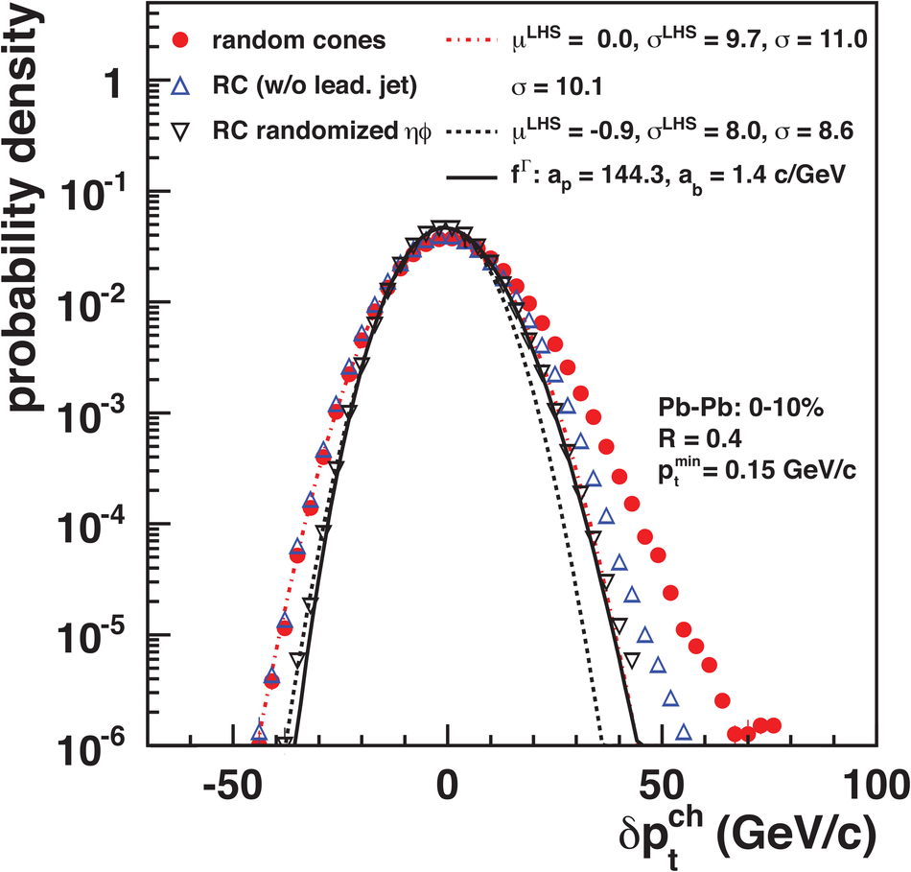
Random cones in ALICE
Estimate ρ
  k_{T} jet finder→jet candidates
  ρ = Median(p_{T}/A)
Draw Random cone
JHEP 03 (2012) 053
$δp_{T}=p_{T}^{reco}−ρA$

Slide 11
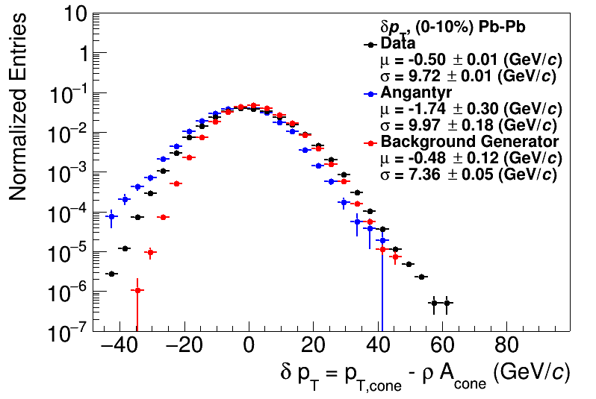
Random cones
JHEP 03 (2012) 053
ALICE
arXiv:2005.02320

Slide 12
Shape of width of the distribution
Single particle spectra
$f_{Γ}\left(p_{T},p,b\right)=\frac{b}{Γ\left(p\right)}{\left(bp_{T}\right)}^{p−1}e^{−bx}$
Σp_{T} of N particles→N-fold convolution:
$\frac{{dpT}^{total}}{dy}∝f_{N}\left(p_{T},Np,b\right)$
$f_{N}\left(p_{T},p,b\right)=f_{Γ}\left(p_{T},Np,b\right)$
$\frac{dN}{dy}∝f_{Γ}\left(p_{T},2,b\right)=b^{2}p_{T}e^{−kp_{T}}$
$N=\frac{N_{total}}{A_{total}}πR^{2}$
$μ_{total}=\frac{Np}{b}=Nμ_{p_{T}},σ_{total}=\frac{\sqrt{Np}}{b}=\sqrt{N}σ_{p_{T}}$
$μ_{p_{T}}=\frac{p}{b},σ_{p_{T}}=\frac{\sqrt{p}}{b}$
Tannenbaum, PLB(498),1–2,Pg.29-34(2001)
Add Poissonian fluctuations in N:
$σ_{total}=\sqrt{Nσ_{p_{T}}^{2}+Nμ_{p_{T}}^{2}}$
Add non-Poissonian fluctuations in N due to flow
$σ_{total}=\sqrt{Nσ_{p_{T}}^{2}+\left(N+2\sum{v_{n}^{2}}\right)μ_{p_{T}}^{2}}$

Slide 13
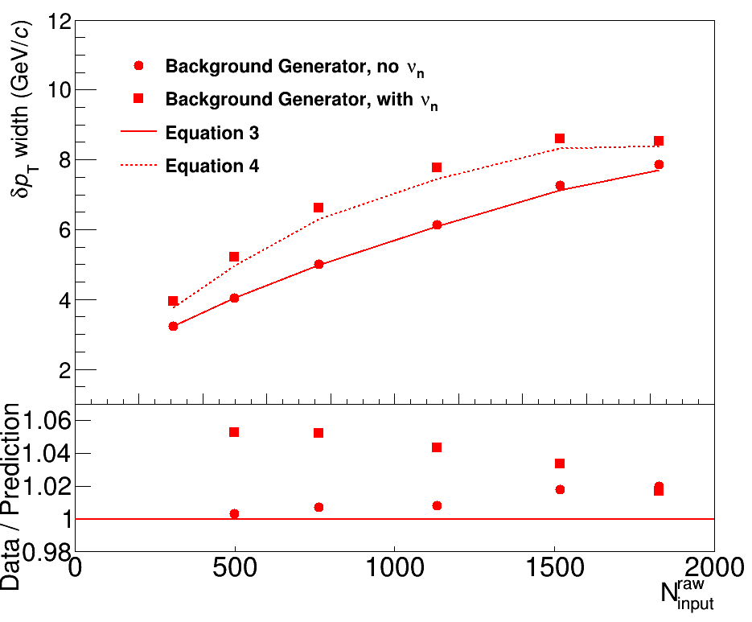
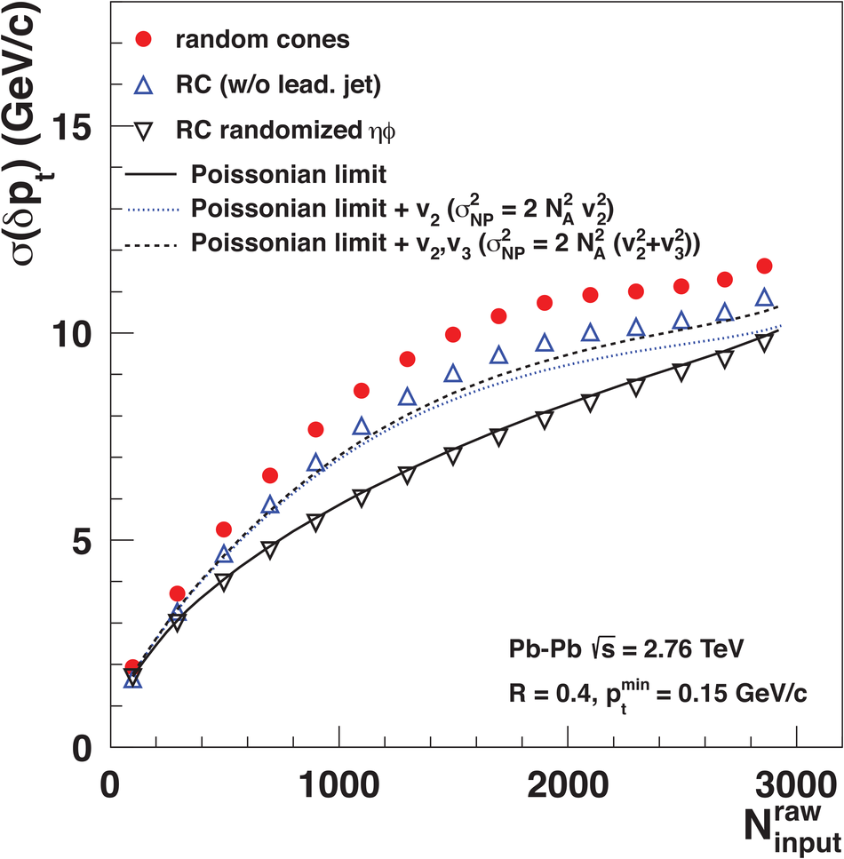
Width vs multiplicity
TennGen
ALICE
Small deviations

Slide 14
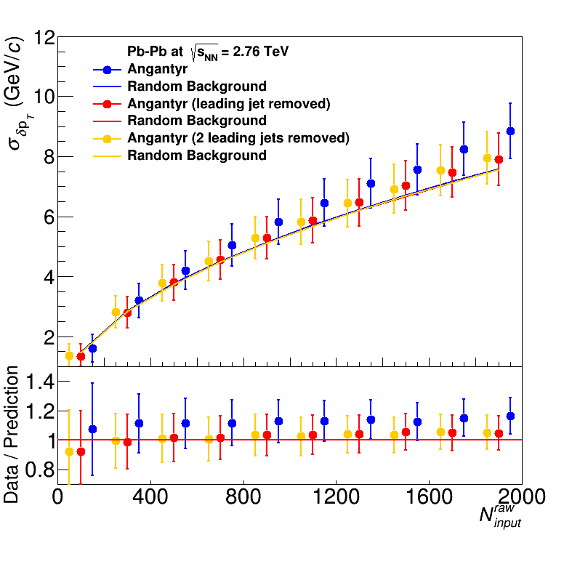
Width vs multiplicity
Angantyr
ALICE

Slide 15
Shape of width of the distribution
Single particle spectra
$f_{Γ}\left(p_{T},p,b\right)=\frac{b}{Γ\left(p\right)}{\left(bp_{T}\right)}^{p−1}e^{−bx}$
Σp_{T} of N particles→N-fold convolution:
$\frac{{dpT}^{total}}{dy}∝f_{N}\left(p_{T},Np,b\right)$
$f_{N}\left(p_{T},p,b\right)=f_{Γ}\left(p_{T},Np,b\right)$
$\frac{dN}{dy}∝f_{Γ}\left(p_{T},2,b\right)=b^{2}p_{T}e^{−kp_{T}}$
$N=\frac{N_{total}}{A_{total}}πR^{2}$
$μ_{total}=\frac{Np}{b}=Nμ_{p_{T}},σ_{total}=\frac{\sqrt{Np}}{b}=\sqrt{N}σ_{p_{T}}$
$μ_{p_{T}}=\frac{p}{b},σ_{p_{T}}=\frac{\sqrt{p}}{b}$
Tannenbaum, PLB(498),1–2,Pg.29-34(2001)
Add Poissonian fluctuations in N:
$σ_{total}=\sqrt{Nσ_{p_{T}}^{2}+Nμ_{p_{T}}^{2}}$
Assumes shape
Add non-Poissonian fluctuations in N due to flow
Assumes uncorrelated number fluctuations
$σ_{total}=\sqrt{Nσ_{p_{T}}^{2}+\left(N+2\sum{v_{n}^{2}}\right)μ_{p_{T}}^{2}}$

Slide 16
Mini-summary
Jet finders put all input clusters, tracks in a jet candidate
Background is dominated by random particles
  But ~5% effects from
  non-Poissonian fluctuations
Models have background too!
  Sensitive to multiplicity,
  implementation of flow
Cacciari DIS 2006
Energy (arb. units)
Cacciari & Salam
Phys.Lett.B641:57-61,2006
$ϕ$
$η$

Slide 17
Signal and background overlap
Real jets
Jet-like
p_{T}
Combinatorial jets
Background-like

Slide 18
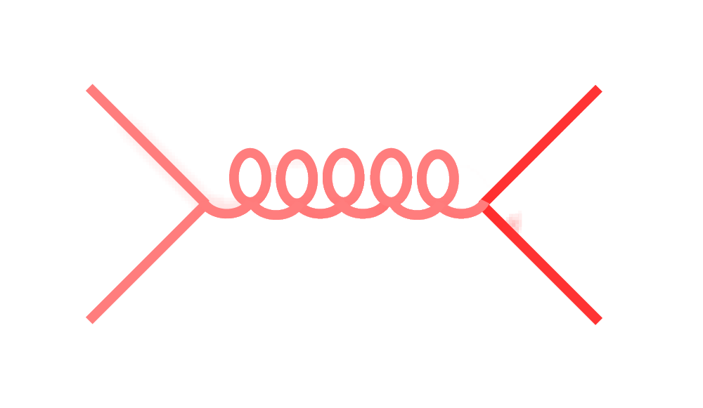
Signal vs Background:
The standard paradigm
Background
Signal

Slide 19
Signal vs Background:
The standard paradigm
Background
Combinatorial jets
Signal

Slide 20
Signal vs Background:
The standard paradigm
Background
Combinatorial jets
Signal
= “fake” jets

Slide 21
Signal vs Background:
The standard paradigm
Background
Combinatorial jets
Signal
*Some gray areas

Slide 22
Technique
Anti-k_{T} jet finder, |η_{jet}|<0.5
Combinatorial jets: Only contain TennGen particles
Real jets: Add a PYTHIA pp event. Real jets contain >80% of p_{Thard}^{min}

Slide 23
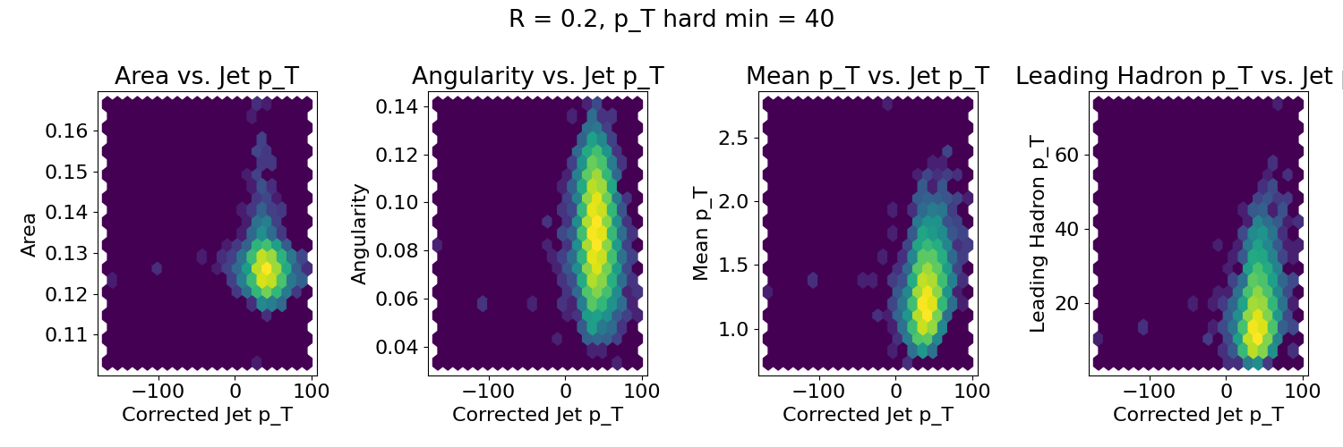
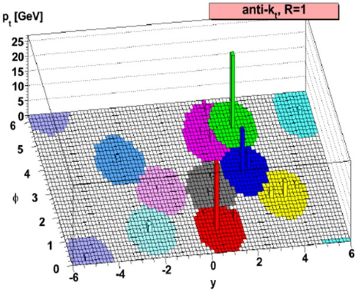
Real jets
Log z scale
Area
Angularity
Average p_{T}
Leading p_{T}
$α=\frac{1}{p_{T}^{jet}}\sum{z_{k}}\left(\vec{R_{k}}\right)$

Slide 24
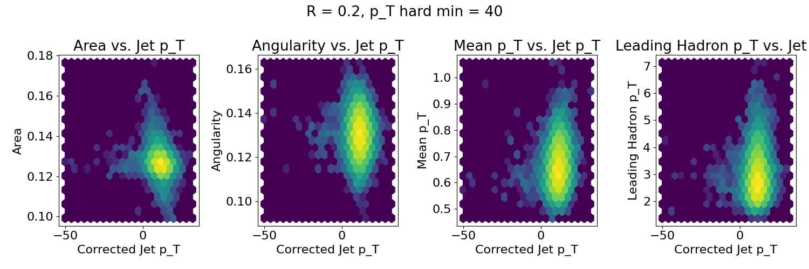
p_{Thard}>40 GeV/c, R=0.2
Log z scale
Real
Combinatorial

Slide 25
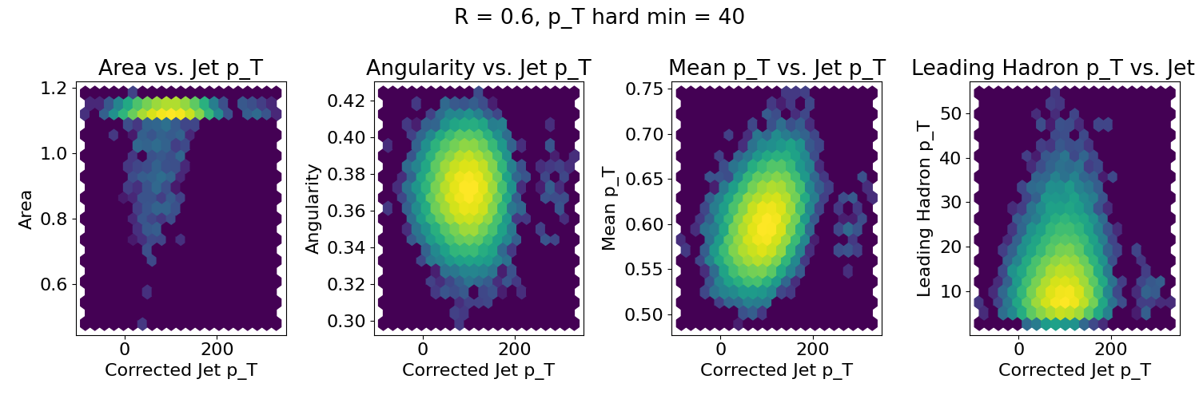
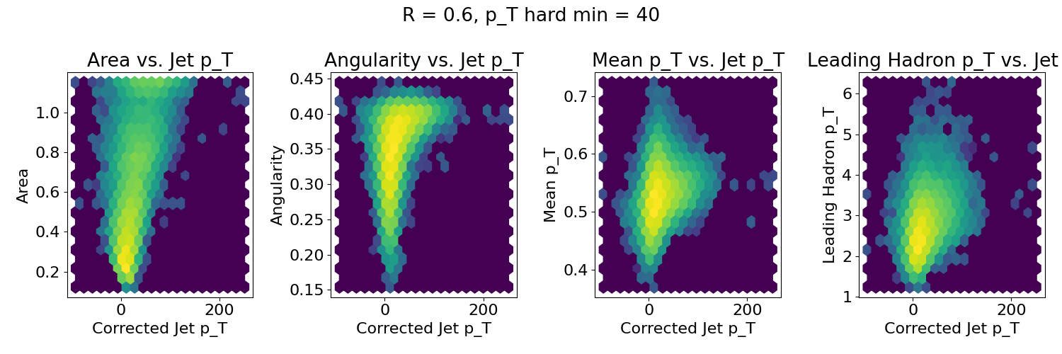
p_{Thard}>40 GeV/c, R=0.6
Log z scale
Real
Combinatorial

Slide 26
Silhouette Values
Define a distance between two jet candidates to determine how similar they are
$d_{i,j}=\sqrt{{\left(\frac{A_{i}−A_{j}}{A^{max}−A^{min}}\right)}^{2}+{\left(\frac{α_{i}−α_{j}}{α^{max}−α^{min}}\right)}^{2}+{\left(\frac{{\left\langle p_{T}\right\rangle }_{i}−{\left\langle p_{T}\right\rangle }_{j}}{{\left\langle p_{T}\right\rangle }^{max}−{\left\langle p_{T}\right\rangle }^{min}}\right)}^{2}+{\left(\frac{p_{T,i}^{L}−p_{T,j}^{L}}{p_{T}^{L,max}−p_{T}^{L,min}}\right)}^{2}}$
Area
Angularity
Average p_{T}
Leading p_{T}
$α=\frac{1}{p_{T}^{jet}}\sum{z_{k}}\left(\vec{R_{k}}\right)$

Slide 27
Silhouette Values
Average distance between a jet candidate and other jet candidates in its cluster (signal or background)
Average distance between jet candidate and jet candidates in the other cluster
Silhouette value
$a_{i}={\left\langle d_{i,j}\right\rangle }_{j≠i}$
$b_{i}=\left\langle d_{i,j}\right\rangle$
$s_{i}=\frac{b_{i}−a_{i}}{max\left[b_{i},a_{i}\right]}$
-1
1
0
Looks more like another cluster
Indistinguishable from other clusters
Looks more like its own cluster

Slide 28
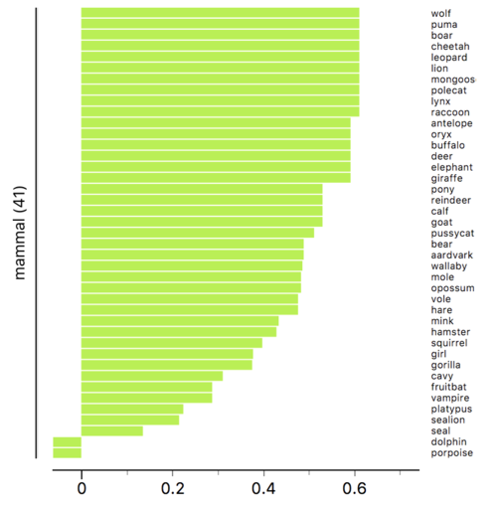
Silhouette values
Example from Wikipedia
s
Silhouette scores from three types of animals rendered by Orange data mining suite.
s

Slide 29
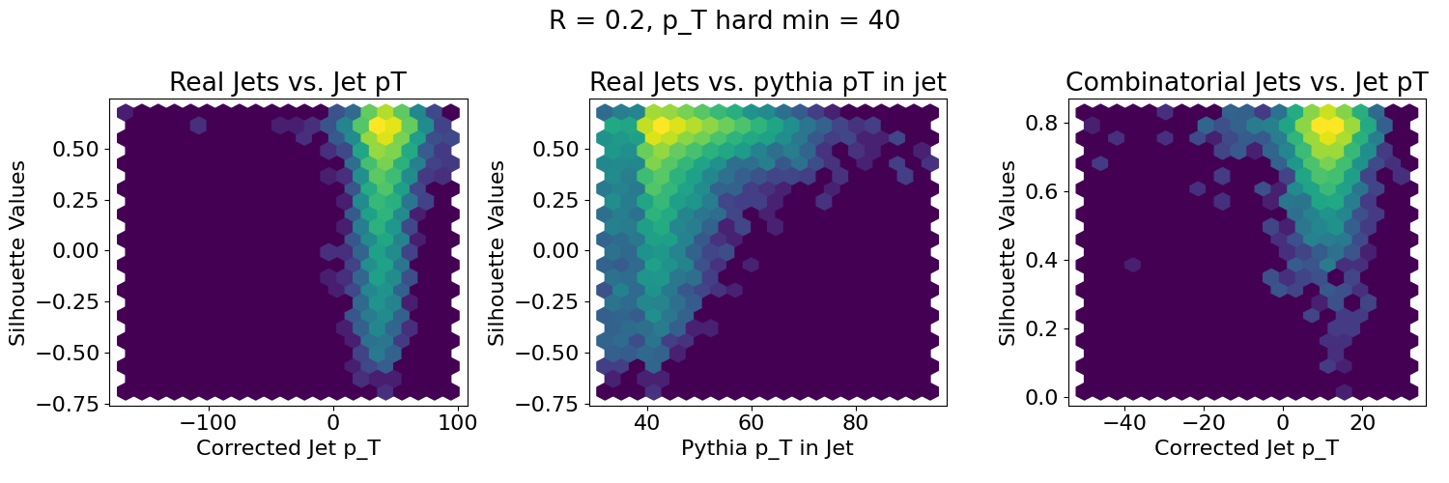
Log z scale
Silhouette values
s<0: look more like background
Real jets look more real if PYTHIA p_{T} is higher
s~0: look similar to signal

Slide 30
Log z scale
Silhouette values – decreasing p_{T}

Slide 31
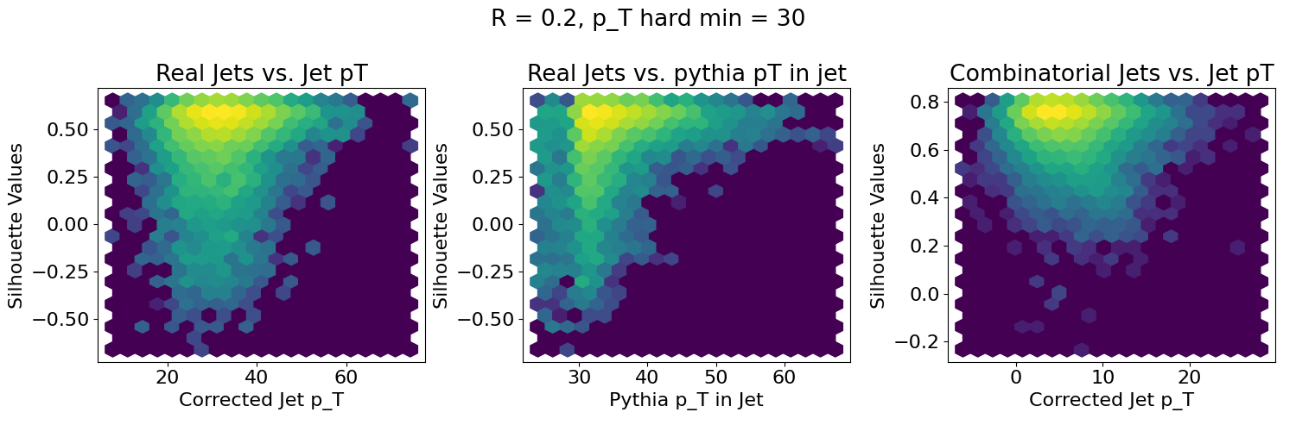
Log z scale
Silhouette values – decreasing p_{T}

Slide 32
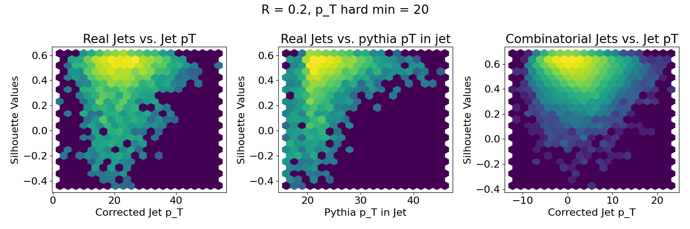
Log z scale
Silhouette values – decreasing p_{T}

Slide 33
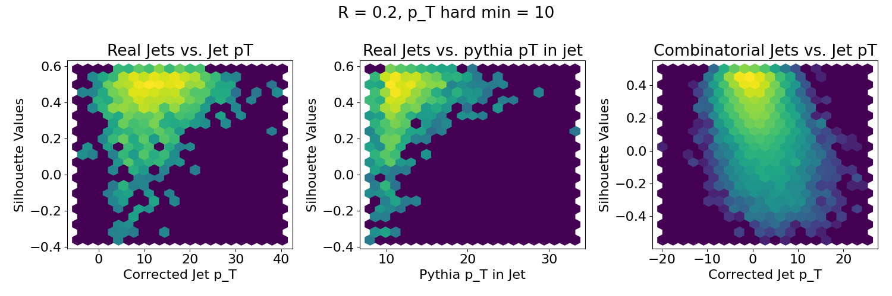
Log z scale
Silhouette values – decreasing p_{T}
Real jets look more like combinatorial jets
These aren’t random jets!
Combinatorial jets look more like real jets

Slide 34
Log z scale
Silhouette values – increasing R

Slide 35
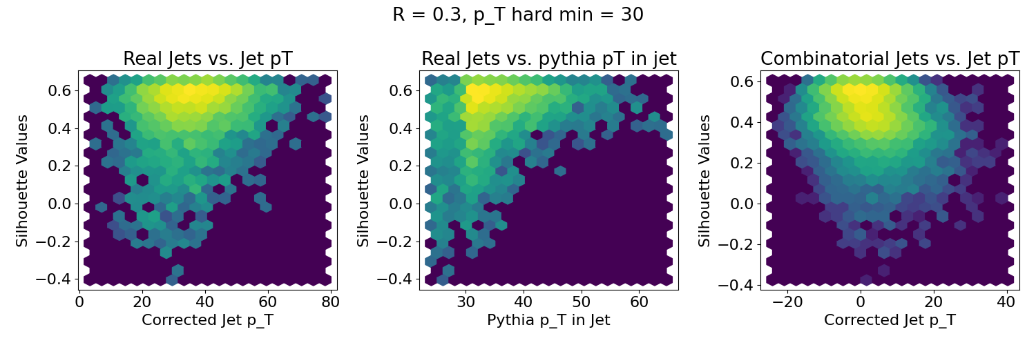
Log z scale
Silhouette values – increasing R

Slide 36
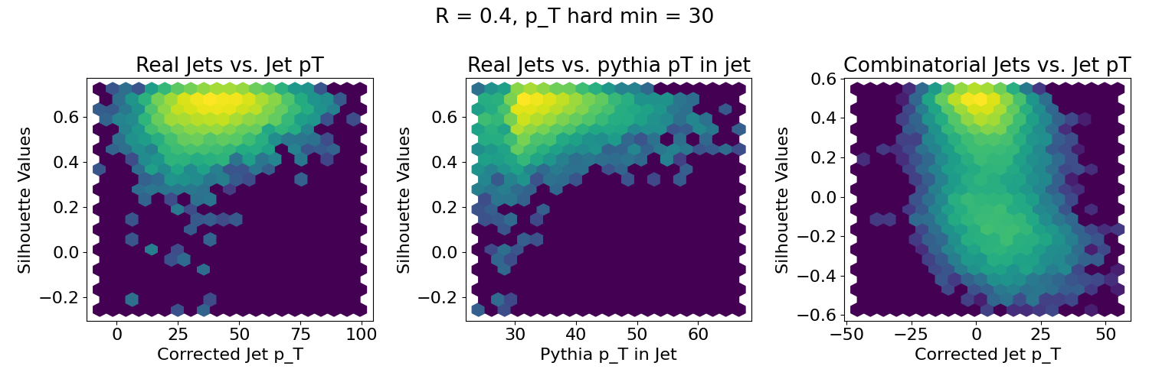
Log z scale
Silhouette values – increasing R

Slide 37
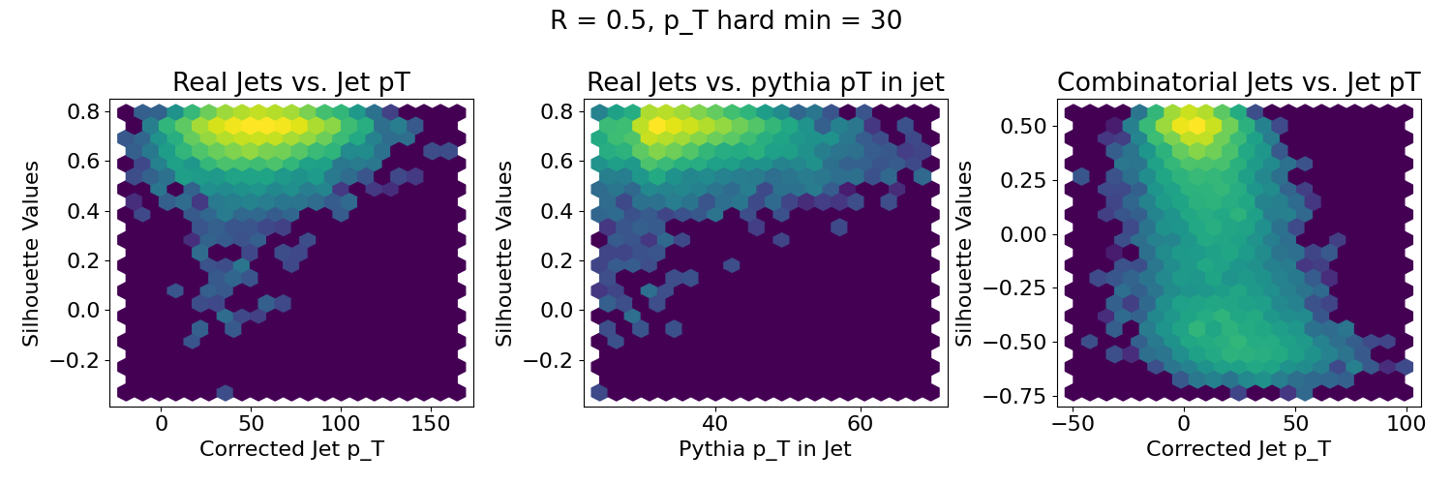
Log z scale
Silhouette values – increasing R

Slide 38
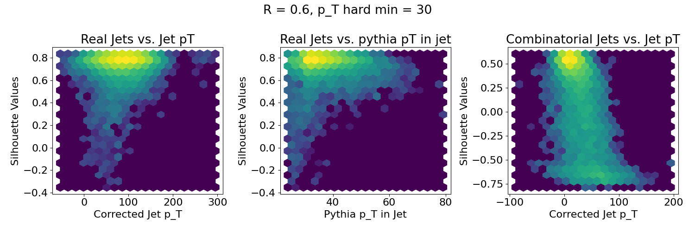
Log z scale
Silhouette values – increasing R
These aren’t random jets!
Real jets look more like real jets
Tail in distribution of real jets gets smaller
Combinatorial jets look more like real jets

Slide 39
Mini-summary
“Signal” and “background” have different properties, but...
Always overlap somewhat
Any procedure to remove “background” will also cut signal

Slide 40
How to compare to models

Slide 41

Iterative procedure
Constituent biases don't matter that much up here
Used by ATLAS & CMS
ATLAS
  Calorimeter jets: Reconstruct jets with R=0.2. v₂ modulated <Bkgd> estimated by energy in calorimeters excluding jets with at least one tower with
  E_{tower} > <E_{tower}>
  Track jets: Use tracks with p_{T}>4 GeV/c
  Calorimeter jets from above with E>25 GeV and track jets with p_{T}>10 GeV/c used to estimate background again.
  Calorimeter tracks matching one track with p_{T}>7 GeV/c or containing a high energy cluster E >7 GeV are used for analysis down to E_{jet} = 20 GeV
But they do matter down here!
Phys. Lett. B 719 (2013) 220-241

Slide 42
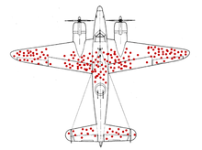
Survivor bias
WWII Example: holes planes returning indicate where it’s safer to get hit
We’re looking at the jets which remain

Slide 43
Bias
Experimental background subtraction methods: complex, make assumptions, apply biases
Survivor bias: Modified jets probably look more like the medium
Quark/Gluon bias:
  Quark jets are narrower, have fewer tracks, fragment harder [Z Phys C 68, 179-201 (1995), Z Phys C 70, 179-196 (1996), ]
  Gluon jets reconstructed with k_{T} algorithm have more particles than jets reconstructed with anti-k_{T} algorithm [Phys. Rev. D 45, 1448 (1992)]
  Gluon jets fragment into more baryons [EPJC 8, 241-254, 1998]
Fragmentation bias: Experimental measurements explicitly select jets with hard fragments

Slide 44
Snowmass Accord: Apply the same algorithm to data and your model. Then the measurement and the calculation are the same.

Slide 45
Rivet: Apply the same algorithm to data and your model. Then the measurement and the calculation are the same.

Slide 46
What is Rivet?

Slide 47
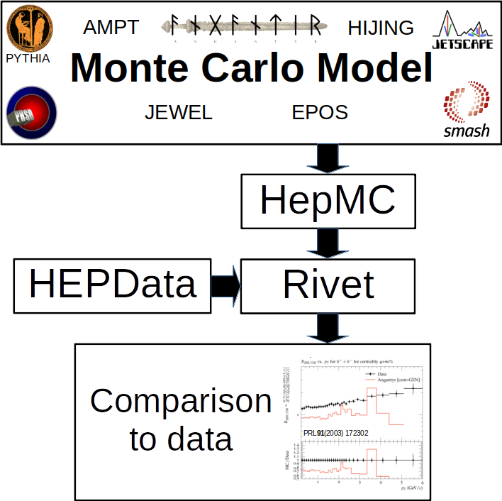

Slide 48
Why use Rivet?
Facilitates comparisons between Monte Carlos and data
It’s not that hard
It preserves analysis details

Slide 49
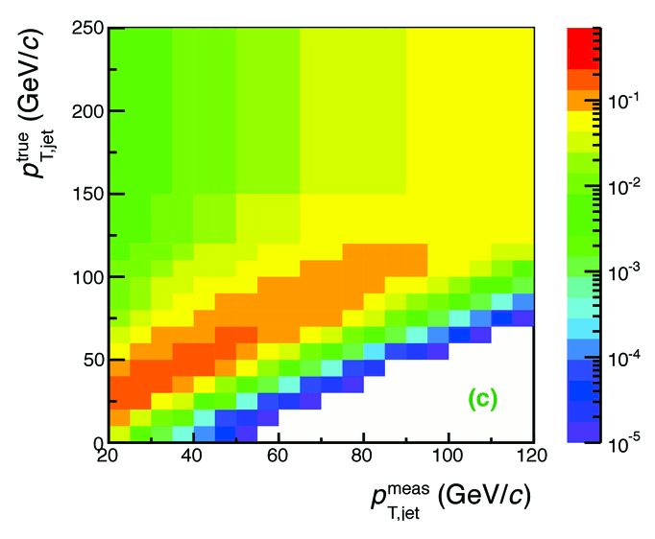

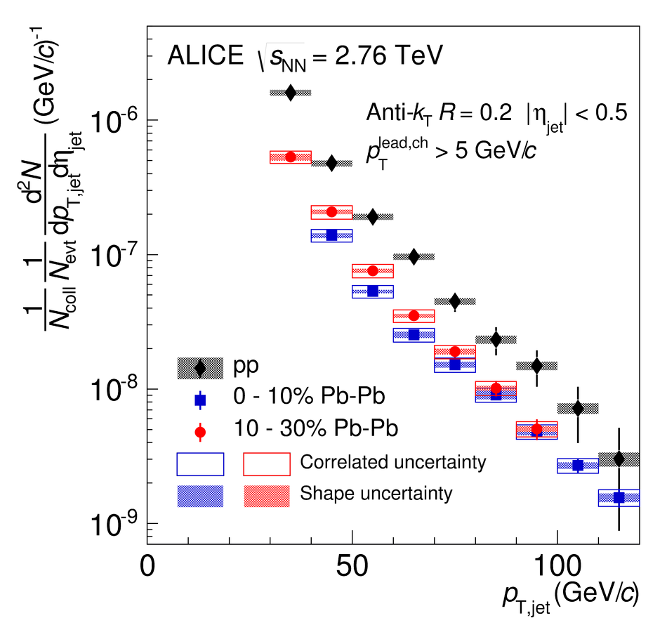
Analysis steps
Tracks
Jet finding algorithm
Jet candidates
Background subtraction
Clusters
Jet spectrum smeared by energy resolution, background fluctuations
Unfolding – corrects for single track reco ε, E resolution, background fluctuations
Corrected spectra

Slide 50
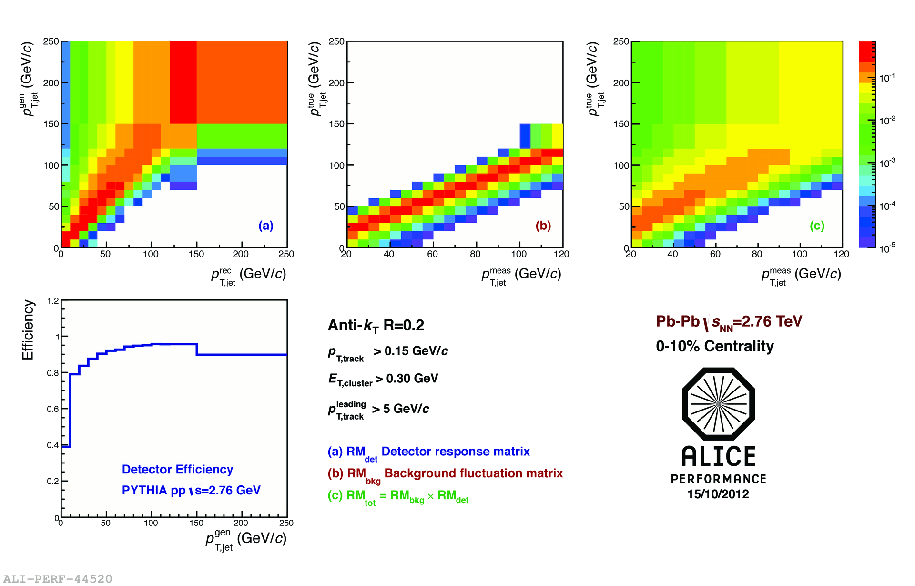
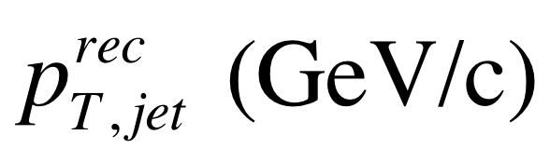
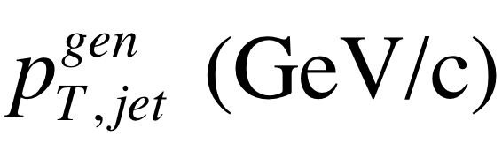
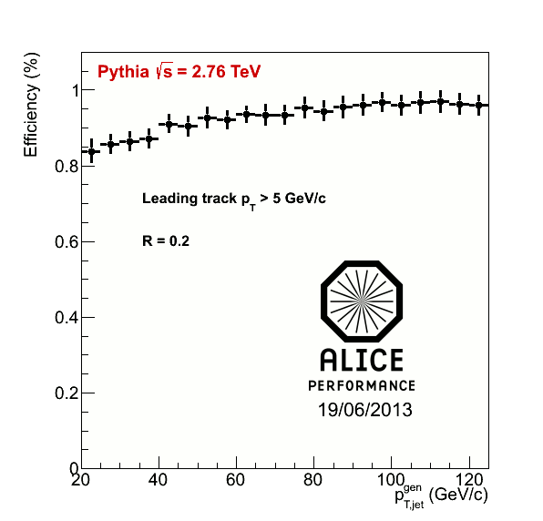
<footer>
Jets in ALICE: Response Matrix Construction
RMdet X RMbkg = RM
NOT A DETECTOR EFFECT!!
DETECTOR EFFECT
RM_{bkg} and RM_{det} are approximately factorizable
Notes:
----- Meeting Notes (6/24/13 16:47) -----
Put Large Labels on
b) change pT true -> pT rec so consistence
c) change gT true ->pT gen
<number>

Slide 51
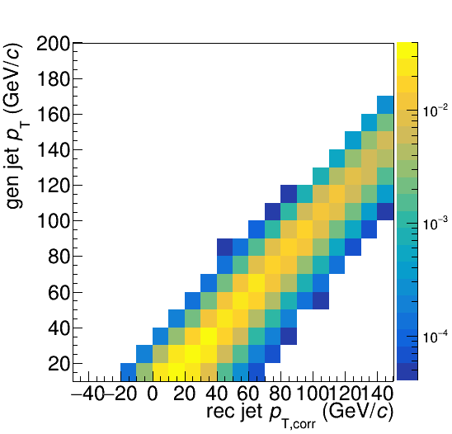
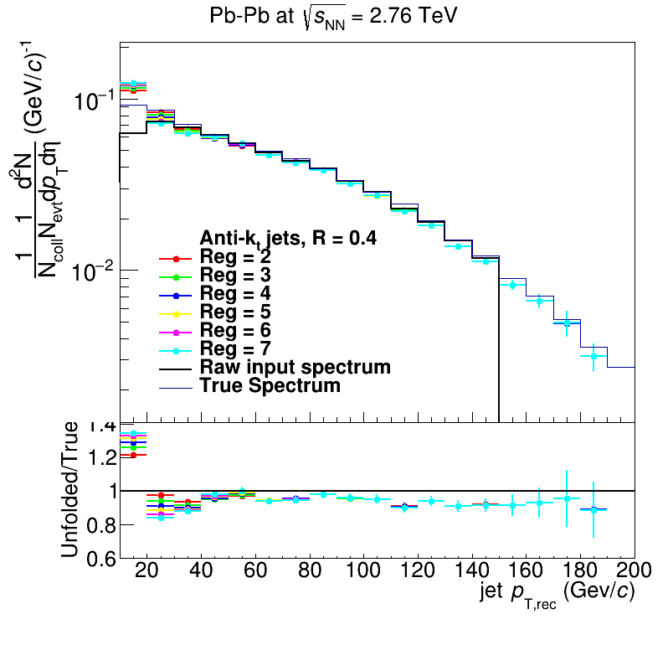
Analysis steps: Full Monte Carlo
Jet finding algorithm
Jet candidates
Background subtraction
Particles
Unfolding – corrects for background fluctuations and other effects
Jet spectrum smeared by energy resolution
Corrected spectra

Slide 52
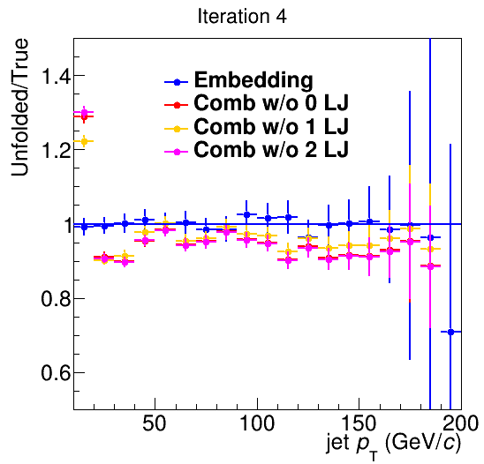
Closure
Methods
  Use δp_{T} method to measure width of fluctuations with varying numbers of leading jets (LJ) discarded
  Embed PYTHIA pp event into PYTHIA heavy ion event
  The PYTHIA pp event is “true”
Only embedding leads to full closure

Slide 53
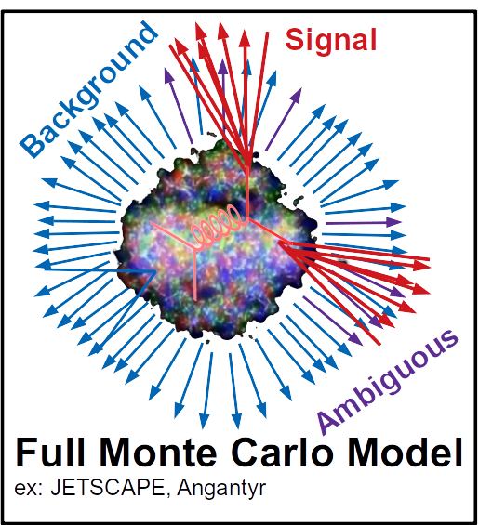
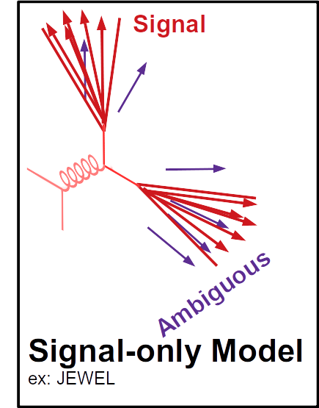
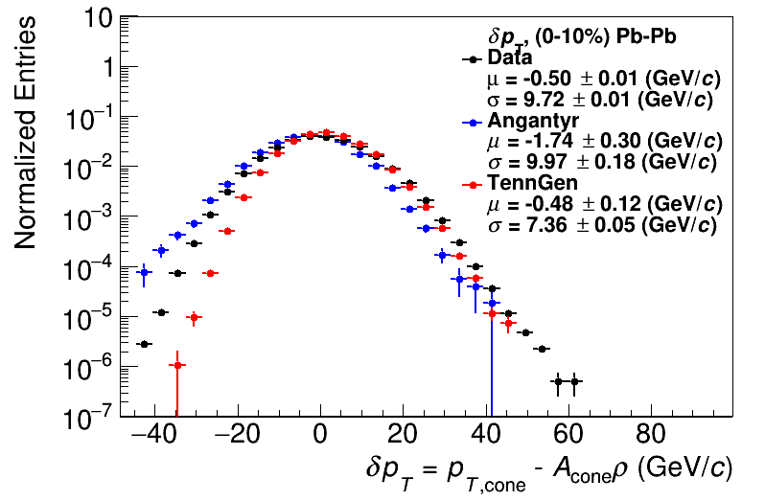
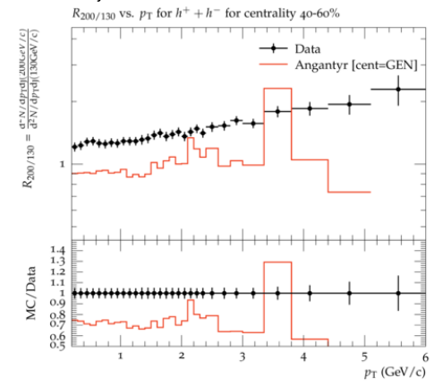
Comparison to data
HepMC
Rivet
Unfold to correct for fluctuations and other effects
HEPData
HepMC
Rivet
arXiv:2005.02320
[hep-ph]
Comparison to data
See poster by
Nattrass et al
PRL91(2003) 172302
Unfold to correct for fluctuations
Comparison to data
PRL91(2003) 172302

Slide 54
Conclusions
“Background” is not just an experimental problem!
“Signal” and “background” jets overlap → impossible to suppress background without biasing jets
Gold standard is to use Rivet
  But it requires treating the model exactly like data
  A number of issues specific to jets need to be discussed in the field
Recorded tutorials from Rivetizing Heavy Ion Collisions at RHIC

Slide 55
Backup: undergraduates

Slide 56
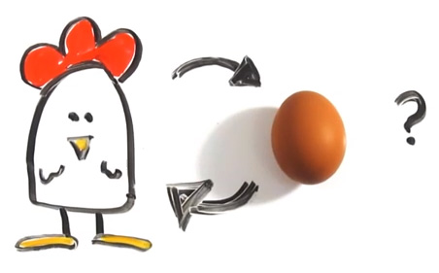
Few heavy ion analyses in Rivet
Theorists don’t use Rivet
http://iterated-reality.com/en/2015/03/17/the-chicken-or-the-egg-causality-dilemma-solved-by-unity-consciousness/

Slide 57

Undergraduates!*
Left to right: Ricardo Santos (Berea), James Neuhaus, Jerrica Wilson, Mariah McCreary, Christine Nattrass, Austin Schmier (UTK)
*And one beginning graduate student with no programming experience

Slide 58

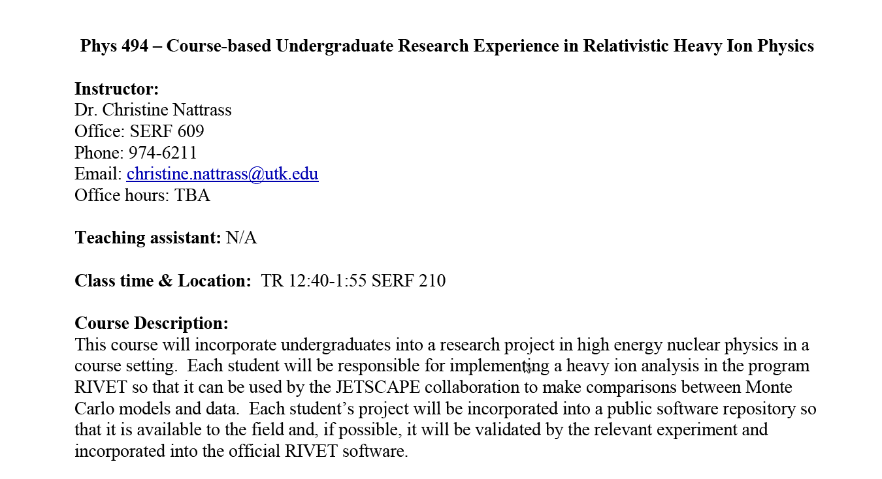
Course-based undergraduate research experience
Ask me if you want more info!
3 semesters
15 students
8 women
3 minorities
3 non-traditional
All Rivet students
22 students
11 women
7 minorities
4 non-traditional

Slide 59



https://i.ytimg.com/vi/mZnv6LXD9qs/maxresdefault.jpg

Slide 60
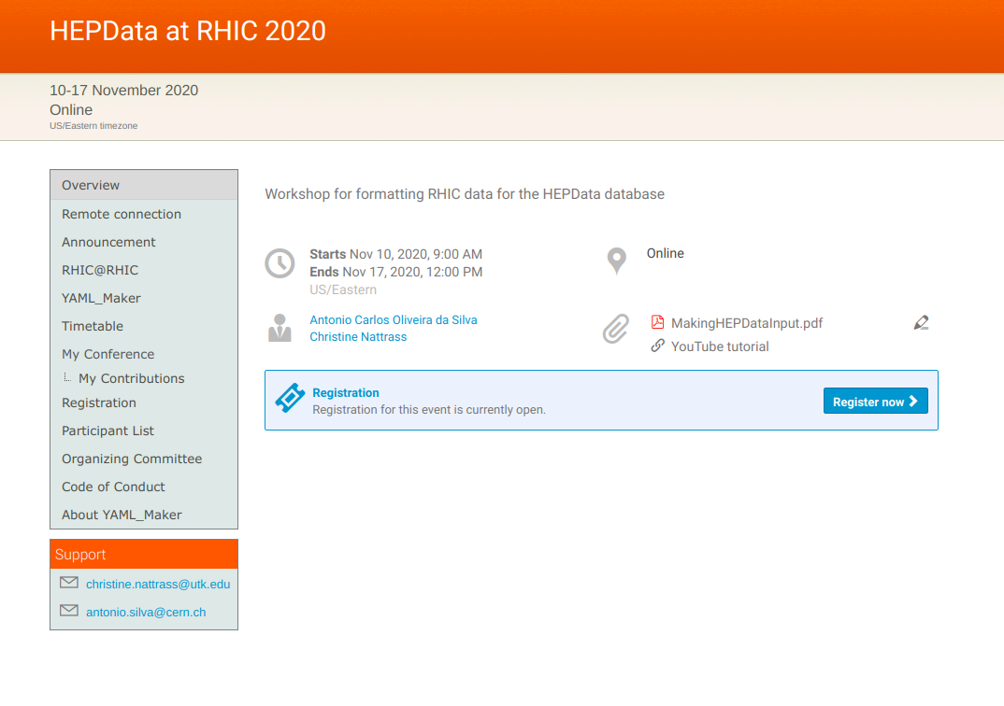
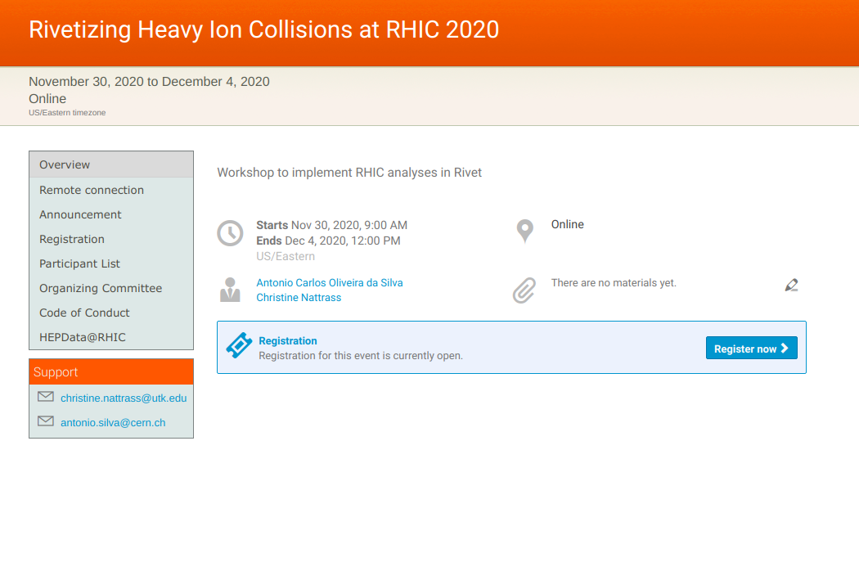
Learn Rivet yourself!
Or send your students & postdocs!
https://indico.bnl.gov/event/8843/
https://indico.bnl.gov/event/8840

Slide 61
Backup: jet properties

Slide 62
p_{Thard}>40 GeV/c, R=0.2
Log z scale
Real
Combinatorial

Slide 63
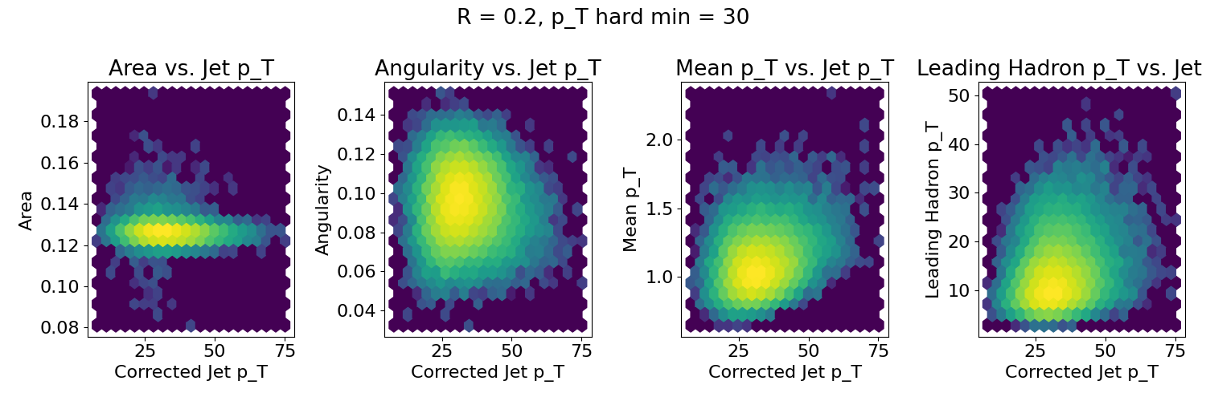
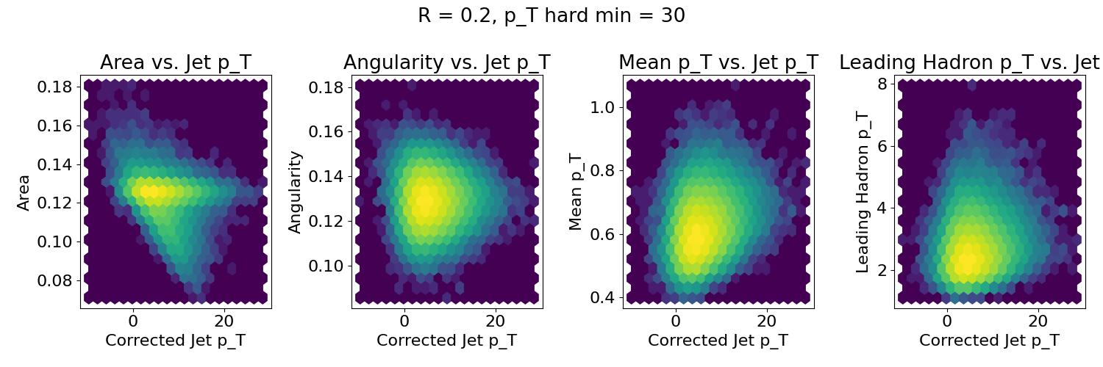
p_{Thard}>30 GeV/c, R=0.2
Log z scale
Real
Combinatorial

Slide 64
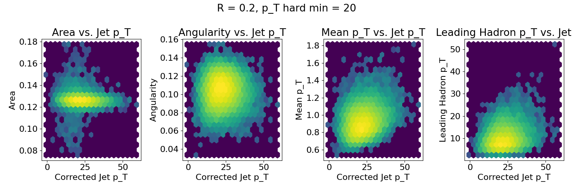
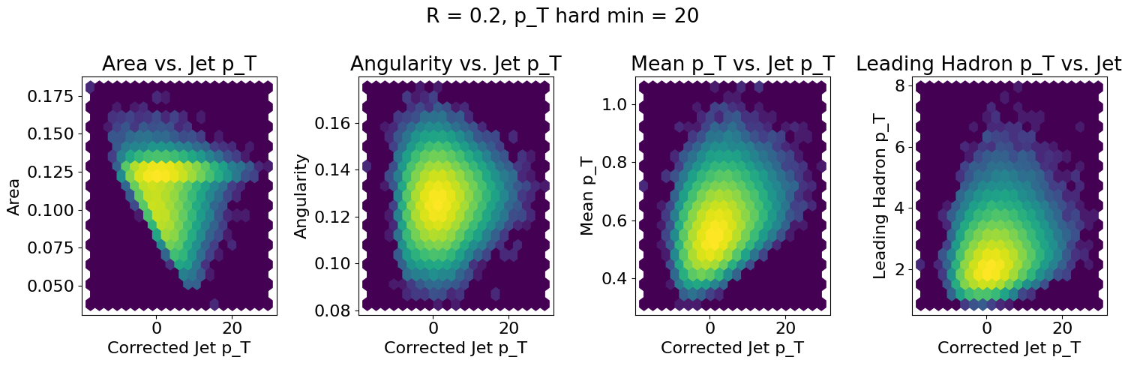
p_{Thard}>20 GeV/c, R=0.2
Log z scale
Real
Combinatorial

Slide 65
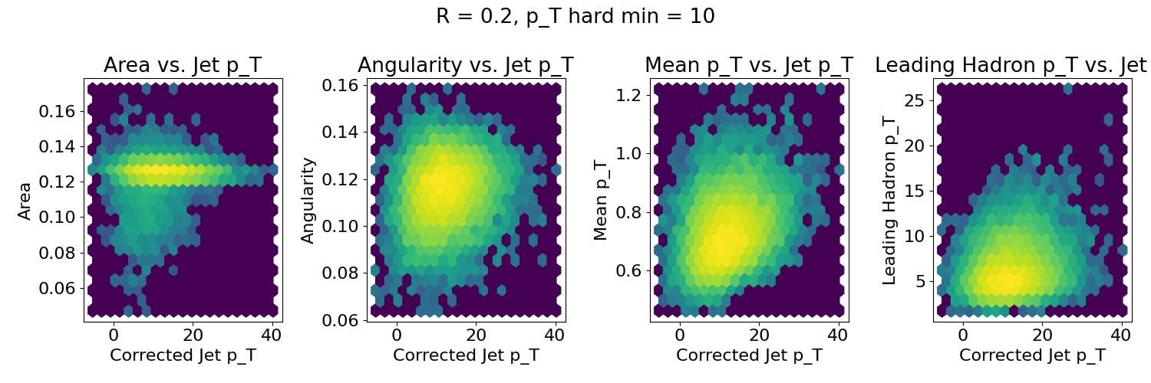

p_{Thard}>10 GeV/c, R=0.2
Log z scale
Real
Combinatorial

Slide 66
p_{Thard}>40 GeV/c, R=0.2
Log z scale
Real
Combinatorial

Slide 67


p_{Thard}>40 GeV/c, R=0.3
Log z scale
Real
Combinatorial

Slide 68


p_{Thard}>40 GeV/c, R=0.4
Log z scale
Real
Combinatorial

Slide 69


p_{Thard}>40 GeV/c, R=0.5
Log z scale
Real
Combinatorial

Slide 70
p_{Thard}>40 GeV/c, R=0.6
Log z scale
Real
Combinatorial

Slide 71
Backup: silhouette scores

Slide 72
Log z scale
Silhouette values – decreasing p_{T}
Real jets look more like combinatorial jets
Combinatorial jets look more like real jets

Slide 73
Log z scale
Silhouette values – increasing R
Real jets look more like real jets
Tail in distribution of real jets gets smaller
Combinatorial jets look more like real jets

Slide 74
Backup: jet definition

Slide 75




Jets in principle
Jet measures partons
Hadronic degrees of freedom are integrated out
Algorithms are infrared and colinear safe
OK
BAD: 2 jets are merged in one

Slide 76

k_{T} jet finding algorithm
Particles, clusters
k_{T} algorithm
$k_{T}=p_{T},ΔR_{ij}=\sqrt{{\left(η_{i}−η_{j}\right)}^{2}+{\left(ϕ_{i}−ϕ_{j}\right)}^{2}}$
For all i,j calculate:
Combine smallest d_{ij}.
If d_{iB} smallest, d_{iB}→ jet
Repeat until no particles left
$d_{ij}=min\left(p_{T,i}^{2},p_{T,j}^{2}\right)\frac{ΔR_{ij}^{2}}{R^{2}}$
$d_{iB}=p_{T,i}^{2}$
Jet candidates

Slide 77
anti-k_{T} jet finding algorithm
Particles, clusters
k_{T} algorithm
$k_{T}=p_{T},ΔR_{ij}=\sqrt{{\left(η_{i}−η_{j}\right)}^{2}+{\left(ϕ_{i}−ϕ_{j}\right)}^{2}}$
For all i,j calculate:
Combine smallest d_{ij}.
If d_{iB} smallest, d_{iB}→ jet
Repeat until no particles left
$d_{ij}=min\left(p_{T,i}^{−2},p_{T,j}^{−2}\right)\frac{ΔR_{ij}^{2}}{R^{2}}$
$d_{iB}=p_{T,i}^{−2}$
Jet candidates

Slide 78

Cambridge/Aachen jet finding algorithm
Particles, clusters
k_{T} algorithm
$k_{T}=p_{T},ΔR_{ij}=\sqrt{{\left(η_{i}−η_{j}\right)}^{2}+{\left(ϕ_{i}−ϕ_{j}\right)}^{2}}$
For all i,j calculate:
Combine smallest d_{ij}.
If d_{iB} smallest, d_{iB}→ jet
Repeat until no particles left
$d_{ij}=\frac{ΔR_{ij}^{2}}{R^{2}}$
$d_{iB}=1$
Jet candidates

Slide 79
Backup: misc

Slide 80

Unfolding
: the “true” histogram
: the actual data we measure
: background
R : the response matrix
$\vec{μ}$
$\vec{ν}$
$\vec{β}$
May correct for “missing” jets!

Slide 81

Mixed events
Gets background up to a normalization factor
Good agreement with the data… but 20% discrepancies still within uncertainties
In measurement with background suppressed (h-jet correlations)
Did not see such agreement at the LHC for jet spectra
STAR
Phys. Rev. C 96 (2017) 24905

Slide 82
Mini-summary
Experimental techniques can bias measurement in subtle ways
  Background subtraction
  Kinematic cuts
  Choice of jet finder, R
  Centrality determination
  Technique for finding reaction plane
Larger influence at low momentum
Safest to do the same analysis on data and model
  But unfolding is necessary in a full Monte Carlo model!

Slide 83
Experimental techniques for background

Slide 84

Focus on smaller angles
Pros
  Background is smaller
  Background fluctuations smaller
Cons:
  Modifications expected at higher R
  Biases sample towards quarks
JHEP 03 (2012) 053
Aside: “quark” and “gluon” jet only defined at leading order.

Slide 85




Focus on high p_{T}
Pros:
  Reduces combinatorial background
Cons:
  Cuts signal where we expect modifications
  Could bias towards partons which have not interacted
  Biases sample towards quark jets
PoS High-pTphysics09:023,2009
“Quark” and “gluon” jets only defined at leading order!

Slide 86


<footer>
Area-based subtraction
ALICE/STAR
Require leading track p_{T} > 5 GeV/c
  Suppresses combinatorial “jets”
  Biases fragmentation
No threshold on constituents
Limited to small R – unstable unfolding
Combinatorial jets
Notes:
<number>

Slide 87

Jet R_{AA}
arXiv:1705.01974

Slide 88
Jet R_{AA}
arXiv:1705.01974
Tension between ATLAS & ALICE/CMS

Slide 89
Mini-summary
Most studies do one or more of the following:
  Explicitly apply a (non-purturbative) bias
  Implicitly apply a (non-purturbative) bias
  Focus on small R
  Focus on high pT
May also → survivor bias
Background subtraction should be part of definition of algorithm

