Slide 1

Measurements of jets in heavy ion collisions
Christine Nattrass
University of Tennessee, Knoxville
Largely based on Connors, Nattrass, Reed, & Salur arxiv:1705.01974

Slide 2

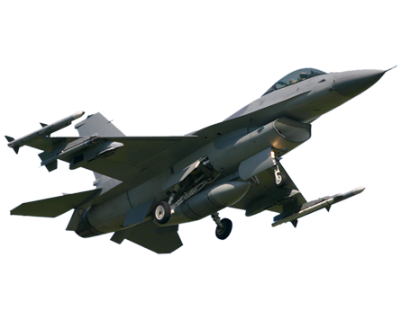
Overview
Jet quenching in a nutshell
  Partons lose energy in the medium
  This lost energy makes jets broader and softer
  See also talks from
  Abhijit Majumder
  Yen-jie Lee
  Justin Frantz
  Laura Havener
  Cesar Luis da Silva
  ...
Towards quantitative understanding

Slide 3


Energy loss

Slide 4

Fragmentation
Energy loss

Slide 5
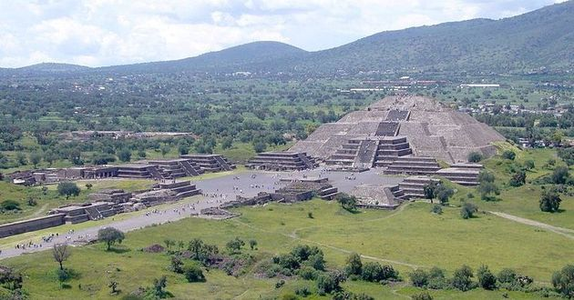


Jet
structure
Fragmentation
Energy loss

Slide 6
Energy loss

Slide 7


Nuclear modification factor
Measure spectra of probe (jets) and compare to those in p+p collisions or peripheral A+A collisions
If high-p_{T} probes (jets) are suppressed, this is evidence of jet quenching
Enhancement
Suppression

Slide 8

Nuclear modification factor
LHCb-PAPER-2017-015
Control
Control
Probe
Charged hadrons (colored probes) suppressed in Pb—Pb
Charged hadrons not suppressed in p—Pb at midrapidity
Electroweak probes not suppressed in Pb—Pb

Slide 9


Nuclear modification factor R_{AA}
RHIC
LHC
arXiv:1705.01974 [nucl-ex]
Electromagnetic probes – consistent with no modification – medium is transparent to them
Strong probes – significant suppression – medium is opaque to them - even heavy quarks!

Slide 10


Jet R_{AA}
arXiv:1705.01974
arXiv:1705.01974
Jet R_{AA} also demonstrates suppression
Similar suppression of heavy quark jets?

Slide 11
Jet R_{AA}
arXiv:1705.01974
arXiv:1705.01974
Tension between ATLAS & ALICE/CMS
Jet R_{AA} also demonstrates suppression
Similar suppression of heavy quark jets?

Slide 12
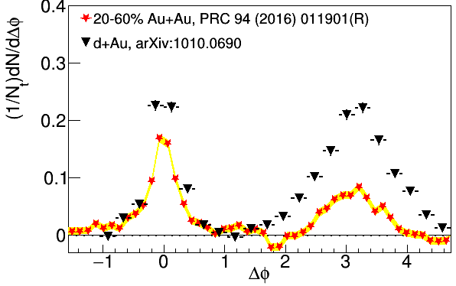
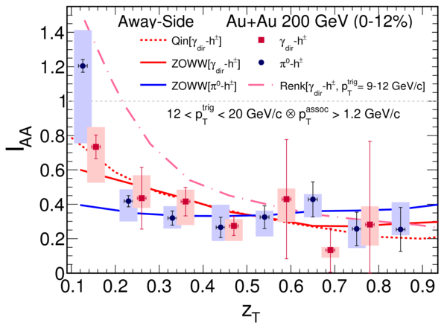
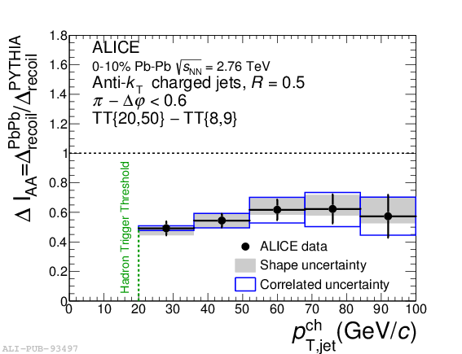

suppression
Jet v₂
[Phys.Lett. B 753 (2016) 511-525,
Phys. Rev. Lett.111 152301 (2013)]
suppression
Di-hadron correlations
[Too many to list]
γ-hadron correlations
[Phys.Rev.C80:024908,2009,
Phys.Rev.D82:072001,2010,
Phys.Rev.C82:034909,2010
Physics Letters B 760 (2016)]
Au+Au √s_{NN}=200 GeV
Pb+Pb √s_{NN}=2.76 TeV
Pb+Pb √s_{NN}=2.76 TeV
[Phys. Rev. C 90, 014909 (2014)]
γ-jet
correlations
[Phys. Lett. B 718 (2013) 773]
suppression
High-p_{T}
hadron v₂
[too many to list]
Dijet asymmetry
[Phys.Rev.C84:024906,2011,
Phys. Lett. B 712 (2012) 176,
Phys.Rev.Lett.105:252303,2010,
Phys. Rev. Lett. 119, 062301 (2017)]
Hadron-jet correlations
[JHEP 09 (2015) 170,
Phys. Rev. C 96, 024905 (2017)]

Slide 13
Fragmentation

Slide 14
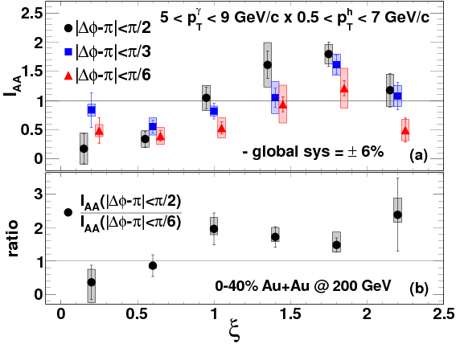
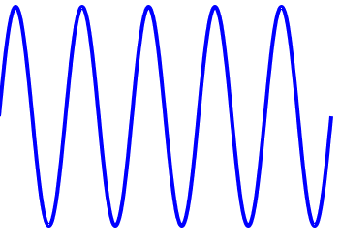
Fragmentations from γ-hadron correlations
z=p_{T}/E_{γ}
1.00
0.61
0.37
0.22
0.14
0.08
Enhancement at low z
Slight suppression at high z

Slide 15





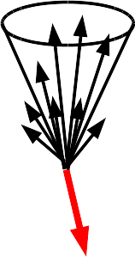
Jet-hadron correlations vs reaction plane
Full jets
1) signal+bkgd
2) bkgd dominated
3) bkgd RPF fit
Trigger
Associated
No modification of constituents relative to reaction plane
→ Jet-by-jet fluctuations more important than path length [PLB 735 157(2014)]
  Also needed to explain high p_{T} v₂ [PRL 116 252301 (2016)]

Slide 16



Modified fragmentation
Jet-hadron correlations
Fragmentation functions with jets
Fragmentation functions with jets
arXiv:1609.03878
Di-jet asymmetry
Leading jet
z=p_{T}/E_{γ}
Di-hadron correlations
[Lots of papers]
Jet shapes
[arXiv:1708.09429,
arXiv:1512.07882,
arXiv:1704.03046]
Sys. Uncertainties:
Tracking:6%
Tower energy scale: 2%
Kolja Kauder, RHIC/AGS
User's Meeting 2016
Subleading jet

Slide 17
Jet
structure

Slide 18


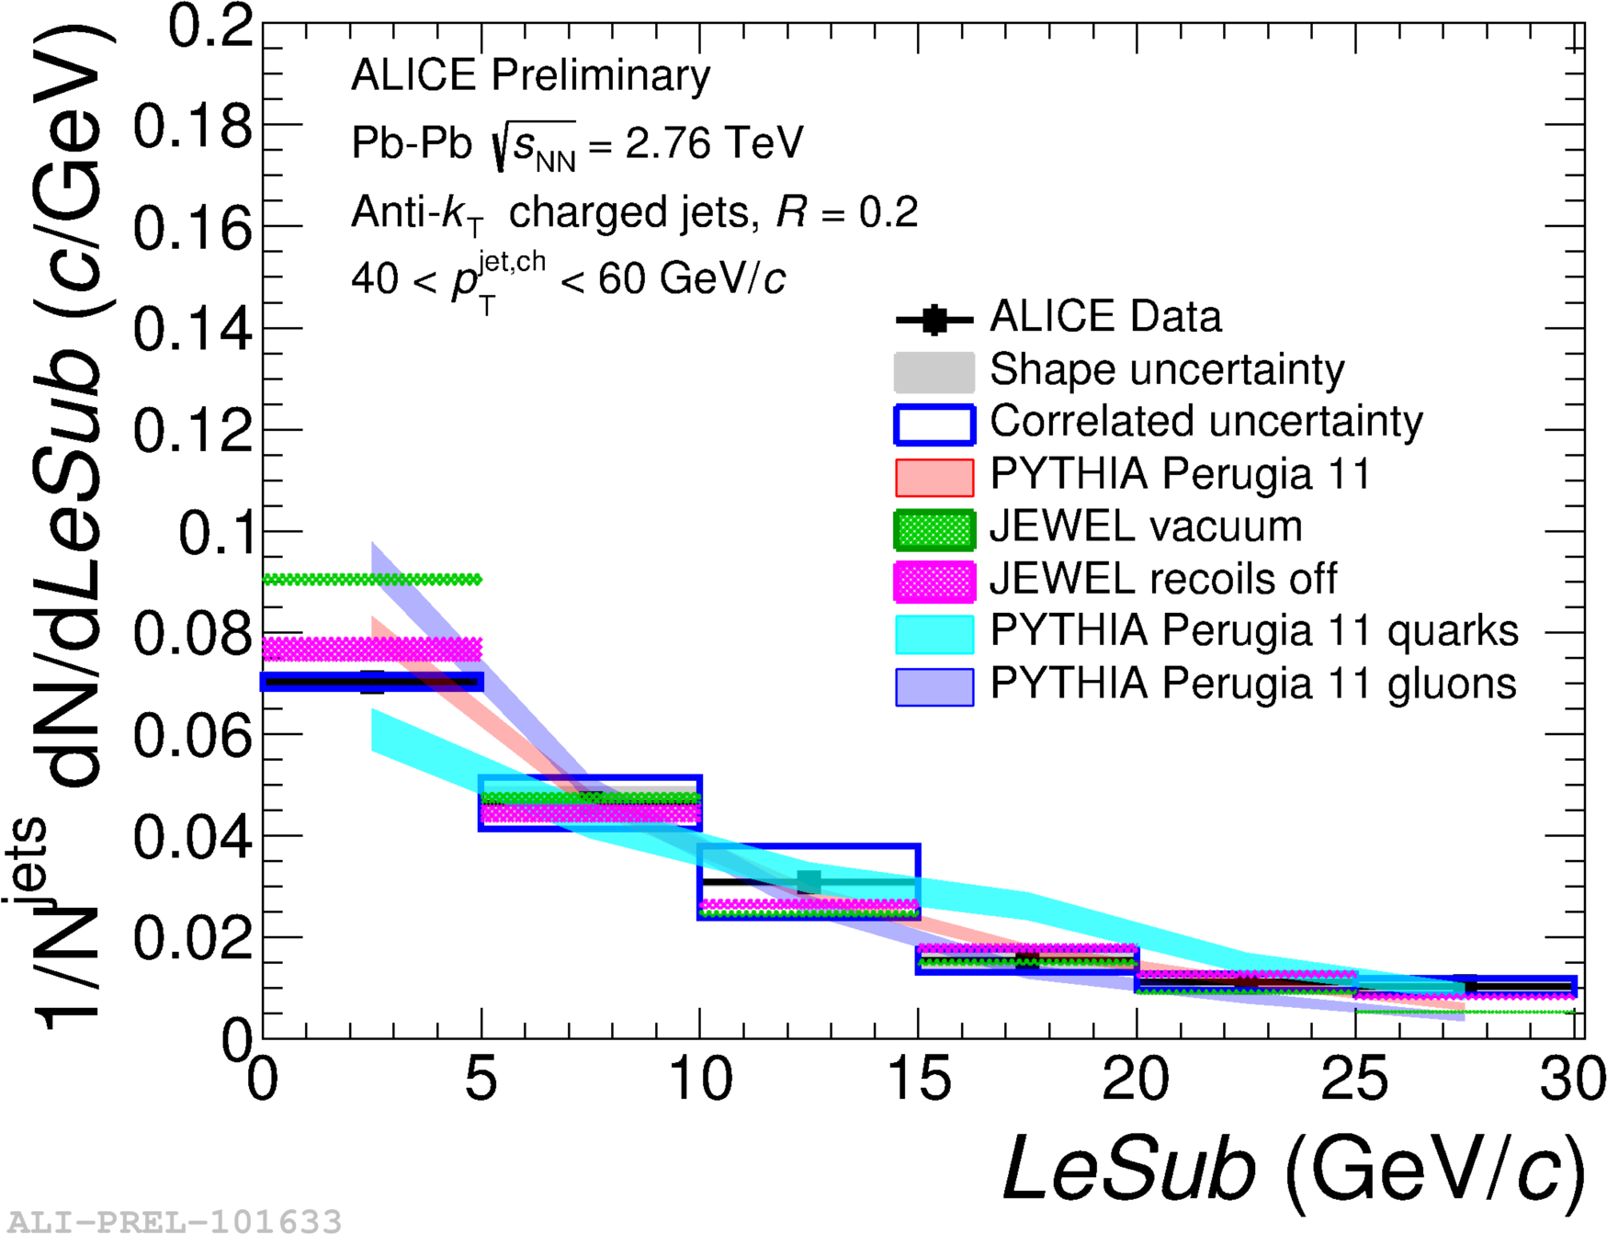
Girth g
Dispersion p_{T}D
LeSub
Jets are slightly more collimated than in pp
Agrees with PYTHIA
See also jet grooming (Yen-jie Lee)

Slide 19

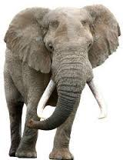

Slide 20
I do not care about jets.
Paraphrased from Sevil Salur

Slide 21
I want to learn about the QGP.
Paraphrased from Sevil Salur

Slide 22
It is 2017. What have we learned?

Slide 23
It is 2017. What have we learned?
Qualitative confirmation of our model for partonic energy loss
Reasonable constraints on
  Using mostly hadron spectra
We have not gotten many quantitative constraints out of other observables.
We don't truly know if they are actually sensitive to the physics we want to measure.
Theoretical calculations sensitive to things we might not have under control

Slide 24
It is 2017. What have we learned?
Qualitative confirmation of our model for partonic energy loss
Reasonable constraints on
  Using mostly hadron spectra
We have not gotten many quantitative constraints out of other observables.
We don't truly know if they are actually sensitive to the physics we want to measure.
Theoretical calculations sensitive to things we might not have under control

Slide 25
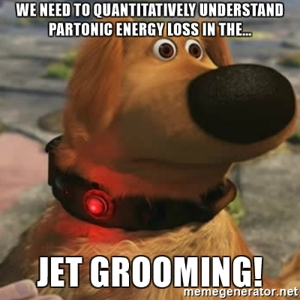
It is 2017. What have we learned?
Qualitative confirmation of our model for partonic energy loss
Reasonable constraints on
  Using mostly hadron spectra
We have not gotten many quantitative constraints out of other observables.
We don't truly know if they are actually sensitive to the physics we want to measure.
Theoretical calculations sensitive to things we might not have under control

Slide 26
It is 2017. What have we learned?
Qualitative confirmation of our model for partonic energy loss
Reasonable constraints on
  Using mostly hadron spectra
We have not gotten many quantitative constraints out of other observables.
We don't truly know if they are actually sensitive to the physics we want to measure.
Theoretical calculations sensitive to things we might not have under control

Slide 27
It is 2017. What have we learned?
Qualitative confirmation of our model for partonic energy loss
Reasonable constraints on
  Using mostly hadron spectra
We have not gotten many quantitative constraints out of other observables.
We don't truly know if they are actually sensitive to the physics we want to measure.
Theoretical calculations sensitive to things we might not have under control.

Slide 28
What is a jet?

Slide 29
What is a jet?
A measurement of a jet is a measurement of a parton.

Slide 30

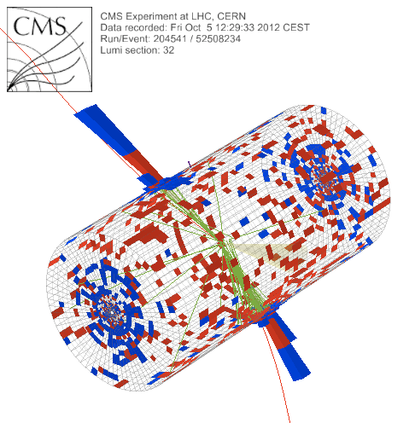
What is a jet?
p+p → dijet
Beam pipe

Slide 31
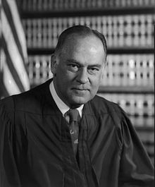
What is a jet?
p+p → dijet
Beam pipe
“I know it when I see it”
US Supreme Court Justice Potter Stewart, Jacobellis v. Ohio

Slide 32

Jet finding
in pp collisions
Jet finder: groups final state particles into jet candidates
  Anti-k_{T} algorithm
  JHEP 0804 (2008) 063 [arXiv:0802.1189]
Depends on hadronization
Ideally
  Infrared safe
  Colinear safe
Snowmass Accord: Theoretical calculations and experimental measurements should use the same jet finding algorithm. Otherwise they will not be comparable.

Slide 33
A jet is what a jet finder finds.

Slide 34
Jet finding
in AA collisions
Jet finder: groups final state particles into jet candidates
  Anti-k_{T} algorithm
  JHEP 0804 (2008) 063 [arXiv:0802.1189]
Combinatorial jet candidates
Energy smearing from background
Sensitive to methods to suppress combinatorial jets and correct energy
Focus on narrow/high energy jets

Slide 35
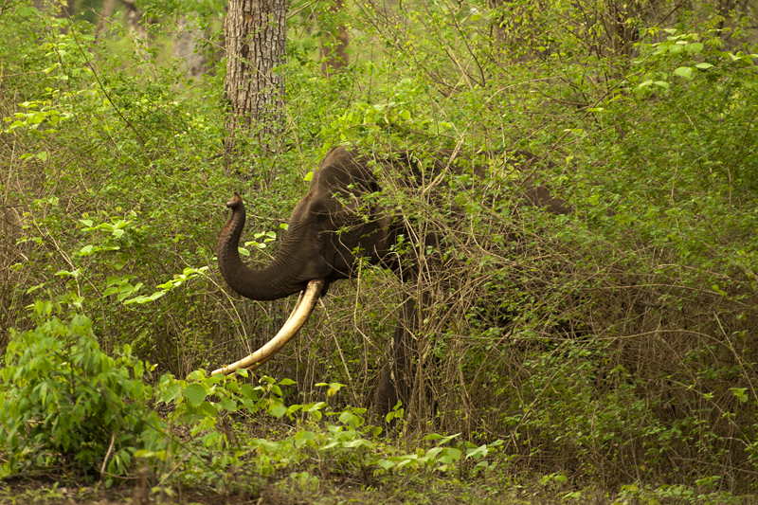
http://walkthewilderness.net/animals-of-india-72-asiatic-elephant/

Slide 36

http://walkthewilderness.net/animals-of-india-72-asiatic-elephant/

Slide 37

What you see depends on what you're looking for
http://walkthewilderness.net/animals-of-india-72-asiatic-elephant/

Slide 38
Bias & background
Experimental background subtraction methods: complex, make assumptions, apply biases
Survivor bias: Modified jets probably look more like the medium
Quark/Gluon bias:
  Quark jets are narrower, have fewer tracks, fragment harder [Z Phys C 68, 179-201 (1995), Z Phys C 70, 179-196 (1996), ]
  Gluon jets reconstructed with k_{T} algorithm have more particles than jets reconstructed with anti-k_{T} algorithm [Phys. Rev. D 45, 1448 (1992)]
  Gluon jets fragment into more baryons [EPJC 8, 241-254, 1998]
Fragmentation bias: Experimental measurements explicitly select jets with hard fragments
http://walkthewilderness.net/animals-of-india-72-asiatic-elephant/

Slide 39
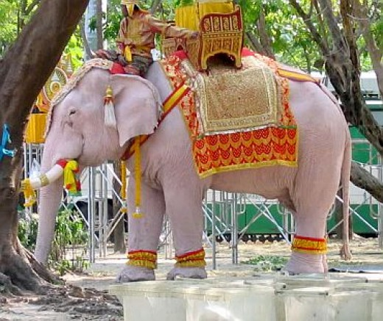
Wiki: “A white elephant is a possession which its owner cannot dispose of and whose cost, particularly that of maintenance, is out of proportion to its usefulness.

Slide 40
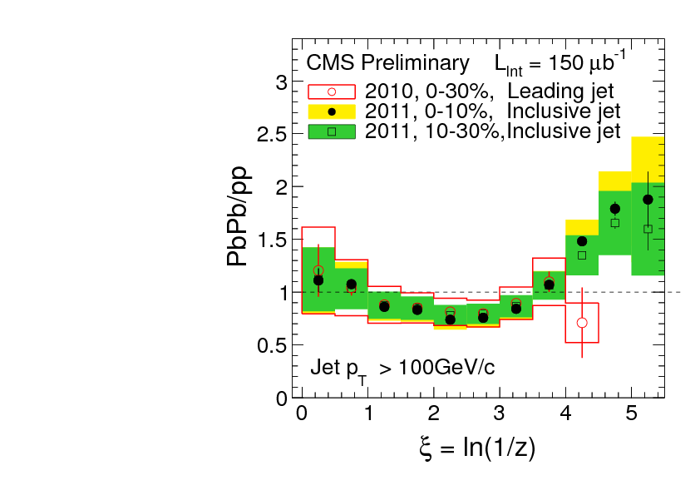
What you see depends on where you look
?
Phys. Rev. C 90, 024908 (2014)
JHEP10(2012)087
z = p_{T}/E_{jet}
Low p_{T}
High p_{T}
Low p_{T}
Low p_{T}
Low p_{T}
Low p_{T}
High p_{T}
Low p_{T}
High p_{T}
High p_{T}
High p_{T}

Slide 41

ATLAS
Background subtraction method:
Iterative procedure
  Calorimeter jets: Reconstruct jets with R=0.2. v₂ modulated <Bkgd> estimated by energy in calorimeters excluding jets with at least one tower with
  E_{tower} > <E_{tower}>
  Track jets: Use tracks with p_{T}>4 GeV/c
  Calorimeter jets from above with E>25 GeV and track jets with p_{T}>10 GeV/c used to estimate background again.
Calorimeter tracks matching one track with p_{T}>7 GeV/c or containing a high energy cluster E >7 GeV are used for analysis down to E_{jet} = 20 GeV
Constituent biases don't matter that much up here
But they do matter down here!
Phys. Lett. B 719 (2013) 220-241

Slide 42
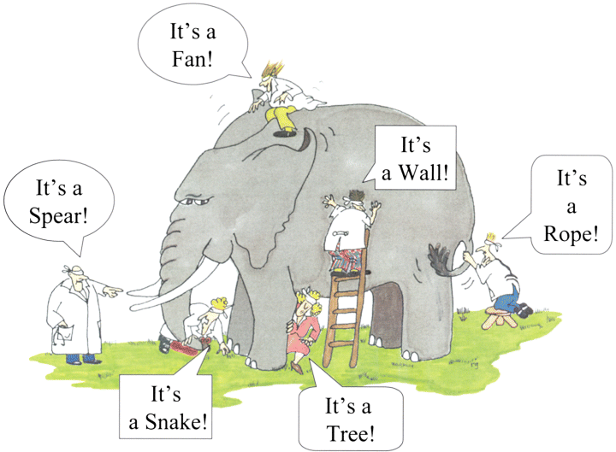
Blind men and the elephant

Slide 43
Lessons from the Blind men and the elephant
Balaji Viswanathan
https://balajiviswanathan.quora.com/Lessons-from-the-Blind-men-and-the-elephant
Ignore judgment
Be careful in giving/receiving advice
Improve your sampling
Collaborate
World is complex

Slide 44
Lessons from measurements of jets
Understand bias – it's a tool, not a dirty word
  What you see depends on what you look for
  Listen to the data – not what you want to hear
Make quantitative comparisons to theory
  We should look for new observables... but we should make sure they're sensitive and that we know
  Need realistic models where we can apply experimental methods to models – Jetscape is coming!
Make more differential measurements
We need an accord on how to treat background
  Experimental cuts matter and are unavoidable
Scott Moreland, Thursday
Abhijit Majumder, Tuesday

Slide 45



Jet mass
arXiv:1702.00804
Quenching models (JEWEL, Q-PYTHIA) show a larger mass than pp-like PYTHIA jets
Pb-Pb measurement can discriminate among these predictions

Slide 46
Modified fragmentation
z=p_{T}/E_{γ}
Enhancement at low z
No modification/enhancement at high z?

Slide 47
Di-jet asymmetry
Leading jet
Sys. Uncertainties:
Tracking:6%
Tower energy scale: 2%
Kolja Kauder, RHIC/AGS
User's Meeting 2016
arXiv:1609.03878
Subleading jet
Au+Au di-jets more imbalanced than p+p for pTcut>2 GeV/c
Au+Au AJ ~ p+p AJ for matched di-jets (R=0.4)

Slide 48
Jet-hadron correlations
Jets are broader, constituents are softer
Also seen in:
  Di-hadron correlations [Lots of papers]
  Jet shapes [arXiv:1708.09429, arXiv:1512.07882, arXiv:1704.03046]
  Dijet asymmetry with soft constituents [PRL119 (2017) 62301]

