Slide 1
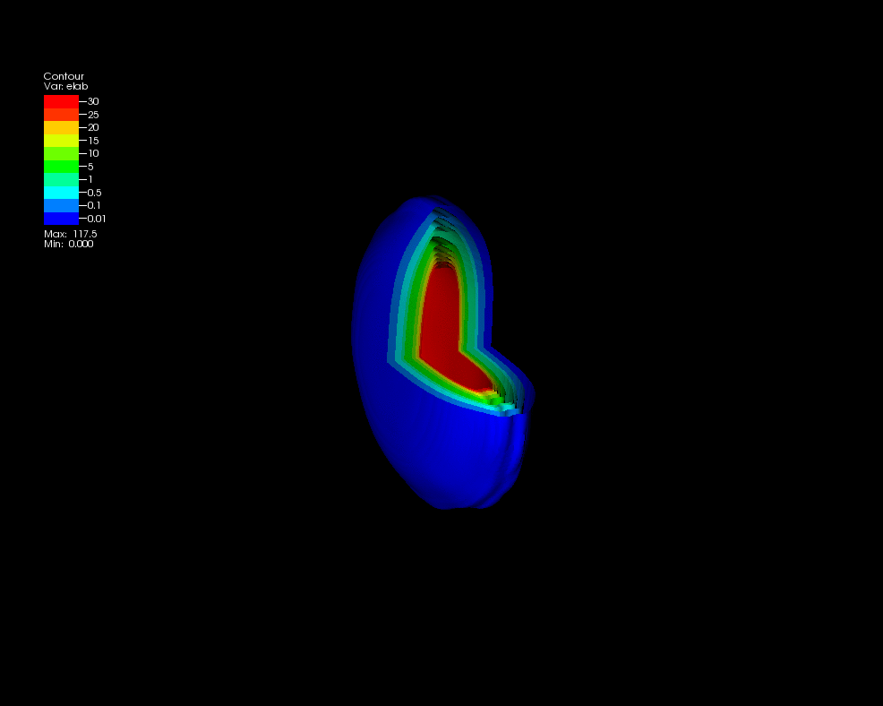
Melting Nuclei
Christine Nattrass
University of Tennessee at Knoxville
Calculations done on the Titan supercomputer by the CJet collaboration https://sites.google.com/site/cjetsite/

Slide 2




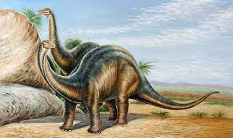
Structure of matter
Hadrons
Baryons
Standard model
Mesons
125000
Higgs

Slide 3



QCD Phase Diagram
Quark Gluon Plasma
Hadron Gas
Phys. Rev. C 96, 044904 (2017)
Notes:
But wait – how can we have a liquid of quarks and gluons? Doesn't asymptotic freedom tell us that we can't have free quarks and gluons? How, then, can we have a liquid of quarks and gluons?

Slide 4

How to make a Quark Gluon Plasma

Slide 5



The phase transition in the laboratory
Initial State
QGP
Freeze-out
  K, O’Hara, S. Hemmer, M. Gehm, S. Granade, J. Thomas Science 298 2179 (2002)
Hydrodynamical flow
Jet quenching
https://physics.aps.org/articles/v7/97

Slide 6















Relativistic Heavy Ion Collider
Large Hadron Collider
PHOBOS
BRAHMS
CMS
PHENIX
STAR
RHIC
LHCb
ALICE
ATLAS
LHCf
LHC
Upton, NY
1.2km diameter
p+p, d+Au, Cu+Cu, Au+Au, U+U
√s_{NN} = 9 - 200 GeV
Geneva, Switzerland
8.6km diameter
p+p, p+Pb, Pb+Pb
√s_{NN} = 2.76 GeV, 5.5 TeV
RHIC
Notes:
Mention that RHIC planning began 1983

Slide 8
Particle Detectors

Slide 9

ALICE
ATLAS
CMS
STAR
PHENIX
Notes:
Mention that RHIC planning began 1983

Slide 10




Size: 16 x 26 meters
Weight: 10,000 tons
Detectors: 18
Trigger detectors: When do we have a collision?
Tracking detectors: Where did the particle go?
Identification detectors: What kind of particle is it?
Calorimeters: How much energy does the particle have?
<number>
Notes:
By comparison ATLAS is 25 meters in diameter and 44 meters long – not quite twice as large

Slide 11

p+p collisions
3D image of each collision

Slide 12

Pb+Pb collisions
5

Slide 14
Forming the QGP

Slide 15

How can we estimate the energy density?
Transverse energy (E_{T})
  sum of particle energies in transverse direction
Volume V = A_{T} τc
τ = formation time
Energy density ε
QGP formation for ε > 0.5 GeV/fm³
A_{T}
= τc
$ϵ=\frac{1}{V}\frac{{dE}_{T}}{dy}=\frac{J}{A_{T}τc}\frac{{dE}_{T}}{dη}$

Slide 16
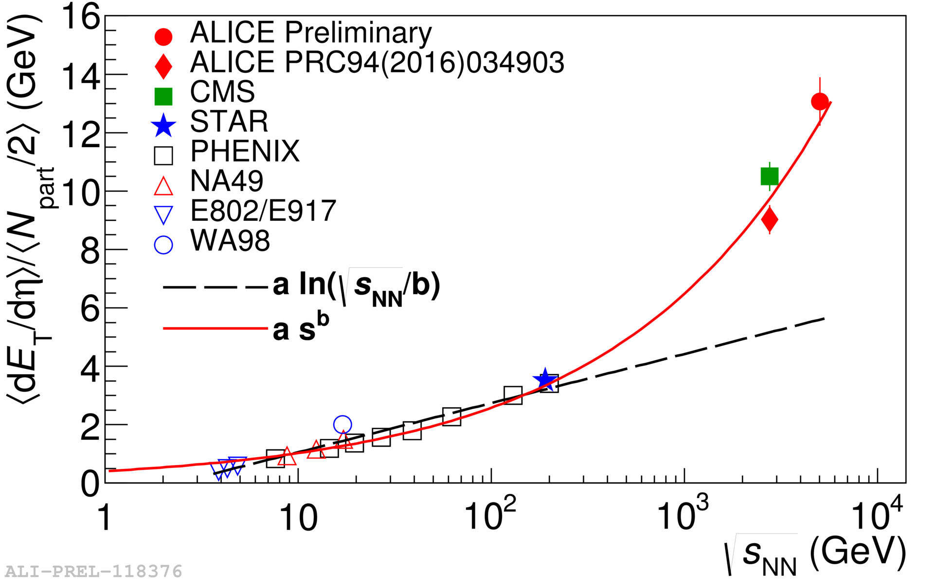

Energy dependence from dE_{T}/dy
RHIC
Standard estimate τ₀ ≈ 1 fm/c
QGP formation
Collision energy
$ϵ=\frac{1}{Acτ_{0}}\frac{{dE}_{T}}{dy}$
Higher than extrapolations of RHIC data

Slide 17
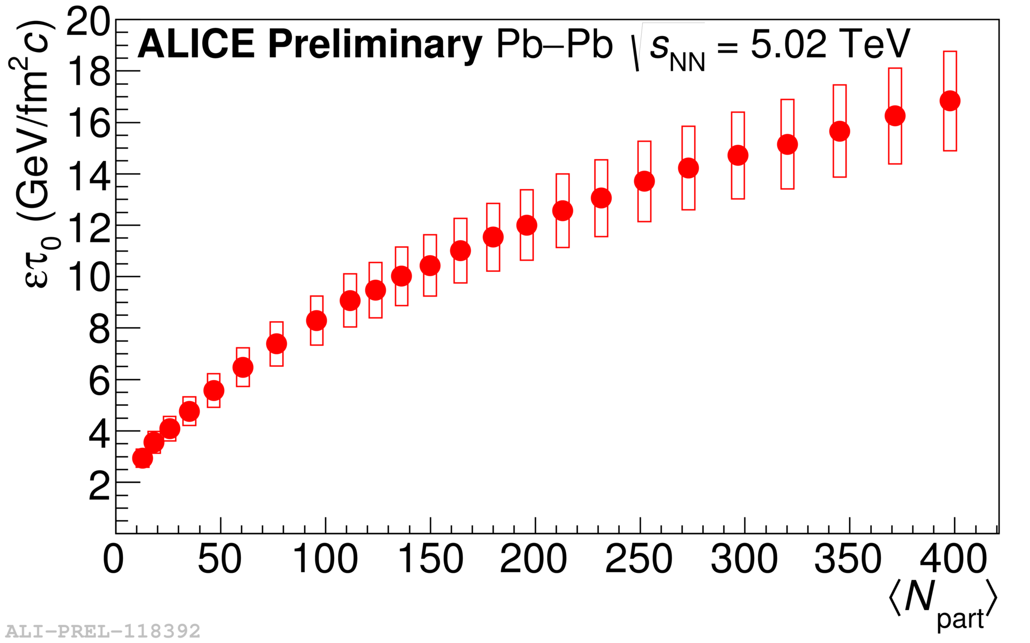
Energy dependence from dE_{T}/dy
RHIC
Standard estimate τ₀ ≈ 1 fm/c
QGP formation
$ϵ=\frac{1}{Acτ_{0}}\frac{{dE}_{T}}{dy}$
Higher than extrapolations of RHIC data

Slide 19
QGP Chemistry

Slide 20

Chemistry - equilibrium
T~170 MeV
Nuclear Physics A Volume 757, 102-183
Ratios of particles expected from a model
Even strange quarks are at equilibrium!

Slide 22
QGP Thermometers

Slide 23


Measuring temperature

Slide 24


Thermal photons
Phys.Rev.Lett.104:132301,2010
Thermal photons
QCD processes
ALICE collaboration:
Pb+Pb collisions at √s_{NN}=2.76 TeV
Inverse slope: T = 304 +/-51
PHENIX collaboration: Au+Au collisions at √s_{NN}=200 GeV
Inverse slope: T = 221 +/- 19 (stat) +/- 19 (syst) MeV

Slide 25





Building a quarkonium-thermometer
CMS-PAS HIN-11-011
N_{part}
Clear hierarchy in R_{AA} of different quarkonium states
c
c
b
b

Slide 26

Building a quarkonium-thermometer
Note: 6.5<p_{T}<30 GeV for J/ψ and ψ(2s)
CMS-PAS HIN-11-011
N_{part}
Clear hierarchy in R_{AA} of different quarkonium states
Expected in terms of binding energy
CMS-PAS HIN-12-014, HIN-12-007

Slide 28
QGP Fluid Dynamics

Slide 29


If we have a fluid...
Au+Au √s_{NN} = 200 GeV
b=7 fm
Particles pushed out
Equipotential lines
arXiv:nucl-th/0305084
Initial overlap asymmetric → pressure gradients
Momentum anisotropy → Fourier decomposition:
$\frac{d^{2}N}{{dp}_{T}dϕ}≈1+2v_{1}cos\left(dϕ\right)+2v_{2}cos\left(2dϕ\right)+2v_{3}cos\left(3dϕ\right)+2v_{4}cos\left(4dϕ\right)+2v_{5}cos\left(5dϕ\right)+...$
Notes:
So at this point you're probably wondering how on earth we measure the viscosity of this thing that exists for only a few fermi/c – for less than 10^-24 seconds
When the nuclei collide, they create a droplet of QGP. This droplet of QGP is not symmetric – this shows the incoming nuclei - and there are huge pressure gradients in it. This shows a calculation of the equipotential lines in the QGP.
These pressure gradients push particles out – meaning that particles in this direction are going faster than particles in this direction
What we do is measure the Fourier coefficients of the distribution of particles

Slide 30
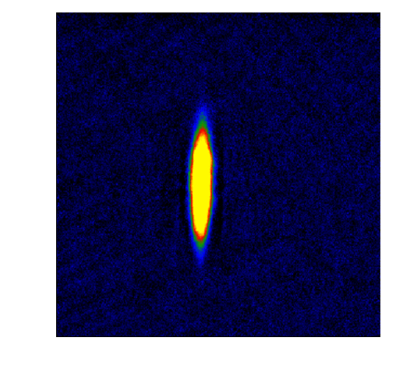
What does this mean?
Same phenomena observed in gases of strongly interacting atoms
  K, O’Hara, S. Hemmer, M. Gehm, S. Granade, J. Thomas Science 298 2179 (2002)
High viscosity
Low viscosity

Slide 31










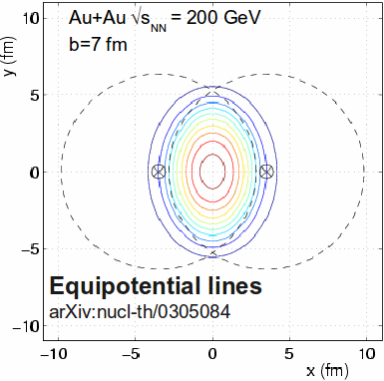
What does it mean?
Same phenomena observed in gases of strongly interacting atoms
Time
K, O’Hara, S. Hemmer, M. Gehm, S. Granade, J. Thomas Science 298 2179 (2002)
Initial state anisotropies converted to final state anisotropies
Fourier decomposition:
$\frac{d^{2}N}{{dp}_{T}dϕ}≈1+2v_{1}cos\left(dϕ\right)+2v_{2}cos\left(2dϕ\right)+2v_{3}cos\left(3dϕ\right)+2v_{4}cos\left(4dϕ\right)+2v_{5}cos\left(5dϕ\right)+...$
Offset
measured

Slide 32
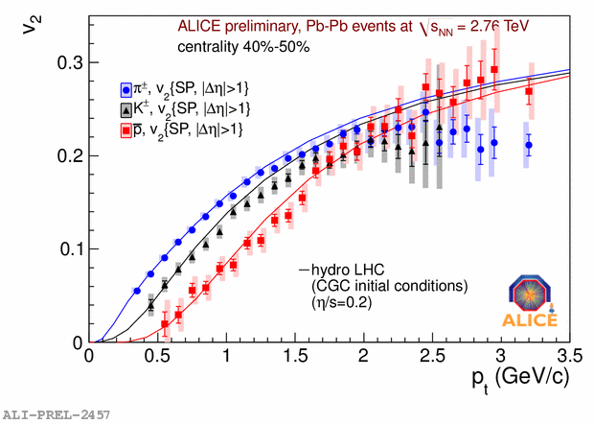
Does this describe the data?
Lower viscosity
arXiv: 1108.5323v1
Yes!
Notes:
Now I don't want to get into the details of this plot but

Slide 33
What does this mean?
Same phenomena observed in gases of strongly interacting atoms
  K, O’Hara, S. Hemmer, M. Gehm, S. Granade, J. Thomas Science 298 2179 (2002)
High viscosity
Low viscosity
The Quark Gluon Plasma has a very low viscosity

Slide 34
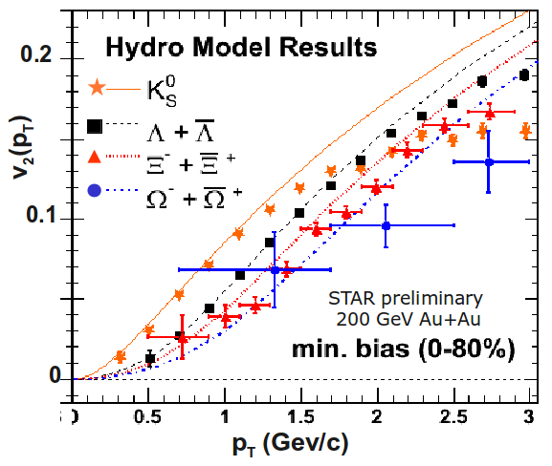
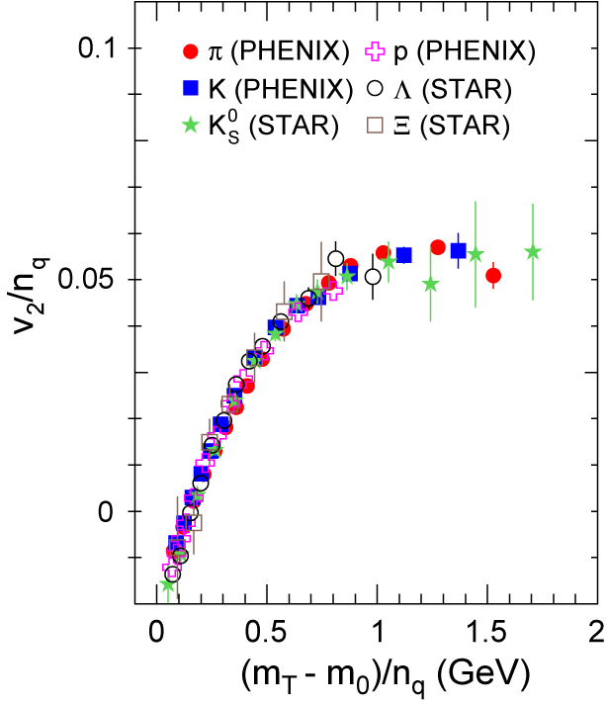
More data
Phys. Rev. Lett. 98, 162301 (2007)
$m_{T}=\sqrt{p_{T}^{2}{\text{+m}}^{2}}$
Mass ordering:
v₂(K) > v₂(Λ) > v₂(Ξ)
v₂(p_{T}^{hadron}) µ n_{quark}v₂(p_{T}^{quark})
We have a liquid of quarks and gluons!

Slide 35
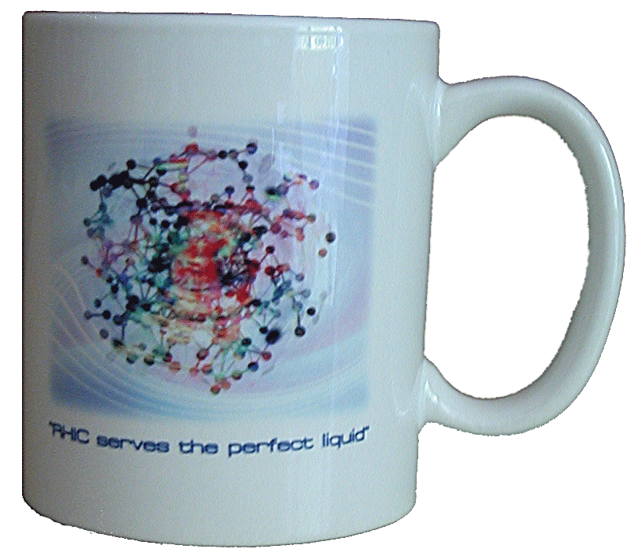
What do we learn about the QGP?
Hydrodynamics works →
  (local) thermalization
  image of the initial state
Really low viscosity
  Near AdS/CFT bound
  η/S ~ 1/4π
The QGP is the perfect liquid!
(not the gas of “free” quarks and gluons we expected)

Slide 37
QGP Spectroscopy: Jets Part 1

Slide 38
Probing the Quark Gluon Plasma
Medium
Probe
Detector
Want a probe which traveled through the collision
QGP is very short-lived (~1-10 fm/c) →
cannot use an external probe

Slide 39


Probes of the Quark Gluon Plasma
nucleus
nucleus
Want a probe which traveled through the medium
QGP is short lived → need a probe created in the collision

Slide 40
Probes of the Quark Gluon Plasma
nucleus
nucleus
Want a probe which traveled through the medium
QGP is short lived → need a probe created in the collision
We expect the medium to be dense → absorb/modify probe

Slide 41





Jets
p+p → dijet
D
c, x_{c}
p
a, x_{a}
b, x_{b}
p
σ_{ab}
Beam pipe
d, x_{d}
D
Jets – hard parton scattering leads to back-to-back quarks or gluons, which then fragment as a columnated spray of particles

Slide 42

Jet reconstruction
p+p di-jet event in STAR
Central Au+Au collision in STAR
Identify all of the particles in the jet → parton energy, momentum
Difficult in heavy ion collisions – but possible!

Slide 43

Jets
Phys.Rev.Lett. 105 (2010) 252303
nucleus
nucleus
ATLAS

Slide 44

Quenched jets
nucleus
nucleus
One of the jets is absorbed by the medium
The quark or gluon has equilibrated with the medium
Phys. Rev. Lett. 105, 252303 (2010)
ATLAS

Slide 45


Nuclear modification factor
Measure spectra of probe (jets) and compare to those in p+p collisions or peripheral A+A collisions
If high-p_{T} probes (jets) are suppressed, this is evidence of jet quenching
Enhancement
Suppression

Slide 46

Nuclear modification factor
LHCb-PAPER-2017-015
Control
Control
Probe
Charged hadrons (colored probes) suppressed in Pb—Pb
Charged hadrons not suppressed in p—Pb at midrapidity
Electroweak probes not suppressed in Pb—Pb

Slide 47


Nuclear modification factor R_{AA}
RHIC
LHC
Connors, Nattrass, Reed, SalurarXiv:1705.01974 [nucl-ex]
Electromagnetic probes – consistent with no modification – medium is transparent to them
Strong probes – significant suppression – medium is opaque to them - even heavy quarks!

Slide 48



Di-hadron correlations
p+p → dijet
Trigger
nucleus
Associated
Phys.Rev.Lett.93:252301,2004
nucleus

Slide 49

Di-hadron correlations
p+p → dijet
Trigger
nucleus
Associated
nucleus
Updated to include latest information about background

Slide 50
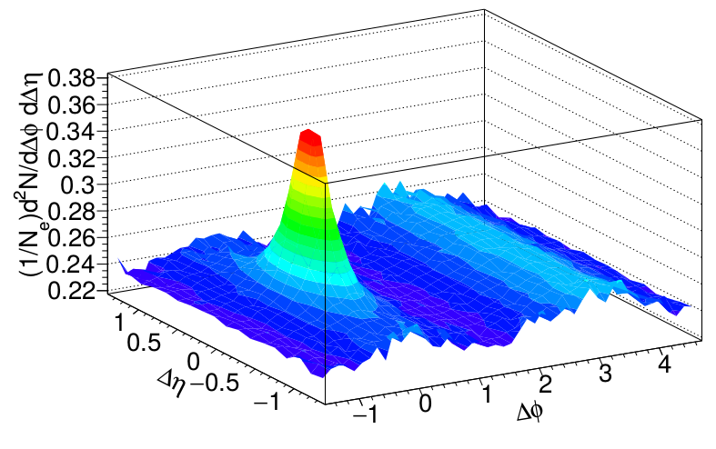
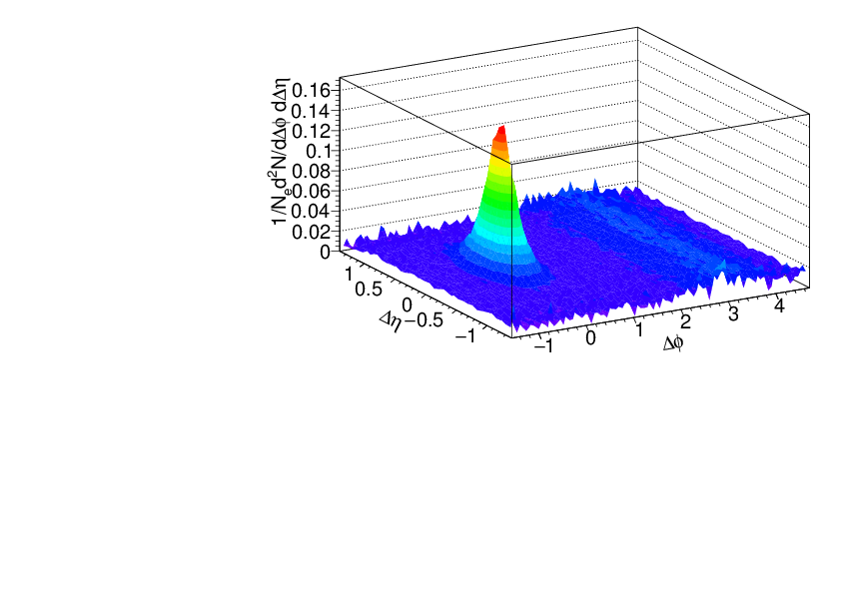
Signal+background
Signal+background
Signal only
h-h
√s_{NN} = 2.76 TeV
30-40% PbPb
8<p_{T}^{trigger}<10 GeV/c
1<p_{T}^{assoc}<2 GeV/c

Slide 52
QGP Spectroscopy: Jets Part 2

Slide 53
What is a jet?

Slide 54
What is a jet?
A measurement of a jet is a measurement of a parton.

Slide 55
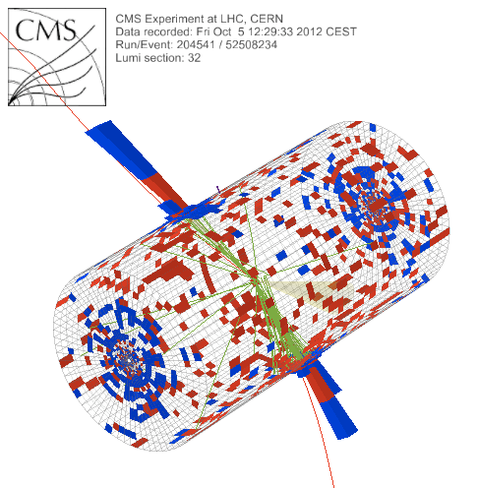
What is a jet?
p+p dijet
Beam pipe

Slide 56

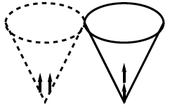
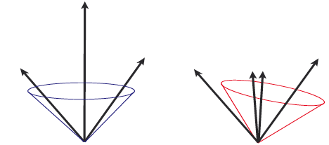
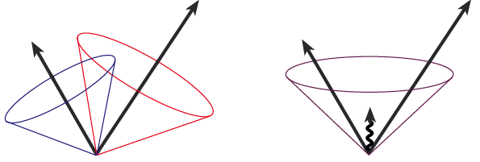
Jets in principle
Jet measures partons
Hadronic degrees of freedom are integrated out
Algorithms are infrared and colinear safe
OK
BAD: 2 jets are merged in one

Slide 57
Jet finding
in pp collisions
Jet finder: groups final state particles into jet candidates
  Anti-k_{T} algorithm
  JHEP 0804 (2008) 063 [arXiv:0802.1189]
Depends on hadronization
Ideally
  Infrared safe
  Colinear safe
Snowmass Accord: Theoretical calculations and experimental measurements should use the same jet finding algorithm. Otherwise they will not be comparable.

Slide 58
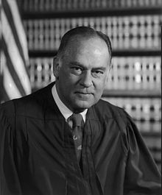
What is a jet?
p+p dijet
Beam pipe
“I know it when I see it”
US Supreme Court Justice Potter Stewart, Jacobellis v. Ohio

Slide 59
A jet is what a jet finder finds.

Slide 60
Jet finding
in AA collisions
Jet finder: groups final state particles into jet candidates
  Anti-k_{T} algorithm
  JHEP 0804 (2008) 063 [arXiv:0802.1189]
Combinatorial jet candidates
Energy smearing from background
Sensitive to methods to suppress combinatorial jets and correct energy
Focus on narrow/high energy jets

Slide 61

Jet finding algorithms
Tracks
Jet finding algorithm
Jet candidates
Clusters
Particles
Any list of objects works as input
Use the same algorithm on theory & experiment
Output only as good as input
M. Cacciari, G. P. Salam, G.Soyez, JHEP 0804:063,2008

Slide 62
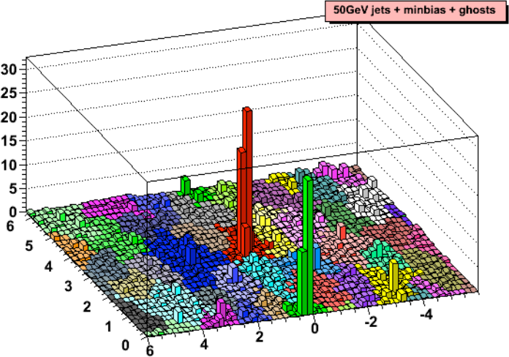
Area-based background subtraction
Cacciari & Salam, PLB659:119–126,2008
Particles, clusters
k_{T} algorithm
Cacciari DIS 2006
$k_{T}=p_{T},ΔR_{ij}=\sqrt{{\left(η_{i}−η_{j}\right)}^{2}+{\left(ϕ_{i}−ϕ_{j}\right)}^{2}}$
For all i,j calculate:
Combine smallest d_{ij}.
If d_{iB} smallest, d_{iB}→ jet
Repeat until no particles left
$d_{ij}=min\left(p_{T,i}^{2},p_{T,j}^{2}\right)ΔR_{ij}^{2}$
Energy (arb. units)
$d_{iB}=p_{T,i}$
Cacciari & Salam
Phys.Lett.B641:57-61,2006
Jet candidates
$ϕ$
Median ρ=p_{T}/A
$η$
$p_{T}^{jet}=p_{T}^{reco}−ρ_{median}A^{jet}$

Slide 63
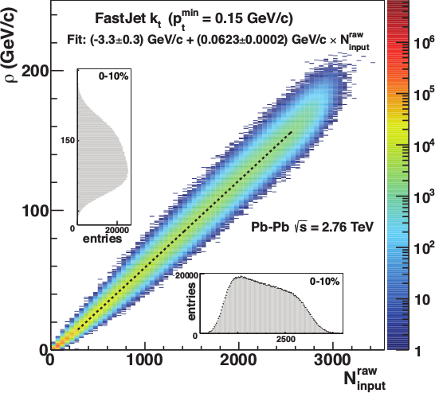
Focus on smaller angles
Pros
  Background is smaller
  Background fluctuations smaller
Cons:
  Modifications expected at higher R
  Biases sample towards quarks
JHEP 03 (2012) 053

Slide 64
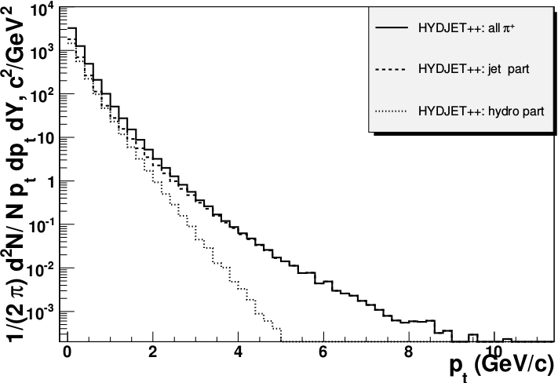
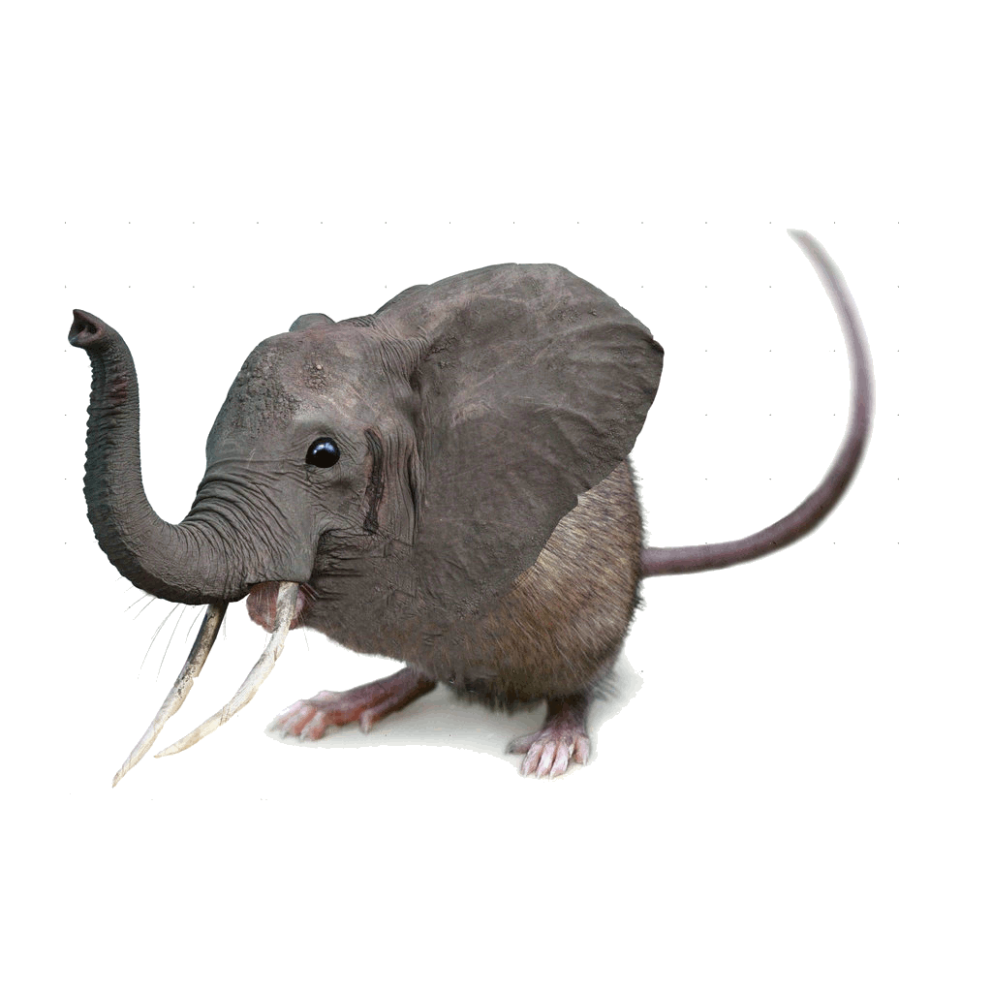
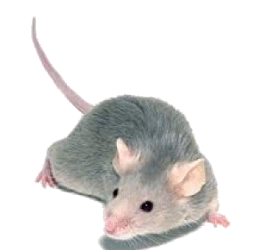

Focus on high p_{T}
Pros:
  Reduces combinatorial background
Cons:
  Cuts signal where we expect modifications
  Could bias towards partons which have not interacted
  Biases sample towards quarks
PoS High-pTphysics09:023,2009

Slide 65



<footer>
ALICE/STAR
Combinatorial “jets”
Estimate combinatorial jet contributions and its fluctuations from data
Require leading track p_{T} > 5 GeV/c
  Suppresses combinatorial “jets”
  Biases fragmentation
No threshold on constituents
Limited to small R
Measured spectra:
Full jets
Where
comes from FastJet anti-k_{T} algorithm
Notes:
<number>

Slide 66

ATLAS
Constituent biases don't matter that much up here
Iterative procedure
  Calorimeter jets: Reconstruct jets with R=0.2. v₂ modulated <Bkgd> estimated by energy in calorimeters excluding jets with at least one tower with
  E_{tower} > <E_{tower}>
  Track jets: Use tracks with p_{T}>4 GeV/c
  Calorimeter jets from above with E>25 GeV and track jets with p_{T}>10 GeV/c used to estimate background again.
Calorimeter tracks matching one track with p_{T}>7 GeV/c or containing a high energy cluster E >7 GeV are used for analysis down to E_{jet} = 20 GeV
But they do matter down here!
Definitely imposes a bias, especially at 20 GeV!
We should treat that bias as a tool, not a handicap
Phys. Lett. B 719 (2013) 220-241

Slide 67


Jet R_{AA}
arXiv:1705.01974
arXiv:1705.01974
Jet R_{AA} also demonstrates suppression
Similar suppression of heavy quark jets?

Slide 68
Jet R_{AA}
arXiv:1705.01974
arXiv:1705.01974
Tension between ATLAS & ALICE/CMS
Jet R_{AA} also demonstrates suppression
Similar suppression of heavy quark jets?

Slide 70
JETSCAPE

Slide 71
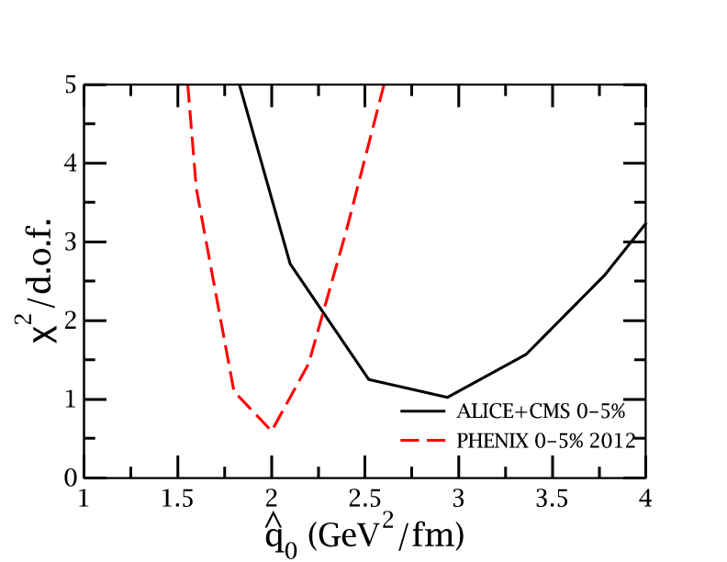
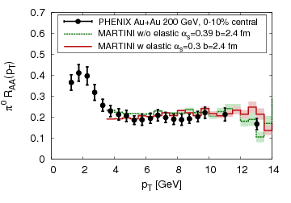

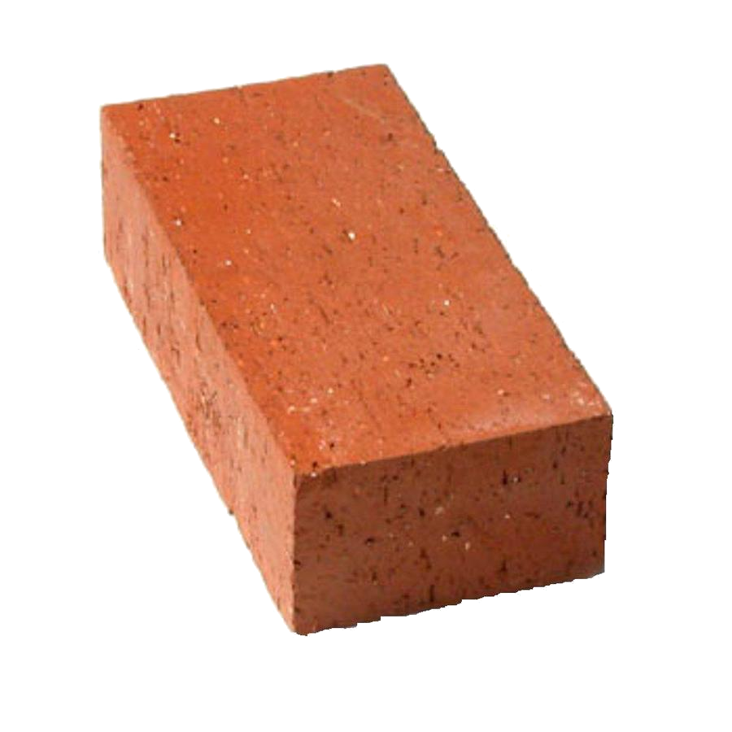
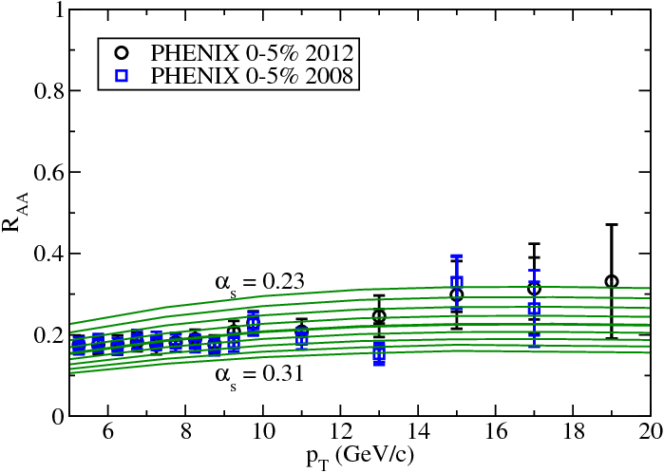

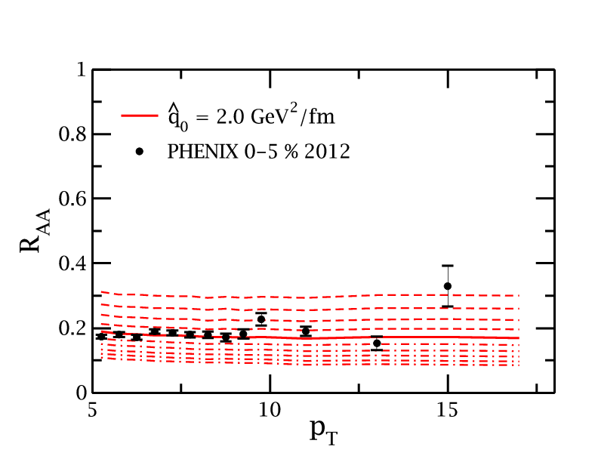
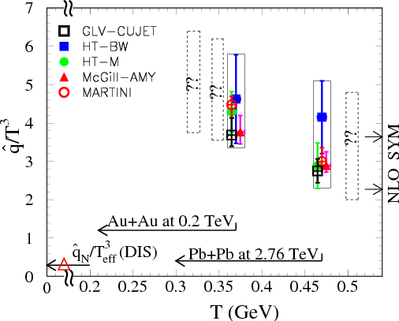
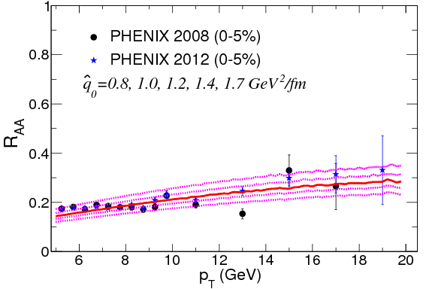
JET collaboration
Phys. Rev. C 90, 014909 (2014)
Martini
McGill
$χ^{2}minimization$
QGP brick + jet
HTM
HTBW
Data
$\hat{q}=1.2±0.3 {GeV}^{2}$
200 GeV Au+Au
$\hat{q}=1.9±0.7 {GeV}^{2}$
2.76 TeV Pb+Pb

Slide 72

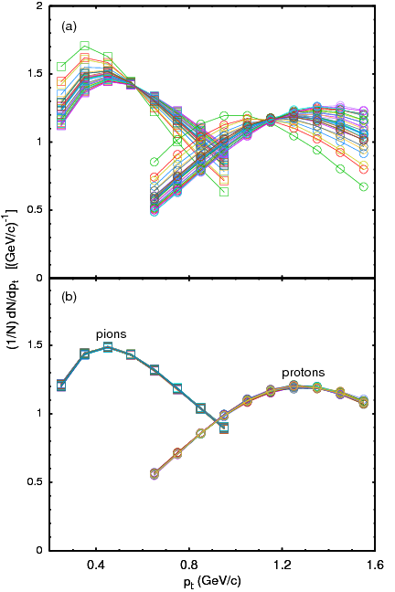
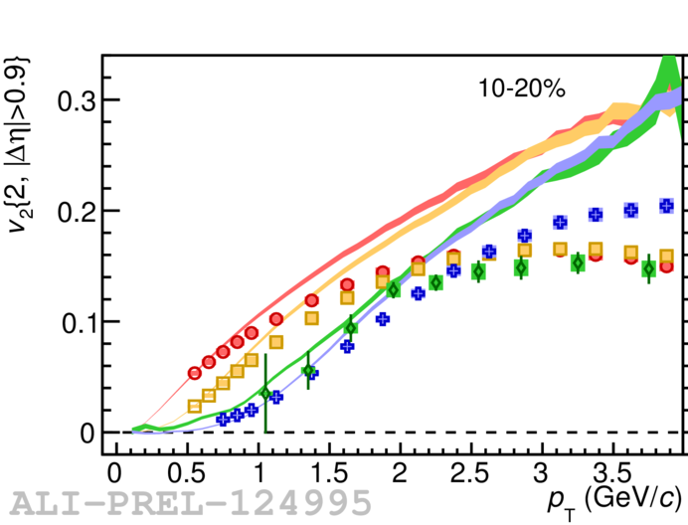
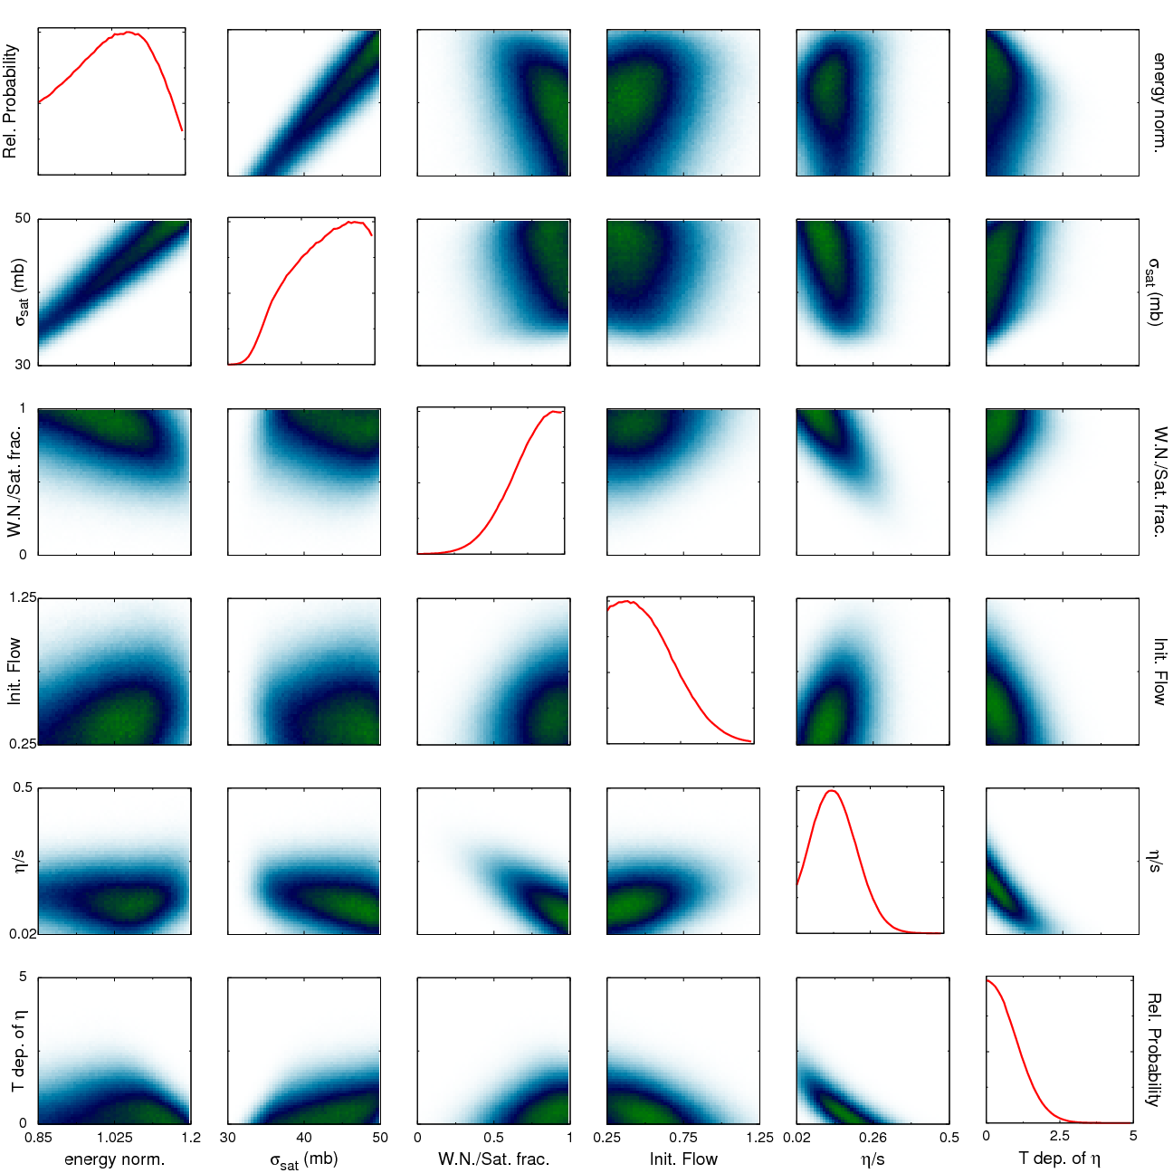

Bayesian Statistical Analysis
Models and Data Analysis Initiative
http://madai.us
Prior
Data
Posterior
Optimization
Monte Carlo
models
Model emulation
Run full model ~1000 times
MCMC parameter search uses emulator (interpolator) in lieu of full model
Constraint of QGP properties
Novak et al, Phys.Rev. C89 (2014) no.3, 034917

Slide 73

JETSCAPE
Event generator
Jet Energy-loss Tomography with a Statistically and Computationally Advanced Program Envelope
http://jetscape.wayne.edu/
Realistic medium
Realistic
theoretical
calculations
Experimental
techniques
Realistic Monte Carlo Model
Realistic jets

Slide 74


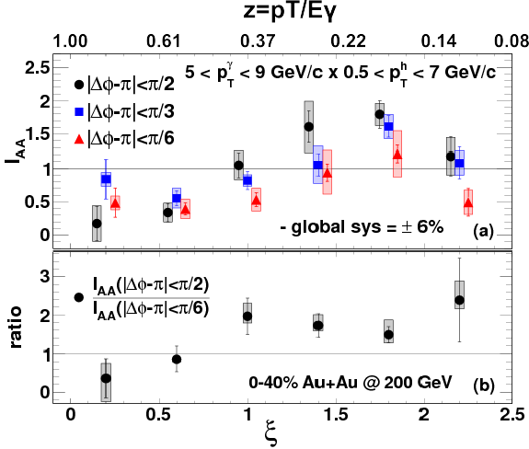




Event Generator + Bayesian Statistical analysis
Realistic theoretical calculations
Data
Bayesian Statistical Analysis
Constraint of QGP properties

Slide 75
RIVET
Robust Independent Validation of Experiment and Theory
Realistic
theoretical
calculations
Experimental
techniques
Realistic Monte Carlo Model
Works here

Slide 76
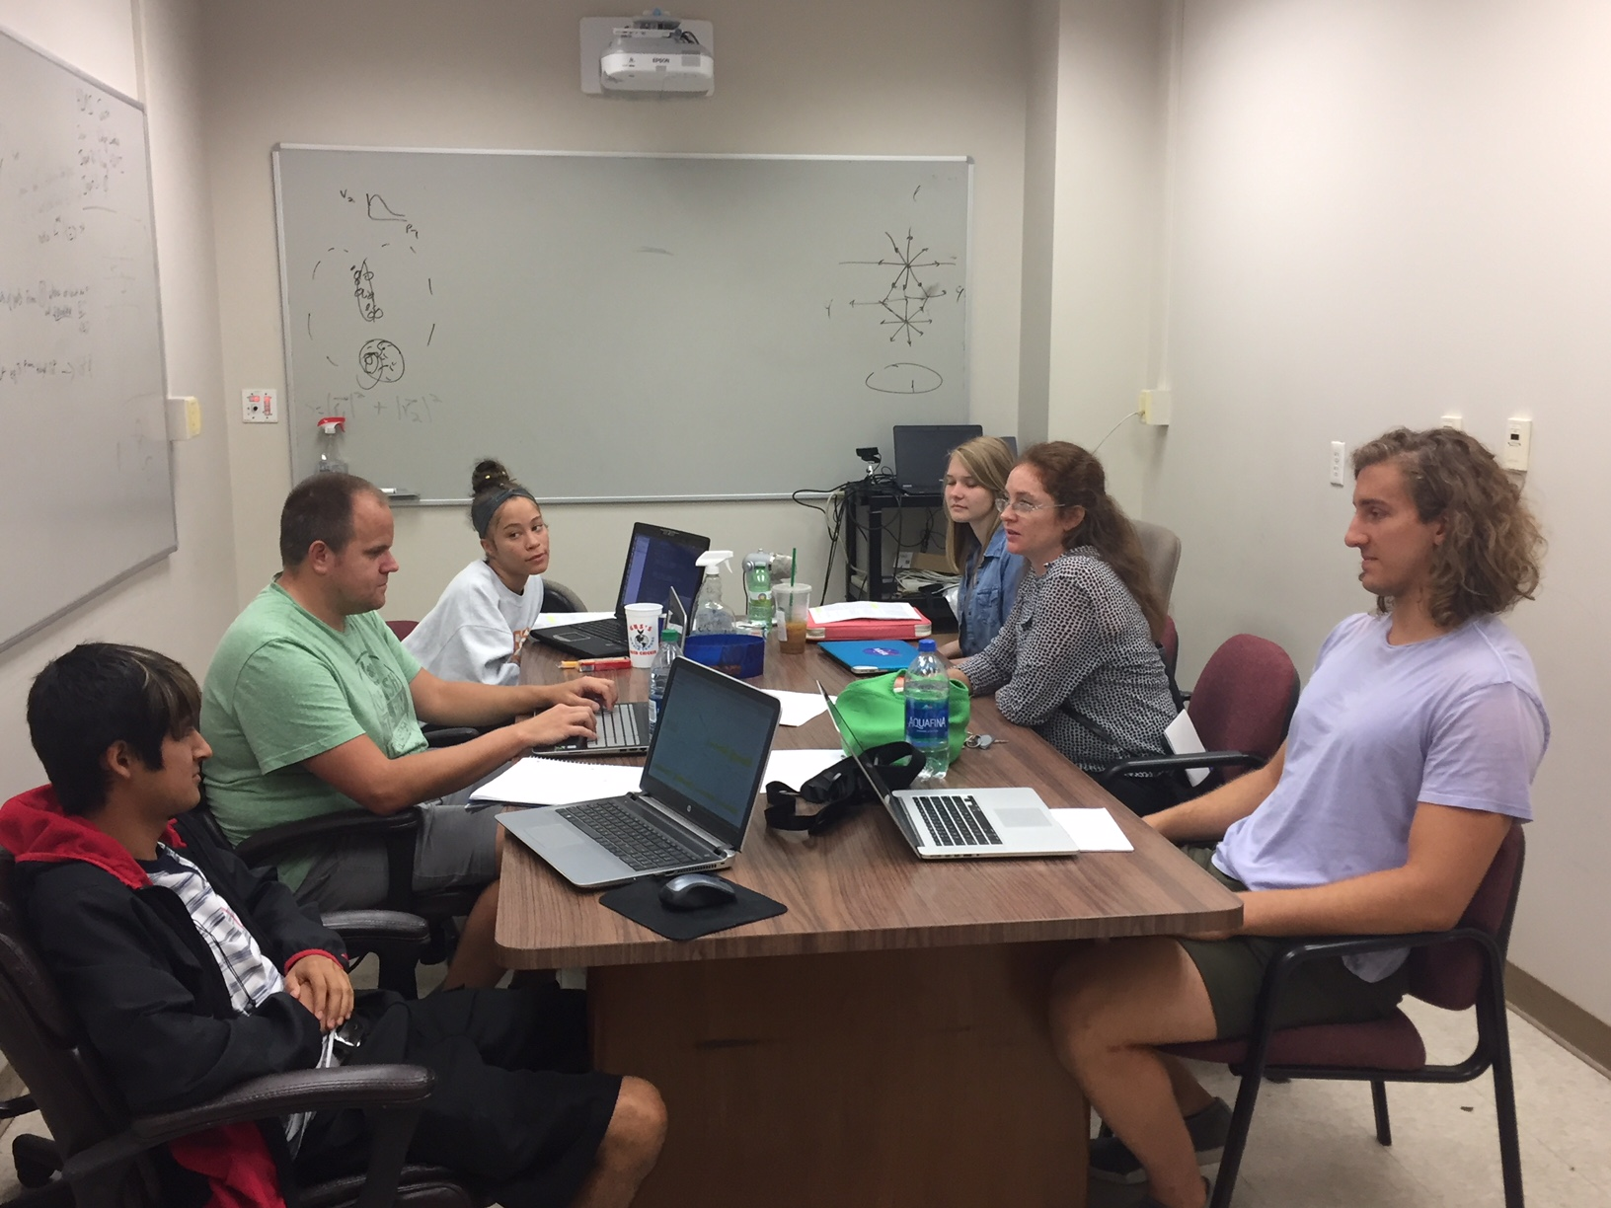
UTK JETSCAPE Group
James Neuhaus
Jerrica Wilson
Mariah McCreary
Ricardo Santos (Berea)
Austin Schmier
4 undergrads + 1 beginning grad student
Redmer Bertens (post doc)
Before: 3 heavy ion analyses implemented
After: 9 heavy ion analyses, 2 more in progress

Slide 77


Take home messages
If we get nuclear matter dense enough, we make a new phase of matter, which we produce in high energy heavy ion collisions.
This medium is extremely hot and dense...
...and opaque to colored probes and translucent to electromagnetic probes.

Slide 79


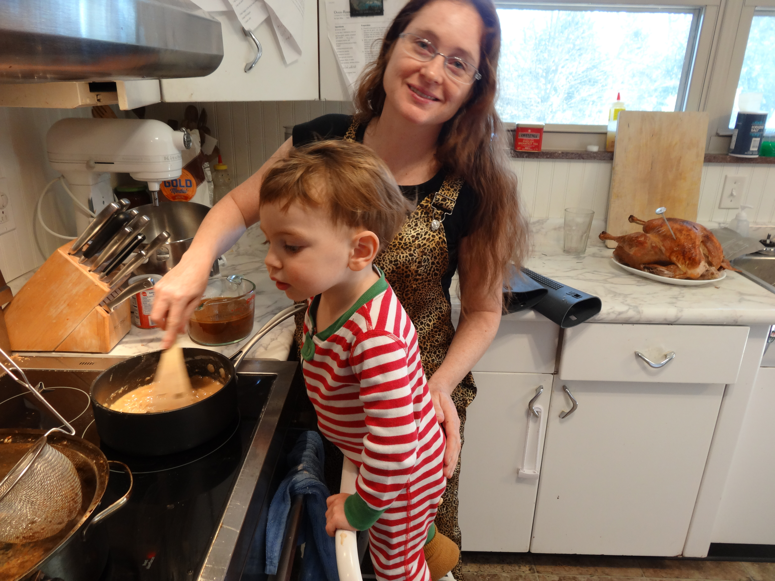
About me
BS, Colorado State University, 2003
PhD, Yale University, 2009
Postdoc, University of Tennessee, Knoxville, 2009-2012
Assistant prof, University of Tennessee, Knoxville 2012 –
Active on issues related to women in physics and working on being a more effective ally for people of color
Parent
Brew beer & wine, keep bees, avid cook, cyclist

Slide 80
Careers in high energy physics
You should consider high energy physics if...
  You like programming and working with computers
  You're a people person – and don't mind working with 1000 people
  You like to travel around the world – and work
  You enjoy giving talks
Common career options for people with a Ph.D. in high energy physics
  Academia – research and teaching universities
  Research at a National Laboratory
  National security
  Finance
  Computer programming

Slide 81




What I spend my time doing
Programming (c++) - analyzing data
Writing and giving talks – 3 research talks, 1 seminar, 2 posters, 1 software tutorial, and lots of talks (>30) at internal meetings in 2010
Hardware work: assembling & testing the detector
Outreach: blogging for ALICE, giving tours of PHENIX to the public...
Writing papers and conference proceedings
Reviewing the work of my collaborators
Reading papers
Taking shifts – including being on call 24/7
Teaching, advising students (undergrad & grad)
Committee work

Slide 82
Resources
US LHC blog and Facebook page
Experiments
  Relativistic Heavy Ion Collider: STAR PHENIX
  Large Hadron Collider: ALICE ATLAS CMS LHCb TOTEM
Event displays and pretty pictures from ALICE
Really cool ATLAS event animation
Links to articles in the press on PHENIX
Scientific American article

Slide 83
US Universities with graduate programs in experimental heavy ion physics
Relativistic Heavy Ion Collider
STAR
  University of California at Davis
  University of California Los Angelos
  University of Houston
  University of Illinois at Chicago
  Creighton University (masters only)
  Kent State University
  Michigan State University
  Ohio State University
  Purdue University
  Texas A&M University
  University of Texas Austin
  University of Washington
  Wayne State University
  Yale University
PHENIX
  University of California Riverside
  University of Colorado Boulder
  Columbia University
  Florida State University
  Georgia State University
  Iowa State University
  Ohio University
  State University of New York (Chemistry & Physics departments)
  University of Tennessee at Knoxville
  Vanderbilt University

Slide 84
US Universities with graduate programs in experimental heavy ion physics
Large Hadron Collider
ALICE
  University of Texas Austin
  Chicago State University
  Ohio State University
  Wayne State University
  University of Texas Houston
  University of Tennessee Knoxville
  Yale University
  Creighton University (masters only)
  Purdue University
CMS
  University of California Davis
  University of Illinois Chicago
  University of Kansas
  University of Maryland
  University of Iowa
  Rutgers University
  Massachusetts Institute of Technology
  Vanderbilt University
ATLAS
  Columbia University

Slide 85
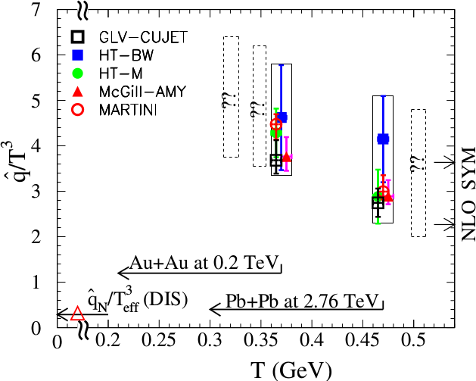
Quantifying
$\hat{q}$
Phys. Rev. C 90, 014909 (2014)
Jet Collaboration: For a 10 GeV quark traveling 4 fm
≈1.2±0.3 GeV²/fm at τ₀=0.6 fm/c in Au+Au at √s_{NN}=200 GeV →loses 2.2 Gev
≈1.9±0.7 GeV²/fm in Pb+Pb collisions at √s_{NN}=2.76 TeV →loses 2.8 Gev
$\hat{q}$
$\hat{q}$
$\hat{q}={Q^{2}}/L$
Q = Momentum transfer from parton to medium
L = path length

Slide 86
QGP Chemistry

Slide 87

Chemistry - equilibrium
T~170 MeV
arXiv:1701.07065
Nuclear Physics A Volume 757, 102-183
Ratios of particles expected from a model
Even strange quarks are at equilibrium!

Slide 88
QCD Phase Diagram
Quark Gluon Plasma
Hadron Gas
arXiv:1701.07065
Notes:
But wait – how can we have a liquid of quarks and gluons? Doesn't asymptotic freedom tell us that we can't have free quarks and gluons? How, then, can we have a liquid of quarks and gluons?

Slide 89

trajectory of system
arXiv:1701.07065

Slide 90
QGP Thermometers

Slide 91
Measuring temperature

Slide 92
Thermal photons
Phys.Rev.Lett.104:132301,2010
Thermal photons
QCD processes
ALICE collaboration:
Pb+Pb collisions at √s_{NN}=2.76 TeV
Inverse slope: T = 304 +/-51
PHENIX collaboration: Au+Au collisions at √s_{NN}=200 GeV
Inverse slope: T = 221 +/- 19 (stat) +/- 19 (syst) MeV

Slide 93
Building a quarkonium-thermometer
CMS-PAS HIN-11-011
N_{part}
Clear hierarchy in R_{AA} of different quarkonium states
c
c
b
b

Slide 94
Building a quarkonium-thermometer
Note: 6.5<p_{T}<30 GeV for J/ψ and ψ(2s)
CMS-PAS HIN-11-011
N_{part}
Clear hierarchy in R_{AA} of different quarkonium states
Expected in terms of binding energy
CMS-PAS HIN-12-014, HIN-12-007

Slide 95
~600
trajectory of system
arXiv:1701.07065

Slide 96
QGP Energy Density

Slide 97
How can we estimate the energy density?
Transverse energy (E_{T})
  sum of particle energies in transverse direction
Volume V = A_{T} τc
τ = formation time
Energy density ε
QGP formation for ε > 0.5 GeV/fm³
A_{T}
= τc
$ϵ=\frac{1}{V}\frac{{dE}_{T}}{dy}=\frac{J}{A_{T}τc}\frac{{dE}_{T}}{dη}$

Slide 98
Energy density
RHIC
Standard estimate τ₀ ≈ 1 fm/c
QGP formation
$ϵ=\frac{1}{Acτ_{0}}\frac{{dE}_{T}}{dy}$

