Slide 1
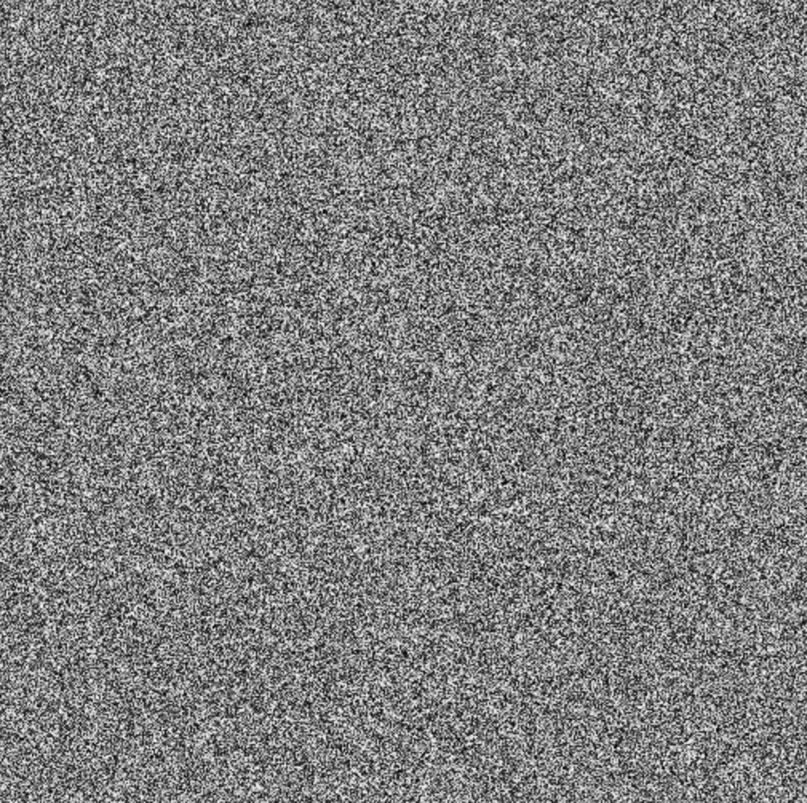
Working with jets in a high background environment

Slide 2
Working with jets in a high background environment

Slide 3
Working with jets in a high background environment

Slide 4
Working with jets in a high background environment

Slide 5
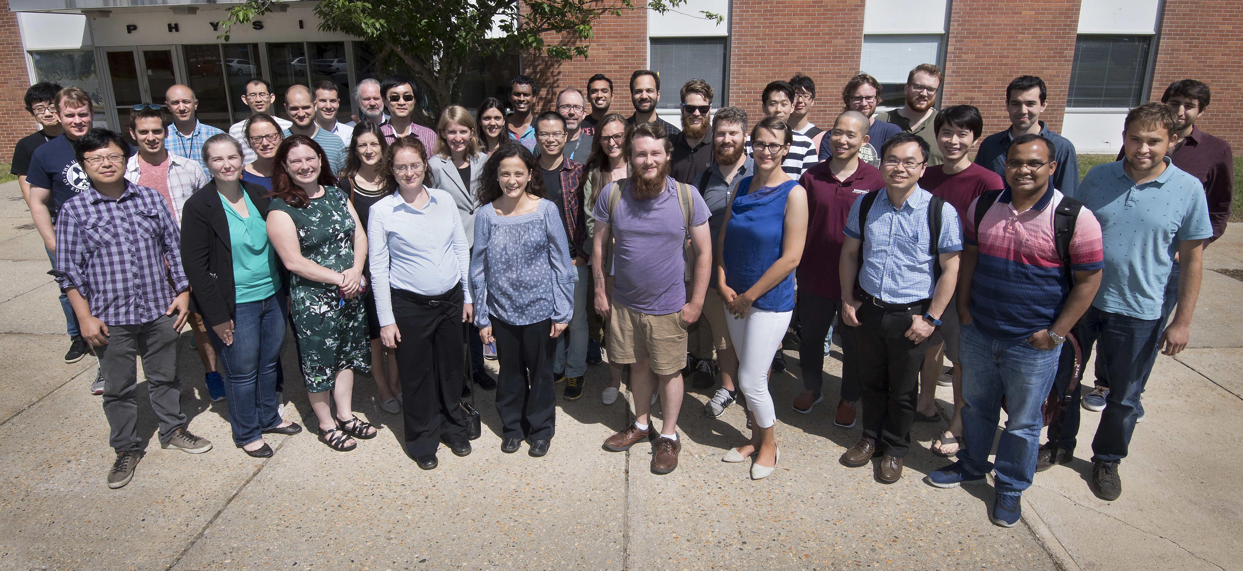
Definition of Jets in a Large Background
Organizers: M. Connors, G. Milhano, C. Nattrass, R. Reed, S. Salur
Spectra conveners: R. Kunnawalkam Elayavalli, Y. Mehtar-Tani (R. Bertens)
Correlation conveners: J. Noronha-Hostler, J. Huang
Substructure conveners: Y. Lee, Y. Chien
62 Registered but due to various visa & travel complications: 45 + several BNL employees attended.

Slide 6


GOAL
Extensively discussed the interplay between experimental techniques and theoretical calculations with the aim of reaching an agreement* on the way forward for extracting jet measurements from large background events such as those in heavy ion collisions and high luminosity p-p or electron-ion collisions.
*Consensus on some points

Slide 7



Korinna Zapp
Include anything correlated in definition of jet
Provide enough details to make comparisons between data and models
Reconsider role of collinear safety
Discuss and put effort into the problem

Slide 8
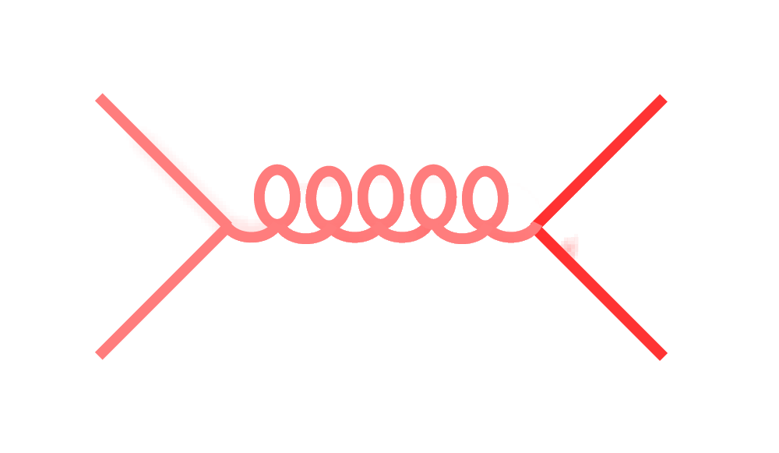
Signal vs Background: the standard paradigm
Background
Signal
See Peter Jacob’s talk

Slide 9
Problem 1: what about medium interactions?
Background
Signal

Slide 10
Problem 1: what about medium interactions?
Background
Signal
Korinna Zapp

Slide 11
Problem 1: what about medium interactions?
Background
Signal
Solution: Particles which are correlated with the jet are part of the signal.
Korinna Zapp

Slide 12
Problem 1: what about medium interactions?
Background
Signal
Solution: Particles which are correlated with the jet are part of the signal.
Problem 1a: May need to apply the same background on data and models to make sure we use the same definition of background.
Korinna Zapp

Slide 13
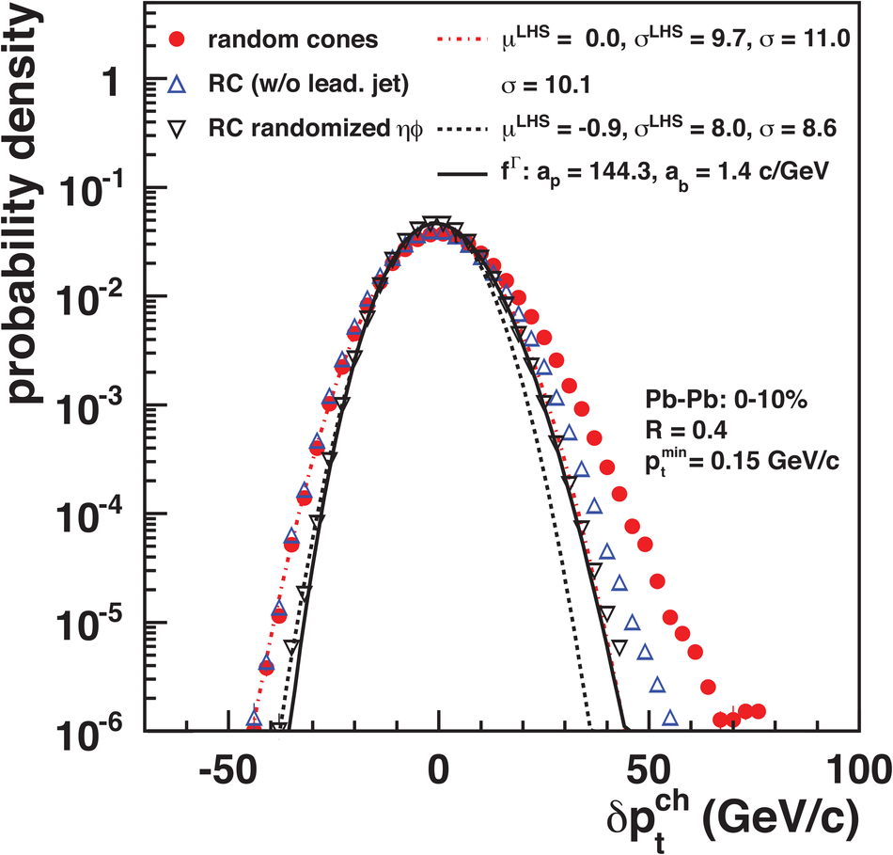
Problem 2: The background fluctuates
Background
Signal
JHEP 03 (2012) 053

Slide 14
Problem 2: The background fluctuates
Background
Signal
JHEP 03 (2012) 053
...even in Monte Carlo!

Slide 15
Problem 2: The background fluctuates
Background
Signal
JHEP 03 (2012) 053
...even in Monte Carlo!
Solution: Implement analyses in RIVET

Slide 16
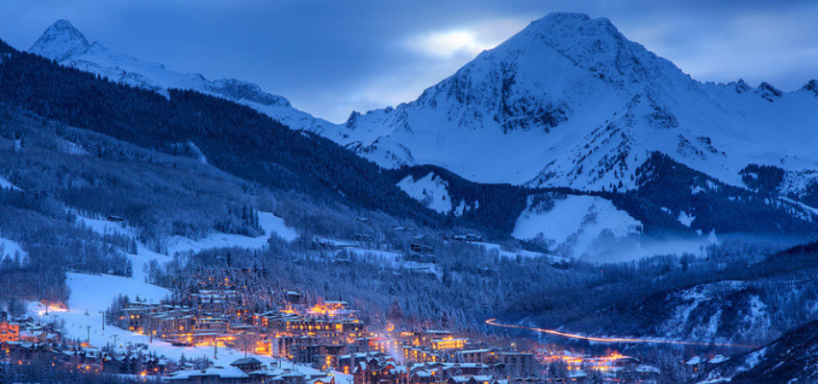
Snowmass Accord: Theoretical calculations and experimental measurements should use the same jet finding algorithm. Otherwise they will not be comparable.
https://www.stayaspensnowmass.com/info/snowmass-colorado

Slide 17
RIVET
Robust Independent Validation of Experiment and Theory
Realistic
theoretical
calculations
Experimental
techniques
Realistic Monte Carlo Model
Works here

Slide 18
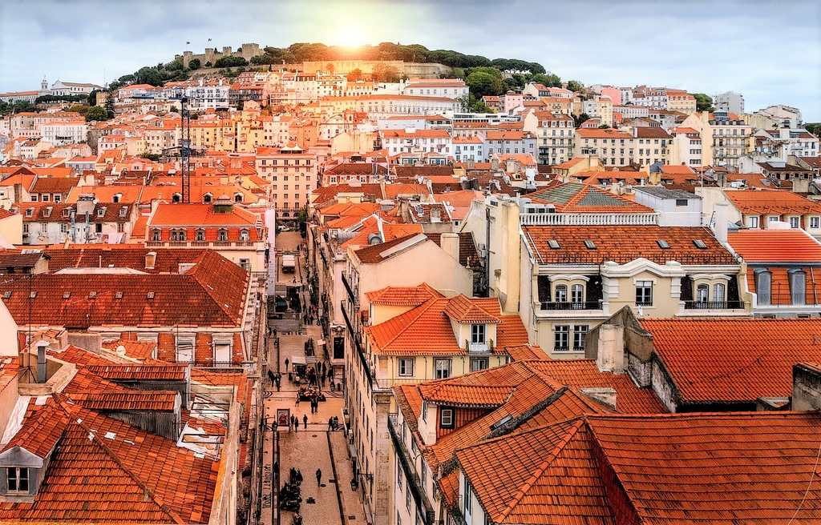
The Lisbon Accord
Lisbon Accord proposed that heavy ion analyses adopt RIVET in July 2014
Workshop position paper will second this recommendation
https://www.aworldtotravel.com/things-lisbon-is-famous-for/

Slide 19
Problems with RIVET
Not all heavy ion functionality exists
Very few heavy ion analyses exist
Only takes in HEPMC 2.0 input
No way to deal with fluctuations

Slide 20
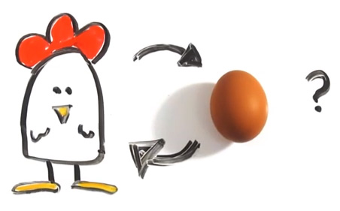
Few heavy ion analyses in RIVET
RIVET lacks heavy ion functionality
http://iterated-reality.com/en/2015/03/17/the-chicken-or-the-egg-causality-dilemma-solved-by-unity-consciousness/

Slide 21
RIVET-HI
https://github.com/alisw/rivet-hi
ALICE extended RIVET to enable heavy ion analyses (Przemyslaw Karczmarczyk, Jochen Klein, Jan Fiete Grosse-Oetringhaus)
Adds centrality determination
No option to fit functions
UTK clone of RIVET-HI
https://github.com/cnattras/rivet-hi
  Implementation of STAR/ALICE, CMS, and ATLAS background subtraction methods for jets
  Calculation of v_{n} from thrown particles

Slide 22
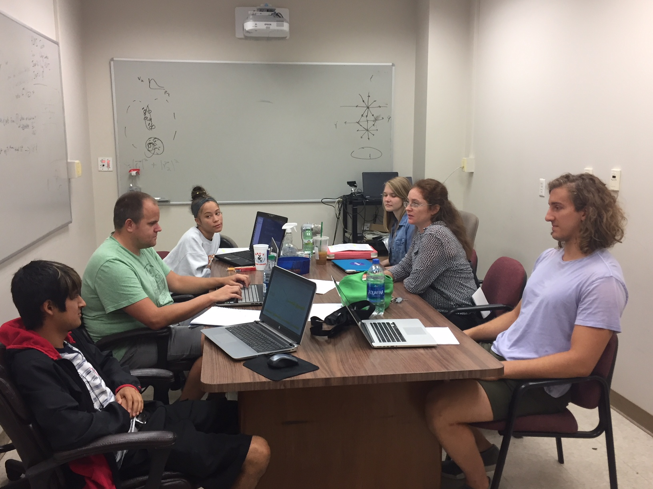
Undergraduates!*
JETSCAPE REU
Left to right: Ricardo Santos (Berea), James Neuhaus, Jerrica Wilson, Mariah McCreary, Christine Nattrass, Austin Schmier (UTK)
*And one beginning graduate student with no programming experience

Slide 23
RIVET-HI
https://github.com/alisw/rivet-hi
ALICE extended RIVET to enable heavy ion analyses (Przemyslaw Karczmarczyk, Jochen Klein, Jan Fiete Grosse-Oetringhaus)
Adds centrality determination
No option to fit functions
UTK clone of RIVET-HI
https://github.com/cnattras/rivet-hi
  Implementation of STAR/ALICE, CMS, and ATLAS background subtraction methods for jets
  Calculation of v_{n} from thrown particles

Slide 24
Problems with RIVET
✔
Not all heavy ion functionality exists
Very few heavy ion analyses exist
Only takes in HEPMC 2.0 input
No way to deal with fluctuations

Slide 25
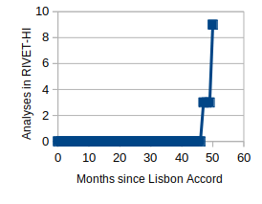
Implementing analyses in RIVET-HI*
*Not yet checked in to RIVET-HI but in a UTK mirror

Slide 26
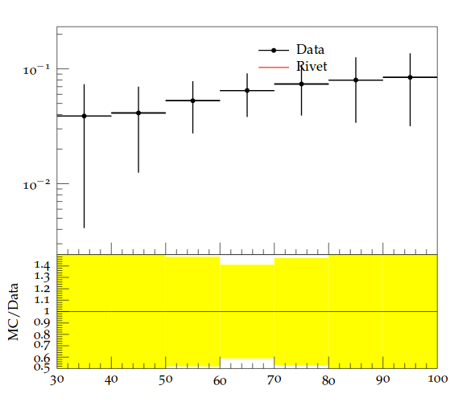
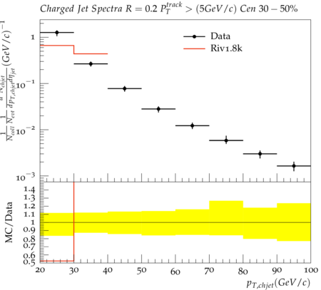
Progress
Charged jet v₂
Mariah McCreary
0-5% collision centrality
100 Pythia PbPb events
Ricardo Santos
1800 Pythia PbPb events
Phys.Lett. B753 (2016) 511-525
p_{T}^{Jet,ch}
JHEP 30 (2014) 013
WARNING: Very small sample size, highly biased results, need to coordinate with Przemyslaw, Jochen, & Jan Fiete to ensure code can eventually be committed. Fluctuations in combinatorial background not subtracted.
Undergraduates Mariah McCreary (UTK), James Neuhaus (UTK), Jerrica Wilson (UTK), Ricardo Santos (Berea); Graduate student Austin Schmier (UTK); Post doc Redmer Bertens (UTK)
Mariah and Ricardo implementing ALICE analyses, James and Redmer providing key support.
Funding from JETSCAPE, Berea, and the UTK physics department.

Slide 27
Available data
RHIC: High-p_{T} hadron correlations 52%, reconstructed jets 3%
LHC: High-p_{T} hadron correlations 23%, reconstructed jets 40%
Analysis about 1 year old, some may disagree with classifications, but the gist holds

Slide 28

Course-based undergraduate research experience

Slide 29
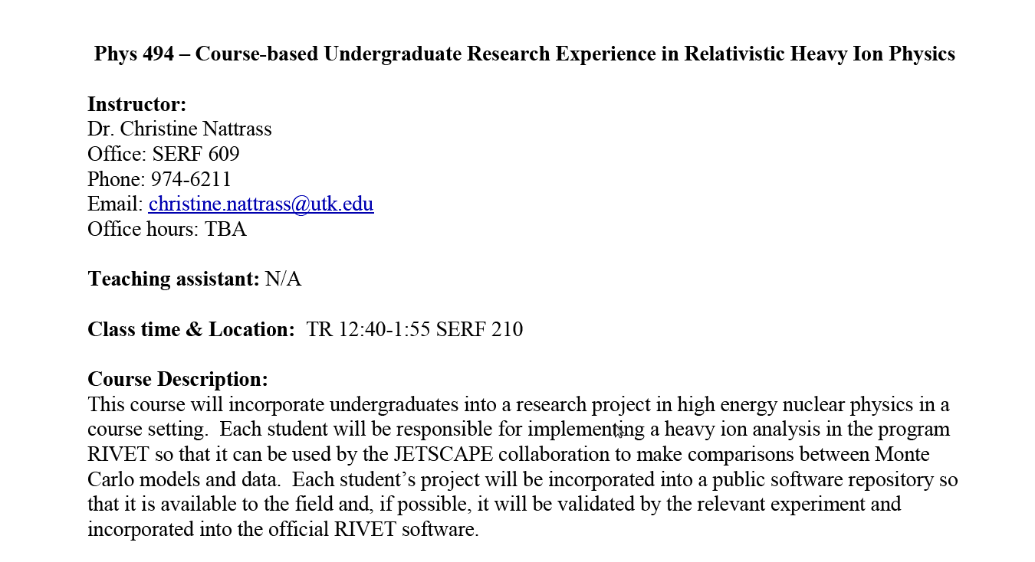

Slide 30

https://i.ytimg.com/vi/mZnv6LXD9qs/maxresdefault.jpg

Slide 31
Problems with RIVET
✔
Not all heavy ion functionality exists
Very few heavy ion analyses exist
Only takes in HEPMC 2.0 input
No way to deal with fluctuations
✔ (in progress)

Slide 32
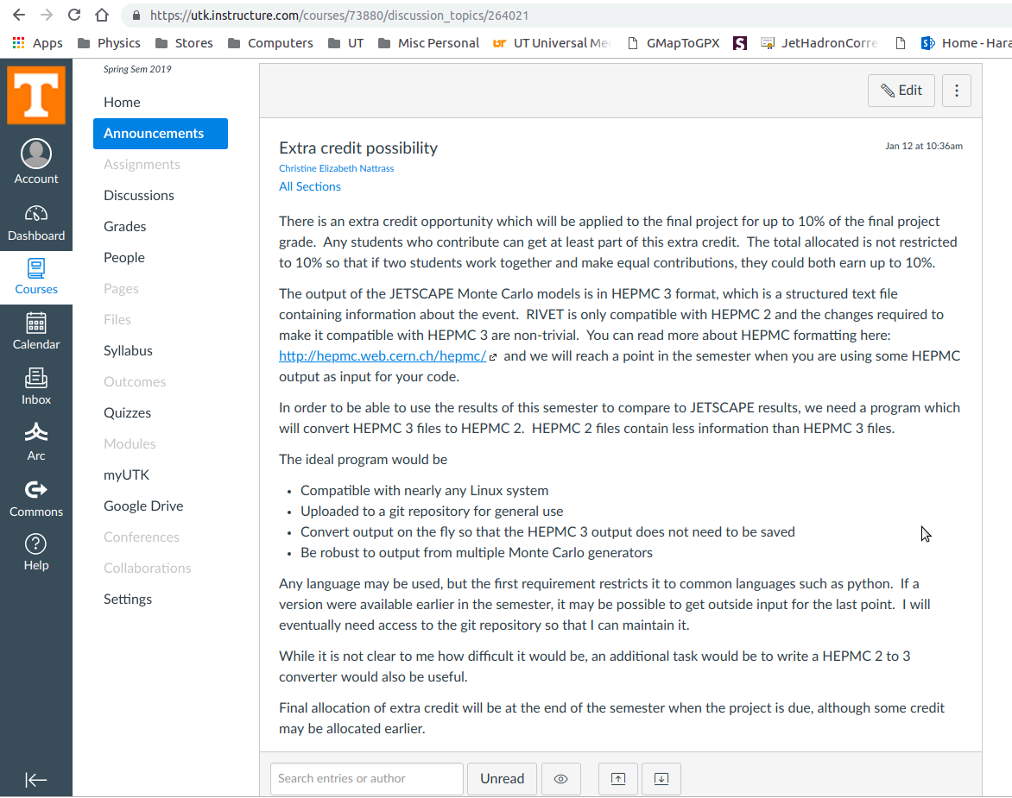

Slide 33
Problems with RIVET
✔
Not all heavy ion functionality exists
Very few heavy ion analyses exist
Only takes in HEPMC 2.0 input
No way to deal with fluctuations
✔ (in progress)
✔ (in progress)

Slide 34
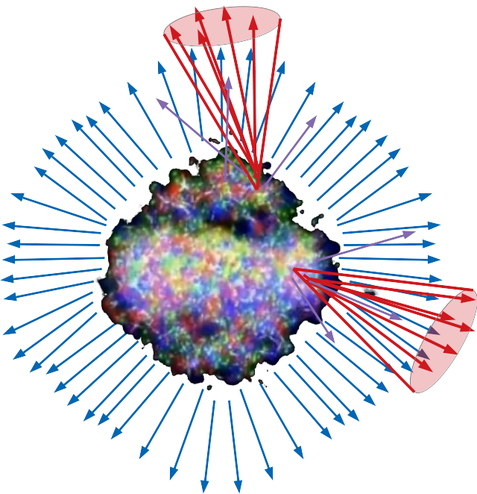
Ways to deal with fluctuations
Tag final state hadrons as part of signal or background and only put these into jet finder
  May work OK but conceptually suboptimal
Compare to data which have not been corrected for fluctuations in the background
Unfold Monte Carlo results
  Treating MC just like data
  Unfolding is highly non-trivial

Slide 35
Conclusions
Jet background is tricky
It will be an issue for JETSCAPE
  Especially fluctuations!
RIVET(-HI) is progressing
Undergraduates are great!

Slide 36
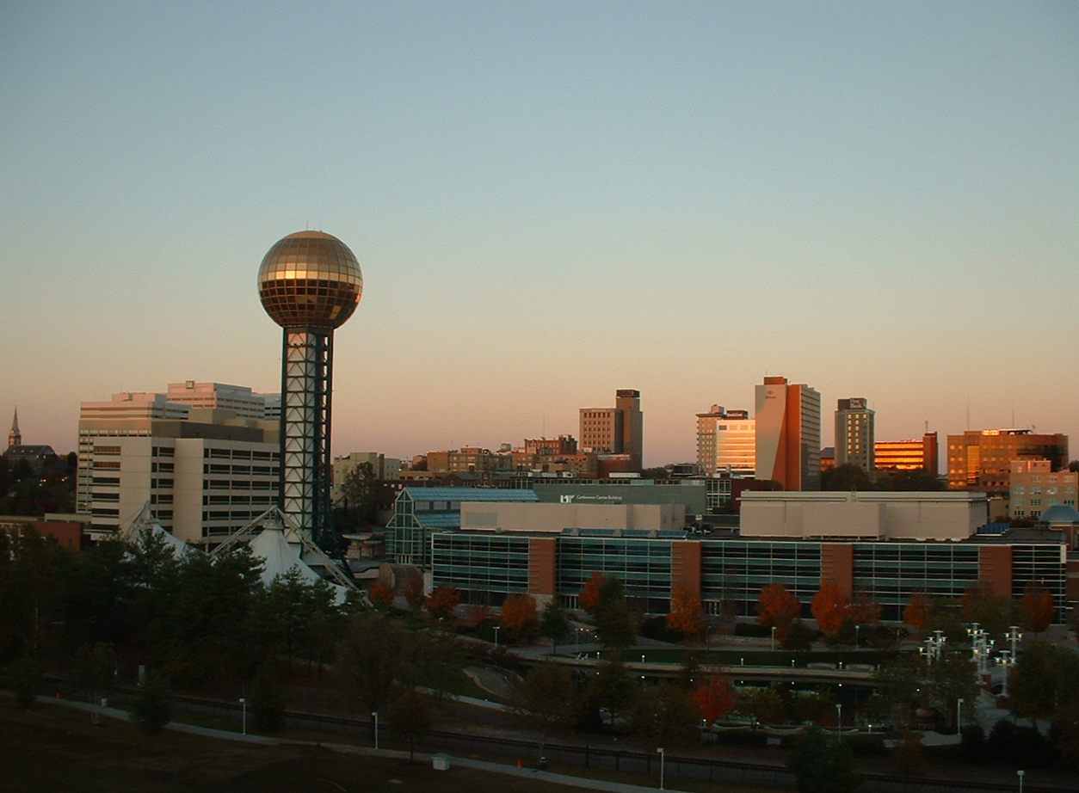
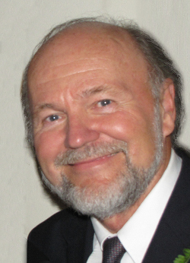
13th International Workshop on High-p_{T} Physics in the RHIC/LHC Era
The Past, Present, and Future of Heavy Ion Collisions
March 18
A symposium in celebration of Miklos Gyulassy’s 70th birthday
Registration deadline: Jan. 19, 2019
Registration fee: $170 ($120 students)
Student support available
Participants requiring a visa strongly encouraged to apply early
Knoxville, Tennessee
March 19-22 2019

