Slide 1
Grad school and research:
Tips and advice
Slides available here: nattrass.utk.edu/Talks/NSBP2016/

Slide 2
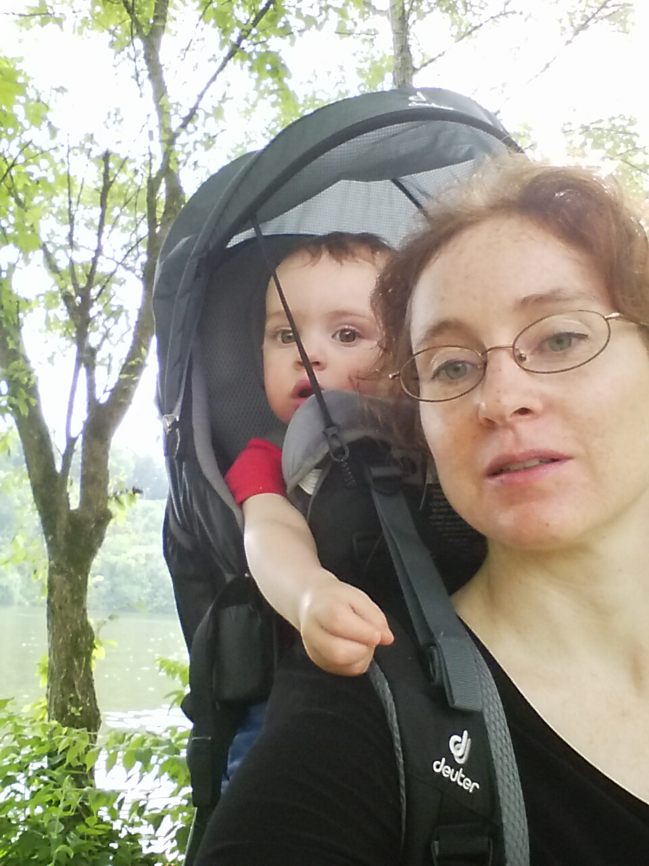
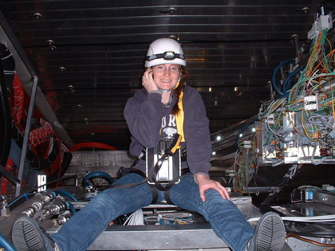
Who I am
Tenure Track Assistant Professor, University of Tennessee, Knoxville
High energy nuclear physicist on ALICE experiment
Undergraduate academic advisor
Currently supervising 2 post docs, 4+2 graduate students, 4 undergraduates
I brew beer & wine, keep bees, bike ride as much as possible, and have a toddler

Slide 3
Advice
Think strategically about your career
Build a network of mentors
Take advantage of opportunities
Build a network of support
Be selfish & self-promote

Slide 4
Should you do undergraduate research?
Most undergraduates do some research
Nearly all graduate students did undergraduate research
Undergraduate research is
  The best way to find out if you like research
  Find out what you like to do
  Practical training
  Leads to letter of rec
Yes for almost everyone

Slide 5
How to do undergraduate research
Data base of almost all summer programs nationwide
http://pathwaystoscience.org/
Talk to faculty at your university
Be persistent
Be flexible
  Topic doesn't matter
  It's only a summer

Slide 6
Should you go to grad school?
About 23% of students go to grad school
  2014-2015: 8122 bachelors degrees, 891 masters, 1860 PhDs
  (https://www.aip.org/statistics)
Major career decision
Specialization: lose some career and geographic flexibility
Normal not to go to graduate school
Most people who go to graduate school do not stay in a research career
You should only go to graduate school if doing so helps you achieve your career goals.
Any credible school gives you a stipend and covers your tuition.

Slide 7
Getting in to grad school
Three components
  GRE subject exam
  Letters of recommendation
  Grades
Grades & GRE are best predictors of performance in classes
Letters of rec are best predictors of research ability
Rejections are not a reflection of your self worth. Do not take it personally.

Slide 8
Choosing a grad school
Try to choose a school with 2-3 people you think you could work with
Look at qualifier pass rate and student graduation rates
Consider selectivity, academic difficulty and reputation
Consider school environment, location, cost of living, culture, etc.

Slide 9
Choosing an advisor
Where are his students now?
  In and out of research!
What do his students say about him?
What is his style?
  Working with post docs and senior grad students is fine.
What topic?

Slide 10
Once you're there
Develop network of mentors beyond your research advisor
  Faculty, students, post docs
  Others in your field outside your university
Approach this like a job. Show up 9-5. Make sure your supervisor knows what you are getting done and show progress/report problems regularly.
Take advantage of flexibility and resources of academia
Network, network, network
Have a life outside of work

Slide 11
What I am thinking when I meet with students to discuss research
Do I have the resources to take this student on?
What impact would this student have on my group?
Does working in my group help this student?
Does taking on this student help me?
Does taking on this student help the community?

Slide 12
What I am looking for?
Good traits
Red flags
Strong work ethic
Enthusiasm
Skills, experience
Squeaky wheel
Severe interpersonal problems
Unrealistic/mismatched career expectations
Attendance problems

Slide 13
Random good advice I've gotten over the years
If you are not available outside of normal working hours, do not make excuses – just say you're not available.
Learn to say no.
If you can't say anything nice, don't put it in writing.

