Slide 1

The little bang: understanding the Quark Gluon Plasma
Christine Nattrass
University of Tennessee, Knoxville

Slide 2



QCD Phase Diagram
Quark Gluon Plasma
Hadron Gas
arXiv:1701.07065
Notes:
But wait – how can we have a liquid of quarks and gluons? Doesn't asymptotic freedom tell us that we can't have free quarks and gluons? How, then, can we have a liquid of quarks and gluons?

Slide 3

How to make a Quark Gluon Plasma

Slide 4



The phase transition in the laboratory
Initial State
QGP
Freeze-out
  K, O’Hara, S. Hemmer, M. Gehm, S. Granade, J. Thomas Science 298 2179 (2002)
Hydrodynamical flow
Jet quenching
https://physics.aps.org/articles/v7/97

Slide 5















Relativistic Heavy Ion Collider
Large Hadron Collider
PHOBOS
BRAHMS
CMS
PHENIX
STAR
RHIC
LHCb
ALICE
ATLAS
LHCf
LHC
Upton, NY
1.2km diameter
p+p, d+Au, Cu+Cu, Au+Au, U+U
√s_{NN} = 9 - 200 GeV
Geneva, Switzerland
8.6km diameter
p+p, p+Pb, Pb+Pb
√s_{NN} = 2.76 GeV, 5.5 TeV
RHIC
Notes:
Mention that RHIC planning began 1983

Slide 6




Size: 16 x 26 meters
Weight: 10,000 tons
Detectors: 18
Trigger detectors: When do we have a collision?
Tracking detectors: Where did the particle go?
Identification detectors: What kind of particle is it?
Calorimeters: How much energy does the particle have?
<number>
Notes:
By comparison ATLAS is 25 meters in diameter and 44 meters long – not quite twice as large

Slide 7

p+p collisions
3D image of each collision

Slide 8

Pb+Pb collisions
5

Slide 9
QGP Energy Density

Slide 10

How can we estimate the energy density?
Transverse energy (E_{T})
  sum of particle energies in transverse direction
Volume V = A_{T} τc
τ = formation time
Energy density ε
QGP formation for ε > 0.5 GeV/fm³
A_{T}
= τc

Slide 11

Energy density
RHIC
Standard estimate τ₀ ≈ 1 fm/c
QGP formation

Slide 12
QGP Chemistry

Slide 13


Chemistry - equilibrium
T~170 MeV
arXiv:1701.07065
Nuclear Physics A Volume 757, 102-183
Ratios of particles expected from a model
Even strange quarks are at equilibrium!

Slide 14
Phase diagram of nuclear matter
Critical point?
arXiv:1701.07065
Quark Gluon Plasma – a liquid of quarks and gluons created at temperatures above ~170 MeV (2·10¹²K) – over a million times hotter than the core of the sun
Notes:
But wait – how can we have a liquid of quarks and gluons? Doesn't asymptotic freedom tell us that we can't have free quarks and gluons? How, then, can we have a liquid of quarks and gluons?

Slide 15


trajectory of system
arXiv:1701.07065

Slide 16
QGP Thermometers

Slide 17


Measuring temperature

Slide 18


Thermal photons
Phys.Rev.Lett.104:132301,2010
Thermal photons
QCD processes
ALICE collaboration:
Pb+Pb collisions at √s_{NN}=2.76 TeV
Inverse slope: T = 304 +/-51
PHENIX collaboration: Au+Au collisions at √s_{NN}=200 GeV
Inverse slope: T = 221 +/- 19 (stat) +/- 19 (syst) MeV

Slide 19


Take home messages
If we get nuclear matter dense enough, we make a new phase of matter, which we produce in high energy heavy ion collisions.
This medium is extremely hot and dense.

Slide 20




Building a quarkonium-thermometer
CMS-PAS HIN-11-011
N_{part}
Clear hierarchy in R_{AA} of different quarkonium states
c
c
b
b

Slide 21

Building a quarkonium-thermometer
Note: 6.5<p_{T}<30 GeV for J/ψ and ψ(2s)
CMS-PAS HIN-11-011
N_{part}
Clear hierarchy in R_{AA} of different quarkonium states
Expected in terms of binding energy
CMS-PAS HIN-12-014, HIN-12-007

Slide 22
~600
trajectory of system
arXiv:1701.07065

Slide 23
QGP Spectroscopy

Slide 24
Probing the Quark Gluon Plasma
Medium
Probe
Detector
Want a probe which traveled through the collision
QGP is very short-lived (~1-10 fm/c) →
cannot use an external probe

Slide 25


Probes of the Quark Gluon Plasma
nucleus
nucleus
Want a probe which traveled through the medium
QGP is short lived → need a probe created in the collision

Slide 26
Probes of the Quark Gluon Plasma
nucleus
nucleus
Want a probe which traveled through the medium
QGP is short lived → need a probe created in the collision
We expect the medium to be dense → absorb/modify probe

Slide 27


Nuclear modification factor
Measure spectra of probe (jets) and compare to those in p+p collisions or peripheral A+A collisions
If high-p_{T} probes (jets) are suppressed, this is evidence of jet quenching
Enhancement
Suppression

Slide 28

Nuclear modification factor
LHCb-PAPER-2017-015
Control
Control
Probe
Charged hadrons (colored probes) suppressed in Pb—Pb
Charged hadrons not suppressed in p—Pb at midrapidity
Electroweak probes not suppressed in Pb—Pb

Slide 29


Nuclear modification factor R_{AA}
RHIC
LHC
Connors, Nattrass, Reed, SalurarXiv:1705.01974 [nucl-ex]
Electromagnetic probes – consistent with no modification – medium is transparent to them
Strong probes – significant suppression – medium is opaque to them - even heavy quarks!

Slide 30
Careers in high energy physics
You should consider high energy physics if...
  You like programming and working with computers
  You're a people person – and don't mind working with 1000 people
  You like to travel around the world – and work
  You enjoy giving talks
Common career options for people with a Ph.D. in high energy physics
  Academia – research and teaching universities
  Research at a National Laboratory
  National security
  Finance
  Computer programming

Slide 31




What I spend my time doing
Programming (c++) - analyzing data
Writing and giving talks – 3 research talks, 1 seminar, 2 posters, 1 software tutorial, and lots of talks (>30) at internal meetings in 2010
Hardware work: assembling & testing the detector
Outreach: blogging for ALICE, giving tours of PHENIX to the public...
Writing papers and conference proceedings
Reviewing the work of my collaborators
Reading papers
Taking shifts – including being on call 24/7
Teaching, advising students (undergrad & grad)
Committee work

Slide 32
Resources
US LHC blog and Facebook page
Experiments
  Relativistic Heavy Ion Collider: STAR PHENIX
  Large Hadron Collider: ALICE ATLAS CMS LHCb TOTEM
Event displays and pretty pictures from ALICE
Really cool ATLAS event animation
Links to articles in the press on PHENIX
Scientific American article

Slide 33
US Universities with graduate programs in experimental heavy ion physics
Relativistic Heavy Ion Collider
STAR
  University of California at Davis
  University of California Los Angelos
  University of Houston
  University of Illinois at Chicago
  Creighton University (masters only)
  Kent State University
  Michigan State University
  Ohio State University
  Purdue University
  Texas A&M University
  University of Texas Austin
  University of Washington
  Wayne State University
  Yale University
PHENIX
  University of California Riverside
  University of Colorado Boulder
  Columbia University
  Florida State University
  Georgia State University
  Iowa State University
  Ohio University
  State University of New York (Chemistry & Physics departments)
  University of Tennessee at Knoxville
  Vanderbilt University

Slide 34
US Universities with graduate programs in experimental heavy ion physics
Large Hadron Collider
ALICE
  University of Texas Austin
  Chicago State University
  Ohio State University
  Wayne State University
  University of Texas Houston
  University of Tennessee Knoxville
  Yale University
  Creighton University (masters only)
  Purdue University
CMS
  University of California Davis
  University of Illinois Chicago
  University of Kansas
  University of Maryland
  University of Iowa
  Rutgers University
  Massachusetts Institute of Technology
  Vanderbilt University
ATLAS
  Columbia University

Slide 35
Interesting observables
Different hadronization mechanisms
→ Identify particle types
Collective motion of particles
→ Low momentum acceptance
Even common processes are not well understood
→ Do not need 4π acceptance or high rates

Slide 36
Probing the Quark Gluon Plasma

Slide 37
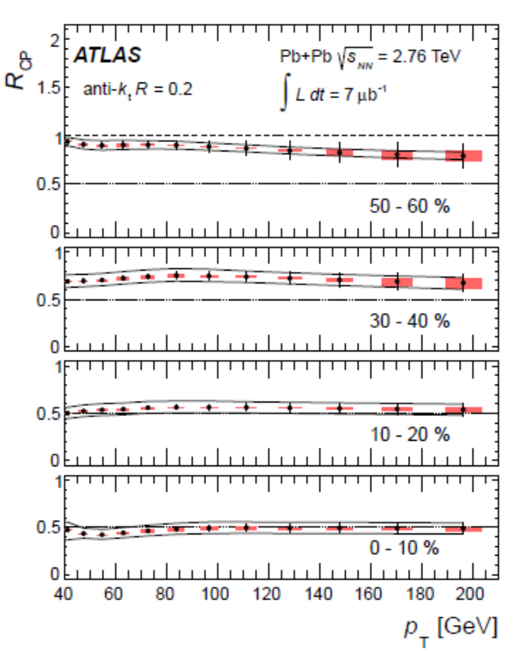
Jet nuclear modification factor*
arXiv:1208.1967 [hep-ex] Submitted to Phys. Lett.B
ATLAS collaboration
Anti-kT algorithm
R=0.2
*Rcp is the ratio of central to peripheral A+A collisions instead of A+A collisions to p+p

Slide 38
Measuring temperature

Slide 39
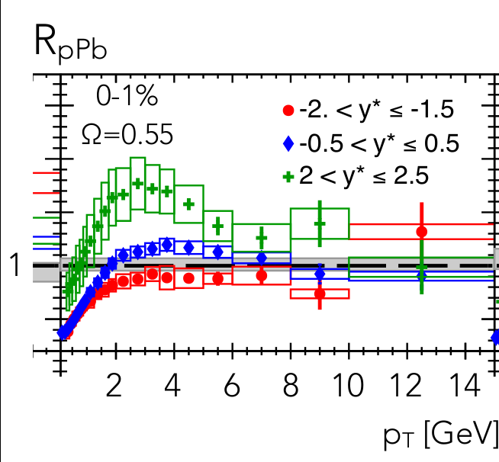
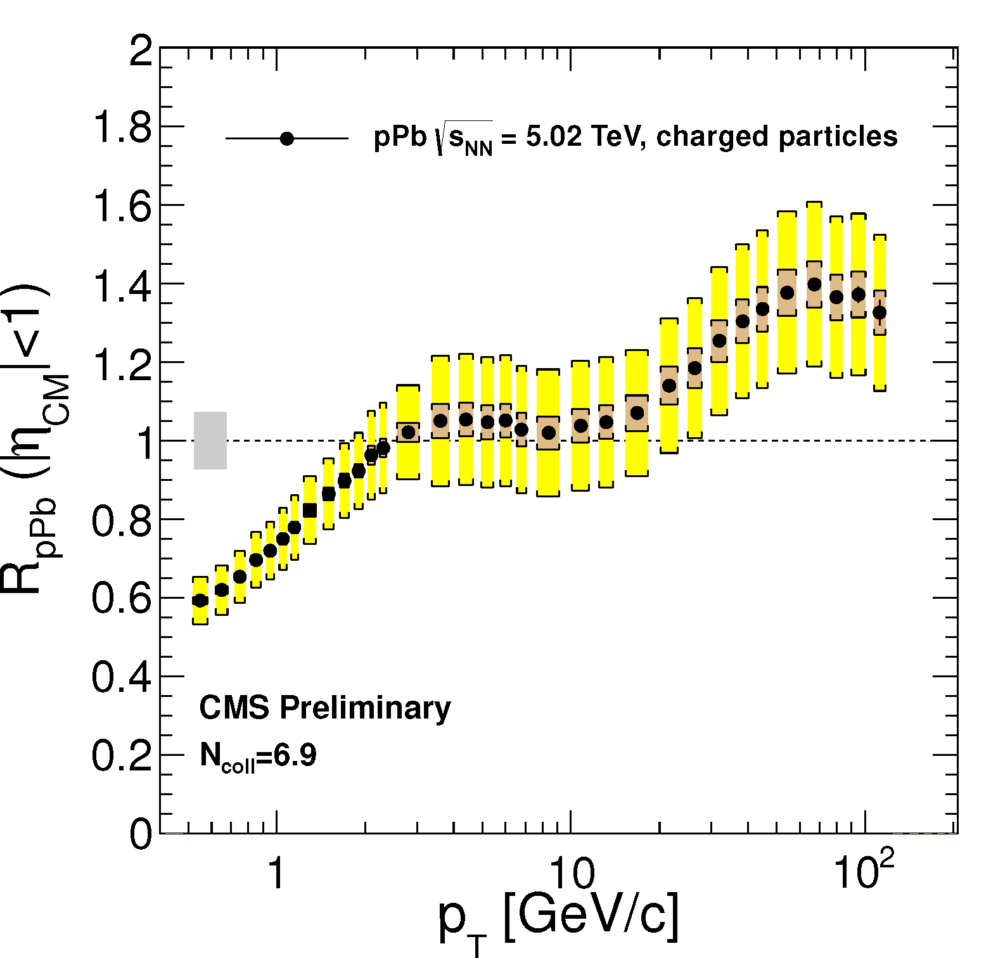
p+Pb as a control
ATLAS-CONF-2013-096
CMS
ATLAS

Slide 40
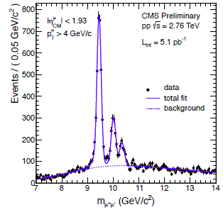
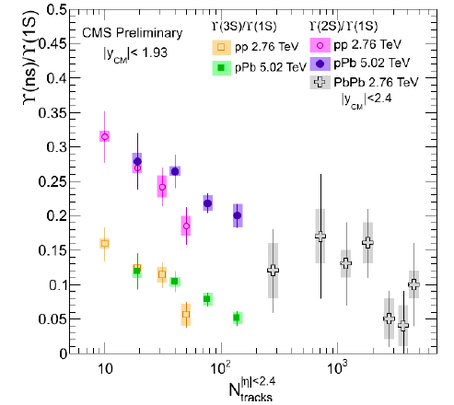
Suppression of quarkonia in p+Pb
pp
pPb
PbPb
p
pPb

Slide 41

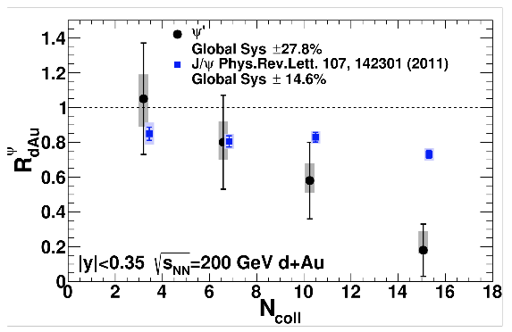
Suppression of quarkonia in d+Au
PHENIX

Slide 42
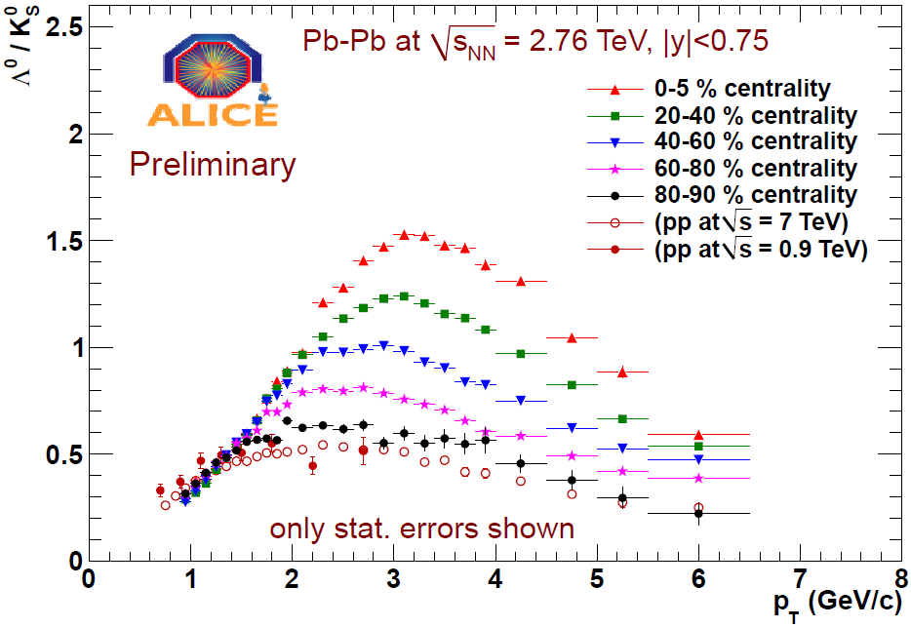
Baryon anomaly: Λ/K⁰_{S}
Pb+Pb

Slide 43
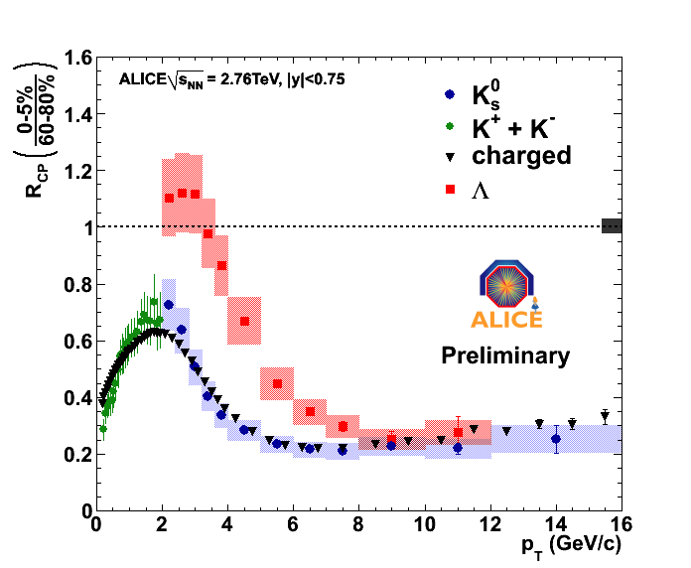
Nuclear modification factor (R_{AA})
Λ
K⁰_{S}
K±
Pb+Pb

Slide 44
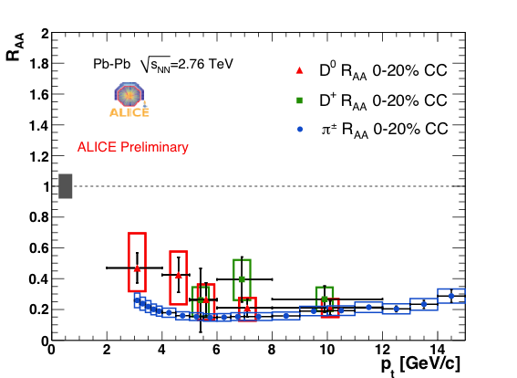
Charm nuclear modification factor
Pb+Pb

