Slide 1
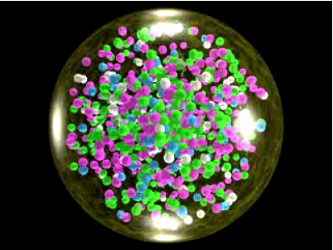
The little bang: understanding the quark gluon plasma
Christine Nattrass
University of Tennessee at Knoxville

Slide 2



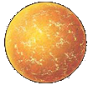

Phase diagram of nuclear matter
Quark Gluon Plasma
Core of neutron stars?
Quark Gluon Plasma – a liquid of quarks and gluons created at temperatures above ~170 MeV (2·1012K) – over a million times hotter than the core of the sun
Notes:
But wait – how can we have a liquid of quarks and gluons? Doesn't asymptotic freedom tell us that we can't have free quarks and gluons? How, then, can we have a liquid of quarks and gluons?

Slide 3
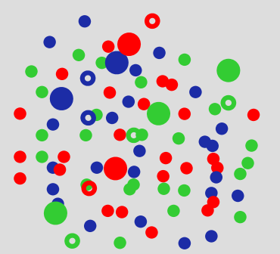
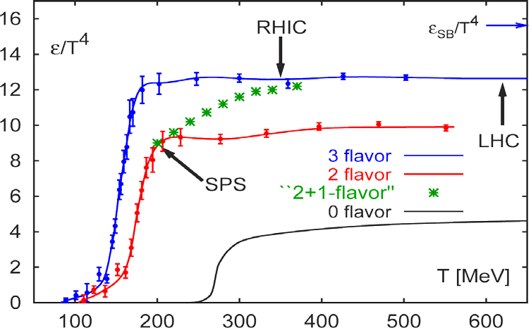
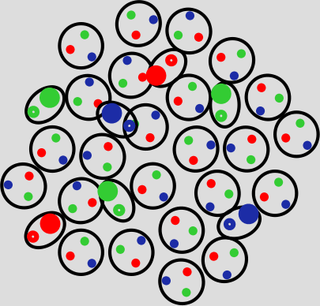
Exploring QCD at high temperatures
Quark-gluon plasma
TC ~ 175 ±8 MeV →εC ~ 0.3 -1 GeV/fm3
Deconfined - more degrees of freedom
F. Karsch, et al.
Nucl. Phys. B605 (2001) 579
ε/T4~ # degrees of freedom
Confined - fewer degrees of freedom

Slide 4

How to make a Quark Gluon Plasma

Slide 5

The phase transition in the laboratory

Slide 6













Relativistic Heavy Ion Collider
Large Hadron Collider
PHOBOS
BRAHMS
CMS
PHENIX
STAR
RHIC
LHCb
ALICE
ATLAS
LHCf
Upton, NY
1.2km diameter
p+p, d+Au, Cu+Cu, Au+Au, U+U
√sNN = 9 - 200 GeV
Geneva, Switzerland
8.6km diameter
p+p, p+Pb, Pb+Pb
√sNN = 2.76 GeV, 5.5 TeV
LHC
Quark Gluon Plasma
RHIC
Core of neutron stars?
Notes:
Mention that RHIC planning began 1983

Slide 7
Comparison of colliders
 | RHIC | LHC
√sNN (GeV) | 9-200 | 2760, 5500 | center of mass energy
dNch/dη | ~1200 | ~1600, ?? | number of particles
T/Tc | 1.9 | 3.0-4.2 | temperature
ε (GeV/fm3) | 5 | ~15 | energy density
τQGP (fm/c) | 2-4 | >10 | lifetime of QGP
RHIC and LHC:
Cover 2 –3 decades of energy (√sNN= 9 GeV –5.5 TeV)
To discover the properties of hot nuclear matter at T ~ 150 –600 MeV

Slide 8
Interesting observables
Different hadronization mechanisms
→ Identify particle types
Collective motion of particles
→ Low momentum acceptance
Even common processes are not well understood
→ Do not need 4π acceptance or high rates

Slide 9




Size: 16 x 26 meters
Weight: 10,000 tons
Detectors: 18
Trigger detectors: When do we have a collision?
Tracking detectors: Where did the particle go?
Identification detectors: What kind of particle is it?
Calorimeters: How much energy does the particle have?
<number>
Notes:
By comparison ATLAS is 25 meters in diameter and 44 meters long – not quite twice as large

Slide 10

p+p collisions
3D image of each collision

Slide 11

Pb+Pb collisions
5

Slide 12
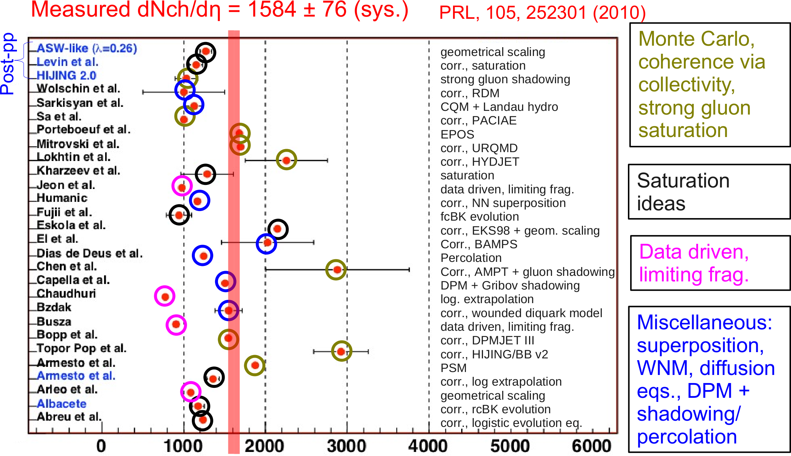
Multiplicity in Pb-Pb collisions at √sNN=2.76 TeV
Compilation from N. Armesto

Slide 13
How do we study a QGP?
Tool | Analogous to:
Thermal photons, charmonium | Thermometer
Hard probes – jets, heavy flavor (charm & beauty), direct photons | Spectroscopy – probe travels through the medium, changes indicate interaction with the medium
Hydrodynamical flow | Measurements of viscosity
Particle ratios | Measuring chemical composition in a solution

Slide 14
Measuring temperature

Slide 15

Thermal photons
Phys.Rev.Lett.104:132301,2010
PHENIX collaboration
Au+Au collisions at √sNN=200 GeV
Thermal photons
Inverse slope:
T = 221 +/- 19 (stat) +/- 19 (syst) MeV
Consistent with models with T=300-600 MeV
Tc ~ 170 MeV
QCD processes

Slide 16






Building a quarkonium-thermometer
CMS-PAS HIN-11-011
Note: 6.5<pT<30 GeV for J/ψ and ψ(2s)
Npart
Clear hierarchy in RAA of different quarkonium states
Expected in terms of binding energy
c
c
b
b
CMS-PAS HIN-12-014, HIN-12-007

Slide 17
Hard probes

Slide 18
Probing the Quark Gluon Plasma
Medium
Probe
Detector
Want a probe which traveled through the collision
QGP is very short-lived (~1-10 fm/c) →
cannot use an external probe

Slide 19

Probes of the Quark Gluon Plasma
nucleus
nucleus
Want a probe which traveled through the medium
QGP is short lived → need a probe created in the collision

Slide 20
Probes of the Quark Gluon Plasma
nucleus
nucleus
Want a probe which traveled through the medium
QGP is short lived → need a probe created in the collision
We expect the medium to be dense → absorb/modify probe

Slide 21






Slide 22

Jet reconstruction
p+p di-jet event in STAR
Central Au+Au collision in STAR
Identify all of the particles in the jet → parton energy, momentum
Difficult in heavy ion collisions – but possible!

Slide 23

Jets
nucleus
nucleus
Quarks and gluons are confined – we don't see them outside of mesons and baryons
Instead we see a cone of particles around the outgoing quark or gluon
Looking at jets analogous to spectroscopy

Slide 24

Quenched jets
nucleus
nucleus
One of the jets is absorbed by the medium
The quark or gluon has equilibrated with the medium
Phys. Rev. Lett. 105, 252303 (2010)

Slide 25


Nuclear modification factor
Measure spectra of probe (jets) and compare to those in p+p collisions or peripheral A+A collisions
If high-pT probes (jets) are suppressed, this is evidence of jet quenching
Enhancement
Suppression

Slide 26
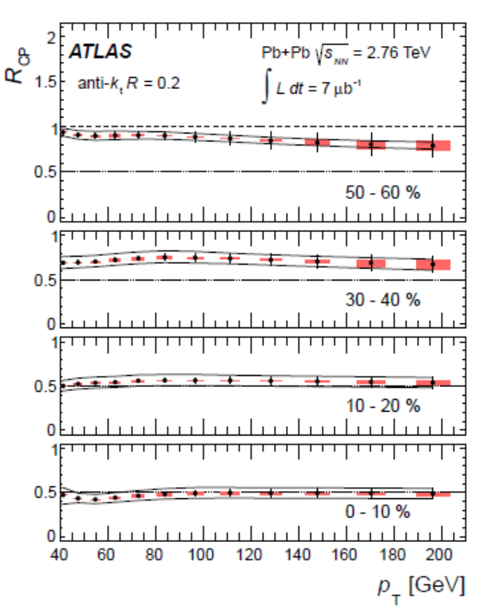
Jet nuclear modification factor*
arXiv:1208.1967 [hep-ex] Submitted to Phys. Lett.B
ATLAS collaboration
Anti-kT algorithm
R=0.2
*Rcp is the ratio of central to peripheral A+A collisions instead of A+A collisions to p+p

Slide 27
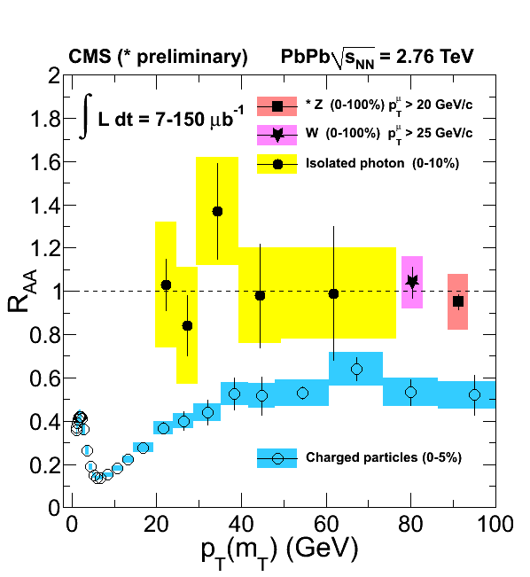
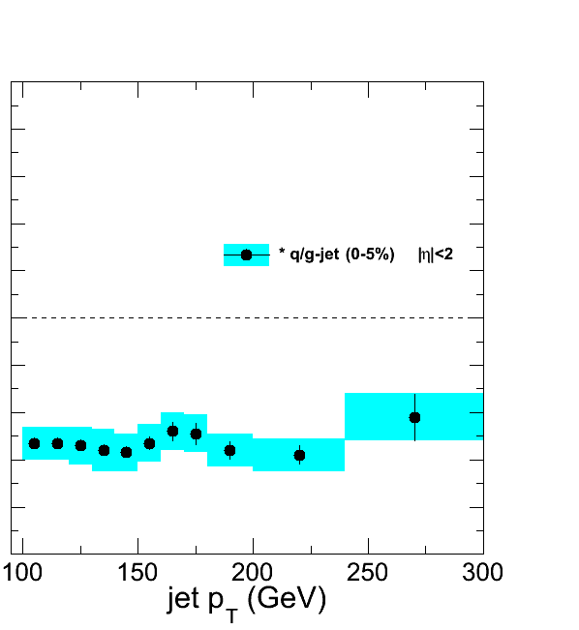
Nuclear modification factors
Fully unfolded inclusive jet RAA
pp 2.76 TeV reference
CMS-PAS HIN-12-004
Like for charged particles, high-pT jet RAA flat at ≈ 0.5

Slide 28
Hard probes

Slide 29

If we have a fluid...
Au+Au √sNN = 200 GeV
b=7 fm
Particles pushed out
Equipotential lines
arXiv:nucl-th/0305084
Initial overlap asymmetric → pressure gradients
Momentum anisotropy → Fourier decomposition:
Notes:
So at this point you're probably wondering how on earth we measure the viscosity of this thing that exists for only a few fermi/c – for less than 10^-24 seconds
When the nuclei collide, they create a droplet of QGP. This droplet of QGP is not symmetric – this shows the incoming nuclei - and there are huge pressure gradients in it. This shows a calculation of the equipotential lines in the QGP.
These pressure gradients push particles out – meaning that particles in this direction are going faster than particles in this direction
What we do is measure the Fourier coefficients of the distribution of particles

Slide 30










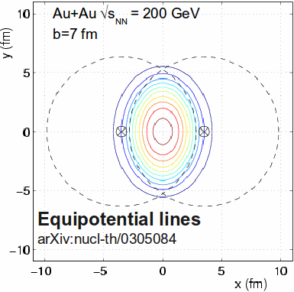
What does it mean?
Same phenomena observed in gases of strongly interacting atoms
Time
K, O’Hara, S. Hemmer, M. Gehm, S. Granade, J. Thomas Science 298 2179 (2002)
Initial state anisotropies converted to final state anisotropies
Fourier decomposition:
Offset
measured
Nuclei are symmetric →
No odd coefficients

Slide 31
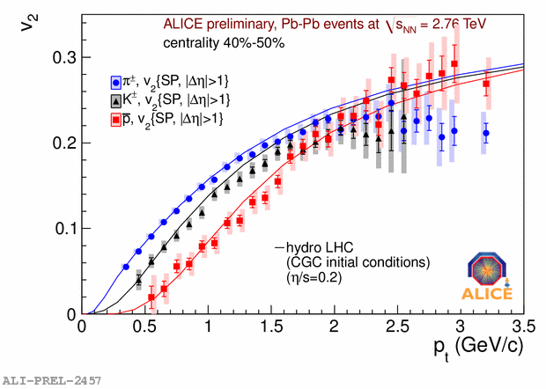
Does this describe the data?
Lower viscosity
arXiv: 1108.5323v1
Yes!
Notes:
Now I don't want to get into the details of this plot but

Slide 32
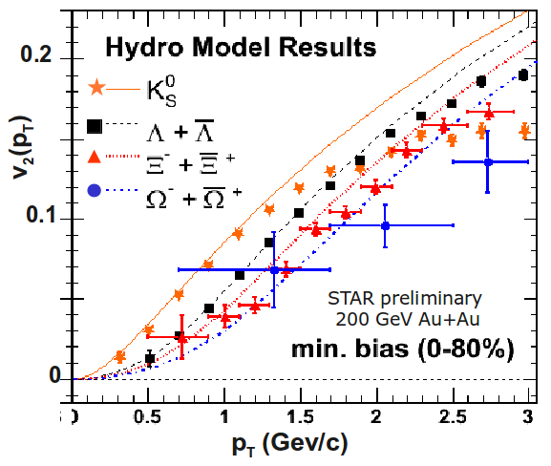
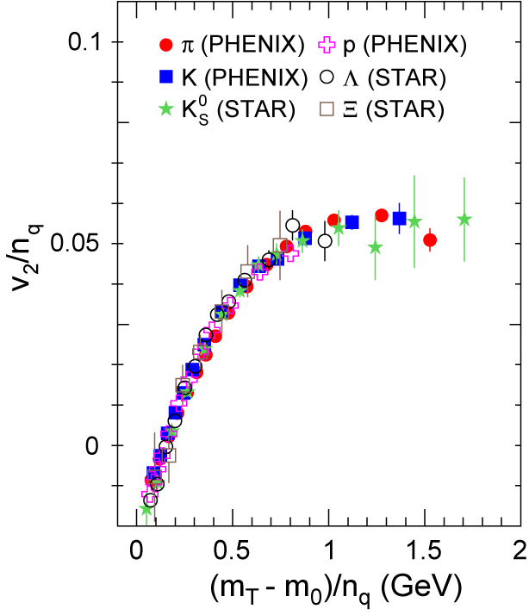
More data
Phys. Rev. Lett. 98, 162301 (2007)
Mass ordering:
v2(K) > v2(Λ) > v2(Ξ)
v2(pThadron) µ nquarkv2(pTquark)
We have a liquid of quarks and gluons!

Slide 33
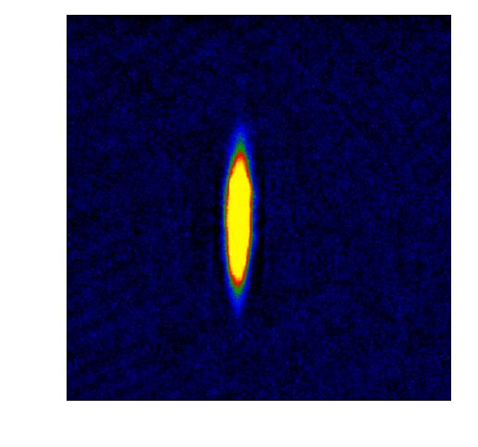

What do we learn about the QGP?
Same phenomena observed in gases of strongly interacting atoms
  K, O’Hara, S. Hemmer, M. Gehm, S. Granade, J. Thomas Science 298 2179 (2002)
High viscosity
Low viscosity
The Quark Gluon Plasma has a very low viscosity

Slide 34
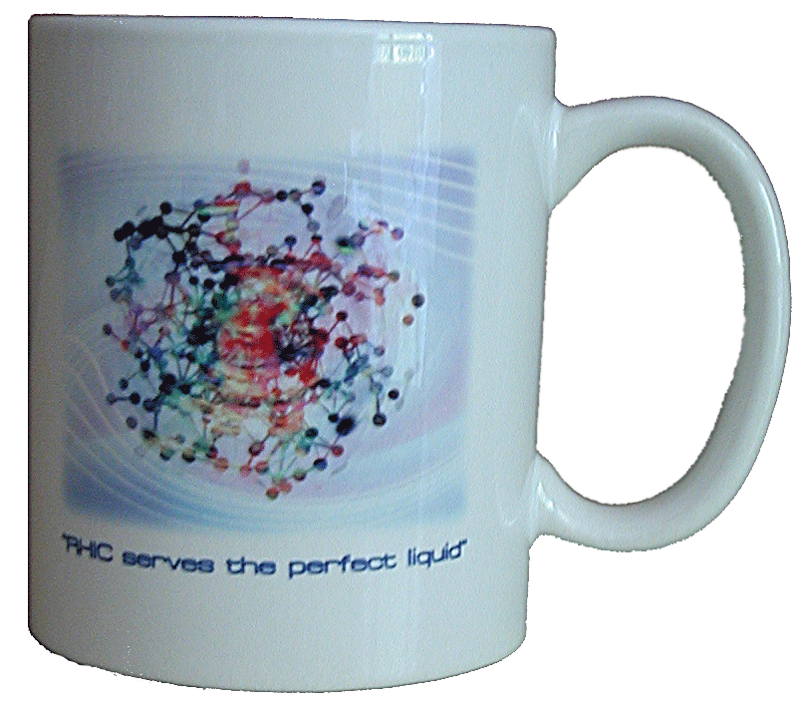
What do we learn about the QGP?
Hydrodynamics works →
  (local) thermalization
  image of the initial state
Really low viscosity
  Near AdS/CFT bound
  η/S ~ 1/4π
The QGP is the perfect liquid!
(not the gas of “free” quarks and gluons we expected)

Slide 35
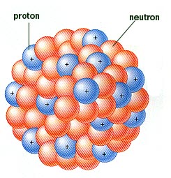
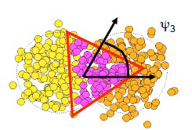
This is not what a nucleus looks like
This is what a nucleus looks like
This is not what our collision looks like
Phys.Rev.C81:054905,2010
This is what our collision looks like

Slide 36
What does it mean?
Same phenomena observed in gases of strongly interacting atoms
Time
K, O’Hara, S. Hemmer, M. Gehm, S. Granade, J. Thomas Science 298 2179 (2002)
Initial state anisotropies converted to final state anisotropies
Fourier decomposition:
Offset
measured
Nuclei are symmetric →
No odd coefficients
Notes:
I have a confession to make – I lied.

Slide 37
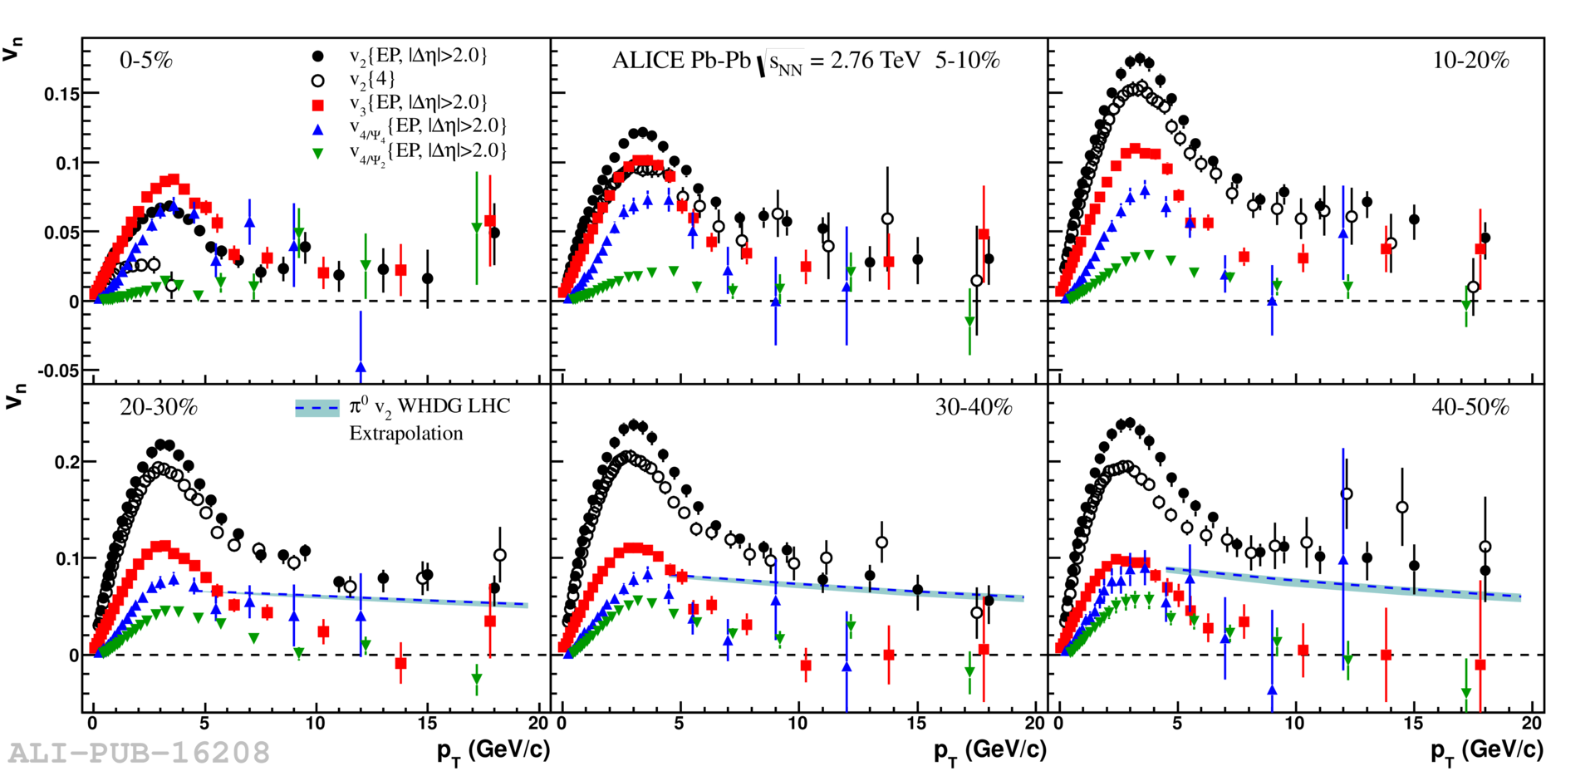
Odd and even vn
0–5%
10–20%
5–10%
30–40%
40–50%
20–30%
Odd n: sensitive to fluctuations in the initial state

Slide 38
Conclusions
Form Quark Gluon Plasma in A+A collisions
T>Tc
Jet suppression → strongly interacting medium
Hydrodynamical flow → low η/S, perfect liquid

Slide 39
QGP Chemistry

Slide 40

Chemistry - equilibrium
T~170 MeV
Nuclear Physics A Volume 757, 102-183
Ratios of particles expected from a model
Even strange quarks are at equilibrium!

Slide 41
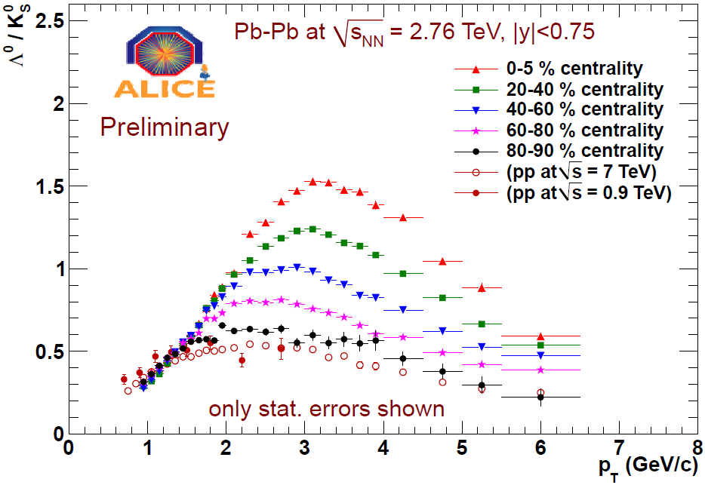
Baryon anomaly: Λ/K0S
Pb+Pb

Slide 42
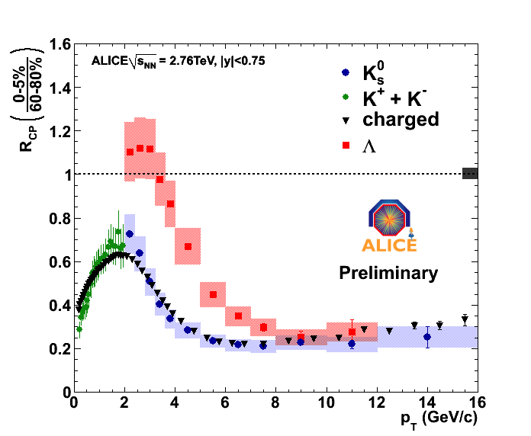

Slide 43
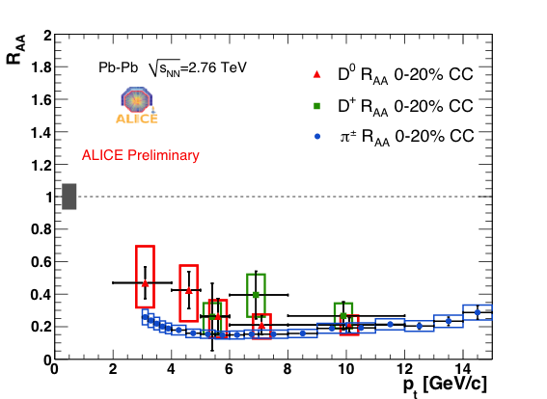
Charm nuclear modification factor
Pb+Pb

Slide 44
Conclusions
Form Quark Gluon Plasma in A+A collisions
T>Tc
Jet suppression → strongly interacting medium
Hydrodynamical flow → low η/S, perfect liquid
Quark chemistry modified in QGP

