Slide 1
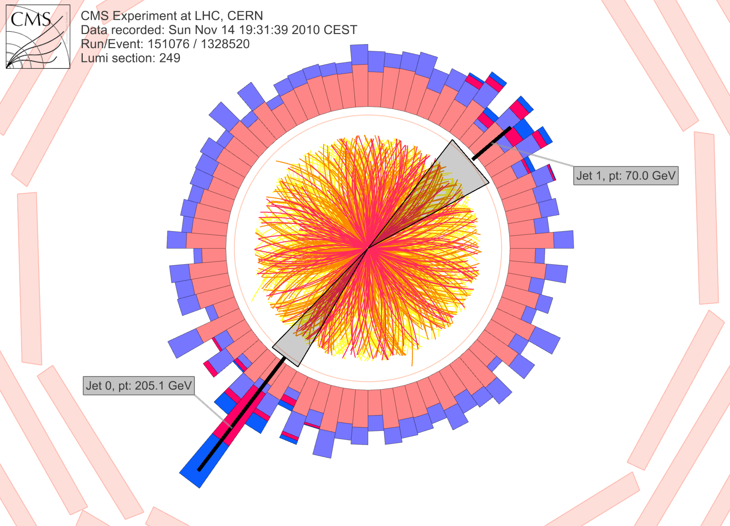
Precision background subtraction in dihadron and jet-hadron correlations
Based on nucl-ex/1509.04732 submitted to PRC
Contributions from Natasha Sharma, Joel Mazer, Meg Stuart, Aram Bejnood

Slide 2

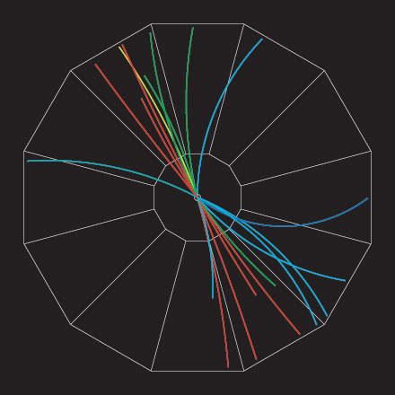



Jets
p+p → dijet
D
c, x_{c}
p
a, x_{a}
b, x_{b}
p
σ_{ab}
Beam pipe
d, x_{d}
D
Jets – hard parton scattering leads to back-to-back quarks or gluons, which then fragment as a columnated spray of particles

Slide 3
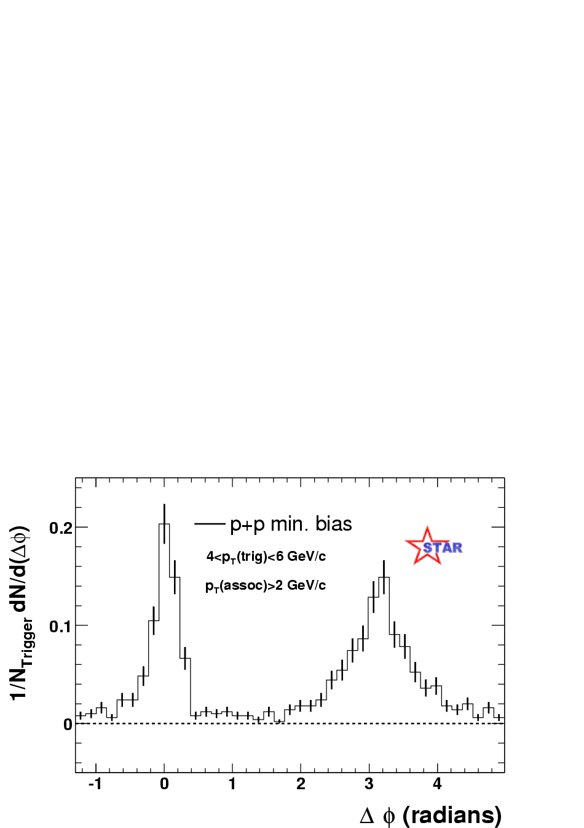
Azimuthal correlations
Jets are dominantly produced as di-jets
Find high-p_{T} trigger particle or jet candidate
Look at distribution of high-p_{T} associated particles relative to trigger
p+p → dijet
Near-side
200 GeV
Trigger
Near-side
Away-side
Away-side
trigger
Phys Rev Lett 90, 082302

Slide 4
Jets – azimuthal correlations
p+p → dijet
Trigger
trigger
Phys Rev Lett 90, 082302
Associated
Select high momentum particles → biased towards jets

Slide 5
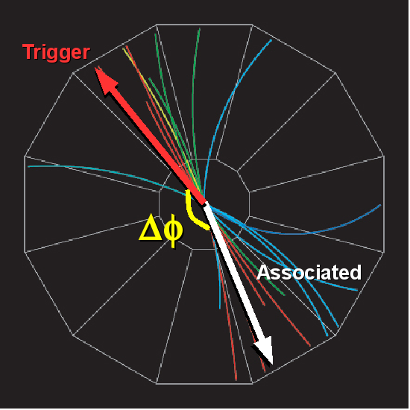
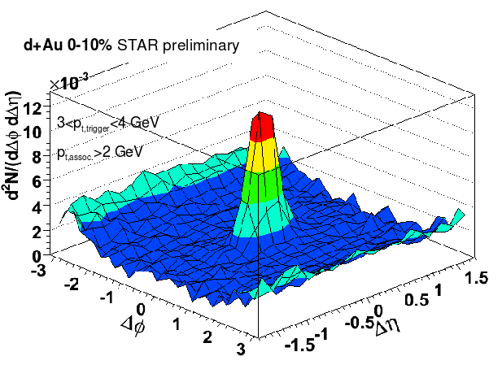
Looking in two dimensions
d+Au
Angle in plane perpendicular to beam pipe
Along direction of beam

Slide 6
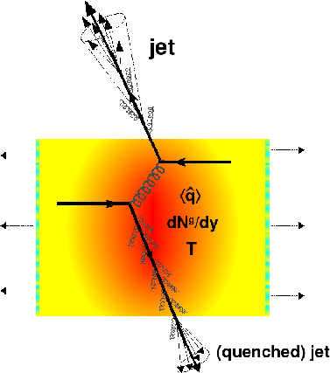
Jet quenching
Quenched jet
  Softer constituents
  Broader radius
→Looks more like background
Figure from Nucl.Phys. A827 (2009) 356C-364C arXiv:0902.2488 [nucl-ex]

Slide 7
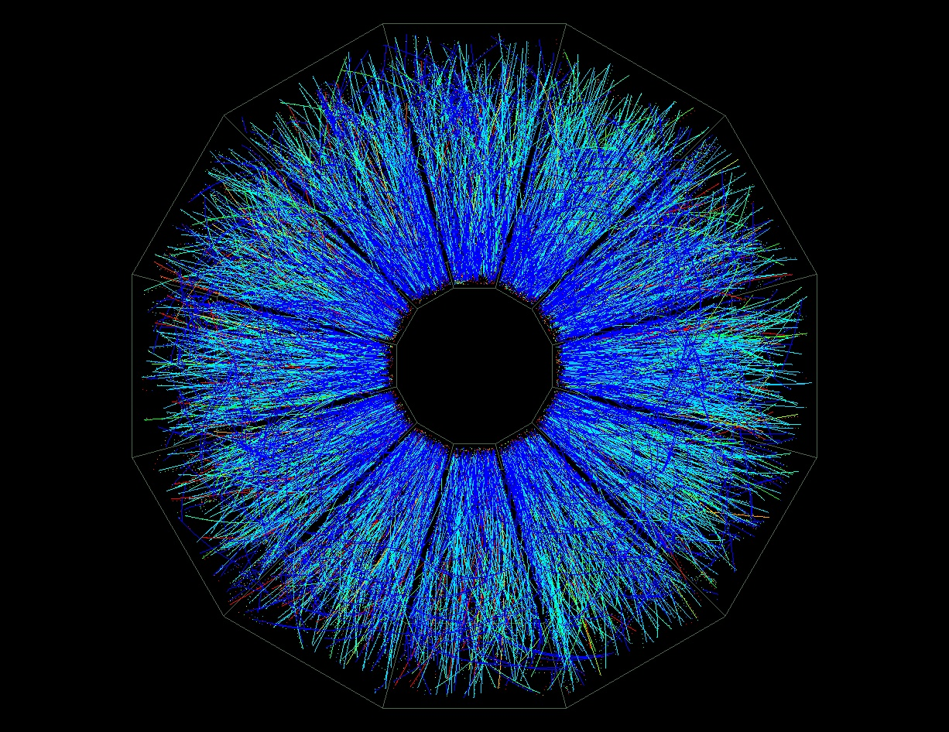
Large combinatorial background in heavy ion collisions
p+p di-jet event in STAR
Central Au+Au collision in STAR

Slide 8
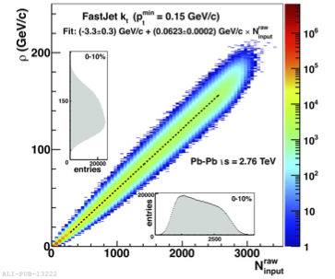
Background in heavy ion collisions
Increase signal/ background by
  Increasing p_{T}^{min} threshold for jet finding
  Increase jet energy
  Require high p_{T} constituent
  Restrict angular size of jet R = √(Δη²+ΔΦ²)
→Bias measurement towards unmodified jets
JHEP 1203:053, 2012
(arxiv:1201.2423)

Slide 9
Background in heavy ion collisions

Slide 10
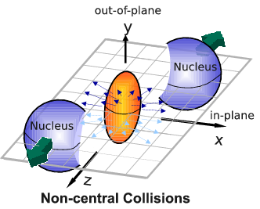
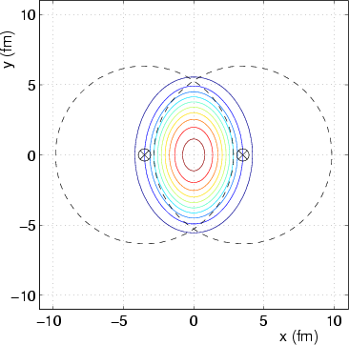
If we have a fluid...
Au+Au √s_{NN} = 200 GeV
b=7 fm
Particles pushed out
Equipotential lines
arXiv:nucl-th/0305084
Initial overlap asymmetric → pressure gradients
Momentum anisotropy → Fourier decomposition:
Notes:
So at this point you're probably wondering how on earth we measure the viscosity of this thing that exists for only a few fermi/c – for less than 10^-24 seconds
When the nuclei collide, they create a droplet of QGP. This droplet of QGP is not symmetric – this shows the incoming nuclei - and there are huge pressure gradients in it. This shows a calculation of the equipotential lines in the QGP.
These pressure gradients push particles out – meaning that particles in this direction are going faster than particles in this direction
What we do is measure the Fourier coefficients of the distribution of particles

Slide 11
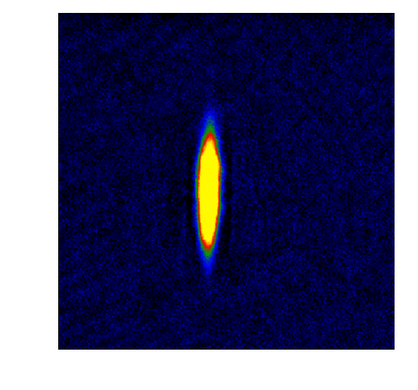
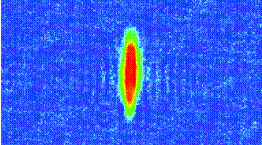
What does this mean?
Same phenomena observed in gases of strongly interacting atoms
  K, O’Hara, S. Hemmer, M. Gehm, S. Granade, J. Thomas Science 298 2179 (2002)
High viscosity
Low viscosity

Slide 12





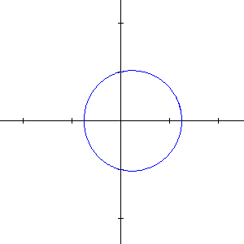
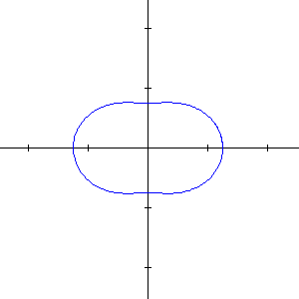
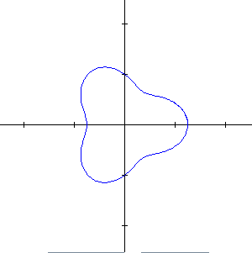
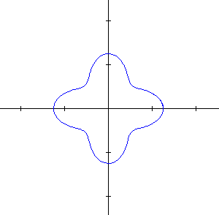
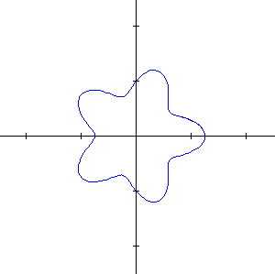
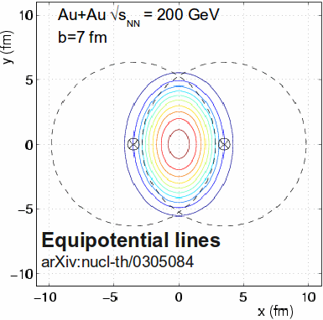
What does it mean?
Same phenomena observed in gases of strongly interacting atoms
Time
K, O’Hara, S. Hemmer, M. Gehm, S. Granade, J. Thomas Science 298 2179 (2002)
Initial state anisotropies converted to final state anisotropies
Fourier decomposition:
Offset
measured

Slide 13
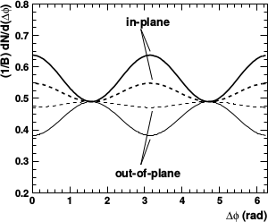
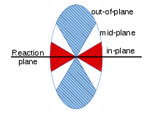
Background in correlations
All reaction plane angles
When trigger is restricted relative to reaction plane
  Background level modified
  Effective v_{n} modified
φ_{S} is the angular threshold
Phys.Rev. C69 (2004) 021901 arXiv:nucl-ex/0311007

Slide 14
Toy model

Slide 15
Model for background
True reaction plane angle is always at φ=0 in detector coordinates
Throw random reconstructed reaction plane angle
  Assume Gaussian reaction plane resolution
  Selected to approximate data
Use measured particle yields to calculate how many associated particles would be measured
Use measured vn to determine their anisotropy relative to the reaction plane
Throw associated particles matching distribution observed in data

Slide 16
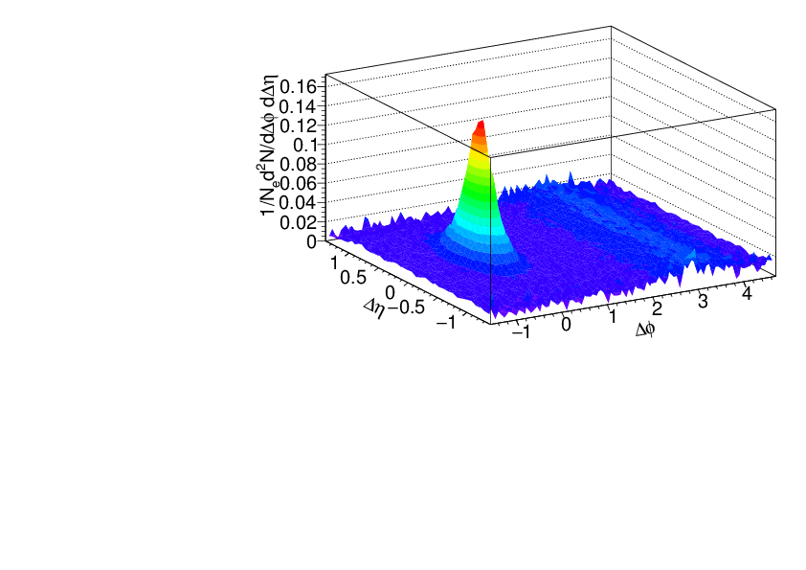
Model for signal
Use PYTHIA Perugia 2011
π±, K±,`p, p for unidentified hadrons
Quarks and gluons as proxy for reconstructed jets
h-h
√s = 2.76 TeV
pp collisions
8<p_{T}^{trigger}<10 GeV/c
1<p_{T}^{assoc}<2 GeV/c

Slide 17
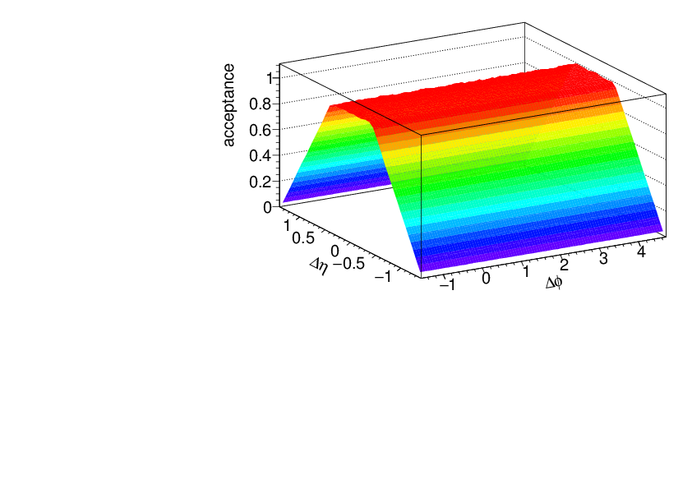
Acceptance correction
Fixed acceptance cuts leads to a trivial structure due to acceptance
This is fixed with a “mixed event” correction
  Throw random trigger, associated particle within acceptance
  Calculate Δφ, Δη
  Use this distribution
  to correct for
  acceptance

Slide 18
Separating the signal and the background

Slide 19
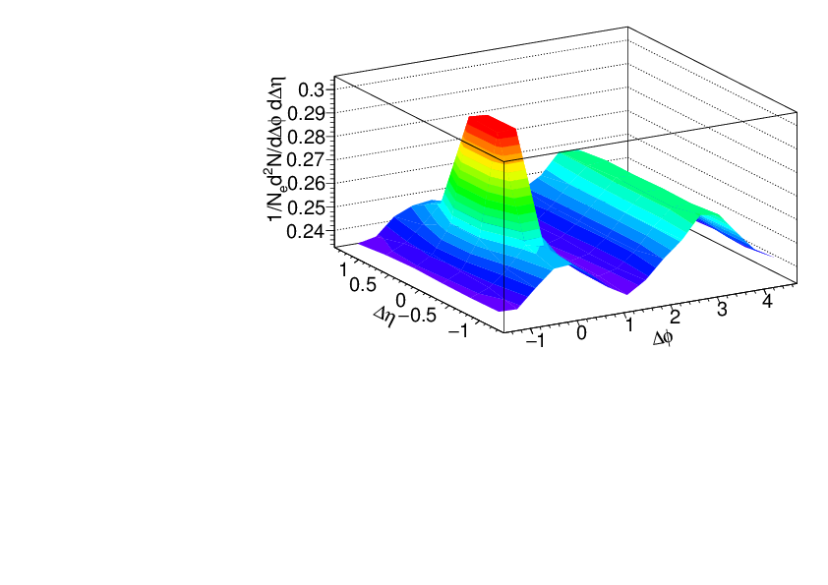
Separating signal+background
Signal+background
Signal only
h-h
√s_{NN} = 2.76 TeV
30-40% PbPb
8<p_{T}^{trigger}<10 GeV/c
1<p_{T}^{assoc}<2 GeV/c
Background dominated region

Slide 20
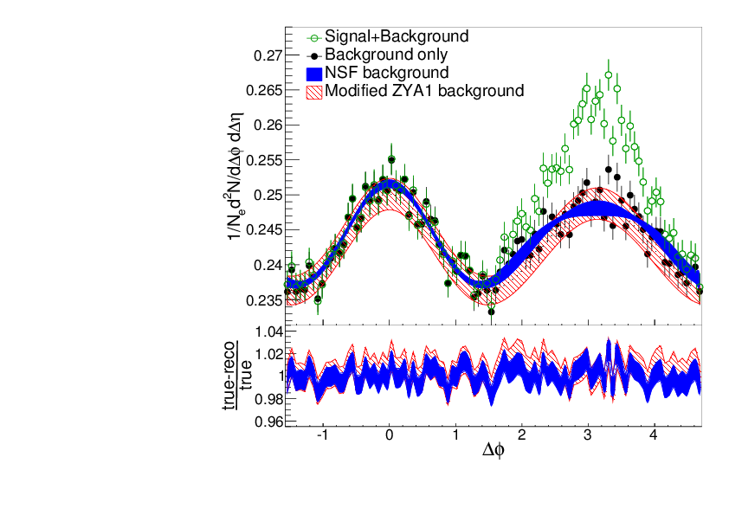
Near-Side Fit (NSF) method
No reaction plane dependence
Signal+background
h-h
√s_{NN} = 2.76 TeV
30-40% PbPb
8<p_{T}^{trigger}<10 GeV/c
1<p_{T}^{assoc}<2 GeV/c
Fit
extrapolation
Background dominated region
Project signal+background over 1.0<|Δη|<1.4
Fit background in |Δφ|<π/2

Slide 21
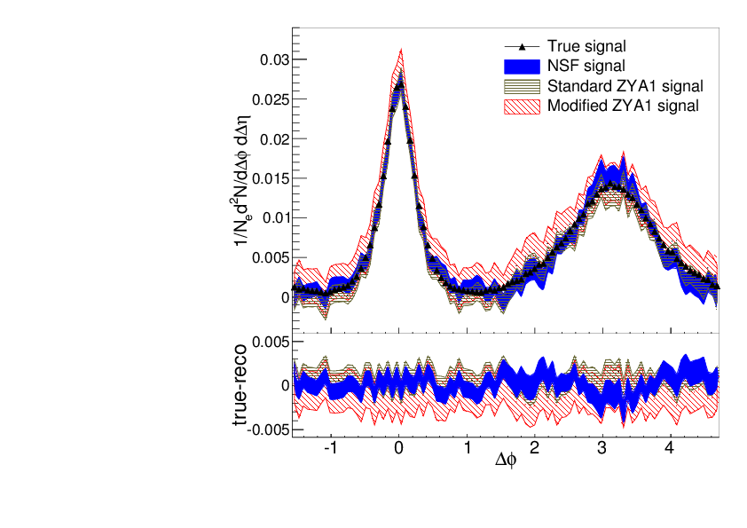
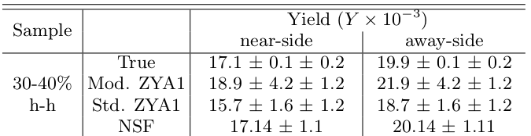
Near-Side Fit (NSF) method
No reaction plane dependence
Reconstructs signal with less bias and smaller errors than ZYA1 method
Extract v_{n} consistent with input
h-h
√s_{NN} = 2.76 TeV
30-40% PbPb
8<p_{T}^{trigger}<10 GeV/c
1<p_{T}^{assoc}<2 GeV/c
Standard ZYA1 = Zero Yield at ΔΦ=1
Modified ZYA1 = Zero Yield at ΔΦ=1 for 1.0<|Δη|<1.4

Slide 22
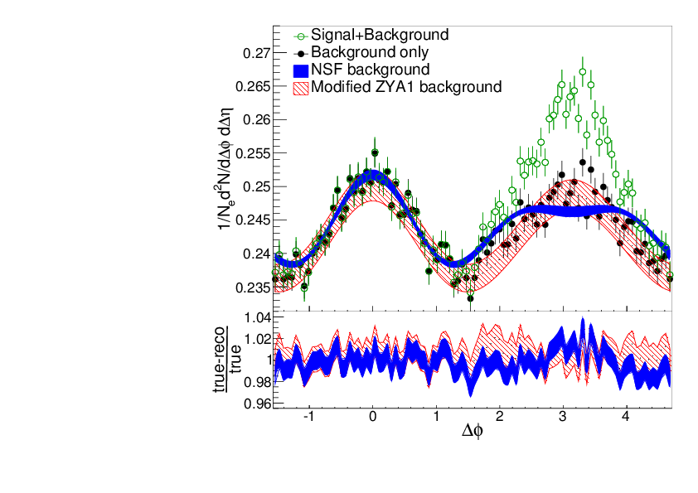
Near-Side Fit (NSF) method
No reaction plane dependence
Signal+background
h-h
√s_{NN} = 2.76 TeV
30-40% PbPb
8<p_{T}^{trigger}<10 GeV/c
1<p_{T}^{assoc}<2 GeV/c
Fit
extrapolation
Background dominated region
Project signal+background over 1.0<|Δη|<1.4
Fit background in |Δφ|<1
Not reliable over narrower Δφ region

Slide 23
Adding reaction plane dependence

Slide 24
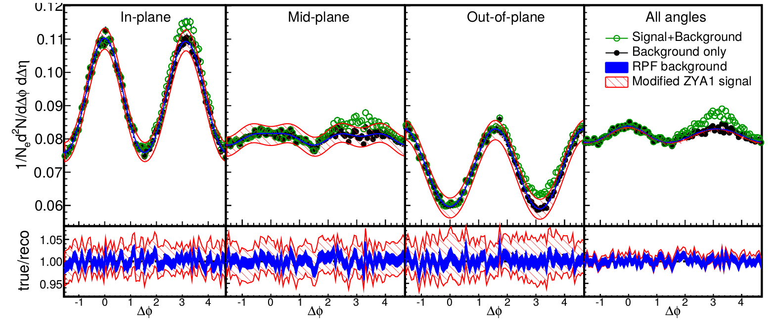
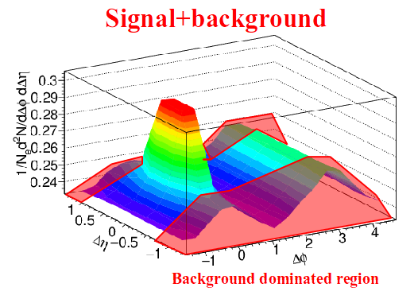
Reaction Plane Fit (RPF) method
30-40% central
h-h
√s_{NN} = 2.76 TeV
30-40% PbPb
8<p_{T}^{trigger}<10 GeV/c
1<p_{T}^{assoc}<2 GeV/c
Fit
Project signal+background over 1.0<|Δη|<1.4
Fit background in |Δφ|<1 including reaction plane dependence
v_{n} and B extracted

Slide 25
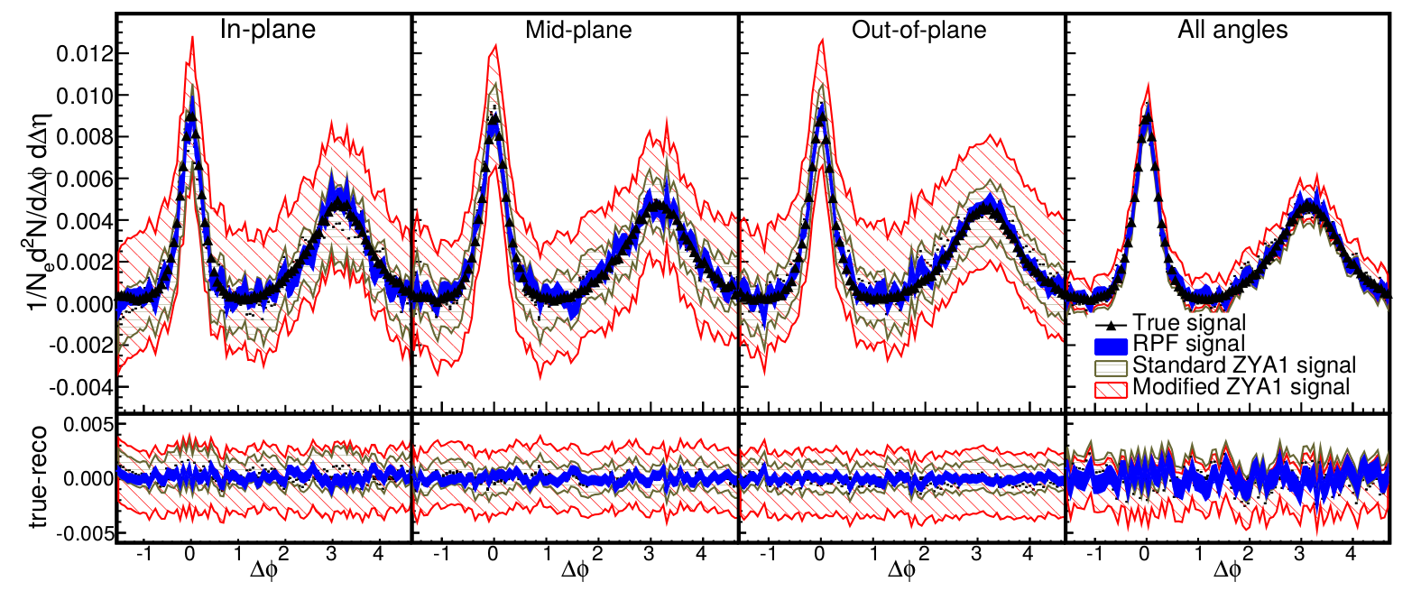
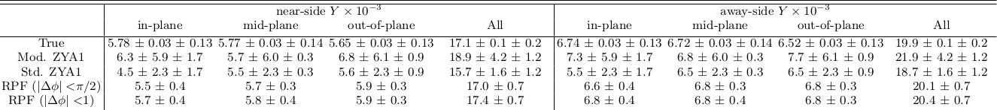
Reaction Plane Fit (RPF) method
30-40% central
h-h
√s_{NN} = 2.76 TeV
30-40% PbPb
8<p_{T}^{trigger}<10 GeV/c
1<p_{T}^{assoc}<2 GeV/c

Slide 26
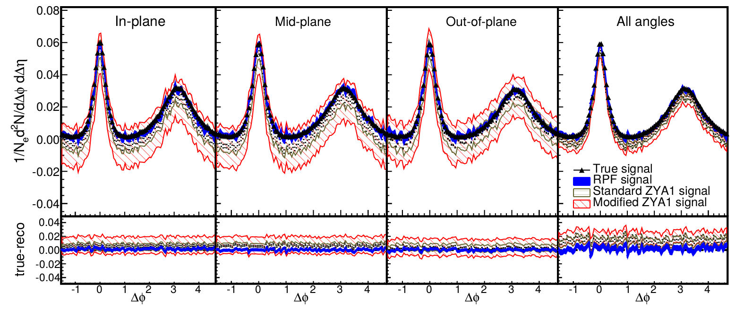
Reaction Plane Fit (RPF) method
0-10% central
Also works for central collisions even though reaction plane resolution is not great
h-h
√s_{NN} = 2.76 TeV
0-10% PbPb
8<p_{T}^{trigger}<10 GeV/c
1<p_{T}^{assoc}<2 GeV/c

Slide 27
Next steps...

Slide 28
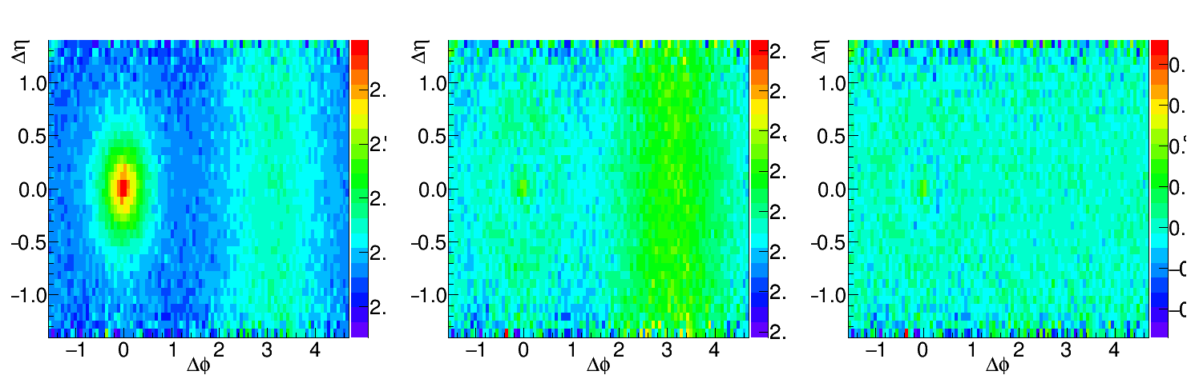
Going to lower momenta, medium modifications
Peak gets broader
Fit near-side peak and subtract it
Increase Δη range available for background subtraction
Before subtraction
After subtraction
Data/Fit
h-h, √s_{NN} = 2.76 TeV, 0-10% PbPb
8<p_{T}^{trigger}<10 GeV/c
1<p_{T}^{assoc}<2 GeV/c for background, 0.5<p_{T}^{assoc}<1.0 GeV/c for signal
Structure from imperfect fit

Slide 29
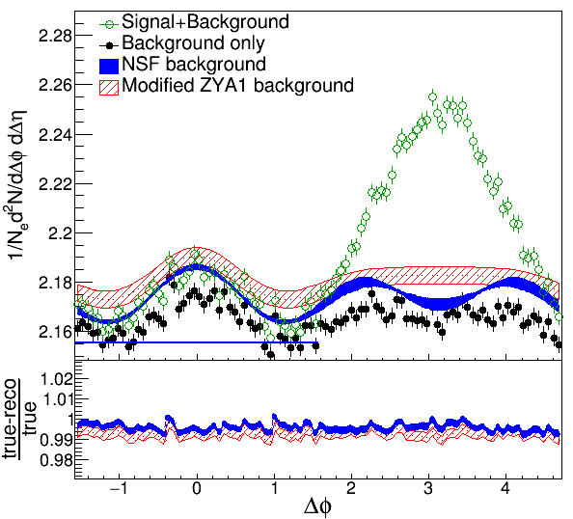
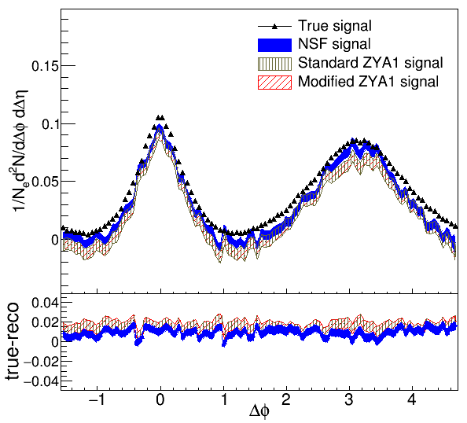
NSF method
h-h, √s_{NN} = 2.76 TeV, 0-10% PbPb
8<p_{T}^{trigger}<10 GeV/c
1<p_{T}^{assoc}<2 GeV/c for background
0.5<p_{T}^{assoc}<1.0 GeV/c for signal
Project signal+background over 0.0<|Δη|<1.4
Fit background in |Δφ|<1 including reaction plane dependence
Bias from residual contamination by near-side

Slide 30
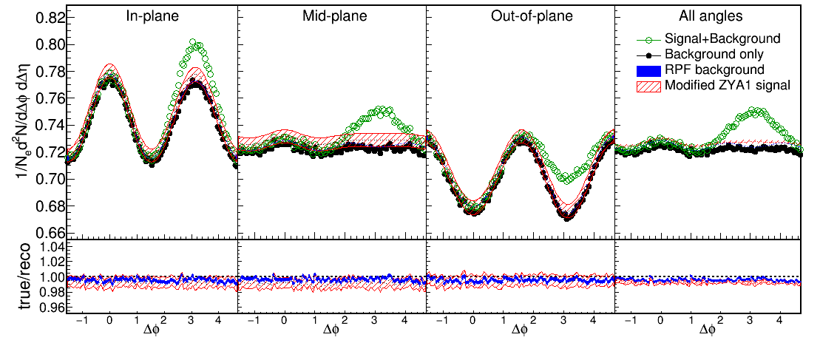
Reaction Plane Fit (RPF) method
30-40% central
h-h, √s_{NN} = 2.76 TeV, 0-10% PbPb
8<p_{T}^{trigger}<10 GeV/c
1<p_{T}^{assoc}<2 GeV/c for background
0.5<p_{T}^{assoc}<1.0 GeV/c for signal
Fit
Project signal+background over 0.0<|Δη|<1.4
Fit background in |Δφ|<1 including reaction plane dependence
v_{n} and B extracted

Slide 31
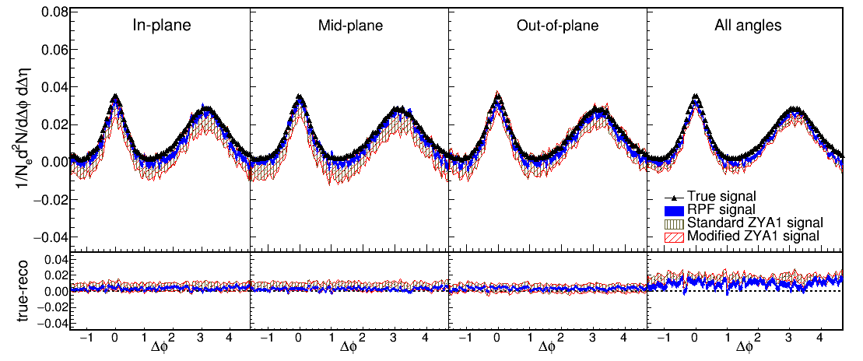
Reaction Plane Fit (RPF) method
30-40% central
h-h
√s_{NN} = 2.76 TeV
30-40% PbPb
8<p_{T}^{trigger}<10 GeV/c
1<p_{T}^{assoc}<2 GeV/c
h-h, √s_{NN} = 2.76 TeV, 0-10% PbPb
8<p_{T}^{trigger}<10 GeV/c
1<p_{T}^{assoc}<2 GeV/c for background
0.5<p_{T}^{assoc}<1.0 GeV/c for signal
Works beautifully!

Slide 32
Remaining work
Use proper background level
Study impact of changing Δη_{min}
  Background determined from Δη_{min}<|Δη|<1.4
Add RMS calculations with error

Slide 33
Conclusions
Conclusions
NSF & RPF methods better than ZYAM/ZYA1
Benefits of RPF & NSF methods
  Do not require independent measurements of v_{n}
    v_{n} could be different for events with jets
      Sample different events
      Effective v_{n} is a weighted average over v_{n} due to jets and due to flow
    v_{n} is not available for jets for n>2
  ZYAM/ZYA1 biased towards underestimating background
  Extracts signal with lower error
Can be extended to low momenta/modified jets!

