Slide 1

Measurements of jets in heavy ion collisions
Christine Nattrass
University of Tennessee, Knoxville

Slide 2

Largely based on Connors, Nattrass, Reed, & Salur
arxiv:1705.01974, accepted in RMP

Slide 3

How to make a Quark Gluon Plasma

Slide 4



The phase transition in the laboratory
Initial State
QGP
Freeze-out
  K, O’Hara, S. Hemmer, M. Gehm, S. Granade, J. Thomas Science 298 2179 (2002)
Hydrodynamical flow
Jet quenching
https://physics.aps.org/articles/v7/97

Slide 5















Relativistic Heavy Ion Collider
Large Hadron Collider
PHOBOS
BRAHMS
CMS
PHENIX
STAR
RHIC
LHCb
ALICE
ATLAS
LHCf
LHC
Upton, NY
1.2km diameter
p+p, d+Au, Cu+Cu, Au+Au, U+U
√s_{NN} = 9 - 200 GeV
Geneva, Switzerland
8.6km diameter
p+p, p+Pb, Pb+Pb
√s_{NN} = 2.76 GeV, 5.5 TeV
RHIC
Notes:
Mention that RHIC planning began 1983

Slide 6

ALICE
ATLAS
CMS
STAR
PHENIX
Notes:
Mention that RHIC planning began 1983

Slide 7




Size: 16 x 26 meters
Weight: 10,000 tons
Detectors: 18
Trigger detectors: When do we have a collision?
Tracking detectors: Where did the particle go?
Identification detectors: What kind of particle is it?
Calorimeters: How much energy does the particle have?
<number>
Notes:
By comparison ATLAS is 25 meters in diameter and 44 meters long – not quite twice as large

Slide 8

p+p collisions
3D image of each collision

Slide 9

Pb+Pb collisions
5

Slide 10
Probing the Quark Gluon Plasma
Medium
Probe
Detector
Want a probe which traveled through the collision
QGP is very short-lived (~1-10 fm/c) →
cannot use an external probe

Slide 11


Probes of the Quark Gluon Plasma
nucleus
nucleus
Want a probe which traveled through the medium
QGP is short lived → need a probe created in the collision

Slide 12
Probes of the Quark Gluon Plasma
nucleus
nucleus
Want a probe which traveled through the medium
QGP is short lived → need a probe created in the collision
We expect the medium to be dense → absorb/modify probe

Slide 13
What is a jet?

Slide 14
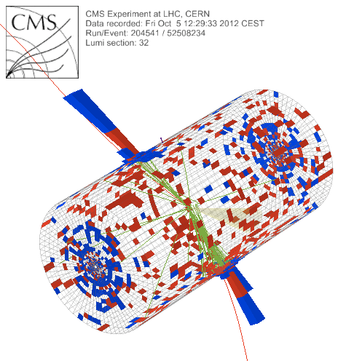

What is a jet?
p+p → dijet
Beam pipe

Slide 15
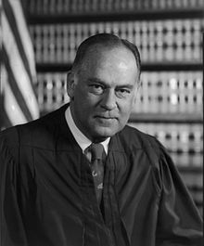
What is a jet?
p+p → dijet
Beam pipe
“I know it when I see it”
US Supreme Court Justice Potter Stewart, Jacobellis v. Ohio

Slide 16

Jet finding
in pp collisions
Jet finder: groups final state particles into jet candidates
  Anti-k_{T} algorithm
  JHEP 0804 (2008) 063 [arXiv:0802.1189]
Depends on hadronization
Ideally
  Infrared safe
  Colinear safe
Snowmass Accord: Theoretical calculations and experimental measurements should use the same jet finding algorithm. Otherwise they will not be comparable.

Slide 17
A jet is what a jet finder finds.

Slide 18
Jet finding
in AA collisions
Jet finder: groups final state particles into jet candidates
  Anti-k_{T} algorithm
  JHEP 0804 (2008) 063 [arXiv:0802.1189]
Combinatorial jet candidates
Energy smearing from background
Large, fluctuating, correlated background
Sensitive to methods to suppress combinatorial jets and correct energy
Focus on narrow/high energy jets

Slide 19

Energy loss

Slide 20


Nuclear modification factor
Measure spectra of probe (jets) and compare to those in p+p collisions or peripheral A+A collisions
If high-p_{T} probes (jets) are suppressed, this is evidence of jet quenching
Enhancement
Suppression

Slide 21

Nuclear modification factor
LHCb-PAPER-2017-015
Control
Control
Probe
Charged hadrons (colored probes) suppressed in Pb—Pb
Charged hadrons not suppressed in p—Pb at midrapidity
Electroweak probes not suppressed in Pb—Pb

Slide 22


Nuclear modification factor R_{AA}
RHIC
LHC
Connors, Nattrass, Reed, SalurarXiv:1705.01974 [nucl-ex]
Electromagnetic probes – consistent with no modification – medium is transparent to them
Strong probes – significant suppression – medium is opaque to them - even heavy quarks!

Slide 23

Jet R_{AA}
arXiv:1705.01974
Jet R_{AA} also demonstrates suppression

Slide 24


Di-hadron correlations
p+p → dijet
Trigger
nucleus
Associated
Phys.Rev.Lett.93:252301,2004
nucleus

Slide 25

Di-hadron correlations
p+p → dijet
Trigger
nucleus
Associated
nucleus
Updated to include latest information about background

Slide 26
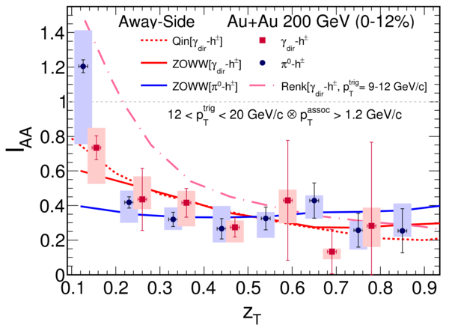
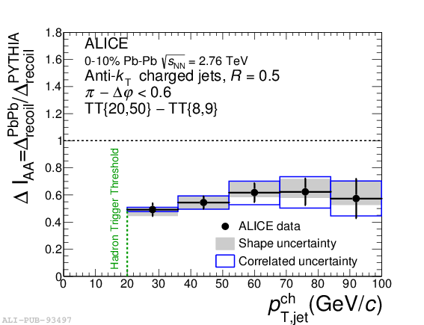

suppression
suppression
Jet v₂
[Phys.Lett. B 753 (2016) 511-525,
Phys. Rev. Lett.111 152301 (2013)]
Di-hadron correlations
[Too many to list]
γ-hadron correlations
[Phys.Rev.C80:024908,2009,
Phys.Rev.D82:072001,2010,
Phys.Rev.C82:034909,2010
Physics Letters B 760 (2016)]
γ-jet
correlations
[Phys. Lett. B 718 (2013) 773]
High-p_{T}
hadron v₂
[too many to list]
suppression
Dijet asymmetry
[Phys.Rev.C84:024906,2011,
Phys. Lett. B 712 (2012) 176,
Phys.Rev.Lett.105:252303,2010,
Phys. Rev. Lett. 119, 062301 (2017)]
Hadron-jet correlations
[JHEP 09 (2015) 170,
Phys. Rev. C 96, 024905 (2017)]

Slide 27
Fragmentation

Slide 28
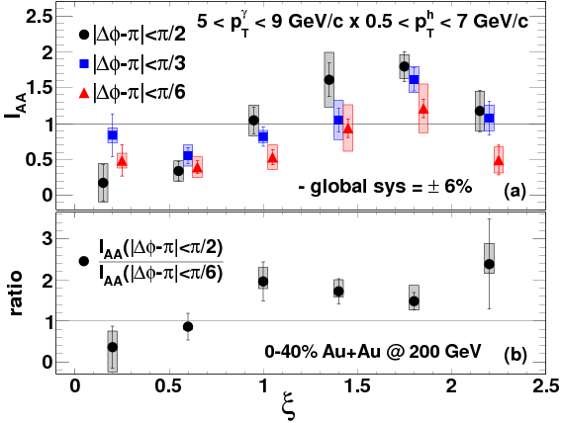
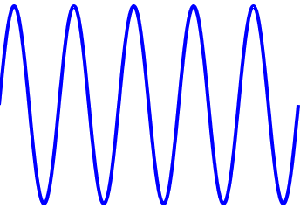
Fragmentations from γ-hadron correlations
z=p_{T}/E_{γ}
1.00
0.61
0.37
0.22
0.14
0.08
Enhancement at low z
Slight suppression at high z

Slide 29

Modified fragmentation
z=p_{T}/E_{γ}
Enhancement at low z
No modification/enhancement at high z?

Slide 30






Jet-hadron correlations vs reaction plane
Full jets
1) signal+bkgd
2) bkgd dominated
3) bkgd RPF fit
Trigger
Associated
No modification of constituents relative to reaction plane
→ Jet-by-jet fluctuations more important than path length [PLB 735 157(2014)]
  Also needed to explain high p_{T} v₂ [PRL 116 252301 (2016)]

Slide 31

Jet-hadron correlations
Jets are broader, constituents are softer
Also seen in:
  Di-hadron correlations [Lots of papers]
  Jet shapes [arXiv:1708.09429, arXiv:1512.07882, arXiv:1704.03046]
  Dijet asymmetry with soft constituents [PRL119 (2017) 62301]

Slide 32

Modified fragmentation
Jet-hadron correlations
Fragmentation functions with jets
Fragmentation functions with jets
arXiv:1609.03878
Di-jet asymmetry
Leading jet
z=p_{T}/E_{γ}
Di-hadron correlations
[Lots of papers]
Jet shapes
[arXiv:1708.09429,
arXiv:1512.07882,
arXiv:1704.03046]
Sys. Uncertainties:
Tracking:6%
Tower energy scale: 2%
Kolja Kauder, RHIC/AGS
User's Meeting 2016
Subleading jet
$0A_{j}=\frac{p_{T}^{leading}−p_{T}^{subleading}}{p_{T}^{leading}+p_{T}^{subleading}}$

Slide 33


Jet structure

Slide 34


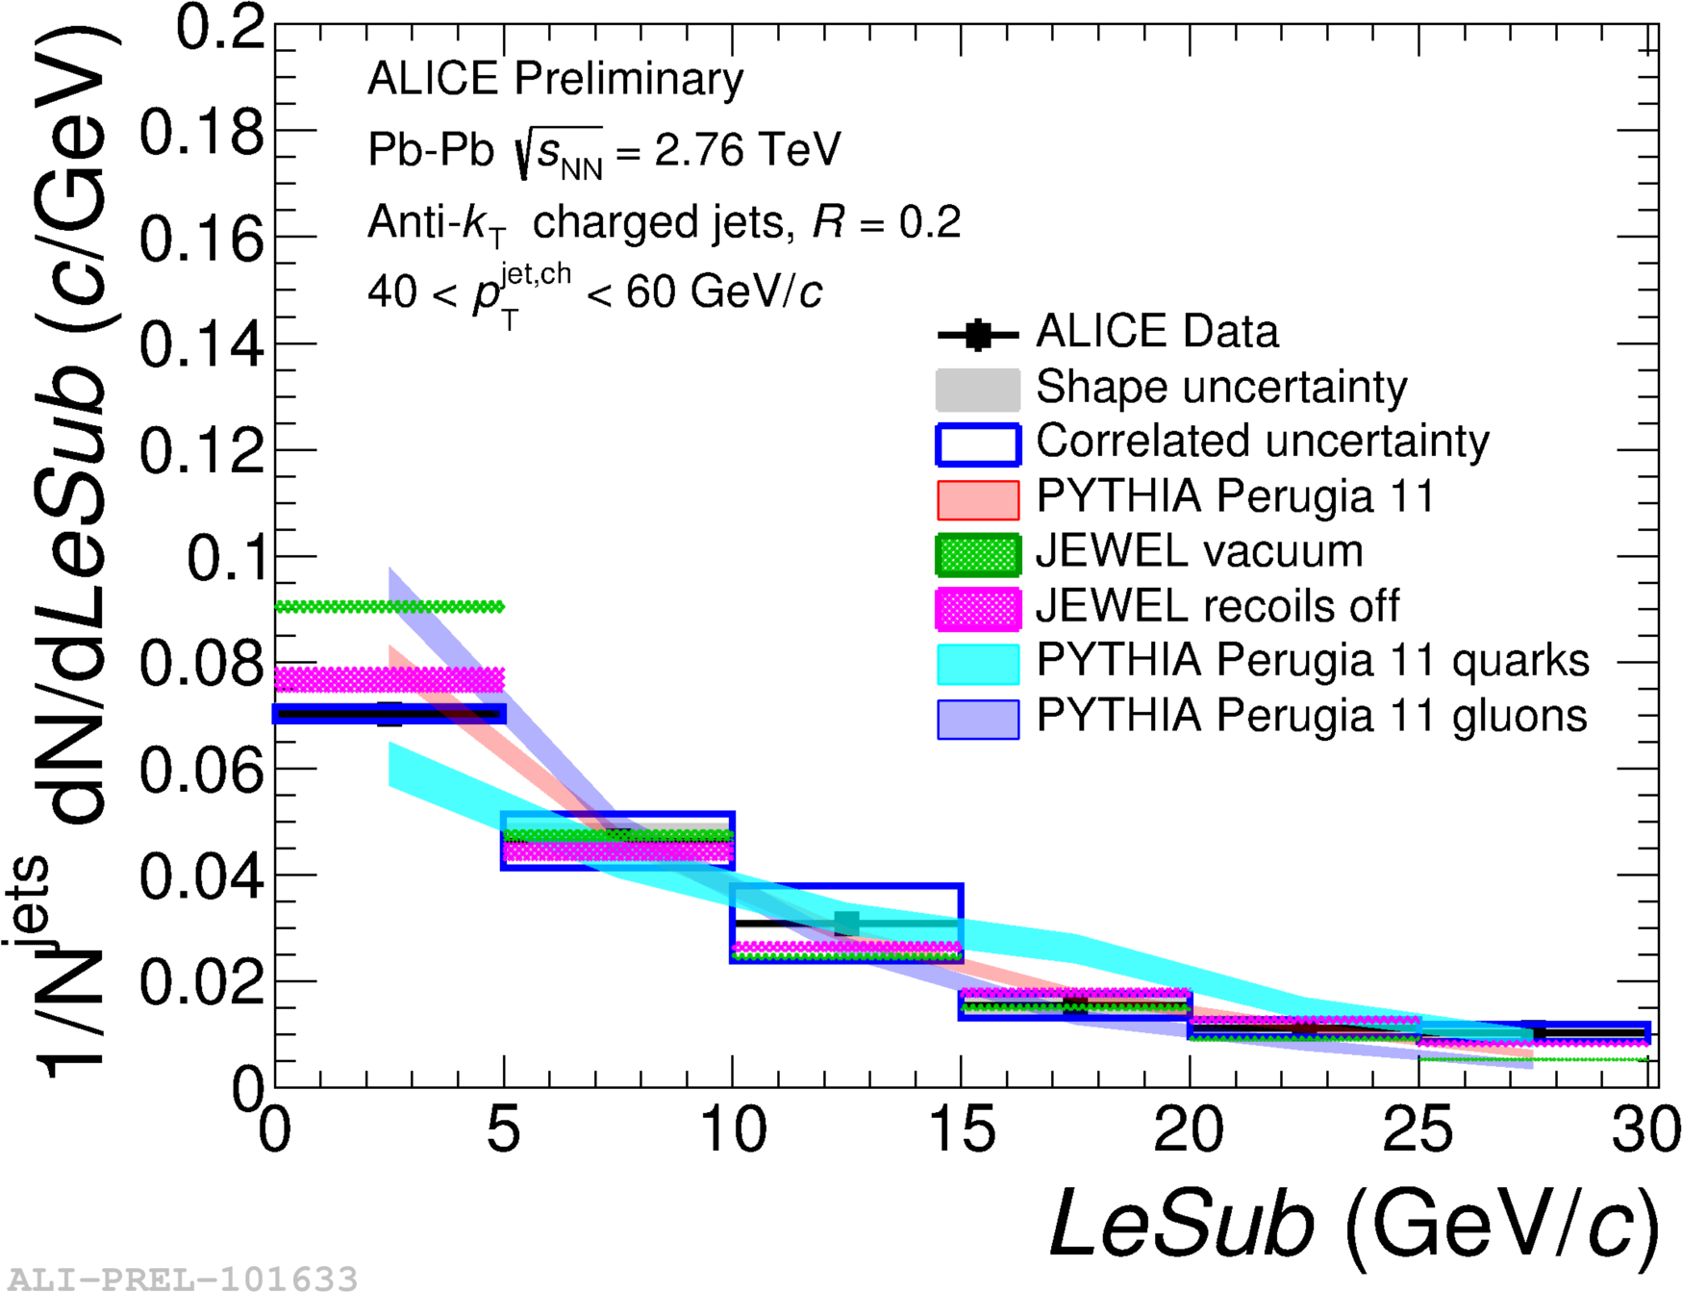
Girth g
Dispersion p_{T}D
LeSub
$g=\sum_{i∈jet}{\frac{p_{T}^{i}}{p_{T}^{jet}}r_{i}}$
$p_{T}D=\frac{\sqrt{\sum_{i∈jet}{{\left(p_{T}^{i}\right)}^{2}}}}{\sum_{i∈jet}{p_{T}^{i}}}$
$LeSub=p_{T}^{leading}−p_{T}^{subleading}$
Jets are slightly more collimated than in pp
Agrees with PYTHIA

Slide 35
Theory

Slide 36
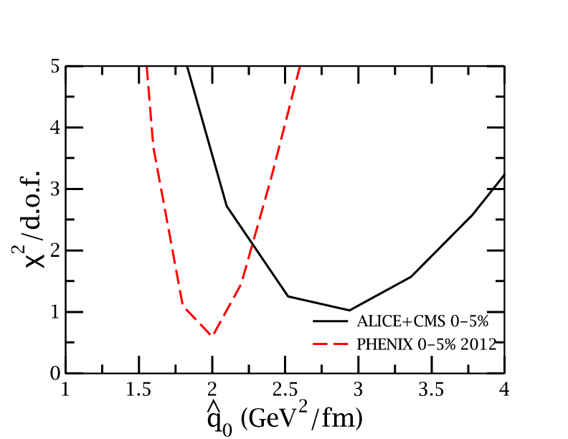
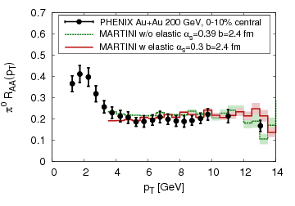
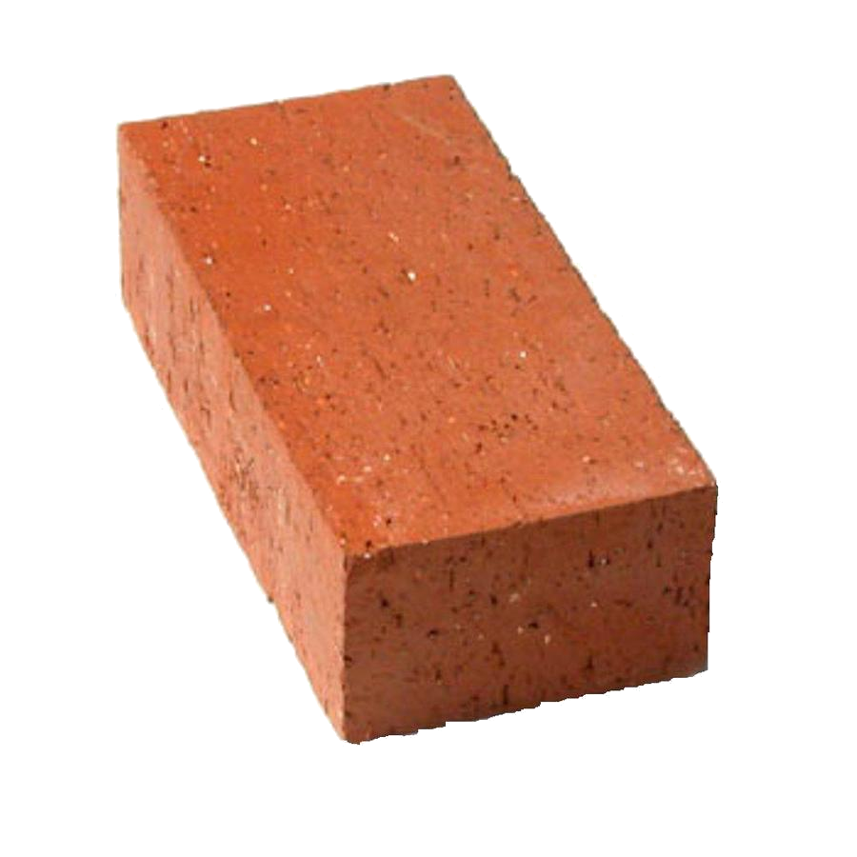
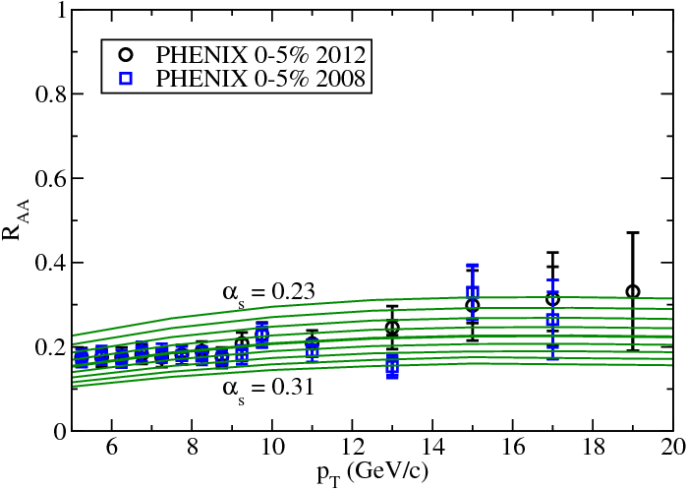
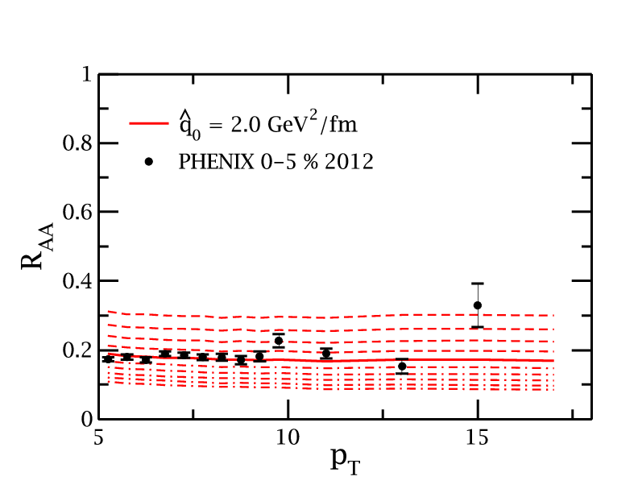
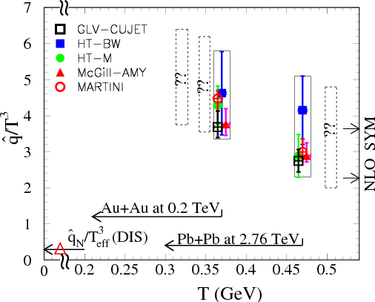
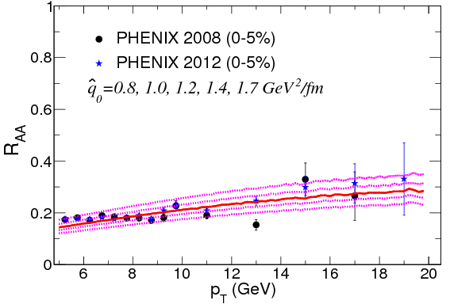
JET collaboration
Phys. Rev. C 90, 014909 (2014)
Martini
McGill
$χ^{2}minimization$
QGP brick + jet
HTM
HTBW
Data
$\hat{q}=1.2±0.3 {GeV}^{2}$
200 GeV Au+Au
$\hat{q}=1.9±0.7 {GeV}^{2}$
2.76 TeV Pb+Pb

Slide 37

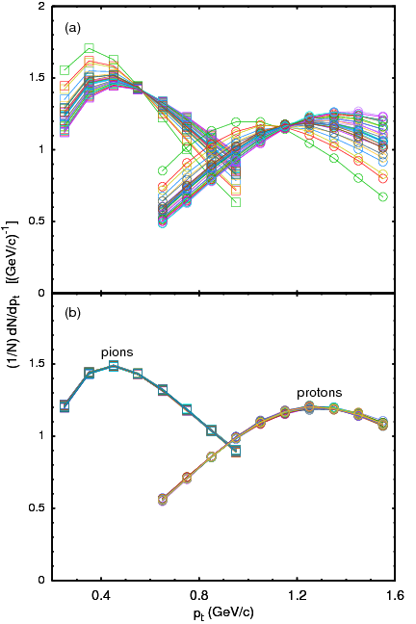
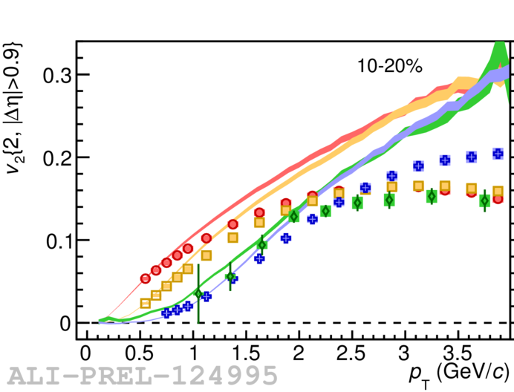
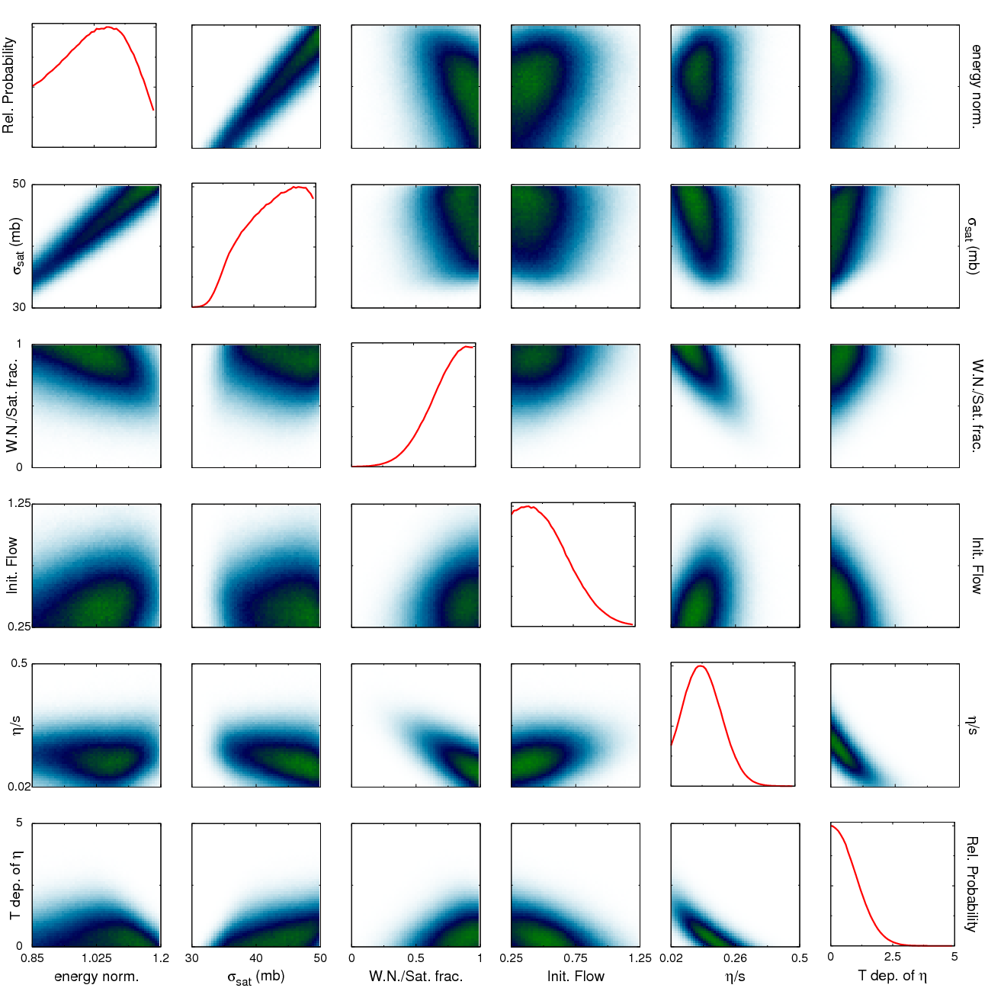

Bayesian Statistical Analysis
Models and Data Analysis Initiative
http://madai.us
Prior
Data
Posterior
Optimization
Monte Carlo
models
Model emulation
Run full model ~1000 times
MCMC parameter search uses emulator (interpolator) in lieu of full model
Constraint of QGP properties
Novak et al, Phys.Rev. C89 (2014) no.3, 034917

Slide 38

JETSCAPE
Event generator
Jet Energy-loss Tomography with a Statistically and Computationally Advanced Program Envelope
http://jetscape.wayne.edu/
Realistic medium
Realistic
theoretical
calculations
Experimental
techniques
Realistic Monte Carlo Model
Realistic jets

Slide 39
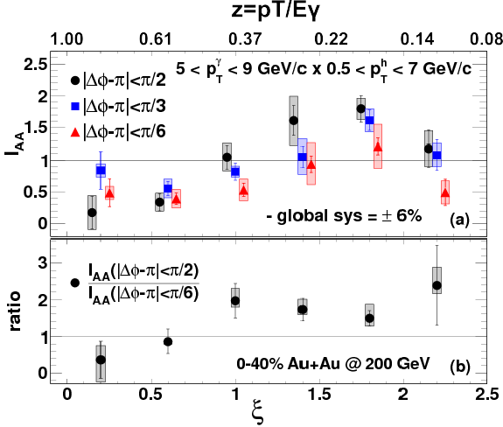
Event Generator + Bayesian Statistical analysis
Realistic theoretical calculations
Data
Bayesian Statistical Analysis
Constraint of QGP properties

Slide 40
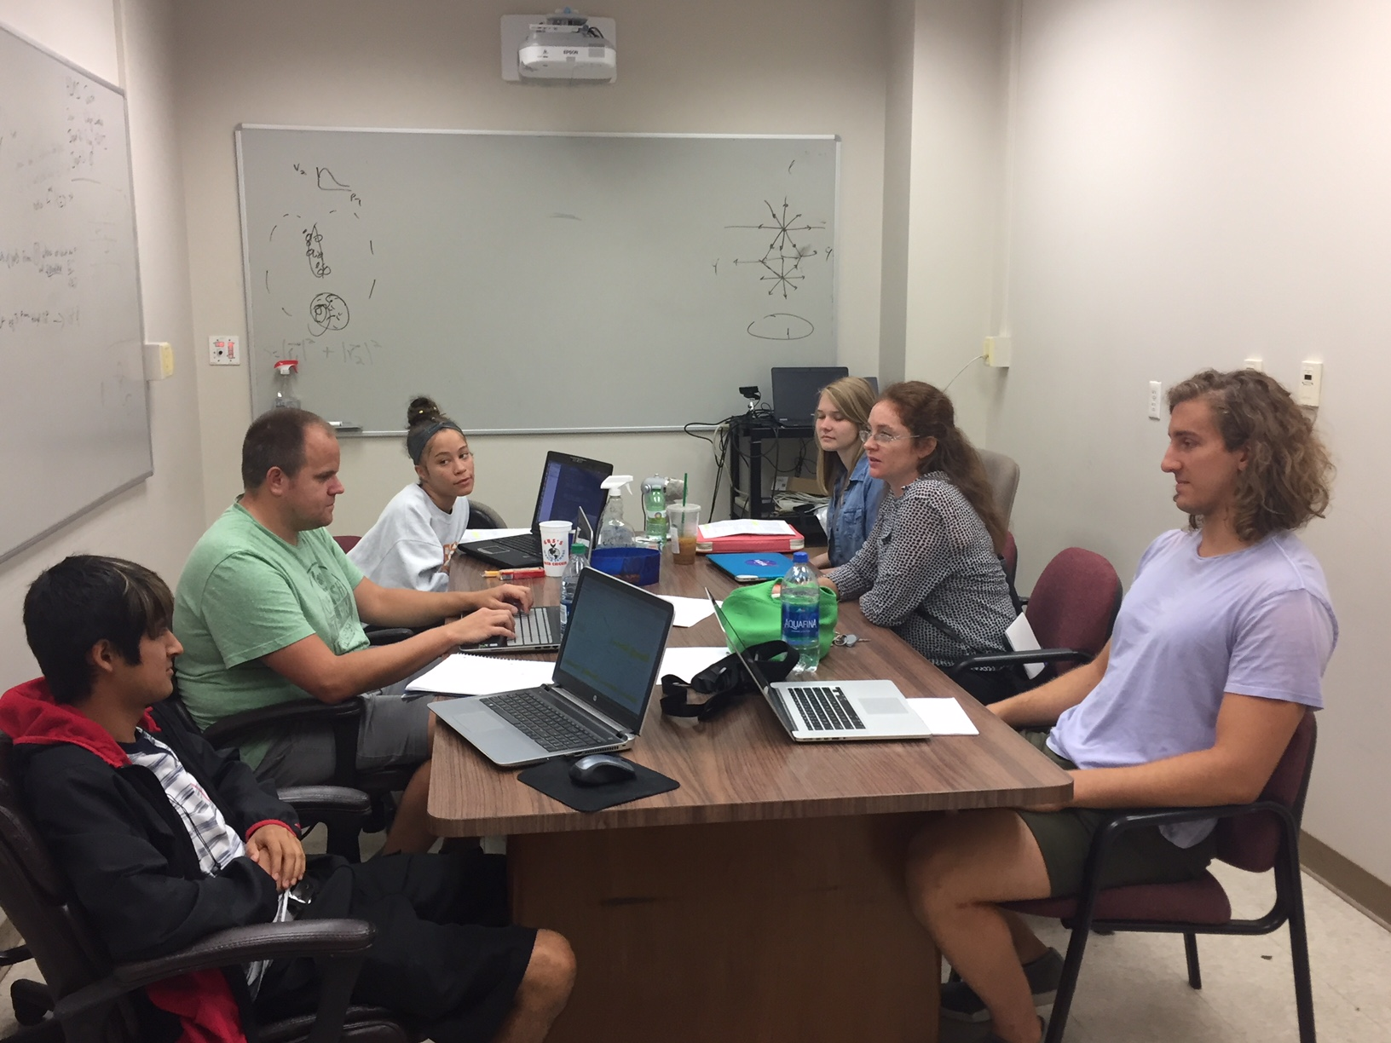
Undergraduates!*
JETSCAPE REU
Left to right: Ricardo Santos (Berea), James Neuhaus, Jerrica Wilson, Mariah McCreary, Christine Nattrass, Austin Schmier (UTK)
*And one beginning graduate student with no programming experience.
We acknowledge substantial support from the US NSF and the JETSCAPE Collaboration

Slide 41

Course-based undergraduate research experience

Slide 42
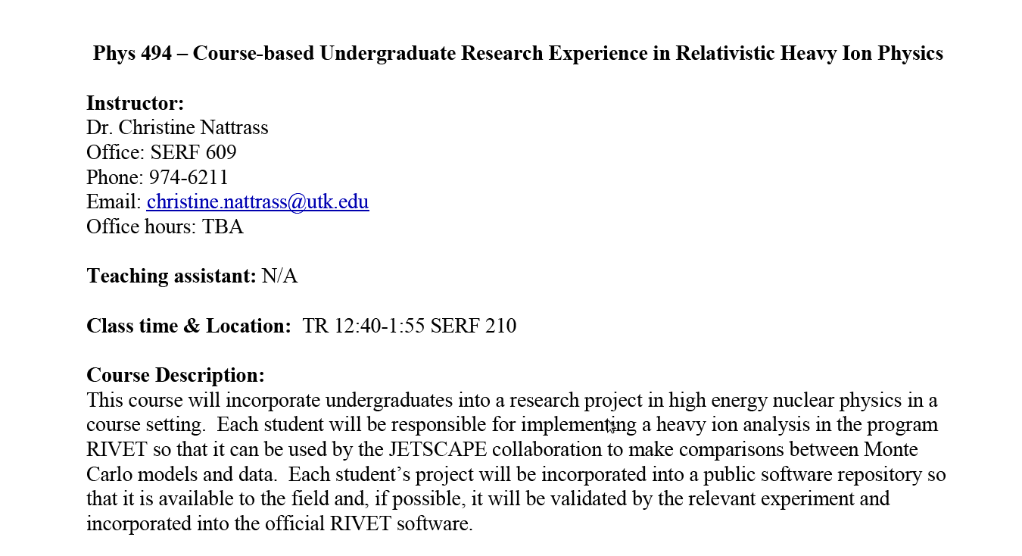

Slide 43

https://i.ytimg.com/vi/mZnv6LXD9qs/maxresdefault.jpg

Slide 44
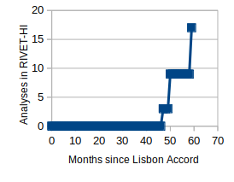
Analyses (almost) implemented in UTK copy of RIVET
Spring 2019 UTK research class, RHIC dihadron and gamma hadron analyses
2018 UTK summer students, reconstructed jet analyses
ALICE implementations
https://github.com/cnattras/rivet-hi
Need to be finalized! Hold me to it!

Slide 45
What have we accomplished?
Qualitative confirmation of partonic energy loss models
Quantitative constraints of
Lots of measurements
$\hat{q}$
What do we still have to do?
Understand bias
Make quantitative comparisons to theory
Make more differential measurements
We need an accord on how to treat background
Connors, Nattrass, Reed, SalurarXiv:1705.01974 [nucl-ex]

