Slide 1
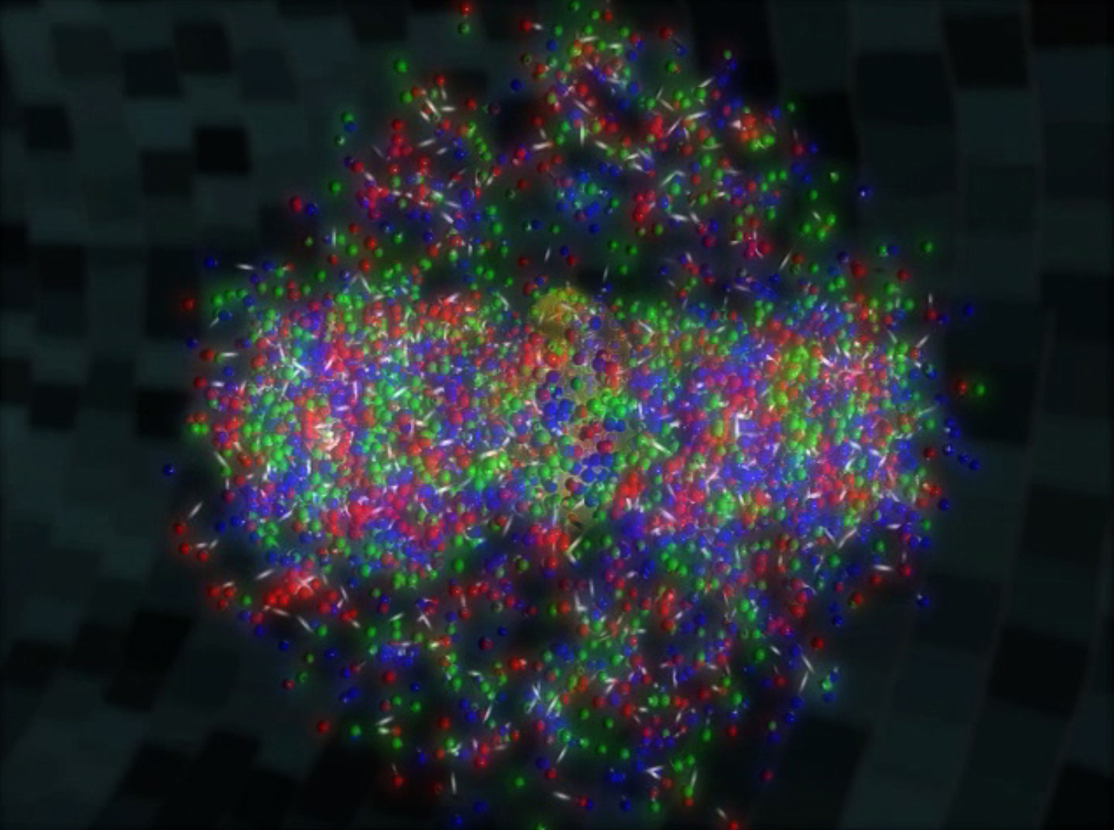
Results from heavy ion collisions
Christine Nattrass
University of Tennessee at Knoxville

Slide 2

Standard model of heavy ion physics

Slide 3
Standard model of heavy ion physics
Initial State
QGP
Freeze-out

Slide 4


Standard model of heavy ion physics
Initial State
QGP
Freeze-out
  K, O’Hara, S. Hemmer, M. Gehm, S. Granade, J. Thomas Science 298 2179 (2002)
Hydrodynamical flow
Jet quenching
https://physics.aps.org/articles/v7/97

Slide 5



















Relativistic Heavy Ion Collider
Large Hadron Collider
PHOBOS
BRAHMS
CMS
PHENIX
STAR
RHIC
LHCb
ALICE
ATLAS
LHCf
Upton, NY
1.2km diameter
p+p, d+Au, Cu+Cu, Au+Au, U+U
√s_{NN} = 9 - 200 GeV
Geneva, Switzerland
8.6km diameter
p+p, p+Pb, Pb+Pb
√s_{NN} = 2.76 GeV, 5.5 TeV
LHC
Quark Gluon Plasma
RHIC
Core of neutron stars?
Notes:
Mention that RHIC planning began 1983

Slide 6

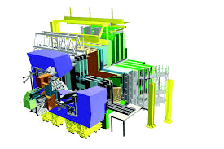
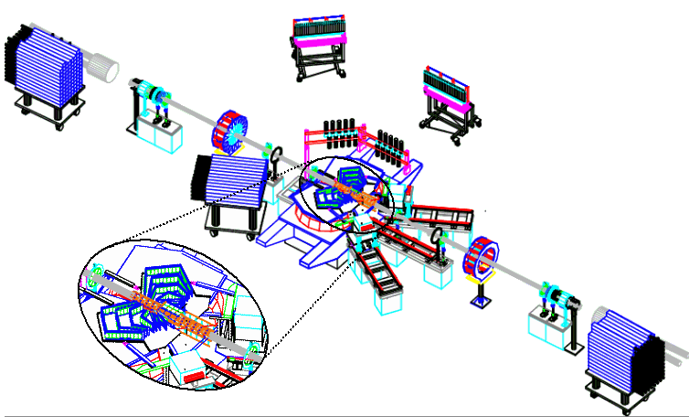
ALICE
ATLAS
CMS
STAR
LHCb
PHENIX
BRAHMS
Phobos
Notes:
Mention that RHIC planning began 1983

Slide 7
Forming the QGP

Slide 8

How can we estimate the energy density?
Transverse energy (E_{T})
  sum of particle energies in transverse direction
Volume V = A_{T} τc
τ = formation time
Energy density ε
QGP formation for ε > 0.5 GeV/fm³
A_{T}
= τc

Slide 9
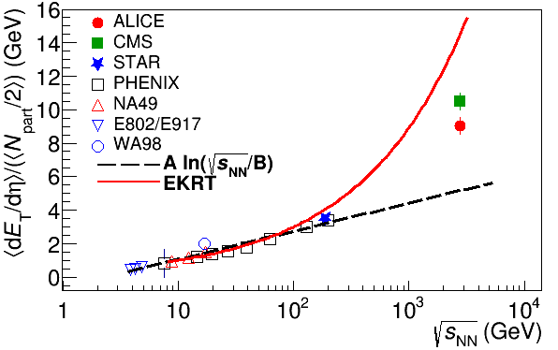

Energy dependence from dE_{T}/dy
RHIC
Standard estimate τ₀ ≈ 1 fm/c
QGP formation
Higher than extrapolations of RHIC data

Slide 10
Where are we on the phase diagram?

Slide 11
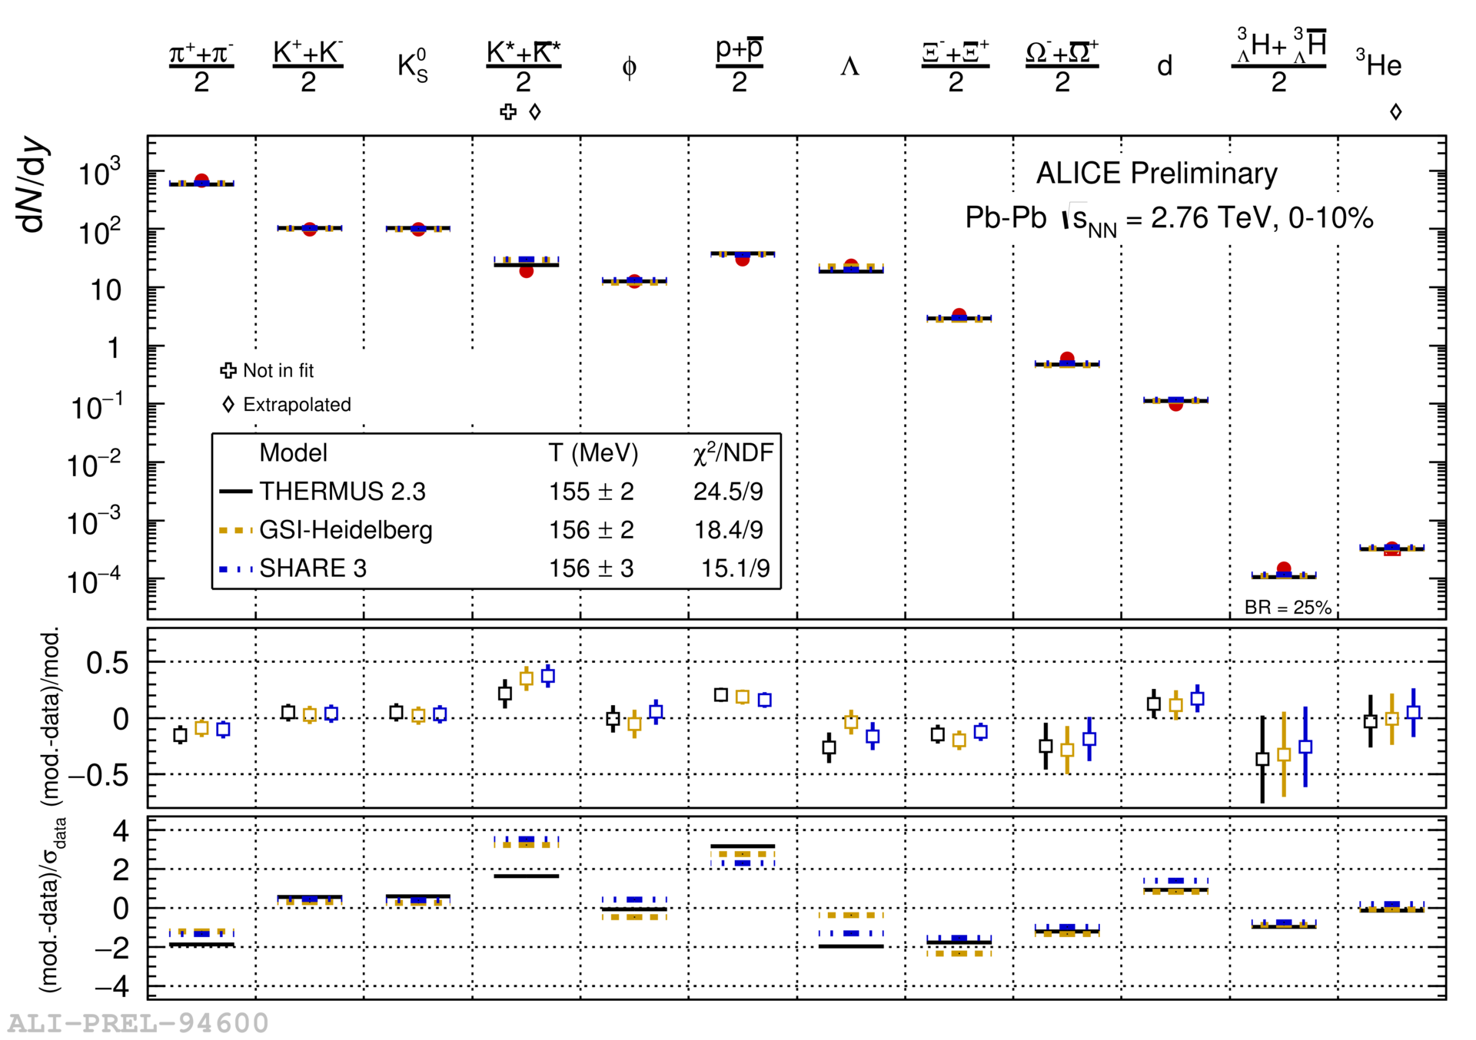

Chemistry - equilibrium
arXiv:1701.07065
Nuclear Physics A Volume 757, 102-183
Ratios of particles expected from a model

Slide 12

QCD Phase Diagram
Quark Gluon Plasma
Hadron Gas
arXiv:1701.07065
Notes:
But wait – how can we have a liquid of quarks and gluons? Doesn't asymptotic freedom tell us that we can't have free quarks and gluons? How, then, can we have a liquid of quarks and gluons?

Slide 13


?
trajectory of system
arXiv:1701.07065

Slide 14

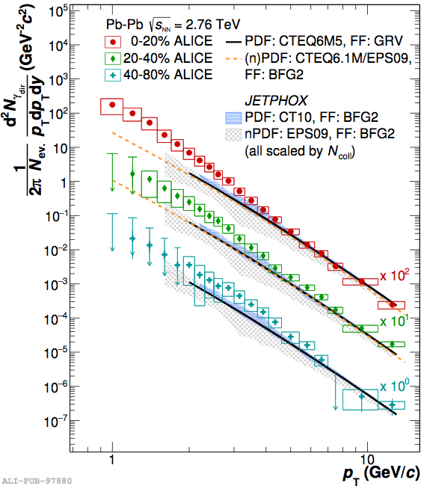
Thermal photons
Phys.Rev.Lett.104:132301,2010
Thermal photons
PHENIX
QCD processes
ALICE
Au+Au collisions at √s_{NN}=200 GeV
Inverse slope: T = 221 +/- 19 (stat) +/- 19 (syst) MeV
Pb+Pb collisions at √s_{NN}=2.76 TeV
Inverse slope: T = 304 +/-51 MeV

Slide 15





A quarkonium-thermometer
CMS-PAS HIN-11-011
arXiv:1708.04962 [nucl-ex]
N_{part}
Clear hierarchy in R_{AA} of different quarkonium states
c
c
b
b

Slide 16

A quarkonium-thermometer
CMS-PAS HIN-11-011
arXiv:1708.04962 [nucl-ex]
Note: 6.5<p_{T}<30 GeV for J/ψ and ψ(2s)
N_{part}
Clear hierarchy in R_{AA} of different quarkonium states
Expected in terms of binding energy
CMS-PAS HIN-12-014, HIN-12-007

Slide 17
~600
trajectory of system
arXiv:1701.07065

Slide 18
Hydrodynamical flow

Slide 19

Hydrodynamical flow
Radial Flow
  Affects shape of low p_{T} particle spectra
Elliptic Flow
  Sensitive to initial geometry
  Requires early thermalization of the medium
Directed Flow
  Produced in the pre-equilibrium phase of the collision
  Decreases with increasing √s_{NN}
y
x
y
x
x
z

Slide 20

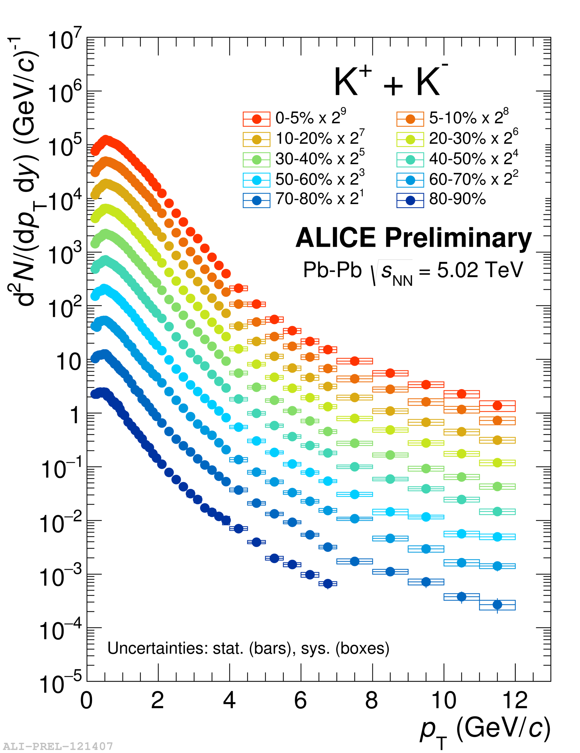
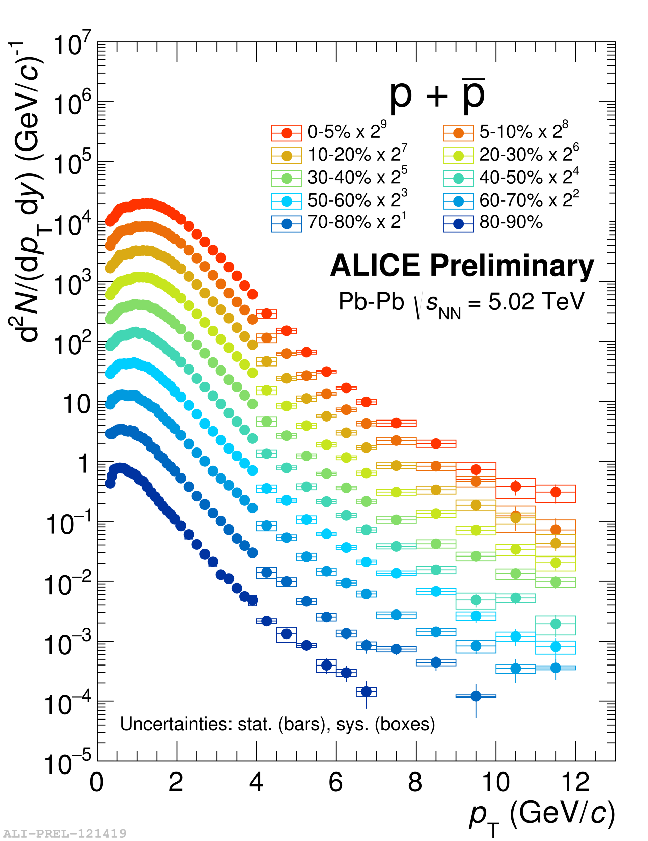
Hadron spectra
Radial flow boosts hadrons
  low p_{T}: mass dependent slope
  high p_{T}: common hardening of p_{T} spectra

Slide 21
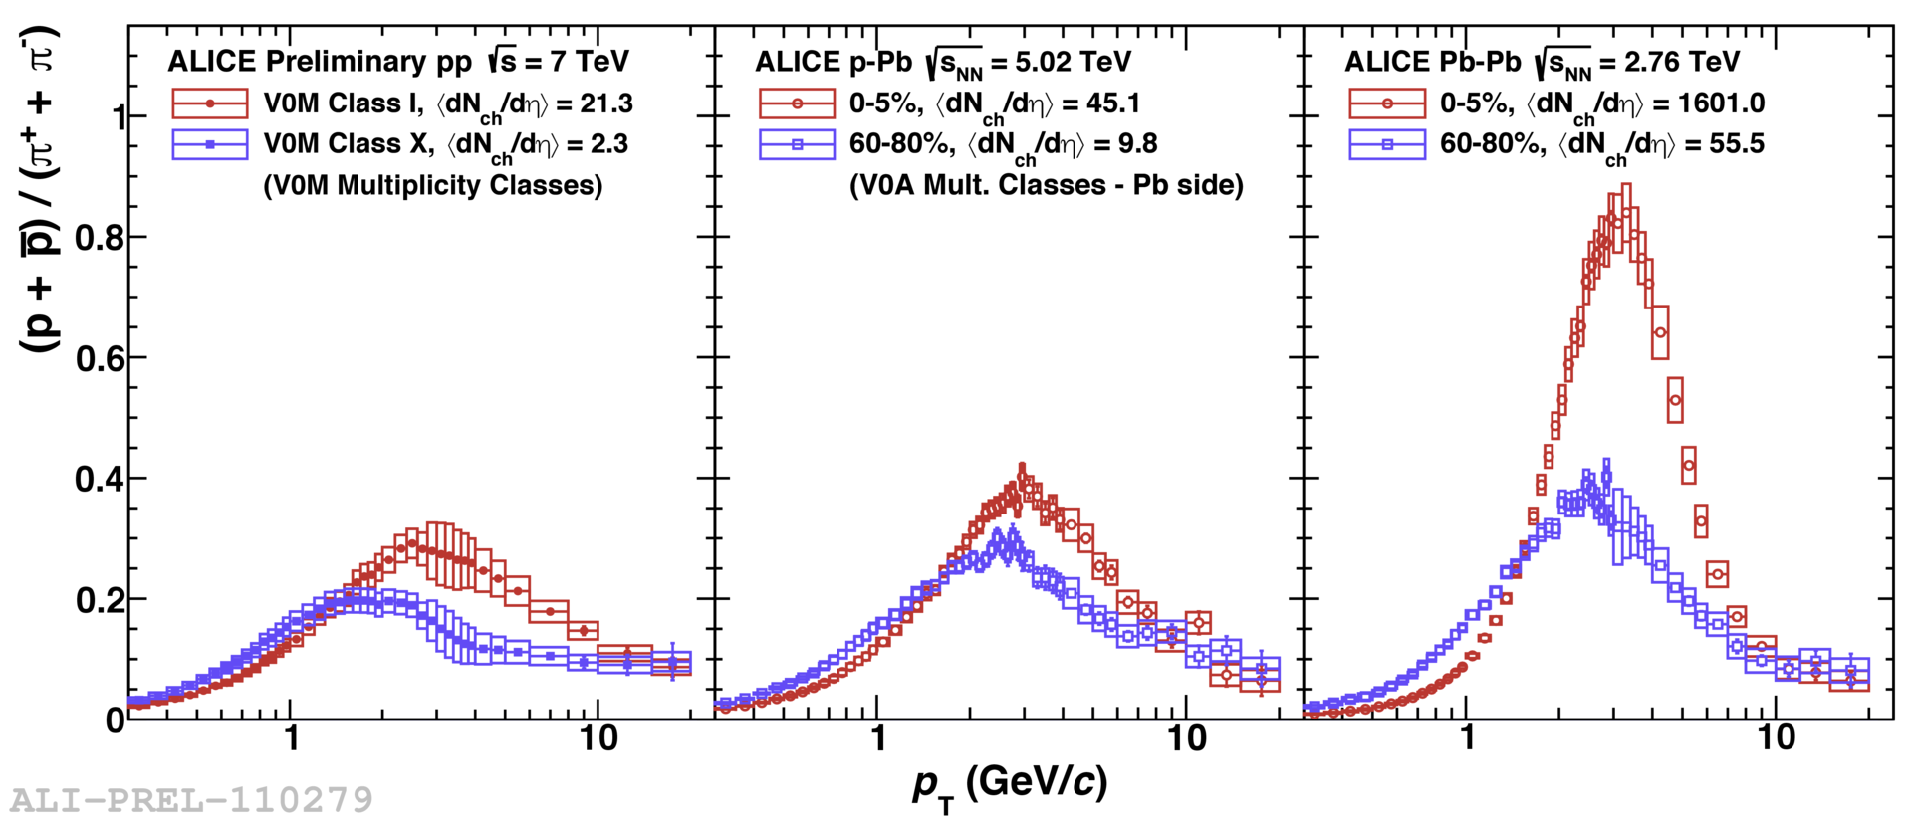
Radial Flow and Baryon/Meson Ratio
Radial flow pushes protons to intermediate p_{T} and depletes low p_{T}
  Stronger radial flow in central Pb–Pb collisions
Similar effects observed in high-multiplicity pp and p–Pb collisions

Slide 22
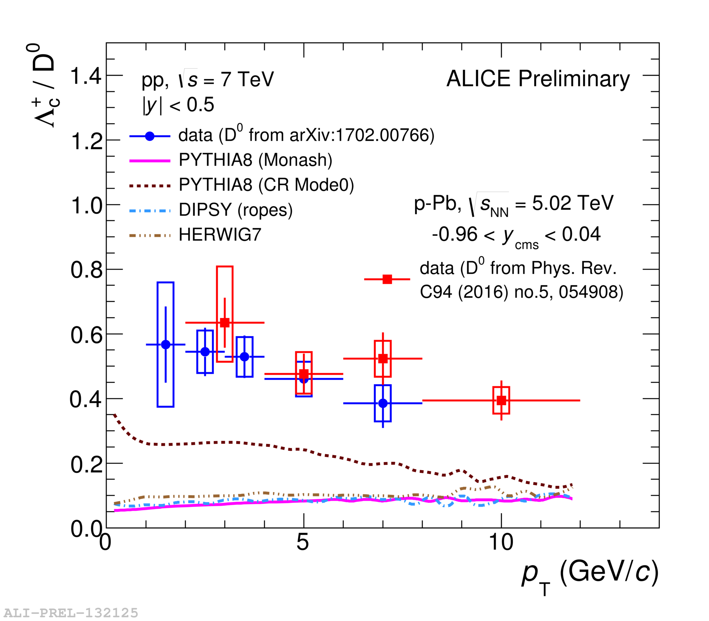
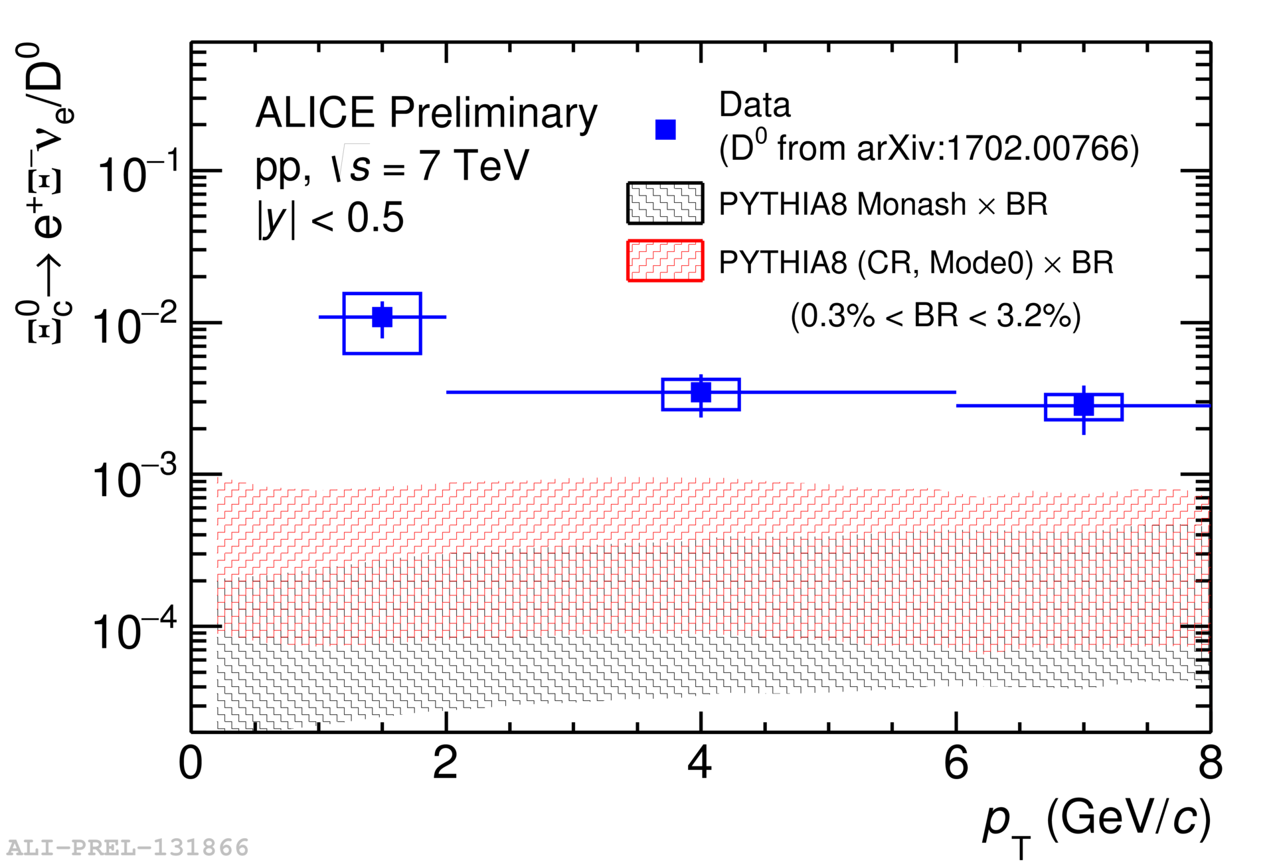
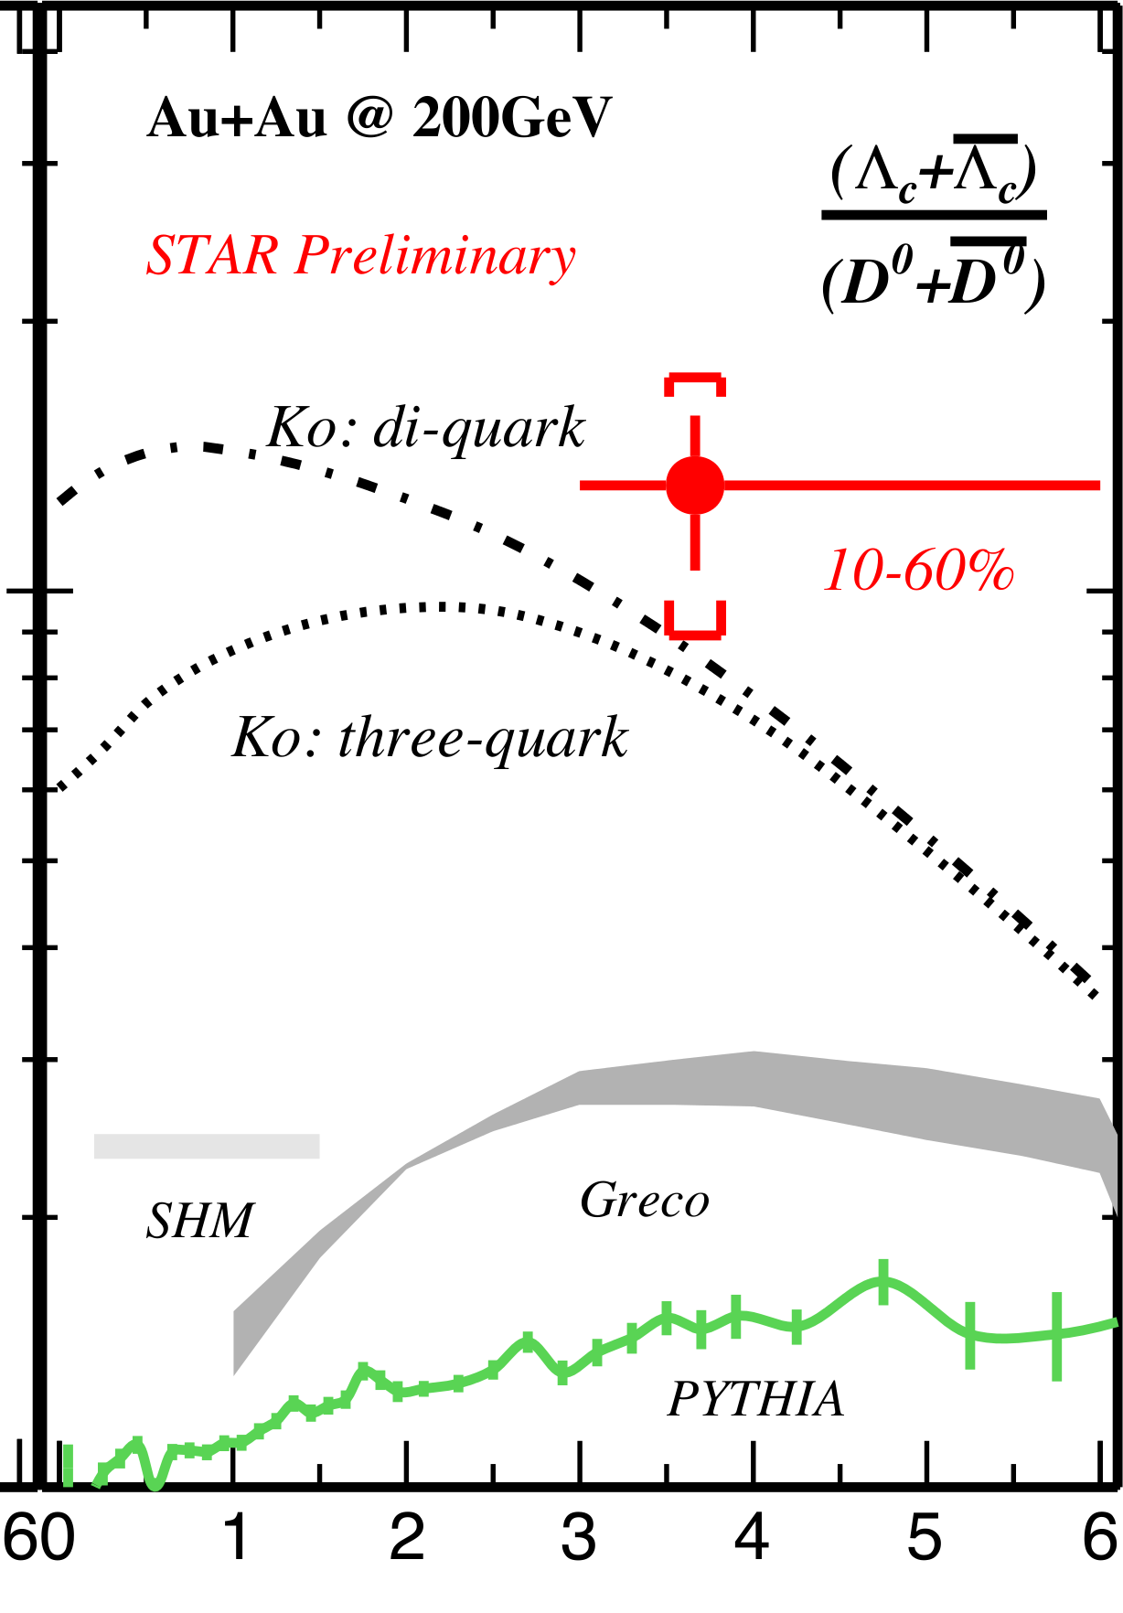
Charmed baryons
(Λ_{C}+‾Λ_{C})/(D⁰+‾D⁰)
p_{T} (GeV/c)
First midrapidity measurement of Λ_{c} in pp and p–Pb collisions
  Charmed baryon/meson ratio not reproduced by event generators
First measurement of Ξ_{c} in pp collisions
Constraints of charm hadronization
Benchmark for measurements in heavy ion collisions

Slide 23







Anisotropic flow
Au+Au √s_{NN} = 200 GeV
b=7 fm
Particles pushed out
Equipotential lines
arXiv:nucl-th/0305084
Initial overlap asymmetric → pressure gradients
Momentum anisotropy → Fourier decomposition:
Notes:
So at this point you're probably wondering how on earth we measure the viscosity of this thing that exists for only a few fermi/c – for less than 10^-24 seconds
When the nuclei collide, they create a droplet of QGP. This droplet of QGP is not symmetric – this shows the incoming nuclei - and there are huge pressure gradients in it. This shows a calculation of the equipotential lines in the QGP.
These pressure gradients push particles out – meaning that particles in this direction are going faster than particles in this direction
What we do is measure the Fourier coefficients of the distribution of particles

Slide 24
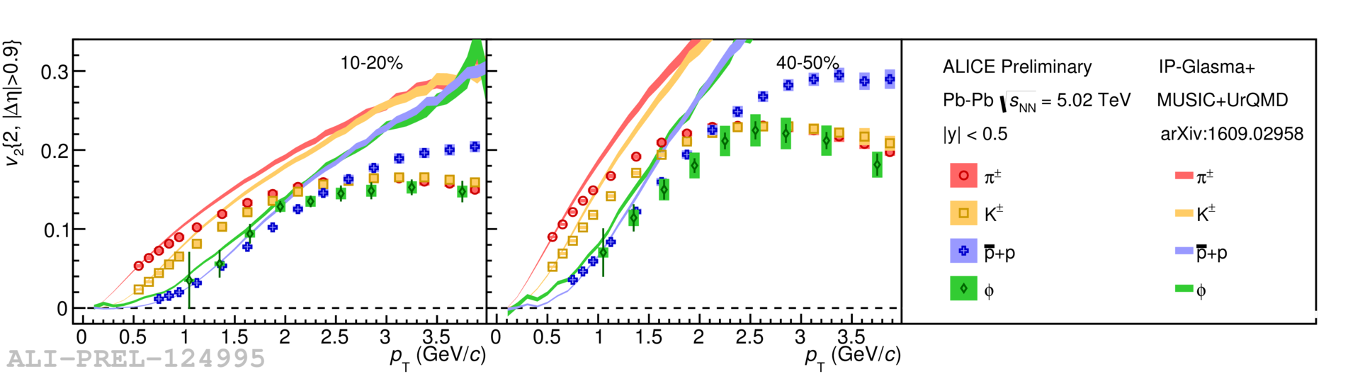
Anisotropic flow - v₂
v₂ sensitive to:
  initial conditions: geometry
  final state: particle interactions (medium properties, e.g. shear viscosity)
Data in agreement with hydrodynamic models at low p_{T}

Slide 25
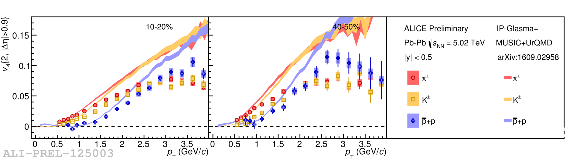
Anisotropic flow - v₄
v₄ more sensitive to interactions and less to initial state
  hydrodynamic models work at low p_{T} (p_{T}<1 GeV/c)
  only describes trend at intermediate p_{T} (1<p_{T}<2 GeV/c)

Slide 26
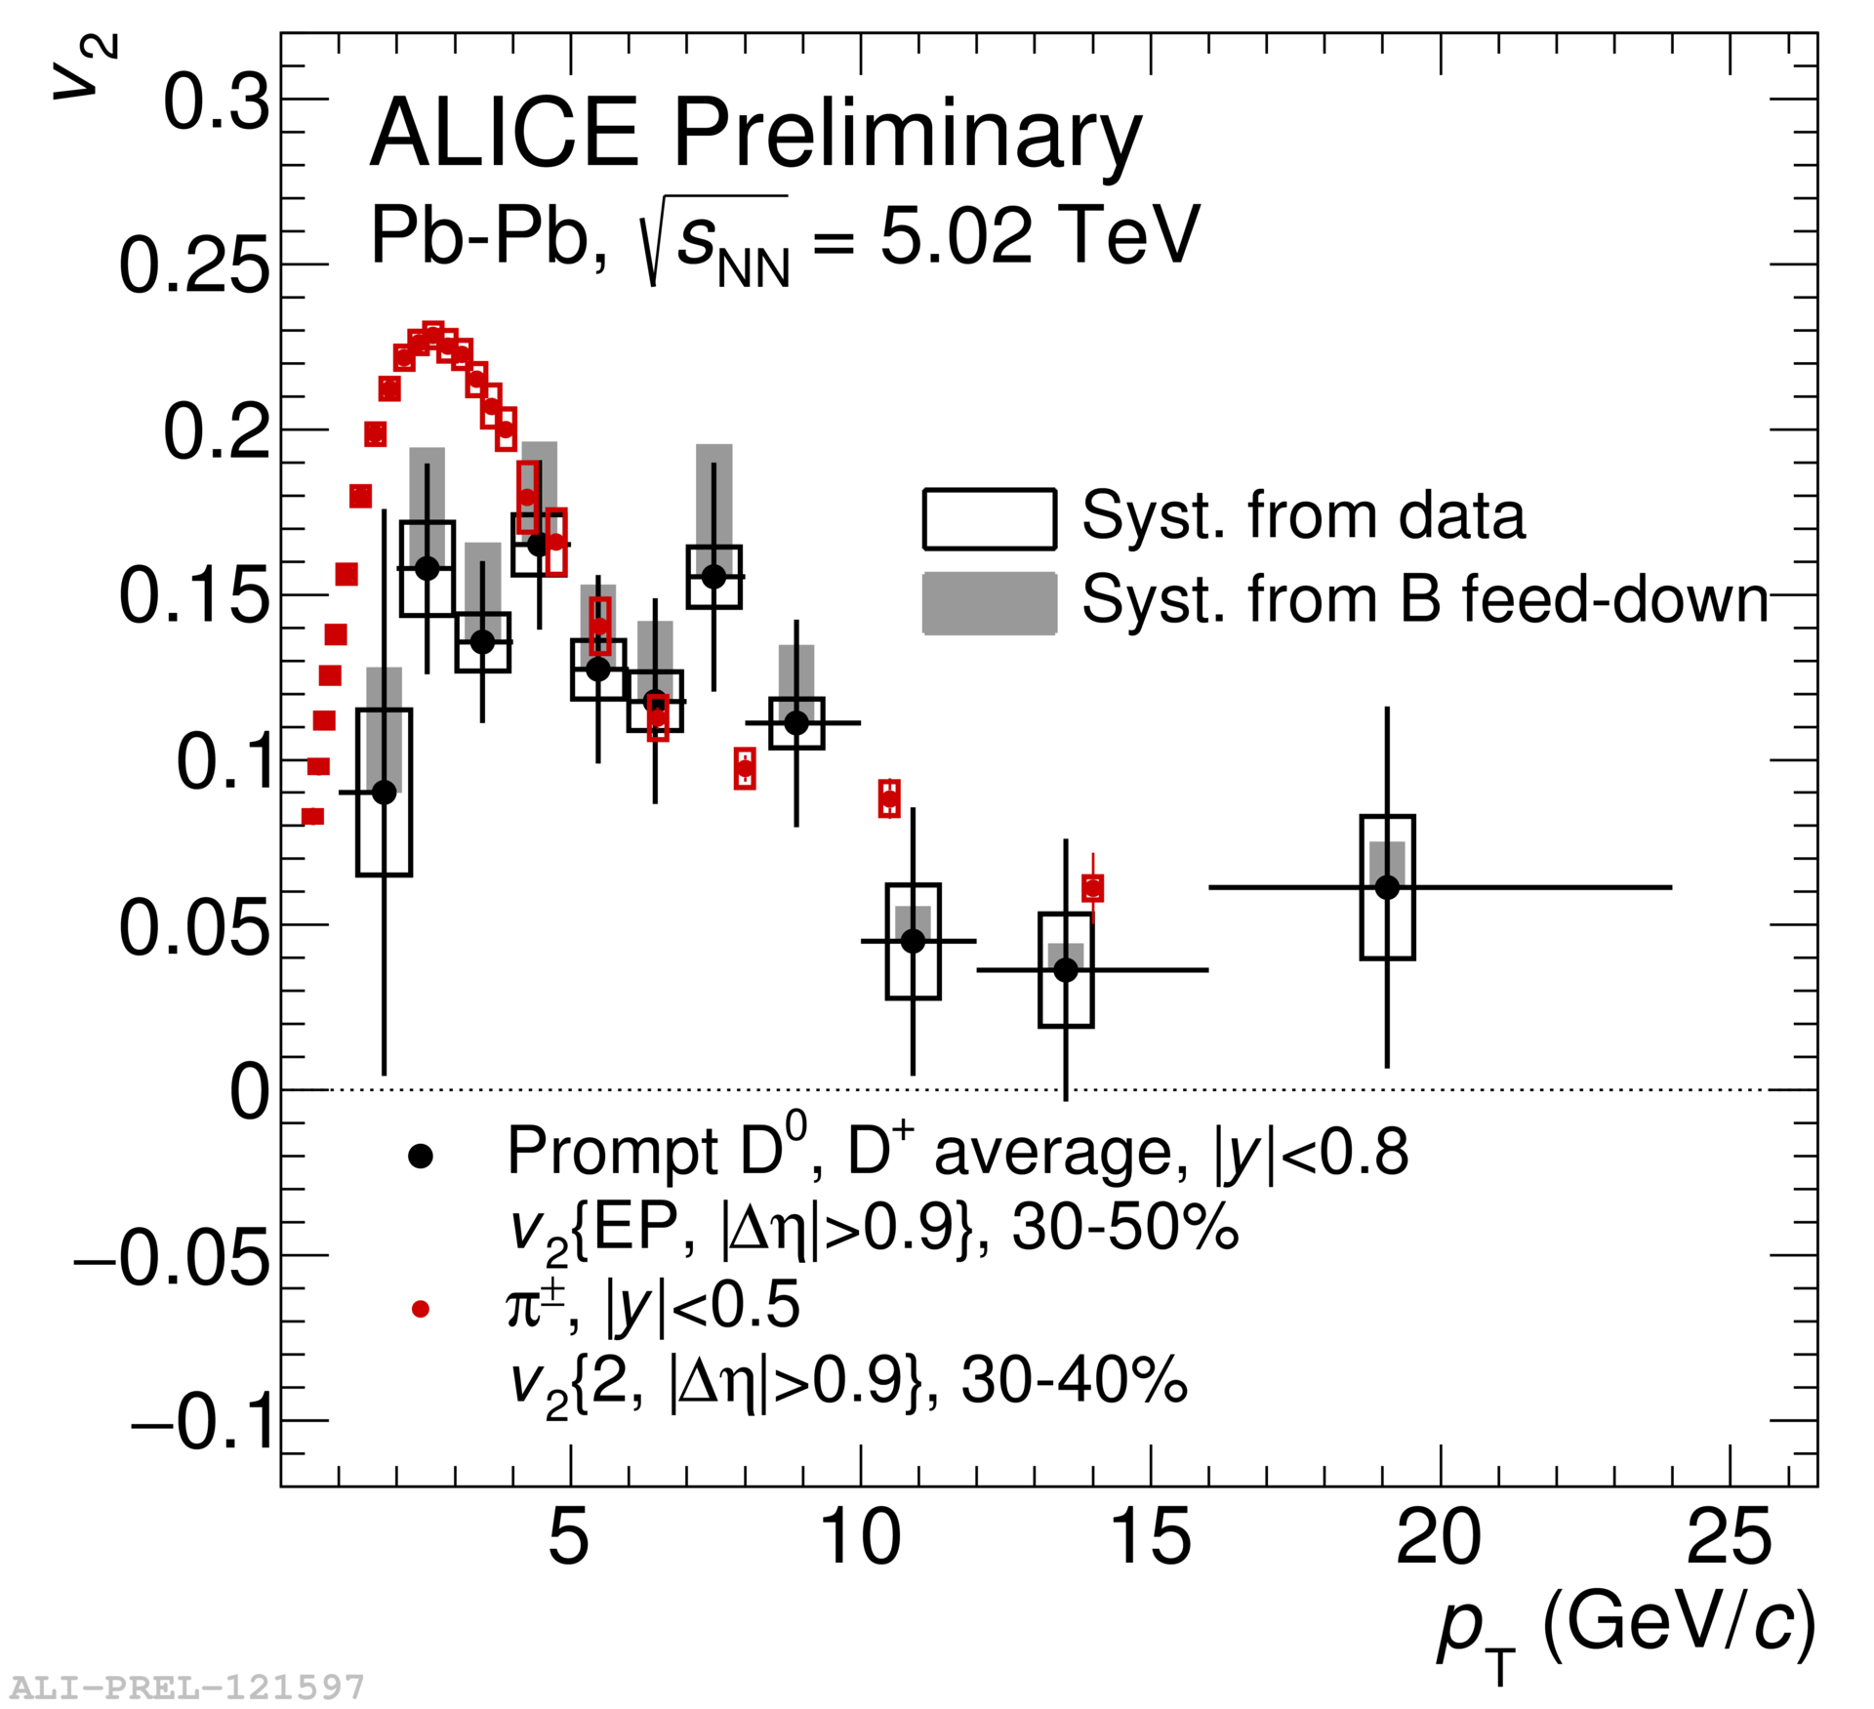
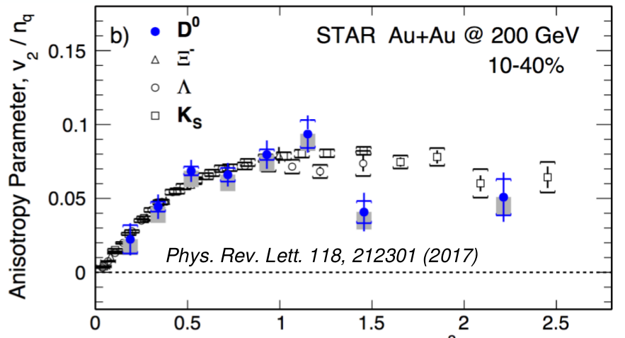
D meson v₂
p_{T}
Even heavy quarks flow!

Slide 27
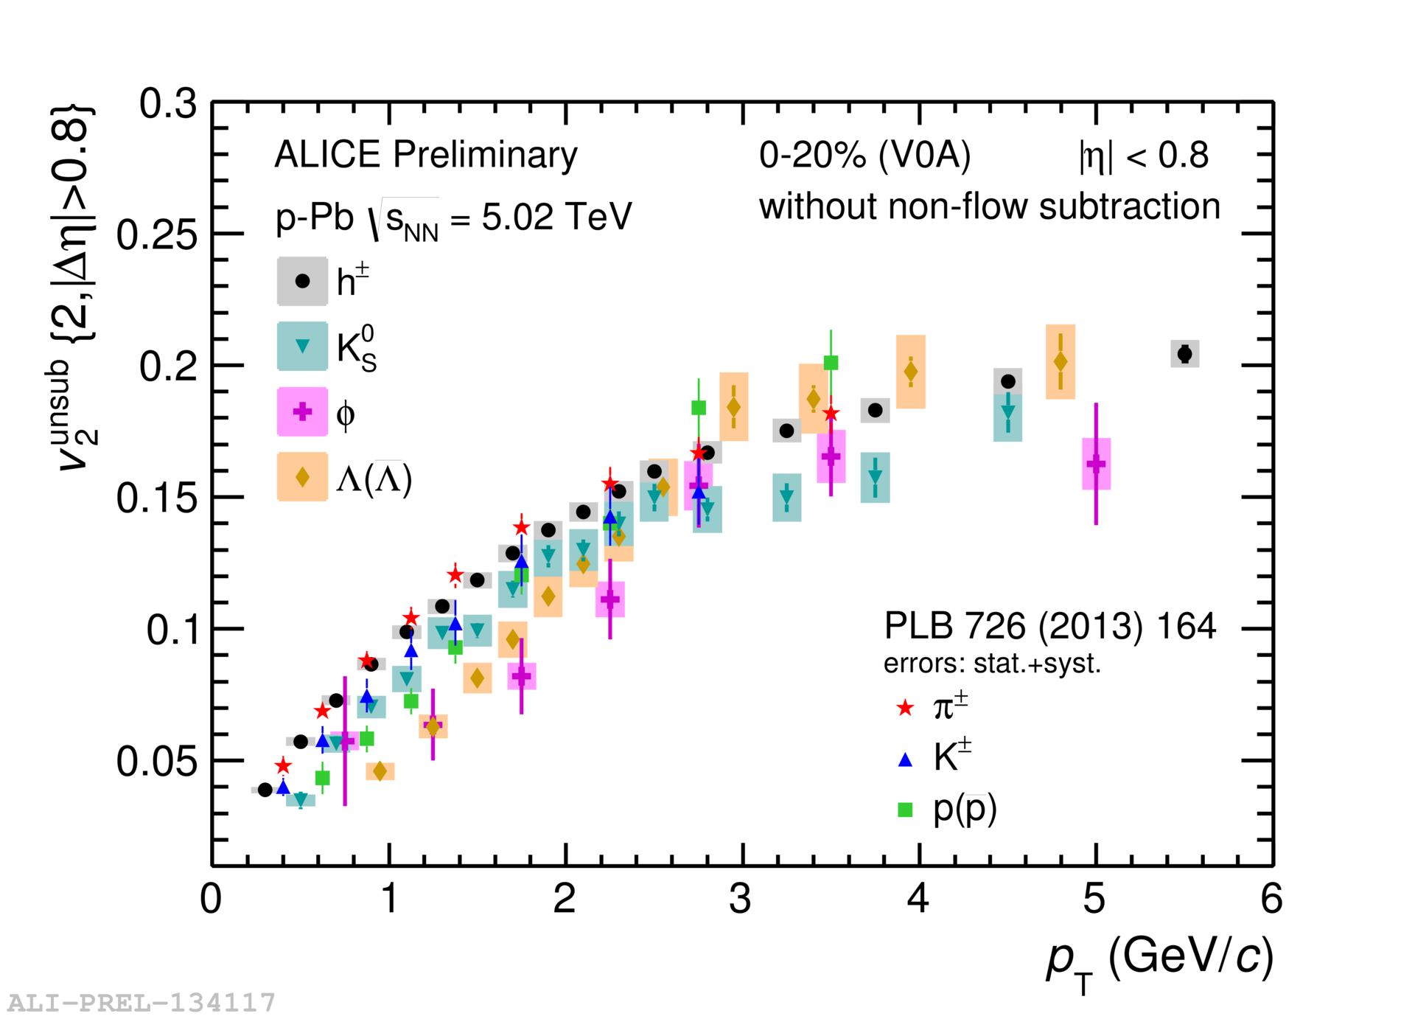
v₂ in p—Pb
mass ordering like in Pb–Pb

Slide 28
Energy loss in the medium

Slide 29


Nuclear modification factor
Measure spectra of probe (jets) and compare to those in p+p collisions or peripheral A+A collisions
If high-p_{T} probes (jets) are suppressed, this is evidence of jet quenching
Enhancement
Suppression

Slide 30
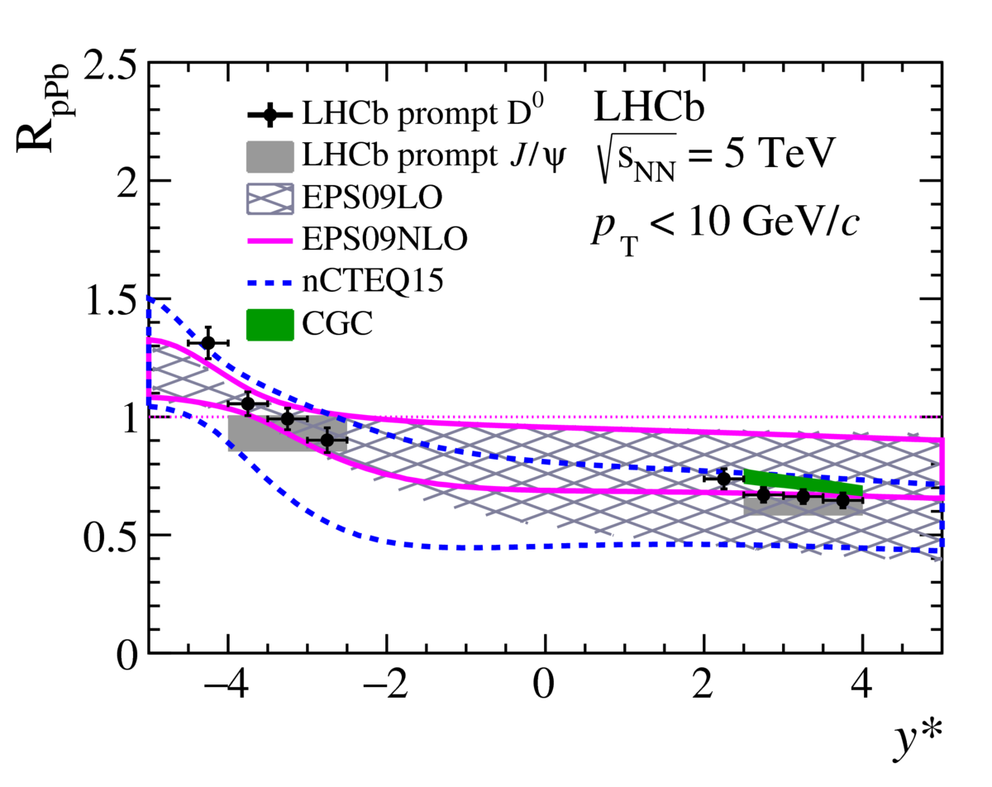

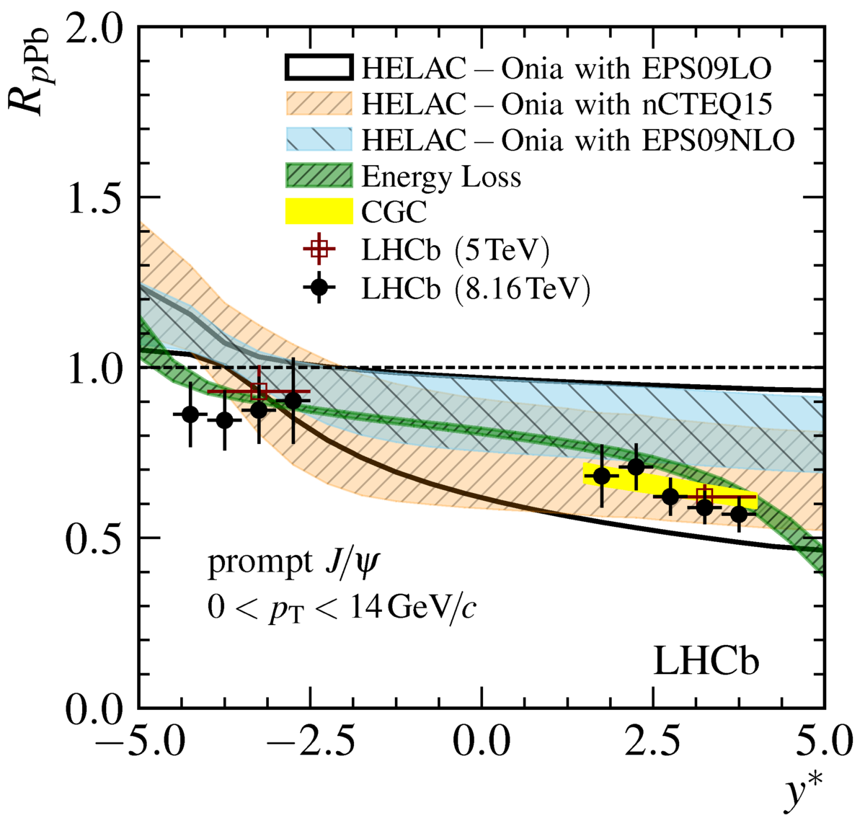
Nuclear modification factor
LHCb-PAPER-2017-015
arXiv:1706.07122
Charged hadrons (colored probes)
  Suppressed in Pb—Pb
  Not suppressed in p—Pb at midrapidity
  Some cold nuclear matter effects at forward rapidities
Electroweak probes not suppressed
Qualitatively in agreement with models

Slide 31
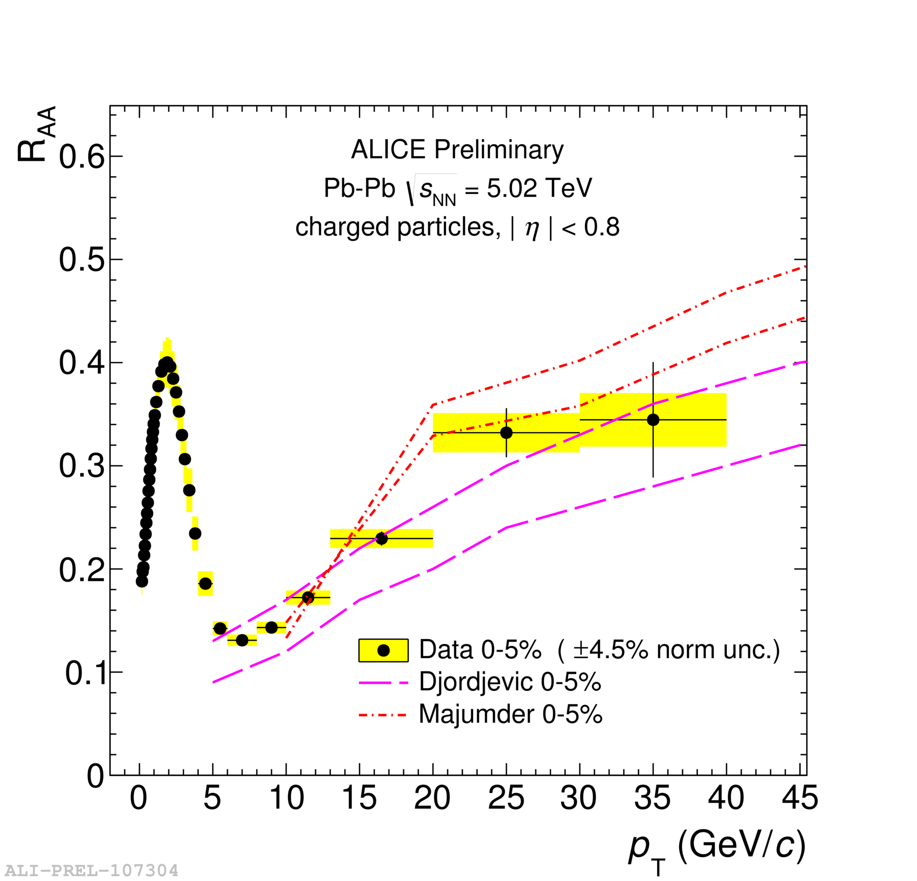
Nuclear modification factor
arXiv:1706.07122
Charged hadrons (colored probes)
  Suppressed in Pb—Pb
  Not suppressed in p—Pb at midrapidity
  Some cold nuclear matter effects at forward rapidities
Electroweak probes not suppressed
Qualitatively in agreement with models

Slide 32


Nuclear modification factor R_{AA}
RHIC
LHC
arXiv:1705.01974 [nucl-ex]
Electromagnetic probes – consistent with no modification – medium is transparent to them
Strong probes – significant suppression – medium is opaque to them - even heavy quarks!

Slide 33


Jet R_{AA}
arXiv:1705.01974
arXiv:1705.01974
Jet R_{AA} also demonstrates suppression
Less suppression of heavy quark jets

Slide 34
Conclusions
Mapping out the phase diagram
Evidence for hydrodynamical flow
  Some indications of similar phenomena in small systems
Evidence for jet quenching
  No evidence of similar phenomena in small systems
Need for systematic extraction of QGP properties

Slide 35
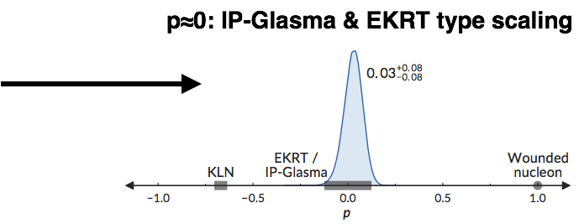
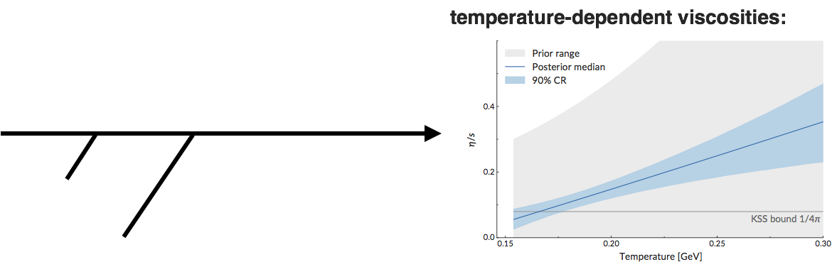
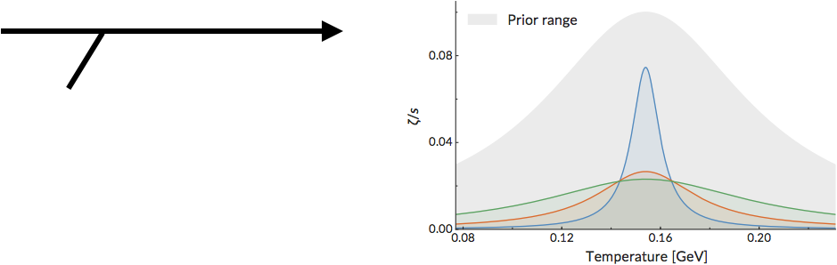
Next step: global fits of models to wide array of heavy ion collision data
Global Bayesian Analysis; S. Bass, Quark Matter 2017
MADAI collaboration
Parton distributions in projectiles
(density, correlations, fluctuations)
diagonals: probability distribution of each parameter, integrating out all others
off-diagonals: pairwise distributions showing dependence between parameters
Equilibration dynamics
Shear viscosity
Bulk viscosity
Tsw⩽Tc
β
arXiv:1706.03666, Phys. Rev. C 94, 024907 (2016)
Notes:
<number>

Slide 36
Backup

Slide 37
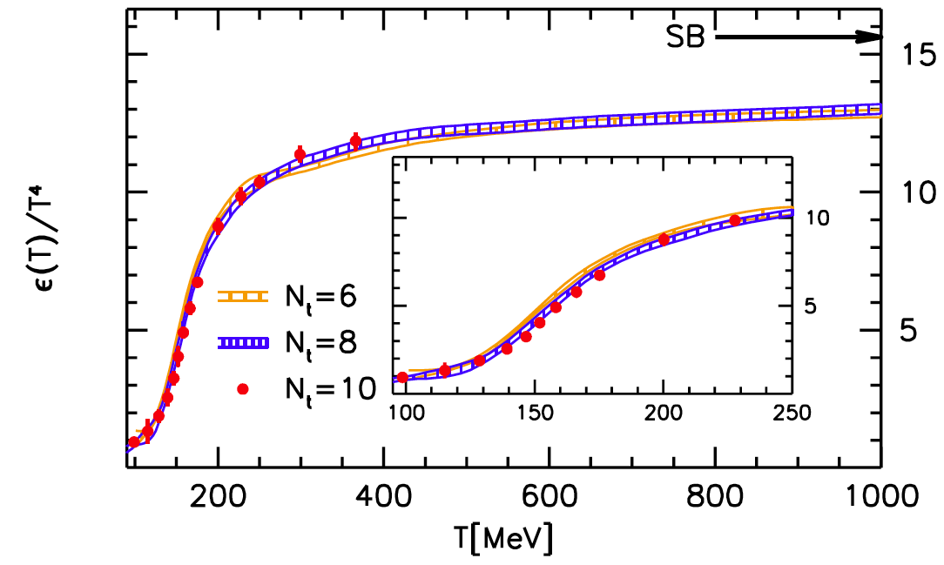
Finite Temperature QCD on the Lattice (μ_{B}=0)
Slow convergence to non-interacting Steffan-Boltzmann limit
What carries energy - complex bound states of q+g? “strongly-coupled” plasma?
Energy density
S. Borsanyi et al., JHEP 1011, 077 (2010)
Temperature [MeV]
Cross-over, not sharp phase transition
(like ionization of atomic plasma)

Slide 38
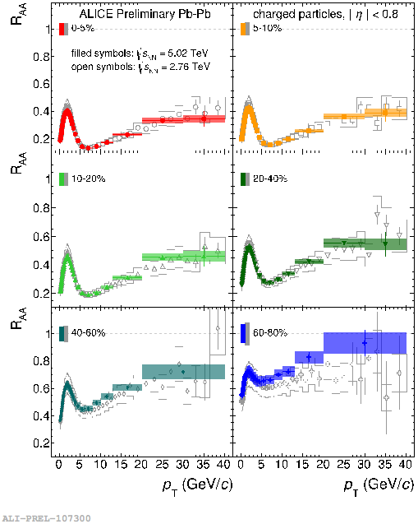
Charged particle R_{AA}
R_{AA}>1: enhancement
R_{AA}<1: suppression
Strong modification of the spectrum shape in most central collisions
Strong centrality dependence
RAA at 5.02 TeV similar to 2.76 TeV

Slide 39
Light-by-light scattering

Slide 40
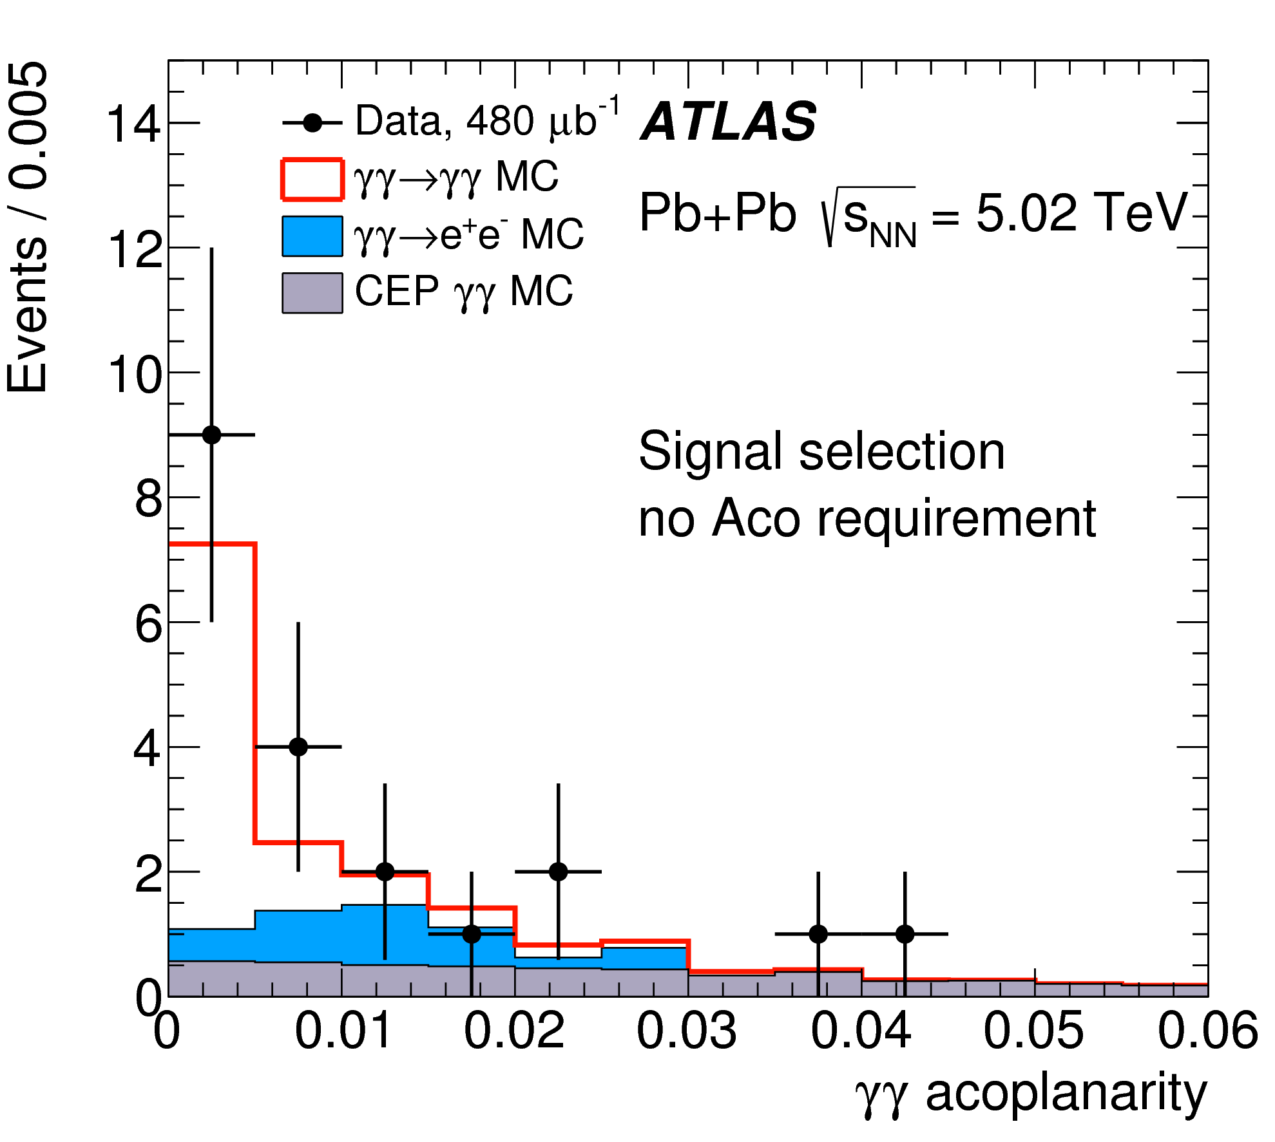
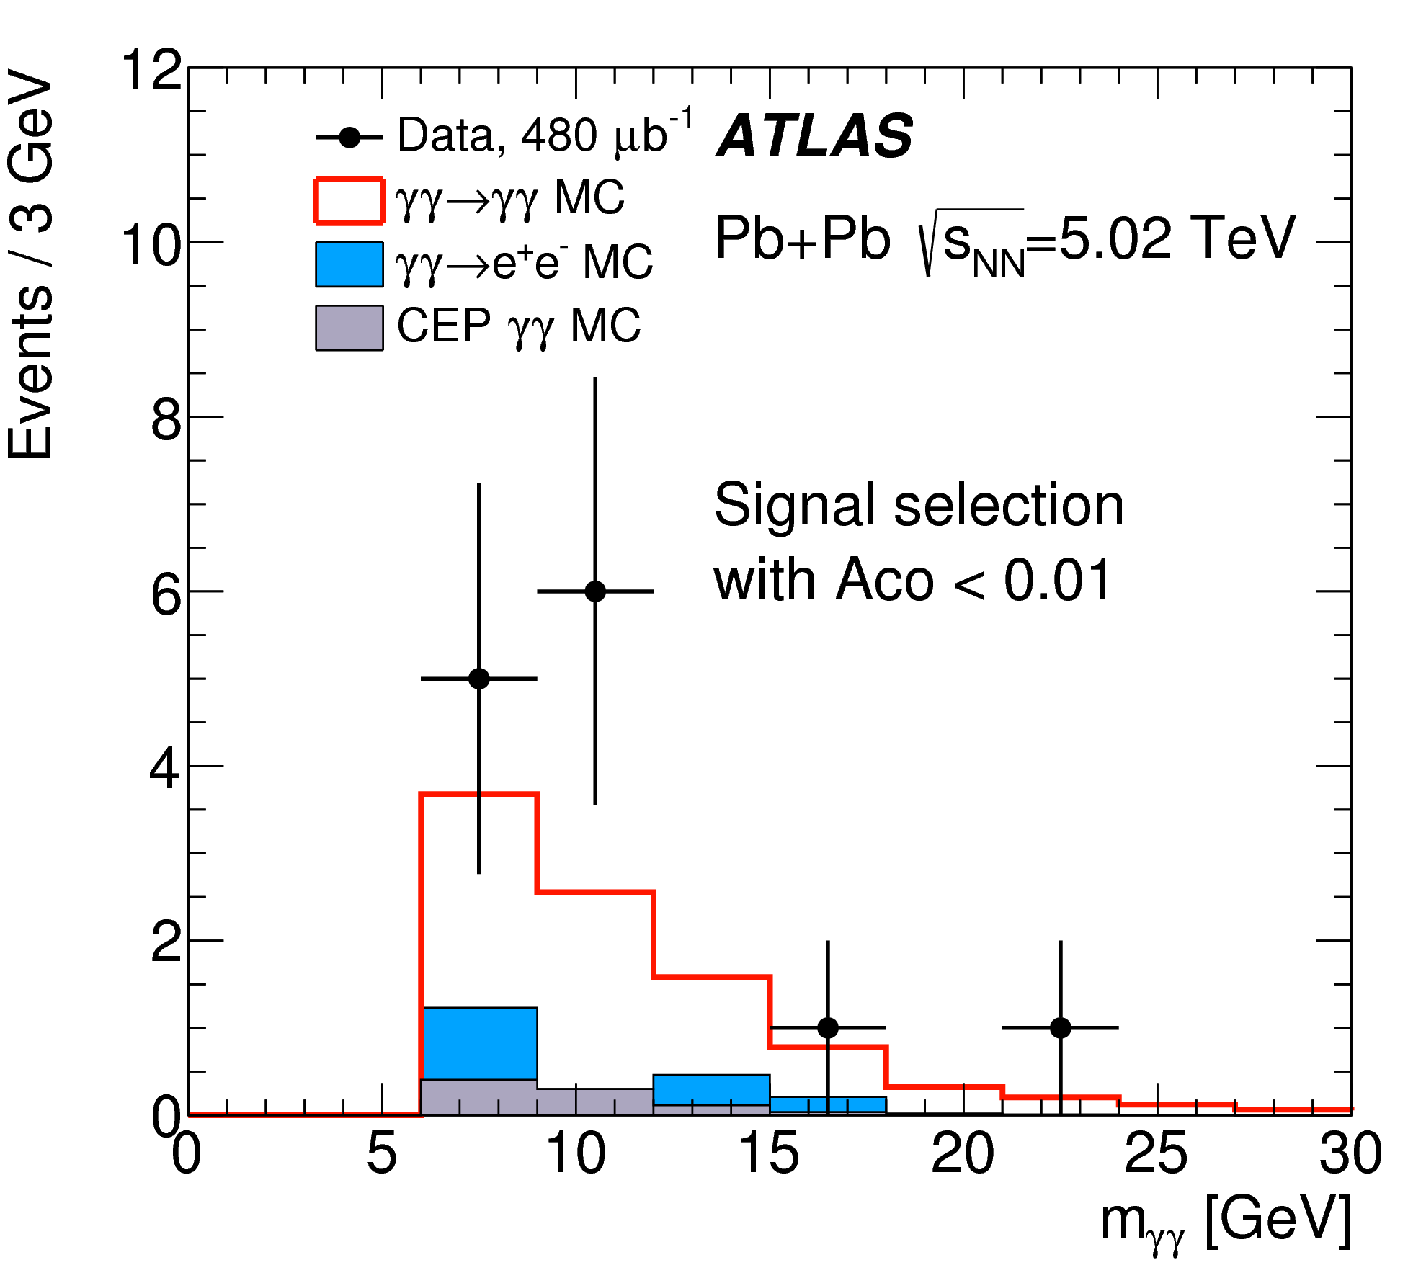
First evidence of light-by-light scattering
NPHYS4208

