Slide 1
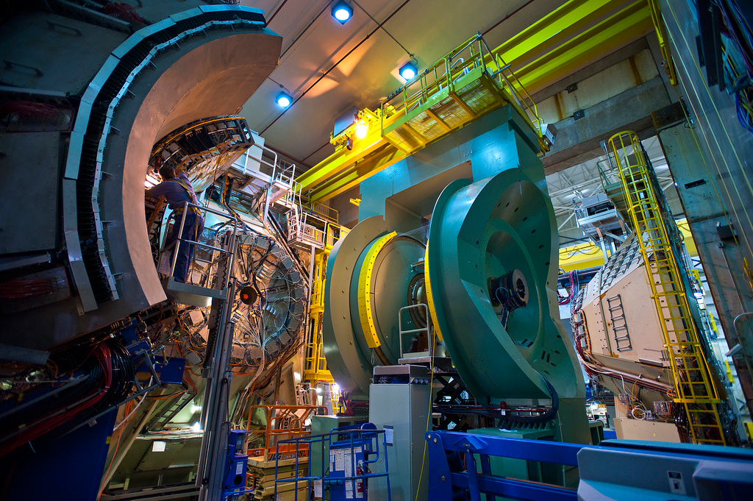

Results from PHENIX
Christine Nattrass (University of Tennessee, Knoxville)

Slide 2
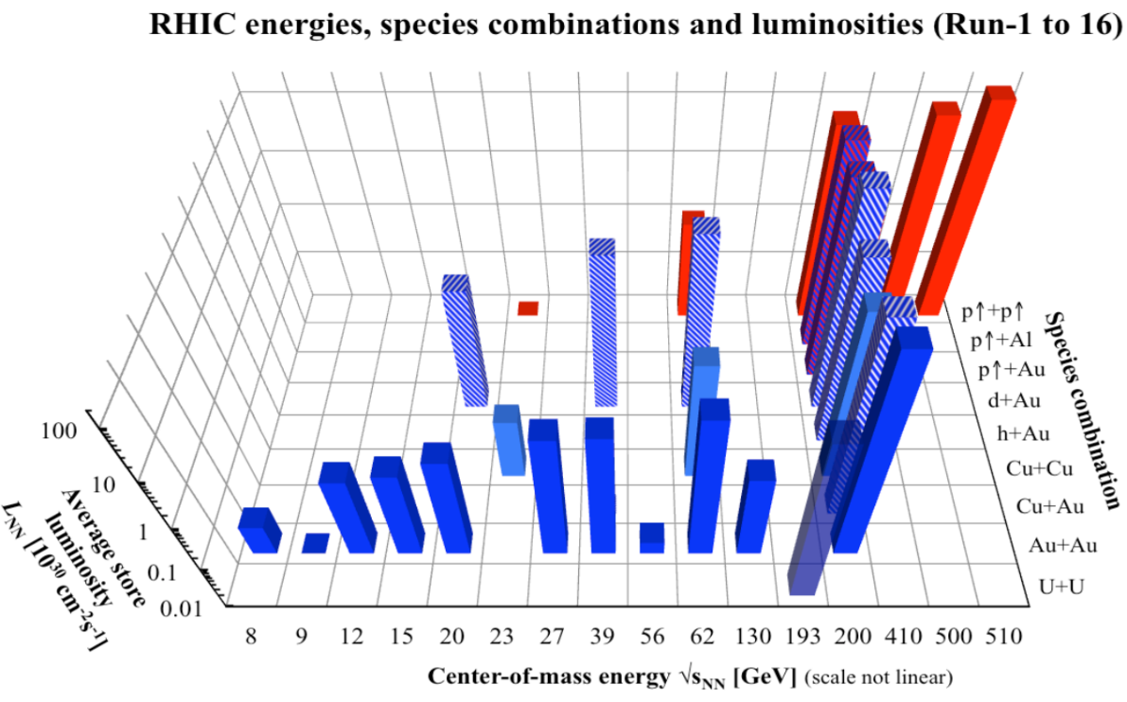
Data collected
³He+Au
Completed taking data in 2016
Many high impact analyses ongoing

Slide 3
Papers since Quark Matter 2022
PRL130, 251901 (2023) Direct γ cross section in p+p √s=510 GeV
PRD107, 112004 (2023) Transverse spin asymmetry of π⁰, η in p+Al and p+Au √sNN=200 GeV
PRD107, 052012 (2023) Transverse spin asymmetry of heavy flavor decay electrons
PRC107, 024907 (2023) Flow in p+p, p+Al, d+Au, ³He+Au √sNN=200 GeV
PRC107,024914 (2023) Low pT γ in Au+Au at √sNN=39 and 62.4GeV
PRC107, 014907 (2023) φ in Cu+Au and U+U √sNN= 200 GeV
PRC106, 014908 (2022) φ in p+p, p+Al, d+Au, ³He+Au √sNN=200 GeV
PRC105, 064912 (2022) ψ(2S) in p+p, p+Al, and p+Au √sNN=200 GeV
arXiv:2303.12899 Suppression of high pT π⁰ relative to direct γ in central d+Au √sNN=200 GeV
arXiv:2303.07191 Transverse spin asymmetry of h± in p+p, p+Al, and d+Au √sNN=200 GeV
arXiv:2203.17187 Non-prompt γ in Au+Au √sNN=200 GeV
arXiv:2203.17058 Charm and bottom production in Au+Au √sNN=200 GeV
Press coverage
PRC Editor’s suggestion
PRC Editor’s suggestion
8 published + 4 in journal review

Slide 4
New preliminary results for QM23
Dilepton continuum in p+p √s=200 GeV
Talk Tues. 15:30 Vassu Doomra Poster Roli Esha
Elliptic flow of direct γ in Au+Au at 200 GeV
Talk Tues. 15:30 Vassu Doomra
Elliptic flow of μ± from heavy flavor decays in Au+Au at √sNN=200 GeV
Talk Tues. 11:00 Krista Smith Poster Brandon Blankenship
Elliptic flow of π⁰ in Cu+Au at 200 GeV
Ψ(2s), J/Ψ vs Nch in p+p √s=200 GeV
Talk Tues. 11:00 Krista Smith Poster JongHo Oh
Forward η cross-section in p+p √s=200 GeV
Npart dependence of v2 to investigate multiparton interactions in Au+Au at √sNN=200 GeV
Poster Maya Shimomura

Slide 5
PHENIX at QM23
Talk Heavy Flavor and Quarkonia results from the PHENIX experiment Tues. 11:00 Krista Smith (LANL)
Talk Isolating final state effects in high pT π⁰ production using direct photons in small system collisions with PHENIX Tues. 13:00 Daniel Firak (Stony Brook)
Talk Measurement of low pT direct photons with PHENIX Tues. 15:30 Vassu Doomra (Stony Brook)
Talk Measurement of in-medium modification of energy-space structure of jets via and triggered hadrons in Au+Au collisions
at RHIC Wed. 10:10 Megan Connors (Georgia State)
Poster Elliptic flow measurement of J/ψ in PHENIX Run14 Au+Au at √sNN=200 GeV Tues. 17:30 Luis Bichon III (Vanderbilt)
Poster Forward Physics with light vector mesons and π⁰ from the PHENIX Experiment Tues. 17:30 Uttam Acharya (Georgia State)
Poster Particle multiplicity dependent Charmonia production in p+p collisions by the PHENIX experiment Tues. 17:30 JongHo Oh (Pusan National University)
Poster PHENIX measurements of identified charged hadron production in p+Al,p+Au, and Cu+Au collisions at √sNN = 200 GeV Tues. 17:30 Sanghoon Lim (Pusan National University)
Poster Systematic study of energy loss in the QGP for various collision systems at PHENIX Tues. 17:30 Takashi Hachiya (Nara Women’s University)
Poster Di-electron continuum in p+p collisions at 200 GeV
Tues. 17:30 Roli Esha (Stony Brook)
Poster Neutral pion and eta meson production in Au+Au collisions at 200 GeV Tues. 17:30 Dading Chen(Stony Brook)
Poster Measurement of neutral pions and direct photons in ³He+Au collisions Tues. 17:30 Daniel Firak (Stony Brook)
Poster PHENIX Measurements of Azimuthal Anisotropy of Light and Heavy Flavor Hadrons in Au+Au Collisions at Forward Rapidity Tues. 17:30 Brandon Blankenship (Vanderbilt)
Poster The study of with a new double-differential event categorization using multiplicity and spectator neutrons in PHENIX Tues. 17:30 Maya Shimomura (Nara Women’s University)

Slide 6
p+p

Slide 7
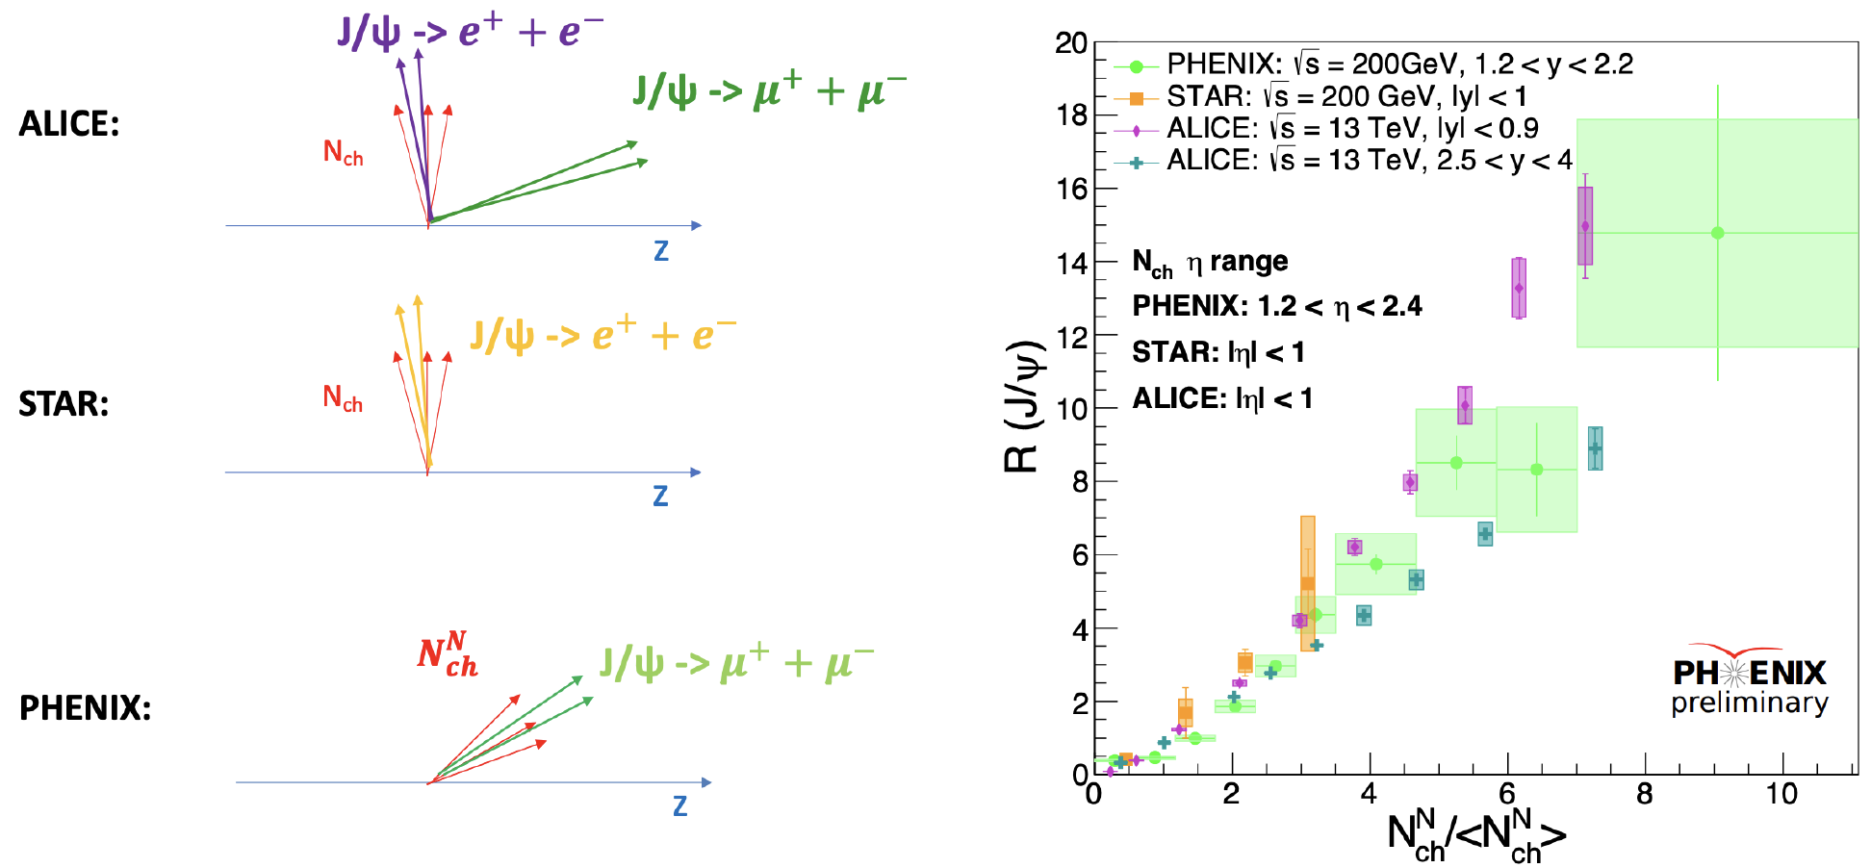
J/ψ yield in p+p
p+p
Talk Tues. 11:00 Krista Smith
${N_{J/Ψ}}/{\left\langle N_{J/Ψ}\right\rangle }$
=
Poster JongHo Oh
New for QM 2023
J/ψ yield exhibits large dependence on local track multiplicity
Often attributed to multi-parton interactions

Slide 8
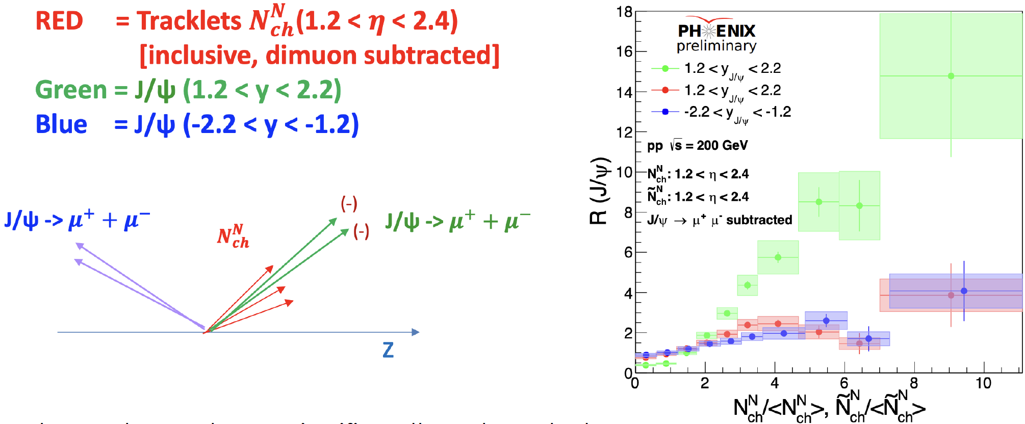
J/ψ yield in p+p
p+p
$N_{ch}^{N}$
Red = Tracklets (1.2<η<2.4)
Green = J/ψ (1.2<y<2.2)
Green = J/ψ (-2.2<y<-1.2)
${N_{J/Ψ}}/{\left\langle N_{J/Ψ}\right\rangle }$
=
New for QM 2023
J/ψ yield vs multiplicity significantly reduced when
Looking at J/ψ and multiplicity in separate rapidity
windows
    Looking at J/ψ and multiplicity in the same rapidity window but removing the μ+ μ− from the multiplicity
Implications for MPI picture
Poster JongHo Oh
Talk Tues. 11:00 Krista Smith

Slide 9
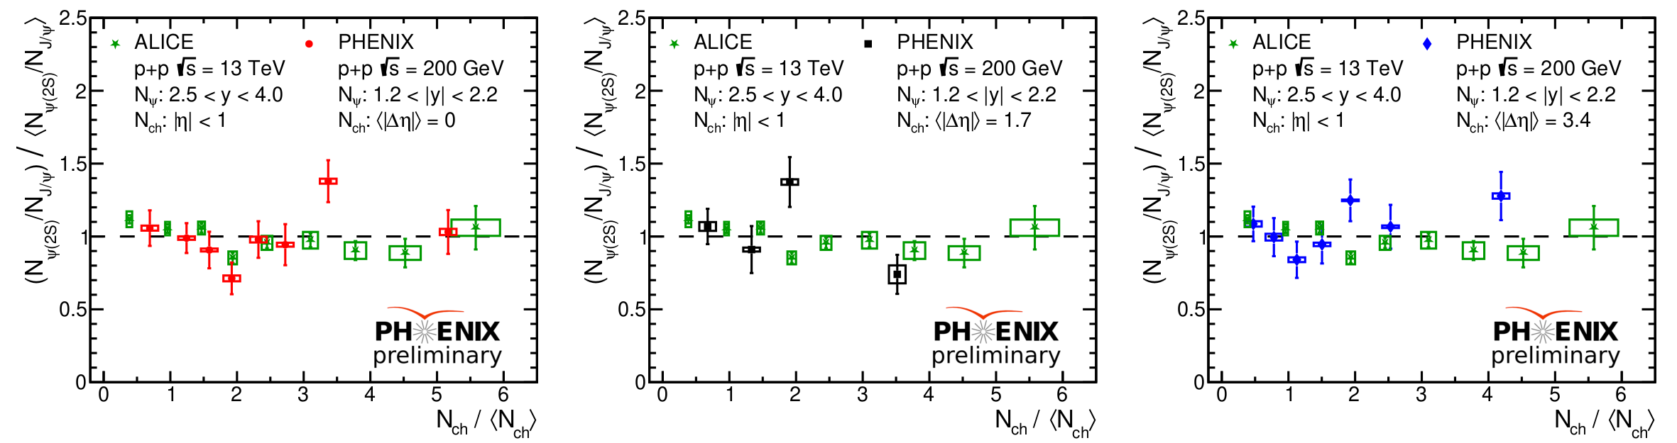
Multiplicity dependent ψ(2s) to J/ψ ratio
p+p
New for QM 2023
Talk Tues. 11:00 Krista Smith
Poster JongHo Oh
Multiplicity-dependent studies test for onset of QGP-like effects
PHENIX and ALICE results consistent, weak multiplicity dependence consistent w/unity

Slide 10
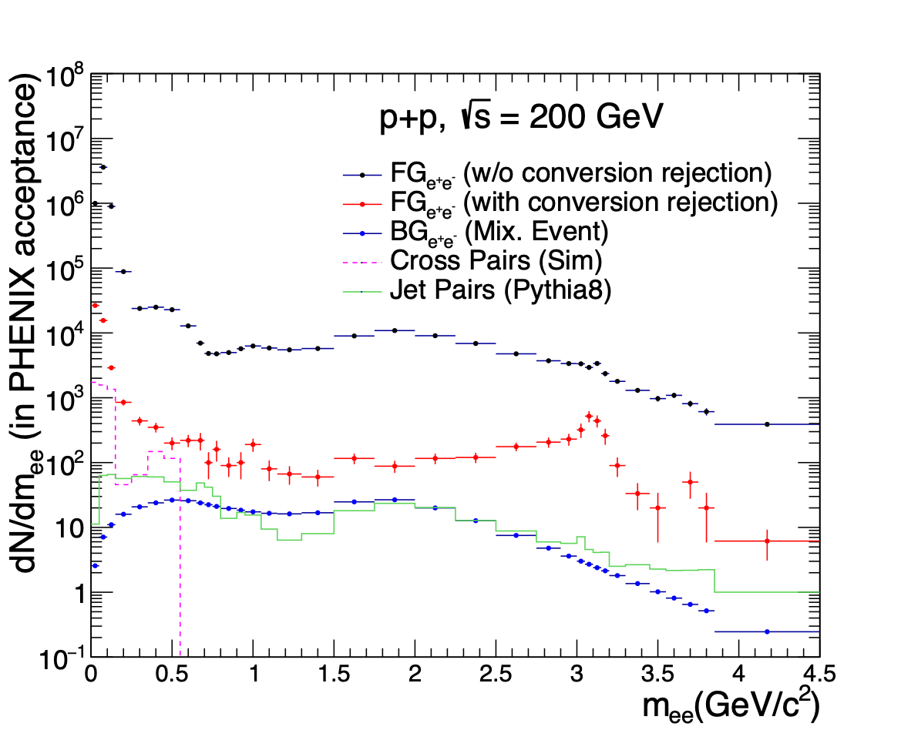
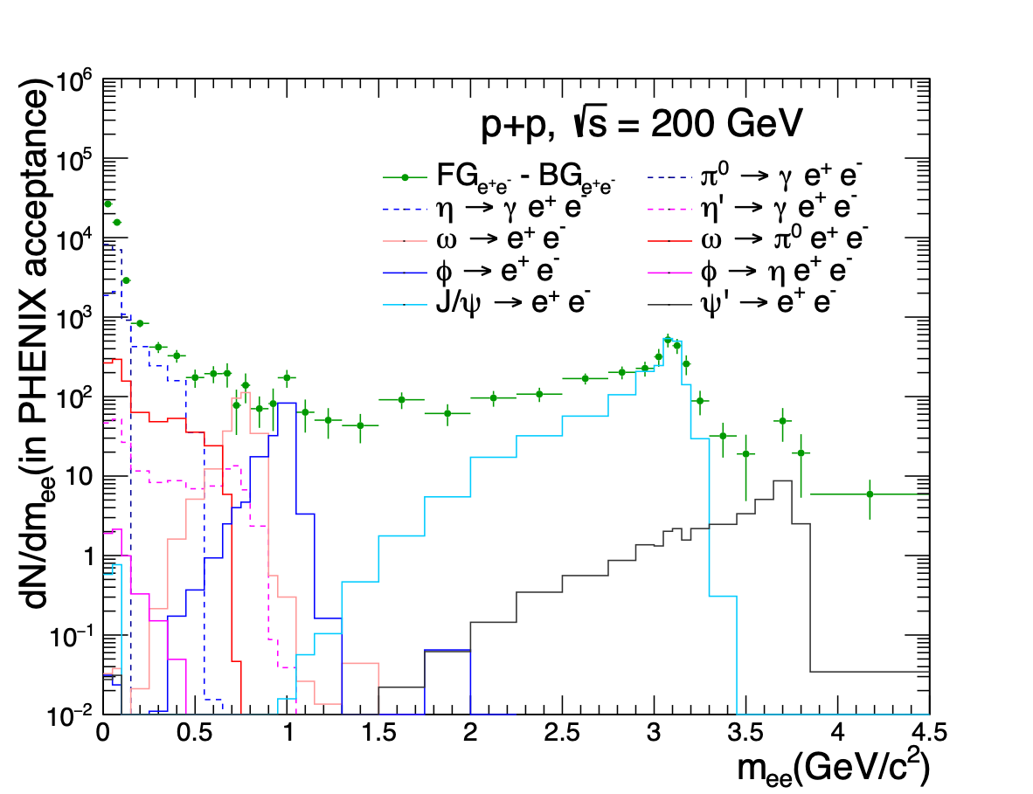
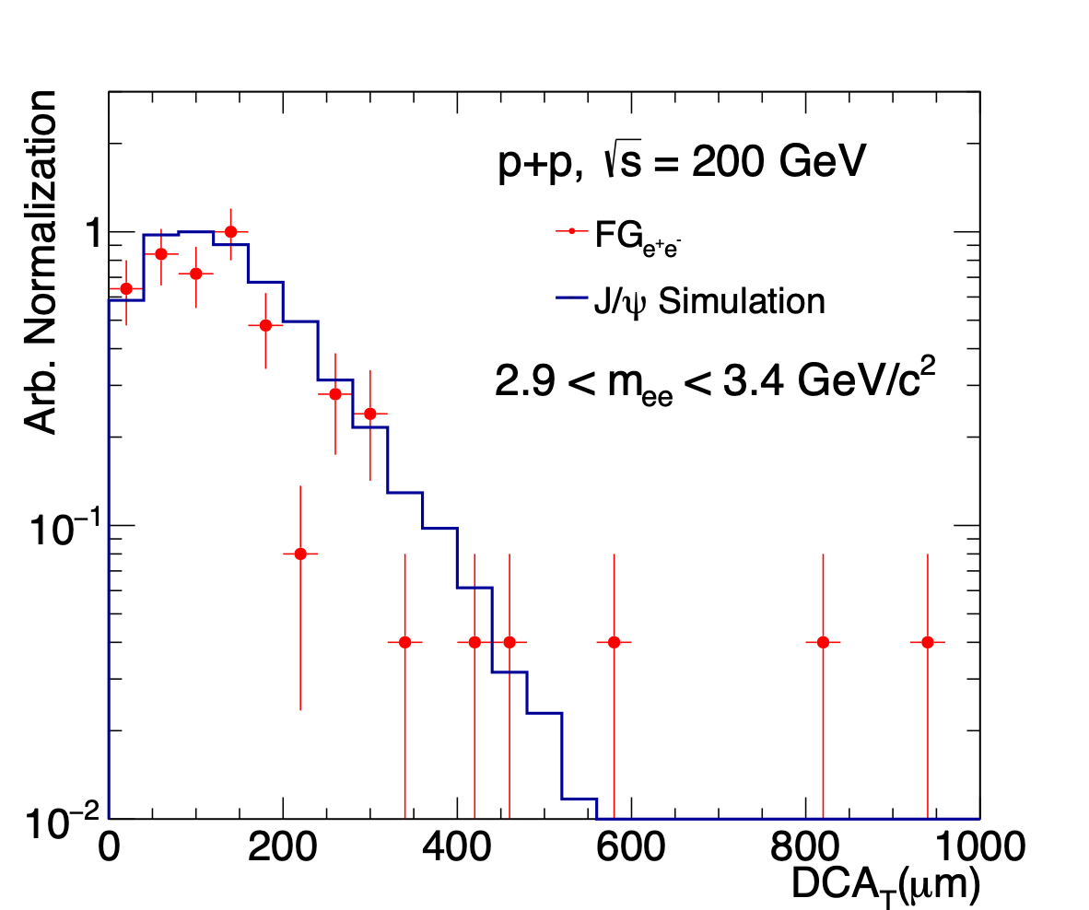

Dilepton invariant mass
p+p
Talk Tues. 15:30 Vassu Doomra
New for QM 2023
Measurements of intermediate mass dilepton pairs
Separation from semi-leptonic decay and prompt pairs

Slide 11
p,d,
³He,Al
+Au

Slide 12
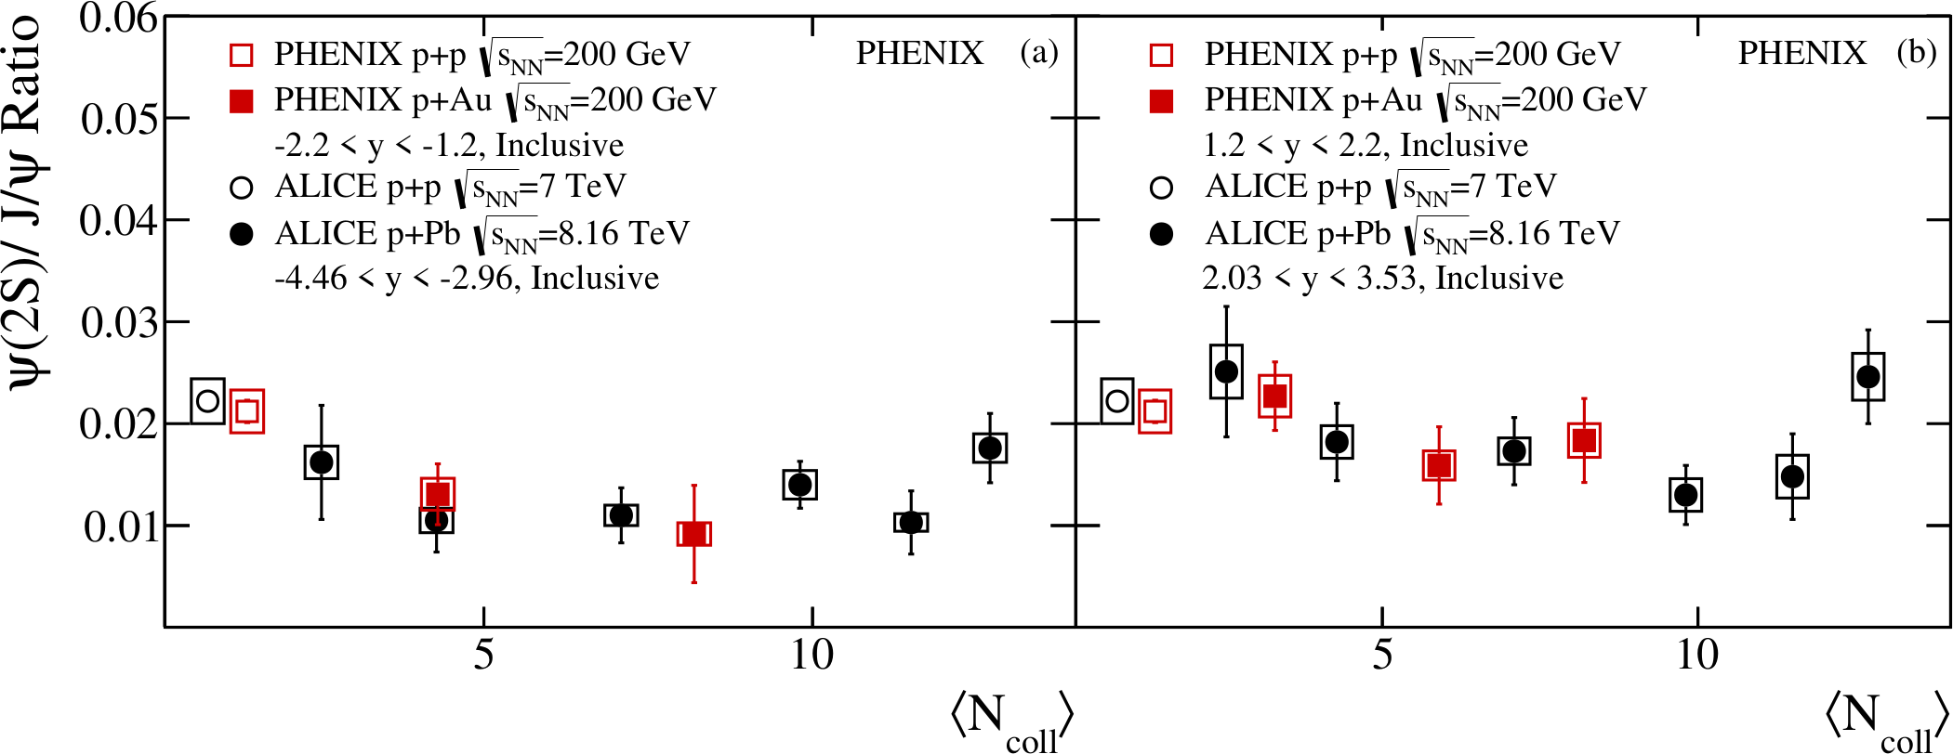

ψ(2s) to J/ψ ratio
p+p
x+Au
Phys.Rev.C 105 (2022) 6, 064912
Poster JongHo Oh
Talk Tues. 11:00 Krista Smith
ψ(2s) to J/ψ ratios p+p at RHIC, LHC show no clear energy dependence
Suggests final state effects at backward rapidity

Slide 13
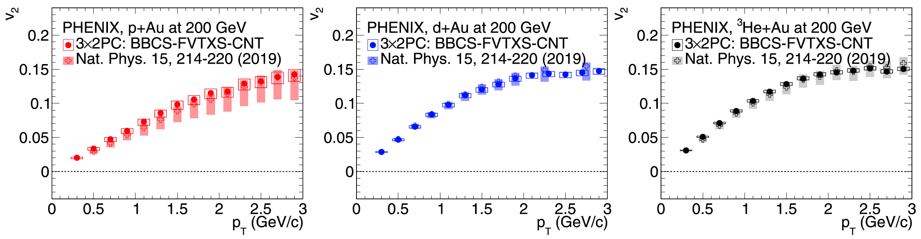



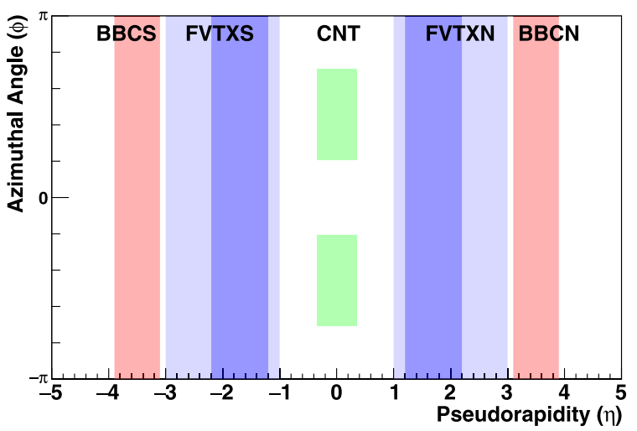
v2 in small systems
x+Au
PRC107 (2023) 2, 024907
Nat. Phys. 15, 214–220(2019)
Using two particle correlations over large rapidity range
Nature Physics results confirmed
Consistent with small droplet of QGP
Different systematics, different sensitivity to non flow effects
Consistent v₂

Slide 14
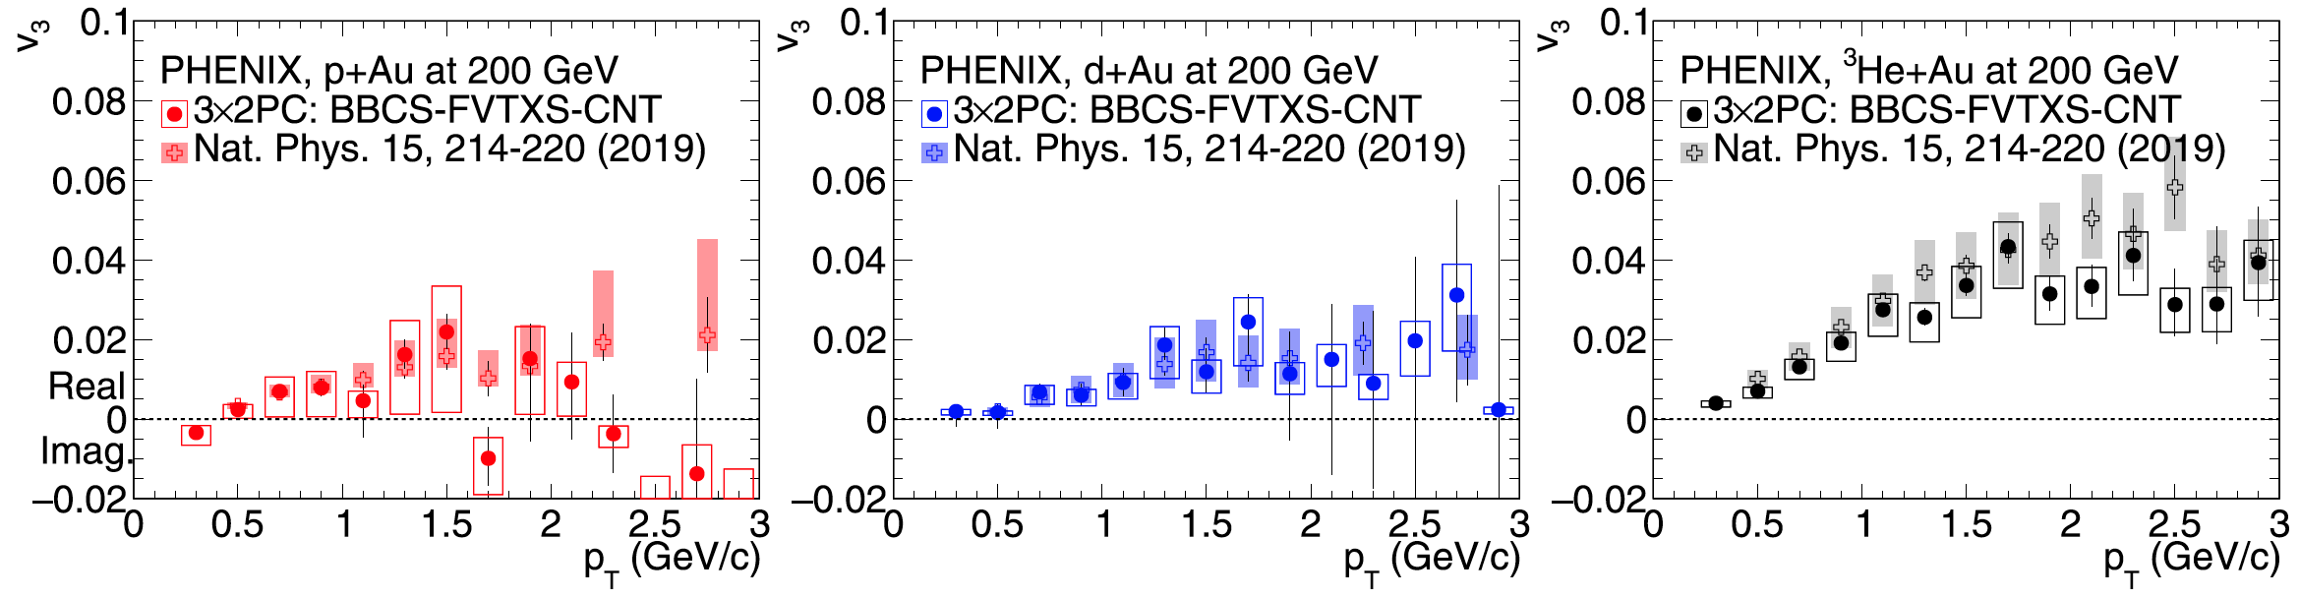
v3 in small systems
x+Au
PRC107 (2023) 2, 024907
Nat. Phys. 15, 214–220(2019)
Using two particle correlations over large rapidity range
Nature Physics results confirmed
Consistent with small droplet of QGP
Different systematics, different sensitivity to non flow effects
Consistent v3

Slide 15
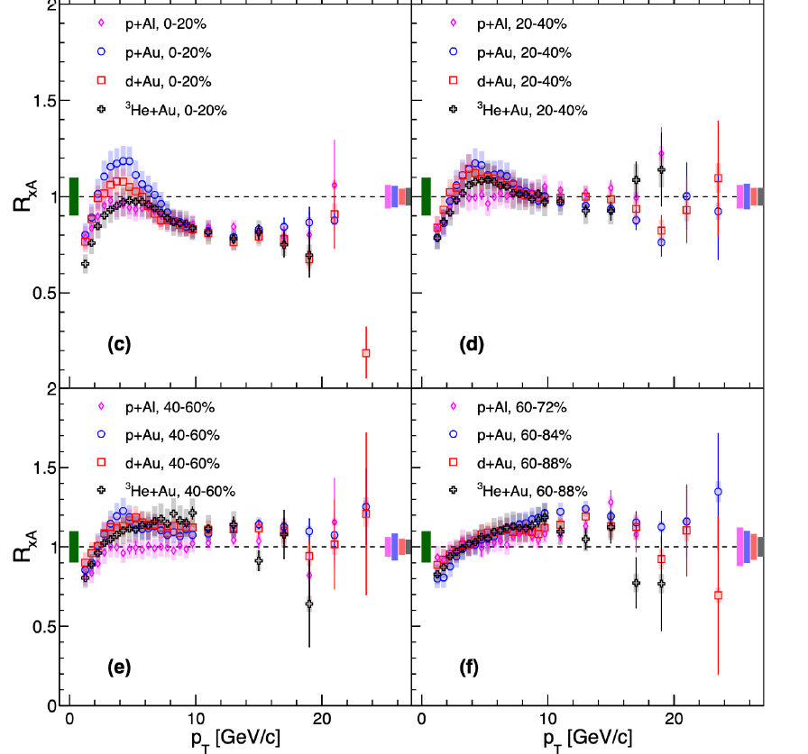
High pT π⁰ in small systems (R_{xA})
x+Au
Talk Tues. 13:00 Daniel Firak
Same suppression at high p_{T} in centrals
Some enhancement in peripherals
Ordering with system size NOT seen at high p_{T}
Potential bias in centrality determination?
Final state effect?
High and low p_{T}: quite different physics!
PRC 105, 064902 (2022)
Bias in N_{coll} at high p_{T} ?

Slide 16
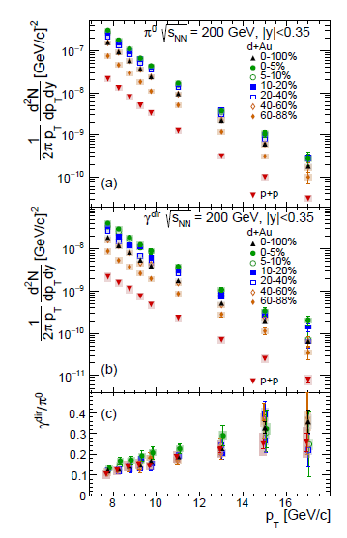
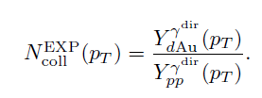
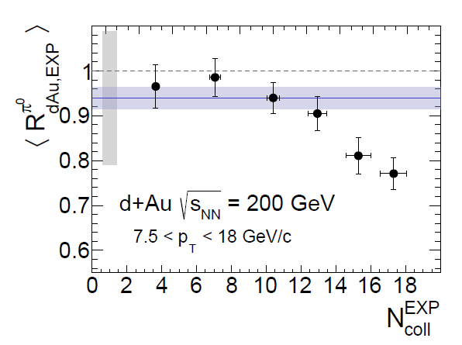
x+Au
Experimental measure of N_{coll}
Talk Tues. 13:00 Daniel Firak
Use electroweak probes
(in our case photons)
to directly measure N_{coll}
arXiv:2303.12899
No enhancement in
peripheral
Suppression in most
central collisions
E_{loss} in QGP droplets?
Something else?
arXiv:2303.12899

Slide 17
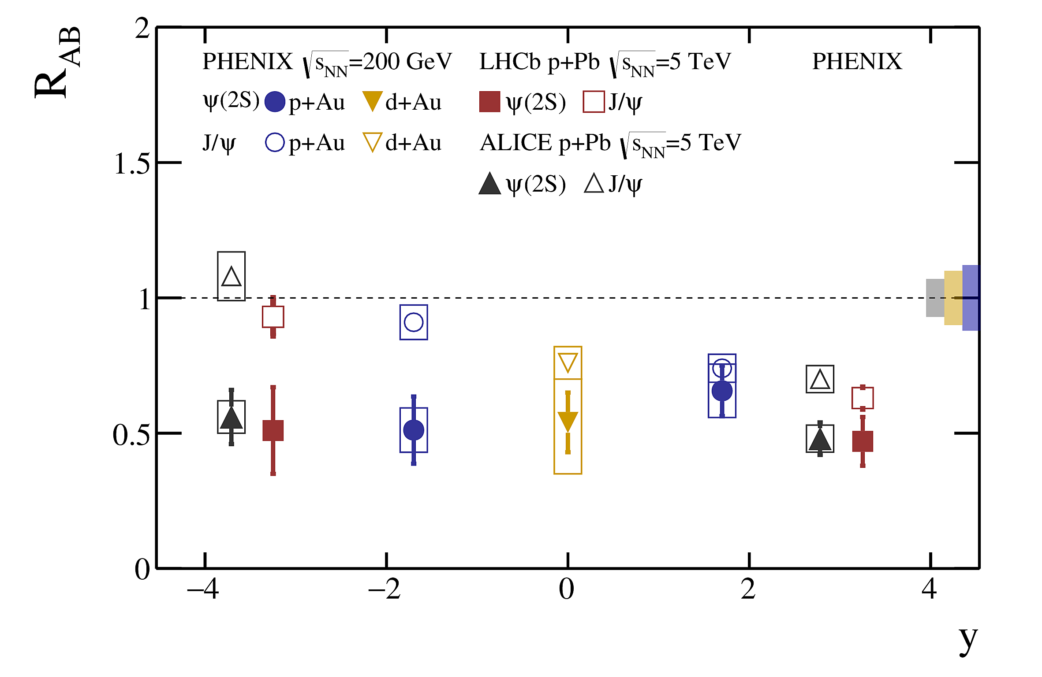
J/ψ and ψ(2S) nuclear modification factor
x+Au
Talk Tues. 11:00 Krista Smith
PRC Editor’s suggestion
Phys.Rev.C 105 (2022) 6, 064912
Similar patterns for J/ψ and ψ(2S) found at RHIC and LHC
Result consistent with final state effects at backward rapidity

Slide 18
Au+Au

Slide 19
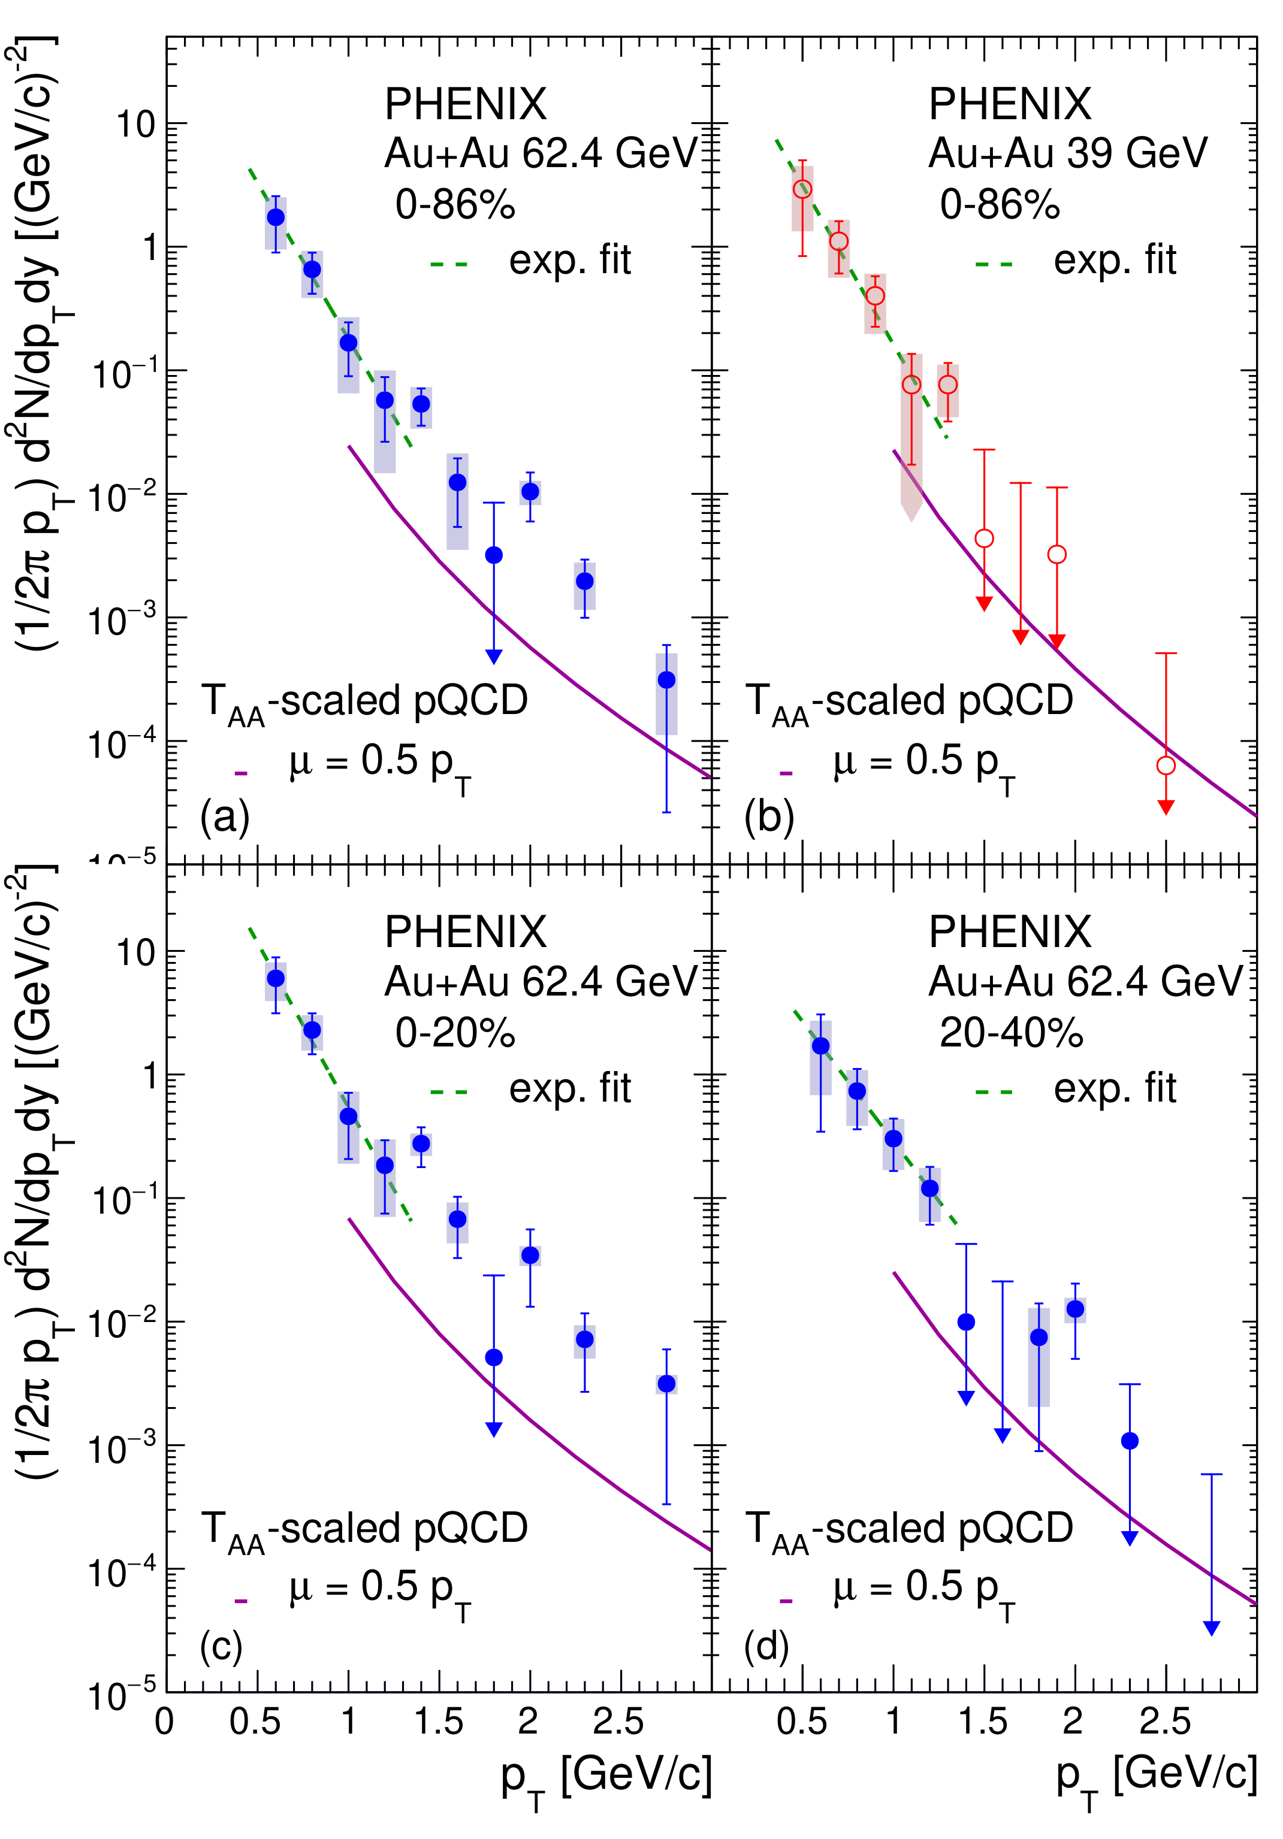
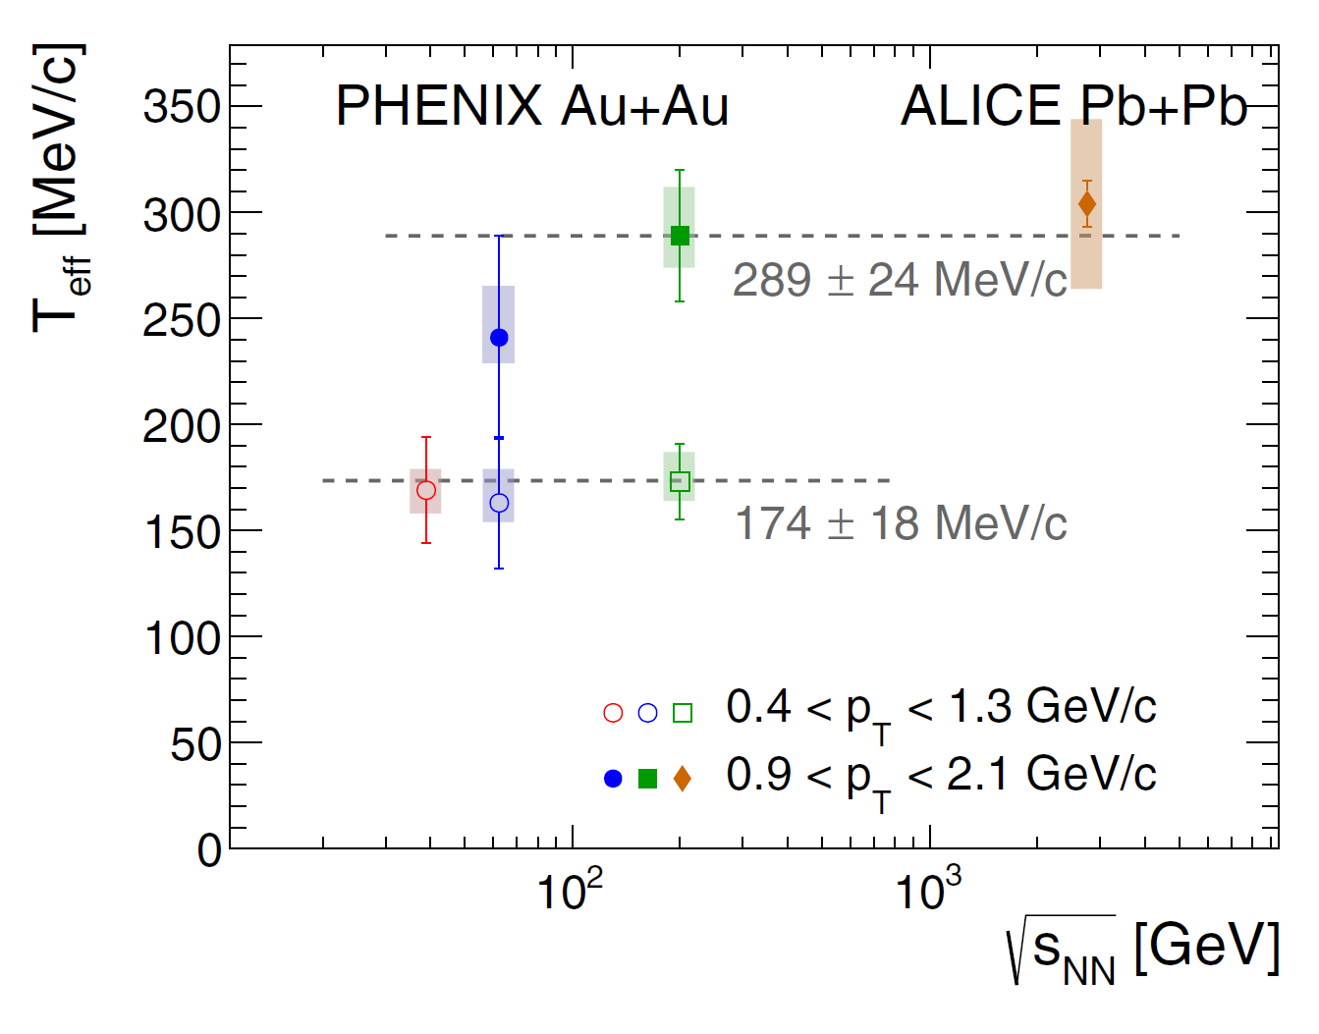
Low pT direct photons
Au+Au
Phys.Rev.C 107 (2023) 2, 024914
Phys.Rev.C 107 (2023) 2, 024914
Talk Tues. 15:30 Vassu Doomra
Systematic measurement of direct γ in various systems and beam energy in wide pT range

Slide 20
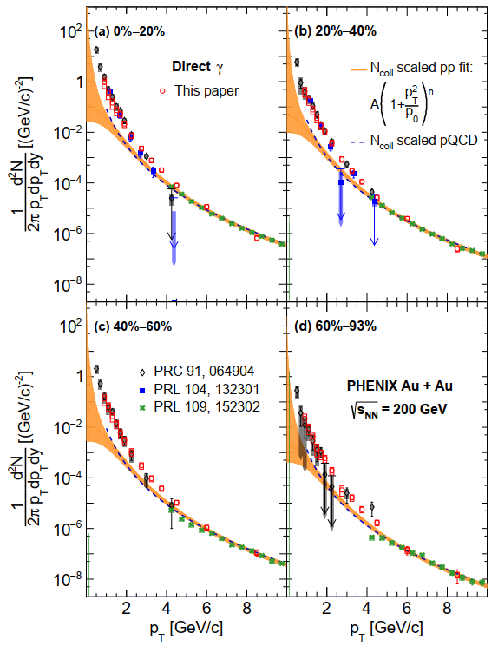
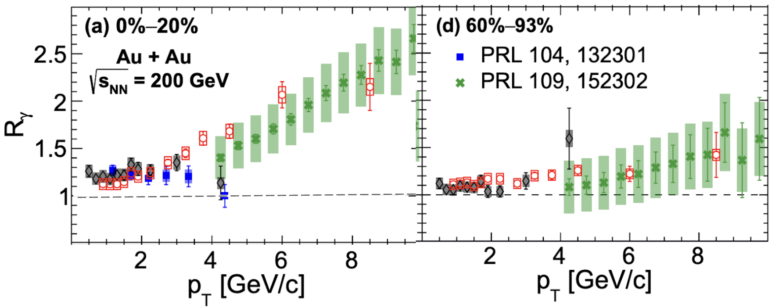

Direct photons in Au+Au
Au+Au
$R_{γ}=\frac{γ_{inclusive}}{γ_{decay}}$
Talk Tues. 15:30 Vassu Doomra
arXiv:2203.17187
∼10× higher statistics
Agreement with previous results
Rγ > 1 → excess direct photon yield
$R_{γ}=\frac{γ_{inclusive}}{γ_{decay}}$

Slide 21
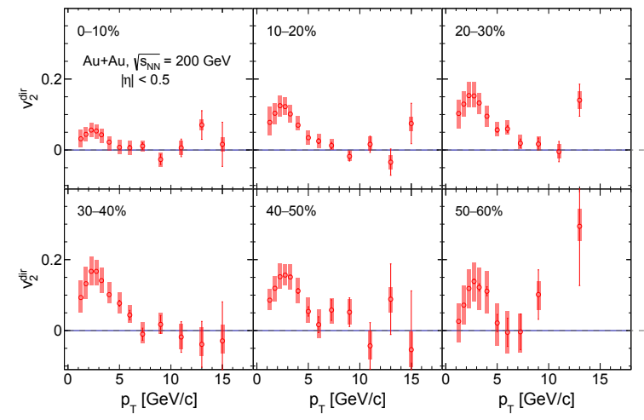
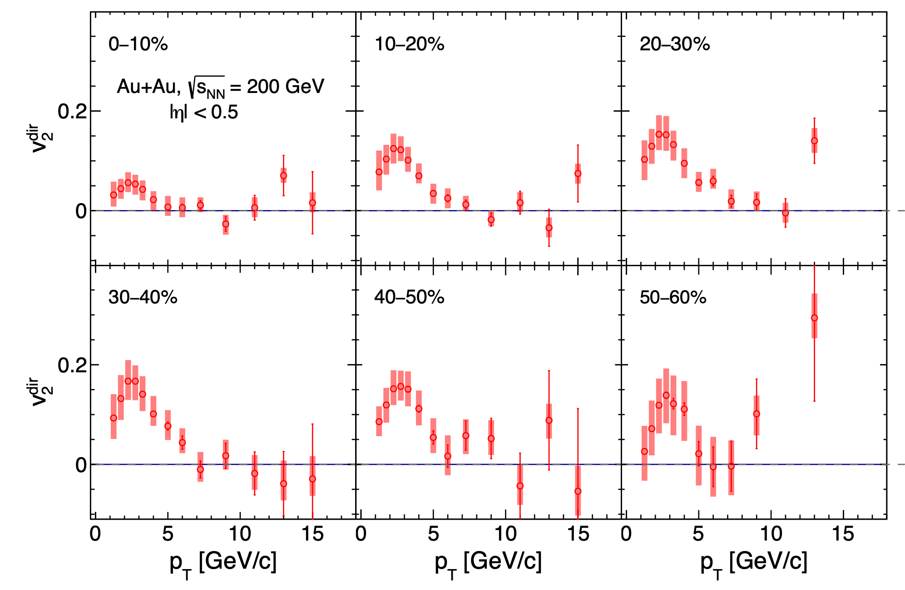
Direct photon v2
Au+Au
New for QM 2023
Talk Tues. 15:30 Vassu Doomra
Significant reduction in stat. & sys. uncertainties
Direct photon v2 at high pT consistent with 0

Slide 22
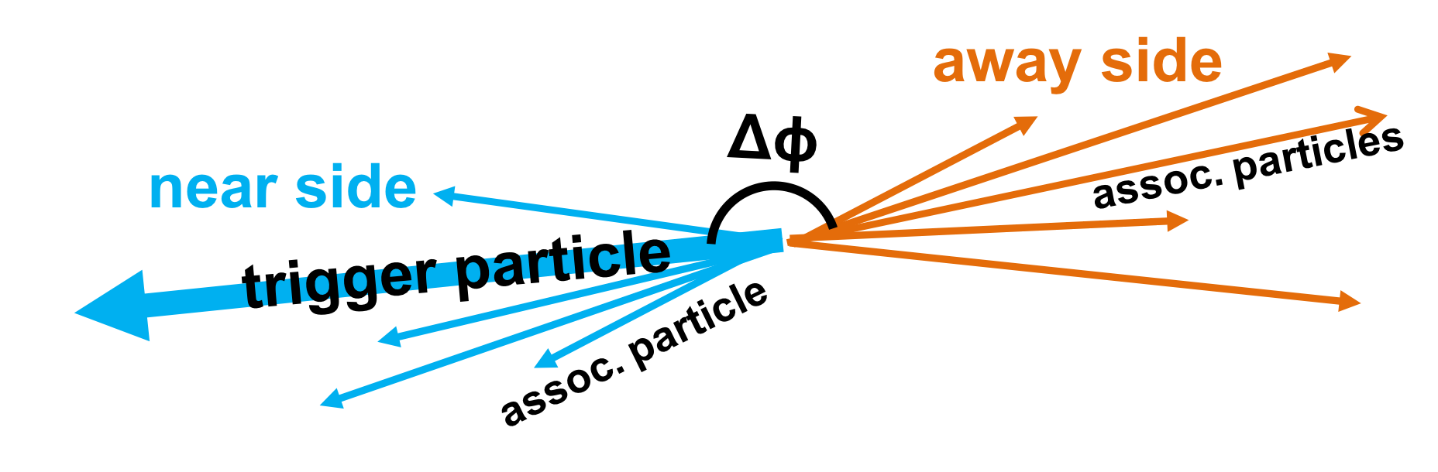
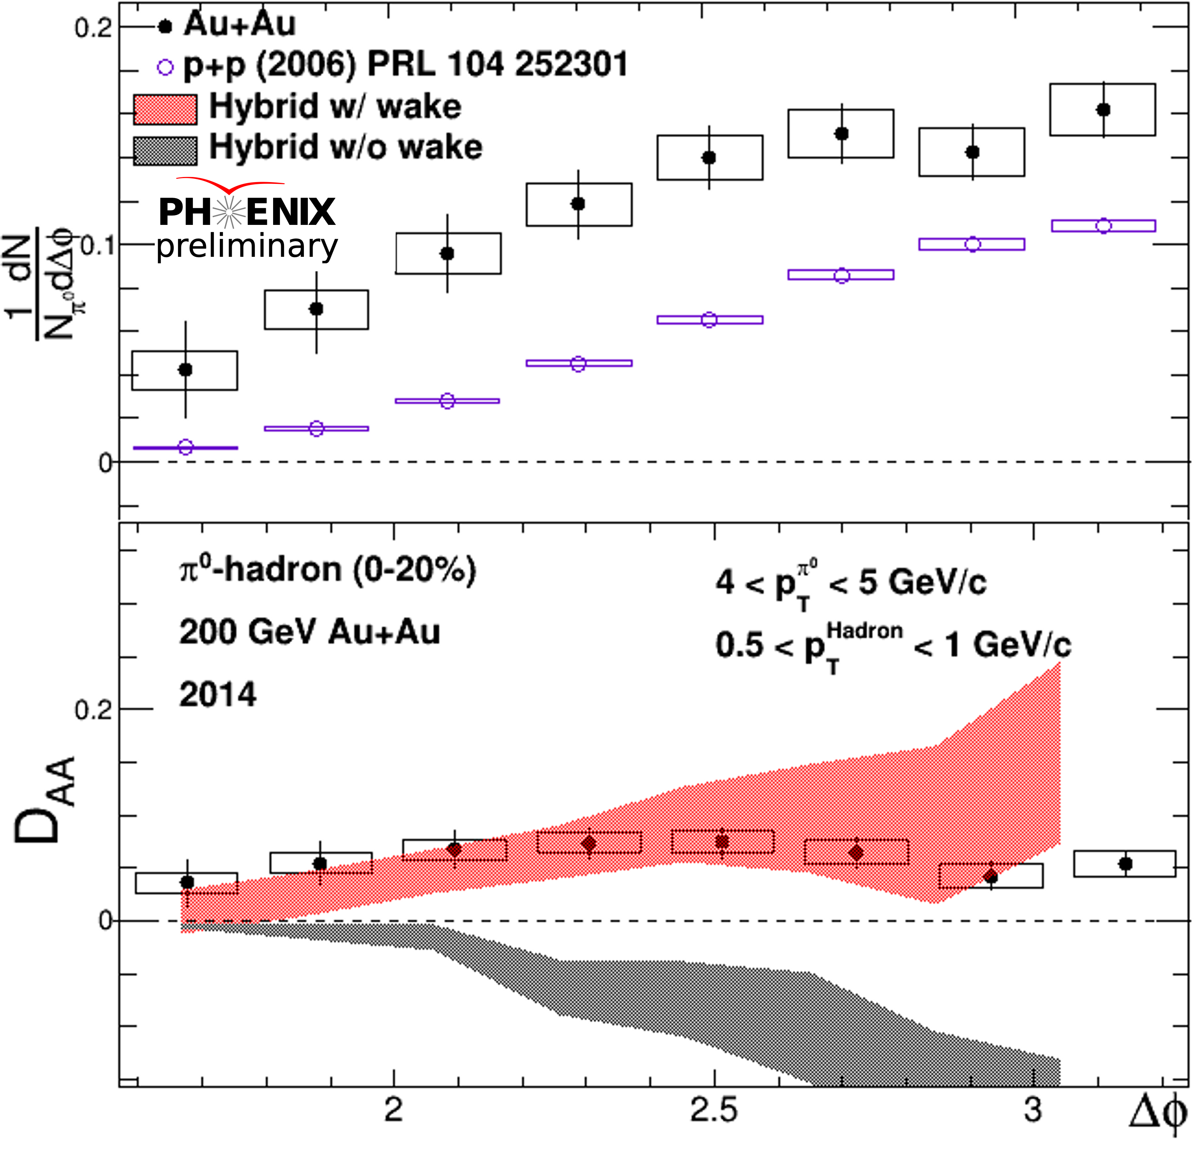
Medium response to jets
Au+Au
$π^{0}$
  Enhancement of low p_{T} hadrons quantified with
  Hybrid model with wake consistent with PHENIX ⁰ –h correlations
  Progressing toward direct –hadron in high statistics Au+Au data sets
$D_{AA}=Y_{AA}−Y_{pp}$
Talk Wed. 10:10 Megan Connors

Slide 23
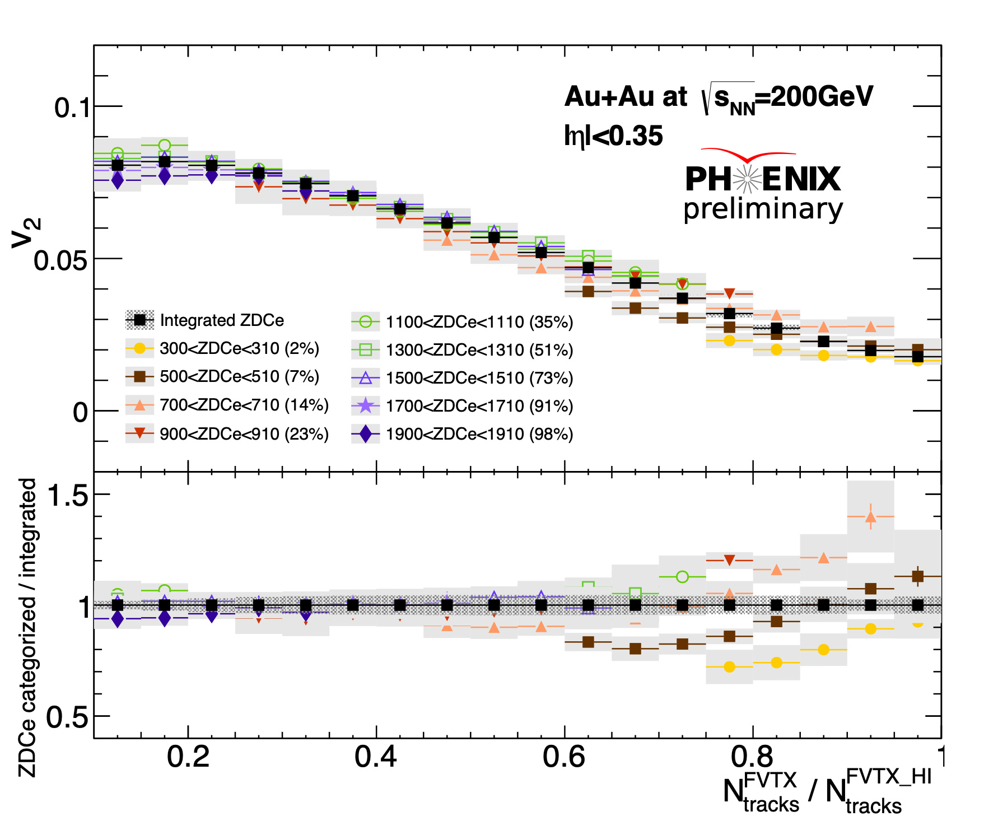
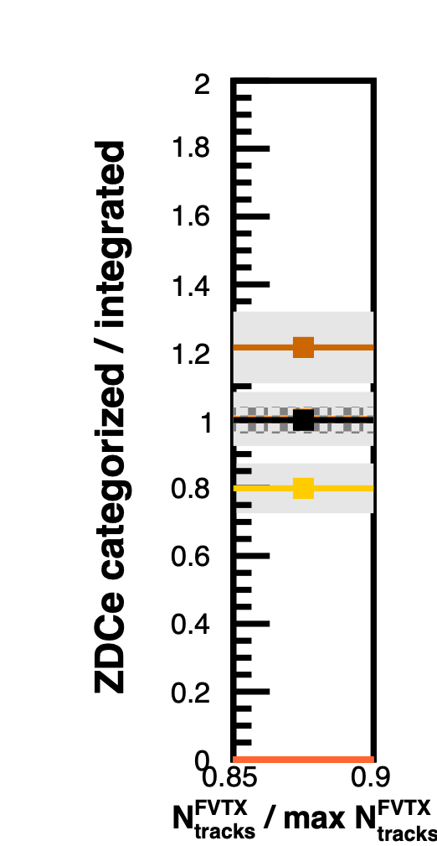
v₂ at different ZDCe event categorization
Au+Au
With fixed ZDC bins, measure v₂ as a function of multiplicity.
Image of the initial geometry
New for QM 2023
These v2 seem to reflect different initial geometry with same multiplicity.
Npart is different but multiplicity is the same.
Poster Maya Shimomura

Slide 24
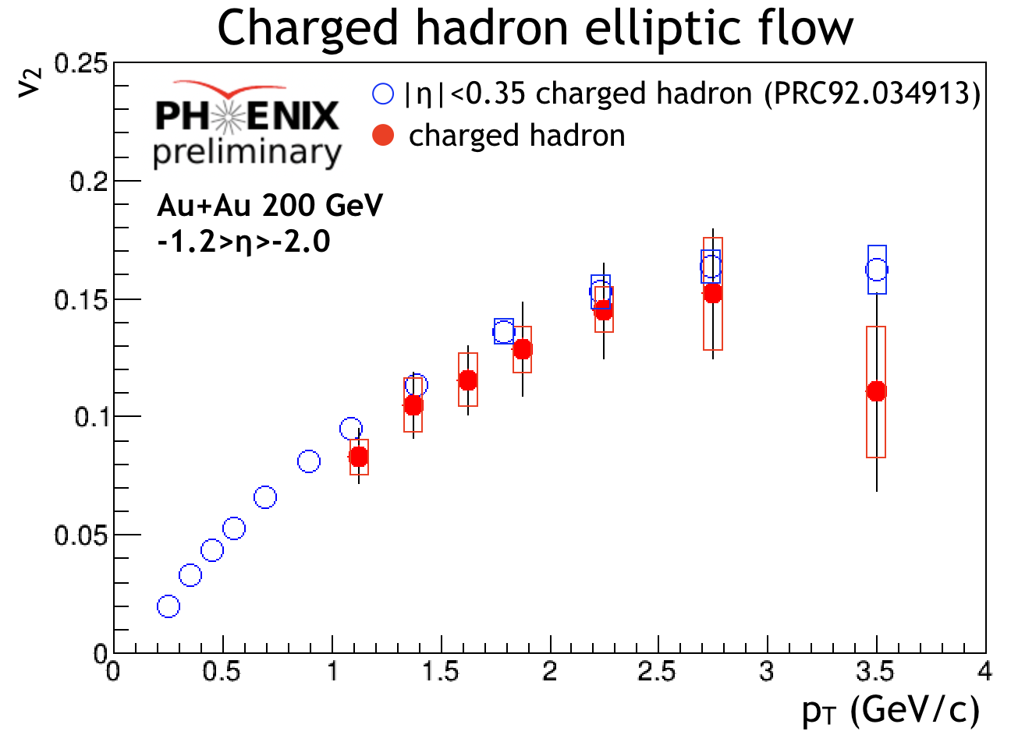
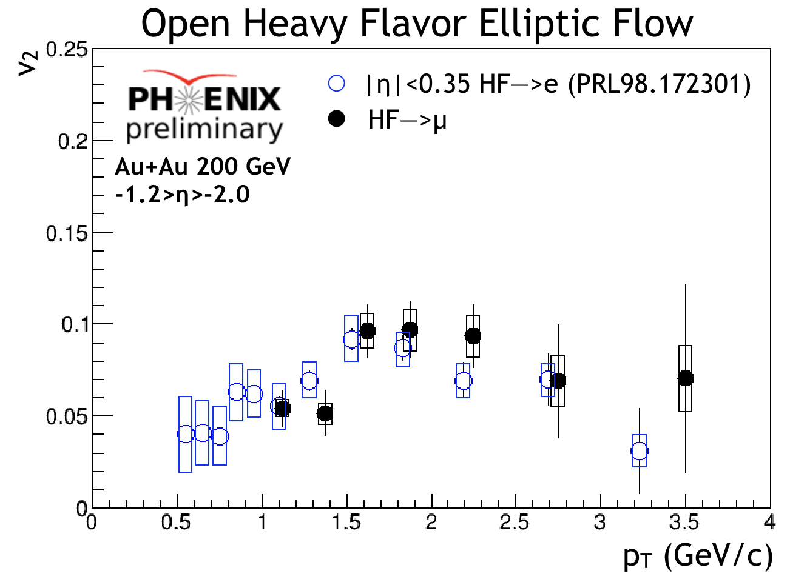
Open Heavy Flavor v2 at RHIC
Au+Au
New for QM 2023
Poster Bran Blankenship
Talk Tues. 11:00 Krista Smith
First-ever RHIC measurement of open heavy flavor elliptic flow at forward rapidity
Mass ordering apparent

Slide 25
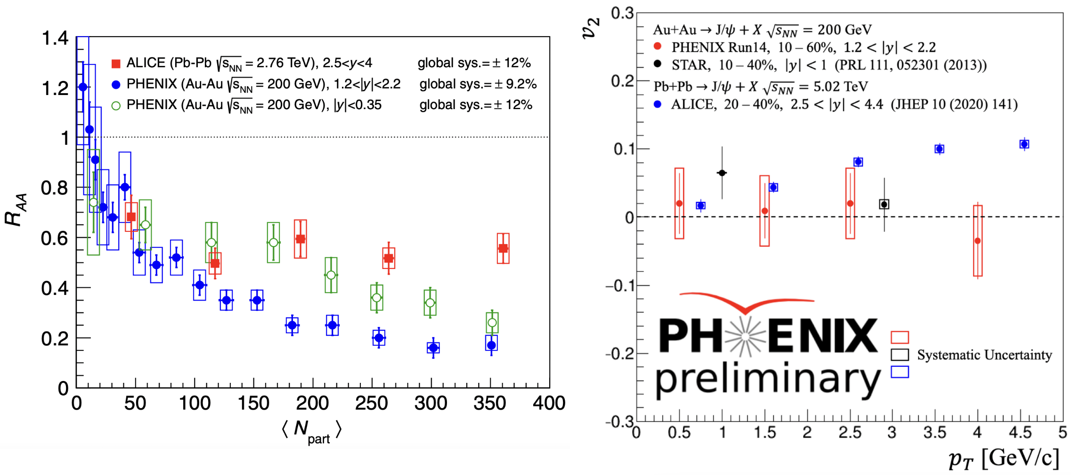
J/ψ in Au+Au
Au+Au
Talk Tues. 11:00 Krista Smith
Poster Tues. 17:30 Luis Bichon III
PHENIX J/ψ shows stronger suppression at both forward and mid-rapidity
At RHIC energies, regeneration not as significant, J/ψ flow consistent with zero

Slide 26
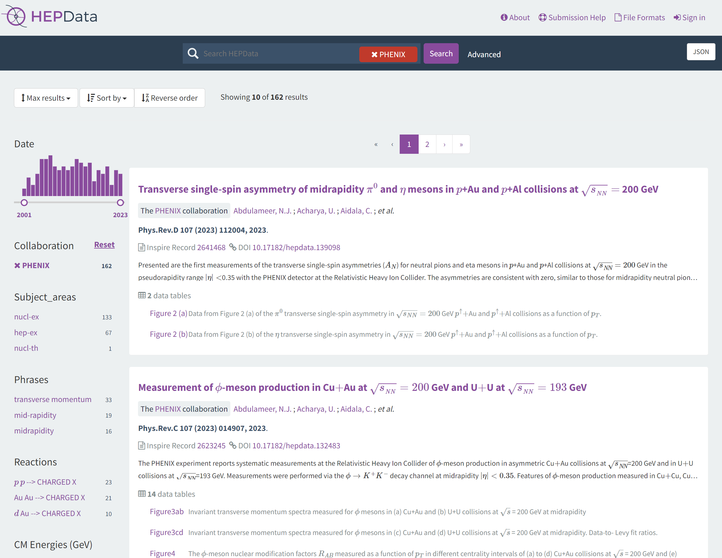
Data and analysis preservation
192/218 PHENIX papers on HEPData
REANA is a framework of analysis preservation
  Analysis environment (libraries, etc) are in container (Docker)
  Workflow in YAML
  π⁰ and direct γ d+Au analyses implemented

Slide 27
Conclusions
PHENIX continues many high impact analyses
Signatures consistent with hot nuclear matter in small systems
  Direct photon excess
  Azimuthal anisotropies
  Suppression in central d+Au
New precision measurements of QGP in Au+Au
  Direct photon v2, spectra
  Heavy flavor v2, spectra

Slide 28
PHENIX at QM23
Talk Heavy Flavor and Quarkonia results from the PHENIX experiment Tues. 11:00 Krista Smith (LANL)
Talk Isolating final state effects in high pT π⁰ production using direct photons in small system collisions with PHENIX Tues. 13:00 Daniel Firak (Stony Brook)
Talk Measurement of low pT direct photons with PHENIX Tues. 15:30 Vassu Doomra (Stony Brook)
Talk Measurement of in-medium modification of energy-space structure of jets via and triggered hadrons in Au+Au collisions
at RHIC Wed. 10:10 Megan Connors (Georgia State)
Poster Elliptic flow measurement of J/ψ in PHENIX Run14 Au+Au at √sNN=200 GeV Tues. 17:30 Luis Bichon III (Vanderbilt)
Poster Forward Physics with light vector mesons and π⁰ from the PHENIX Experiment Tues. 17:30 Uttam Acharya (Georgia State)
Poster Particle multiplicity dependent Charmonia production in p+p collisions by the PHENIX experiment Tues. 17:30 JongHo Oh (Pusan National University)
Poster PHENIX measurements of identified charged hadron production in p+Al,p+Au, and Cu+Au collisions at √sNN = 200 GeV Tues. 17:30 Sanghoon Lim (Pusan National University)
Poster Systematic study of energy loss in the QGP for various collision systems at PHENIX Tues. 17:30 Takashi Hachiya (Nara Women’s University)
Poster Di-electron continuum in p+p collisions at 200 GeV
Tues. 17:30 Roli Esha (Stony Brook)
Poster Neutral pion and eta meson production in Au+Au collisions at 200 GeV Tues. 17:30 Dading Chen(Stony Brook)
Poster Measurement of neutral pions and direct photons in ³He+Au collisions Tues. 17:30 Daniel Firak (Stony Brook)
Poster PHENIX Measurements of Azimuthal Anisotropy of Light and Heavy Flavor Hadrons in Au+Au Collisions at Forward Rapidity Tues. 17:30 Brandon Blankenship (Vanderbilt)
Poster The study of with a new double-differential event categorization using multiplicity and spectator neutrons in PHENIX Tues. 17:30 Maya Shimomura

