Slide 1

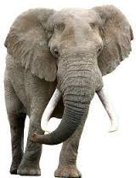
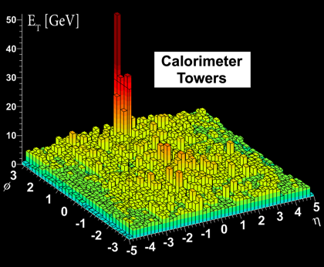
Bias and background
Christine Nattrass
RHIC/AGS User's Meeting 2016

Slide 2




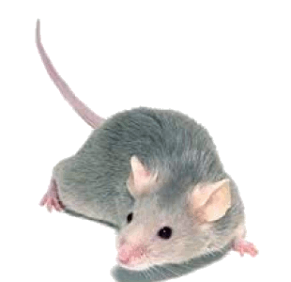
Jets in principle
Jet measures partons
Hadronic degrees of freedom are integrated out
Algorithms are infrared and colinear safe
D
c, x_{c}
p
a, x_{a}
b, x_{b}
p
σ_{ab}
d, x_{d}
D

Slide 3
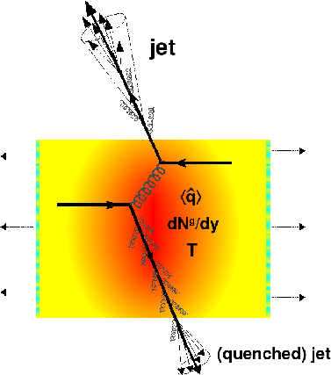
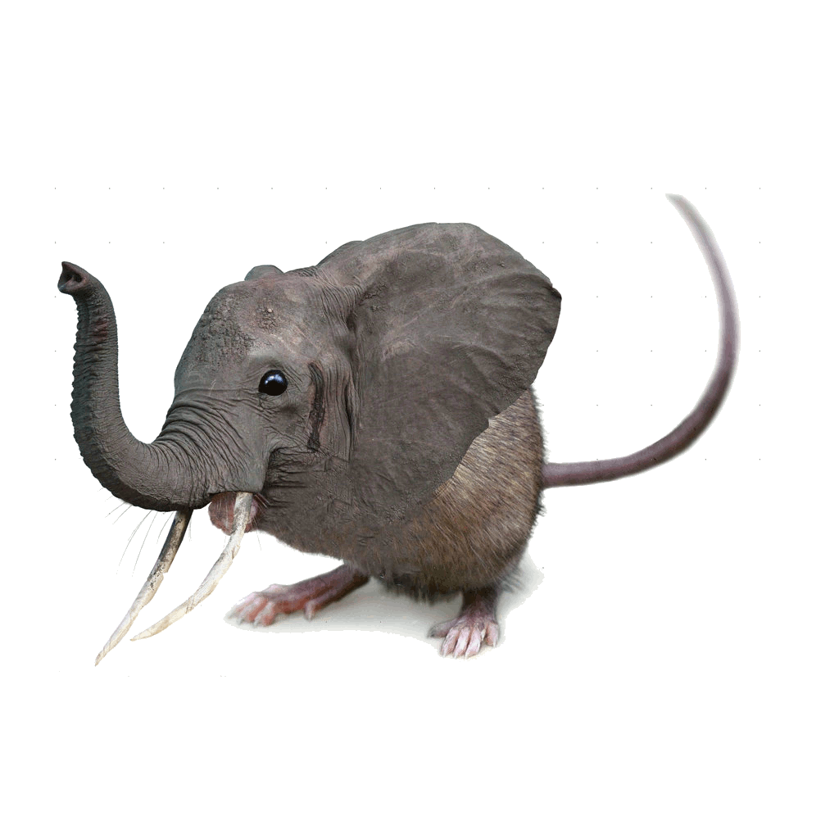
Quenched jets:
what we're trying to study
Quenched jet
  Softer constituents
  Broader radius
→Looks more like background
Figure from Nucl.Phys. A827 (2009) 356C-364C arXiv:0902.2488 [nucl-ex]

Slide 4
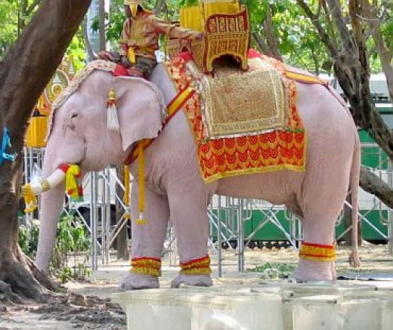
Background: our white elephant
Wiki: “A white elephant is a possession which its owner cannot dispose of and whose cost, particularly that of maintenance, is out of proportion to its usefulness. The term derives from the story that the kings of Siam, now Thailand, were accustomed to make a present of one of these animals to courtiers who had rendered themselves obnoxious, in order to ruin the recipient by the cost of its maintenance.”
Background properties
Impact of background subtraction/suppression on reconstructed jets
Background subtraction in jet-h and h-h correlations

Slide 5

Properties of the background

Slide 6
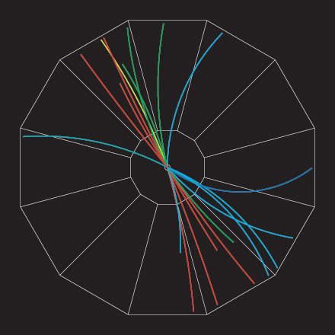
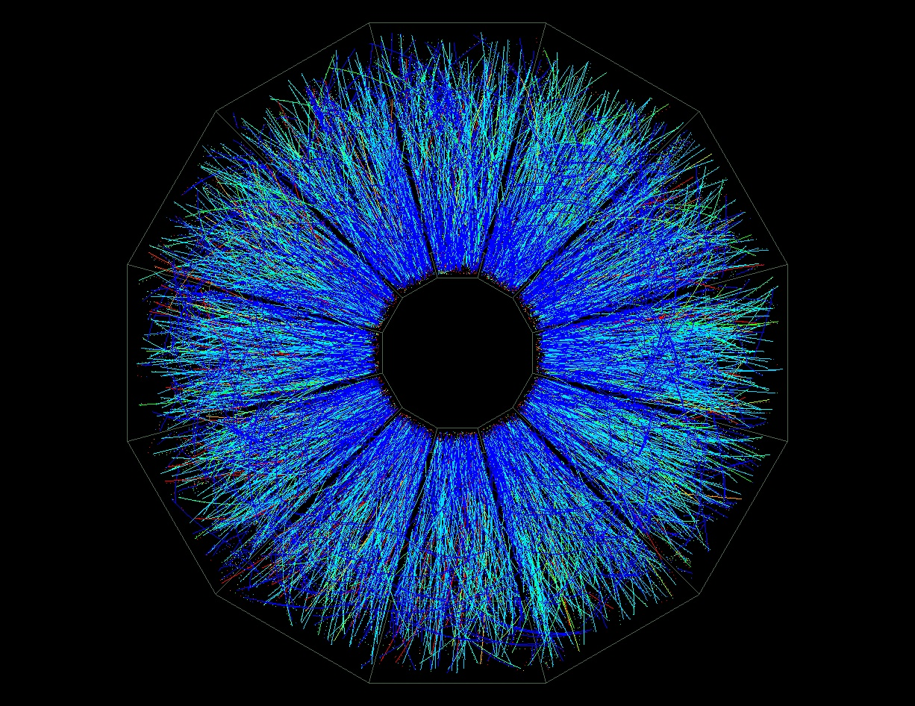

p+p di-jet event in STAR
Central Au+Au collision in STAR
Background
Signal
Harder
Correlated with rxn plane
Low p_{T} modifications
Flavor modifications?
Softer
Correlated with rxn plane
Large fluctuations/hot spots
Combinatorial background
Degraded energy resolution

Slide 7
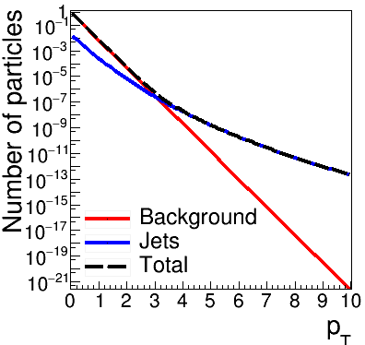
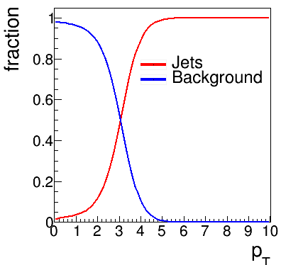
Focus on high p_{T}
Pros:
  Reduces combinatorial background
Cons:
  Cuts signal where we expect modifications
  Could impose a bias
Schematic only!

Slide 8
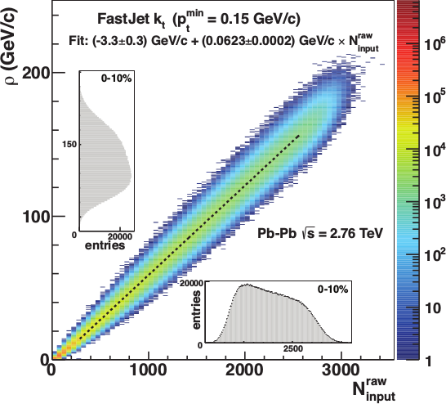
Focus on smaller angles
Pros
  Background is smaller
  Background fluctuations smaller
Cons:
  Modifications expected at higher R
JHEP 03 (2012) 053

Slide 9
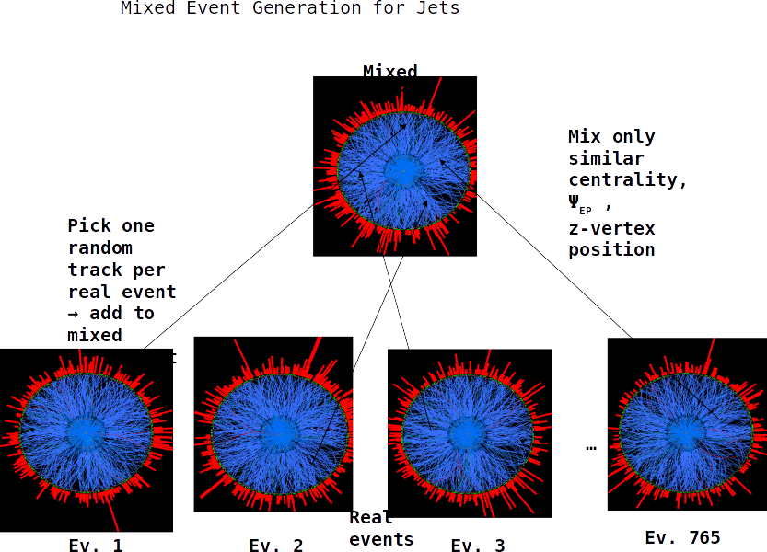
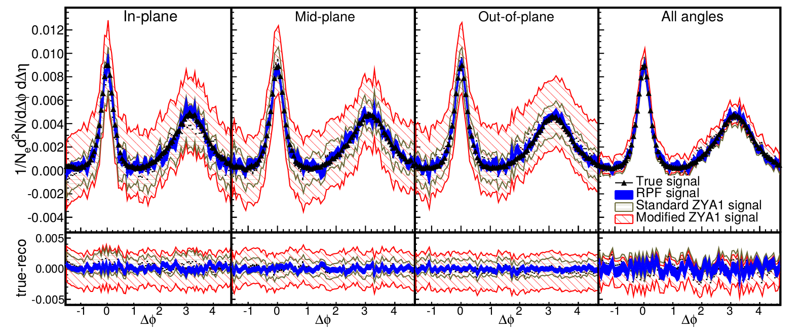
Carefully quantify background
Jet reconstruction: mixed events
Correlations: go beyond ZYAM

Slide 10
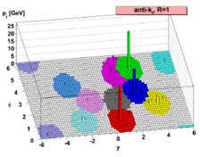
Reconstructed jets

Slide 11
Jet finding algorithms
Tracks
Jet finding algorithm
Jet candidates
Clusters
Particles
Any list of objects works as input
Output only as good as input
IR Safe
Colinear safe
M. Cacciari, G. P. Salam, G.Soyez, JHEP 0804:063,2008

Slide 12
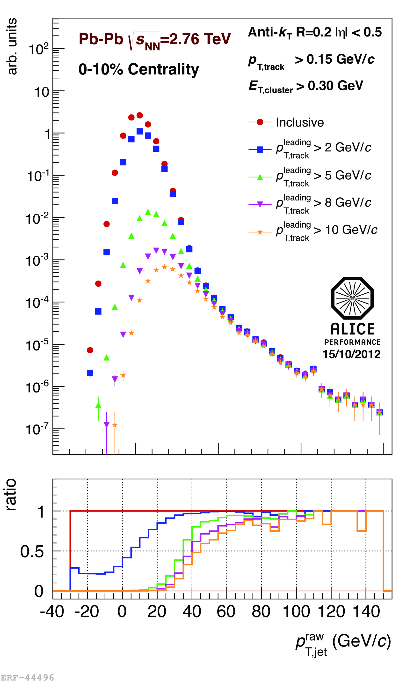
<footer>
ALICE/STAR
Combinatorial “jets”
Estimate combinatorial jet contributions and its fluctuations from data
Require leading track p_{T} > 5 GeV/c
  Suppresses combinatorial “jets”
  Biases fragmentation
No threshold on constituents
Limited to small R
Measured spectra:
Full jets
Where
comes from FastJet anti-k_{T} algorithm
Notes:
<number>

Slide 13
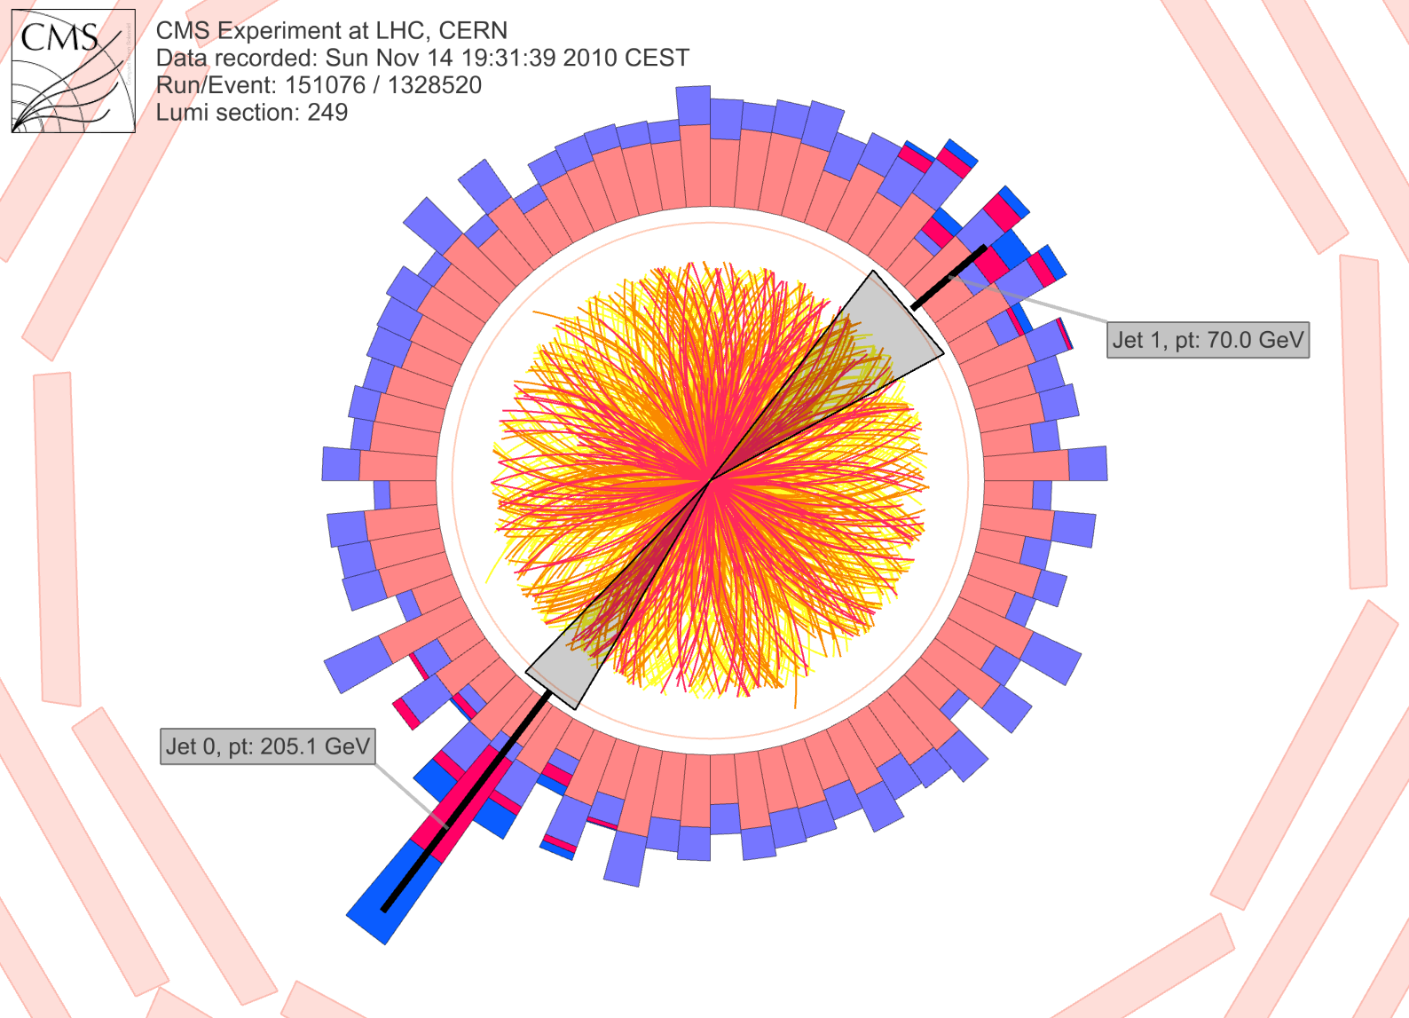
CMS: Iterative Pile-Up Event Background Subtraction
Background is estimated
for each calorimeter ring of constant η
subtracted before jet finding
re-iterated after excluding the jets found in the first iteration
Fake Jets: After the background subtraction, some local fluctuations remain!
Fluctuations will deteriorate the jet resolution in central events.
Sevil Salur
<number>

Slide 14
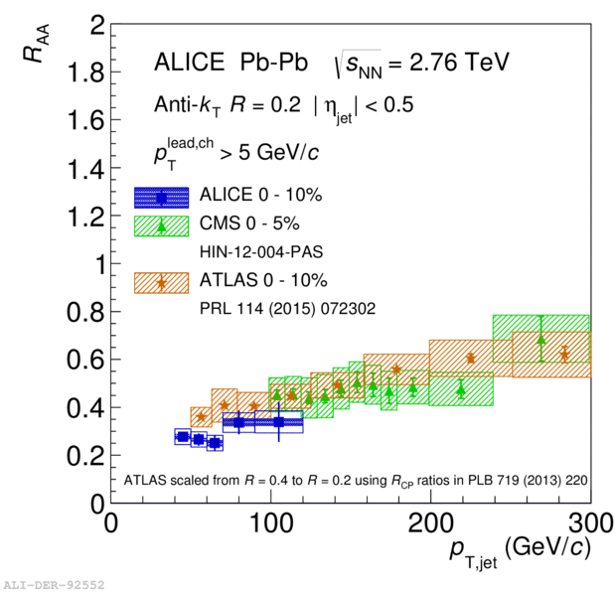
ATLAS
Constituent biases don't matter that much up here
Iterative procedure
  Calorimeter jets: Reconstruct jets with R=0.2. v₂ modulated <Bkgd> estimated by energy in calorimeters excluding jets with at least one tower with
  E_{tower} > <E_{tower}>
  Track jets: Use tracks with p_{T}>4 GeV/c
  Calorimeter jets from above with E>25 GeV and track jets with p_{T}>10 GeV/c used to estimate background again.
Calorimeter tracks matching one track with p_{T}>7 GeV/c or containing a high energy cluster E >7 GeV are used for analysis down to E_{jet} = 20 GeV
But they do matter down here!
Definitely imposes a bias, especially at 20 GeV!
We should treat that bias as a tool, not a handicap
Phys. Lett. B 719 (2013) 220-241

Slide 15
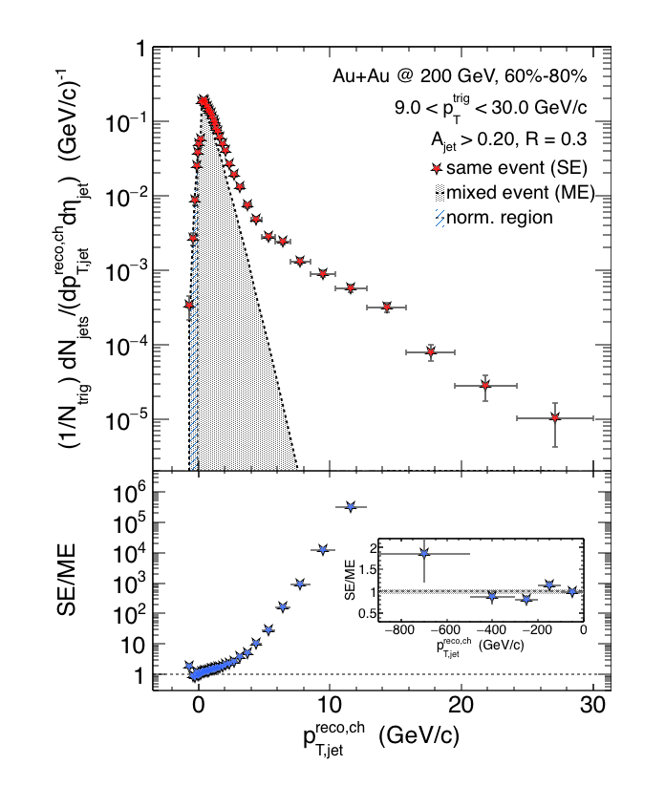

Charged Raw Recoil Jet Spectrum: Reference
Event mixing
Peripheral
Reference spectrum:
peripheral collisions
Much less combinatorial
background compared to
most central data
Excellent signal/background
ratio down to 3 GeV/c
Preliminary
Requires normalization at low p_{T}
All physical correlations treated like jets
Alex Schmah, Hard Probes 2015
06/29/2015
Alexander Schmah - Hard Probes 2015
<number>

Slide 16
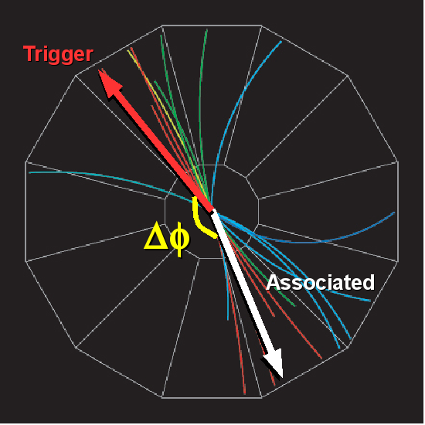
h-h and jet-h correlations
Based largely on:
Sharma, Mazer, Stuart, Nattrass Phys. Rev. C 93, 044915
Nattrass, Sharma, Mazer, Stuart,Bejnood arXiv:1606.00677

Slide 17
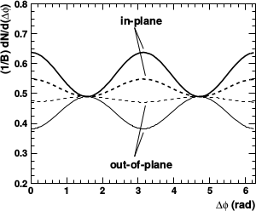
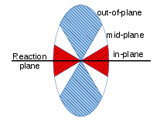
Correlation with reaction plane
All reaction plane angles
When trigger is restricted relative to reaction plane
  Background level modified
  Effective v_{n} modified
φ_{S} is the angular threshold
Phys.Rev. C69 (2004) 021901 arXiv:nucl-ex/0311007

Slide 18
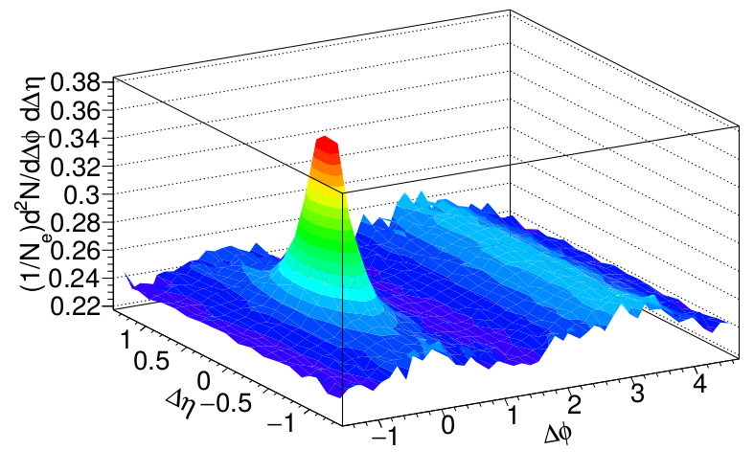
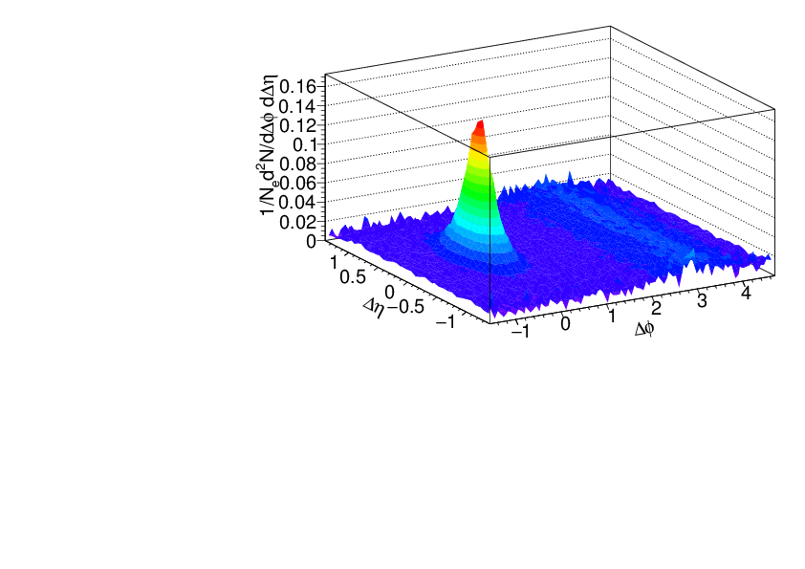
Separating signal+background
Signal+background
Signal only
h-h
√s_{NN} = 2.76 TeV
30-40% PbPb
8<p_{T}^{trigger}<10 GeV/c
1<p_{T}^{assoc}<2 GeV/c
Background dominated region
Using toy model
described in Sharma, Mazer, Stuart, Nattrass Phys. Rev. C 93, 044915

Slide 19
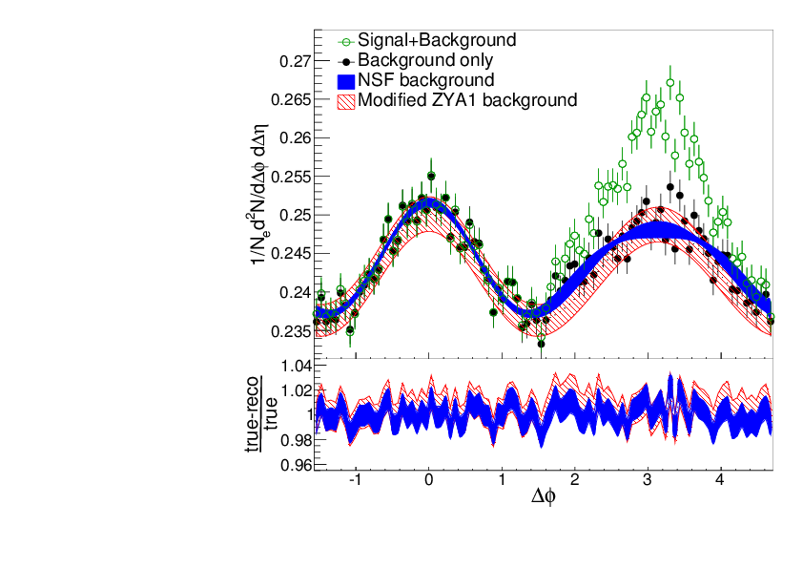
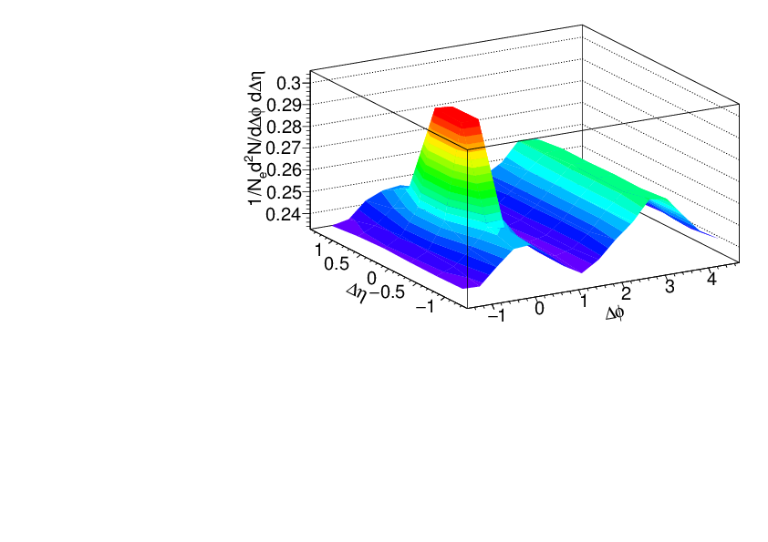
Near-Side Fit (NSF) method
No reaction plane dependence
Signal+background
h-h
√s_{NN} = 2.76 TeV
30-40% PbPb
8<p_{T}^{trigger}<10 GeV/c
1<p_{T}^{assoc}<2 GeV/c
Fit
extrapolation
Background dominated region
Project signal+background over 1.0<|Δη|<1.4
Fit background in |Δφ|<π/2 with v_{n} up to n=4

Slide 20
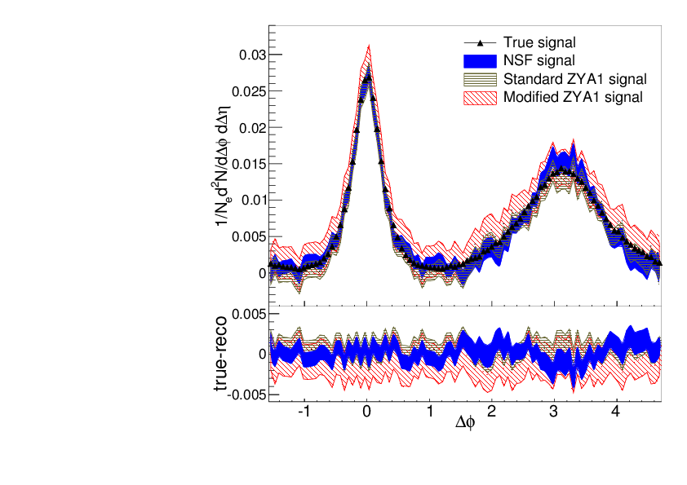
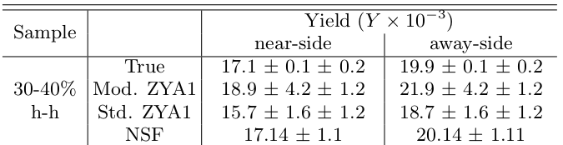
Near-Side Fit (NSF) method
No reaction plane dependence
Reconstructs signal with less bias and smaller errors than ZYA1 method
Extract v_{n} consistent with input
h-h
√s_{NN} = 2.76 TeV
30-40% PbPb
8<p_{T}^{trigger}<10 GeV/c
1<p_{T}^{assoc}<2 GeV/c
Standard ZYA1 = Zero Yield at ΔΦ=1
Modified ZYA1 = Zero Yield at ΔΦ=1 for 1.0<|Δη|<1.4

Slide 21
Adding reaction plane dependence

Slide 22
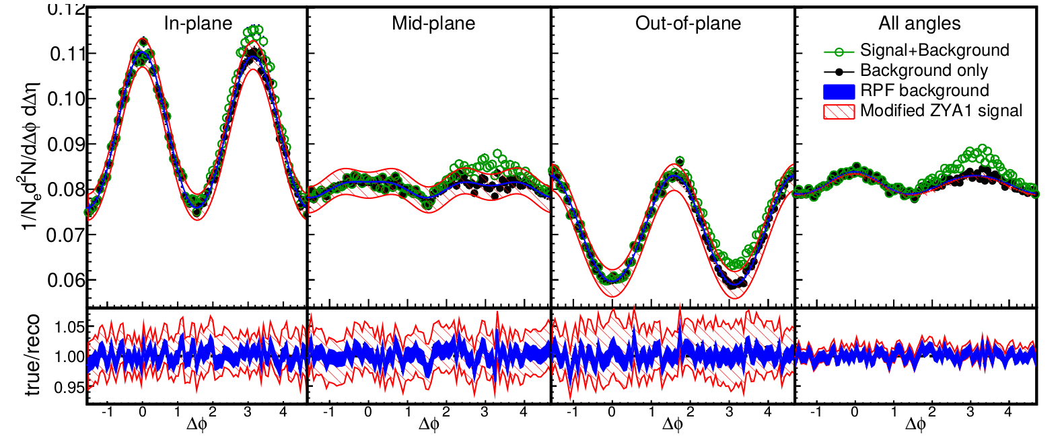
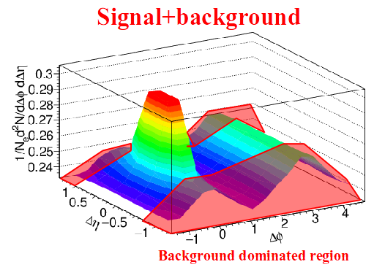
Reaction Plane Fit (RPF) method
30-40% central
h-h
√s_{NN} = 2.76 TeV
30-40% PbPb
8<p_{T}^{trigger}<10 GeV/c
1<p_{T}^{assoc}<2 GeV/c
Fit
Project signal+background over 1.0<|Δη|<1.4
Fit background in |Δφ|<1 including reaction plane dependence
v_{n} and B extracted with v_{n} up to n=4

Slide 23
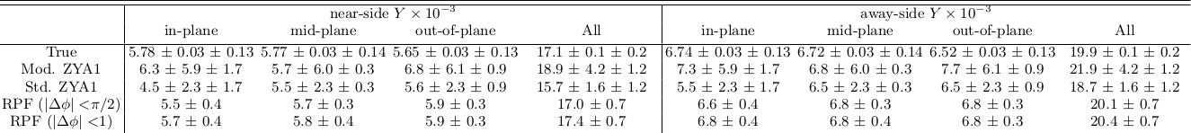
Reaction Plane Fit (RPF) method
30-40% central
h-h
√s_{NN} = 2.76 TeV
30-40% PbPb
8<p_{T}^{trigger}<10 GeV/c
1<p_{T}^{assoc}<2 GeV/c

Slide 24
Going to lower momenta

Slide 25
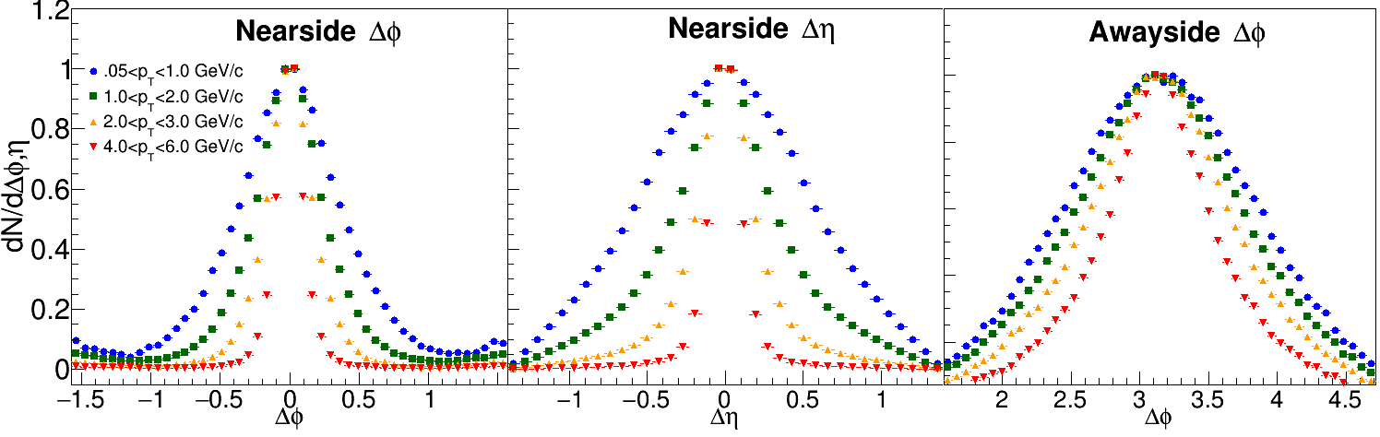
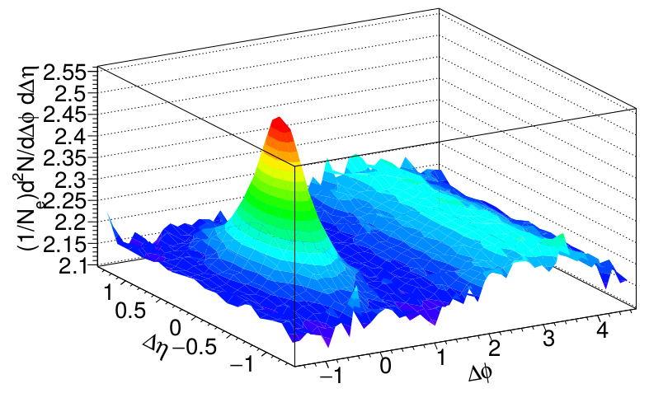
Low momenta
ZYAM assumptions break down at low p_{T}
If method doesn't work on PYTHIA, it can't be trusted on data!
But low p_{T} is interesting!
h-h
√s_{NN} = 2.76 TeV
30-40% PbPb
8<p_{T}^{trigger}<10 GeV/c
0.5<p_{T}^{assoc}<1 GeV/c

Slide 26
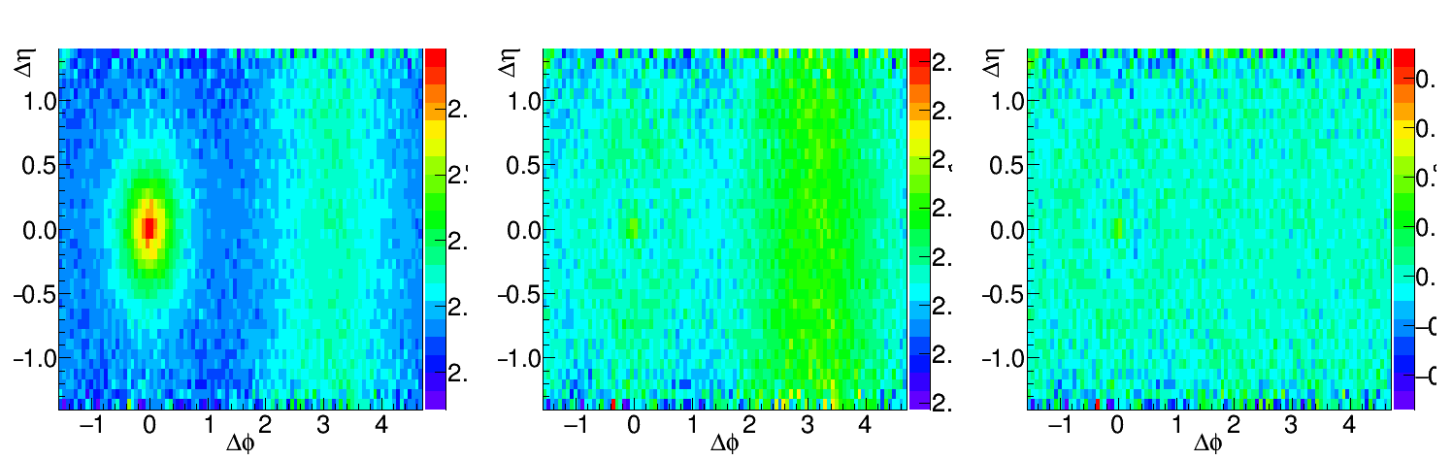
Going to lower momenta, medium modifications
Peak gets broader
Fit near-side peak and subtract it
Increase Δη range available for background subtraction
Before subtraction
After subtraction
Data/Fit
h-h, √s_{NN} = 2.76 TeV, 0-10% PbPb
8<p_{T}^{trigger}<10 GeV/c
1<p_{T}^{assoc}<2 GeV/c for background, 0.5<p_{T}^{assoc}<1.0 GeV/c for signal
Structure from imperfect fit

Slide 27
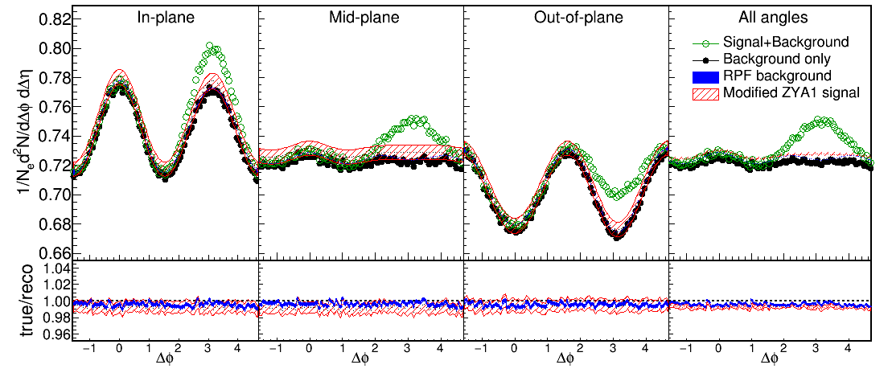
Near-Side Subtracted RPF method
30-40% central
h-h, √s_{NN} = 2.76 TeV, 0-10% PbPb
8<p_{T}^{trigger}<10 GeV/c
1<p_{T}^{assoc}<2 GeV/c for background
0.5<p_{T}^{assoc}<1.0 GeV/c for signal
Fit
Project signal+background over 0.0<|Δη|<1.4
Fit background in |Δφ|<1 including reaction plane dependence
v_{n} and B extracted with v_{n} up to n=4

Slide 28
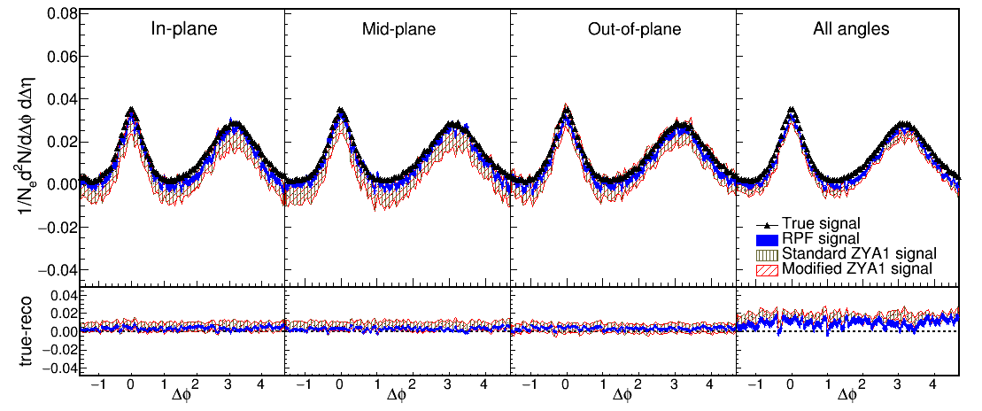
Reaction Plane Fit (RPF) method
30-40% central
h-h
√s_{NN} = 2.76 TeV
30-40% PbPb
8<p_{T}^{trigger}<10 GeV/c
1<p_{T}^{assoc}<2 GeV/c
h-h, √s_{NN} = 2.76 TeV, 0-10% PbPb
8<p_{T}^{trigger}<10 GeV/c
1<p_{T}^{assoc}<2 GeV/c for background
0.5<p_{T}^{assoc}<1.0 GeV/c for signal
Works beautifully!

Slide 29
Revisiting dihadron correlations

Slide 30
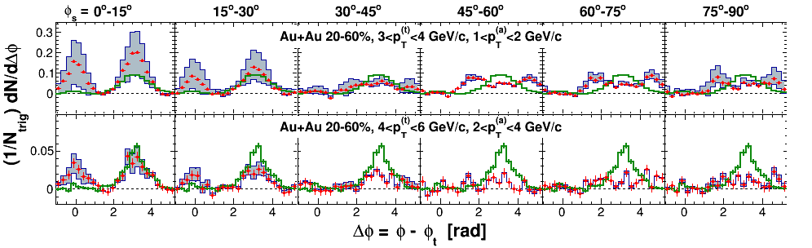
STAR measurements of dihadron correlations relative to reaction plane
Correlations on arxiv (nucl-ex/1010.0690 v2)
  Published article (Phys. Rev. C 89 (2014) 41901) does not include raw correlations
ZYAM background subtraction
  Reports ridge at Δη> 0.7
  RPF method assumes no signal at Δη> 0.7
  0.7<Δη< 2

Slide 31
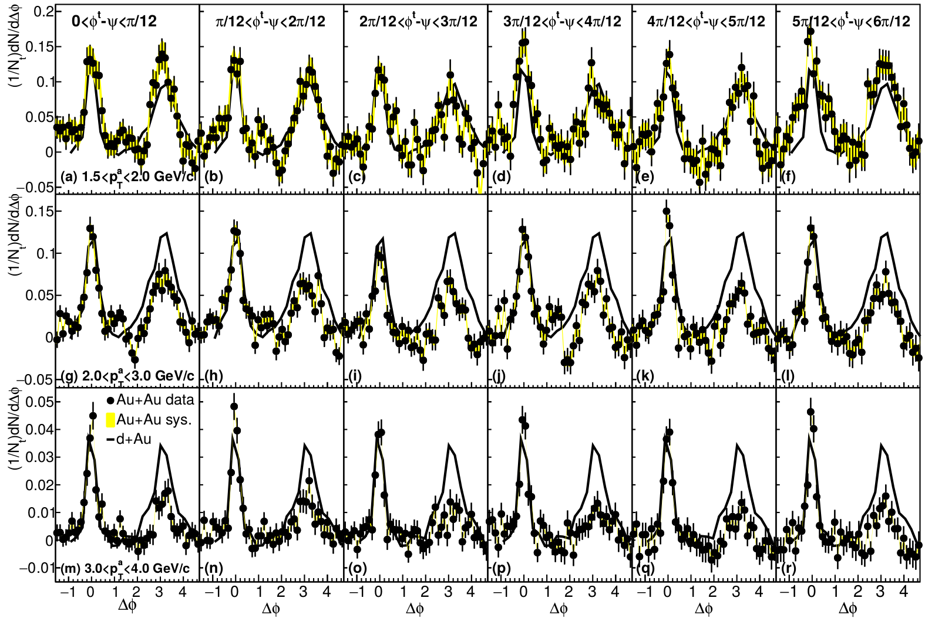
Background subtracted correlations 4<p_{T}^{t}<6 GeV/c
No “Mach Cone”, up to 10x higher precision
Statistical error bars include correlated statistical error on background

Slide 32
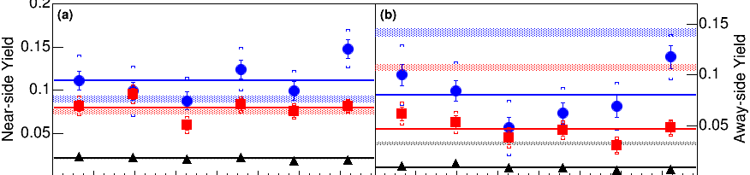

Yields 4<p_{T}^{t}<6 GeV/c
Near-side
Away-side
NS: No dependence on φ_{S}=φ^{t}-ψ
AS: can see φ_{S} dependence
Higher precision than previous analyses

Slide 33
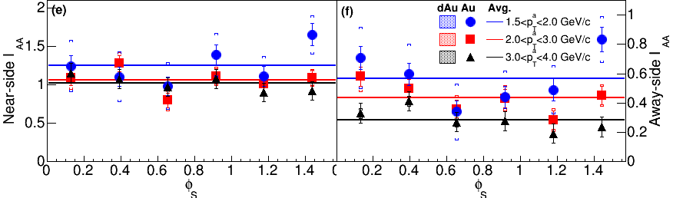
I_{AA} = Y_{AuAu}/Y_{dAu}
Near-side
Away-side
NS: No dependence on φ_{S}=φ^{t}-ψ
AS: can see φ_{S} dependence
Higher precision than previous analyses

Slide 34
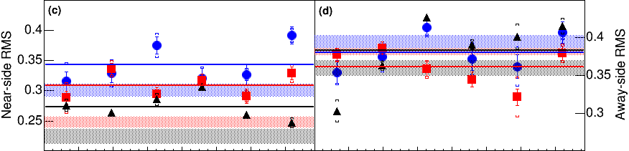
Truncated RMS 4<p_{T}^{t}<6 GeV/c
Near-side
Away-side
Lines show averages
Higher precision than public analysis (different p_{T})

Slide 35
Conclusions

Slide 36
Conclusions
With right background subtraction,
we can see low p_{T} modifications!
Dihadron correlations:
  now consistent with fully reconstructed jets
  Broadening and softening of jet
Need to continue to work to understand background better!
Need to treat bias as a toolls

Slide 37
Background for jet studies
Central Au+Au collision in STAR
New method for subtracting combinatorial background from flow (nucl-ex/1509.04732 accepted to PRC)
Improvements on new method
Reanalysis of published STAR data (nucl-ex/1010.0690)

Slide 38
Conclusions
Conclusions
NSF, RPF, NSS(NSF/RPF) methods work!
  Much higher precision than ZYAM
  NSS works to extend analyses to low p_{T}
Qualitatively different results from public STAR analysis
  Little/no reaction plane dependence in yield, RMS at these momenta
  Away-side does not disappear completely, comparable to d+Au
  More subtle effects than with ZYAM

Slide 39
Background Subtraction Methods
Zero-Yield at Minimum (ZYAM): Assumes v_{n} from other studies, assumes region around Δφ≈1 is background dominated
Near-Side Fit (NSF): assumes small Δφ/large Δη region background dominated, fits v_{n} and B
Reaction Plane Fit (RPF): assumes small Δφ/large Δη region background dominated, fits v_{n} and B using reaction plane dependence
Near-Side Subtracted NSF/RPF (NSS NSF/RPF): fits v_{n} and B at small small Δφ using reaction plane dependence after subtracting the near-side with a fit

Slide 40
RPF Method as applied to STAR data
6 bins relative to reaction plane
Background level
  Normalized per trigger → B same in all bins if v₂^{t} is the only effect → reduces info for RPF
  “The background levels can be different for the different φ_{s} slices because of the net effect of the variations in jet-quenching with φ_{s} and the centrality cuts in total charged particle multiplicity in the TPC within |η| < 0.5.” (Pg. 10, arxiv version) → Not consistent with ZYAM assumptions!
Used reaction plane resolution values from paper and their uncertainties
  Used TPC for reaction plane and analysis – potential autocorrelations
Data available for Δη< 0.7 (signal+background) and 0.7<Δη< 2 (background dominated)
  Acceptance correction in not applied → background must be scaled → uncertainty
  Jet-like correlation not eliminated in 0.7<Δη< 2 for all p_{T}^{t}, p_{T}ª given in paper → focus on high p_{T}

Slide 41
Toy model

Slide 42
Model for background
True reaction plane angle is always at φ=0 in detector coordinates
Throw random reconstructed reaction plane angle
  Assume Gaussian reaction plane resolution
  Selected to approximate data
Use measured particle yields to calculate how many associated particles would be measured
Use measured v_{n} to determine their anisotropy relative to the reaction plane
Throw associated particles matching distribution observed in data using v_{n} up to n=10

Slide 43
Model for signal
Use PYTHIA Perugia 2011
π±, K±,`p, p for unidentified hadrons
Quarks and gluons as proxy for reconstructed jets
h-h
√s = 2.76 TeV
pp collisions
8<p_{T}^{trigger}<10 GeV/c
1<p_{T}^{assoc}<2 GeV/c

Slide 44
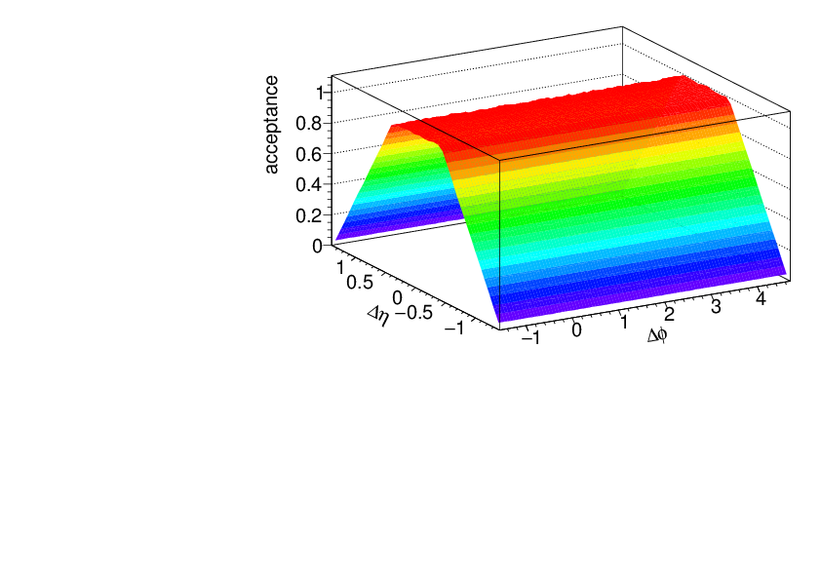
Acceptance correction
Fixed acceptance cuts leads to a trivial structure due to acceptance
This is fixed with a “mixed event” correction
  Throw random trigger, associated particle within acceptance
  Calculate Δφ, Δη
  Use this distribution
  to correct for
  acceptance

Slide 45
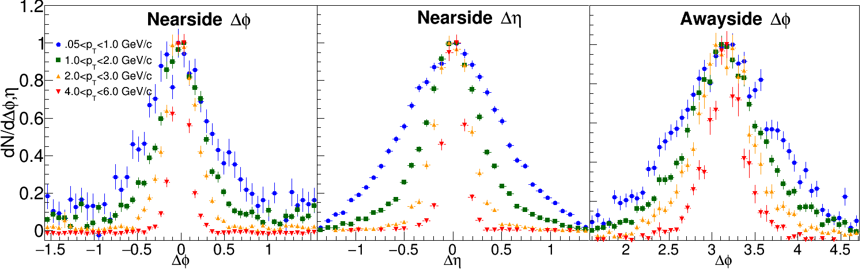
PYTHIA at 200 GeV
8<p_{T}^{t}<10 GeV/c

Slide 46
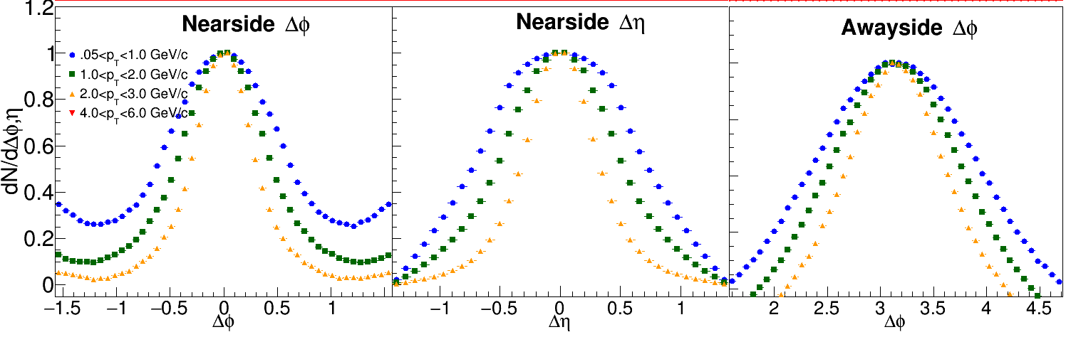
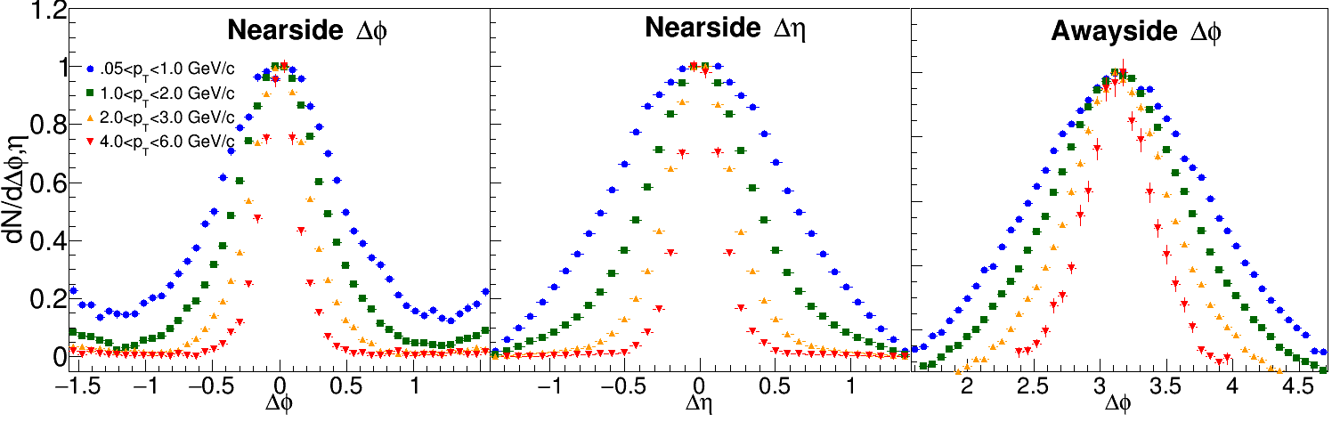
PYTHIA at 200 GeV
3<p_{T}^{t}<4 GeV/c
4<p_{T}^{t}<6 GeV/c

Slide 47
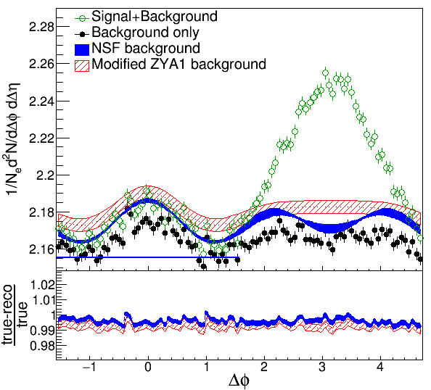
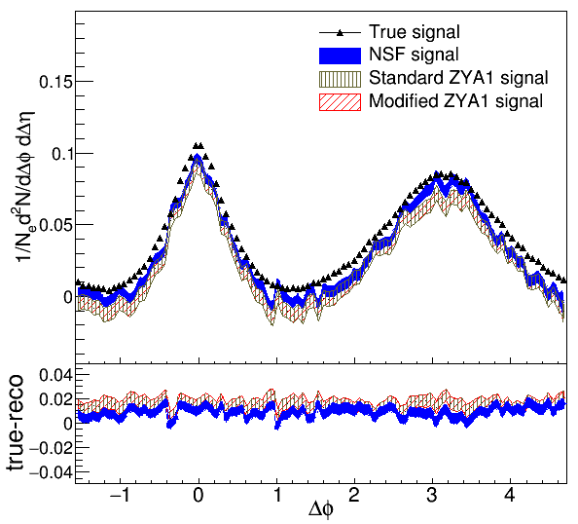
Near-Side Subtracted NSF method
h-h, √s_{NN} = 2.76 TeV, 0-10% PbPb
8<p_{T}^{trigger}<10 GeV/c
1<p_{T}^{assoc}<2 GeV/c for background
0.5<p_{T}^{assoc}<1.0 GeV/c for signal
Project signal+background over 0.0<|Δη|<1.4
Fit background in |Δφ|<1 including reaction plane dependence
Bias from residual contamination by near-side

Slide 48
v₂ STAR vs Fit
 | v₂ STAR (Table I) | v₂ Fit (stat. errors only)
1.5<p_{T}<2.0 GeV/c | 0.164 ± 0.011 | 0.194 ± 0.008
2.0<p_{T}<3.0 GeV/c | 0.189 ± 0.012 | 0.237 ± 0.010
3.0<p_{T}<4.0 GeV/c | 0.194 ± 0.013 | 0.293 ± 0.058
4.0<p_{T}<6.0 GeV/c | 0.163 ± 0.020 | 0.073 ± 0.025 0.036 ± 0.033 0.033 ± 0.068
Centrality bin is 20-60% - proper weighting of average?
Bias in event selection with high p_{T} trigger?
Bias in reconstructed reaction plane in the presence of a jet?
Residual jet-like signal in background dominated region?
Less information in fit due to normalization by N_{trigger}?

Slide 49
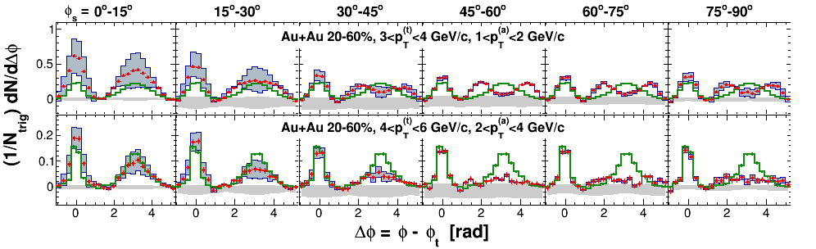
Correlations - STAR
Green: d+Au, Red: Au+Au
Large error bars
“Mach Cone” evident, even decrease in amplitude for higher p_{T}^{t}

Slide 50
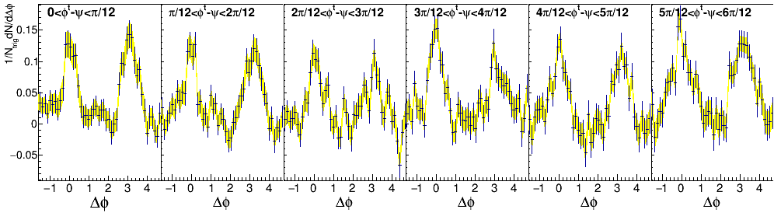
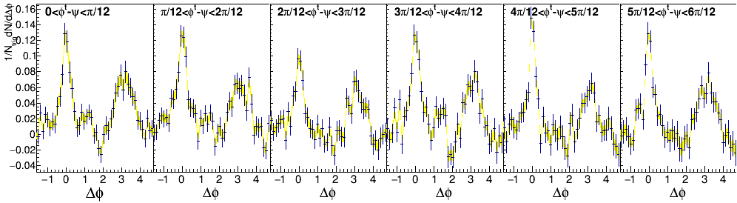
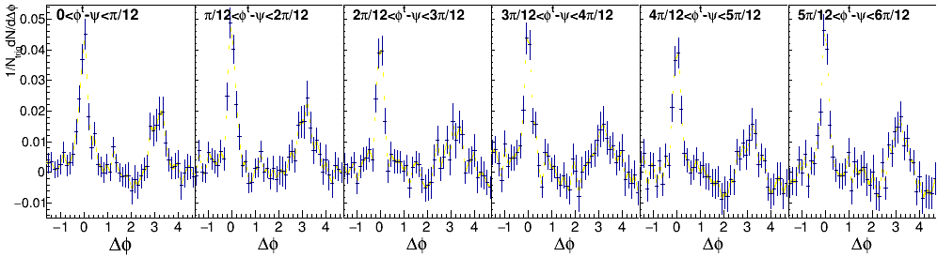
Background subtracted correlations 4<p_{T}^{t}<6 GeV/c
1.5<p_{T}ª<2.0 GeV/c
2.0<p_{T}ª<3.0 GeV/c
3.0<p_{T}ª<4.0 GeV/c
Yellow bands: uncertainty in rescaling of background
Statistical error bars include correlated statistical error on background
No “Mach Cone”

Slide 51

RMS - STAR
Large error bars (shown as lines)
Strong reaction plane dependence

Slide 52

STAR

Slide 53

Yields – STAR
Large error bars (shown as lines)
Indications of reaction plane dependence?

Slide 54

Near-Side Fit (NSF) method
No reaction plane dependence
Signal+background
h-h
√s_{NN} = 2.76 TeV
30-40% PbPb
8<p_{T}^{trigger}<10 GeV/c
1<p_{T}^{assoc}<2 GeV/c
Fit
extrapolation
Background dominated region
Project signal+background over 1.0<|Δη|<1.4
Fit background in |Δφ|<1
Not reliable over narrower Δφ region

