Slide 1
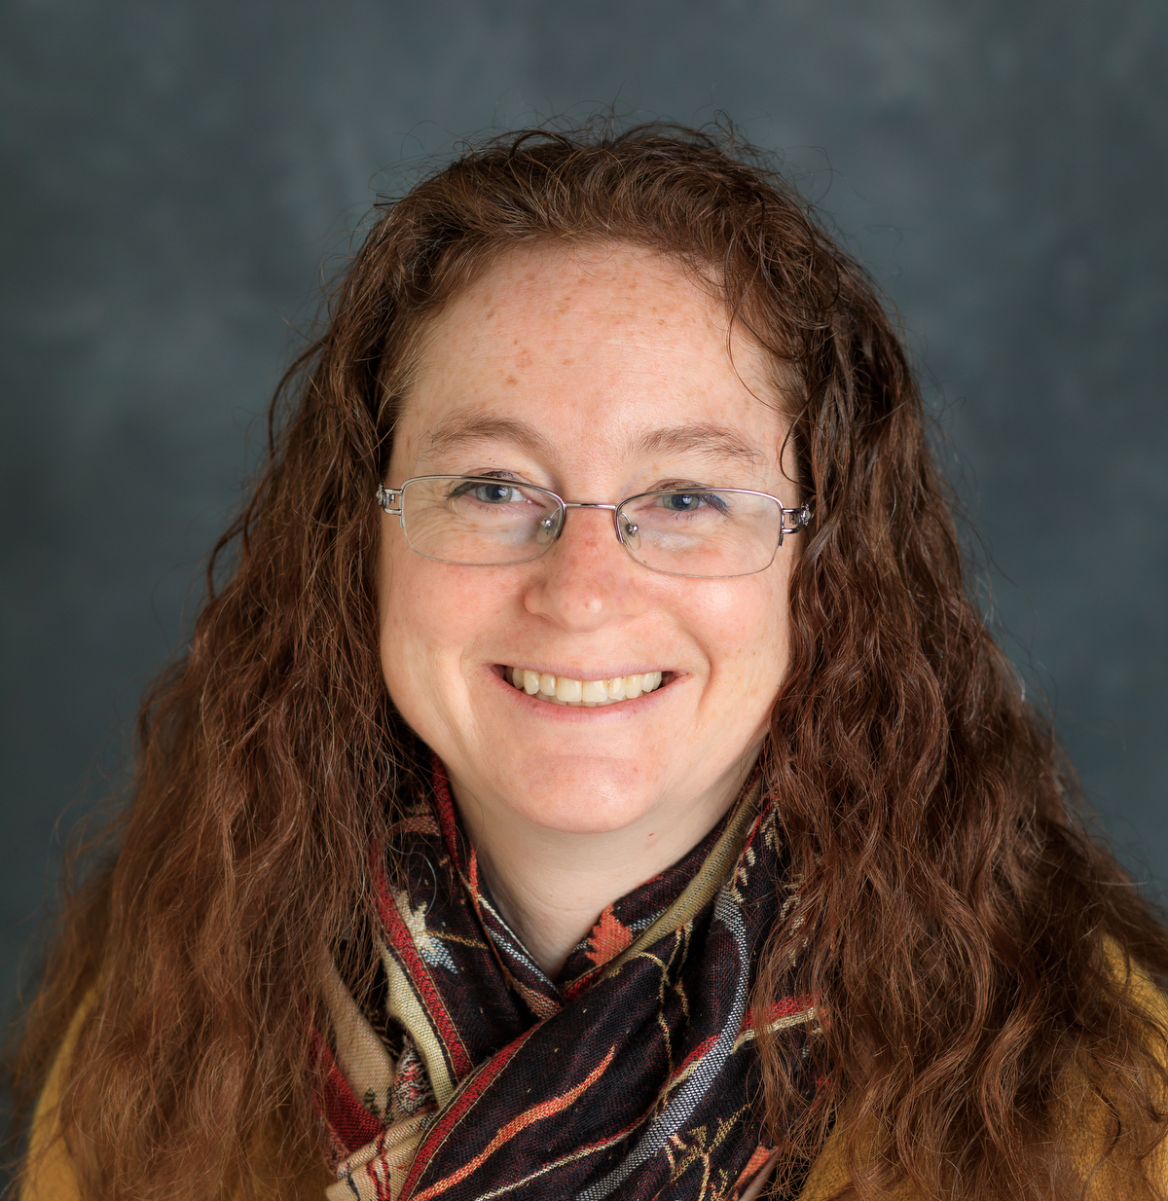
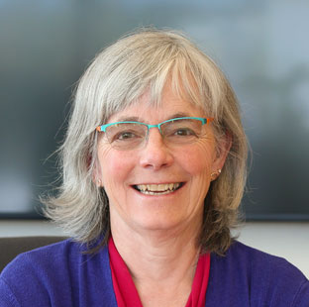
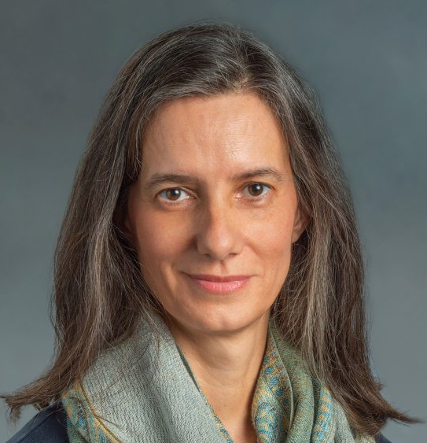
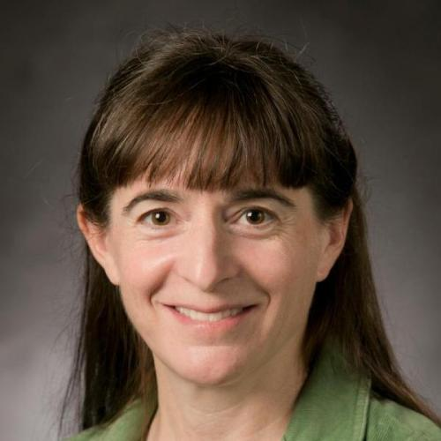
APS DNP DEI Committee
Christine Nattrass
Chair
Susan Seestrom
Vice Chair
Filomena Nunes
Former Co-chair
Roxanne Springer
Former Co-chair
We are deeply indebted to Roxanne and Filomena for their many contributions!
2023 Members: Paul Gueye, Elena Long, Sanjay Reddy, Warren Rogers, Loida Rosado del Rio, Sherry Yennello, Allison Zec, Jennifer James
These slides reflect my personal view, not those of the committee.

Slide 2
APS DEI committee activities
Items delegated to other chairs
  DNP Allies – vetted and trained colleagues who can intervene when incidents occur at conferences
  Session chair training – all DNP session chairs at APS meetings have training including bystander intervention training
Committee activities
  Writing committee bylaws
  Guidelines for collaboration Community Agreements
  Cooperation with Conference Experience for Undergraduates on training CEU Mentors
  Writing letter to ask APS to standardize approach for child care support at APS conferences so there’s one place to apply, with one procedure, instead of separate procedures for each unit
  Considering writing best practices guide

Slide 3
Biggest issues in the community – My personal opinions
Systems for reporting harassment and bullying do not work, particularly when that harassment/bullying is inter-institutional. Processes are largely punitive and legalistic but do not address the needs or well-being of those targeted by this behavior.
Many other problems (ie, representation at conferences/in awards) arise not because of malice but because diversity is hard and individuals either do not feel responsible for or empowered to fix the problem.
Many DEI efforts are not actually effective.
Our infrastructure and people in positions of power are slow to respond to changes in the community. In particular younger members of our community are more
  likely to have children while in grad school/as post docs
  open about mental health problems
  likely to identify as members of the LGBTQ+ community

