Slide 1
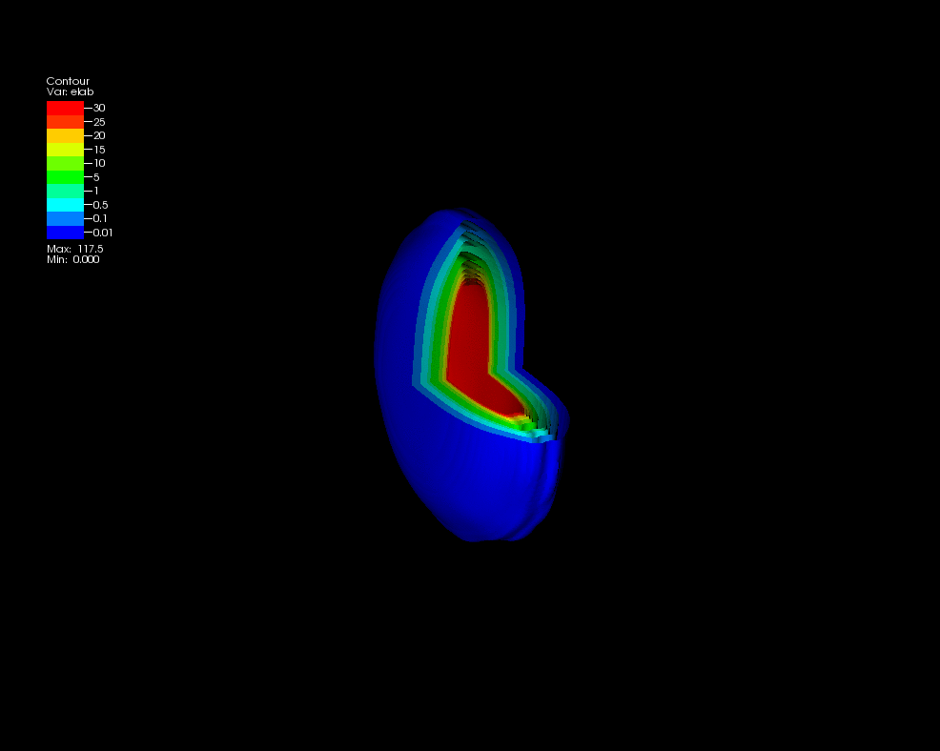
Probing the quark gluon plasma
Christine Nattrass
University of Tennessee at Knoxville
Calculations done on the Titan supercomputer by the CJet collaboration https://sites.google.com/site/cjetsite/

Slide 2





Phase diagram of nuclear matter
Quark Gluon Plasma
Core of neutron stars?
Quark Gluon Plasma – a liquid of quarks and gluons created at temperatures above ~170 MeV (2·1012K) – over a million times hotter than the core of the sun
Notes:
But wait – how can we have a liquid of quarks and gluons? Doesn't asymptotic freedom tell us that we can't have free quarks and gluons? How, then, can we have a liquid of quarks and gluons?

Slide 3

How to make a Quark Gluon Plasma

Slide 4

The phase transition in the laboratory

Slide 5













Relativistic Heavy Ion Collider
Large Hadron Collider
PHOBOS
BRAHMS
CMS
PHENIX
STAR
RHIC
LHCb
ALICE
ATLAS
LHCf
Upton, NY
1.2km diameter
p+p, d+Au, Cu+Cu, Au+Au, U+U
√sNN = 9 - 200 GeV
Geneva, Switzerland
8.6km diameter
p+p, p+Pb, Pb+Pb
√sNN = 2.76 GeV, 5.5 TeV
LHC
Quark Gluon Plasma
RHIC
Core of neutron stars?
Notes:
Mention that RHIC planning began 1983

Slide 6
Comparison of colliders
 | RHIC | LHC
√sNN (GeV) | 9-200 | 2760, 5500 | center of mass energy
dNch/dη | ~1200 | ~1600 | number of particles
T/Tc | 1.9 | 3.0-4.2 | temperature
ε (GeV/fm3) | 5 | ~15 | energy density
τQGP (fm/c) | 2-4 | >10 | lifetime of QGP
RHIC and LHC:
Cover 2 –3 decades of energy (√sNN= 9 GeV –5.5 TeV)
To discover the properties of hot nuclear matter at T ~ 150 –600 MeV

Slide 7
ALICE
ATLAS
CMS
STAR
PHENIX
Notes:
Mention that RHIC planning began 1983

Slide 8

p+p collisions
3D image of each collision

Slide 9

Pb+Pb collisions
5

Slide 10
Probing the Quark Gluon Plasma
Medium
Probe
Detector
Want a probe which traveled through the collision
QGP is very short-lived (~1-10 fm/c) →
cannot use an external probe

Slide 11
Probing the Quark Gluon Plasma
Medium
Probe
Detector
Want a probe which traveled through the collision
QGP is very short-lived (~1-15 fm/c) →
cannot use an external probe

Slide 12

Probes of the Quark Gluon Plasma
nucleus
nucleus
Want a probe which traveled through the medium
QGP is short lived → need a probe created in the collision

Slide 13
Probes of the Quark Gluon Plasma
nucleus
nucleus
Want a probe which traveled through the medium
QGP is short lived → need a probe created in the collision
We expect the medium to be dense → absorb/modify probe

Slide 14






Slide 15

Jet reconstruction
p+p di-jet event in STAR
Central Au+Au collision in STAR
Identify all of the particles in the jet → parton energy, momentum
Difficult in heavy ion collisions – but possible!

Slide 16

Jets
Phys.Rev.Lett. 105 (2010) 252303
nucleus
nucleus
ATLAS

Slide 17

Quenched jets
nucleus
nucleus
One of the jets is absorbed by the medium
The quark or gluon has equilibrated with the medium
Phys. Rev. Lett. 105, 252303 (2010)
ATLAS

Slide 18


Nuclear modification factor
Measure spectra of probe (jets) and compare to those in p+p collisions or peripheral A+A collisions
If high-pT probes (jets) are suppressed, this is evidence of jet quenching
Enhancement
Suppression

Slide 19
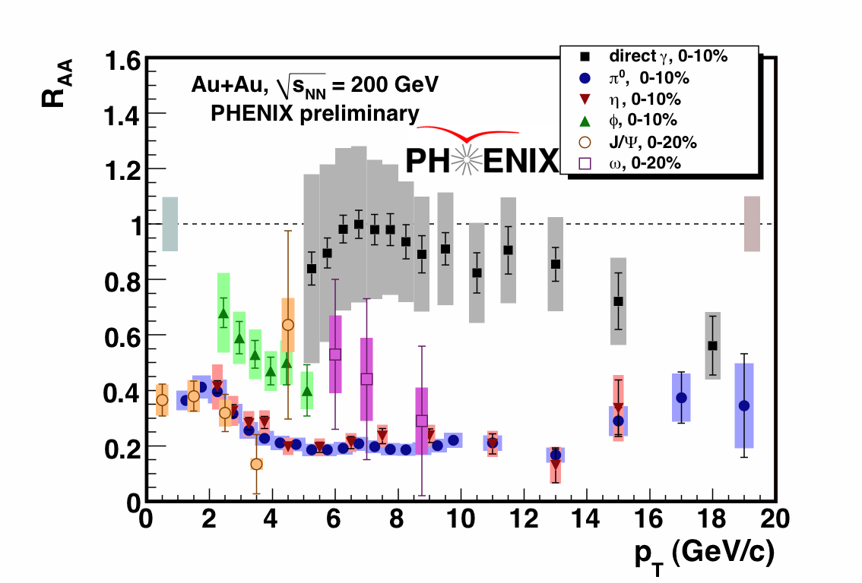

Nuclear modification factor RAA
RHIC
LHC
CMS
Electromagnetic probes – consistent with no modification – medium is transparent to them
Strong probes – significant suppression – medium is opaque to them

Slide 20
Nuclear modification factor RAA at LHC
Fully unfolded inclusive jet RAA
pp 2.76 TeV reference
CMS-PAS HIN-12-001
Like for charged particles, high-pT jet RAA flat at ≈ 0.5

Slide 21
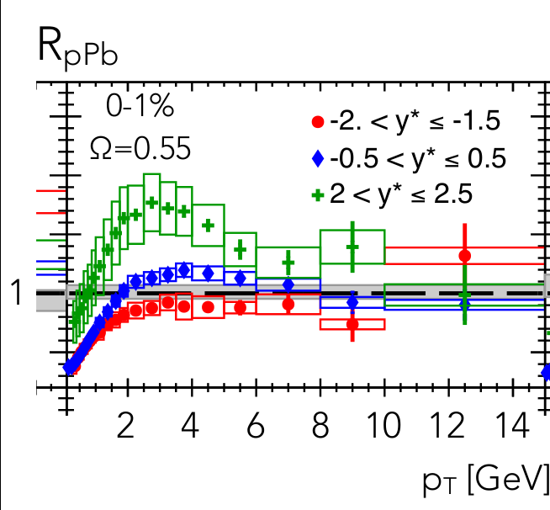
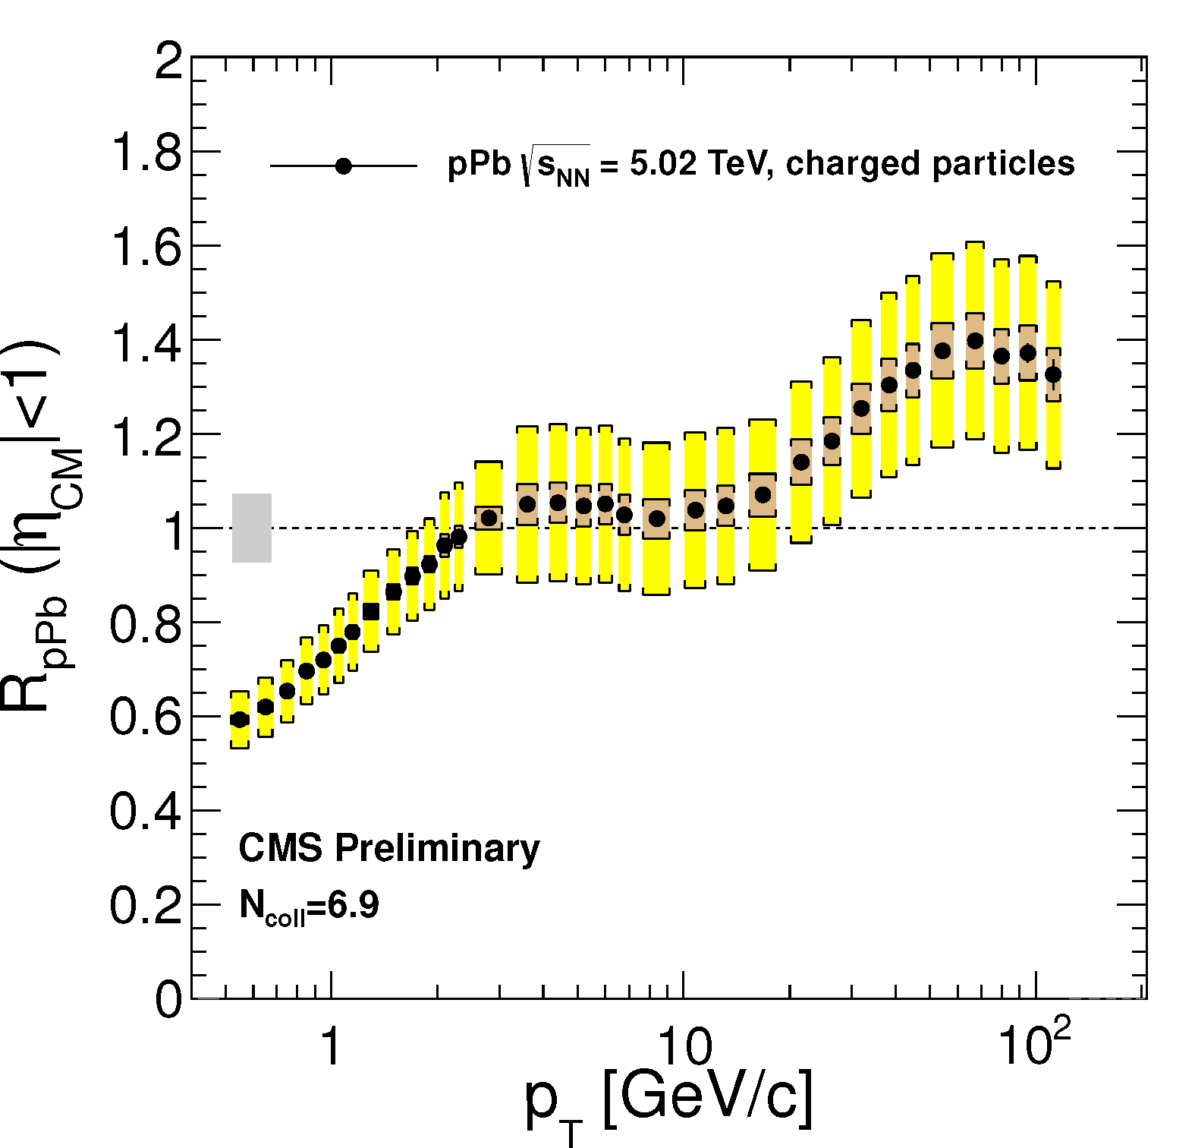
p+Pb as a control
ATLAS-CONF-2013-096
CMS
ATLAS

Slide 22


Measuring temperature

Slide 23


Thermal photons
Phys.Rev.Lett.104:132301,2010
Thermal photons
QCD processes
ALICE collaboration:
Pb+Pb collisions at √sNN=2.76 TeV
Inverse slope: T = 304 +/-51
PHENIX collaboration: Au+Au collisions at √sNN=200 GeV
Inverse slope: T = 221 +/- 19 (stat) +/- 19 (syst) MeV

Slide 24
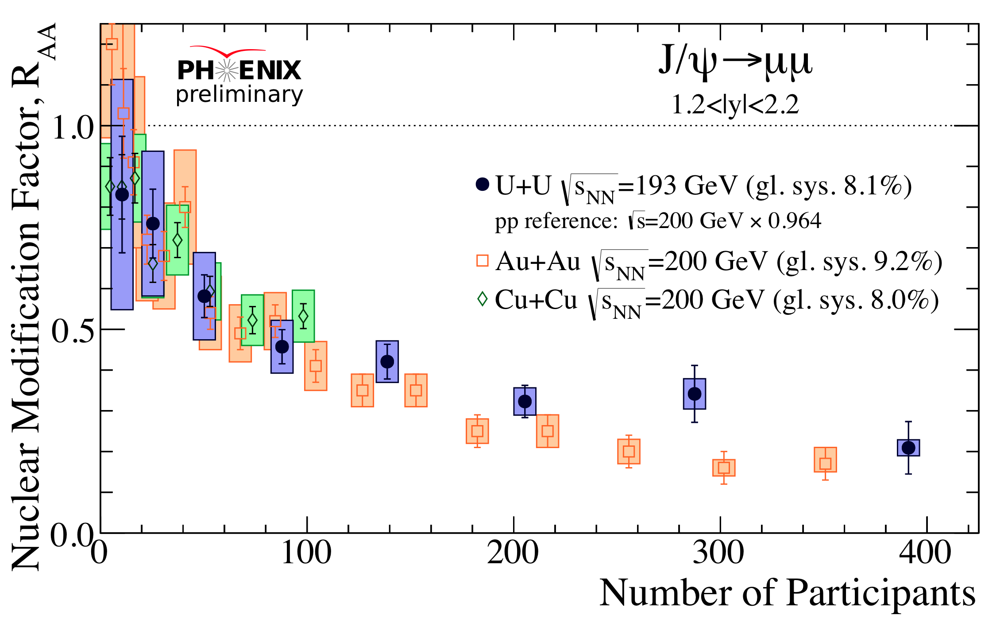




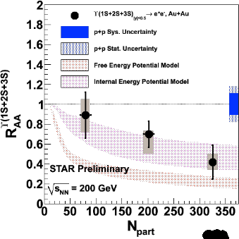


Building a quarkonium-thermometer
CMS-PAS HIN-11-011
Note: 6.5<pT<30 GeV for J/ψ and ψ(2s)
Npart
Clear hierarchy in RAA of different quarkonium states
Expected in terms of binding energy
c
c
b
b
CMS-PAS HIN-12-014, HIN-12-007

Slide 25
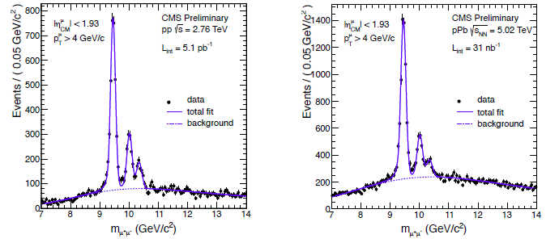
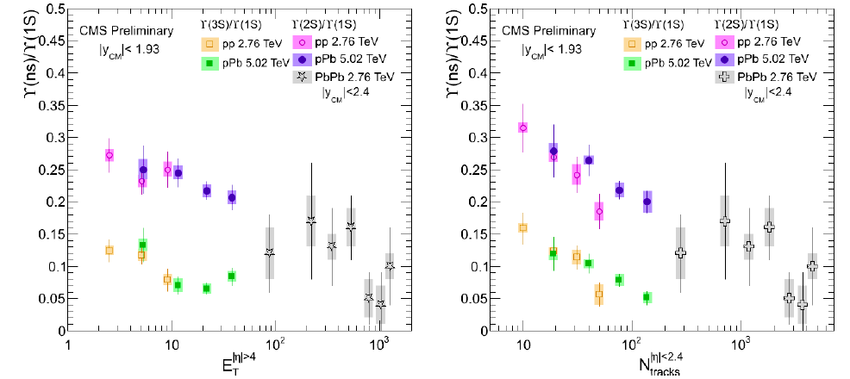
Suppression of quarkonia in p+Pb
pp
pPb
PbPb
p
pPb

Slide 26

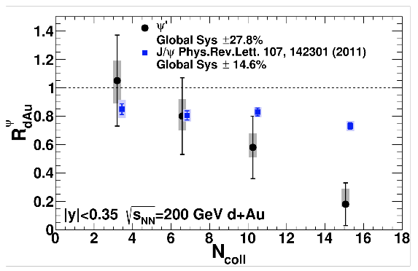
Suppression of quarkonia in d+Au
PHENIX

Slide 27


Take home messages
If we get nuclear matter dense enough, we make a new phase of matter, which we produce in high energy heavy ion collisions.
This medium is transparent to colored probes and translucent to electromagnetic probes...
...And extremely hot and dense.

Slide 28
Interesting observables
Different hadronization mechanisms
→ Identify particle types
Collective motion of particles
→ Low momentum acceptance
Even common processes are not well understood
→ Do not need 4π acceptance or high rates

Slide 29
Probing the Quark Gluon Plasma

Slide 30
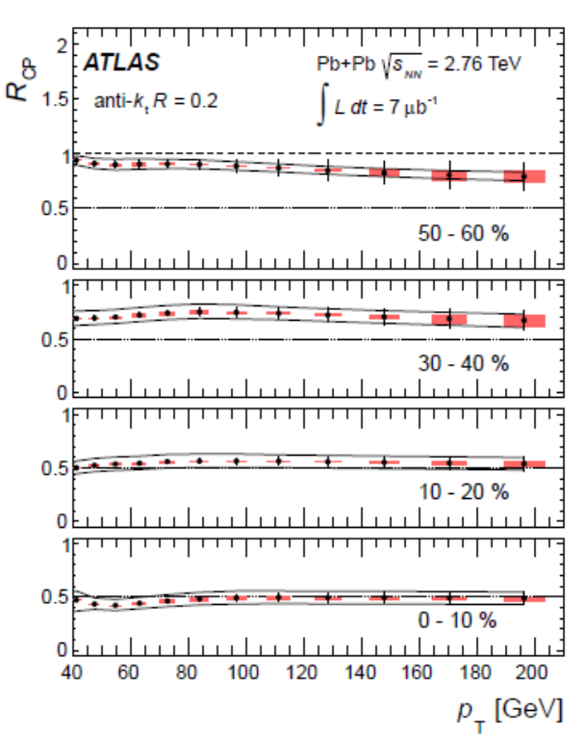
Jet nuclear modification factor*
arXiv:1208.1967 [hep-ex] Submitted to Phys. Lett.B
ATLAS collaboration
Anti-kT algorithm
R=0.2
*Rcp is the ratio of central to peripheral A+A collisions instead of A+A collisions to p+p

Slide 31
Measuring temperature

