Slide 1
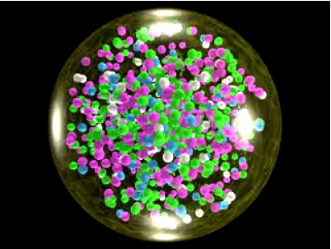
The little bang: understanding the quark gluon plasma
Christine Nattrass
University of Tennessee at Knoxville

Slide 2
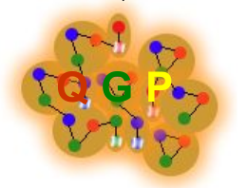
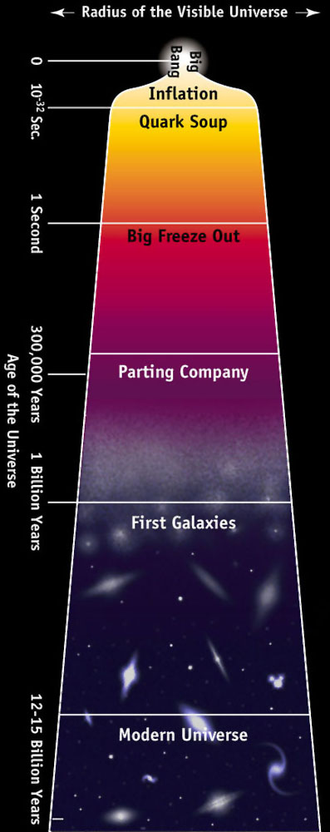

Take home messages
If we get nuclear matter dense enough, we make a new phase of matter
This quark gluon plasma is similar to what was present in the early universe
We can produce a QGP in high energy heavy ion collisions

Slide 3
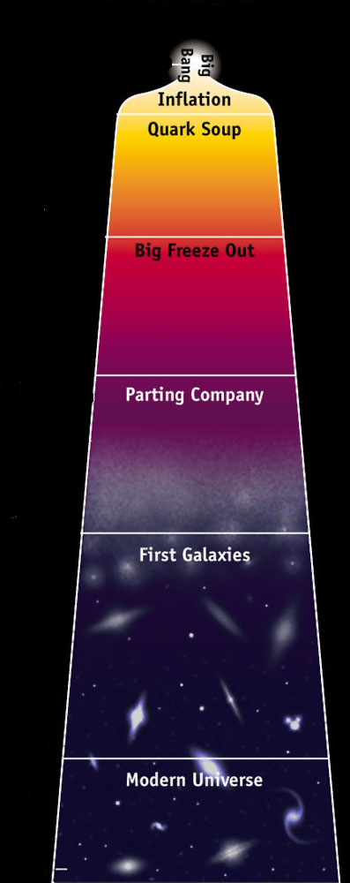
Evolution of the Universe
10⁻⁴⁴ sec
The universe gets
cooler!
10⁻³⁵ sec
10⁻³⁵ sec
Reheating matter?
Need temperatures around 1.5·10¹² K
~10⁶ times hotter than the core of the sun
2 10⁻¹⁰ sec
2·10⁻⁶ sec
6 sec
3 min
10⁶ yrs
10⁹ yrs ?

Slide 4

Nucleons – the proton and neutron
Neutron
Proton
http://en.wikipedia.org/wiki/Image:Quark_structure_neutron.svg
http://en.wikipedia.org/wiki/Image:Quark_structure_proton.svg

Slide 5

How can we see “free” quarks?

Slide 6
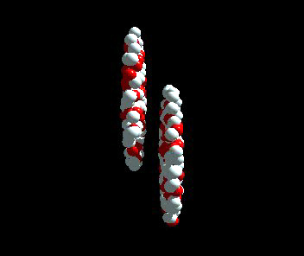
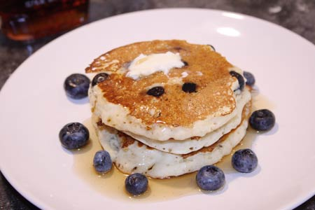
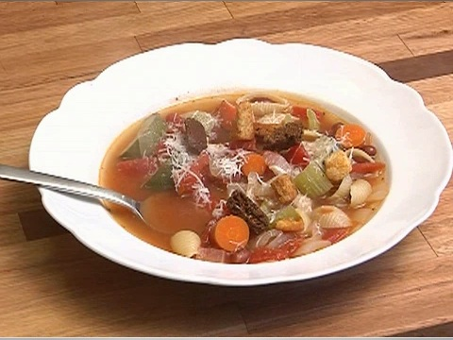
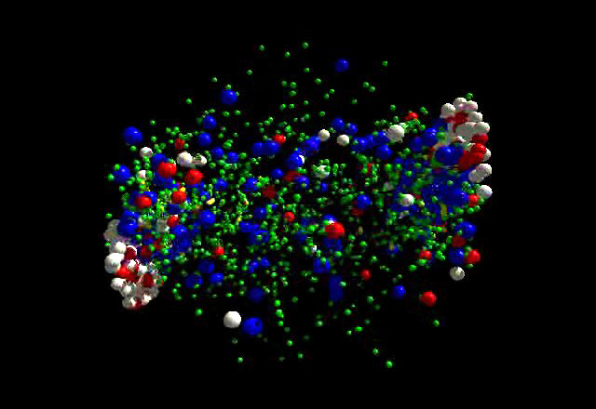
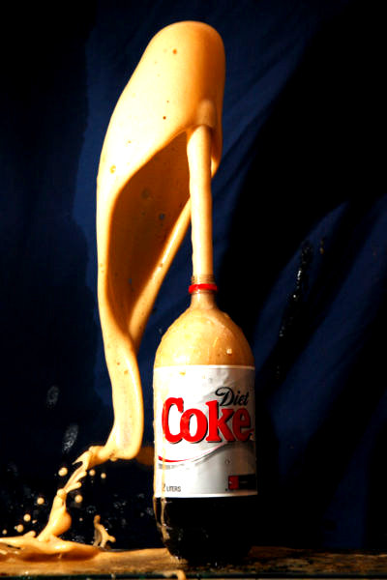
Making a QGP in the laboratory
Relativistic pancakes
Quark soup
Explosive hadron soda

Slide 7

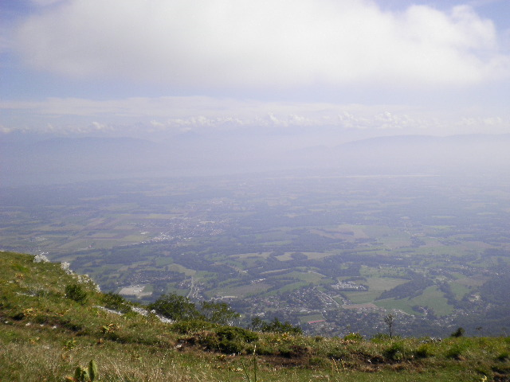
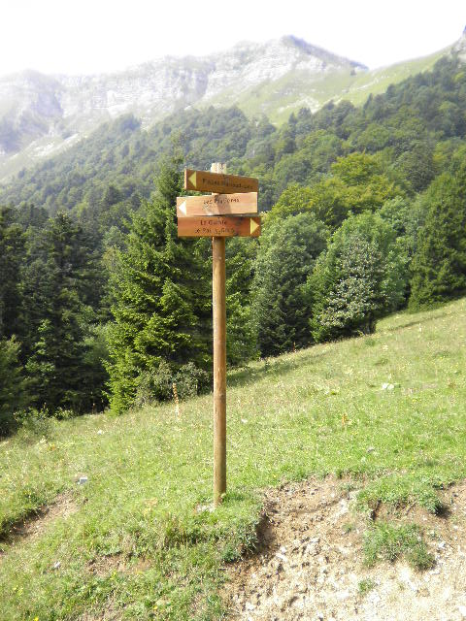




CMS
5.3 miles
1.4 miles
LHCb
ATLAS
LHCf
ALICE

Slide 8




Size: 16 x 26 meters
Weight: 10,000 tons
Detectors: 18
Trigger detectors: When do we have a collision?
Tracking detectors: Where did the particle go?
Identification detectors: What kind of particle is it?
Calorimeters: How much energy does the particle have?
<number>

Slide 9
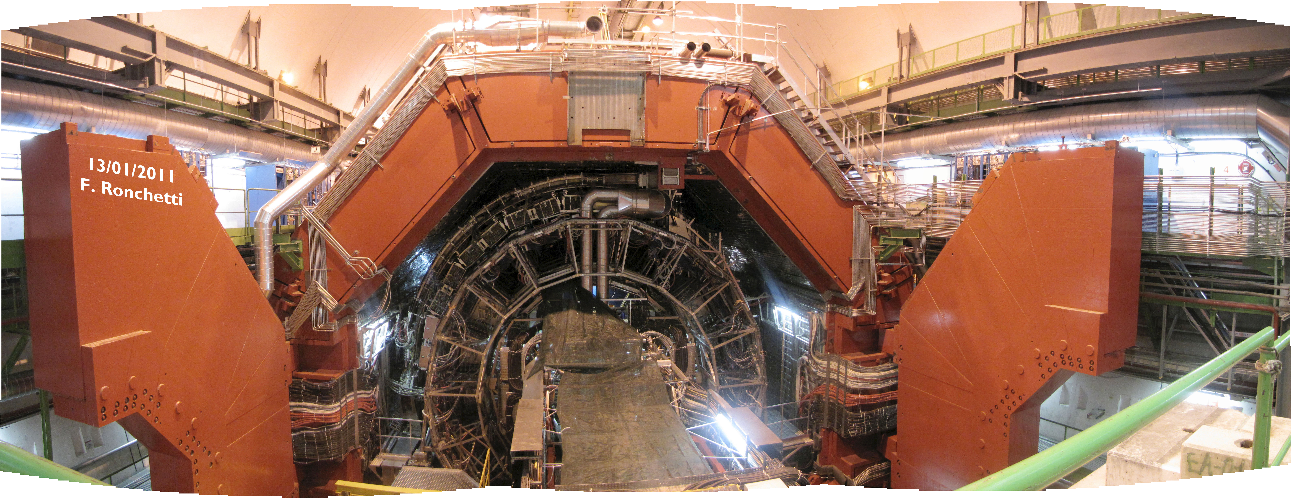

Slide 10
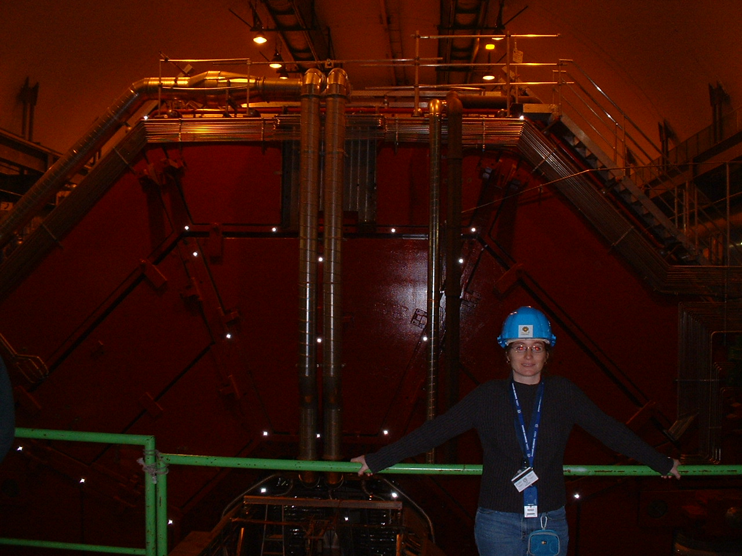

Slide 11

p+p collisions

Slide 12

Pb+Pb collisions

Slide 13
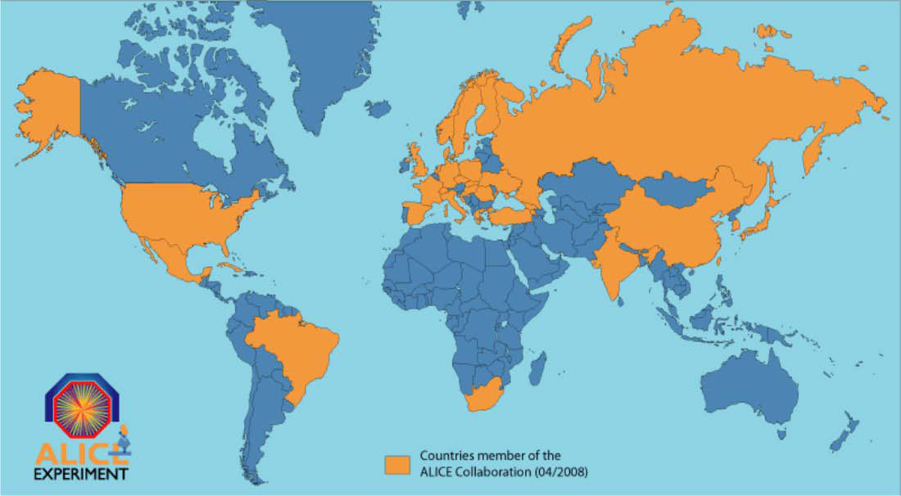
The ALICE Collaboration
~1000 | Members 63% from CERN member states
~30 | Countries
~100 | Institutes
~$150 million | Capital cost (+magnet)

Slide 14
Scales
Time: ~10⁻²³ seconds
  1 minute for us ~ 1,000,000 lifetimes of the universe for QGP
Energy: 1 TeV ~ 10 trillionths (10⁻¹¹) of a Calorie
  About the amount of energy if two mosquitoes collide
  About 1 trillionth of a candy bar
Energy density: ~6-8 GeV/fm³
  10³⁵ times that of a candy bar (~trillion trillion trillion candy bars)
  About the energy density if you packed the energy that could be released from a million kg of fuel for a nuclear power plant into a cube with each side the width of a hair
Temperature: ~1.5 billion Kelvin
  A million times hotter than the core of the sun

Slide 15
Scales
Number of particles: ~2000-3000
  Same number as in 1 μm³ = 1/16 in³ of air
Size of QGP: 1 fm³ = 10⁻⁴⁵ m³
  If this room were the size of the solar system, the QGP could fit in 1 cm³
Data volume: PB ~ 1,000,000 GB
Data rates: ~1 PB/month written to disk, a few GB/second

Slide 16
Measuring temperature

Slide 17


Thermal photons

Slide 18

Thermal photons
Phys.Rev.Lett.104:132301,2010
Thermal photons
Inverse slope:
T = 221 +/- 19 (stat) +/- 19 (syst) MeV
Consistent with models with T=300-600 MeV
T_{c} ~ 170 MeV
Other processes
PHENIX collaboration
Au+Au collisions at √s_{NN}=200 GeV

Slide 19


Quarkonium-thermometer
Number of particles seen/number of particles created
Melting point (GeV)
c
c
b
b
CMS-PAS HIN-12-014, HIN-12-007

Slide 20
Imaging the Quark Gluon Plasma

Slide 21
Probing the Quark Gluon Plasma
Medium
Probe
Detector
Want a probe which traveled through the collision
QGP is very short-lived (~1-10 fm/c) →
cannot use an external probe

Slide 22


Probes of the Quark Gluon Plasma
nucleus
nucleus
Want a probe which traveled through the medium
QGP is short lived → need a probe created in the collision

Slide 23
Probes of the Quark Gluon Plasma
nucleus
nucleus
Want a probe which traveled through the medium
QGP is short lived → need a probe created in the collision
We expect the medium to be dense → absorb/modify probe

Slide 24

Jets
nucleus
nucleus
Quarks and gluons are confined – we don't see them outside of mesons and baryons
Instead we see a cone of particles around the outgoing quark or gluon
Looking at jets analogous to spectroscopy

Slide 25

Quenched jets
nucleus
nucleus
One of the jets is absorbed by the medium
The quark or gluon has equilibrated with the medium
Phys. Rev. Lett. 105, 252303 (2010)

Slide 26
Take home messages
If we get nuclear matter dense enough, we make a new phase of matter
This quark gluon plasma is similar to what was present in the early universe
We can produce a QGP in high energy heavy ion collisions

Slide 27




What I spend my time doing
Programming (c++) - analyzing data
Writing and giving talks – 3 research talks, 1 seminar, 2 posters, 1 software tutorial, and lots of talks (>30) at internal meetings in 2010
Hardware work: assembling & testing the detector
Working with graduate students
Outreach: blogging for ALICE, giving tours of PHENIX to the public...
Writing papers and conference proceedings
Reviewing the work of my collaborators
Running our journal club
Reading papers
Taking shifts – including being on call 24/7
Teaching
Advising undergraduate students
Supervising/mentoring students & post docs on research
Reviewing papers, proposals

Slide 28


Slide 29
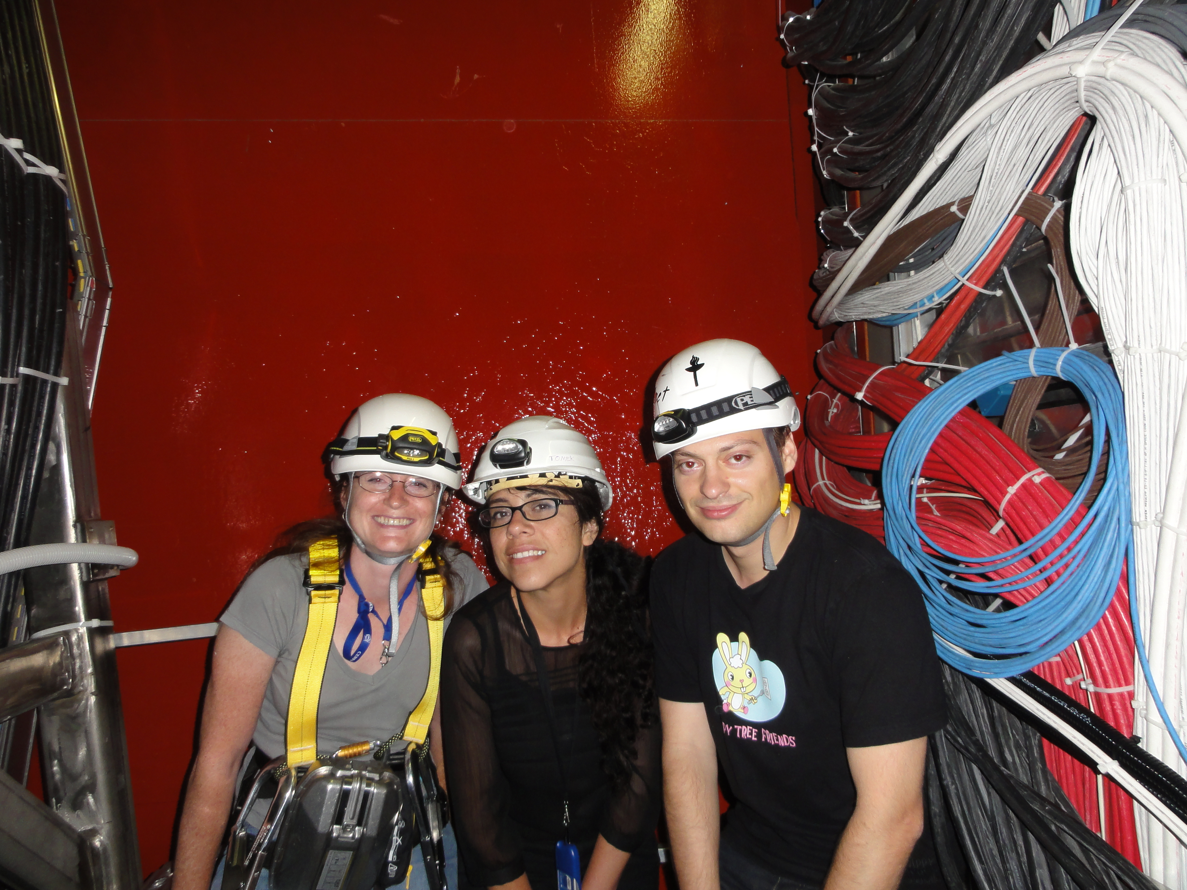

Slide 30
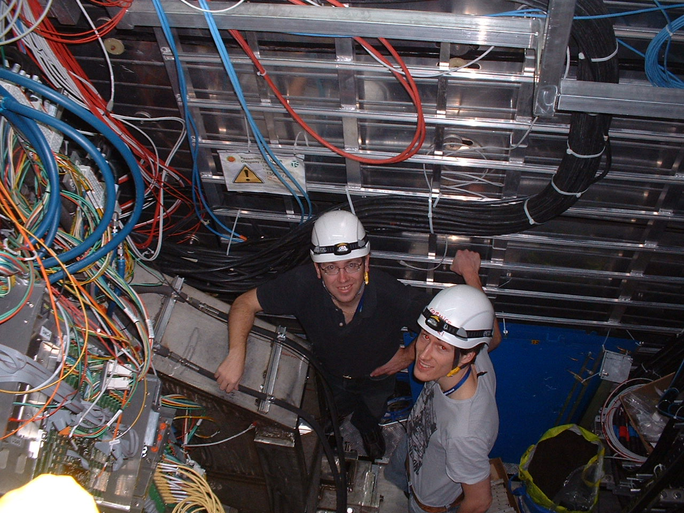

Slide 31
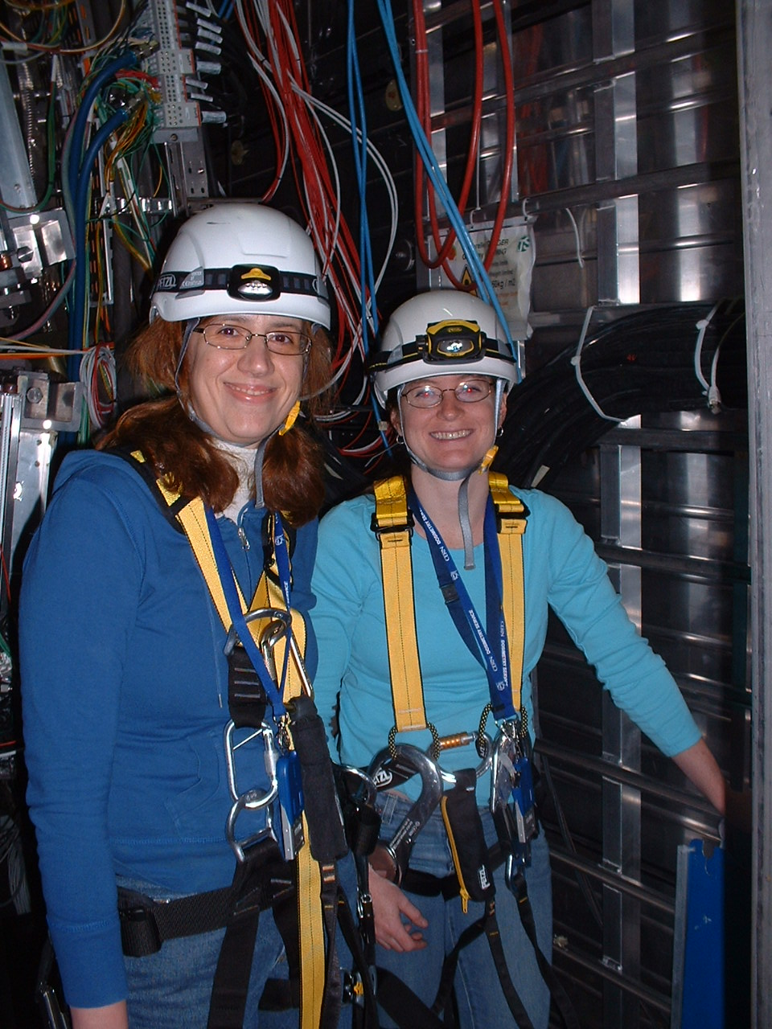

Slide 32
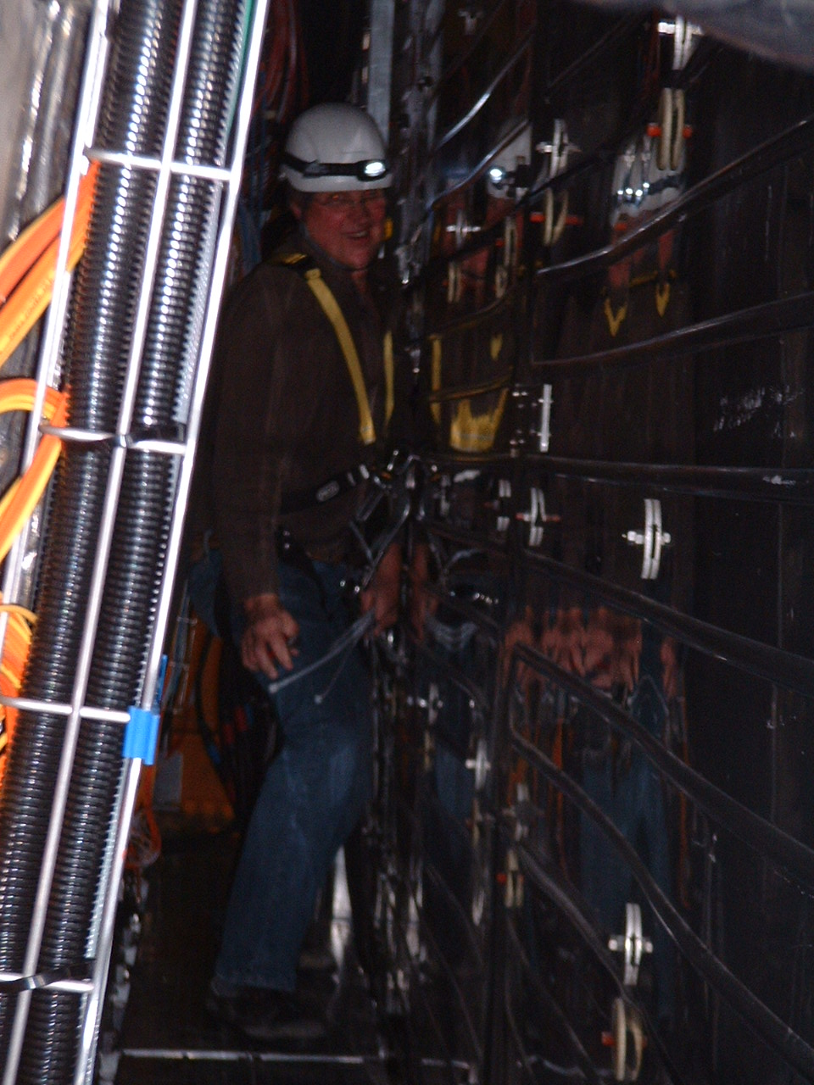

Slide 33
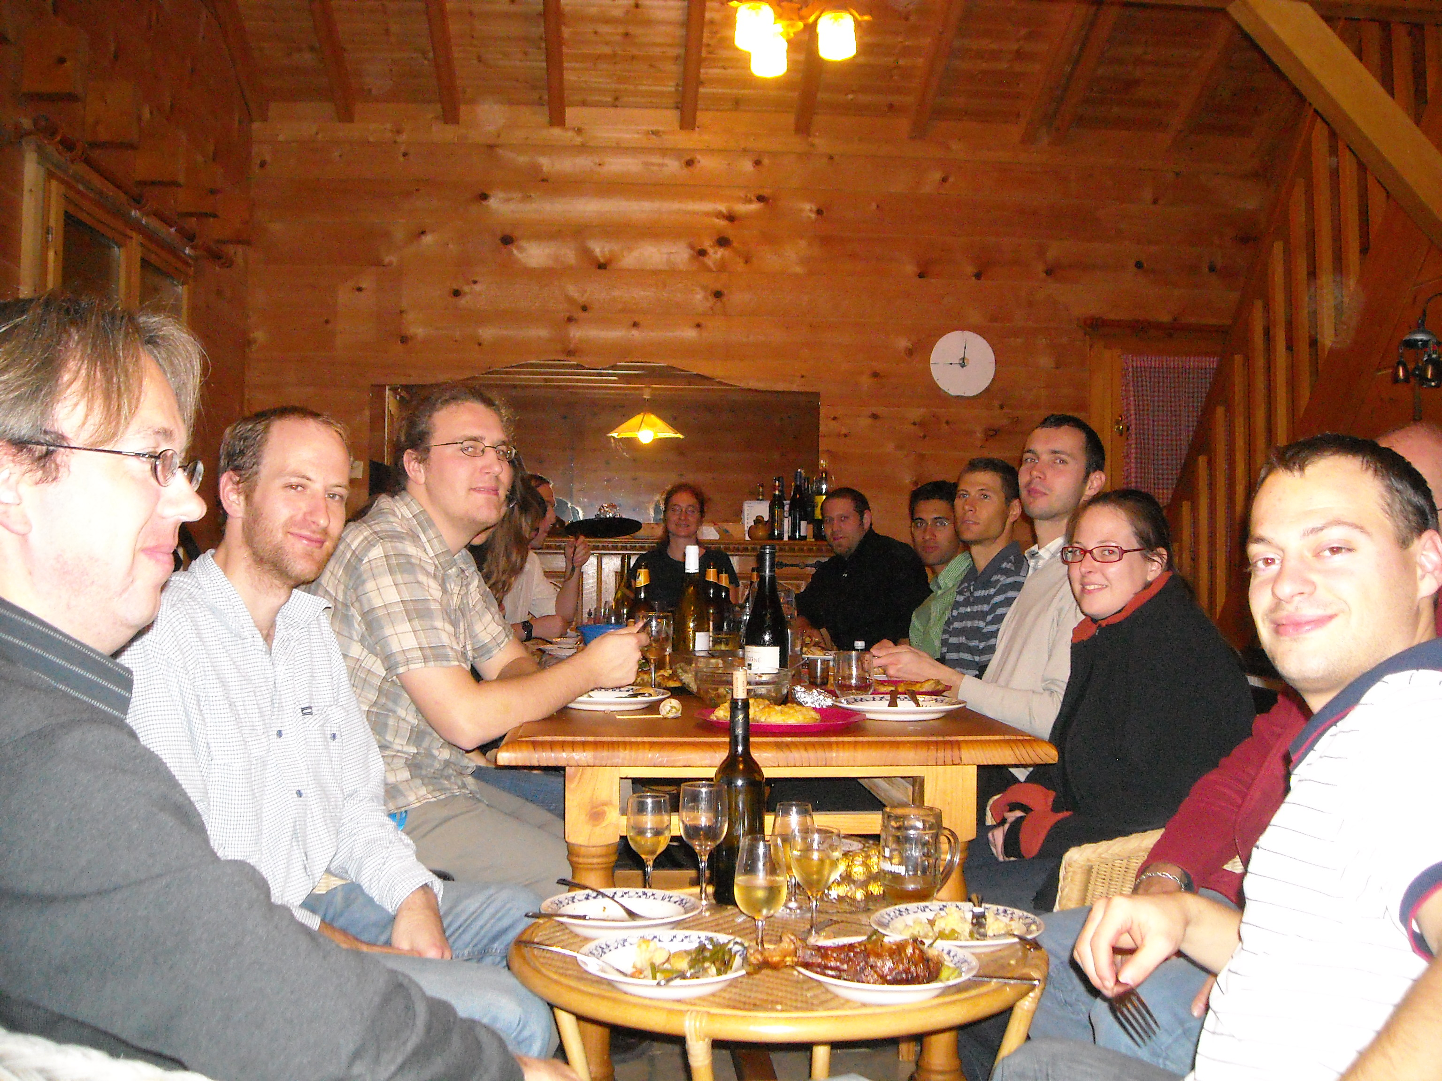

Slide 34
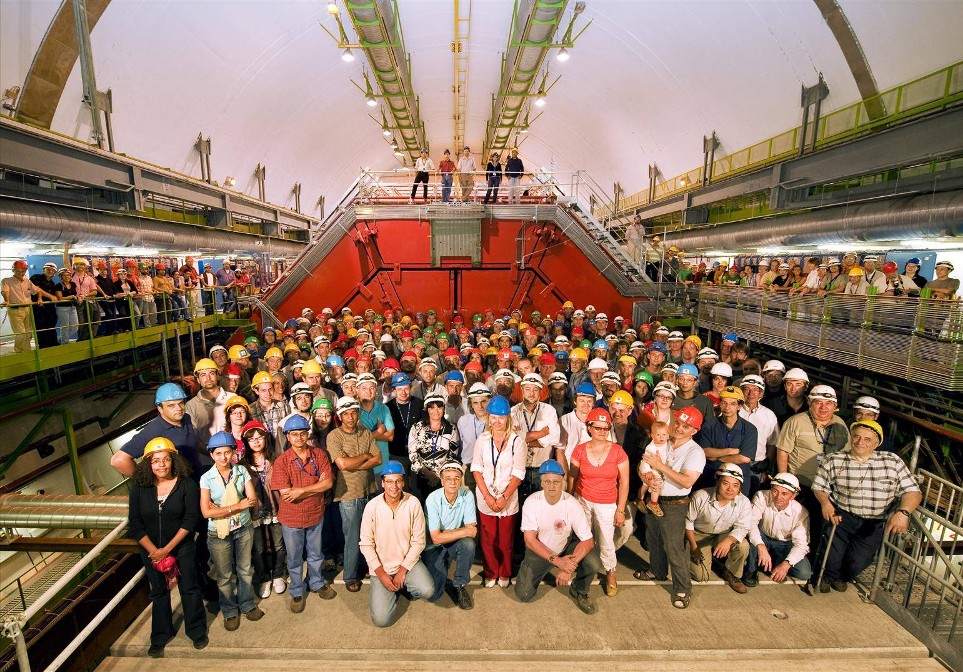

Slide 35
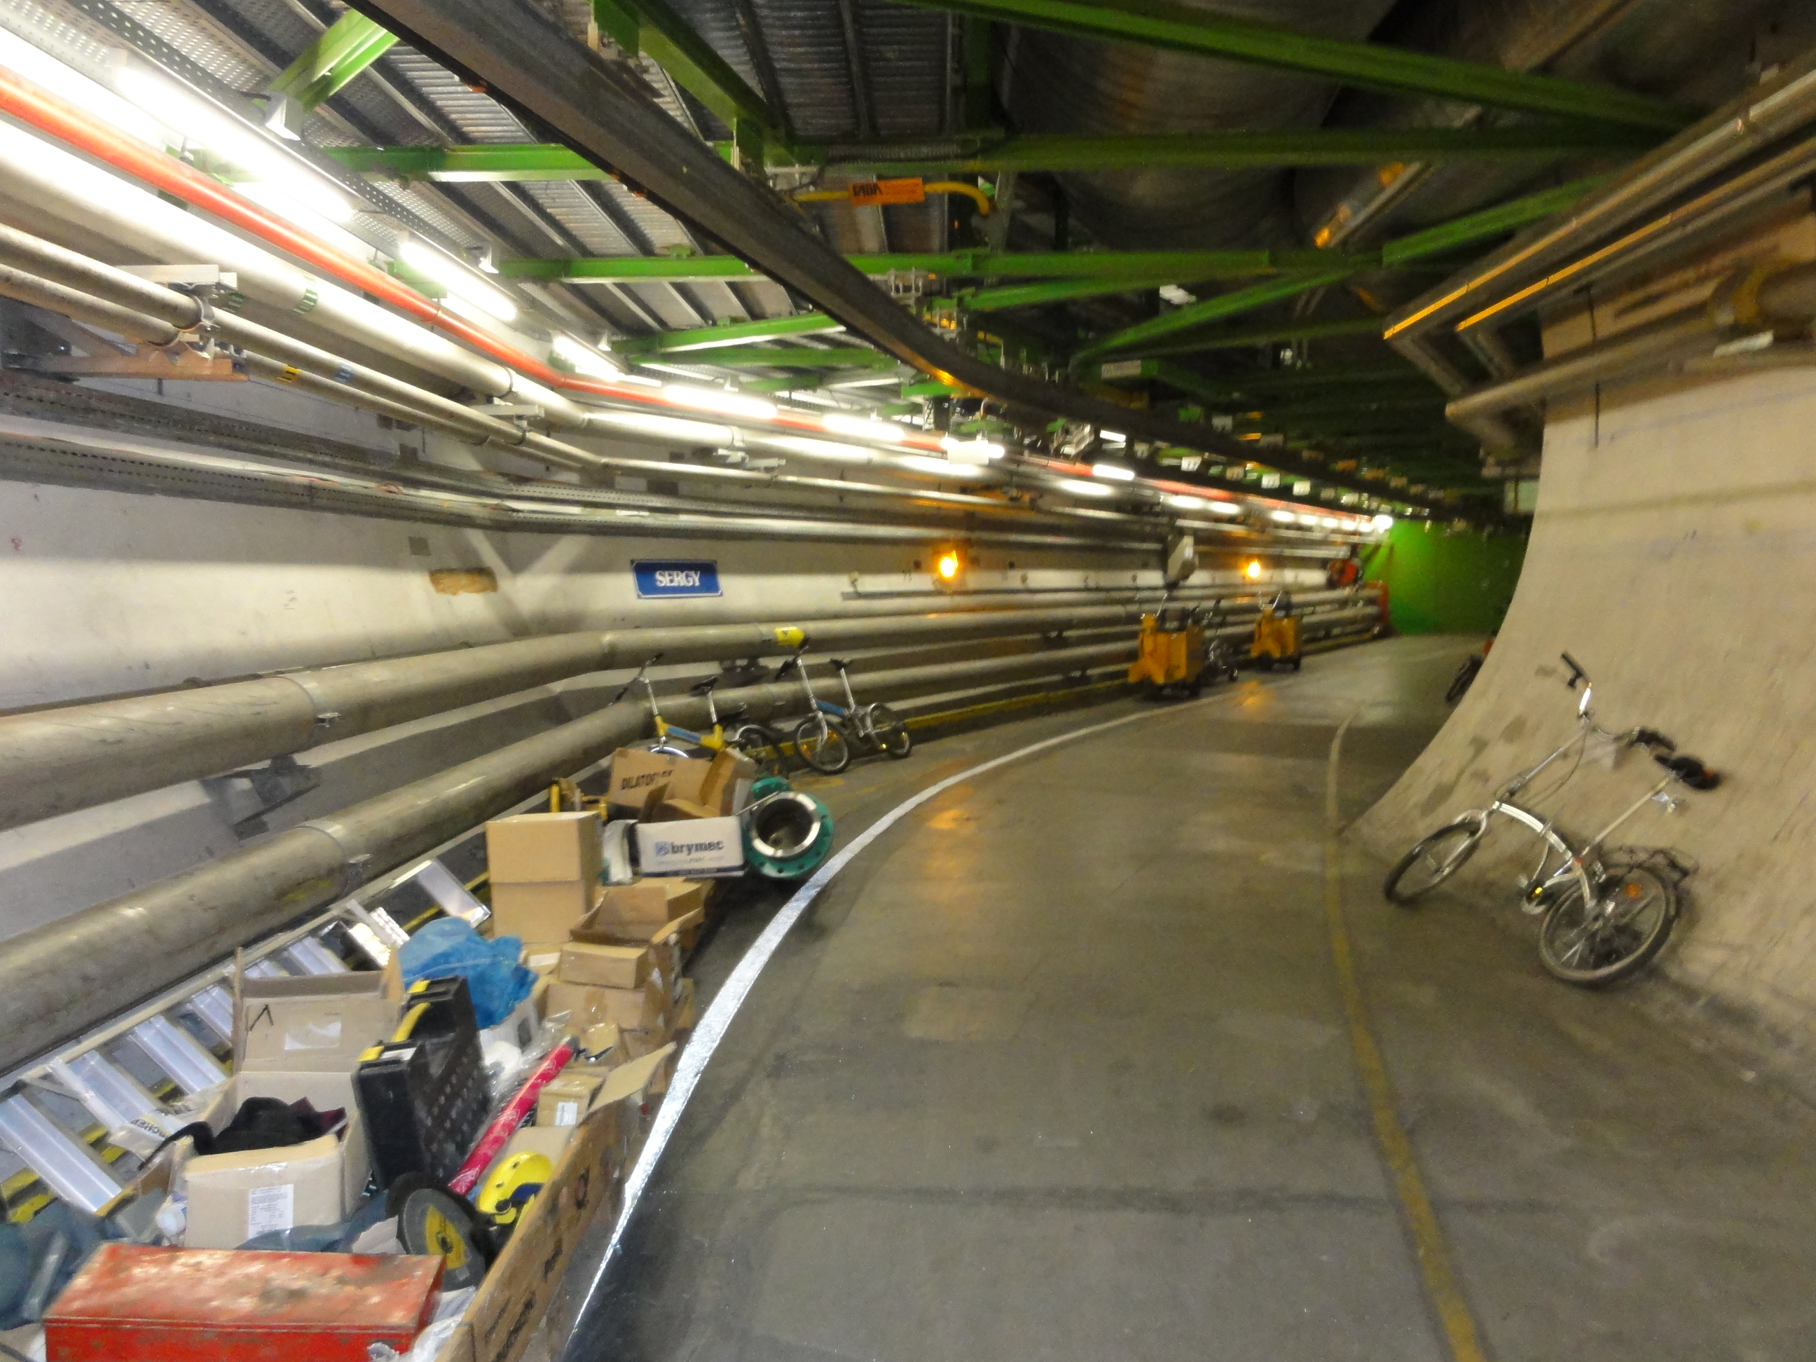

Slide 36
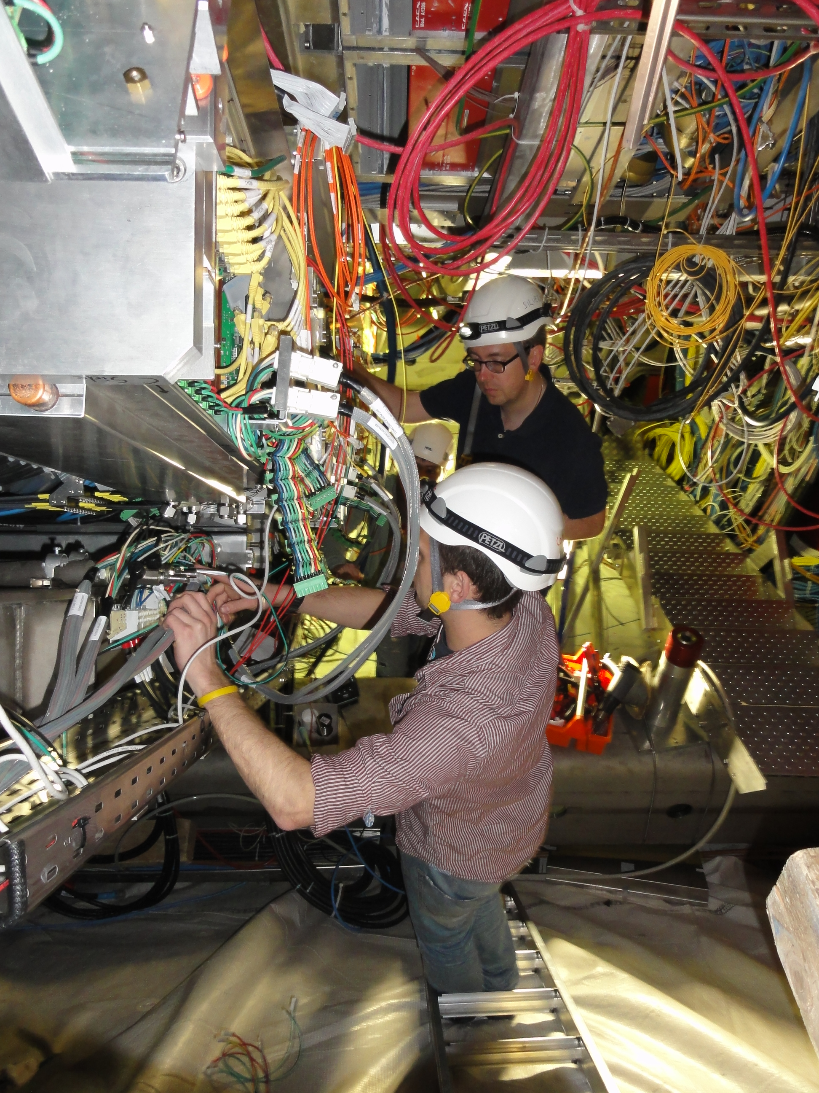

Slide 37
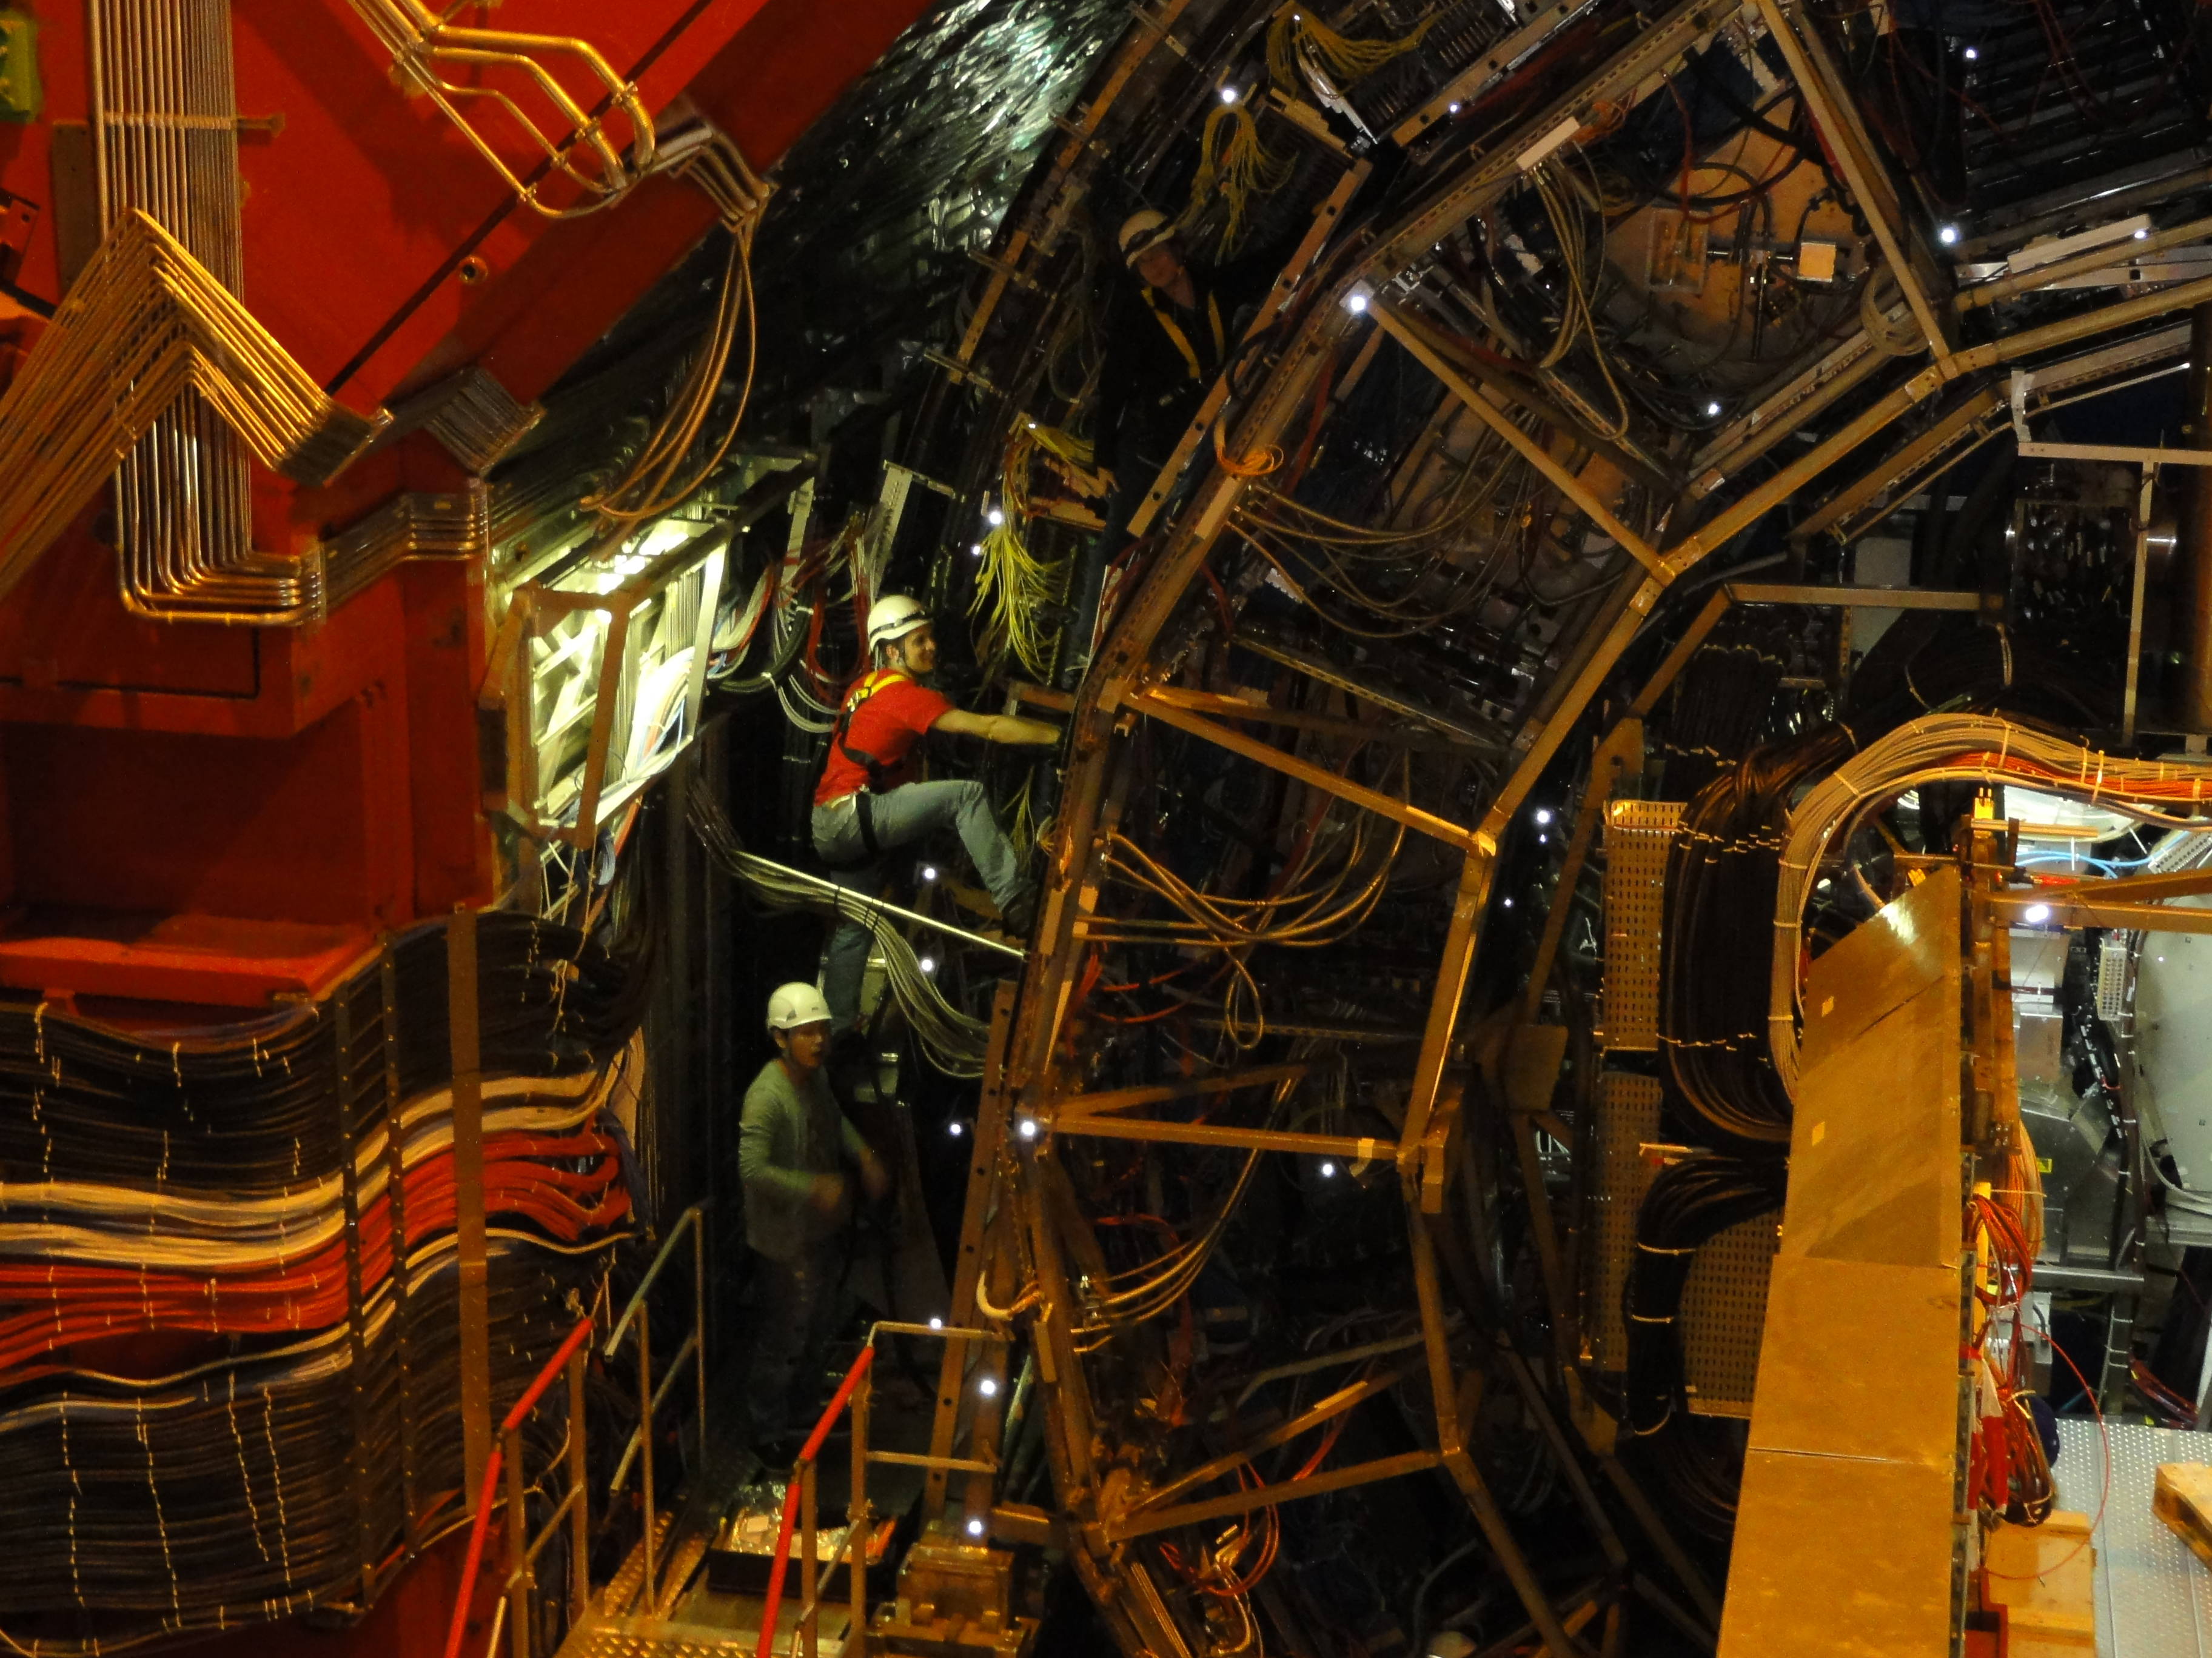

Slide 38
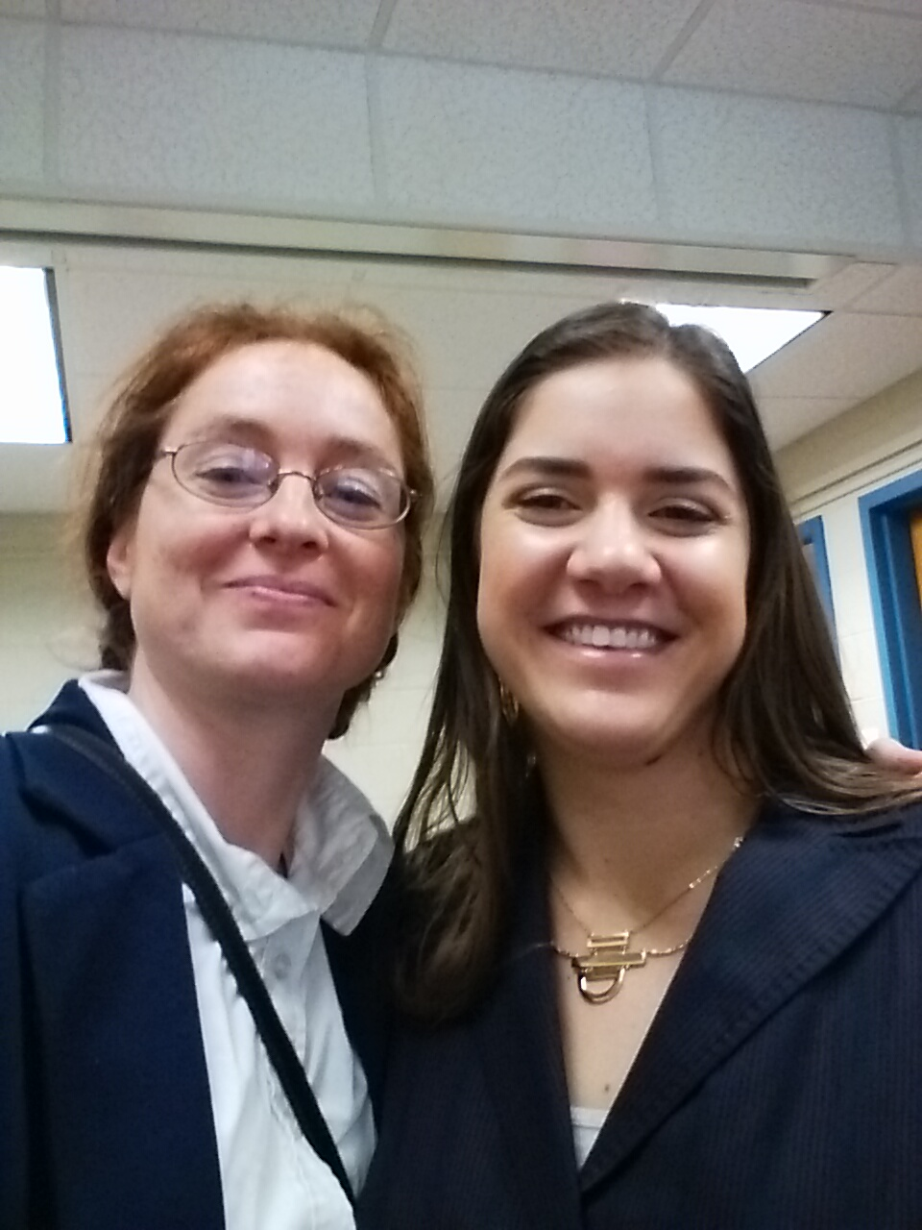
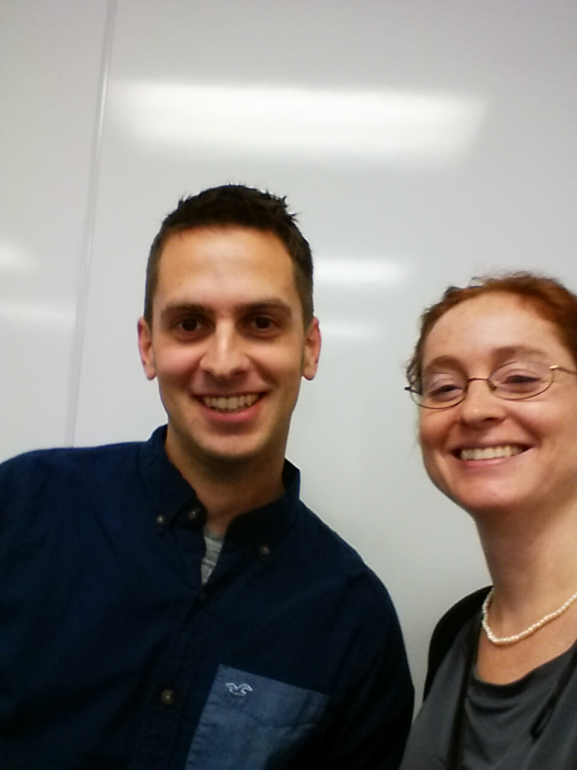

Slide 39
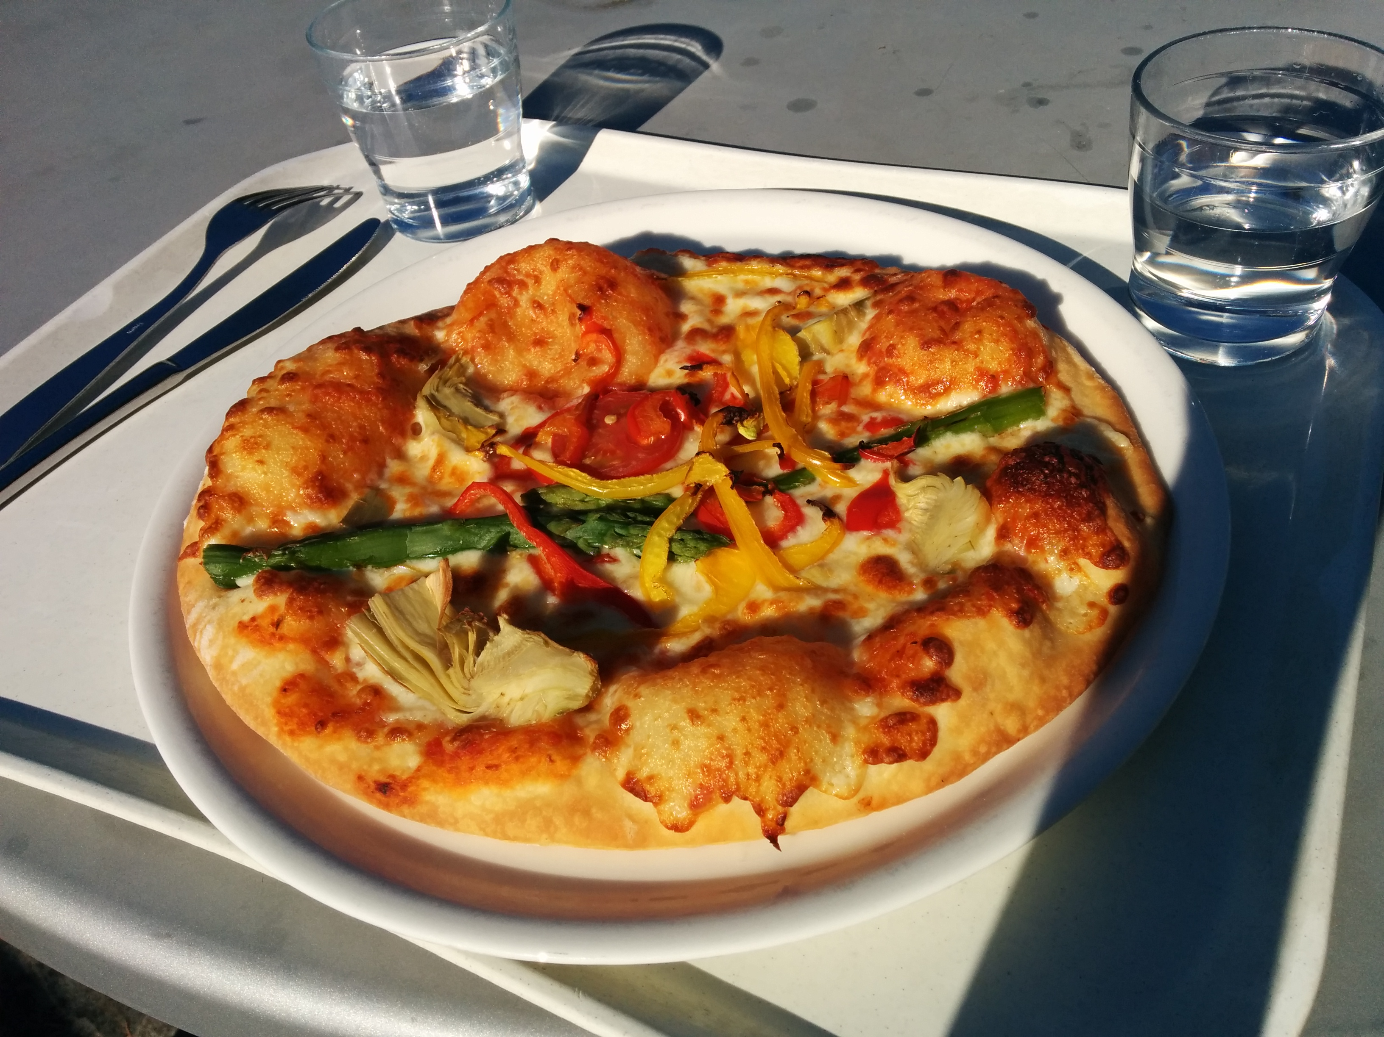

Slide 40
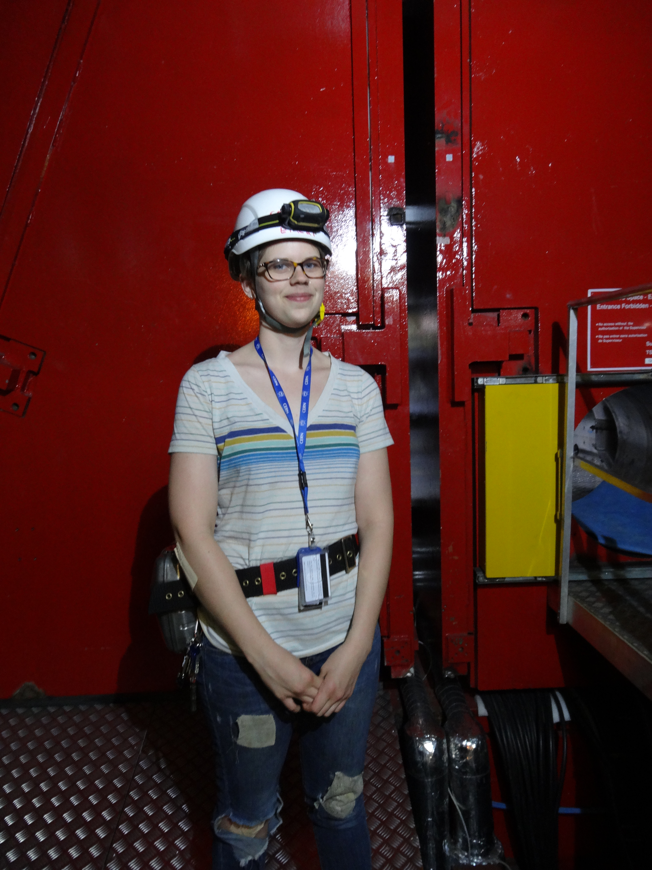

Slide 41
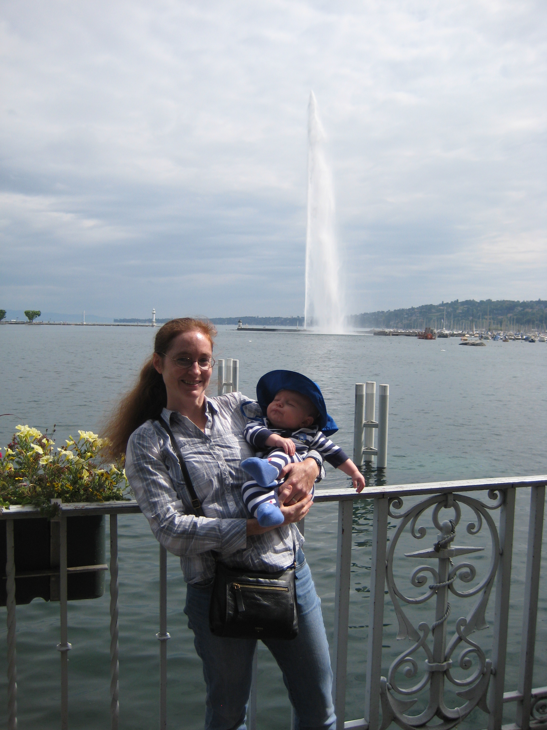

Slide 42
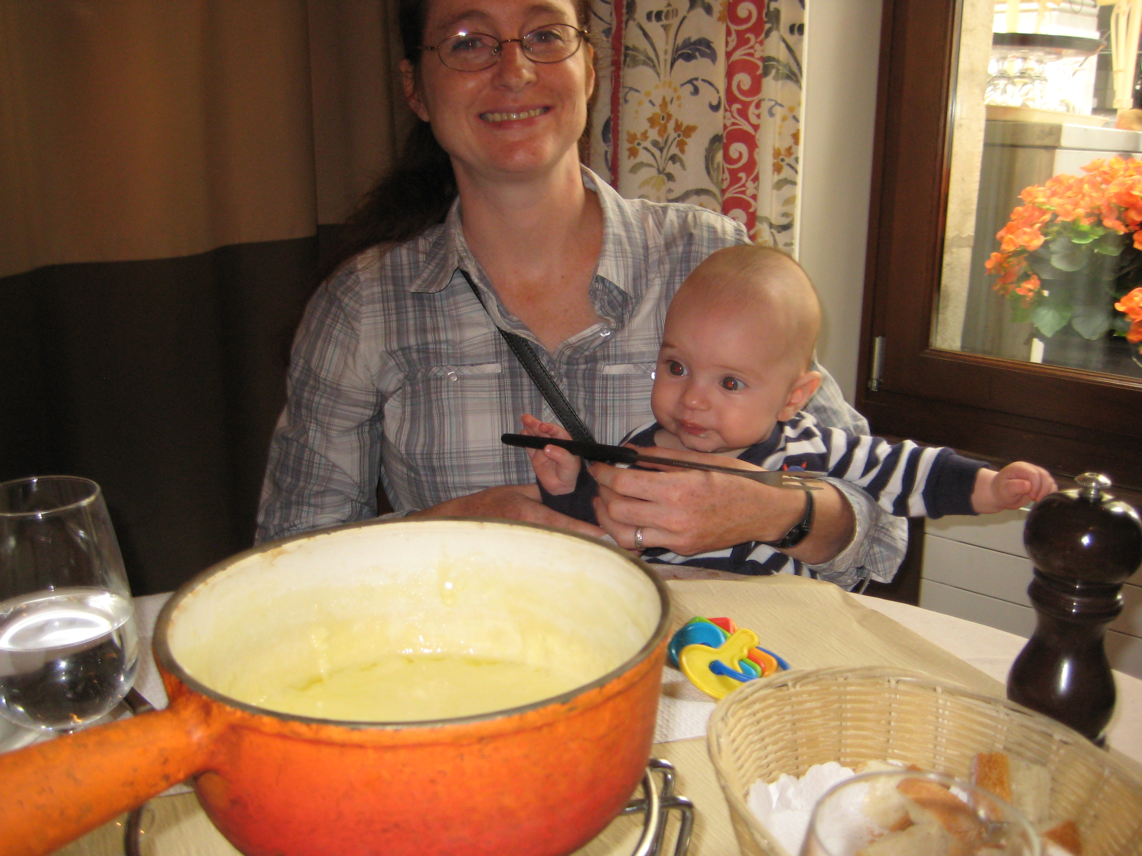

Slide 43
Resources
US LHC blog and Facebook page
Experiments
  Relativistic Heavy Ion Collider: STAR PHENIX
  Large Hadron Collider: ALICE ATLAS CMS LHCb TOTEM
Event displays and pretty pictures from ALICE
Really cool ATLAS event animation
Links to articles in the press on PHENIX
Scientific American article

