Slide 1


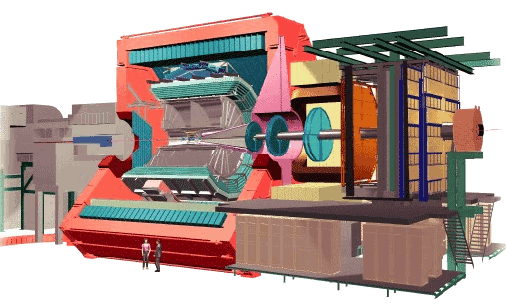
Results from ALICE
Christine Nattrass
University of Tennessee at Knoxville

Slide 2





Phase diagram of nuclear matter
Quark Gluon Plasma
Core of neutron stars?
Quark Gluon Plasma – a liquid of quarks and gluons created at temperatures above ~170 MeV (2·10¹²K) – over a million times hotter than the core of the sun
Notes:
But wait – how can we have a liquid of quarks and gluons? Doesn't asymptotic freedom tell us that we can't have free quarks and gluons? How, then, can we have a liquid of quarks and gluons?

Slide 3

The phase transition in the laboratory

Slide 4




Size: 16 x 26 meters
Weight: 10,000 tons
Notes:
By comparison ATLAS is 25 meters in diameter and 44 meters long – not quite twice as large

Slide 5
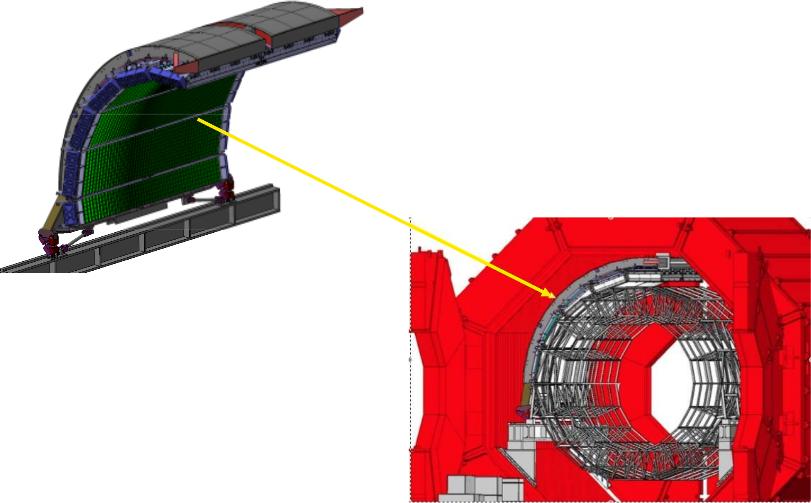
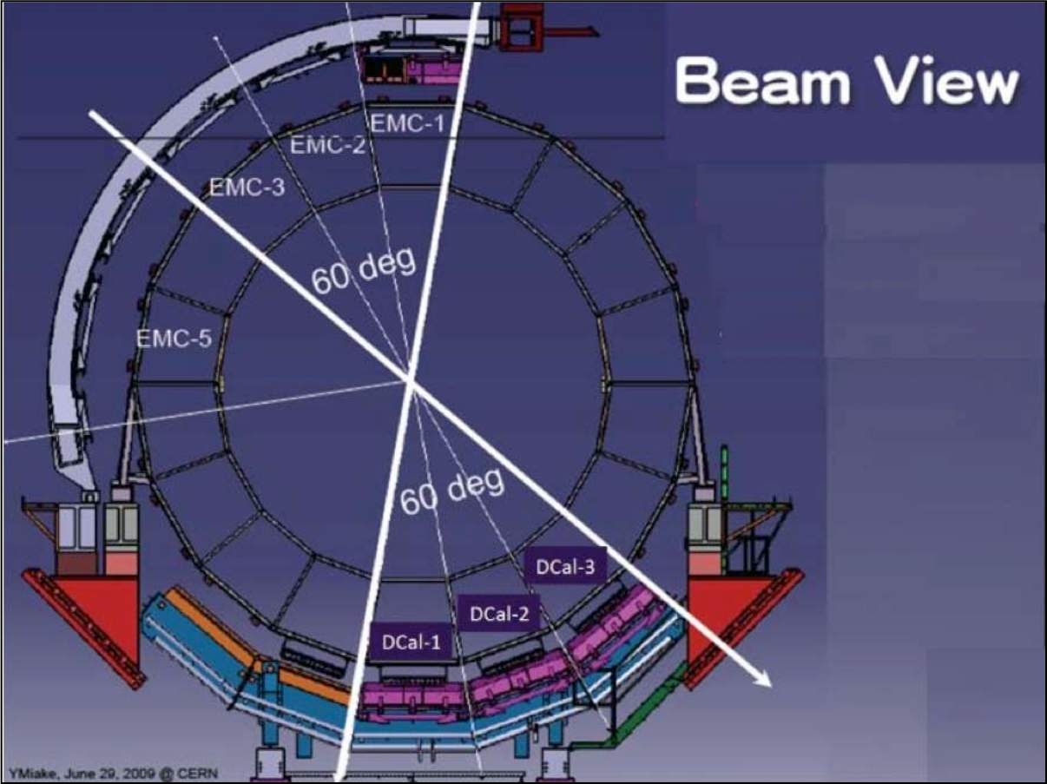
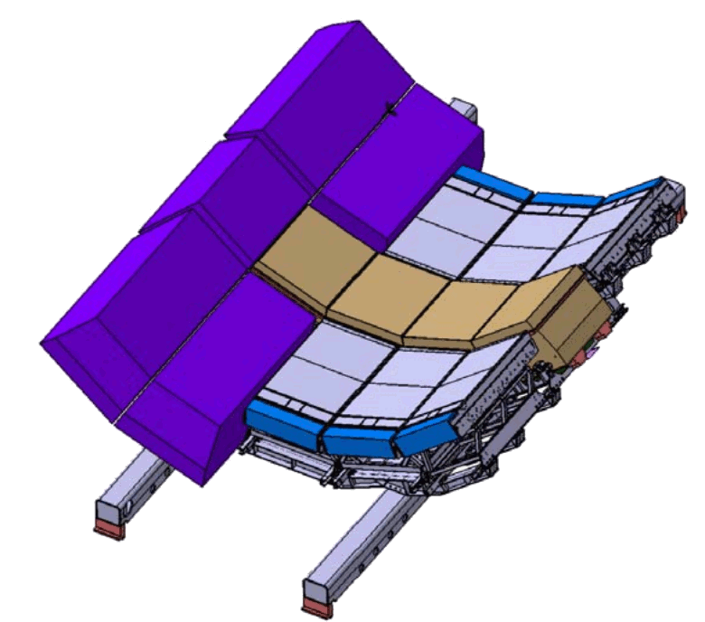
EMCal
& DCal
Δη=1.4,Δφ=107º
Installed in Fall 2014
Δη=1.4,Δφ=60º
Lead-scintillator sampling calorimeter
13 k towers
Each tower Δη x Δφ= 0.014 x 0.014
σ(E)/E=0.12/√E + 0.02

Slide 6
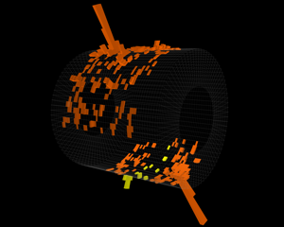
EMCal
& DCal
Pb-Pb √s_{NN} = 5.02 TeV
Δη=1.4,Δφ=107º
Installed in Fall 2014
Δη=1.4,Δφ=60º
Lead-scintillator sampling calorimeter
13 k towers
Each tower Δη x Δφ= 0.014 x 0.014
σ(E)/E=0.12/√E + 0.02

Slide 7

p+p collisions
3D image of each collision

Slide 8

Pb+Pb collisions
5

Slide 9
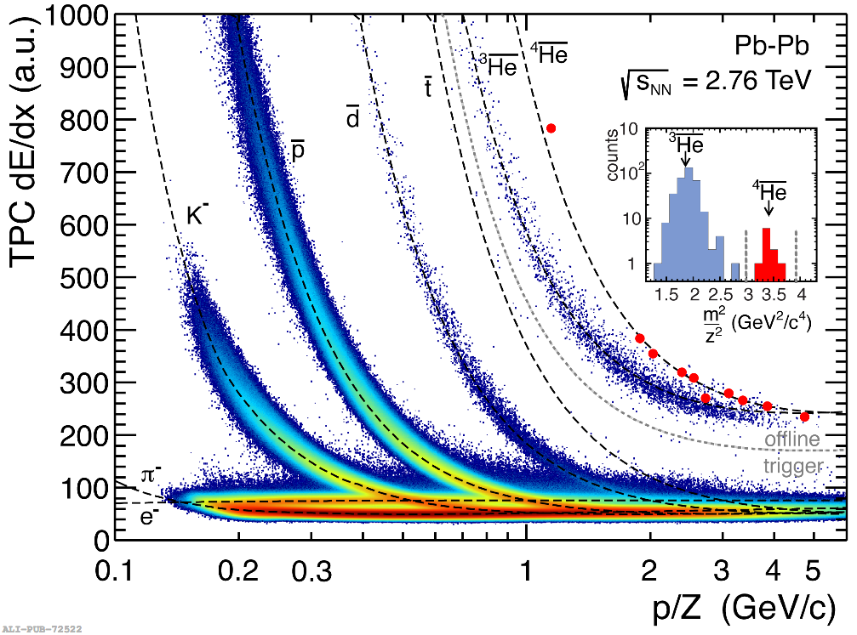
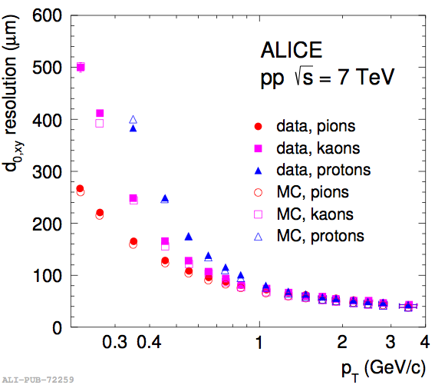
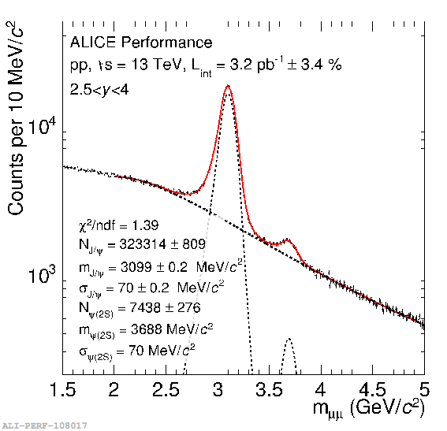
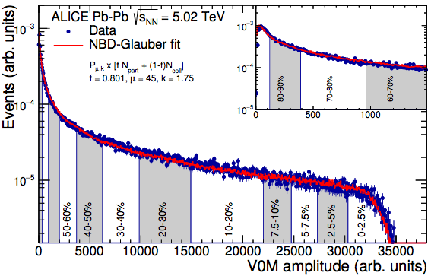
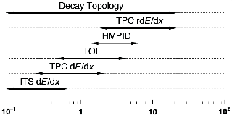
ALICE Performance
di-muon
Vertexing
ALICE Int.J. Mod. Phys. A29 (2014) 1430044
p_{T} (GeV/c)
ALICE-PUBLIC-2015-008
Low-p_{T} tracking: down to 150 MeV/c
PID: anti-³He observed directly
Vertexing capabilities: heavy flavors, V⁰, cascades, conversions

Slide 10
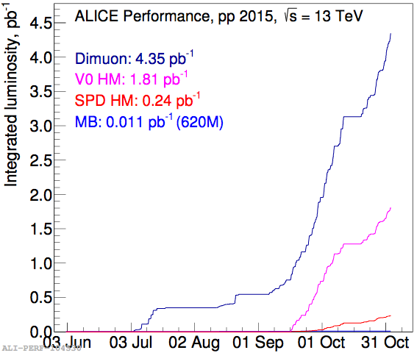
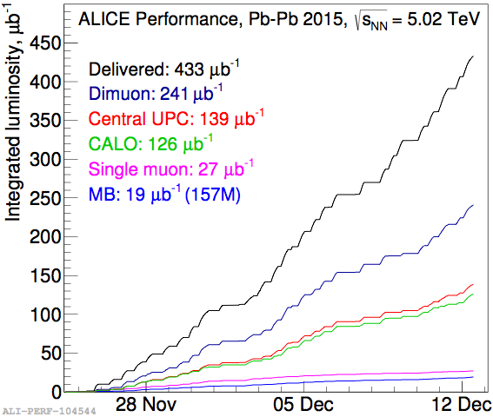
Data collection
Pb–Pb at 5.02 TeV: up to 0.5 nb⁻¹
pp at 13 TeV and 4 days at 5.02 TeV (~100 nb⁻¹)
Upcoming p–Pb at 5.02 and 8 TeV: 10 times more statistics than in RUN-I

Slide 11
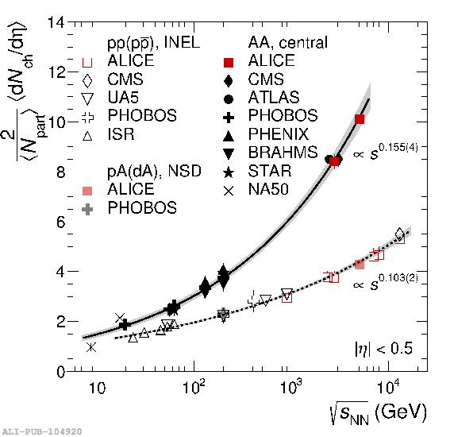
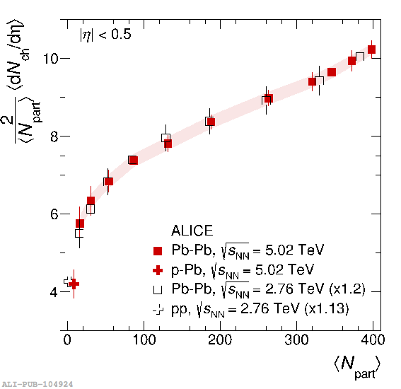
Charged particle multiplicity
Phys. Rev. Lett. 116 (2016) 222302
ALICE: Pb–Pb at 5.02 TeV — highest energy so far
  For 0–5% most central collisions, confirms trend from lower energies
<dNch/dη> vs. <Npart>: similar evolution with centrality between 5.02 and 2.76 TeV
  Provides further constraints for models
  ~20% increase going from 2.76 to 5.02 TeV

Slide 12
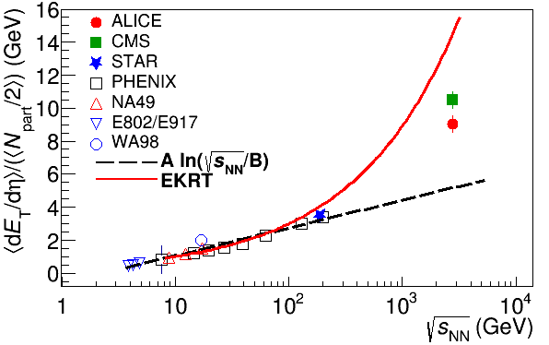

Energy dependence from dE_{T}/dy
RHIC
Standard estimate τ₀ ≈ 1 fm/c
Phys. Rev. C 94 (2016) 034903
QGP formation
Higher than extrapolations of RHIC data

Slide 13
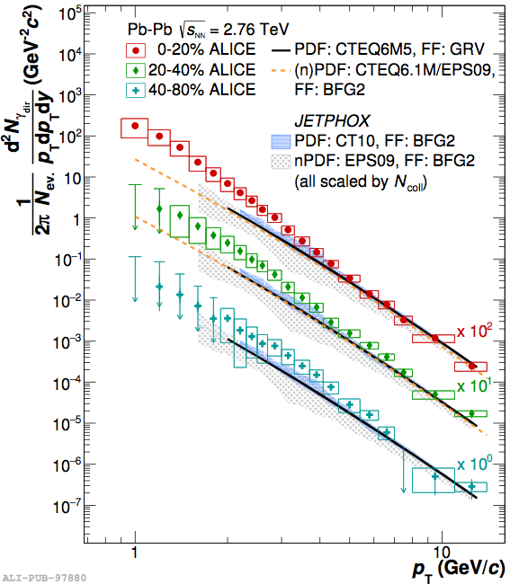
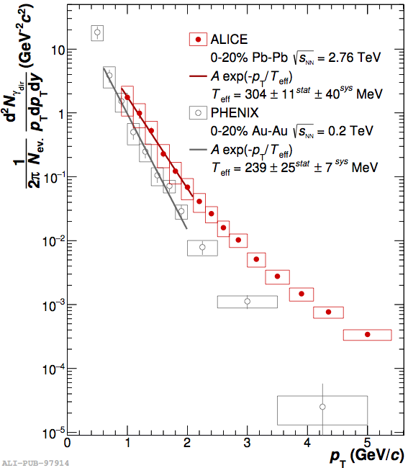
Direct photons in Pb-Pb collisions
Phys. Lett. B 754 (2016) 235-248
Low-p_{T}: 2.6σ excess w. r. t. models in 0–20% central — thermal contribution
T_{eff} = 304 ± 11(stat.) ± 40 (syst.) MeV in central Pb–Pb collisions at 2.76 TeV
30% higher than at RHIC (Au–Au at √s_{NN}=200 GeV)

Slide 14


Relativistic fluids
Au+Au √s_{NN} = 200 GeV
b=7 fm
Particles pushed out
Equipotential lines
arXiv:nucl-th/0305084
Initial overlap asymmetric → pressure gradients
Momentum anisotropy → Fourier decomposition:
Notes:
So at this point you're probably wondering how on earth we measure the viscosity of this thing that exists for only a few fermi/c – for less than 10^-24 seconds
When the nuclei collide, they create a droplet of QGP. This droplet of QGP is not symmetric – this shows the incoming nuclei - and there are huge pressure gradients in it. This shows a calculation of the equipotential lines in the QGP.
These pressure gradients push particles out – meaning that particles in this direction are going faster than particles in this direction
What we do is measure the Fourier coefficients of the distribution of particles

Slide 15
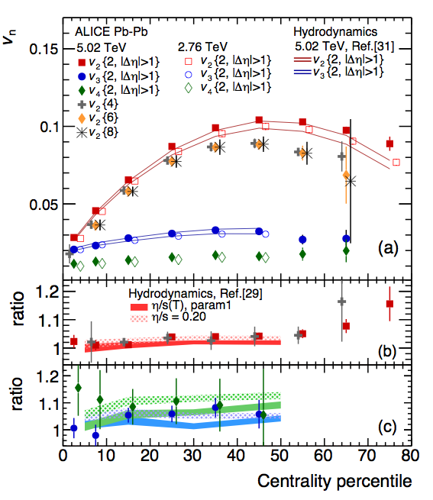
Ratio of v_{n} at different energies
Phys. Rev. Lett. 116 (2016) 132302

Slide 16
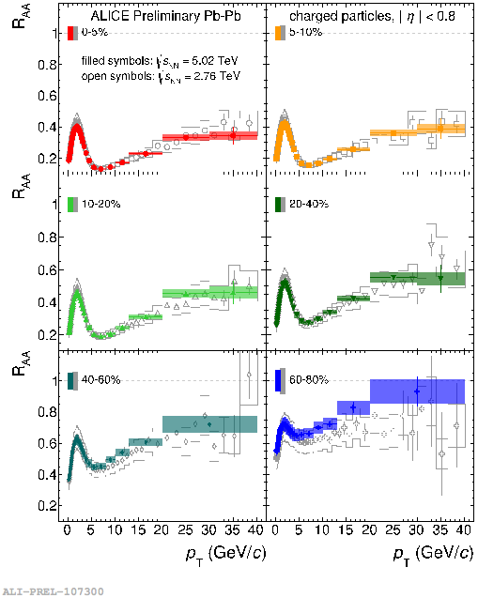

Charged particle R_{AA}
R_{AA}>1: enhancement
R_{AA}<1: suppression
Strong modification of the spectrum shape in most central collisions
Strong centrality dependence
RAA at 5.02 TeV similar to 2.76 TeV

Slide 17
Heavy-Flavor R_{AA}
arXiv:1609.07104
Phys. Lett. B 754 (2016) 81
JHEP 03 (2016) 081
Heavy flavor electron R_{pPb} consistent with unity for p_{T} > 2 GeV/c
Large suppression at high p_{T} heavy quark in-medium energy loss
R_{AA}(D) and R_{AA}(π) compatible with uncertainty at high p_{T}

Slide 18
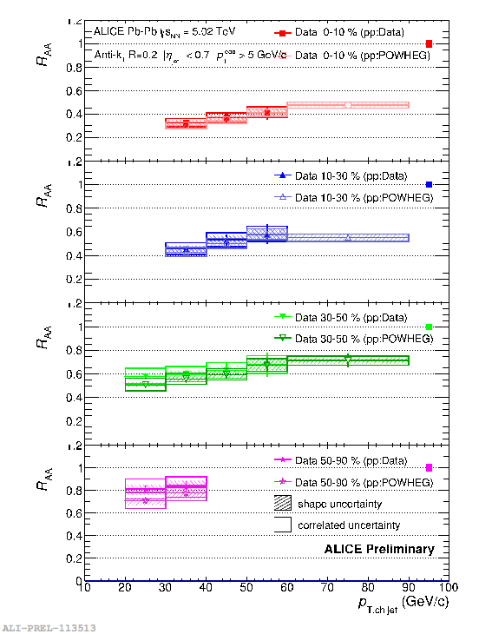
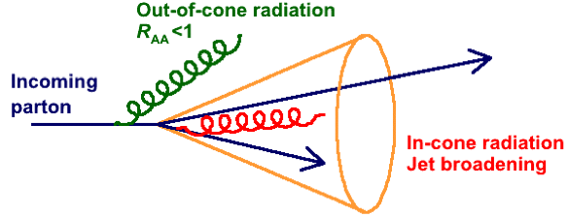
Jet R_{AA}
Out-of-cone radiation: energy loss in jet cone
  Jet yield suppression, di-jet energy imbalance, jet-jet/hadron-jet acoplanarity…
In-cone radiation: medium modified fragmentation
  Jet shape broadening, modification of transverse energy profile…
Consistent with RAA of charged particles and charged-jet RAA at 2.76 TeV

Slide 19
Hadronic Phase
Reconstructible resonance yields may be changed by hadronic scattering processes after chemical freeze-out:
  Regeneration: pseudo-elastic scattering of decay products
  Re-scattering:
    Resonance decay products undergo elastic scattering
    Or pseudo-elastic scattering through a different resonance (e.g. r)
    Resonance not reconstructed through invariant mass
π
K
π
π
π
Kinetic freeze-out
K
ρ
K
K*
π
π
Chemical freeze-out
K
K*
π
K*
π

Slide 20
Other Resonances
K*⁰
φ
Ξ*⁰
π–
K–
Ξ–
ds
B.R. = 66.6%
ss
B.R. = 48.9%
uss
B.R. = 66.7%
m = 896 MeV/c²
Γ = 47.4 MeV/c²
K⁺
m = 1019 MeV/c²
Γ = 4.266 MeV/c²
K⁺
π⁺
m = 1532 MeV/c²
Γ = 9.1 MeV/c²
NEW
NEW
Σ*⁻
π–
Σ*⁺
π⁺
dds
B.R. = 87%
uus
B.R. = 87%
Λ
Λ
m = 1383 MeV/c²
Γ = 36.0 MeV/c²
m = 1387 MeV/c²
Γ = 39.4 MeV/c²

Slide 21
Ratios to Stable Hadrons
Suppression of ρ⁰/p and K*⁰/K in central Pb–Pb w.r.t. peripheral, pp, p–Pb, thermal model
  Suggests that re-scattering is dominant over regeneration
  Well described by EPOS+UrQMD
K*⁰/K in small systems:
  decreasing trend observed in p–Pb (slope not consistent with 0)
  Multiplicity-dependent suppression in pp
No suppression of f/K, no strong centrality dependence
  Central Pb–Pb consistent w/ thermal model
  Lifetime of f ~10× longer than K*⁰, ~35× longer than ρ⁰, re-scattering effects not significant
  Ratio in p–Pb consistent with trend from pp to peripheral Pb–Pb
pp
NEW
Phys. Rev. C 91 024609 (2015)
Eur. Phys. J. C 76 245 (2016)

Slide 22



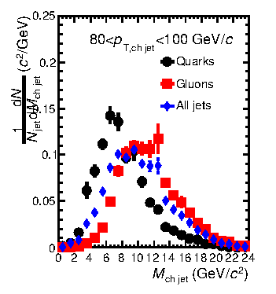
Jet mass and virtuality
Jet mass increases with the radial distance of the constituents from the jet axis
  Soft constituents, away from the jet axis within the cone → larger mass
  Few hard constituents → smaller mass
→ E.g. gluon vs quark jets jet mass difference

Slide 23
Comparison to models
Quenching models (JEWEL, Q-PYTHIA) show a larger mass than pp-like PYTHIA jets
  JEWEL: 2→2 pQCD matrix elements with parton shower taking into account radiation. For charged jets the background subtraction is implemented by shifting the distribution considering the background estimated for full jets and the difference between full and charged jets in pp
  Q-PYTHIA: PYTHIA with medium effects in the final state branching through an additive term in the splitting functions computed in the multiple-soft scattering approximation
JEWEL with “recoil off” (removing recoil centres before hadronization) shows a depletion of the jet mass wrt pp due to less low-p_{T} fragments wrt recoil on
Pb-Pb measurement can discriminate among these predictions

Slide 24
Conclusions
Precision tracking and PID enable precision measurements of
  Global observables (N_{ch}, E_{T})
  Direct photons
  Hydrodynamical flow
  Jets
  Resonances
More to come!
  Results from DCal
  Upgrades for run 3

