Slide 1

Understanding the Quark Gluon Plasma
Christine Nattrass
University of Tennessee, Knoxville

Slide 2



QCD Phase Diagram
Quark Gluon Plasma
Hadron Gas
arXiv:1701.07065
Notes:
But wait – how can we have a liquid of quarks and gluons? Doesn't asymptotic freedom tell us that we can't have free quarks and gluons? How, then, can we have a liquid of quarks and gluons?

Slide 3

How to make a Quark Gluon Plasma

Slide 4

The phase transition in the laboratory

Slide 5


The phase transition in the laboratory
Initial State
QGP
Freeze-out
  K, O’Hara, S. Hemmer, M. Gehm, S. Granade, J. Thomas Science 298 2179 (2002)
Hydrodynamical flow
Jet quenching
https://physics.aps.org/articles/v7/97

Slide 6



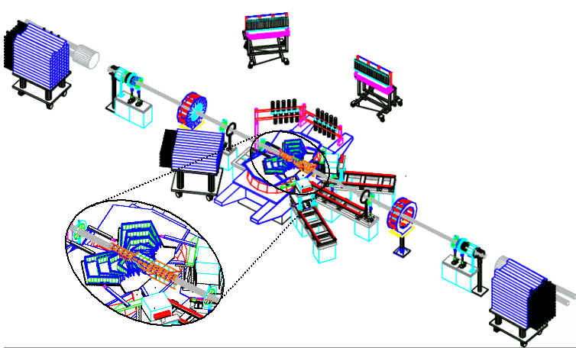
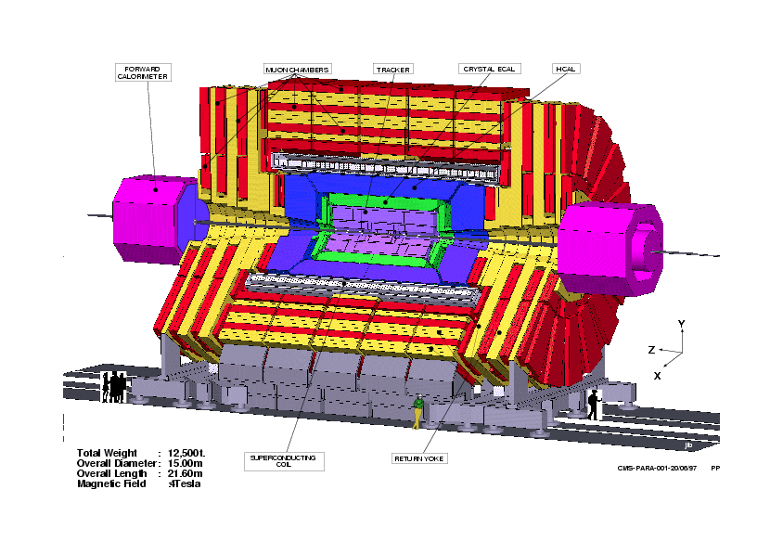
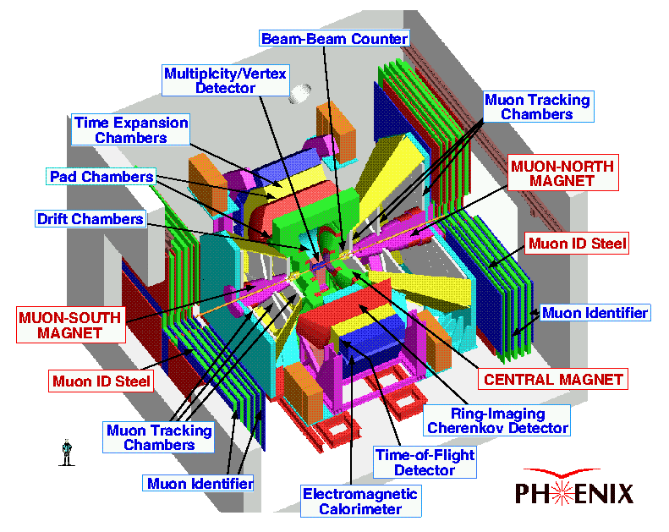









Relativistic Heavy Ion Collider
Large Hadron Collider
PHOBOS
BRAHMS
CMS
PHENIX
STAR
RHIC
LHCb
ALICE
ATLAS
LHCf
LHC
Upton, NY
1.2km diameter
p+p, d+Au, Cu+Cu, Au+Au, U+U
√s_{NN} = 9 - 200 GeV
Geneva, Switzerland
8.6km diameter
p+p, p+Pb, Pb+Pb
√s_{NN} = 2.76 GeV, 5.5 TeV
RHIC
Notes:
Mention that RHIC planning began 1983

Slide 7

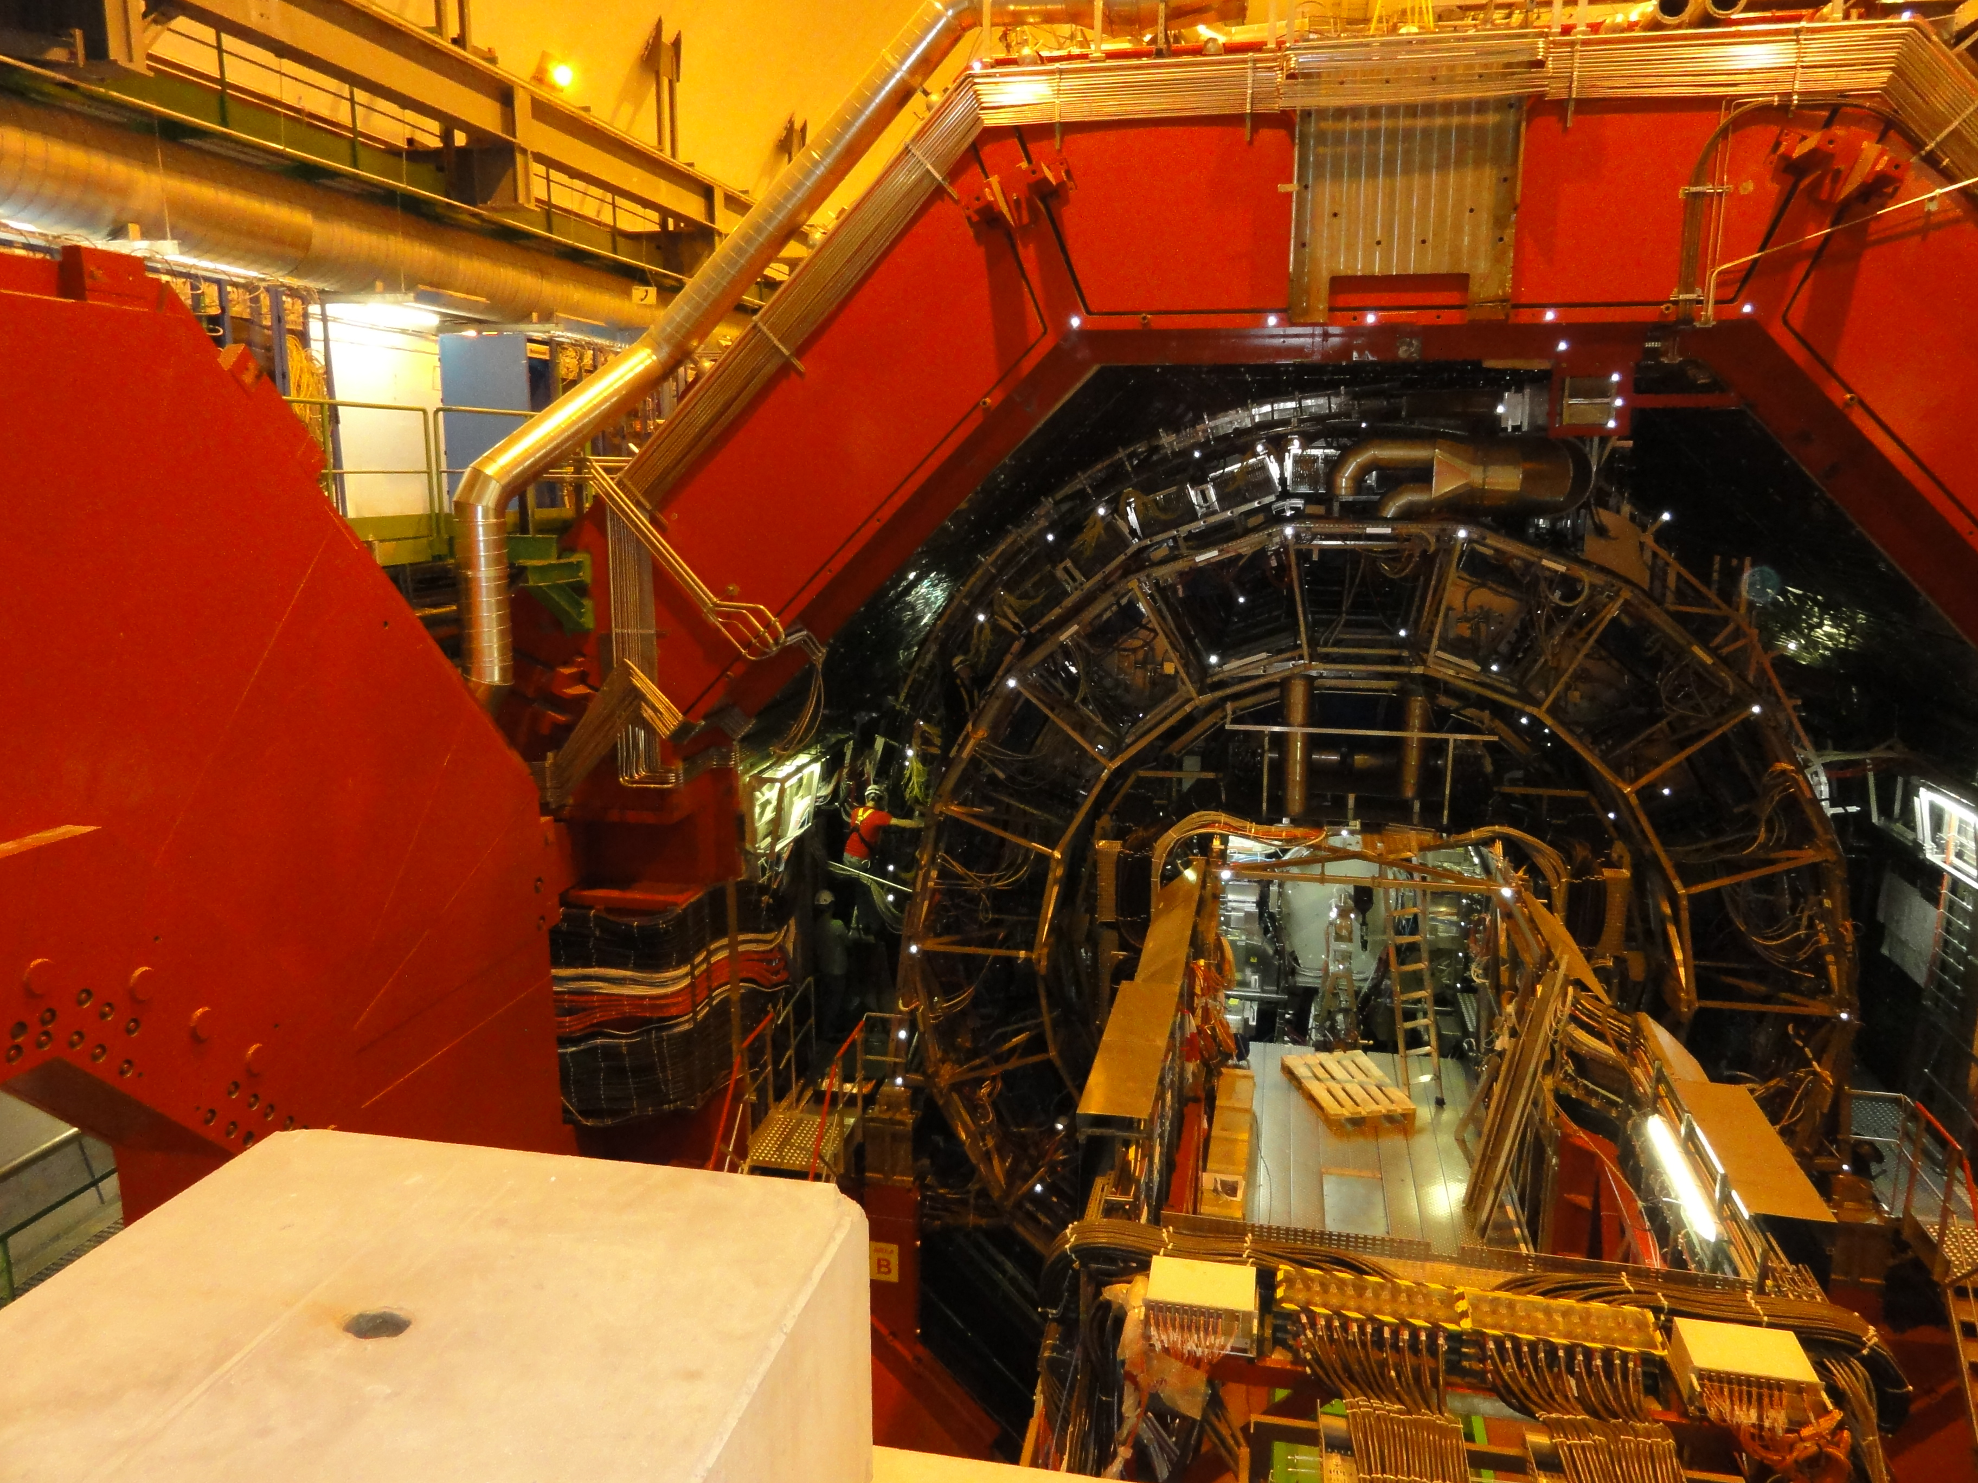




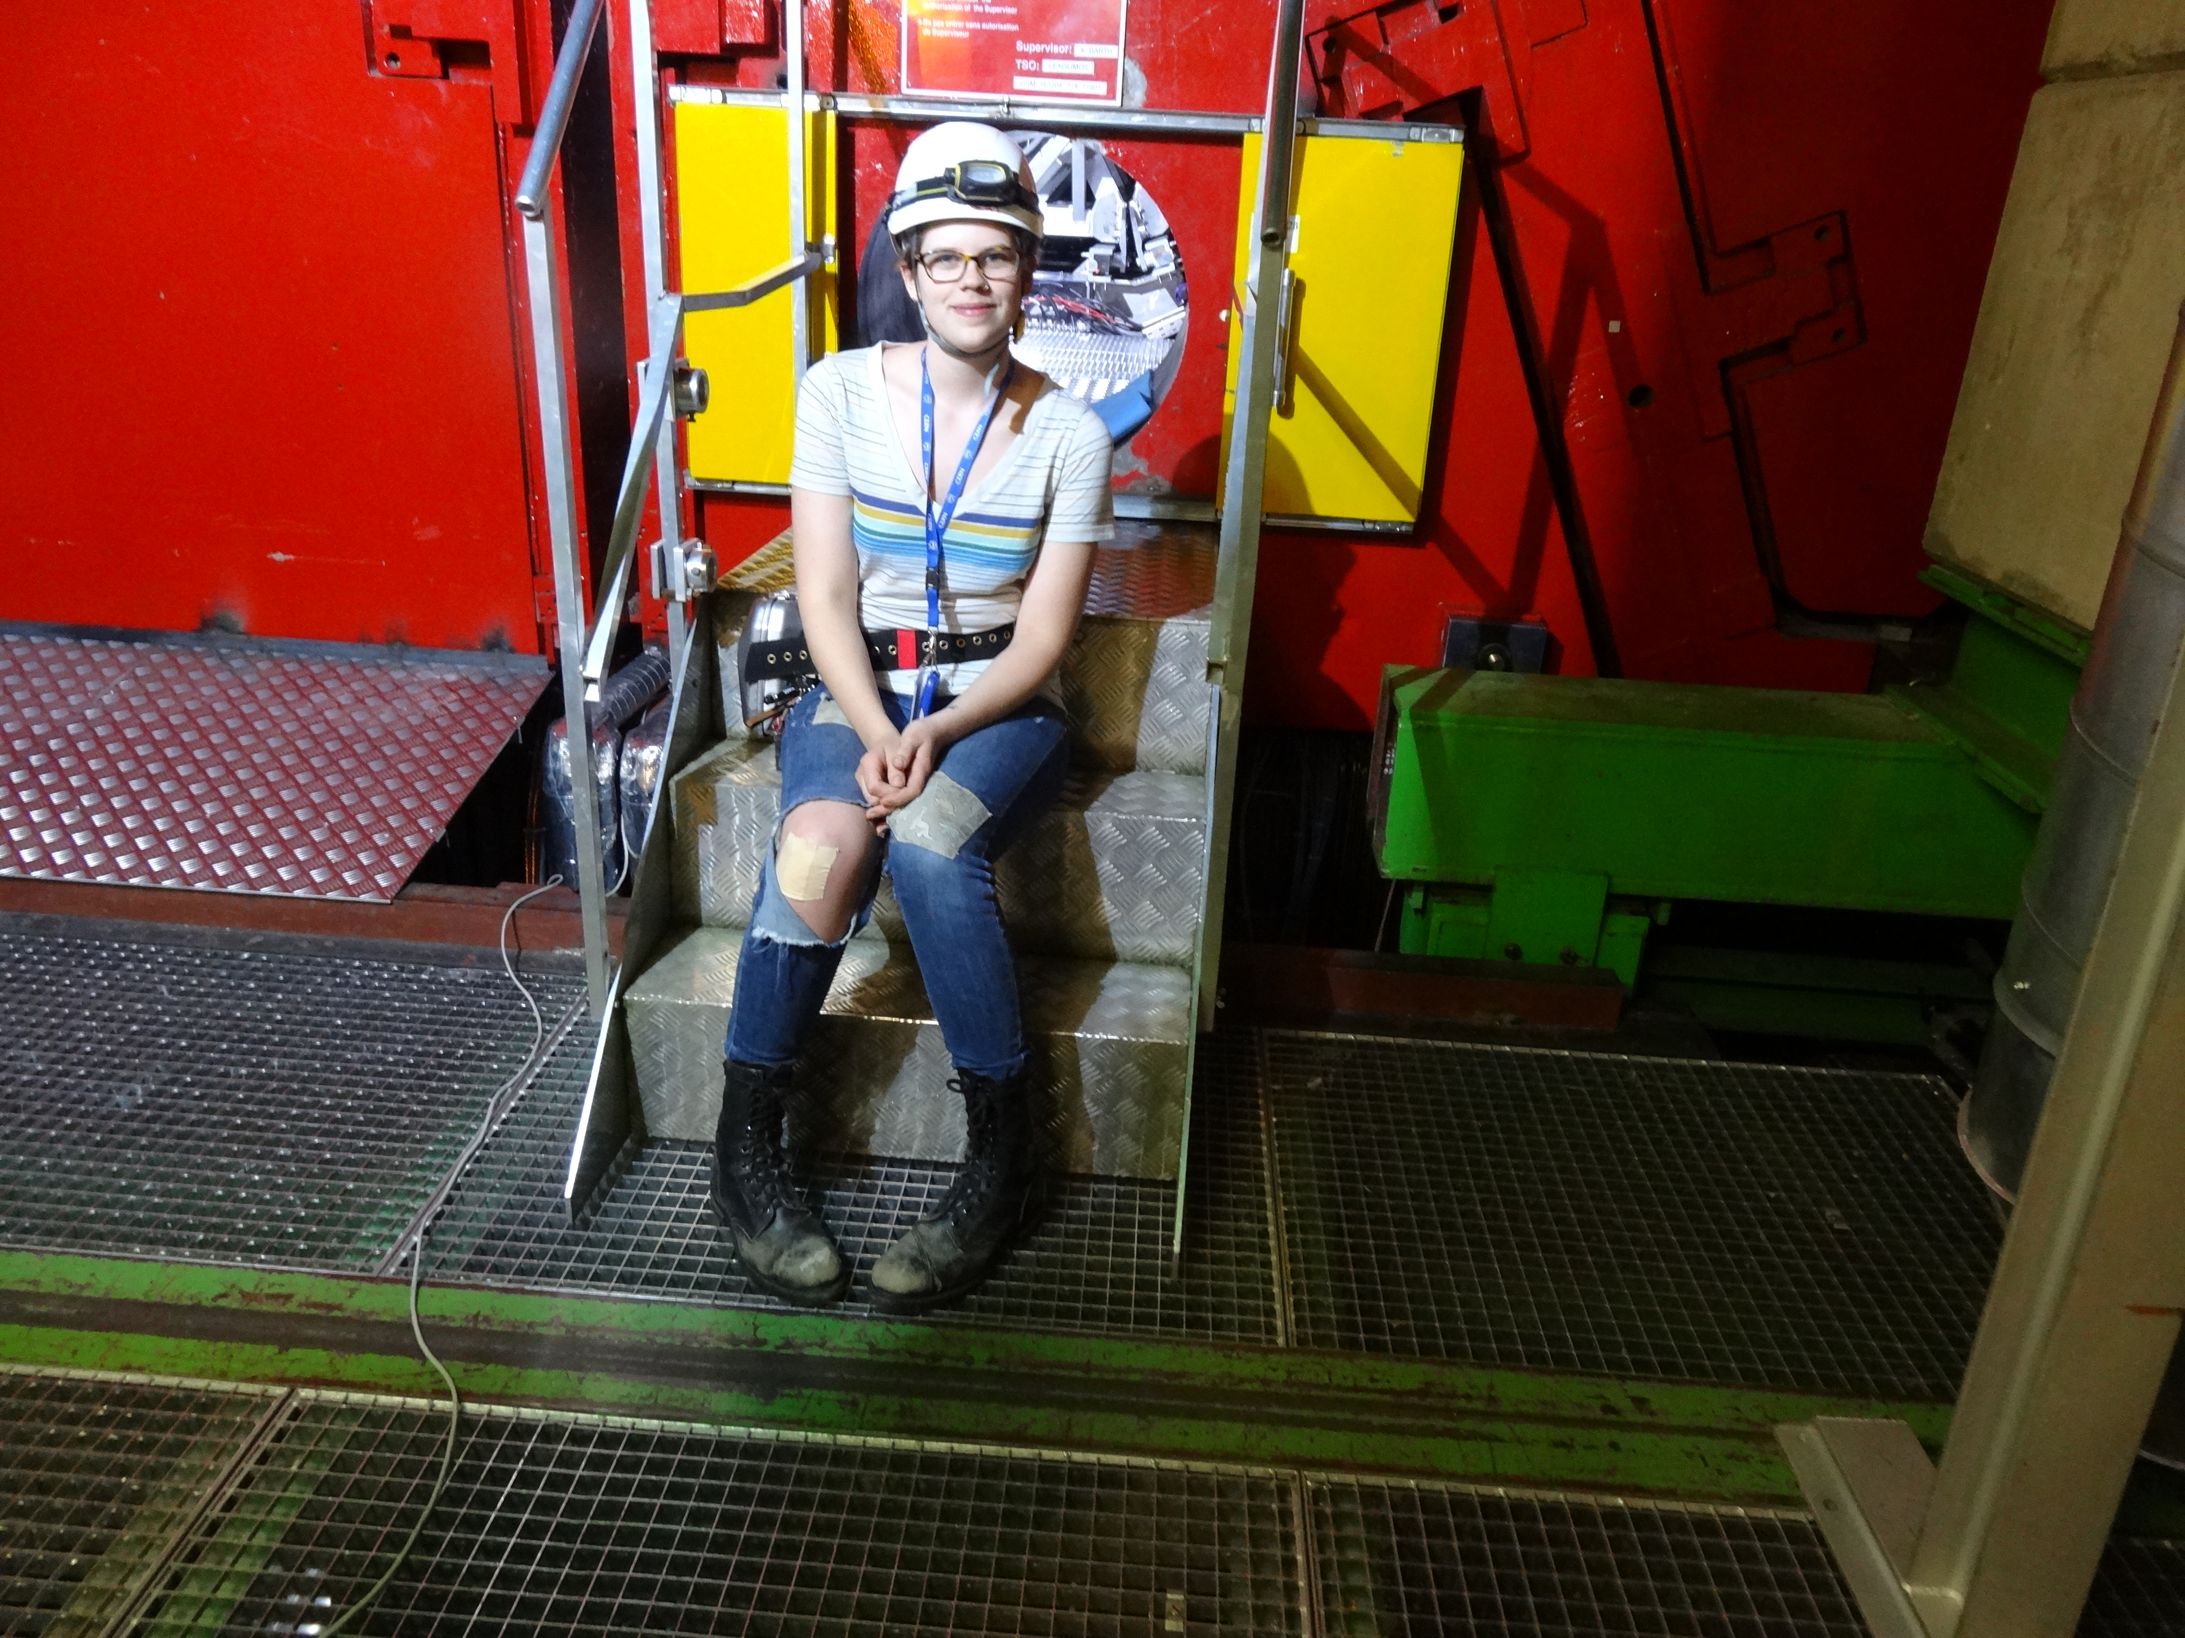
Size: 16 x 26 meters
Weight: 10,000 tons
Detectors: 18
Trigger detectors: When do we have a collision?
Tracking detectors: Where did the particle go?
Identification detectors: What kind of particle is it?
Calorimeters: How much energy does the particle have?
<number>
Notes:
By comparison ATLAS is 25 meters in diameter and 44 meters long – not quite twice as large

Slide 8

p+p collisions
3D image of each collision

Slide 9

Pb+Pb collisions
5

Slide 10
Forming the QGP

Slide 11

How can we estimate the energy density?
Transverse energy (E_{T})
  sum of particle energies in transverse direction
Volume V = A_{T} τc
τ = formation time
Energy density ε
QGP formation for ε > 0.5 GeV/fm³
A_{T}
= τc

Slide 12
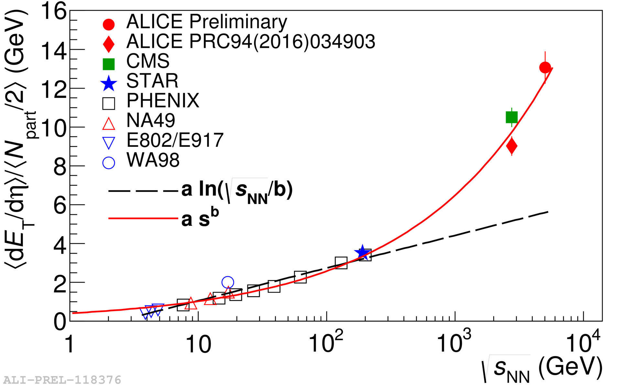

Energy dependence from dE_{T}/dy
RHIC
Standard estimate τ₀ ≈ 1 fm/c
QGP formation
Collision energy
Higher than extrapolations of RHIC data

Slide 13
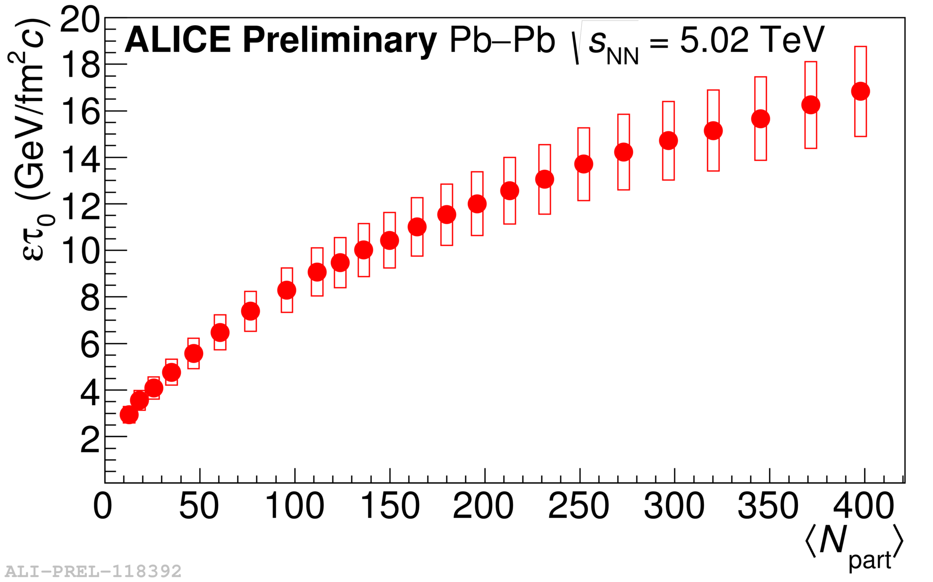
Energy dependence from dE_{T}/dy
RHIC
Standard estimate τ₀ ≈ 1 fm/c
QGP formation
Higher than extrapolations of RHIC data

Slide 14
QGP Spectroscopy

Slide 15
Probing the Quark Gluon Plasma
Medium
Probe
Detector
Want a probe which traveled through the collision
QGP is very short-lived (~1-10 fm/c) →
cannot use an external probe

Slide 16


Probes of the Quark Gluon Plasma
nucleus
nucleus
Want a probe which traveled through the medium
QGP is short lived → need a probe created in the collision

Slide 17
Probes of the Quark Gluon Plasma
nucleus
nucleus
Want a probe which traveled through the medium
QGP is short lived → need a probe created in the collision
We expect the medium to be dense → absorb/modify probe

Slide 18





Jets
p+p → dijet
D
c, x_{c}
p
a, x_{a}
b, x_{b}
p
σ_{ab}
Beam pipe
d, x_{d}
D
Jets – hard parton scattering leads to back-to-back quarks or gluons, which then fragment as a columnated spray of particles

Slide 19


Nuclear modification factor
Measure spectra of probe (jets) and compare to those in p+p collisions or peripheral A+A collisions
If high-p_{T} probes (jets) are suppressed, this is evidence of jet quenching
Enhancement
Suppression

Slide 20

Nuclear modification factor
LHCb-PAPER-2017-015
Control
Control
Probe
Charged hadrons (colored probes) suppressed in Pb—Pb
Charged hadrons not suppressed in p—Pb at midrapidity
Electroweak probes not suppressed in Pb—Pb

Slide 21
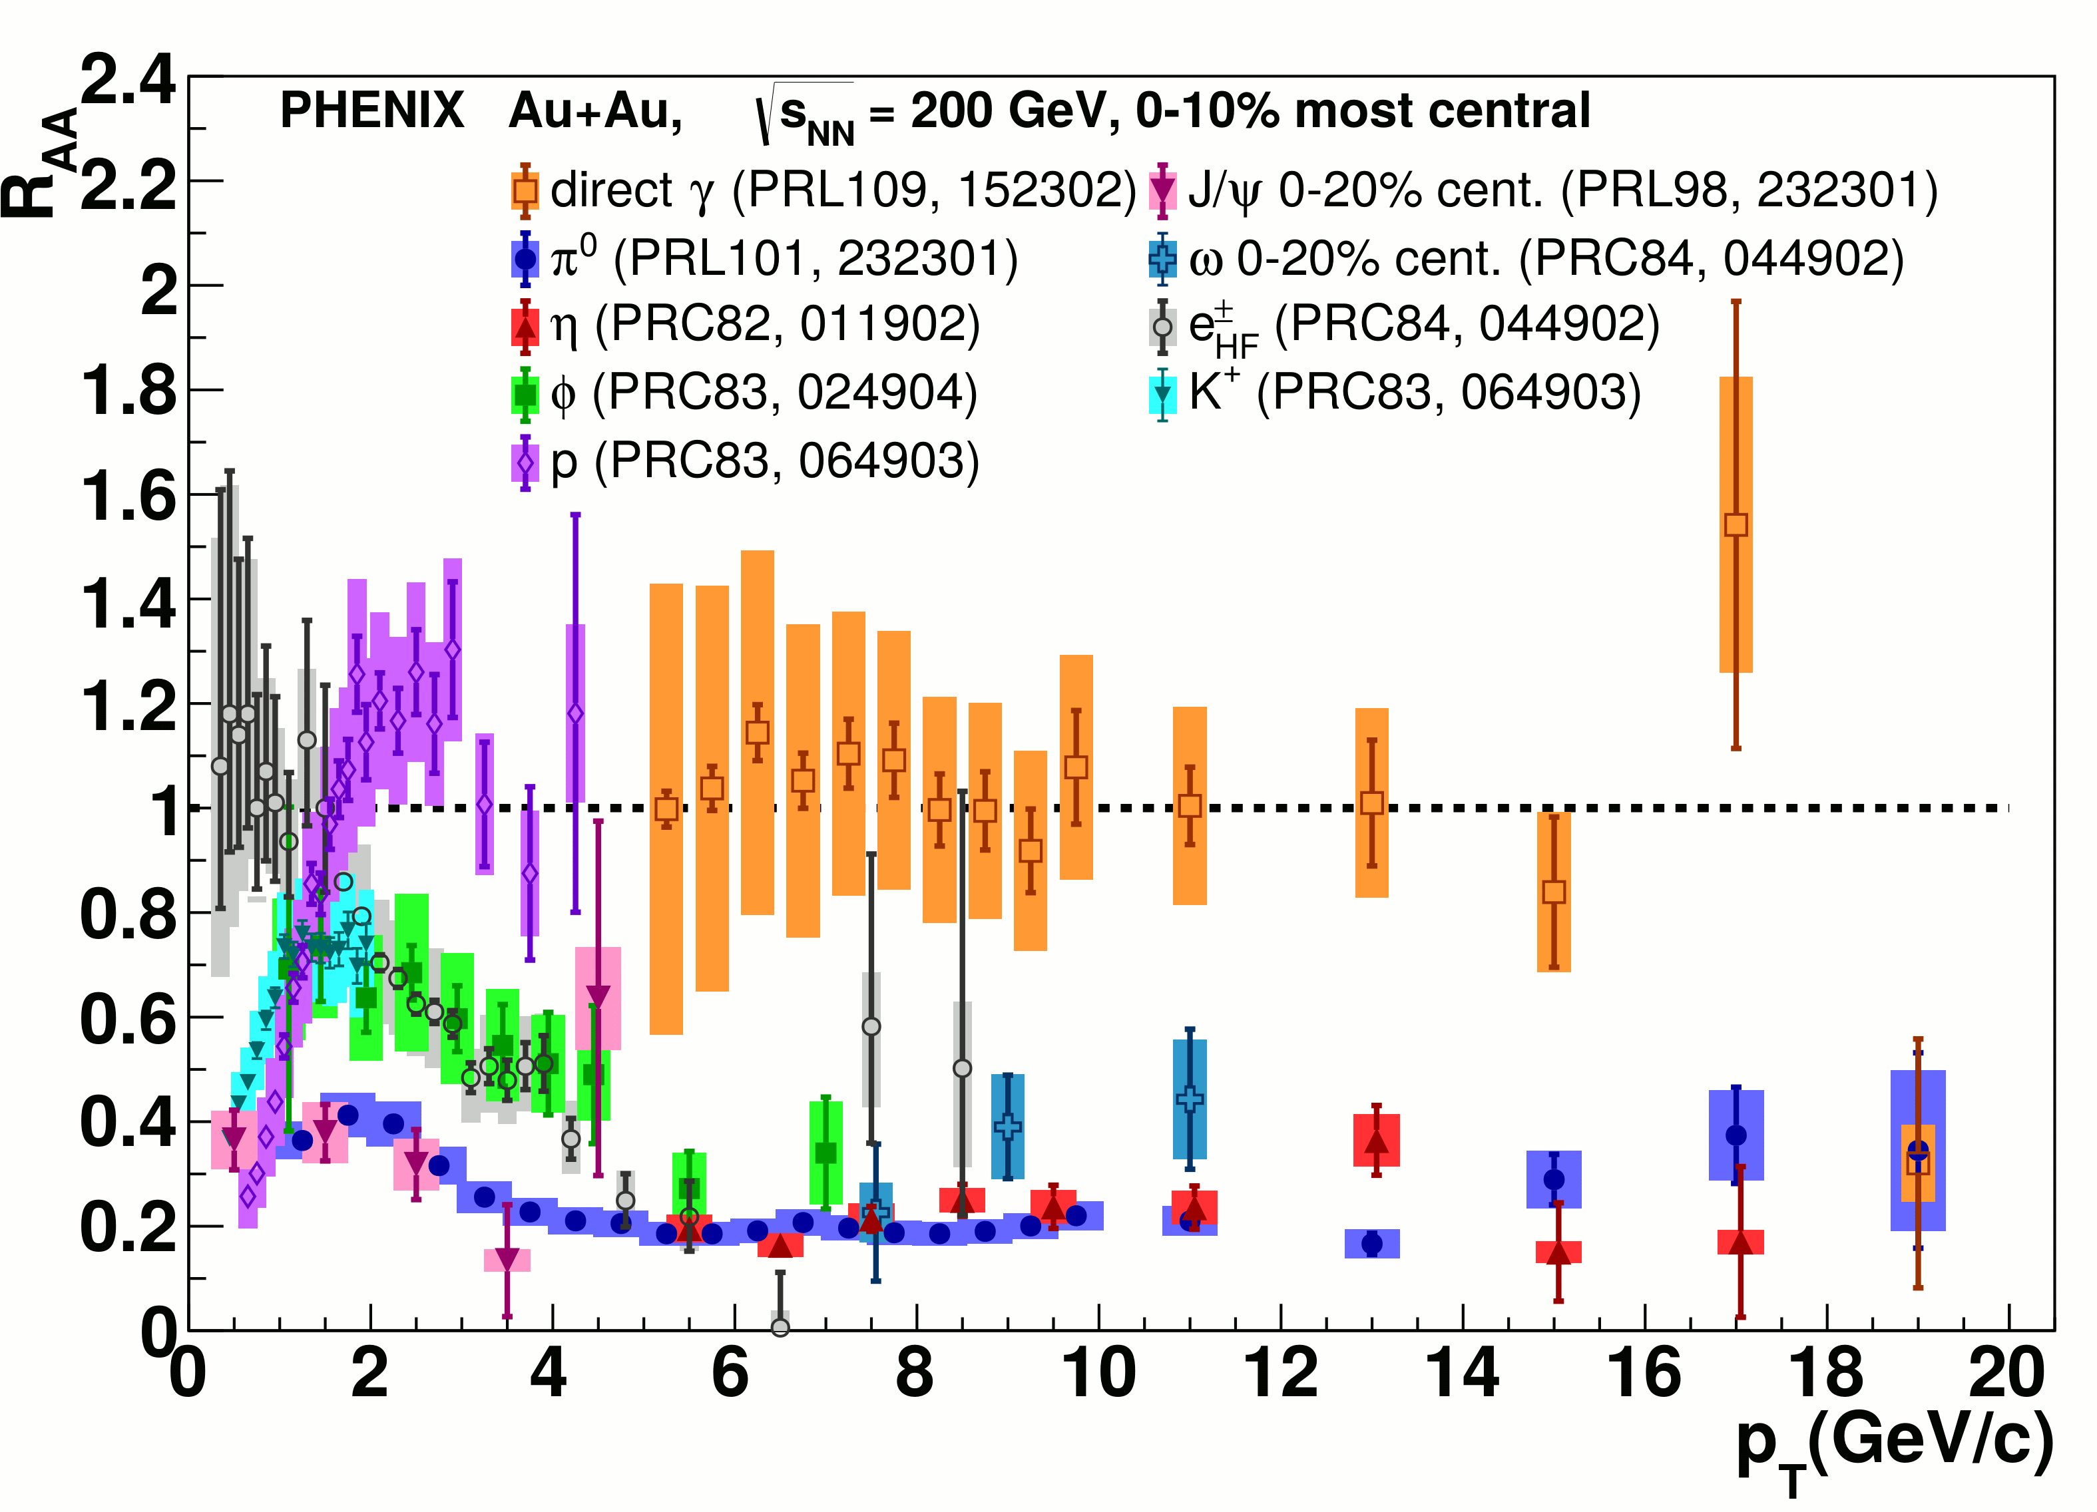

Nuclear modification factor R_{AA}
RHIC
LHC
Connors, Nattrass, Reed, SalurarXiv:1705.01974 [nucl-ex]
Electromagnetic probes – consistent with no modification – medium is transparent to them
Strong probes – significant suppression – medium is opaque to them - even heavy quarks!

Slide 22
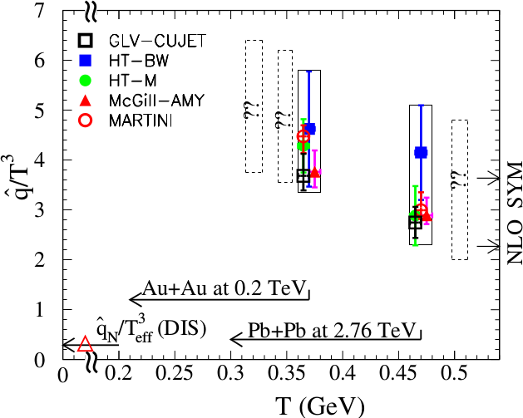
Quantifying
Phys. Rev. C 90, 014909 (2014)
Jet Collaboration: For a 10 GeV quark traveling 4 fm
≈1.2±0.3 GeV²/fm at τ₀=0.6 fm/c in Au+Au at √s_{NN}=200 GeV →loses 2.2 Gev
≈1.9±0.7 GeV²/fm in Pb+Pb collisions at √s_{NN}=2.76 TeV →loses 2.8 Gev
Q = Momentum transfer from parton to medium
L = path length

Slide 23
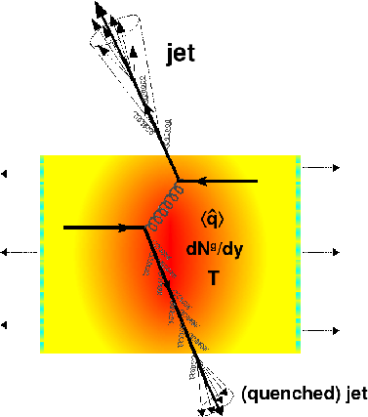
Gluon bremsstrahlung
Softer constituents
Broader radius
Figure from Nucl.Phys. A827 (2009) 356C-364C arXiv:0902.2488 [nucl-ex]

Slide 24



Di-hadron correlations
p+p → dijet
Trigger
nucleus
Associated
Phys.Rev.Lett.93:252301,2004
nucleus

Slide 25
Jet-hadron correlations
p+p → dijet
Trigger
nucleus
Associated
Phys.Rev.Lett.93:252301,2004
nucleus

Slide 26
Separating the signal and the background
Testing with a model
Sharma, Mazer, Stuart, Nattrass: (Phys. Rev. C 93, 044915 2016)

Slide 27
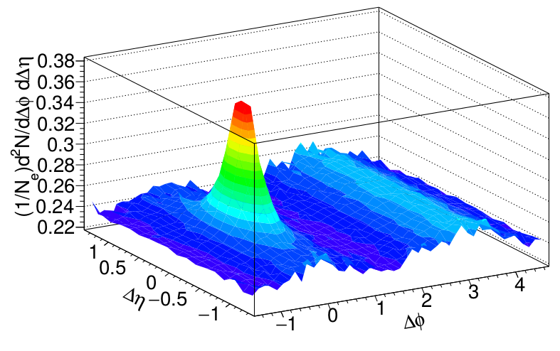
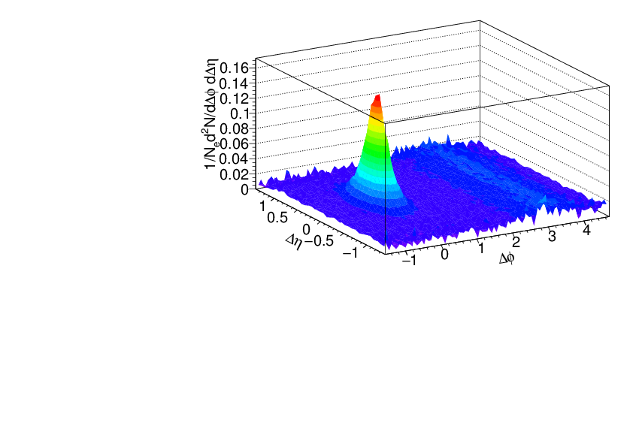
Separating signal+background
Signal+background
Signal only
h-h
√s_{NN} = 2.76 TeV
30-40% PbPb
8<p_{T}^{trigger}<10 GeV/c
1<p_{T}^{assoc}<2 GeV/c
Background dominated region

Slide 28
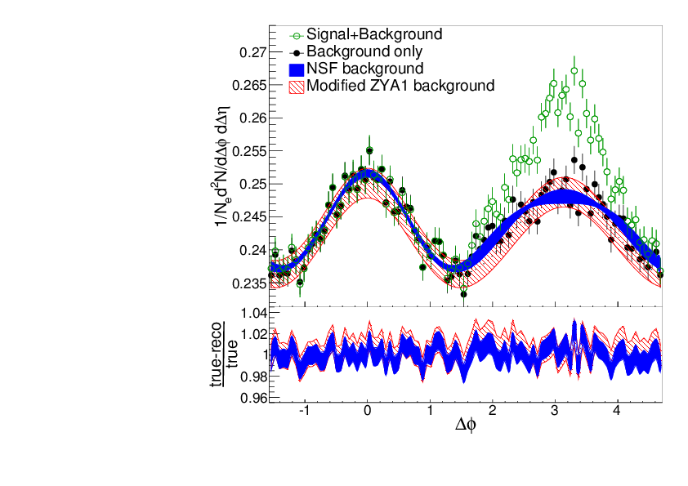
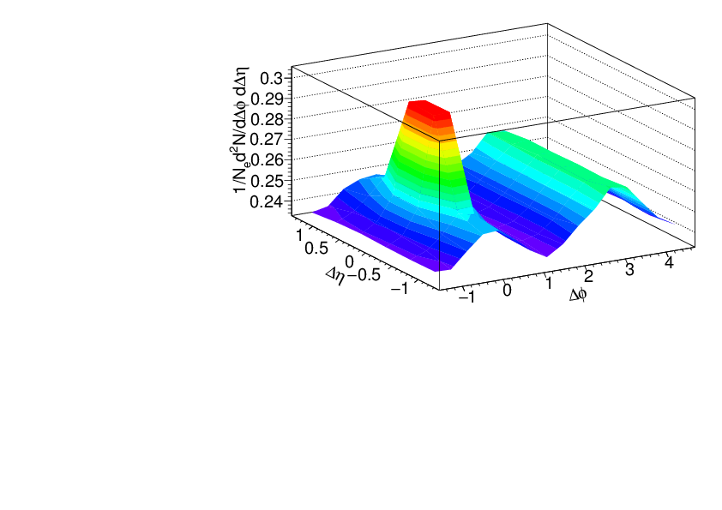





Background in correlations
Signal+background
h-h
√s_{NN} = 2.76 TeV
30-40% PbPb
8<p_{T}^{trigger}<10 GeV/c
1<p_{T}^{assoc}<2 GeV/c
Fit
extrapolation
Background dominated region
Fourier decomposition:

Slide 29


Reaction plane
Can reconstruct from outgoing particles
Changes background
Also changes path length traversed by a parton

Slide 30
Background in correlations
Signal+background
h-h
√s_{NN} = 2.76 TeV
30-40% PbPb
8<p_{T}^{trigger}<10 GeV/c
1<p_{T}^{assoc}<2 GeV/c
Fit
extrapolation
Background dominated region
Fourier decomposition:
Change with reaction plane

Slide 31
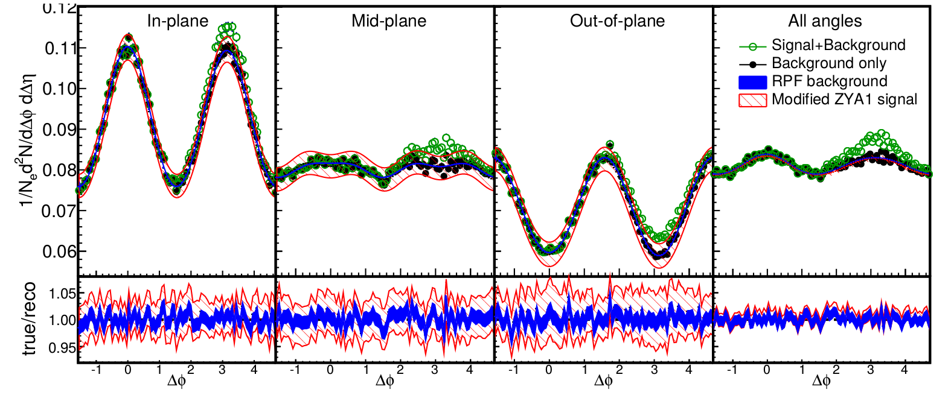
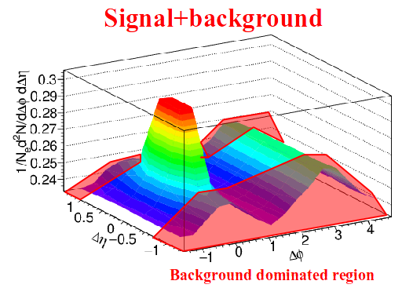
Reaction Plane Fit (RPF) method
30-40% central
h-h
√s_{NN} = 2.76 TeV
30-40% PbPb
8<p_{T}^{trigger}<10 GeV/c
1<p_{T}^{assoc}<2 GeV/c
Fit
Project signal+background over 1.0<|Δη|<1.4
Fit background in |Δφ|<1 including reaction plane dependence
v_{n} and B extracted with v_{n} up to n=4

Slide 32
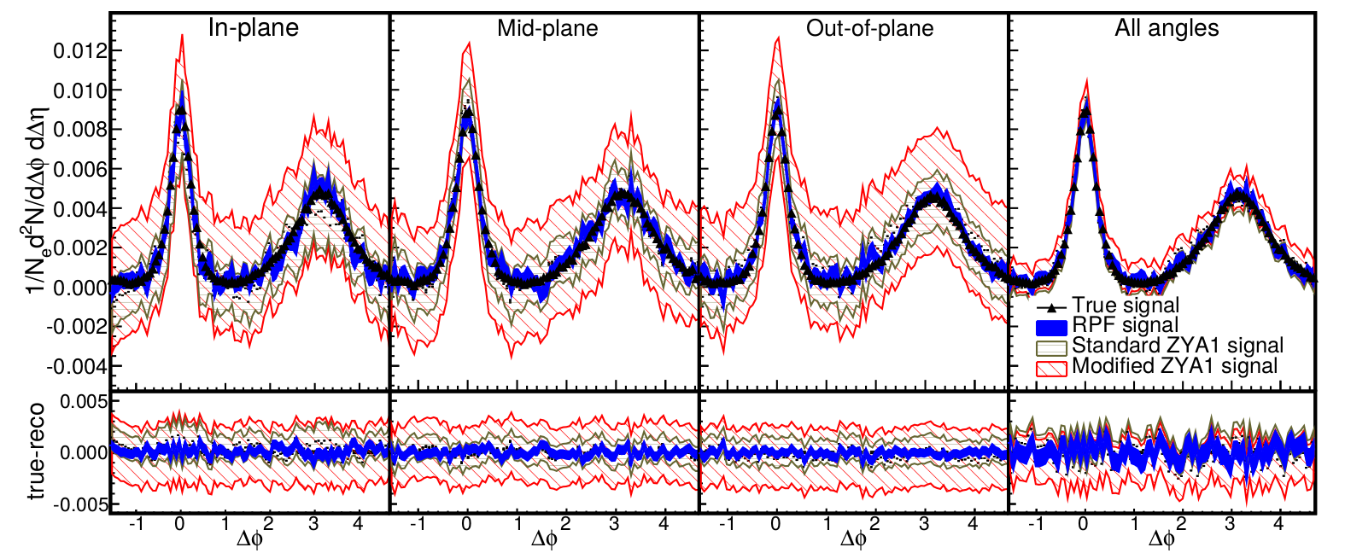
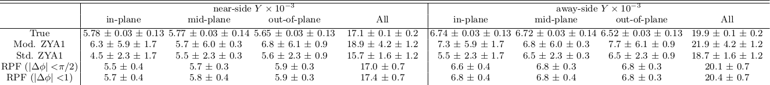
Reaction Plane Fit (RPF) method
30-40% central
h-h
√s_{NN} = 2.76 TeV
30-40% PbPb
8<p_{T}^{trigger}<10 GeV/c
1<p_{T}^{assoc}<2 GeV/c

Slide 33
Applying the method to data

Slide 34
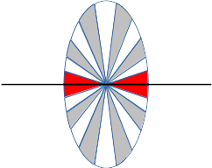
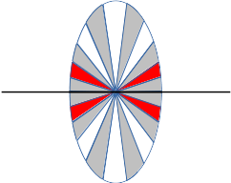
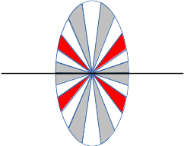
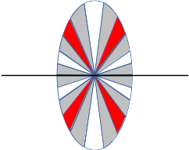
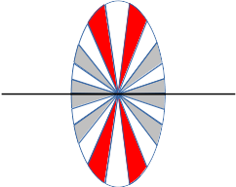
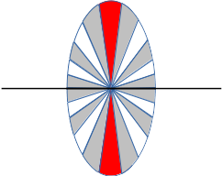
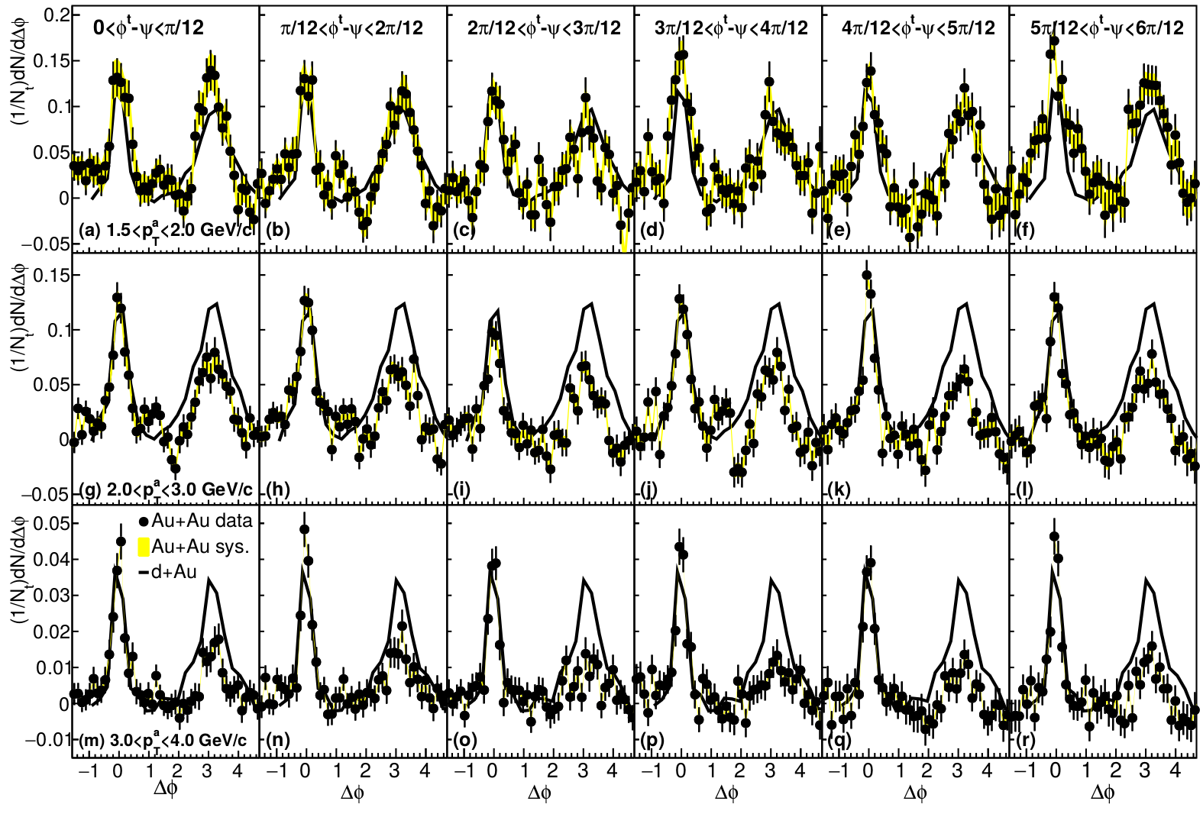
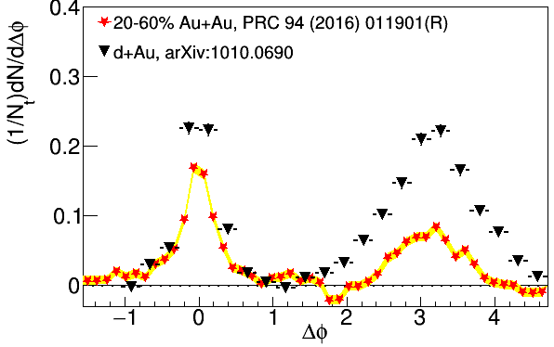
Dihadron correlations
4.0<p_{T}^{trig}<6.0 GeV/c
Phys.Rev.Lett.93:252301,2004
Phys. Rev. C 94, 011901(R) 2016
Nattrass, Sharma, Mazer, Stuart, Bejnood Phys. Rev. C 94, 011901(R) 2016

Slide 35
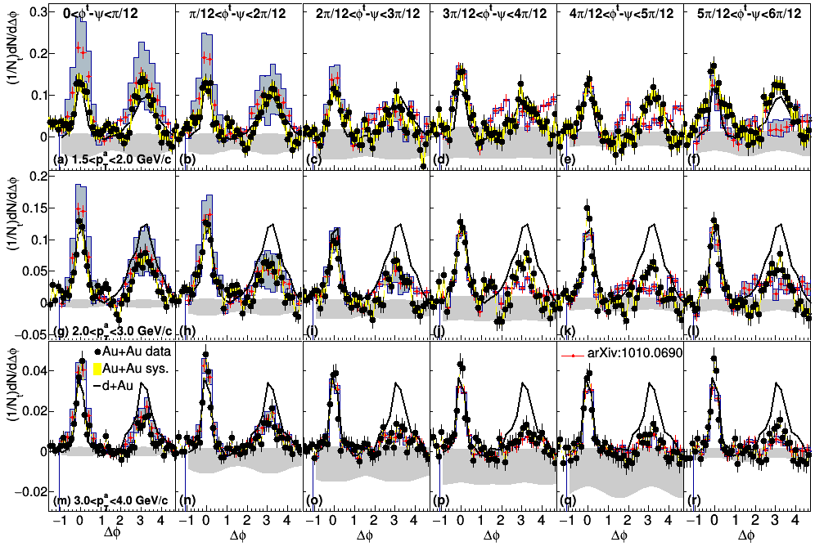
Dihadron correlations
4.0<p_{T}^{trig}<6.0 GeV/c
Nattrass, Sharma, Mazer, Stuart, Bejnood Phys. Rev. C 94, 011901(R) 2016

Slide 36
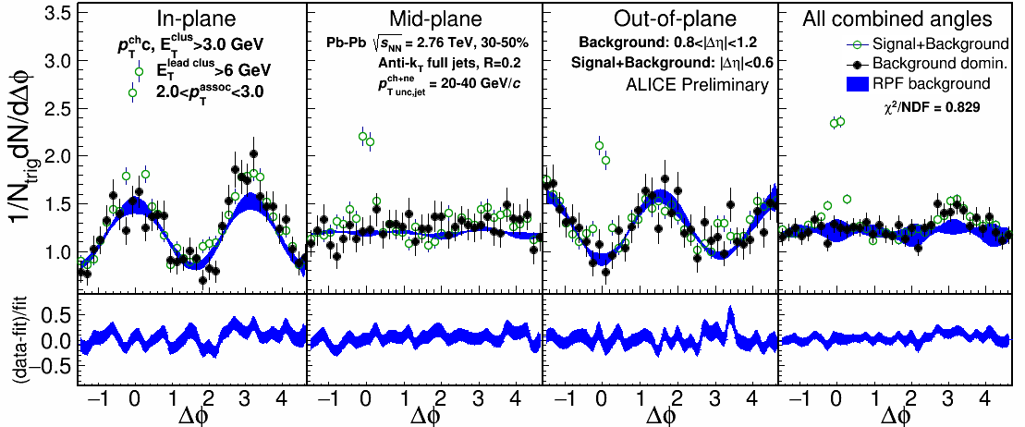
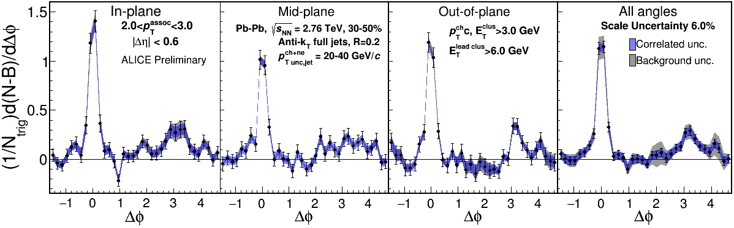
2.0-3.0 GeV/c
1) signal+bkgrd
2) bkgrd dominated
3) bkgrd RPF fit
Correlation function
Joel Mazer
Quark Matter 2017
Away side clearly there and suppressed

Slide 37





Jet-hadron correlations vs reaction plane
Full jets
1) signal+bkgd
2) bkgd dominated
3) bkgd RPF fit
Trigger
Associated
No modification of constituents relative to reaction plane
→ Jet-by-jet fluctuations more important than path length [PLB 735 157(2014)]
  Also needed to explain high p_{T} v₂ [PRL 116 252301 (2016)]

Slide 38


Conclusions
If we get nuclear matter dense enough, we make a new phase of matter, which we produce in high energy heavy ion collisions.
This medium is opaque to colored probes and translucent to electromagnetic probes.
We see little path length dependence in the modifications to these probes.

Slide 39
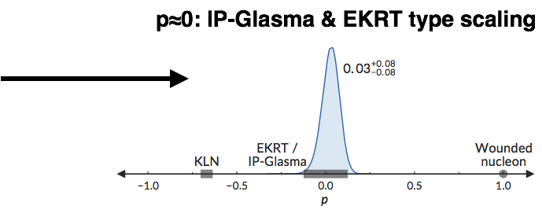
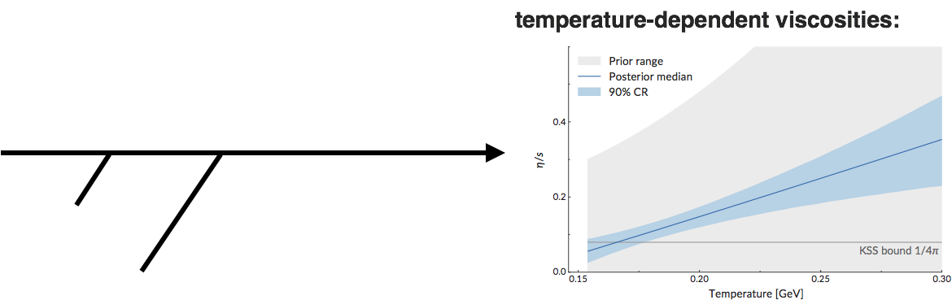
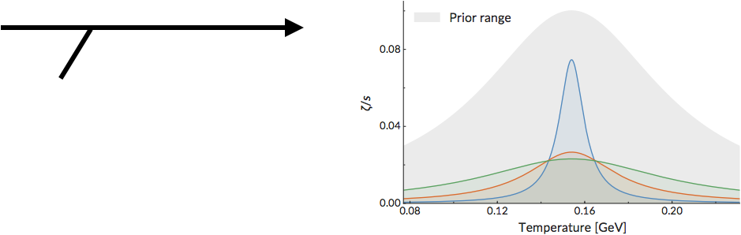
Next step: global fits of models to wide array of heavy ion collision data
Global Bayesian Analysis; S. Bass, Quark Matter 2017
MADAI collaboration
Parton distributions in projectiles
(density, correlations, fluctuations)
diagonals: probability distribution of each parameter, integrating out all others
off-diagonals: pairwise distributions showing dependence between parameters
Equilibration dynamics
Shear viscosity
Bulk viscosity
Tsw⩽Tc
β
arXiv:1706.03666, Phys. Rev. C 94, 024907 (2016)
Notes:
<number>

Slide 40
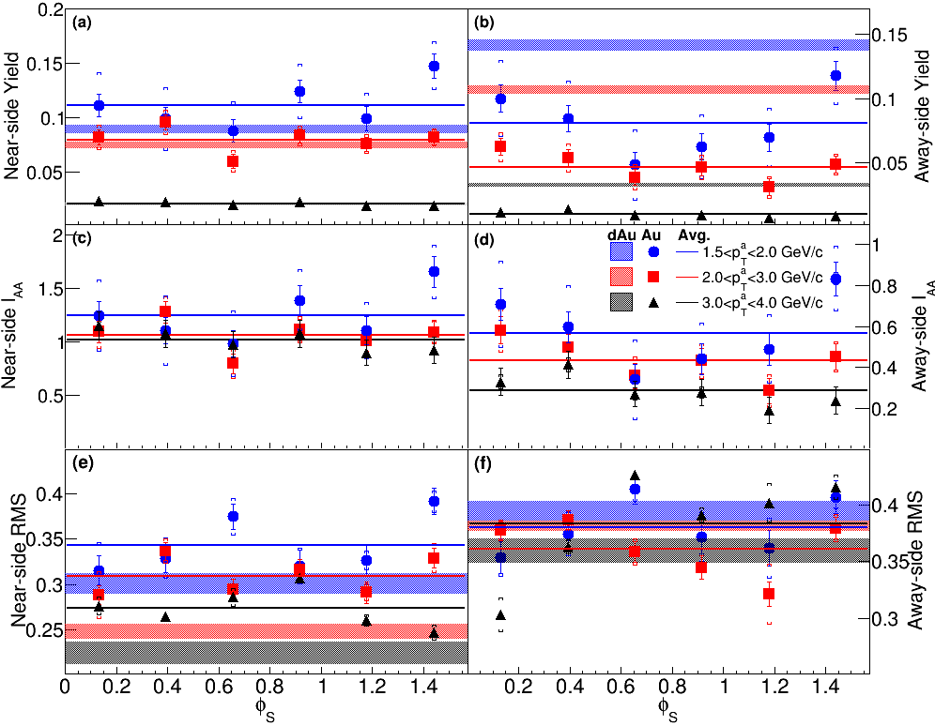
Dihadron correlations
Phys. Rev. C 94, 011901(R) 2016

Slide 41
Comparison of colliders
 | RHIC | LHC
√s_{NN} (GeV) | 9-200 | 2760, 5500 | center of mass energy
dN_{ch}/dη | ~1200 | ~1600 | number of particles
T/T_{c} | 1.9 | 3.0-4.2 | temperature
ε (GeV/fm³) | 5 | 12, 16 | energy density
τ_{QGP} (fm/c) | 2-4 | >10 | lifetime of QGP
RHIC and LHC:
Cover 2 –3 decades of energy (√s_{NN}= 9 GeV –5 TeV)
To discover the properties of hot nuclear matter at T ~ 150 –600 MeV

Slide 42
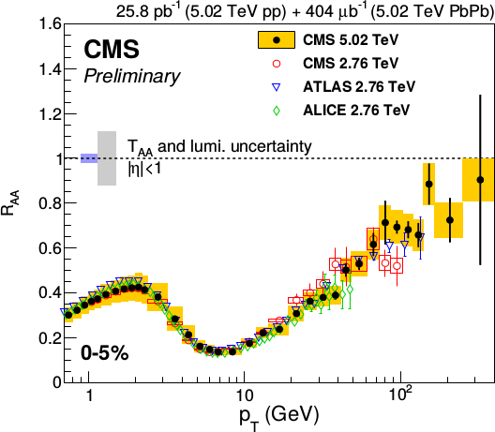
Nuclear modification factor R_{AA}
Single particles at the LHC
Reaches 1 at very high p_{T}
Must happen due to causality
Feature of all QCD-inspired models

Slide 43
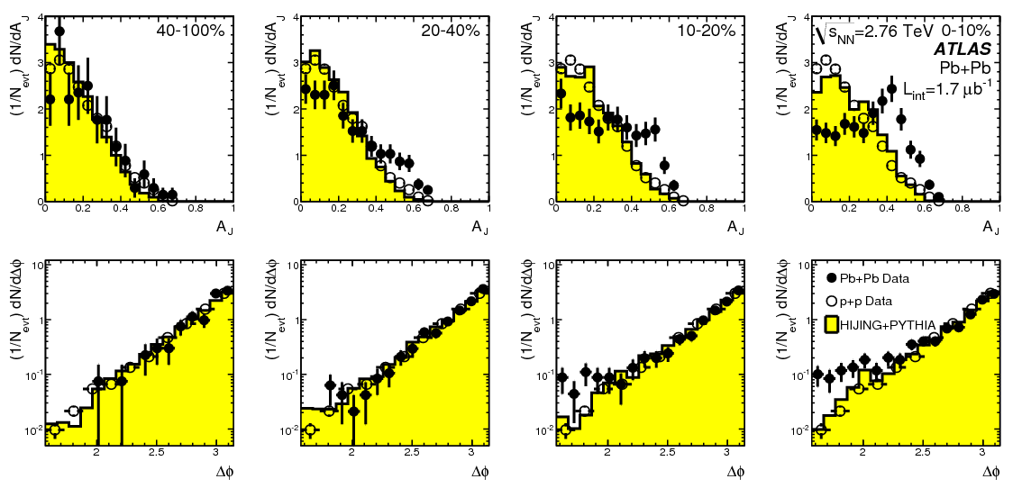
Di-jet asymmetry
PRL 105 (2010) 252303

Slide 44

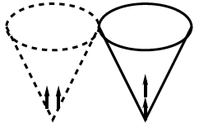
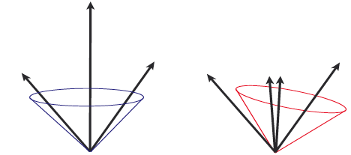
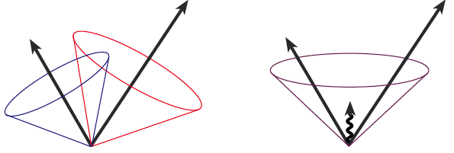
Jets in principle
Jet measures partons
Hadronic degrees of freedom are integrated out
Algorithms are infrared and colinear safe
OK
BAD: 2 jets are merged in one

Slide 45
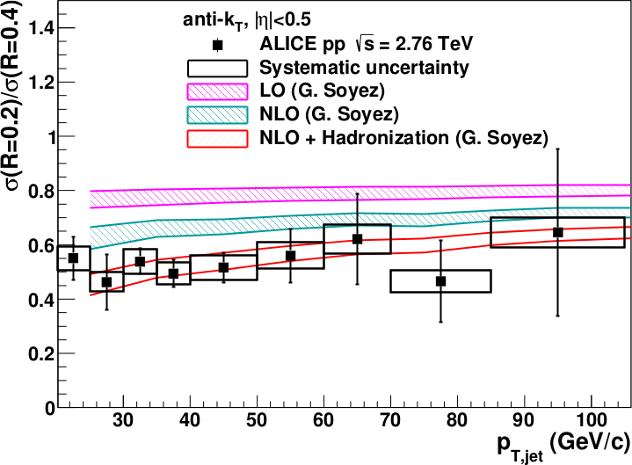
<footer>
Full jet ratios in pp
√s = 2.76 TeV, R = 0.2, 0.4 Inclusive
arXiv:1301.3475
PLB: 10.1016/j.physletb.2013.04.026
Hadronization is important even in pp collisions!
Notes:
----- Meeting Notes (6/24/13 16:47) -----
PRB -> PLB
mention ratio
<number>

Slide 46

Jet finding algorithms
Tracks
Jet finding algorithm
Jet candidates
Clusters
Particles
Any list of objects works as input
Use the same algorithm on theory & experiment
Output only as good as input
M. Cacciari, G. P. Salam, G.Soyez, JHEP 0804:063,2008

Slide 47
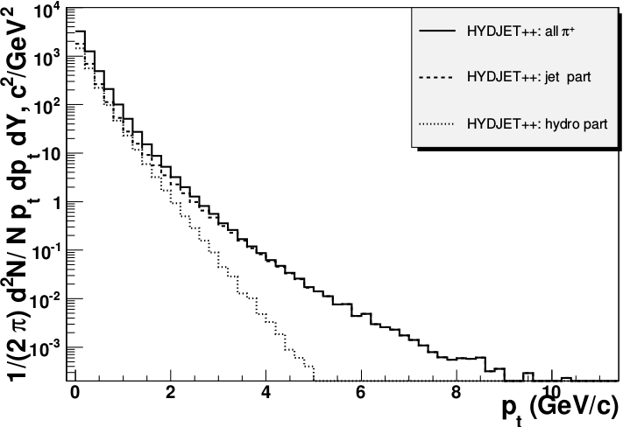
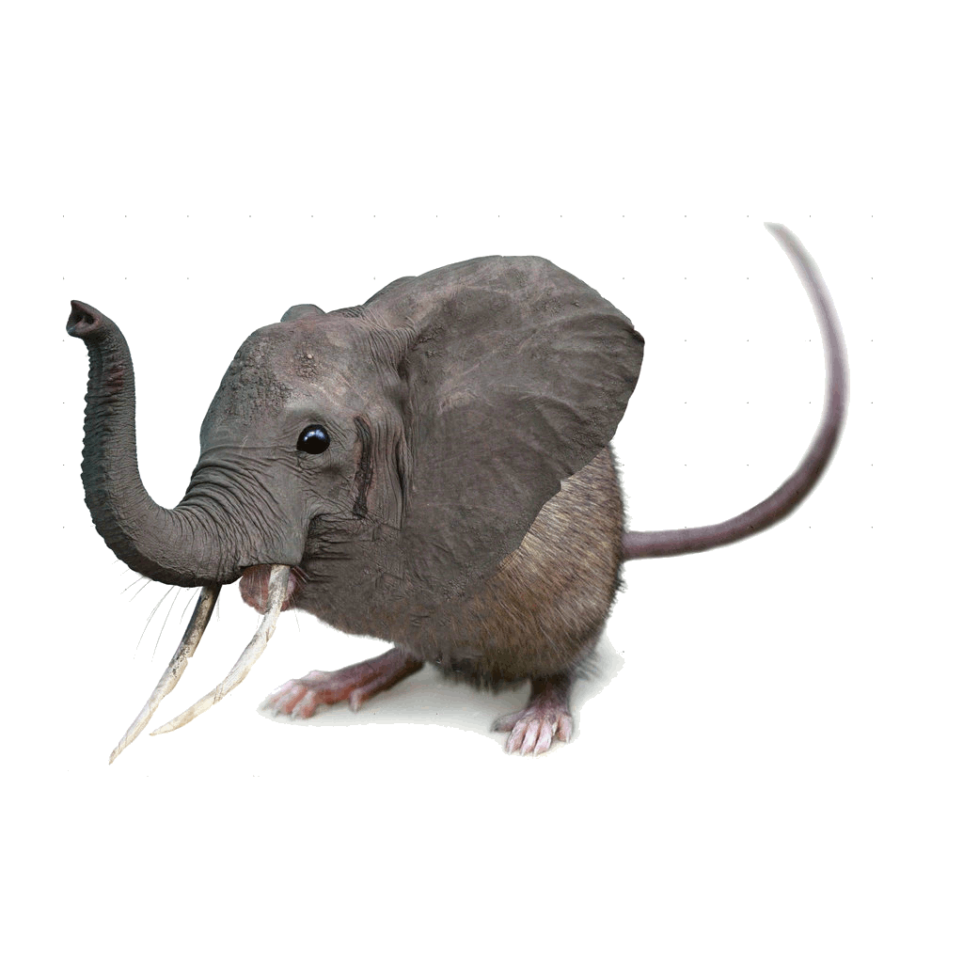
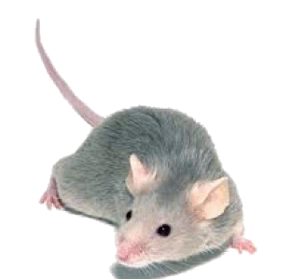

Focus on high p_{T}
Pros:
  Reduces combinatorial background
Cons:
  Cuts signal where we expect modifications
  Could bias towards partons which have not interacted
  Biases sample towards quarks
PoS High-pTphysics09:023,2009

Slide 48
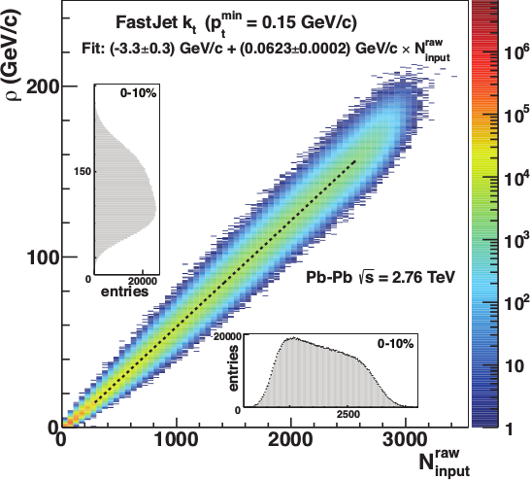
Focus on smaller angles
Pros
  Background is smaller
  Background fluctuations smaller
Cons:
  Modifications expected at higher R
  Biases sample towards quarks
JHEP 03 (2012) 053

Slide 49

<footer>
ALICE/STAR
Combinatorial “jets”
Estimate combinatorial jet contributions and its fluctuations from data
Require leading track p_{T} > 5 GeV/c
  Suppresses combinatorial “jets”
  Biases fragmentation
No threshold on constituents
Limited to small R
Measured spectra:
Full jets
Where
comes from FastJet anti-k_{T} algorithm
Notes:
<number>

Slide 50

ATLAS
Constituent biases don't matter that much up here
Iterative procedure
  Calorimeter jets: Reconstruct jets with R=0.2. v₂ modulated <Bkgd> estimated by energy in calorimeters excluding jets with at least one tower with
  E_{tower} > <E_{tower}>
  Track jets: Use tracks with p_{T}>4 GeV/c
  Calorimeter jets from above with E>25 GeV and track jets with p_{T}>10 GeV/c used to estimate background again.
Calorimeter tracks matching one track with p_{T}>7 GeV/c or containing a high energy cluster E >7 GeV are used for analysis down to E_{jet} = 20 GeV
But they do matter down here!
Definitely imposes a bias, especially at 20 GeV!
We should treat that bias as a tool, not a handicap
Phys. Lett. B 719 (2013) 220-241

Slide 51
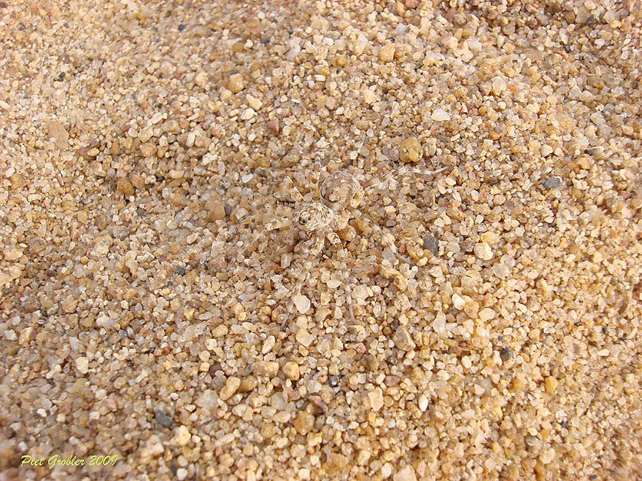
http://www.boredpanda.com/animal-camouflage/

Slide 52
Bias
Modified jets probably look more like the medium
Quark jets are narrower, have fewer tracks, fragment harder [Z Phys C 68, 179-201 (1995), Z Phys C 70, 179-196 (1996), ]
Gluon jets reconstructed with k_{T} algorithm have more particles than jets reconstructed with anti-k_{T} algorithm [Phys. Rev. D 45, 1448 (1992)]
Gluon jets fragment into more baryons [EPJC 8, 241-254, 1998]
http://www.boredpanda.com/animal-camouflage/

Slide 53
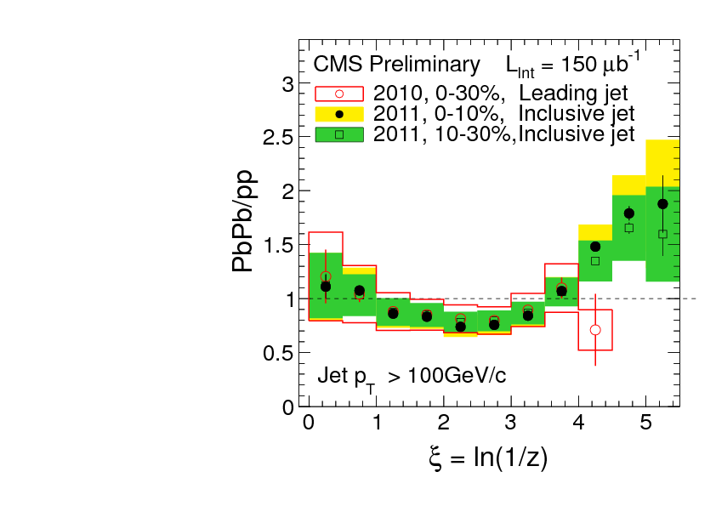
What you see depends on where you look
Phys. Rev. C 90, 024908 (2014)
JHEP10(2012)087
z = p_{T}/E_{jet}
Low p_{T}
High p_{T}
Low p_{T}
Low p_{T}
Low p_{T}
Low p_{T}
High p_{T}
Low p_{T}
High p_{T}
High p_{T}
High p_{T}

Slide 54
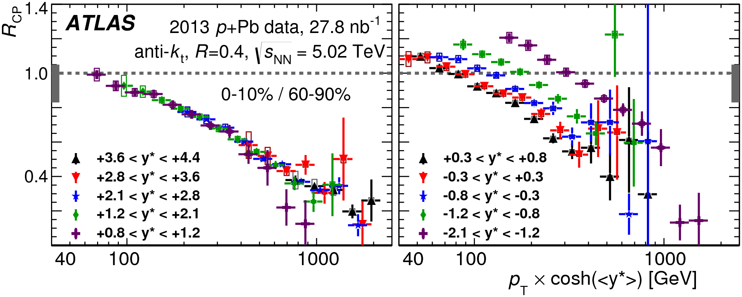
Cold Nuclear Matter effects
PLB 748 (2015) 392-413
No indication of modified jet structure in cold nuclear matter (d+Au and p+Pb collisions)
[Phys.Rev.C73:054903,2006, Phys.Rev.Lett.96:222301,2006]
Minimum bias R_{pPb}, R_{dAu} for charged particles, jets consistent with 1 [Phys.Rev.Lett.98:172302,2007,Phys.Rev.C81:064904,2010,Phys. Rev. Lett. 110 (2013) 082302, arXiv:1605.06436]
Indications of modification at forward rapidities from dihadron correlations
[Phys. Rev. Lett. 107, 172301 (2011)]
Centrality dependence observed
[PLB 748 (2015) 392-413, Phys. Rev. Lett. 116, 122301 (2016)]

Slide 55
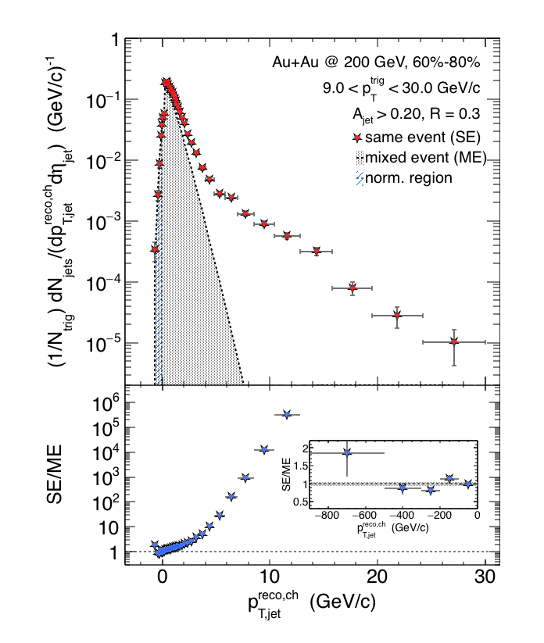

Charged Raw Recoil Jet Spectrum: Reference
Event mixing
Peripheral
Reference spectrum:
peripheral collisions
Much less combinatorial
background compared to
most central data
Excellent signal/background
ratio down to 3 GeV/c
Preliminary
Requires normalization at low p_{T}
All physical correlations treated like jets
Alex Schmah, Hard Probes 2015
06/29/2015
Alexander Schmah - Hard Probes 2015
<number>

Slide 56
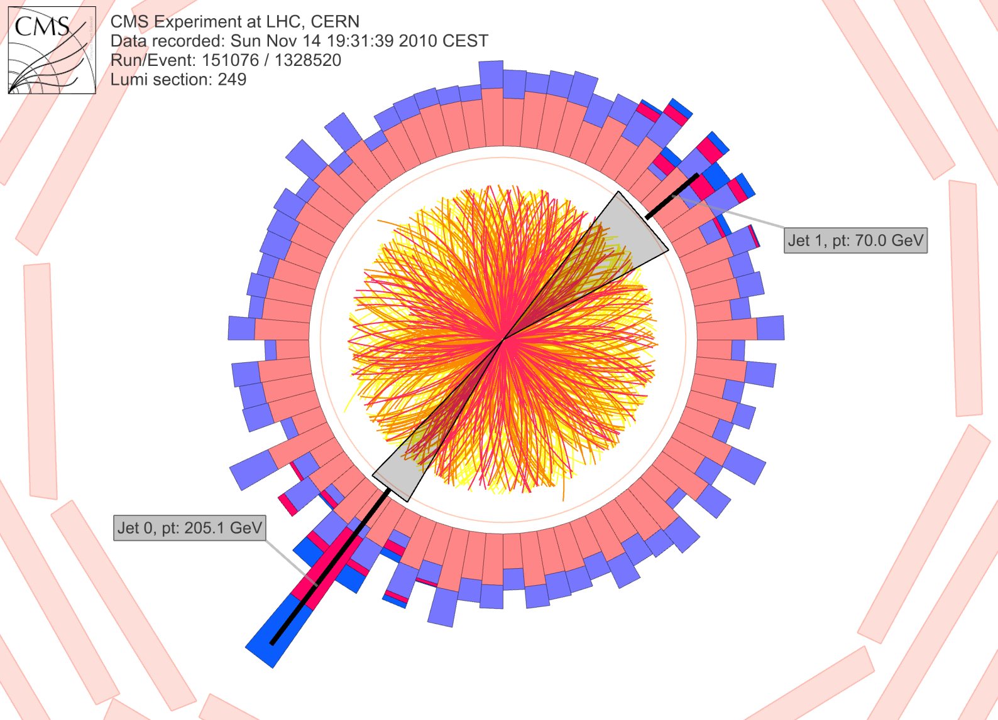
CMS: Iterative Pile-Up Event Background Subtraction
Background is estimated
for each calorimeter ring of constant η
subtracted before jet finding
re-iterated after excluding the jets found in the first iteration
Fake Jets: After the background subtraction, some local fluctuations remain!
Fluctuations will deteriorate the jet resolution in central events.
Sevil Salur
<number>

Slide 57
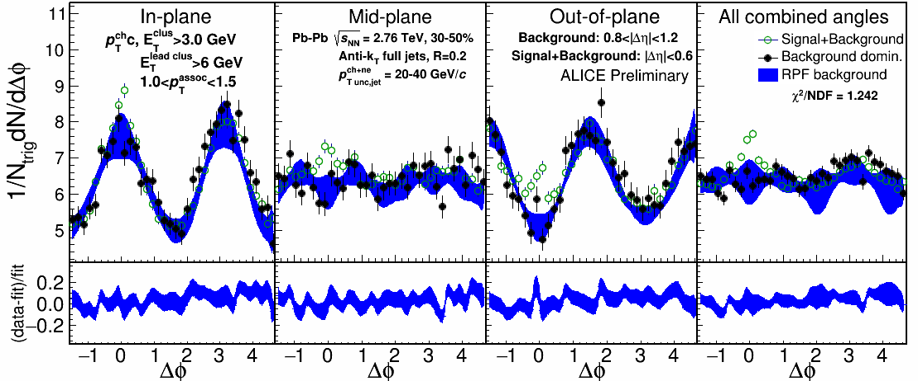
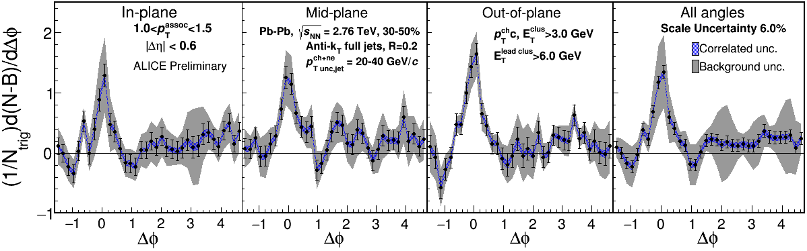
1.0-1.5 GeV/c
1) signal+bkgrd
2) bkgrd dominated
3) bkgrd RPF fit
Correlation function
Uncertainties dominated by statistics
Background uncertainty is non-trivially correlated point-to-point

Slide 58


1.5-2.0 GeV/c
1) signal+bkgrd
2) bkgrd dominated
3) bkgrd RPF fit
Correlation function
v₃ and v₄ components important
Background uncertainty is non-trivially correlated point-to-point

Slide 59


4.0-5.0 GeV/c
1) signal+bkgrd
2) bkgrd dominated
3) bkgrd RPF fit
Correlation function
Background level negligible

Slide 60

Near-side jet yields vs EP
Jets 20-40 GeV/c, 30-50% centrality
Within uncertainties of
current statistics, no
event plane ordering
Different effects in
different p_{T} associated
bins
Competing effects
1) Quenching
2) Bremsstrahlung
3) etc

Slide 61

Di-jet asymmetry
Kolja Kauder, RHIC/AGS User's Meeting 2016
arXiv:1609.03878
Au+Au di-jets more imbalanced than p+p for pTcut>2 GeV/c
Au+Au AJ ~ p+p AJ for matched di-jets (R=0.4)

Slide 62

Fragmentation functions
z = p_{T}/E_{jet}
CMS
PRC 90 (2014) 024908
High p_{T}
Low p_{T}

Slide 63
Reaction plane fit (RPF) method
TOY MODEL
Signal is negligible at large Δη and small ΔΦ region.
NSF method
h-h
√s_{NN} = 2.76 TeV
30-40% PbPb
8<p_{T}^{trigger}<10 GeV/c
1<p_{T}^{assoc}<2 GeV/c
Fit
extrapolation
Project signal+background over 0.8 < |Δη| < 1.2
Fit background in |Δφ| < π/2
Fitting till 4th order v_{n} term, total 6 fit parameters: B, v₂^{assoc}, v₂^{trig}, v₃^{assoc}×v₃^{trig}, v₄^{assoc}, and v₄^{trig}
Sharma, Mazer, Stuart, Nattrass: (Phys. Rev. C 93, 044915 2016)
Nattrass, Sharma, Mazer, Stuart, and Bejnood: (Phys. Rev. C 94, 011901(R) 2016)

Slide 64
Reaction plane fit (RPF) method
30-40% central (simulation)
TOY MODEL
Each orientation has different functional form, but require same parameters
More robust method, now have a higher constrained background
with more information going into fit
h-h
√s_{NN} = 2.76 TeV
30-40% PbPb
8<p_{T}^{trigger}<10 GeV/c
1<p_{T}^{assoc}<2 GeV/c
Fit
Project signal+background over 0.8<|Δη|<1.2
v_{n} and B extracted
Fewer assumptions and bias than ZYAM while having much smaller errors

Slide 65

Background in correlations
All reaction plane angles
When trigger is restricted relative to reaction plane
  Background level modified
  Effective v_{n} modified
φ_{S} is the angular threshold
Phys.Rev. C69 (2004) 021901 arXiv:nucl-ex/0311007

Slide 66


Thermal photons
Phys.Rev.Lett.104:132301,2010
Thermal photons
PHENIX
QCD processes
ALICE
Au+Au collisions at √s_{NN}=200 GeV
Inverse slope: T = 221 +/- 19 (stat) +/- 19 (syst) MeV
Pb+Pb collisions at √s_{NN}=2.76 TeV
Inverse slope: T = 304 +/-51 MeV

Slide 67





A quarkonium-thermometer
CMS-PAS HIN-11-011
arXiv:1708.04962 [nucl-ex]
N_{part}
Clear hierarchy in R_{AA} of different quarkonium states
c
c
b
b

Slide 68

A quarkonium-thermometer
CMS-PAS HIN-11-011
arXiv:1708.04962 [nucl-ex]
Note: 6.5<p_{T}<30 GeV for J/ψ and ψ(2s)
N_{part}
Clear hierarchy in R_{AA} of different quarkonium states
Expected in terms of binding energy
CMS-PAS HIN-12-014, HIN-12-007

Slide 69

~600
trajectory of system
arXiv:1701.07065

