Slide 1
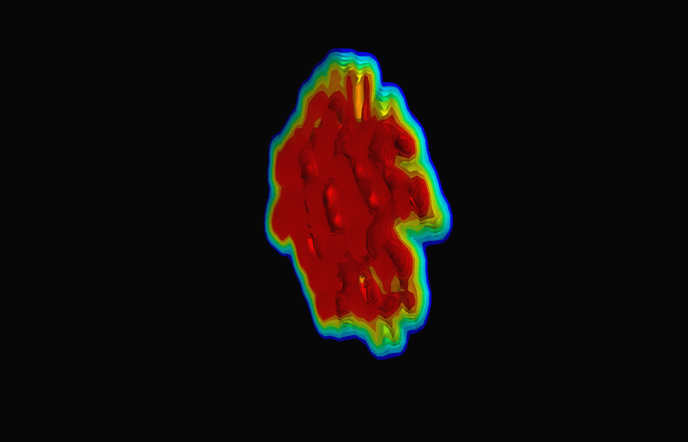
Image from arXiv:1009.3244
Quantifying properties of liquid nuclei
Christine Nattrass, University of Tennessee, Knoxville

Slide 2



QCD Phase Diagram
Quark Gluon Plasma
Hadron Gas
Phys. Rev. C 96, 044904 (2017)
Notes:
But wait – how can we have a liquid of quarks and gluons? Doesn't asymptotic freedom tell us that we can't have free quarks and gluons? How, then, can we have a liquid of quarks and gluons?

Slide 3

How to make a Quark Gluon Plasma

Slide 4



The phase transition in the laboratory
QGP
Freeze-out
Initial
State
Hydrodynamical flow
Jet quenching
  K, O’Hara, S. Hemmer, M. Gehm, S. Granade, J. Thomas Science 298 2179 (2002)
https://physics.aps.org/articles/v7/97

Slide 5















Relativistic Heavy Ion Collider
Large Hadron Collider
PHOBOS
BRAHMS
CMS
LHC
PHENIX
STAR
RHIC
LHCb
RHIC
ALICE
ATLAS
LHCf
Upton, NY
1.2km diameter
p+p, d+Au, Cu+Cu, Au+Au, U+U
√sNN = 9 - 200 GeV
Geneva, Switzerland
8.6km diameter
p+p, p+Pb, Pb+Pb
√sNN = 2.76 GeV, 5.5 TeV
Notes:
Mention that RHIC planning began 1983

Slide 6




Size: 16 x 26 meters
Weight: 10,000 tons
Detectors: 18
Trigger detectors: When do we have a collision?
Tracking detectors: Where did the particle go?
Identification detectors: What kind of particle is it?
Calorimeters: How much energy does the particle have?
<number>
Notes:
By comparison ATLAS is 25 meters in diameter and 44 meters long – not quite twice as large

Slide 7
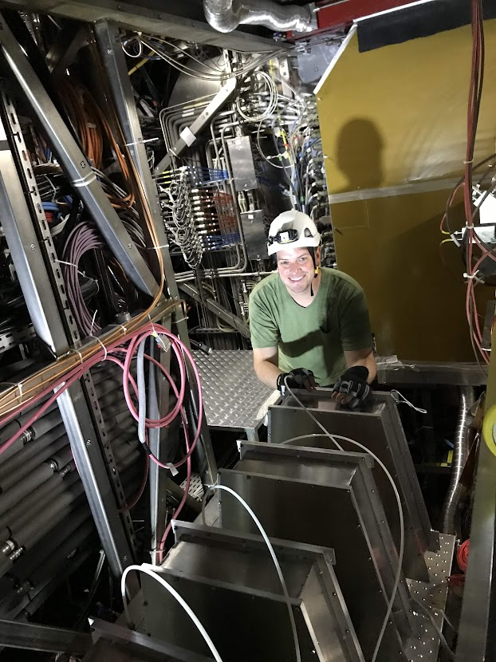
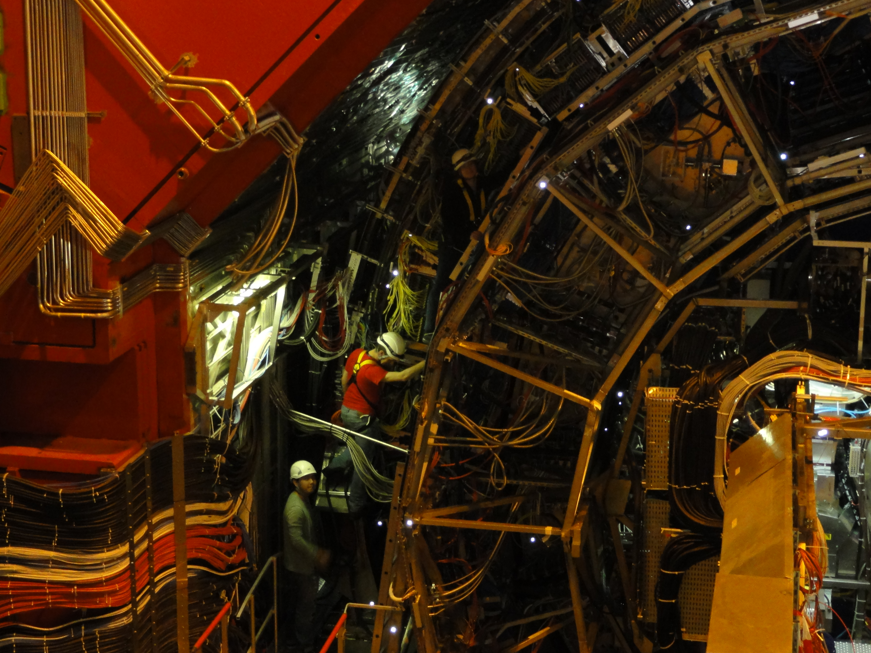
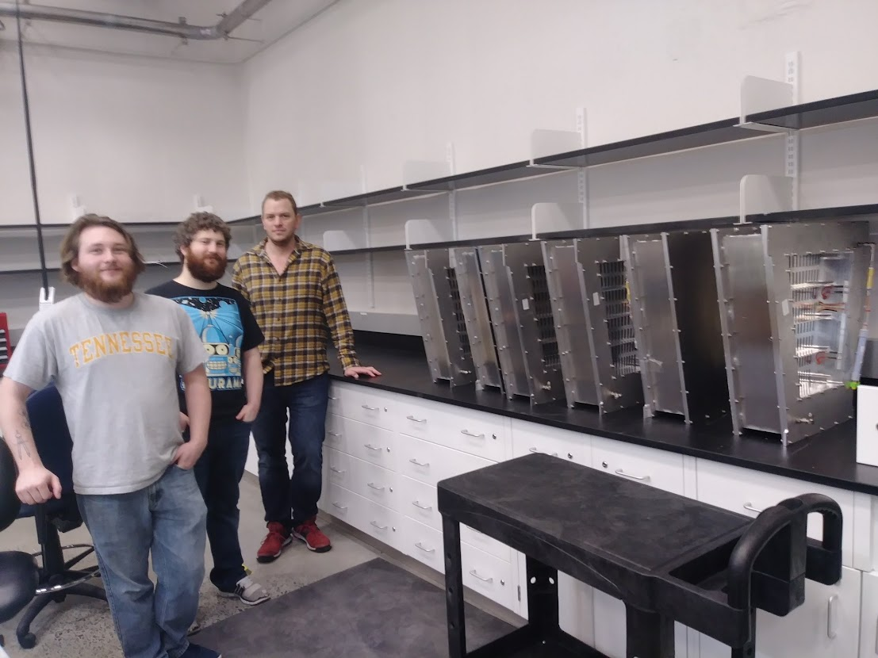

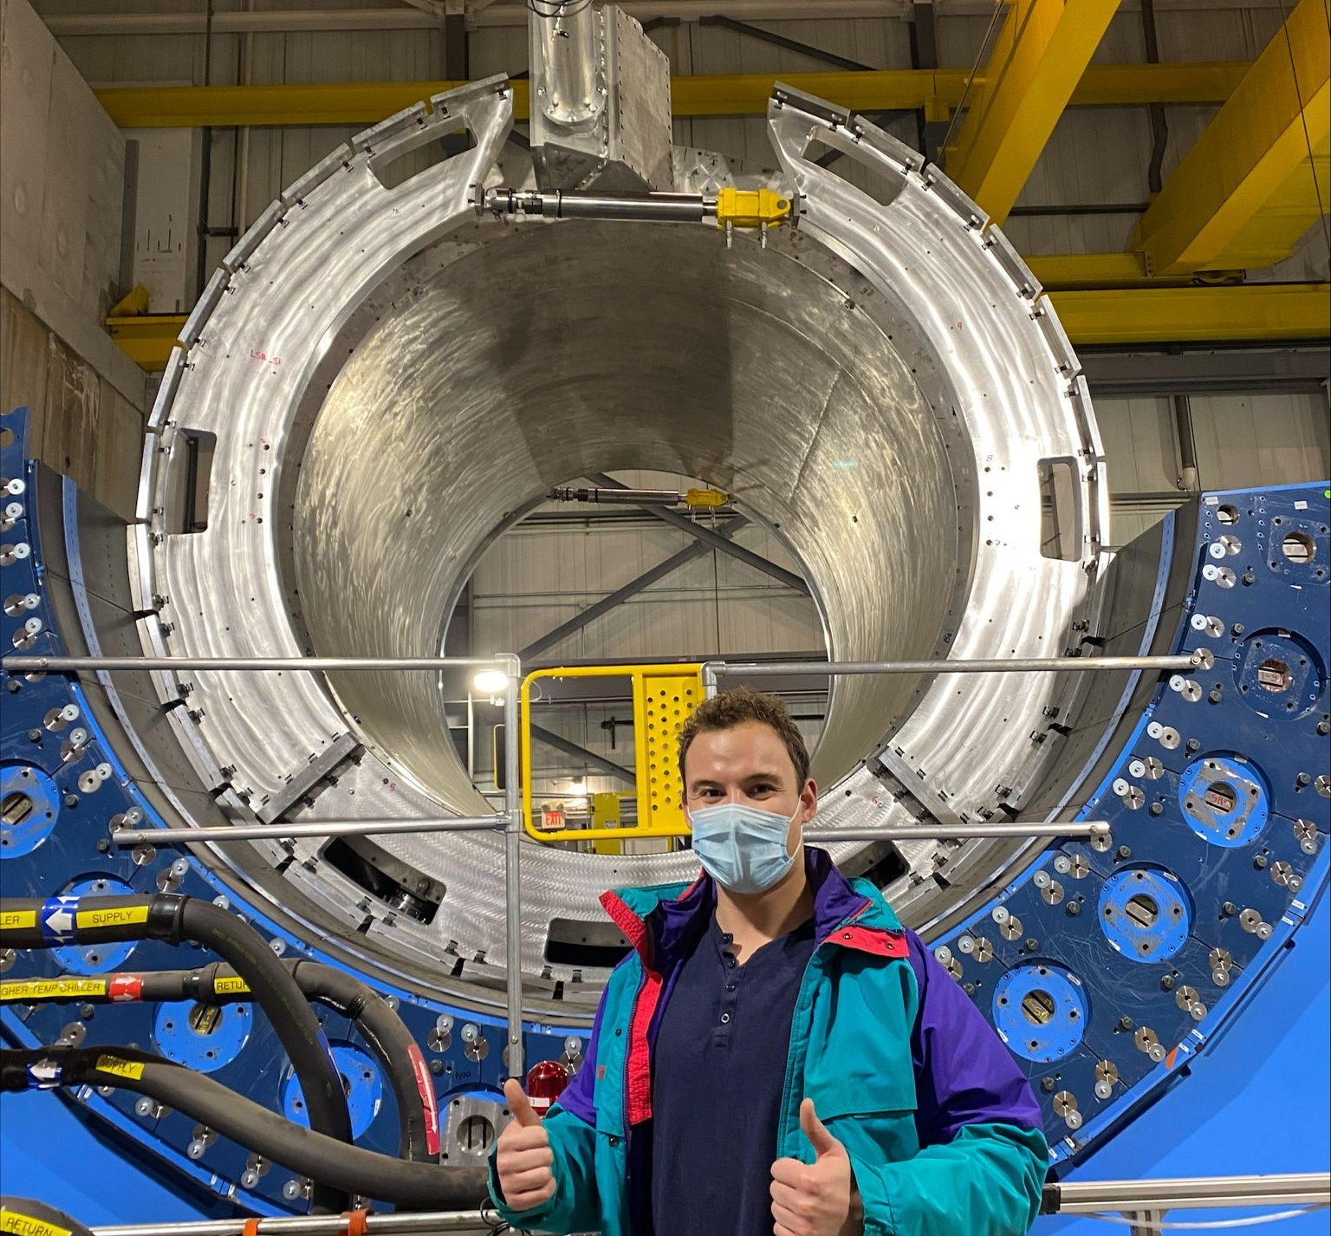

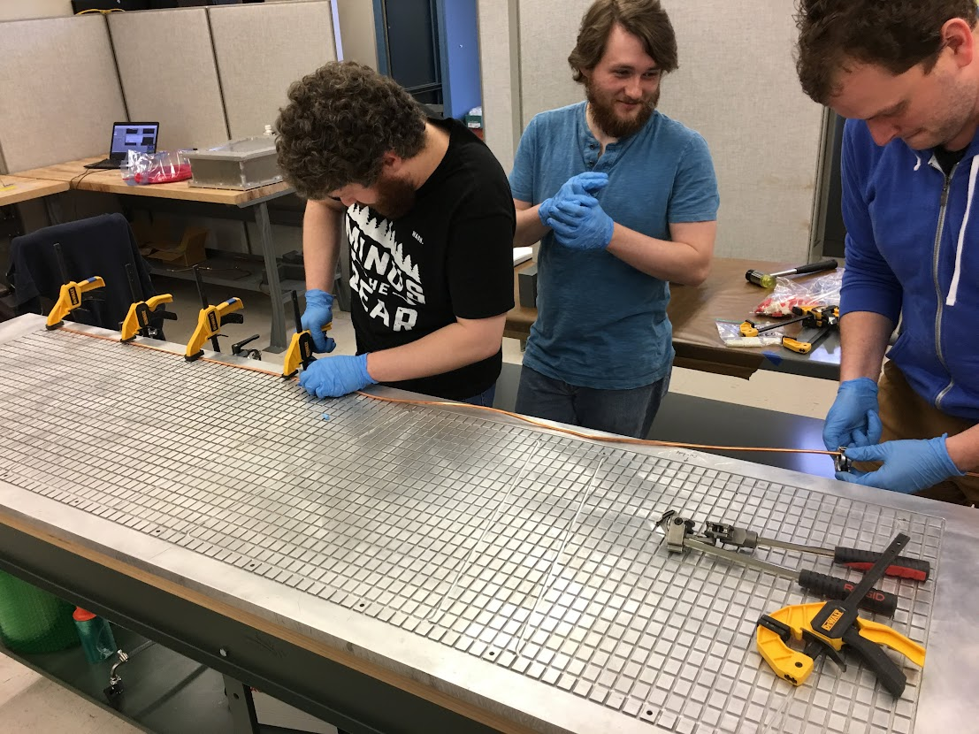
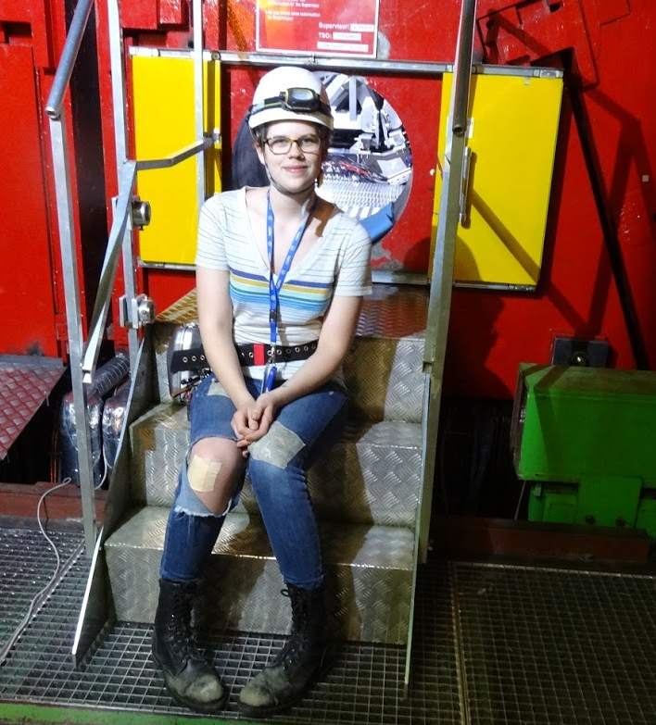
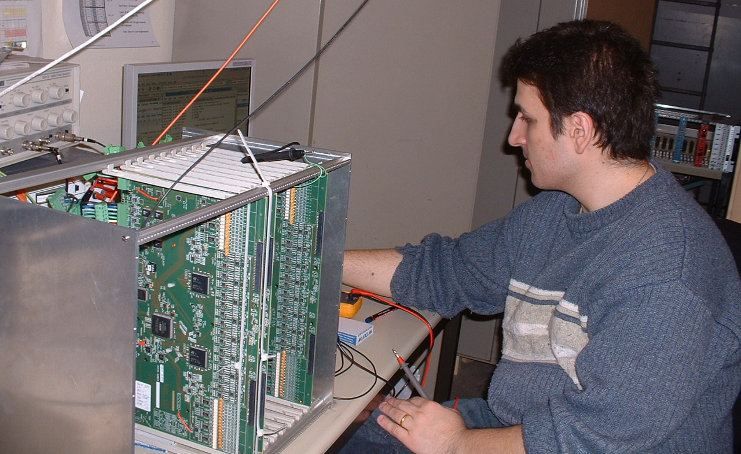
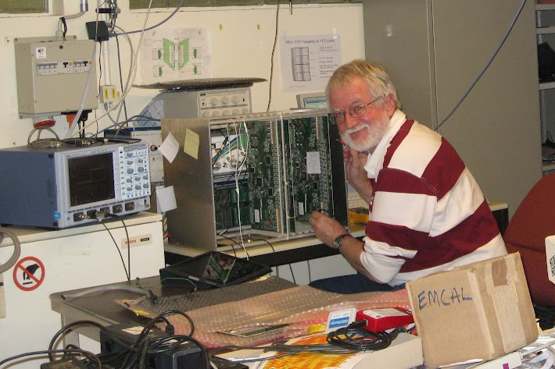

Slide 8

p+p collisions
3D image of each collision

Slide 9

Pb+Pb collisions
5

Slide 10
Probing the Quark Gluon Plasma
Medium
Probe
Detector
Want a probe which traveled through the collision
QGP is very short-lived (~1-10 fm/c) →
cannot use an external probe

Slide 11


Probes of the Quark Gluon Plasma
nucleus
nucleus
Want a probe which traveled through the medium
QGP is short lived → need a probe created in the collision

Slide 12
Probes of the Quark Gluon Plasma
nucleus
nucleus
Want a probe which traveled through the medium
QGP is short lived → need a probe created in the collision
We expect the medium to be dense → absorb/modify probe

Slide 13


Nuclear modification factor
Measure spectra of probe (jets) and compare to those in p+p collisions or peripheral A+A collisions
If high-pT probes (jets) are suppressed, this is evidence of jet quenching
Enhancement
Suppression

Slide 14

Nuclear modification factor
LHCb-PAPER-2017-015
Control
Control
Probe

Slide 15
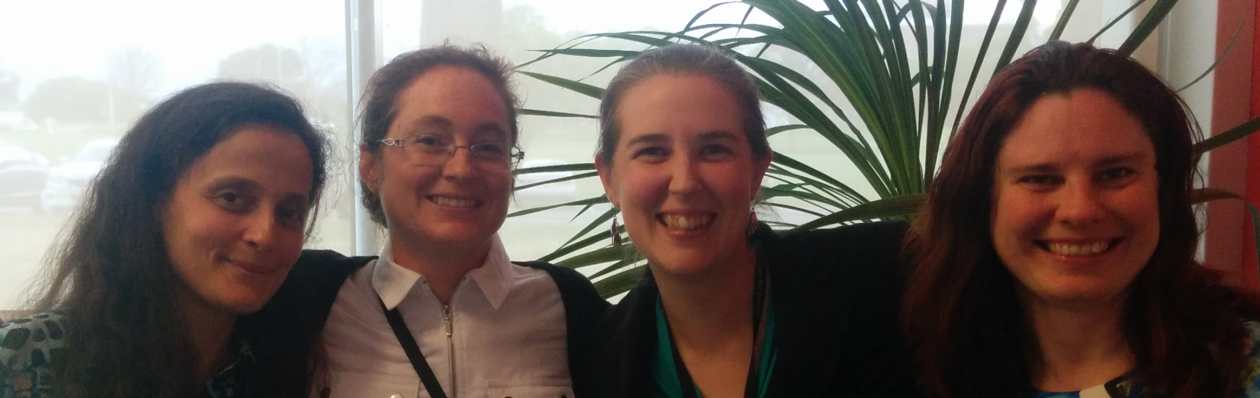


Nuclear modification factor RAA
Connors, Nattrass, Reed, Salur” Rev. Mod. Phys. 90, 025005 (2018).
LHC
RHIC
Electromagnetic probes – consistent with no modification – medium is transparent to them
Strong probes – significant suppression – medium is opaque to them - even heavy quarks!

Slide 16
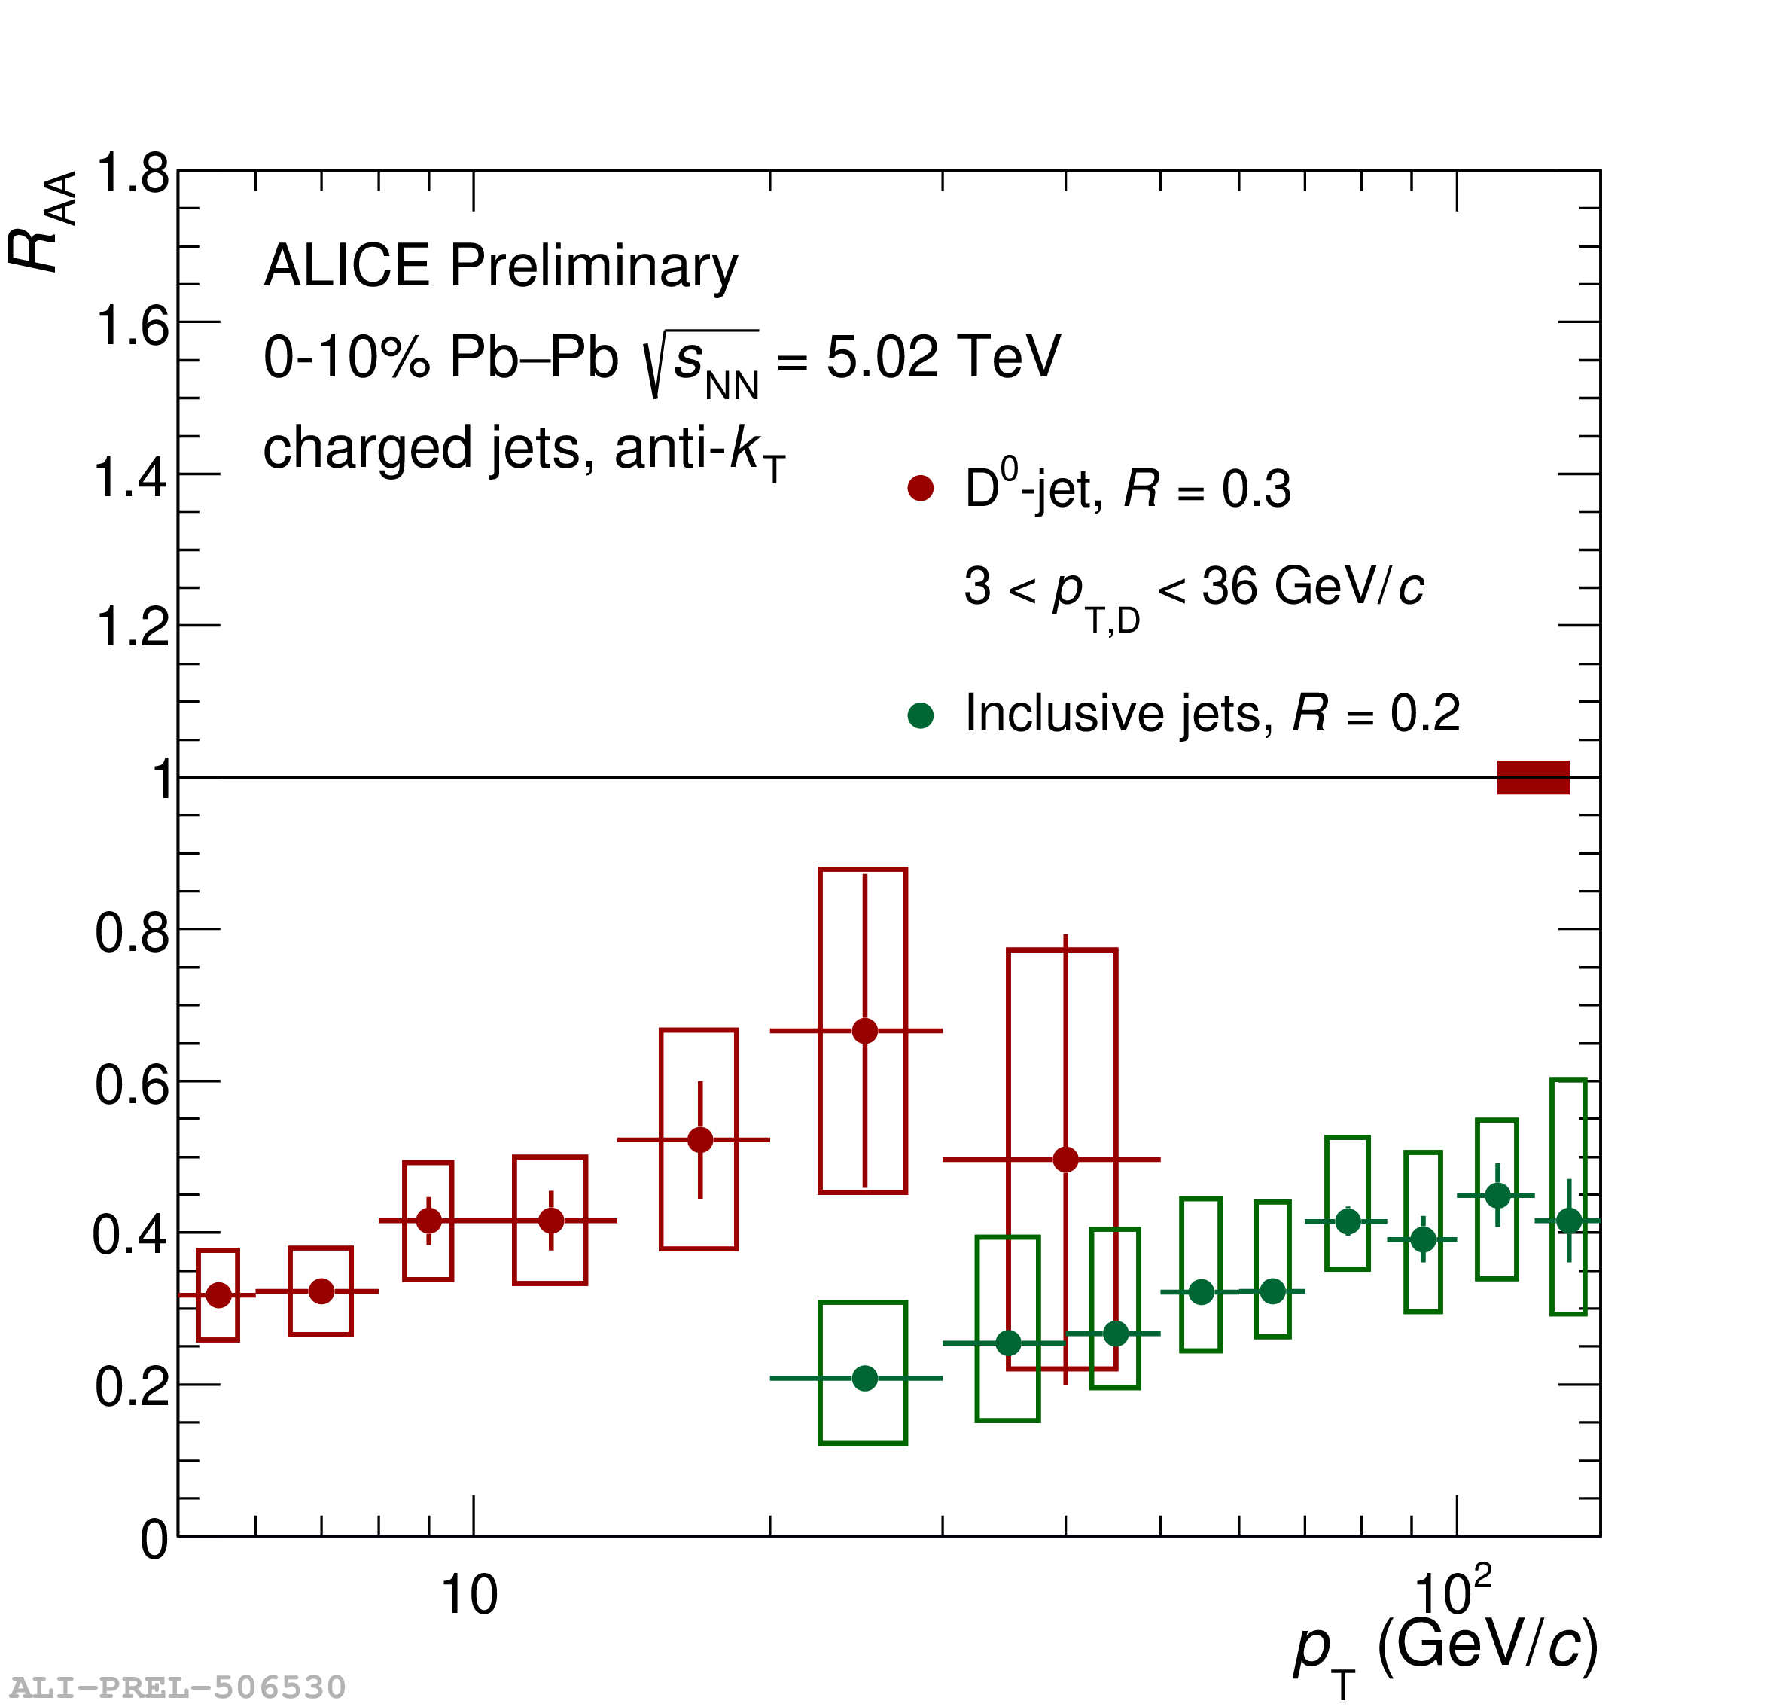



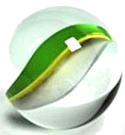
D⁰-tagged jets
Antonio Da Silva

Slide 17





Jets
p+p → dijet
D
c, x_{c}
Beam pipe
a, x_{a}
b, x_{b}
p
σ_{ab}
p
d, x_{d}
D
Jets – hard parton scattering leads to back-to-back quarks or gluons, which then fragment as a columnated spray of particles

Slide 18

Jet reconstruction
p+p di-jet event in STAR
Central Au+Au collision in STAR
Identify all of the particles in the jet → parton energy, momentum
Difficult in heavy ion collisions – but possible!

Slide 19


Di-hadron correlations
p+p → dijet
Trigger
nucleus
Associated
Phys.Rev.Lett.93:252301,2004
nucleus

Slide 20
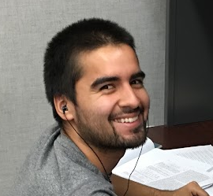
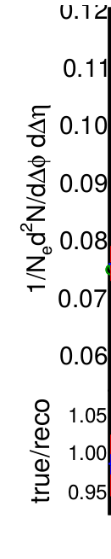
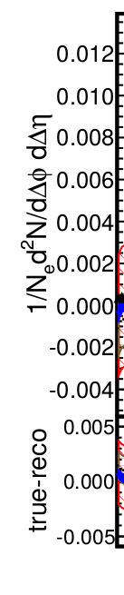

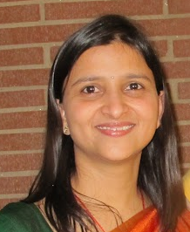

Method development
Model studies
30-40% central
Tony Perez
h-h
√sNN = 2.76 TeV
30-40% PbPb
8<pT^{trigger}<10 GeV/c
1<pT^{assoc}<2 GeV/c
Joel Mazer
Meg Stuart
Sharma, Mazer, Stuart, & Nattrass, Phys. Rev. C 93 (2016), 044915
Nattrass & Todoroki, Phys. Rev. C 97 (2018), 054911
Sharma, Perez, Castro, Kumar, & Nattrass, Phys. Rev. C 98 (2018), 014914
Natasha Sharma
Andy Castro

Slide 21

Di-hadron correlations
p+p → dijet
Nattrass, Sharma, Mazer, Stuart, Bejnood
Phys. Rev. C 94, 011901(R) 2016
Nattrass, Phys. Rev. C 97, 034916 (2018).
Trigger
nucleus
Associated
nucleus

Slide 22
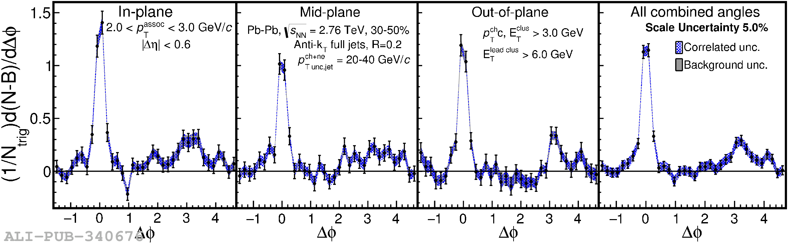
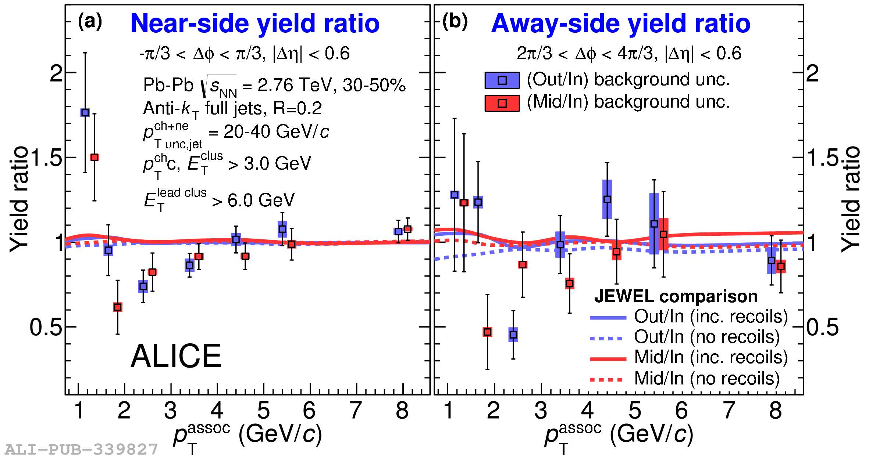



Jet-hadron correlations vs reaction plane
Full jets
1) signal+bkgd
2) bkgd dominated
3) bkgd RPF fit
Phys. Rev. C 101, 064901 (2020)
Trigger
Joel Mazer
Associated

Slide 23
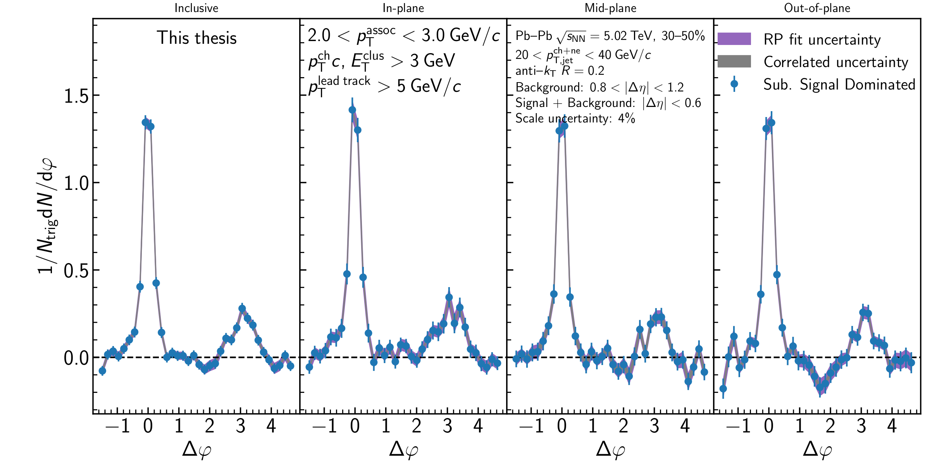
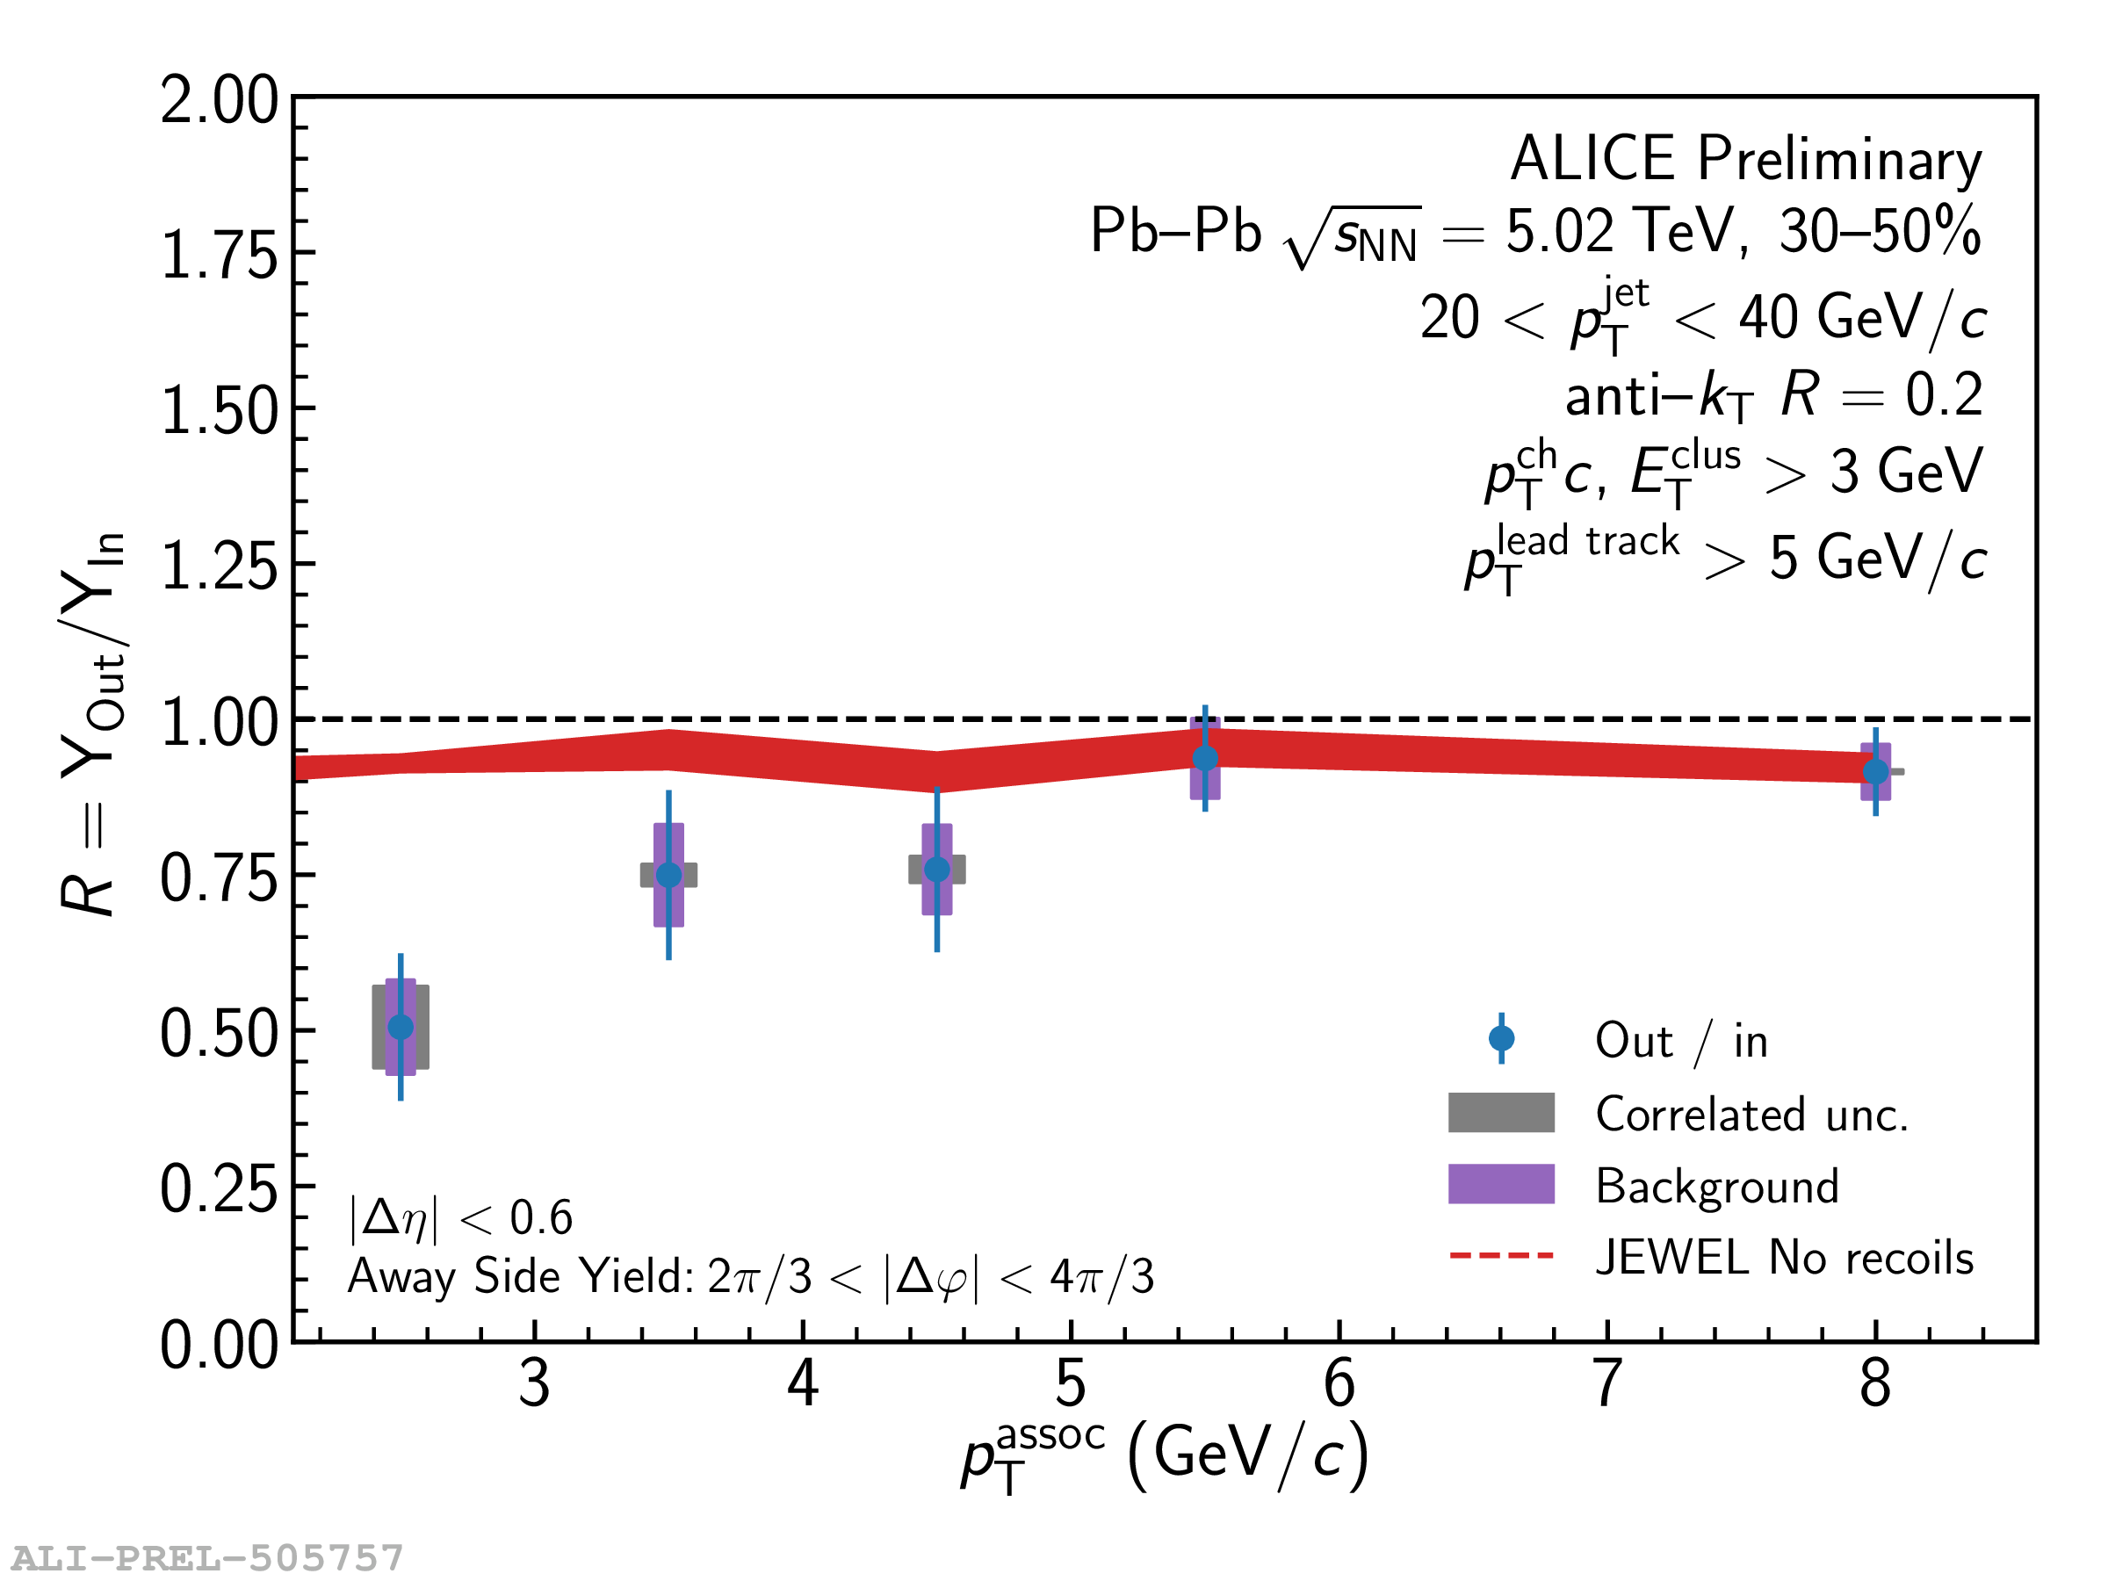
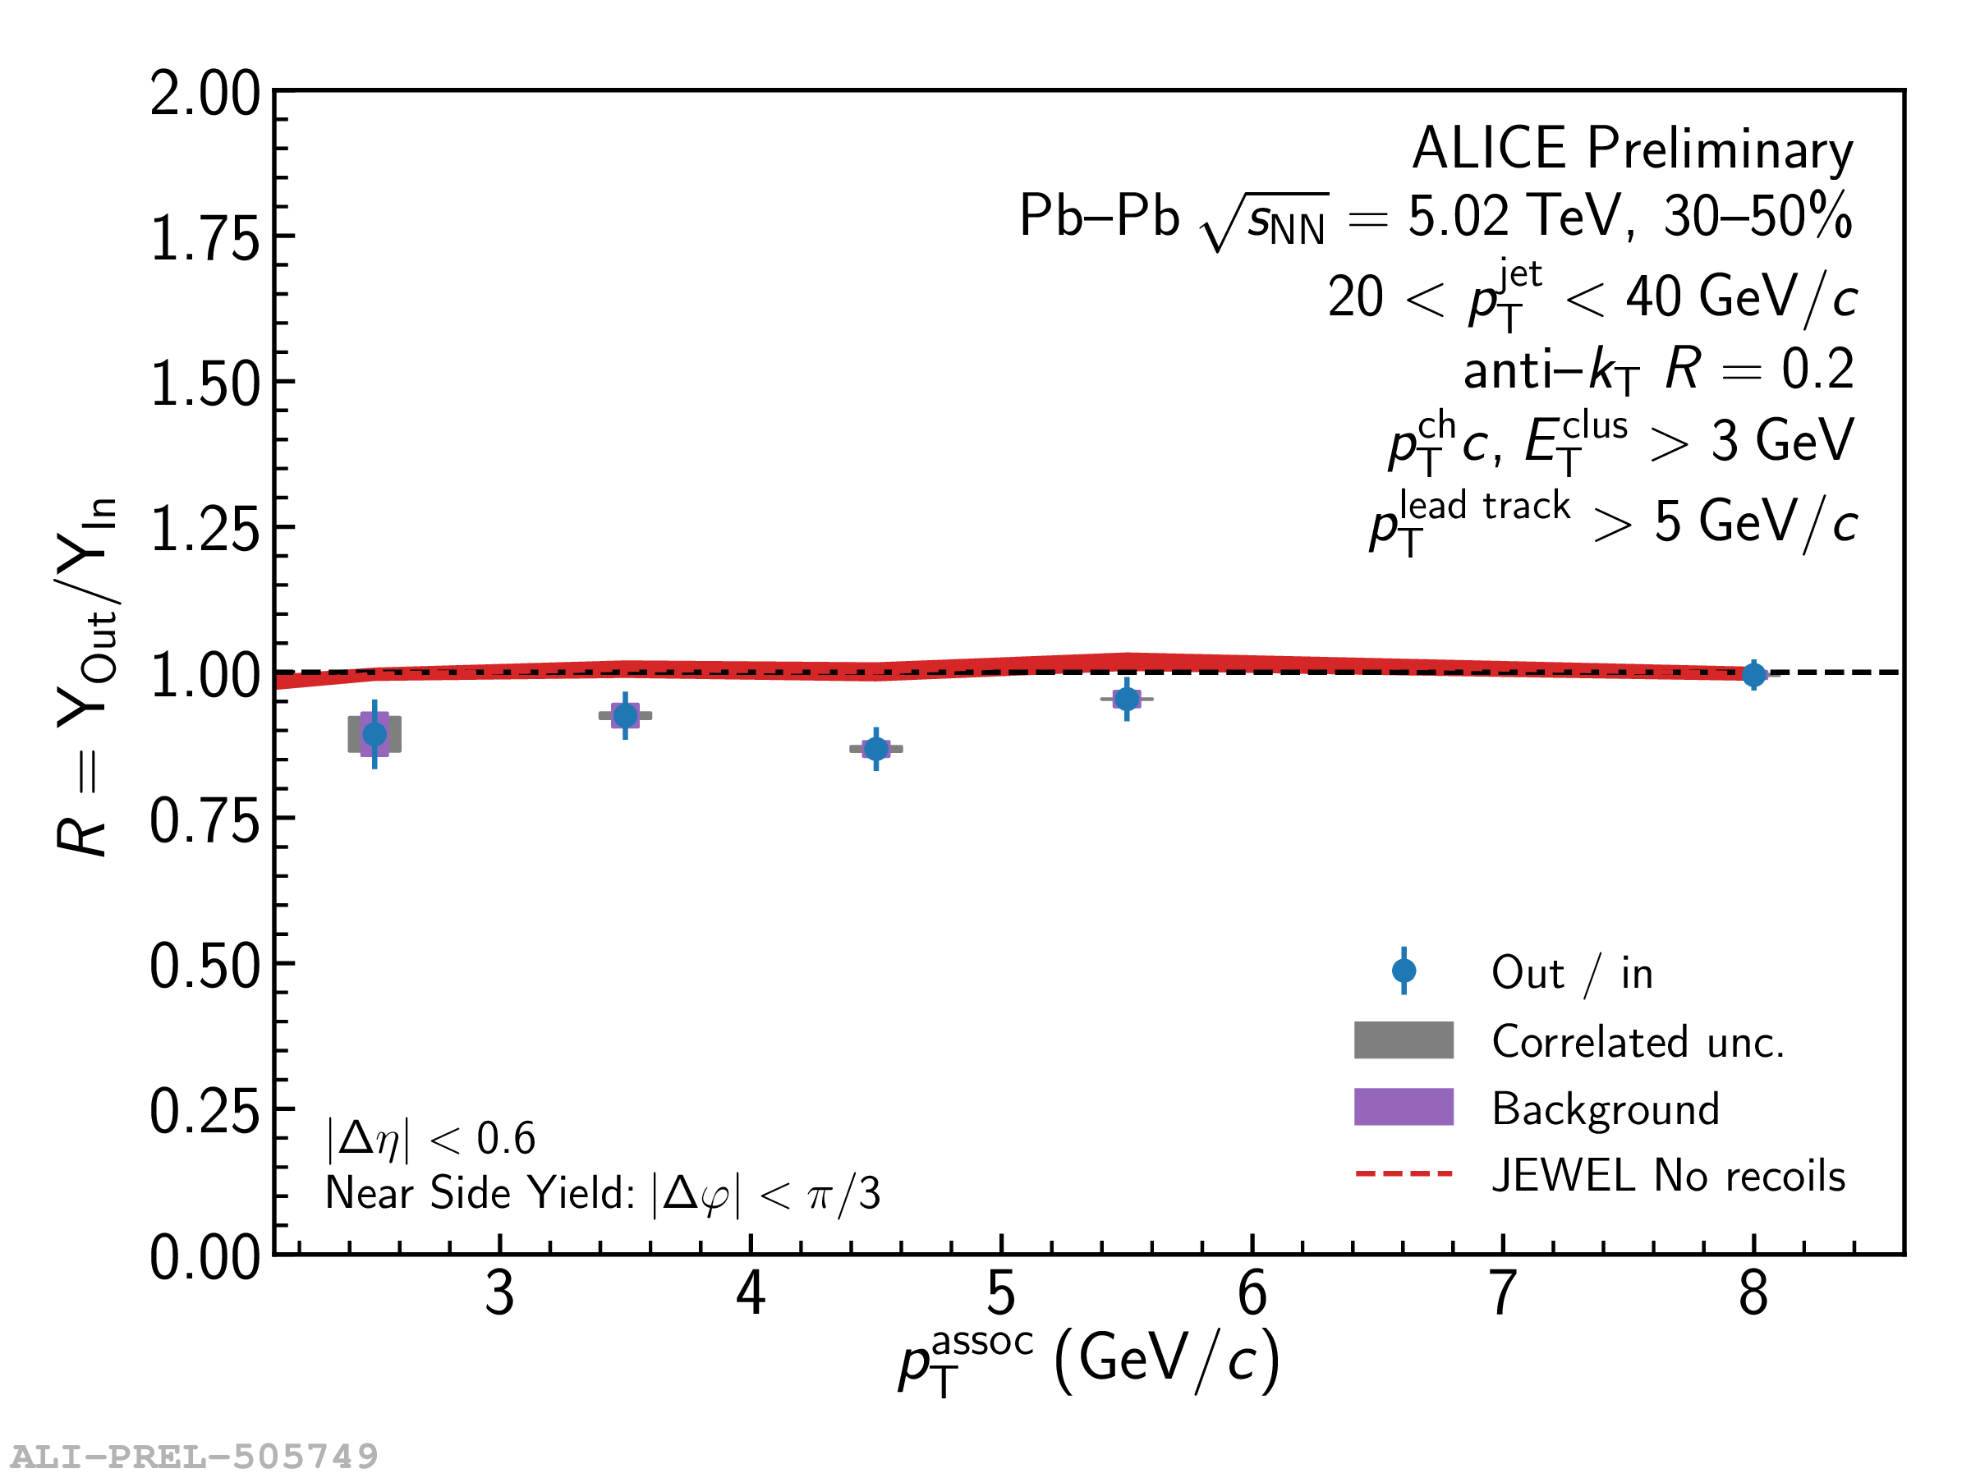

Jet-hadron correlations vs reaction plane
Full jets
1) signal+bkgd
2) bkgd dominated
3) bkgd RPF fit
Trigger
Charles Hughes
Associated

Slide 24
Towards quantitative understanding

Slide 25

There is no partionic energy loss.

Slide 26


There is only partionic energy redistribution.

Slide 27

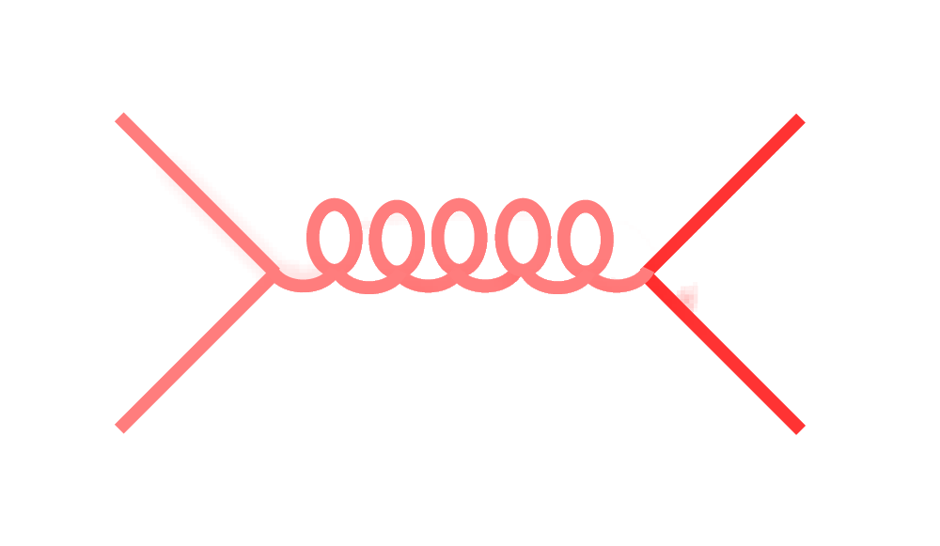
Signal vs Background:
The standard paradigm
More method improvements:
Hughes, Da Silva, & Nattrass
arXiv:2005.02320, accepted in PRC
More work in progress
Background
Combinatorial jets
Signal
*Some gray areas

Slide 28
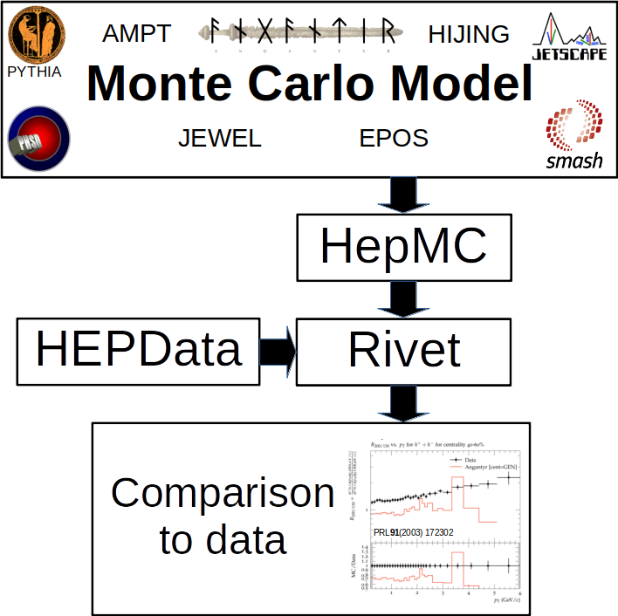

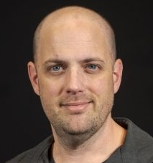
Adopted by all major experiments (PHENIX)
Christal Martin
Antonio Da Silva
Now standard! See
HEPMC in HI Workshop
1-week workshopworkshop for implementing analyses in Rivet
Tom Krobatsch

Slide 29
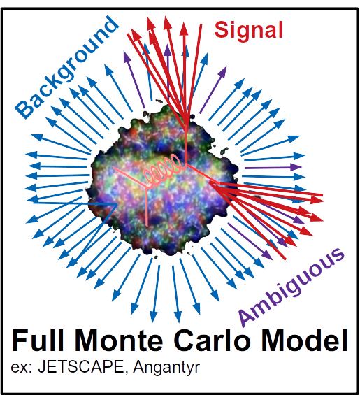
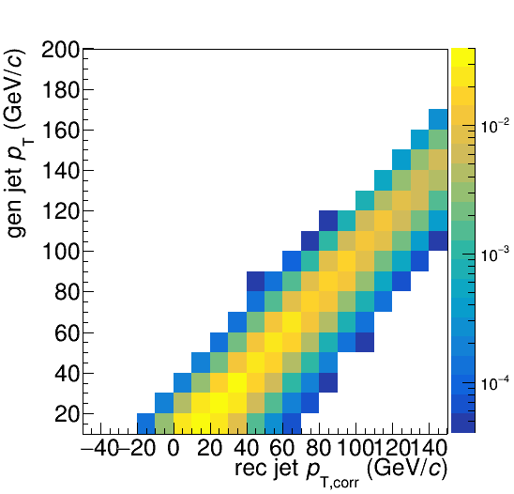
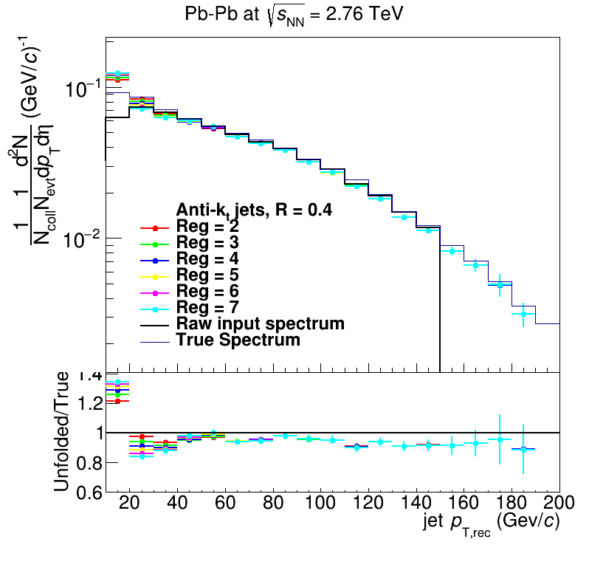
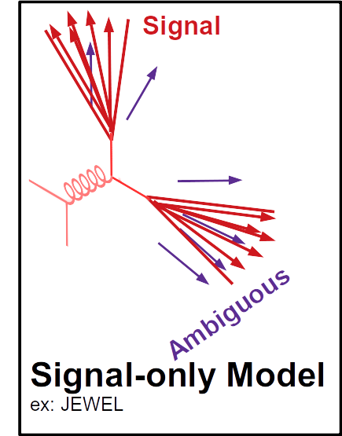
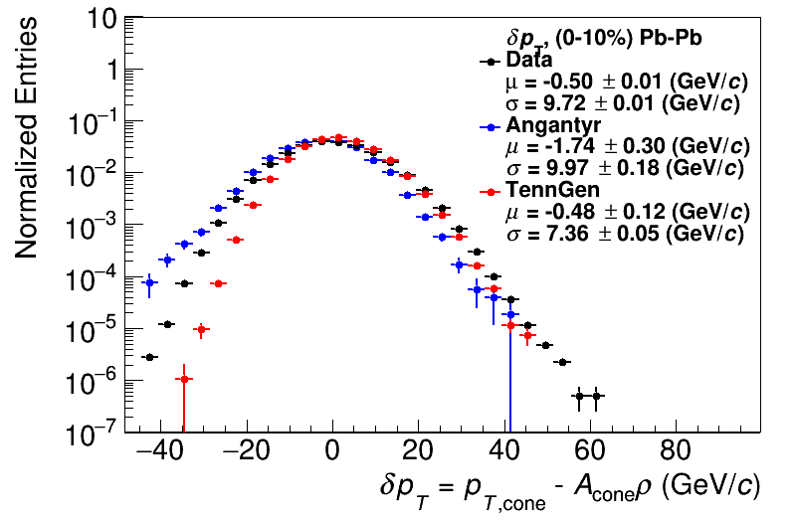
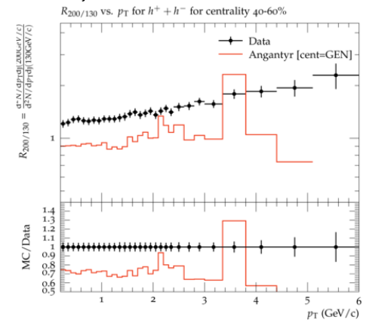
Comparison to data
HepMC
Rivet
Unfold to correct for fluctuations
HEPData
HepMC
Rivet
arXiv:2005.02320
[hep-ph]
Comparison to data
See poster by
Nattrass et al
PRL91(2003) 172302
Unfold to correct for fluctuations
Comparison to data
PRL91(2003) 172302

Slide 30
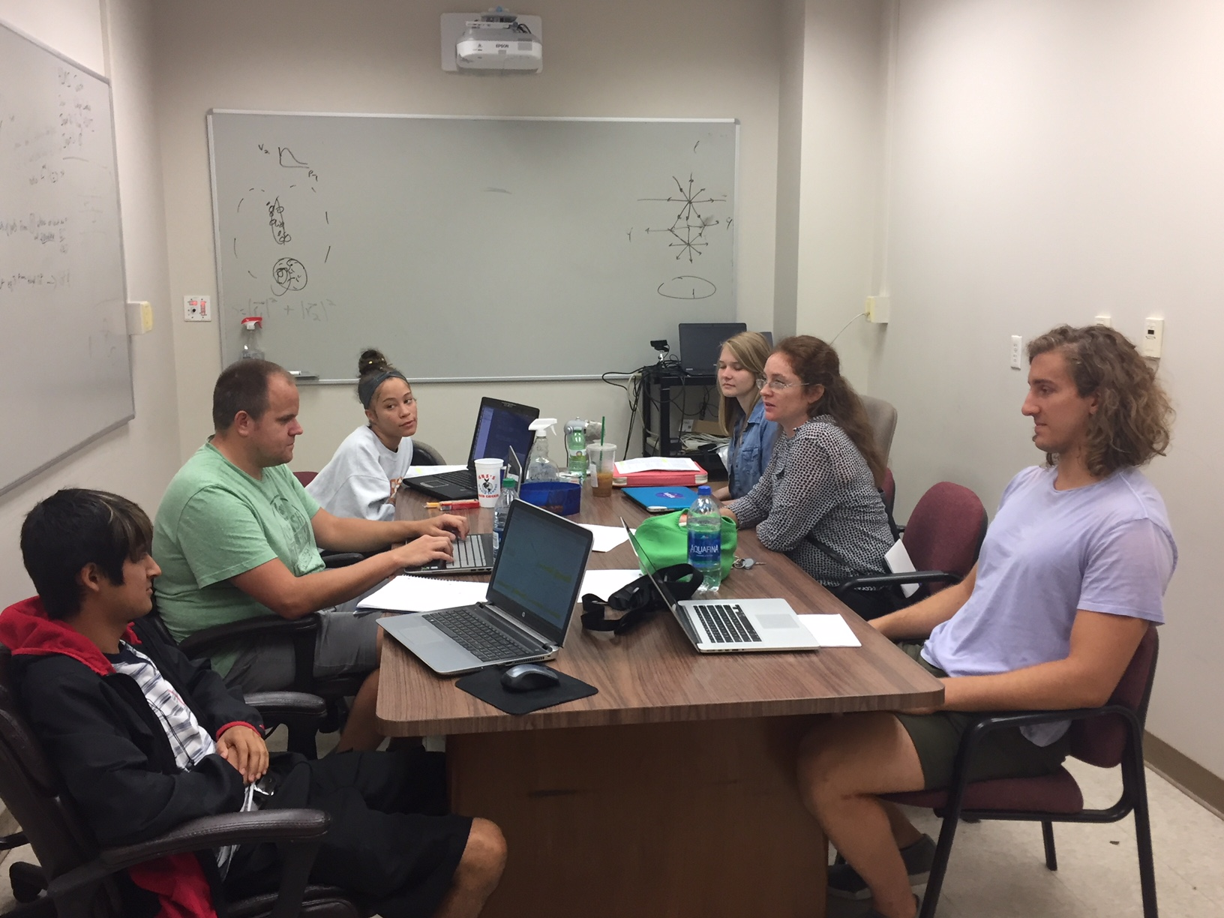
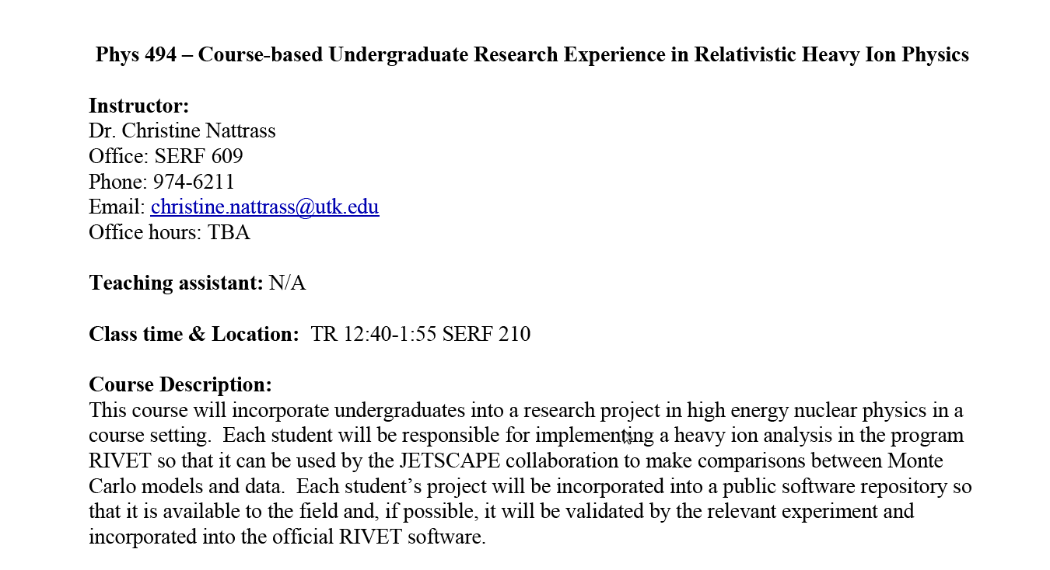
Undergraduates!*
5 semesters
20 students
10 women
5 minorities
3 non-traditional
All Rivet students
35 students
14 women
10 minorities
5 non-traditional
Left to right: Ricardo Santos (Berea), James Neuhaus, Jerrica Wilson, Mariah McCreary, Christine Nattrass, Austin Schmier (UTK)
*And one beginning graduate student

Slide 31

JETSCAPE Event generator
Jet Energy-loss Tomography with a Statistically and Computationally Advanced Program Envelope http://jetscape.wayne.edu/
Realistic medium
Realistic
theoretical
calculations
Experimental
techniques
Realistic Monte Carlo Model
Realistic jets

Slide 32

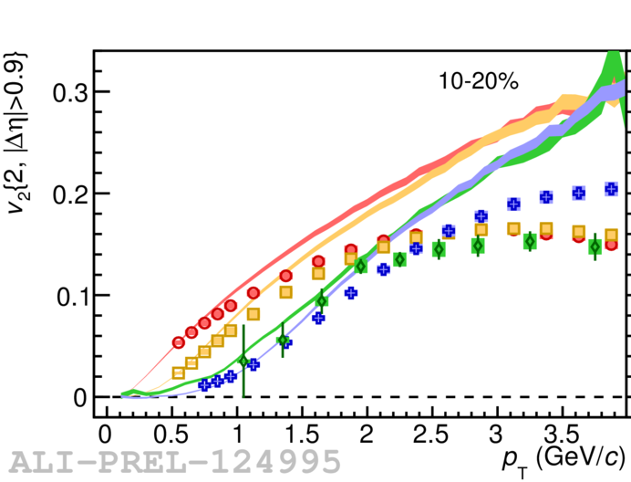
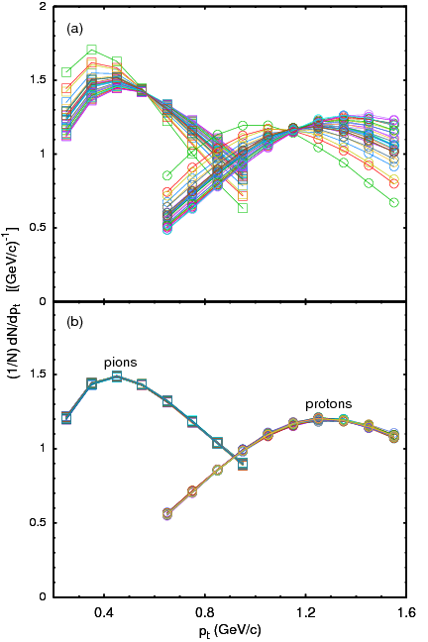
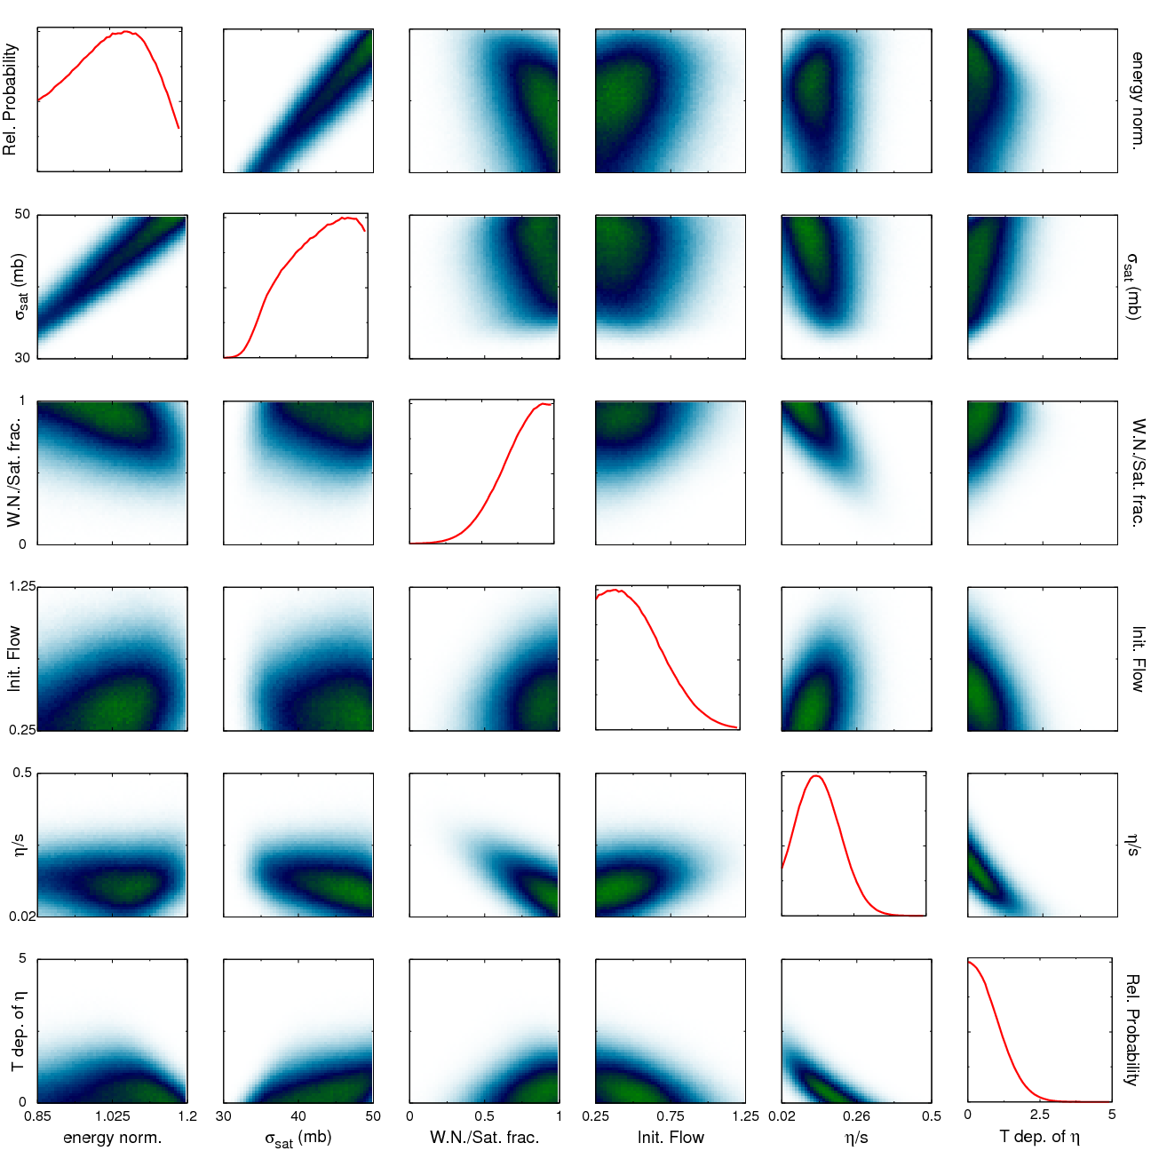
Bayesian Statistical Analysis
Models and Data Analysis Initiative http://madai.us
Data
Prior
Monte Carlo
models
Model emulation
Run full model ~1000 times
MCMC parameter search uses emulator (interpolator) in lieu of full model
Posterior
Constraint of QGP properties
Novak et al, Phys.Rev. C89 (2014) no.3, 034917
Optimization

Slide 33
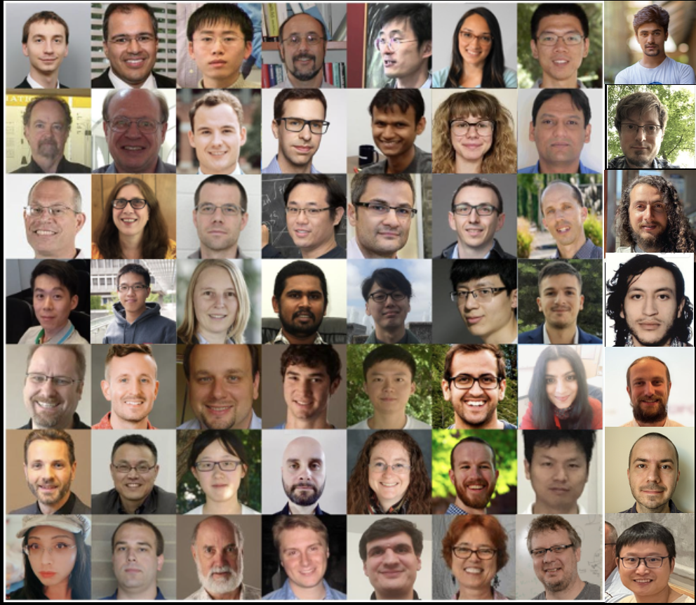

Slide 34
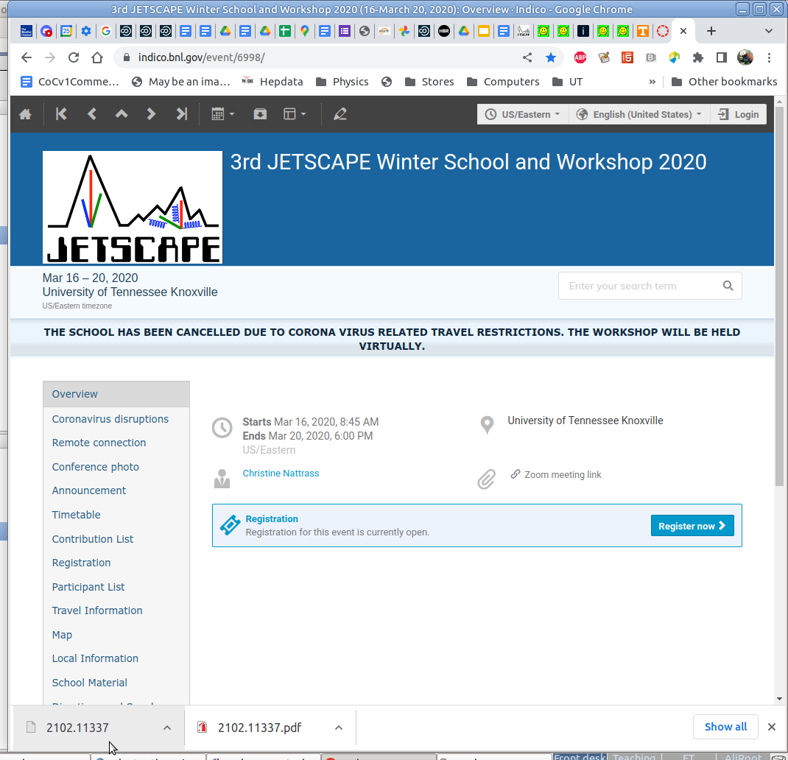
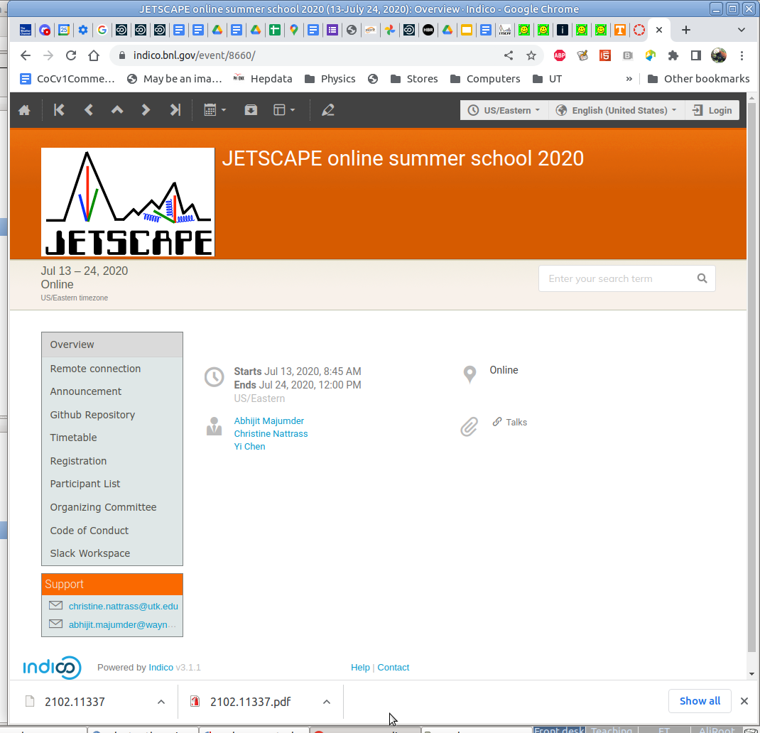
Over >180 participants (was: ~20)
Recorded and posted lectures online → resource for community
Broadened participation
Increased software downloads, citations
First online workshop in heavy ion physics?

Slide 35
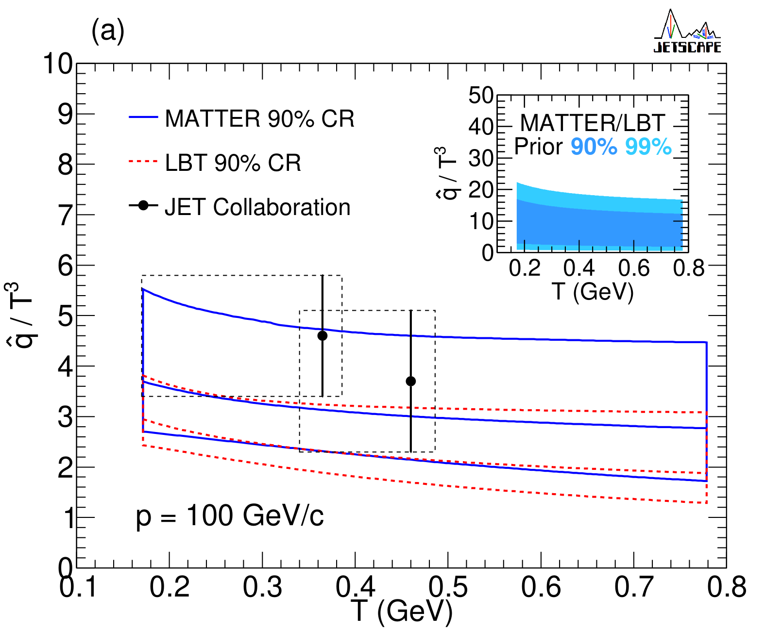
Bayesian Parameter Estimation -
$\hat{q}$
Phys. Rev. C 104, 024905 (2021)
Still only includes single hadrons!

Slide 36


Take home messages
If we get nuclear matter dense enough, we make a new phase of matter, which we produce in high energy heavy ion collisions.
This medium is opaque to colored probes and translucent to electromagnetic probes.
We can quantify its properties with realistic models.

Slide 37


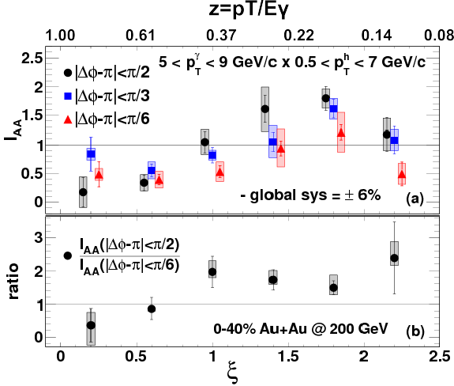

Event Generator + Bayesian Statistical analysis
Realistic theoretical calculations
Data
Bayesian Statistical Analysis
Constraint of QGP properties

Slide 38

Course-based undergraduate research experience
Ask me if you want more info!
3 semesters
15 students
8 women
3 minorities
3 non-traditional
All Rivet students
22 students
11 women
7 minorities
4 non-traditional

