Slide 1

Melting nuclei
Christine Nattrass
University of Tennessee, Knoxville

Slide 2




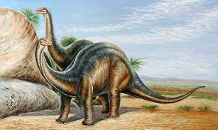
Structure of matter
Hadrons
Baryons
Standard model
Mesons
125000
Higgs

Slide 3



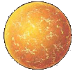

Phase diagram of nuclear matter
Quark Gluon Plasma
Core of neutron stars?
Quark Gluon Plasma – a liquid of quarks and gluons created at temperatures above ~170 MeV (2·10¹²K) – over a million times hotter than the core of the sun
Notes:
But wait – how can we have a liquid of quarks and gluons? Doesn't asymptotic freedom tell us that we can't have free quarks and gluons? How, then, can we have a liquid of quarks and gluons?

Slide 4

How to make a Quark Gluon Plasma

Slide 5

The phase transition in the laboratory

Slide 6












Relativistic Heavy Ion Collider
Large Hadron Collider
PHOBOS
BRAHMS
CMS
PHENIX
STAR
RHIC
LHCb
ALICE
ATLAS
LHCf
Upton, NY
1.2km diameter
p+p, d+Au, Cu+Cu, Au+Au, U+U
√s_{NN} = 9 - 200 GeV
Geneva, Switzerland
8.6km diameter
p+p, p+Pb, Pb+Pb
√s_{NN} = 2.76 GeV, 5.5 TeV
LHC
Quark Gluon Plasma
RHIC
Core of neutron stars?
Notes:
Mention that RHIC planning began 1983

Slide 7

ALICE
ATLAS
CMS
STAR
PHENIX
Notes:
Mention that RHIC planning began 1983

Slide 8




Size: 16 x 26 meters
Weight: 10,000 tons
Detectors: 18
Trigger detectors: When do we have a collision?
Tracking detectors: Where did the particle go?
Identification detectors: What kind of particle is it?
Calorimeters: How much energy does the particle have?
<number>
Notes:
By comparison ATLAS is 25 meters in diameter and 44 meters long – not quite twice as large

Slide 9

p+p collisions
3D image of each collision

Slide 10

Pb+Pb collisions
5

Slide 11
QGP Chemistry

Slide 12


Chemistry - equilibrium
T~170 MeV
arXiv:1701.07065
Nuclear Physics A Volume 757, 102-183
Ratios of particles expected from a model
Even strange quarks are at equilibrium!

Slide 13

Phase diagram of nuclear matter
Quark Gluon Plasma
Critical point?
arXiv:1701.07065
Core of neutron stars?
Quark Gluon Plasma – a liquid of quarks and gluons created at temperatures above ~170 MeV (2·10¹²K) – over a million times hotter than the core of the sun
Notes:
But wait – how can we have a liquid of quarks and gluons? Doesn't asymptotic freedom tell us that we can't have free quarks and gluons? How, then, can we have a liquid of quarks and gluons?

Slide 14


trajectory of system
arXiv:1701.07065

Slide 15
QGP Thermometers

Slide 16


Measuring temperature

Slide 17


Thermal photons
Phys.Rev.Lett.104:132301,2010
Thermal photons
QCD processes
ALICE collaboration:
Pb+Pb collisions at √s_{NN}=2.76 TeV
Inverse slope: T = 304 +/-51
PHENIX collaboration: Au+Au collisions at √s_{NN}=200 GeV
Inverse slope: T = 221 +/- 19 (stat) +/- 19 (syst) MeV

Slide 18





Building a quarkonium-thermometer
CMS-PAS HIN-11-011
N_{part}
Clear hierarchy in R_{AA} of different quarkonium states
c
c
b
b

Slide 19

Building a quarkonium-thermometer
Note: 6.5<p_{T}<30 GeV for J/ψ and ψ(2s)
CMS-PAS HIN-11-011
N_{part}
Clear hierarchy in R_{AA} of different quarkonium states
Expected in terms of binding energy
CMS-PAS HIN-12-014, HIN-12-007

Slide 20
~600
trajectory of system
arXiv:1701.07065

Slide 21
QGP Energy Density

Slide 22

How can we estimate the energy density?
Transverse energy (E_{T})
  sum of particle energies in transverse direction
Volume V = A_{T} τc
τ = formation time
Energy density ε
QGP formation for ε > 0.5 GeV/fm³
A_{T}
= τc

Slide 23

Energy density
RHIC
Standard estimate τ₀ ≈ 1 fm/c
QGP formation

Slide 24
QGP Spectroscopy

Slide 25
Probing the Quark Gluon Plasma
Medium
Probe
Detector
Want a probe which traveled through the collision
QGP is very short-lived (~1-10 fm/c) →
cannot use an external probe

Slide 26

Probes of the Quark Gluon Plasma
nucleus
nucleus
Want a probe which traveled through the medium
QGP is short lived → need a probe created in the collision

Slide 27
Probes of the Quark Gluon Plasma
nucleus
nucleus
Want a probe which traveled through the medium
QGP is short lived → need a probe created in the collision
We expect the medium to be dense → absorb/modify probe

Slide 28





Jets
p+p → dijet
D
c, x_{c}
p
a, x_{a}
b, x_{b}
p
σ_{ab}
Beam pipe
d, x_{d}
D
Jets – hard parton scattering leads to back-to-back quarks or gluons, which then fragment as a columnated spray of particles

Slide 29

Jets
Phys.Rev.Lett. 105 (2010) 252303
nucleus
nucleus
ATLAS

Slide 30

Quenched jets
nucleus
nucleus
One of the jets is absorbed by the medium
The quark or gluon has equilibrated with the medium
Phys. Rev. Lett. 105, 252303 (2010)
ATLAS

Slide 31


Nuclear modification factor
Measure spectra of probe (jets) and compare to those in p+p collisions or peripheral A+A collisions
If high-p_{T} probes (jets) are suppressed, this is evidence of jet quenching
Enhancement
Suppression

Slide 32
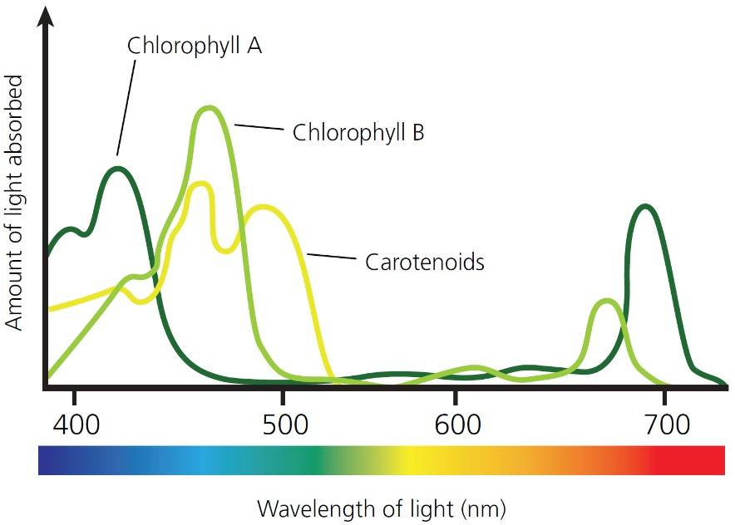
Nuclear modification factor
Measure spectra of probe (jets) and compare to those in p+p collisions or peripheral A+A collisions
If high-p_{T} probes (jets) are suppressed, this is evidence of jet quenching
Enhancement
Suppression

Slide 33


Nuclear modification factor R_{AA}
RHIC
LHC
Electromagnetic probes – consistent with no modification – medium is transparent to them
Strong probes – significant suppression – medium is opaque to them

Slide 34
Nuclear modification factor R_{AA} at LHC
Fully unfolded inclusive jet R_{AA}
pp 2.76 TeV reference
CMS-PAS HIN-12-001
Like for charged particles, high-p_{T} jet R_{AA} flat at ≈ 0.5

Slide 35


Take home messages
If we get nuclear matter dense enough, we make a new phase of matter, which we produce in high energy heavy ion collisions.
This medium is extremely hot and dense...
...and opaque to colored probes and translucent to electromagnetic probes.

Slide 36


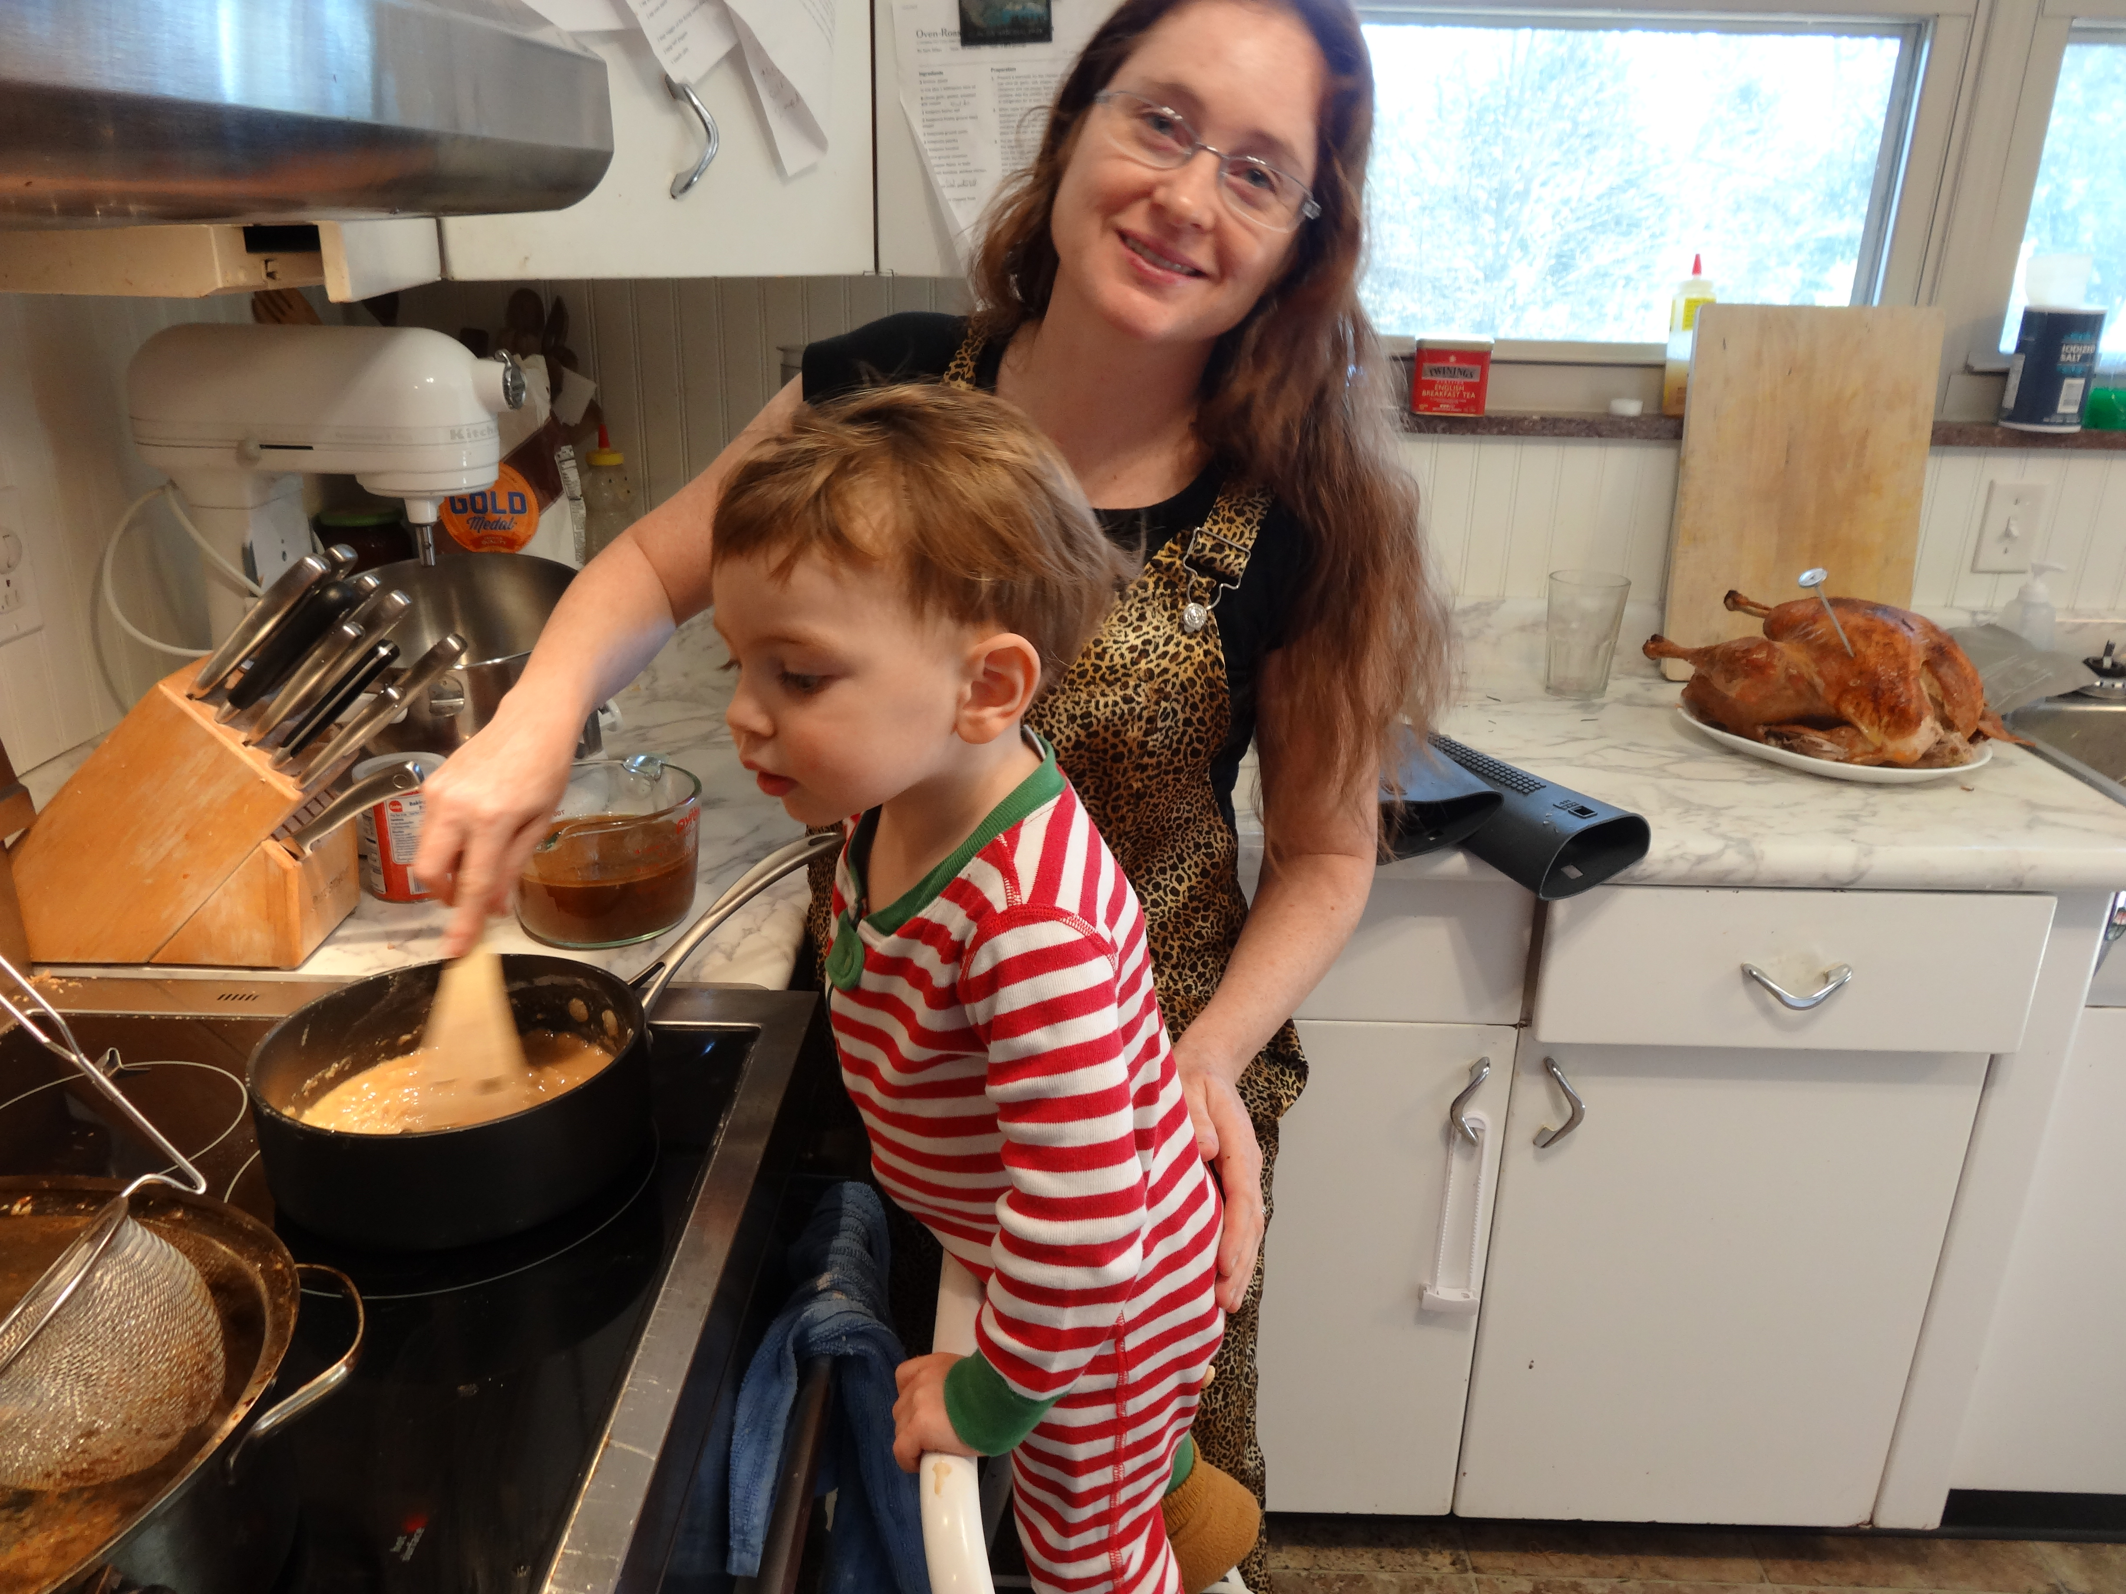
About me
BS, Colorado State University, 2003
PhD, Yale University, 2009
Postdoc, University of Tennessee, Knoxville, 2009-2012
Assistant prof, University of Tennessee, Knoxville 2012 –
Active on issues related to women in physics
Working on being a more effective ally for people of color
Parent
Brew beer & wine, keep bees, avid cook, cyclist
Talk to me about: strategies for dealing with harassment, careers outside of physics, choosing a mentor, having kids and a career

