Slide 1
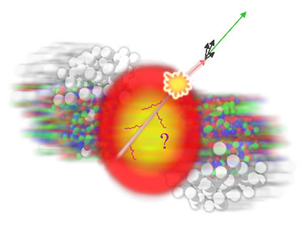
Precision measurements of jet-like correlations
And what they teach us about flow
Christine Nattrass
Based on Phys. Rev. C 93, 044915(2016) & Phys.Rev. C94 011901(2016)
Contributions from Natasha Sharma, Joel Mazer, Meg Stuart, Aram Bejnood

Slide 2

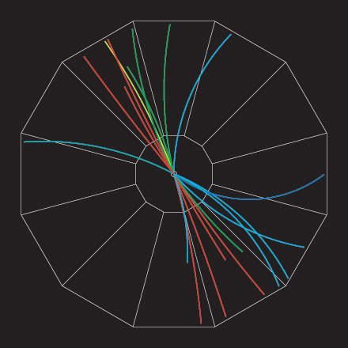
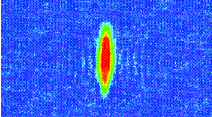



Jets and flow
D
c, x_{c}
p
a, x_{a}
b, x_{b}
p
σ_{ab}
d, x_{d}
D
  K, O’Hara, S. Hemmer, M. Gehm, S. Granade, J. Thomas Science 298 2179 (2002)
p+p di-jet event in STAR
Both lead to azimuthal correlations
Jets → background for flow
Flow → background for jets

Slide 3
Overview
New method for separating jets from flow
Apply it to data
  Di-hadron correlations
  Jet-hadron correlations
And what we learn about flow from jet-like correlations

Slide 4
Methods

Slide 5
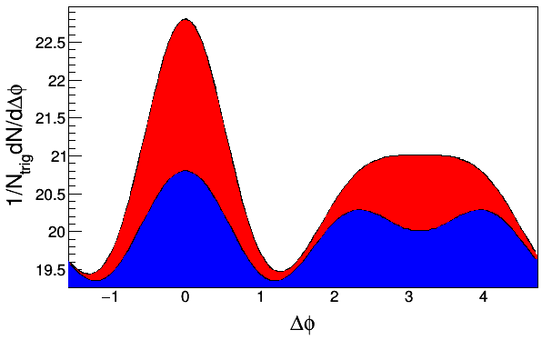
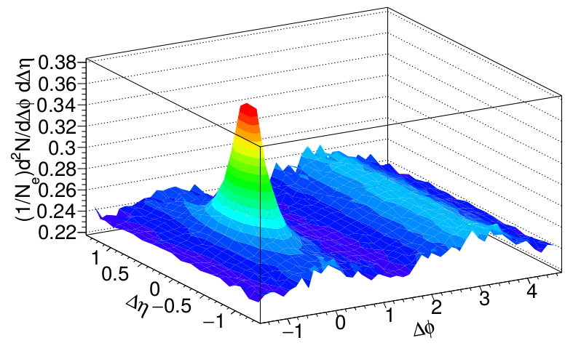
Two component model
h-h
√s_{NN} = 2.76 TeV
30-40% PbPb
8<p_{T}^{trigger}<10 GeV/c
1<p_{T}^{assoc}<2 GeV/c
Jets
Flow
Two component model
  Assume contributions can be factorized
  Alternately, define signal as anything which isn't consistent with separable flow and jet components
  Assumptions even embedded in studies of full jets

Slide 6
Zero Yield At Minimum
Jets
Flow
Flow component given by
Fix background level at minimum
Use independent measurements of v_{n}

Slide 7
Issues with ZYAM
Jets
Flow
Tends to underestimate background level
  Can use fixed point (e.g. Δφ=1) instead
v_{n} for background may not be the same as independent measurements
  Cumulant methods suppress fluctuations
  Reaction plane measurements may include effects from jets
  Events with jets may be different
  High and low p_{T} reaction planes may be different
If jet peak is broadened, may overestimate background (underestimate signal)

Slide 8
Background Subtraction Methods
Δη Method: Project near-side signal onto Δη and subtract constant background. Near-side only
Δη Gap Method: Use signal at large Δη to determine background, assuming constant background in Δη. Near-side only
Zero-Yield at Minimum (ZYAM): Assumes v_{n} from other studies, assumes region around Δφ≈1 is background dominated
Near-Side Fit (NSF): assumes small Δφ/large Δη region background dominated, fits v_{n} and B
Reaction Plane Fit (RPF): assumes small Δφ/large Δη region background dominated, fits v_{n} and B using reaction plane dependence
Near-Side Subtracted NSF/RPF (NSS NSF/RPF): fits v_{n} and B at small small Δφ using reaction plane dependence after subtracting the near-side with a fit

Slide 9
Separating the signal and the background
Toy model:
Signal: PYTHIA
Background: thrown to v_{n} = 10 to match data
Details in backup and paper

Slide 10
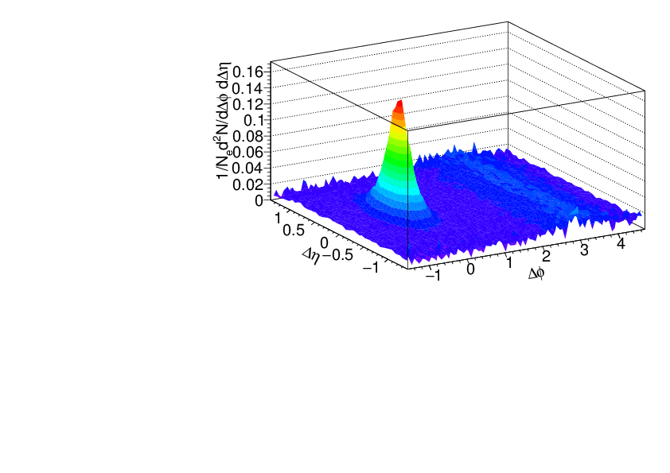
Signal vs background
Signal+background
Signal only
h-h
√s_{NN} = 2.76 TeV
30-40% PbPb
8<p_{T}^{trigger}<10 GeV/c
1<p_{T}^{assoc}<2 GeV/c
Background dominated region

Slide 11
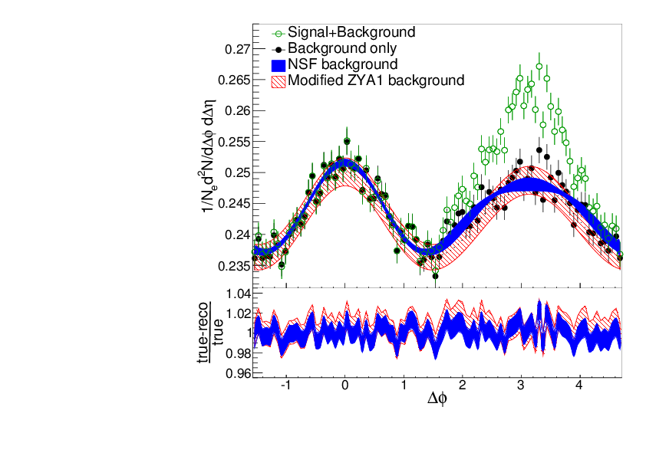
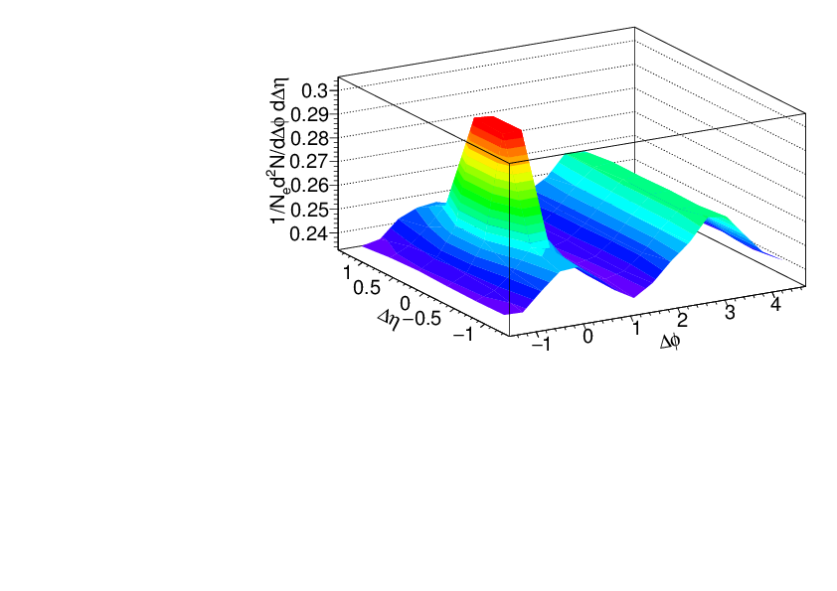
Near-Side Fit (NSF) method
No reaction plane dependence
Signal+background
h-h
√s_{NN} = 2.76 TeV
30-40% PbPb
8<p_{T}^{trigger}<10 GeV/c
1<p_{T}^{assoc}<2 GeV/c
Fit
extrapolation
Background dominated region
Project signal+background over 1.0<|Δη|<1.4
Fit background in |Δφ|<π/2 with v_{n} up to n=4

Slide 12
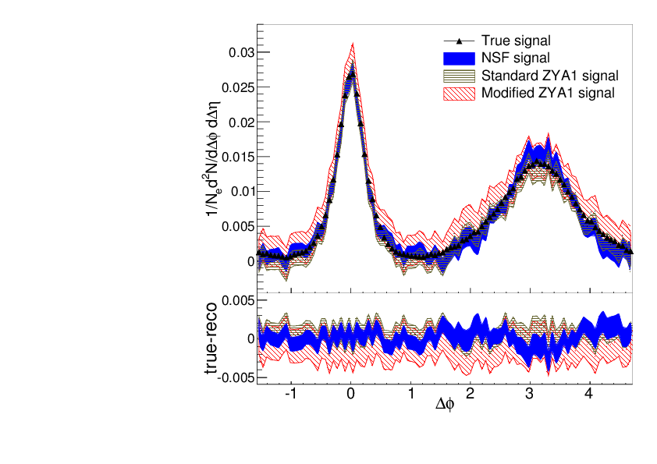
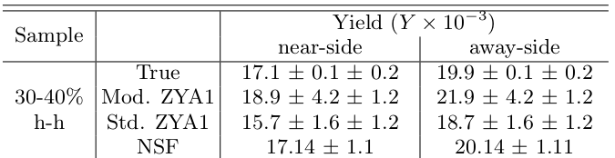
Near-Side Fit (NSF) method
No reaction plane dependence
Reconstructs signal with less bias and smaller errors than ZYA1 method
Extract v_{n} consistent with input
h-h
√s_{NN} = 2.76 TeV
30-40% PbPb
8<p_{T}^{trigger}<10 GeV/c
1<p_{T}^{assoc}<2 GeV/c
Standard ZYA1 = Zero Yield at ΔΦ=1
Modified ZYA1 = Zero Yield at ΔΦ=1 for 1.0<|Δη|<1.4

Slide 13
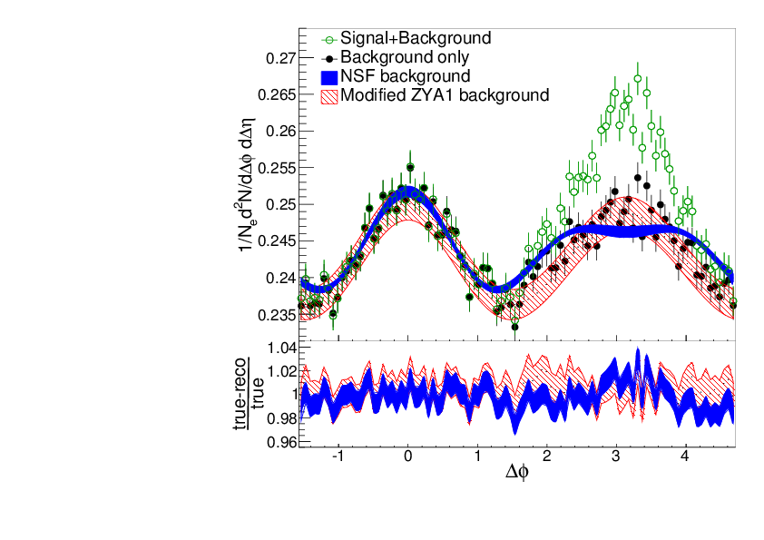
Near-Side Fit (NSF) method
No reaction plane dependence
Signal+background
h-h
√s_{NN} = 2.76 TeV
30-40% PbPb
8<p_{T}^{trigger}<10 GeV/c
1<p_{T}^{assoc}<2 GeV/c
Fit
extrapolation
Background dominated region
Project signal+background over 1.0<|Δη|<1.4
Fit background in |Δφ|<1
Not reliable over narrower Δφ region

Slide 14
Background Subtraction Methods
Δη Method: Project near-side signal onto Δη and subtract constant background. Near-side only
Δη Gap Method: Use signal at large Δη to determine background, assuming constant background in Δη. Near-side only
Zero-Yield at Minimum (ZYAM): Assumes v_{n} from other studies, assumes region around Δφ≈1 is background dominated
Near-Side Fit (NSF): assumes small Δφ/large Δη region background dominated, fits v_{n} and B
Reaction Plane Fit (RPF): assumes small Δφ/large Δη region background dominated, fits v_{n} and B using reaction plane dependence
Near-Side Subtracted NSF/RPF (NSS NSF/RPF): fits v_{n} and B at small small Δφ using reaction plane dependence after subtracting the near-side with a fit

Slide 15
Adding reaction plane dependence

Slide 16
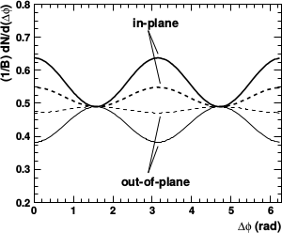
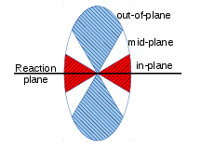
Background in correlations
All reaction plane angles
When trigger is restricted relative to reaction plane
  Background level modified
  Effective v_{n} modified
φ_{S} is the angular threshold
Phys.Rev. C69 (2004) 021901 arXiv:nucl-ex/0311007

Slide 17
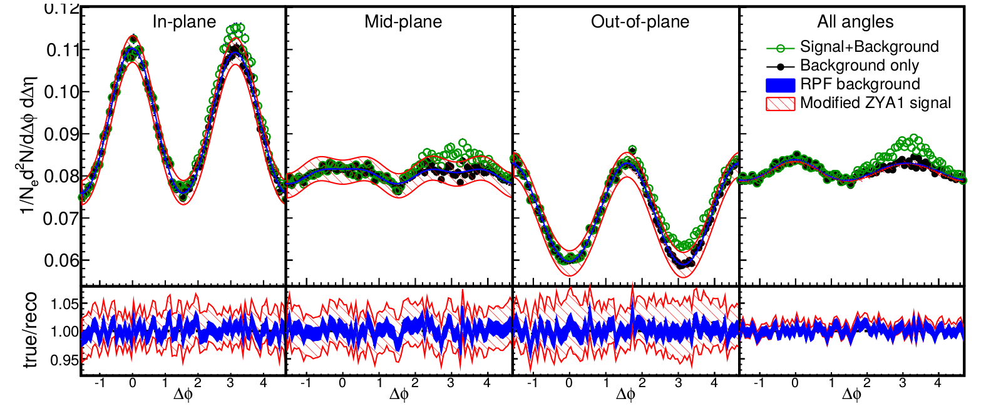
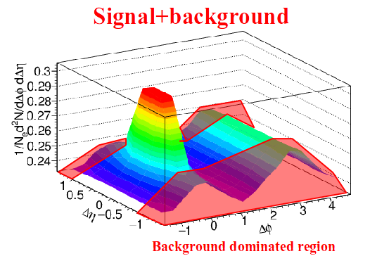
Reaction Plane Fit (RPF) method
30-40% central
h-h
√s_{NN} = 2.76 TeV
30-40% PbPb
8<p_{T}^{trigger}<10 GeV/c
1<p_{T}^{assoc}<2 GeV/c
Fit
Project signal+background over 1.0<|Δη|<1.4
Fit background in |Δφ|<1 including reaction plane dependence
v_{n} and B extracted with v_{n} up to n=4

Slide 18
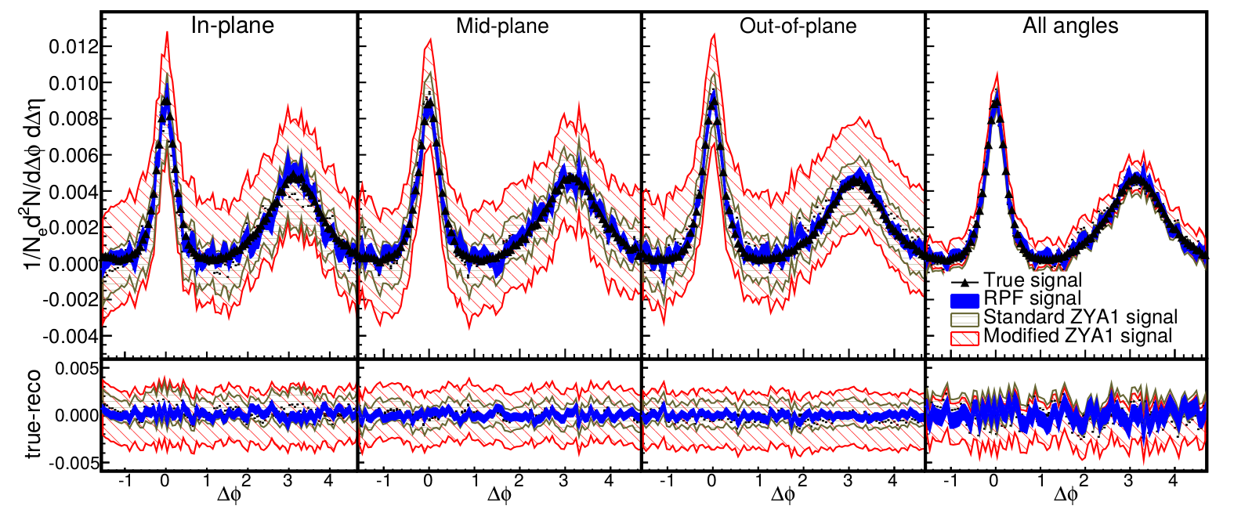
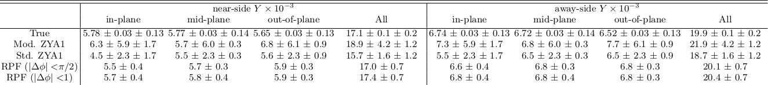
Reaction Plane Fit (RPF) method
30-40% central
h-h
√s_{NN} = 2.76 TeV
30-40% PbPb
8<p_{T}^{trigger}<10 GeV/c
1<p_{T}^{assoc}<2 GeV/c

Slide 19
Background Subtraction Methods
Δη Method: Project near-side signal onto Δη and subtract constant background. Near-side only
Δη Gap Method: Use signal at large Δη to determine background, assuming constant background in Δη. Near-side only
Zero-Yield at Minimum (ZYAM): Assumes v_{n} from other studies, assumes region around Δφ≈1 is background dominated
Near-Side Fit (NSF): assumes small Δφ/large Δη region background dominated, fits v_{n} and B
Reaction Plane Fit (RPF): assumes small Δφ/large Δη region background dominated, fits v_{n} and B using reaction plane dependence
Near-Side Subtracted NSF/RPF (NSS NSF/RPF): fits v_{n} and B at small small Δφ using reaction plane dependence after subtracting the near-side with a fit

Slide 20
Background Subtraction Methods
Δη Method: Project near-side signal onto Δη and subtract constant background. Near-side only
Δη Gap Method: Use signal at large Δη to determine background, assuming constant background in Δη. Near-side only
Zero-Yield at Minimum (ZYAM): Assumes v_{n} from other studies, assumes region around Δφ≈1 is background dominated
Near-Side Fit (NSF): assumes small Δφ/large Δη region background dominated, fits v_{n} and B
Reaction Plane Fit (RPF): assumes small Δφ/large Δη region background dominated, fits v_{n} and B using reaction plane dependence
Near-Side Subtracted NSF/RPF (NSS NSF/RPF): fits v_{n} and B at small small Δφ using reaction plane dependence after subtracting the near-side with a fit

Slide 21
STAR data

Slide 22
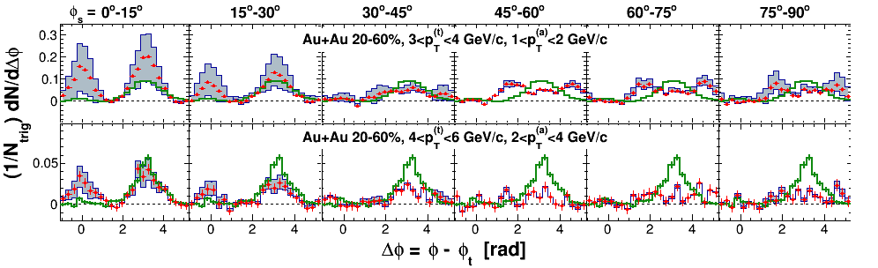
STAR measurements of dihadron correlations relative to reaction plane
Correlations on arxiv (nucl-ex/1010.0690 v2)
  Published article (Phys. Rev. C 89 (2014) 41901) does not include raw correlations
ZYAM background subtraction
  Reports ridge at Δη> 0.7
  RPF method assumes no signal at Δη> 0.7
  0.7<Δη< 2

Slide 23
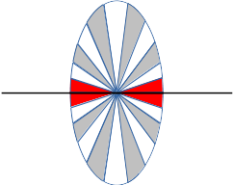
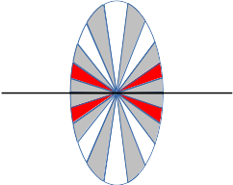
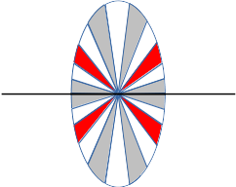
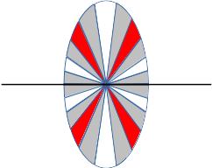
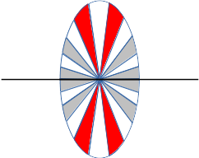
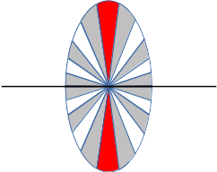
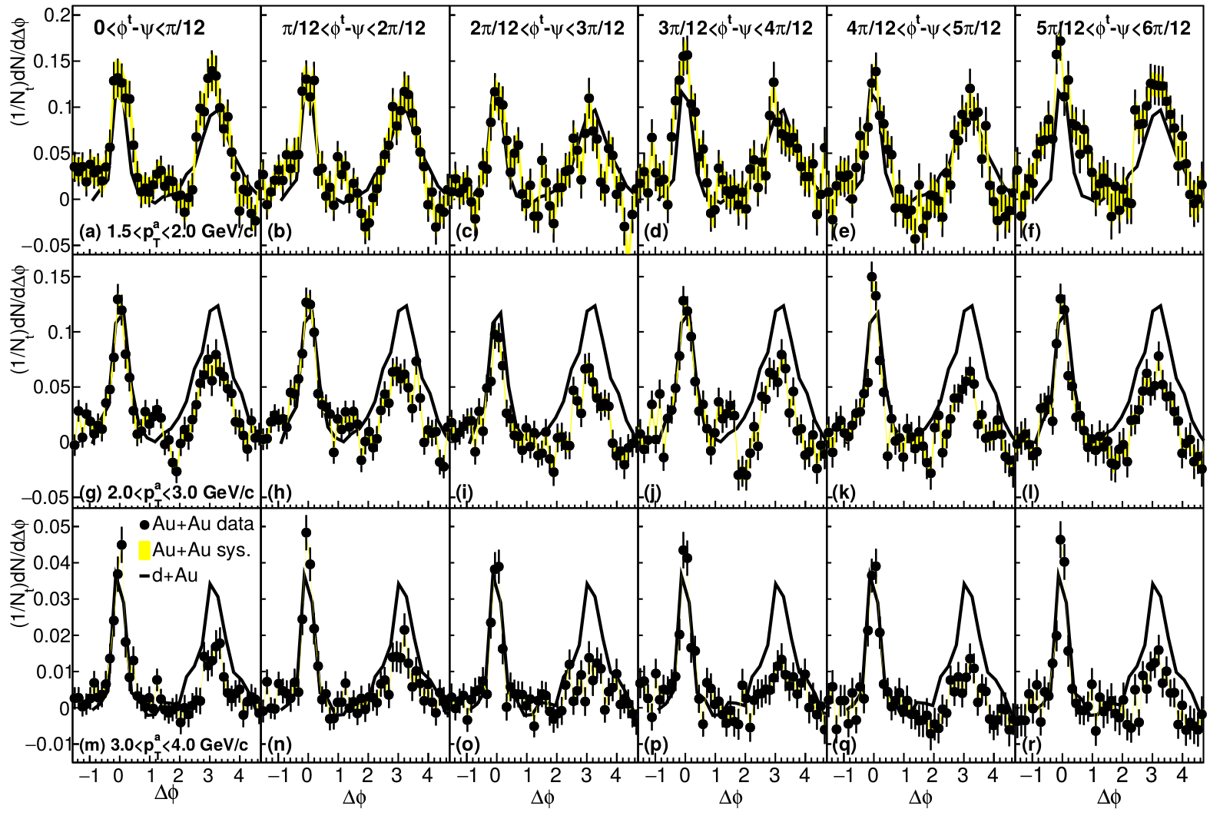
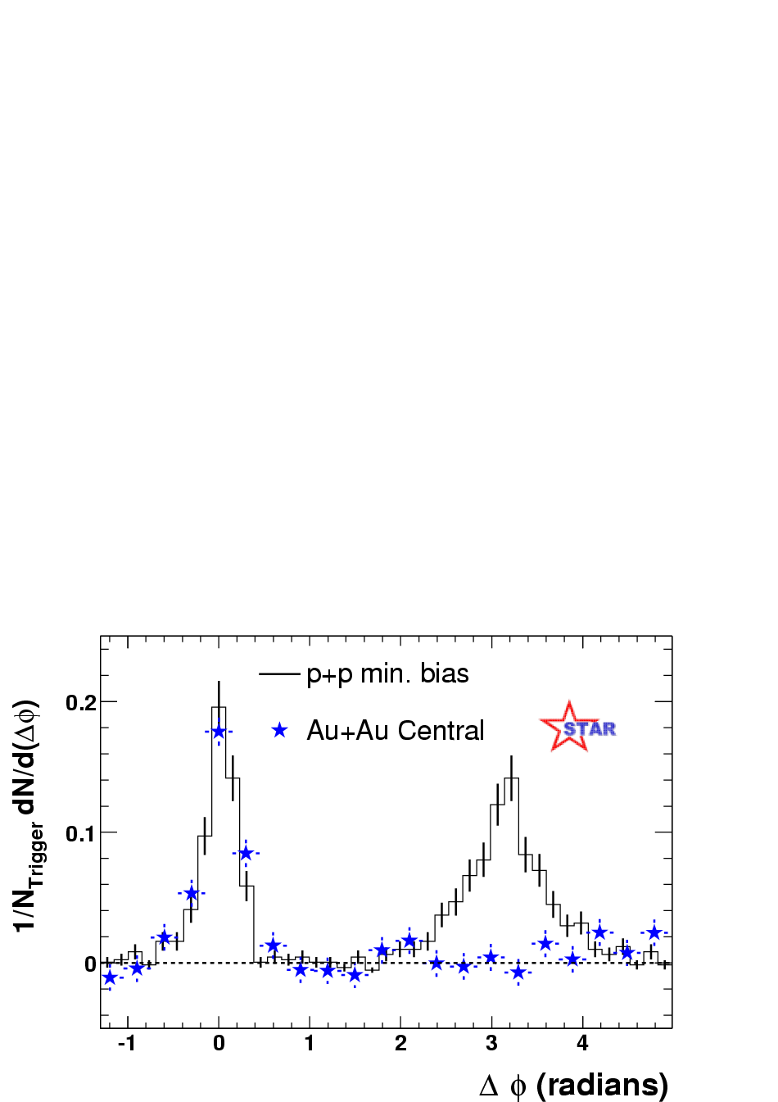
Dihadron correlations
4.0<p_{T}^{trig}<6.0 GeV/c
Phys.Rev.Lett.93:252301,2004
Phys. Rev. C 94, 011901(R) 2016

Slide 24
ALICE data
Joel Mazer: Hot Quarks 2016, Quark Matter 2017

Slide 25
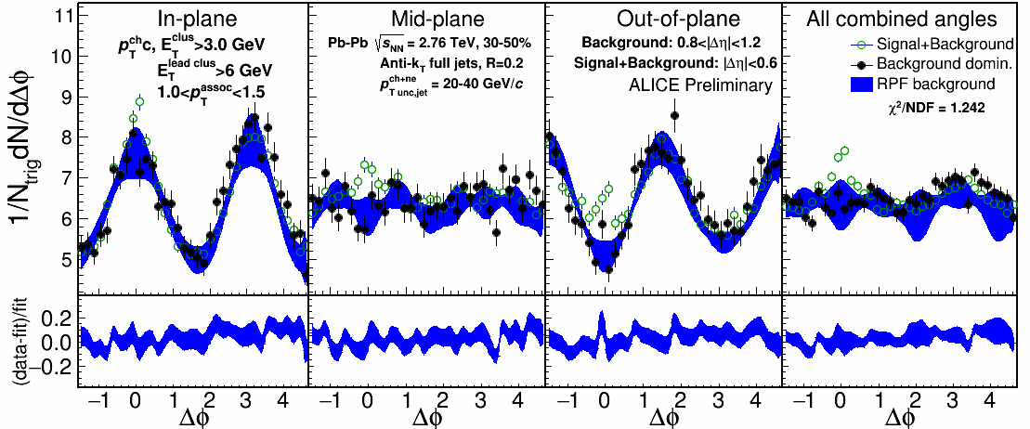
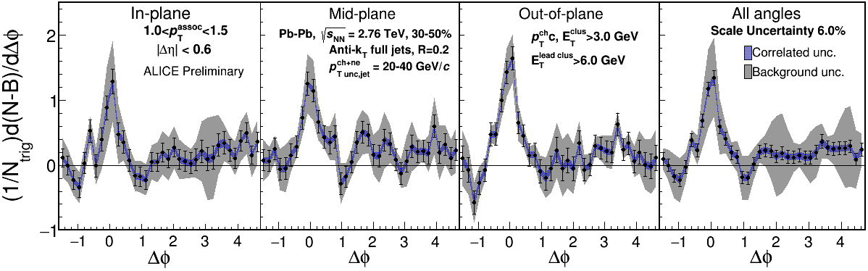
1.0-1.5 GeV/c
1) signal+bkgrd
2) bkgrd dominated
3) bkgrd RPF fit
Correlation function
Uncertainties dominated by statistics
Background uncertainty is non-trivially correlated point-to-point

Slide 26
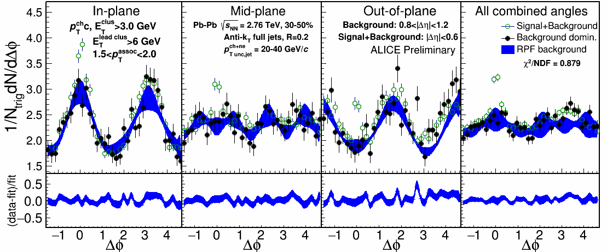
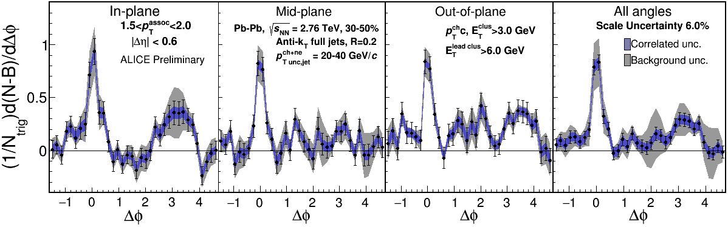
1.5-2.0 GeV/c
1) signal+bkgrd
2) bkgrd dominated
3) bkgrd RPF fit
Correlation function
v₃ and v₄ components important
Background uncertainty is non-trivially correlated point-to-point

Slide 27
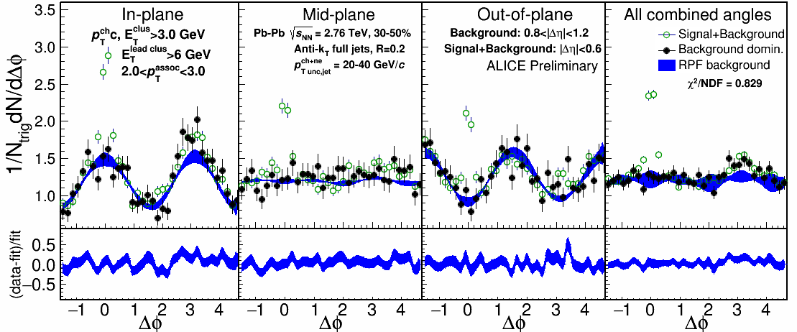
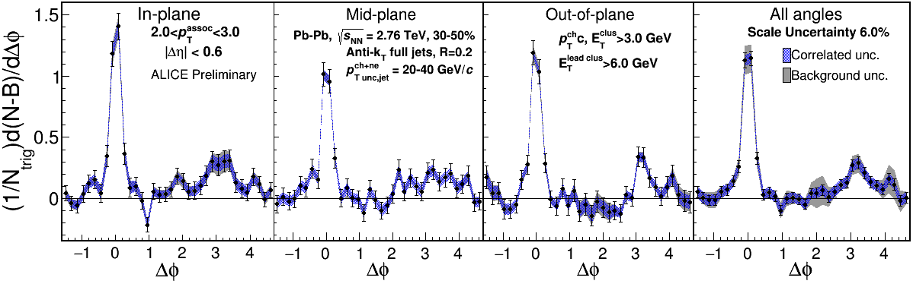
2.0-3.0 GeV/c
1) signal+bkgrd
2) bkgrd dominated
3) bkgrd RPF fit
Correlation function
Away side clearly there and suppressed

Slide 28
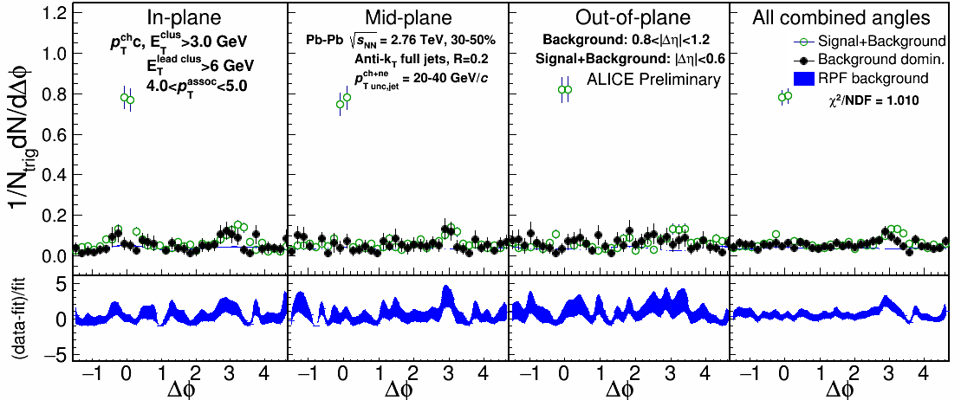
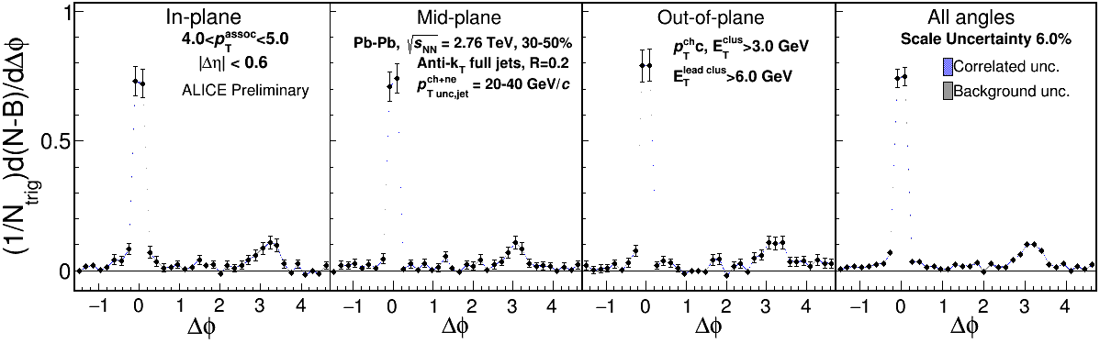
4.0-5.0 GeV/c
1) signal+bkgrd
2) bkgrd dominated
3) bkgrd RPF fit
Correlation function
Background level negligible

Slide 29
What about flow?

Slide 30
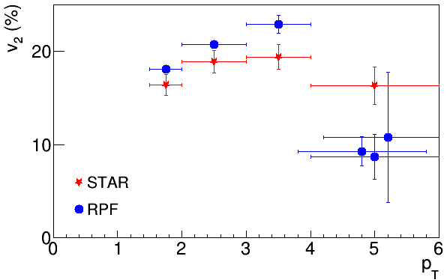
v_{n} from RPF method
Different v_{n} from RPF method for h-h correlations
Same v_{n} as inclusive studies from RPF for jet-h correlations

Slide 31
One of the following must be true:
v_{n}^{jet} ≠ v_{n}^{bkgd}
  Dihadron correlations:
    Background: J-B, B-J, B-B
    Signal: J-J
  Jet-hadron correlations: fake jets negligible
    Background: J-B
    Signal: J-J
Hard and soft rxn planes decorrelated
  Soft rxn plane reconstructed
Reaction plane measurements may include effects from jets
Events with jets have different flow

Slide 32
Conclusions
Conclusions
RPF method is robust
  Allows studies of away side
  Move beyond ZYAM.
Precision correlation studies possible
  No more Mach cone!
Jets exhibit little/no reaction plane dependence
Something interesting is going on with flow

Slide 33
Toy model

Slide 34
Model for signal
Use PYTHIA Perugia 2011
π±, K±,`p, p for unidentified hadrons
Quarks and gluons as proxy for reconstructed jets
h-h
√s = 2.76 TeV
pp collisions
8<p_{T}^{trigger}<10 GeV/c
1<p_{T}^{assoc}<2 GeV/c

Slide 35
Model for background
True reaction plane angle is always at φ=0 in detector coordinates
Throw random reconstructed reaction plane angle
  Assume Gaussian reaction plane resolution
  Selected to approximate data
Use measured particle yields to calculate how many associated particles would be measured
Use measured v_{n} to determine their anisotropy relative to the reaction plane
Throw associated particles matching distribution observed in data using v_{n} up to n=10

Slide 36
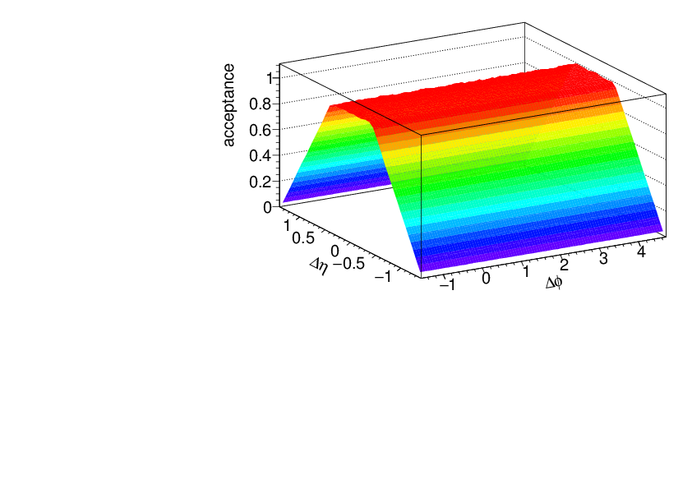
Acceptance correction
Fixed acceptance cuts leads to a trivial structure due to acceptance
This is fixed with a “mixed event” correction
  Throw random trigger, associated particle within acceptance
  Calculate Δφ, Δη
  Use this distribution
  to correct for
  acceptance

Slide 37
Going to lower momenta

Slide 38
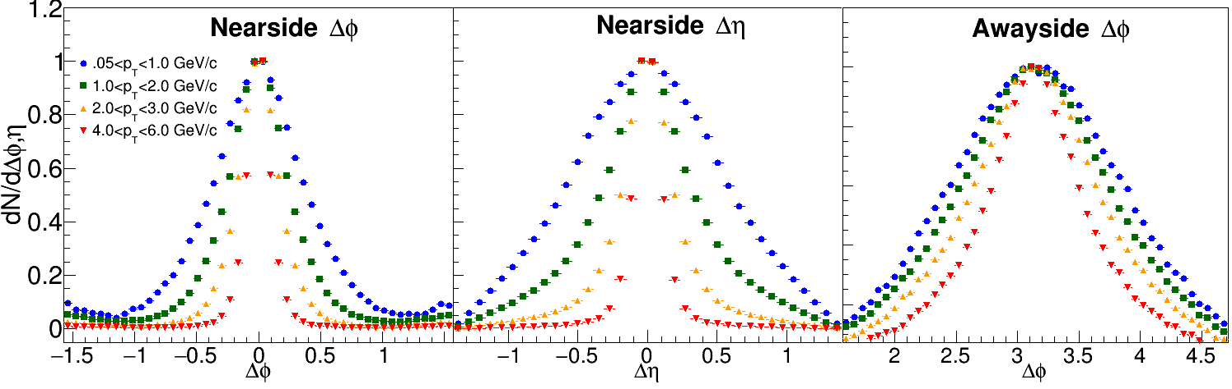
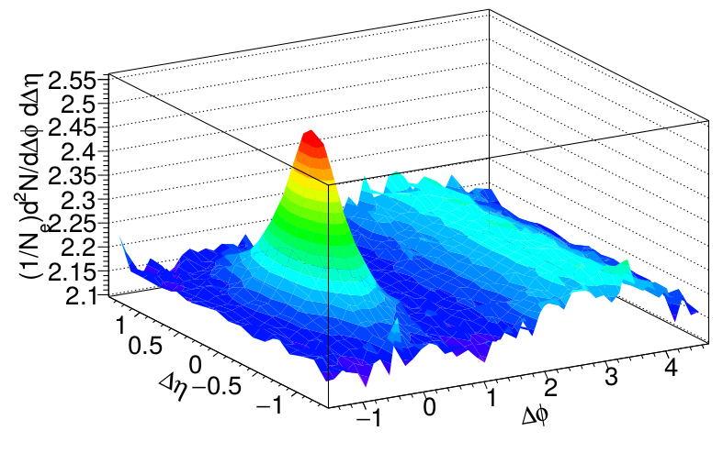
Low momenta
ZYAM assumptions break down at low p_{T}
If method doesn't work on PYTHIA, it can't be trusted on data!
But low p_{T} is interesting!
h-h
√s_{NN} = 2.76 TeV
30-40% PbPb
8<p_{T}^{trigger}<10 GeV/c
0.5<p_{T}^{assoc}<1 GeV/c

Slide 39
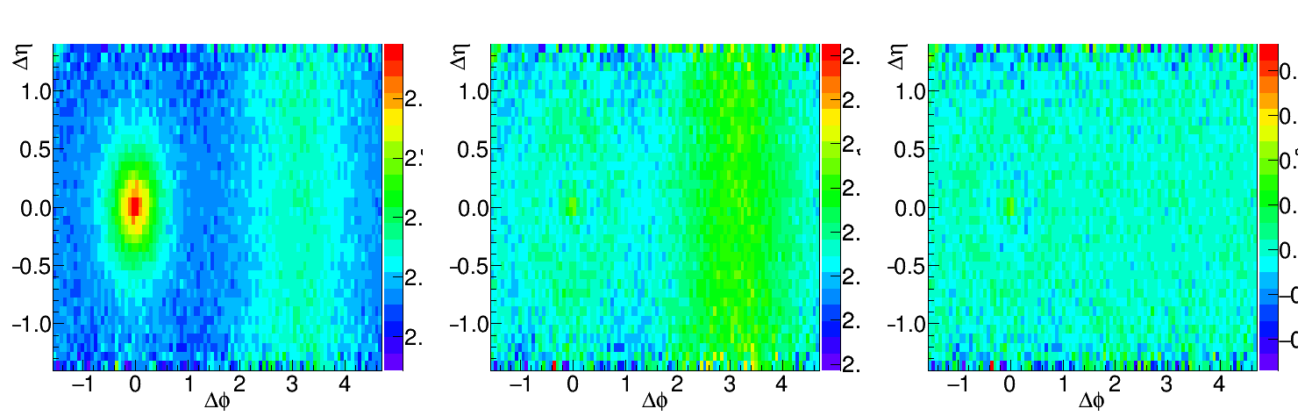
Going to lower momenta, medium modifications
Peak gets broader
Fit near-side peak and subtract it
Increase Δη range available for background subtraction
Before subtraction
After subtraction
Data/Fit
h-h, √s_{NN} = 2.76 TeV, 0-10% PbPb
8<p_{T}^{trigger}<10 GeV/c
1<p_{T}^{assoc}<2 GeV/c for background, 0.5<p_{T}^{assoc}<1.0 GeV/c for signal
Structure from imperfect fit

Slide 40
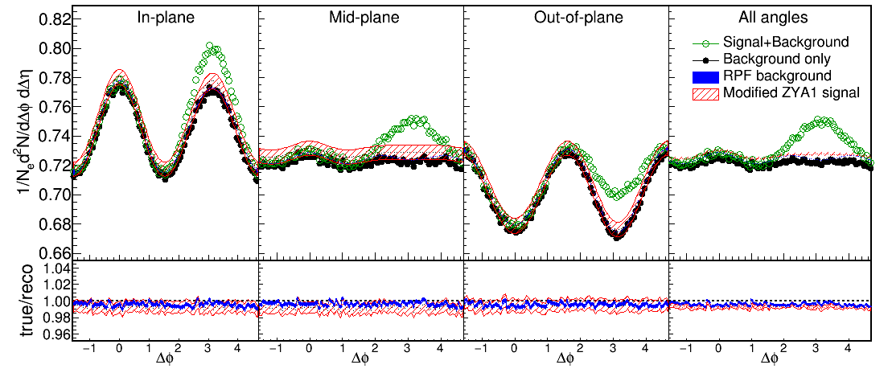
Near-Side Subtracted RPF method
30-40% central
h-h, √s_{NN} = 2.76 TeV, 0-10% PbPb
8<p_{T}^{trigger}<10 GeV/c
1<p_{T}^{assoc}<2 GeV/c for background
0.5<p_{T}^{assoc}<1.0 GeV/c for signal
Fit
Project signal+background over 0.0<|Δη|<1.4
Fit background in |Δφ|<1 including reaction plane dependence
v_{n} and B extracted with v_{n} up to n=4

Slide 41
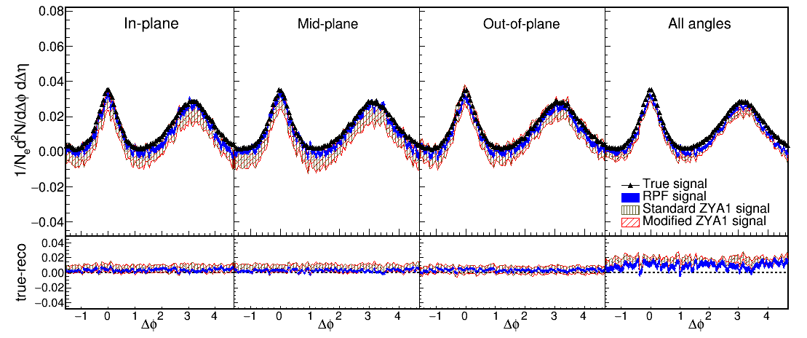
Reaction Plane Fit (RPF) method
30-40% central
h-h
√s_{NN} = 2.76 TeV
30-40% PbPb
8<p_{T}^{trigger}<10 GeV/c
1<p_{T}^{assoc}<2 GeV/c
h-h, √s_{NN} = 2.76 TeV, 0-10% PbPb
8<p_{T}^{trigger}<10 GeV/c
1<p_{T}^{assoc}<2 GeV/c for background
0.5<p_{T}^{assoc}<1.0 GeV/c for signal
Works beautifully!

Slide 42
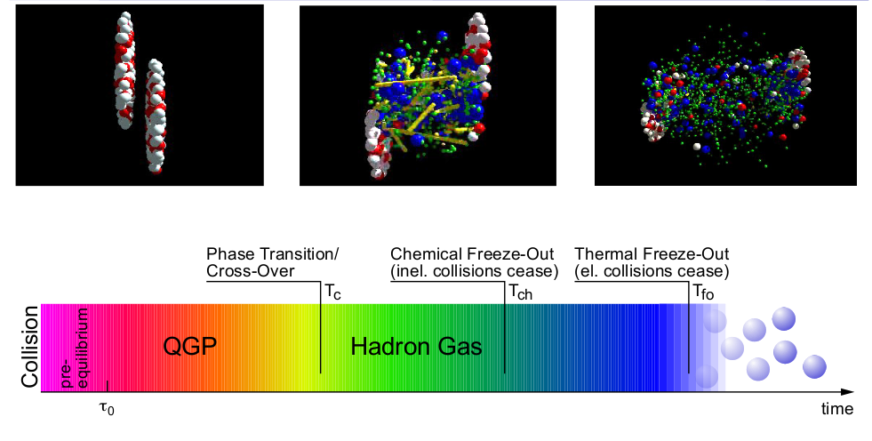
Stages of a heavy ion collision
Jets
Flow

Slide 43
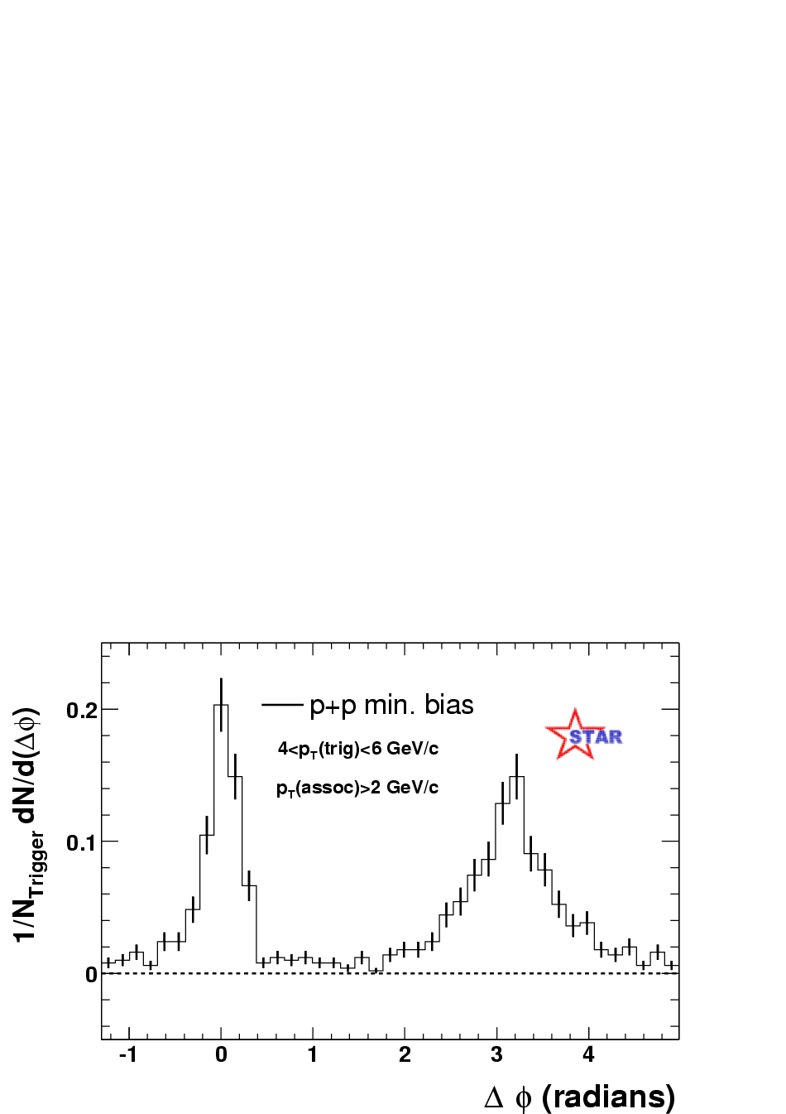
Jets – azimuthal correlations
p+p → dijet
Trigger
trigger
Phys Rev Lett 90, 082302
Associated
Select high momentum particles → biased towards jets

Slide 44
Azimuthal correlations
Phys.Rev.Lett.93:252301,2004

Slide 45
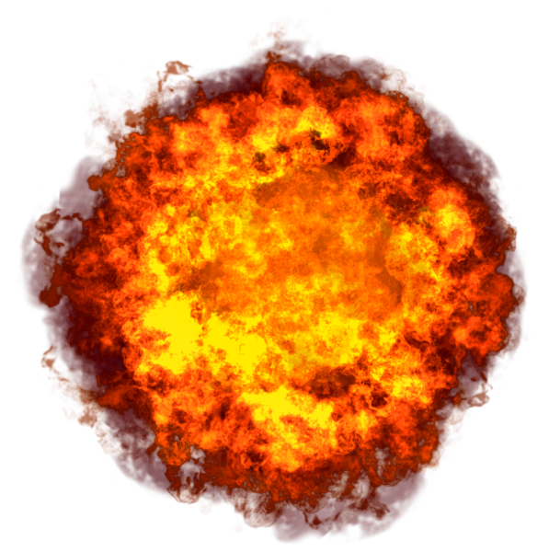

Competing effects
Quenching
Fewer jets, lower yield out of plane
Bremsstrahlung
Softer, higher yield out of plane
Fluctuations
Individual jets' energy loss may vary

Slide 46
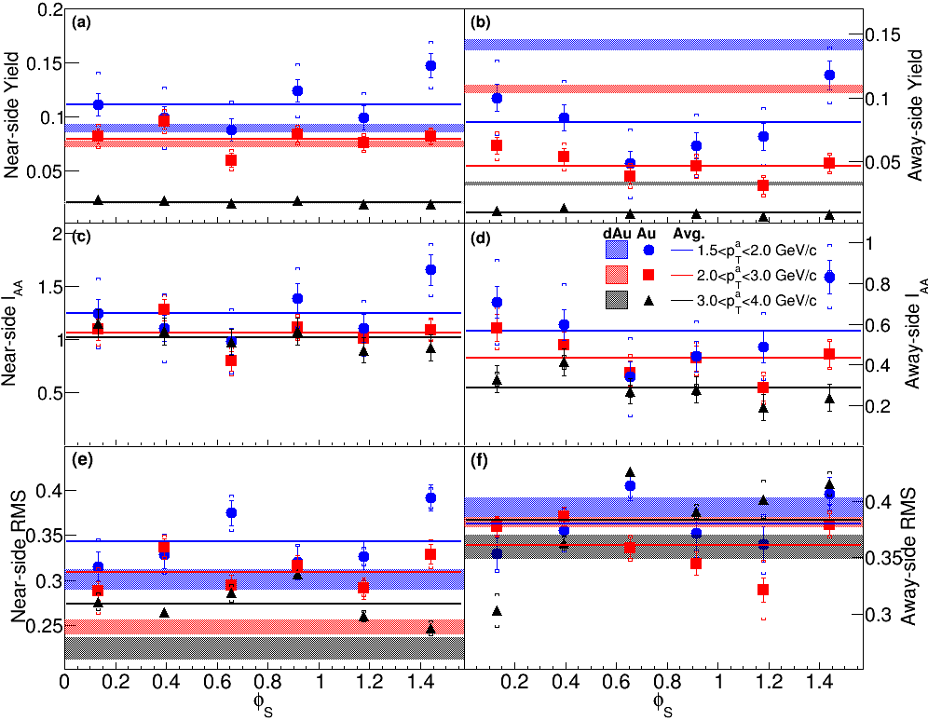
Dihadron correlations
Phys. Rev. C 94, 011901(R) 2016

Slide 47
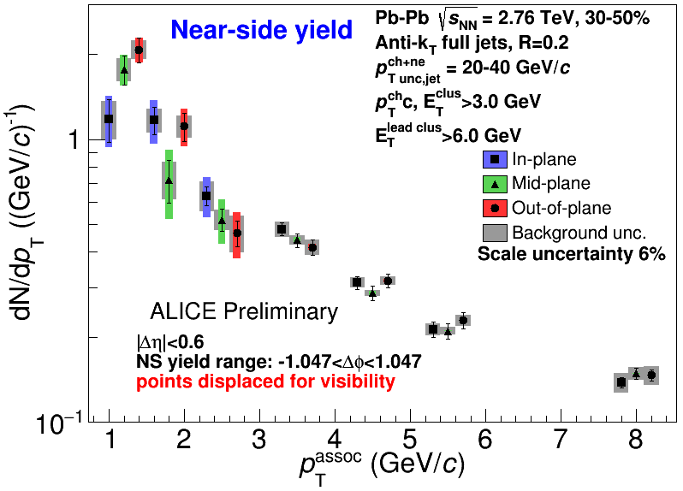
Near-side jet yields vs EP
Jets 20-40 GeV/c, 30-50% centrality
Within uncertainties of
current statistics, no
event plane ordering
Different effects in
different p_{T} associated
bins
Competing effects
1) Quenching
2) Bremsstrahlung
3) etc

Slide 48
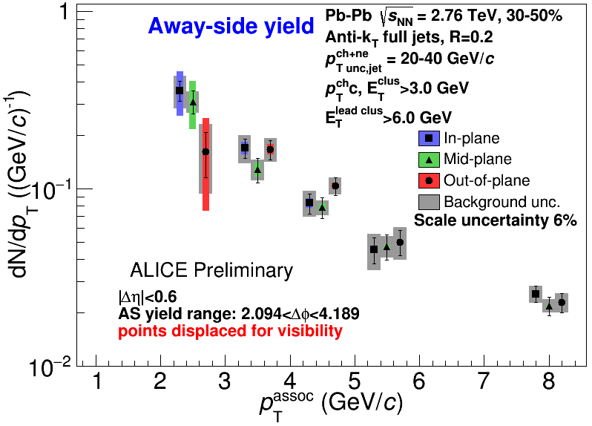
Away-side jet yields vs EP
Jets 20-40 GeV/c, 30-50% centrality
Within uncertainties of
current statistics, no
event plane ordering
Different effects in
different p_{T} associated
bins
Competing effects
1) Quenching
2) Bremsstrahlung
3) etc

Slide 49
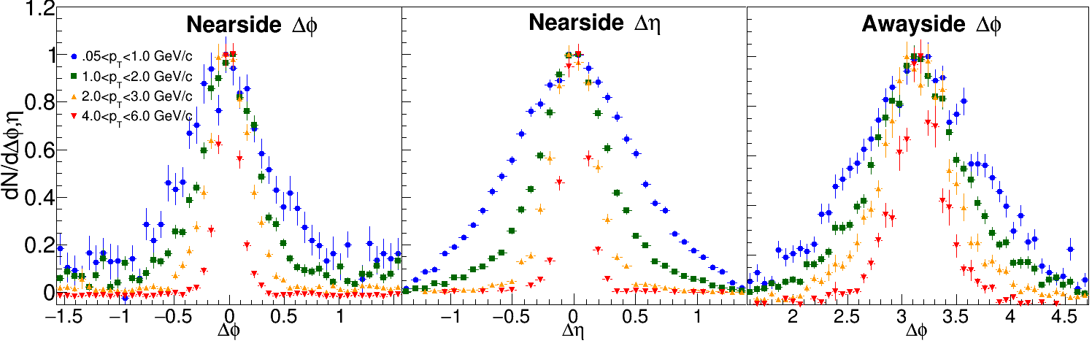
PYTHIA at 200 GeV
8<p_{T}^{t}<10 GeV/c

Slide 50
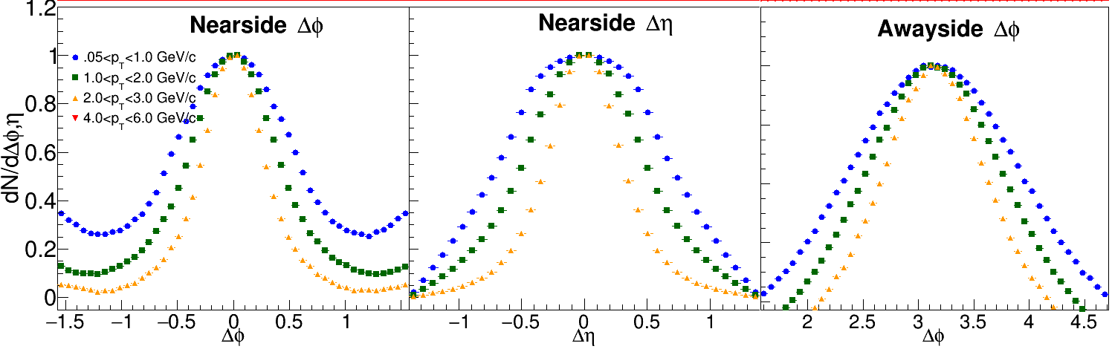
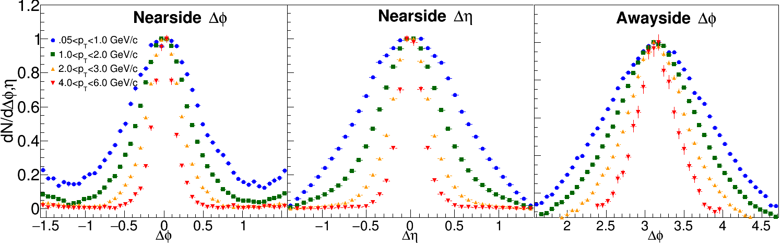
PYTHIA at 200 GeV
3<p_{T}^{t}<4 GeV/c
4<p_{T}^{t}<6 GeV/c

Slide 51


Near-Side Subtracted NSF method
h-h, √s_{NN} = 2.76 TeV, 0-10% PbPb
8<p_{T}^{trigger}<10 GeV/c
1<p_{T}^{assoc}<2 GeV/c for background
0.5<p_{T}^{assoc}<1.0 GeV/c for signal
Project signal+background over 0.0<|Δη|<1.4
Fit background in |Δφ|<1 including reaction plane dependence
Bias from residual contamination by near-side

Slide 52

Correlations - STAR
Green: d+Au, Red: Au+Au
Large error bars
“Mach Cone” evident, even decrease in amplitude for higher p_{T}^{t}

Slide 53



Background subtracted correlations 4<p_{T}^{t}<6 GeV/c
1.5<p_{T}ª<2.0 GeV/c
2.0<p_{T}ª<3.0 GeV/c
3.0<p_{T}ª<4.0 GeV/c
Yellow bands: uncertainty in rescaling of background
Statistical error bars include correlated statistical error on background
No “Mach Cone”

Slide 54

STAR

Slide 55
RPF Method
6 bins relative to reaction plane
Background level
  Normalized per trigger → B same in all bins if v₂^{t} is the only effect → reduces info for RPF
  “The background levels can be different for the different φ_{s} slices because of the net effect of the variations in jet-quenching with φ_{s} and the centrality cuts in total charged particle multiplicity in the TPC within |η| < 0.5.” (Pg. 10, arxiv version) → Not consistent with ZYAM assumptions!
Used reaction plane resolution values from paper and their uncertainties
  Used TPC for reaction plane and analysis – potential autocorrelations
Data available for Δη< 0.7 (signal+background) and 0.7<Δη< 2 (background dominated)
  Acceptance correction in not applied → background must be scaled → uncertainty
  Jet-like correlation not eliminated in 0.7<Δη< 2 for all p_{T}^{t}, p_{T}ª given in paper → focus on high p_{T}

Slide 56
v₂ STAR vs Fit
 | v₂ STAR (Table I) | v₂ Fit (stat. errors only)
1.5<p_{T}<2.0 GeV/c | 0.164 ± 0.011 | 0.194 ± 0.008
2.0<p_{T}<3.0 GeV/c | 0.189 ± 0.012 | 0.237 ± 0.010
3.0<p_{T}<4.0 GeV/c | 0.194 ± 0.013 | 0.293 ± 0.058
4.0<p_{T}<6.0 GeV/c | 0.163 ± 0.020 | 0.073 ± 0.025 0.036 ± 0.033 0.033 ± 0.068
Centrality bin is 20-60% - proper weighting of average?
Bias in event selection with high p_{T} trigger?
Bias in reconstructed reaction plane in the presence of a jet?
Residual jet-like signal in background dominated region?
Less information in fit due to normalization by N_{trigger}?

Slide 57
Jets – azimuthal correlations
p+p → dijet
Trigger
trigger
Phys Rev Lett 90, 082302
Associated
Select high momentum particles → biased towards jets

Slide 58
Azimuthal correlations
Phys.Rev.Lett.93:252301,2004

Slide 59
Dihadron correlations
4.0<p_{T}^{trig}<6.0 GeV/c
Phys.Rev.Lett.93:252301,2004
Phys. Rev. C 94, 011901(R) 2016
Sharma, Mazer, Stuart, Nattrass: (Phys. Rev. C 93, 044915 2016)

Slide 60
Dihadron correlations
Phys. Rev. C 94, 011901(R) 2016

Slide 61
2.0-3.0 GeV/c
1) signal+bkgrd
2) bkgrd dominated
3) bkgrd RPF fit
Correlation function
Joel Mazer
Hot Quarks 2016
Away side clearly there and suppressed

Slide 62
Away-side jet yields vs EP
Jets 20-40 GeV/c, 30-50% centrality
Within uncertainties of
current statistics, no
event plane ordering
Different effects in
different p_{T} associated
bins
Competing effects
1) Quenching
2) Bremsstrahlung
3) etc
Joel Mazer
Hot Quarks 2016

Slide 63
Little/no path length dependence?
Path length dependence naively predicted by every model
  No path length dependence seen in rxn plane dependent A_{j} either
Insufficient sensitivity?
Statistical variation in energy loss is more important than path length dependence
  J. G. Milhano and K. C. Zapp, “Origins of the di-jet asymmetry in heavy ion collisions,” arXiv:1512.08107
  F. Senzel, O. Fochler, J. Uphoff, Z. Xu, and C. Greiner, “Influence of multiple in-medium scattering processes on the momentum imbalance of reconstructed di-jets,” J. Phys. G42 no. 11, (2015) 115104, arXiv:1309.1657 [hep-ph].

Slide 64

http://www.boredpanda.com/animal-camouflage/

Slide 65

Bias
Modified jets probably look more like the medium
Quark jets are narrower, have fewer tracks, fragment harder [Z Phys C 68, 179-201 (1995), Z Phys C 70, 179-196 (1996), ]
Gluon jets reconstructed with k_{T} algorithm have more particles than jets reconstructed with anti-k_{T} algorithm [Phys. Rev. D 45, 1448 (1992)]
Gluon jets fragment into more baryons [EPJC 8, 241-254, 1998]
http://www.boredpanda.com/animal-camouflage/

