Slide 1

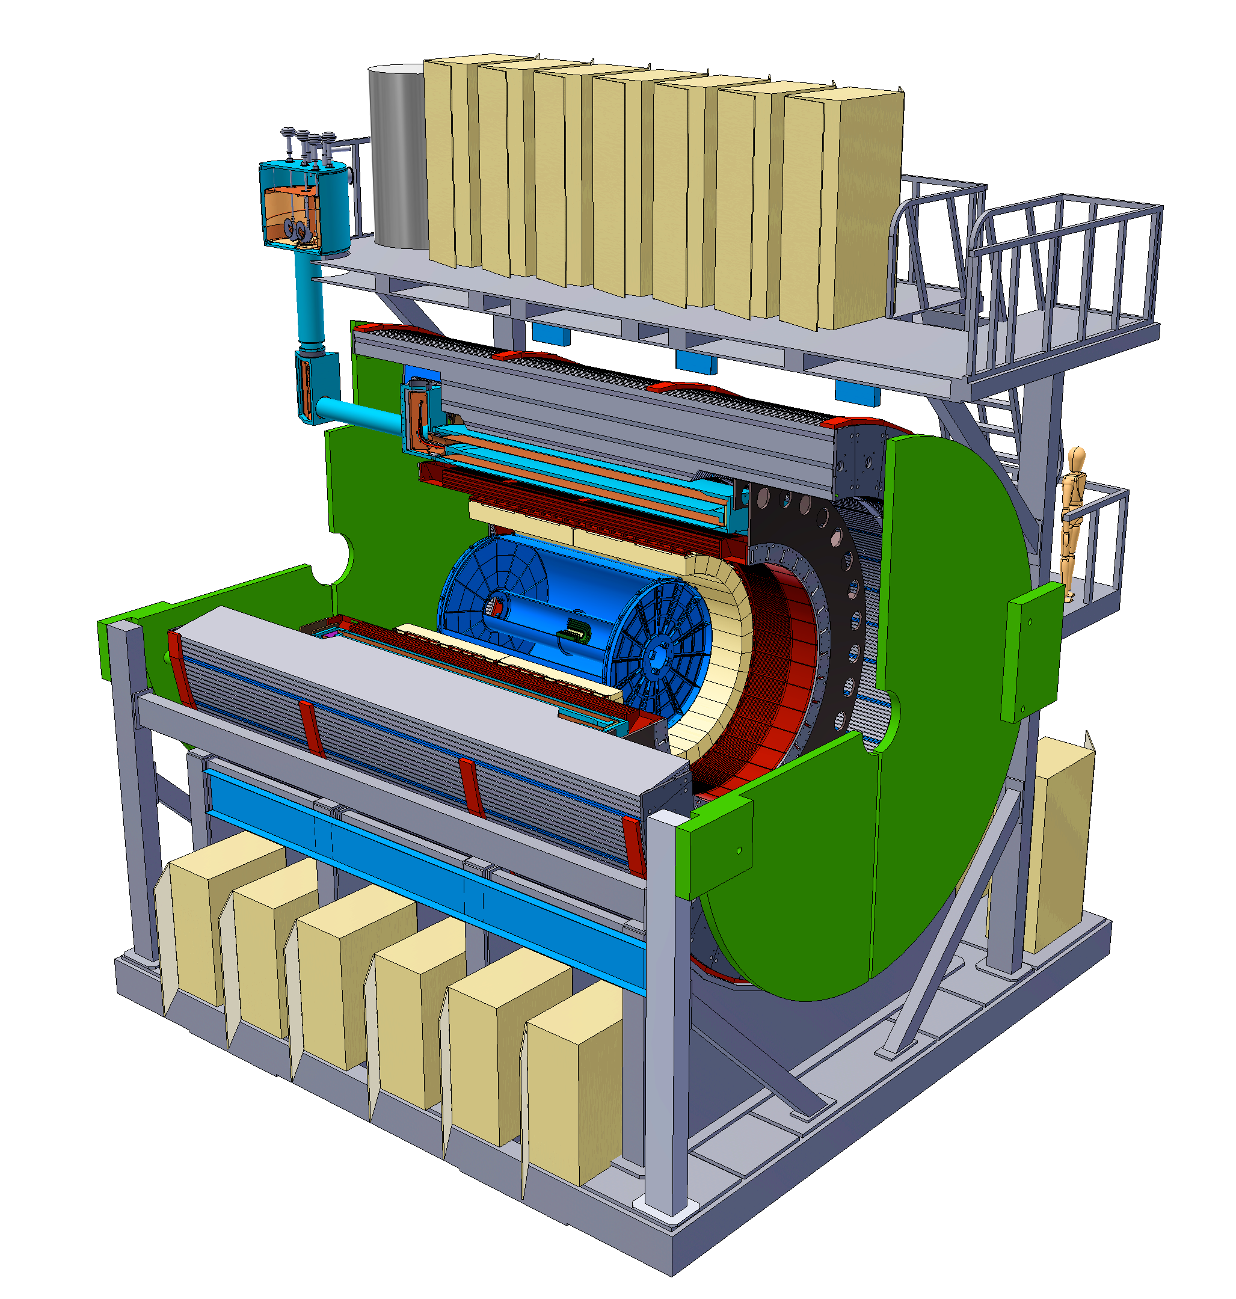
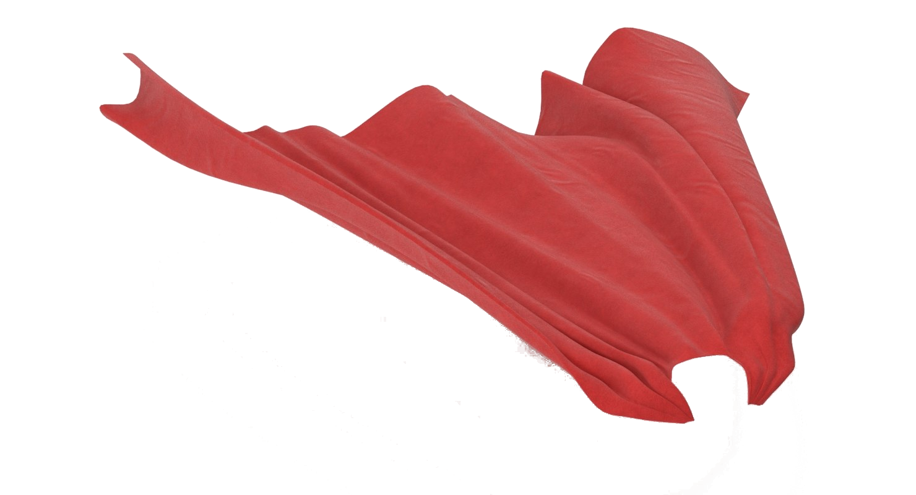
sPHENIX
Christine Nattrass
For the sPHENIX Collaboration

Slide 2
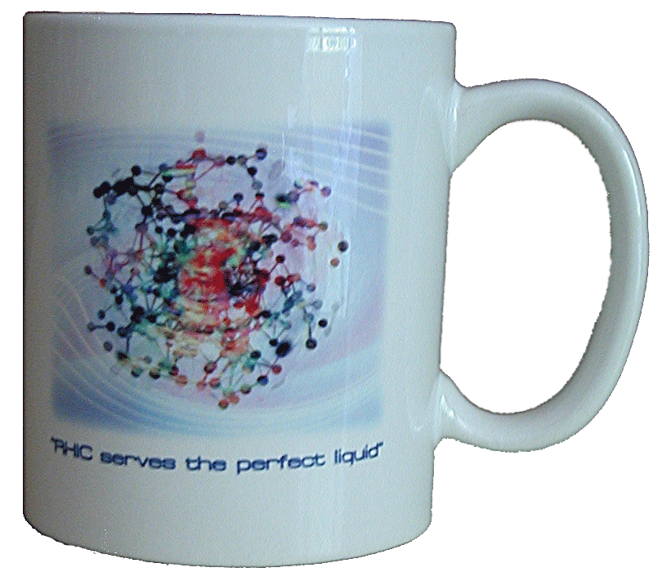


What have we learned from RHIC
Some of
Phys.Rev.Lett.93:252301,2004
The QGP is the perfect liquid!
Jet quenching

Slide 3
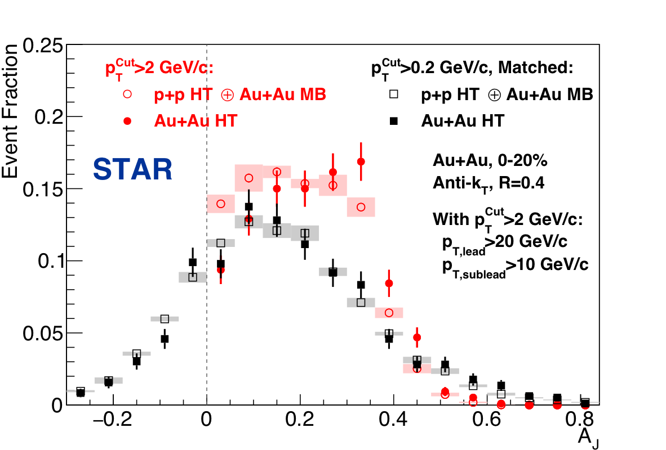
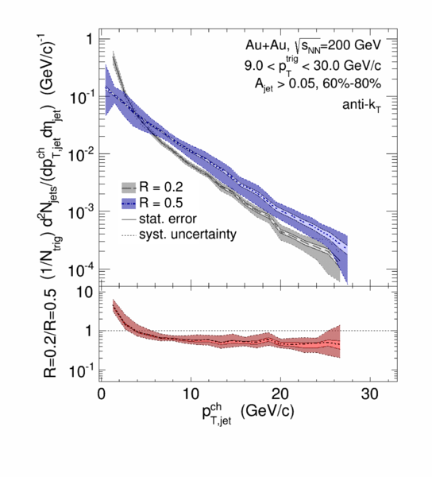
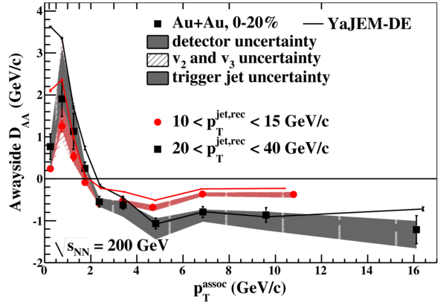
Some of
What have we learned from RHIC
Di-jet asymmetries
Hadron-jet correlations
Phys. Rev. Lett. 119 (2017) 62301
Jet-hadron correlations
Phys. Rev. C 96 (2017) 24905
Phys. Rev. Lett. 112 (2014) 122301
3 published measurements of reconstructed jets

Slide 4


What we haven’t learned from RHIC
Yet!
Jet R_{AA}

Slide 5

What we haven’t learned from RHIC
Yet!
Quarkonia
Melting point (GeV)
CMS-PAS HIN-12-014, HIN-12-007

Slide 6

Understanding the QGP
Global observables
Spectra, strangeness
Jets
Quarkonia
Soft probes
Hard probes

Slide 7

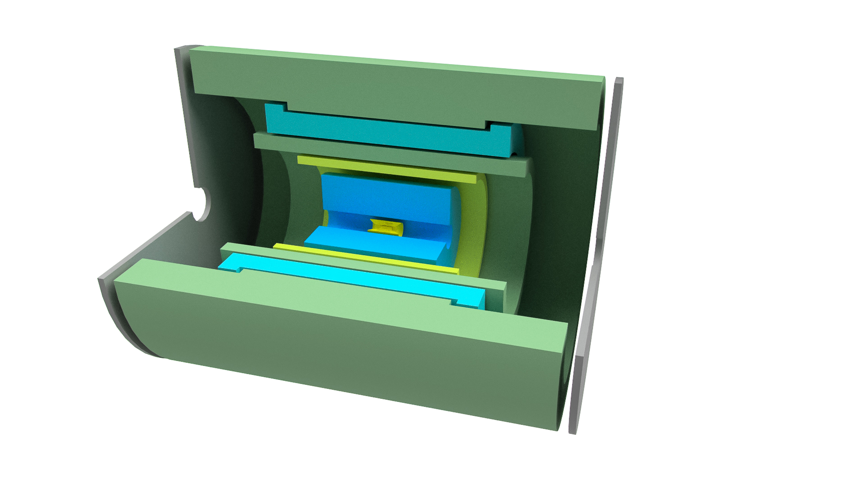
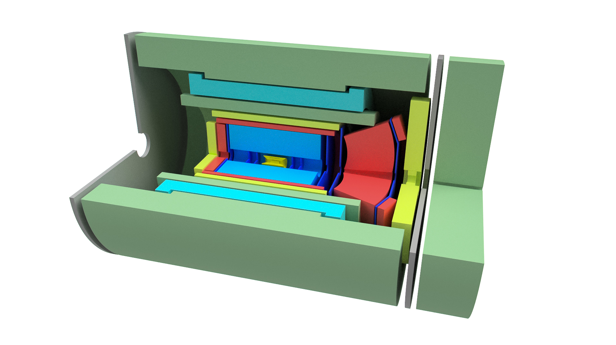
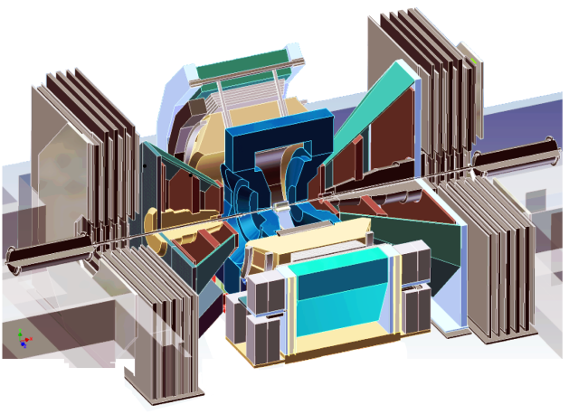
Evolution of the PHENIX Interaction region
PHENIX experiment
An EIC detector
16y+ operation
Broad spectrum of physics (QGP, Hadron Physics, DM)
170+ physics papers with 24k citations
Last run in this form 2016
Comprehensive central upgrade base on BaBar magnet
Rich jet and HF physics program
→ nature of QGP
Possible forward tracking, and calorimeter → Spin, CNM
Path of PHENIX upgrade leads to a capable EIC detector
Large coverage of tracking, calorimetry and PID
Update LOI this year, open to new collaborators/new ideas
arXiv:1501.06197 [nucl-ex]
arXiv:1402.1209 [nucl-ex]
~2000
2017→2022, CD-0 @ 2016
>2025
Time
RHIC: A+A, spin-polarized p+p, spin-polarized p+A
EIC: e+p, e+A
Notes:
<number>

Slide 8
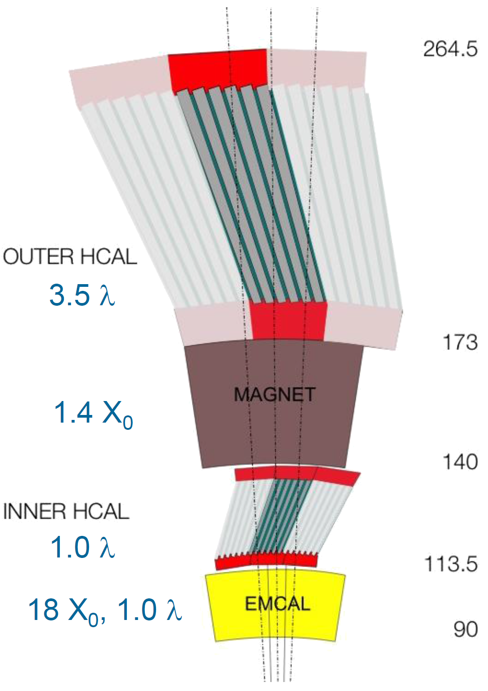
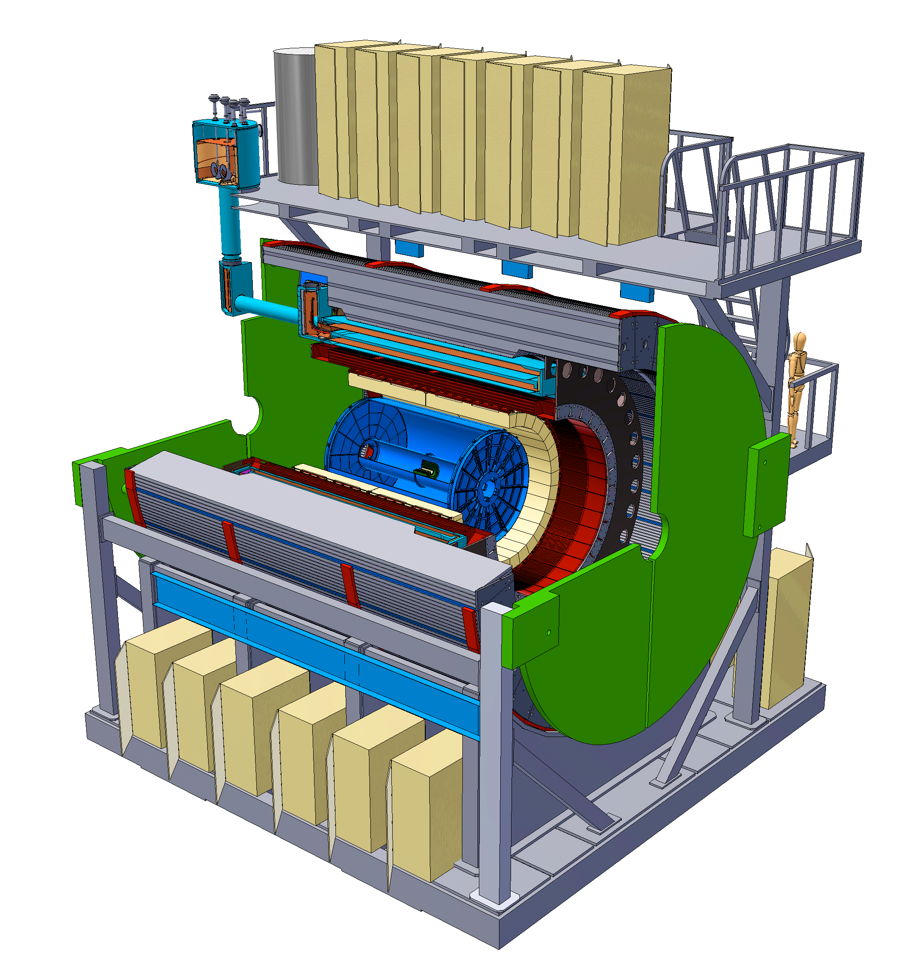
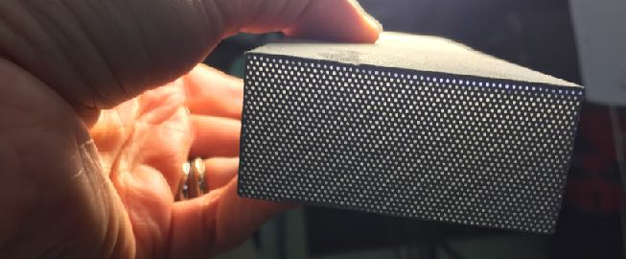
SPHENIX Detector
Radius (cm)
|η|<1.1
B_{z} = 1.4 T
EMCal SPACAL prototype-1

Slide 9
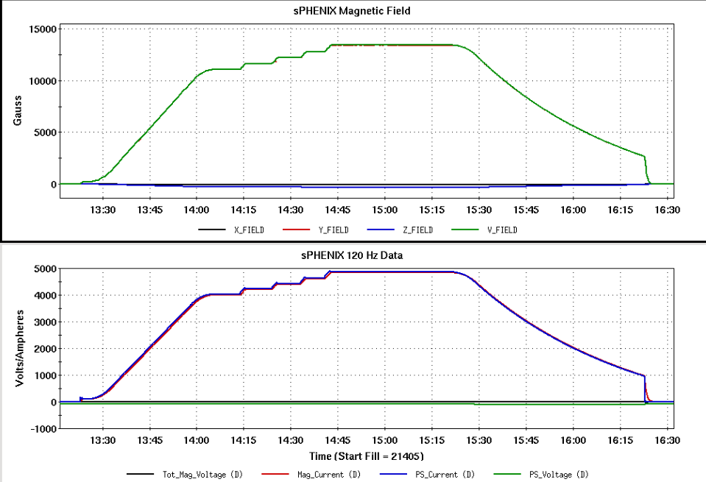
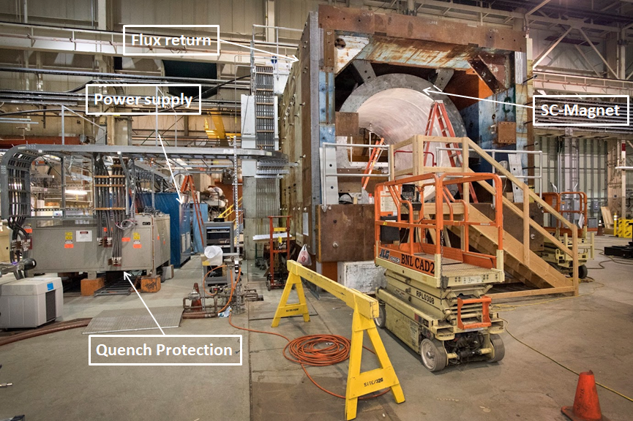
Super conducting magnet
1.4 Tesla magnet, Ф = 2.8 m, L = 3.8 m
Previously used in BaBar @ SLAC
Moved to BNL in Feb 2015
Successful cold low field test in 2016
Full field test in February successful
SC-Magnet Testing ramped the magnet to 105% Full Current twice. We held the magnet at the top current for ~ 40 minutes each time.
Conclusion: The magnet works to spec. PS, control and quench protection system checks out.

Slide 10
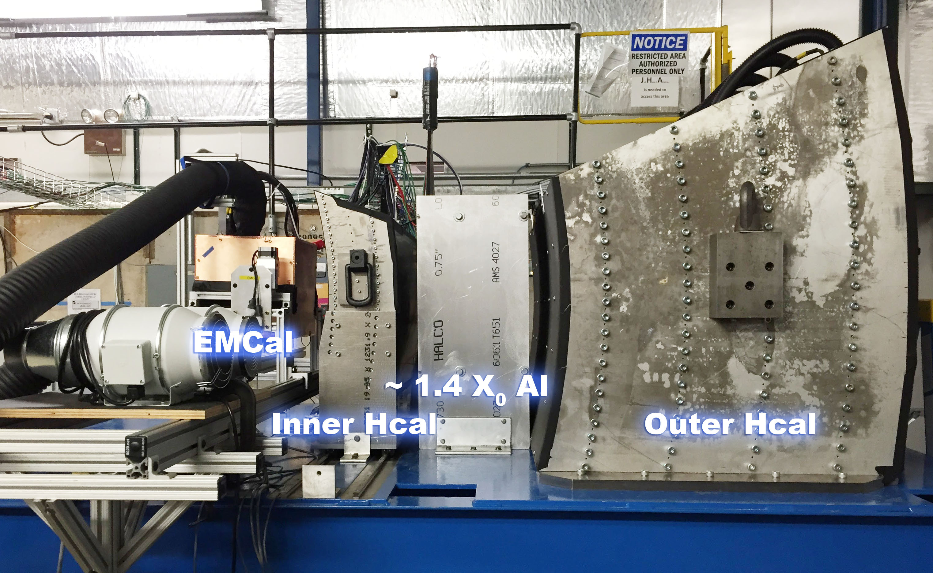
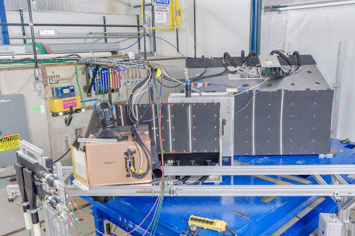
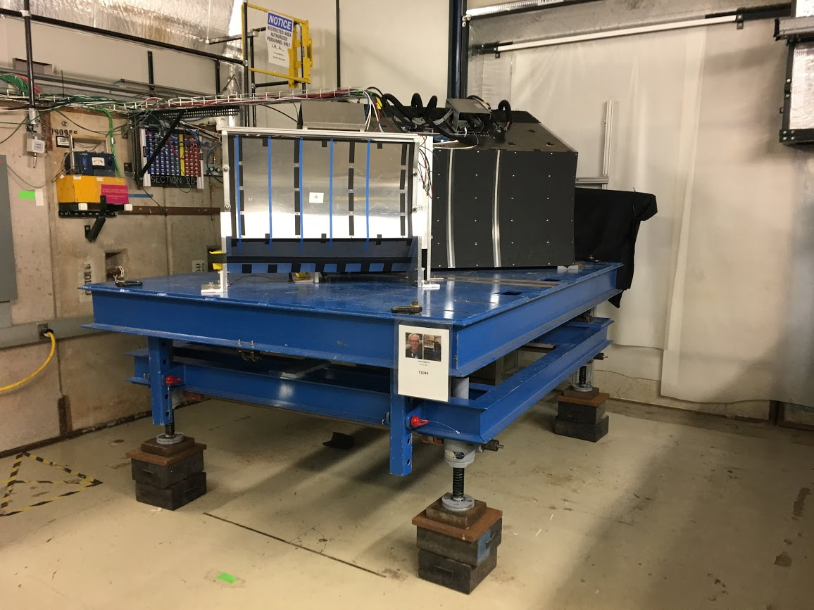
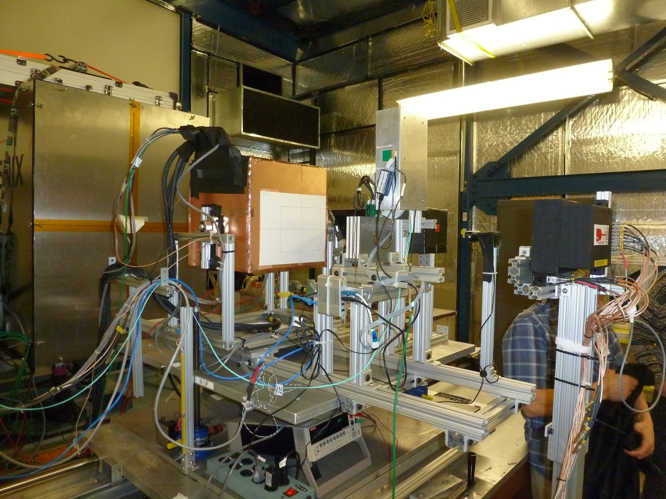
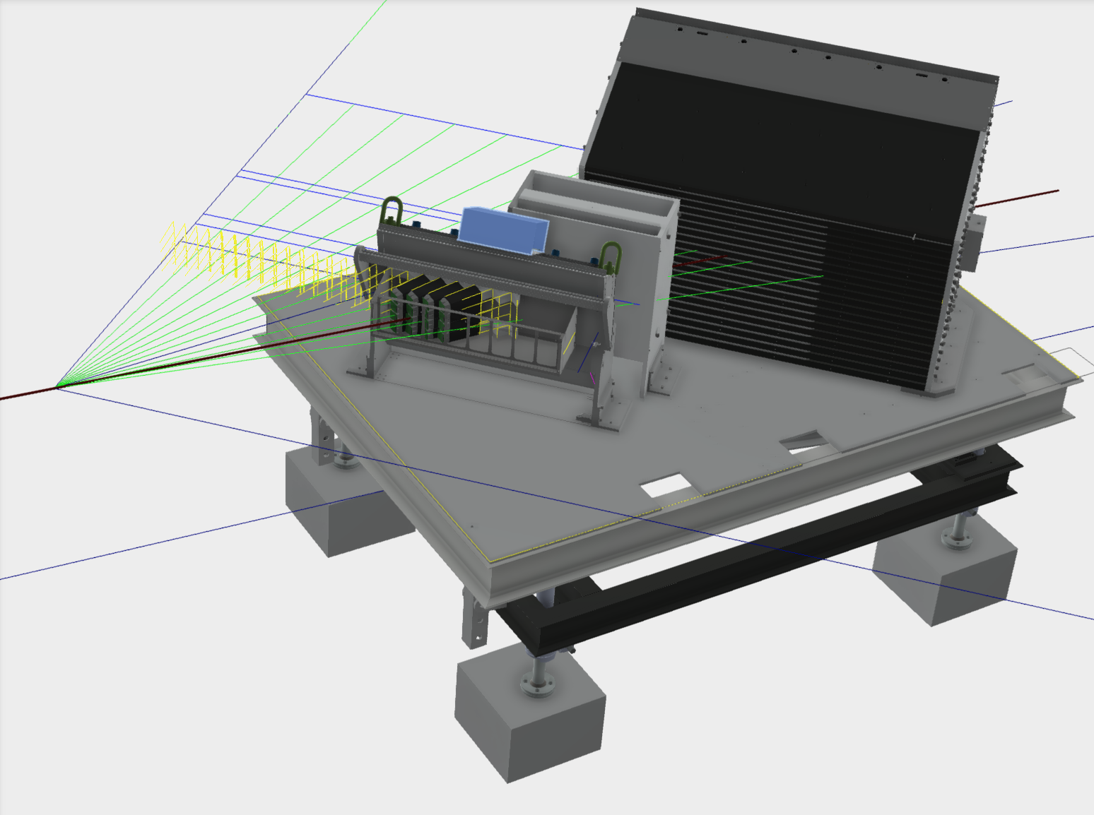
Calorimeter beam tests
February 2014
Proof of principle
February 2016
η~0 prototype
February 2017
η~0.9 prototype
March - June 2017
Final η~0.9 prototype
Electron, Energy resolution
Pion, Energy resolution and linearity

Slide 11
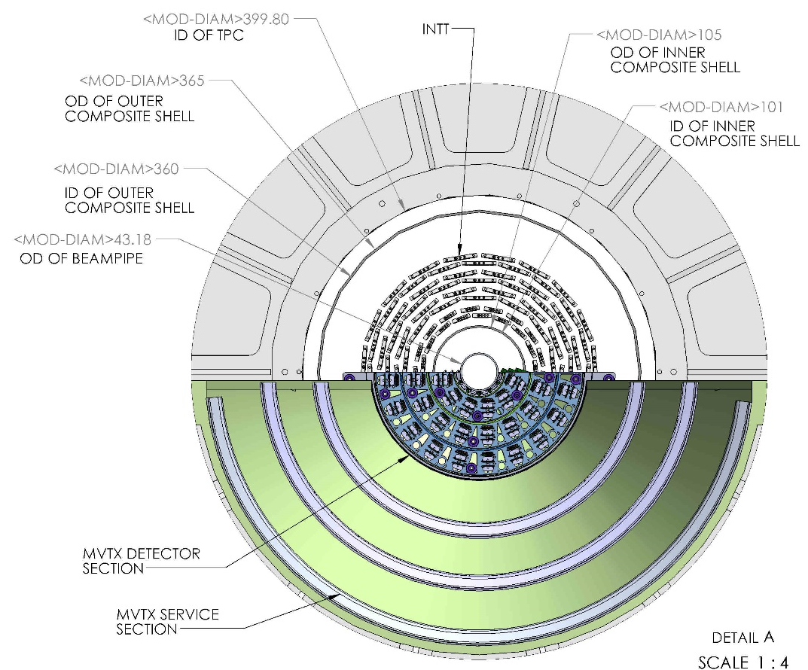
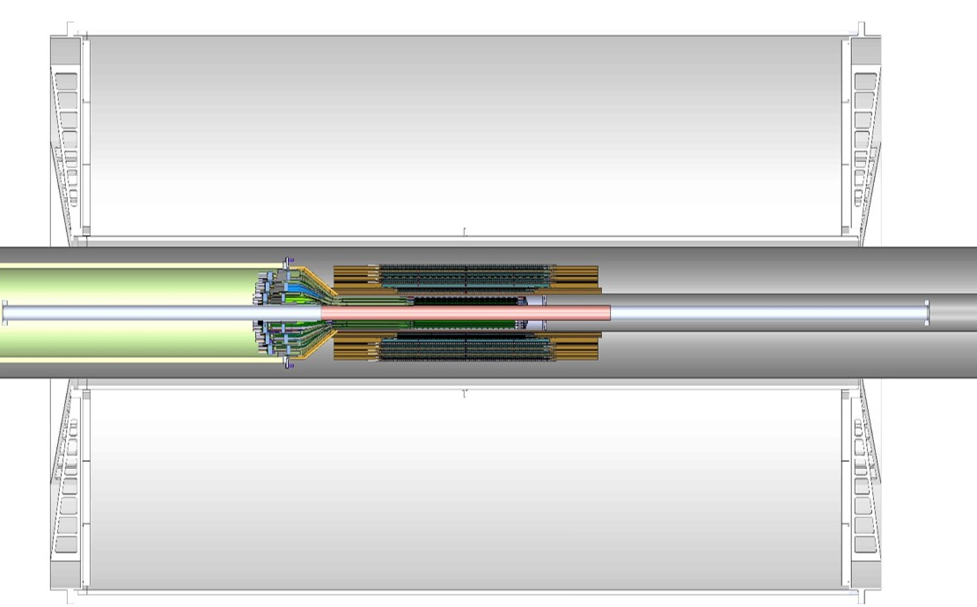
Tracking detectors
Inner tracking:
MVTX: 30-um-pitch MAPS pixel sensors (3-layer)
  Precision vertexing
INTT: strip silicon sensors (4-layer)
  Pattern recognition, timing
DCA^{π}< 50um for p_{T}>1 GeV/c, <10 um for p_{T}>10 GeV/c
Outer tracking:
TPC: gateless and continuous readout
Low diffusion, high ion mobility Ne-CF₄ gas + Quad GEM + mini pads
1 Tbps DAQ, FPGA-based reduction, 100 Gbps data file rate
RδФ < 200 um
δp/p < 2% for p_{T}<10 GeV/c

Slide 12
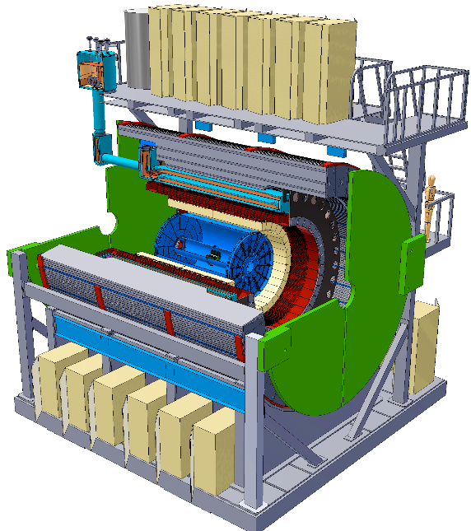

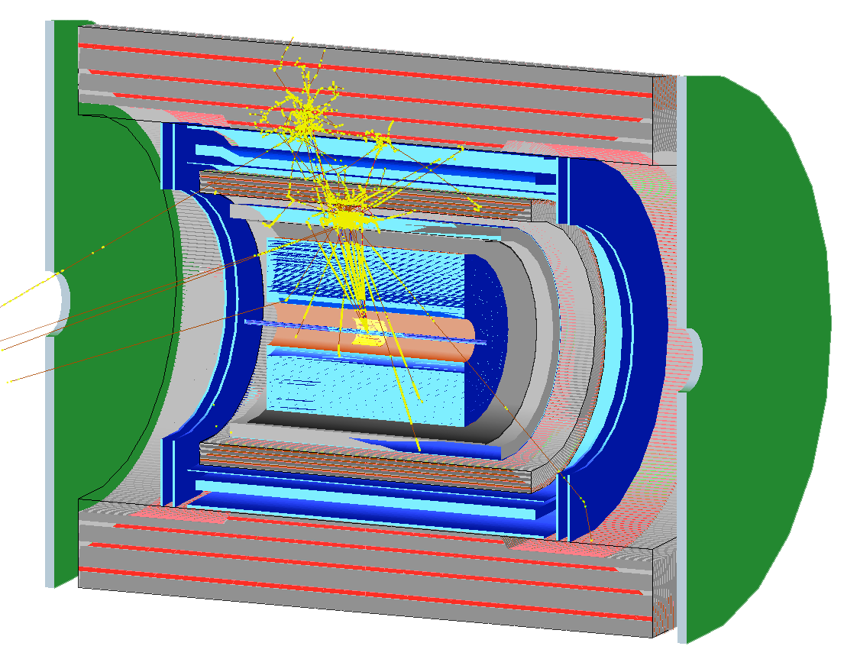
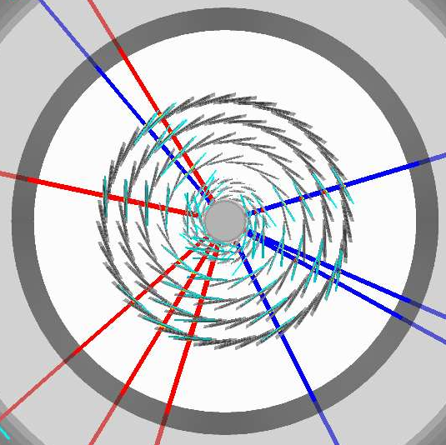
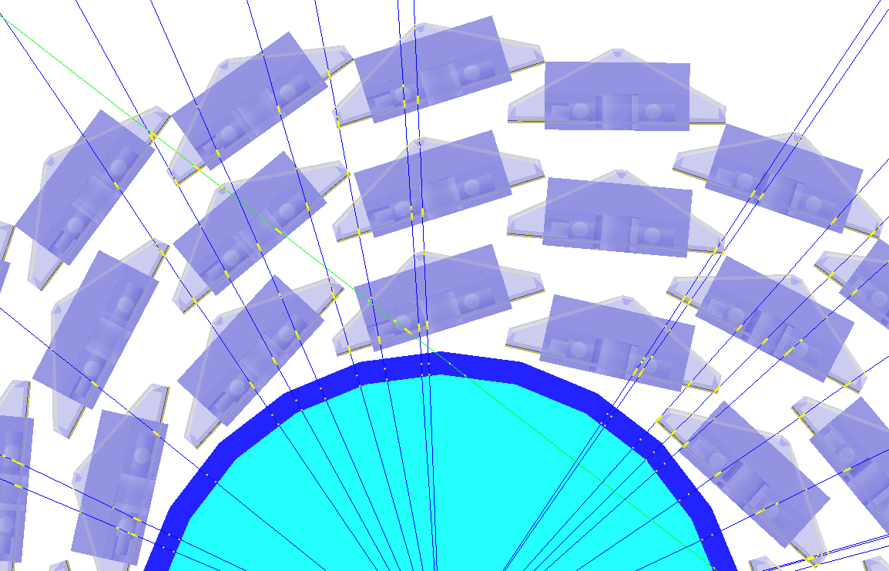
Full detector simulation + reconstruction
Open source @ : https://github.com/sPHENIX-Collaboration/
sPHENIX Geant4 display of p_{T}=30 GeV/c B⁺-hadron
Design to Simulation
Inner tracker (MVTX and INTT) _
_ MVTX Ladders modeled in detail

Slide 13
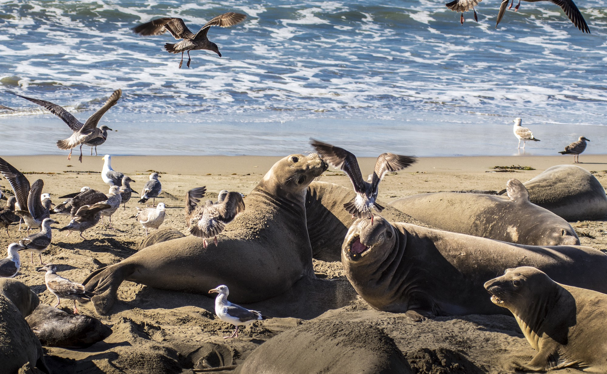
Heavy Flavor

Slide 14
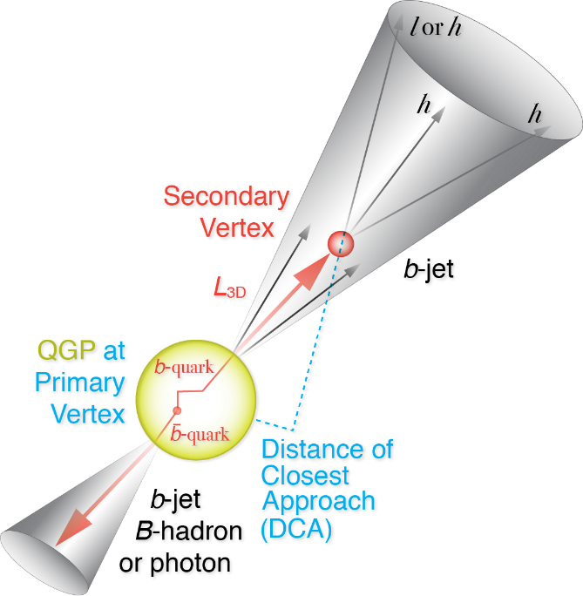
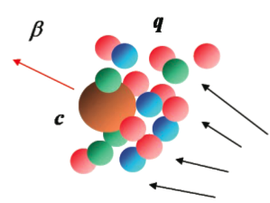
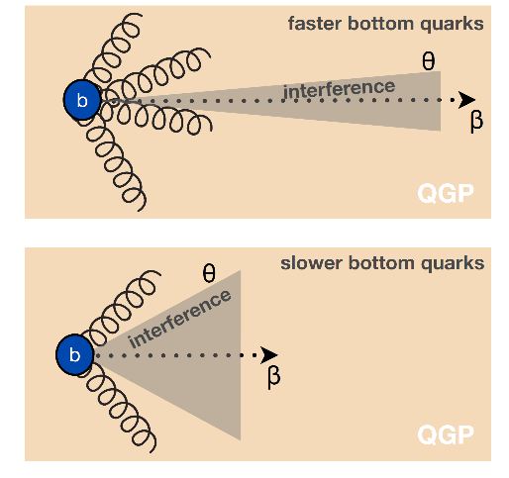
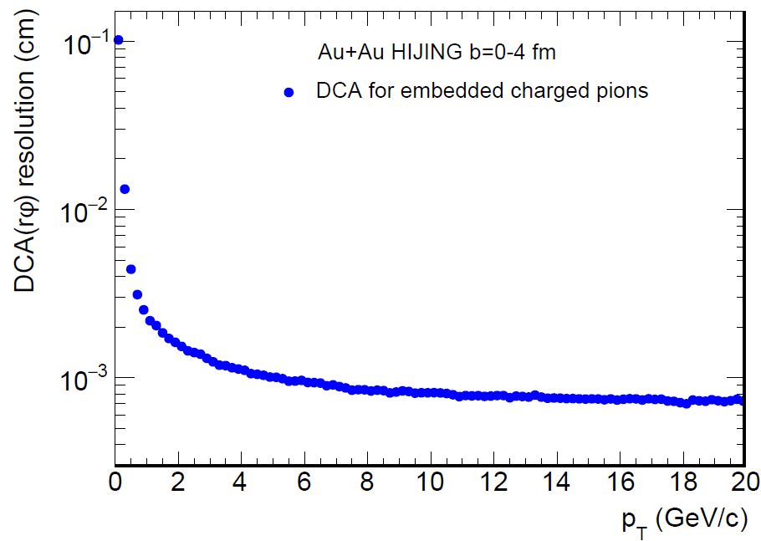
Open heavy flavor observables
Precision vertex tracker + High rate
→ Precision bottom observables
B-meson @ Low p_{T} : diffusion of HF quark in QGP
b-jet @ Higher p_{T}: differentiate collisional vs radiative energy loss

Slide 15
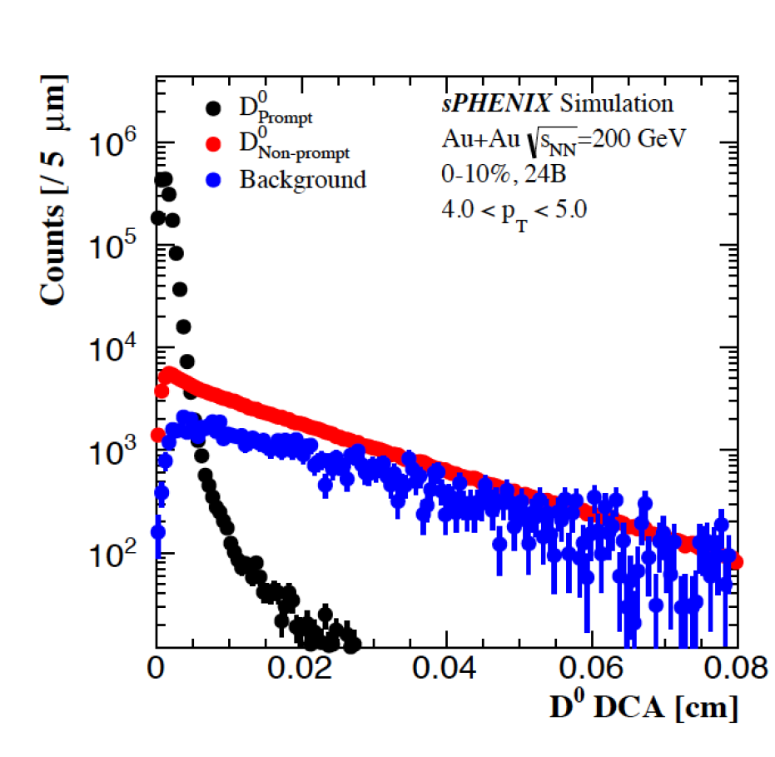
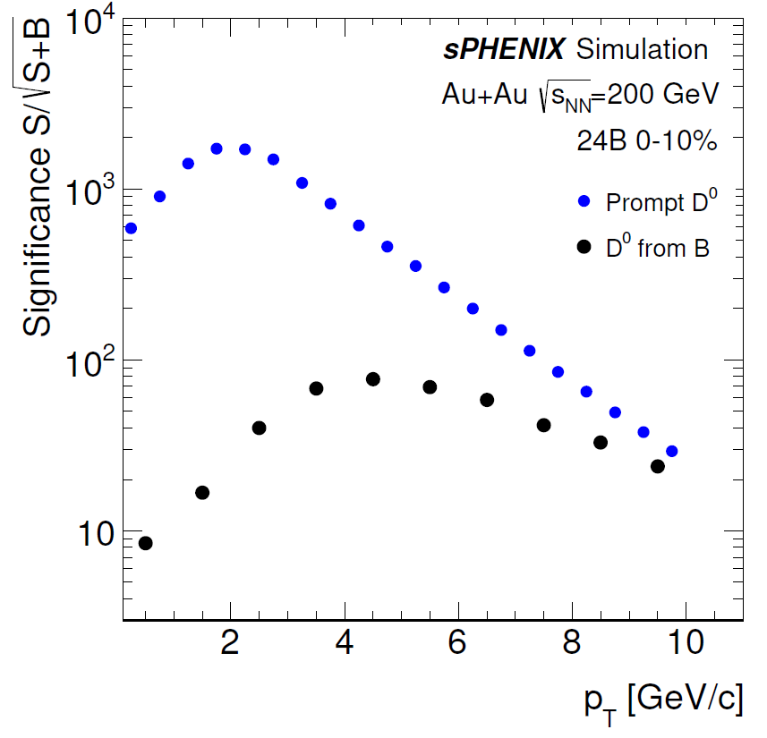
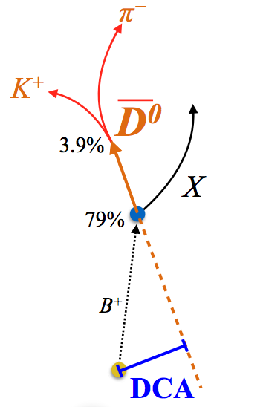
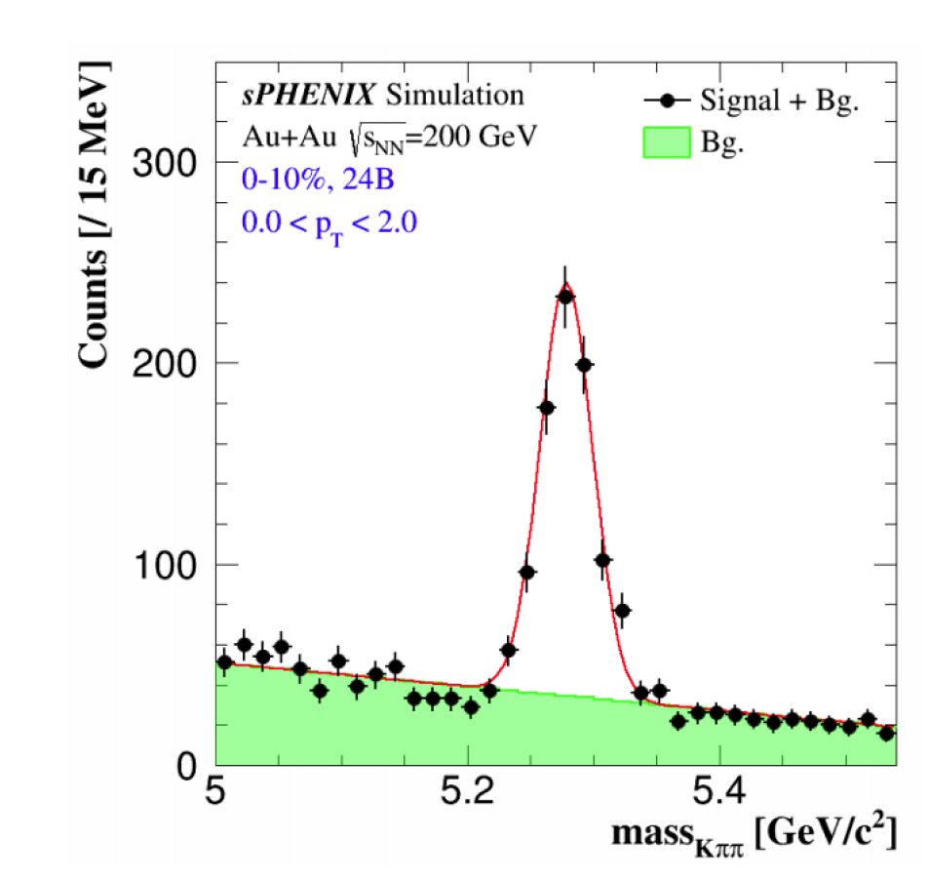
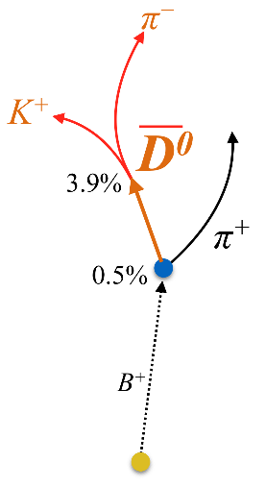
Precision open bottom meson
Prompt and non-prompt D-meson
After a BDT tagger
Exclusive B±
240 MB Au+Au collisions and high precision tracking allow accumulate high significance of HF-meson signals
Measuring high statistics B meson via non-prompt D decay channel
Exclusive B reconstruction too!

Slide 16
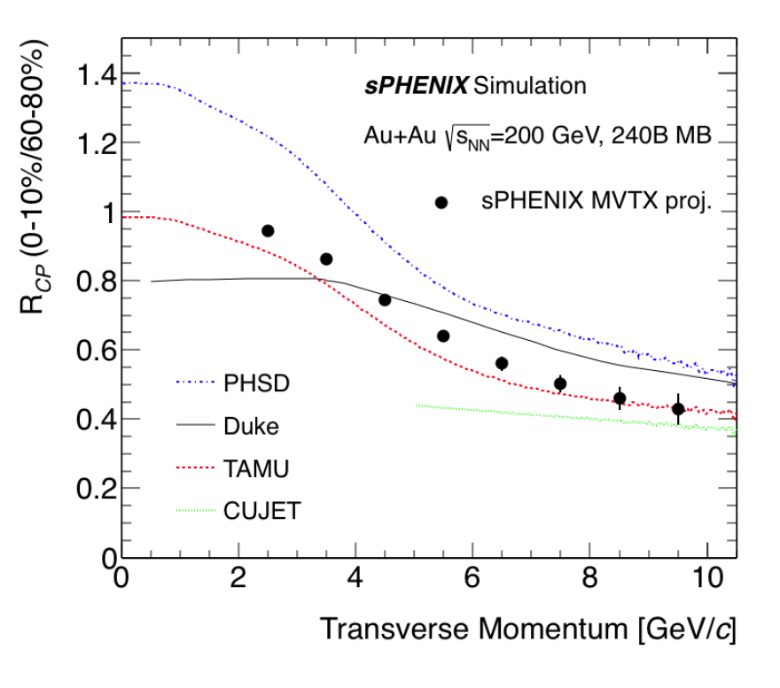
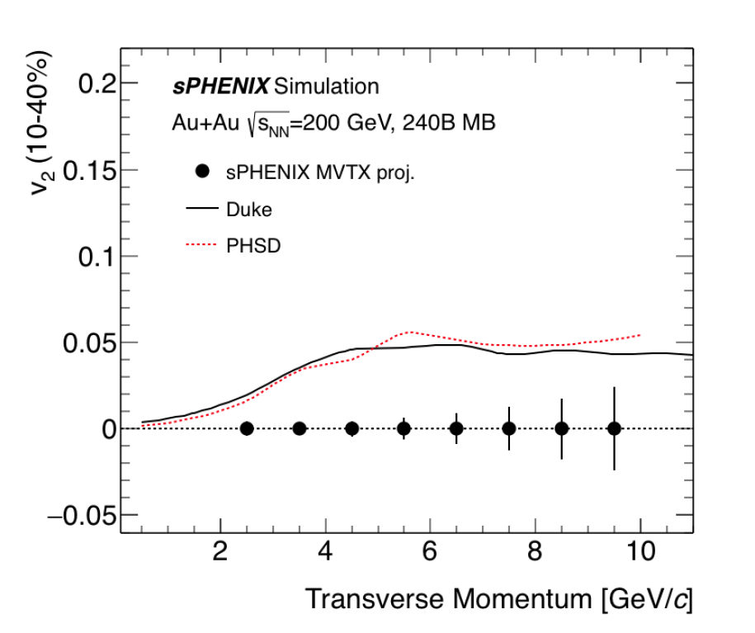
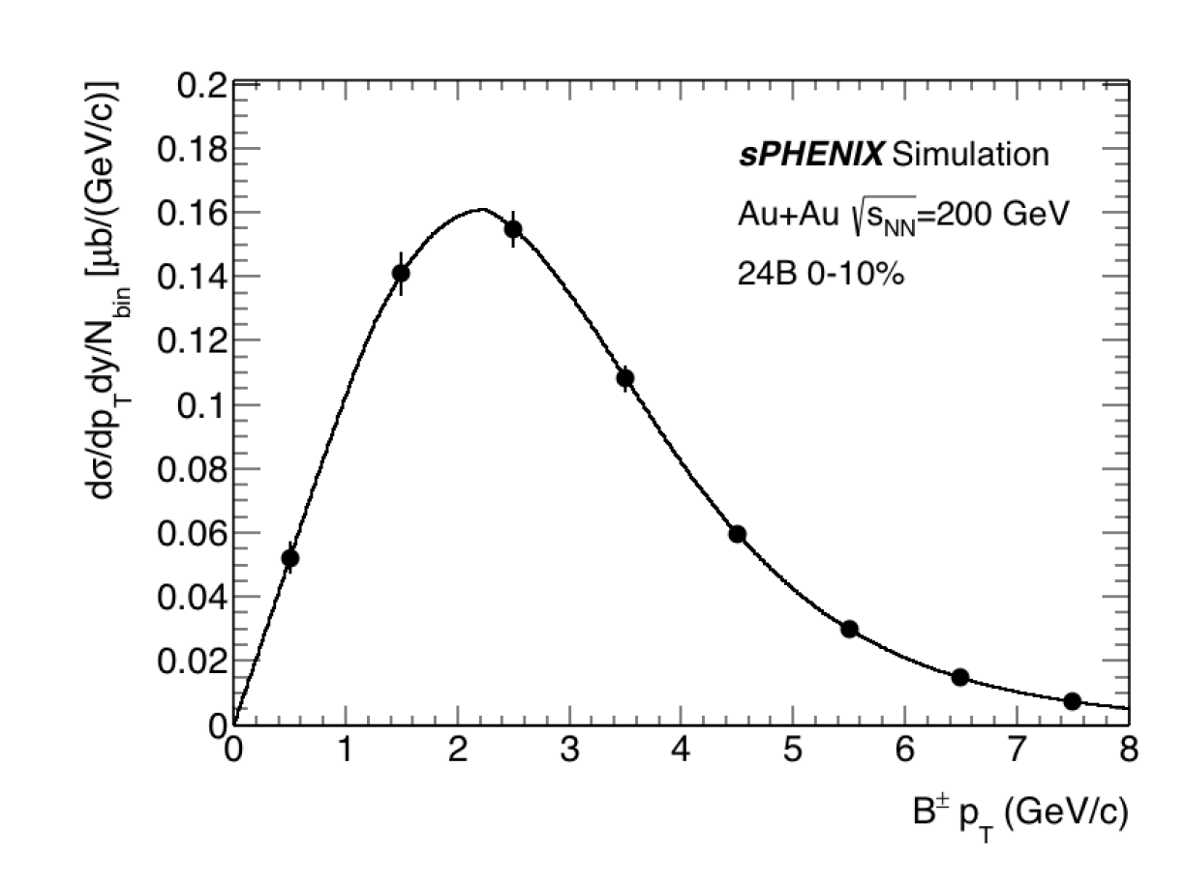
B-meson projections
non-prompt D-meson and predictions for sPHENIX
Bring high precision non-prompt-D suppression and flow to RHIC
Determine the bottom quark collectivity → clean access to D_{HQ} at RHIC energy
Broader program:
  Total b-cross section for Upsilon program
  Charm chemistry and HF hadronization
  D fragmentation function with Jets
Exclusive B± in most central Au+Au
90%
67%

Slide 17
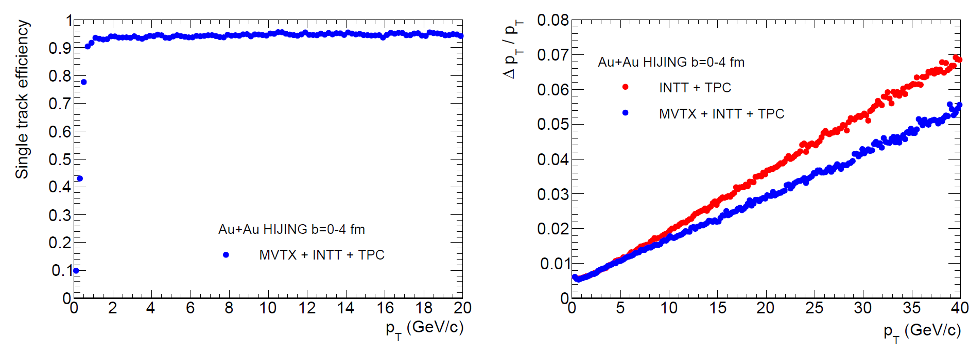
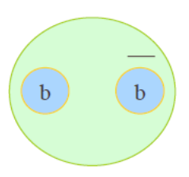
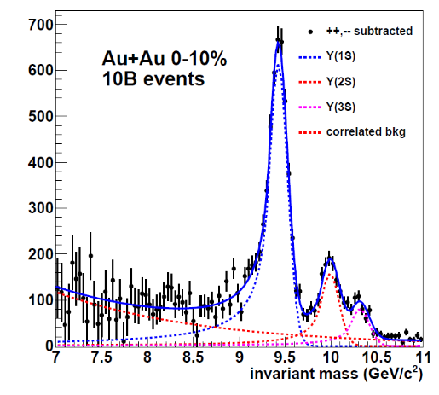
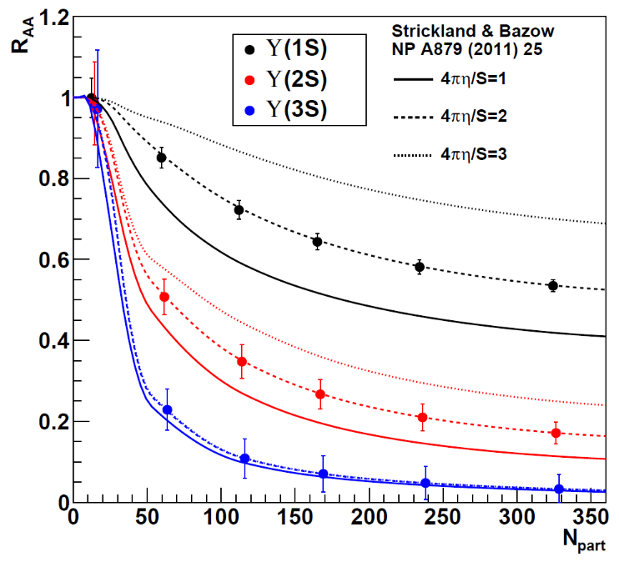
Upsilon spectroscopy
Tracking efficiency and transverse momentum resolution
ϒ(3s)-0.78fm
ϒ(2s) – 0.56fm
ϒ(1s) – 0.28fm
Precision tracking → Separated Upsilon states at RHIC → Probe of the QGP at distinct length scales.
After comb. background
subtraction

Slide 18
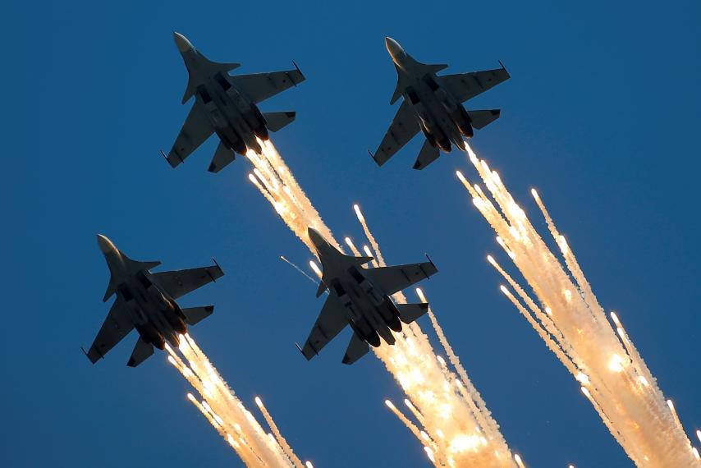
Jets

Slide 19
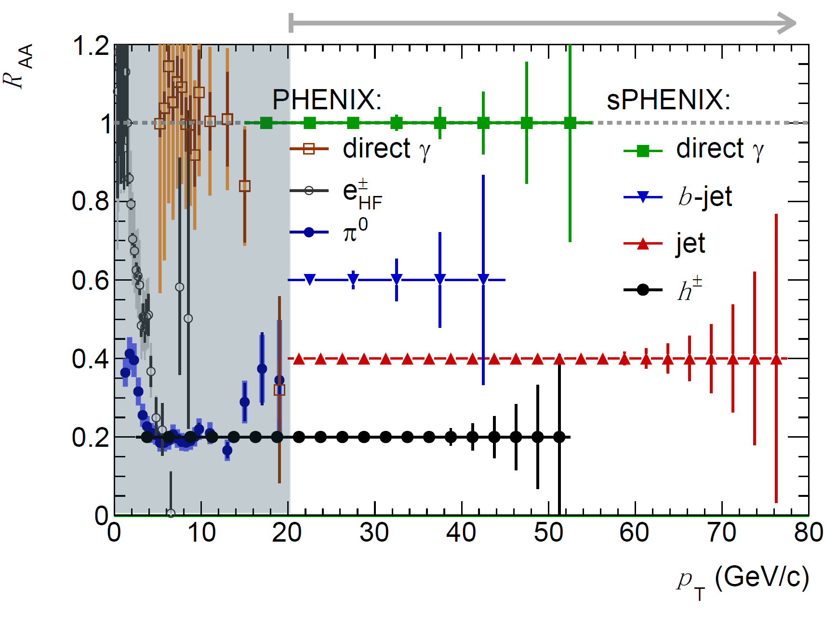
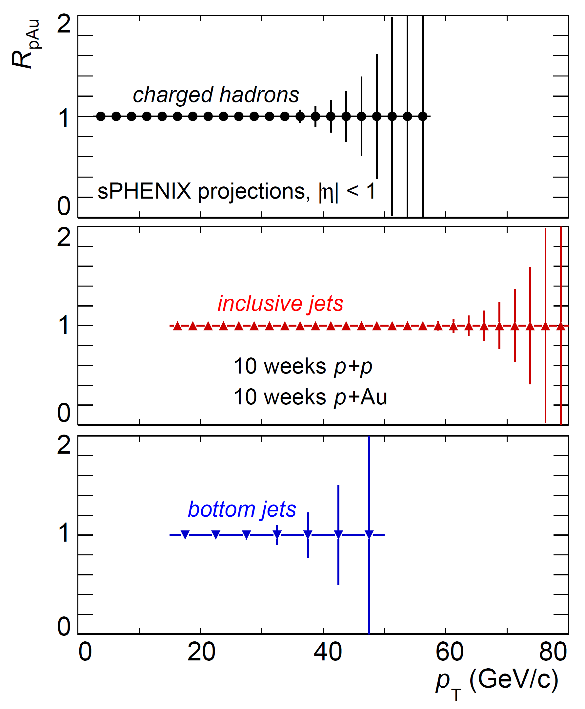
High statistics hard probes
High statistics data represents large extend in hard probes in jets, photon and hadrons
Extended kinematic reach

Slide 20
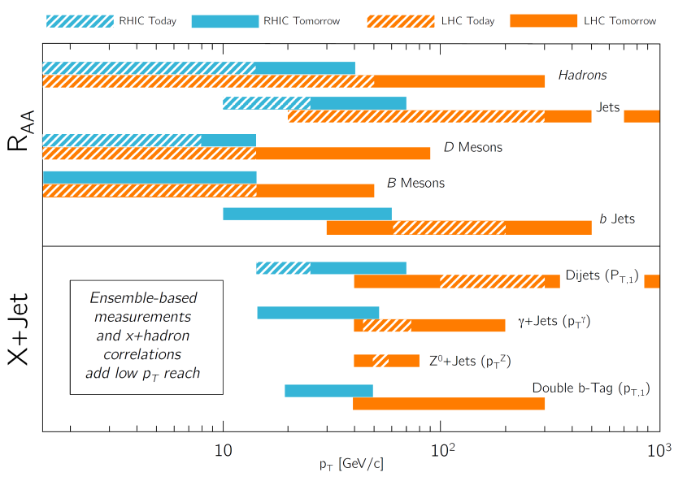

Slide 21
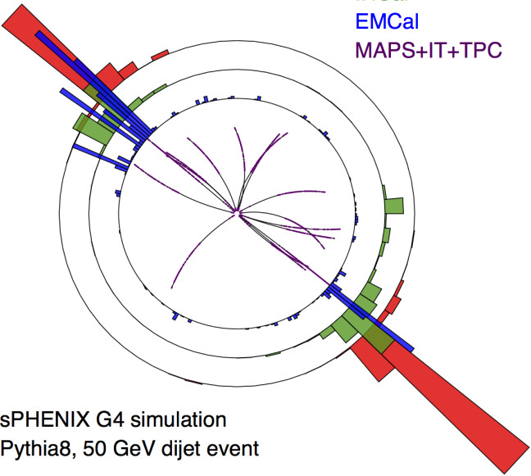
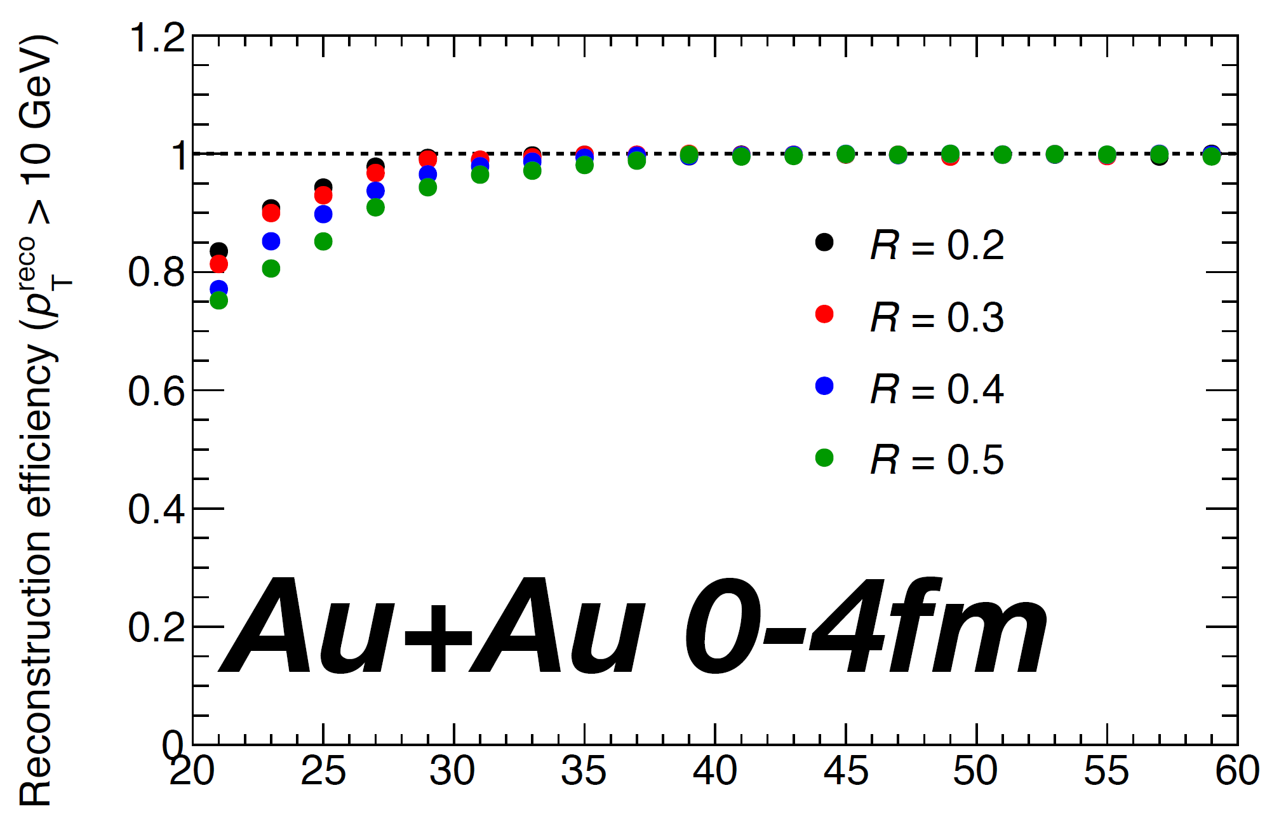
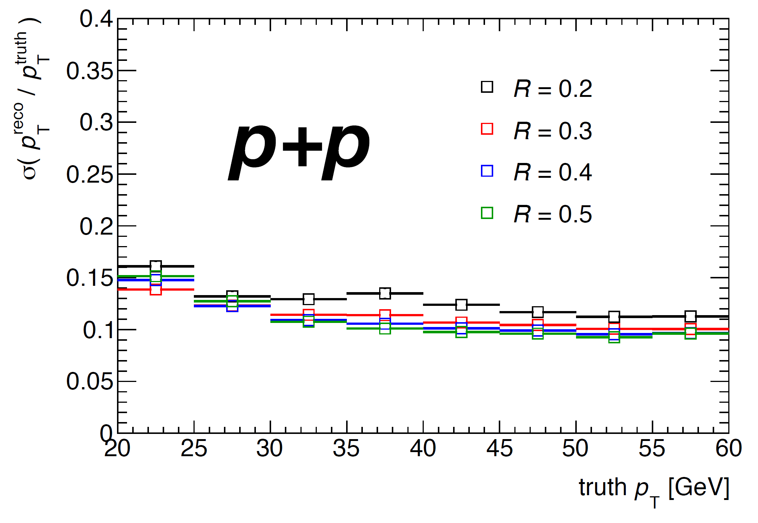
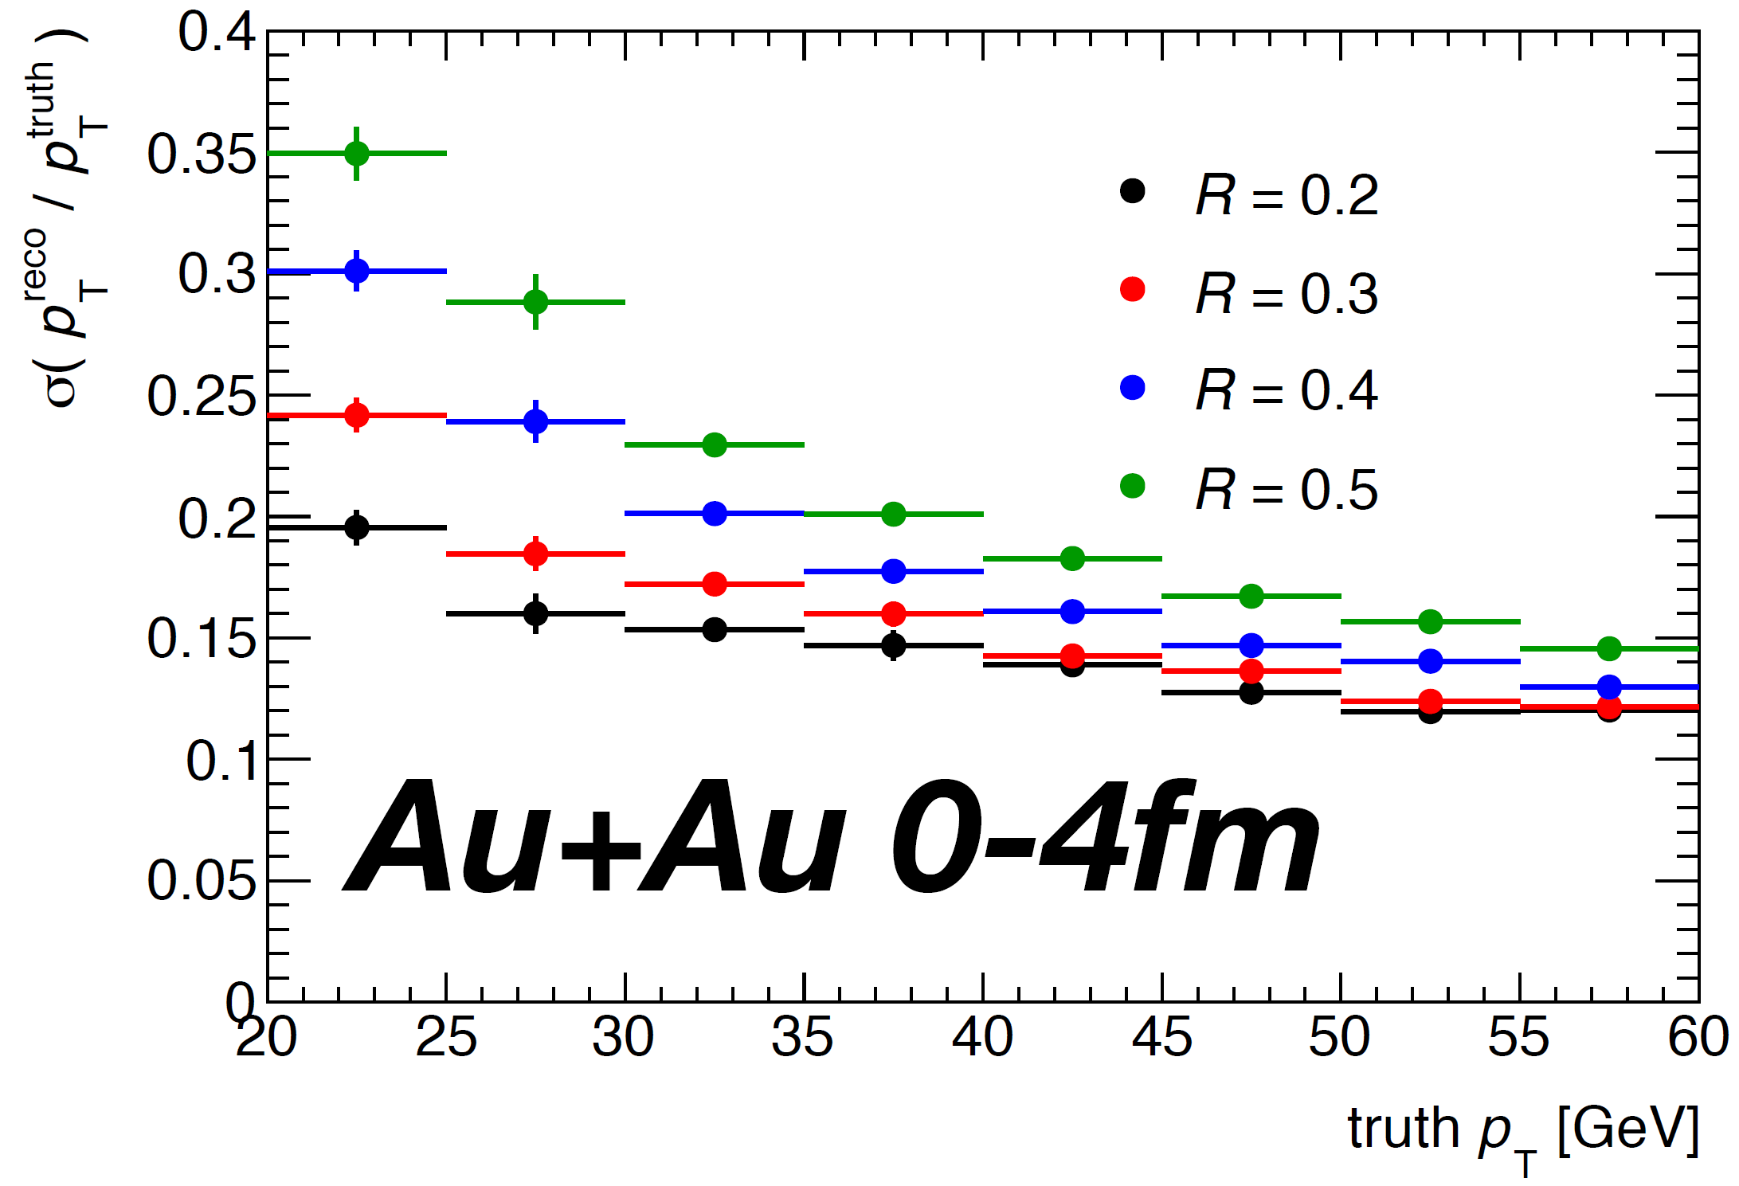
sPHENIX: calorimetry jet at RHIC
Calorimetric triggering and measurement of jets
Minimum bias to jet flavor and FF
Iterative background subtraction [PRC 86 (2012) 024908] demonstrated in sPHENIX full event simulations

Slide 22
More differential measurement
High statistics also allows more differential measurements
For example, path-length dependent studies via
γ-jet transverse balance in correlation with event plane

Slide 23


Heavy FlavorJets

Slide 24



b-jet tagging @ sPHENIX
Demonstrate b-jet capability: tagging algorithms evaluated using full detector HI simulation
Reaching a promising working point in central Au+Au collisions
Track-counting tagger
Secondary-vertex tagger
Secondary-vertex mass

Slide 25


Inclusive b-jet R_{AA} Performance
MVTX aiming first b-jet nuclear modification factor
@ RHIC, covering ~15-40 GeV/c
  Mass dependence of parton energy loss
  Cleaner access to partonic kinematics
Uniqueness at RHIC (vs. LHC)
  Gluon splitting contribution is much less (~10%)

Slide 26



b-jet projection
Inclusive b-jet R_{AA}
Inclusive b-jet v₂
Bring inclusive b-jet suppression
and v₂ to RHIC
  Covering jet p_{T} = 15-35 GeV/c
  Strong constraints of high energy probe in QGP
Broader opportunities on more differentiating observables
  Di-b-jet and b-jet-B-meson correlations
  b-jet substructures
Di-b-jet p_{T} balance

Slide 27

Summary
Rich physics case
  Precision jet and HF @ RHIC
  Predictions on sPHENIX observables
  welcomed!
  Completing scientific RHIC mission and
  connect to EIC
Advanced design and many progress in detector R&D
  CD-0 approved, in preparation for CD-1.
  Data planned for 2023
Growing collaboration
  ~70 institutions with 9 new in the past year
  Abundant opportunities to contribute

Slide 28


Welcoming more collaborators!
Established in Dec 2015
~70 institutions and growing

Slide 29
BACKUP

Slide 30




Performance : Single Hadron showers
Single pion shower studied with clusters of digitized towers (3x3 and 5x5 clusters), which is compared with ideal sum of Geant4 hit in scintillator (label G4Hits)
Energy resolution satisfied design goal.
Tails <= 10%
Refinement underway: time cut-off and light collection variations
Linearity
Energy resolution
Single-side tail
10% stat. in each tail
Requirement: 100%/√E ⊕ 10%
2.5% stat. in tails as expected from Gauss shape
Notes:
<number>

Slide 31



Evolving upgrade concepts
arXiv:1501.06197
CDR in preparation
To RHIC PAC 2017
LOI/arXiv:1402.1209

Slide 32


Slide 33

Meeting the grand challenge
Notes:
<number>

