Slide 1
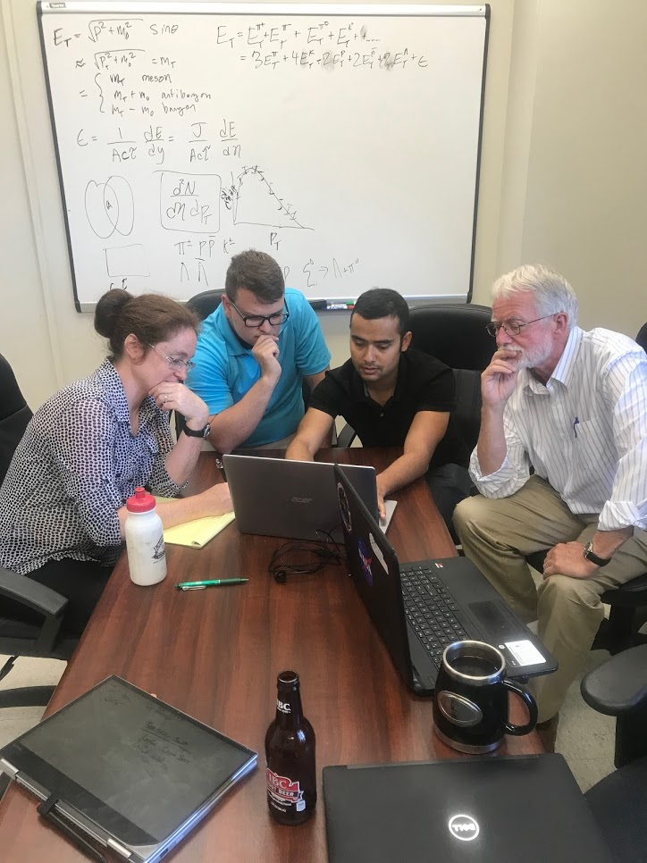
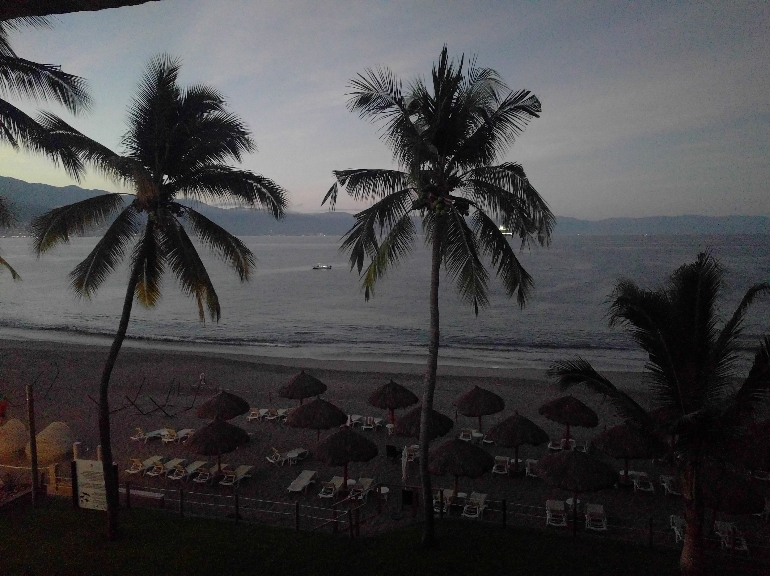
$\frac{1}{2πp_{T}}\frac{d^{2}N}{dy{dp}_{T}}→\frac{{dE}_{T}}{dη}$
using STAR Data
Christine Nattrass, Biswas Sharma, Soren Sorensen,Ben Smith, Tanner Mengel,Charles Hughes, Nathan Webb

Slide 2

How can we estimate the energy density?
Transverse energy (E_{T})
  sum of particle energies in transverse direction
Volume V = A_{T} τc
τ = formation time
Energy density ε
QGP formation for ε > 0.5 GeV/fm³
A_{T}
$ϵ=\frac{1}{V}\frac{{dE}_{T}}{dy}=\frac{J}{A_{T}τc}\frac{{dE}_{T}}{dη}$
= τc

Slide 3
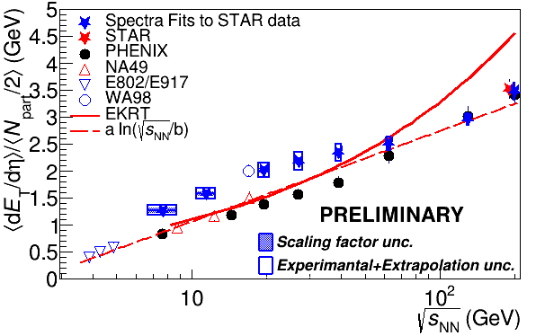
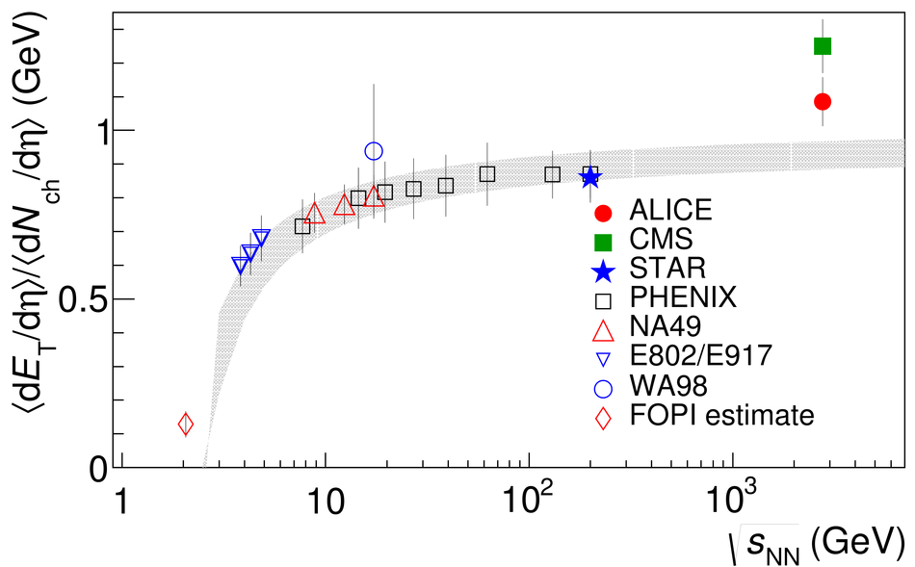
Motivation
Cross check data
Study PID distribution of energy
Understand E_{T}/N_{ch} better

Slide 4
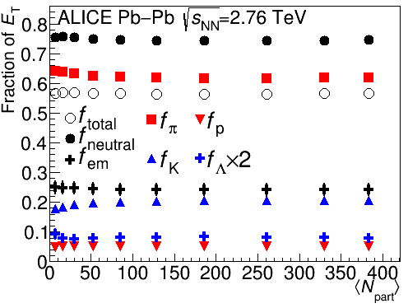
Where is the energy?
K⁺
π⁻
K⁻
_{S}
K⁰
_{L}
K⁰
π⁺
$\bar{Λ}$
Λ
π⁰
$\bar{p}$
p
$\bar{n}$
n
Scale: diameter in inches = √fraction * 5
Numbers from 2.76 TeV Phys. Rev. C 94 (2016) 034903

Slide 5
How does it hit your detector?
γ
γ
π⁰
π⁺
π⁻
π⁺
π⁻
_{S}
~69%
~64%
π⁻
K⁰
Λ
p
~64%
‾p
π⁺
$\bar{Λ}$
~31%
n
n
γ
~36%
π⁰
γ
n
n
γ
γ
~36%
π⁰
γ
π⁰
π⁰
π⁰
γ
π⁰
γ
γ
_{L}
K⁰
K⁺
K⁻
$\bar{n}$
n
$\bar{p}$
p
Scale: diameter in inches = √fraction * 5

Slide 6
How does it hit your detector?
π⁻
π⁺
γ
γ
_{L}
K⁰
π⁰
$\bar{n}$
$\bar{p}$
K⁻
K⁺
p
γ
_{S}
n
n
γ
γ
Λ
K⁰
γ
π⁰
π⁰
n
‾Λ
γ
γ
γ
γ
65% charged
35% neutral
7% in secondaries
π⁺
π⁻
‾p
π⁺
p
π⁻
_{S}
11% in neutral hadrons
K⁰
‾Λ
Λ
Scale: diameter in inches = √fraction * 5

Slide 7
Methods for measuring E_{T}
CMS: Tracking + electromagnetic calorimeter + hadronic calorimeter
PHENIX: Electromagnetic calorimeter
STAR: Tracking + Electromagnetic calorimeter
ALICE: Tracking*
*Other methods used as cross checks

Slide 8
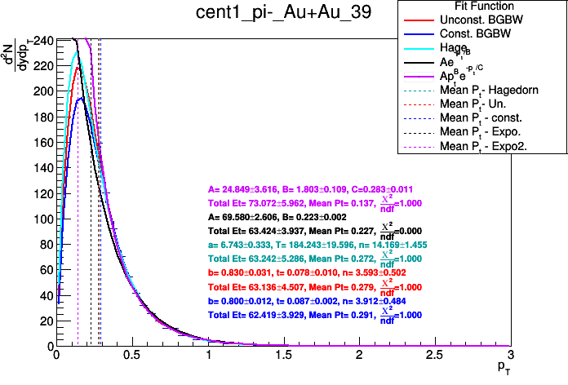
Calculating E_{T} from spectra
$\frac{d^{2}N}{dy{dp}_{T}}$
$E_{T}=\sum{E_{T}^{particlej}}$
5-10% π⁻ Au+Au √s_{NN}=39 GeV
$p_{T}$
$E_{T}^{PID}=\int{f}\left(p_{T}\right)E_{T}{dp}_{T}+\sum{\frac{d^{2}N_{i}}{dy{dp}_{T}}}E_{T}\left(p_{T}^{i},m\right)+\int{f}\left(p_{T}\right)E_{T}{dp}_{T}$
Fit
Data
Fit

Slide 9
Calculating E_{T} from published spectra
$E_{T}=f_{π}E_{T}^{π^{±}}+f_{K}E_{T}^{K^{±}}+f_{p}E_{T}^{p,\bar{p}}+f_{Λ}E_{T}^{Λ,\bar{Λ}}$
η
ω
n
π⁰
π⁻
K⁻
K⁺
$K_{S}^{0}$
$K_{L}^{0}$
$\bar{n}$
$Σ^{0}$
$\bar{Σ^{0}}$
$\bar{Λ}$
Λ
π⁺
p
$\bar{p}$
$\bar{Σ^{+}}$
$Σ^{−}$
$Σ^{+}$
$\bar{Σ^{−}}$
K⁻
K⁺
p
γ,μ±,e±
$\bar{p}$
$Σ^{0}$
$\bar{Σ^{0}}$
$\bar{Λ}$
Λ
π⁻
π⁺

Slide 10
STAR Spectra
Strange hadron production in Au+Au collisions at √s_{NN} = 7.7, 11.5, 19.6, 27, and 39 GeV
arXiv:1906.03732 [nucl-ex]
Bulk Properties of the Medium Produced in Relativistic Heavy-Ion Collisions from the Beam Energy Scan Program
Phys. Rev. C 96, 044904 (2017)
π±, K±, p,
Distance of closest approach to primary vertex< 3 cm
  Includes most but not all daughters
$Λ,\bar{Λ},K_{S}^{0}$
$\bar{p}$
$Λ,\bar{Λ},K_{S}^{0}$

Slide 11
Calculating E_{T} from published spectra
$E_{T}=f_{π}E_{T}^{π^{±}}+f_{K}E_{T}^{K^{±}}+f_{p}E_{T}^{p,\bar{p}}+f_{Λ}E_{T}^{Λ,\bar{Λ}}$
η
ω
n
π⁰
π⁻
K⁻
K⁺
$K_{S}^{0}$
$K_{L}^{0}$
$\bar{n}$
$Σ^{0}$
$\bar{Σ^{0}}$
$\bar{Λ}$
Λ
π⁺
p
$\bar{p}$
$\bar{Σ^{+}}$
$Σ^{−}$
$Σ^{+}$
$\bar{Σ^{−}}$
K⁻
K⁺
p
γ,μ±,e±
$\bar{p}$
$Σ^{0}$
$\bar{Σ^{0}}$
$\bar{Λ}$
Λ
π⁻
π⁺
Feeddown

Slide 12
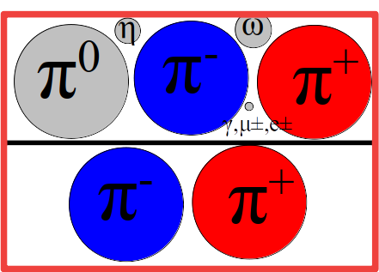
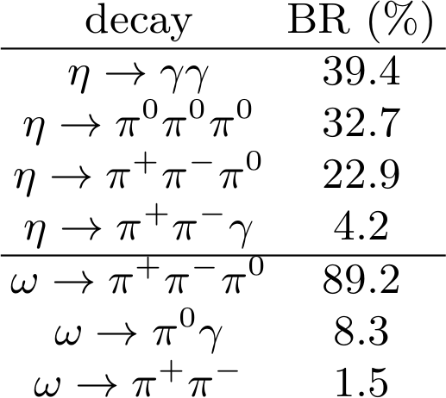
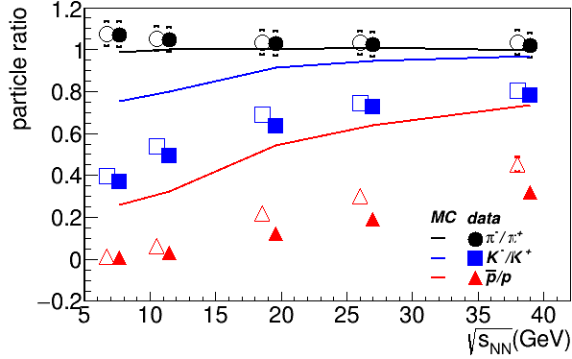
Pion correction
$f_{π}$
Pion ratios influenced by short-lived resonances, dominated by η & ω
Measured ratio of π^{0/}π± roughly consistent with PYTHIA*
PYTHIA Angantyr
*Yuri Kharlov, internal ALICE presentation

Slide 13
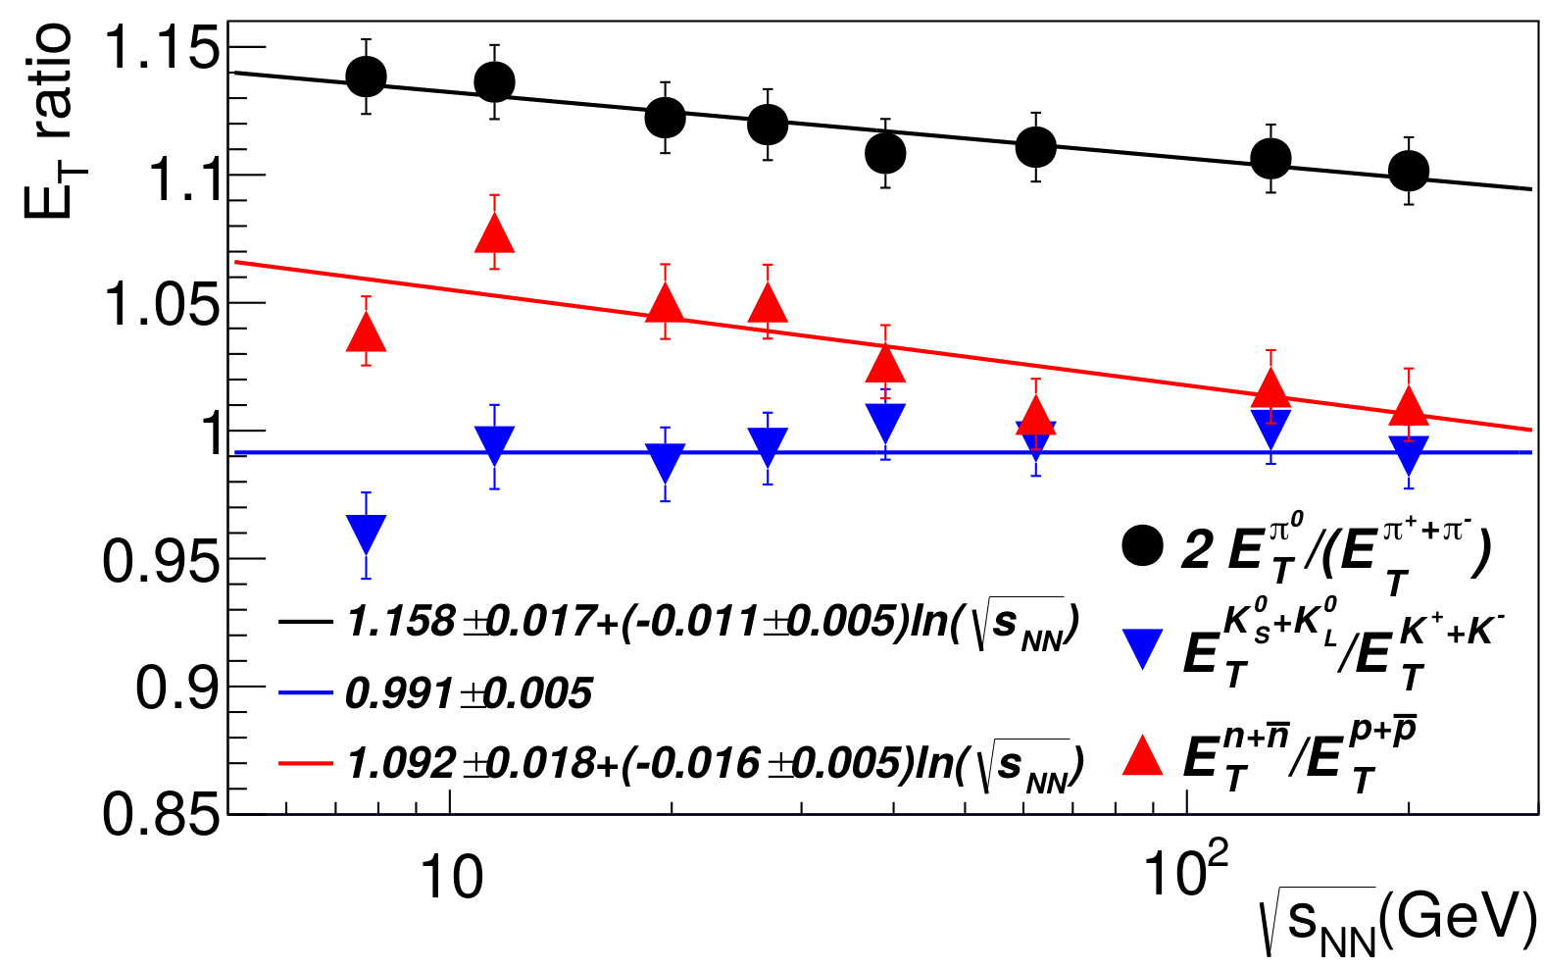
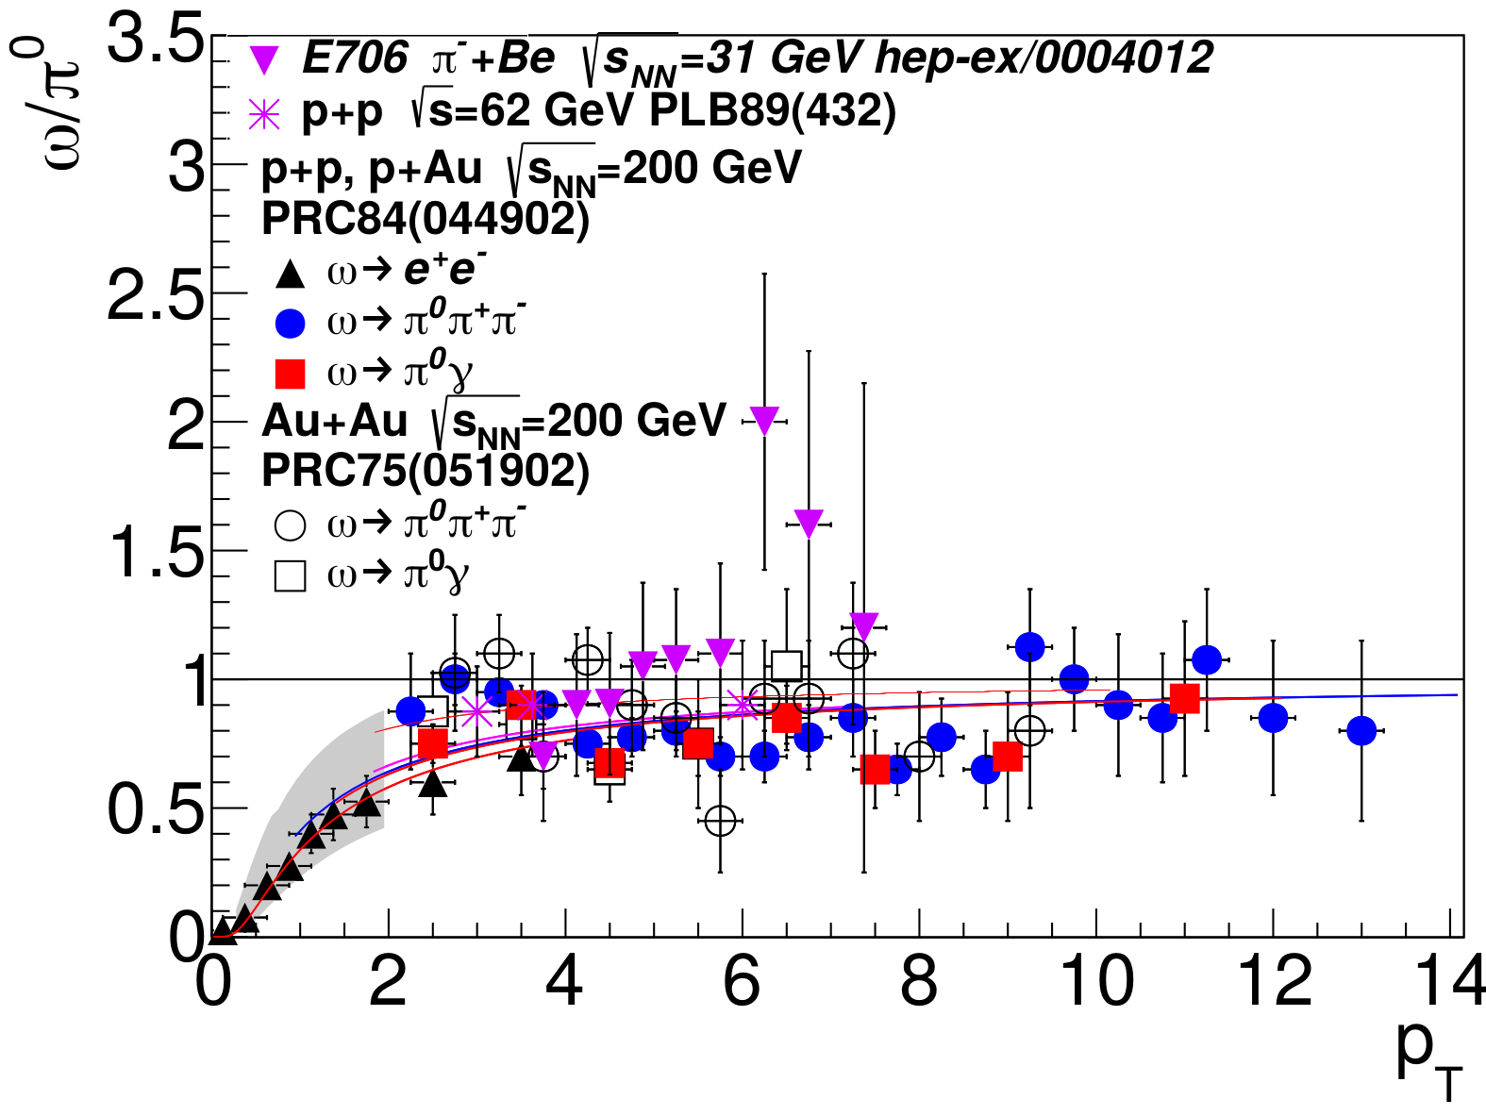
Pion correction
$f_{π}$
PYTHIA Angantyr
$η,ω,X→π^{0},π^{±}$
$η,ω→γ$
$f_{π}=1.56±0.02$
m_{T} scaling
match to η/π⁰ & ω/π⁰ data
100% uncertainties

Slide 14
Kaon correction
$f_{K}$
Also potentially impacted by resonances
Used ratios of the (preliminary) yields from BES data
K⁻
K⁺
$K_{S}^{0}$
$K_{L}^{0}$
$f_{K}=1.8±0.2$
K⁻
K⁺

Slide 15
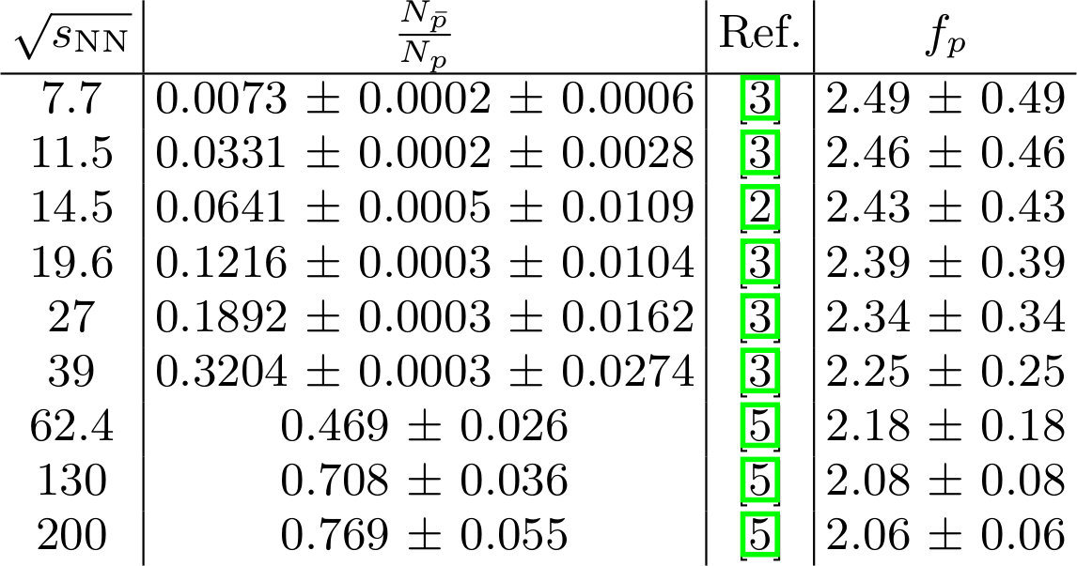
n
Proton correction
$\bar{n}$
$f_{p}$
p
$\bar{p}$
p
$f_{p}=2$
$\bar{p}$
Lower limit:
Upper limit:
Yield=Primordial+Generated
Antibaryons=Generated
Baryons=Primordial+Generated
Primordial n/p = N/Z
$\frac{N_{n}+N_{\bar{n}}}{N_{p}+N_{\bar{p}}}=\frac{N/Z+\left(2−N/Z\right){N_{\bar{p}}}/{N_{p}}}{1+{N_{\bar{p}}}/{N_{p}}}$
[1] J. Adam et al. (ALICE), Phys. Rev. C94, 034903 (2016), 1603.04775.
[2] J. Adam et al. (STAR) (2019), 1908.03585.
[3] L. Adamczyk et al. (STAR), Phys. Rev. C96, 044904 (2017), 1701.07065.
[4] J. Adam et al. (STAR) (2019), 1906.03732.
[5] B. I. Abelev et al. (STAR), Phys. Rev. C79, 034909 (2009), 0808.2041.

Slide 16
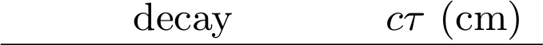
Lambda correction
$Σ^{0}$
$\bar{Σ^{0}}$
$\bar{Λ}$
Λ
$f_{Λ}$
$\bar{Σ^{+}}$
$Σ^{−}$
$Σ^{+}$
$\bar{Σ^{−}}$
$Σ^{0}$
$\bar{Σ^{0}}$
$\bar{Λ}$
Λ
Sigma: Yield ratios
  Isospin scaling: 1.5
  PYTHIA: 1.67
  HIJING: 1.532
$→1.585±0.085$

Slide 17
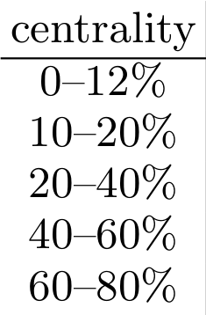
Lambda correction
$f_{Λ}$
n
$\bar{n}$
$Σ^{0}$
$\bar{Σ^{0}}$
$\bar{Λ}$
Λ
p
STAR BES DCA to PV<3 cm
Feeddown due to K⁰_{S} done
Feeddown to p due to Λ not done
STAR published spectra at √s_{NN}=200 GeV (Phys.Rev.Lett.97:152301,2006) with and without feeddown*
→ Calculate E_{T}^{Λ} feeddown
Does not provide a lot of constraint
→ Use branching ratio
$\bar{p}$
$\bar{Σ^{+}}$
$Σ^{−}$
$Σ^{+}$
$\bar{Σ^{−}}$
p
$\bar{p}$
$Σ^{0}$
$\bar{Σ^{0}}$
$\bar{Λ}$
Λ
$→0.68±0.32$
$f_{Λ}=1.08±0.51$
*Thanks to Ron Belmont for pointing this out to us

Slide 18
Calculating E_{T} from published spectra
$E_{T}=f_{π}E_{T}^{π^{±}}+f_{K}E_{T}^{K^{±}}+f_{p}E_{T}^{p,\bar{p}}+f_{Λ}E_{T}^{Λ,\bar{Λ}}$
η
ω
n
π⁰
π⁻
K⁻
K⁺
$K_{S}^{0}$
$K_{L}^{0}$
$\bar{n}$
$Σ^{0}$
$\bar{Σ^{0}}$
$\bar{Λ}$
Λ
π⁺
p
$\bar{p}$
$\bar{Σ^{+}}$
$Σ^{−}$
$Σ^{+}$
$\bar{Σ^{−}}$
K⁻
K⁺
p
γ,μ±,e±
$\bar{p}$
$Σ^{0}$
$\bar{Σ^{0}}$
$\bar{Λ}$
Λ
π⁻
π⁺
$f_{K}=1.8±0.2$
$2<f_{p}<3$
$f_{Λ}=1.08±0.51$
$f_{π}=1.56±0.02+{\left(E_{T}^{η}+E_{T}^{ω}\right)}/{\left(E_{T}^{π}\right)}$

Slide 19
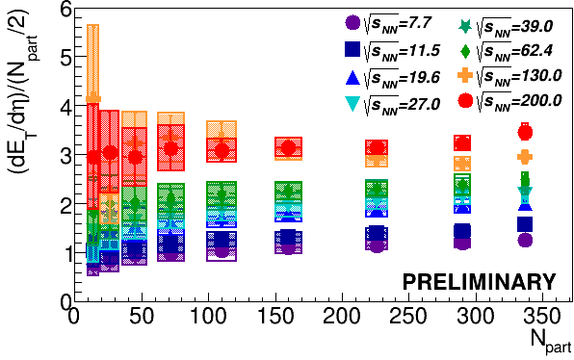

Results

Slide 20
Results

Slide 21
Q&A
Q: Why not do this for PHENIX spectra as well?
A: PHENIX spectra only for p_{T}>0.5 GeV/c, large extrapolation uncertainty
Q: Why not look at energy distribution by particle type?
Q: Why not look at E_{T}/N_{ch}?
A: We are. To be continued…
Q: Why not look at small systems?
A: We will. To be continued…

Slide 22
Conclusions
Tracking detectors can measure E_{T} well
E_{T} calculated from STAR spectra do not agree with PHENIX E_{T}

Slide 23
What we need to do
Suggestions for you
Double check fits
Separate uncertainties from extrapolation to p_{T}=0
Finalize corrections and uncertainties
Write the paper
Calculations in small systems?
STAR: BES E_{T} measurement
PHENIX: BES spectra measurements
sPHENIX E_{T} measurement

Slide 24
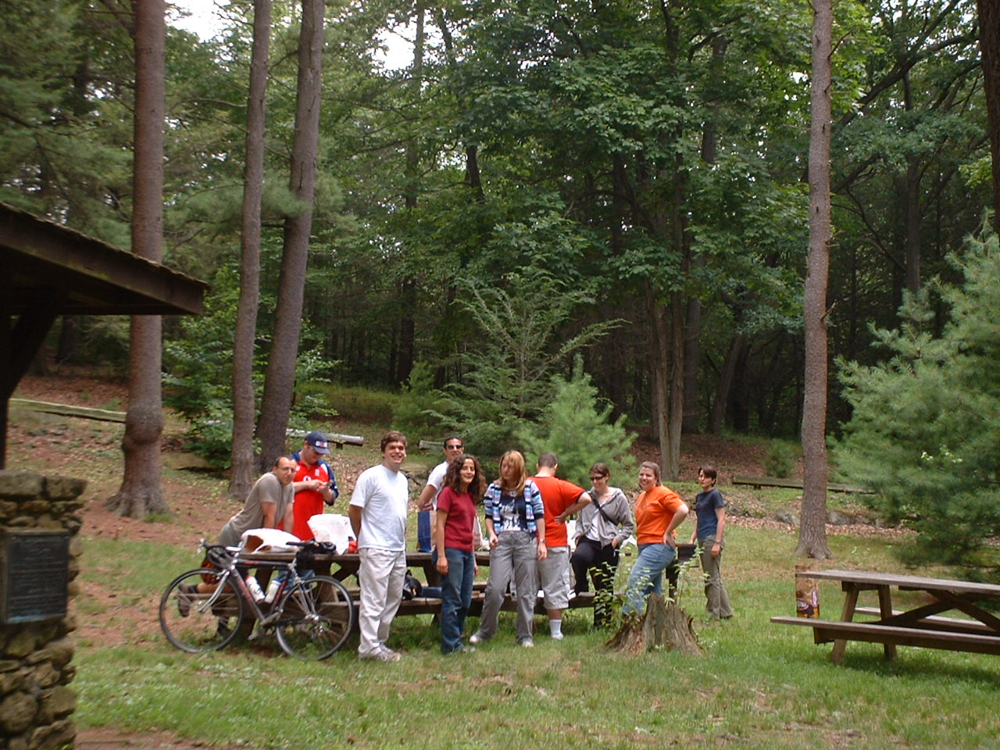
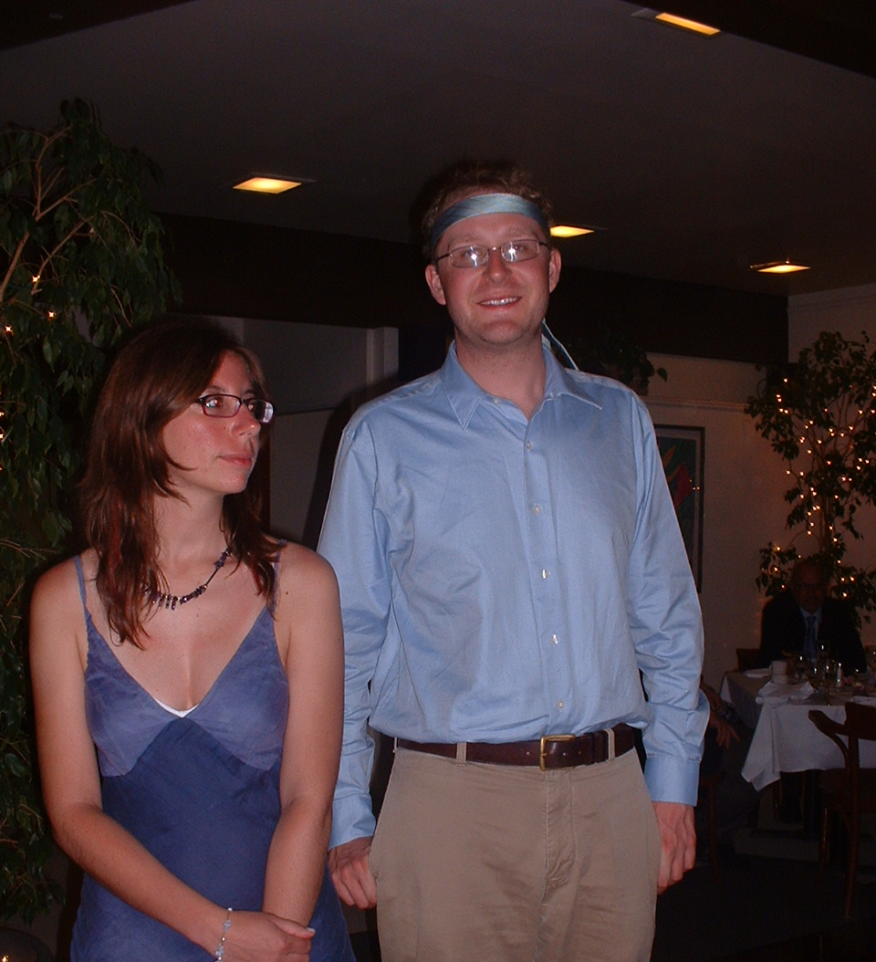
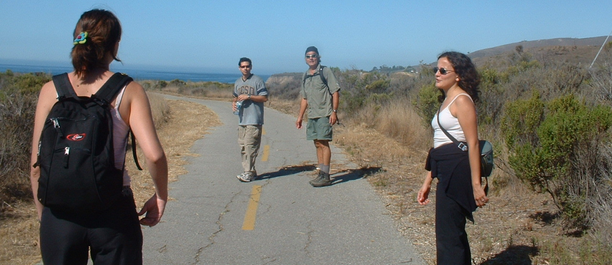
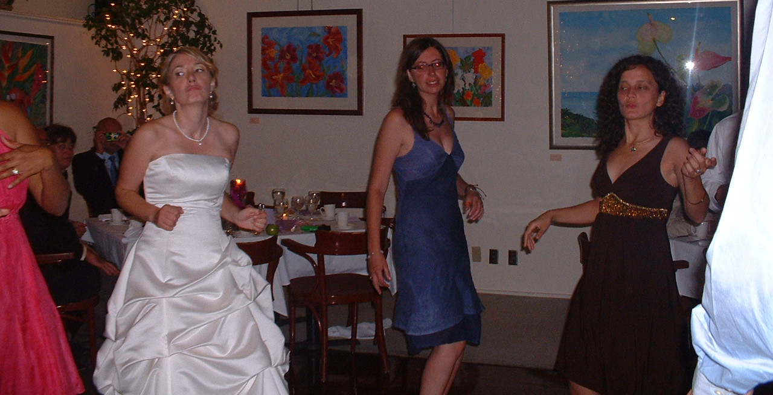
Life in John’s group

Slide 25
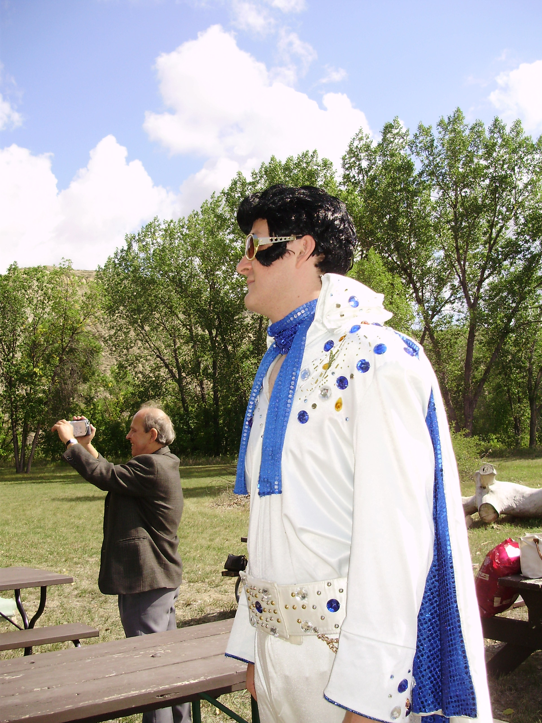
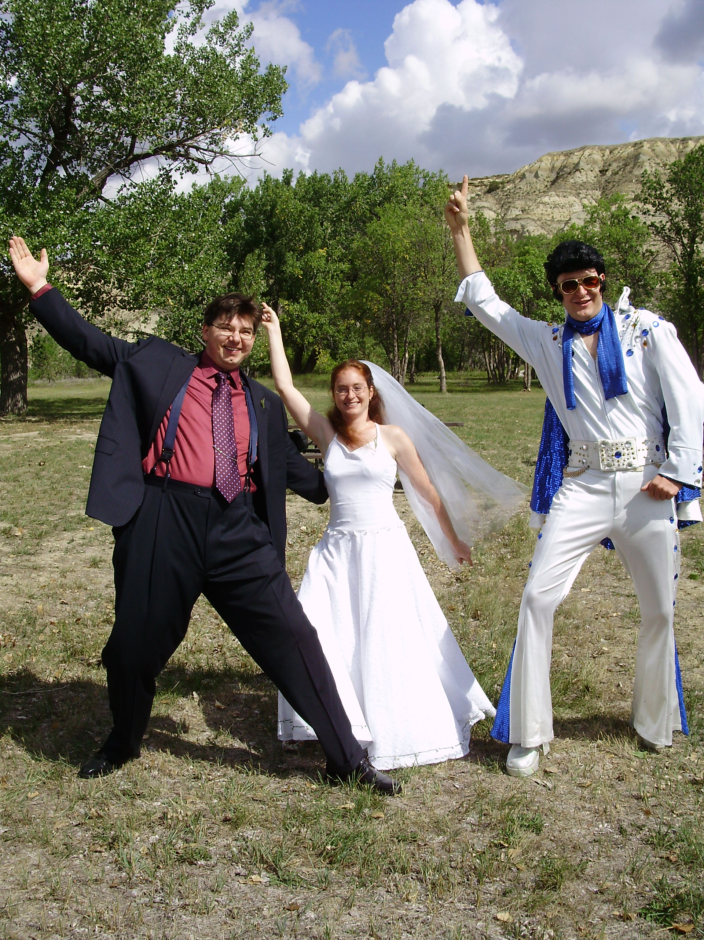

Slide 26
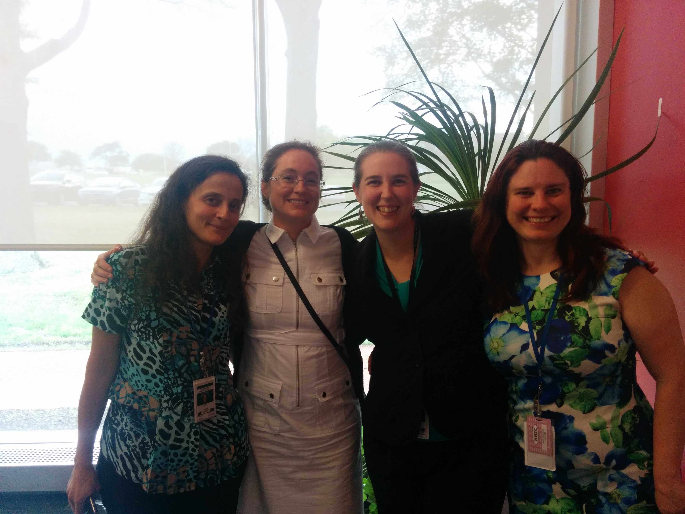

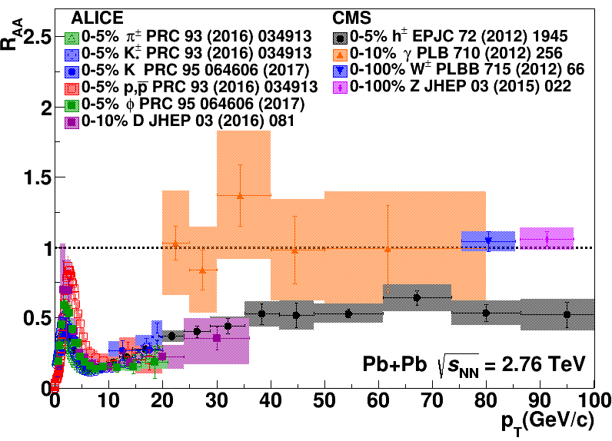
Connors, Nattrass, Reed, & Salur Rev. Mod. Phys. 90, 025005 (2018)

Slide 27
CMS
Hadronic
calorimeter
γ
_{S}
γ
γ
γ
K⁰
π⁰
π⁰
π⁻
γ
γ
π⁺
γ
‾Λ
γ
π⁰
Λ
γ
γ
K⁺
K⁻
24% as a γ
p
$\bar{p}$
Measure in electromagnetic calorimeter
58% in primary hadrons
_{L}
K⁰
π⁺
π⁻
p
π⁻
‾p
π⁺
n
$\bar{n}$
$\bar{n}$
_{S}
‾Λ
$nΛ$
$\bar{n}\bar{Λ}$
K⁰
Λ
7% in secondary hadrons
11% as a neutral hadron
Measure in tracking detectors and hadronic calorimeter
Measure in hadronic calorimeter
Scale: diameter in inches = √fraction * 5

Slide 28
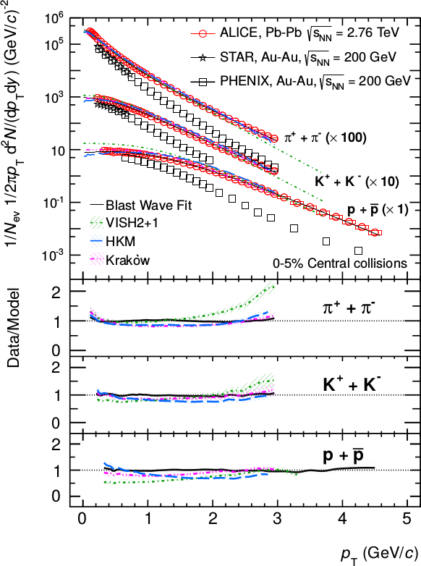
CMS
Tracks: p_{T}>900 MeV/c
Clusters: limited by B
→ ~62% of energy measured
<p_{T}> ~ 700 MeV/c
Phys. Lett. B 727 (2013) 371-380
Phys. Rev. Lett. 109, 252301 (2012)

Slide 29
γ
γ
π⁺
π⁻
γ
_{S}
γ
K⁰
π⁰
π⁰
γ
γ
γ
‾Λ
π⁰
γ
Λ
γ
_{L}
γ
K⁰
K⁺
π⁺
π⁻
_{S}
K⁻
Deposit 100% of energy
K⁰
n
p
p
π⁻
35% of energy in event
$\bar{n}$
Λ
$\bar{p}$
PHENIX
‾p
π⁺
$nΛ$
$\bar{n}\bar{Λ}$
‾Λ
Electromagnetic calorimeter
Deposit about 1/3 of energy
65% of energy in event
→ Measure ~57% of energy
Scale: diameter in inches = √fraction * 5

Slide 30
γ
γ
γ
_{S}
γ
STAR
K⁰
π⁰
π⁰
π⁺
π⁻
γ
γ
γ
‾Λ
γ
π⁰
K⁺
Λ
γ
γ
p
K⁻
$\bar{p}$
24% as a γ
Backgrounds
$nΛ$
$\bar{n}\bar{Λ}$
_{L}
58% in primary hadrons
K⁰
$\bar{n}$
Measure in tracking detector
n
Background
11% as a neutral hadron
π⁺
π⁻
p
π⁻
‾p
π⁺
_{S}
Λ
‾Λ
K⁰
Measure in electromagnetic calorimeter
7% in secondary hadrons
Scale: diameter in inches = √fraction * 5

Slide 31
γ
γ
γ
_{S}
γ
ALICE
K⁰
π⁰
π⁰
π⁺
π⁻
γ
γ
γ
‾Λ
γ
π⁰
K⁺
Λ
γ
γ
p
K⁻
$\bar{p}$
24% as a γ
Measure ~56%
$nΛ$
$\bar{n}\bar{Λ}$
_{L}
58% in primary hadrons
K⁰
$\bar{n}$
Measure in tracking detector
n
π⁺
π⁻
p
π⁻
‾p
π⁺
11% as a neutral hadron
_{S}
Λ
‾Λ
K⁰
7% in secondary hadrons
Don’t measure
Cut out using tight DCA cut
Scale: diameter in inches = √fraction * 5

Slide 32
ALICE
3%
2%
3%
40%
But known well!
$E_{T}=\frac{1}{f_{p_{T}cut}}\frac{1}{f_{total}}\sum_{i=0}^{n}{f_{bg}^{i}}\left(p_{T}\right)\frac{1}{f_{notID}}\frac{1}{eff\left(p_{T}^{i}\right)}E_{i}sin\left(θ^{i}\right)$
What we measure directly
45%
Corrections

Slide 33
ALICE: f_{total}
= 0.567 ± 0.009
π⁺
π⁻
‾p
K⁺
K⁻
p
‾p
Λ
K⁺
K⁻
π⁰
π⁻
π⁺
p
‾Λ
_{S}
_{L}
K⁰
K⁰
‾n
n
Scale: diameter in inches = √fraction * 5

Slide 34
ALICE E_{T}

