Slide 1
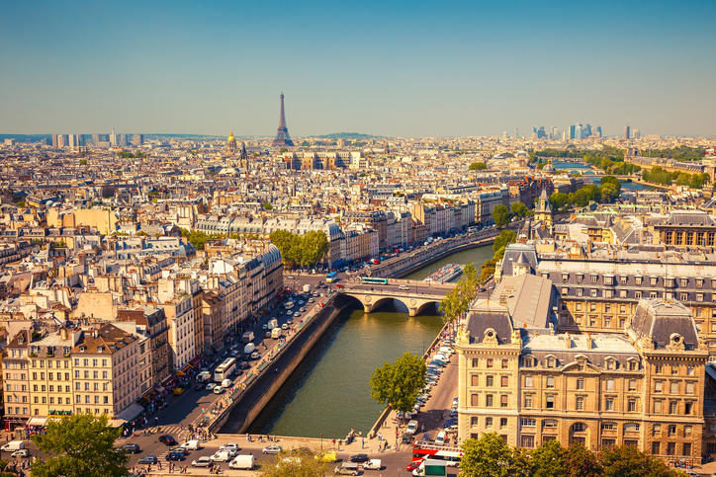
A tale of two jets
Christine Nattrass, University of Tennessee, Knoxville
https://lp-cms-production.imgix.net/image_browser/Effiel%20Tower%20-%20Paris%20Highlights.jpg?auto=format&fit=crop&sharp=10&vib=20&ixlib=react-8.6.4&w=850

Slide 2



Acknowledgements
Antonio Da Silva
Patrick Steffanic
Charles Hughes

Slide 3
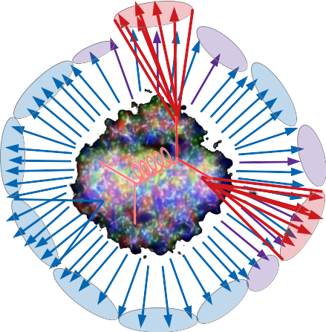
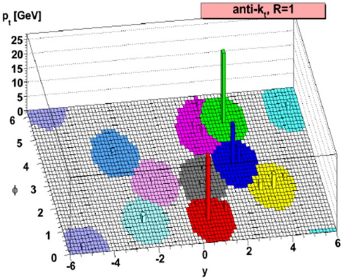



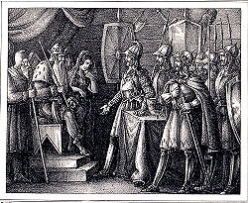
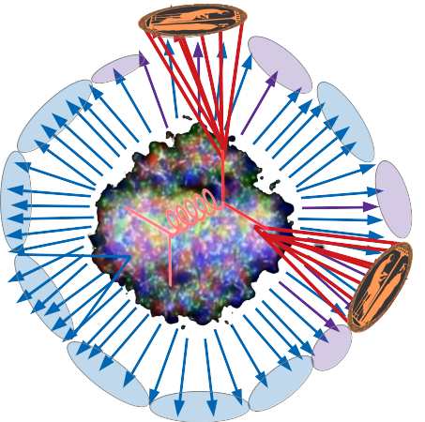
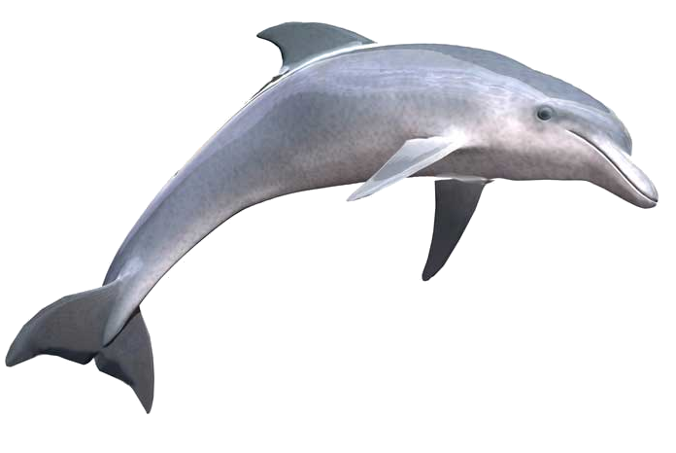

2. Background paradigm
4. Background in Models
1. What is a jet?
3. Models
4. Suppressing combinatorial jets
5. Correcting for background in MC
6. How to compare to models

Slide 4
1. What is a jet?

Slide 5
What is a jet?

Slide 6
What is a jet?
A measurement of a jet is a measurement of a parton.

Slide 7
What is a jet?
A measurement of a jet is a measurement of a parton.

Slide 8
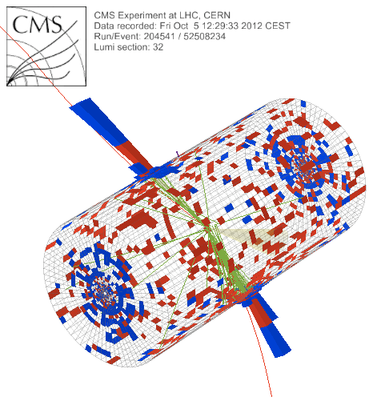

What is a jet?
p+p dijet
Beam pipe

Slide 9
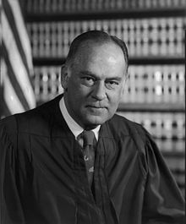
What is a jet?
p+p dijet
Beam pipe
“I know it when I see it”
US Supreme Court Justice Potter Stewart, Jacobellis v. Ohio

Slide 10

in pp collisions
Jet finding
Jet finder: groups final state particles into jet candidates
  Anti-kT algorithm
  JHEP 0804 (2008) 063 [arXiv:0802.1189]
Depends on hadronization
Ideally
  Infrared safe
  Colinear safe
Snowmass Accord: Theoretical calculations and experimental measurements should use the same jet finding algorithm. Otherwise they will not be comparable.

Slide 11
anti-k_{T} jet finding algorithm
Particles, clusters
k_{T} algorithm
$k_{T}=p_{T},ΔR_{ij}=\sqrt{{\left(η_{i}−η_{j}\right)}^{2}+{\left(ϕ_{i}−ϕ_{j}\right)}^{2}}$
For all i,j calculate:
Combine smallest d_{ij}.
If d_{iB} smallest, d_{iB}→ jet
Repeat until no particles left
$d_{ij}=min\left(p_{T,i}^{−2},p_{T,j}^{−2}\right)\frac{ΔR_{ij}^{2}}{R^{2}}$
$d_{iB}=p_{T,i}^{−2}$
Jet candidates

Slide 12

Jet finding algorithms
Tracks
Jet finding algorithm
Jet candidates
Clusters
Particles
Any list of objects works as input
Use the same algorithm on theory & experiment
Output only as good as input
M. Cacciari, G. P. Salam, G.Soyez, JHEP 0804:063,2008

Slide 13
A jet is what a jet finder finds.

Slide 14
Use the same algorithm on data and the model. Then the two will be comparable.

Slide 15
2. Standard paradigm of background

Slide 16

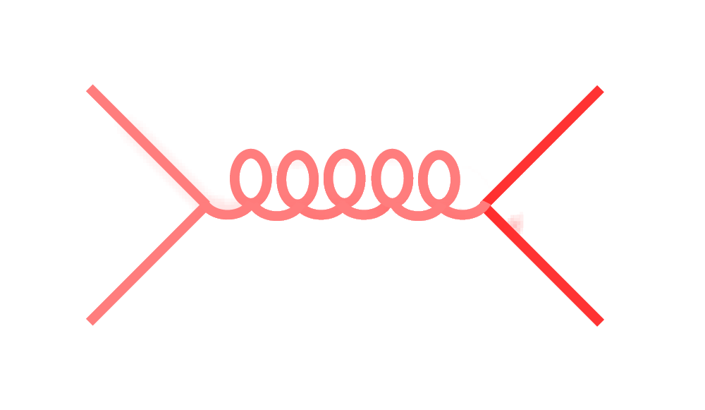
Signal vs Background:
The standard paradigm
Background
Signal

Slide 17
Signal vs Background:
The standard paradigm
Background
Combinatorial jets
Signal

Slide 18
Signal vs Background:
The standard paradigm
Background
Combinatorial jets
Signal
= “fake” jets

Slide 19
Signal vs Background:
The standard paradigm
Background
Combinatorial jets
Signal
*Some gray areas

Slide 20
3. Models

Slide 21
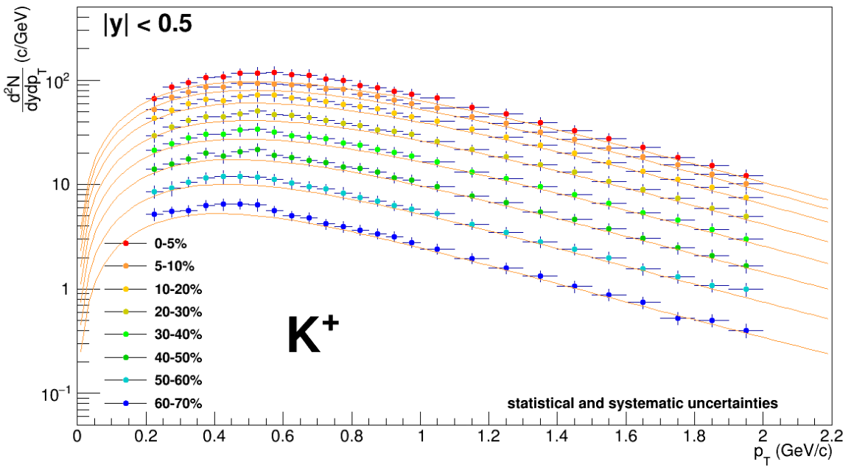
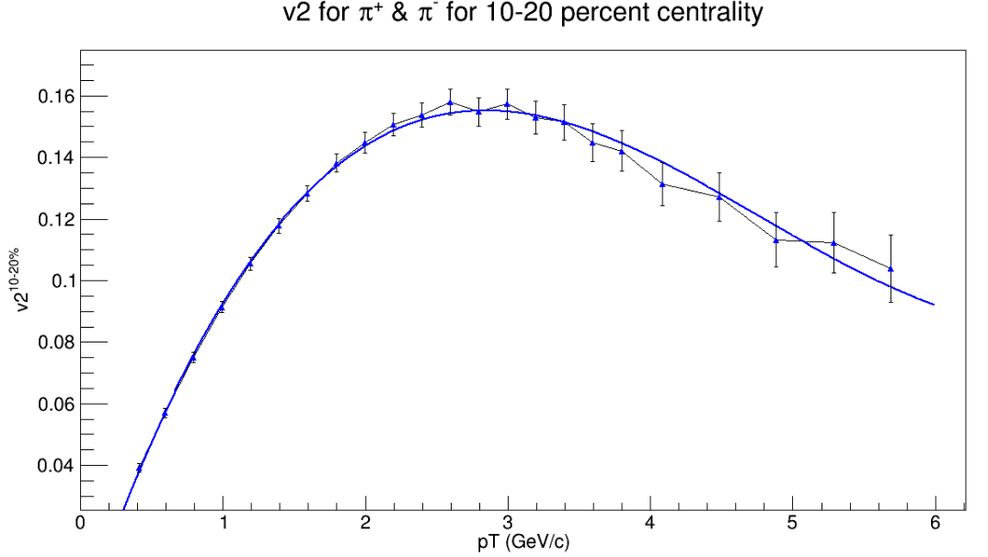

TennGen background generator
Event properties
Track properties
ε₁
ε₃
Momentum spectra
Blast Wave Fit
dN/dy
Random p_{T}
ε₂, ε₄, ε₆
ALICE PLB720 (2013) 52-62
ε₅
p_{T}
Even event planes fixed at Ψ=0
Odd planes at random φ
Multiplies from ALICE PRC88 (2013) 044910
Polynomial Fit
v_{n}
v_{n}
ALICE JHEP 1609 (2016) 164
Azimuthal asymmetries
Random φ
No jets! No resonances
Emulates hydro correlations
p_{T}

Slide 22
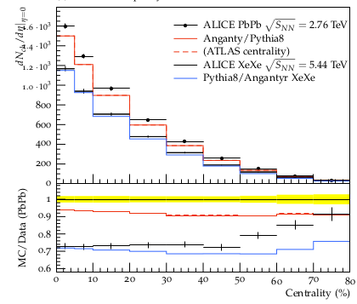
PYTHIA Angantyr
JHEP (2018) 2018: 134
Based on PYTHIA 8
Sjöstrand, Mrenna & Skands,
JHEP05 (2006) 026
Comput. Phys. Comm. 178 (2008) 852.
Based on Fritiof & wounded nucleons
N-N collisions w/fluctuating radii → fluctuating σ
Lots of jets! And resonances!
No hydrodynamics, no jet quenching

Slide 23
4. Suppressing combinatorial jets
Real jets
Jet-like
p_{T}
Combinatorial jets
Background-like

Slide 24
Technique
Anti-k_{T} jet finder, |η_{jet}|<0.5
Combinatorial jets: Only contain TennGen particles
Real jets: Add a PYTHIA pp event. Real jets contain >80% of p_{Thard}^{min}
Squishy jets: Everything else
R=[0.2,0.3,0.4,0.5,0.6], p_{T}=[10,20,40,80]

Slide 25
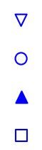
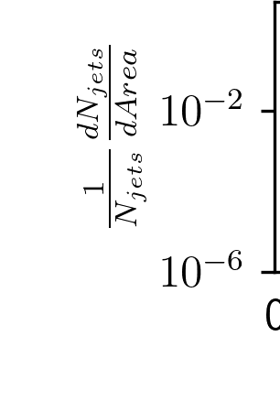
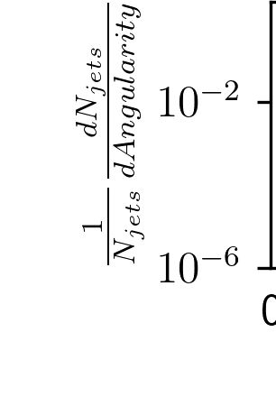
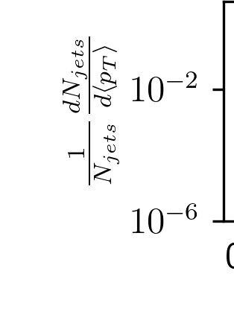
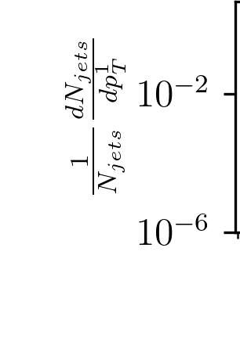
Jet properties – R=0.4
<4% Signal loss
>50% Comb. loss
$Area>0.6R$
Area
Angularity
<p_{T}> (GeV/c)
p_{T}¹ (GeV/c)
Area
Angularity
Average p_{T}
Leading p_{T}
$α=\frac{1}{p_{T}^{jet}}\sum{z_{k}}\left(\vec{R_{k}}\right)$

Slide 26
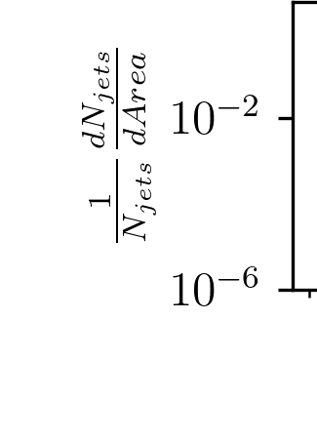
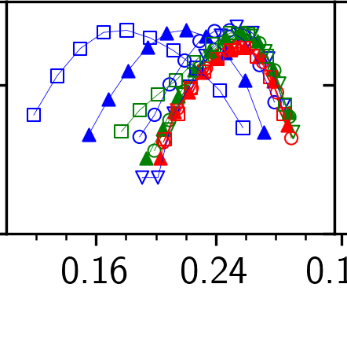
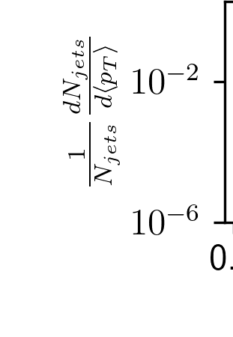
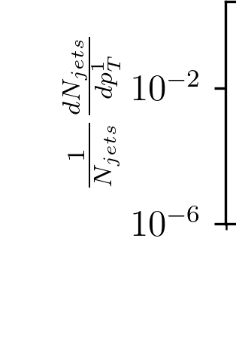
Jet properties – R=0.4
$Area>0.6R$
Area
Angularity
<p_{T}> (GeV/c)
p_{T}¹ (GeV/c)
Area
Angularity
Average p_{T}
Leading p_{T}
$α=\frac{1}{p_{T}^{jet}}\sum{z_{k}}\left(\vec{R_{k}}\right)$

Slide 27
Silhouette Values
Average distance between a jet candidate and other jet candidates in its cluster (signal or background)
Average distance between jet candidate and jet candidates in the other cluster
Silhouette value
$a_{i}={\left\langle d_{i,j}\right\rangle }_{j≠i}$
$b_{i}=\left\langle d_{i,j}\right\rangle$
$s_{i}=\frac{b_{i}−a_{i}}{max\left[b_{i},a_{i}\right]}$
-1
1
0
Looks more like another cluster
Indistinguishable from other clusters
Looks more like its own cluster

Slide 28
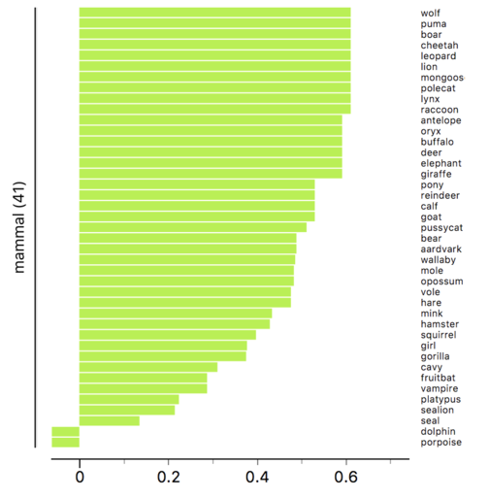
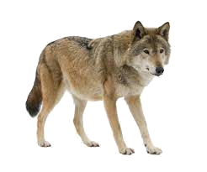

Silhouette values
Example from Wikipedia
s
Silhouette scores from three types of animals rendered by Orange data mining suite.
s

Slide 29
Silhouette Values
Define a distance between two jet candidates to determine how similar they are
$d_{i,j}=\sqrt{{\left(\frac{A_{i}−A_{j}}{A^{max}−A^{min}}\right)}^{2}+{\left(\frac{α_{i}−α_{j}}{α^{max}−α^{min}}\right)}^{2}+{\left(\frac{{\left\langle p_{T}\right\rangle }_{i}−{\left\langle p_{T}\right\rangle }_{j}}{{\left\langle p_{T}\right\rangle }^{max}−{\left\langle p_{T}\right\rangle }^{min}}\right)}^{2}+{\left(\frac{p_{T,i}^{L}−p_{T,j}^{L}}{p_{T}^{L,max}−p_{T}^{L,min}}\right)}^{2}}$
Area
Angularity
Average p_{T}
Leading p_{T}
$α=\frac{1}{p_{T}^{jet}}\sum{z_{k}}\left(\vec{R_{k}}\right)$

Slide 30
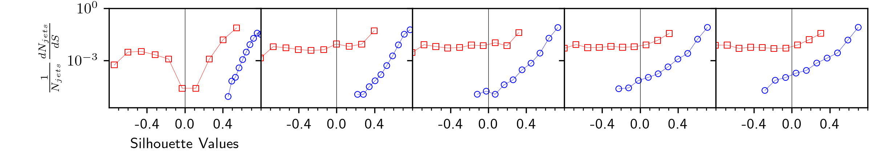
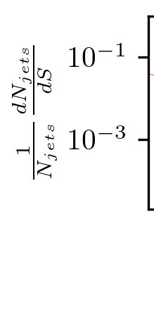
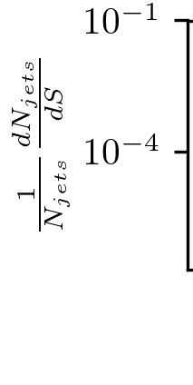
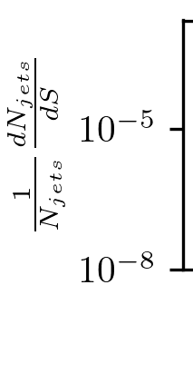
Before area cut
Combinatorial
Signal
p_{T}=20 GeV/c
R=0.2
R=0.3
R=0.4
R=0.5
R=0.6
R=0.3
R=0.4
p_{T}=10 GeV/c
p_{T}=20 GeV/c
p_{T}=40 GeV/c
p_{T}=80 GeV/c
Silhouette Values

Slide 31
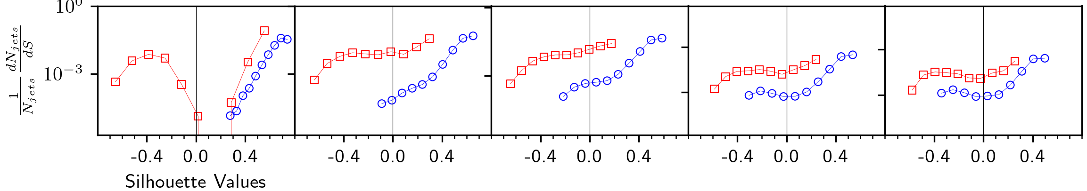
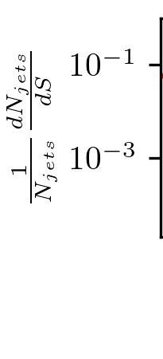
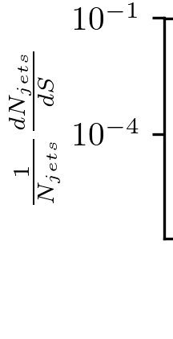
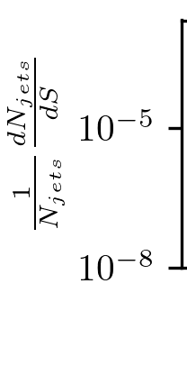
After area cut
Combinatorial
Signal
p_{T}=20 GeV/c
R=0.2
R=0.3
R=0.4
R=0.5
R=0.6
R=0.3
R=0.4
p_{T}=10 GeV/c
p_{T}=20 GeV/c
p_{T}=40 GeV/c
p_{T}=80 GeV/c
Silhouette Values

Slide 32
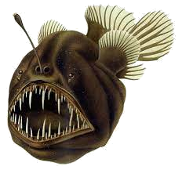
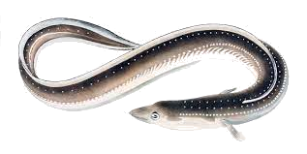

Slide 33
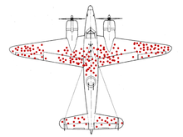
Survivor bias
WWII Example: holes planes returning indicate where it’s safer to get hit
We’re looking at the real and combinatorial jets which remain

Slide 34
5. Background corrections in Monte Carlo

Slide 35
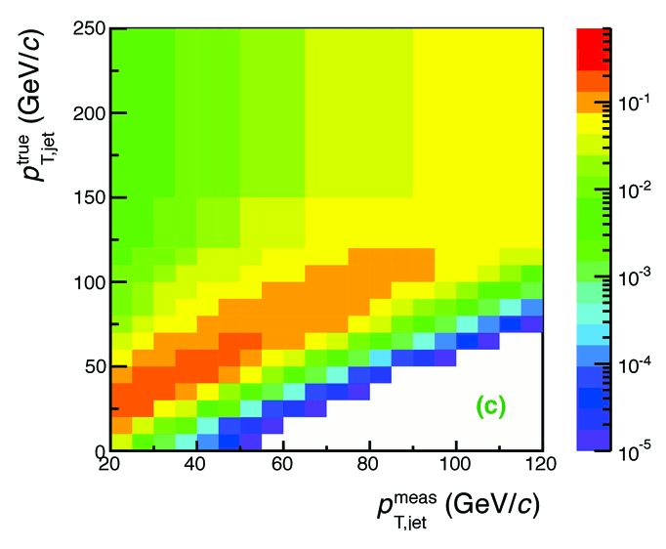

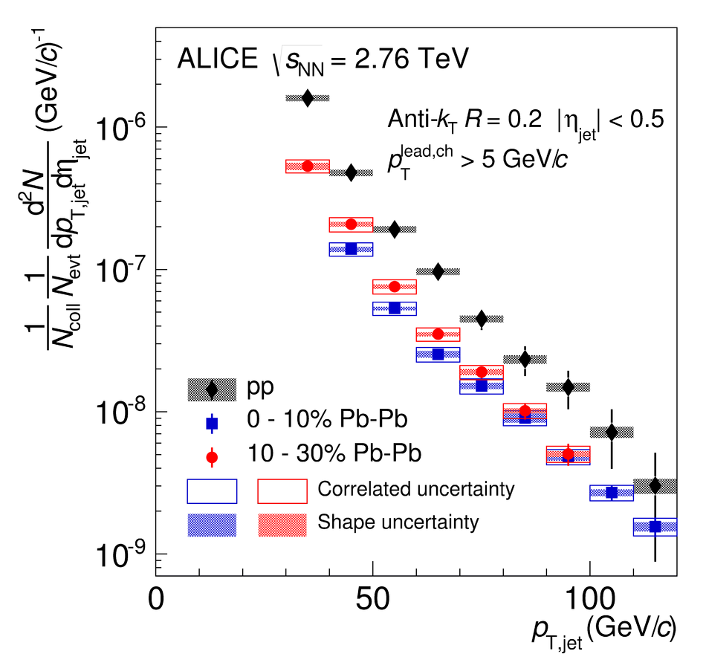
Analysis steps
Tracks
Jet finding algorithm
Jet candidates
Background subtraction
Clusters
Jet spectrum smeared by energy resolution, background fluctuations
Unfolding – corrects for single track reco ε, E resolution, background fluctuations
Corrected spectra

Slide 36
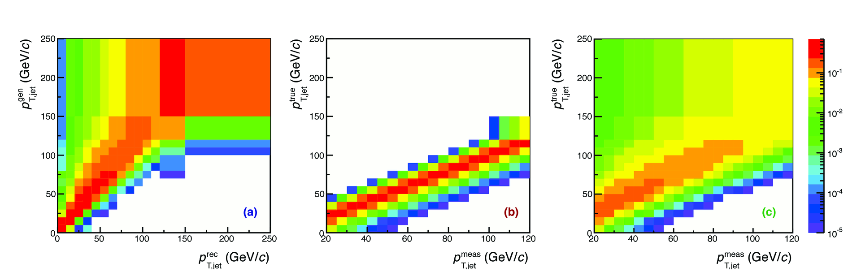
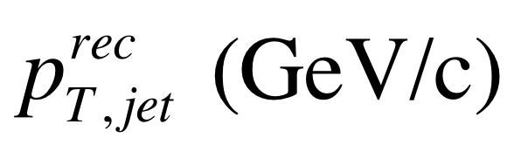
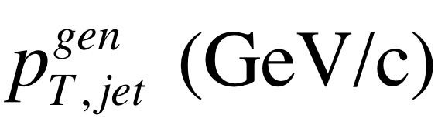
Jets in ALICE: Response Matrix Construction
RMdet X RMbkg = RM
NOT A DETECTOR EFFECT!!
DETECTOR EFFECT
RMbkg and RMdet are approximately factorizable
Notes:
----- Meeting Notes (6/24/13 16:47) -----
Put Large Labels on
b) change pT true -> pT rec so consistence
c) change gT true ->pT gen

Slide 37
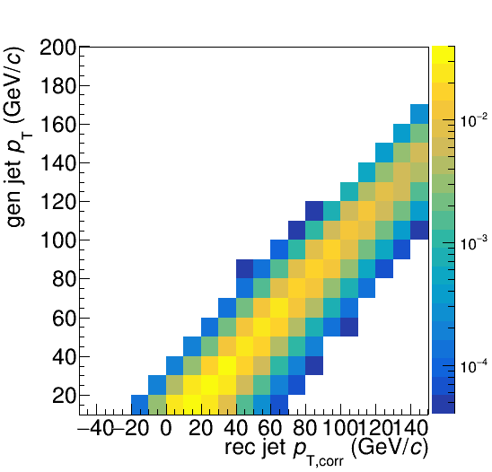
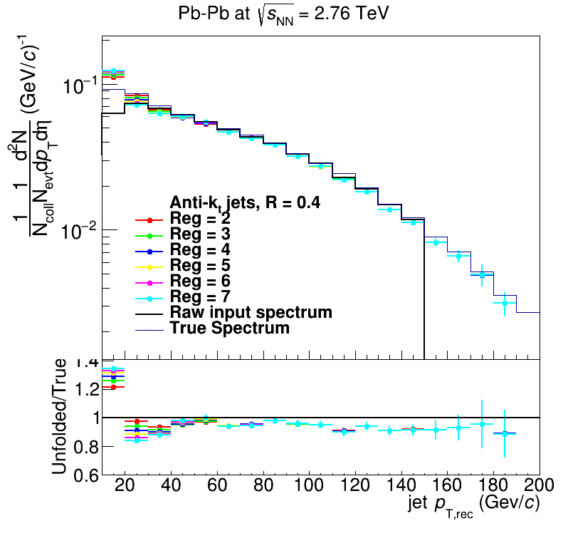
Analysis steps: Full Monte Carlo
Jet finding algorithm
Jet candidates
Background subtraction
Particles
Unfolding – corrects for background fluctuations and other effects
Jet spectrum smeared by energy resolution
Corrected spectra

Slide 38
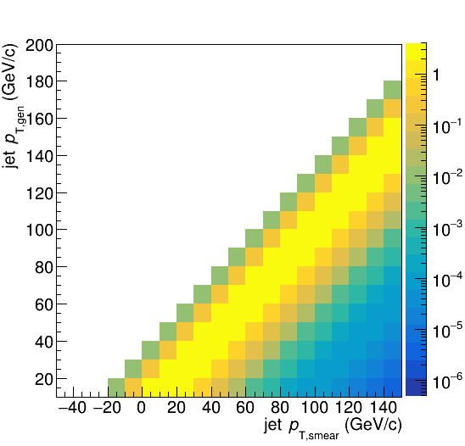
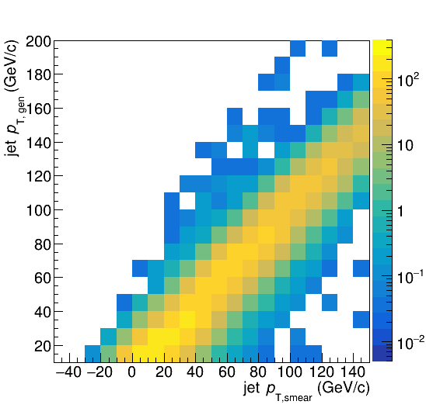
Construct a response matrix in Monte Carlo
Background fluctuations
Embedding

Slide 39
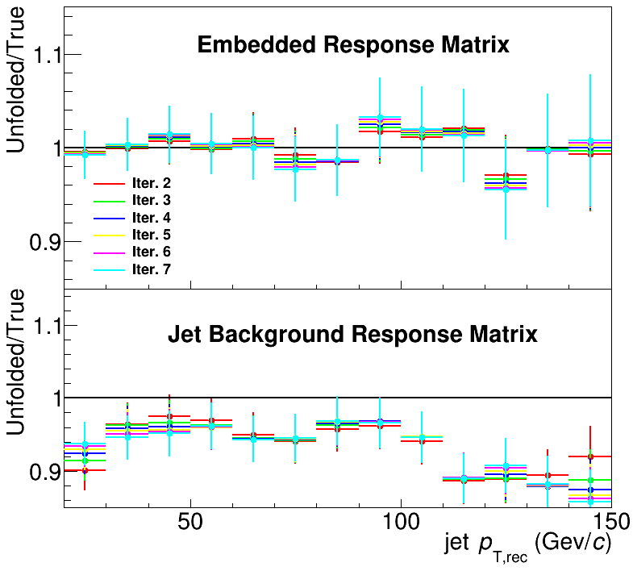
Closure
Methods
  Use δp_{T} method to measure width of fluctuations with varying numbers of leading jets (LJ) discarded
  Embed PYTHIA event into heavy ion event
Only embedding leads to full closure
Not due to jet finder behavior in background → interplay between background and jet finder

Slide 40
Need unfolding and embedding in MC!

Slide 41
6. How to compare to models

Slide 42
Snowmass Accord: Apply the same algorithm to data and your model. Then the measurement and the calculation are the same.

Slide 43
Rivet: Apply the same algorithm to data and your model. Then the measurement and the calculation are the same.

Slide 44
What is Rivet?

Slide 45
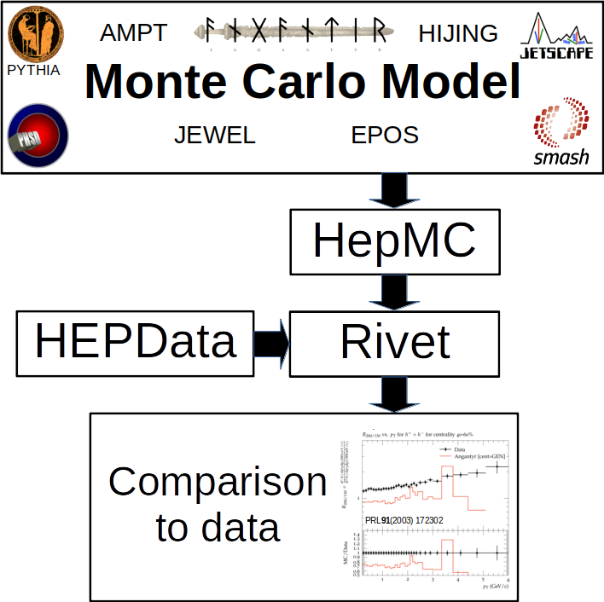

Slide 46
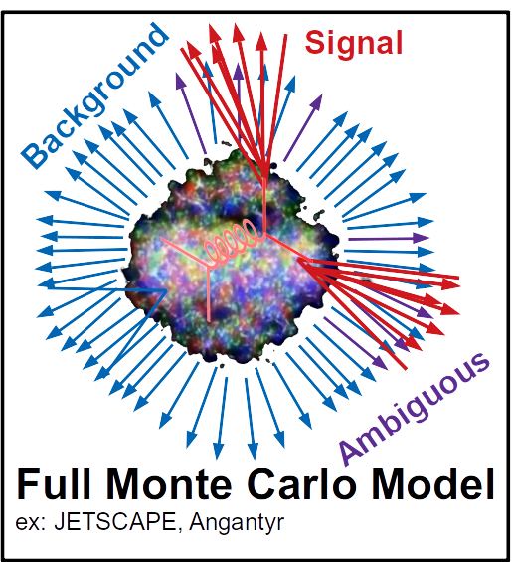
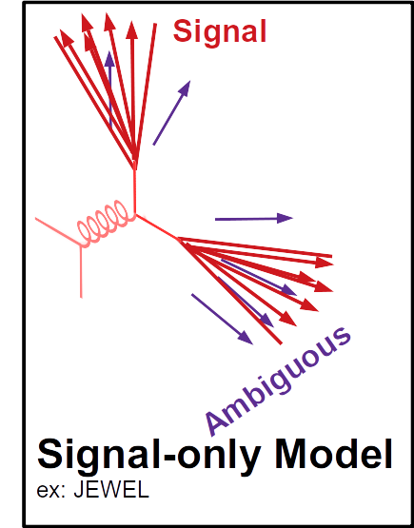
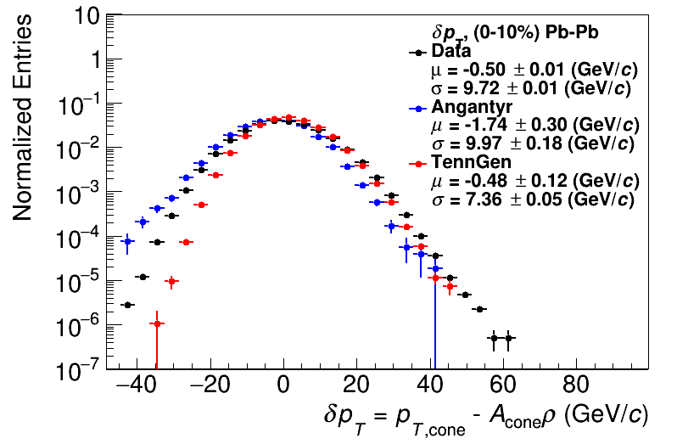
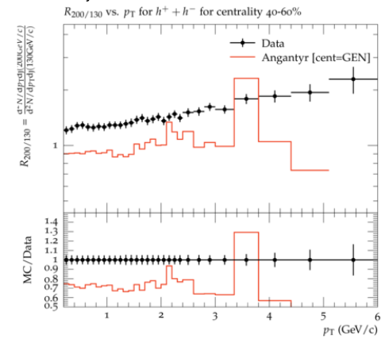
Comparison to data
HepMC
Rivet
Unfold to correct for fluctuations
HEPData
HepMC
Rivet
arXiv:2005.02320
[hep-ph]
Comparison to data
See poster by
Nattrass et al
PRL91(2003) 172302
Unfold to correct for fluctuations
Comparison to data
PRL91(2003) 172302

Slide 47
Why use Rivet?
Facilitates comparisons between Monte Carlos and data
It’s not that hard
It preserves analysis details

Slide 48
Conclusions
Models have background too!
Correcting for it requires unfolding, embedding
Background suppression → combinatorial jets which look like real jets
Treat models like data
Recorded tutorials from Rivetizing Heavy Ion Collisions at RHIC

Slide 49
4. Background:
Not just an experimental problem!
arXiv:2005.02320

Slide 50
Random cones
X
Excluded
$ϕ$
R=0.4
Real jets
Excluded
$η$

Slide 51
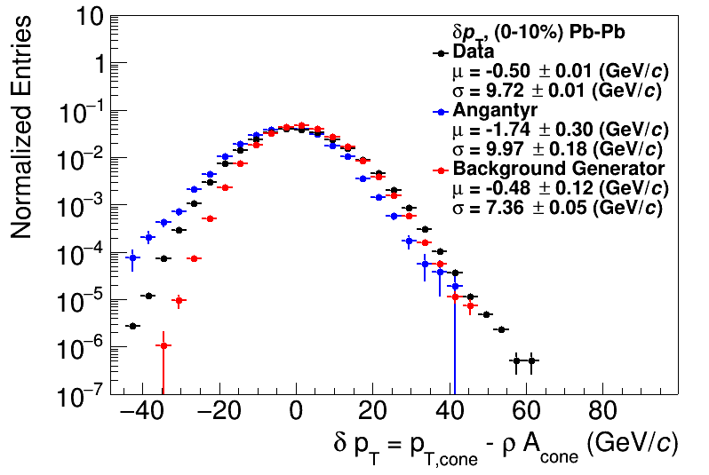
Random cones
ALICE Data: JHEP 03 (2012) 053
arXiv:2005.02320
ρ = Median(p_{T}/A)

Slide 52
Shape of width of the distribution
Single particle spectra
$f_{Γ}\left(p_{T},p,b\right)=\frac{b}{Γ\left(p\right)}{\left(bp_{T}\right)}^{p−1}e^{−bx}$
Σp_{T} of N particles→N-fold convolution:
$\frac{{dpT}^{total}}{dy}∝f_{N}\left(p_{T},Np,b\right)$
$f_{N}\left(p_{T},p,b\right)=f_{Γ}\left(p_{T},Np,b\right)$
$\frac{dN}{dy}∝f_{Γ}\left(p_{T},2,b\right)=b^{2}p_{T}e^{−kp_{T}}$
$N=\frac{N_{total}}{A_{total}}πR^{2}$
$μ_{total}=\frac{Np}{b}=Nμ_{p_{T}},σ_{total}=\frac{\sqrt{Np}}{b}=\sqrt{N}σ_{p_{T}}$
$μ_{p_{T}}=\frac{p}{b},σ_{p_{T}}=\frac{\sqrt{p}}{b}$
Tannenbaum, PLB(498),1–2,Pg.29-34(2001)
Add Poissonian fluctuations in N:
$σ_{total}=\sqrt{Nσ_{p_{T}}^{2}+Nμ_{p_{T}}^{2}}$
Assumes shape
Add non-Poissonian fluctuations in N due to flow
Assumes uncorrelated number fluctuations
$σ_{total}=\sqrt{Nσ_{p_{T}}^{2}+\left(N+2\sum{v_{n}^{2}}\right)μ_{p_{T}}^{2}}$

Slide 53


Width vs multiplicity
Angantyr
ALICE

Slide 54

Width vs multiplicity
TennGen
ALICE
Impact of shape of spectrum
Correlations between event planes

Slide 55
Backup

Slide 56

Random cones in ALICE
Estimate ρ
  k_{T} jet finder→jet candidates
  ρ = Median(p_{T}/A)
Draw Random cone
JHEP 03 (2012) 053
$δp_{T}=p_{T}^{reco}−ρA$

Slide 57

Mini-summary
Jet finders put all input clusters, tracks in a jet candidate
Background is dominated by random particles
  But ~5% effects from
  non-Poissonian fluctuations
Models have background too!
  Sensitive to multiplicity,
  implementation of flow
Cacciari DIS 2006
Energy (arb. units)
Cacciari & Salam
Phys.Lett.B641:57-61,2006
$ϕ$
$η$

Slide 58
Mini-summary
“Signal” and “background” have different properties, but...
Always overlap somewhat
Any procedure to remove “background” will also cut signal

Slide 59


Slide 60




Slide 61
Area-based background subtraction
Cacciari & Salam, PLB659:119–126,2008
Particles, clusters
k_{T} algorithm
Cacciari DIS 2006
$k_{T}=p_{T},ΔR_{ij}=\sqrt{{\left(η_{i}−η_{j}\right)}^{2}+{\left(ϕ_{i}−ϕ_{j}\right)}^{2}}$
For all i,j calculate:
Combine smallest d_{ij}.
If d_{iB} smallest, d_{iB}→ jet
Repeat until no particles left
$d_{ij}=min\left(p_{T,i}^{2},p_{T,j}^{2}\right)ΔR_{ij}^{2}$
Energy (arb. units)
$d_{iB}=p_{T,i}$
Cacciari & Salam
Phys.Lett.B641:57-61,2006
Jet candidates
$ϕ$
Median ρ=p_{T}/A
$η$
$p_{T}^{jet}=p_{T}^{reco}−ρ_{median}A^{jet}$

Slide 62


Background density ρ
`
ALICE
arXiv:2005.02320

Slide 63


Subjet z
$p_{T}^{subjet}$
$z_{r}=\frac{p_{T}^{subjet}}{p_{T}^{jet}}$
$p_{T}^{jet}$
James Mulligan
CERN seminar Dec. 2021
Cluster jets with anti-k_{T} with resolution parameter R
Recluster constituents with anti-k_{T} with resolution parameter r
Some discriminating power between quark-like and gluon-like jets
  Strained at low momentum, small R

Slide 64
Subjet z_{r}: Area cut

Slide 65
Subjet z_{r}: Leading hadron p_{T}¹ cut

Slide 66
Subjet z_{r}: Leading hadron p_{T}¹ cut

Slide 67
Look for a clever solution with Machine Learning
Input Features
Standardize
Random Forest
Area
Angularity
Mean Const. p_T
Leading hadron p_T
Scale Max to one and min to zero for each feature
Oracle
Most effective
Kinematic cut
Calculate Loss
Leading
hadron p_{T}
> 4.3 GeV
Random
Forest
Prediction:
Signal
Oracle
Prediction:
Signal
Random
Forest
Prediction:
Signal
75-90% Combinatorial Rejection
40-90% Squishy Rejection
1-15% signal loss
Actual:
Squishy
Calculate Loss

Slide 68
Bias & background
Background suppression → Bias
Survivor bias: Modified jets probably look more like the medium
Quark/Gluon bias:
  Quark jets are narrower, have fewer tracks, fragment harder [Z Phys C 68, 179-201 (1995), Z Phys C 70, 179-196 (1996), ]
  Gluon jets reconstructed with kT algorithm have more particles than jets reconstructed with anti-kT algorithm [Phys. Rev. D 45, 1448 (1992)]
  Gluon jets fragment into more baryons [EPJC 8, 241-254, 1998]
Fragmentation bias: Experimental measurements explicitly select jets with hard fragments
http://walkthewilderness.net/animals-of-india-72-asiatic-elephant/

