Slide 1
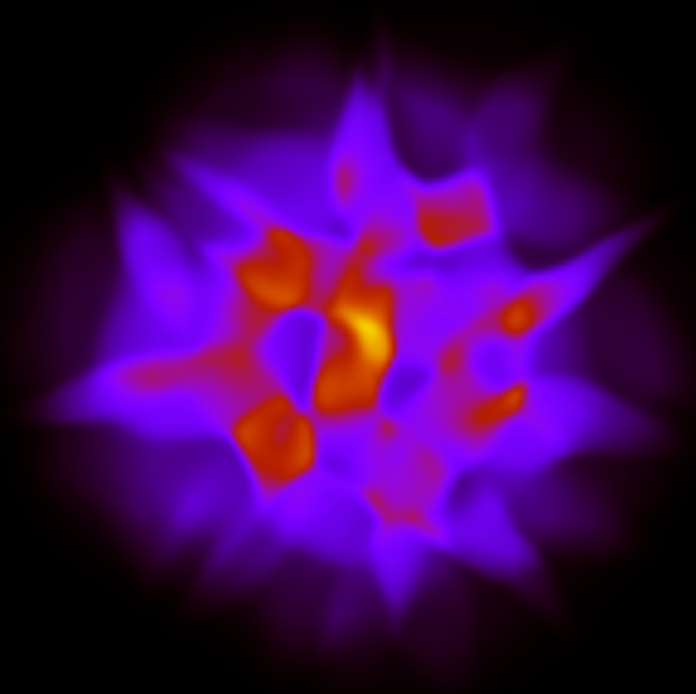

Jet-hadron correlations
Christine Nattrass
University of Tennessee, Knoxville
Hydro simulation of a single Au+Au collision
Shown is the energy density in the transverse plane. For more information on the simulation refer to arXiv:1009.3244.

Slide 2
Why measure jet-hadron correlations?

Slide 3
Because we understand the background

Slide 4
So we can study the away side

Slide 5
What is measured

Slide 6





Jets and flow
D
c, x_{c}
p
a, x_{a}
b, x_{b}
p
σ_{ab}
d, x_{d}
D
Hydro simulation of a single Au+Au collision
Shown is the energy density in the transverse plane. For more information on the simulation refer to arXiv:1009.3244.
p+p di-jet event in STAR
Both lead to azimuthal correlations
Jets → background for flow
Flow → background for jets

Slide 7
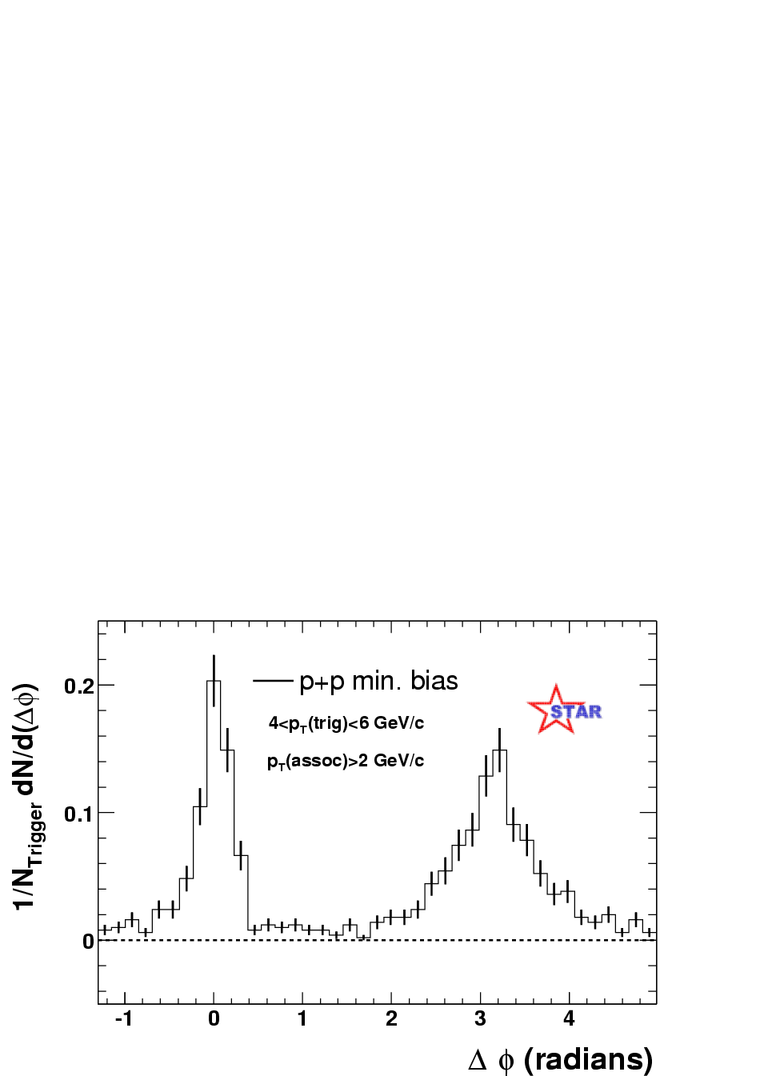
Jets – azimuthal correlations
p+p → dijet
Trigger
trigger
Phys Rev Lett 90, 082302
Associated
Select high momentum particles → biased towards jets

Slide 8
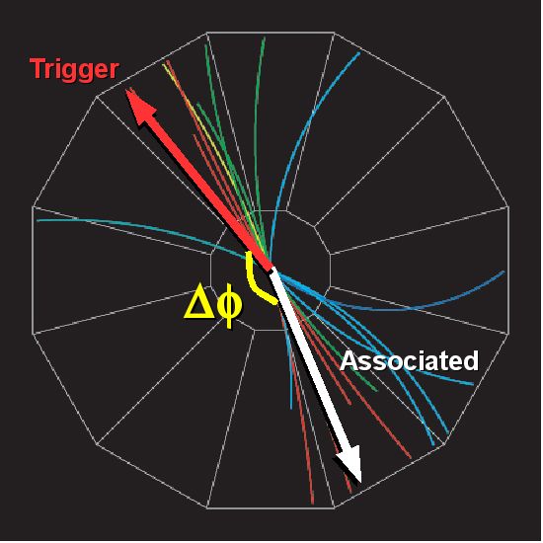
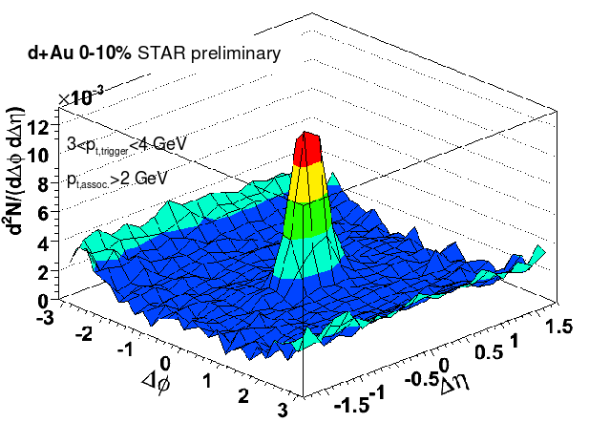
Looking in two dimensions
d+Au
Angle in plane perpendicular to beam pipe
Along direction of beam

Slide 9
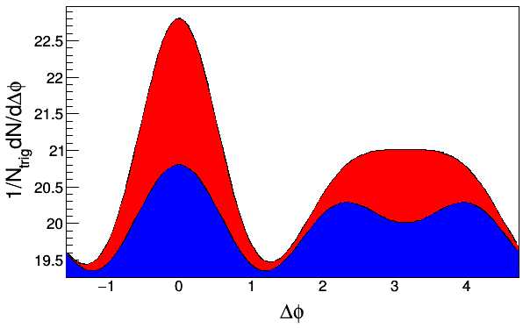
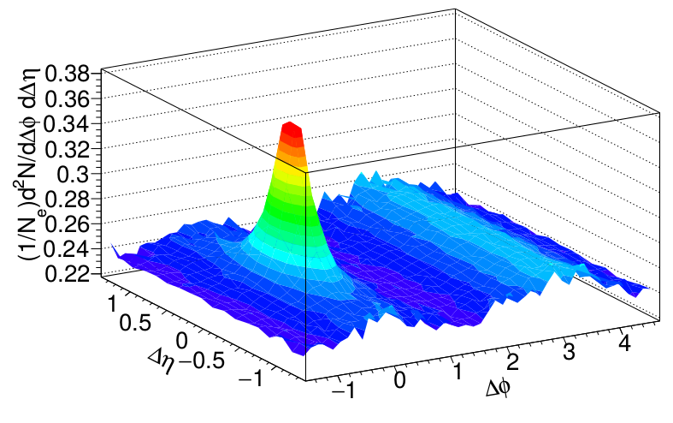
Two component model
h-h
√s_{NN} = 2.76 TeV
30-40% PbPb
8<p_{T}^{trigger}<10 GeV/c
1<p_{T}^{assoc}<2 GeV/c
SIMULATION
Jets
Flow
Two component model
  Assume contributions can be factorized
  Alternately, define signal as anything which isn't consistent with separable flow and jet components
  Assumptions even embedded in most studies of full jets
Flow component given by
$B\left(1+\sum{\tilde{v_{n}^{t}}}\tilde{v_{n}^{a}}cos\left(nΔϕ\right)\right)$

Slide 10
Background Subtraction Methods
Zero-Yield at Minimum (ZYAM): Assumes v_{n} from other studies, assumes region around Δφ≈1 is background dominated
Δη Method: Project near-side signal onto Δη and subtract constant background. Near-side only
Δη Gap Method: Use signal at large Δη to determine background, assuming constant background in Δη. Near-side only
Near-Side Fit (NSF): assumes small Δφ/large Δη region background dominated, fits v_{n} and B
Reaction Plane Fit (RPF): assumes small Δφ/large Δη region background dominated, fits v_{n} and B using reaction plane dependence
Near-Side Subtracted NSF/RPF (NSS NSF/RPF): fits v_{n} and B at small small Δφ using reaction plane dependence after subtracting the near-side with a fit

Slide 11


Dihadron correlations
with vs without v₃
Nattrass, Phys. Rev. C 97, 034916 (2018).
Phys.Rev.Lett.93:252301,2004

Slide 12
ZYAM

Slide 13
Zero Yield At Minimum
Jets
Flow
Flow component given by
Fix background level at minimum
Use independent measurements of v_{n}
$B\left(1+\sum{\tilde{v_{n}^{t}}}\tilde{v_{n}^{a}}cos\left(nΔϕ\right)\right)$

Slide 14
Issues with ZYAM
Tends to underestimate background level
  Can use fixed point (e.g. Δφ=1) instead
v_{n} for background may not be the same as independent measurements
  Cumulant methods suppress fluctuations
  Reaction plane measurements may include effects from jets
  Events with jets may be different
  High and low p_{T} reaction planes may be different
  Effective v_{n} are average over particle pairs and includes background from other jets. Measurements of flow are averaged over events and the goal is to suppress contributions from jets.
If jet peak is broadened, may overestimate background (underestimate signal)
Only v₂ measured for jets
$v_{n}<\tilde{v_{n}}$
$v_{n}>\tilde{v_{n}}$
$v_{n}≠\tilde{v_{n}}$
$v_{n}≠\tilde{v_{n}}$
$v_{n}≠\tilde{v_{n}}$

Slide 15
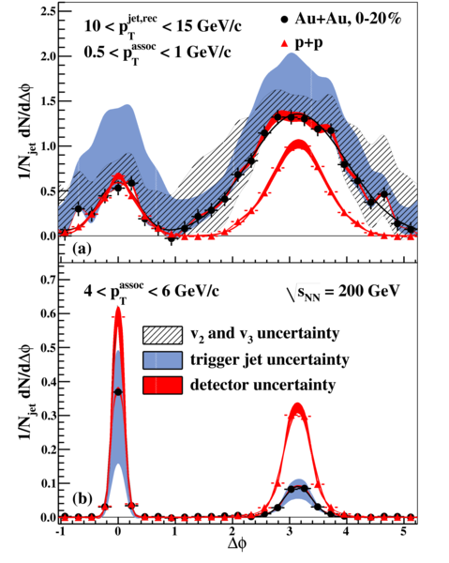
STAR
Phys. Rev. Lett. 112 (2014) 122301

Slide 16
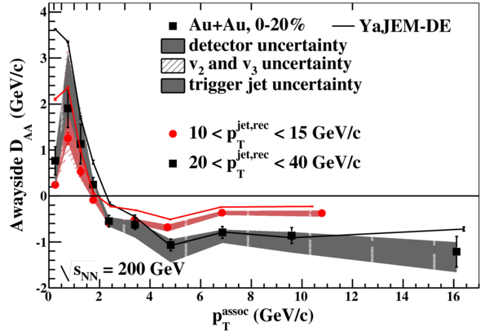
STAR
Phys. Rev. Lett. 112 (2014) 122301

Slide 17
Δη Method

Slide 18
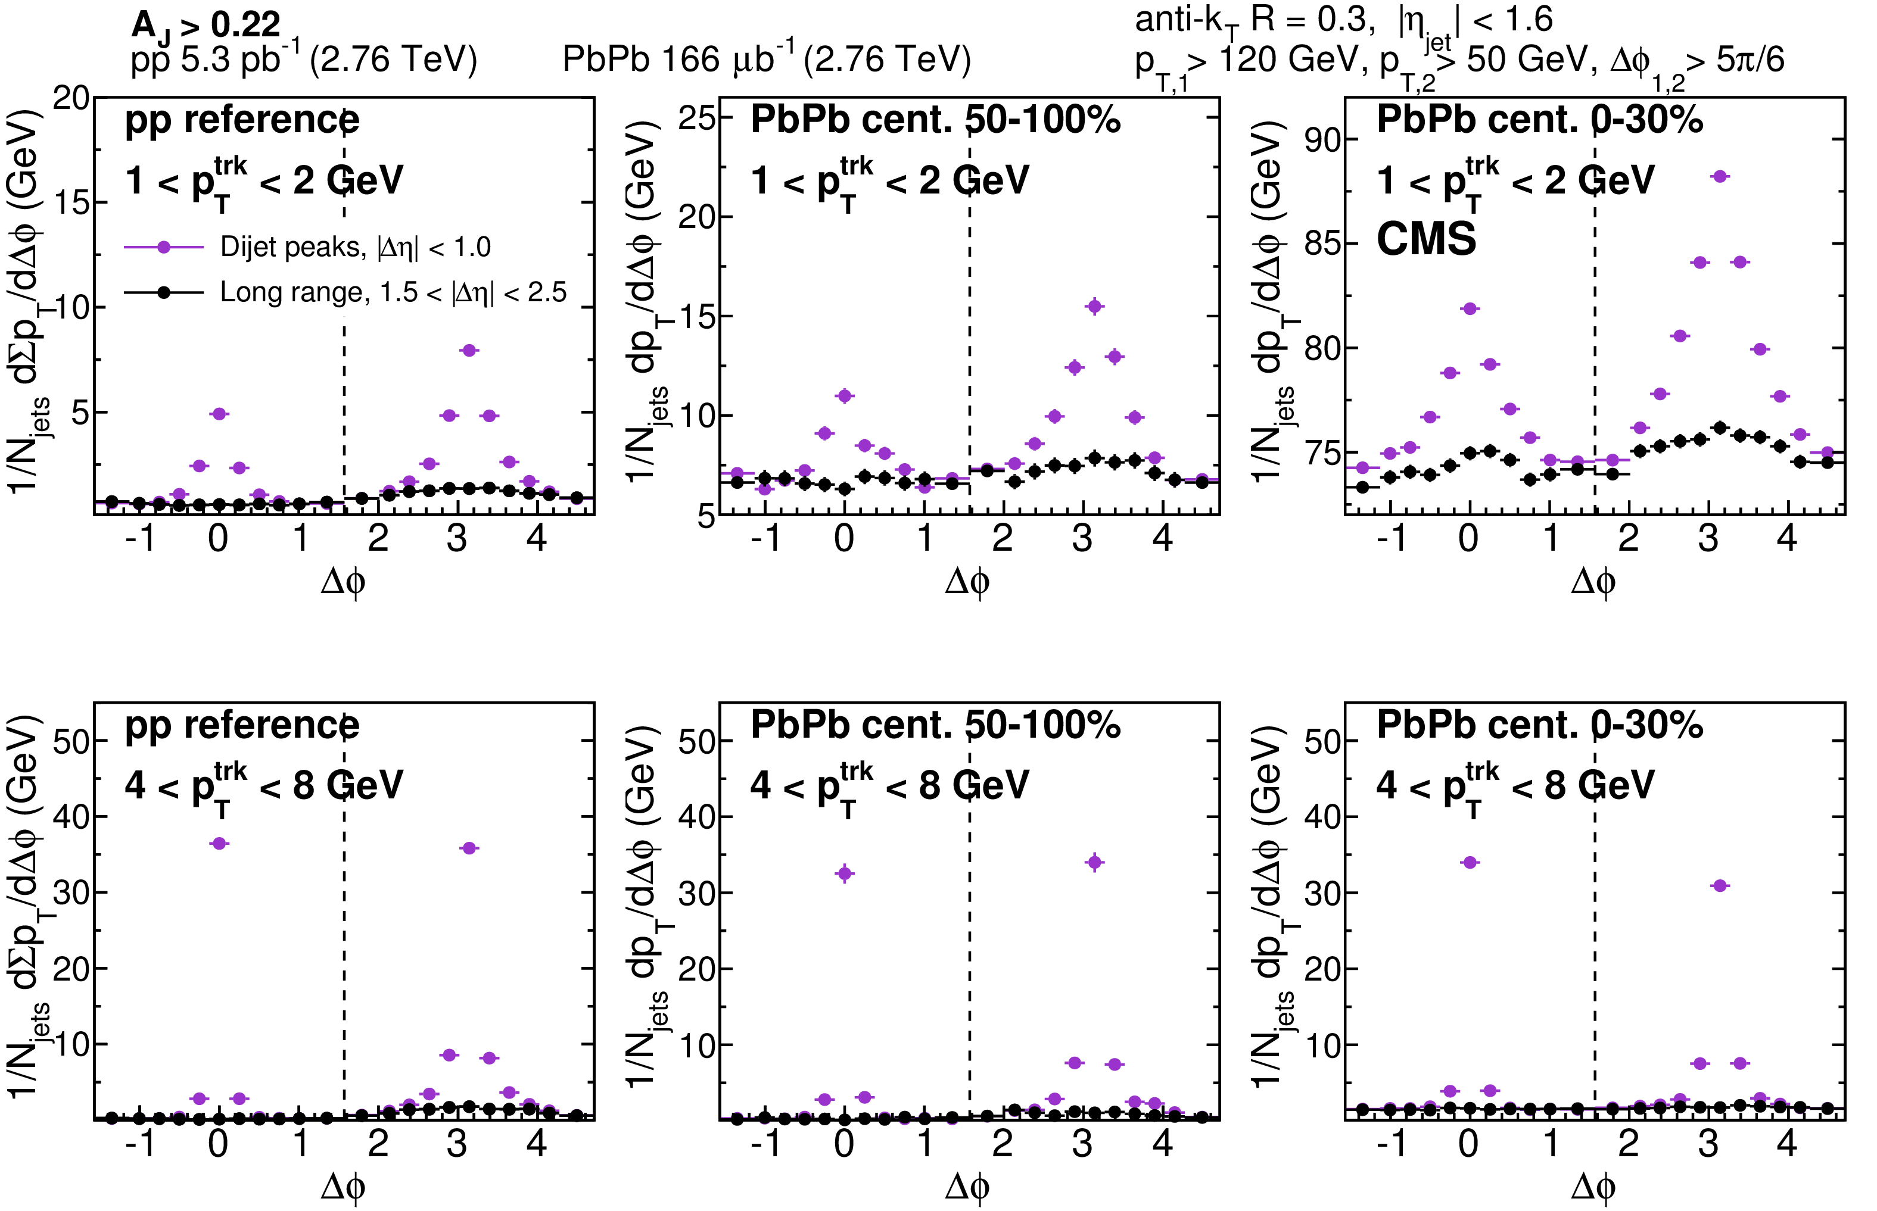
CMS-HIN-PAS-15-011
JHEP 11 (2016) 055

Slide 19
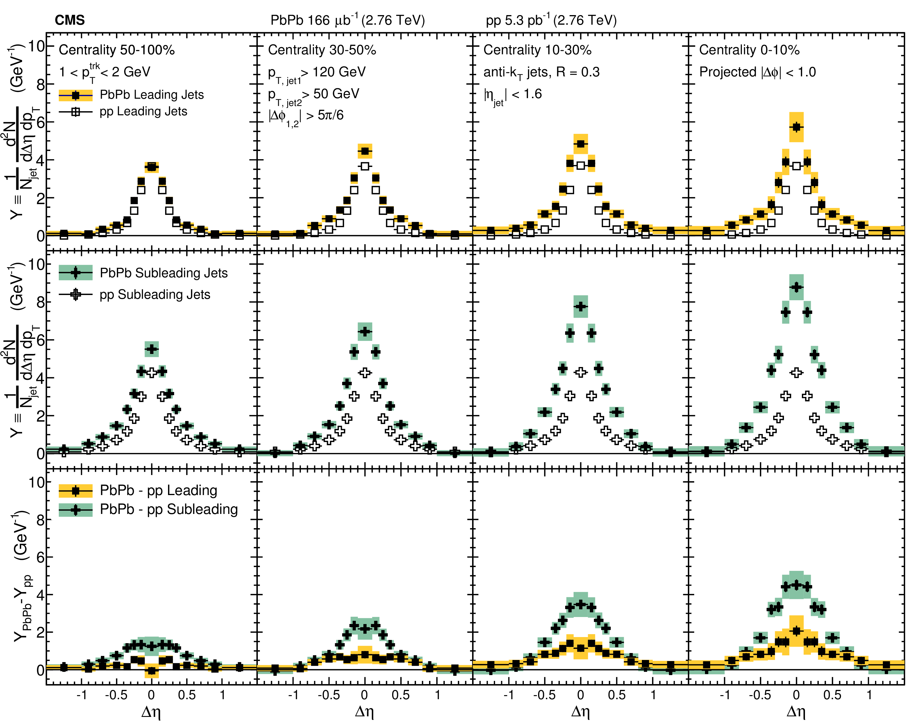
CMS-HIN-PAS-14-016
JHEP 1602 (2016) 156

Slide 20
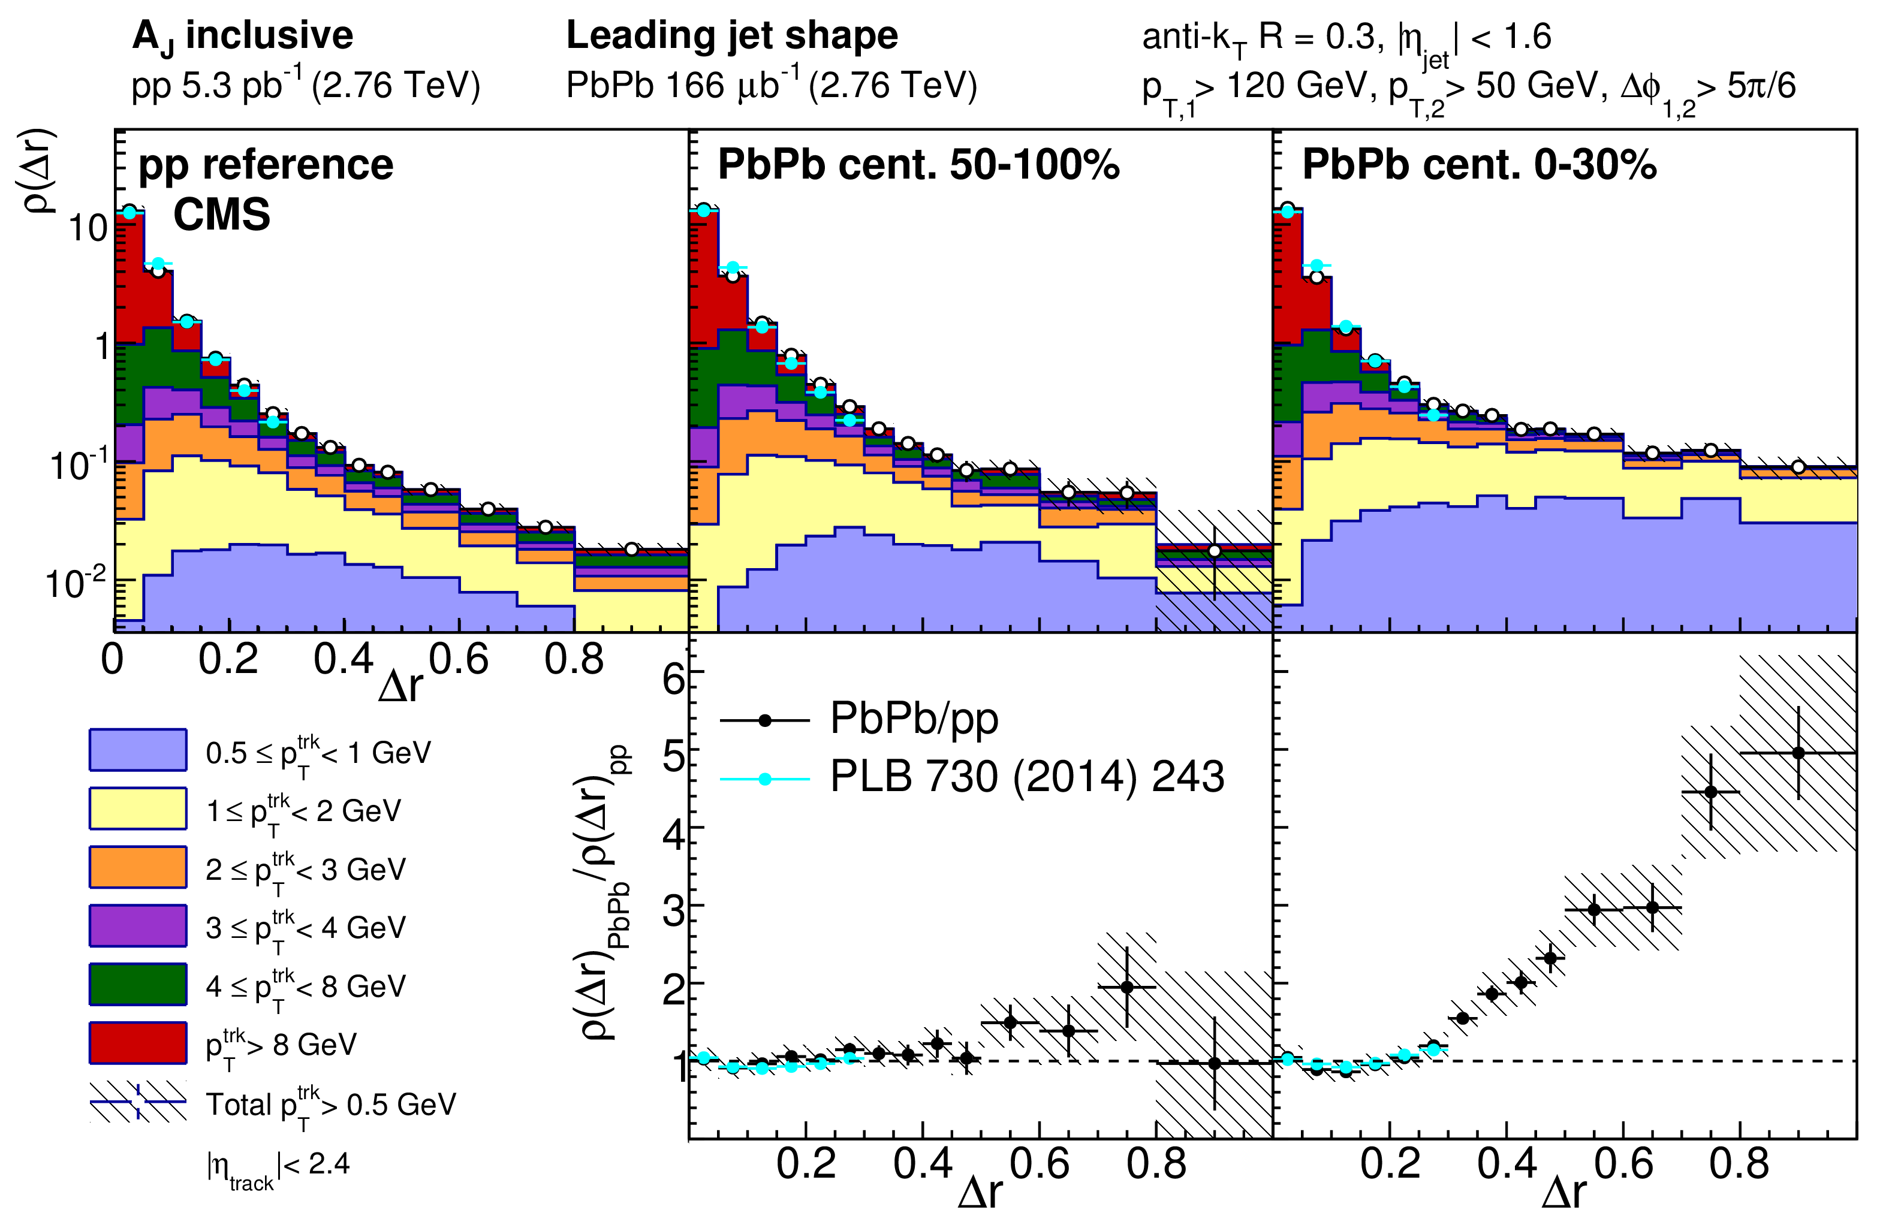
CMS-HIN-PAS-15-011
JHEP 11 (2016) 055

Slide 21
Reaction Plane Fit
Based on Phys. Rev. C 93, 044915(2016)

Slide 22
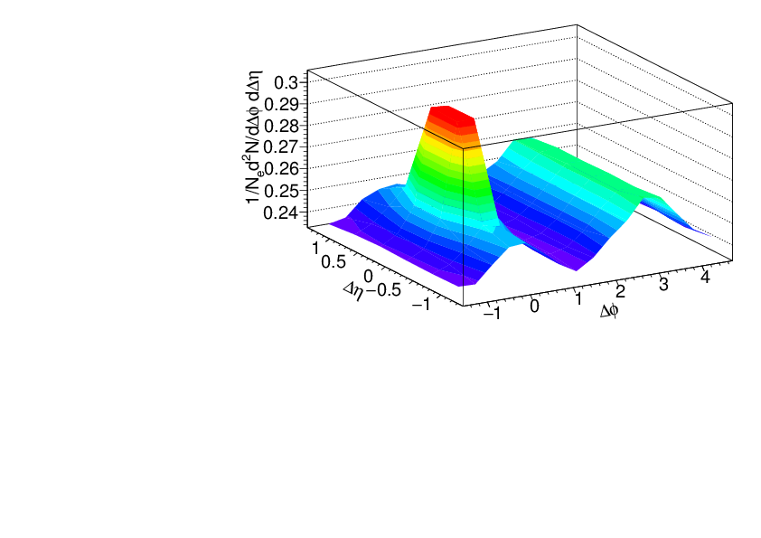
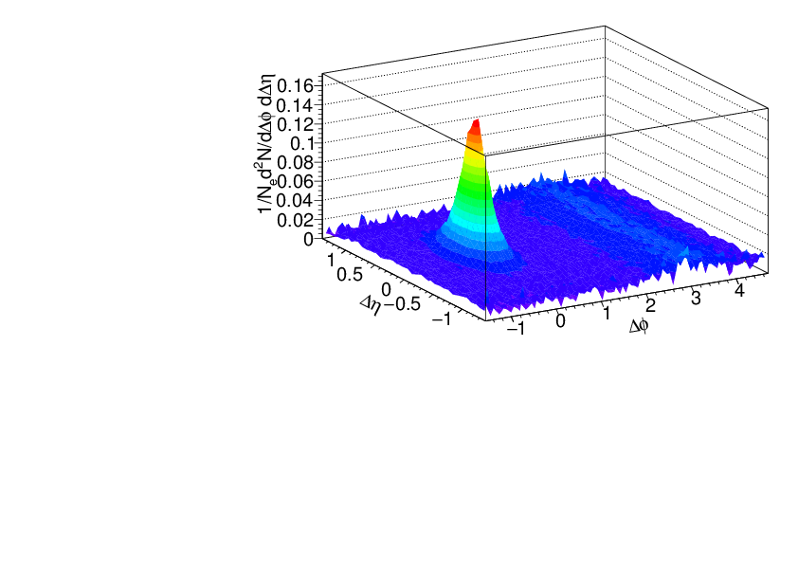
Separating signal+background
Signal+background
Signal only
h-h
√s_{NN} = 2.76 TeV
30-40% PbPb
8<p_{T}^{trigger}<10 GeV/c
1<p_{T}^{assoc}<2 GeV/c
Background dominated region
MODEL STUDIES

Slide 23
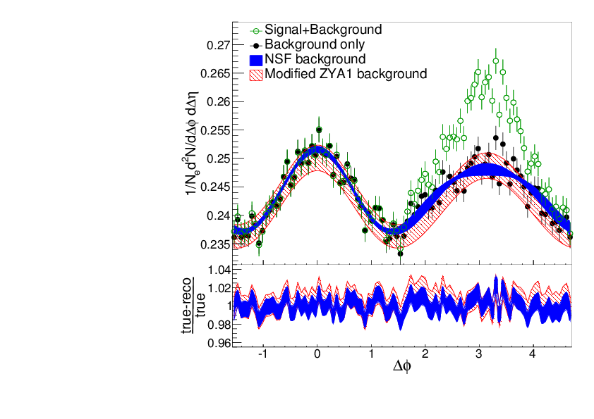
Near-Side Fit (NSF) method
No reaction plane dependence
MODEL
STUDIES
Signal+background
h-h
√s_{NN} = 2.76 TeV
30-40% PbPb
8<p_{T}^{trigger}<10 GeV/c
1<p_{T}^{assoc}<2 GeV/c
Fit
extrapolation
Background dominated region
Project signal+background over 1.0<|Δη|<1.4
Fit background in |Δφ|<π/2

Slide 24
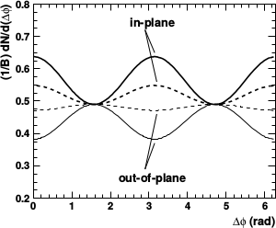

Background in correlations
All reaction plane angles
When trigger is restricted relative to reaction plane
  Background level modified
  Effective v_{n} modified
$B\left(1+\sum{v_{n}^{t}}v_{n}^{a}cos\left(nΔϕ\right)\right)$
$B=1+\sum{2}v_{k}^{R,t}cos\left(kϕ_{S}\right)\frac{sin\left(kc\right)}{kc}R_{n}$
$v_{n}^{R,t}=\frac{v_{n}+cos\left(n\text{\%}8_{S}\right)\frac{sin\left(nc\right)}{nc}R_{n}+\sum{\left(v_{k+n}+v_{k−n}\right)}cos\left(kϕ_{S}\right)\frac{sin\left(kc\right)}{kc}R_{n}}{1+\sum{2}v_{k}cos\left(kϕ_{S}\right)\frac{sin\left(kc\right)}{kc}R_{n}},n=even$
φ_{S} is the angular threshold
$R_{n}=\left\langle cos\left(n\left(ψ_{true}−ψ_{reco}\right)\right)\right\rangle$
Bielcikova et al, Phys.Rev. C69 (2004) 021901

Slide 25
Background in correlations
All reaction plane angles
When trigger is restricted relative to reaction plane
  Background level modified
  Effective v_{n} modified
$B\left(1+\sum{v_{n}^{t}}v_{n}^{a}cos\left(nΔϕ\right)\right)$
$B=1+\sum{2}v_{jk}^{R,t}cos\left(jkϕ_{S}\right)\frac{sin\left(jkc\right)}{jkc}R_{j,n}C_{jk,0,j}$
$v_{n}^{R,t}=\frac{v_{n}+δ_{n,multj}cos\left(nϕ_{S}\right)\frac{sin\left(nc\right)}{nc}R_{j,n}C_{n,0,j}+\sum{\left(v_{jk+n}C_{jk+n∨,n,j}+v_{jk−n}C_{jk−n∨,n,j}\right)}cos\left(jkϕ_{S}\right)\frac{sin\left(jkc\right)}{jkc}R_{jk,n}}{1+\sum{2}v_{jk}cos\left(jkϕ_{S}\right)\frac{sin\left(jkc\right)}{jkc}R_{j,jk}C_{jk,0,j}}$
φ_{S} is the angular threshold
$C_{n,m,j}=\left\langle cos\left(nψ_{n}+mψ_{m}−\left(n+m\right)ψ_{j}\right)\right\rangle$
$R_{n,j}=\left\langle cos\left(n\left(ψ_{true,j}−ψ_{reco,j}\right)\right)\right\rangle$
Nattrass & Todoroki, Phys. Rev. C 97, 054911 (2018).
Bielcikova et al, Phys.Rev. C69 (2004) 021901

Slide 26
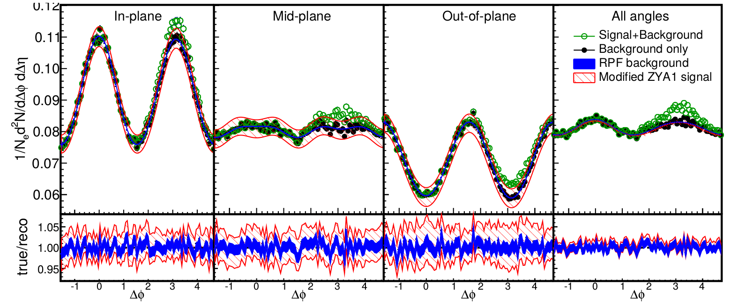
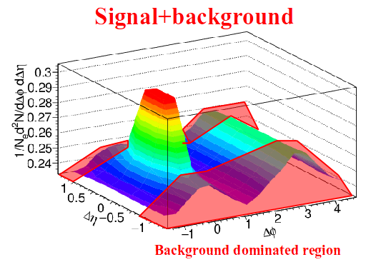
Reaction Plane Fit (RPF) method
30-40% central
h-h
√s_{NN} = 2.76 TeV
30-40% PbPb
8<p_{T}^{trigger}<10 GeV/c
1<p_{T}^{assoc}<2 GeV/c
Fit
MODEL STUDIES
Project signal+background over 1.0<|Δη|<1.4
Fit background in |Δφ|<1 including reaction plane dependence
v_{n} and B extracted with v_{n} up to n=4

Slide 27
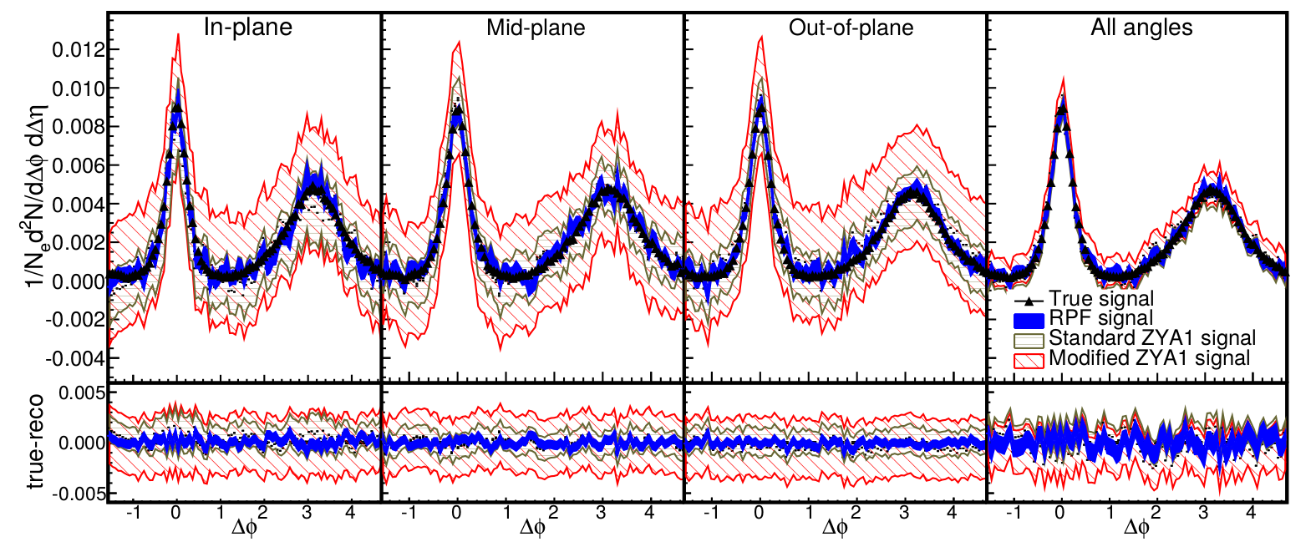
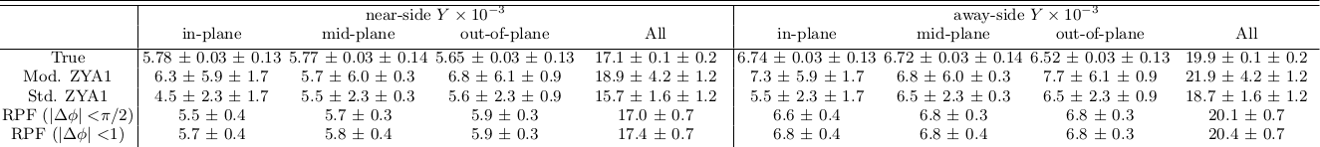
Reaction Plane Fit (RPF) method
30-40% central
h-h
√s_{NN} = 2.76 TeV
30-40% PbPb
8<p_{T}^{trigger}<10 GeV/c
1<p_{T}^{assoc}<2 GeV/c
MODEL STUDIES

Slide 28
ALICE jet-hadron correlations

Slide 29
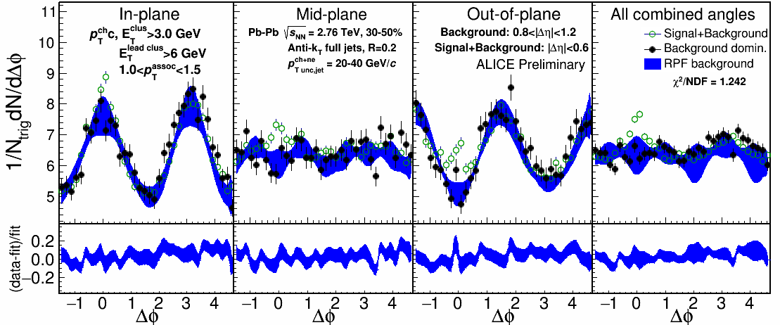
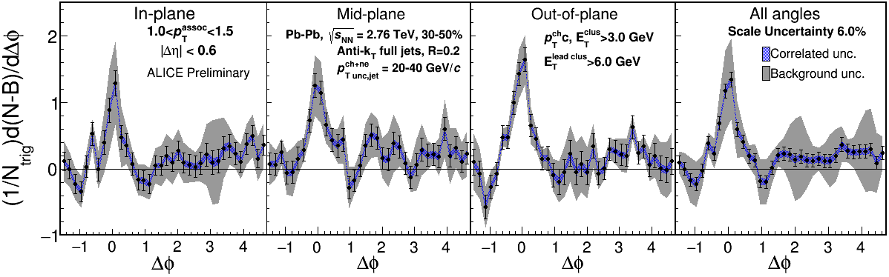
1.0-1.5 GeV/c
$p_{T}^{\text{assoc}}$
1) signal+bkgrd
2) bkgrd dominated
3) bkgrd RPF fit
Correlation function
Uncertainties dominated by statistics
Background uncertainty is non-trivially correlated point-to-point

Slide 30
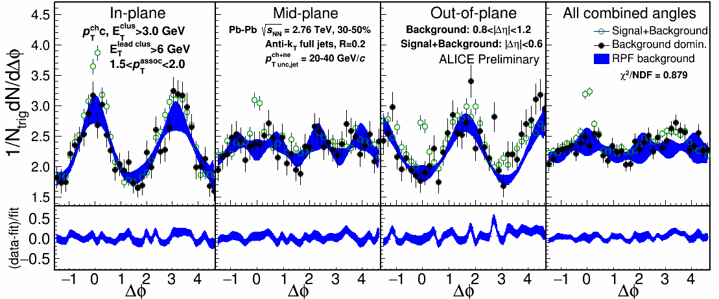
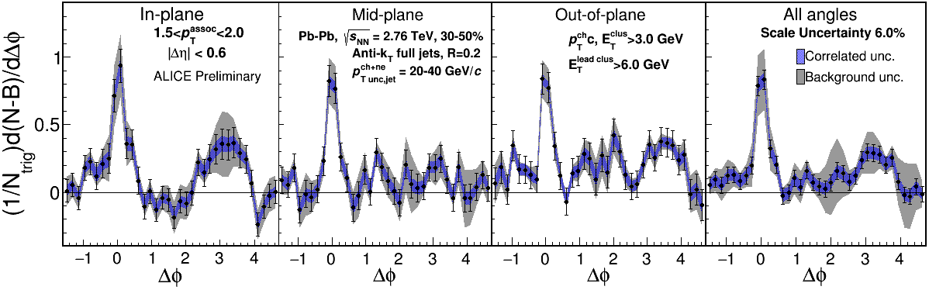
1.5-2.0 GeV/c
$p_{T}^{\text{assoc}}$
1) signal+bkgrd
2) bkgrd dominated
3) bkgrd RPF fit
Correlation function
v₃ and v₄ components important
Background uncertainty is non-trivially correlated point-to-point

Slide 31
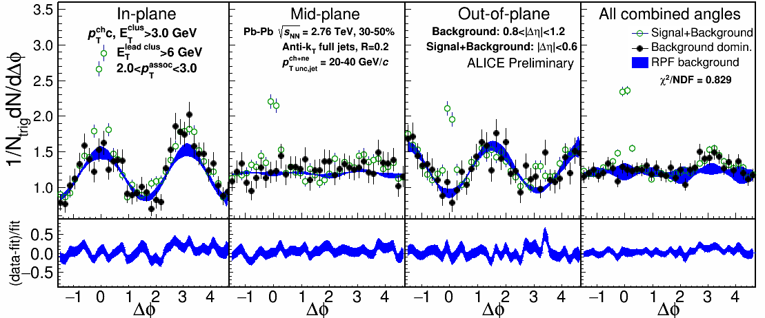
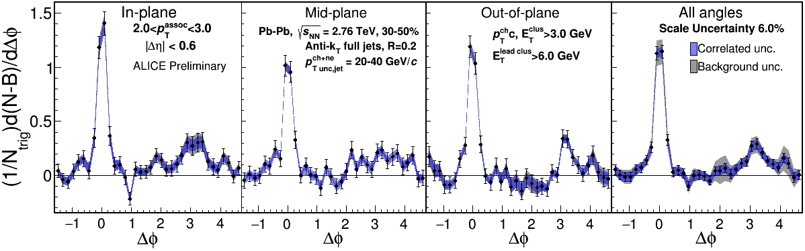
2.0-3.0 GeV/c
$p_{T}^{\text{assoc}}$
1) signal+bkgrd
2) bkgrd dominated
3) bkgrd RPF fit
Correlation function
Away side clearly there and suppressed

Slide 32
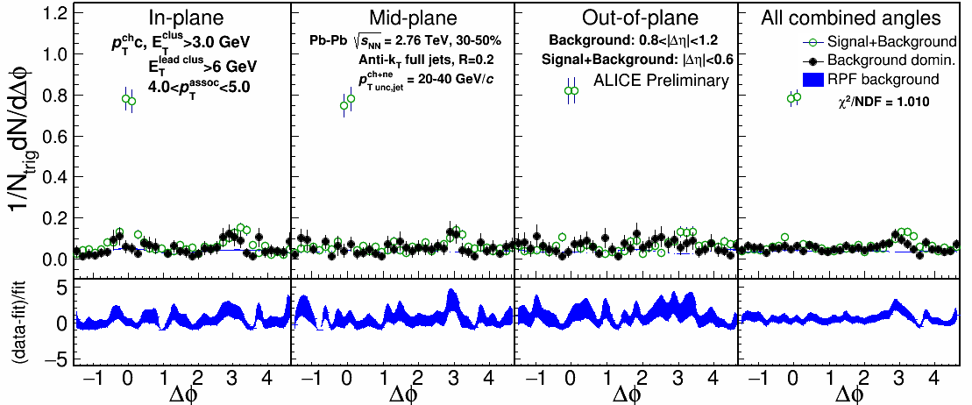
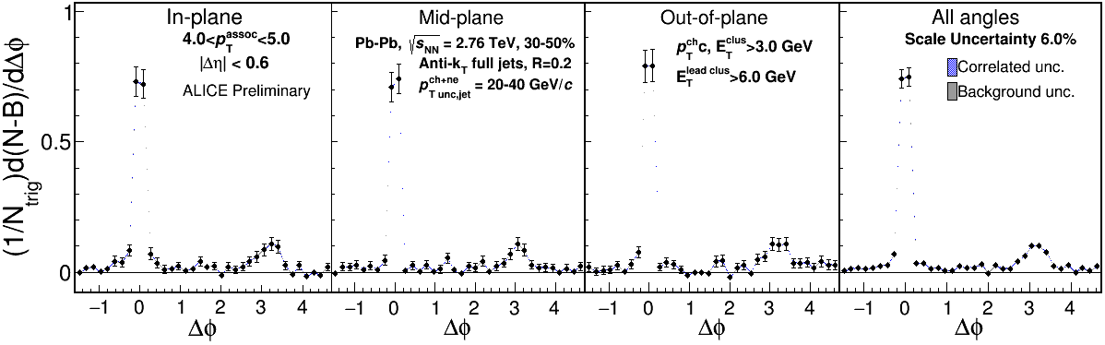
4.0-5.0 GeV/c
$p_{T}^{\text{assoc}}$
1) signal+bkgrd
2) bkgrd dominated
3) bkgrd RPF fit
Correlation function
Background level negligible

Slide 33
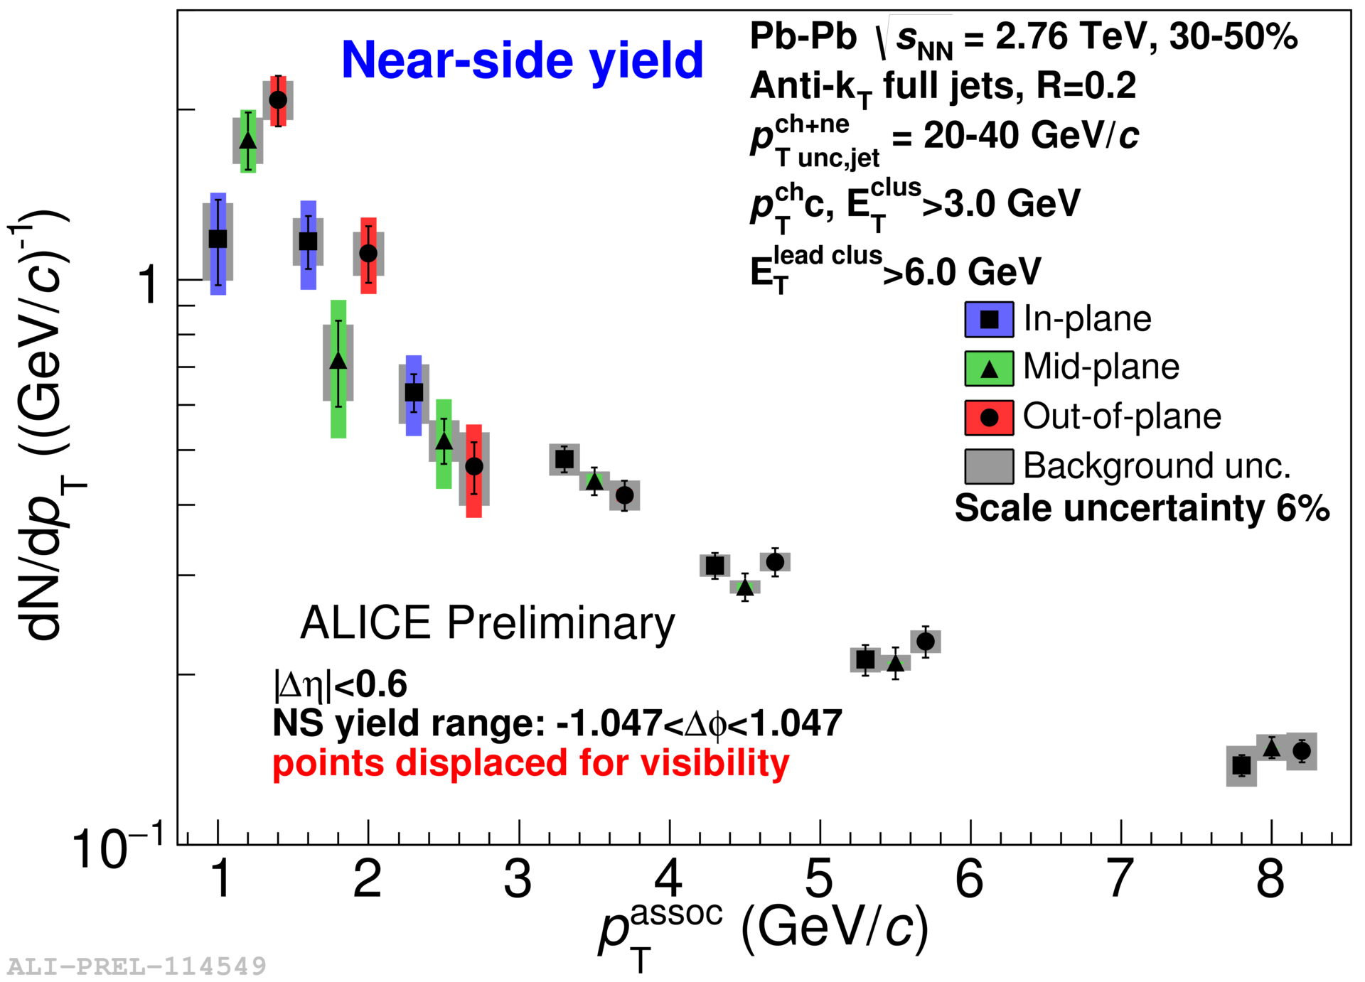
Yields

Slide 34


Yield Ratios

Slide 35
Conclusions
Conclusions
Jet-hadron correlations allow precise measurements
  Show broadening, softening of fragmentation
RPF method is robust
  Allows studies of away side
  Move beyond ZYAM.
Jets exhibit little/no reaction plane dependence
  Consistent with expectations from energy loss?
  Indicative of importance of fluctuations?
  Not yet sensitive?

Slide 36

Jet measurements in heavy ion collisions
Connors, Nattrass, Reed, & Salur
arxiv:1705.01974, accepted in RMP
The way forward
Understand bias
Make quantitative comparisons to theory
Make more differential measurements
Come to an agreement on the treatment of background

Slide 37
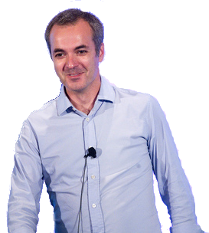
Workshop on the Definition of Jets in a Large Background
https://www.bnl.gov/jets18/index.php
June 25-27

Slide 38
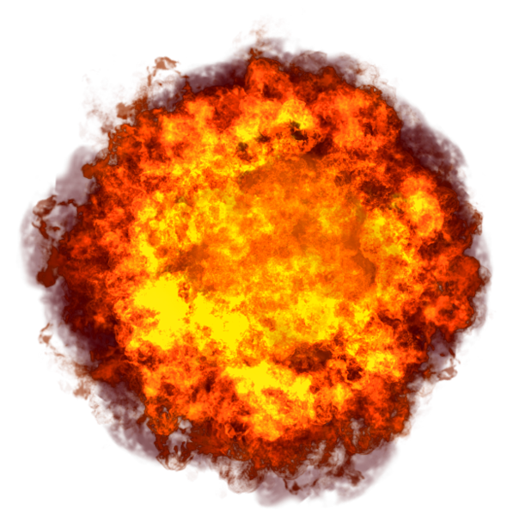

Competing effects
Quenching
Fewer jets, lower yield out of plane
Bremsstrahlung
Softer, higher yield out of plane
Fluctuations
Individual jets' energy loss may vary

Slide 39
Little/no path length dependence?
Path length dependence naively predicted by every model
  No path length dependence seen in rxn plane dependent A_{j} either
Insufficient sensitivity?
Statistical variation in energy loss is more important than path length dependence
  J. G. Milhano and K. C. Zapp, “Origins of the di-jet asymmetry in heavy ion collisions,” arXiv:1512.08107
  F. Senzel, O. Fochler, J. Uphoff, Z. Xu, and C. Greiner, “Influence of multiple in-medium scattering processes on the momentum imbalance of reconstructed di-jets,” J. Phys. G42 no. 11, (2015) 115104, arXiv:1309.1657 [hep-ph].

Slide 40
What should we expect?
From the JET collaboration Phys. Rev. C 90, 014909 (2014)*
  *this is for a 10 GeV parton!
  RHIC
  LHC
Use PHENIX paper Phys.Rev.C80:054907(2009) for ballpark estimate of L for 30-40% collisions
  4.8 fm in-plane, 6.4 fm out-of-plane
At RHIC: 2.4 GeV in-plane, 2.8 GeV out-of-plane
At LHC: 3.0 GeV in-plane, 3.5 GeV out-of-plane
$\hat{q}={Q^{2}}/L=1.2±0.3 {GeV}^{2}$
$\hat{q}={Q^{2}}/L=1.9±0.7 {GeV}^{2}$

Slide 41
Reanalysis of STAR
di-hadron correlations
Based on Phys.Rev. C94 011901(2016)

Slide 42
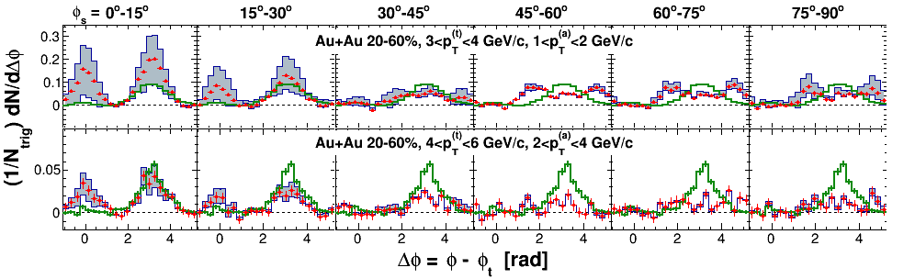
STAR measurements of dihadron correlations relative to reaction plane
Correlations on arxiv (nucl-ex/1010.0690 v2)
  Published article (Phys. Rev. C 89 (2014) 41901) does not include raw correlations
ZYAM background subtraction
  Reports ridge at Δη> 0.7
  RPF method assumes no signal at Δη> 0.7
  0.7<Δη< 2

Slide 43
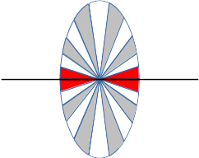
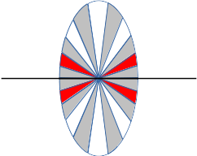
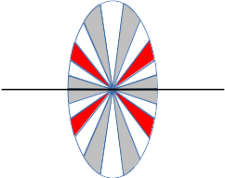
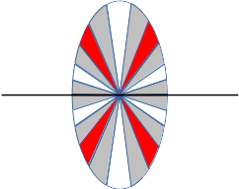
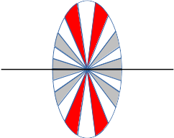
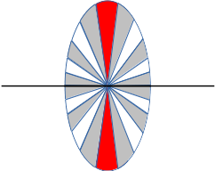
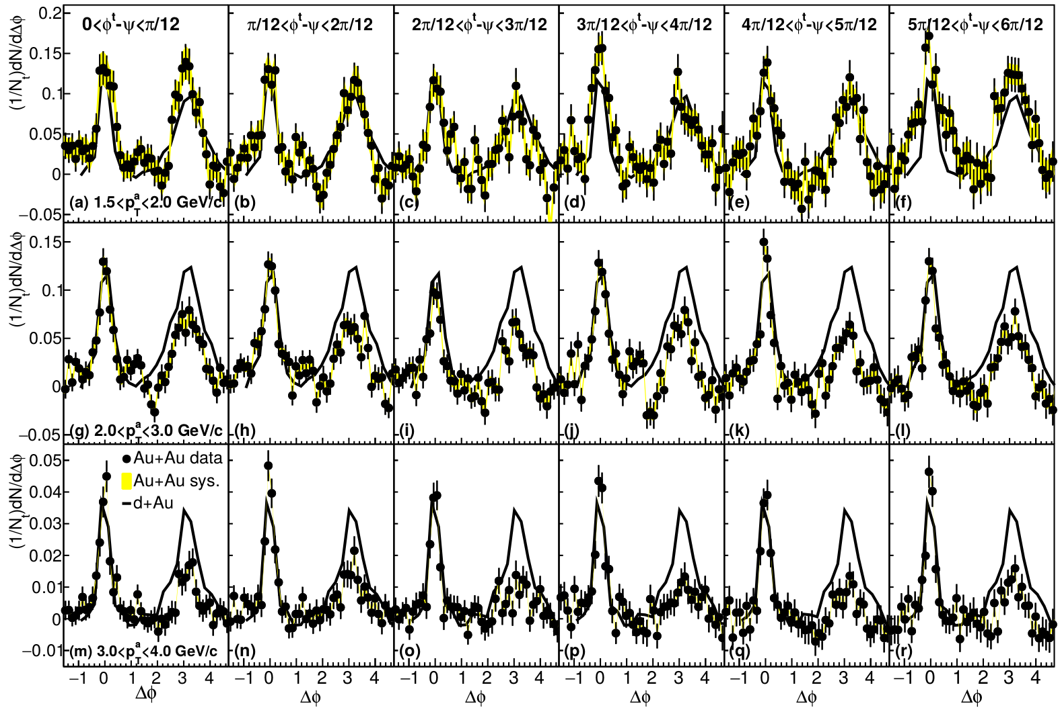
Dihadron correlations
4.0<p_{T}^{trig}<6.0 GeV/c
Phys. Rev. C 94, 011901(R) 2016

Slide 44
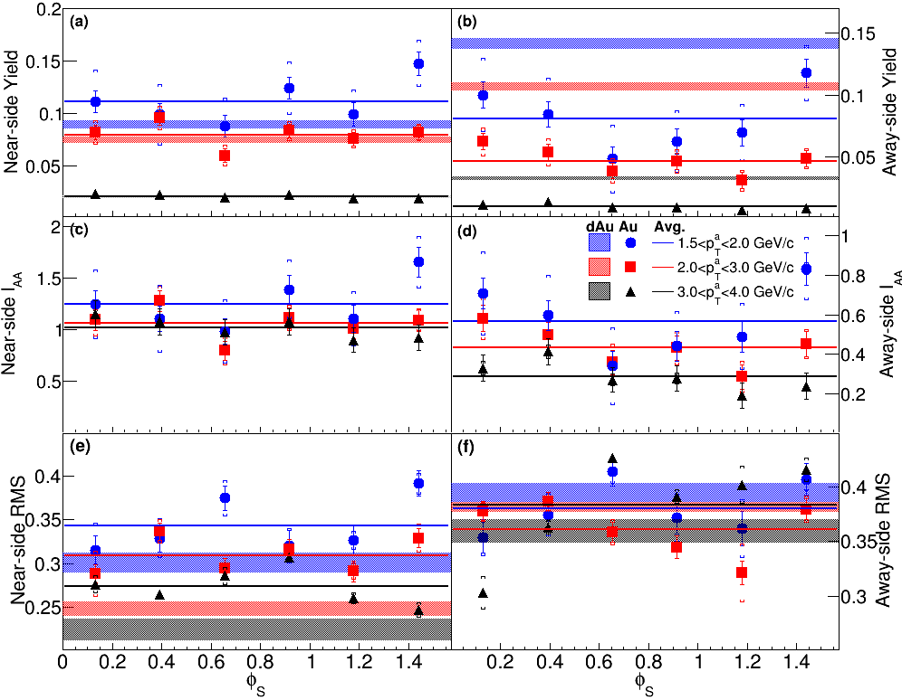
Dihadron correlations
Near side
Away side
Phys. Rev. C 94, 011901(R) 2016

Slide 45
Toy model

Slide 46
Model for signal
Use PYTHIA Perugia 2011
π±, K±,`p, p for unidentified hadrons
Quarks and gluons as proxy for reconstructed jets
h-h
√s = 2.76 TeV
pp collisions
8<p_{T}^{trigger}<10 GeV/c
1<p_{T}^{assoc}<2 GeV/c

Slide 47
Model for background
True reaction plane angle is always at φ=0 in detector coordinates
Throw random reconstructed reaction plane angle
  Assume Gaussian reaction plane resolution
  Selected to approximate data
Use measured particle yields to calculate how many associated particles would be measured
Use measured v_{n} to determine their anisotropy relative to the reaction plane
Throw associated particles matching distribution observed in data using v_{n} up to n=10

Slide 48
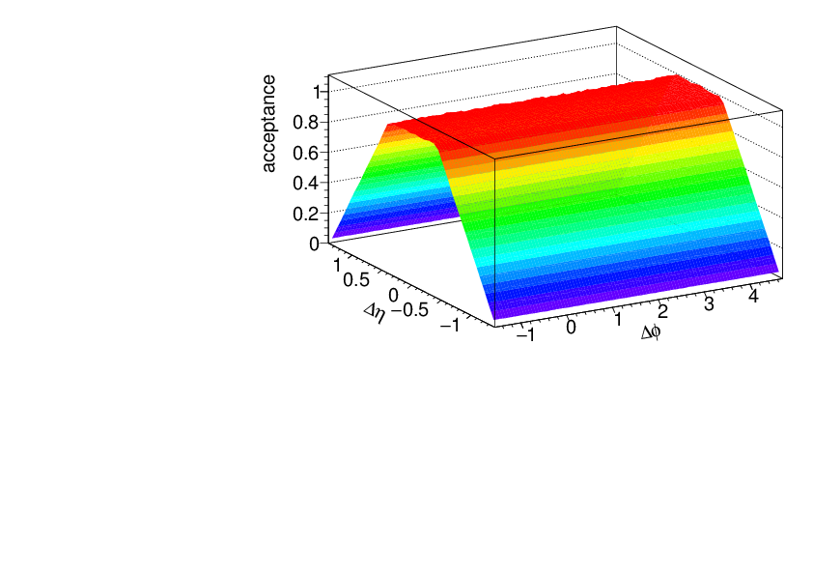
Acceptance correction
Fixed acceptance cuts leads to a trivial structure due to acceptance
This is fixed with a “mixed event” correction
  Throw random trigger, associated particle within acceptance
  Calculate Δφ, Δη
  Use this distribution
  to correct for
  acceptance

Slide 49
Going to lower momenta

Slide 50
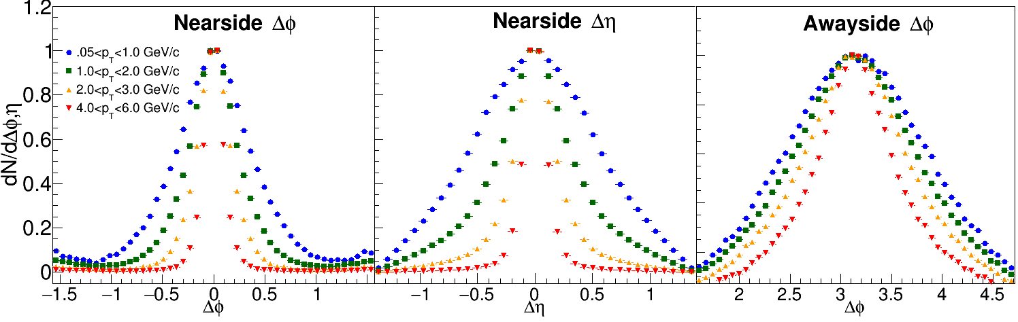
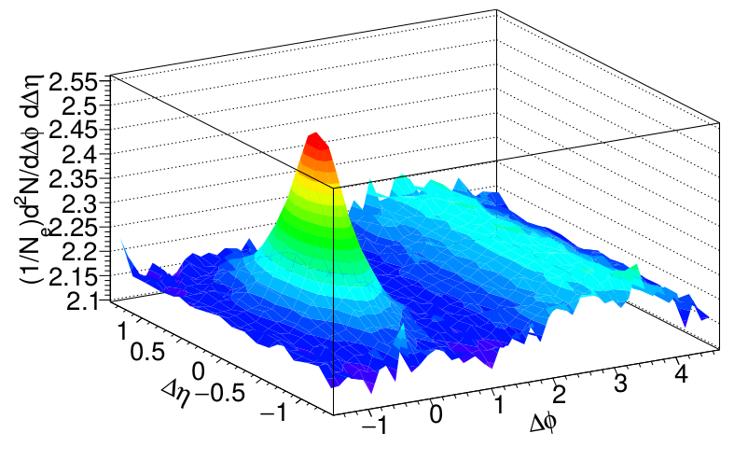
Low momenta
ZYAM assumptions break down at low p_{T}
If method doesn't work on PYTHIA, it can't be trusted on data!
But low p_{T} is interesting!
h-h
√s_{NN} = 2.76 TeV
30-40% PbPb
8<p_{T}^{trigger}<10 GeV/c
0.5<p_{T}^{assoc}<1 GeV/c

Slide 51
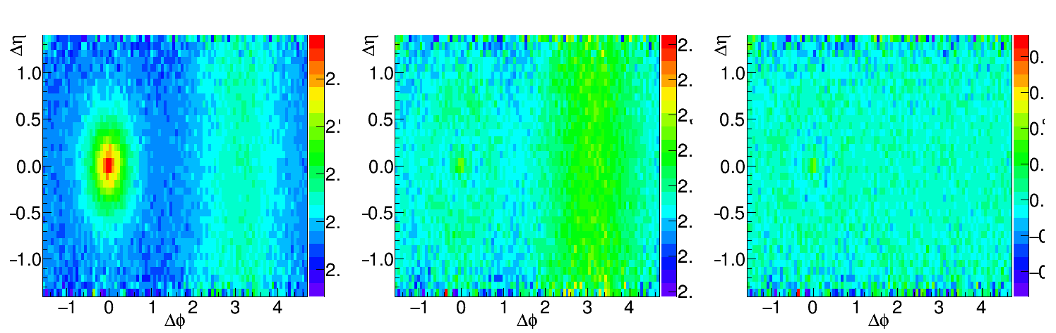
Going to lower momenta, medium modifications
Peak gets broader
Fit near-side peak and subtract it
Increase Δη range available for background subtraction
Before subtraction
After subtraction
Data/Fit
h-h, √s_{NN} = 2.76 TeV, 0-10% PbPb
8<p_{T}^{trigger}<10 GeV/c
1<p_{T}^{assoc}<2 GeV/c for background, 0.5<p_{T}^{assoc}<1.0 GeV/c for signal
Structure from imperfect fit

Slide 52
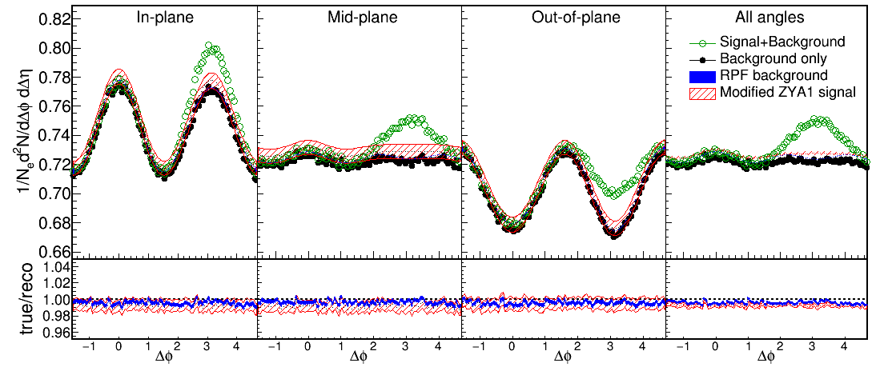
Near-Side Subtracted RPF method
30-40% central
h-h, √s_{NN} = 2.76 TeV, 0-10% PbPb
8<p_{T}^{trigger}<10 GeV/c
1<p_{T}^{assoc}<2 GeV/c for background
0.5<p_{T}^{assoc}<1.0 GeV/c for signal
Fit
Project signal+background over 0.0<|Δη|<1.4
Fit background in |Δφ|<1 including reaction plane dependence
v_{n} and B extracted with v_{n} up to n=4

Slide 53
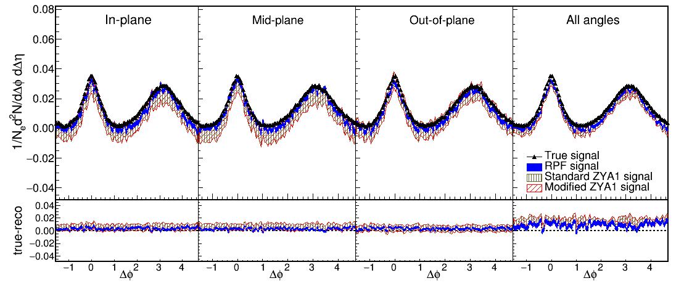
Reaction Plane Fit (RPF) method
30-40% central
h-h
√s_{NN} = 2.76 TeV
30-40% PbPb
8<p_{T}^{trigger}<10 GeV/c
1<p_{T}^{assoc}<2 GeV/c
h-h, √s_{NN} = 2.76 TeV, 0-10% PbPb
8<p_{T}^{trigger}<10 GeV/c
1<p_{T}^{assoc}<2 GeV/c for background
0.5<p_{T}^{assoc}<1.0 GeV/c for signal
Works beautifully!

Slide 54
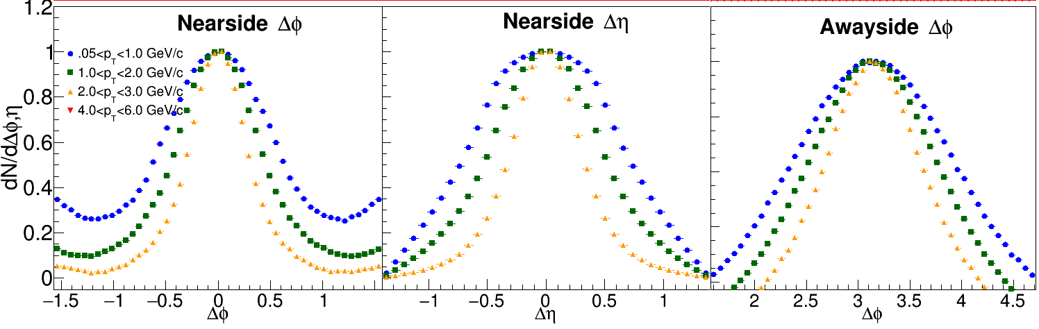
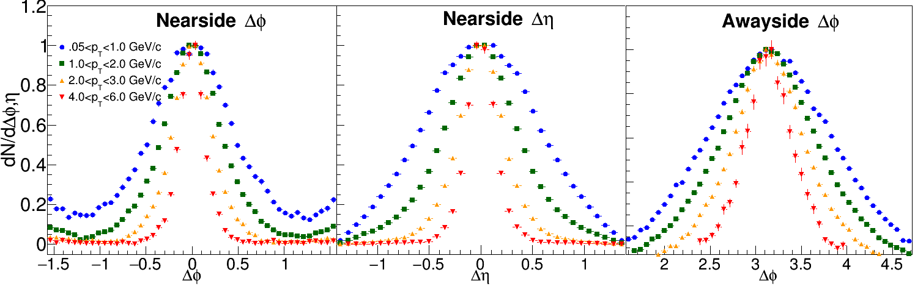
PYTHIA at 200 GeV
3<p_{T}^{t}<4 GeV/c
4<p_{T}^{t}<6 GeV/c

Slide 55
RPF Method
6 bins relative to reaction plane
Background level
  Normalized per trigger → B same in all bins if v₂^{t} is the only effect → reduces info for RPF
  “The background levels can be different for the different φ_{s} slices because of the net effect of the variations in jet-quenching with φ_{s} and the centrality cuts in total charged particle multiplicity in the TPC within |η| < 0.5.” (Pg. 10, arxiv version) → Not consistent with ZYAM assumptions!
Used reaction plane resolution values from paper and their uncertainties
  Used TPC for reaction plane and analysis – potential autocorrelations
Data available for Δη< 0.7 (signal+background) and 0.7<Δη< 2 (background dominated)
  Acceptance correction in not applied → background must be scaled → uncertainty
  Jet-like correlation not eliminated in 0.7<Δη< 2 for all p_{T}^{t}, p_{T}ª given in paper → focus on high p_{T}

Slide 56
v₂ STAR vs Fit
 | v₂ STAR (Table I) | v₂ Fit (stat. errors only)
1.5<p_{T}<2.0 GeV/c | 0.164 ± 0.011 | 0.194 ± 0.008
2.0<p_{T}<3.0 GeV/c | 0.189 ± 0.012 | 0.237 ± 0.010
3.0<p_{T}<4.0 GeV/c | 0.194 ± 0.013 | 0.293 ± 0.058
4.0<p_{T}<6.0 GeV/c | 0.163 ± 0.020 | 0.073 ± 0.025 0.036 ± 0.033 0.033 ± 0.068
Centrality bin is 20-60% - proper weighting of average?
Bias in event selection with high p_{T} trigger?
Bias in reconstructed reaction plane in the presence of a jet?
Residual jet-like signal in background dominated region?
Less information in fit due to normalization by N_{trigger}?

